Slide 1
Commercialisation & Impact
Gary BOORMAN
RHUL and ANGARA Technology
24th April 2025

Slide 2
Contents
Strategy
JAI approach to Commercialisation
Projects
  Beam Delivery Simulation (RHUL)
  Precision Cavity BPMs (RHUL)
  ANGARA Technology (RHUL)
  Plasma-Modulated Plasma Accelerator (Oxford)
  Advisory Board Recommendations 2024
  Inventorship of accelerator cancer therapy systems
  Marketing for Cavity BPMs for FELs
  BDSIM as an example of a success story
  Spinout promotion
  Grow JAI on LinkedIn

Slide 3
Strategy
The John Adams Institute for Accelerator Science is a centre of excellence in the UK for advanced and novel accelerator technology. The Institute provides expertise and training in accelerator techniques, participates in research and development, and promotes advanced accelerator applications in science and society at large.
Seeking applications of accelerators in industry – developing new technology – engaging with industry / users when relevant
No direct funding for commercialisation activity in JAI budget.
JAI staff encouraged to apply for dedicated funds inc:
  STFC Impact Acceleration Accounts held by universities - £50k p.a.
  STFC Early Stage Research and Development scheme (on-hold)
  STFC Late stage commercialisation (on-hold)
  UKRI Proof of Concept fund (new)
Notes:
Seeking applications in industry – developing new technology – engaging with industry / users when relevant
No direct funding for commercialisation – resources are available at each university
To understand commercial potential and
develop tech toward commercial application – apply for additional funding from STFC – £50k p.a IAA – very helpful
The below funds are usually annual but have not been launched this year – possibly due to STFC funding delays
STFC Early Stage Research and Development scheme (on-hold)
STFC Late stage commercialisation (on-hold)

Slide 4
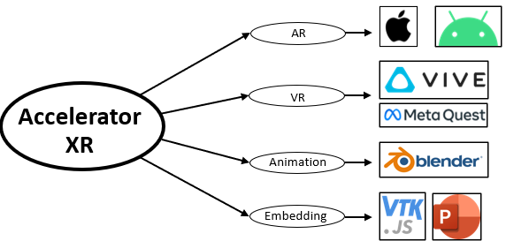
RHUL Projects
Beam Delivery Simulation (BDSIM)
Internationally recognized & adopted accelerator physics tracking code
323+ citations of BDSIM since 2013 (collated from Google Scholar up to 23/04/25)
Impact activity: Accelerator Extended Reality
  Showcasing accelerator technology to the
  general public through augmented and
  virtual reality
Public Engagement opportunities:
  LhARA exhibition at the Great Exhibition
  Road Festival, June 2025 – VR vdeo
First BDSIM medical citation

Slide 5
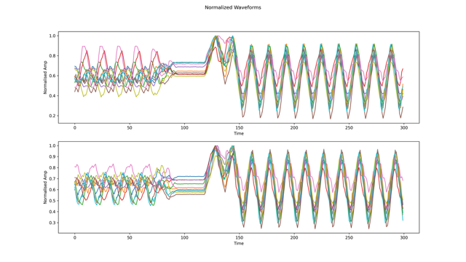
RHUL Projects
Precision Cavity BPMs
  Project started by Alexey Lyapin and a PhD student
  Impact money from RHUL used to develop the
  required triggered phase-synchronised RF sources
  This RF source is of great interest to quantum computing researchers
    Conversations had with RHUL condensed matter group
    Discussion with researchers from Oxford Quantum Circuits
    Survey of RF manufacturers and resellers at ARMMS conference and elsewhere – nothing like it on the market (Nov 2024)
  Intention to submit for UKRI funding to further develop and commercialise the RF source
    Only one application from RHUL is permitted (UKRI rules) so entered internal competition against 13 other entries – results awaited
  Possible partnership with ANGARA Technology to develop control system

Slide 6

RHUL Projects
ANGARA Technology Sàrl
  Geneva-based consultancy created in May 2019 by two former CERN employees and RHUL project associate (PJAS)
  Primary focus is developing high-performance control and automation systems for
    Big Physics labs
    Universities
    Hadron Therapy
    Energy Distribution
    Chemical and Mechanical Engineering
  Independent of JAI, but has close ties with both RHUL and JAI
  Six years of applying engineering/physics experience to commercial activities
  RHUL PhD student to work for us for a few months starting soon

Slide 7
Oxford Projects
Plasma-Modulated Plasma Accelerators (P-MoPA)
Funded by STFC IAA to write a Pre-Conceptual Design Report for a 600MeV P-MoPA accelerator (patented) with estimates of size, cost, components, performance etc. and scaling to 300 MeV and 1 GeV energies
P-MoPA driven by current, commercially available technology (1 Joule thin-disk laser with repetition rate of 1kHz)
Comparison of toy-model P-MoPA with X-band EuPRAXIA accelerator and also P-MoPA-driven Compton source comparison with current Compton sources (STAR, SMART*LIGHT)
P-MoPA Commercialisation paper produced January 2025 with expert industry input by Christoph Quitmann identifying next steps
A water window FEL based on P-MoPA would be the long term goal but an inverse Compton scattering source at 100-300 keV is the next step
Further support and collaboration with STFC CLF is being explored

Slide 8
Advisory Board Recommendations 2024
Novel accelerator based cancer therapy systems
“JAI staff should be encouraged to claim “inventorship” by publishing or patenting the results, even if “ownership” cannot be claimed for the JAI due to IP regulations at CERN and other collaboration partners”
Oxford Physics have devoted an area of their website to “Applications of Accelerators and Detectors to Cancer Treatment”, which includes all projects, people and publications from the Manjit Dosanjh Research Group.
https://www.physics.ox.ac.uk/research/group/applications-accelerators-and-detectors-cancer-treatment
Marketing for Cavity BPMs for FELs
“JAI and FMB-Oxford could approach the smaller FEL projects, which do not have the resources to develop their own solutions for diagnostics e.g. TARLA (Turkey), PolFEL (Poland), Smart*Light (The Netherlands), STAR (Italy), Thom-X (France), etc.”
Cavity BPMs are now available from FMB-Oxford

Slide 9
Advisory Board Recommendations 2024
BDSIM as an example of a success story
“BDSIM is already a success as an open-source tool and should be used as an example of a success story in the STFC applications that benefits the community far beyond JAI.”
Survey of user community; user meeting
Spinout promotion
“The spin-outs Mach42 and Living Optics are positive signs and should be promoted internally to encourage other researchers to follow their example.”
These spinouts are discussed in the Graduate Course lecture ‘Commercialisation of Accelerator Technology’ and will feature in future JAI website updates and JAI LinkedIn news stories as they grow.
Grow JAI presence on LinkedIn
“Grow the channel membership and increase the content to keep in touch with alumni”
Followers have increased from 125 to 357 and new posts ~every 2 weeks.

