Slide 1
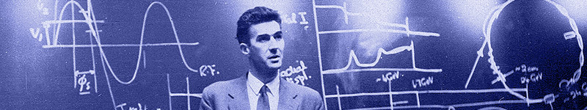

Update on
Education & Training and Public Engagement at JAI
Emmanuel Tsesmelis
CERN & JAI University of Oxford
JAI Advisory Board 2025
24 April 2025

Slide 2
Introduction
The JAI programme is organised around three pillars:
  Research & development for advanced and novel accelerator technology.
  Training of next generation of accelerator scientists in accelerator techniques.
  Advanced accelerator applications in science & society, impact and public engagement / outreach.

Slide 3
Education and Training

Slide 4
Guiding Strategy
Training in accelerator science & technology is one of the pillars of JAI mission and recognised by JAI Advisory Board to be world-leading.
Objective is to develop skills of next generation accelerator scientists.
JAI has provided graduate & undergraduate training in accelerator science & technology since first course delivered in 2005 (for more than 20 academic years).
Students participate in comprehensive core formal training through academic courses & projects and 3 years of cutting-edge research at state-of-the-art facilities (national & international).
Many JAI academic staff invited to give courses & lectures at international accelerator schools.

Slide 5
JAI Graduates & Careers
JAI training is well aligned with STFC strategic aims to address national demand for scientifically-skilled workforce to sustain UK’s world-leading position in research & technology and JAI’s unique aspect of academic training for PhD students as addressed in 2017 STFC Accelerator Strategy Review & 2019 Accelerator Programme Evaluation.
PhD graduates total more than 120; all obtained fruitful employment; about 20% female.
  Alumni consistently pursue careers in science & technology
    Destinations include research positions in universities, ASTeC, BNL, CERN, CI, DESY, LBNL, LLNL, NPL, RAL, SLAC, PSI etc.
    Some reached full academic positions; about 15% work in industry.

Slide 6
Graduate Accelerator Physics Course
Term I October-December 2024
Lectures (24)
Types of Accelerators*
Applications of Accelerators*
Live Connection – LHC Control Centre*
Transverse Optics (2)
Longitudinal Dynamics
Momentum Effects
Lattice Design
Hamiltonian Dynamics (2)
Beams & Imperfections
Basic Plasma Physics Concepts for Plasma Accelerators
Plasma-based Electron Acceleration
Plasma-based Ion Acceleration
RF Cavities (4)
Beam Diagnostics & Instrumentation
Synchrotron Radiation
Wigglers & Undulators
Radiation Damping & Excitation (2)
Parameters for HALHF Student Project
Exercise Classes (6)
Introduction to Accelerators*
Transverse Dynamics
Longitudinal Dynamics
RF Cavities
Hamiltonian Dynamics
Synchrotron Radiation
* Combined Particle Physics &
Accelerator Physics cohort
Course carried out in hybrid format
(in person & Zoom)
NEW: Visit to ISIS Neutron & Muon Source
(Rutherford Appleton Laboratory)

Slide 7
Graduate Accelerator Physics Course
Term II January-March 2025
Lectures (22)
Magnet Design (2)
Non-linear Dynamics (2)
Beam-beam Effects
Space Charge Tune Shift
Injection, Beam Transport and Extraction
Linear Colliders (4)
Instabilities (2)
Beamlines for Fixed-target Experiments
Cyclotrons for Various Applications
Particle Sources
Free Electron Lasers
Vacuum and Surface Science
Accelerator Science & Particle Therapy
Introduction to Radiobiology & its Applications to Accelerator Science
Particle Accelerator Sustainability*
Commercialisation of Accelerator Technologies*
Exercise Classes (2)
Magnet Design
Introduction to HALHF Student Project
Tutorials (6)
HALHF Student Project
JAI Seminar (1)
HALHF Student Project
Course carried out in hybrid format
(in person & Zoom)
* As proposed by JAI AB

Slide 8
Graduate Accelerator Physics Course 2024-2025
Number of Students
    University of Oxford
      JAI Accelerator Physics (3)
      Atomic & Laser Physics (Plasma Physics, 2)
      Particle Physics* (10)
    Royal Holloway, University of London (1)
    Imperial College London (3)
* Term I: first three lectures, first tutorial & ISIS visit only

Slide 9
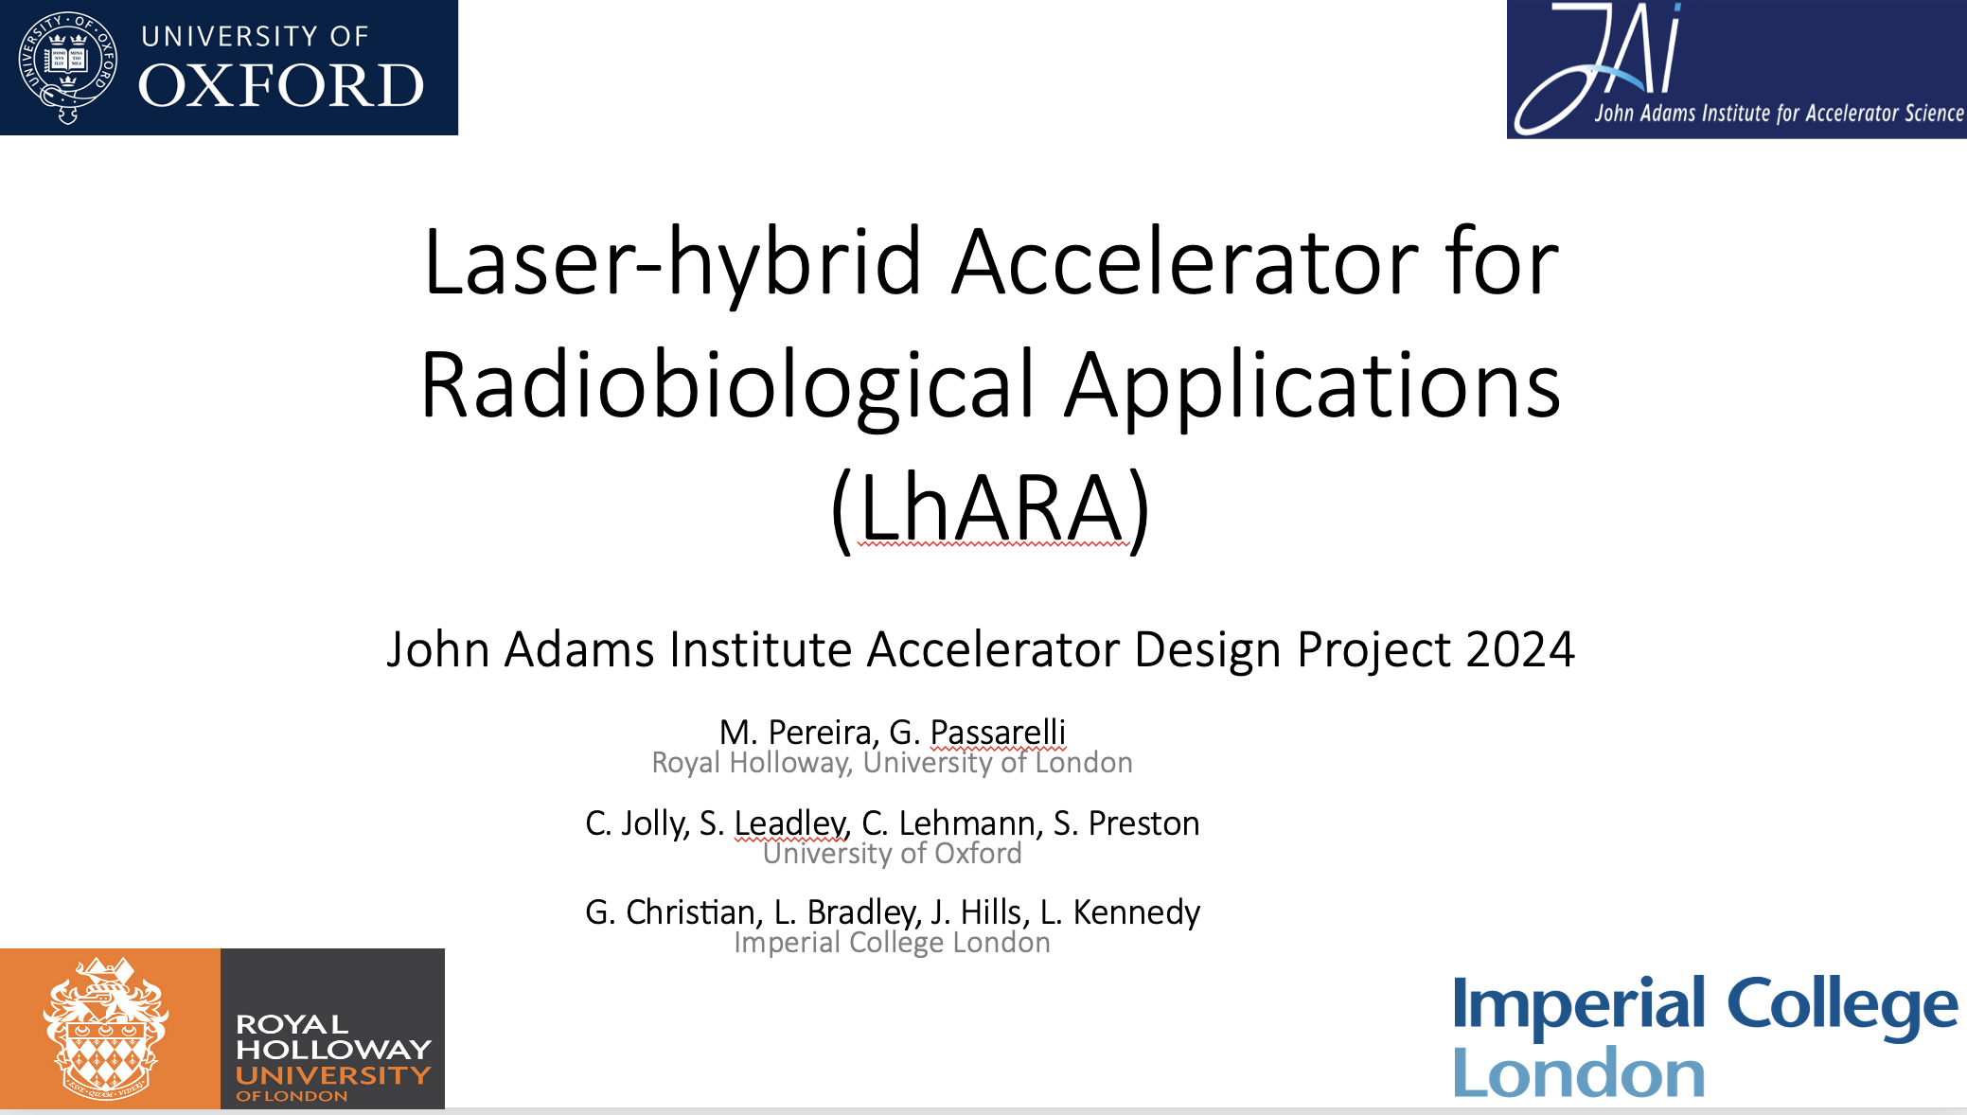
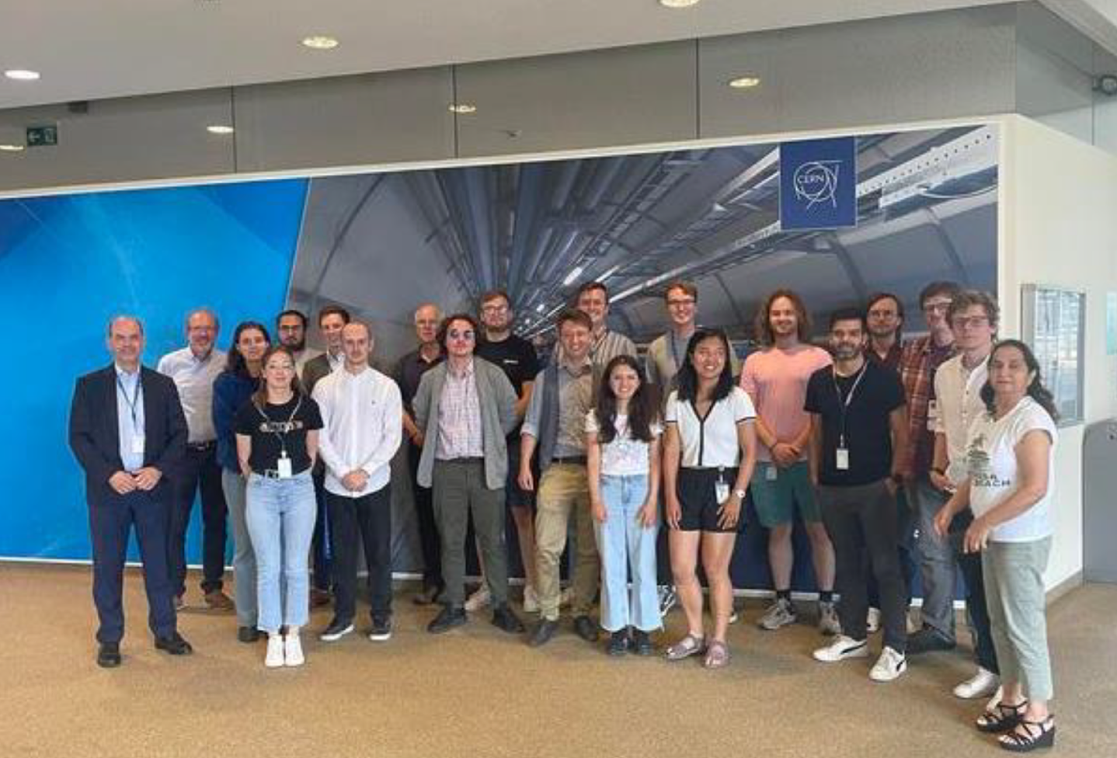
Accelerator Design Project
Accelerator Design Study for
  FCC-ee Positron Damping Ring: 2022-2023
  LhARA Stage I: 2023-2024
  HALHF: 2024-2025
  Design work consisted of study of the lattice, magnet systems and RF cavities.
“The design project significantly contributes to the value of a PhD at the JAI and is a very effective learning tool ... it played an essential role in helping me to find a postdoc.”
“To me, the design project was by far the best part of the course. It puts the material taught into context and bridges the gap between lectures ... and a DPhil project ... .”
2023-2024: LhARA
Design Report published
on CDS (10.17181/CERN.9K4Y.MM92) and students delivered JAI Seminar (March 2024) and visit to CERN (July 2024)
2024-2025: HALHF
Design Report to be published on CDS and students delivered JAI Seminar on 13 March 2025; Visit to CERN planned for July 2025

Slide 10
Consolidated Accelerator Course
Graduate lecture course includes plasma research training.
  Lectures provided by ICL, as part of development of integrated accelerator-laser-plasma training,
  Training in ‘Centre for Postgraduate Training in Plasma Physics & High Energy Density Science’ – established in 2014 by ICL, Oxford, and Warwick.
  Plasma-related lecture courses also provided in Oxford.
Graduate students take additional courses in related subjects – statistics, EM, safety, particle physics and astrophysics.
Universities offer courses on transferable skills – Research Management, Critical Thinking, Personal Effectiveness, Research Skills & Techniques, Written & Oral Communication, Team Working, Career Development, Entrepreneurship, Ethics, and Advanced IT.
Lecturers & Instructors
  J. Bauche (CERN), M. Dosanjh (Oxford), M. Fraser (CERN), H. Garcia-Morales (Oxford/PickleTech), A. Gerbershagen (Groningen), D. Kelliher (RAL), B. Kyle (RAL), S. Lawrie (RAL), S. Mangles (ICL), I. Martin (Diamond), Z. Najmudin (ICL), S. Patel (RAL), C. Plostinar (ESS), D. Posthuma de Boer (RAL), M. Schippers (PSI), P. Tait (Oxford), F. Tecker (CERN),
  E. Tsesmelis (CERN/Oxford), H. Wakeling (Oxford), Rob Williamson (RAL)
  Lecturers / instructors from JAI universities and from external institutes – CERN, Uni. Groningen, DIAMOND, ESS, PSI, RAL.

Slide 11
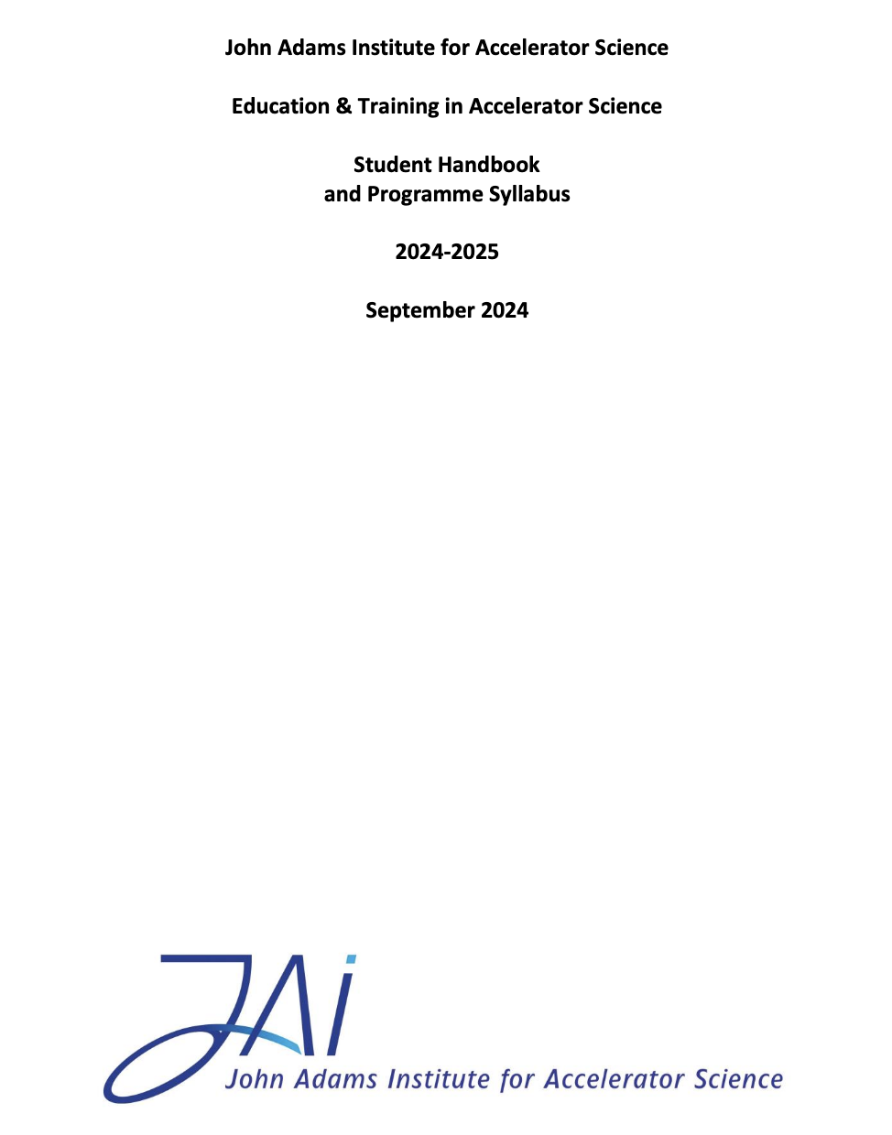
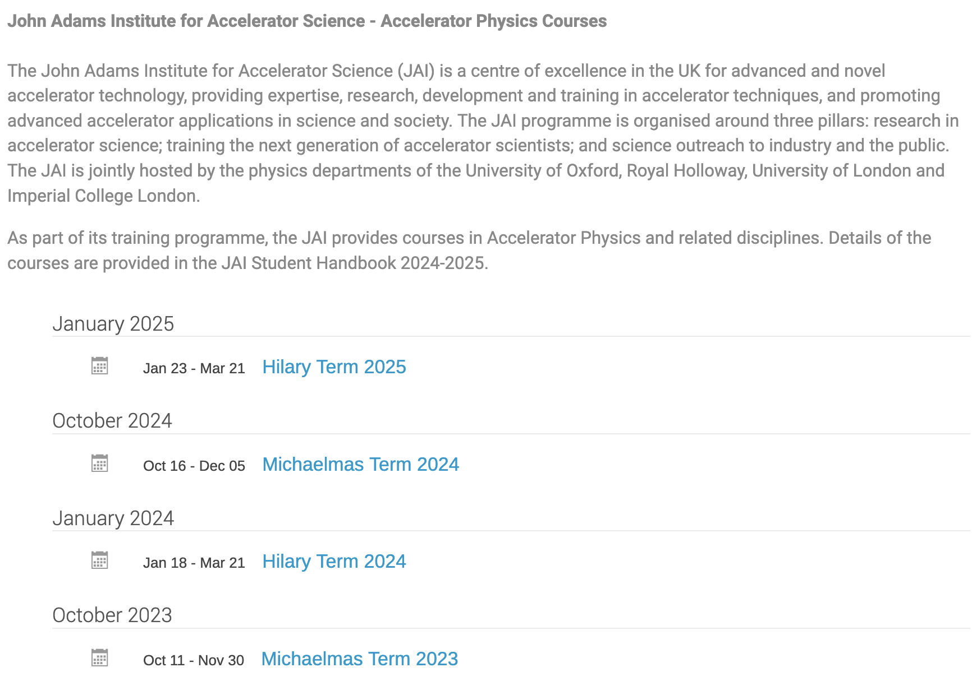
JAI Student Resources
Student Handbook provides information to the students of the training programme in accelerator science at JAI.
  Syllabus & course content, course resources, assessment, evaluation, recommended textbooks.
  Supplementary information (public engagement, lecture series, summer student programme etc.)
Dedicated site on INDICO
  https://indico.cern.ch/category/5869/
  Timetable, slides / documents, Zoom connection

Slide 12
New Graduate Students 2025-2026 Academic Year
Oxford
  Meg Savage: Beam-driven wakefield acceleration (R. d’Arcy);
  STFC & DESY funding
  Francesco Straniero: ISIS beam dynamics (A. Oeftiger);
  STFC & ISIS funding
RHUL
  N.N.: Optical beam diagnostics; STFC funding
ICL
  George Weis: Accelerating deuteron beams for laser-plasma interactions (Z. Najmudin); STFC funding
Process for graduate student selection on-going at all JAI universities
Matching funding and international fee waivers to support non-UK applicants for
CERN Doctoral posts are increasingly difficult to obtain from UK universities.

Slide 13
Graduate Student Funding
Since 2019, JAI included in STFC quota PhD studentships scheme receiving three studentships per year (exceptionally four in 2024).
This leverages additional funding sources allowing JAI to recruit a few additional PhD students / year.
  Various funding sources include most recently JAI universities, the Royal Society, EPSRC Industrial CASE & Centres for Doctoral Training, the CERN Doctoral Student programme, ISIS, Diamond Light Source, the Ada Lovelace Centre, and the Central Laser Facility.
  Successful in collaborating with external universities through cooperation agreements, such as University of Oxford with Humboldt University, Berlin, whose students have attended the JAI course, and other non-UK sources.
Continue to explore wide range of possibilities for sustainable funding.

Slide 14
Undergraduate Accelerator Physics Courses
RHUL
  Short option course (12hr) for 3rd year students.
  Annual intercollegiate course for 4th year MSc students from the University of London and as well as BSc/MSc project students.
University of Oxford
  Undergraduate course is currently being revised and is expected to become available as of 2026-2027 academic year.
    ‘Short option’ in Year 3, consisting of 12 lectures
    (6 detectors and 6 accelerators).
  4th year undergraduate projects undertaken annually (e.g. plasma accelerators, medical accelerators).
Expect programmes to attract undergraduate students to accelerator science.

Slide 15
Undergraduate Accelerator Physics
Summer Student Internships
Oxford University
  Internship Programme (CERN in July/August annually)
    Two or three students join CLEAR accelerator project supervised by Oxford faculty & graduate students.
    Participate in CERN Summer Student lecture series and in an accelerator project.
  Sub-department of Particle Physics Internship Programme
    Three positions: Sustainability (H. Wakeling), Beam-driven wake-field acceleration (R. d’Arcy), Metrology (A. Reichold)
Imperial College
  Around 4 students appointed annually.
  Spend 8 weeks working at Imperial College & RAL.
RHUL
  Around 2 students appointed annually.
  Carry out research work at RHUL.
Expect programmes to attract undergraduate students to accelerator science.

Slide 16
UK Accelerator Institutes Seminar Series
JAI, together with ASTeC and the Cockcroft Institute, organise jointly the UK Accelerator Institutes Seminar Series https://indico.cern.ch/category/13863/
  Delivered by distinguished speakers from the participating institutes and from laboratories / universities world-wide.
Seminars held in person and via videoconference and scheduled so that the graduate student body can attend.
Latest Session in January – March 2025
Title | Speaker
University Neutrons: The High-Flux Facility at Birmingham | Carl Wheldon (Uni. Of Birmingham)
The TWOCRYST Project at the CERN LHC | Pascal Hermes (CERN)
Development of HTS Trapped Field Magnets Using 2G HTS Coated Conductors | Hengpei Liao (Uni. Of Strathclyde)

Slide 17
External Training Commitments (Abridged)
JAI academic staff invited to provide training & to contribute to various international forums:
  EU Integrating Activity Projects on Training, Communications & Outreach in Accelerators –
  TIARA 2011-2014, ARIES 2017-2021, I.FAST 2021-2025 (P. Burrows serves as WP Leader). Will coordinate new European panel on education & training in accelerator science – IFAST2 - under TIARA auspices.
  TIARA - Chair of Task Force on Training in Accelerator Science for Europe (P. Burrows).
  CERN Accelerator School CAS (various JAI faculty and staff, P. Burrows serves on CAS AB).
  Joint Universities Accelerator School (JAI is partner institute, P. Burrows serves on JUAS AB).
  US Particle Accelerator School (USPAS, various JAI faculty and staff).
  Cockcroft Institute graduate accelerator physics course (S. Gibson).
  University of London intercollegiate undergraduate & graduate accelerator physics courses (S. Gibson, P. Karataev).
  University of Melbourne Medical Accelerator Physics Programme (S. Sheehy).
  Nanyang Technological University undergraduate lectures on accelerator physics (E. Tsesmelis).
  Culham Summer School on Plasma Physics - Laser Wakefield Accelerators (S. Mangles)
  EuPRAXIA-DN School on Plasma Accelerators, Introduction to Plasma Diagnostics, (Z. Najmudin)
  Winter School on Intense Laser Science WiSILS 2024), Indian Institute of Technology (Z. Najmudin)
  Public IOP Evening Lecture on Sustainable Accelerators (H. Wakeling)

Slide 18
Future Programme - Training
Proposal & plan for the future education & training programme at JAI:
Continue to deliver an outstanding training programme both within JAI and via our contributions to CAS, JUAS and other schools.
Consolidate, strengthen and augment our programme by:
  further integrating lectures and seminars across our three universities;
  augmenting focus on sustainability in accelerator design and construction;
  strengthening focus on commercialisation and impact;
  linking to dedicated training in AI/ML techniques provided via our universities.
Continue to promote a pipeline of graduate students via our undergraduate portfolio of courses, summer internship programmes and research projects.
Aim to strengthen our collaboration on training with the CI on advanced topics and to continue support of the UK Accelerator Institutes Seminar Series.
Continue to support student participation in relevant specialised external training courses (e.g. Advanced CAS) and presentation of their research work at international conferences and workshops.

Slide 19
Public engagement

Slide 20
Introduction
JAI continues to develop its high-profile, in-person public engagement in post-Covid environment.
Covid pandemic devastated in-person events, throwing them into online events.
Greatly reduced activities and only now events have reached pre-pandemic levels.

Slide 21
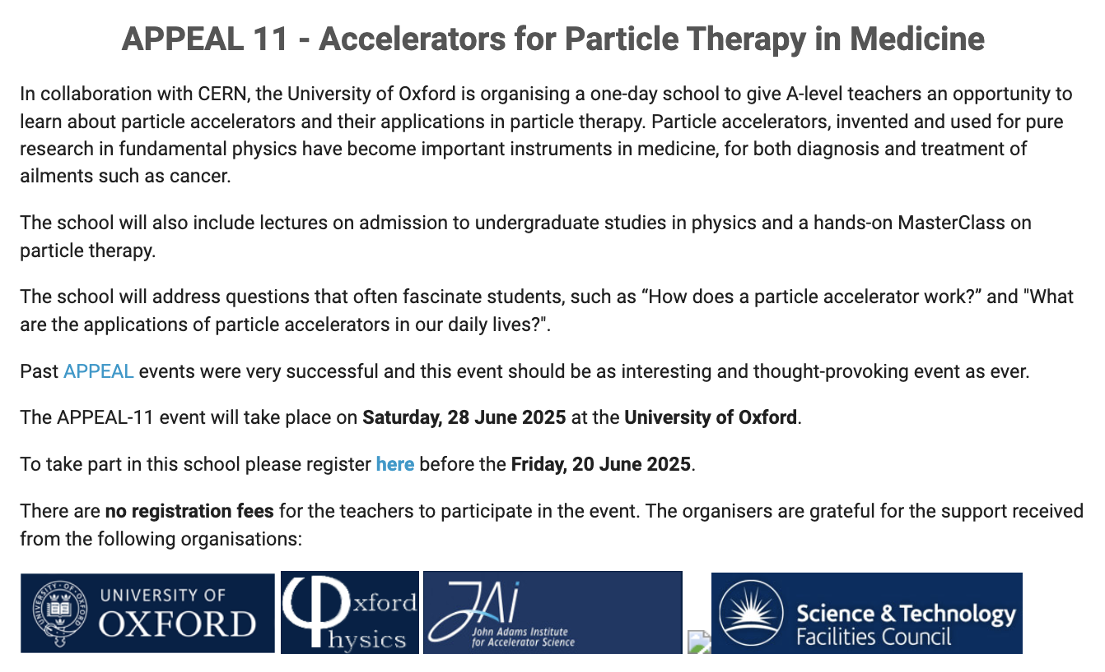
APPEAL
Re-start Accelerator and Particle Physics Education at A-Level (APPEAL) following pause due to Covid-19.
Annual training event started in 2010.
APPEAL-11 in June 2025
Accelerators for
Particle Therapy in Medicine
Consists of lectures and MasterClass
https://indico.cern.ch/event/1539515/

Slide 22
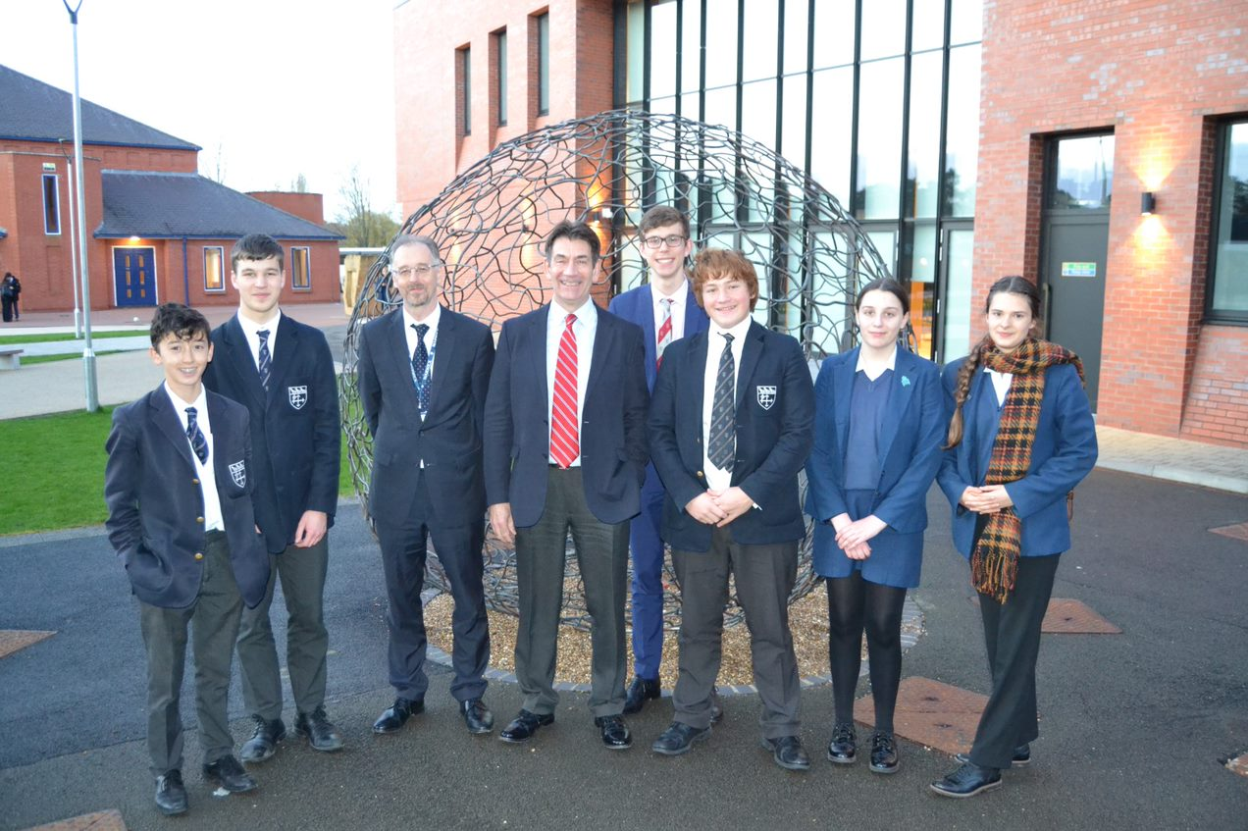
Public Engagement & Schools Outreach
‘Particle Accelerators: from Higgs Bosons to Curing Cancer’
Delivered 40 times in pre-pandemic decade
Continued in 2024 at nearby school: >100 attendees
Feedback from female GCSE student:
‘It meant a lot to me that you spent your time discussing my ambition to have a career in physics once I am older. I greatly appreciate that you talked with me and I thank you for the advice you gave me.
Our discussion really inspired me and I am more determined than ever, … at the moment I am likely to be the only student at my school taking Physics and Further Maths A-Level, but this will not deter me.’
Phil Burrows

Slide 23

Public Engagement & Music
Oxford May Music Festival (May 2024,
15th season).
  4 days of events with a total attendance of around 1000.
Einstein’s Universe given over 100 times over almost 20 years to a live audience totalling more than 30,000
Brian Foster

Slide 24

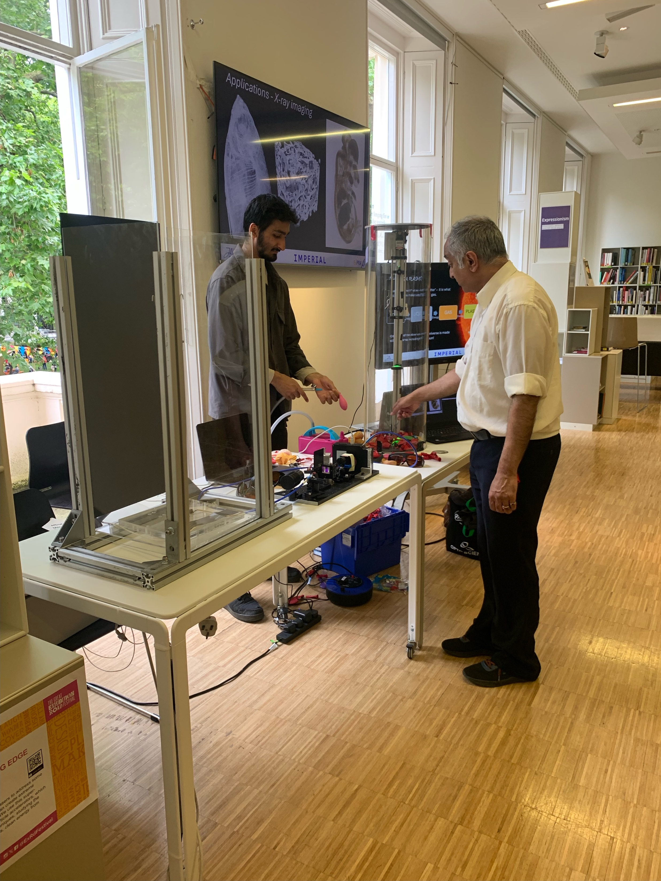
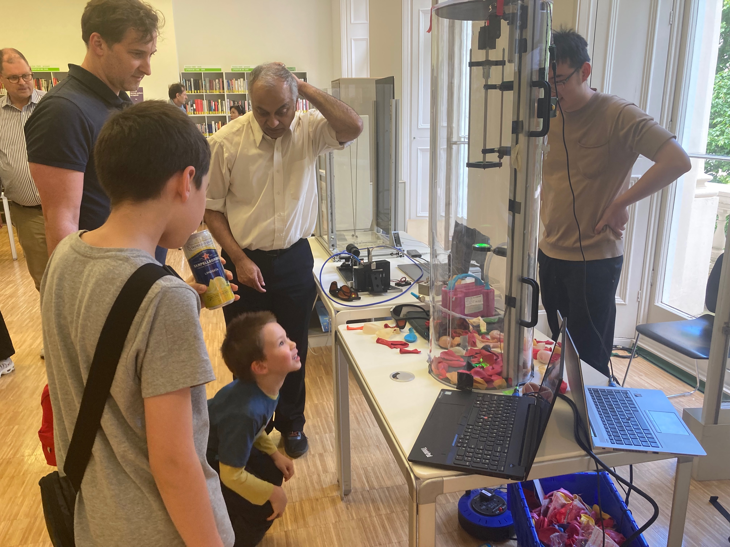
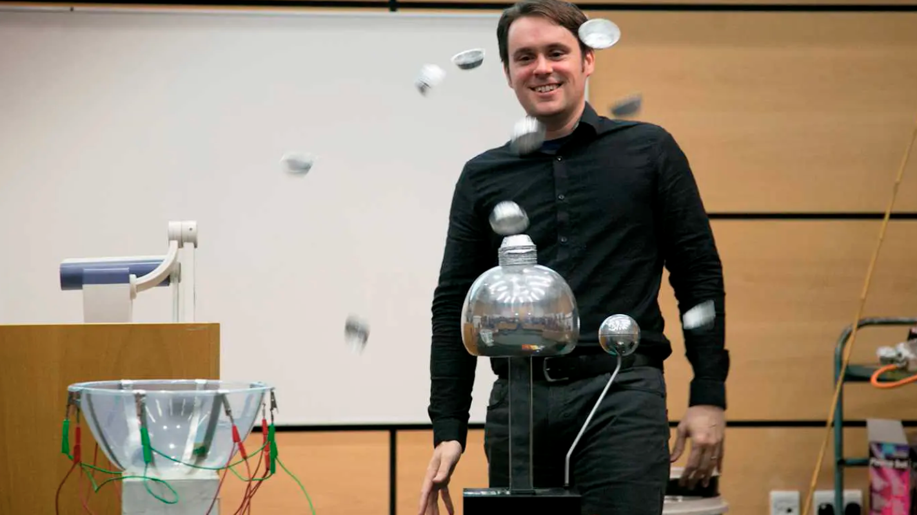
Public Engagement & Festivals
Great Exhibition Road Festival, London
  Celebrate how science and the arts help people, communities and nature to flourish, with a weekend of events for all ages.
  Stall on plasma accelerators by ICL in 2024.
  Preparation of LhARA VR activities by RHUL for Great Exhibition Road Festival
  (June 2025)
Imperial College London
(September 2024)
RHUL Science Festival
(May 2024)

Slide 25
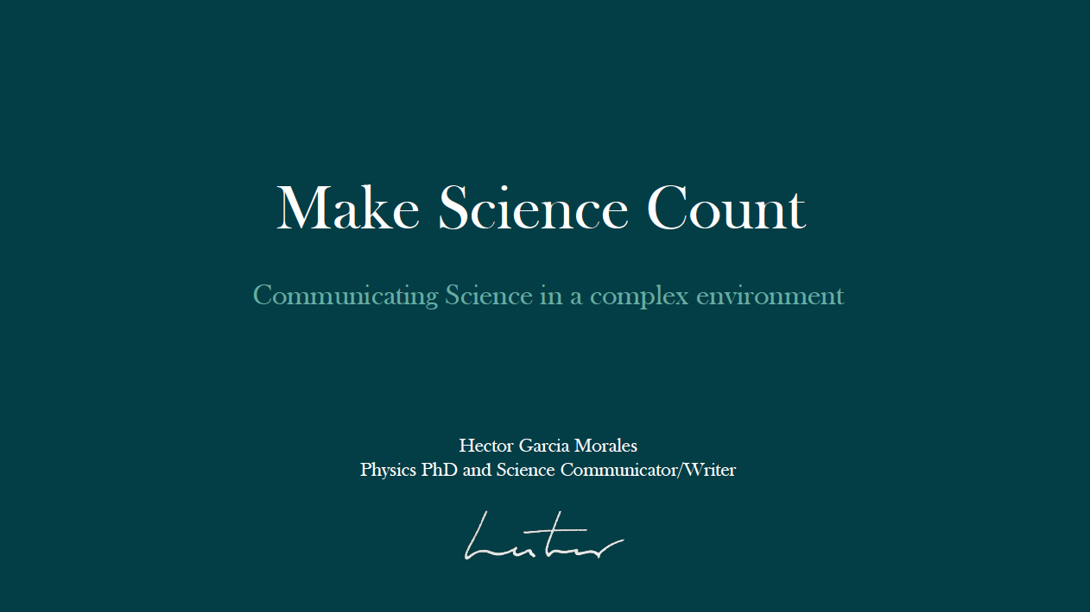
Public Engagement & Students
Science Communication Lectures & Workshops for JAI DPhil Students
Underlined the importance of:
  Communication skills are essential.
  Use of Elements of Storytelling.
  Engage with different audiences.
  Writing is special.
  Trust, ethics and uncertainty in scientific narratives.
Pilot initiative by
Suzie Sheehy & Hector Garcia Morales
In future, could collaborate with similar effort
of Oxford Particle Physics

Slide 26

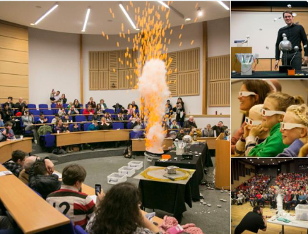
Public Engagement & The Big Bang Experience!
Brief history and future of the LHC revealing wonders of the LHC at CERN and how it is unravelling mysteries of the universe.
  Big Bang Experience at British Science Week (March 2024)
Royal Holloway University London

Slide 27

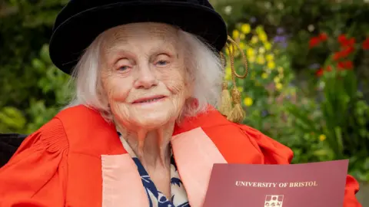
Public Engagement & Literature
Popular science book
by Suzie Sheehy
Outreach events, interviews and coverage in Australia, the UK and the US reaching over 4000 people live.
Suzie awarded Australian Institute of Physics Prize for Physics Communication and Finalist for the Eureka Prize for Public Understanding of Science.
Spin-off Nature article: ‘The Woman Who Broke Parity’ (January 2024).
Rosemary Fowler awarded honorary doctorate (Bristol) 75 years after her discovery of the kaon

Slide 28

Public Engagement & International Forums
IUPAP Working Group 14 Accelerators:
  Project to grow public engagement activities globally with accelerators and their applications (S. Sheehy).
SDG 3 – Good Health and Well-being (M. Dosanjh)
  Climate Change and Health Task Force Meeting (World Health Organization).
  Member of Conference of Non-Governmental Organizations in Consultative Relationship with the United Nations (CoNGO) Board and Invited Speaker at WSIS 2022.
SDG 5 – Gender Equality (M. Dosanjh)
  Committee on Status of Women - Geneva (CSW-Geneva)
  UK Civil Society Women’s Alliance (UKCSWA)

Slide 29
Proposal and Plan for Future
JAI continues to be leader in communicating accelerators & associated physics.
Activities for future include:
  Training days for teachers (APPEAL – Accelerator and Particle Physics at A-Level) for science teachers.
  Long-standing schools programmes – ‘Particle Accelerators: from Higgs Bosons to Curing Cancer’, ‘Einstein’s Universe’ and ‘Big Bang Experience’.
  High-profile collaborative public engagement attracting new audience to science – Big Bang Fair, Oxford May Music, Great Exhibition Road Festival.

Slide 30
Summary
JAI continues to deliver world-class accelerator science education & training and public engagement programmes.
  Intense accelerator physics course.
  Innovative and educational accelerator design projects.
  Successful placement of students once they enter professional careers.
  Recognised and award-winning public engagement activities with global reach - continue strengthening existing portfolio and encourage new & innovative ideas.

