Slide 1

Light Sources Update
I. Martin
JAI Advisory Board Meeting
24th April 2025

Slide 2
Talk Outline
Updates on Diamond-II:
Project status / procurement update
Injection magnet prototyping
Beam loss management
Timeline
Updates from JAI members:
Feasibility Studies of Cherenkov Diffraction Radiation BPMs (A. Clapp, RHUL/DLS)
Application of machine learning for improving operational performance of storage ring light sources (S. Preston, UO/DLS/ALC)
Fast Beam Loss Monitor System for Diamond-II and Machine Learning Applications (C. Lehmann, UO/DLS)
Conclusions
Ian Martin, Light Sources, JAI AB, 24/04/2025

Slide 3
Diamond-II: Project Status
Procurement for Diamond-II machine well underway:
38 major orders placed, totalling £58.3m. Overall 53% of the machine budget has been committed.
All major Magnet contracts placed (other than pulsed magnets).
All major Vacuum vessel contracts placed.
Contracts placed for SR Girders and magnet supports.
Booster girder contracts placed.
All major RF contracts placed (NC cavities, SC 3rd harmonic cavity, Solid-State Amplifiers, platforms...).
Items brought back in scope:
Approval for purchase, and contracts placed, for additional HOM-damped cavity and Solid-State Amplifier.
Successful Final Design Reviews held with Suppliers for most of the vacuum vessels, dipoles, quadrupoles, octupoles, SC 3rd harmonic cavity, HOM-damped cavities, Booster girder assemblies.
Still a lot of procurement ahead: pulsed magnets and power supplies, front-ends, vacuum equipment for straights, APPLE-type Insertion Devices, etc.
Courtesy R Walker
Ian Martin, Light Sources, JAI AB, 24/04/2025

Slide 4
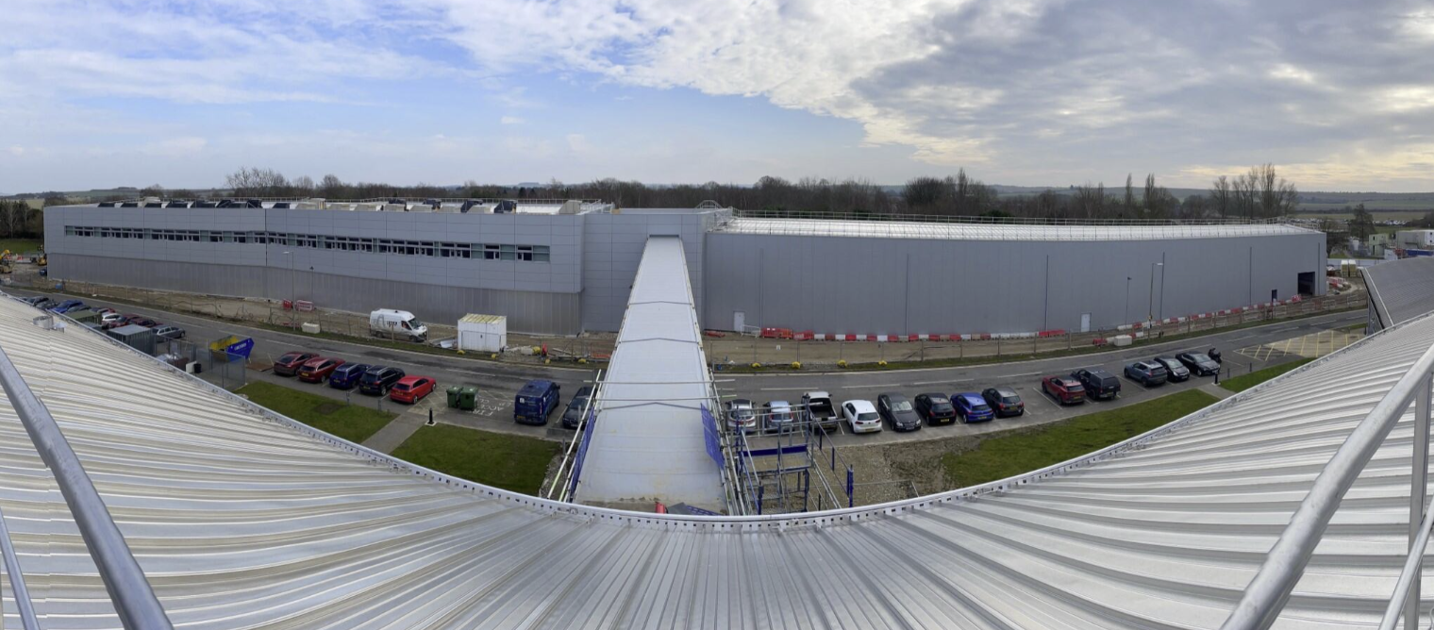
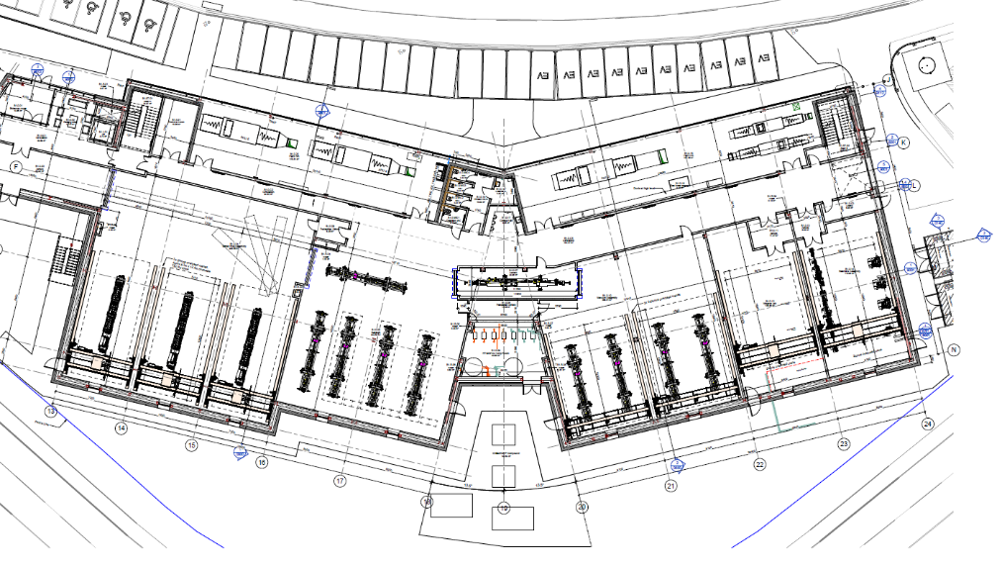
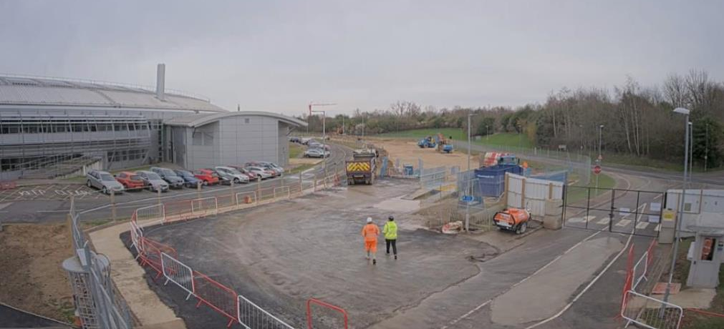
Diamond-II: Extension Building (DEB)
Diamond-II Extension Building nearing completion
Will be used for:
Magnet measurement
Vacuum bakeout
Girder, beamline assembly
Girder storage ahead of dark period
Additional office and lab space
Initial handover delayed Feb’25 => July’25 (TBC)
Mar’25
Feb’24
Magnet Lab.
Girder assembly
Vessel assembly
Bakeout
Beamline assembly
Courtesy P Coll
Ian Martin, Light Sources, JAI AB, 24/04/2025

Slide 5
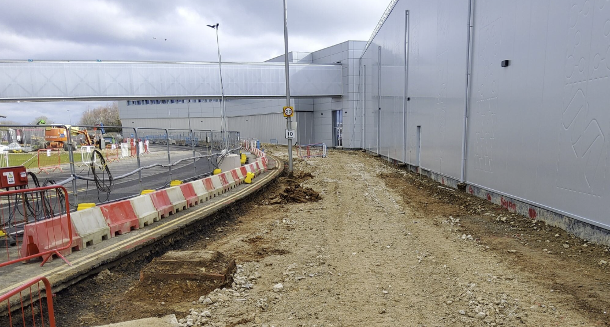
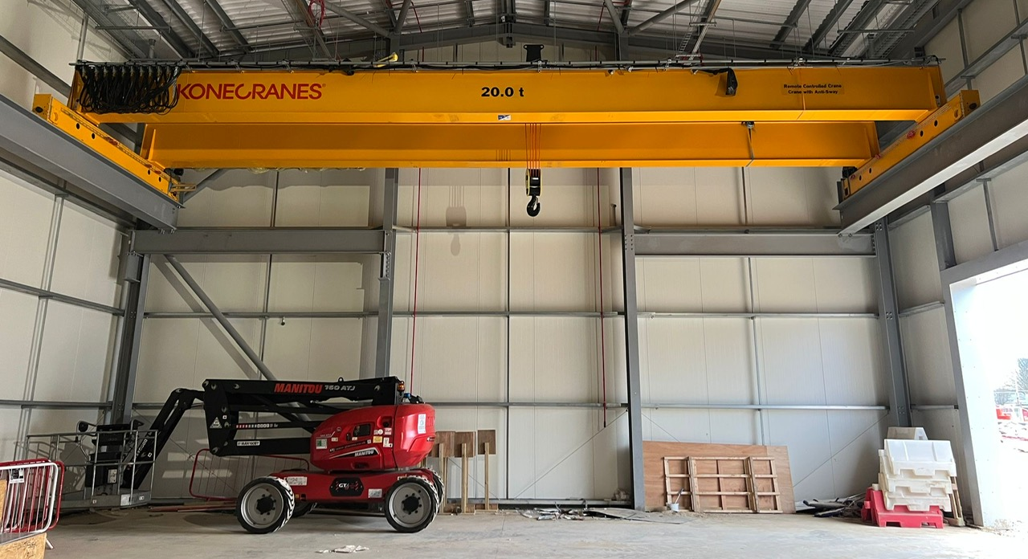
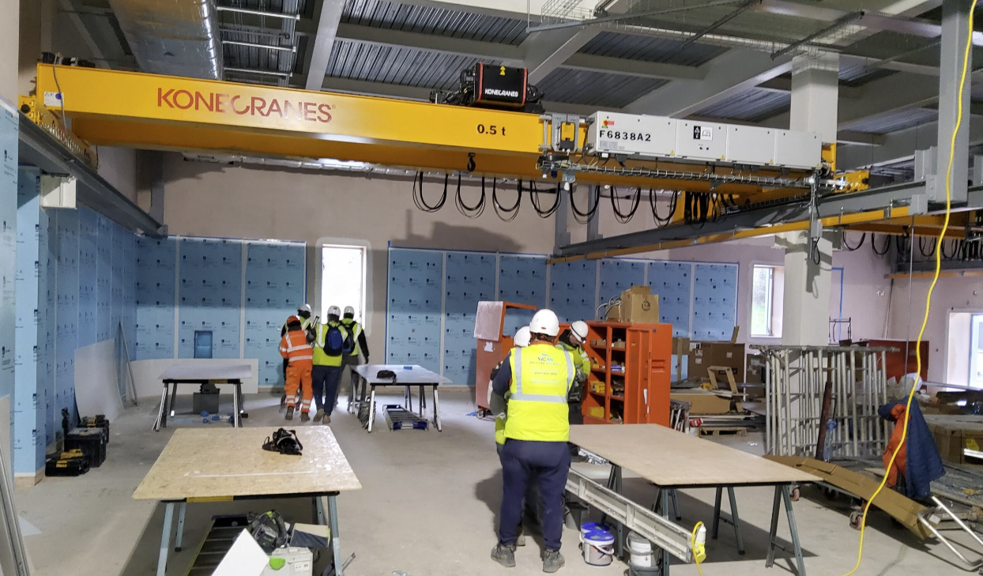
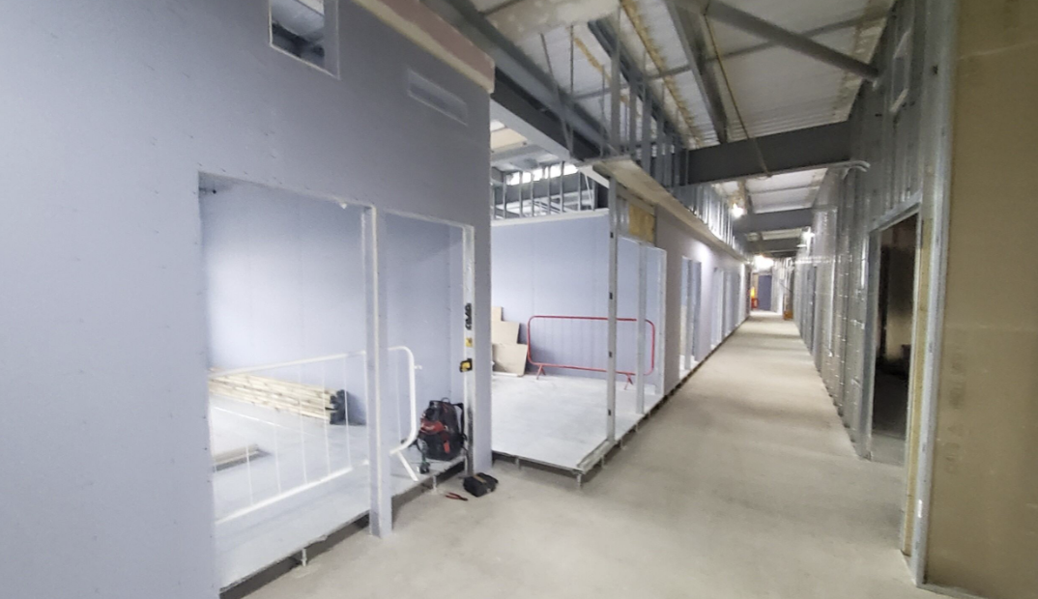
Diamond-II: Extension Building (DEB)
Parking area in front of DEB
20 Tonne crane installed in DEB2
Link bridge to synchrotron building
DEB1 Ground Floor partitioning works
DEB1 Vacuum Assembly Lab
Courtesy P Coll
Ian Martin, Light Sources, JAI AB, 24/04/2025

Slide 6
Diamond-II: Injection Scheme
‘Kick-and-cancel’ top-up injection scheme
Improved overall transparency - only perturbation to users is the injected bunch oscillating at large amplitude
Reduced transverse wakefields / interaction with TMBF compared to aperture-sharing (stored bunch is back on-axis)
Upgrade path for future high-brightness lattices: can move to kick-and-aperture-sharing injection
Key components
6 × short stripline kickers
±20 kV, 3 ns pulsers, >2 kicks per 5 Hz injection cycle
Timing system with tuneable delay (2-8 turns; 1.5-15.0 µs)
Septum magnet(s) with low leakage field:
  PM main septum (7.4 degrees)
  EM final thin septum (1.1 degrees)
Septum plate
Straight I01
Straight K01
Turn = -3
Kick from striplines
Stored bunch
Injected bunch
Turn = 0
I01
K01
magnets
striplines
septum
Δμ_{x} ~ 90 deg
Ian Martin, Light Sources, JAI AB, 24/04/2025

Slide 7
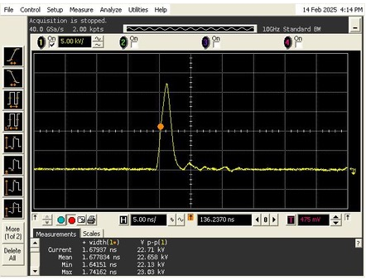
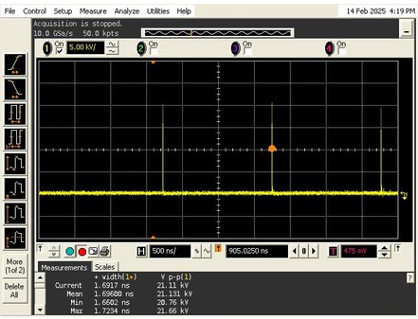

Diamond-II: Stripline Pulsers
To ensure only a single bunch is kicked, require:
$τ_{pulse}<\frac{2}{f_{RF}}−\frac{2L_{strip}}{c}=3 ns$
Prototype pulsers developed by Kentech Ltd.
Stage 1: +2.5kV, <15 ns, 4 pulses/cycle
Stage 2: ±4 kV, <4 ns, >10 pulses/cycle
Stage 3: ±20 kV, <4 ns, >10 pulses/cycle
Specification
Amplitude adjustment: 5:1 (best effort for 10:1)
Post-pulse noise: <±5% for 15 ns, <±2% thereafter (over 2:1 tuning range)
Amplitude / timing jitter: <±5% / <±0.1 ns
2 ns
3 ns
22.7 kV
<1 ns
>1 ns
<1 ns
1.5 µs
# Striplines | Nominal bend angle | Nominal Stripline Voltage | Power Supply Peak Voltage*
6 | 124 µrad | 11.7 kV | 20.0 kV
*includes contingency for 12% cable losses, +20% tuning range and only 5 out of 6 operational
Ian Martin, Light Sources, JAI AB, 24/04/2025

Slide 8
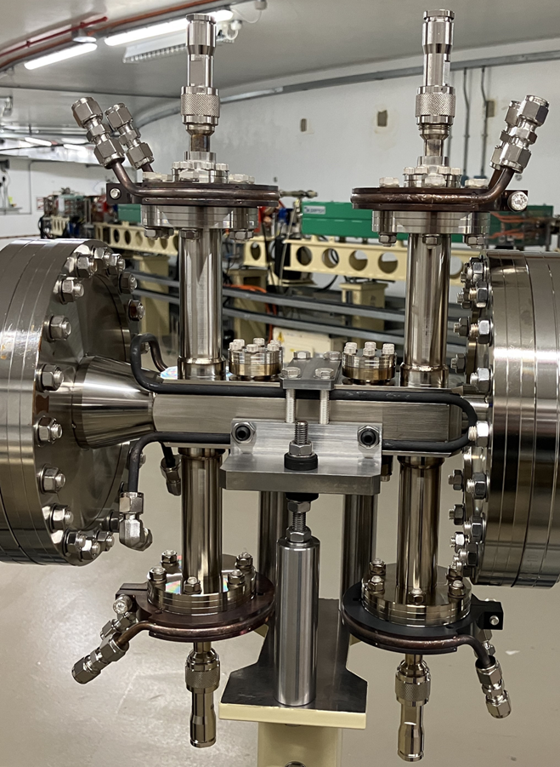
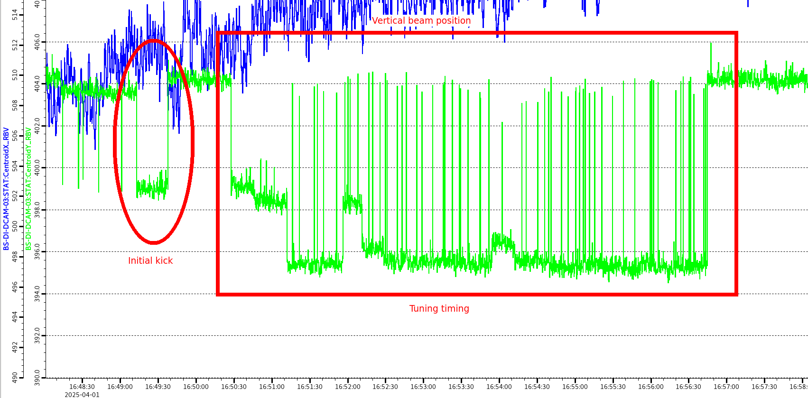
Diamond-II: Prototype Injection Striplines
Prototype striplines have been installed to validate D-II design choices and test individual components:
Stage 1 and 2 – 5 kV testing (Feb-April 2025; Lab and BTS)
S-parameter / pulser / cabling / feed-throughs successfully tested
Kick amplitude, timing adjustment
Stage 3 – 20 kV tests (Summer/Autumn 2025; Lab and SR)
hardware testing, impedance effects, beam dynamics, KC demonstration
Prototype striplines in BTS transfer line
Kick angle ~60 µrad @ 5 kV
Initial kick
Timing adjustment
Courtesy A Morgan
Ian Martin, Light Sources, JAI AB, 24/04/2025

Slide 9
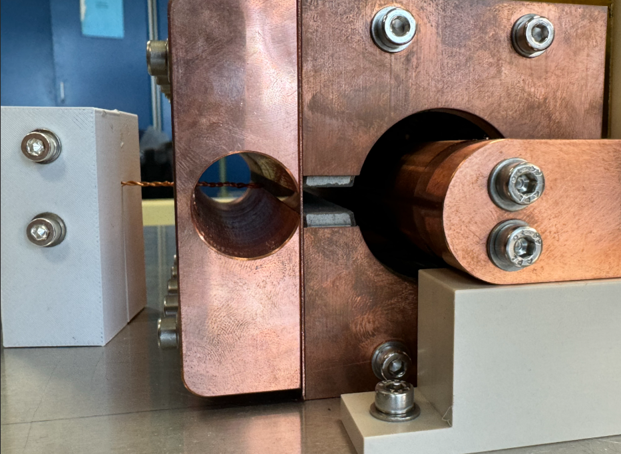
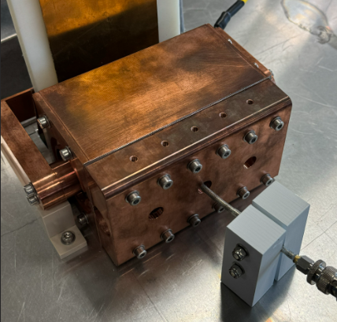
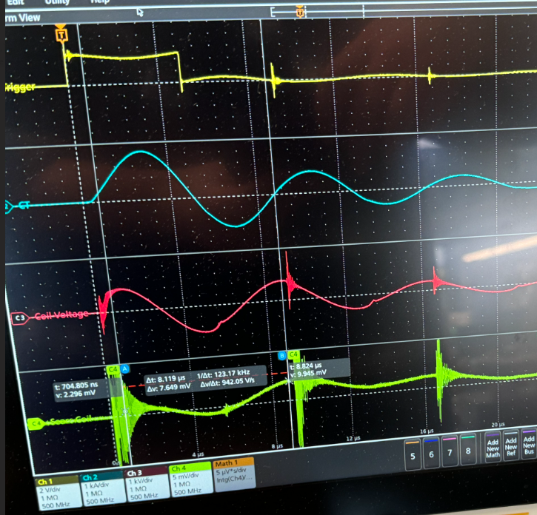
Diamond-II: Pulsed Thin Septum Magnet
Thin electromagnetic septum (1 mm, in-vacuum)
0.6 T, 400 mm long, 10 μsec full sine, iron powder core
Targeting 10 µTm integrated leakage field for transparency
Prototype mock-up
120 mm long, full cross-section
Tested shielding configuration examples:
  0.5 mm copper
  0.5 mm copper + 0.1 mm iron layers
  0.5 mm copper + 0.05 mm mumetal layers
  0.5 mm copper + 0.05 mm nanocrystalline layers
Issues with power supply output (repurposed kicker PS)
  noise in the measurements
  clean full-sine pulse not possible
Believe end leakage might be dominating, even in the centre of the magnet (no end shielding in mock-up)
SmCo
Iron
Trigger
Magnet voltage
Search coil
Courtesy C Bailey
Ian Martin, Light Sources, JAI AB, 24/04/2025

Slide 10
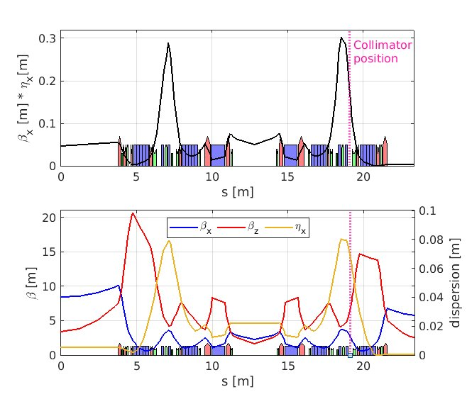
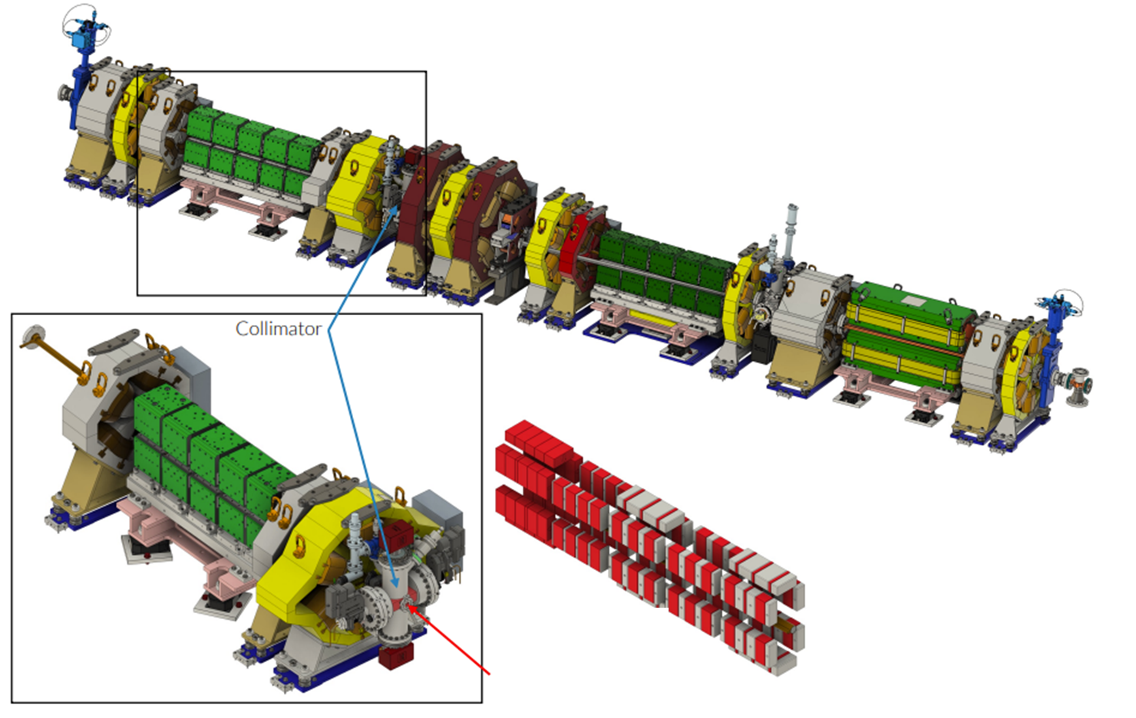
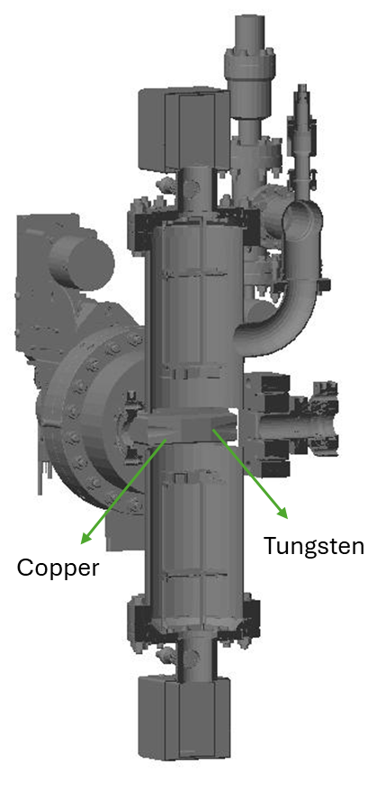
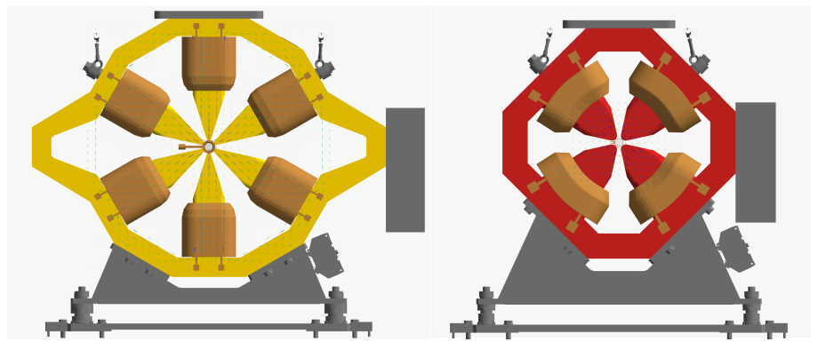
Diamond-II: Beam Loss Management
Diamond-II storage ring contains six collimators to collect lost particles (3H + 3V)
Collect losses during injection, lifetime, beam dumps
Provides protection for permanent magnet devices (DL dipoles, IDs)
Collaboration with RHUL to construct BDSIM model of sensitive region
Engineering STEP file used to construct BDSIM model
  Materials: Cu, Al, W, Fe, Stainless Steel, Sm₂Co₁₇
OPERA field maps for all the magnets included
Field alignment with magnet yoke checked.
Iron
Diamond-II Girder
Insertion device
Diamond-II Quadrupole and Sextupole with OPERA Field Map
collimator
Sm₂Co₁₇ PM blocks in DL dipoles
Beam direction
Courtesy W Shields
Ian Martin, Light Sources, JAI AB, 24/04/2025

Slide 11
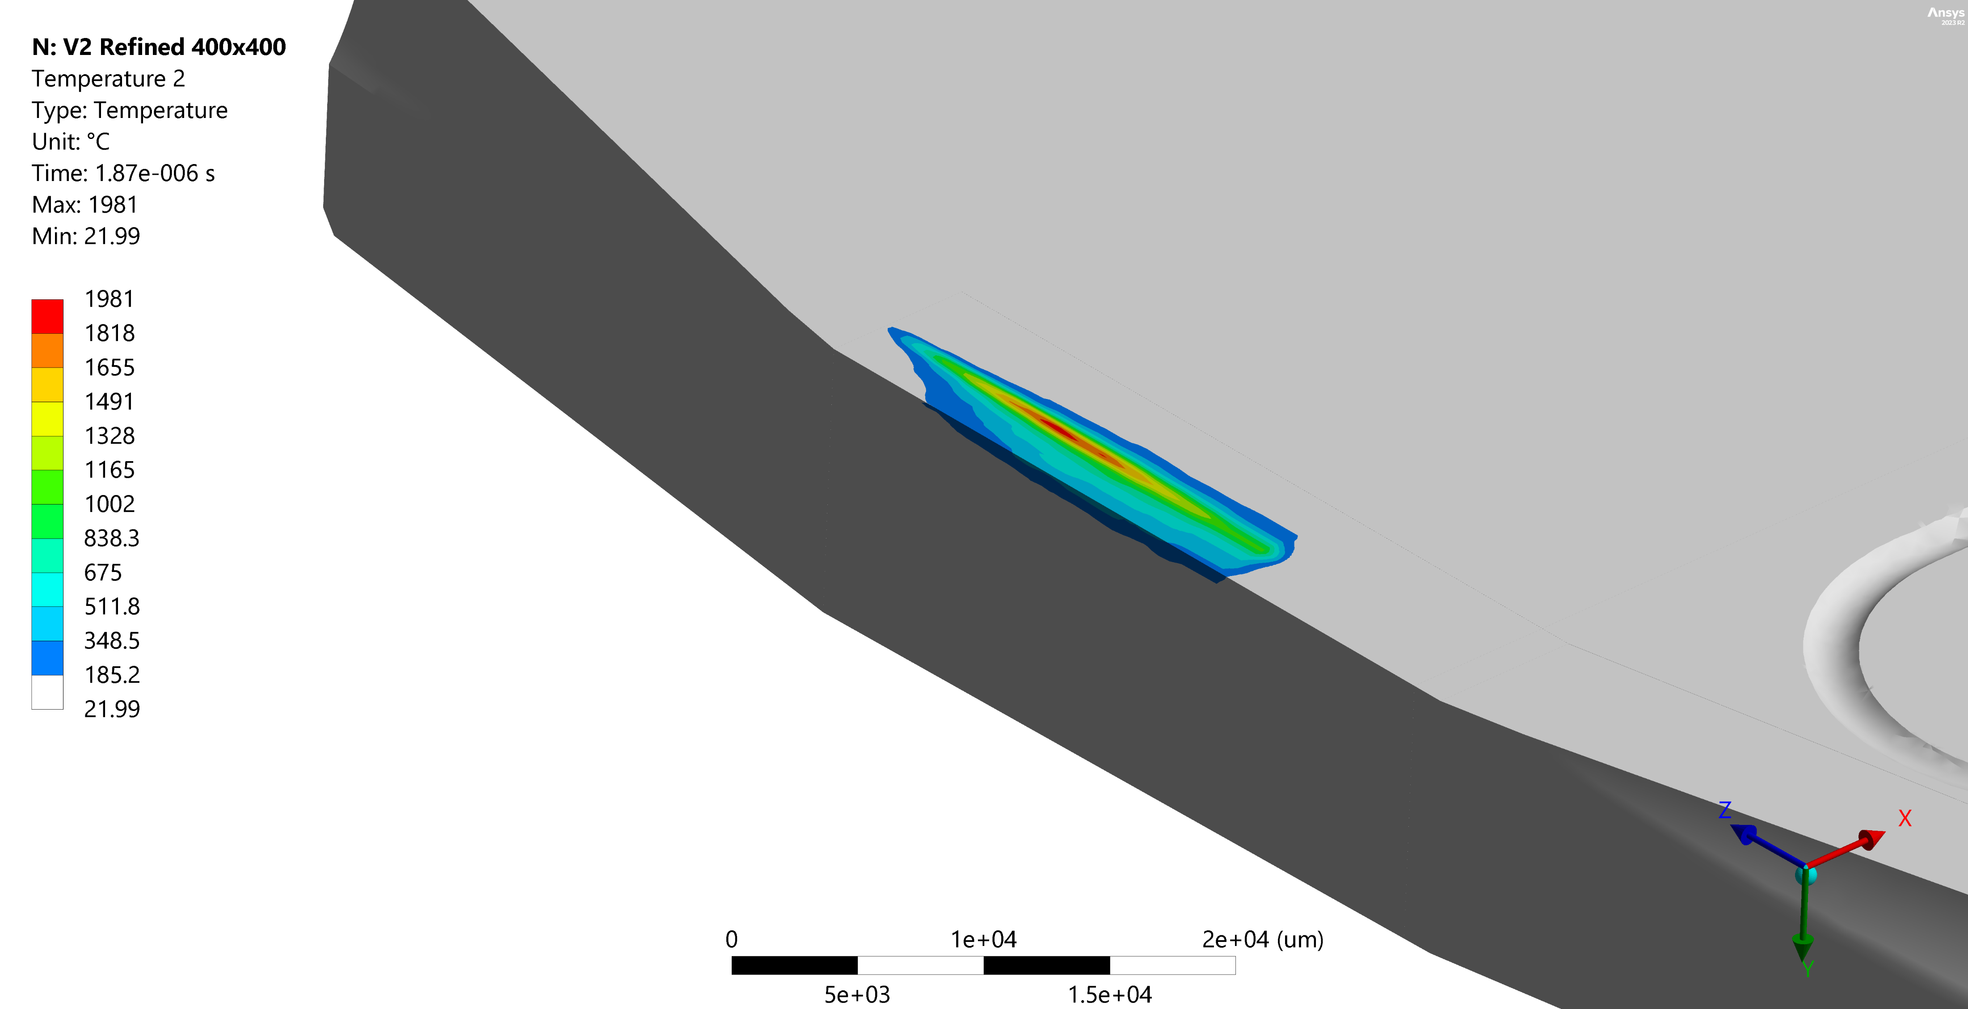
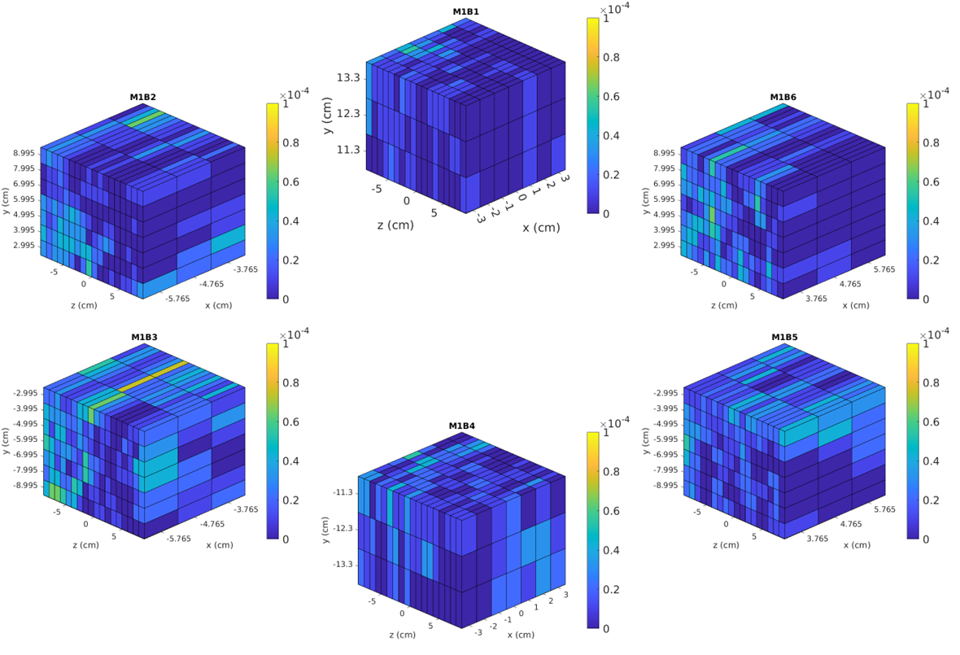
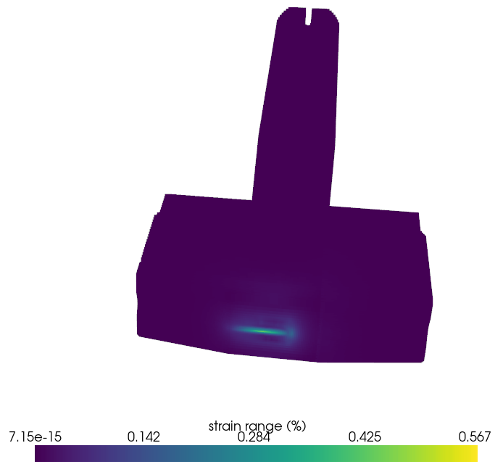
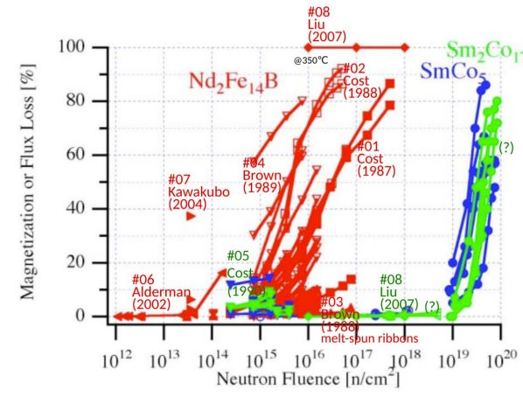
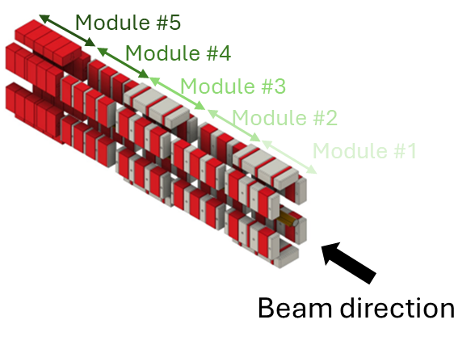
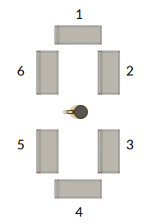
Diamond-II: Beam Loss Management
Risk of long-term damage to collimators after beam trip identified from ANSYS FEA studies, even if decoherence/fan-out kickers are used to spread the beam across the blades
High e⁻ energy density could cause surface melting or cracking from fatigue
Strain range is 0.57% (above the fatigue strength at 100 cycles)
Max tensile stress ~1200MPa (fracture stress ~550MPa in Tungsten)
Crack nucleation is expected above 838°C
Tungsten blade ~2000 °C (below melting point)
SmCo
Neutron fluence at PM dipoles over 30 years expected to remain below damage threshold
Demagnetisation vs neutron fluence
Peak strain range ~0.57%
Neutron population per electron in module #1
RF ON + FK
RF OFF
B. Shepherd, CLIC note 1079
Courtesy H Ghasem, J Linde Cerezo
Ian Martin, Light Sources, JAI AB, 24/04/2025

Slide 12
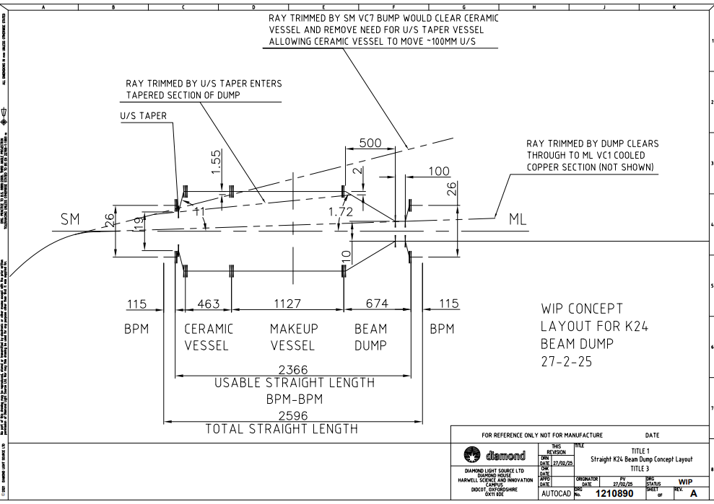
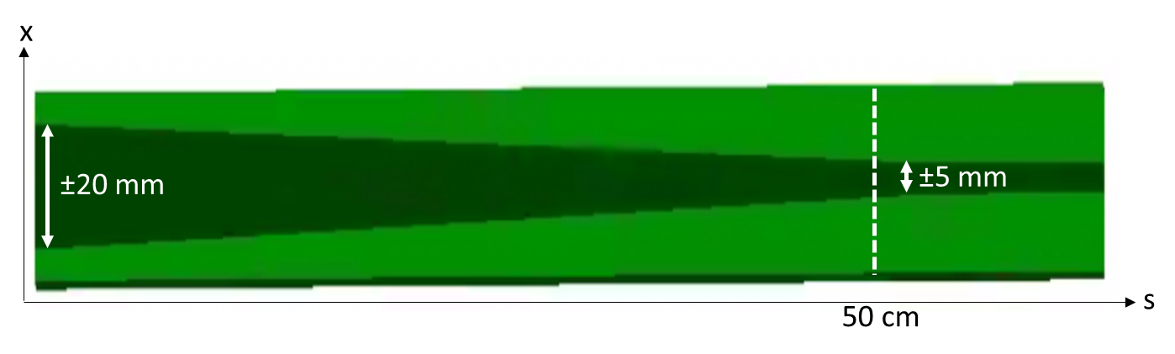
Diamond-II: Beam Loss Management
To avoid risk of damage to the collimators, a dedicate beam dump in mid-straight K24 is under consideration.
Initial concept:
Single-turn kicker at upstream end of straight
Copper beam dump at downstream end (fixed aperture)
SmCo
Iron
Beam dump
Beam dump controller to manage process
Beam Interlocks
Fast (<100 µs)
Low Level RF
Slow (<1 ms)
Orbit
Magnets
Vacuum
Temps
Doors
EPICS Interface
Beam Abort
Fire abort kicker
Inhibit injection
Inhibit linac gun
Turn off RF
Post-Mortems
Low Level RF
BPMs
Multibunch feedback
Fast Loss Monitors
Kicker
Beam dump controller
Ian Martin, Light Sources, JAI AB, 24/04/2025

Slide 13
Diamond-II Timeline
Milestone | Planned date
Approval for the Diamond-II Project and start of funding | July 2023
Completion of the Diamond Extension Building | July 2025
Girder assembly complete | September 2027
Start of the dark period | December 2027
Start of storage ring beam commissioning | December 2028
Start of regular beamline X-ray commissioning | June 2029
First phase of beamlines become operational | September 2029
End of the Diamond-II project | March 2030

Slide 14
PhD Student: Alec Clapp (started 2021; writing thesis)
“Feasibility study on the use of incoherent Cherenkov Diffraction Radiation to develop a non-invasive BPM”
Cherenkov Diffraction Radiation (ChDR) occurs when a charged particle moves in the vicinity of a dielectric medium.
Photon yield depends on the distance between particle and medium
Enables beam position measurement using purely light signals (quartz target + glass fibres; no metal)
Dual pick-up ChDR BPM using two targets installed and first beam tests completed on 3-4th April 2024
→ Demonstration of a 1D ChDR BPM using pick-ups at visible wavelengths presented at IBIC 2024
ChDR Position
A. Clapp et al., Proc. of IBIC’2024, TUP33
A. Clapp et al, Proc. of IBIC’2023, MOP032
Electron beam passes between targets
ChDR is emitted by target and collected by collimators
Light is propagated out of vacuum by fibre optic feedthroughs and PMT
Supervisors: P. Karataev and L. Bobb
L. Bobb, 07/04/2024

Slide 15
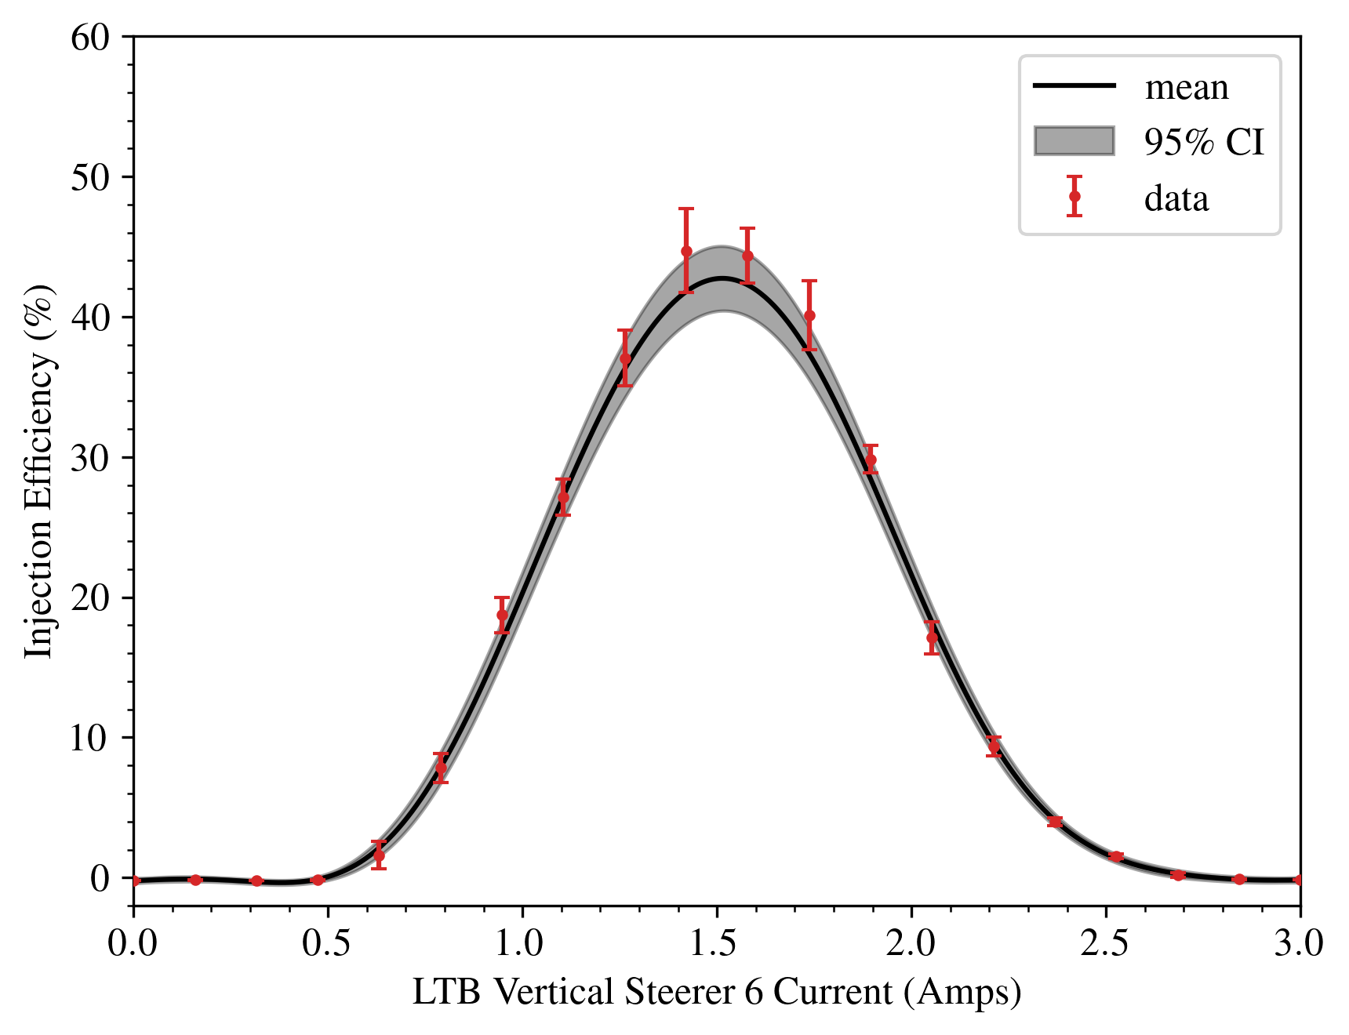
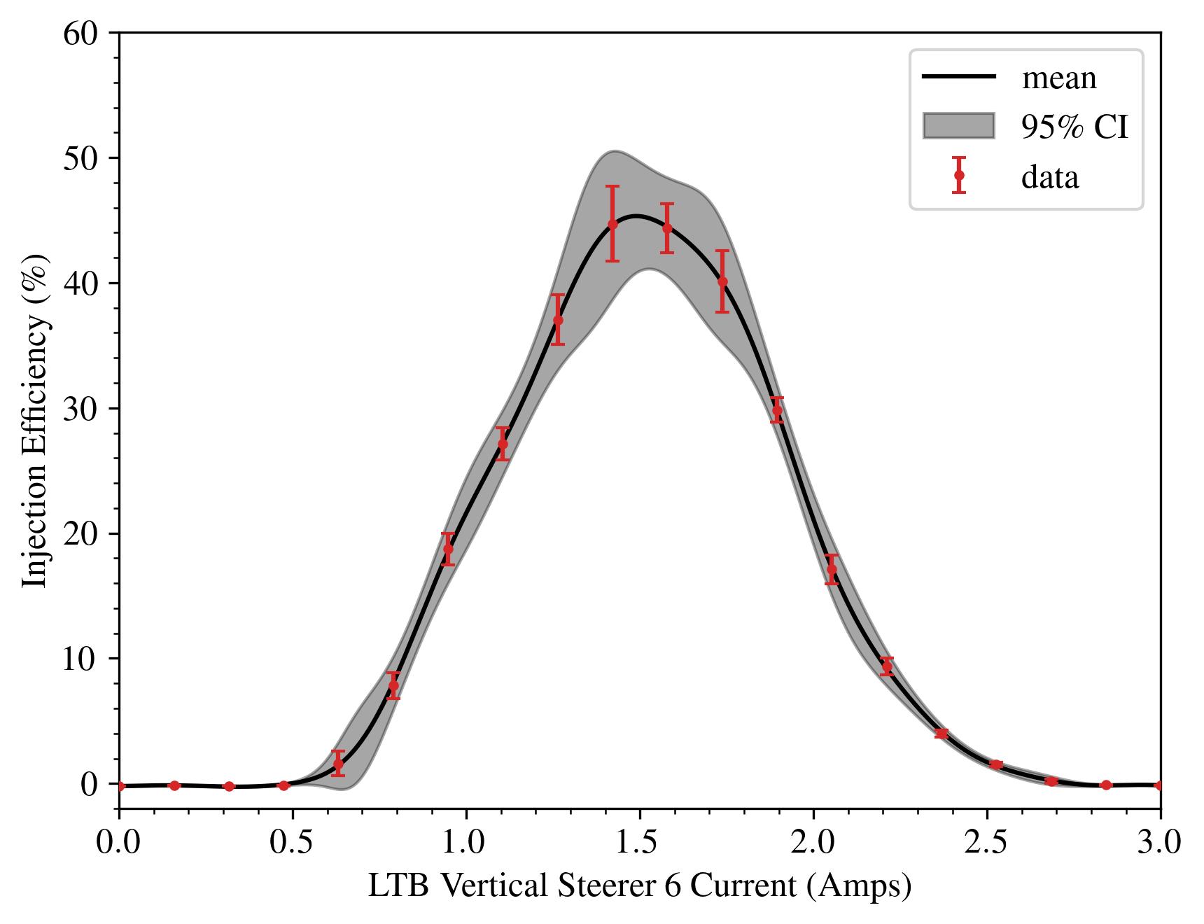
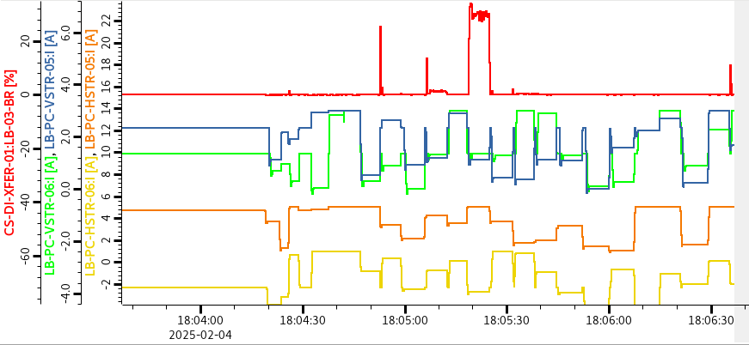
DPhil Student: Shaun Preston (started 2023)
“Application of Machine Learning for Improving Operational Performance of Storage Ring Light Sources”
Main topic of study has been developing a Gaussian Process Optimiser (GPO), specifically targeting online tasks:
  Compensation for ‘Heteroscedastic’ measurement errors
  Compensation for magnet hysteresis effects
  Coping with strictly positive objective functions
Applied to varying numbers transfer line magnet strengths, aiming to improve injection efficiency
Possible test at ISIS to reduce beam halo formation at target station
Single GPO
Gun charge fluctuations
Sensor noise
Double GPO
Increase in efficiency
Varying 4 steerer currents
Non-physical negative value
Supervisors: P. Burrows and I. Martin
Ian Martin, Light Sources, JAI AB, 24/04/2025

Slide 16
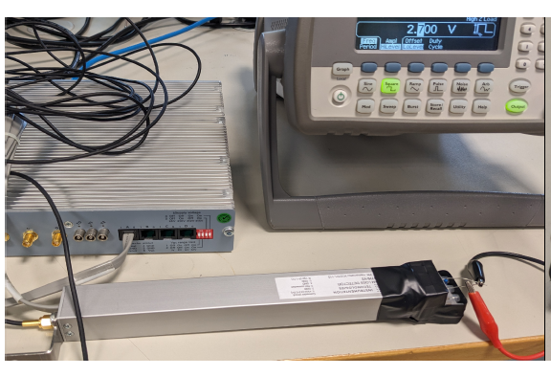
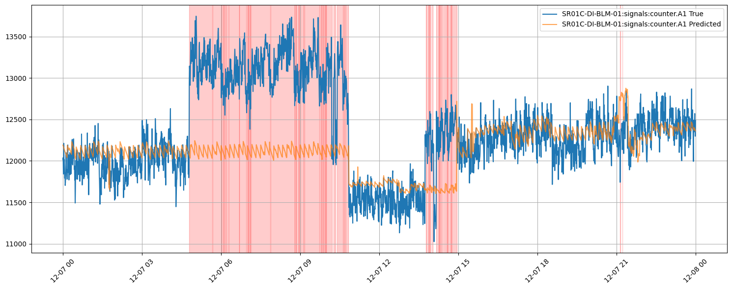
DPhil Student: Corey Lehmann (started 2023)
“Fast Beam Loss Monitor System for Diamond-II and Machine Learning Applications”
Current Status:
4 fast BLMs (13 BLDs) have been calibrated in the lab and deployed around the Diamond storage ring (in cells 1, 4, 13 and 23)
Data characterising typical beam losses in Diamond under user beam conditions has been acquired, including with regular ID gap changes
Linear regression and neural network models have been developed to match loss patterns against known ID states
Starting shifts to purposefully introduce “faults” to the machine to assess sensitivity of ML anomaly detection using the measured beam losses
Fast BLDs deployed on storage ring
Anomaly from movement of I21
Calibration set-up in the lab
Beam Loss Detector (i-Tech)
Supervisors: P. Burrows and L. Bobb
L. Bobb, 07/04/2024

Slide 17
Conclusions
JAI is active in many areas of light source design and operation:
Enhanced performance / special operating modes / facility design
Photon / electron beam diagnostics
Exploitation of machine learning and related techniques
Directly supports and well-integrated with Diamond-II Project. Collaborations / synergies with ISIS, ILC and Ada Lovelace Centre
Providing training and expertise in light sources for next generation of accelerator physicists:
Four PhD/DPhil Studentships (RHUL and Oxford)
Joint Diamond / JAI PDRA working on Diamond-II – to be readvertised pending confirmation of JAI grant renewal and availability of Diamond funding
Ian Martin, Light Sources, JAI AB, 24/04/2025

