Slide 1
Division of Particles and Fields
2025 APS April Meeting
Heidi Schellman 2025 Chair
Oregon State University

Slide 2
DPF Business Meeting
Chair Report
  APS Fellow Recognition
  Computing Panel
Treasurer’s Report
Discussion

Slide 3
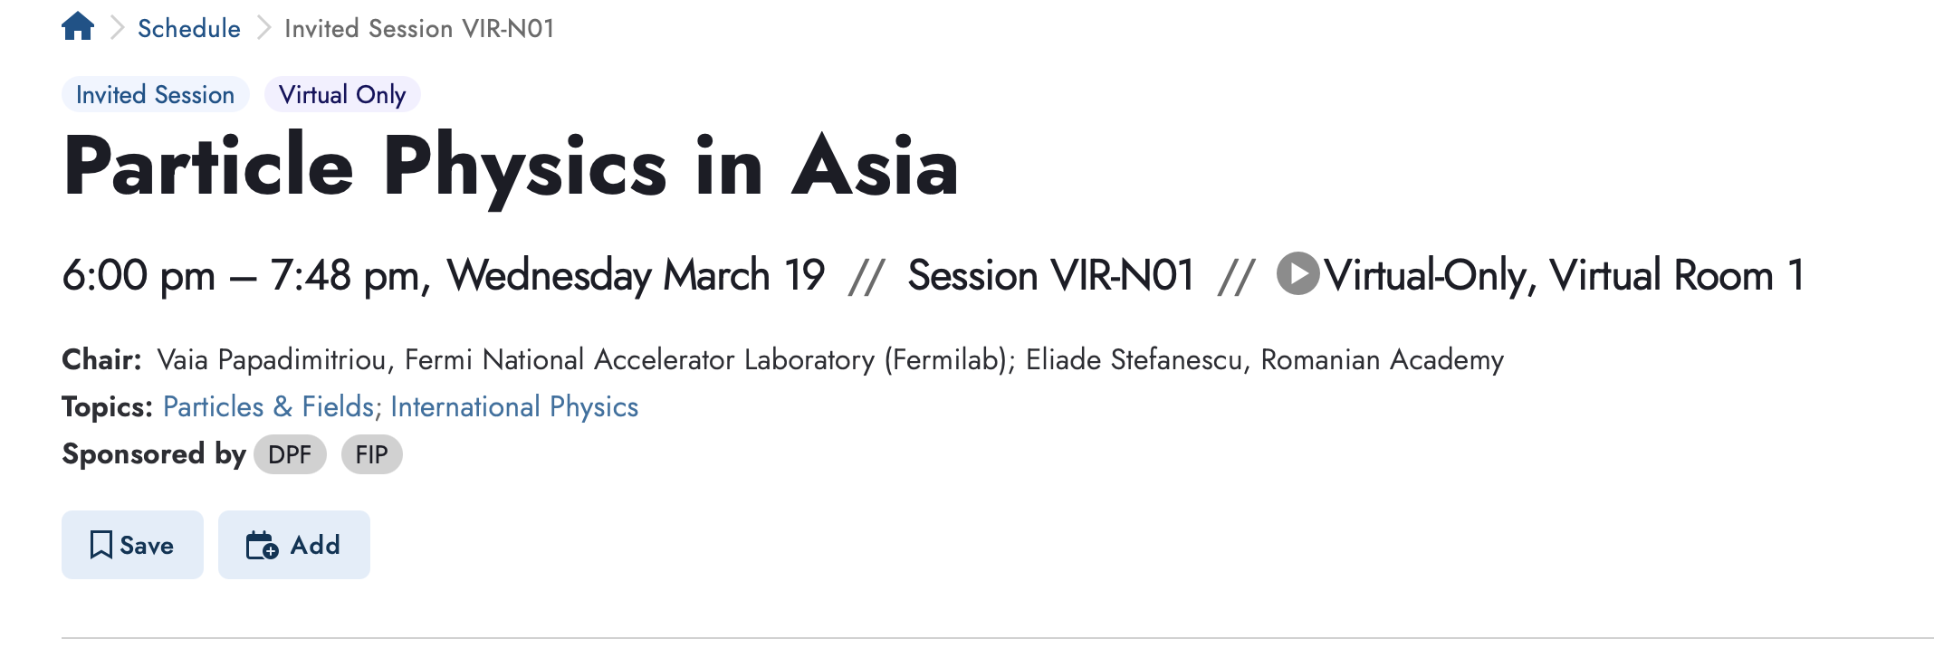
Special session - Virtual
There will be a connection through the app – a green button appears 5 minutes ahead

Slide 4
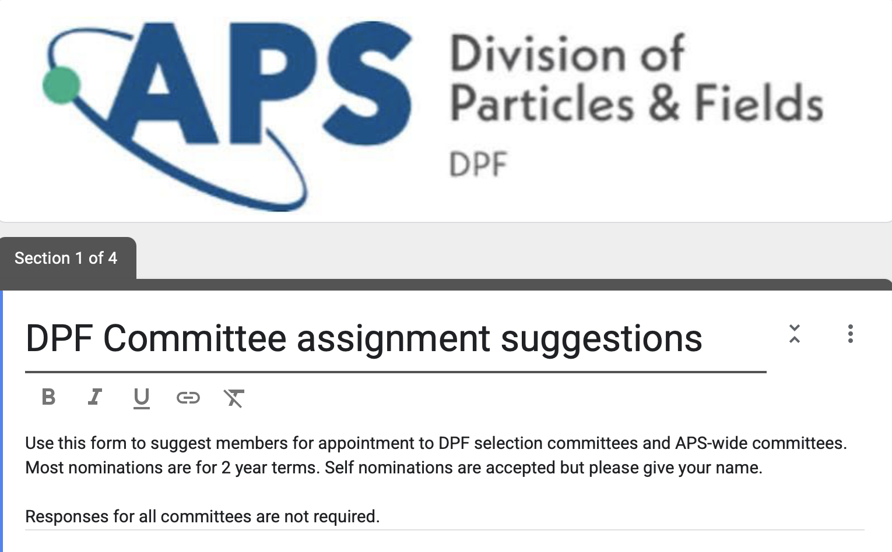
Nominations for Awards Committees
You will get an email soon with the form.

Slide 5
DPF Executive Committee
Chair: Heidi M Schellman (01/25–12/25)
Oregon State University
Chair-Elect: Sarah C Eno (01/25–12/25)
University of Maryland College Park
Vice Chair: Hitoshi Murayama (01/25–12/25)
University of California, Berkeley
Past Chair: Andre C de Gouvea (01/25–12/25)
Northwestern University
Secretary/Treasurer: Kenneth Bloom (01/25–12/27)
University of Nebraska – Lincoln
Past Secretary/Treasurer: Tulika Bose (01/25–12/25)
University of Wisconsin – Madison
Councilor: Robert H Bernstein (01/22–12/25)
Fermi National Accelerator Laboratory (Fermilab)
Member-at-Large: Vaia Papadimitriou (01/23–12/25)
Fermi National Accelerator Laboratory (Fermilab)
Member-at-Large: Mark D Messier (01/23–12/25)
Indiana University Bloomington
Member-at-Large: Mu-Chun Chen (01/24–12/26)
University of California, Irvine
Member-at-Large: Todd Adams (01/24–12/26)
Florida State University
Member-at-Large: Sarah M Demers (01/25–12/27)
Yale University
Member-at-Large: Nathaniel Craig (01/25–12/27)
University of California, Santa Barbara
Early Career Member-at-Large: Saptaparna Bhattacharya (01/24–12/25)
Southern Methodist University
Early Career Member-at-Large: Samuel David Homiller (01/25–12/26)
Cornell Laboratory for Accelerator-based Sciences and Education
Student Member: Olivia M Bitter (01/25–12/25)
Northwestern University

Slide 6
Bylaws Revision – Complete!
DPF bylaws were last reviewed in 2020. Minor edits were made in 2024 to bring the bylaws in line with current governance language and consistency with other unit bylaws. In addition, a number of changes were made at the unit’s request.
i. Composition of Executive Committee amended to increase Early Career member representation from one member to two members (staggered two-year terms), and to add a Student Member (one-year term).
ii. Clarification added to Article VII.3 on definition of Early Career Members and Student Member and Article VII.6 related to the Early Career and Student Member terms of office.
iii. Nominating Committee membership clarified (the member of the Executive Committee serving on the Nominating Committee shall be the Early Career Member. (Article VIII.1)
iv. Fellowship Committee membership increased from two to four members to comply with APS Honors Guidelines. (Article VIII.3)
v. Coordinating Panel for Advanced Detectors (CPAD) Committee membership increased from six to ten members; language related to the committee chair line term was added for clarity. (Article VIII.4)
vi. Boilerplate Honors Policies and Procedures language was inserted. (Article VIII.7)
vii. Pronouns updated to reflect gender-neutral inclusivity, where noted (two instances).

Slide 7
European Strategy
Andre, Hitoshi, Mark Palmer (DPB) and I have drafted a 10-page summary of US community input for the European Strategy for Particle Physics Update (ESPP). Preliminary white papers are due by March 31, 2025
We ran an online forum to encourage white papers and hear from the community on Feb 27 with ~ 180 attendees.
Next step is finalizing our summary document (which you should have gotten)
We can then iterate
Participate in a Symposium in Venice in late June. (Hitoshi)

Slide 8
DPF APS Fellows
Presentation of 2024 fellows

Slide 9
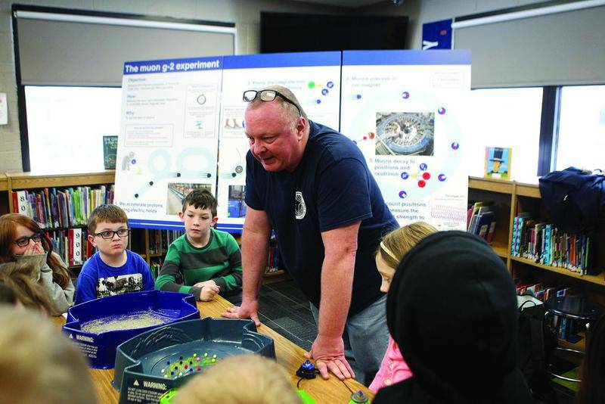
Brendan Casey
Fermilab
For the determination of the muon anomalous magnetic moment to 0.2 ppm, design and construction of the tracking detectors for the Muon g-2 experiment that were essential for controlling systematics for the measurement, and for overall leadership of the global charged lepton physics program.

Slide 10
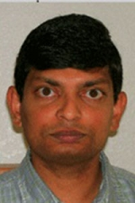
Zackaria Chacko
University of Maryland, College Park
For discovering two of the major theoretical scenarios for particle physics beyond the Standard Model — neutral naturalness and gaugino mediated supersymmetry breaking — and for inspiring experimental programs to test them.

Slide 11
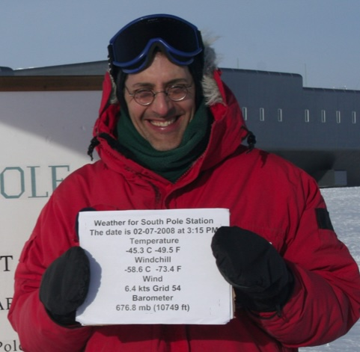
Douglas Cowen
Pennsylvania State University
For pioneering contributions to the study of the tau neutrino, including its mass limit using tau decays to five pions, its appearance from oscillations in the atmospheric neutrino flux, and its first high-significance detection in the astrophysical neutrino flux.

Slide 12
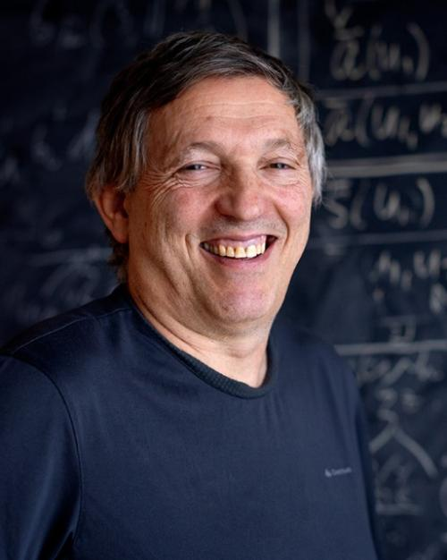
Yuval Grossman
Cornell University
For seminal contributions in flavor physics, especially physics of the D mesons, CP violation in the B system, and novel flavor physics from extra dimensions.

Slide 13
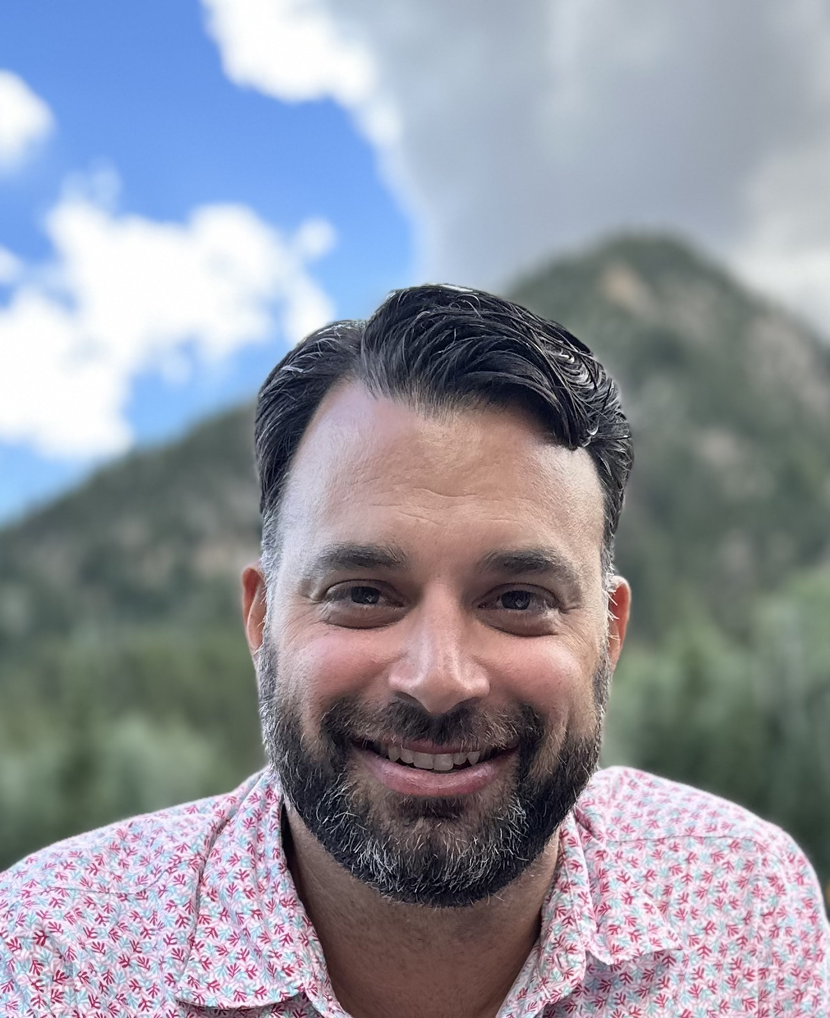
Patrick Meade
Stony Brook University
For pioneering research and leadership in particle theory and phenomenology, including signatures of gauge-mediated supersymmetry, top partners, long-lived particles, Higgs sectors, phase transitions of the early universe, and the science capabilities of proposed facilities.

Slide 14
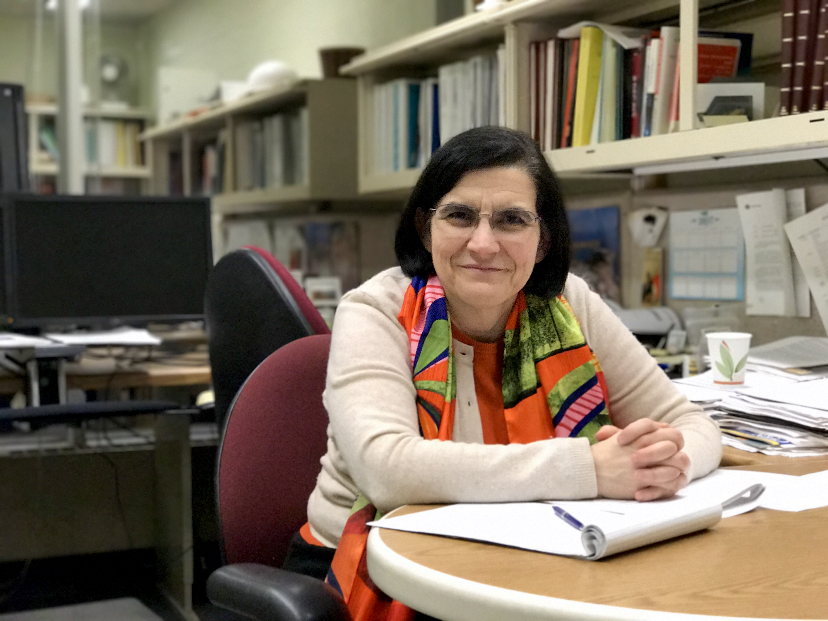
Vaia Papadimitriou
Fermilab
For exceptional leadership in advancing our understanding of nature and international high energy physics programs, pioneering and continuing leadership of QCD studies with B particles and quarkonia, high-impact leadership in the LBNF and CMS projects, and key contributions to the success of the Tevatron Collider.

Slide 15
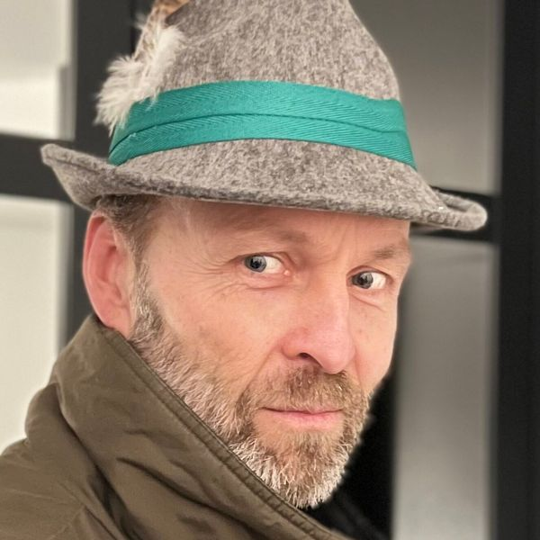
Martin Schmaltz
Boston University
For contributions to theories for particle physics beyond the standard model, and their implications for cosmology, flavor physics, and electroweak symmetry breaking.

Slide 16
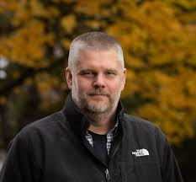
Eric Torrence
University of Oregon
For significant contributions with the ATLAS and FASER Collaborations, particularly in the searches for new physics, measurement of the LHC luminosity, and for leadership in the operations of both experiments.

Slide 17
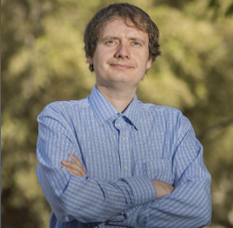
Jaroslav Trnka
University of California, Davis
For deep contributions to exposing hidden mathematical structures in particle scattering amplitudes.

Slide 18
Additional 2024 Fellows (DPF Members)
Giorgio Ambrosio (DPB)
Patrizia Azzi (FIP)
Tanmoy Bhattacharya (DCOMP)
David Kawall (DNP)
Rachel Mandelbaum (DAP)
Emil Mottola (DGRAV)
Andrea Pocar (DNP)

Slide 19
Congratulations to all our new Fellows!

Slide 20
APS/DPF Awards and Prizes
J J Sakurai Prize: Aneesh Manohar, UCSD, Elizabeth Jenkins, UCSD
Panofky Prize: Robert Klanner (DESY), Eckhard Elsen (CERN)
Wilson Prize: Alexander Zholents, ANL
Primakoff Award: Kevin Kelly, Texas A&M
Narain Mentoring Award: Tao Han, Pittsburgh
J J and Noriko Sakurai Dissertation Award: Stella Schindler, MIT
Tanaka Dissertation Award: Gray Putnam, Chicago
Bethe Prize (DNP): Baha Balantekin, Wisconsin
Feshbach Prize (DNP): Richard Furnstahl
Pais Prize (FHP): Michael Riordan
Nicholson Medal (E+0): Don Lincoln, Fermilab

Slide 21
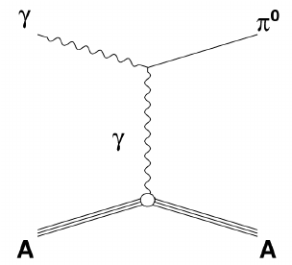
Primakoff fundraising
DPF Campaign to support the Henry Primakoff Award for Early Career Particle Physics
The Henry Primakoff Award for Early Career Particle Physics honors exceptional research in particle physics by early-career scientists.
The award currently includes a $3,000 stipend, and your generous support will allow us to increase this stipend to $5,000, making it on par with other APS early-career awards and sustaining early-career scientists' work in particle physics.

Slide 22
Discussion
Membership and Communication
  Only ~1/2 of active US HEP Physicists belong to APS/DPF!
  How can we improve this?
  How do we communicate with the community as a whole?
Codes of Conduct, especially at Meetings.
  APS Code applies to our meetings
  Successful Chair training program adopted from DNP
Coordinating Panel for Software and Computing
  Snowmass Computational Frontier Recommendation
  Modeled on “CPAD” – Coordinating Panel for Advanced Detectors.
  Panel is formed, we’re talking to Ian Fisk tomorrow.

