Slide 1
Idea for Target Support

Slide 2
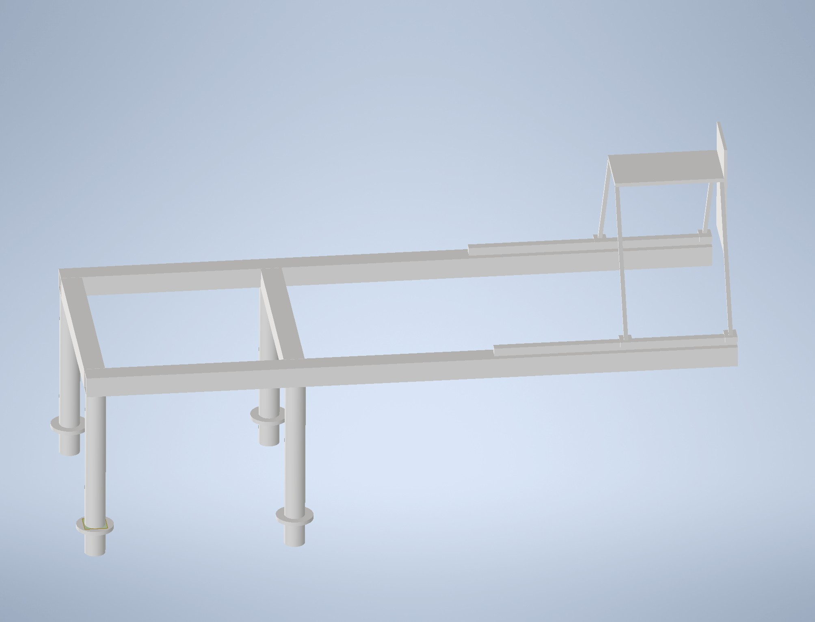
Requirements
Material Aluminium or non magnetic
Mount for Target
Target Movement Horizontal and Vertcal
Mount for Gamma Shield
Schield Movement Horizontal
Movement System suitable for Vacuum
Support should be decoupled from Vacuumcamber to prevent deformation or movement of the Structure when Chamber is evacuated
Gamma Shield
Target

Slide 3
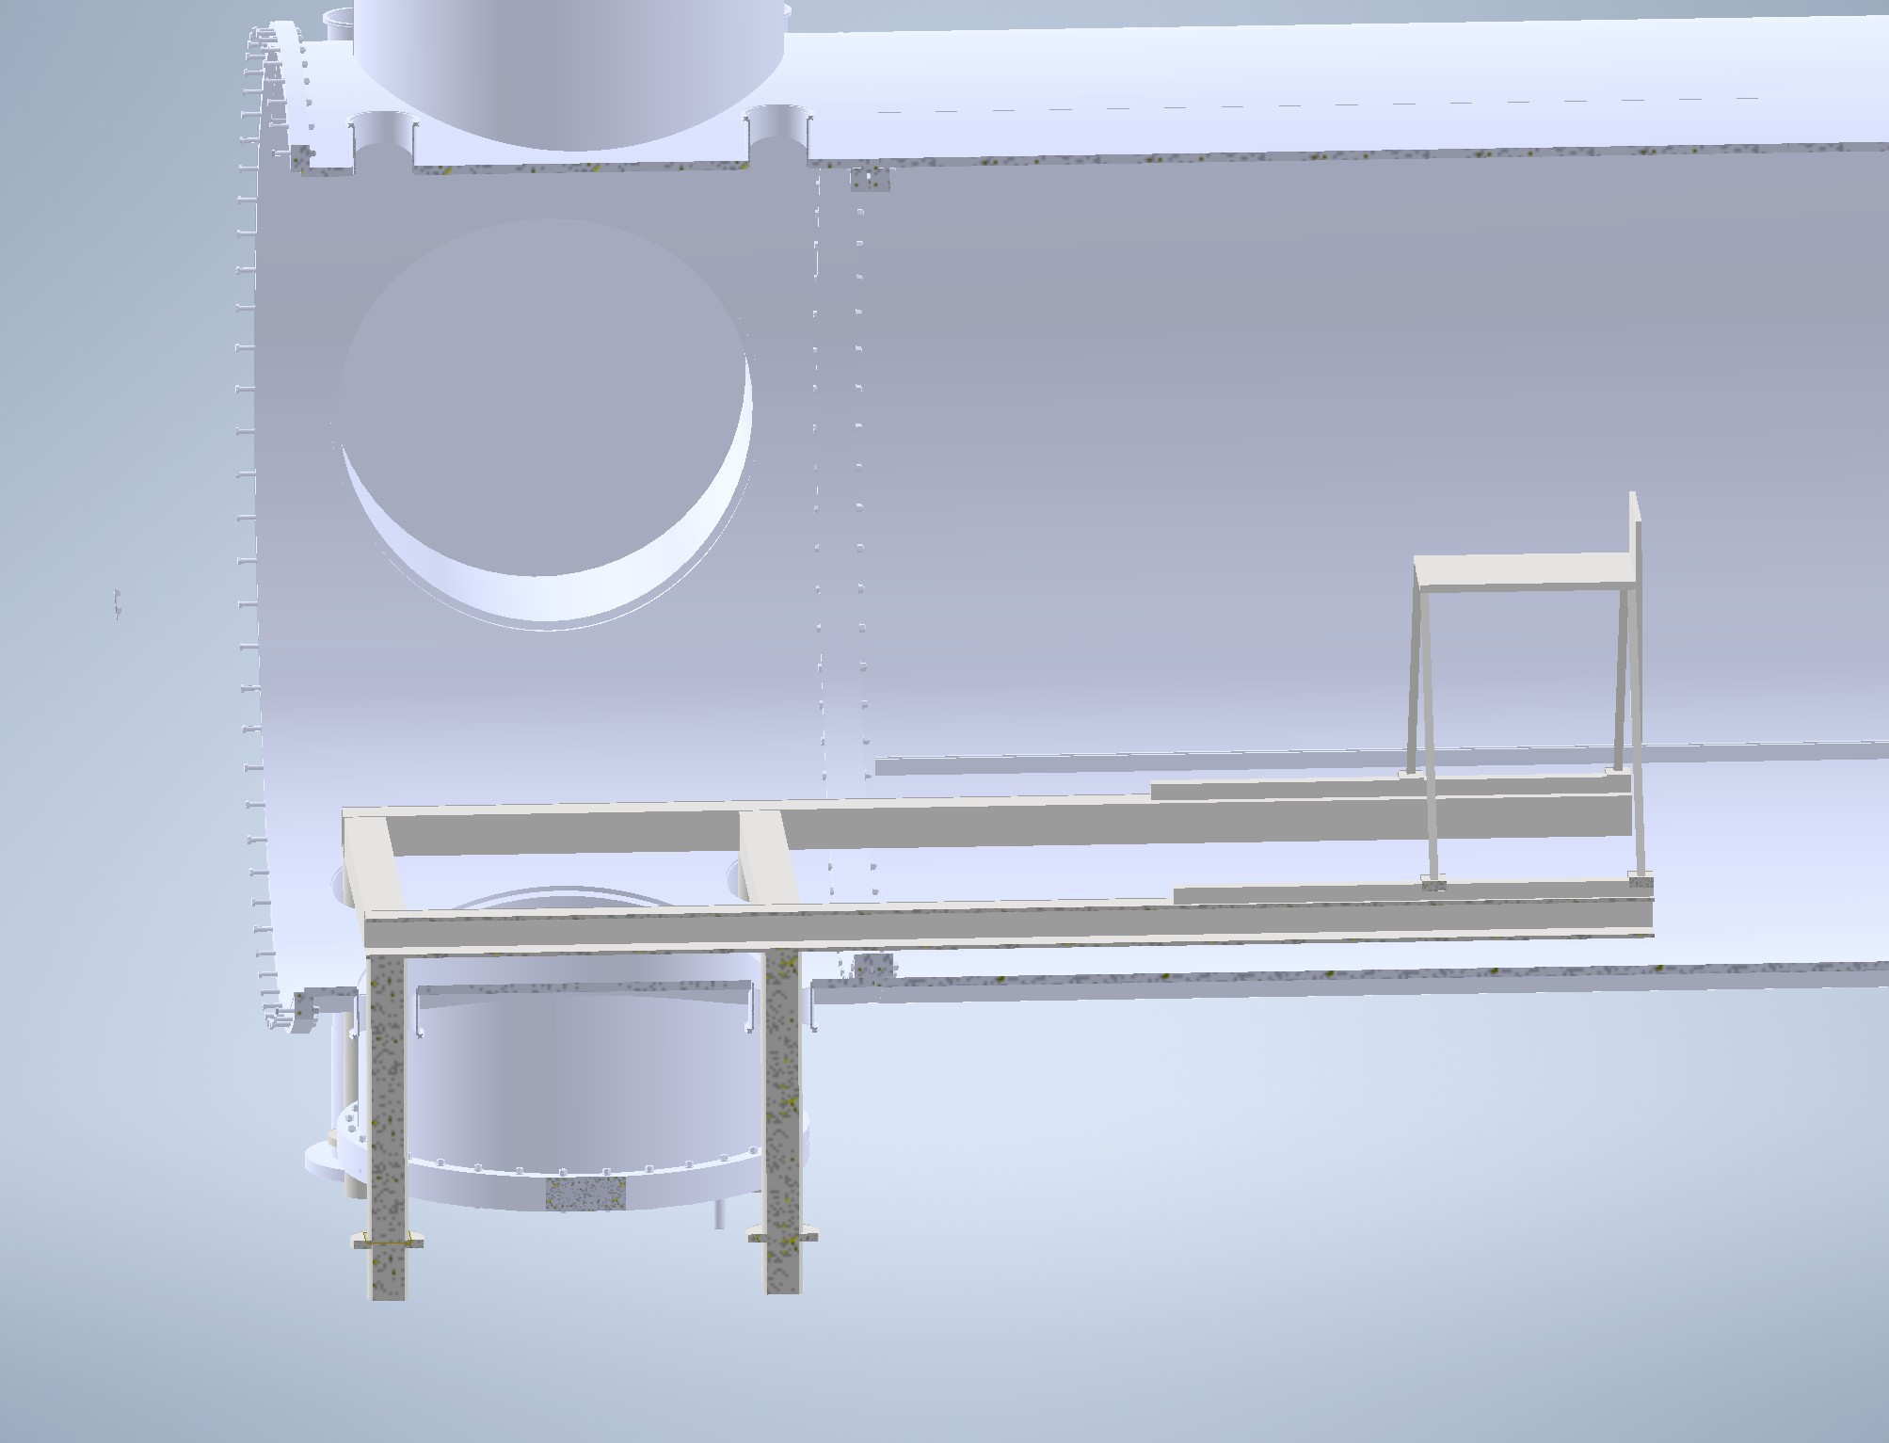
In Scattering Chamber
Decoupled from vacuum Camber
Feet shout be mounted to the Floor
~1.8 m
~3 m

Slide 4
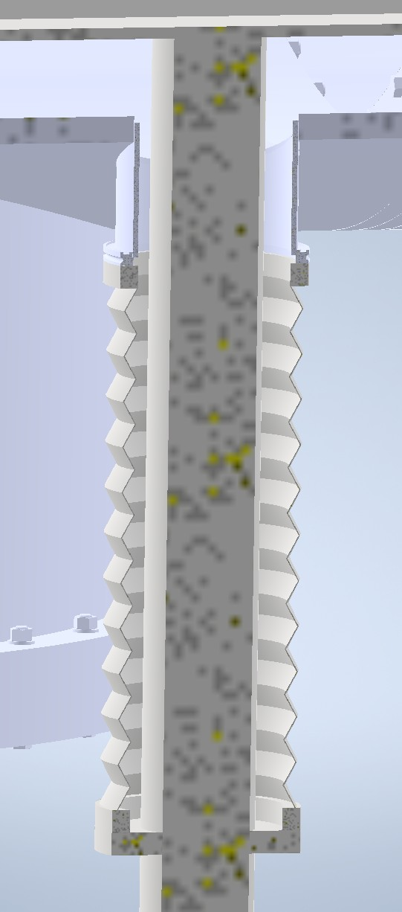
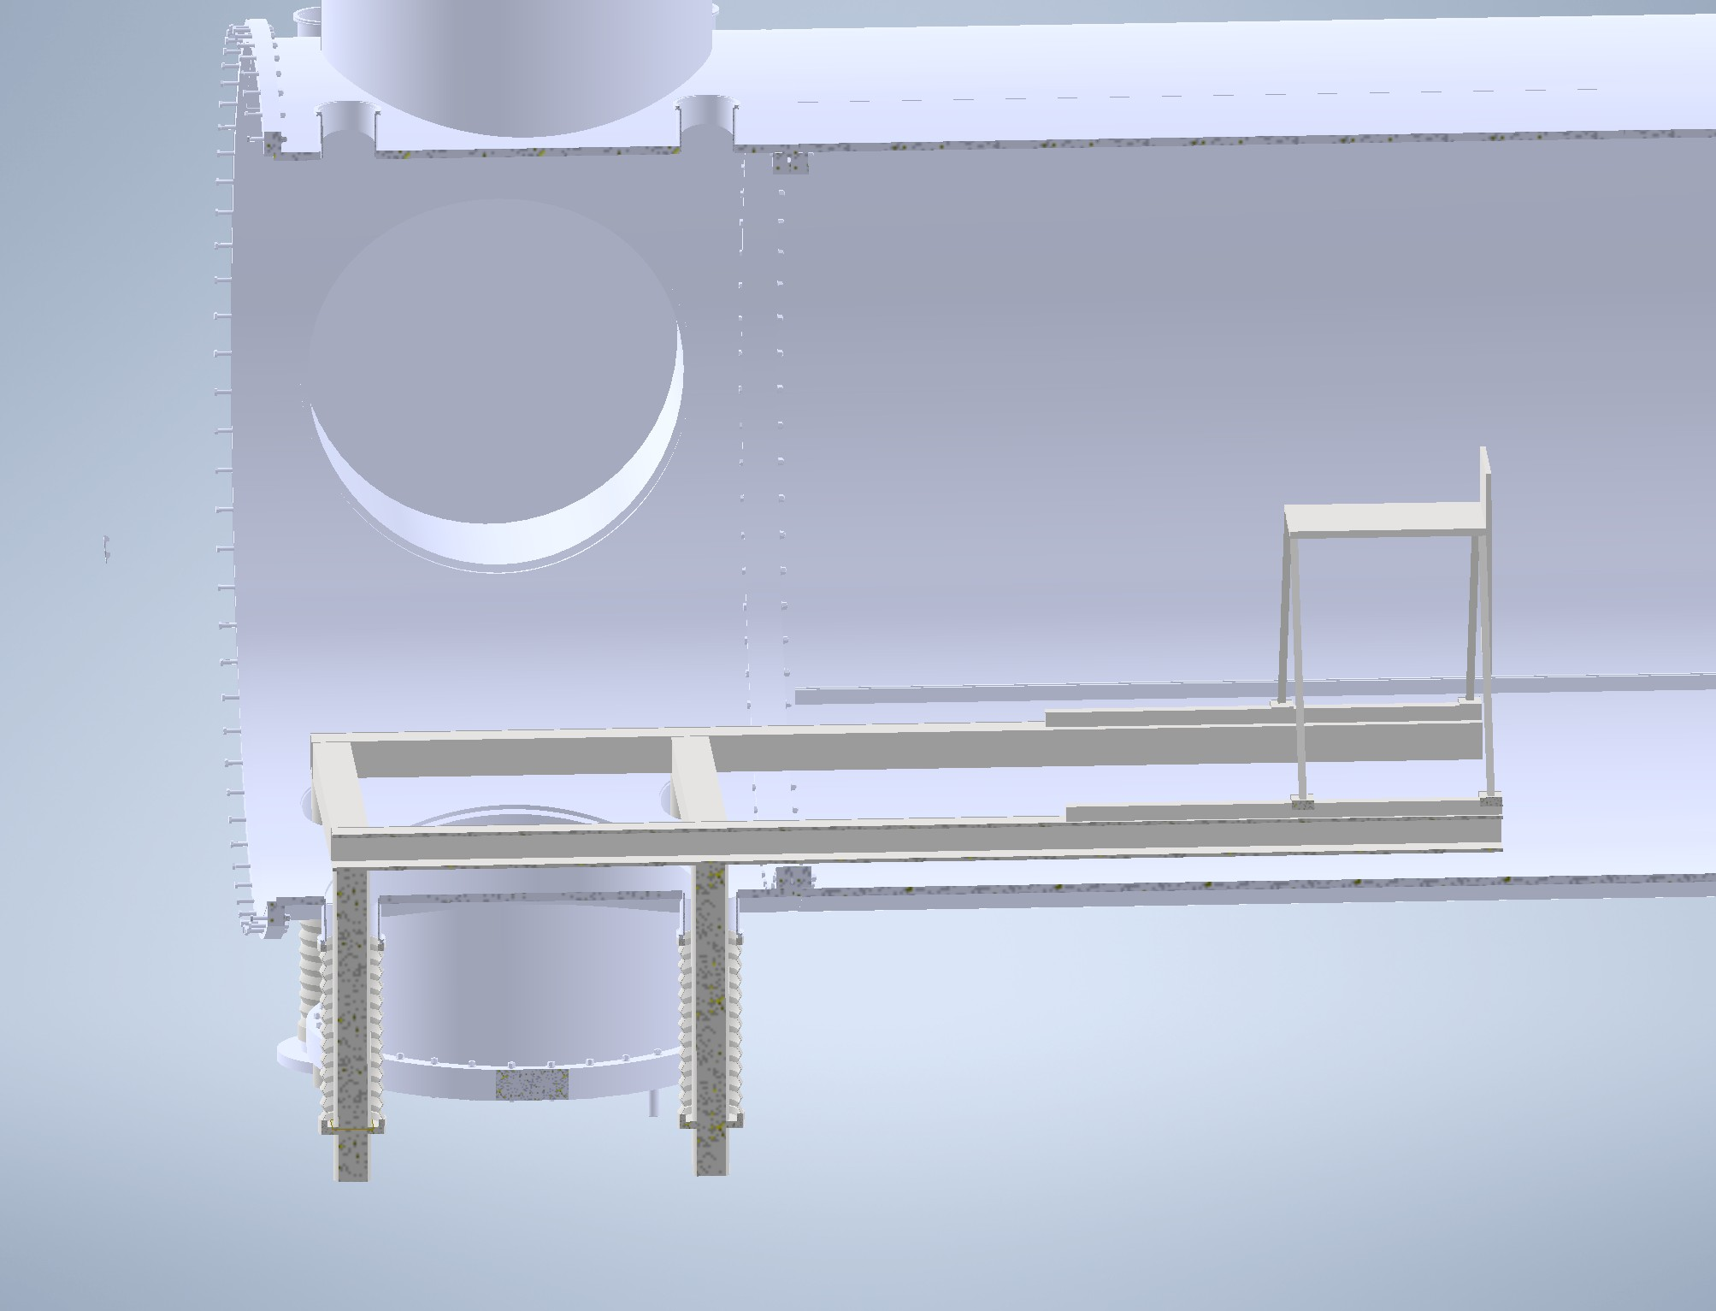
In Scattering Chamber with Bellows
Decoupled from vacuum Camber
Feet shout be mounted to the Floor
Decoupled and Vacuum tight by using Bellows

Slide 5
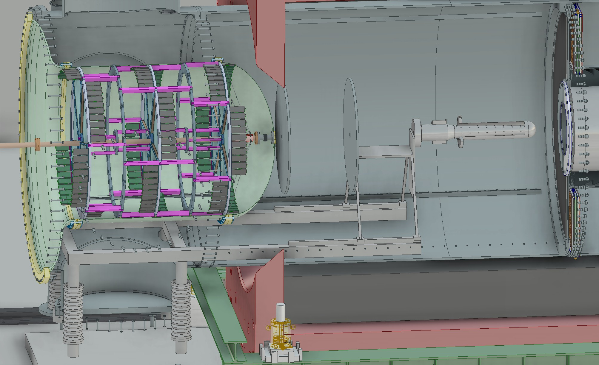
P2 Experiment

Slide 6
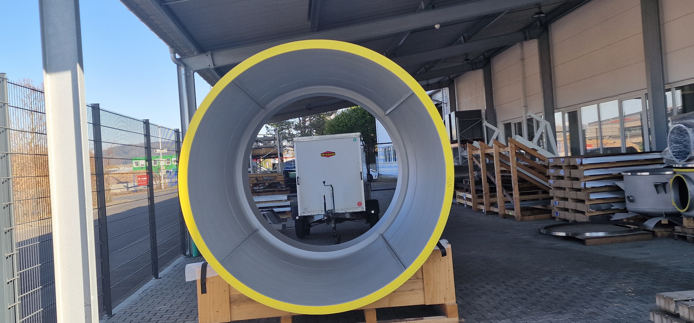

Slide 7
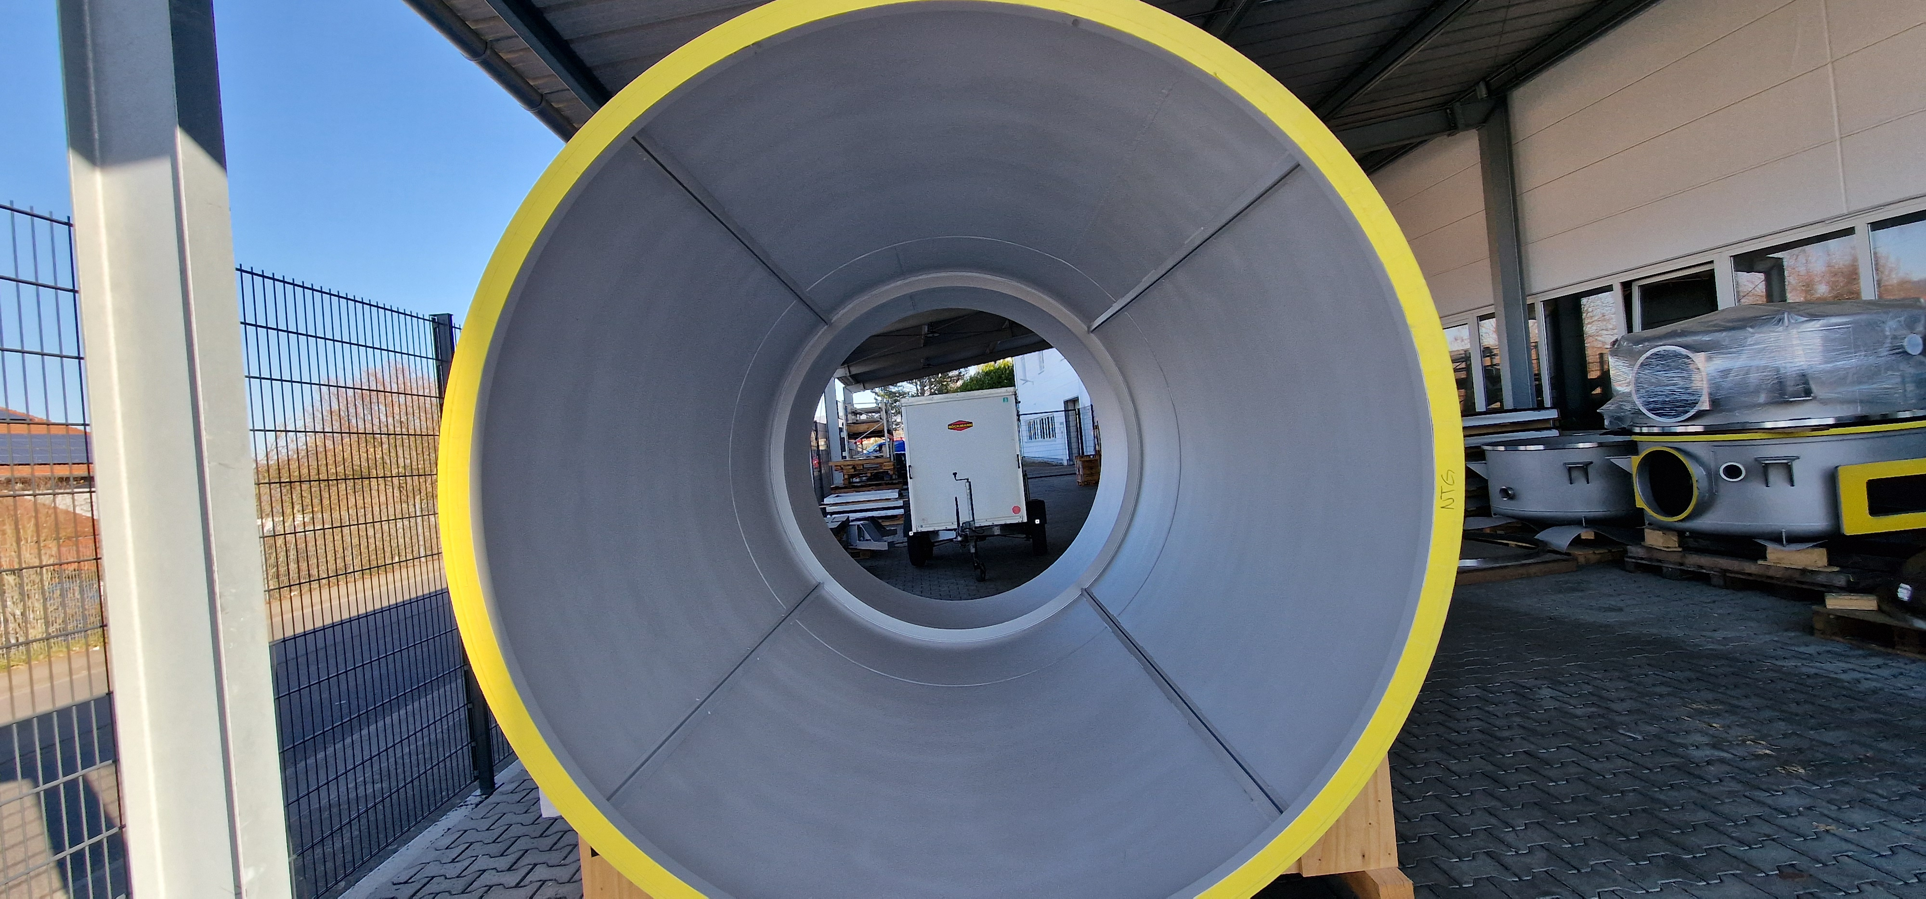

Slide 8
