Slide 1

Particle Astrophysics
Susan Cartwright
University of Sheffield

Slide 2
High energy particle astrophysics: mechanisms and sources
Acceleration mechanisms
Diffusive shock acceleration
Supernova remnants as cosmic ray accelerators
Extragalactic cosmic rays

Slide 3
Astrophysical accelerators
Terrestrial accelerators use electric fields to accelerate particles and magnetic fields to steer them.
  Magnetic fields do not accelerate particles because the force is perpendicular to the velocity, so no work is done.
However, persistent electric fields are very rare in the cosmos, because much of the interstellar medium is ionised.
  Therefore acceleration must be due to magnetic fields.
  Static magnetic fields cannot do this, but moving ones can.
    The process is exactly analogous to gravitational slingshot manoeuvres used by spacecraft.

Slide 4
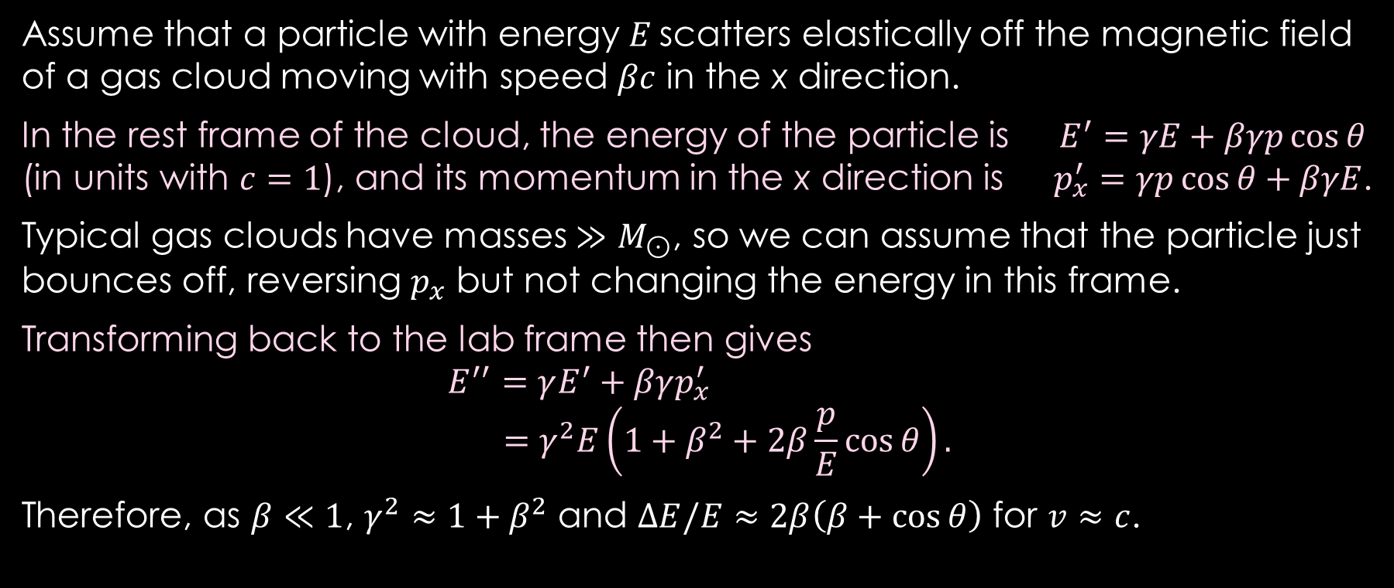
Acceleration by a moving magnetic field
Assume that a particle with energy E scatters elastically off the magnetic field of a gas cloud moving with speed $βc$ in the x direction.
In the rest frame of the cloud, the energy of the particle is $E^{′}=γE+βγp\cos{θ}$
(in units with $c=1$), and its momentum in the x direction is $p_{x}^{′}=γp\cos{θ}+βγE$.
Typical gas clouds have masses $≫M_{⊙}$, so we can assume that the particle just bounces off, reversing $p_{x}$ but not changing the energy in this frame.
Transforming back to the lab frame then gives
$$E^{′′}=γE^{′}+βγp_{x}^{′} \\ =γ^{2}E\left(1+β^{2}+2β\frac{p}{E}\cos{θ}\right).$$
Therefore, as $β≪1$, $γ^{2}≈1+β^{2}$ and $ΔE/E≈2β\left(β+\cos{θ}\right)$ for $v≈c$.
βc
v
θ

Slide 5

The role of shocks
If $ΔE/E≈2β\left(β+\cos{θ}\right)$ and $β≪1,$ almost half of all randomly oriented collisions result in a loss of energy
  the average fractional energy gain is $∝β^{2}$.
This is too slow and too inefficient in most circumstances—
we need an environment that guarantees favourable
kinematics (i.e. $\cos{θ}>0$).
  This is true when fast particles diffuse across a shock front:
  whichever way they go, they “see” the bulk gas and its
  entrained magnetic field coming towards them.
This is diffusive shock acceleration, and is the preferred
model for astrophysical acceleration in many source types.

Slide 6
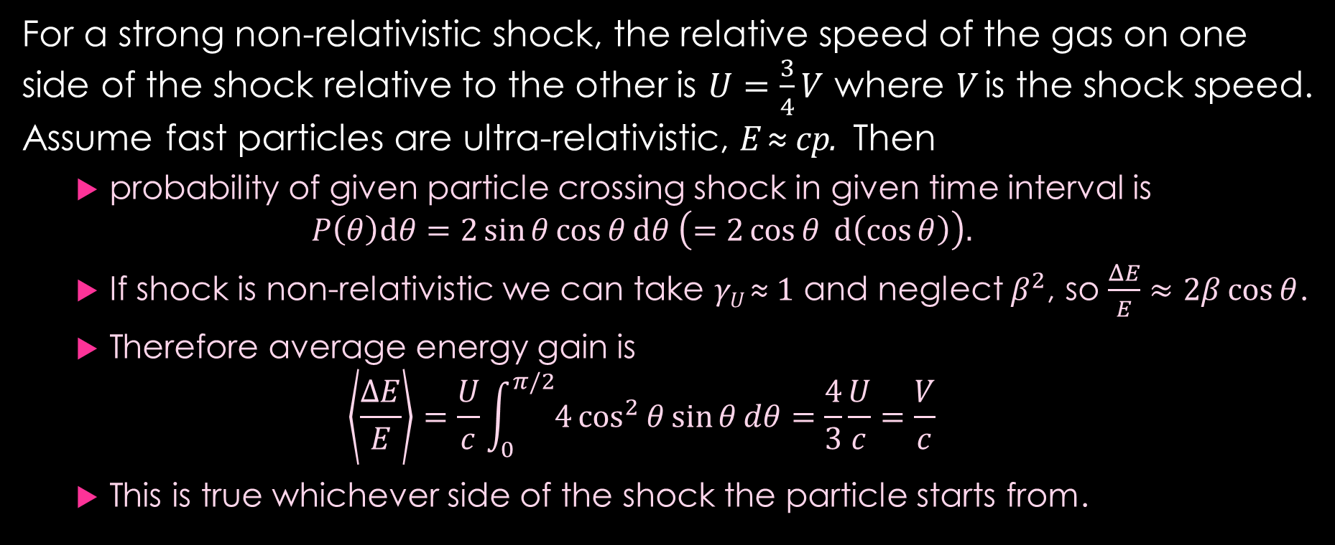
Diffusive shock acceleration
For a strong non-relativistic shock, the relative speed of the gas on one side of the shock relative to the other is $U=\frac{3}{4}V$ where V is the shock speed.
Assume fast particles are ultra-relativistic, E ≈ cp. Then
  probability of given particle crossing shock in given time interval is
  $P\left(θ\right)dθ=2\sin{θ}\cos{θ}dθ \left(=2\cos{θ} d\left(\cos{θ}\right)\right).$
  If shock is non-relativistic we can take γ_{U} ≈ 1 and neglect $β^{2}$, so $\frac{ΔE}{E}≈2β\cos{θ}$.
  Therefore average energy gain is
  $\left\langle \frac{ΔE}{E}\right\rangle =\frac{U}{c}\int_{0}^{π/2}{4\cos^{2}{θ}\sin{θ}dθ}=\frac{4}{3}\frac{U}{c}=\frac{V}{c}$
  This is true whichever side of the shock the particle starts from.

Slide 7

Energy spectrum from diffusive shock acceleration
After k shock crossings, the particle has energy $E_{k}={\left(1+β_{V}\right)}^{k}E_{0}$.
The probability that the particle is carried downstream and never crosses the shock again also turns out to be $V/c$, so after k shock crossings the number of particles remaining is $N_{k}={\left(1−β_{V}\right)}^{k}N_{0}$.
  Taking logs, $\ln{E_{k}}=kβ_{V}+\ln{E_{0}}$ and $\ln{N_{k}}=−kβ_{V}+\ln{N_{0}}$
    since $\ln{(1±β_{V})}≈±β_{V}$ for $β_{V}≪1$.
  Therefore $\ln{N_{k}}=−\ln{E_{k}}+\ln{(N_{0}/E_{0})}$, i.e. $N\left(E≥E_{k}\right)∝E_{k}^{−1}$.
  To get dN/dE we differentiate: $N\left(E\right)dE∝E^{−2}dE$.
Note that this is independent of the details of the shock.

Slide 8
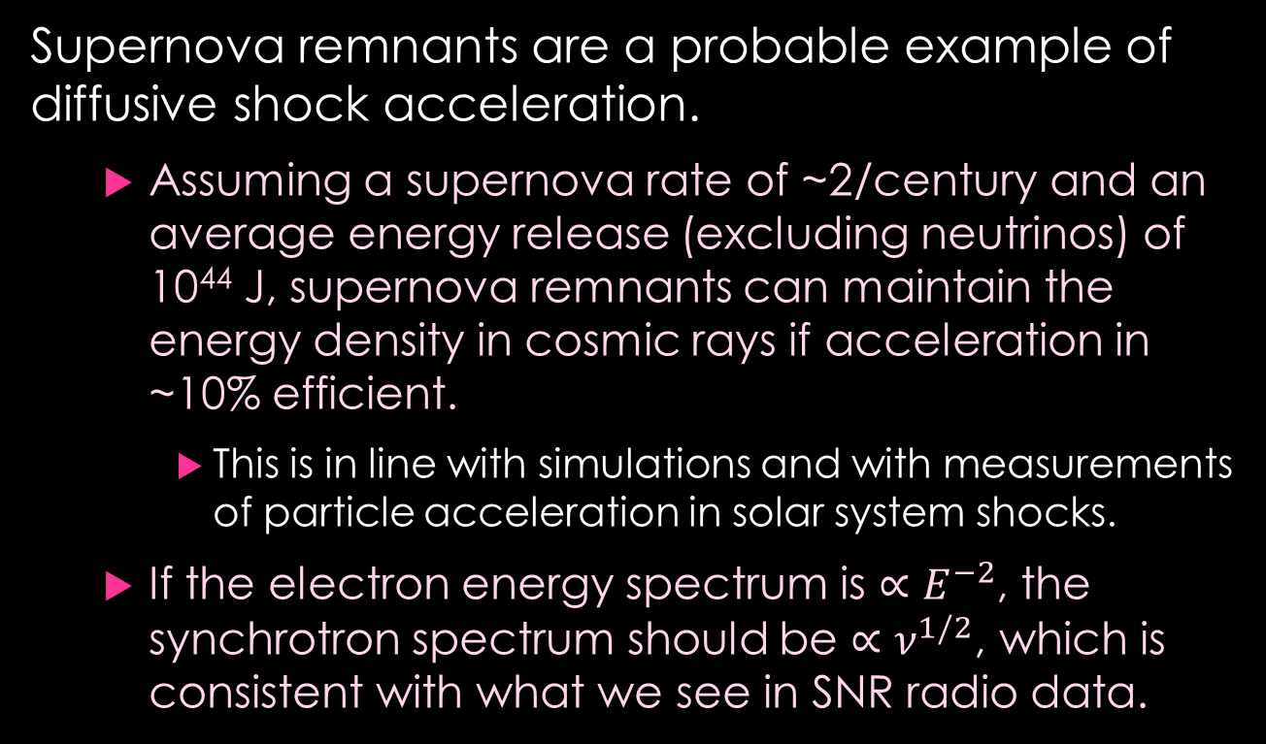
Supernova remnants as cosmic ray sources
Supernova remnants are a probable example of diffusive shock acceleration.
  Assuming a supernova rate of ~2/century and an average energy release (excluding neutrinos) of 10⁴⁴ J, supernova remnants can maintain the energy density in cosmic rays if acceleration in ~10% efficient.
    This is in line with simulations and with measurements of particle acceleration in solar system shocks.
  If the electron energy spectrum is $∝E^{−2}$, the synchrotron spectrum should be $∝ν^{1/2}$, which is consistent with what we see in SNR radio data.
Data from Green’s catalogue of supernova remnants.

Slide 9
Observational evidence
SN 1006
Chandra
SNRs are typically observed in radio and X-rays.
  The X-ray emission is thermal over most of the SNR, but there is a thin rim of synchrotron emission.
  This is consistent with high-energy electrons
  being present only close to the shock front
  generated by the original explosion.
    This is expected, because high-energy
    electrons radiate their energy away quickly
    so do not travel far from where they were
    accelerated.
There is a strong case for diffusive shock
acceleration.
Suzaku
Images from Katsuda, arXiv 1702.02054 [astro-ph.HE] (2017).

Slide 10
SNRs and Galactic cosmic rays
Models of acceleration by SNRs seem to be capable of explaining the observed cosmic ray spectrum up to about 10⁷ GeV.
  Above this we need additional sources.
  Above the ankle it is generally
  accepted that the sources are
  extragalactic.
    The proton gyroradius at these
    energies indicates that protons
    would not be confined in the Galaxy.
  In between may be Galactic (maybe
  from a different source type) or
  extragalactic.
Thoudam et al., A&A 595 (2016) A33

Slide 11

Origins of the highest energy cosmic rays
The very highest energy cosmic rays must be extragalactic.
  The relativistic gyroradius is given by $r=\frac{γmv_{⊥}}{qB}$.
    For a proton of energy 10¹⁹ eV and a Galactic magnetic field of order 0.1 to 1 nT, this gives a gyroradius of order 1–10 kpc.
    Therefore protons of this energy should rapidly escape from the Galaxy.
  This also suggests that the deflection of these cosmic rays should be small enough to retain some correlation between arrival direction and point of origin.
Note that the range of cosmic rays with energies $≳{10}^{19}$ eV is quite limited, because of interactions with the CMB.

Slide 12
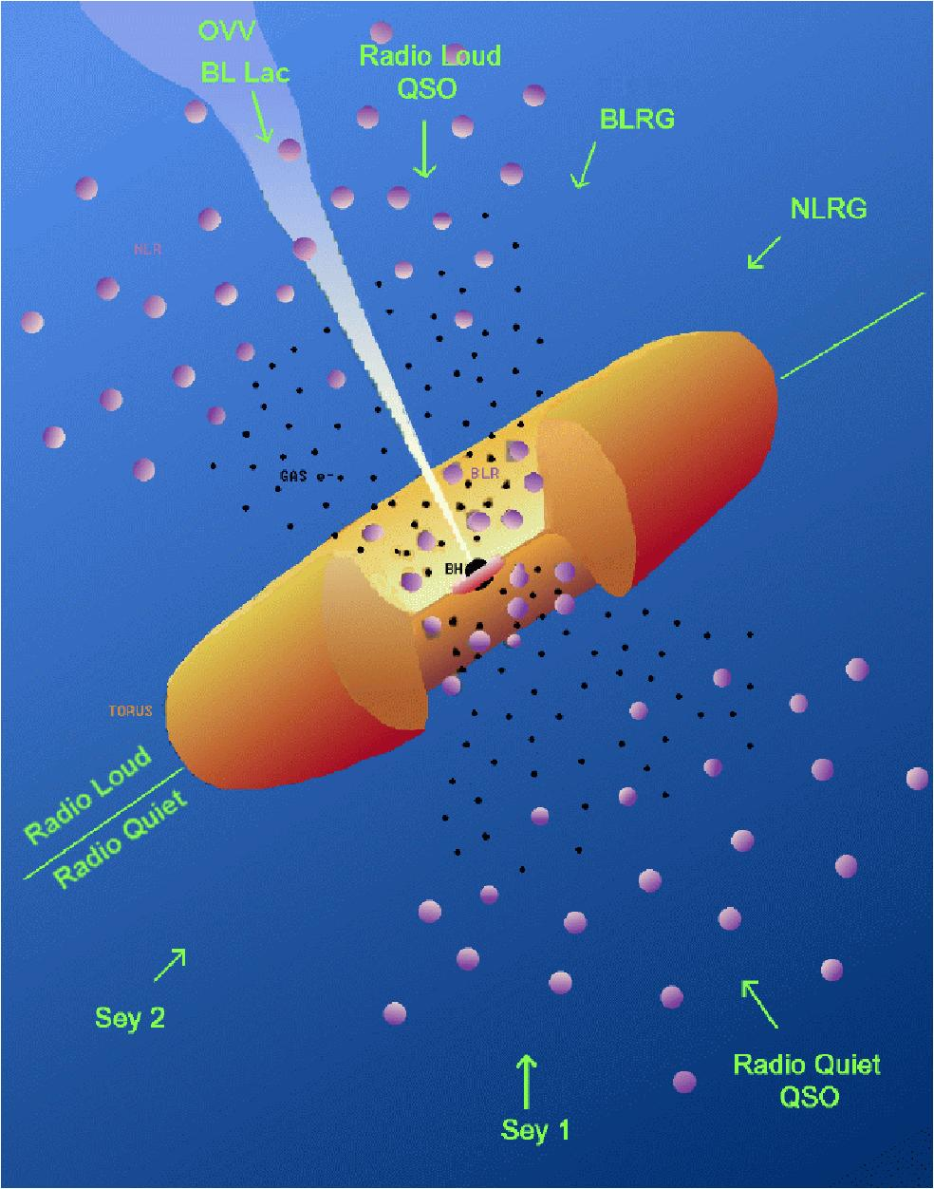

The prime suspects: active galactic nuclei (AGN)
Urry and Padovani
Active galaxies are galaxies whose luminosity comes largely from an actively accreting supermassive black hole.
  Radio-loud AGN launch relativistic jets from near the black hole; radio-quiet AGN (the majority) do not.
    Blazars—radio-loud AGN where we look almost directly down the jet—are the dominant extragalactic source of GeV and TeV photons.
    However, IceCube do not find a significant correlation between high-energy neutrinos and radio-loud AGN with $S_{8.6 GHz}≥150$ mJy.

Slide 13
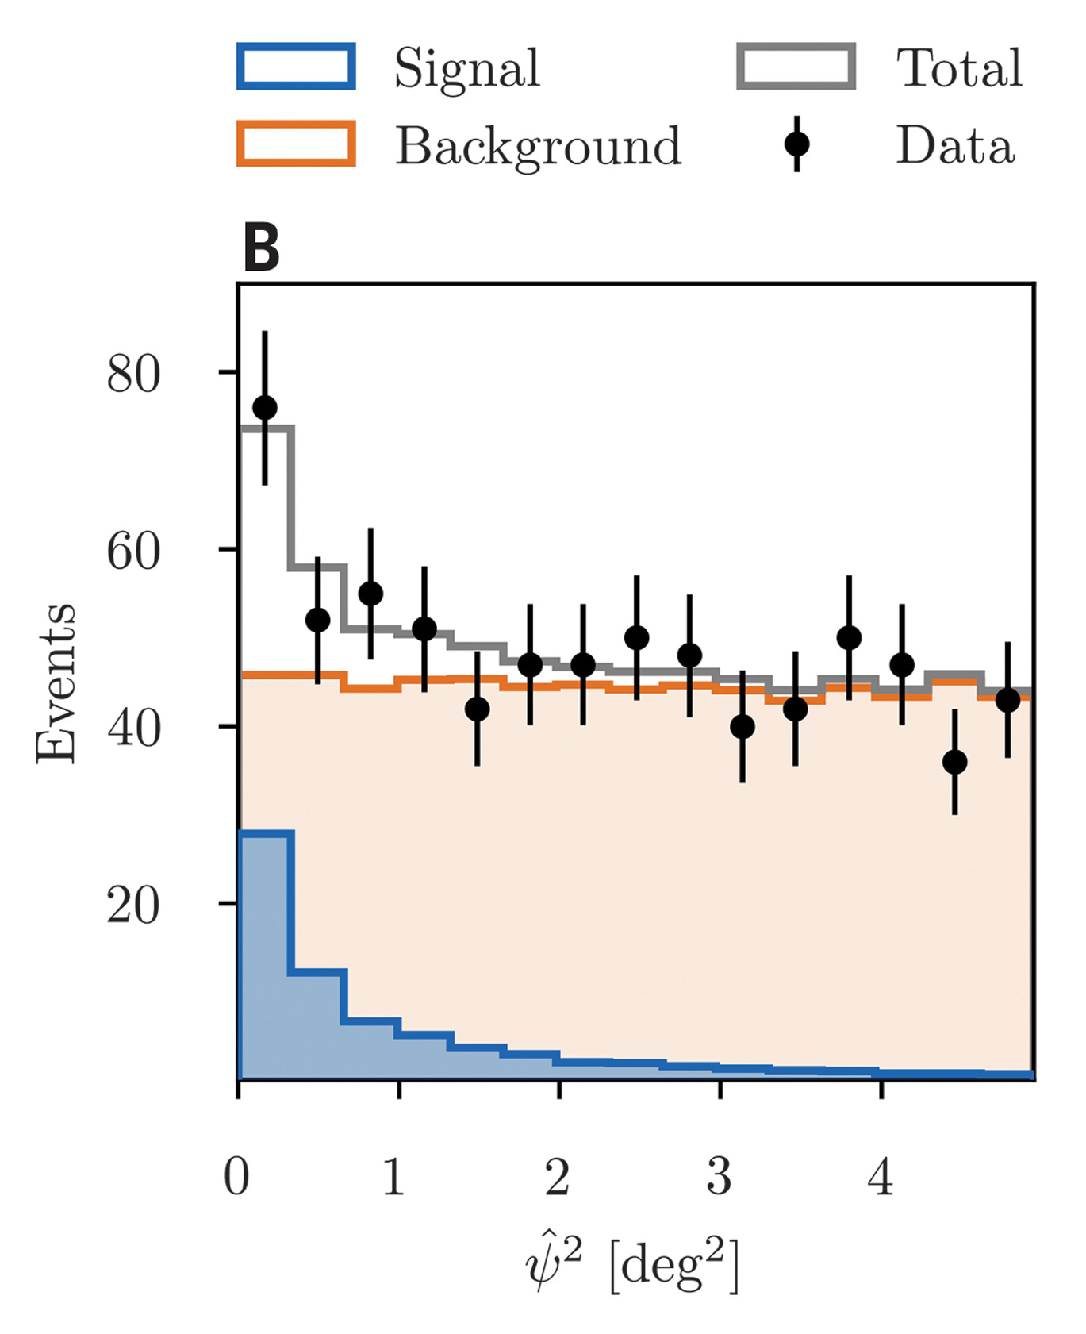
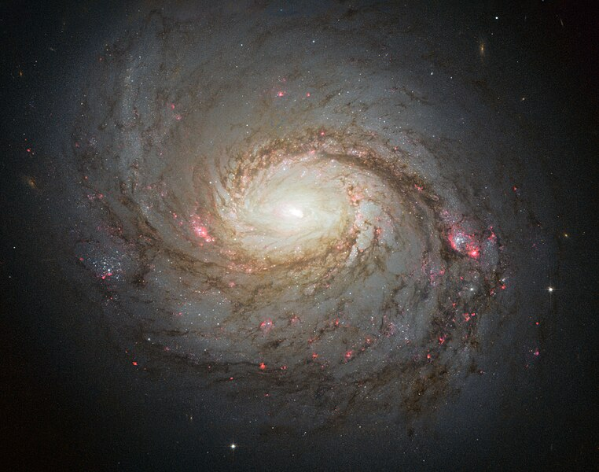
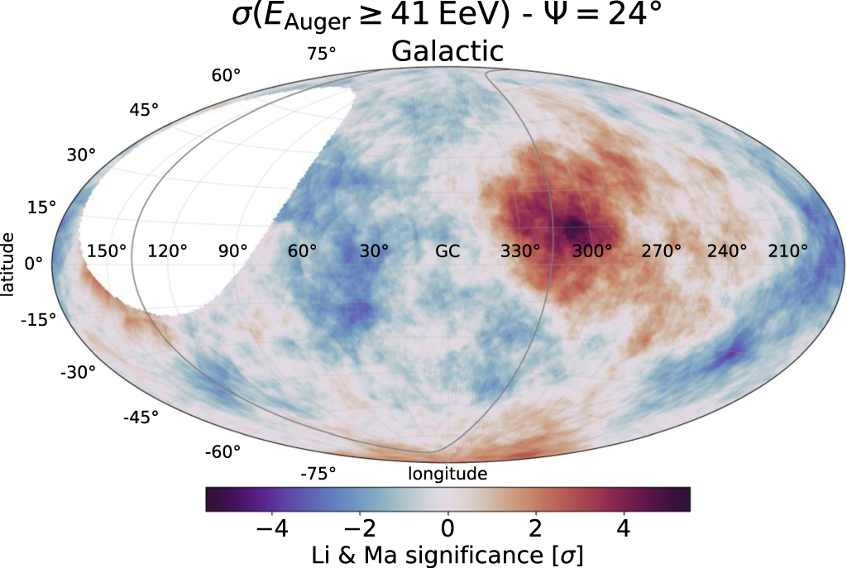
Smoking guns?
NASA, ESA & A. van der Hoeven
No correlation found between IceCube neutrinos and PAO UHECRs.
(Not as surprising as it might seem, because of limited range of UHECRs.)
M77: Seyfert galaxy which appears to be a neutrino source.
IceCube, Science 378 (2022) 538
Clear “hot spot” in arrival directions of UHECRs from Pierre Auger Observatory—but this encompasses a radio galaxy, a Seyfert galaxy and a starburst galaxy.
Abreu et al., ApJ 935 (2022) 170.

Slide 14
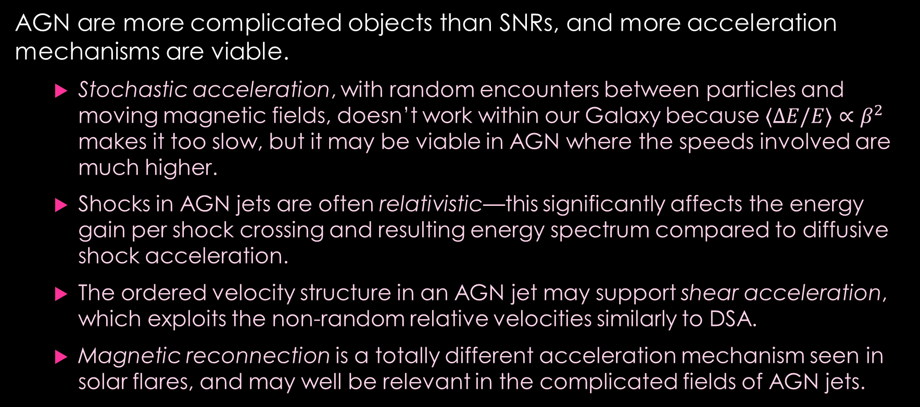
Acceleration mechanisms
AGN are more complicated objects than SNRs, and more acceleration mechanisms are viable.
  Stochastic acceleration, with random encounters between particles and moving magnetic fields, doesn’t work within our Galaxy because $⟨ΔE/E⟩∝β^{2}$ makes it too slow, but it may be viable in AGN where the speeds involved are much higher.
  Shocks in AGN jets are often relativistic—this significantly affects the energy gain per shock crossing and resulting energy spectrum compared to diffusive shock acceleration.
  The ordered velocity structure in an AGN jet may support shear acceleration, which exploits the non-random relative velocities similarly to DSA.
  Magnetic reconnection is a totally different acceleration mechanism seen in solar flares, and may well be relevant in the complicated fields of AGN jets.

Slide 15
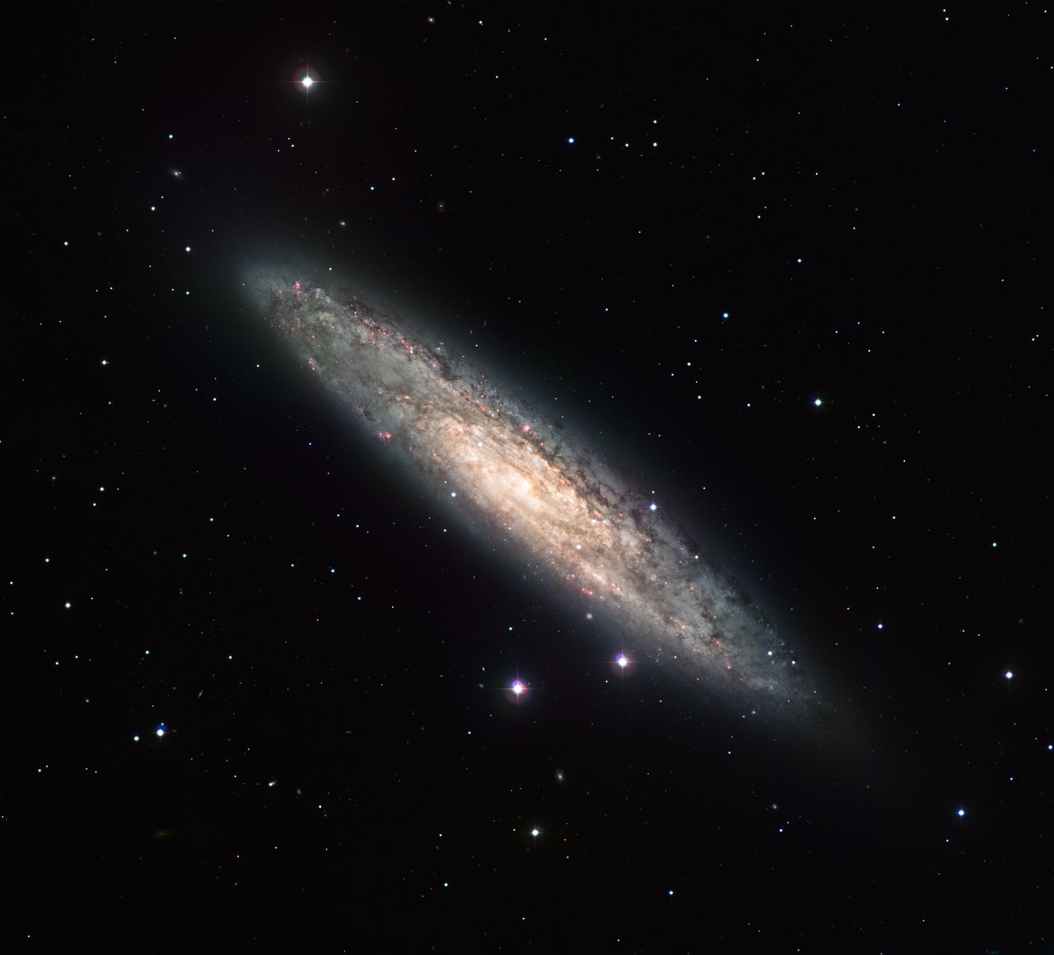
Starbursts vs AGN
PAO say that the distribution of their UHECRs matches starburst galaxies better than AGN.
  Superwinds in starburst galaxies do create appropriate conditions for acceleration.
  The cosmic ray energy density in starburst galaxies is
  very high—not surprising since the supernova rate is
  high—so there is a seed population of fast particles
  which might be reaccelerated to higher energies.
  However, a detailed study of conditions in the nearby
  starburst galaxy NGC 253 suggests that it would be
  difficult to achieve energies above 10¹⁸ eV in this
  galaxy. (Romero, Müller & Roth A&A 616 (2018) A57)
NGC 253
ESO CC-BY-SA 4.0

Slide 16
Summary
Particles can be accelerated in astrophysical sources by encounters with moving magnetic fields.
  Probably the most prevalent mechanism is diffusive shock acceleration, in which particles are accelerated by repeatedly crossing a supersonic but non-relativistic shock front.
    This is almost certainly the mechanism operating in supernova remnants, which are believed to be responsible for the bulk of Galactic cosmic rays.
The highest energy cosmic rays are extragalactic, but the source(s) are not certainly identified.
  A few individual sources are known, but may not represent the main source type.
    These higher-energy accelerators may involve a number of different acceleration mechanisms.

