Slide 1

Particle Astrophysics
Susan Cartwright
University of Sheffield

Slide 2
High energy particle astrophysics: the data
Cosmic rays
Photons
Neutrinos
Expected relationships between observables

Slide 3
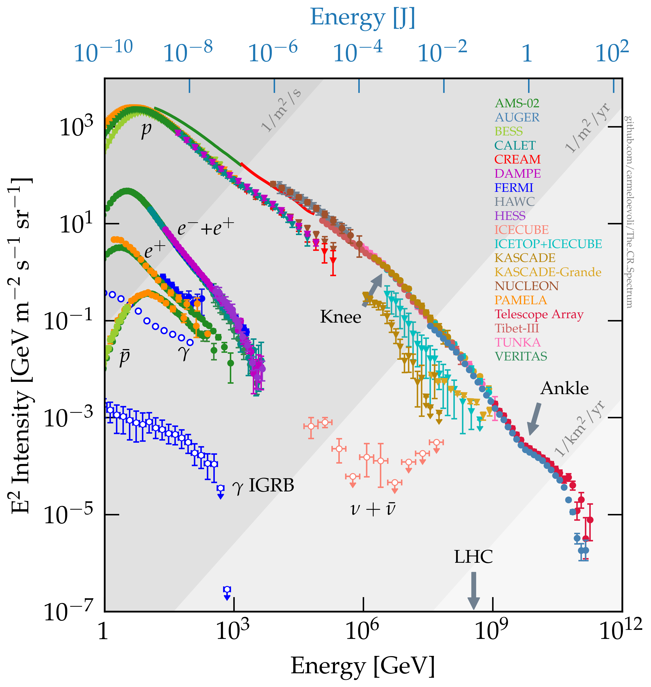
Cosmic rays
Diagram by Carmelo Evoli, doi:10.5281/zenodo.1468852
Cosmic rays were discovered about 1913 by Victor Hess.
  They consist mostly of protons and heavier ions, and have a power law spectrum with approximate spectral index 2.7.
    There are two conspicuous slope breaks, the “knee” above 10⁶ GeV and the “ankle” above 10⁹ GeV, and an apparent cut-off around 10¹¹ GeV.
Cosmic rays do not point back to their origin because of deflection by the Galactic magnetic field.

Slide 4
Composition, rigidity and sources
For cosmic rays to be accelerated, they must be confined within the accelerating region.
  This can’t be done by gravity—it must involve magnetic fields.
  The response of a charged particle to a magnetic field is determined by its rigidity cp/q.
  Therefore the maximum
  energy attainable in a given
  source is higher for heavy ions
  than for protons.
Increasing mean mass is a
signature for a source type
cutting off.
Supanitsky, Galaxies 10 (2022) 75.

Slide 5
Cosmic ray origins
To identify the origins of cosmic rays we need a neutral messenger.
The possibilities are:
  Photons, if produced by a non-thermal mechanism that requires the presence of high-energy particles
    examples: synchrotron radiation, inverse Compton scattering, π⁰ decay.
  High-energy neutrinos
    produced by π± decay (much higher energy than solar or supernova neutrinos).
Photons may only signal the presence of high-energy electrons; neutrinos definitely require high-energy hadrons.

Slide 6
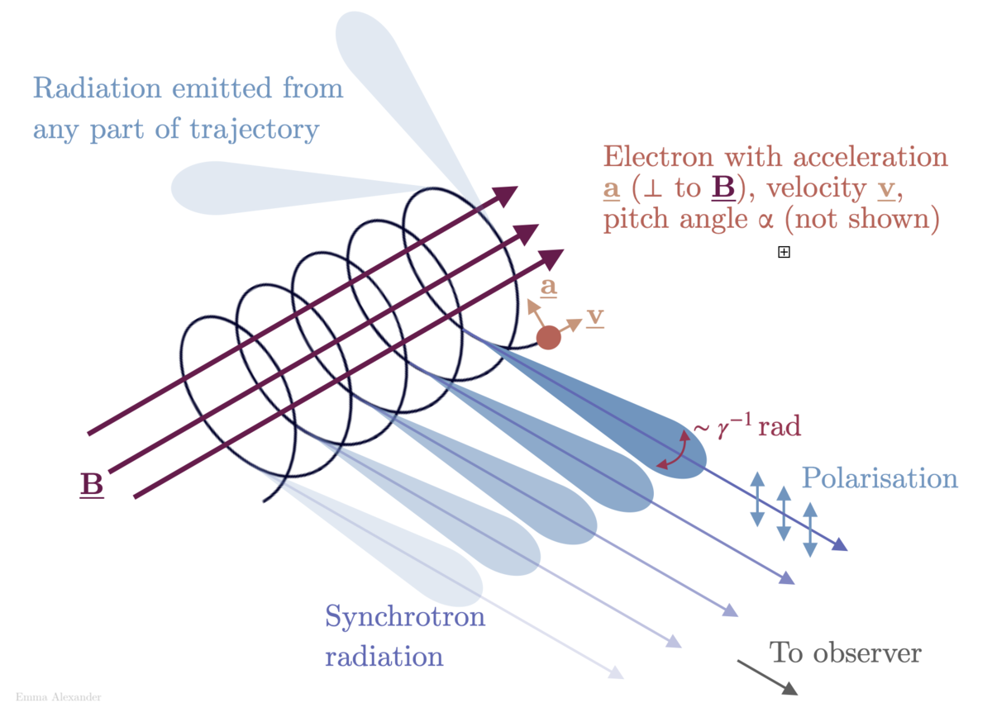
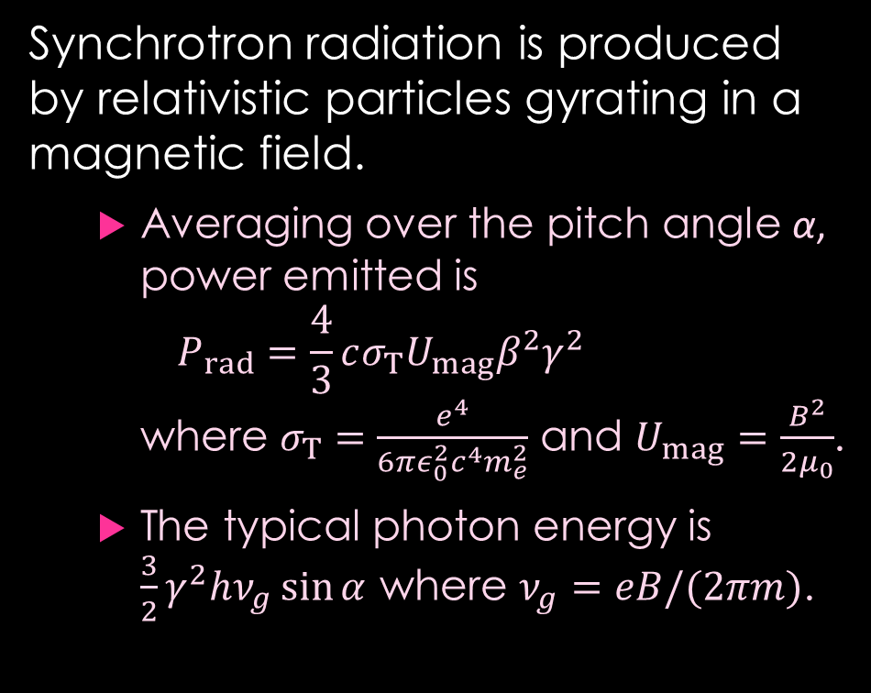
Photons: synchrotron radiation
Synchrotron radiation is produced by relativistic particles gyrating in a magnetic field.
  Averaging over the pitch angle α, power emitted is
  $P_{rad}=\frac{4}{3}cσ_{T}U_{mag}β^{2}γ^{2}$
  where $σ_{T}=\frac{e^{4}}{6πε_{0}^{2}c^{4}m_{e}^{2}}$ and $U_{mag}=\frac{B^{2}}{2μ_{0}}$.
  The typical photon energy is $\frac{3}{2}γ^{2}hν_{g}\sin{α}$ where $ν_{g}=eB/(2πm)$.
Emma Alexander, Wikipedia CC-BY-4.0

Slide 7
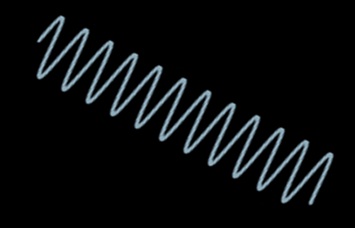

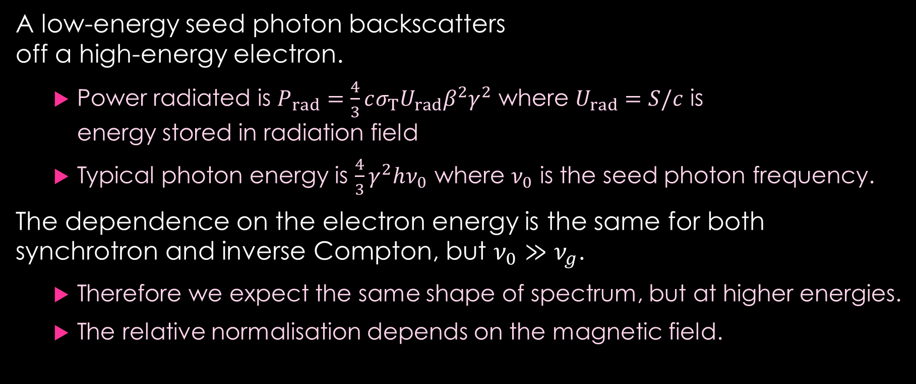
Photons: inverse Compton scattering
A low-energy seed photon backscatters
off a high-energy electron.
  Power radiated is $P_{rad}=\frac{4}{3}cσ_{T}U_{rad}β^{2}γ^{2}$ where $U_{rad}=S/c$ is
  energy stored in radiation field
  Typical photon energy is $\frac{4}{3}γ^{2}hν_{0}$ where $ν_{0}$ is the seed photon frequency.
The dependence on the electron energy is the same for both synchrotron and inverse Compton, but $ν_{0}≫ν_{g}$.
  Therefore we expect the same shape of spectrum, but at higher energies.
  The relative normalisation depends on the magnetic field.

Slide 8
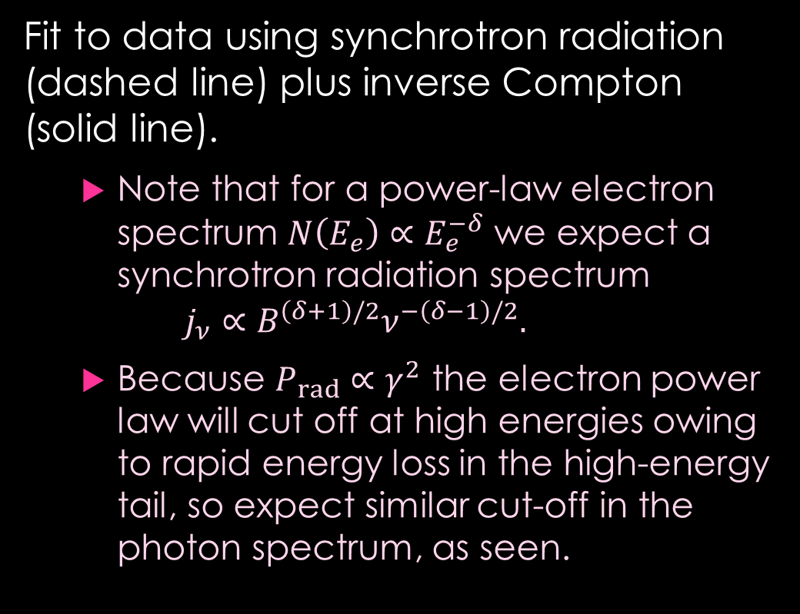

Example: SNR RX J1713.7–3946
Chuyuan Yang and Siming Liu ApJ 773 (2013) 138
Fit to data using synchrotron radiation (dashed line) plus inverse Compton (solid line).
  Note that for a power-law electron spectrum $N\left(E_{e}\right)∝E_{e}^{−δ}$ we expect a synchrotron radiation spectrum
  $j_{ν}∝B^{\left(δ+1\right)/2}ν^{−\left(δ−1\right)/2}.$
  Because $P_{rad}∝γ^{2}$ the electron power law will cut off at high energies owing to rapid energy loss in the high-energy tail, so expect similar cut-off in the photon spectrum, as seen.
Suzaku
H.E.S.S.
Fermi-LAT
ATCA
Observed photon energy spectrum is roughly $E^{2}\frac{dN}{dE}∝E^{0.5}⇒j_{ν}∝ν^{−0.5}⇒N\left(E_{e}\right)∝E_{e}^{−2}$.

Slide 9
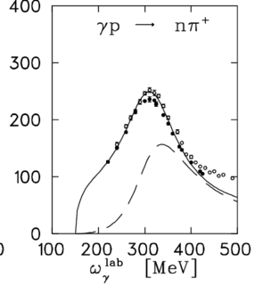
Photons and neutrinos: pion decay
Cosmic rays are predominantly protons, with some heavier nuclei.
High-energy protons colliding with ambient gas or photons will produce both π± and π⁰, and therefore ν_{μ} and photons.
  Muon decay will then produce more ν_{μ} and ν_{e}.
    Oscillation will change the mix of flavours.
  The photon spectrum from π⁰ decay differs from the
  inverse Compton spectrum, so we can distinguish cases
  where high-energy photon emission is dominated by
  pion decay.
There is no realistic way to produce a detectable neutrino
flux without high-energy hadrons.
Schmidt et al., Z. Phys. A 355 (1996) 421

Slide 10
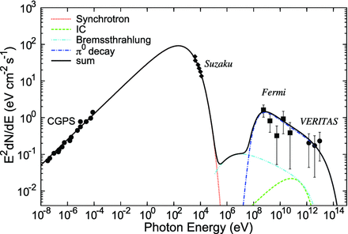
Example: Tycho’s supernova
The remnant of the supernova observed by Tycho Brahe in 1572.
  Known to have been Type Ia from reflected spectrum observed in 2008.
  Shape of high-energy spectrum quite different from the synchrotron spectrum, so not inverse Compton.
  Can be well fitted by π⁰ decay.
Zhang et al., MNRAS 429 (2013) L25.

Slide 11
Neutrino detection
High-energy neutrinos are detected by observing neutrino interactions in large water Cherenkov detectors
  currently the only one with a large enough active volume is IceCube, but it will be joined by KM3NeT/ARCA.
The principal problem is the background from atmospheric neutrinos
  this means that only very high-energy neutrinos can be identified as astrophysical on an event-by-event basis.
IceCube Coll., arXiv 2402.18026 [astro-ph.HE]

Slide 12
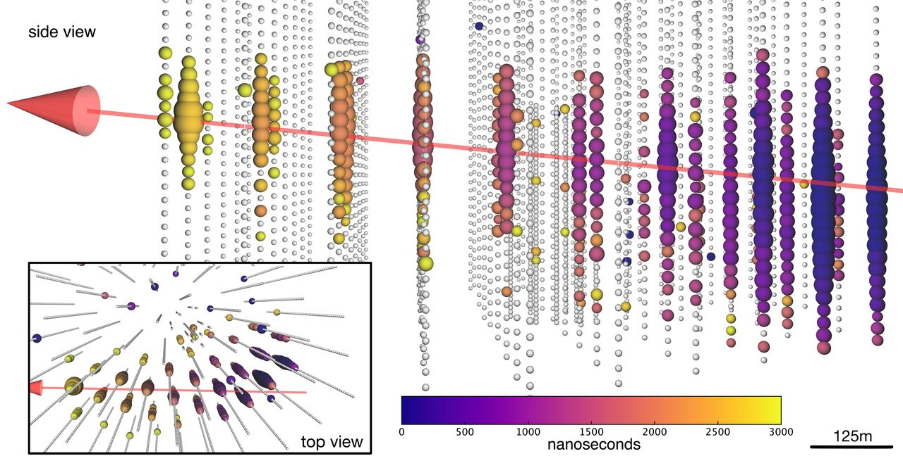
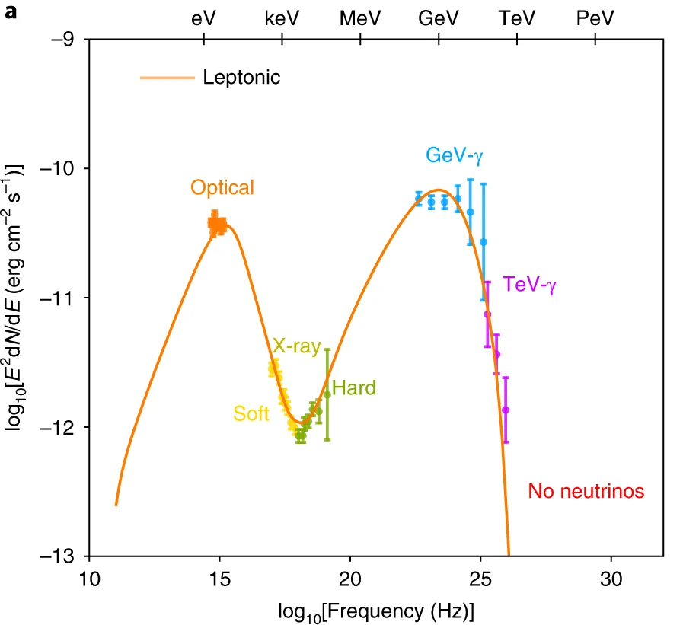
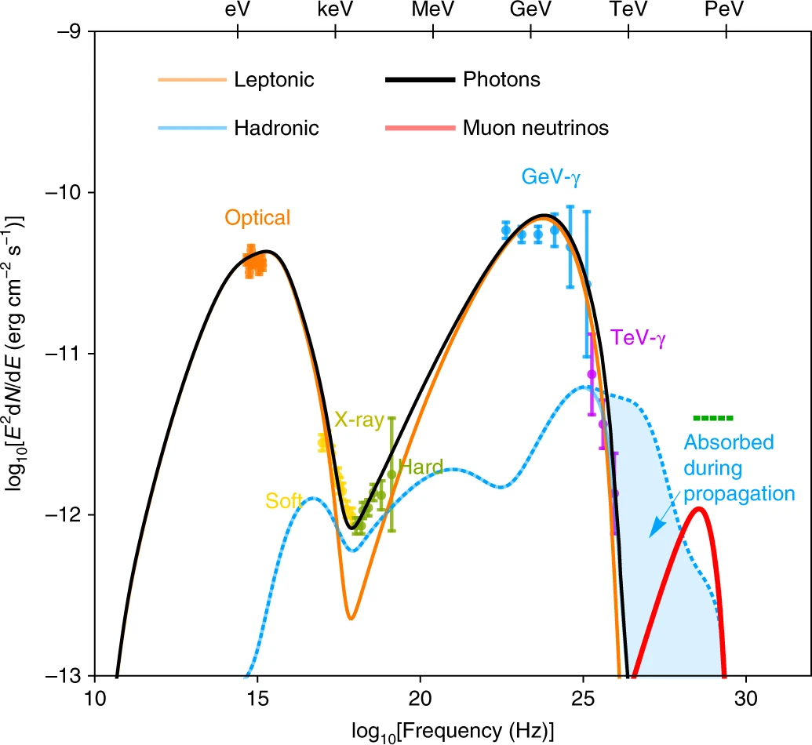
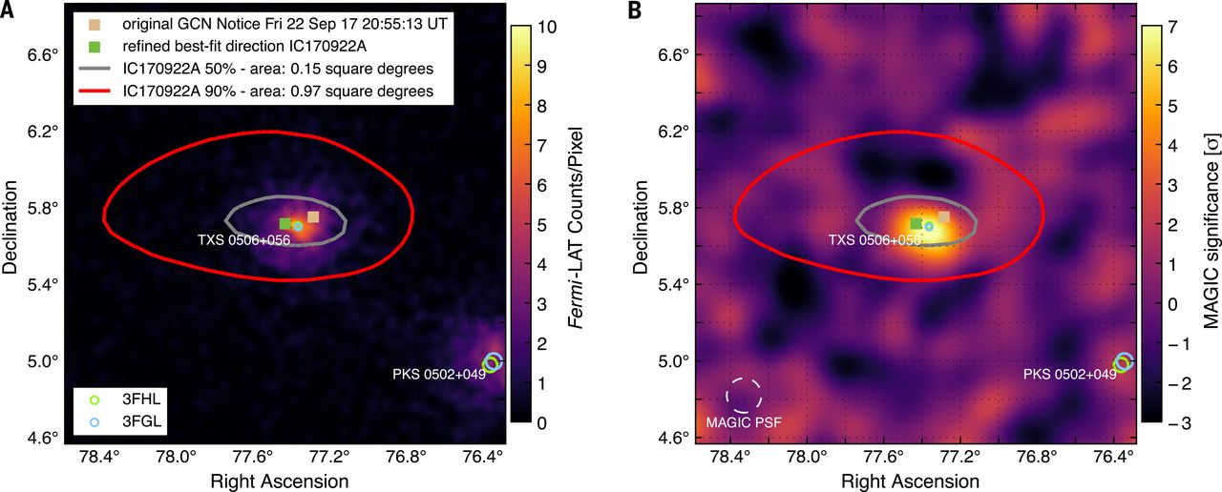
Example: TXS 0506+056
Gao et al. Nature Astro. 3 (2019) 88.
Though we know this object produces neutrinos, its spectrum looks purely leptonic…
…however, a “hybrid” model with a hadronic component does also work.
IceCube Coll. et al, Science 361 (2018) eaat1378

Slide 13
Expected correlations
High-energy neutrinos should be accompanied by high-energy photons, as π± production should imply π⁰ production
  but if the source region (or its surroundings) is very dense, the photons might not escape.
High energy photons from π⁰ decays should be accompanied by neutrinos, for the same reason
  but the neutrino signal may be too weak to see, or buried in the atmospheric neutrino background
Most acceleration mechanisms should accelerate all charged particles, so high-energy electrons should imply high-energy hadrons
  but they might not, if the seed material is mostly e⁺e⁻ pair plasma (which it may be in some environments).

Slide 14
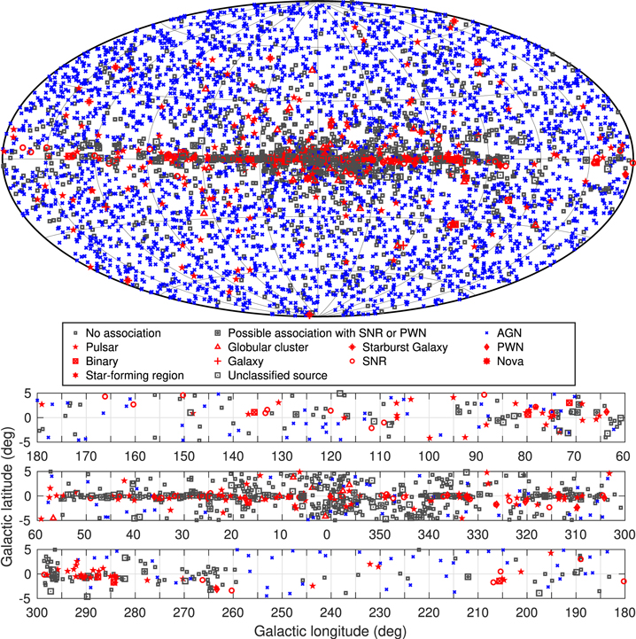
Photon sources
S. Abdollahi et al ApJS 247 (2020) 33
High-energy photon sources in our Galaxy are mainly pulsars and supernova remnants.
Extragalactic sources are mainly blazars.
In addition, there are also transient sources of MeV γ-rays, i.e. gamma-ray bursts (GRBs).

Slide 15
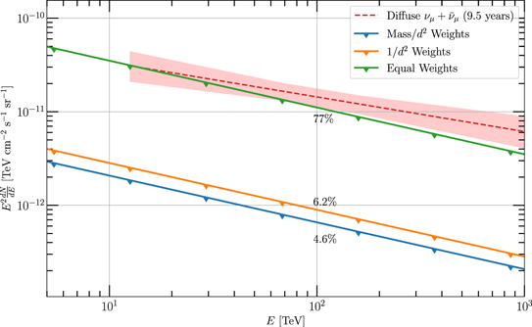
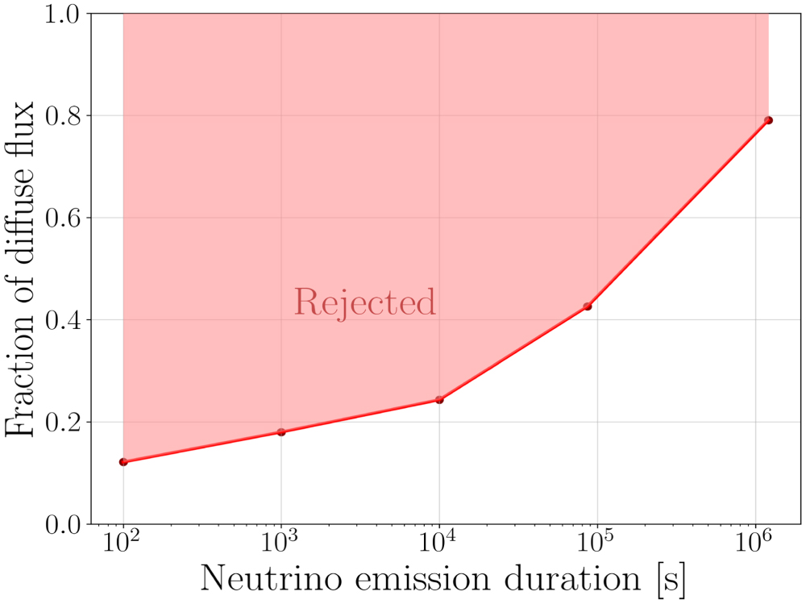
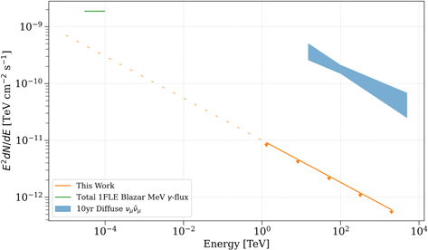
Not neutrino sources!
IceCube has conscientiously searched for correlations between high-energy neutrinos and various source catalogues. They find:
  GRBs are not neutrino sources (<1%)
  though at least one blazar is a neutrino source, blazars do not account for the vast majority of the
  neutrino flux.
  Nor do galaxy
  clusters.
But AGN in general
could do so.
IceCube, ApJL 938 (2022) L11
IceCube, ApJ 939 (2022) 116
IceCube, ApJ 938 (2022) 38

Slide 16
Summary
Cosmic rays, consisting primarily of protons and heavier ions, are observed to have a power-law energy spectrum extending out to ~10²⁰ eV.
  This implies the existence of extremely powerful astrophysical accelerators.
  Cosmic rays do not pinpoint these directly because their trajectories are deflected by the Galaxy’s magnetic field.
Acceleration of hadrons should be accompanied by γ-ray and neutrino emission from pion decay, and of electrons by photons from synchrotron radiation (radio to X-rays) and inverse Compton (γ-rays).
  These are all seen, but a complete explanation is still lacking
  in particular, the origins of astrophysical neutrinos are not yet established.

