Slide 1

Particle Astrophysics
Susan Cartwright
University of Sheffield

Slide 2
Dark matter
The astrophysical evidence
The candidates
WIMPs
Axions

Slide 3

Astrophysical evidence for dark matter
Planck Coll. A&A 641 (2020) A6
X-ray: NASA/CXC/CfA/M.Markevitch, Optical and lensing map: NASA/STScI, Magellan/U.Arizona/D.Clowe,
Lensing map: ESO WFI
Rubin, Ford & Thonnard, ApJ 238 (1980) 471

Slide 4
Dark matter candidates
 | WIMPs | SuperWIMPs | Light G̃ | Hidden DM | Sterile ν | Axions
Motivation | GHP | GHP | GHP/NPFP | GHP/NPFP | ν mass | Strong CP
Natural Ω | Yes | Yes | No | Maybe | No | No
Production | Freeze-out | Decay | Thermal | Various | Various | Various
Mass range | GeV – TeV | GeV – TeV | eV – keV | GeV – TeV | keV | μeV – meV
Temperature | cold | cold/warm | cold/warm | cold/warm | warm | cold
Collisional |  |  |  | ✓
Cosmology |  | ✓✓ |  | ✓
Direct | ✓✓ |  |  | ✓ |  | ✓✓
Indirect | ✓✓ | ✓ |  | ✓ | ✓✓
Collider | ✓✓ | ✓✓ | ✓✓ | ✓
GHP: Gauge Hierarchy Problem
NPFP: New Physics Flavour Problem
from Feng, Ann. Rev. Astron. Astroph. 48 (2010) 495

Slide 5
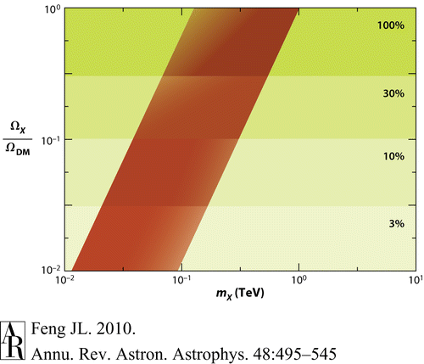
WIMPs
Weakly Interacting Massive Particles are a prediction of many extensions to the Standard Model
  they tend to arise from discrete quantum
  numbers, e.g. R-parity, introduced to
  prevent undesirable features such as rapid
  proton decay.
A nice feature of WIMPs is that if their
annihilation cross section is of the typical
weak scale, they naturally freeze out to give
the “right” relic density
  this is sometimes called the “WIMP miracle”.

Slide 6

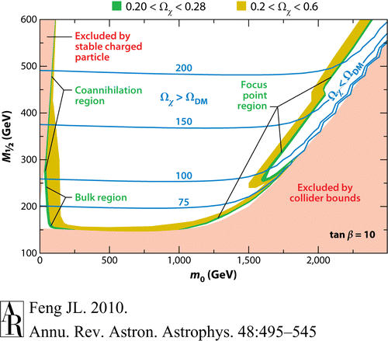
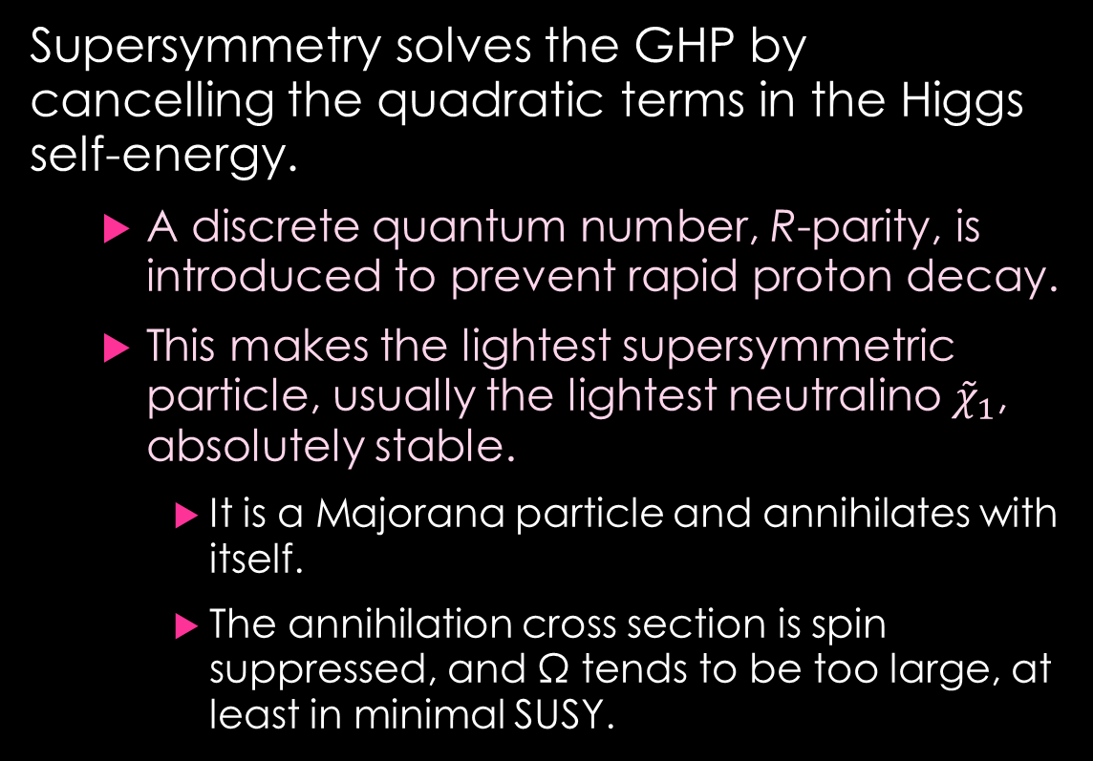
WIMPs in SUSY
fermion
boson
Supersymmetry solves the GHP by cancelling the quadratic terms in the Higgs self-energy.
  A discrete quantum number, R-parity, is introduced to prevent rapid proton decay.
  This makes the lightest supersymmetric particle, usually the lightest neutralino ${\tilde{χ}}_{1}$, absolutely stable.
    It is a Majorana particle and annihilates with itself.
    The annihilation cross section is spin suppressed, and Ω tends to be too large, at least in minimal SUSY.

Slide 7
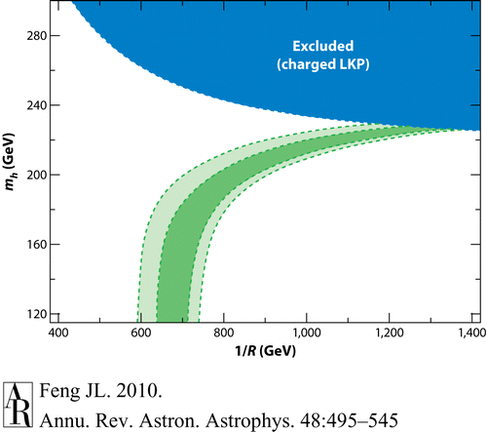

SUSY $⇒$ WIMPs, WIMPs $⇏$ SUSY
Other extensions to the Standard Model also yield WIMP candidates (sometimes naturally, sometimes after a bit of persuasion!), e.g.
  5- or 6-dimensional Universal Extra Dimension
  models
  “Little Higgs” models (in which a light Higgs
  boson arises from spontaneous breaking of
  a new global symmetry)
Fortunately the experimental signature of such
non-SUSY WIMPs is the same as SUSY WIMPs, at
least for direct detection experiments.

Slide 8
Detection of WIMPs
WIMPs in the Galactic halo are gravitationally bound to the Galaxy and are therefore moving at a few hundred km/s.
  Their only possible interaction is elastic scattering.
  Since they are massive they will transfer energy much more efficiently to nuclei than to electrons.
  Therefore the experimental signature is a low-energy (few keV to few tens of keV) nuclear recoil.
    The main backgrounds at these low energies are radioactive decays, either intrinsic to the material or cosmogenic.
    Many of these are β or γ decays which produce electron recoils, so being able to distinguish electron and nuclear recoils is a big advantage.

Slide 9
Detection methods
Possible methods of detection:
  Ionisation
    The recoiling nucleus ionises neighbouring atoms, and you collect (usually) the electrons.
  Scintillation
    The recoiling nucleus excites neighbouring atoms, and they de-excite by scintillation.
  Heat
    You detect the extra energy deposited in your target.
Technologies:
  The most sensitive detectors tend to read out two signals, to aid in rejecting electron recoils
    Semiconductor bolometers (Ge, Si) read out ionisation and heat (phonons)
    Scintillating bolometers (CaWO₄) read out light and heat
    Noble liquid TPCs (LXe, LAr) read out light and ionisation
    Bubble chambers (C₃F₈) read out heat and sound (for α rejection)

Slide 10
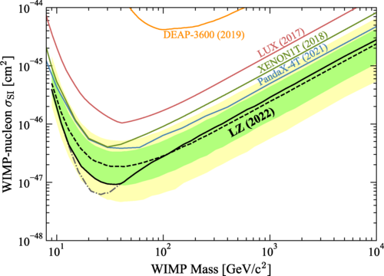

Typical result
The recoil energy of a nucleus of mass M hit by a WIMP of mass 𝑚 is
$$E=\frac{μ^{2}v^{2}}{M}\left(1−\cos{θ}\right),$$
  where $μ=mM/(m+M)$ is the reduced mass
  and θ is the scattering angle in the CM frame.
    For $m≪M$, $E∝m^{2}/M$, so lighter WIMPs give
    lower energy (potentially undetectable)
    recoils.
    For $m≫M$, E is essentially independent of 𝑚
    and the event rate will depend on the
    number density of WIMPs, which is $∝1/m$.
  This explains the shape of the limit curve.
LZ Coll., Phys. Rev. Lett. 131 (2023) 041002

Slide 11
Axions
The strong interaction is observed to conserve CP to very high precision, but in the Standard Model there is no reason for it to do so.
  Axion models introduce a new global symmetry which is spontaneously broken, dynamically relaxing the CP violating parameter to near zero.
    The axion particle is the pseudo-Nambu-Goldstone boson of this field.
The axion mass is not predicted by the model. To make up the dark matter the standard QCD axion needs a mass of around 1 μeV to 1 meV.
  Despite this low mass, axions are cold dark matter because they are not produced thermally.

Slide 12


Detection of axions
a
The axion does not have conventional weak
interactions, but it couples weakly to two photons
via a triangle diagram.
  Axions can therefore be converted to photons (and vice versa) in the presence of a magnetic field.
    This is the basis of most axion detection methods.
    As the axion de Broglie wavelength is extremely large, it can be treated classically as a wave.
  For the classic QCD axion, $m_{a}∝g_{aγγ}$ and there is a fairly narrow allowed band in parameter space.
    However, axion-like particles (ALPs) with a wider range of properties occur in many BSM theories, so it is worth looking in other regions.
g_{aγγ}

Slide 13
Microwave cavity axion detection
Axions in the Galactic halo would convert
to photons in the microwave range.
  These can be searched for by
  immersing a resonant cavity in a strong
  magnetic field.
    Axions with masses corresponding to the
    resonant frequency of the cavity would
    produce a small excess power, which
    is picked up by extremely sensitive
    electronics.
  The experiment has to scan over the mass range by adjusting its resonant frequency, which makes it very slow.
Graham et al., Annu. Rev. Nucl. Part. Sci. 65 (2015) 485

Slide 14
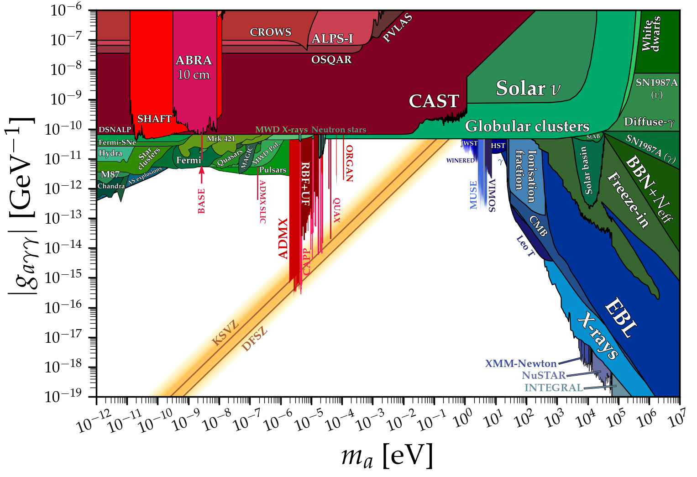
Limits on axions
https://cajohare.github.io/AxionLimits/docs/ap.html
So far the only experiments sensitive to the QCD axion in the mass range appropriate for dark matter are the microwave cavity experiments, known as haloscopes.
Other experiments tend to be sensitive either to high masses or to large coupling constants.

Slide 15
Summary
Astrophysical evidence indicates that dark matter makes up about 84% of the matter in the Universe, is effectively stable, does not interact strongly or electromagnetically, and was non-relativistic at the time of structure formation.
  No Standard Model particle satisfies these criteria. However, many extensions to the Standard Model do predict something with appropriate properties.
The two most widely studied dark matter candidates are WIMPs (especially SUSY WIMPs) and axions.
  There are experimental searches ongoing for both of these, but no success so far.

