Slide 1

PBH and GW from an underdamped axion-like curvaton
Tadepalli Sai Chaitanya
Indiana University
Apr 19, 2025

Slide 2
Layout
Formation of primordial BHs and secondary Gravitational Waves from a typical axion-like curvaton field.
We will see that such fields cannot generically produce any sizable PBH fraction from a vanilla curvaton model.
An underdamped field can however alleviate this quite comfortably with some correlated signals

Slide 3
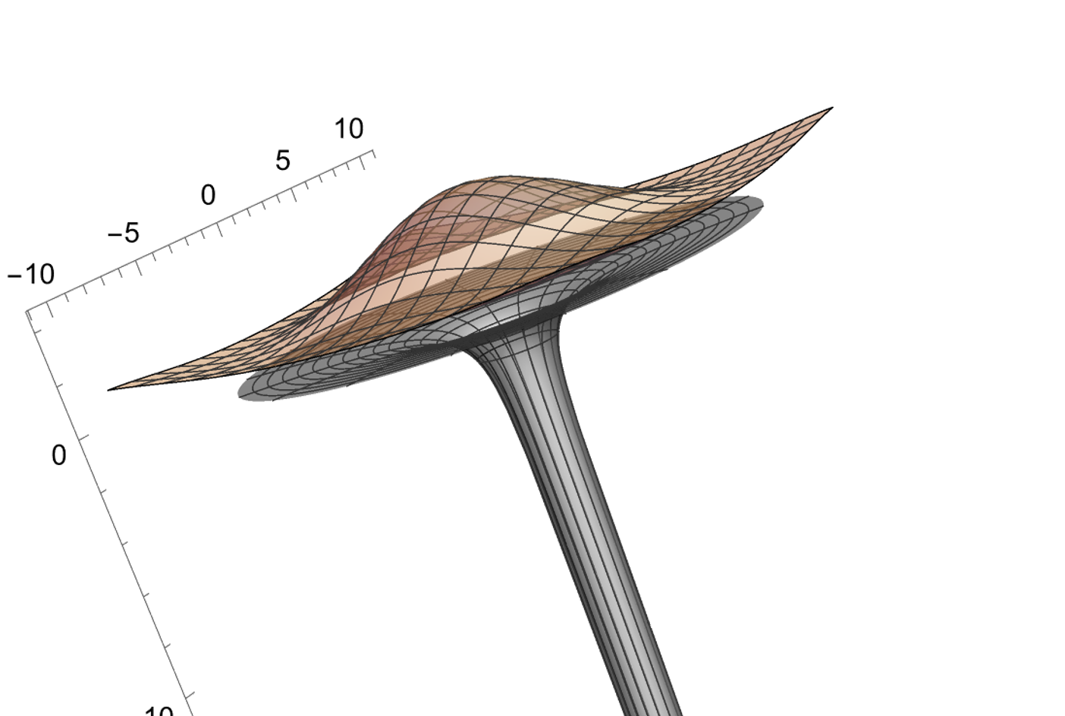





Large fluctuations in homogenous background can seed formation of PBH

Slide 4
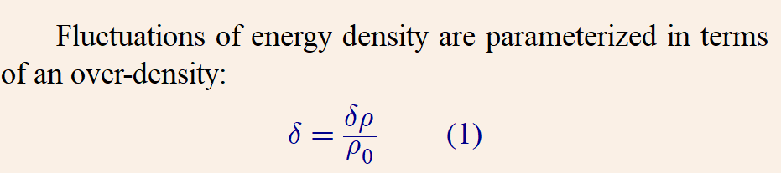
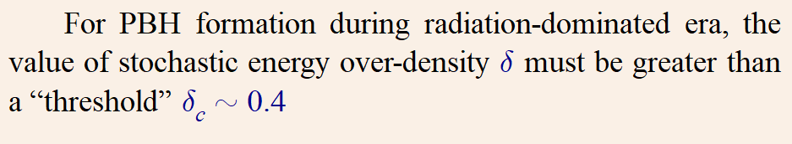

Slide 5
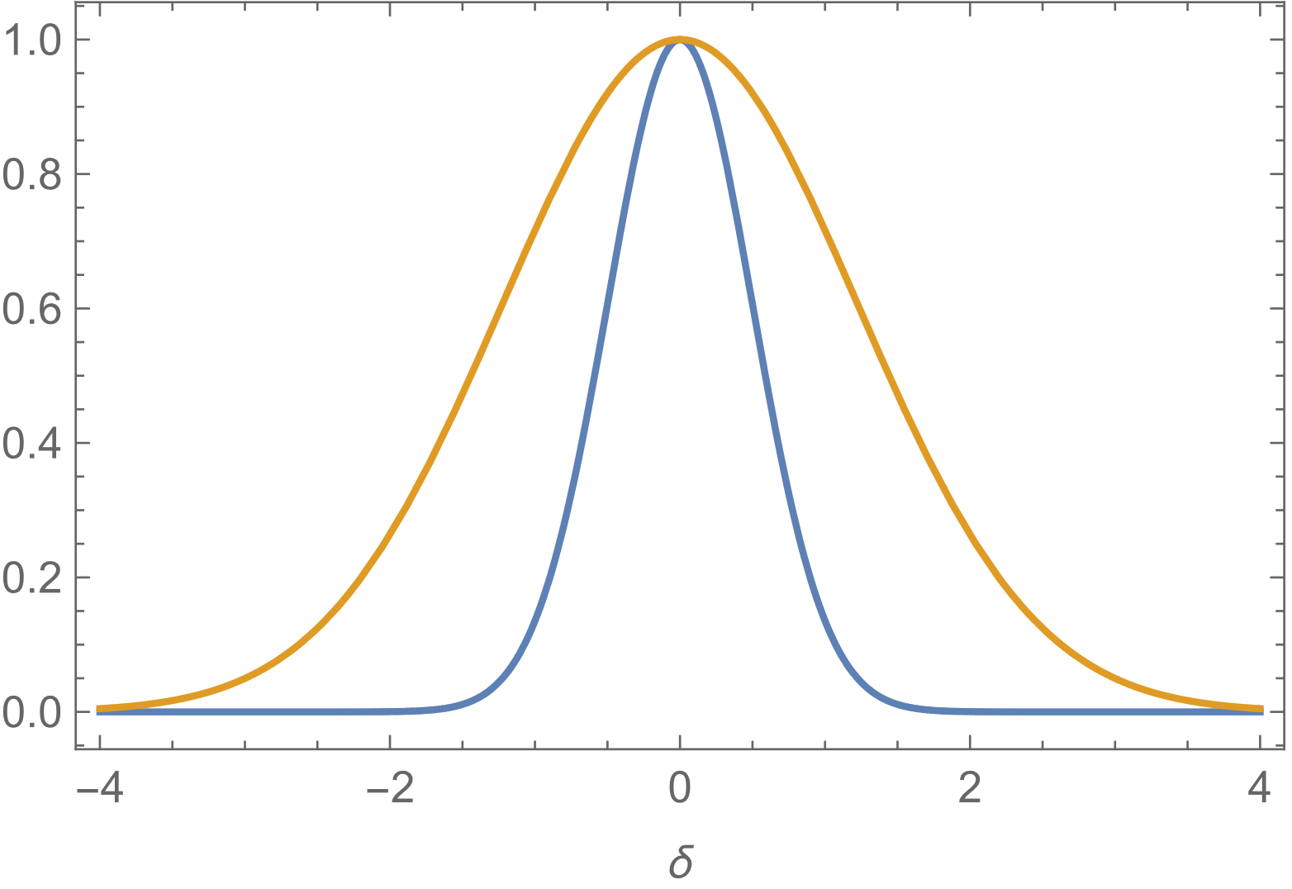
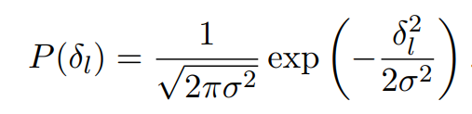
A Gaussian PDF of the perturbations
Large power
A larger variance implies higher probability of getting a certain value of fluctuation
Small power

Slide 6

Interestingly, this small probability is sufficient to form enough PBHs to account for all of current dark-matter.
Gravity is amazing !

Slide 7

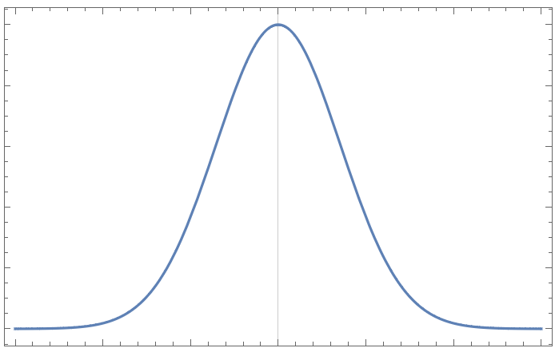
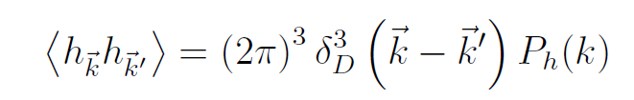
Power spectrum of fluctuations
The fluctuations are stochastic (random) quantities with an overall mean zero,
with a non-zero variance
k ~ 1/L
Power spectrum of the fluctuations

Slide 8
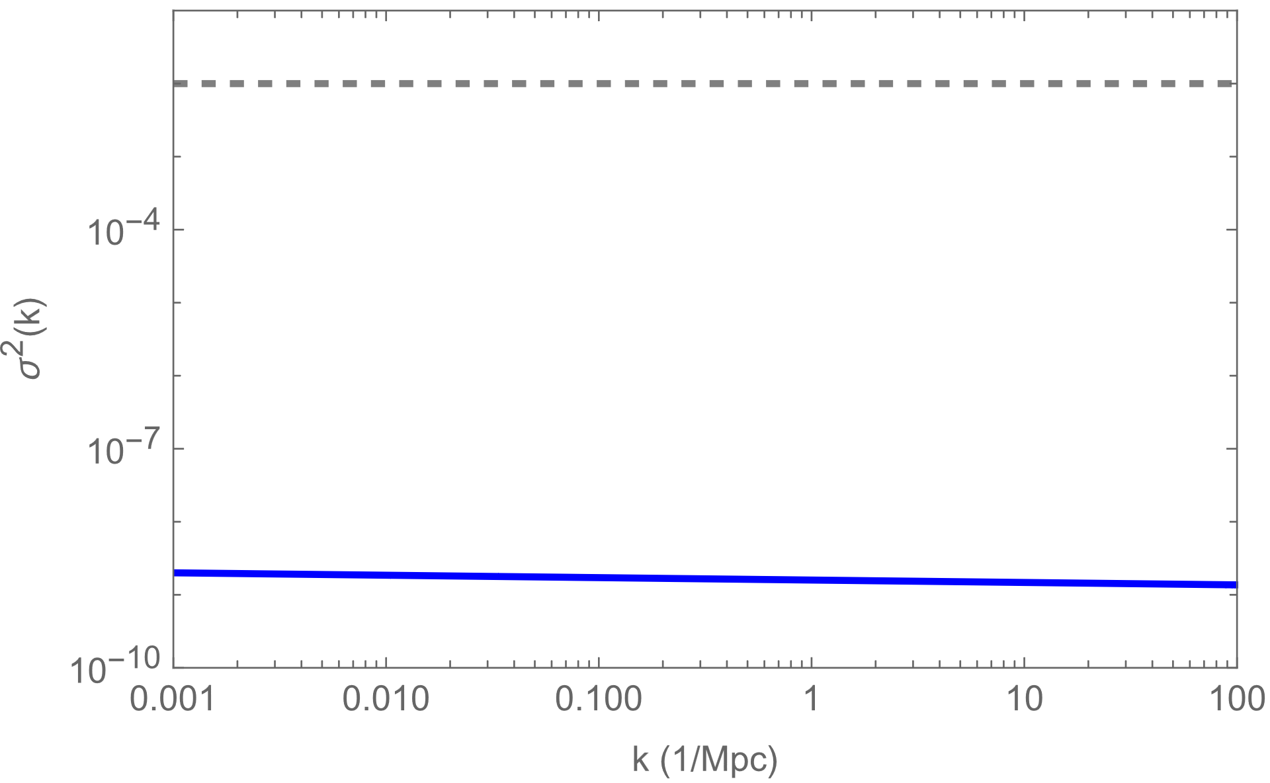

Primordial power spectra (generated during inflation)
Galaxies ~ 10 kpc
Cluster of galaxies ~ 10 Mpc
Required !!!!
A curvaton field that can carry large fluctuation and decay
P ~ $\frac{10000⁢\sqrt{\frac{5}{π}}}{ⅇ^{200000000}}$
Currently measured
1 Mpc is roughly 3.26 million light-years

Slide 9
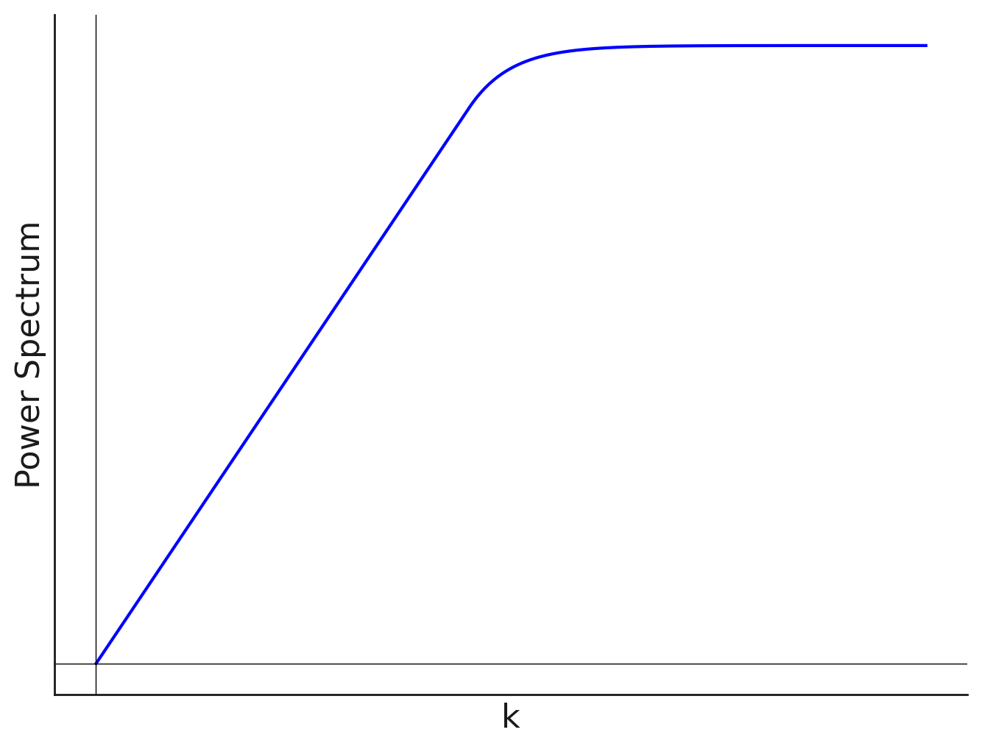
How do we generate large primordial power for curvaton?
threshold

Slide 10

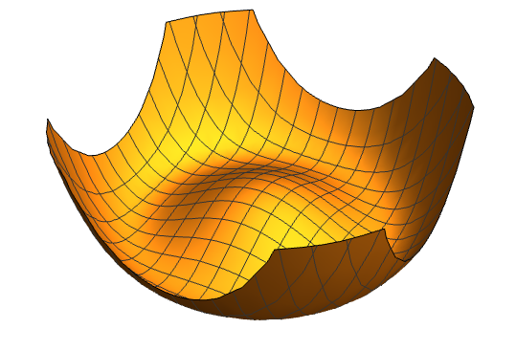
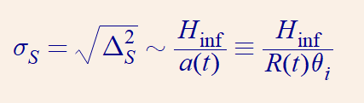

Generate blue-tilted spectra via non-equilibrium radial field
S. Kasuya, M. Kawasaki [0904.3800]
We require displacement away from minimum vev

Slide 11
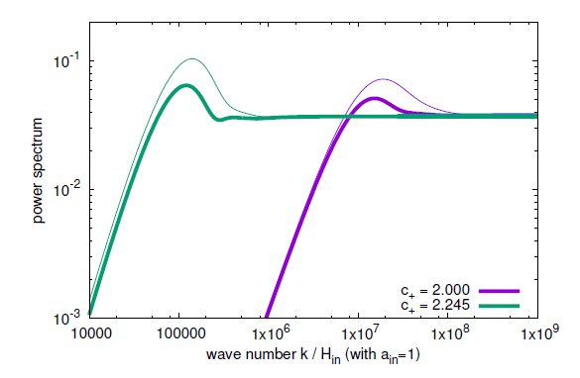
Typical large power spectrum generated for the curvaton field

Slide 12
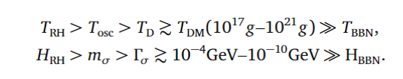
Curvaton constraints:
Inflationary Hubble constraint
Currently measured fluctuation amplitude in CMB
Crossing threshold
Thermal history
Gaussianity
threshold

Slide 13
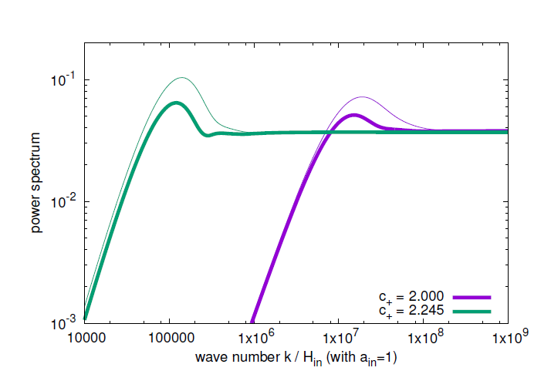
Overdamped curvaton
Bump amplitude: O(1) of plateau
leading exponential solution

Slide 14
Underdamped field
Underdamped fields have enough kinetic energy to slosh around at the bottom of potential and generate new phenomenology

Slide 15
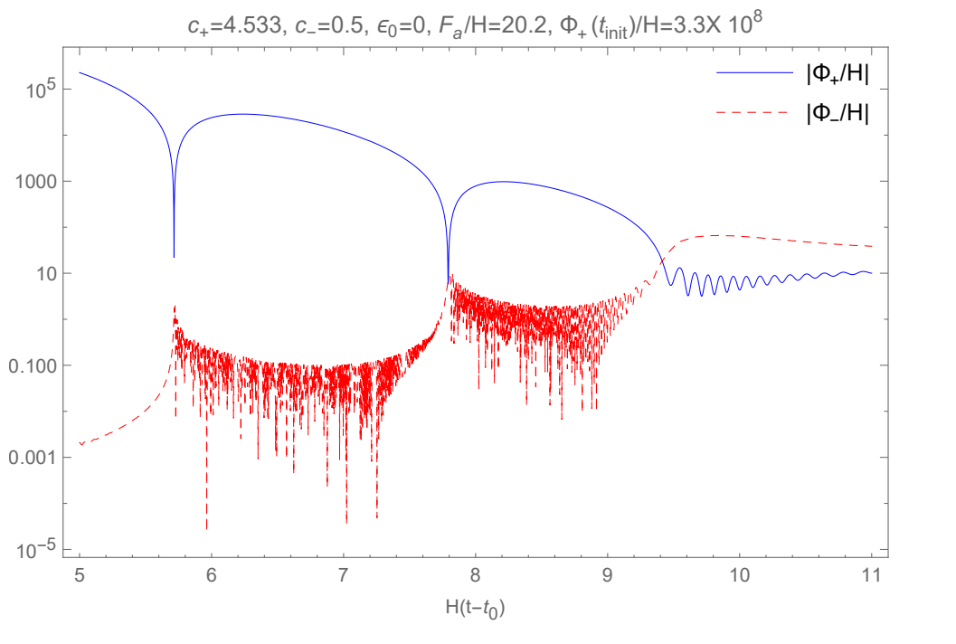
Underdamped curvaton
Harmonic solution

Slide 16
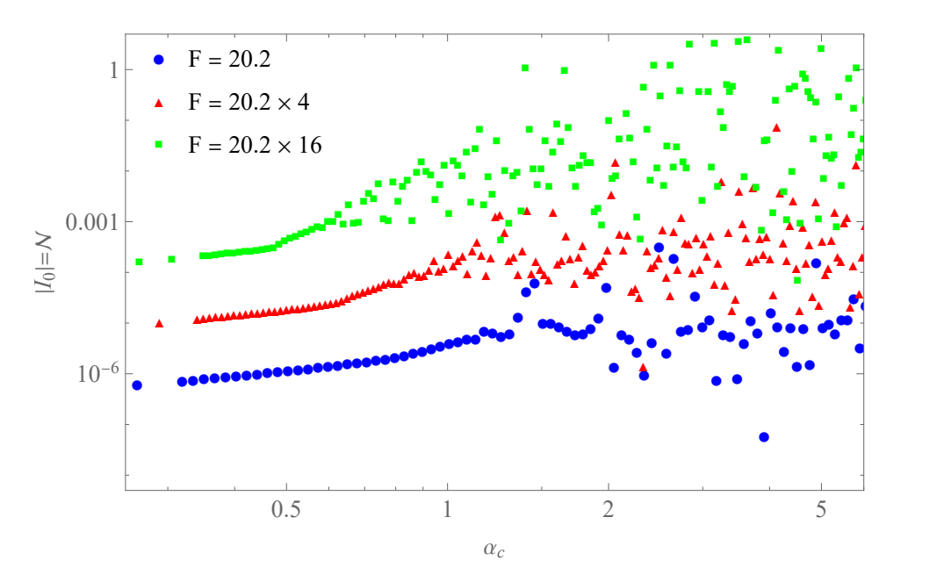
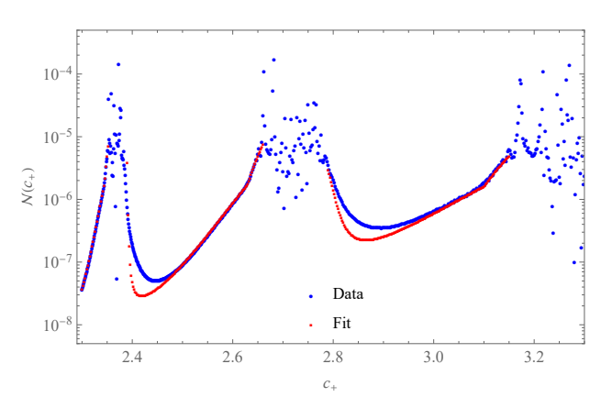
Underdamped fields also exhibit chaos. Laminar to turbulent transition
Sai & Chung: 2309.17010

Slide 17
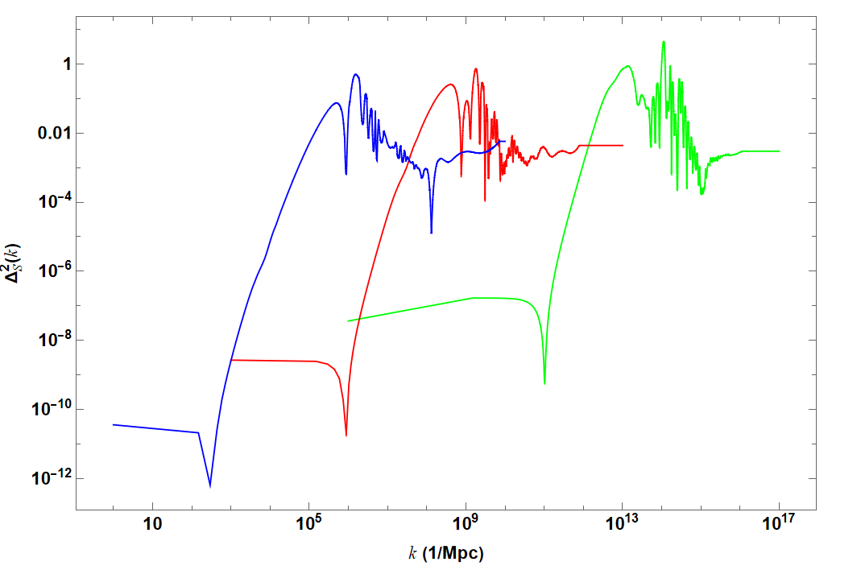

Slide 18
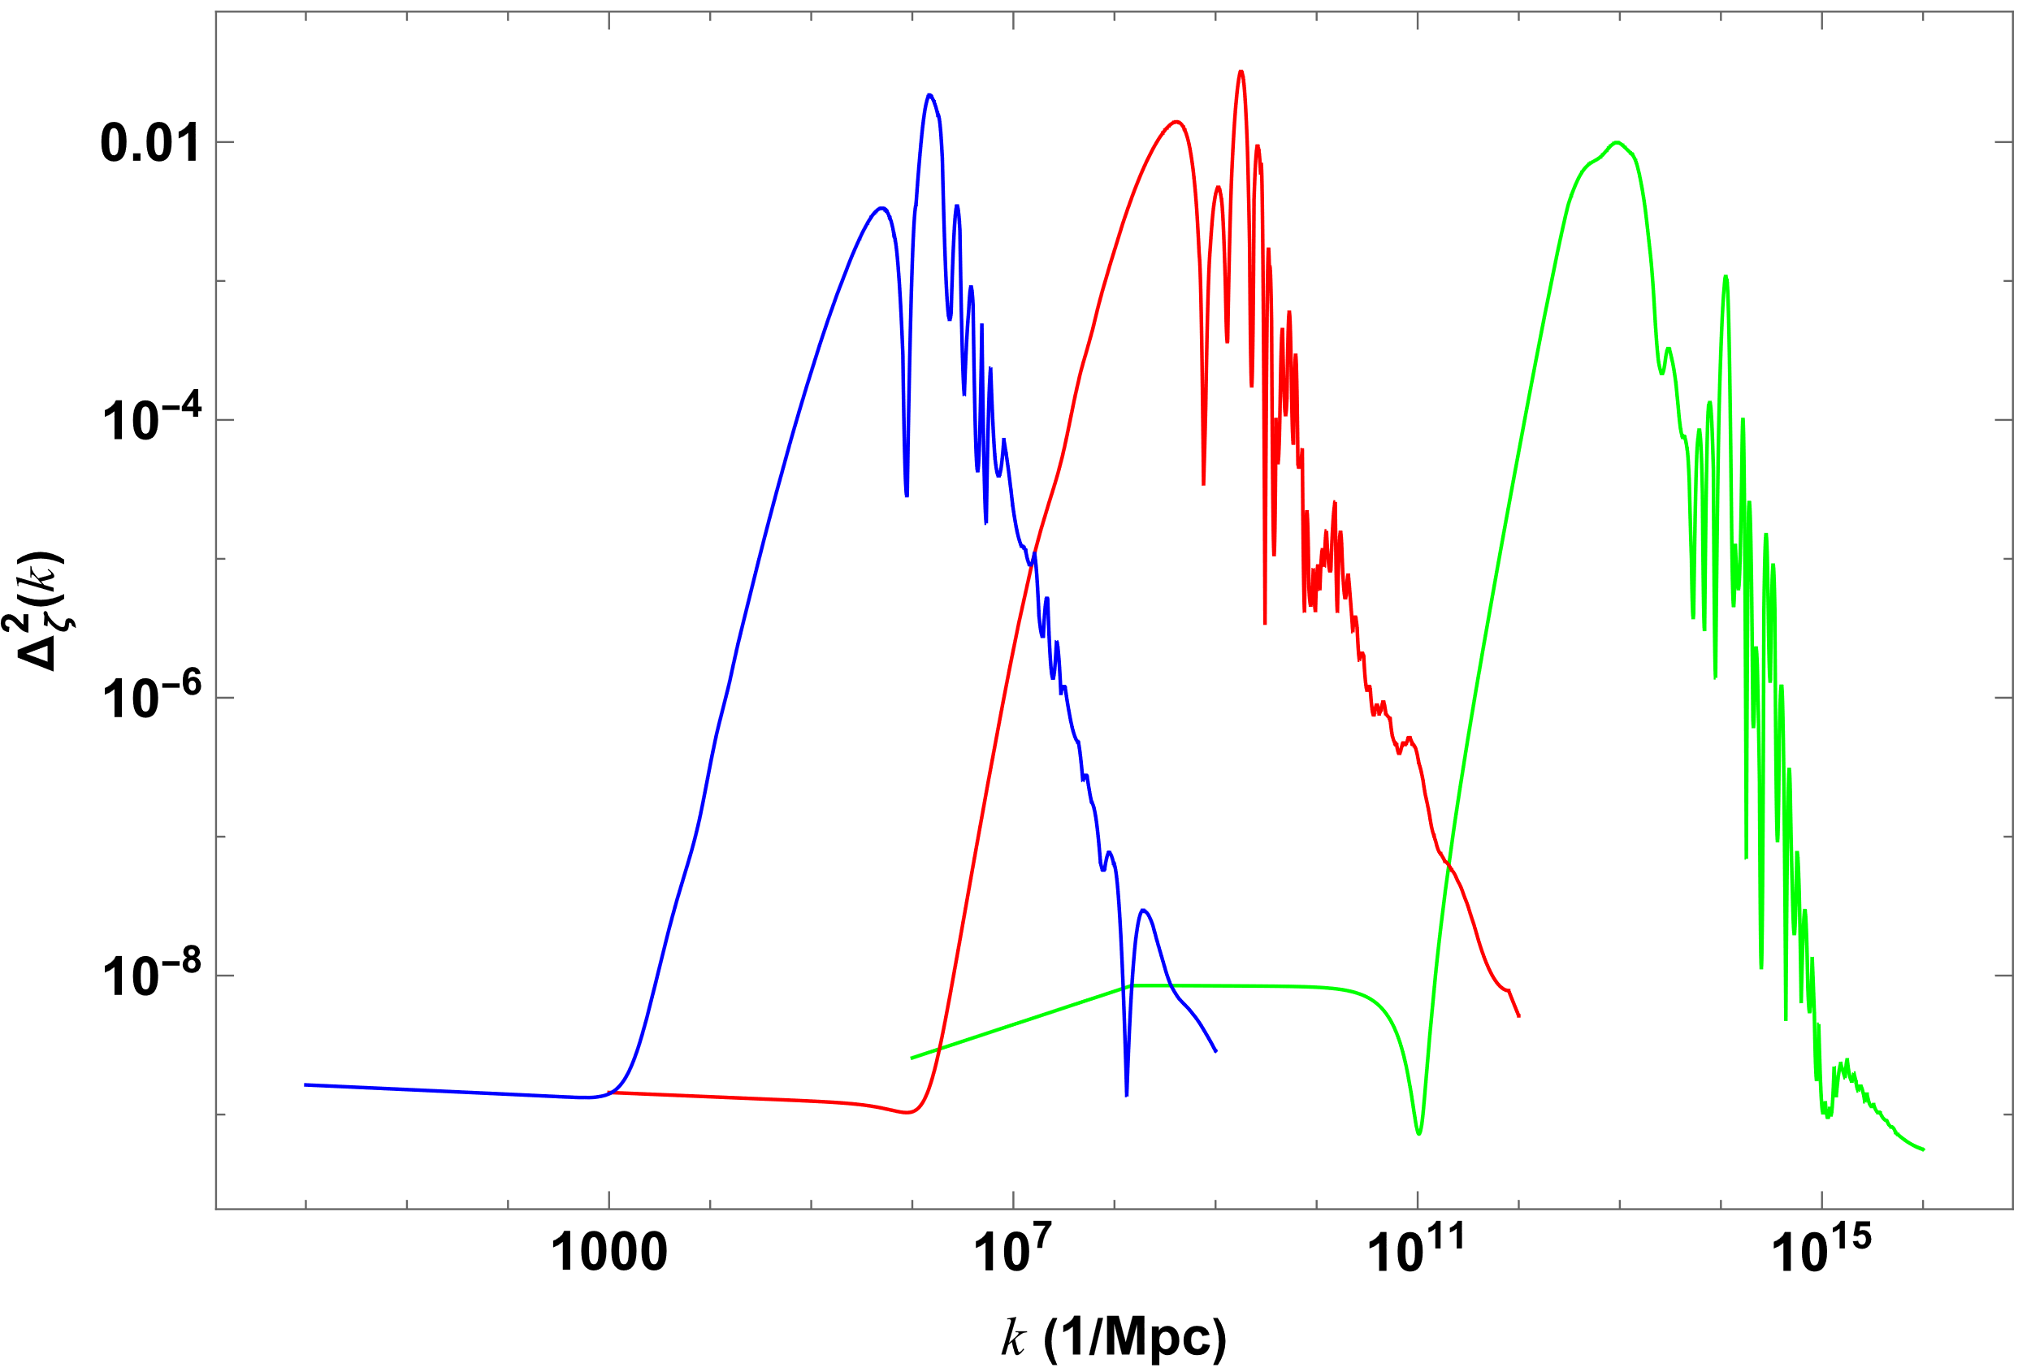
The oscillations in the spectrum go above the threshold
k³
k⁻²

Slide 19
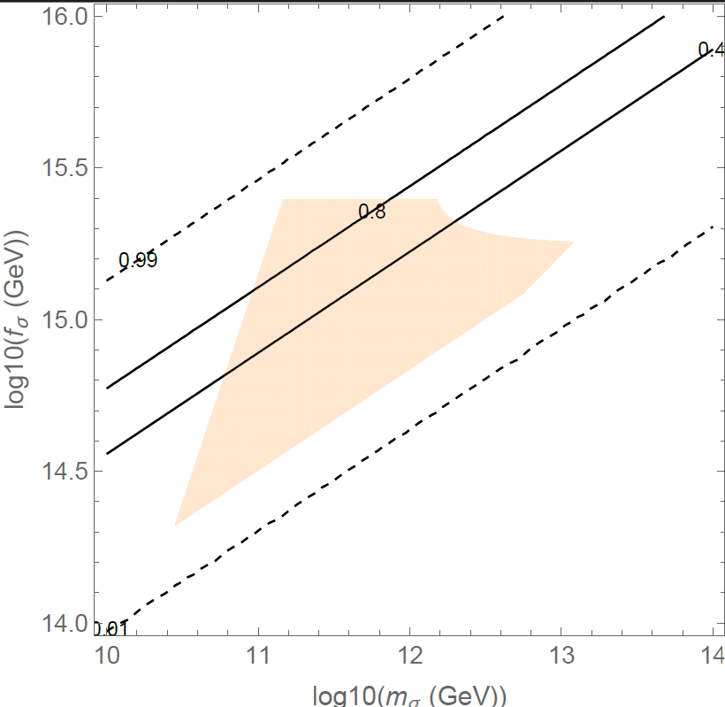
Sizable parameter space now possible

Slide 20
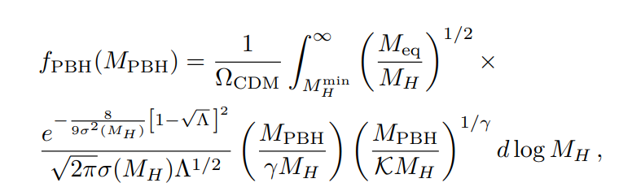
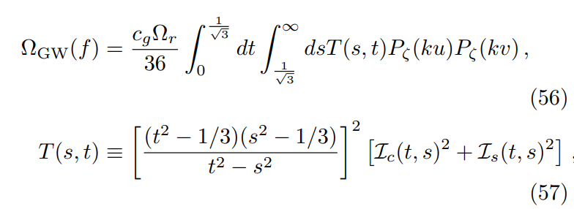
PBH
GW

Slide 21
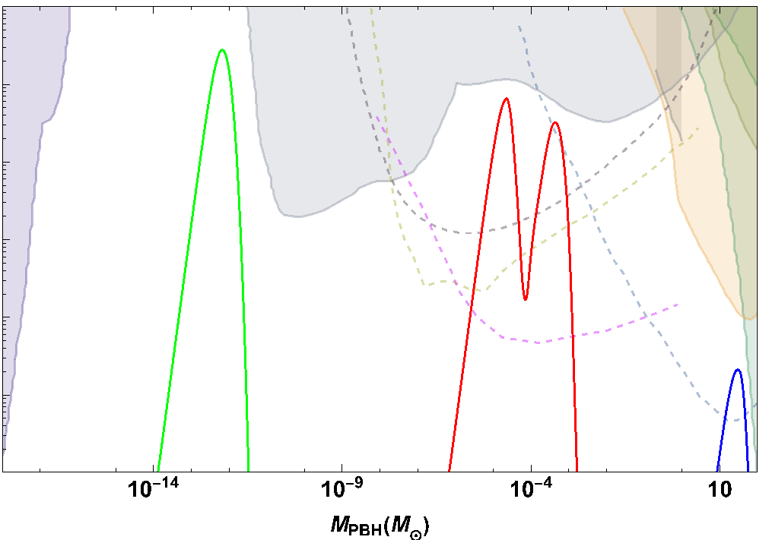

1
Dark-Matter
Micro-lensing
Evaporation
OGLE
1e-3
NGRST
LISA
ET
1e-6

Slide 22
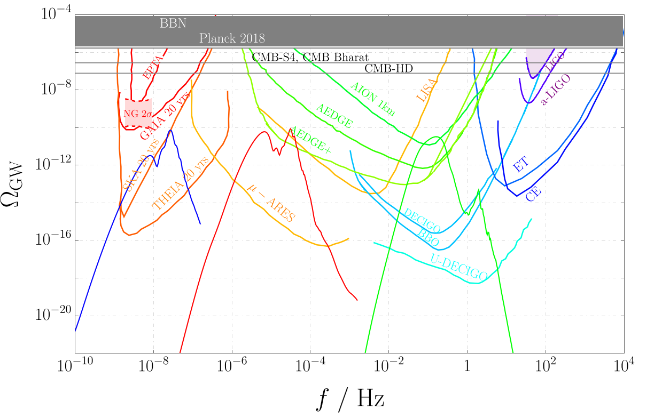

Slide 23
In summary, underdamped curvaton field can result in interesting peak-like structure in the PBH mass spectrum while having correlated features in the induced GW spectrum.

Slide 24
Thanks…

Slide 25
