Slide 1
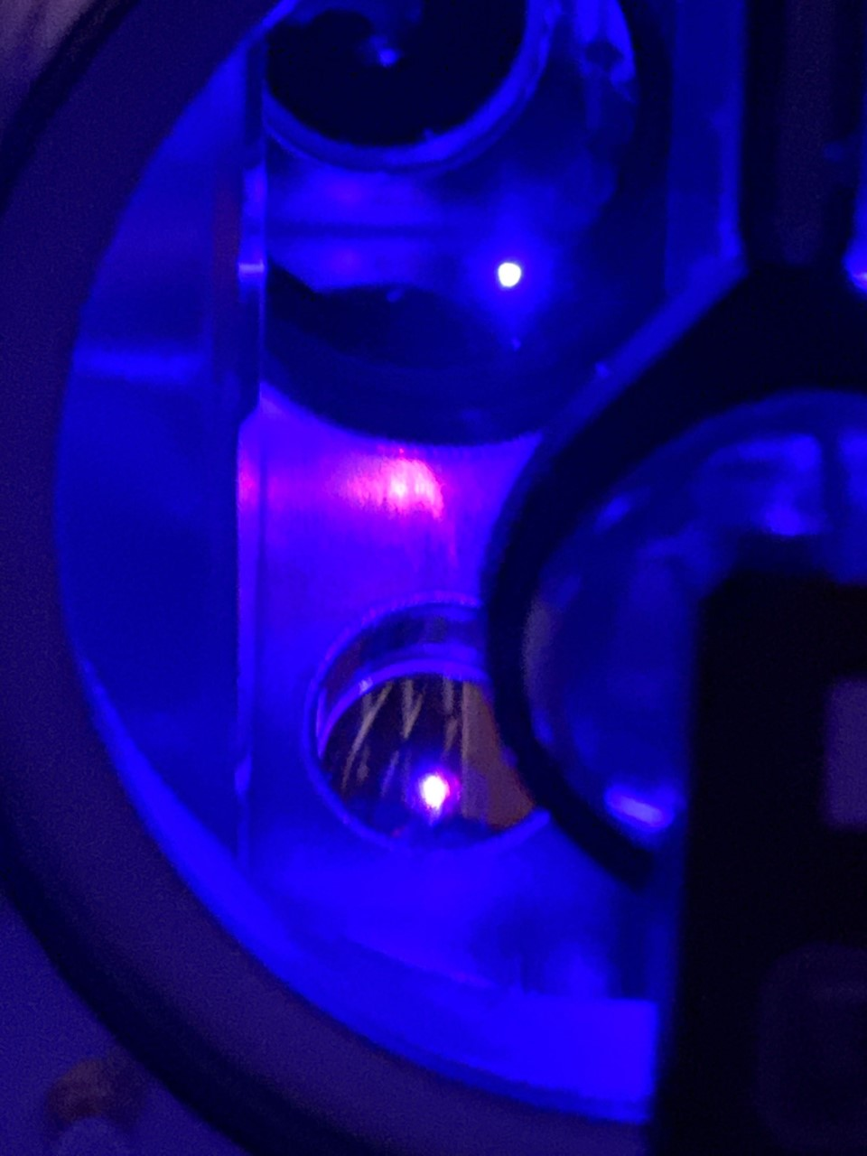
New Tools for Dark Matter and Gravitational Wave Detection: Cryogenic Optical Resonators and Long-Baseline Atom Interferometers
Tim Kovachy
Department of Physics and Astronomy and Center for Fundamental Physics (CFP), Northwestern University
PIKIMO Meeting
April 19, 2025

Slide 2
Summary
Brief introduction to optical cavities and atom interferometers
Science motivation: dark matter (DM) searches and gravitational wave (GW) detection in new frequency ranges
Cryogenic cavity comparison method and DM search results, prospects for GW detection
Introduction to long-baseline (>10 m) atom interferometry
Boosting sensitivity with “self-correcting atom interferometers”
MAGIS-100 100-meter-tall interferometer under construction at Fermilab to pursue DM and GW detection
Outlook and future directions

Slide 3
Optical Cavities
Light circulates between two mirrors
For light at particular “resonance frequencies,” dependent on distance between mirrors, constructive interference leads to large buildup of field inside cavity
At resonance, most light transmitted through cavity
Oscillations of distance between mirrors causes frequency modulation of the light
Manju et al., Scientific Reports 10, 15052 (2020)

Slide 4
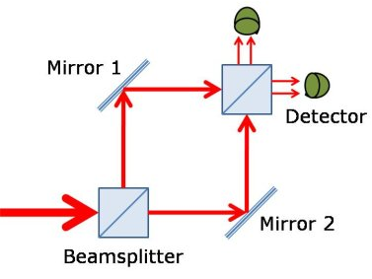
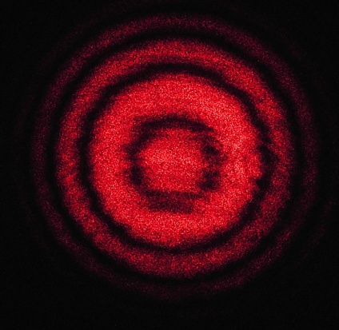
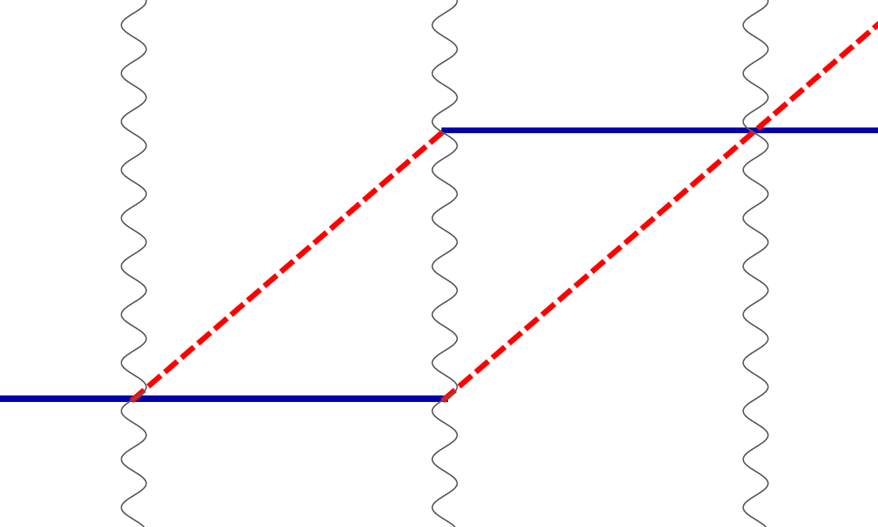
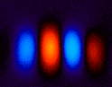
Atom interference
Light interferometer
Light
Light fringes
Atom interferometer
Beamsplitter
Atom fringes
Atom
Beamsplitter
Mirror
http://scienceblogs.com/principles/2013/10/22/quantum-erasure/
http://www.cobolt.se/interferometry.html

Slide 5

Atom optics using light
(1) Light absorption (transition from ground to excited state):
ħk
v = ħk/m
(2) Stimulated emission (transition from excited to ground state):
v = ħk/m
ħk

Slide 6
Atom optics using light
(1) Light absorption:
Rabi oscillations
ħk
v = ħk/m
(2) Stimulated emission:
v = ħk/m
ħk
Time

Slide 7
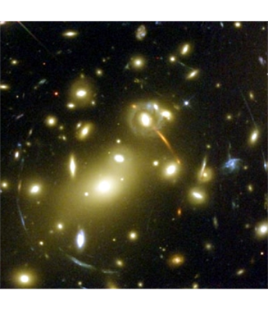
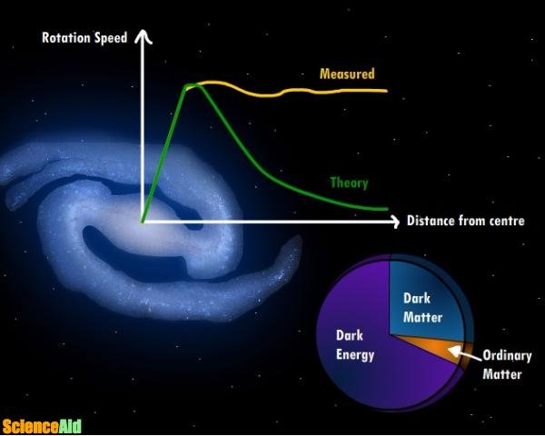
Dark Matter
Strong evidence it’s there, but what is it?
Galactic rotation curves not consistent with luminous matter only
Gravitational lensing that is not explained by luminous matter
Other evidence includes dynamics of galaxy interactions, structure of cosmic microwave background, etc…

Slide 8
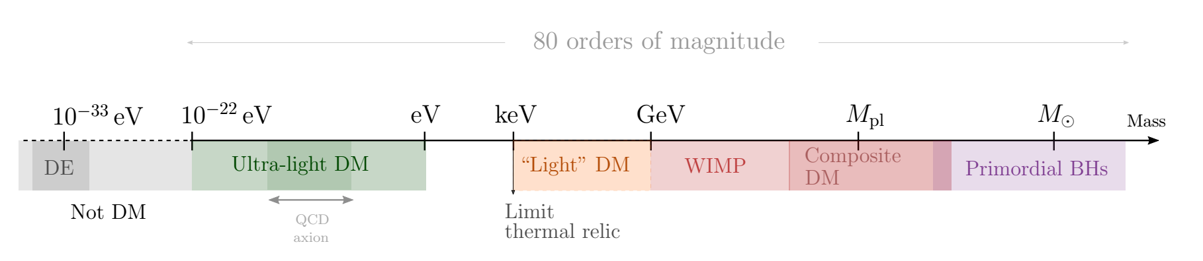
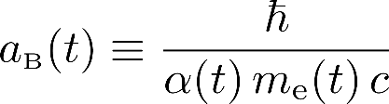
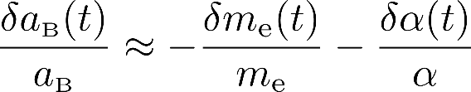
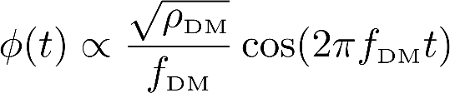
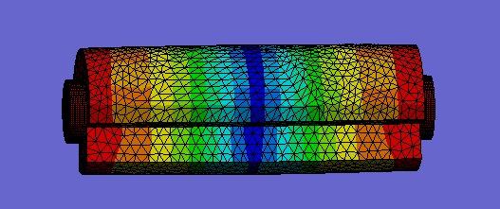
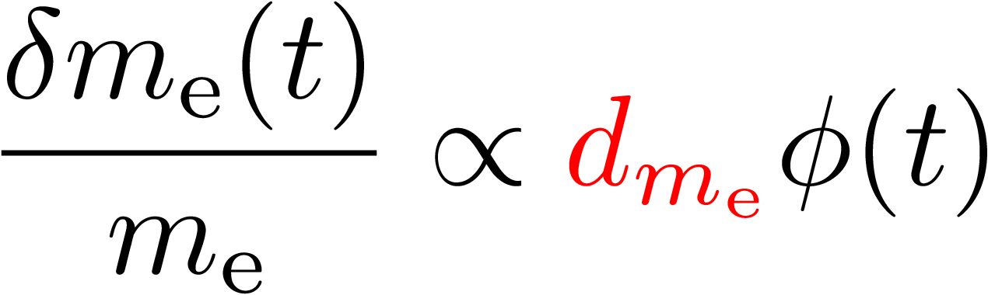
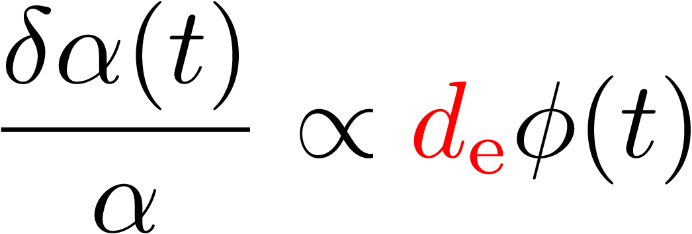

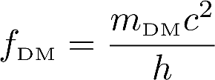
Ultralight dark matter
Ferreira (2021). Astron. Astrophys. Rev. 29, 7
BH: Black Hole
DM: Dark Matter
DE: Dark Energy
WIMP: Weakly Interacting Massive Particle
Ultralight DM acts as a coherent, wavelike background field
One example: scalar field
Bohr radius:
Scalar field:
Electron mass:
Fine structure constant:
Definitions
(Galactic halo)

Slide 9



Ultralight dark matter: effect on atomic energy levels
Oscillation of fine structure constant or electron mass causes time-varying atomic energy levels:
DM induced oscillation
Dark matter coupling
Time

Slide 10
Technologies to Cover Range of Wavelike DM Masses
Antypas et al. (2022). arXiv:2203.14915

Slide 11

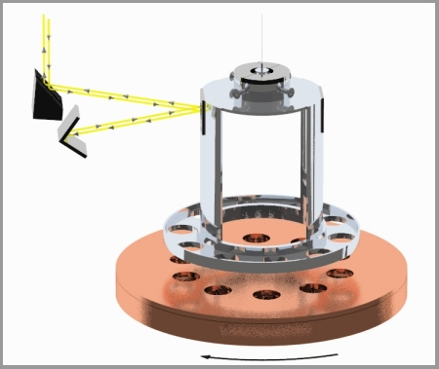
Indirect vs. Direct Probes of DM
as a fifth force mediator
Indirect
Existence of new field mediates “fifth force,” regardless of whether there is enough energy density in the field for the field to be dark matter
Analogy: does the electromagnetic field exist?
Direct
Assuming sufficient field density for it to be dark matter, look for associated effects (e.g., oscillations of fundamental constants)
Analogy: is there a laser beam in my lab
Sensitive to local DM density, especially useful for “clumpy” DM models
https://www.npl.washington.edu/eotwash/inverse-square-law
Antypas et al. (2022). arXiv:2203.14915

Slide 12
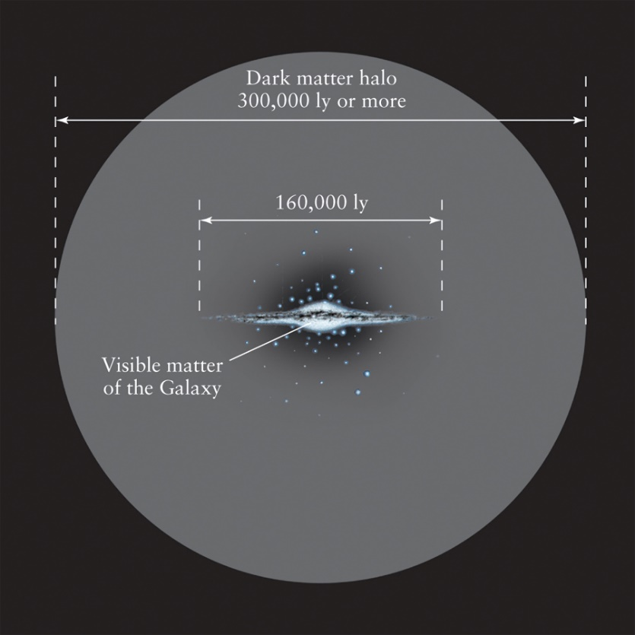
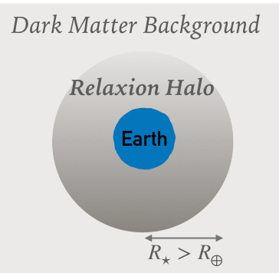
Models of Dark Matter Distribution
https://communities.springernature.com/posts/dark-matter-bound-to-our-solar-system
Banerjee et al. (2020). Communications Physics 3, 1
Standard Halo Model (SHM)
Boson Star Model
Freese et al. (2013). Rev. Mod. Phys. 85, 1561-1581
https://digfir-published.macmillanusa.com/slater2e/asset/img_ch13/c13_fig19.html
https://cosmosatyourdoorstep.com/2023/01/18/how-massive-is-the-milky-way/
Gravitationally bound “dark matter star” around Earth (or sun)
Local enhancement of DM density
Relaxion star: model where relaxion field is DM
Higg mass hierarchy problem: why is Higgs mass small compared to other fundamental energy scales like Planck scale or scale associated new physics that leads to neutrino masses?
Relaxion: natural means for Higgs mass to evolve to smaller values
Graham, Kaplan, and Rajendran, Phys. Rev. Lett. 115, 221801 (2015)

Slide 13
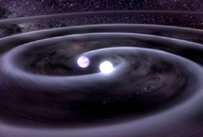

Gravitational Wave Detection
frequency
L (1 + h sin(ωt ))
Megaparsecs…
strain
Gravitational waves science:
New carrier for astronomy: Generated by moving mass instead of electric charge
Probing the early universe: Can see to the earliest times in the universe, study corresponding high energy scales
Tests of gravity: Extreme systems (e.g., black hole binaries) test general relativity

Slide 14
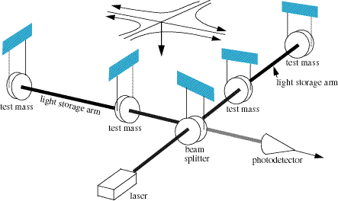
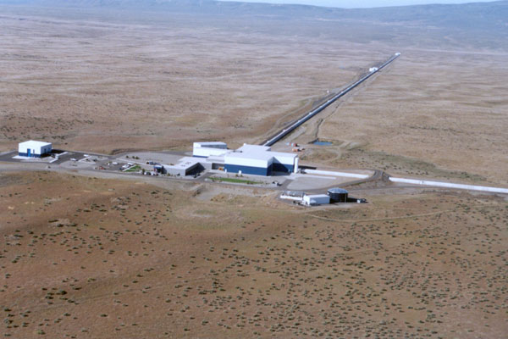
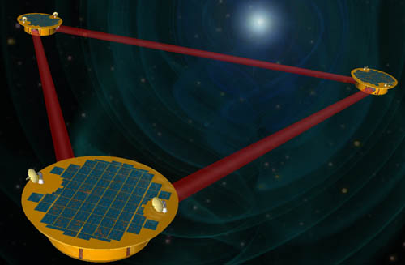
Laser Interferometer Detectors
Gound-based detectors: e.g.: LIGO, VIRGO, GEO, proposed ET (> ~3 Hz)
Space-based detector concept: planned LISA mission (1 mHz – 100 mHz), also proposals to extend LISA concept to higher frequencies (e.g., DECIGO)

Slide 15
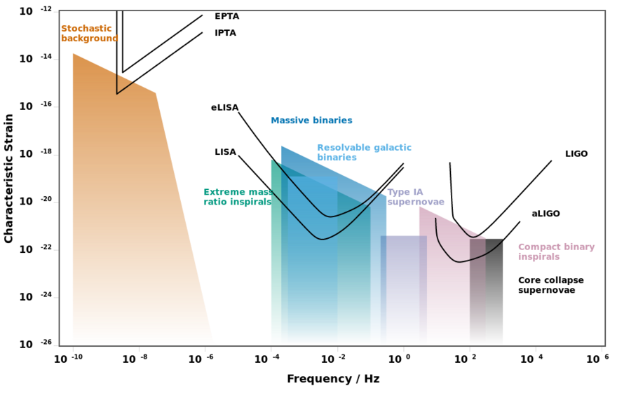
Gravitational wave frequency bands
Moore et al., CQG 32, 015014 (2014)
Mid-band
Atom interferometers: Aim to fill gap between peak sensitivities of LIGO and LISA detectors in ~ 0.1 Hz – 3 Hz “mid-band” range
Cryogenic cavities: 10 – 100 kHz range above peak sensitivity of LIGO
Other approaches for 10-100 kHz range include optically levitated dielectric particles
Aggarwal et al., Phys. Rev. Lett. 128, 111101 (2022)

Slide 16
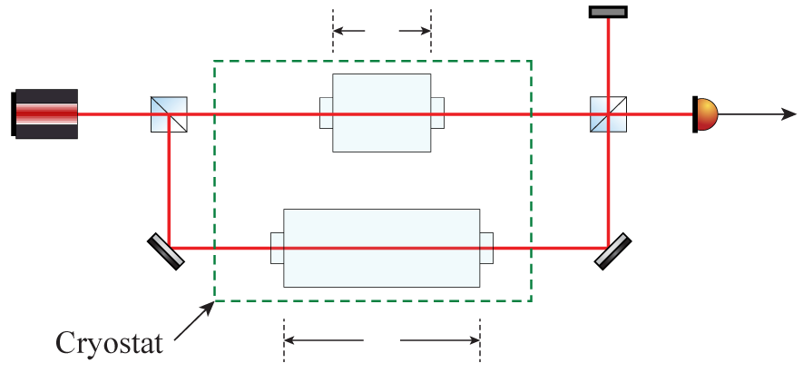
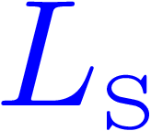

Cavity Comparison Detection Scheme
Differential measurement suppresses noise
Measure beat note of light transmitted through cavities to determine differential cavity strain
DM sensitivity from differential mechanical response due to different mechanical resonance frequencies
Above first longitudinal resonance, cavity length no longer follows DM drive
Bohr radius:

Slide 17
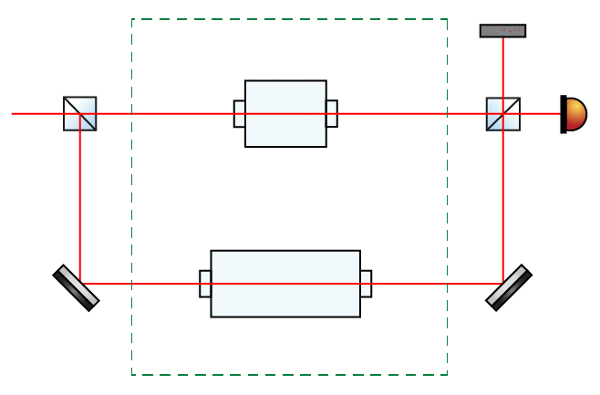
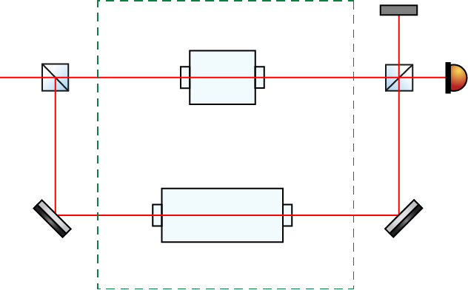
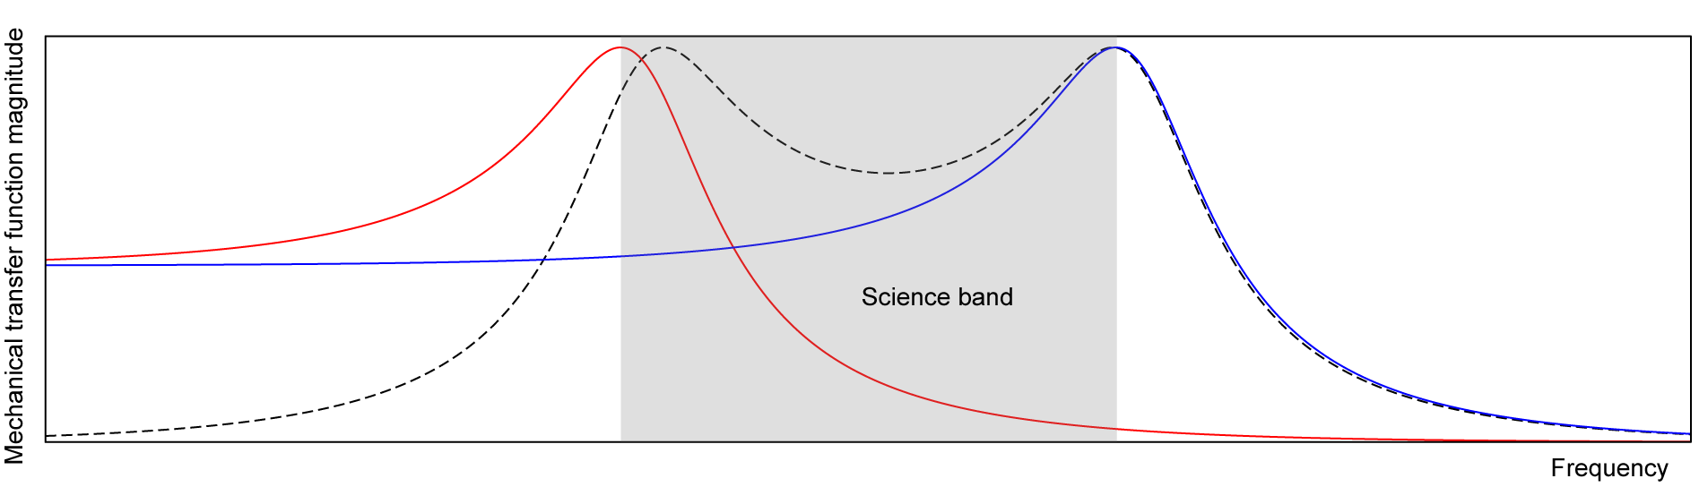

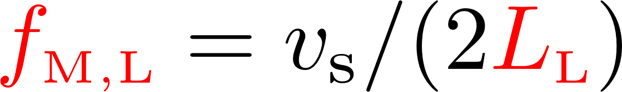
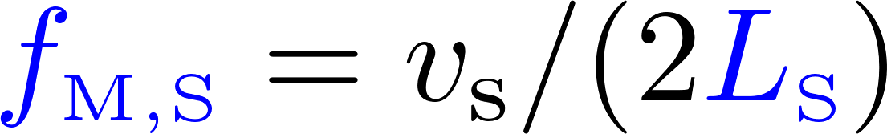
Oscillation Amplitudes of Cavities Across Mechanical Resonances
Length reference
Long cavity
Short cavity
Differential response
Note: oscillation of background objects is not shown for visual clarity
Speed of sound:
A. Geraci et al., PRL 123, 031304 (2019); Stadnik and Flambaum, Phys. Rev. Lett. 114, 161301 (2015)

Slide 18
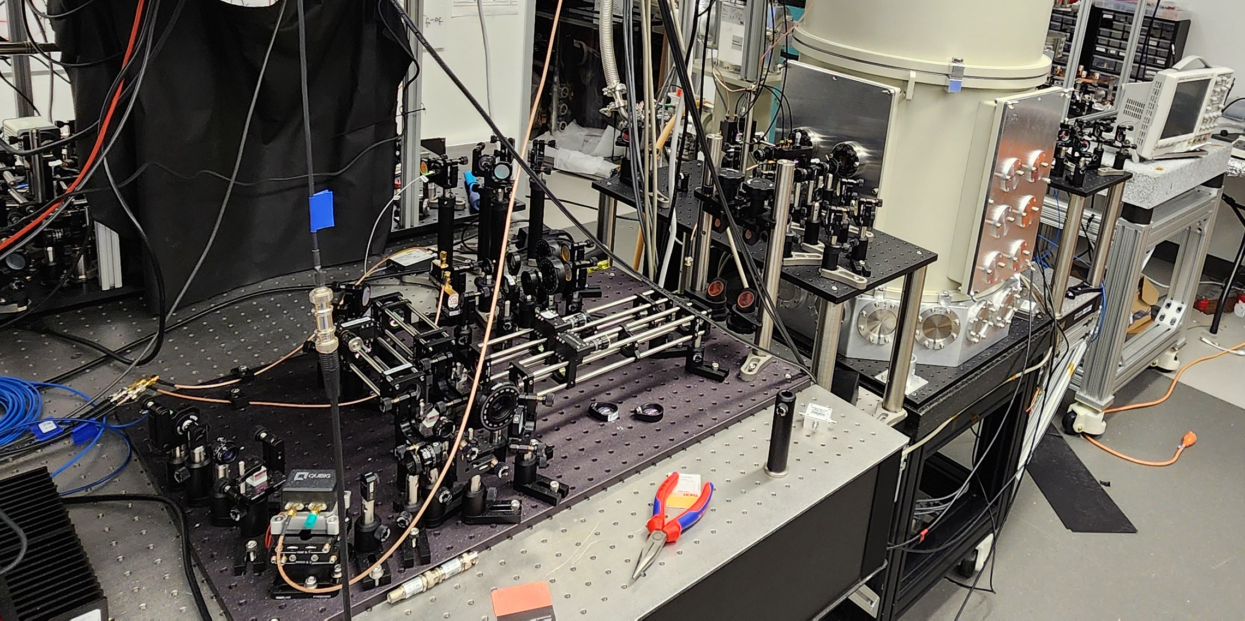
Apparatus
Cryostat
Vibration isolation system inside 4 K cryostat to suppress vibrational and thermal noise

Slide 19
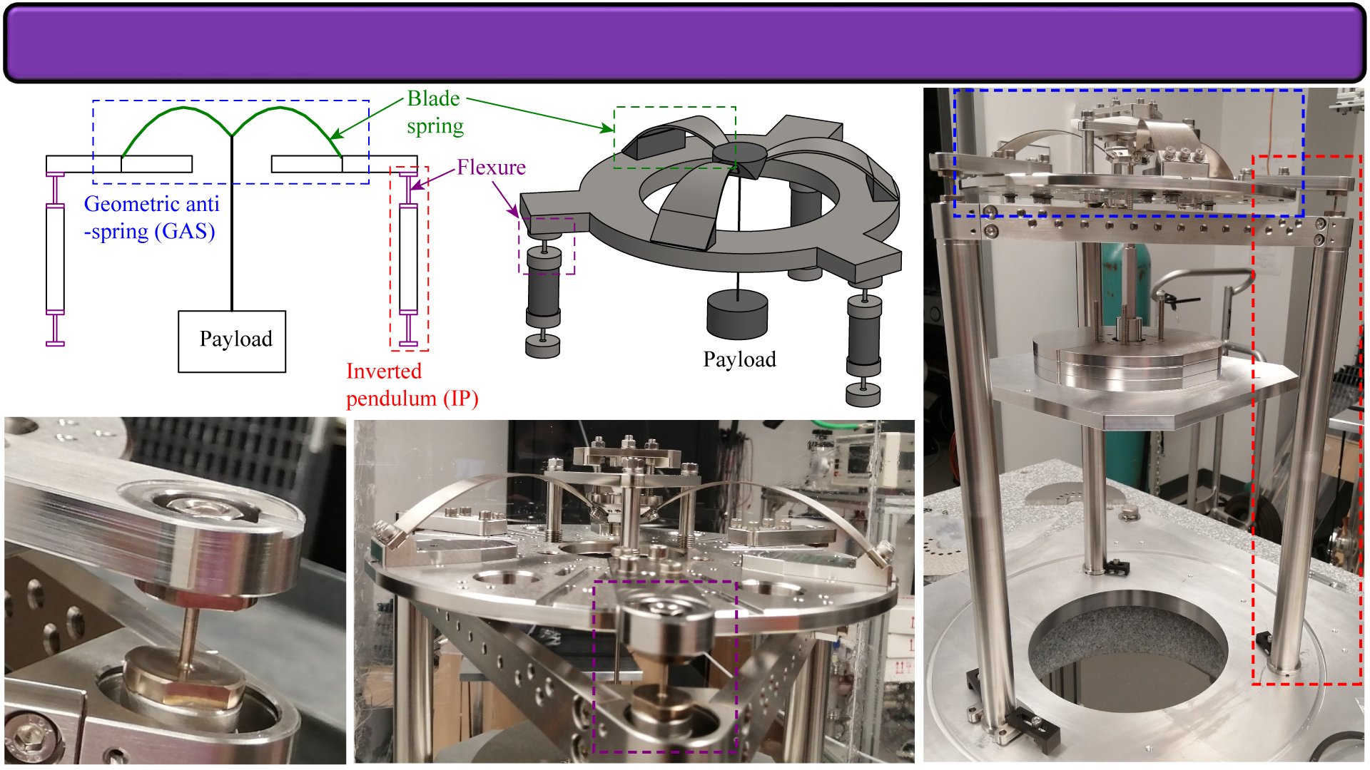
Passive Vibration Isolation
Single-wire pendulum
Flexure
GAS
Payload
Inverted pendulum

Slide 20
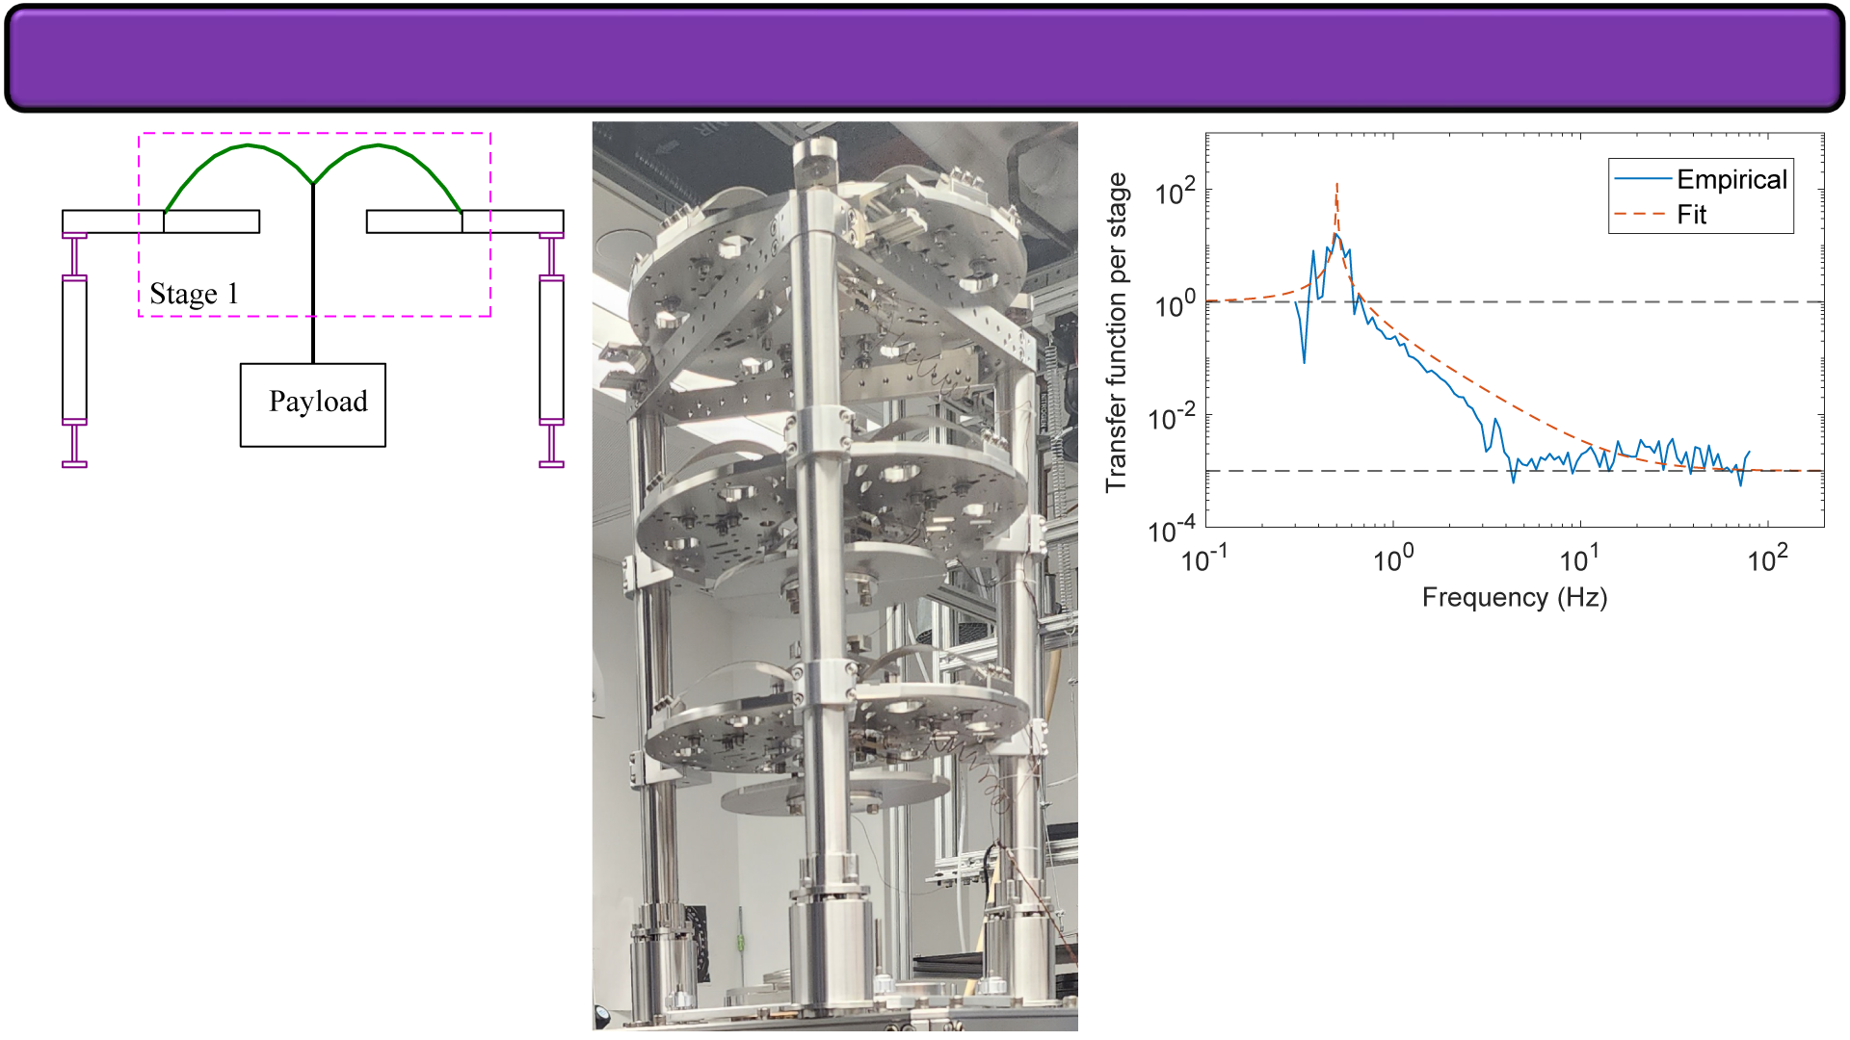
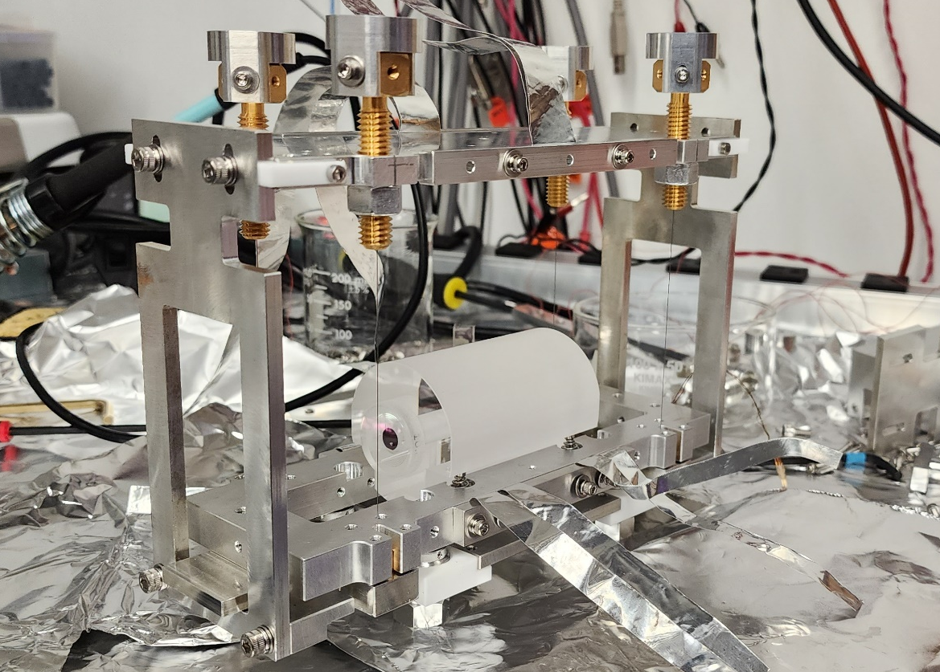
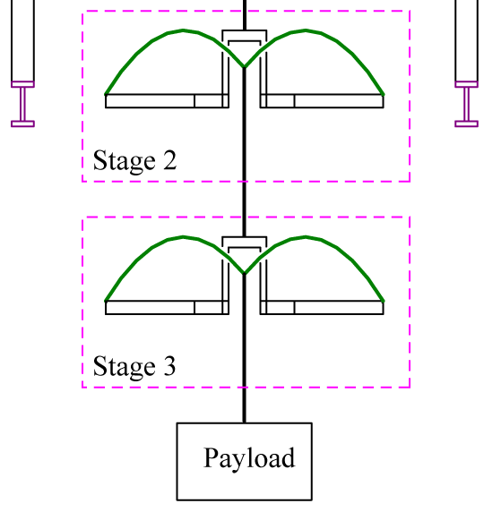
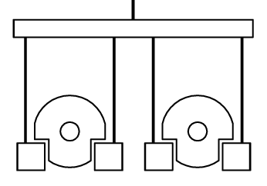
Passive Vibration Isolation
Custom single-crystal sapphire cavities
Final isolation stage: Cavity mounts suspended from 4-wire pendula

Slide 21
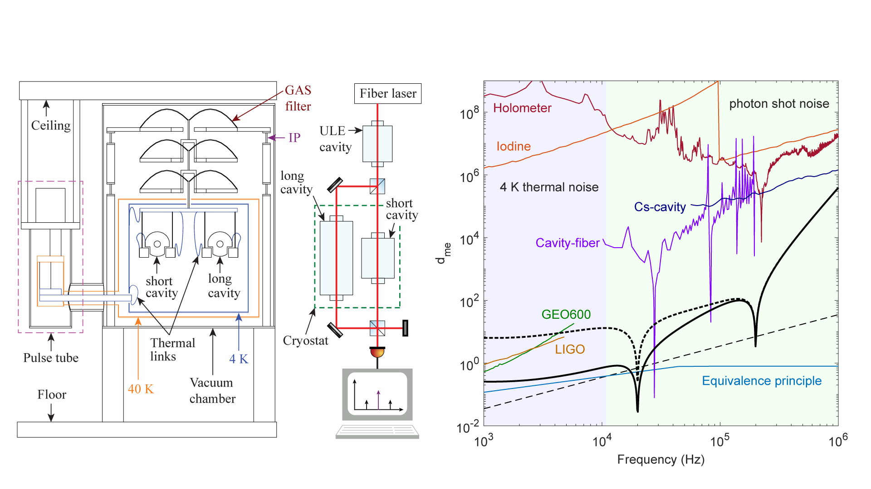
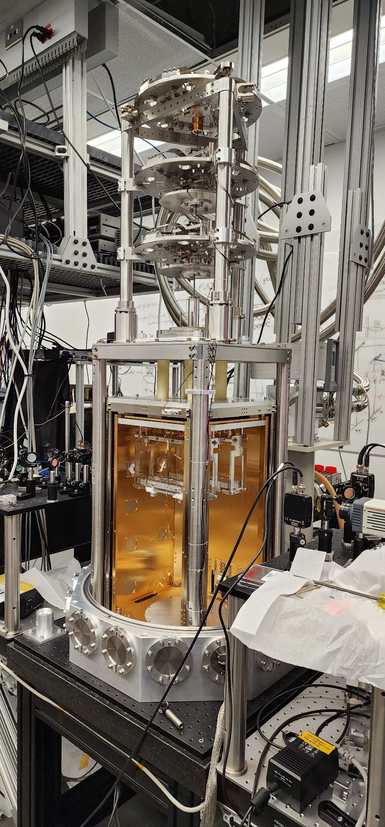
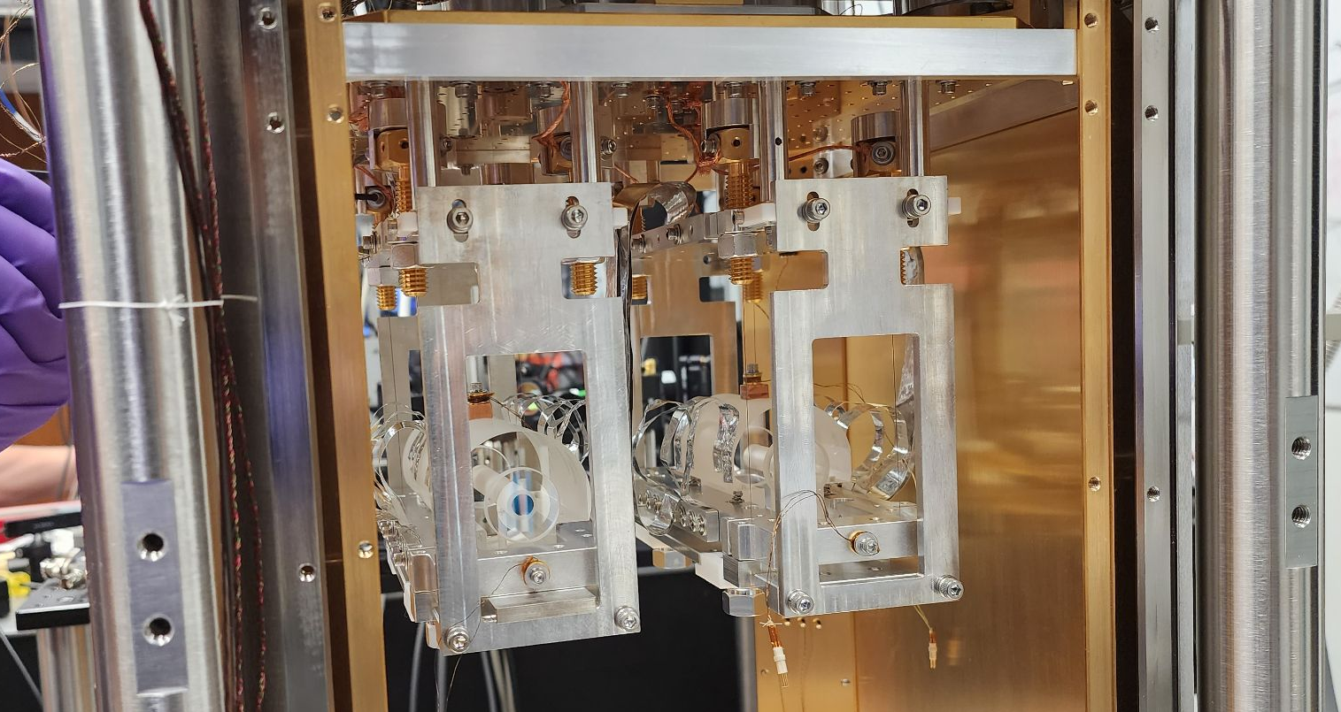
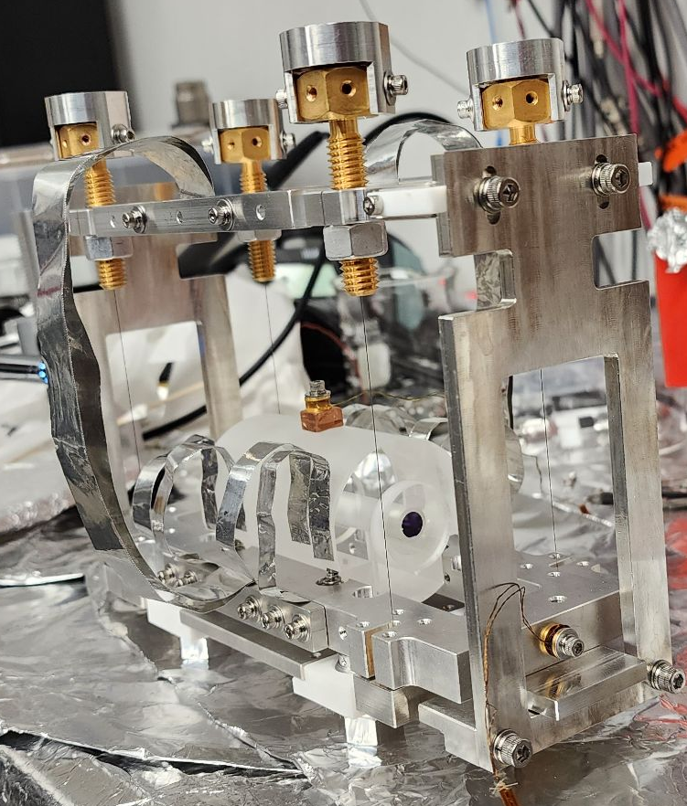
Cryostat with Vibration Isolation
Continuous data collection for 4 days
Analyze to search for DM (follow methods from Derevianko (2018), Phys. Rev. A. 97, 042506)

Slide 22
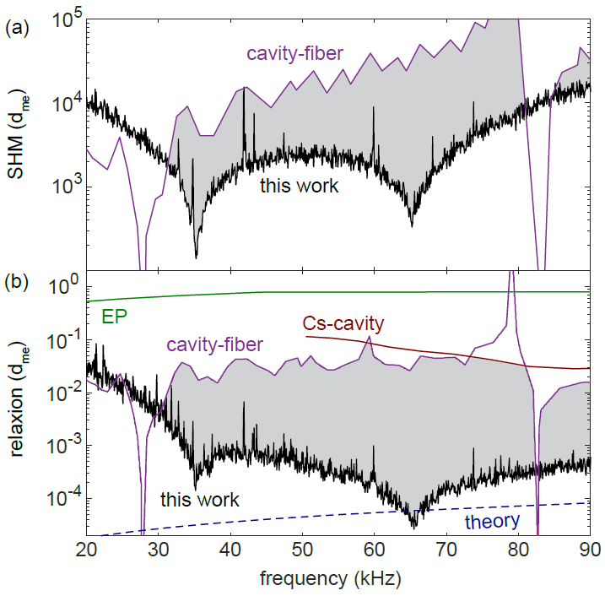
Dark Matter Limits: Standard Halo Model
Up to two orders of magnitude improvement over previous direct bounds
Deshpande et al., arXiv:2412.20623 (2024)

Slide 23
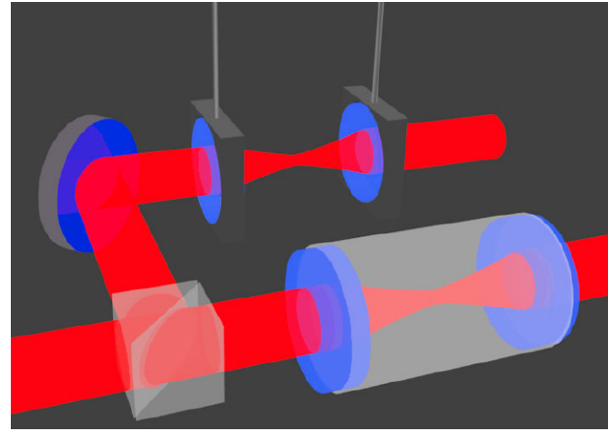
Dark Matter Limits: Relaxion Halo Bound to Earth
Anticipate improvements by several orders of magnitude with future upgrades, e.g. further filtering of laser noise and increasing laser power
Extend search down to ~100 Hz by replacing one rigid cavity with non-rigid cavity with independently suspended mirrors
Non-rigid cavity has very low mechanical resonance frequency, widening science band
A. Geraci et al., PRL 123, 031304 (2019)
Deshpande et al., arXiv:2412.20623 (2024); Tsai, Eby, and Safronova, Nature Astronomy 7, 113 (2023)

Slide 24
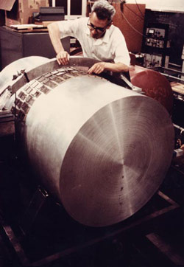
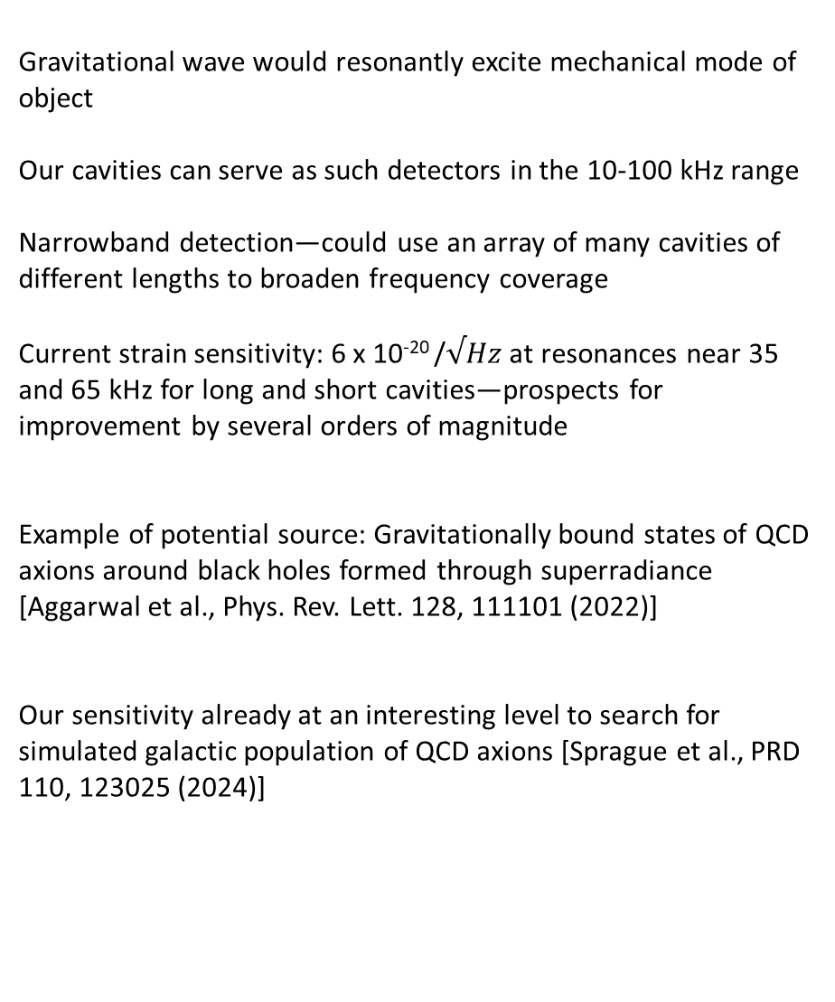
Resonant-Mass Gravitational Wave Detectors
Gravitational wave would resonantly excite mechanical mode of object
Our cavities can serve as such detectors in the 10-100 kHz range
Narrowband detection—could use an array of many cavities of different lengths to broaden frequency coverage
Current strain sensitivity: 6 x 10⁻²⁰ /$√Hz$ at resonances near 35 and 65 kHz for long and short cavities—prospects for improvement by several orders of magnitude
Example of potential source: Gravitationally bound states of QCD axions around black holes formed through superradiance [Aggarwal et al., Phys. Rev. Lett. 128, 111101 (2022)]
Our sensitivity already at an interesting level to search for simulated galactic population of QCD axions [Sprague et al., PRD 110, 123025 (2024)]
Weber Bar
https://physics.aps.org/story/v16/st19
QCD axion: new field proposed to explain strong CP problem—why do strong interactions seem to preserve charge conjugation parity (CP) symmetry despite no known reason why it has
Weber, Phys. Rev. Lett. 22, 1320 (1969)

Slide 25
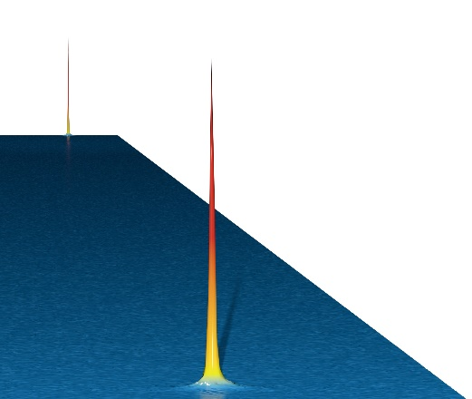
Long-Baseline Atom Interferometry: Science Motivation
Search for various types of wavelike dark matter
  Oscillating atomic transition frequencies
  Oscillating species-dependent accelerations
  Spin precession
Search for new fundamental interactions
  Fifth forces
Gravitational wave (GW) detection in mid-band frequency range
  Complementary to program of laser interferometer detectors
  Promising to detect GWs generated during the early Universe, probe of high energy physics
  Provide forewarning to electromagnetic telescopes in advance of merger
Fundamental tests of quantum mechanics at macroscopic scales
  Matter wave delocalizations >1 m for multiple seconds
  Test fundamental decoherence mechanisms, non-linear quantum mechanics, and their potential relation to gravity
Graham et al., PRD 93, 075029 (2016); Arvanitaki et al., PRD 97, 075020 (2018); Graham et al., PRD 97, 055006 (2018); Kaplan and Rajendran, Phys. Rev. D 105, 055002 (2022); Carney et al., arXiv:2502.17575 (2025)

Slide 26
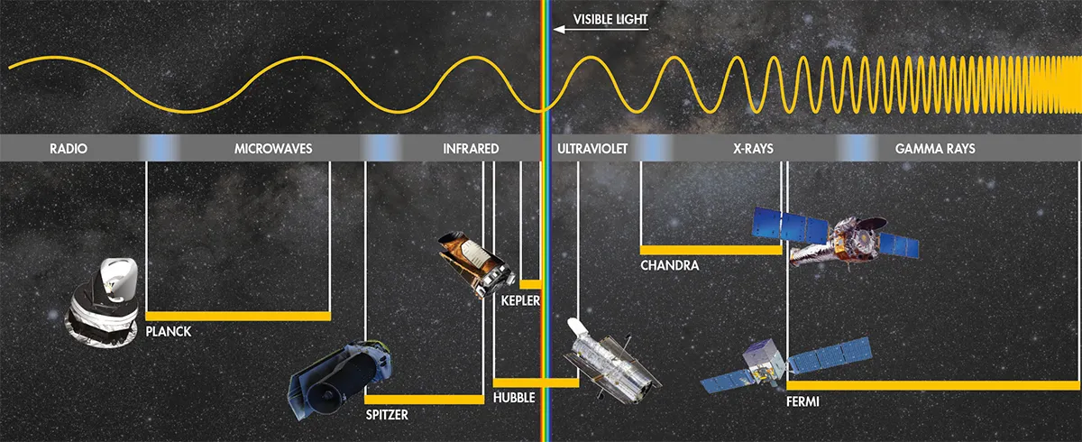
Mid-band Science
Mid-band discovery potential
-Historically, every new band/modality has led to discovery
-Observe LIGO sources earlier in their evolution
Cosmological signals that give insight into high energy physics
-Operating in mid-band instead of lower frequencies advantageous for avoiding white dwarf confusion noise
Promising for sky localization [Graham and Jung, Phys. Rev. D 97, 024052 (2018)]
-Predict when and where events will occur (before they reach LIGO band)
-Observe run-up to coalescence using electromagnetic telescopes
Astrophysical Sources
White dwarf binaries (Type IA supernovae), black hole binaries, intermediate mass black holes, and neutron star binaries
https://c02.purpledshub.com/uploads/sites/48/2020/09/Electromagnetic-spectrum-a0f874b.jpg
MAGIS Collaboration, Quantum Science and Technology 6, 044003 (2021)

Slide 27
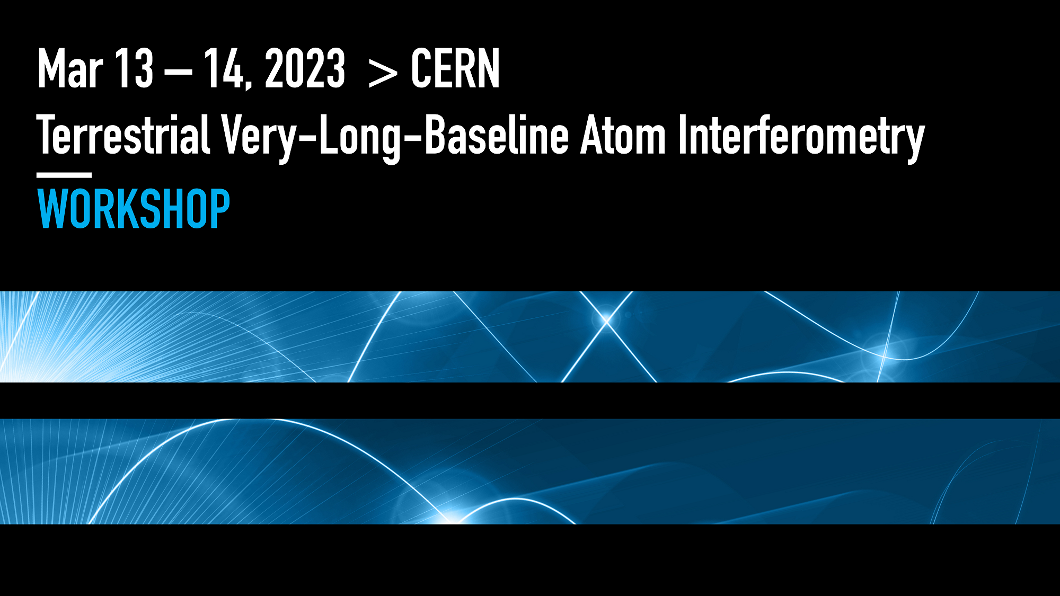
Global Efforts in Long-Baseline Atom Interferometry
- Growing global community in this area
- Example: CERN Very-Long-Baseline Terrestrial Atom Interferometry Workshop, March 13-14 (2023): ~200 registered participants. https://indico.cern.ch/event/1208783/
MAGIS-100 in US (Abe et al., QST 6, 044003 (2021))
AION in UK (Badurina et al., J. of Cosmology and Astrophysics 05 (2020) 011)
MIGA in France (Canuel et al., Scientific Reports 8, 14064 (2018))
ZAIGA in China (Zhan et al., International Journal of Modern Physics D 29, 1940005 (2020))
VLBAI in Germany (Hartwig et al., New Journal of Physics 17, 035011 (2015))
Naval Postgraduate School in US
Community studies of future km scale detectors
- Community is also studying prospects for future space-based detectors (Abou El-Neaj et al., EPJ Quantum Technology 7, 6 (2020)); synergies with related proposals using optical lattice clocks in space (Kolkowitz et al., PRD 94, 124043 (2016))
Workshop summary/roadmap: Abend et al., AVS Quantum Science 6, 024701 (2024)

Slide 28





Measurement Concept
Freely-falling atoms on each end serve as inertial references
Atomic
clock
Atoms act as clocks to measure light travel time across baseline:
“active proof mass”
Multiple pulses across baseline coherently enhance signal
Atomic
clock
Two ways for phase to vary:
Differential phase evolution:
Dark matter
Gravitational wave
Yu and Tinto, GRG 43, 1943 (2011); Graham et al., PRL 110, 171102 (2013); Arvanitaki et al., PRD 97, 075020 (2018); Norcia et al., PRA 96, 042118 (2017)

Slide 29
Strontium clock atom interferometry
Sr has a narrow optical clock transition at 698 nm with a long-lived excited state (natural lifetime >100 s)
Atom optics based on single-photon transitions on this 698 nm line
Can also use stronger 689 nm line, can drive transitions faster but shorter exited state lifetime
Different from conventional atom interferometers, which use multi-photon transitions between different ground states
Hu et al., PRL 119, 263601 (2017); Rudolph et al, PRL 124, 083604 (2020)

Slide 30
Self-Correcting Atom Interferometry
Want to reflect “atom waves” from many “atom mirrors” to amplify signal
Experimental tradeoffs and nonidealities lead to unavoidable errors in each atom mirror
-limits on laser power
-finite size of atom cloud
-finite temperature of atom cloud (Doppler shifts and cloud expansion)
Our approach: Make collective effect of many atom mirrors throughout the interferometer correct for the errors in individual atom mirrors
Wang et al., PRL 133, 243403 (2024)

Slide 31
Multiloop (or Resonant) Atom Interferometry
Ideal for measuring time-dependent signals, or static signals that can be made to appear as time-dependent in the reference frame of the atoms
Applications include:
  Multiple types of dark matter searches
  Gravitational wave detection
  Portable accelerometers and gyroscopes
  Dark energy searches
  Seismometry and geophysical studies
  Tests of gravity
  Etc…
Multiple interferometer loops (N loops) can amplify signal by a factor of 2N at the resonance frequency
Lock-in detection and dynamical decoupling applied to matter waves
Comes at the cost of decreased bandwidth
Some examples: Graham, et al., PRD 94, 104022 (2016); Arvanitaki et al., PRD 97, 075020 (2018); Graham et al., PRD 97, 055006 (2018); Coslovsky et al., Slow Light, Fast Light and OptoAtomic Prevision Metrology X (2017); Jaffe et al. PRL 121, 040402 (2018); Kim et al., arXiv:2201.11888 (2022); Chiow and Yu, PRD 97, 044403 (2018)

Slide 32
Multiloop (or Resonant) Atom Interferometry
With same hardware, can rapidly tune resonance frequency to search for signal of unknown frequency
  Advantage maintained over single-loop mode due to signal amplification
  Note also that many GW sources have frequencies that evolve in time
Can zoom in on a signal at a particular frequency
Can also apply broadband dynamical decoupling sequences (Zaheer et al., arXiv:2302.12956 (2023))
Implement with Sr-88 atom interferometer at Northwestern, using single-photon transitions on 689 nm line
Some examples: Graham, et al., PRD 94, 104022 (2016); Arvanitaki et al., PRD 97, 075020 (2018); Graham et al., PRD 97, 055006 (2018); Coslovsky et al., Slow Light, Fast Light and OptoAtomic Prevision Metrology X (2017); Jaffe et al. PRL 121, 040402 (2018); Kim et al., arXiv:2201.11888 (2022); Chiow and Yu, PRD 97, 044403 (2018)

Slide 33

Limits from Imperfect Atom Mirrors
Fundamental limit from excited state spontaneous emission decay
  Interferometer fringe visibility rapidly decays as we extend number of loops (which is equal to number of atom mirror reflections) past 10
  Why does this happen?
  What can we do about it?

Slide 34

The Ideal (Unrealistic) Case
Perfect atom mirrors
Position
Time

Slide 35

The Realistic Case
Imperfect atom mirrors
Atoms branch off into stray paths, which can interfere with each other (multipath interference)
Position
Time

Slide 36
Self-Correcting Atom Interferometry
Run simulation-based optimization algorithm to find atom mirror laser pulse phases to:
-maximize probability that stray paths constructively recombine into ideal paths
-suppress spreading of atom trajectories through destructive interference
Leverages multipath interference to achieve this
Position
Time

Slide 37
How well does this work in the lab?
Unoptimized
  As a test signal, add resonantly oscillating laser phase with amplitude δφ to pulse sequence
Self-Correcting

Slide 38
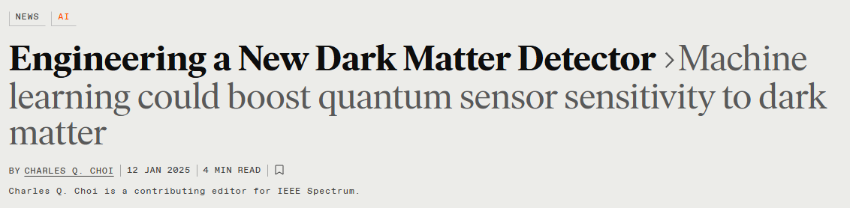
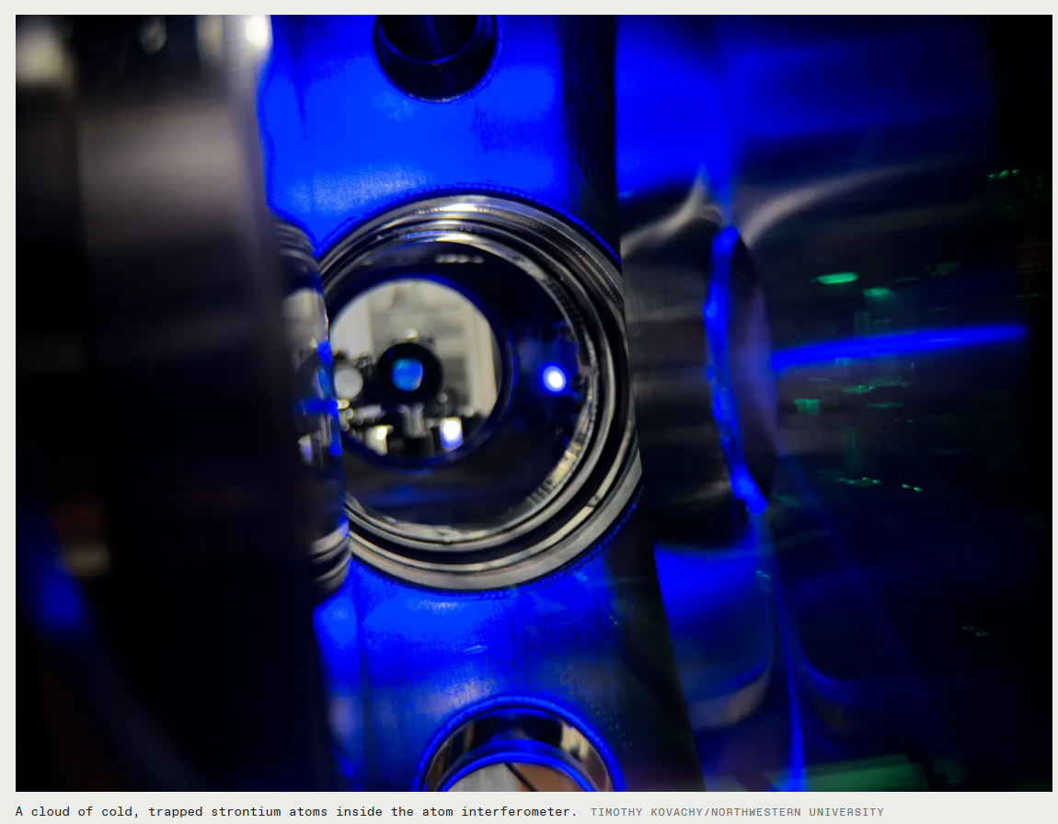
Improvement from Optimization: Data
Highlight in IEEE Spectrum Magazine, Jan. 2025
≈1000x
phase amplification at 504 loops
Ultracold strontium atoms
50x increase in loop number
  Visibility remains within order 1 factor of fundamental spontaneous emission limit on visibility up to ~500 loops
  Further improvements anticipated by using transition with less spontaneous emission
Wang et al., PRL 133, 243403 (2024)

Slide 39
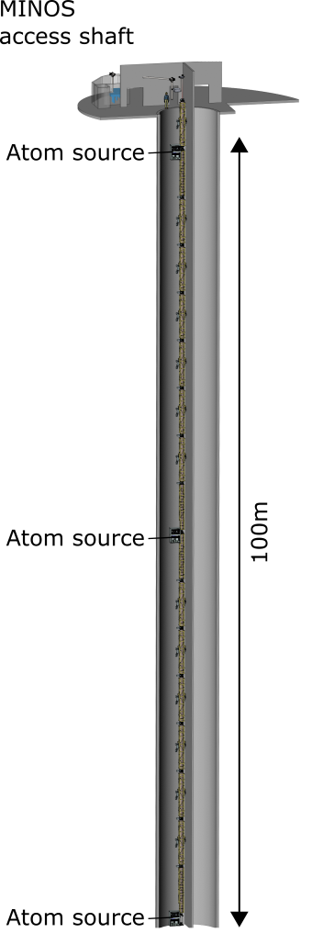












MAGIS-100 detector at Fermilab
Matter wave Atomic Gradiometer Interferometric Sensor
- 100-meter-tall atom interferometry apparatus
- Quantum mechanics at very large scales
- Search for dark matter
- Prototype for mid-band gravitational wave detection, pathfinder for future km-scale and space detectors
MAGIS Collaboration, Quantum Science and Technology 6, 044003 (2021)

Slide 40




MAGIS-100 Experiment
Modular vacuum section
Cold atom source
Magnetic shield
17 modules, each with magnetic shielding, vacuum pipe, current-carrying wires for generating bias magnetic field
Laser lab at top of shaft (currently undergoing construction)
Three Sr atom sources over 100 m baseline, local optical lattices can launch atoms from each source
High-power laser system with agile frequency control, spatially filtered beam mode, and precisely controlled pointing via tip-tilt mirrors
Construction and testing underway
Interferometry laser system
In-vacuum tip-tilt mirror
Laser lab
MAGIS Collaboration, QST 6, 044003 (2021); Glick,…, TK, AVS Quantum Science 6, 014402 (2024); DeRose,…, TK, Optics Letters 48, 3893 (2023)

Slide 41



Laser Beam Steering to Compensate Earth’s Rotation
-Coriolis forces caused by the rotation of the Earth induce large errors
-New approach required to compensate by counter-rotating atom optics laser beam against Earth while maintaining laser beam overlap with atoms
-Piezo-controlled tip-tilt mirrors at top and bottom of MAGIS-100
-Essential to account for atom trajectory deflections under Coriolis forces
Glick,…, TK, AVS Quantum Science 6, 014402 (2024)

Slide 42
MAGIS-100 Interferometry Laser System
  Challenges:
    Combination of high power, high phase stability, rapid and broad tunability, and high-quality spatial mode
    Need to precisely control quantum states of the atoms
    Required development of several new techniques
    Have now demonstrated required performance in the lab
Conceptual schematic
DeRose,…, TK, Optics Letters 48, 3893 (2023)

Slide 43
Newtonian Gravity Gradient Noise (GGN)
-Important at lower frequencies (<1 Hz) for terrestrial detectors: seismic waves disturb local mass distribution, cause oscillating gravity gradient that is a noise background (also atmospheric GGN)
-Potential mitigation strategy: array of atom interferometers along baseline to distinguish between nonlinear dependence of GGN signal on position and a linear dependence from GW or DM signal
-Interesting opportunity to study geophysics
Chaibi et al., PRD 93, 021101(R) (2016); Mitchell, TK, et al., JINST 17, P01007 (2022); Badurina et al., PRD 107, 055002 (2023); Carlton, Gibson, TK, et al., PRD 111, 082003 (2025)

Slide 44
Surprising Systematic Effect from Spontaneous Emission
  -Interplay between spontaneous emission and many-pulse sequences
  -Atoms can spontaneously decay to ground state midway through a mirror pulse
  -Remainder of mirror pulse can once again put the atom in superposition
  -Can there be a nonzero average interference pattern generated by atoms that underwent spontaneous emission at different points in time?
  -Yes, for some pulse sequences these atoms build up with a certain average “cumulative phase”, generating interference fringe with high visibility but insensitive to desired signal
  -Have found that we can mitigate this effect by imposing certain constraints on optimization parameter space
Rabi oscillations
Spontaneous emission decay
Time
Wang,…,TK, PRL 133, 243403 (2024)

Slide 45
Outlook
Cryogenic cavity comparisons and long-baseline atom interferometers: dark matter and gravitational wave detectors over complementary frequency ranges
Long-baseline atom interferometry being pursued by a growing global community
Techniques developed for next-generation atom interferometers have many applications, for example:
  Measurements of fundamental constants
  Tests of gravity
  Inertial sensing
  Geophysics
  Probing the interface between gravity and quantum mechanics

Slide 46








Acknowledgements
Kovachy Group
Tejas Deshpande (postdoc)
Natasha Sachdeva (postdoc)
Zilin Chen (postdoc)
Ken DeRose (PhD student)
Jonah Glick (PhD student)
Yiping Wang (PhD student)
Kefeng Jiang (PhD student)
Sharika Saraf (PhD student)
Nicholas Miller (PhD student)
Anya Abraham (PhD student)
Hardeep Singh (PhD student)
Jay Jachinowski (undergrad)
Garrett Louie (undergrad)
Cryogenic Cavity Collaborators
Gerald Gabrielse
Andrew Geraci
Andra Ionescu (PhD student)
Zhiyuan Wang (PhD student)
MAGIS Collaborators
Jason Hogan (Spokesperson) (Stanford)
Mark Kasevich (Stanford)
Peter Graham (Stanford)
Rob Plunkett (FNAL)
James Kowalkowski (FNAL)
Jan Rudolph (Stanford and FNAL)
Sergei Nagaitsev (Old Dominion and JLab)
Surjeet Rajendran (Johns Hopkins)
Jonathon Coleman (Liverpool)
Daniela Bortoletto (Oxford)
Chris Foot (Oxford)
John March-Russell (Oxford)
Ian Shipsey (Oxford)
Jeremiah Mitchell (Cambridge)
Ulrich Schneider (Cambridge)
Ariel Schwartzman (SLAC)
Michael Kagan (SLAC)
Chris Overstreet (Johns Hopkins)

