Slide 1
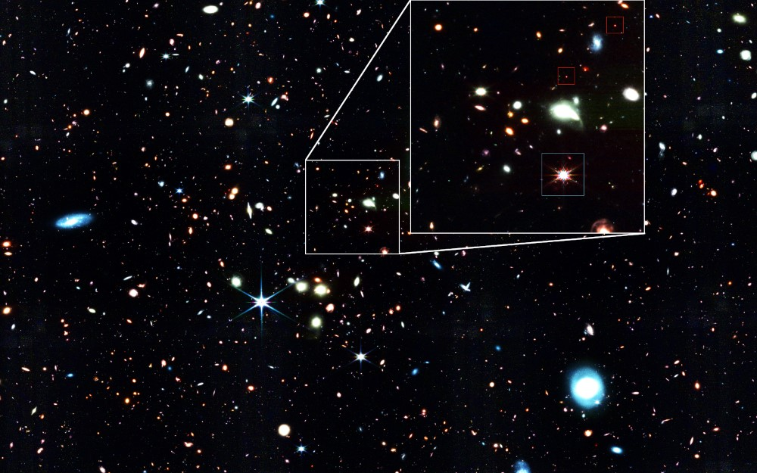






Minihalos and Miniquasars
Finn Karstens and Aster Schnell
In collaboration with: Dr. Laura Sagunski, Lauren Morley, and Dr. Sean Tulin
Image Credit: NASA, ESA, CSA, J. Matthee (ISTA), R. Mackenzie (ETH Zurich), D. Kashino (National Observatory of Japan), S. Lilly (ETH Zurich)
Notes:
@Finn

Slide 2
Outline
1
Project Overview
2
Background
3
Recap
4
Our Code
5
Grackle and Cloudy
6
Preliminary Results

Slide 3




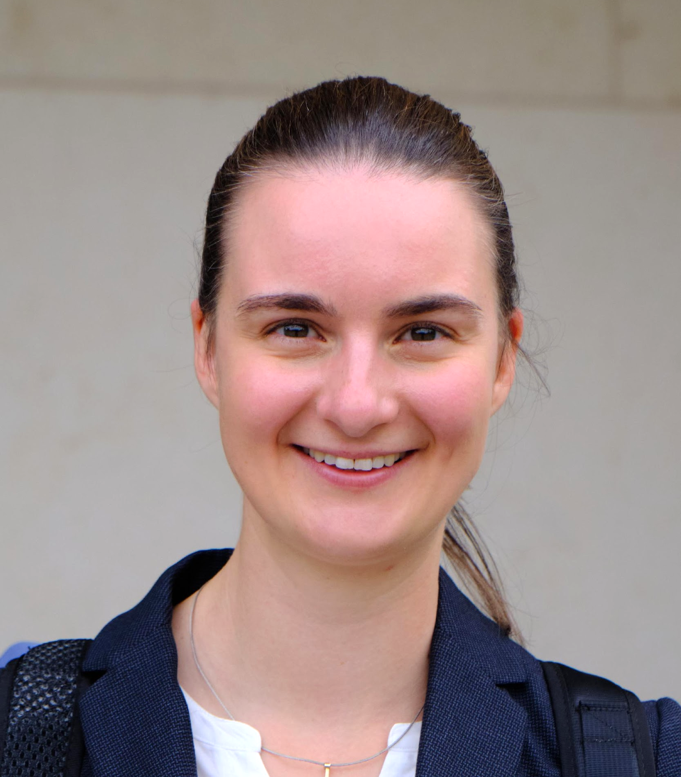







The Minihalos Team
Students
Mentors
And a thanks to our sponsors!
Finn Karstens
Aster Schnell
Dr. Laura Sagunski
Dr. Sean Tulin
International
Laboratory
Visits Program
Lauren Morley

Slide 4
Project Overview
Notes:
@Finn

Slide 5
The Idea
Project
What do time evolution simulations of dark matter minihalos using alternative models of dark matter predict?
How does this compare to observation?

Slide 6



Our Work
Project
Modeling Alternative Dark Matter Physics
Modeling Gas Collapse Physics
Modeling Gas Heating and Cooling
Running Simulations
SPHerical
Our Code
Grackle and Cloudy
Our Code
Code by R. Blaff models alternative dark matter
Code expanded to model gas and dark matter simultaneously
Code expanded by L. Morley to include gas physics related to infalling gas
Code expanded by us to include more robust gas dynamics
Simulations run and compared to observation

Slide 7
Background
Notes:
@Aster

Slide 8
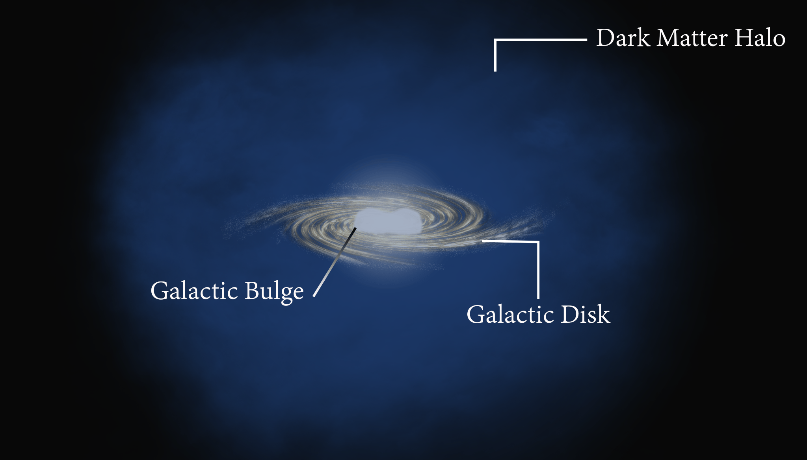
What is dark matter?
Dark matter (DM) is the dominant form of matter in the Universe. It is:
invisible
of unknown nature
There is a lot of indirect observational evidence for dark matter.
Dark matter is highly structured and found in halos surrounding galaxies.
Background
Image credit: L. Jaramillo & O. Macias/Virginia Tech
Notes:
First, what is dark matter?
I won't go into detail since most of you are familiar with dark matter by now but essentially dark matter is a form of matter that is poorly understood
It is the dominant form of matter in the Universe
It does not interact electromagnetically, making it invisible to our eyes
There is a lot of indirect observational evidence for dark matter, many of which have been discussed in other presentations
Essentially, there are a lot of ways we can infer there is more matter than what is visible
We can also infer the rough distribution of dark matter in the Universe and we find it has a web-like structure
We also find that the areas with the most dark matter are the spots galaxies form
These are referred to as dark matter halos and they cover a much larger area than the visible matter of the galaxy which is located in the centre

Slide 9
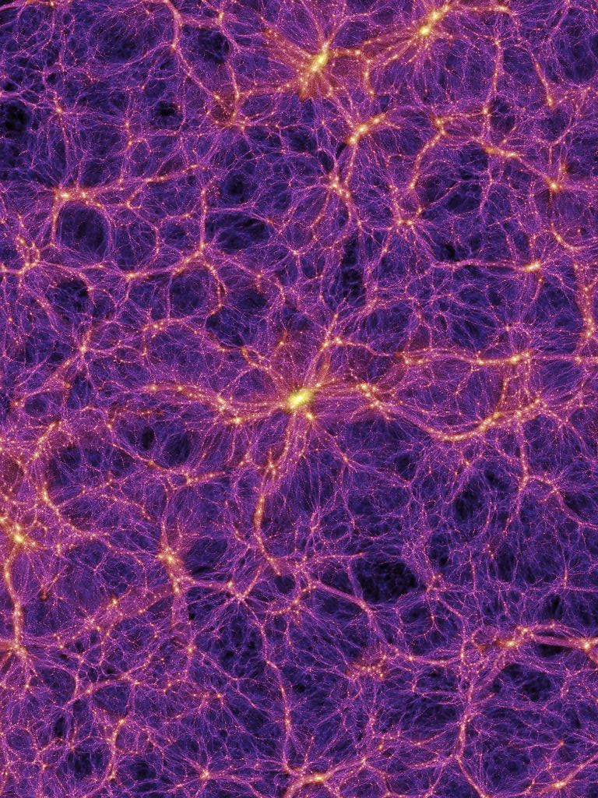
What is the nature of dark matter?
Background
We don't know!
The simplest, Cold Dark Matter (CDM), is accurate at large scales but problematic on small scales, thus alternative models have been suggested.
This project focuses on dark matter with dissipative and self-interactions (dSIDM) and explores its potential.
Image Credit: Volker Springel/Max Planck Institute for Astrophysics/Science Photo Library
Notes:
As mentioned previously, we know very little about the nature of dark matter but many potential models have been suggested
The most popular model is Cold Dark Matter, where dark matter is relatively static and mostly interacts gravitationally
Cold Dark Matter makes very accurate large scale predictions but is inconsistent with observation on small scales
Many different models have been proposed and the ones relevant to this project are those with dissipation and self-interactions
Dissipation allows the dark matter to release energy and self-interactions are analogous to Strong interactions in standard matter

Slide 10
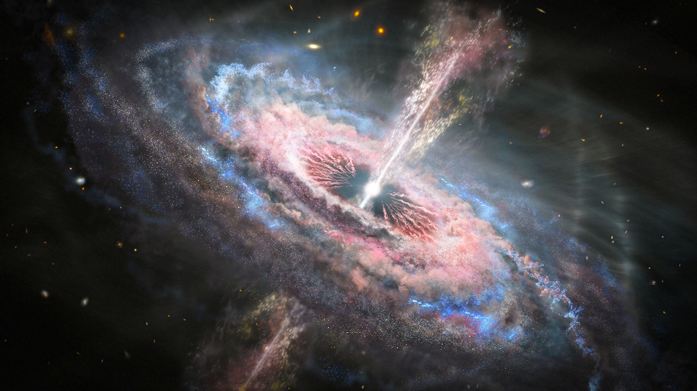
What is a quasar?
Background
Quasars are extremely bright objects found in the early universe. They:
form on supermassive black holes with accreting gas
radiate huge amounts of light from the infalling gas, i.e. radiative feedback
where do supermassive black holes come from?
Image credit: NASA, ESA and J. Olmsted (STScI)
Notes:
Now, what is a quasar?
A quasar is a really bright object that we see primarily in the early Universe
It is essentially a supermassive black hole with a lot of surrounding gas being pulls in
Because it is accreating so quickly, it radiates massive amounts of energy in the form of light
Supermassive black holes are a bit of a mystery at the moment because it's difficult to explain how they can form within our typical model of the Universe

Slide 11
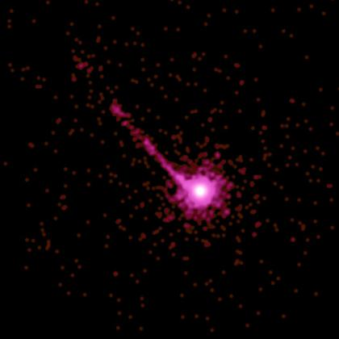
What are minihalos and miniquasars?
Background
Minihalos are small (10⁵-10⁶ M☉) dark matter halos that are the birthplace for the first stars. Can minihalos collapse to form the first black holes that grow to be supermassive? How does this work?
Miniquasars are small quasar-like objects that are theorized to form on these first black holes. Can miniquasars be observed by the James Webb Space Telescope?
Image credit: NASA, CXC, A. Siemiginowska (CfA) , J. Bechtold (U. Arizona)
Notes:
This project focuses specifically on minihalos and miniquasars, can you guess what those are?
Minihalos are essentially small halos and are thought to be the birthplace of the first stars
Miniquasars are small quasars that are theorized to exist but have not yet been observed
They would be found on the first black holes

Slide 12
Recap
Notes:
@Finn

Slide 13
Goals
Project
Can we explain the existence of supermassive black holes by dark matter?
How will the evolution of the first black holes be affected by different dark matter physics?
Research Steps
Model dynamics of gas and dark matter in the early Universe
Implement cooling and heating rates of the gas
Connect with observations
Notes:
Say in words what the parameters are (Crossection elastic + inelastic) + Halo parameters (inital density profile of halo)
SMBH are the most massive black holes (In the center of our Milky Way and Most Galaxys we think there are SMBH)

Slide 14
Our Code
Notes:
@Aster

Slide 15
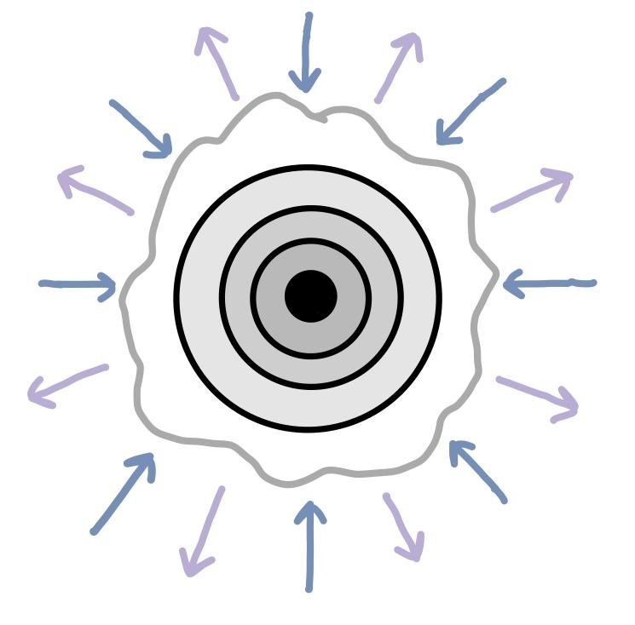
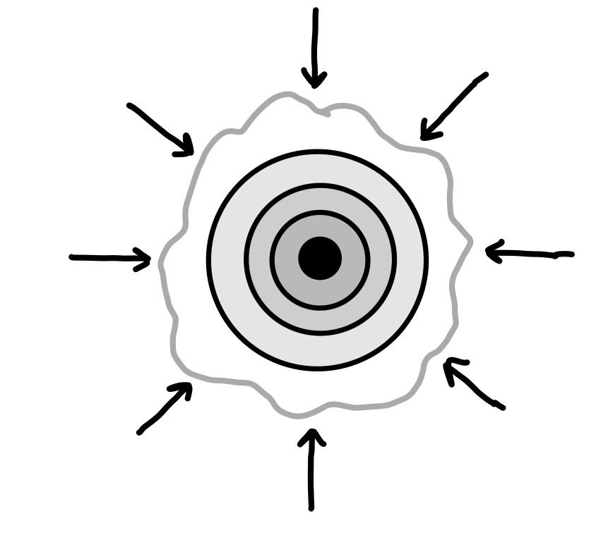
Our Code
Our Code
Grackle
+
SPHerical
Cloudy
Self interacting dark matter physics
Gas and radiation physics
Blue = Infalling Gas
Black = Gravitational collapse and dissipation
Purple = Radiative Photons
Gas
DM
Image Credit: L. Morley (2024)
Notes:
Let's talk about our code
This is essentially the setup of our project
A Python package named SPHerical is the base of the code and this allows us to model the self interacting dark matter physics
We then plan to integrate more accurate gas and radiation physics into our code, using two programs: Grackle and Cloudy

Slide 16
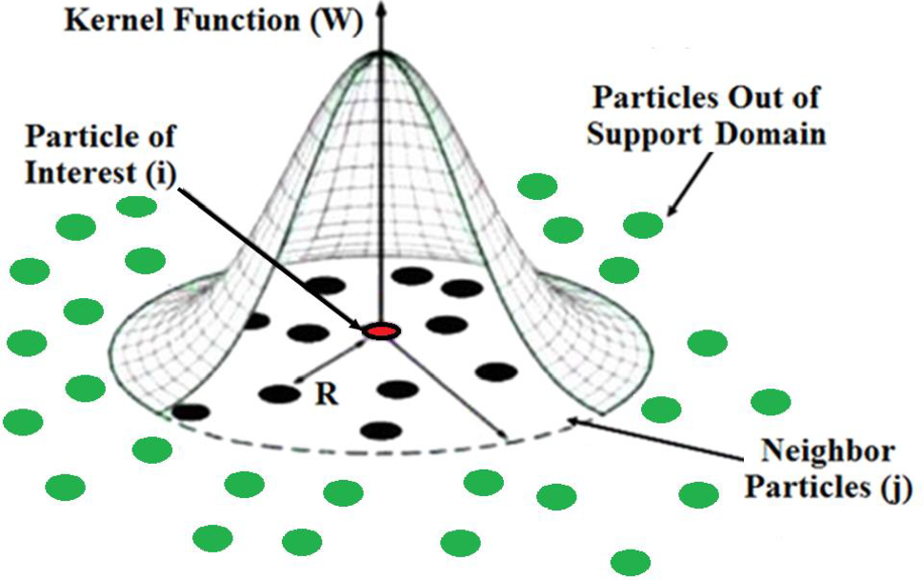
SPHerical
Our Code
Aside: SPH solves hydrodynamics by treating as a sum of fluid "particles" like this—much more computationally efficient than N-body simulations!
A Python package for simulating alternative models of dark matter:
Reuben David Blaff, M.Sc, York University, 2021: http://hdl.handle.net/10315/39132
Expanded to allow the simulation of multiple superimposed fluids, i.e. gas and dark matter
Uses Smoothed Particle Hydrodynamics (SPH) to simulate both fluids over time, which interact gravothermally with each other
Notes:
Let's talk about the base of the code, SPHerical
This is a Python package written by Reuben David Blaff here at York
SPHerical uses a smoothed particle hydrodynamics approach, also known as SPH
This approach is in contrast to an N-body simulation, where individual particles are mapped out
Here, we have fluid "particles" described as a continuous medium
This is much more computationally efficient than an N-body simulation
The package as described in the linked thesis simulates only dark matter physics but we've expanded it to be able to handle the gas portion as well

Slide 17

SPHerical
Our Code
Gas
DM
Initializes two spherical systems of concentric shells, one for gas and one for dark matter, each with its own attributes, such as:
  radius
  velocity
  mass
  specific internal energy
While the dark matter model can be varied, gas will use typical gas physics
Gas + DM
Notes:
The way it works is we initialize two sets of shells, one for gas and one for dark matter, with each shell have specific attributes like a radius, velocity, mass, and internal energy
The shells are superimposed and interact gravitationally with each other
The dark matter physics will take different parameters and can be adjusted as you want, while the gas used standard gas physics

Slide 18
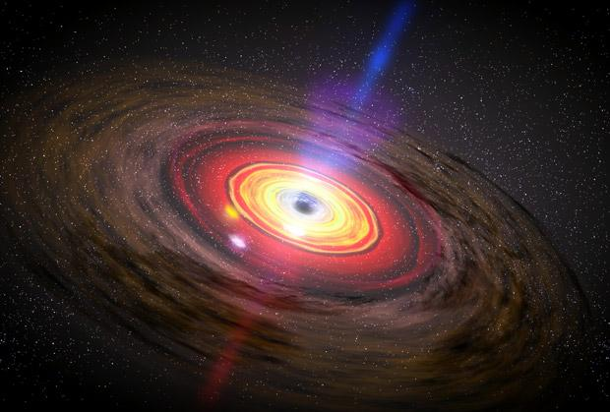
Radiative Feedback
Our Code
Radiative feedback is the process by which infalling gas releases energy, affecting surrounding gas
Recent additions to SPHerical code by Lauren Morley include radiation pressure (outward velocity) and luminosity caused by shell collapse
Luminosity adds heating to the gas—enter Grackle and Cloudy
Image Credit: NASA, Dana Berry, SkyWorks Digital
Notes:
Our current work has been primarily about integrating radiative feedback in the code
Radiative feedback, for those who don't remember, is what occurs when you have infalling gas releasing energy
Much of the radiative feedback code is done, with Ren having added radiation pressure which will give an outward push, and luminosity, for every gas shell that collapses
Luminosity, of course, has a heating effect which is primarily what Finn and I have been working on with Grackle and Cloudy

Slide 19
Grackle and Cloudy
Notes:
@Finn

Slide 20
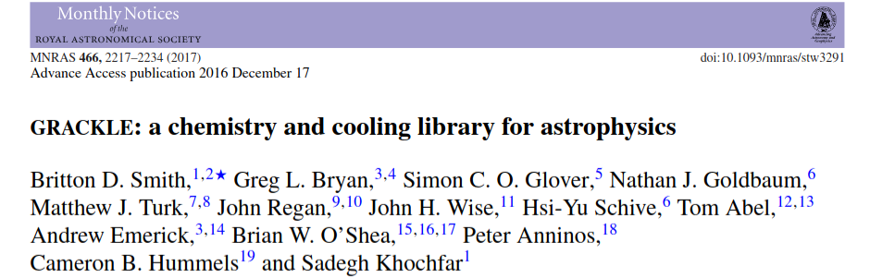
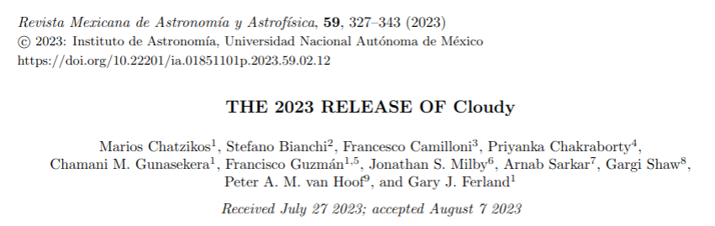
Grackle
Grackle and Cloudy
see: https://grackle.readthedocs.io/
"a chemistry and radiative cooling library for astrophysical simulations and models"
Cloudy
see: http://nublado.org/
"a spectral synthesis code designed to simulate conditions in interstellar matter under a broad range of conditions"

Slide 21
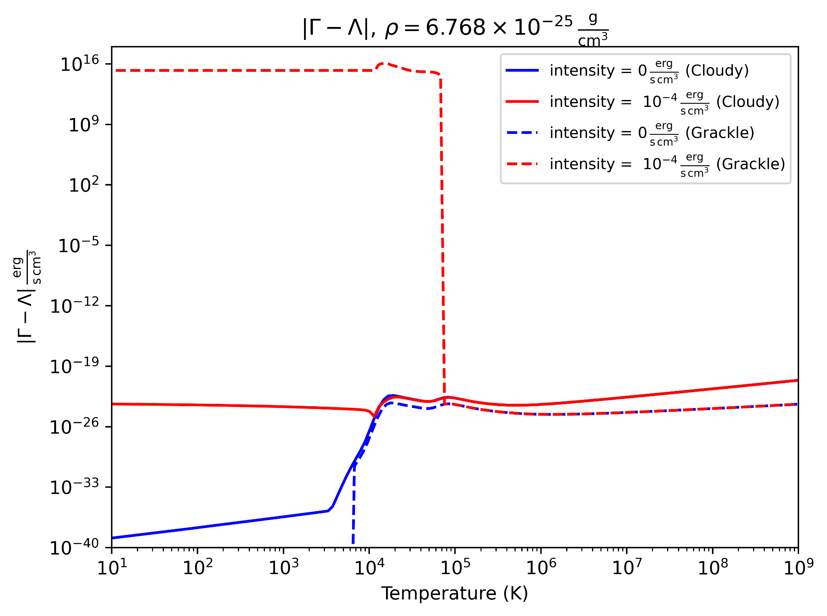
Heating and Cooling Rates
Grackle and Cloudy
Cooling rates can be determined using Grackle and Cloudy, but each program makes different assumptions:
  Cloudy:
    assumes coronal equilibrium
    calculates heating and cooling together
  Grackle:
    calculates heating and cooling separately

Slide 22
Preliminary Results
Notes:
@Finn

Slide 23
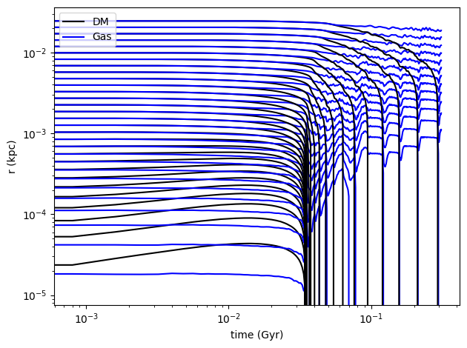
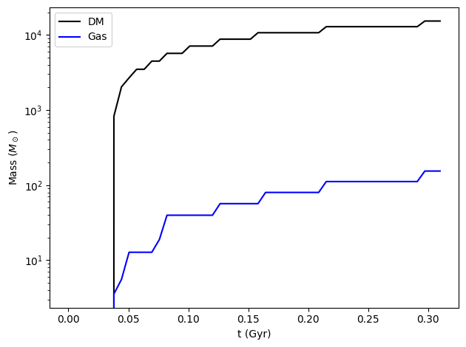
Simulation Results
Results

Slide 24
Conclusion
Notes:
@Aster

Slide 25
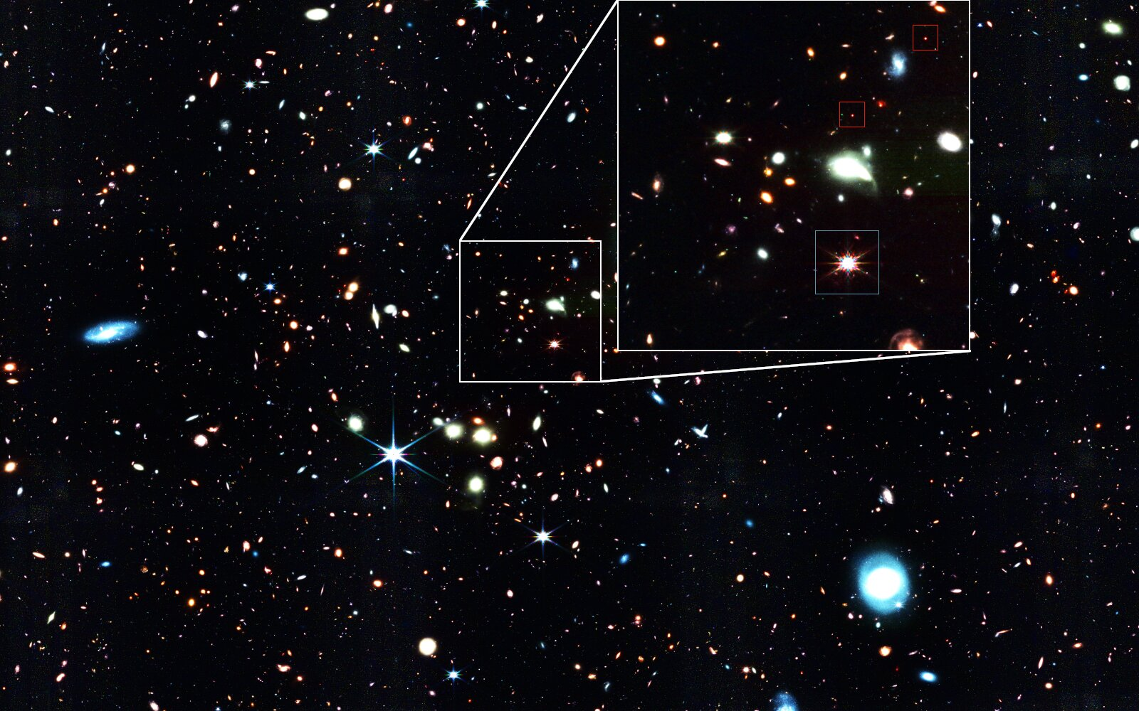
Next Steps
Conclusion
To fully implement Grackle and Cloudy heating and cooling rates
To vary dark matter model parameters and simulate minihalos from the early Universe
To compare to observation!
Remember our title slide? These "little red dots" from the James Webb Space Telescope could be an example of miniquasars!
Image Credit: NASA, ESA, CSA, J. Matthee (ISTA), R. Mackenzie (ETH Zurich), D. Kashino (National Observatory of Japan), S. Lilly (ETH Zurich)
Notes:
This project is very much a work in progress but we are hoping to finalize the integration of Grackle and Cloudy in our code soon
After that, we're interested in running simulations with different dark matter parameters and seeing what we get and how it compares to observation

Slide 26
Thank you!
Any questions?
Notes:
And that's it! Any questions?

