Slide 1


CERES metal-poor accreted candidate stars novel approaches to Galactic archaeology
EXPLORE 2025 Summer School and Conference 2025 Toronto
Dominik Plonka
Supervised by Prof. Dr. Camilla J. Hansen
Notes:
Hi,my name is Dominik Plonka, and I’m currently completing my master’s thesis in observational astrophysics at Goethe University Frankfurt, supervised by Prof. Camilla Hansen.
Today, I’d like to give you an overview of my ongoing research, which focuses on the dynamical and chemical properties of metal-poor stars that likely originated outside the Milky Way.

Slide 2
CERES - Chemical Evolution of R-process Elements in Stars
Main collaborators:
C. J. Hansen (Goethe University Frankfurt, Germany)
A. Koch-Hansen (ARI – Heidelberg, Germany)
A. Schichtel (Goethe University Frankfurt, Germany)
L. Lombardo (University of Trieste, Italy)
Paper:
CERES I: Lombardo et al., 2022
CERES II: Fernandes de Melo et al., 2024
CERES III: Lombardo et al., 2025
CERES IV: Alencastro Puls et al., 2025
CERES V: Plonka et al. (in prep)
Notes:
This is part of the CERES project — the Chemical Evolution of R-process Elements in Stars — and this project contributes to our broader understanding of the Galaxy’s formation and accretion history.
and in particular, of course, for the elements produced by the r process.

Slide 3
Thick stellar disk
Bar/Bulge
Dust
Location of most in-situ
star formation
Thin stellar disk
LMC
SMC
Stellar halo
Mostly stars with
extra-galactic origin
Dark matter halo
Notes:
Let‘s begin with a brief look at the different galactic components of the Milky Way.
Our Galaxy consists of a central bar and bulge, sorrounded by a thin and thick stellar disk,
In terms of star formation, most in-situ stars – meaining stars that formed within the Milky Way – originiate in the disk regions.
The disk is embbedded in a stellar and dark matter halo.
But some stars, especially in the halo, show signatures suggesting an extra-galactic origin – they were likely accerted by past merger events.

Slide 4
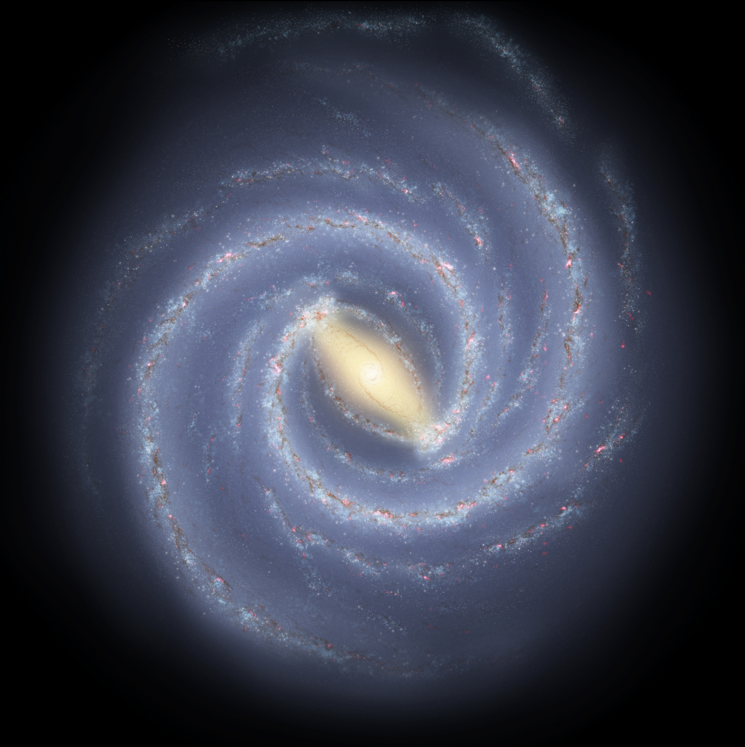
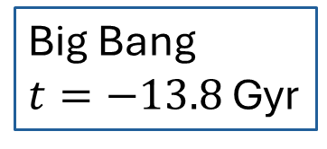
Brief History of the Milky Way
pre Gaia
Ongoing mergers:
Sagittarius
(Ibata+1994)
Big Bang
$t=−13.8$ Gyr
disk formation
???
Merger debris in solar neighborhood identified in Hipparcos data
(e.g. Helmi Stream; Helmi+1999)
LMC, SMC known satellites but infall and orbital history unclear
Notes:
To understand this better, we need to look at the formation history of the Milky Way.
Before Gaia, the dominant view was the so-called monolithic collapse model
According to this idea, the Milky Way formed rapidly through the collapse of a single, massive gas cloud. This would lead to a smooth gradient in stellar populations—older stars in the halo, younger stars in the disk.
However, even before Gaia, observations had started to challenge this picture. The discovery of stellar streams, such as the Sagittarius and Helmi stream, hinted at a more complex history.
It became clear that the Milky Way had grown not only through internal evolution, but also through accretion and mergers of smaller satellite galaxies—an idea that aligns with hierarchical structure formation in ΛCDM cosmology.

Slide 5
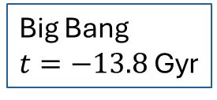
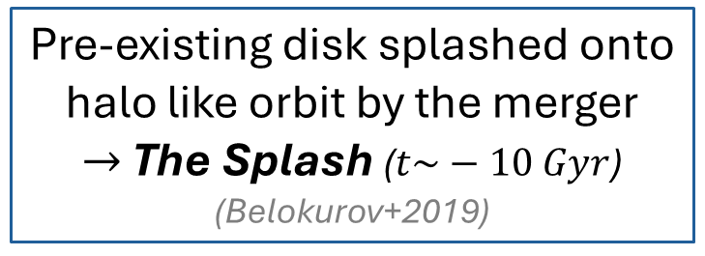
Brief History of the Milky Way
Gaia era
Formation of today‘s thick disk was caused by SN Type II
Big Bang
$t=−13.8$ Gyr
disk formation
thin disk formation
Ongoing mergers:
Sagittarius, LMC, SMC
(Ibata+1994, Cautun+2019)
Gaia Enceladus:
The last major merger
(Belokurov+2018, Helmi+2018)
Pre-existing disk splashed onto halo like orbit by the merger
$→$ The Splash ($t\sim −10 Gyr$)
(Belokurov+2019)
Notes:
Since Gaia, the picture has changed
Gaia provides us precise astrometric measurement, like positions, proper motions, distances and radial velocities. This gave us access to full 6D phase-space information for millions of stars in the Milky Way.
This was a game-changer for studies of Galactic structure and evolution.
One of the most significant results from Gaia DR2 was the discovery of Gaia-Enceladus—the remnant of a massive galaxy that merged with the Milky Way about 8–10 billion years ago.
This discovery confirmed that the stellar halo is - to a large extent - shaped by accretion events, rather than being formed solely in-situ.

Slide 6
Brief History of the Milky Way
Gaia era
Other mergers: Sequoia, Thamnos, LMS-1/Wukong, …
(Myeong+2019, Koppelman+2019, Yuan+2020, Naidu+2020, …)
Gaia Enceladus:
The last major merger
(Belokurov+2018, Helmi+2018)
Big Bang
$t=−13.8$ Gyr
disk formation
thin disk formation
Ongoing mergers:
Sagittarius, LMC, SMC
(Ibata+1994, Cautun+2019)
Early major merger?
Kraken, Heracles
(Kruissjen+2020, Horta+2021)
Helmi Stream:
~7-9 Gyr ago
(Helmi+1999,
Koppelman+2019,
Ruiz-Lara+2022)
Notes:
In addition to Gaia-Enceladus, several other accreted systems have been discovered in recent years— These include Sequoia, Thamnos, and LMS-1, also known as Wukong.
They were less massive than Gaia-Enceladus, they still contributed strongly to the formation of the stellar halo.

Slide 7
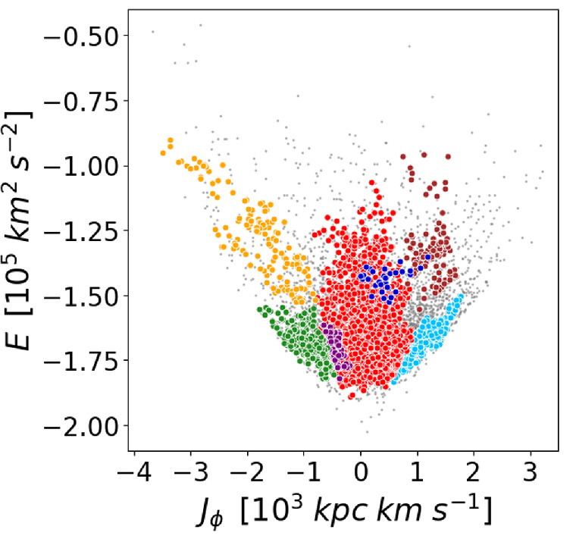


How do we find merger debris?
Integrals of Motion (IoM)
E, L_{z} are conserved quantities
along an orbit when the potential
is axisymmetric (for L_{z}) and static
(for E)
Phase-mixing erases spatial
coherence, not dynamical coherence
Stars from a common progenitor share similar IoM
Basis for substructure detection
algorithms
(Zhang+2024)
Energy [${10}^{5}$ km² s⁻²]
Angular momentum [${10}^{3}$ kpc kms⁻¹]
Gaia-Enceladus
Thamnos
Pontus
Disk
LMS-1/Wukong
Sequoia
Helmi Stream
Notes:
The big question is: How do we identify the remnants of past mergers?
One of the most powerful tools is the use of Integrals of motion.
When we assume that the Galactic potential is axisymmetric and static, the total orbital energy E and the angular momentum Lz are conserved over time, even billions of years after accretion.
This is very useful because phase mixing over time will smear out any spatial coherence of an accreted system.

Slide 8
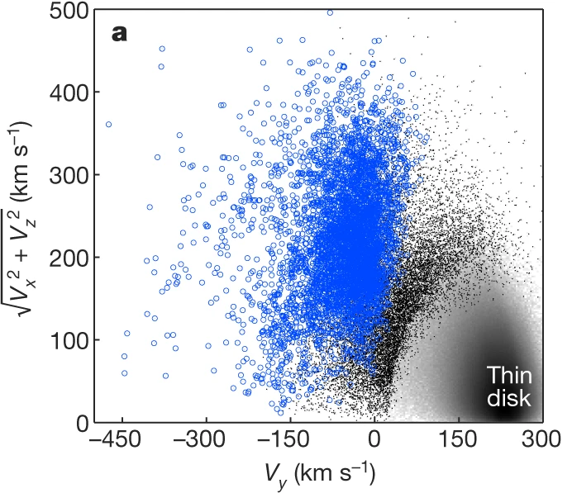
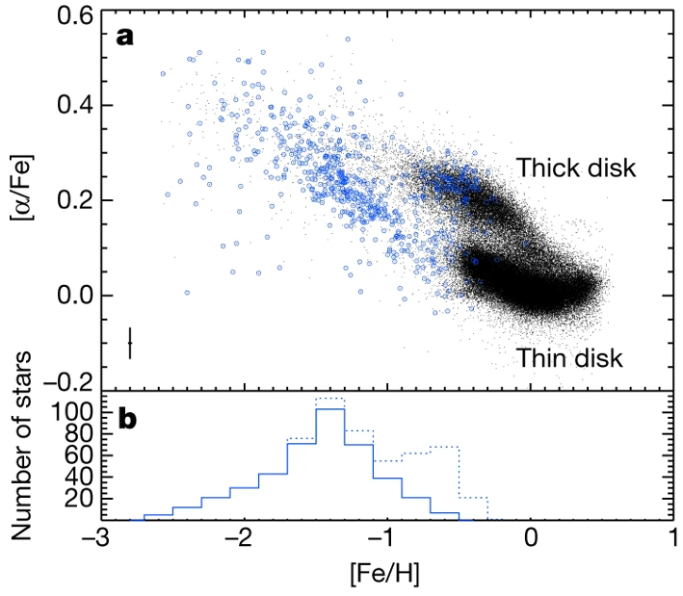
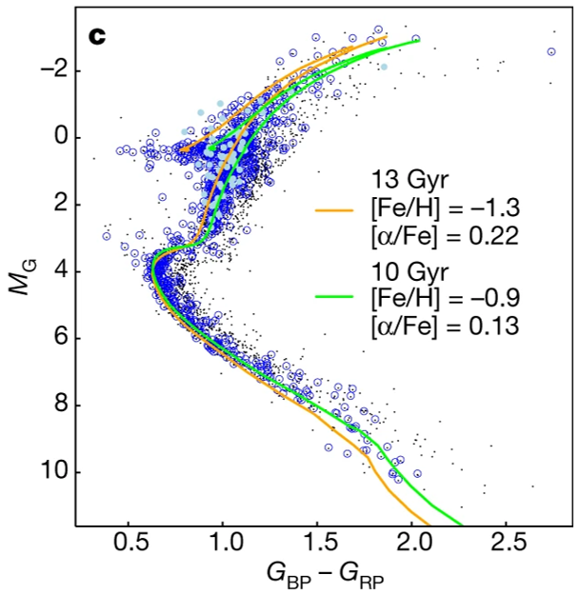
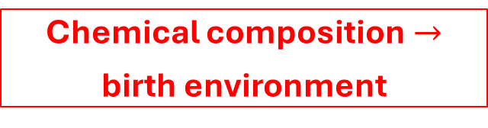
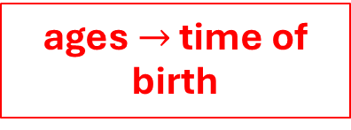

How do we characterize merger debris?
Tools of Galactic archaeology
motions $→$ reveal site of origin
Chemical composition $→$
birth environment
ages $→$ time of birth
Stellar populations
& Ages
Dynamics
Chemistry
Where?
How?
When?
Helmi+2018
Notes:
To characterize a merger candidate, dynamics alone isn‘t enough.
We have to use different tools from Galactic archaelogy: like chemical abundances, stellar populations, and age estimations, which especially give us the infall time in the Milky Way.
Through these tools we know where, how and when these stars are formed before merging with the Milky Way.
CLICK! CLICK! CLICK!

Slide 9

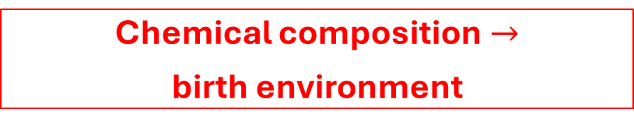
How do we characterize merger debris?
Tools of Galactic archaeology
motions $→$ reveal site of origin
Chemical composition $→$
birth environment
Dynamics
Chemistry
Helmi+2018
Helmi+2018
Notes:
In my project, I focus on dynamics and chemical abundances of the CERES sample.

Slide 10
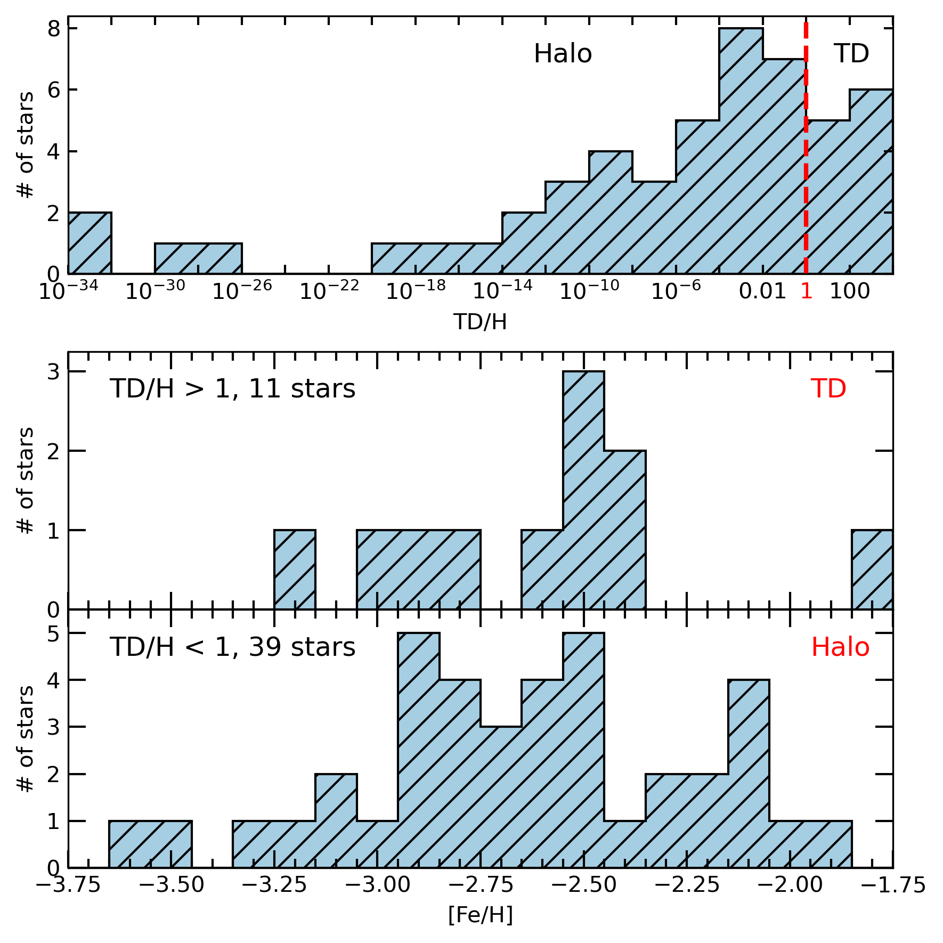
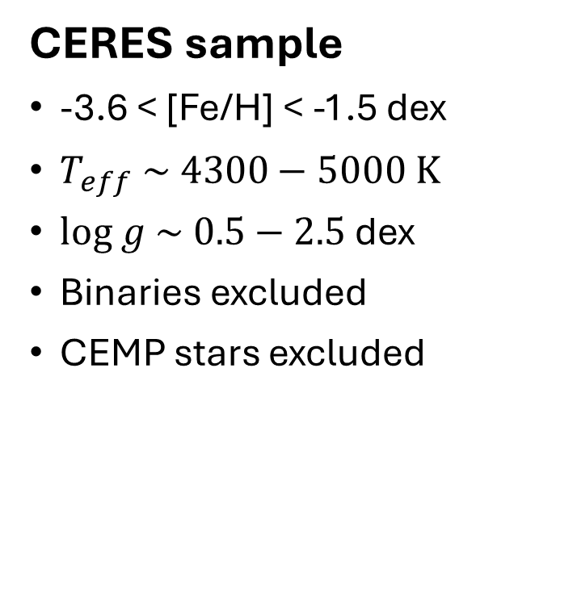

Target selection
CERES sample
-3.6 < [Fe/H] < -1.5 dex
$T_{eff} \sim 4300−5000$ K
$log g \sim 0.5−2.5$ dex
Binaries excluded
CEMP stars excluded
Plonka et al. (in prep)
Thick disk
Spectroscopic Data:
High-resolution spectra from VLT/UVES
$R≥40 000$ (up to $\sim 80 000$)
Wavelength: 303-684 nm; S/N~100-200
Notes:
Let me now explan how the stars in the CERES sample where selected:
We focus on bright red giants with low metallicites – in the range of -3.6 to -1.5 dex.
This metallicity range is where we expect to find r-process enhanced stars, as well as accreted stars. They were likely formed in environments with inefficient or delayed star formation, such as dwarf galaxies.
In total, we selected 52 stars for this study. All were observed with the VLT and the UVES instrument, which gave us high-resolution spectra.
These stars are very good tracers of the early chemical and dynamical history of the Milky Way.
On the right, you can see an visual overview of our sample:

Slide 11
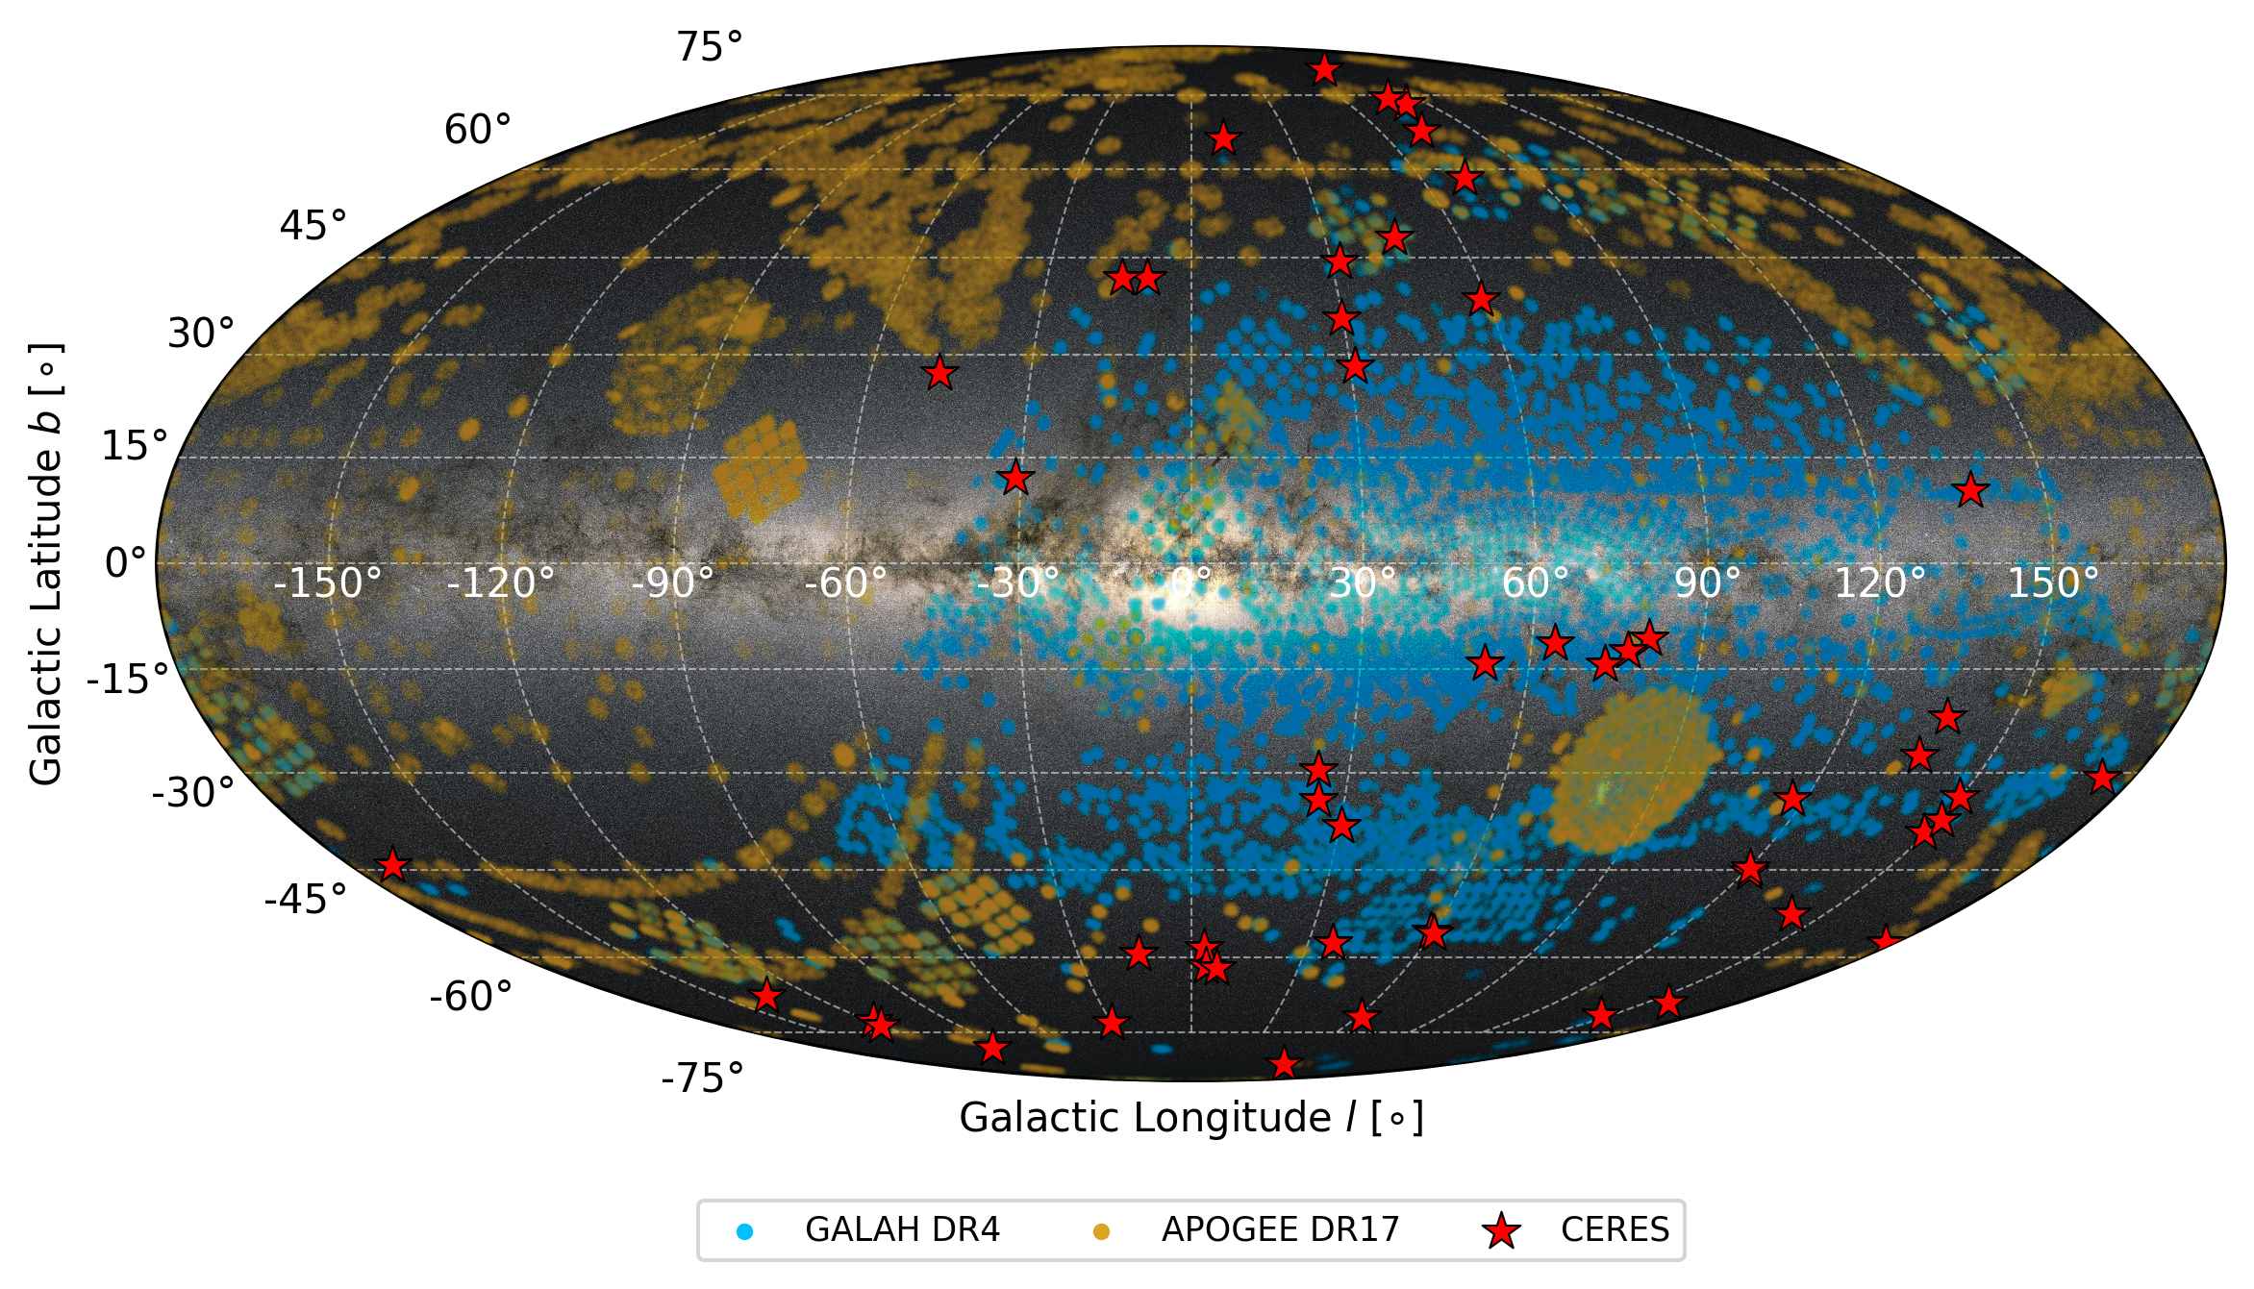
Plonka et al. (in prep)
Notes:
As you can see here, the red stars mark the positions of our CERES sample in galactic coordinates.
Also plotted are two large spectroscopic surveys that we used: GALAH in blue and APOGEE in orange.
The CERES stars were selected independently of these surveys and are distributed across the entire sky.
This broad spatial coverage is crucial as it allows us to detect halo stars with a wide range of orbital properties, especially at high galactic latitudes.
You see here that APOGEE (orange) has lower coverage in the southern sky.
In contrast, GALAH is limited to the southern sky.
→ We need them both to compare with our sample.

Slide 12
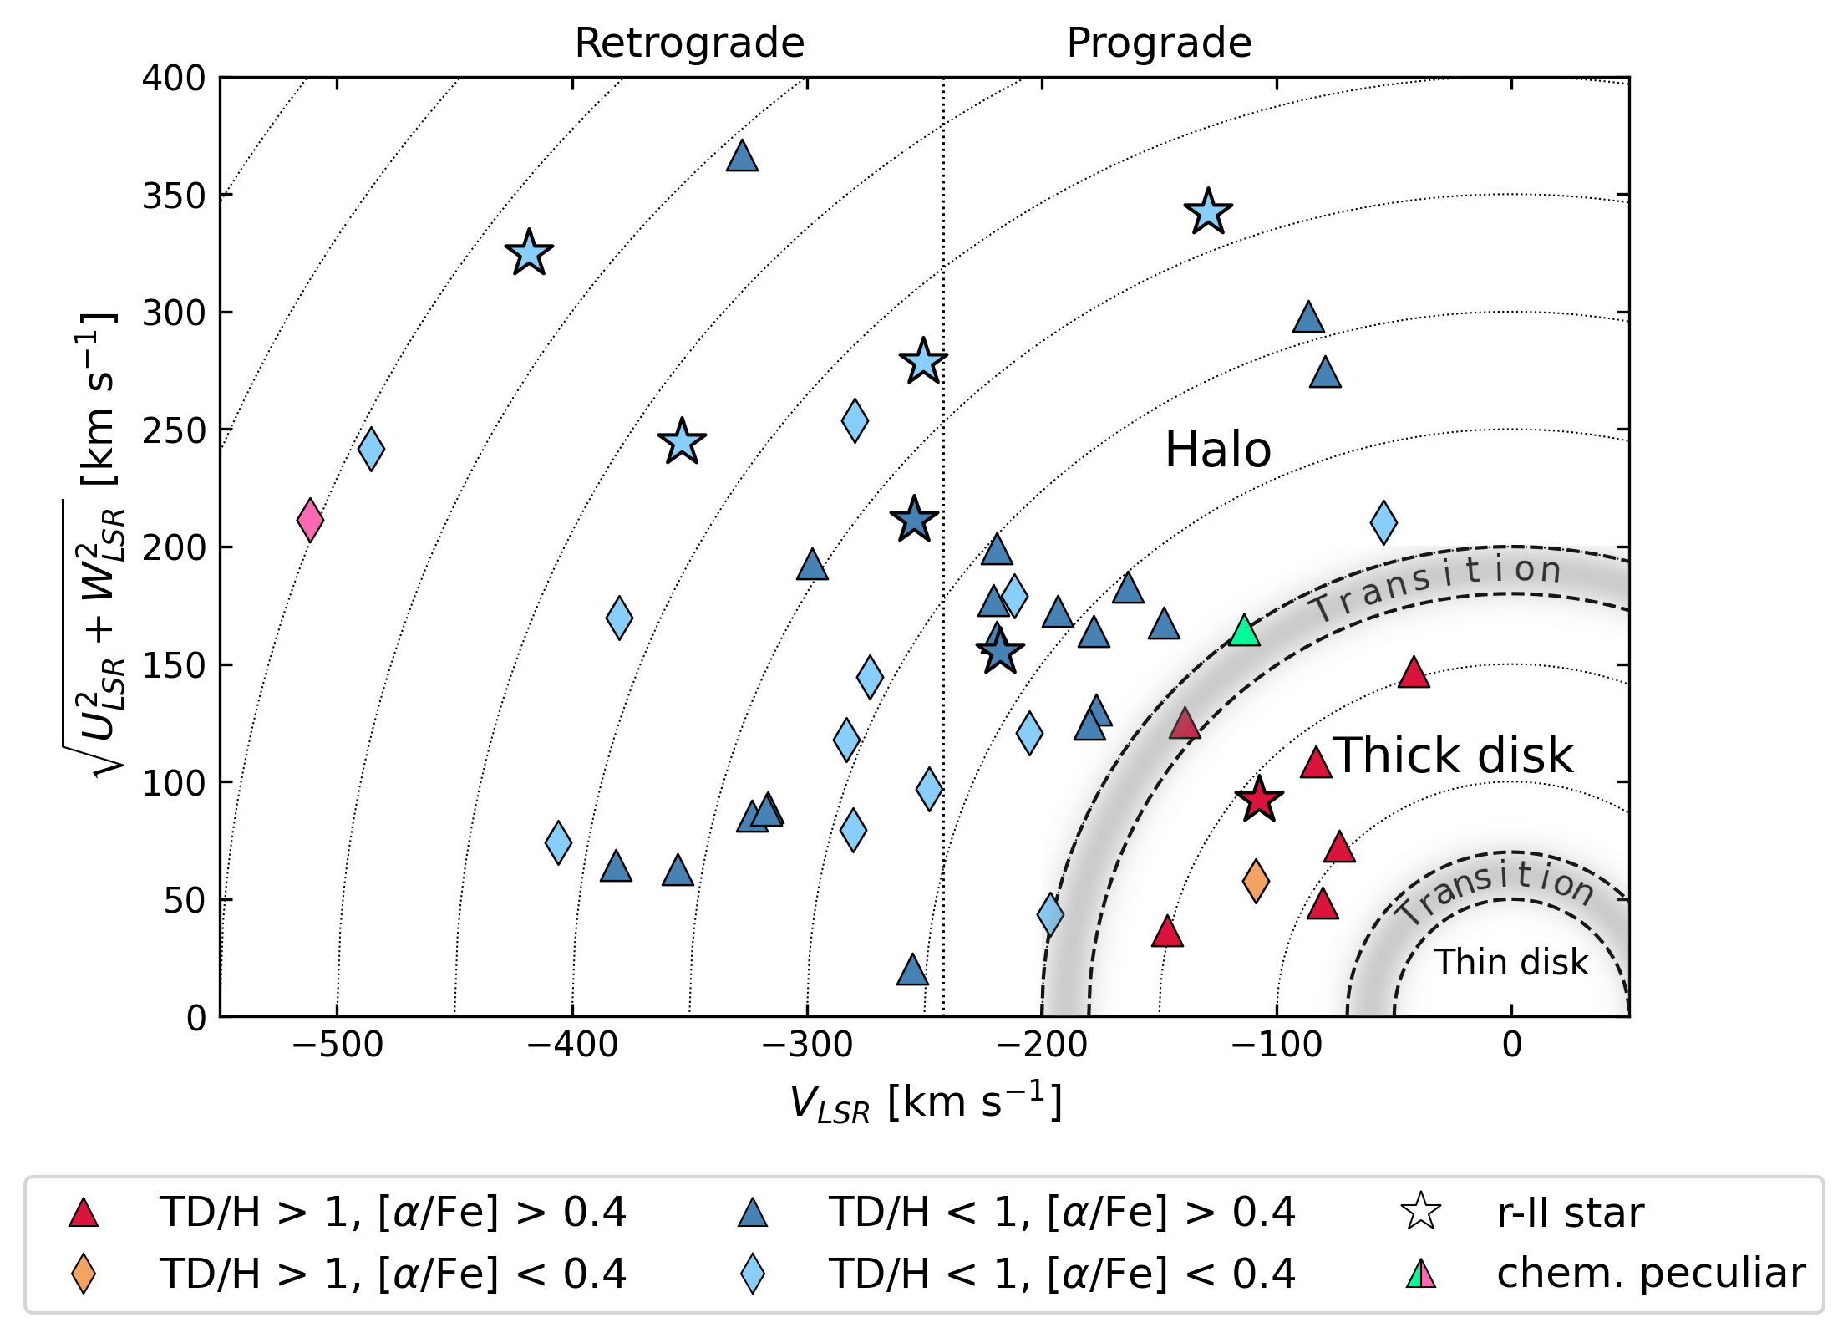
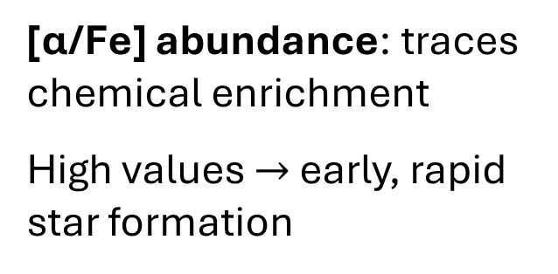
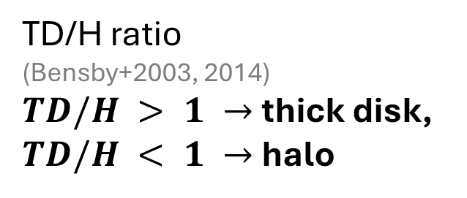
Dynamics
Toomre diagram separates disk and halo populations based on kinematics
(Toomre1964)
Plonka et al. (in prep)
TD/H ratio
(Bensby+2003, 2014)
$TD/H > 1 →$thick disk,
$TD/H < 1 →$halo
[α/Fe] abundance: traces chemical enrichment
High values $→$ early, rapid star formation
Notes:
To separate halo and thick-disk stars in our sample, we use both kinematic and chemical indicators.
This Toomre diagram shows stellar velocities respect to the local standard of rest. Stars with high total velocities or retrograde motion are typically halo members, while stars closer to (0,0) are part of the disk.
We also compute the TD/H ratio following Bensby, which gives a statistical probability of a star being in the thick disk versus the halo. TD/H > 1 means thick disk; TD/H < 1 points to the halo.
Additionally, we consider [α/Fe] as a chemical marker of early enrichment. High [α/Fe] values suggest rapid star formation, typical for both the halo and the thick disk.

Slide 13
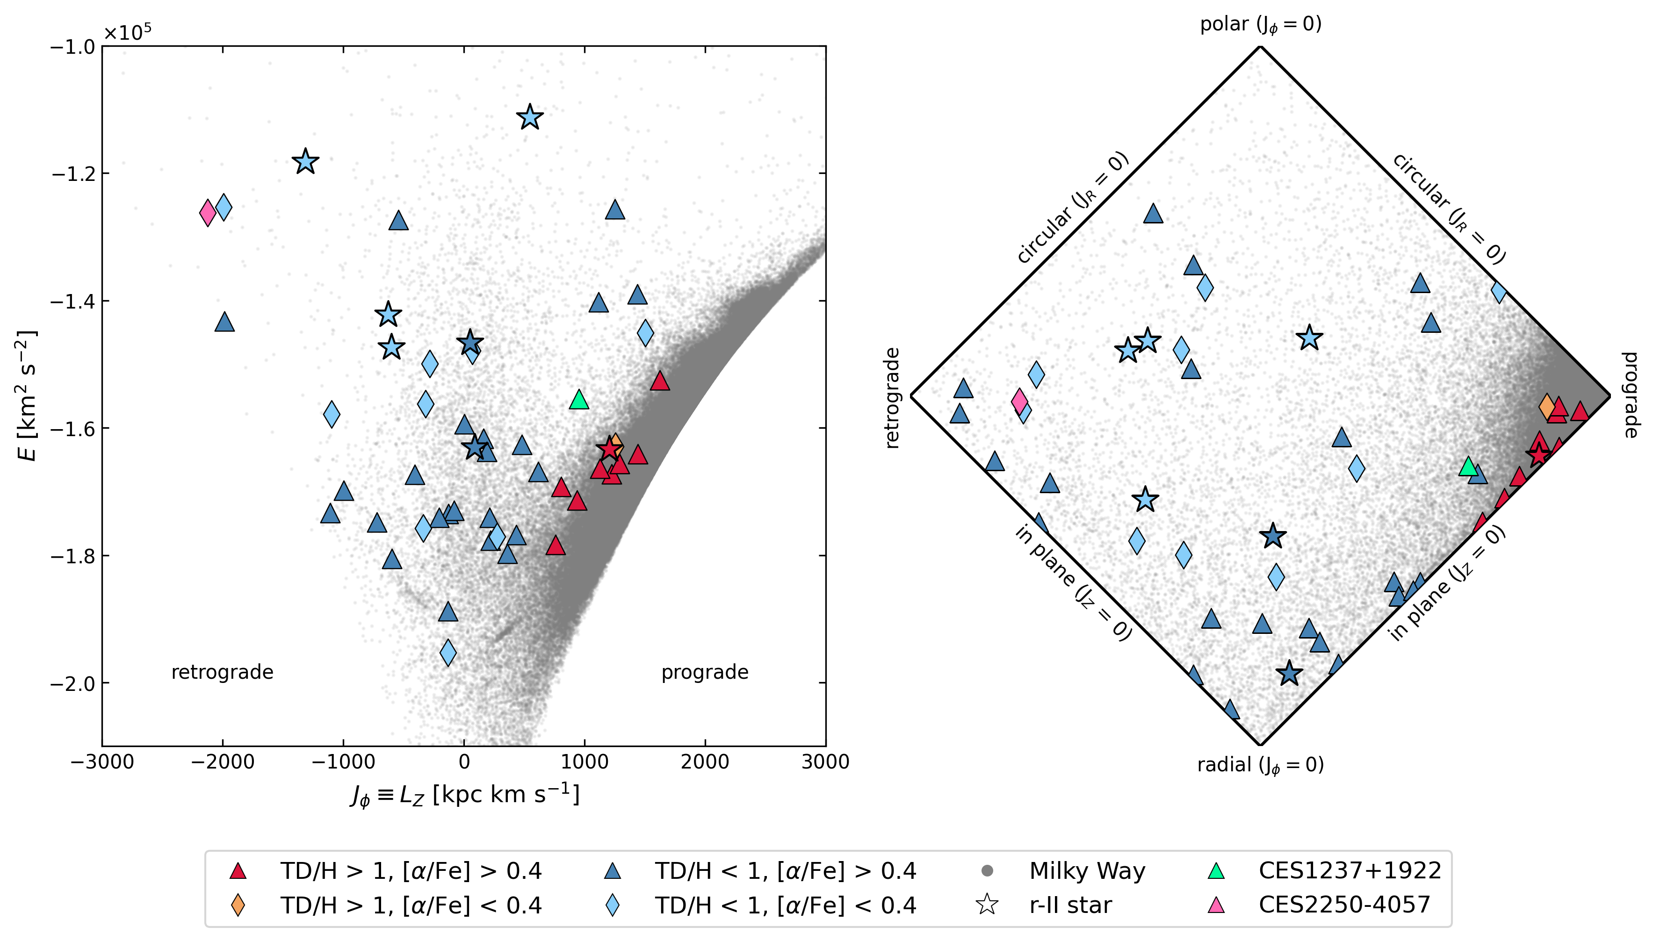
Plonka et al. (in prep)
Notes:
On this slide, we see the distribution of the CERES stars in two different dynamical spaces.
On the left, we have the energy–angular momentum diagram, where the grey background shows the Milky Way reference sample.
The stars with higher energy, which means they have less bound orbits, lie toward the top. We see that most CERES stars occupy the inner halo region.
On the right-hand side, you can see the so-called action diamond, where the three orbital actions — JR , Jϕ and Jz​ — are projected along the diagonals. The center of the diamond corresponds to stars on circular, planar orbits.
As we move away from the center, orbits become more eccentric, more inclined, or more retrograde. This representation helps us disentangle different orbital families: for instance, stars near the top are on polar orbits, while those along the left are strongly retrograde.
And you see most of the Milky Way stars are in the right corner, which means they move prograde.
From the distribution of CERES stars, we observe a clear kinematic spread — some stars occupy regions associated with in-situ populations, but a large fraction lies in areas typical of accreted halo stars, particularly those with high radial action and low Jϕ.
This provides the first indication that these stars may have extragalactic origins.

Slide 14
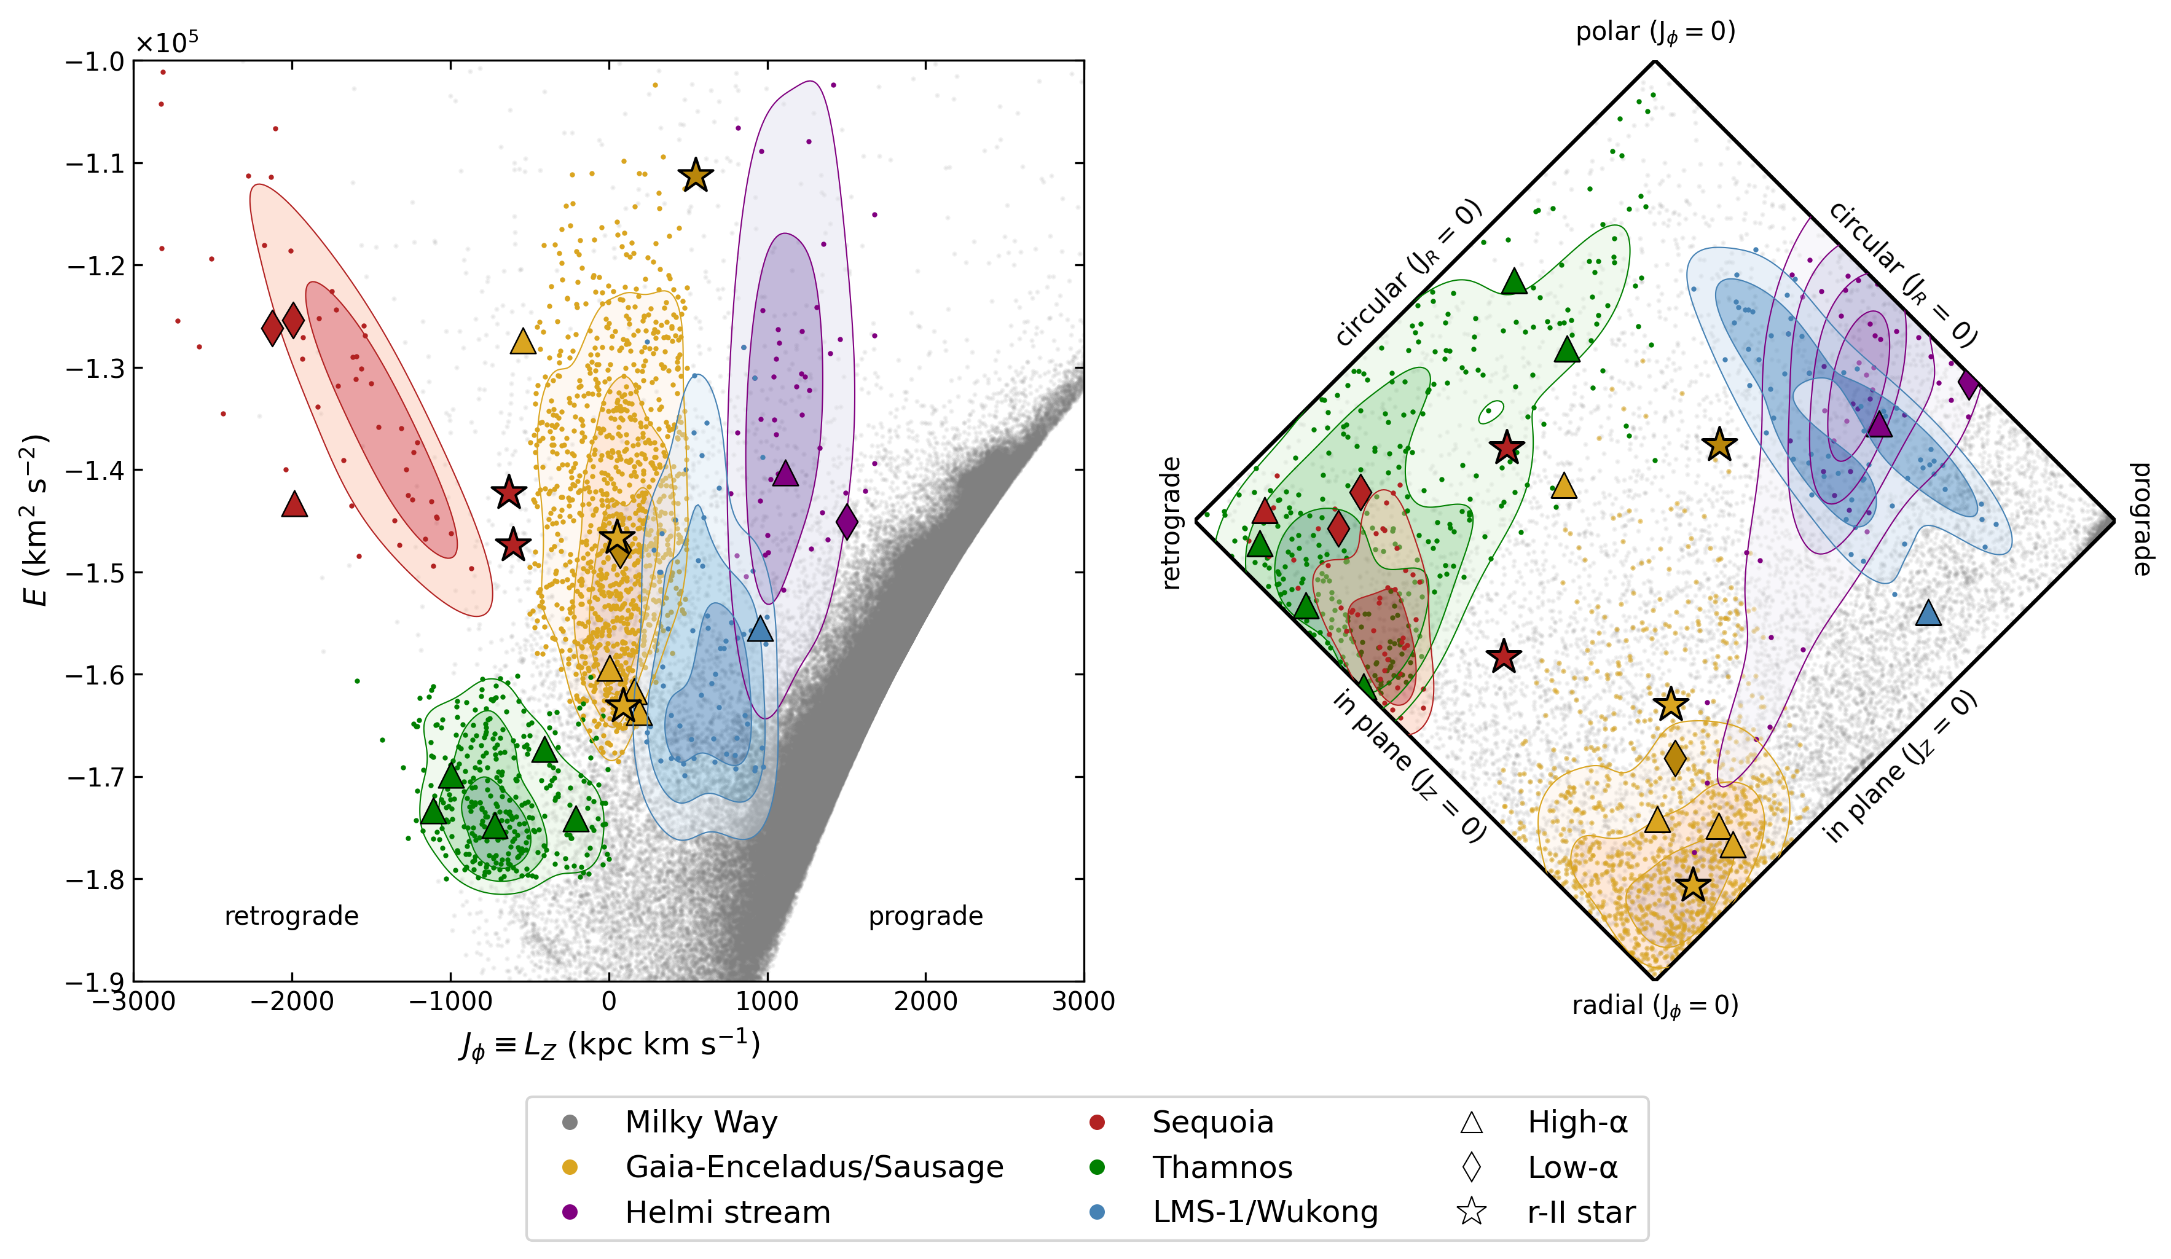
Plonka et al. (in prep)
Notes:
Here I show the same dynamical spaces as before, now overlaid with previously identified merger structures: Gaia-Enceladus, Sequoia, Thamnos, LMS-1/Wukong, and the Helmi stream.
Each region reflects stars from GALAH and APOGEE that fulfill specific dynamical and chemical selection criteria established in the literature.
We applied exactly the same selection criteria to the CERES sample. The stars shown here are those CERES stars that passed these filters and can therefore be assigned to one of the known merger structures with comparable confidence.
The fact that several r-process-enhanced stars from CERES fall into these categories strengthens the evidence that such elements were contributed by multiple accretion events.

Slide 15
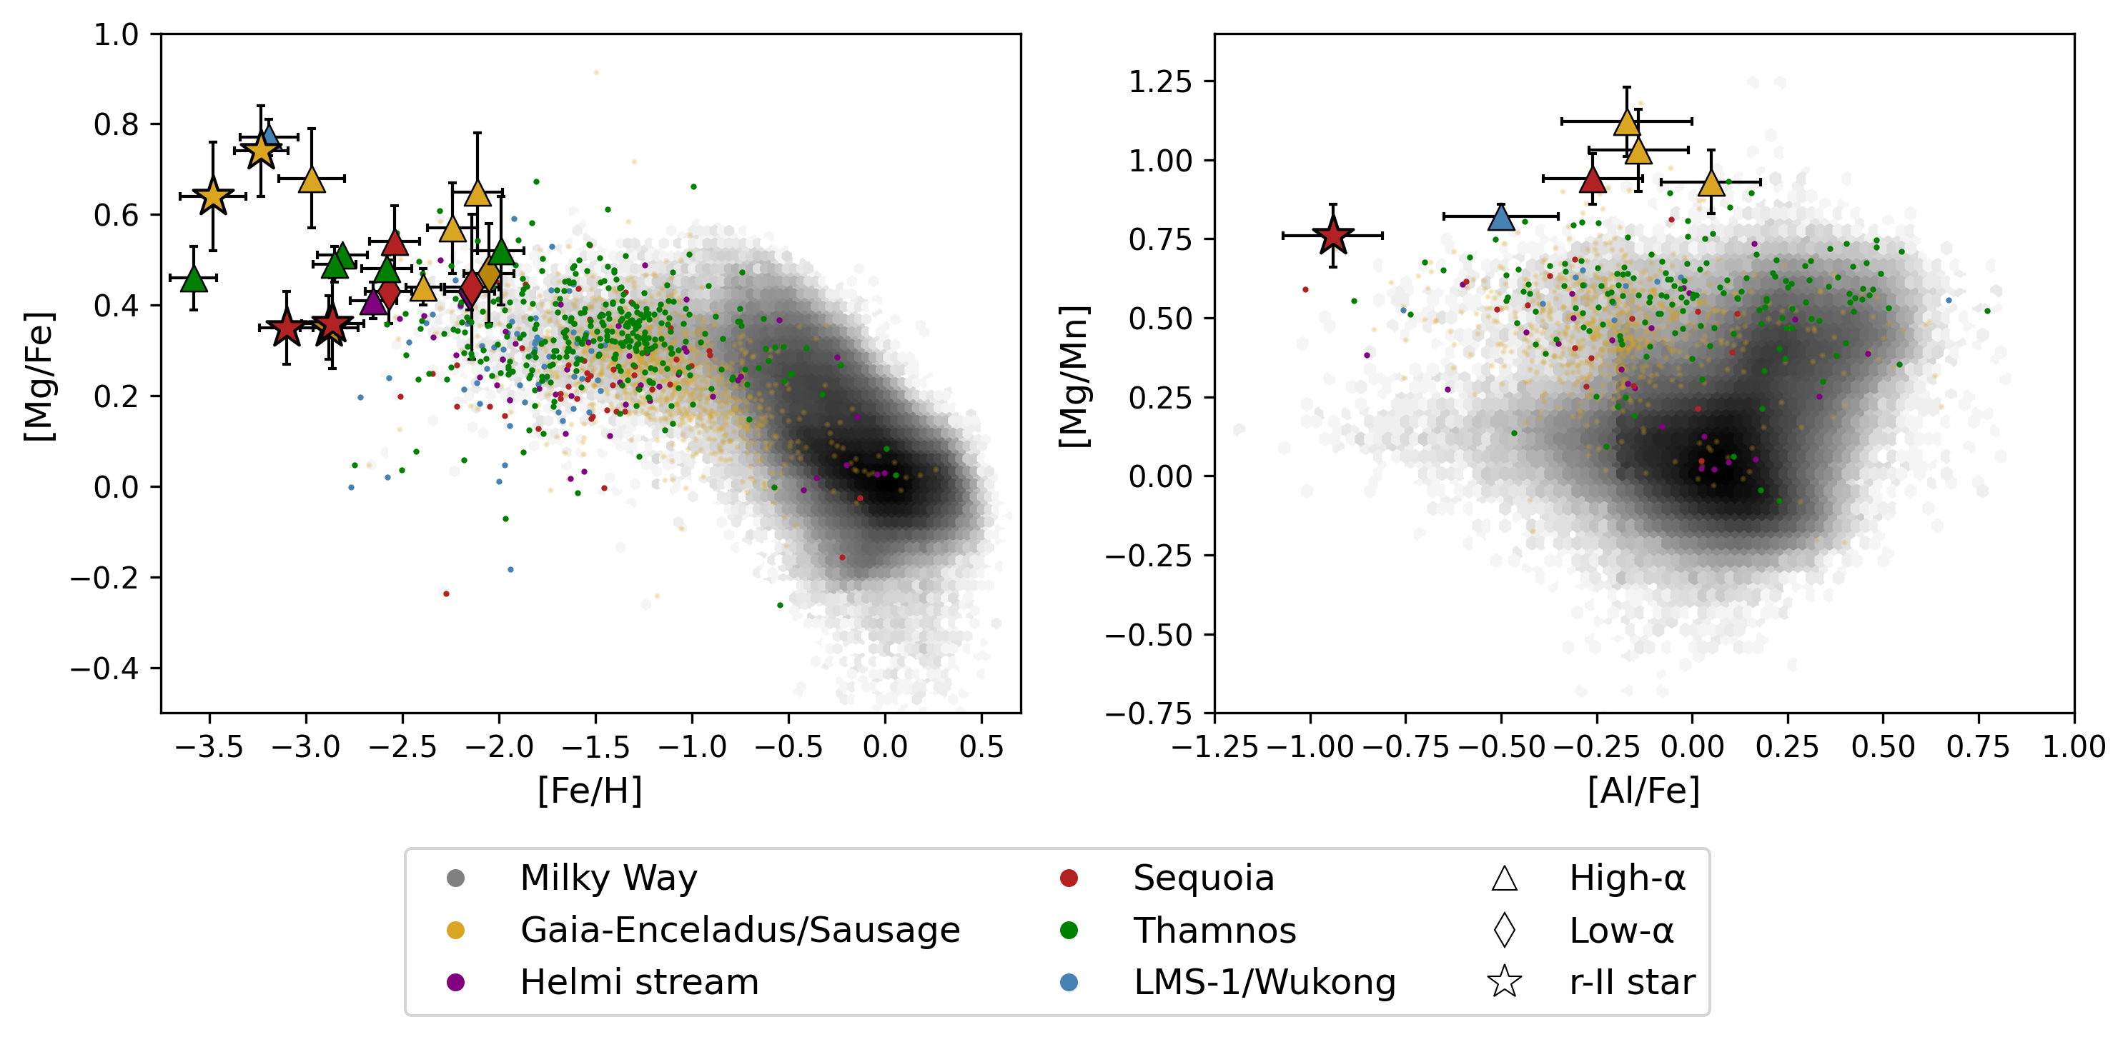
Chemical abundances
accreted
Plonka et al. (in prep)
Notes:
Lets‘ now turn to the chemical abundances.
So, in each panel we overlay our accreted star candidates—colored markers denoting Gaia‑Enceladus, Sequoia, Thamnos, etc.—against the grey Milky Way density background.
You can clearly see that they fall systematically outside the MW locus:
Higher [Mg/Fe] than typical MW,
enhanced [C+N/Fe] at low [Fe/H],
Much lower[Al/Fe],
and occupying the accreted region in [Mg/Mn] vs. [Al/Fe].
This chemical evidence, combined with their kinematics, makes a compelling case that they are ex‑situ, not native to the Milky Way.”
-----------------------------
In upper left panel, we plot [Mg/Fe] against [Fe/H]. Magnesium is an α‑element produced in core-collapse supernovae, while iron builds up more gradually via Type Ia supernovae.
In dwarf galaxies or accreted environments with slow star formation, Type Ia contributions begin to dominate even at low metallicity. This results in systematically lower [Mg/Fe] at a given [Fe/H] than seen in in-situ Milky Way stars.
Our CERES stars currently sit above the Milky Way locus, but this doesn’t rule out accretion. Instead, it suggests they likely came from a different kind of progenitor—possibly one with early, efficient star-forming episodes that enriched α-elements quickly before Type Ia SNe kicked in. These α-rich accreted stars have been recognized in recent analyses
In the last diagram we plotted [Mg/Mn] against [Al/Fe]. Magnesium as an α‑element traces core-collapse supernovae (Type II), while manganese comes mainly from Type Ia supernovae. The ratio [Mg/Mn] therefore captures the balance between rapid and delayed enrichment.
When combined with [Al/Fe], this plane becomes a powerful separator: accreted stars have low [Mg/Mn] and low [Al/Fe], consistent with extended, slow star formation history, whereas in‑situ stars cluster at higher values.

Slide 16
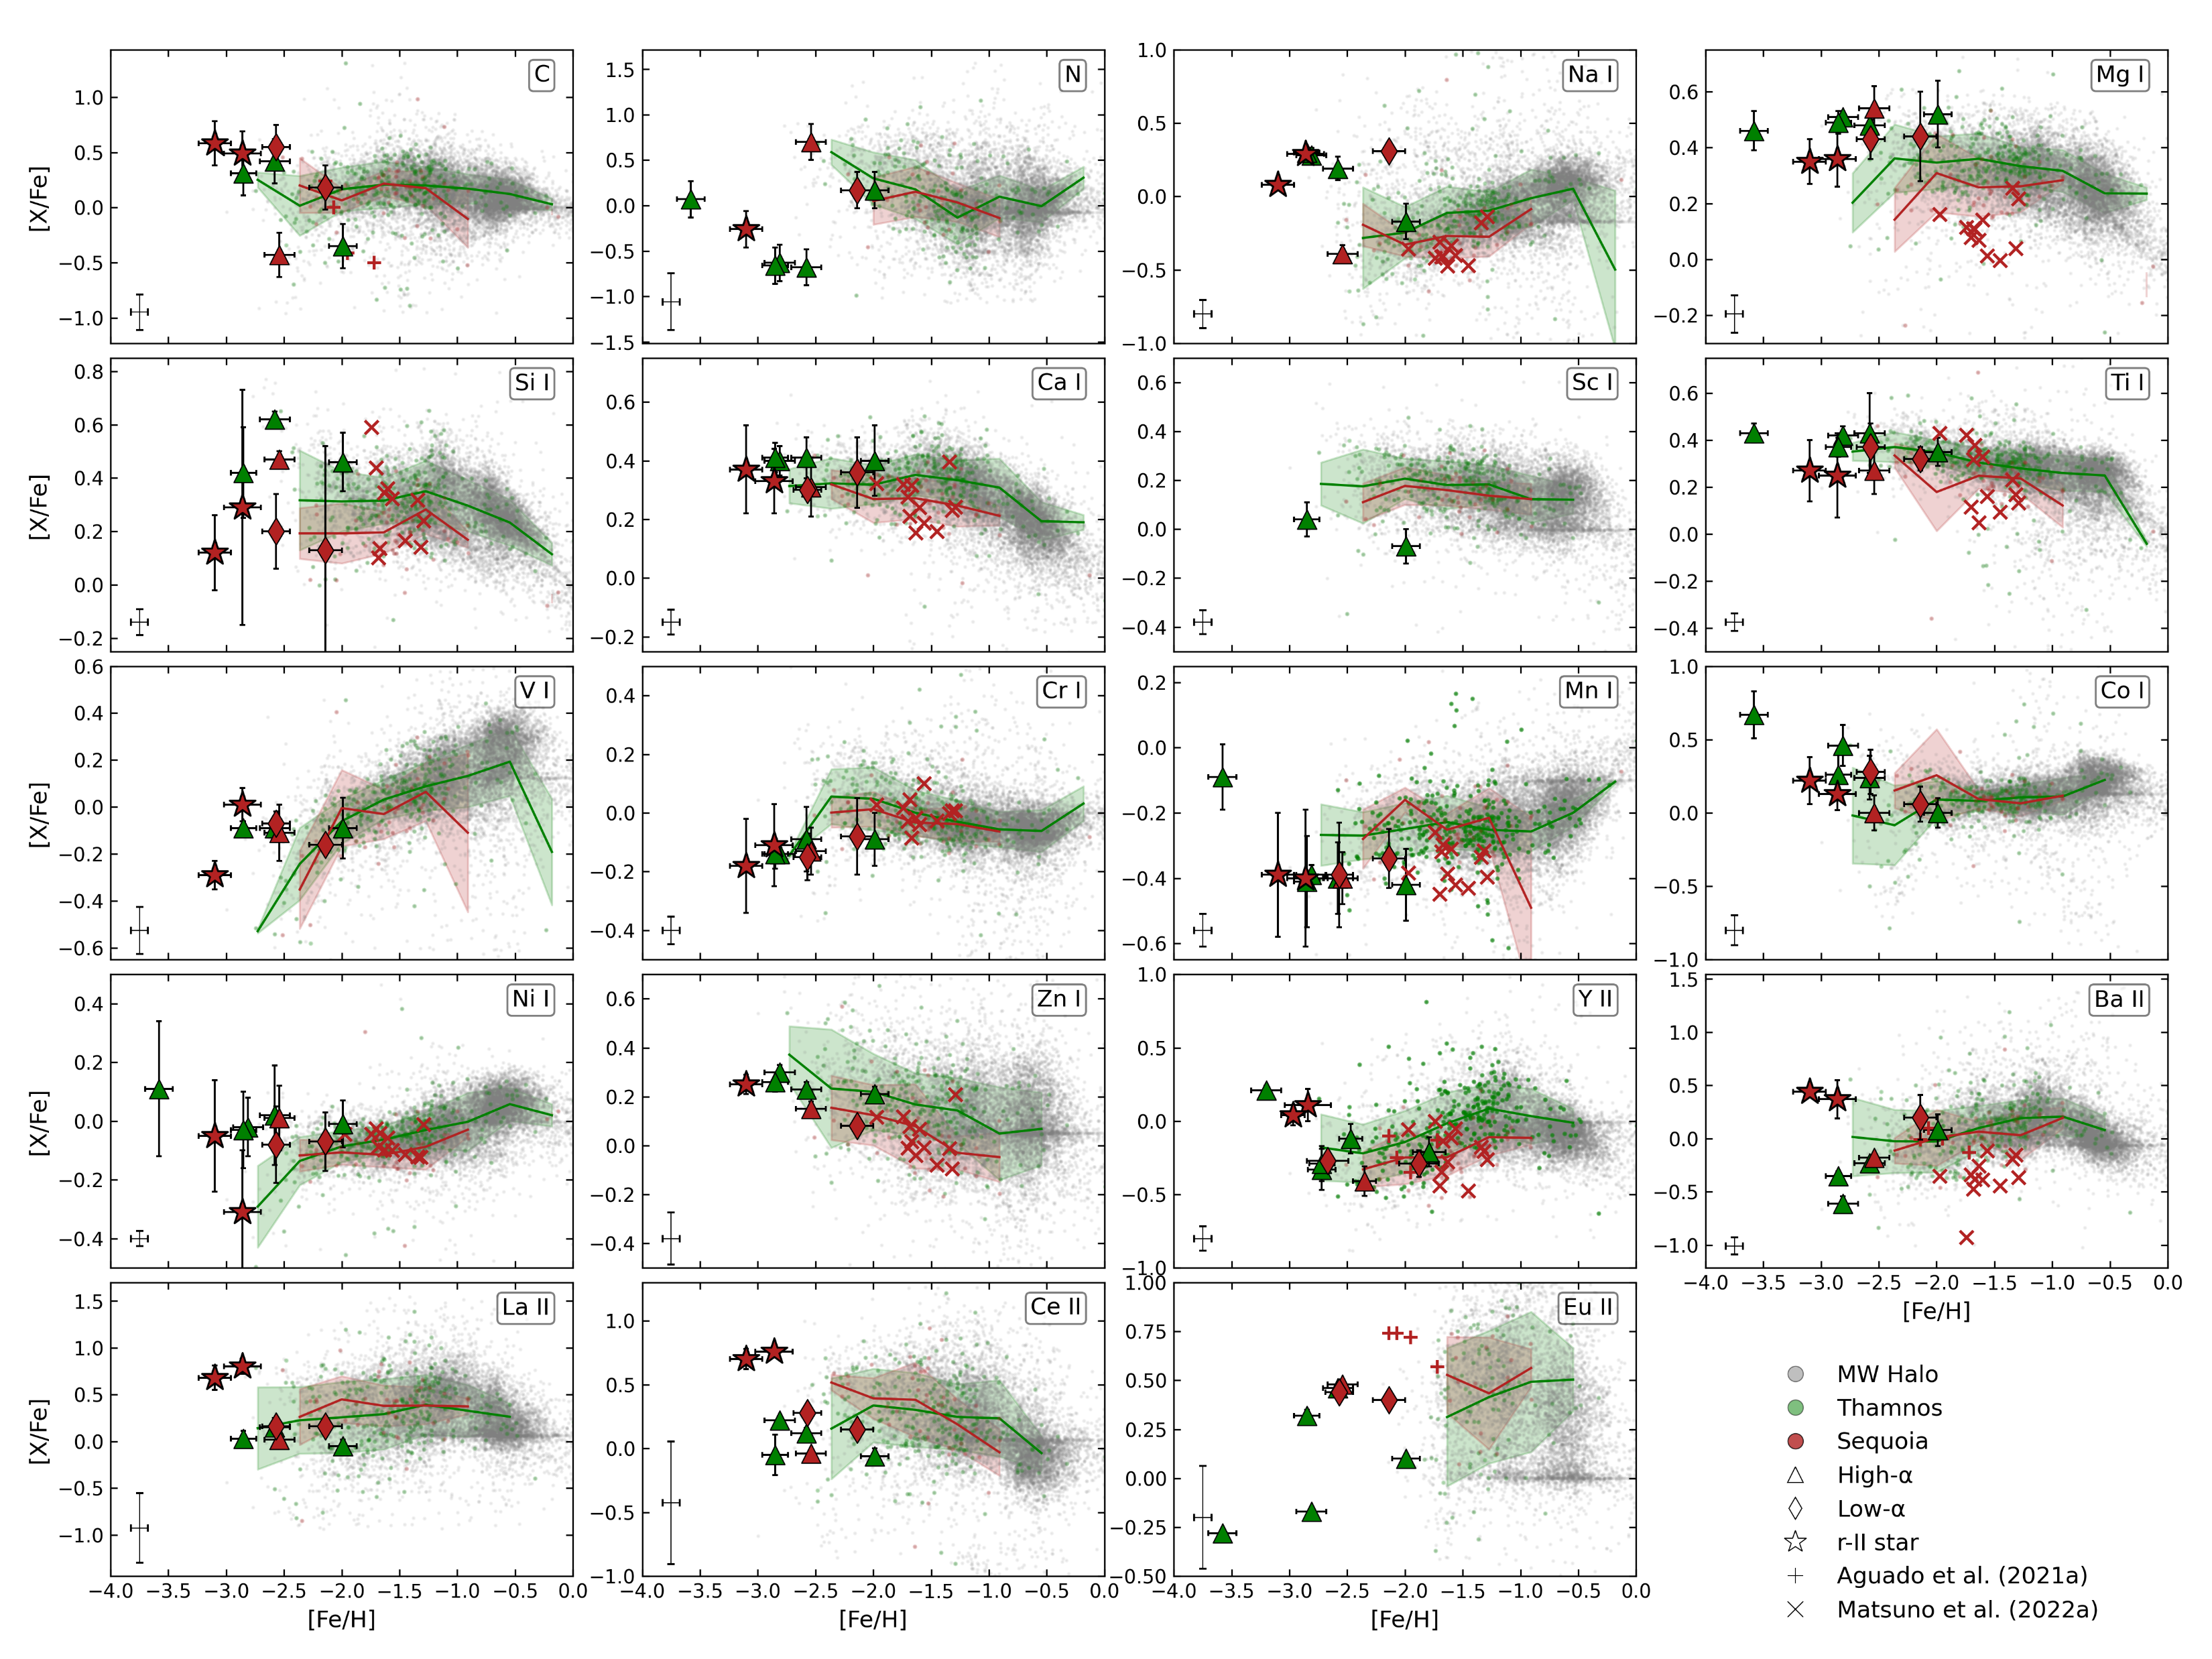
Plonka et al. (in prep)

Slide 17
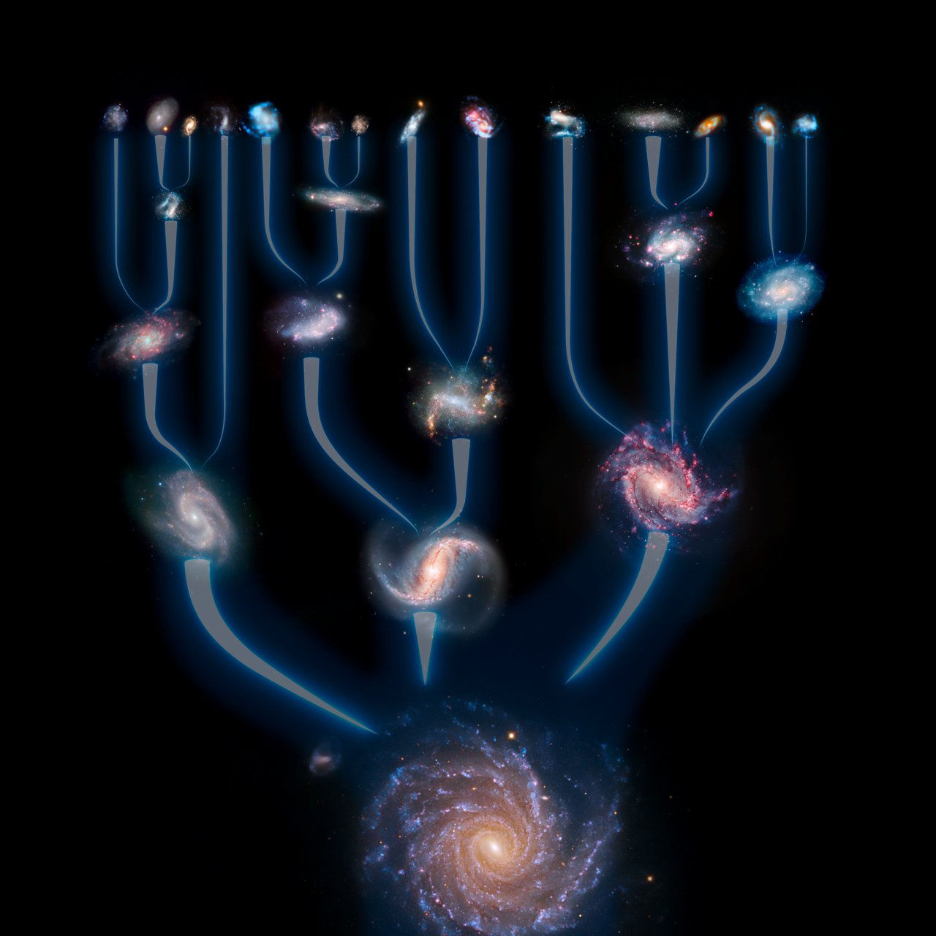
Summary
Kinematic substructures are the keys to understand
the accretion history of our Galaxy
chemical enrichments beyond the
Milky Way
Abundance ratios allow us to
further characterize kinematic substructures
identify members of accreted dwarf galaxies

Slide 18
Additional slides

Slide 19
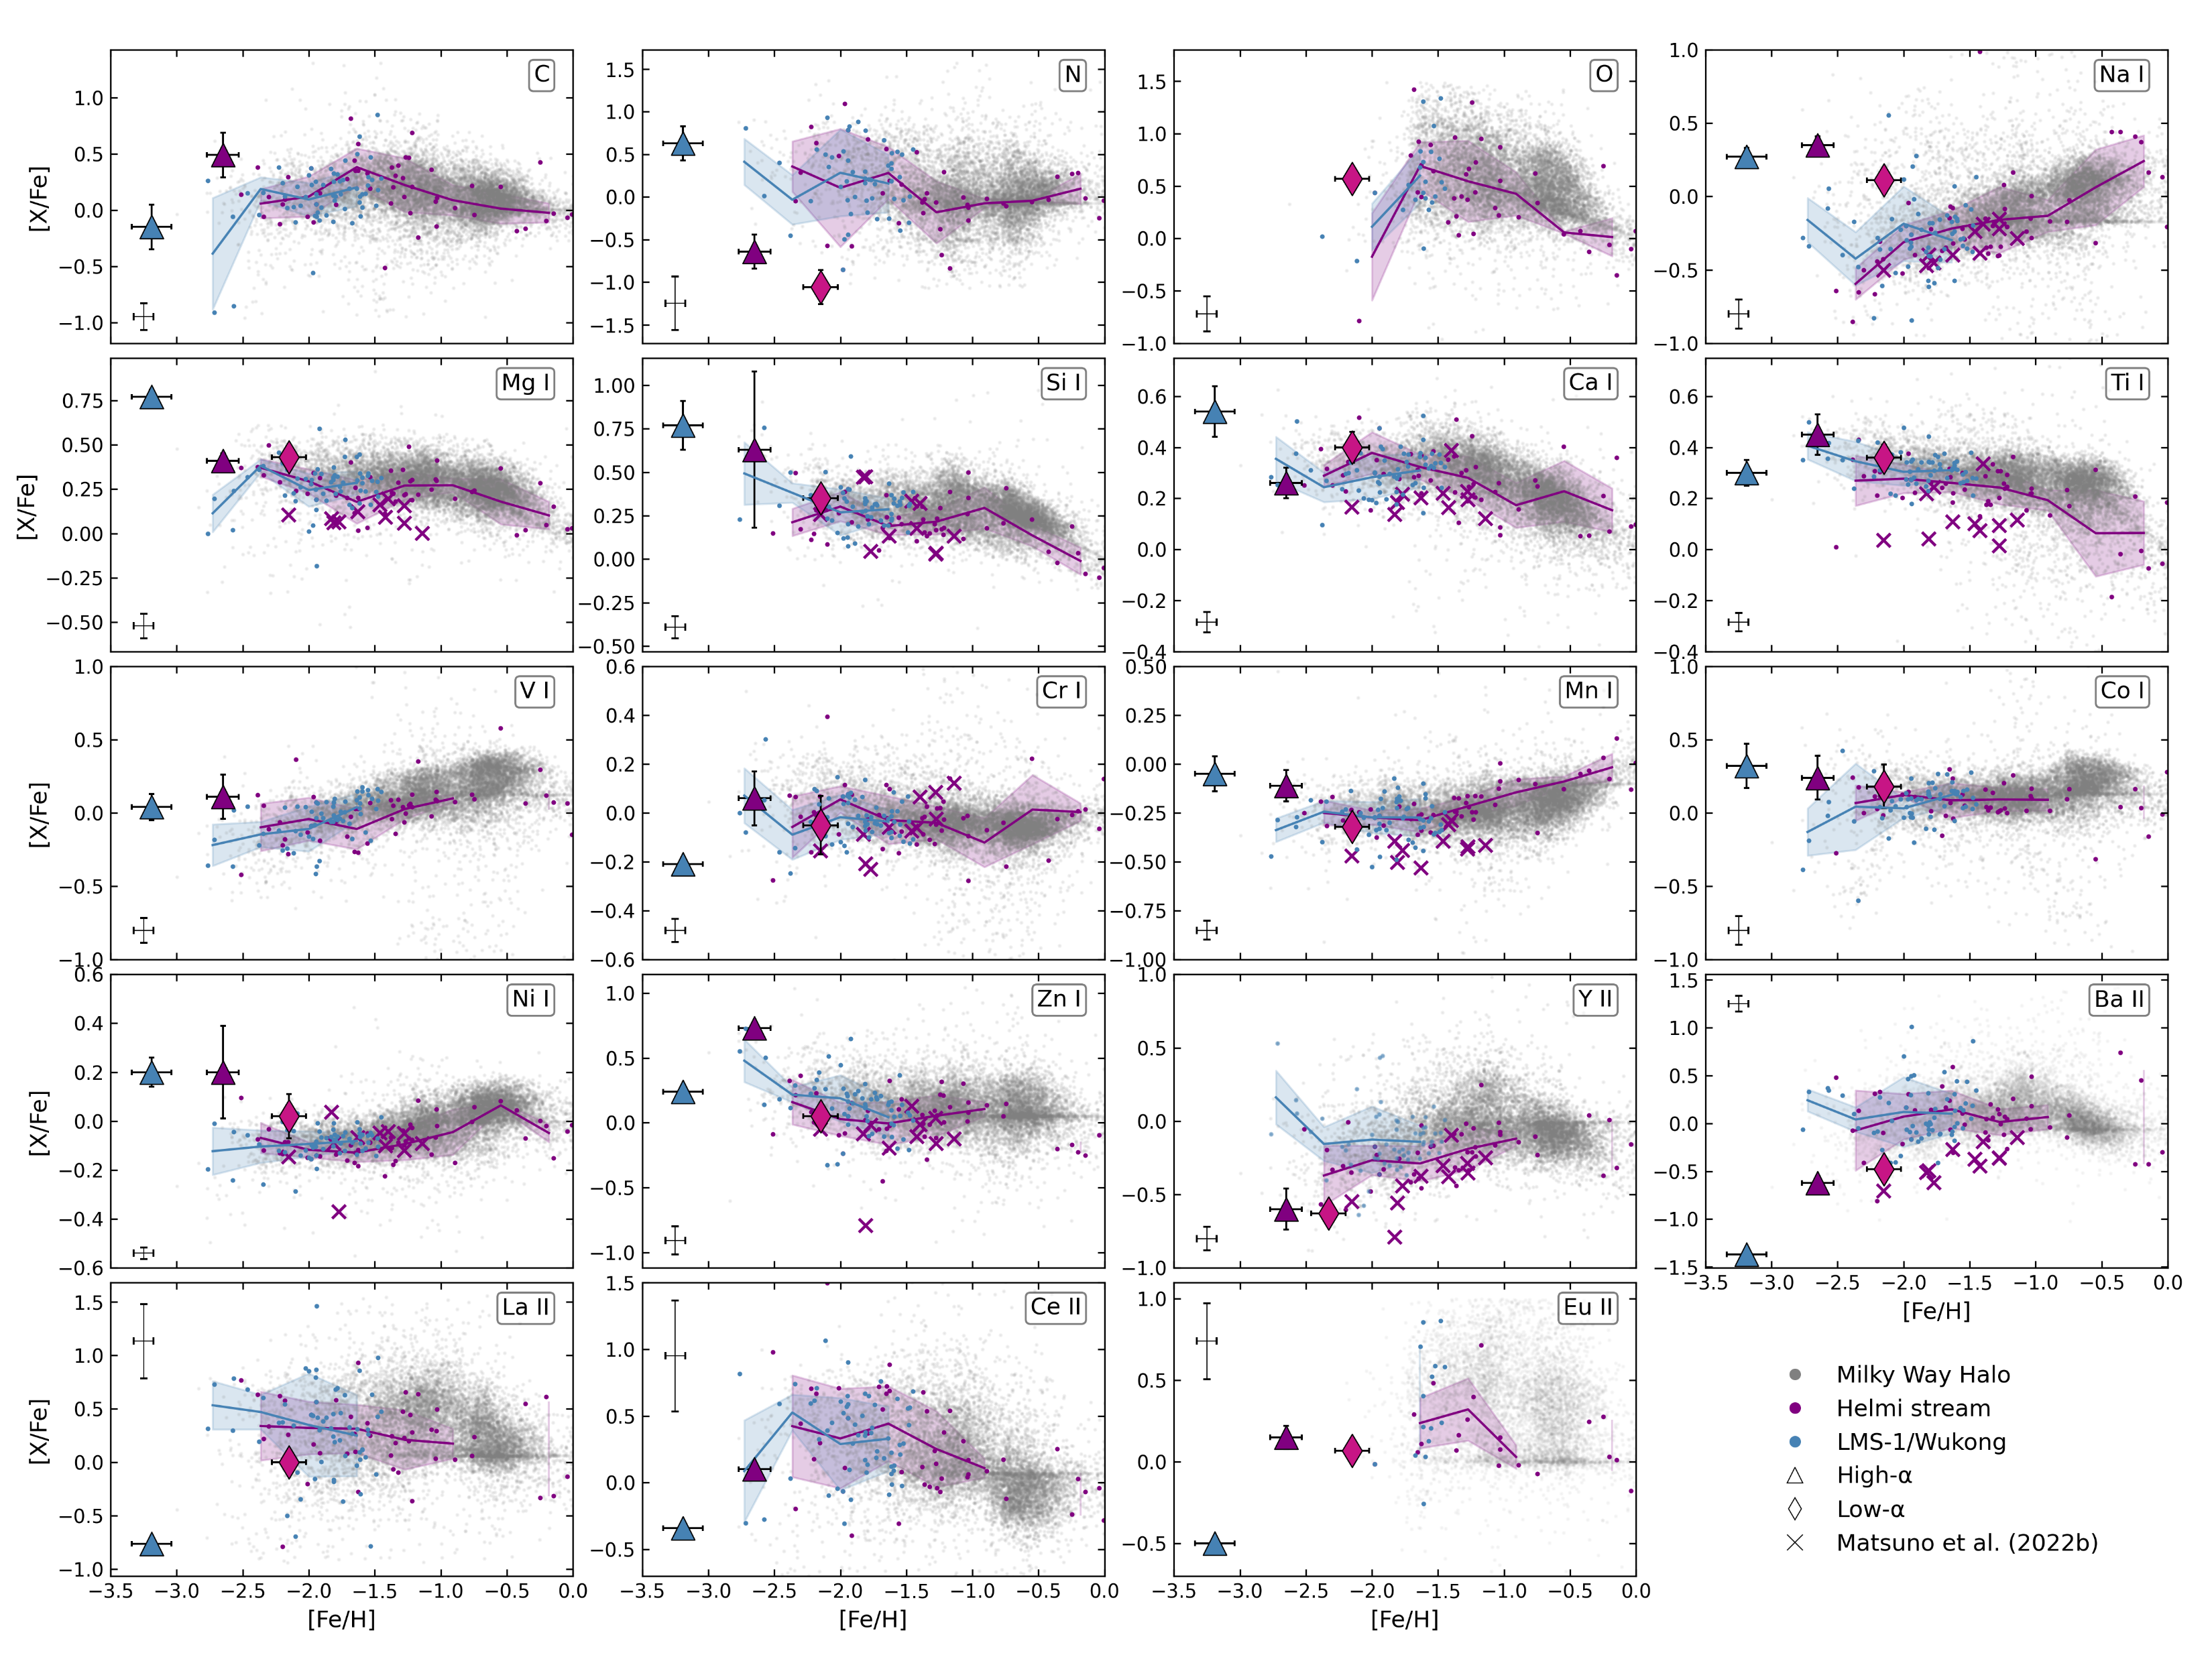
Plonka et al. (in prep)

Slide 20
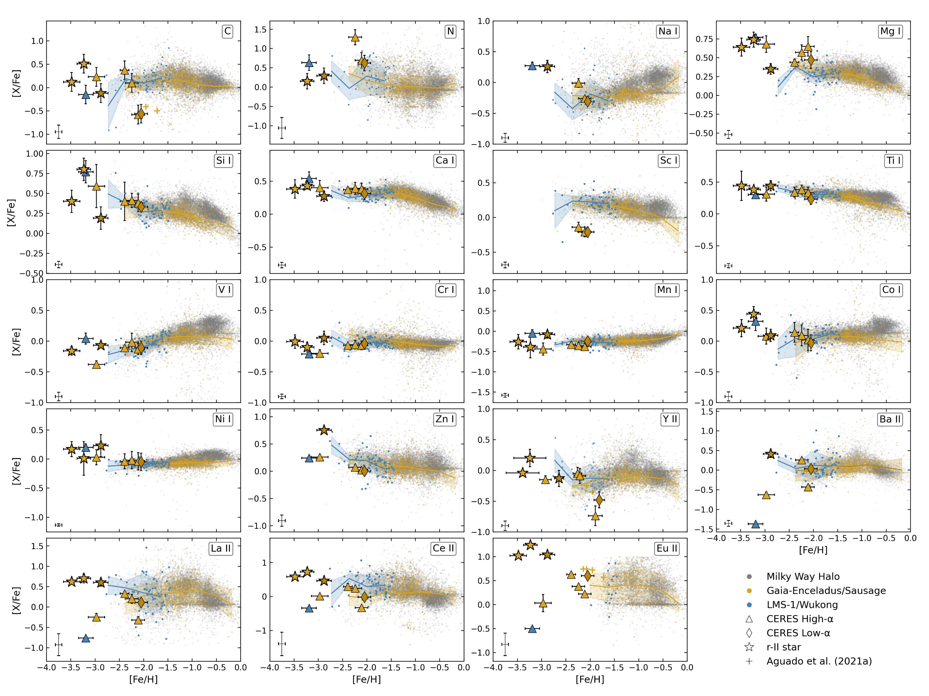
Plonka et al. (in prep)

Slide 21
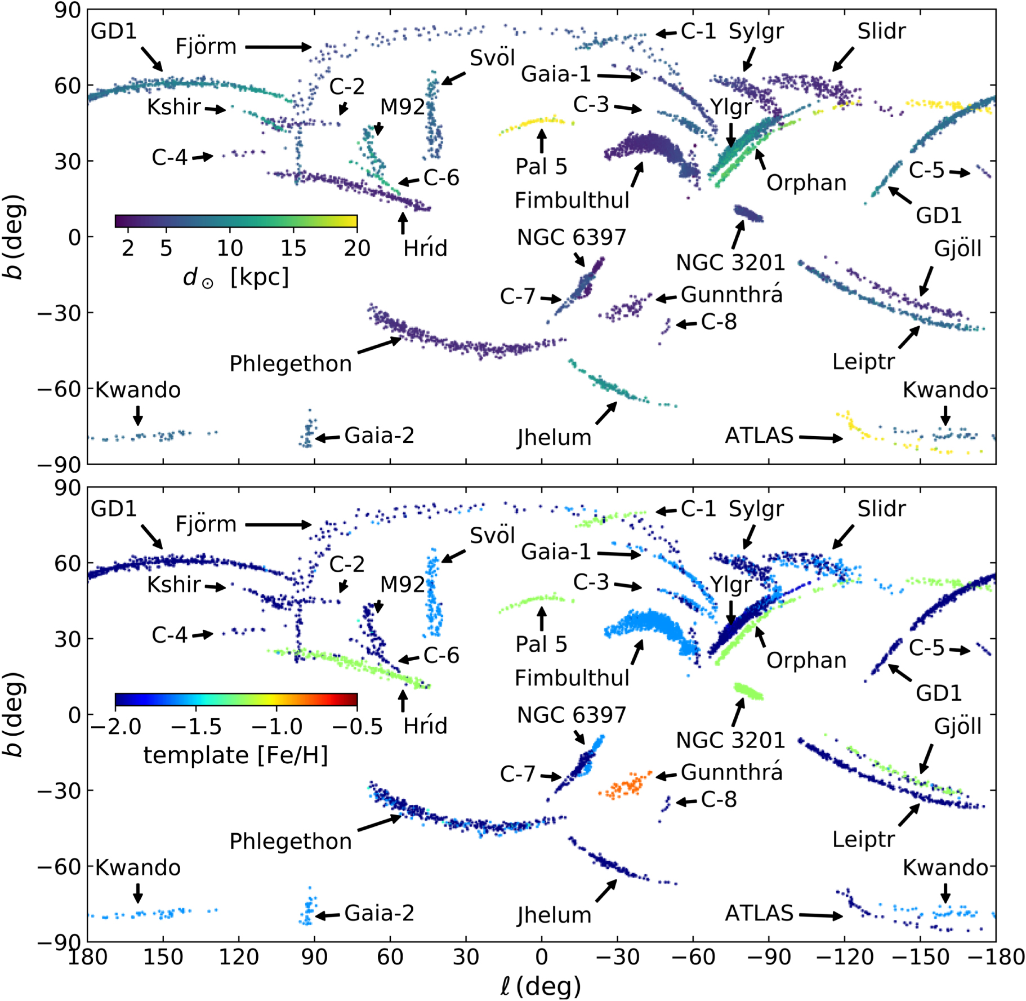
Streams
Gaia revolutionized stream detection:
now ~100 are known in the MW halo
(Bonaca&Price-Whelan2024)
Southern Stellar Stream Spectroscopic
Survey (S⁵) (Li+2019)
targets southern streams using the
AAT/AAOmega
Mapped 12 streams, providing kinematics
and metallicites
High-resolution follow up (Magellan/MIKE)
(Ibata+2021)

Slide 22
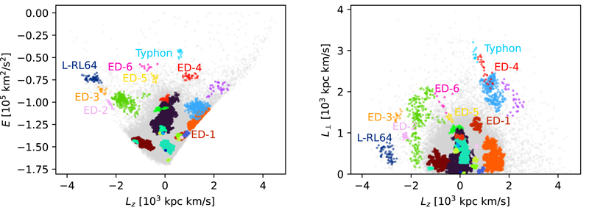
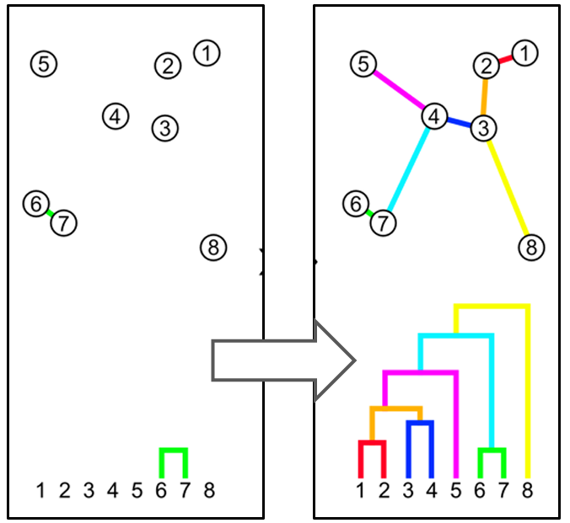
How do we find merger debris?
(Dodd+2023)
Integrals of Motion (IoM)
E, L_{z} are conserved quantities
along an orbit when the potential
is axisymmetric (for L_{z}) and static
(for E)
Phase-mixing erases spatial
coherence, not dynamical coherence
Stars from a common progenitor share similar IoM
Basis for substructure detection
algorithms
Clustering in IoM space
(Lövdal+2022, Ruiz-Lara+2022, Dodd+2023)
Single-linkage algorithm, clusters are built
in herarchically using distances between stars
every stars is in a cluster
use significance to determine where to
stop linkage
Notes:
That makes Integral of Motion space a good place to look for clustering. In the plot here you can see multiple identified groups that are tightly clustered in the (E, Lz)-space.
This forms the base for the detection for many substructures in the halo today and help us to isolate the remnants of disrupted satellites.

Slide 23
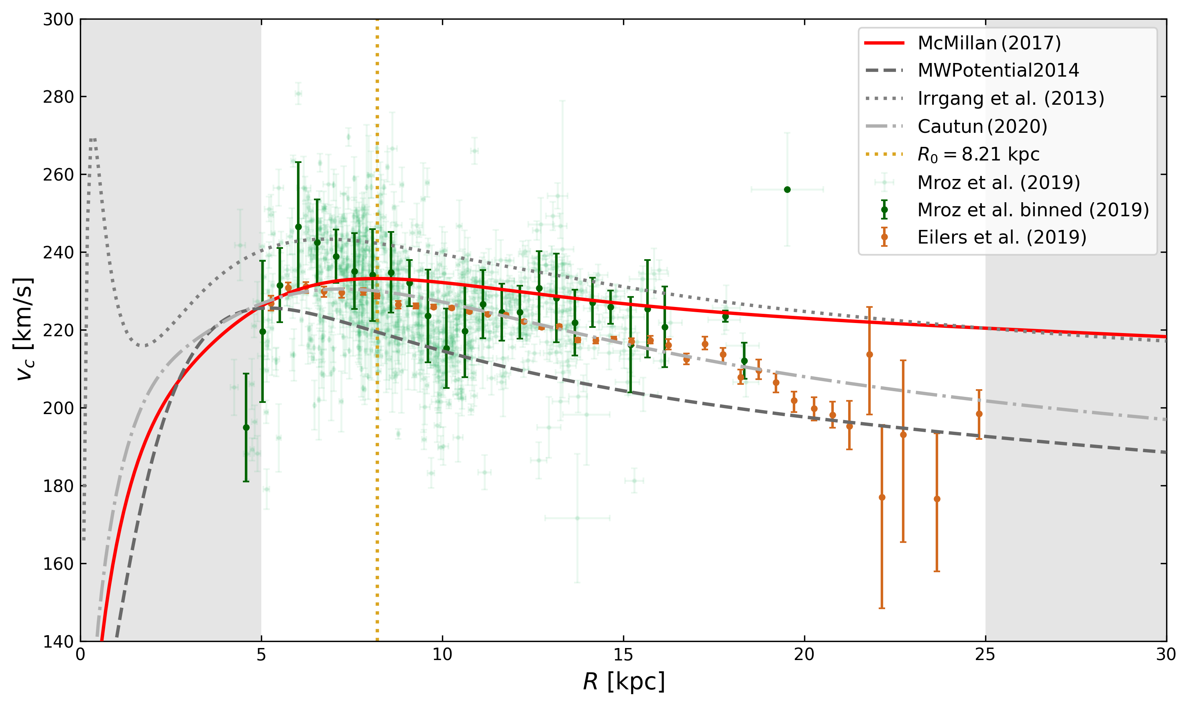

Slide 24
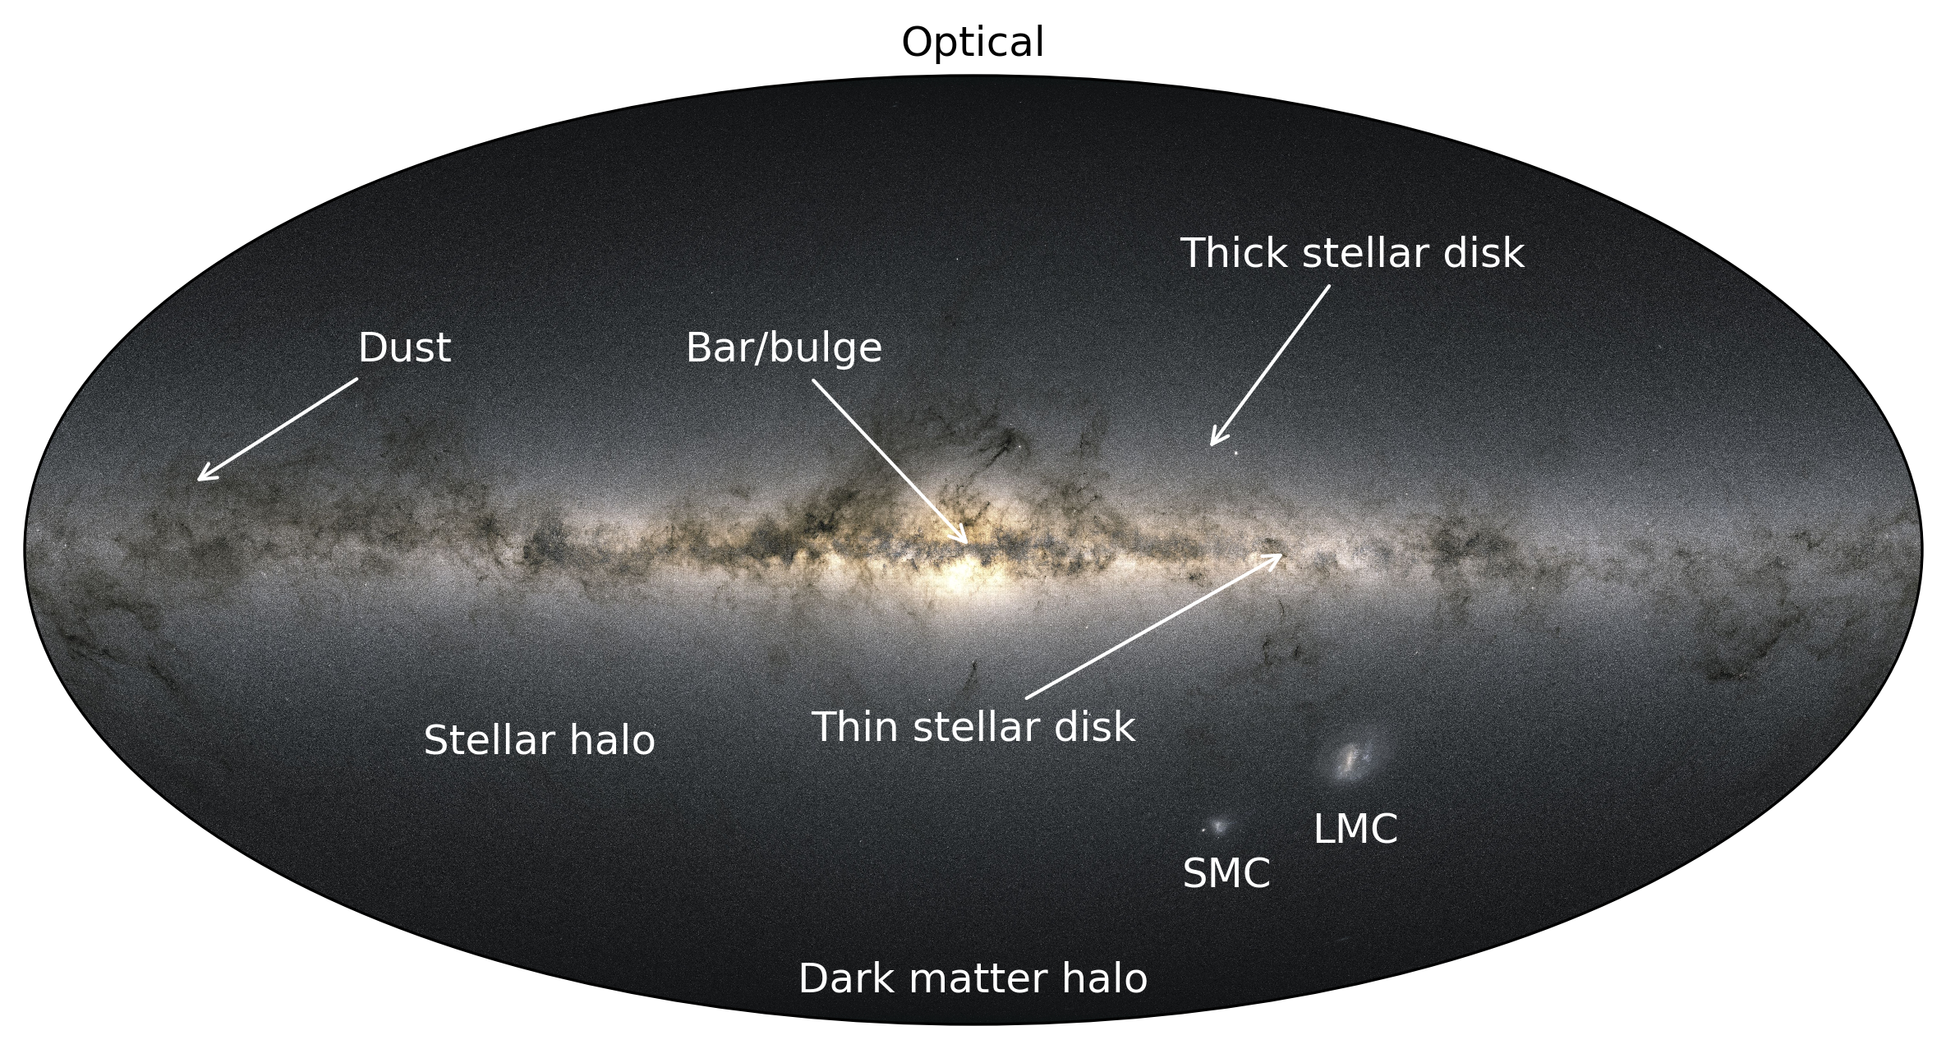
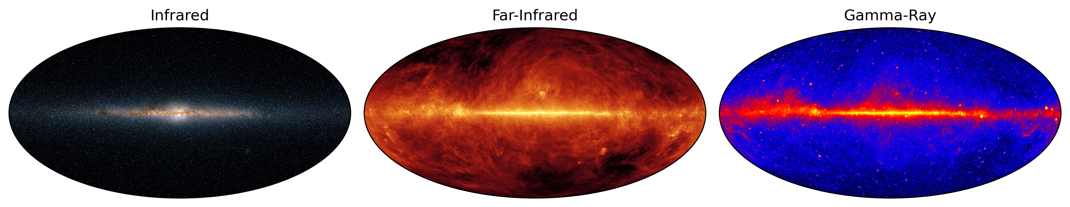

Slide 25
