Slide 1
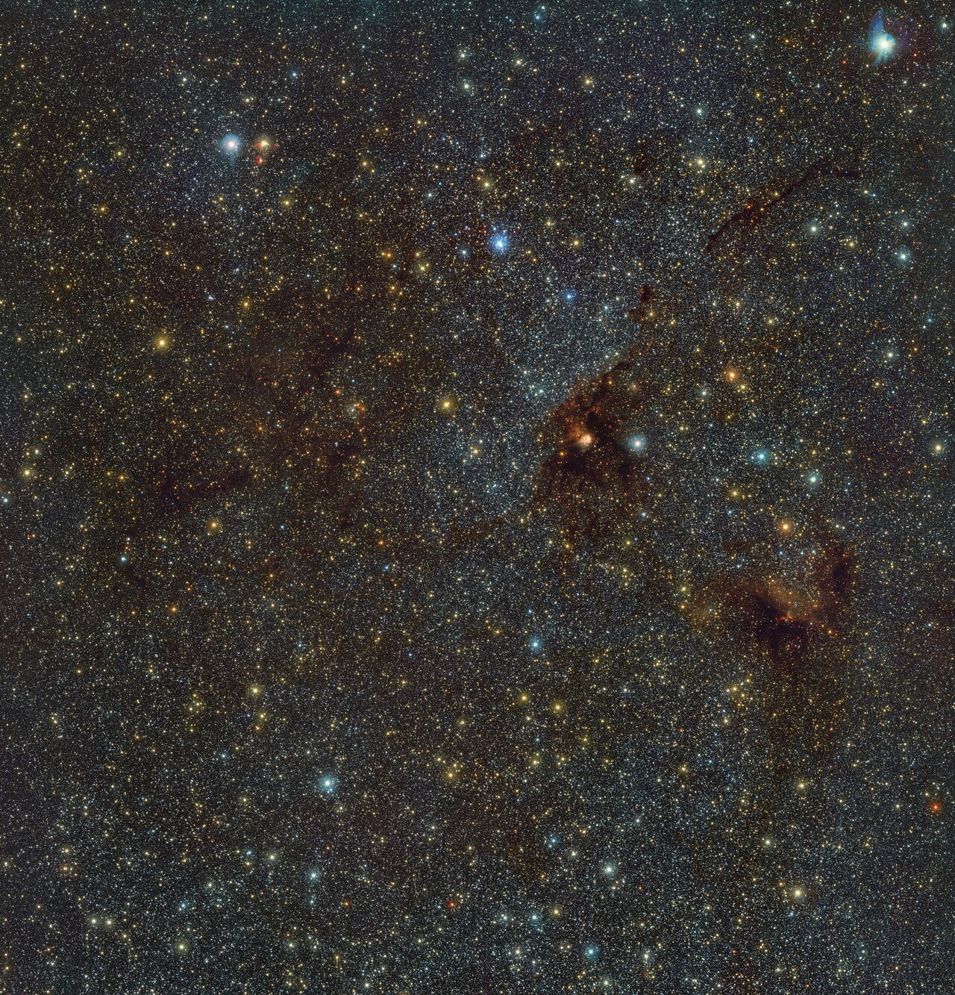
Binary Stars as Sources of Chemical Anomalies in Globular Clusters
Zayna Khadour & Alison Sills
McMaster University
EXPLORE Summer School & Conference, 2025
ESO/VVVX survey

Slide 2
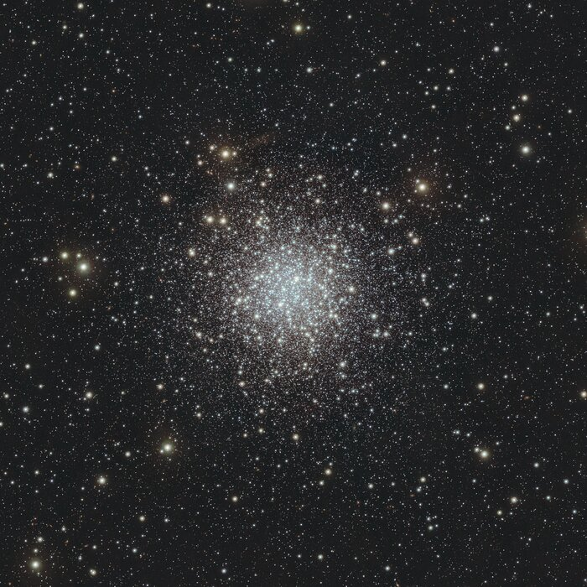
Globular Clusters (GCs)
Clusters are groups of hundreds to millions of stars
Globular Clusters are remarkably massive and dense
GCs were once though to be simple clusters with uniform ages and chemical compositions
NGC 6723: A globular cluster in the constellation Sagittarius. ESO/S. Meingast et al.

Slide 3
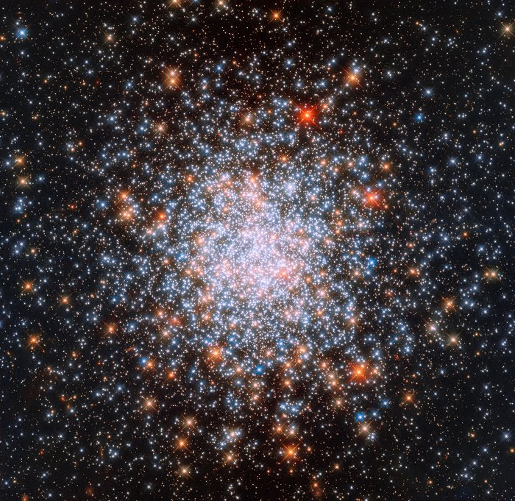
Multiple Populations (MPs)
Groups of stars in GCs have different abundances of light elements
About 50% - 80% of stars in GCs exhibit these abundance patterns
These groups are enhanced in He, N, Na and depleted in C & O
The origins of these abundance spreads are still unknown
NGC 1866: A globular cluster rich with multiple populations. ESA/Hubble & NASA.
Bastian & Lardo. 2018

Slide 4
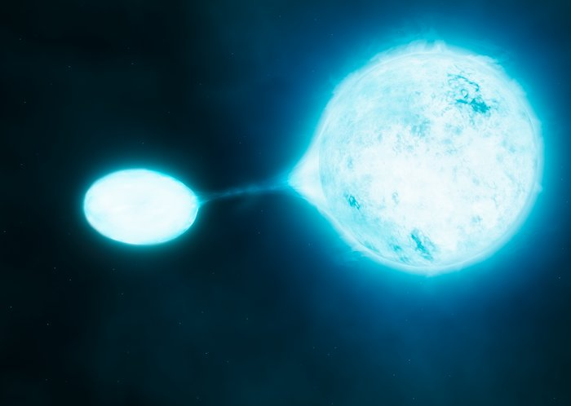
Interacting Massive Binaries
Interacting massive binaries are an attractive solution to MPs
The majority of massive stars are members of interacting binary systems
These systems undergo non-conservative mass transfer which results in material ejection into the environment
Artist's impression of mass transfer in a close binary system. ESO/M. Kornmesser/S.E. de Mink.
de Mink et al. 2009, Moe & Di Stefano. 2017

Slide 5
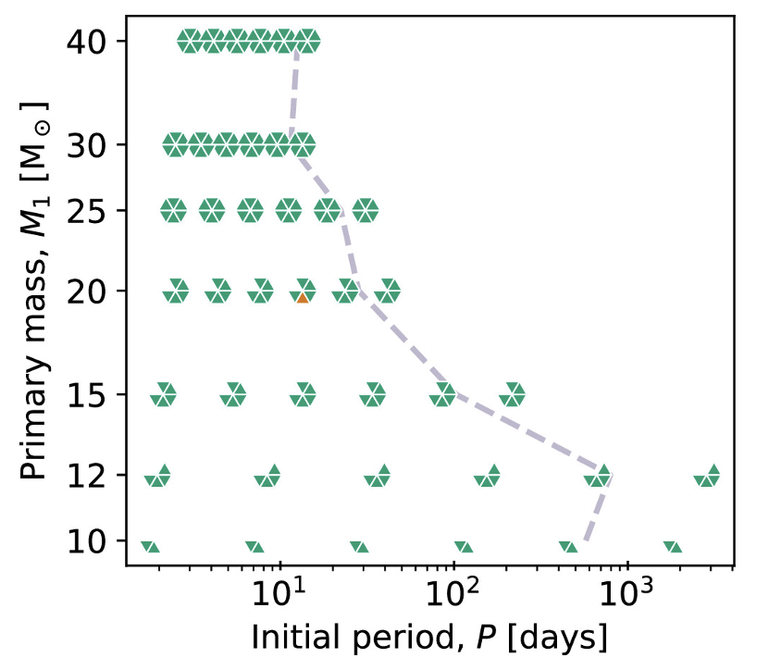

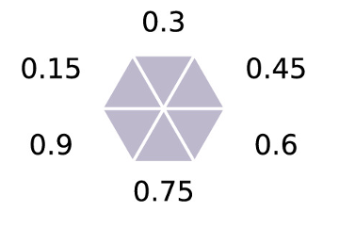
Methods
We employ stellar evolution models to examine mass transfer from binaries
We assign probabilities for each binary based on observations and simulations
We inspect the binary yields in different environments
Nguyen & Sills. 2024, Moe & Di Stefano. 2017
Notes:
The dashed grey lines represents the expected upper limit on the period for binaries of interest based on single-star models at the sampled primary masses.

Slide 6
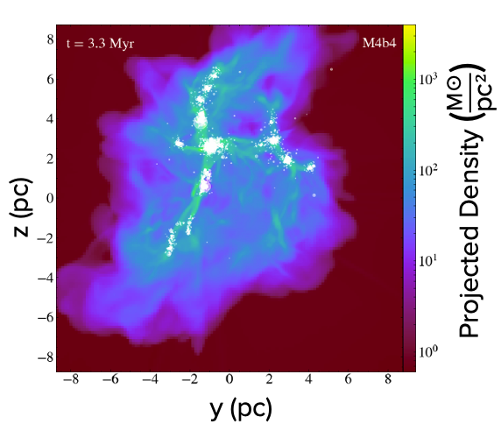
Methods
Different cluster environments are obtained from simulations
Simulations model cluster formation
Including physics of star formation, collisional stellar dynamics, primordial binaries and stellar feedback
Cournoyer-Cloutier et al. 2024b

Slide 7
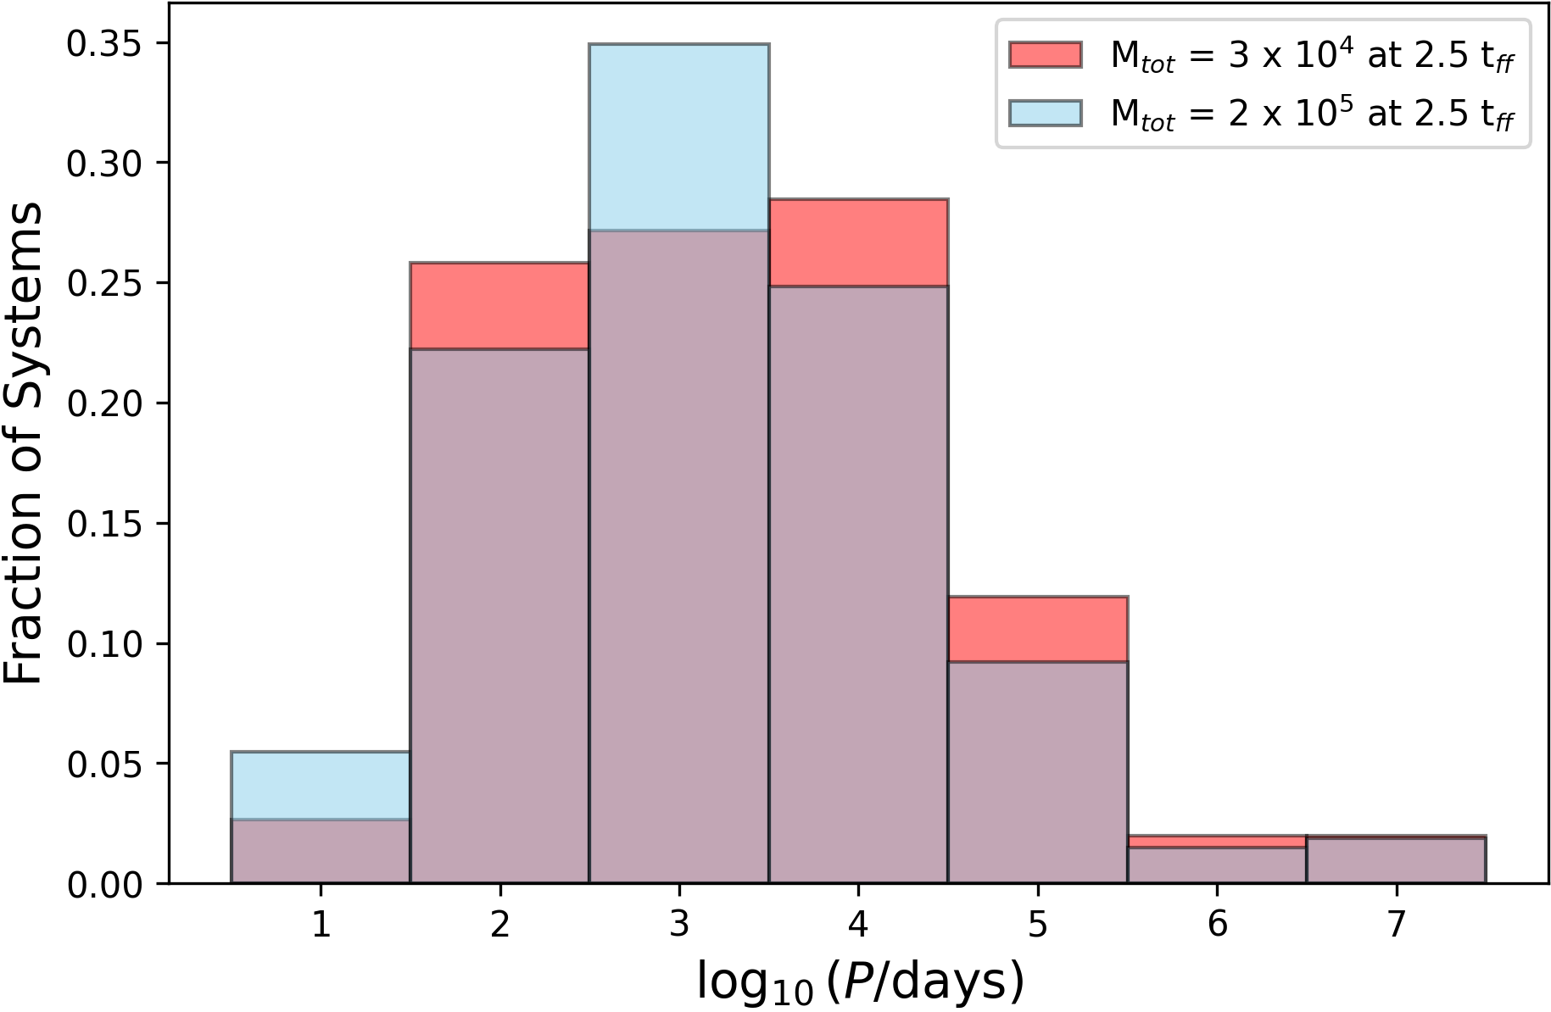
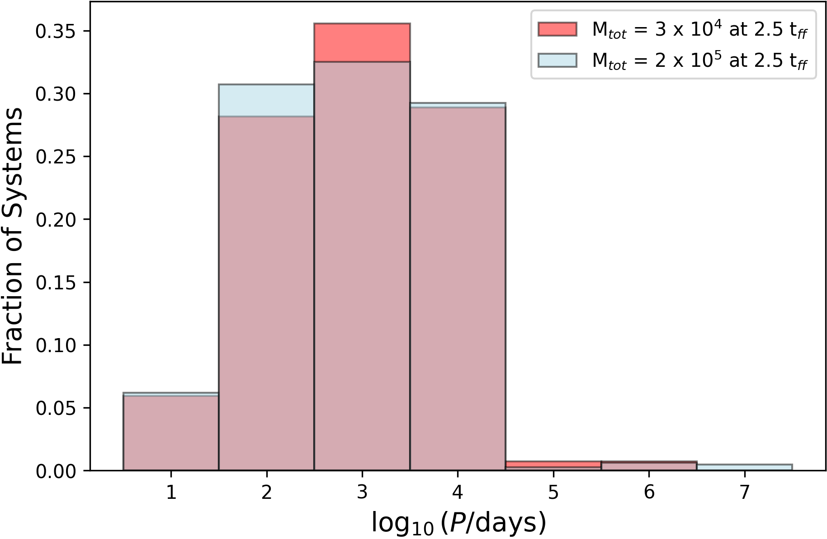
Results – Cluster Mass Comparison
B-type stars
O-type stars

Slide 8
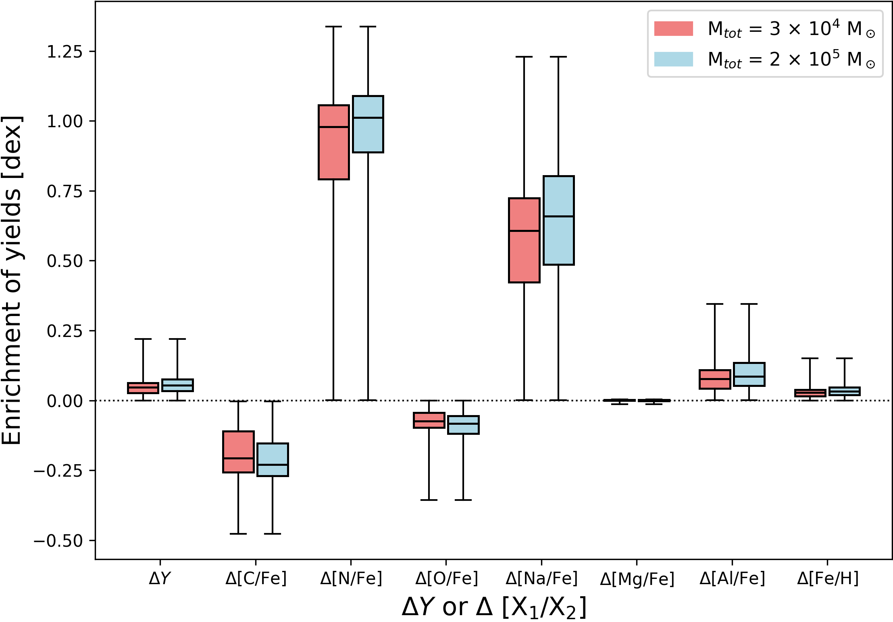
Results – Cluster Mass Comparison

Slide 9
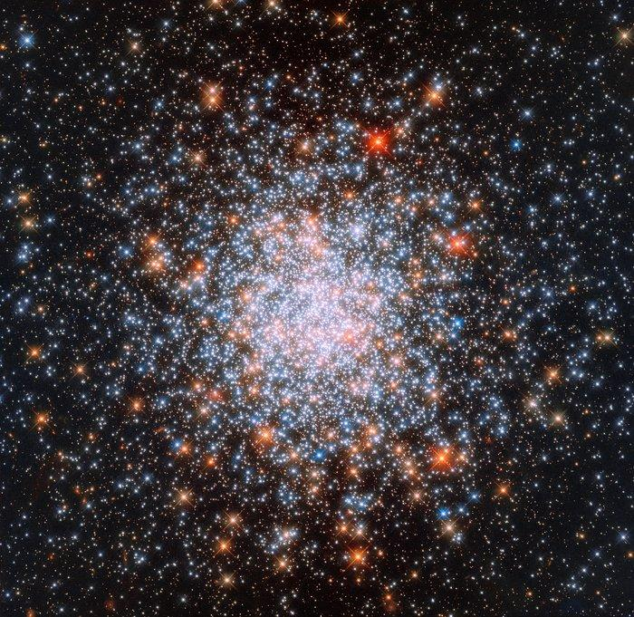


Summary & Future Outlooks
→ Investigate the yields of binary systems for different cluster environments
→ Investigate the amount and timing of ejected material from binaries
Zayna Khadour
khadourz@mcmaster.ca

Slide 10
Additional Slides

Slide 11
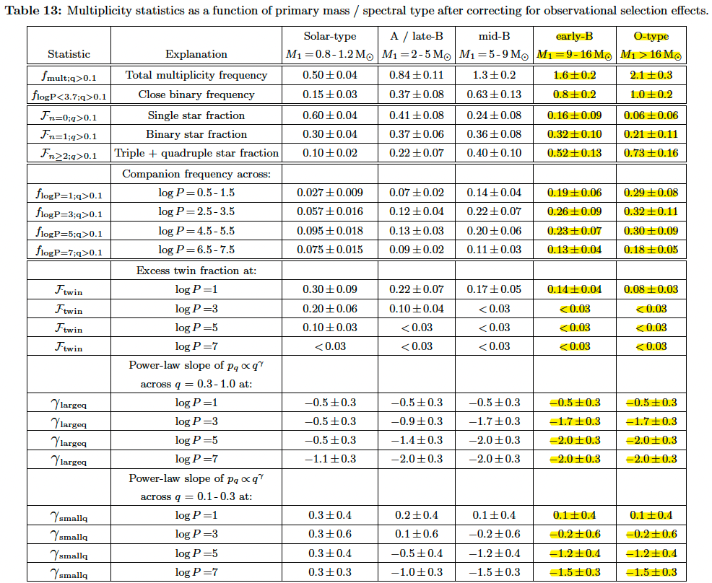
The Moe and DiStefano (2017) Statistics
Notes:
definition of frequency of companions and multiplicity frequency and the relation between them. Provide an example and formulas as well

Slide 12
Probability Grid Calculation
Existence prob = {Binary fraction prob(M₁) x Kroupa prob(M₁) x dM} x
{Period prob(M₁, period) x dP} x
{Mass ratio prob(M₁, period, q) x dq}

Slide 13
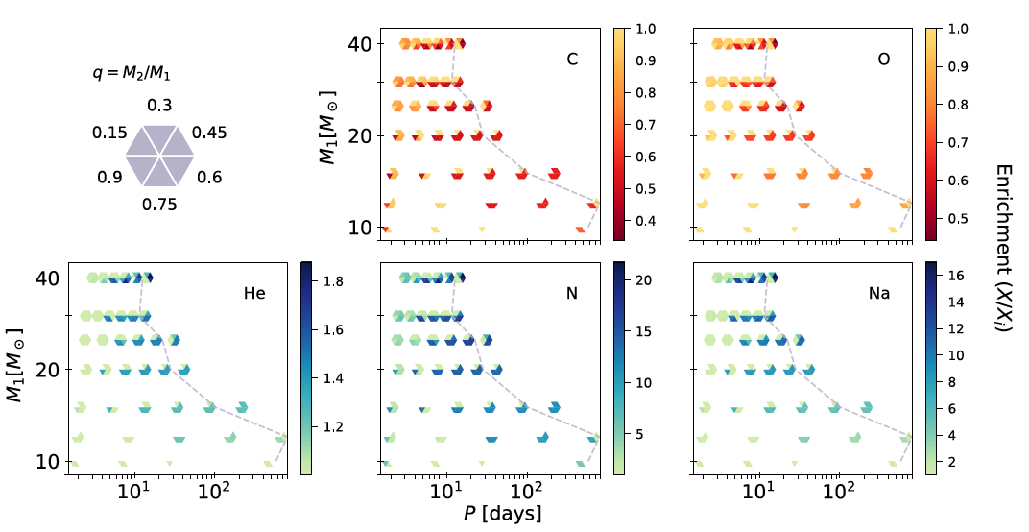
Figure 4 from Nguyen & Sills (2024)
Notes:
enrichment is the relative change in the mass fraction of the element compared to the initial surface abundances

Slide 14
Question – What is the mass budget problem?
Pop2 stars often comprise > 50% of the cluster
Any proposed source must eject enough material to form them
IMBs return approx. 25% of their mass in ejecta (Nguyen & Sills, 2024)
Notes:
de Mink et al 2009 suggest a larger contribution of mass from massive binary ejecta compared to AGB and FRMS yield is possible.
High binary fractions → more systems ejecting material.
Early ejection (≲10 Myr) → consistent with no age spread.
Dynamically modified binaries in dense clusters → more interactions → more mass loss.

Slide 15
Other enrichment sources/theories?
Source | Enrichment timescale | Pros | Cons
AGB stars (3.5 – 8 M☉) | 30 – 100 Myr after cluster formation | Can produce observed light-element trends | Too late → no observed aga spreads Mass budget problem remains Predicts Fe spreads → not seen
Fast Rotating Massive Stars (FRMS) | < 10 Myr | Early ejecta, no age spreads, can produce Na-O anticorrelation | Requires extreme rotation rates, unclear if stars exist in sufficient numbers, mass budget problem remains
Interacting Massive Binaries | < 10 Myr | Observationally supported (high binary fractions), early ejecta, enrichment consistent with MPs | Mass budget problem remains, unclear if sufficient enrichment occurs across all clusters
Bastian & Lardo. 2018
Notes:
Some globular clusters show very large spreads in He and light elements (e.g., NGC 2808 with ΔY ≳ 0.15 and extreme Na-O anticorrelations), while others show much milder spreads. Can the same binary physics explain both mild and extreme cases?

Slide 16
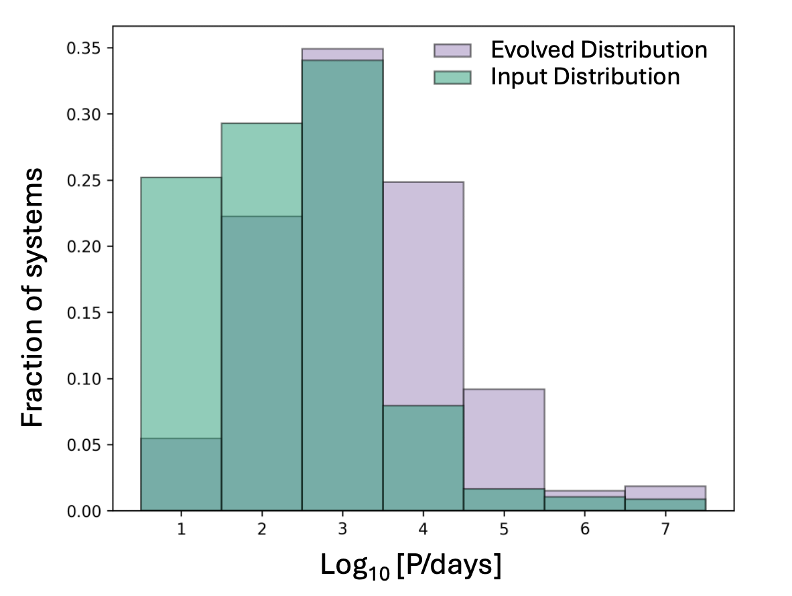
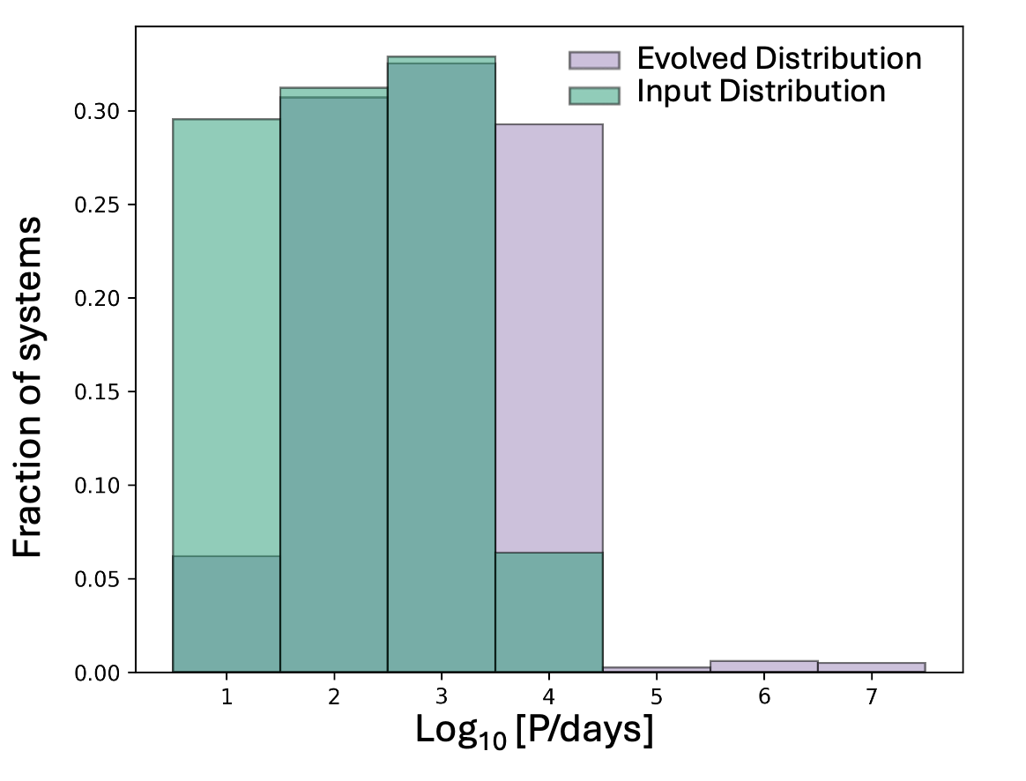
Results -1 Environment Comparison
B-type stars
O-type stars
Moe & Di Stefano. 2017, Cournoyer-Cloutier et al. 2024b
Notes:
Green → compilation of observation from Moe+ and the purple is the simulation output from Cournoyer- + 2024b
The binaries in the different environments undergo dynamical evolution in the simulation (of cluster formation that includes star formation, and collisional stellar dynamics, primordial binaries, stellar feedback) know exactly (resolve) where each star is and when
These are just examples of random output snapshots from the simulations. Or, compare essentially an analytical prescription from Moe & Di Stefano to simulation output.
Make labels 20 pt

Slide 17
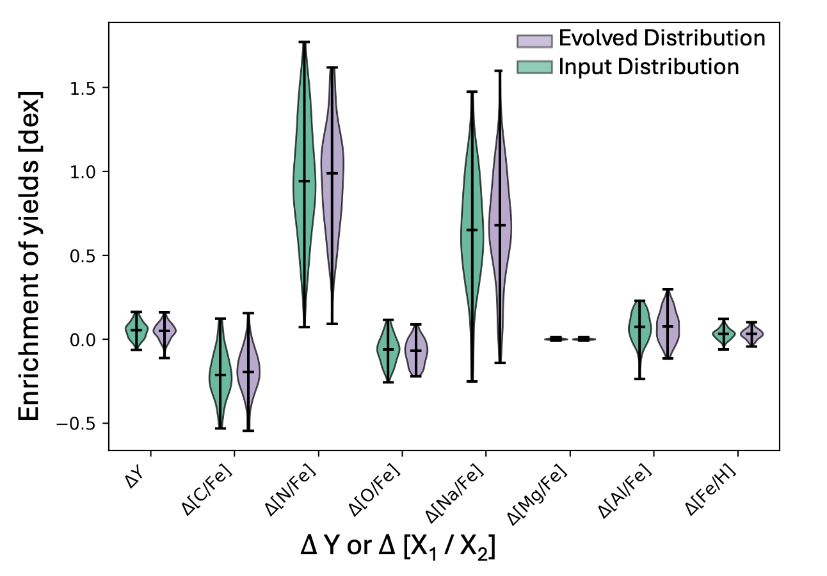
Results -1 Environment Comparison
B-type stars
Notes:
N enrichment is obvious in high redshift galaxies, provide more clear and comprehensive explanation, say it is a violin plot, say what axes are, give an example for N, highlight that the distribution of systems is different in the two environments, if times permits, give an example for a more subtle element (Na)

Slide 18
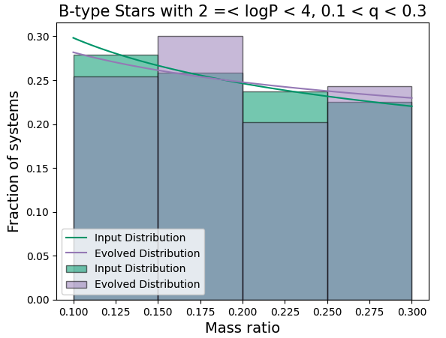
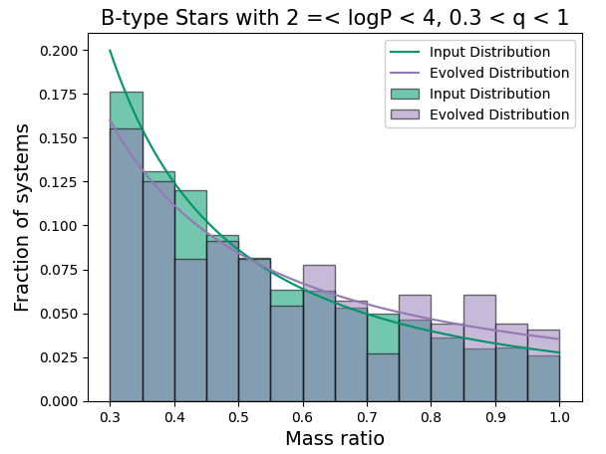
Results -1 Environment Comparison
Input distribution: g_{small} = - 0.28
Evolved distribution: g_{small} = - 0.19
Input B-type bin. fraction = 84%
Input distribution: g_{large} = - 1.64
Evolved distribution: g_{large} = - 1.26
Evolved B-type bin. fraction = 82%

Slide 19
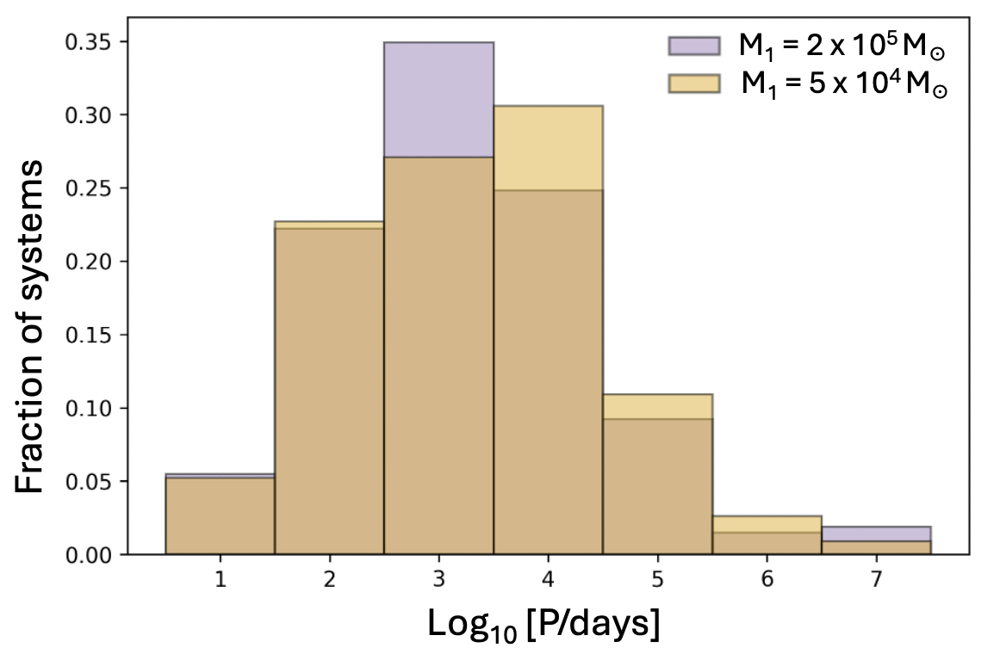
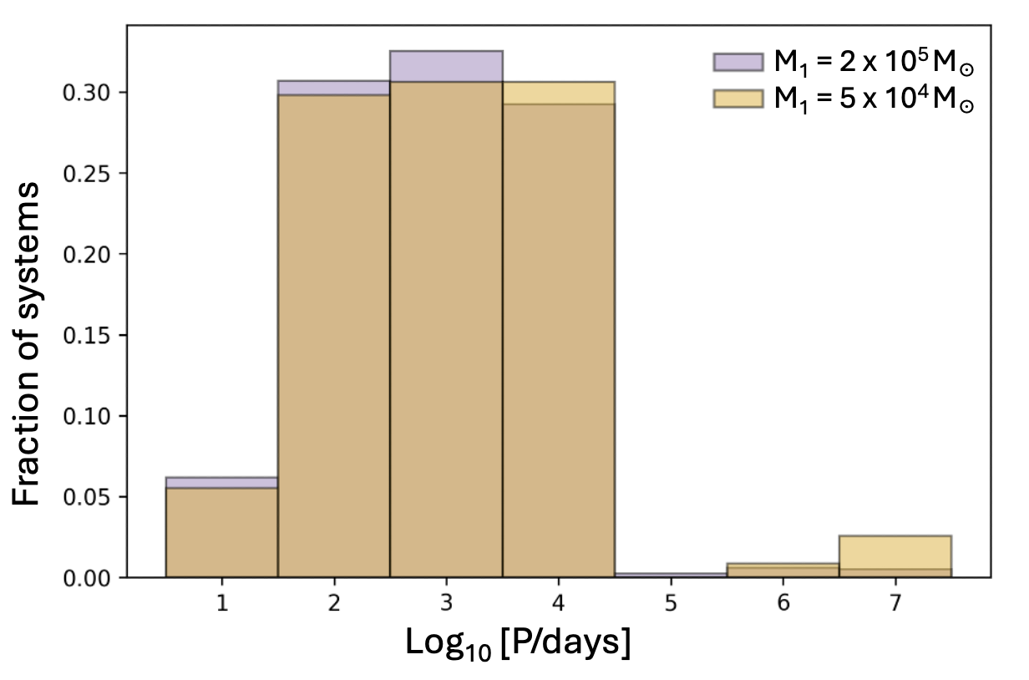

Results -2 Time Evolution Comparison
t = 2.5 t_{ff}
t = 1.5 t_{ff}
t = 2.5 t_{ff}
t = 1.5 t_{ff}
B-type stars
O-type stars
2 x 10⁵ M☉
5 x 10⁴ M☉
Cournoyer-Cloutier et al. 2024b
Notes:
Cluster 1 = 2E5 M_sun, Cluster 2 = 5E4 M_sun
These are the same initial conditions, but they are roughly after 2.5, 1.5 respective, free fall times

Slide 20
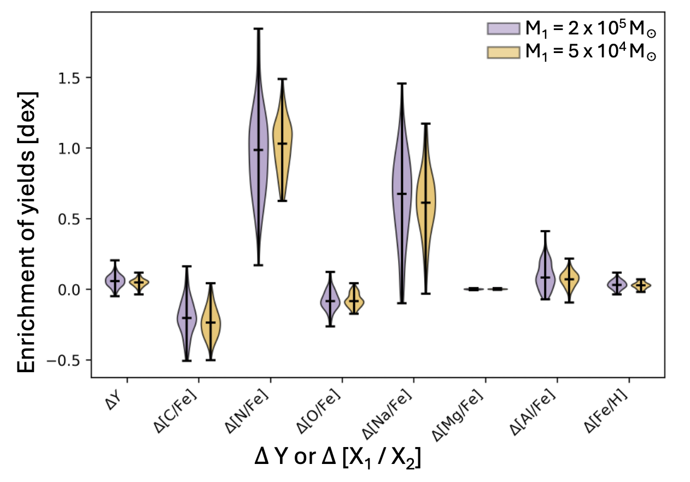
Results -2 Time Evolution Comparison
t = 2.5 t_{ff}
t = 1.5 t_{ff}
t = 2.5 t_{ff}
t = 1.5 t_{ff}
B-type stars
Notes:
Difference in spread for He

Slide 21
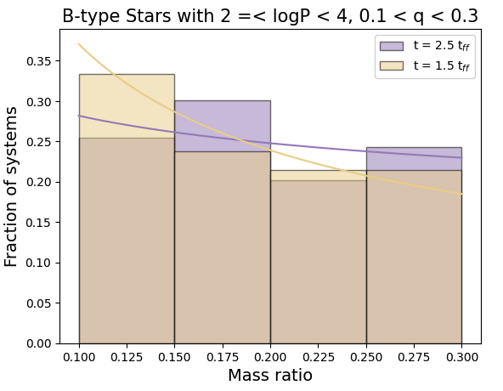
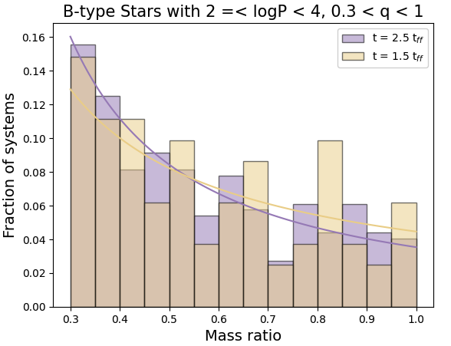
Results -2 Time Evolution Comparison
Purple distribution: g_{small} = - 0.19
Yellow distribution: g_{small} = - 0.63
Purple B-type bin. fraction = 82%
Purple distribution: g_{small} = - 1.26
Yellow distribution: g_{small} = - 1.15
Yellow B-type bin. fraction = 92%

