Slide 1
Intelligent FRB detection
Aylar Sedaei
April 2025

Slide 2
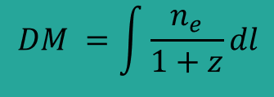
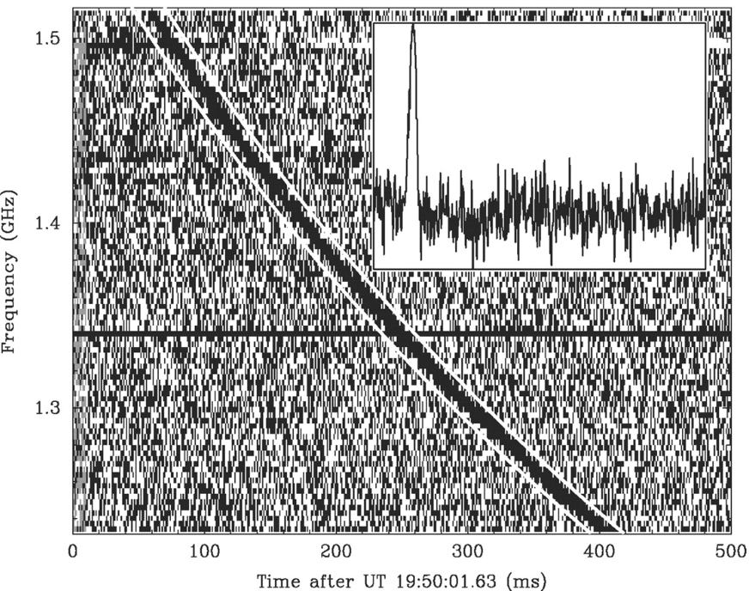
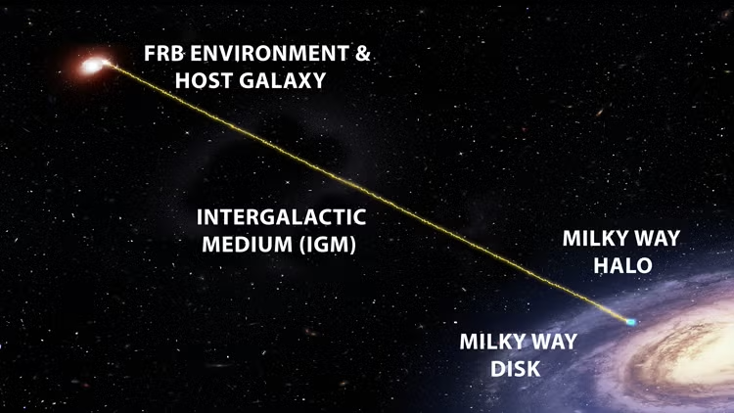
Fast Radio Bursts
First detection: by Lorimer et al. in 2007
Waterfall plots: a brief (millisecond-duration) burst in a wide range of radio frequency.
Dispersion Measure: too high to be originated inside our galaxy.

Slide 3
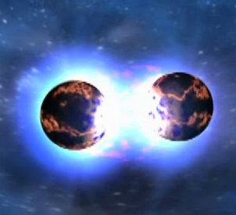
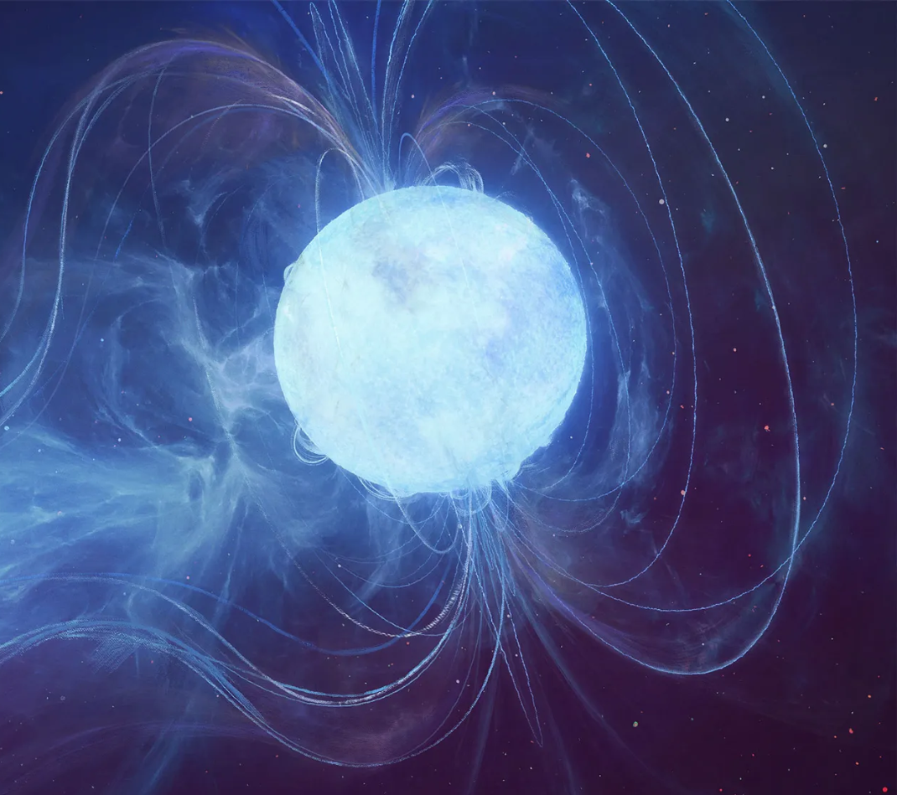
Fast Radio Bursts
Repeating FRBs: Some FRBs detected multiple times! (There’s even a periodic one.)
Possible candidates:
Magnetars
Interacting neutron stars
Black holes
Credit: NASA/CXC/A, Hobart

Slide 4
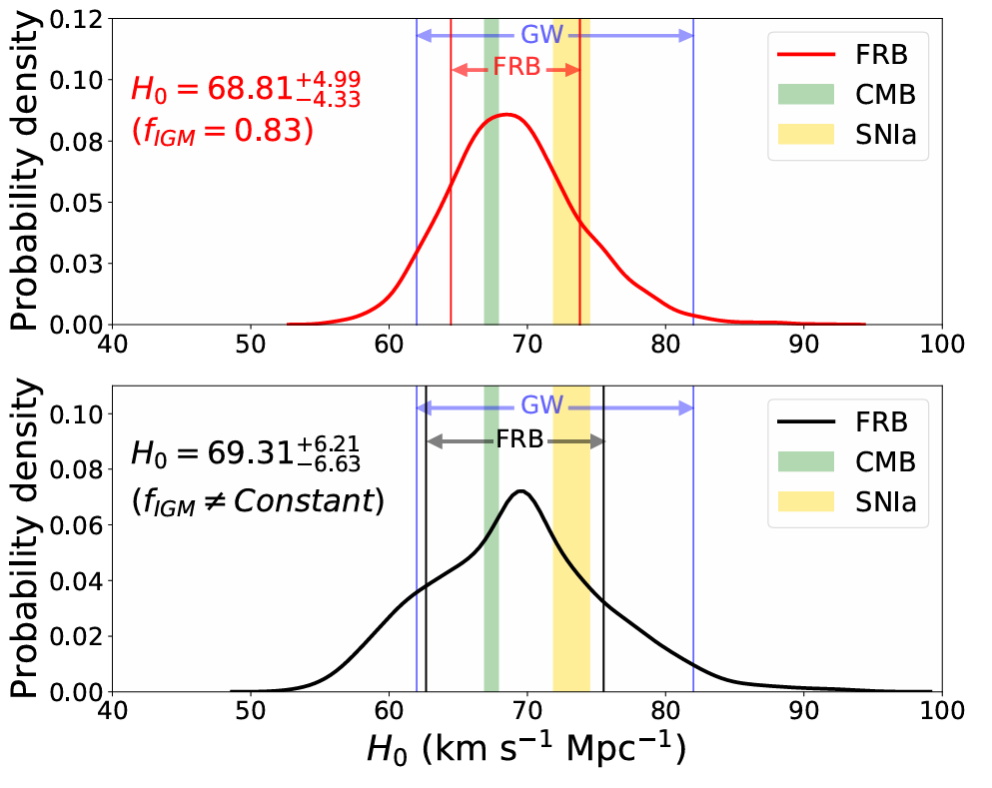
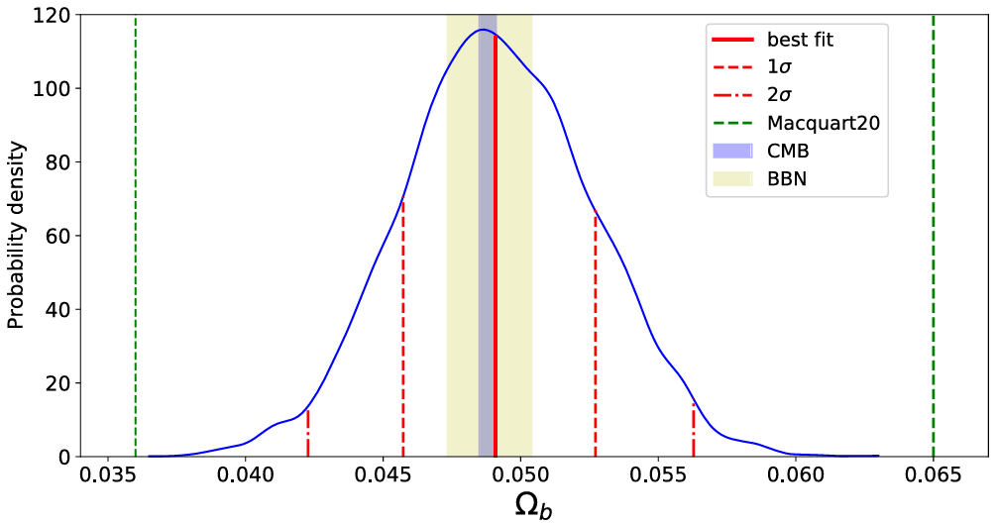
Applications
Probing missing baryons
Measuring the Hubble parameter
Gravitational lensing of FRBs
…Motivating the need for more detections.
Yang, K.B., Wu, Q. and Wang, F.Y. (2022). Finding the Missing Baryons in the Intergalactic Medium with Localized Fast Radio Bursts.
In cosmology
Wu, Q. and Wang, F.-Y. (2024). Statistical properties and cosmological applications of fast radio bursts.

Slide 5
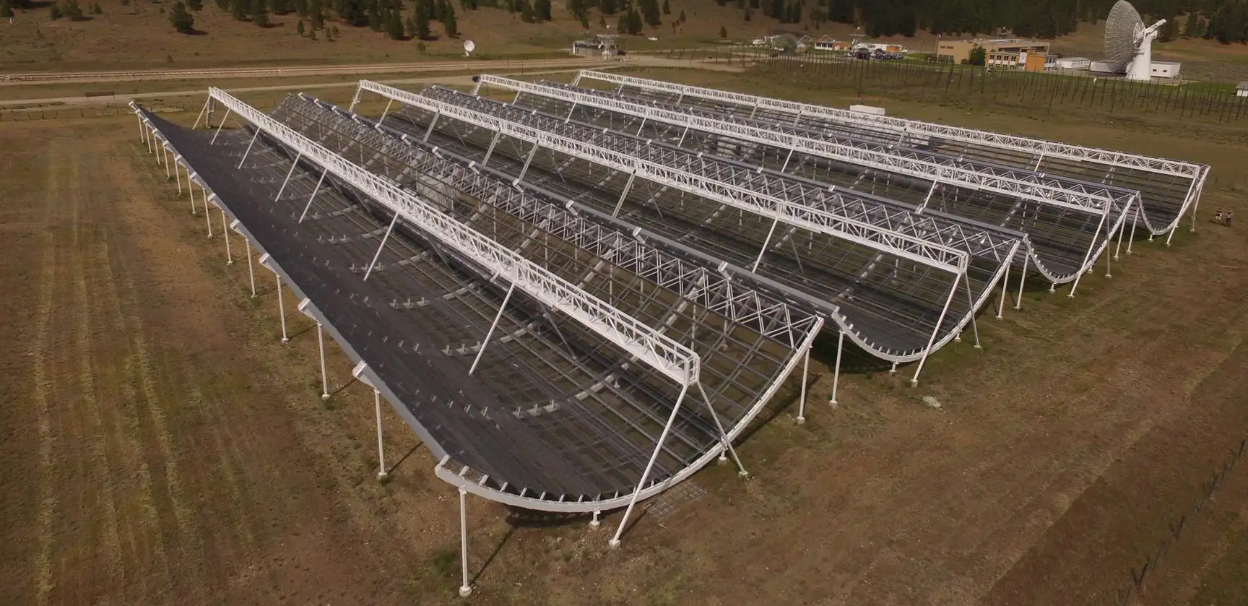
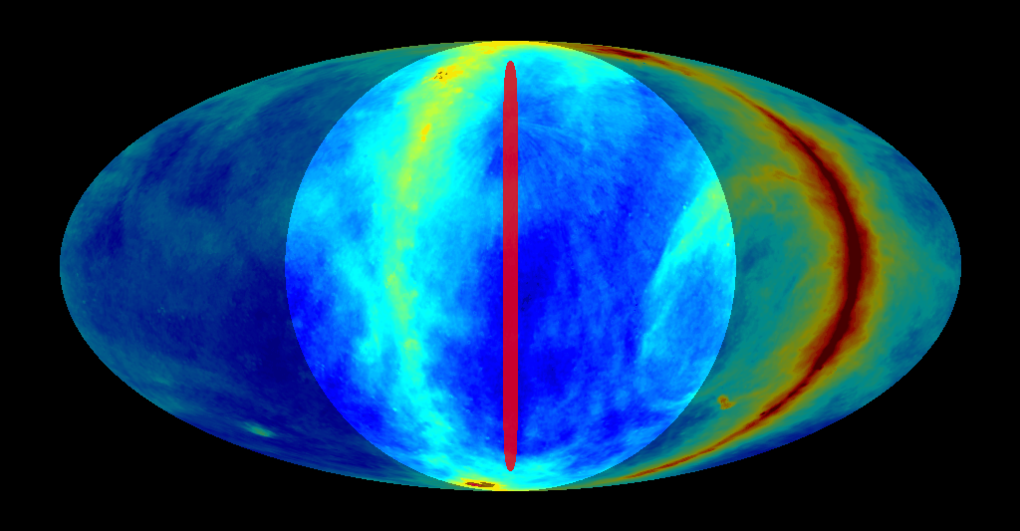
Introducing CHIME
Large field of view due to the cylindrical architecture (110°×2.5°)
Sweeps the whole northern hemisphere everyday in the 400-800 MHz band
Detects ‍‍~ 1000 FRBs per year
Able to localize every detected FRB using 3 outrigger telescopes
Need to process data in real-time basis

Slide 6
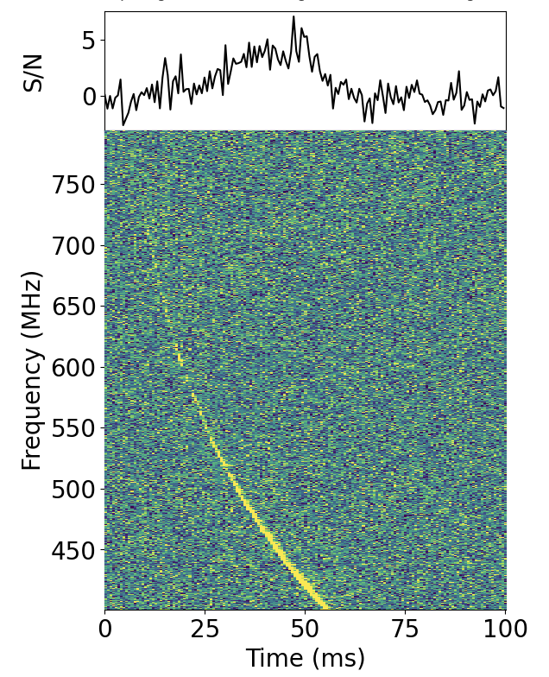
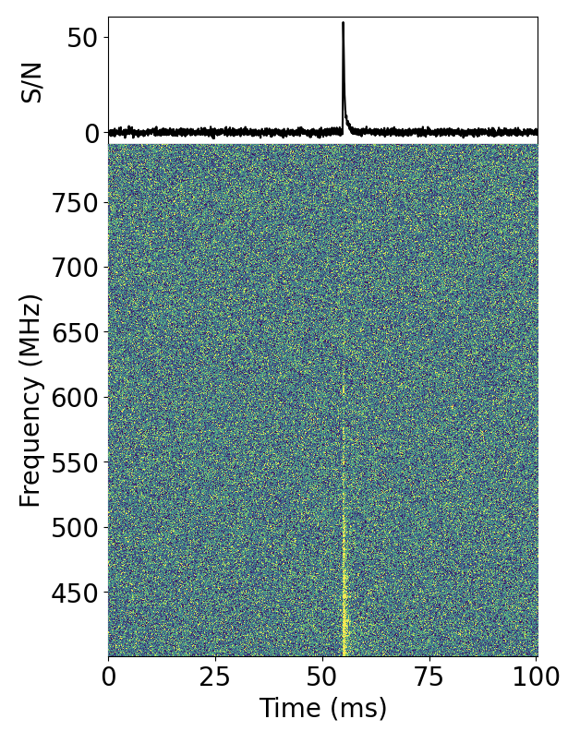
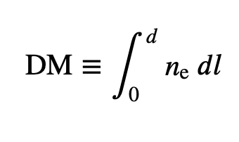
FRB Detection Process
Events passing early filters are buffered and undergo multiple stages to minimize false positives.
Final candidates are manually reviewed by "tsars," Human classifiers who classify them into five categories: New Candidate, Known Candidate, Known Source, RFI, or Faint.
Dispersion measure

Slide 7
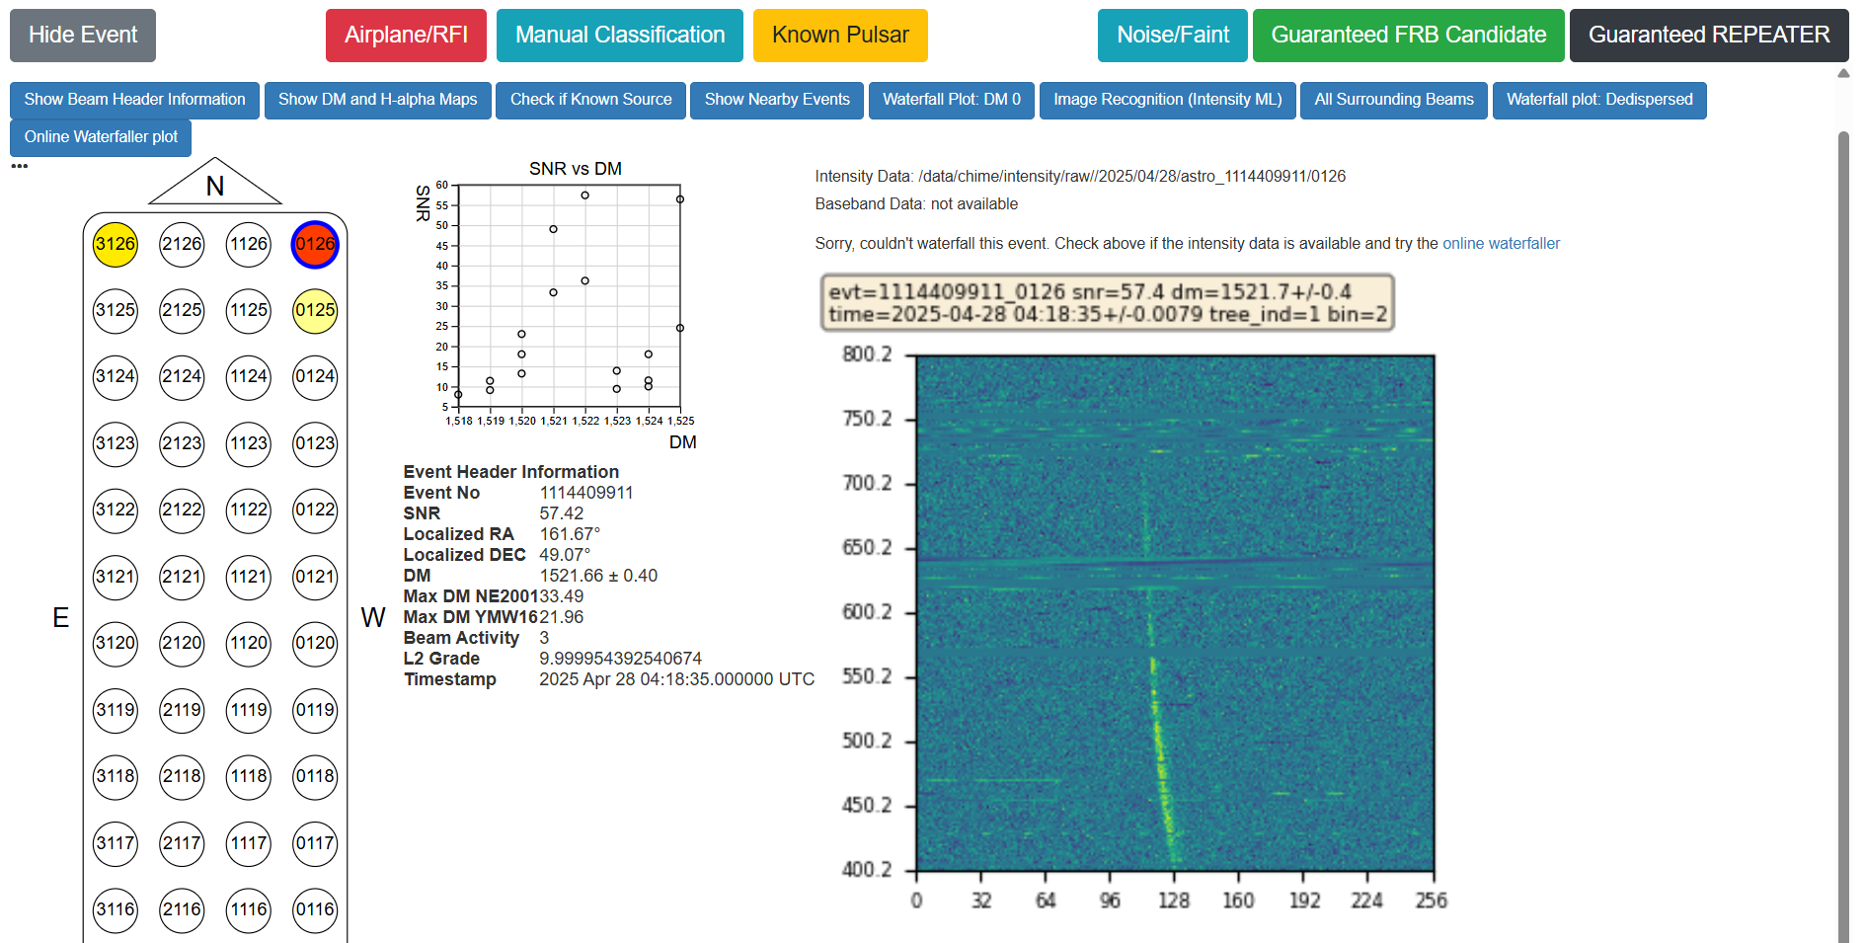
FRB Detection Process: Tsarring

Slide 8
Idea: Replacing tsars with an automated classifier
AI can classify the events using their waterfall plots with high confidence.
Saving several human hours: No need to flag FRBs manually.
CHORD, an extension of CHIME still in construction process, is expected to have a data stream with many orders of magnitude more amount.
First step: developing a binary classifier to distinguish FRB sources using waterfall plots.
Vision Transformers are attention-based image recognition models perfect for the job.

Slide 9
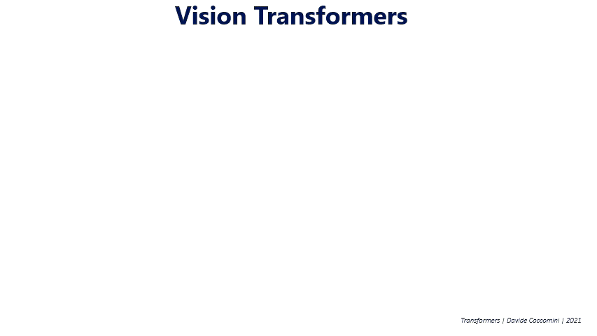
Wikipedia.org. (2021). File:Vision Transformer.gif - Wikipedia. [online]
Notes:
Vision Transformers (ViTs) are a type of deep learning model that analyzes images by dividing them into small parts (called patches) and understanding the relationships between those parts.
Instead of using filters like in traditional convolutional neural networks (CNNs), they use a method called "self-attention" to focus on important areas of the image.

Slide 10
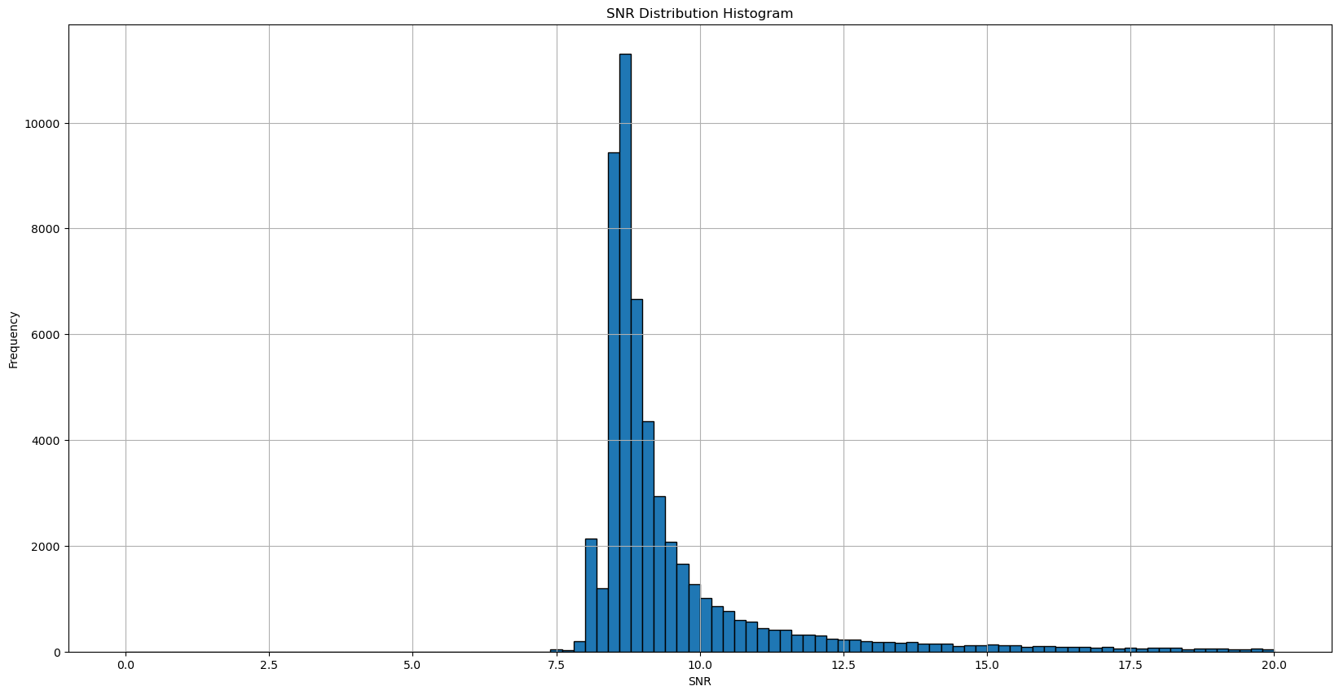
Dataset properties
Source: Waterfall plots from CHIME/FRB’s labelled events (2019 to 2024)
Filtering: SNR ⩾ 9, Excluding events labelled by people other than tsars (citizen scientists from Zooniverse, etc.)
Dataset split:
# Astro: 14,719
# RFI: 22,168
70% training set
20% validation set
10% prediction set

Slide 11
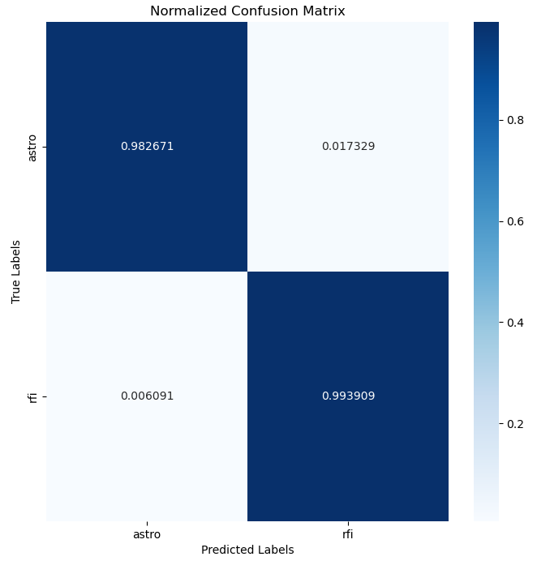
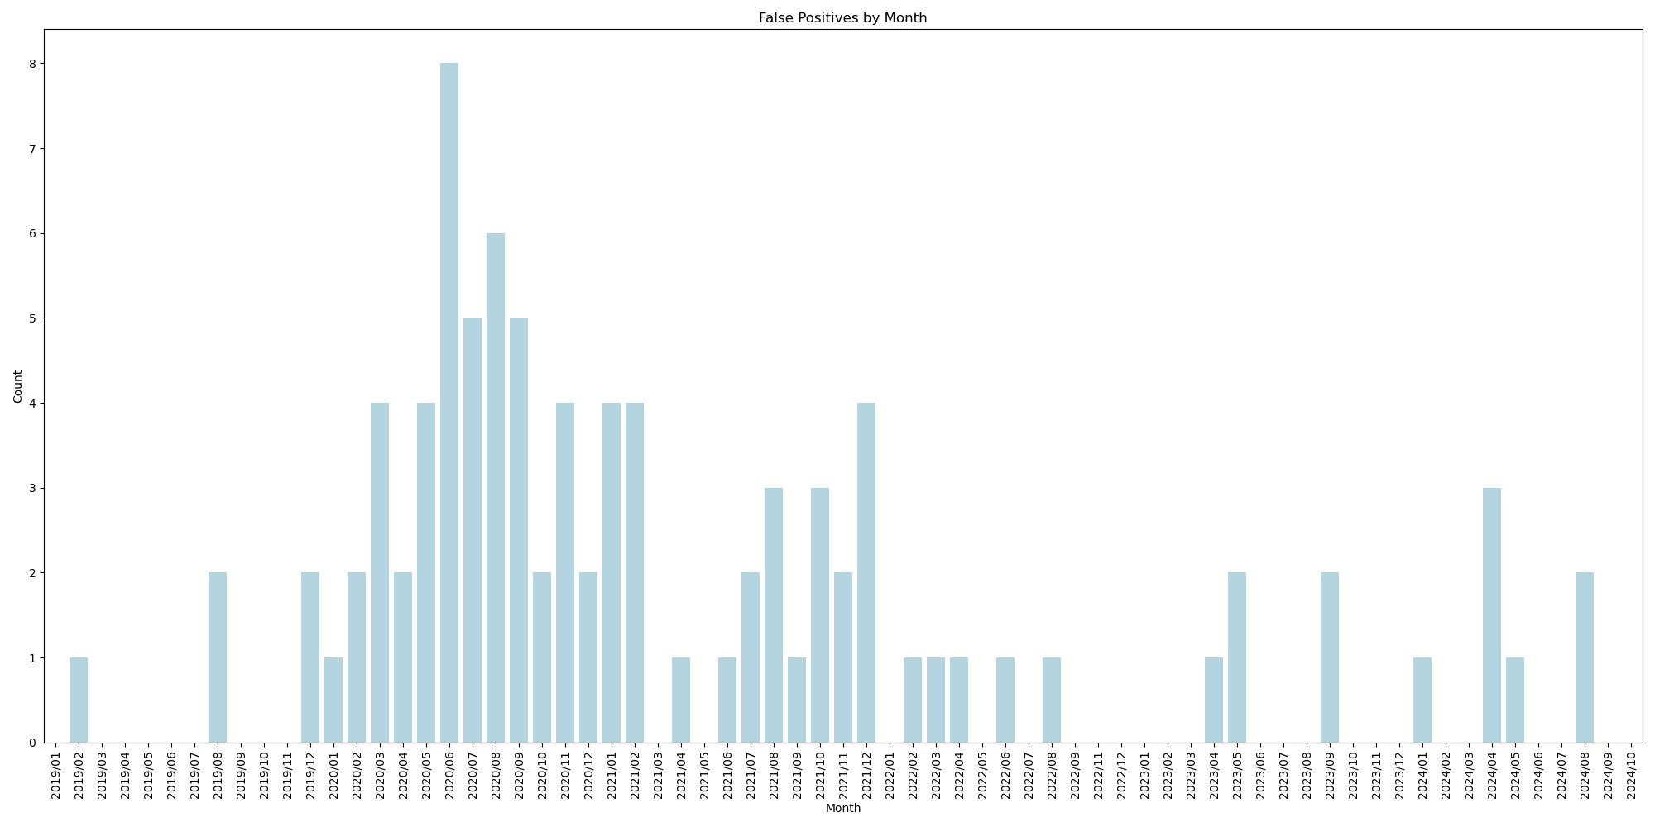
Software used and Model properties
Pytorch python package
Pretrained Vit_b_16 weights: trained on ImageNet 1K dataset (1000 classes, each with 100 images)

Slide 12
Future Plans
Benchmark with FETCH: Compare the transformer model to FETCH using waterfall plots.
Extend to Multi-Class: Train the model to classify into five CHIME/FRB categories.
Improve Faint/RFI Separation: Use clustering to know different kinds of RFI.
Integrating into CHIME’s Pipeline: Deploy the classifier into CHIME/FRB and CHORD real-time systems.
Sharing Results: Present at conferences and submit a journal paper.

Slide 13
Conclusion
Although the nature of Fast Radio Bursts is unknown, they can be used as an independent way to measure important cosmological parameters.
When CHORD is live, its pipeline should be more optimized than CHIME.
Vision transformers can replace human classifiers with a high confidence.

