Slide 1
Constraining cosmology with next-generation gravitational wave detectors
Isaac Rosenberg
Supervised by Professor Maya Fishbach
EXPLORE 2025 Summer School

Slide 2
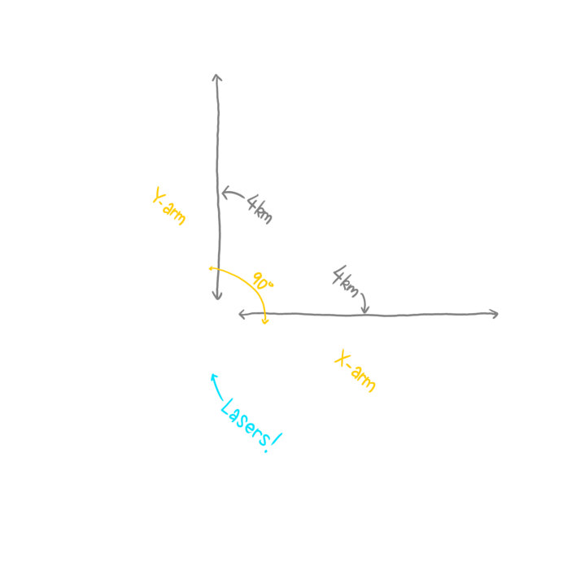
Geraint Lewis, The Conversation

Slide 3
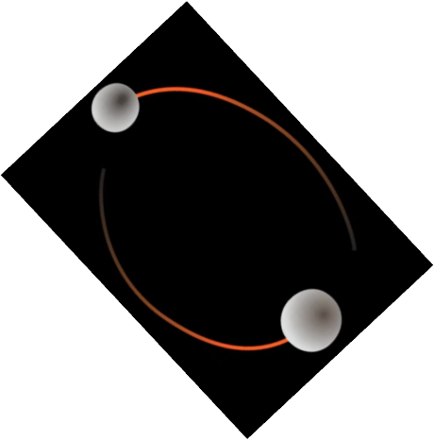
Geraint Lewis, The Conversation

Slide 4
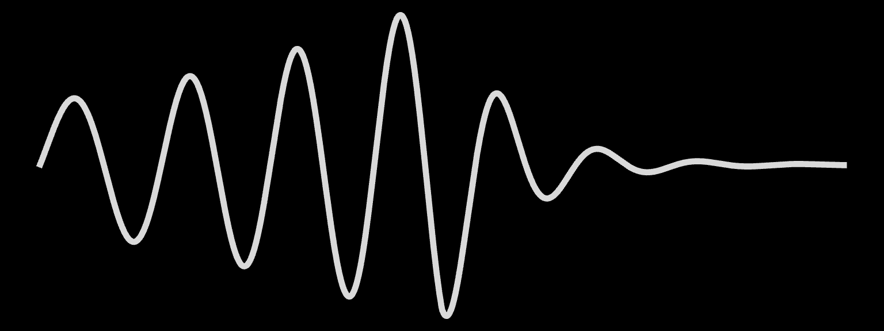
Geraint Lewis, The Conversation

Slide 5
M
Geraint Lewis, The Conversation

Slide 6
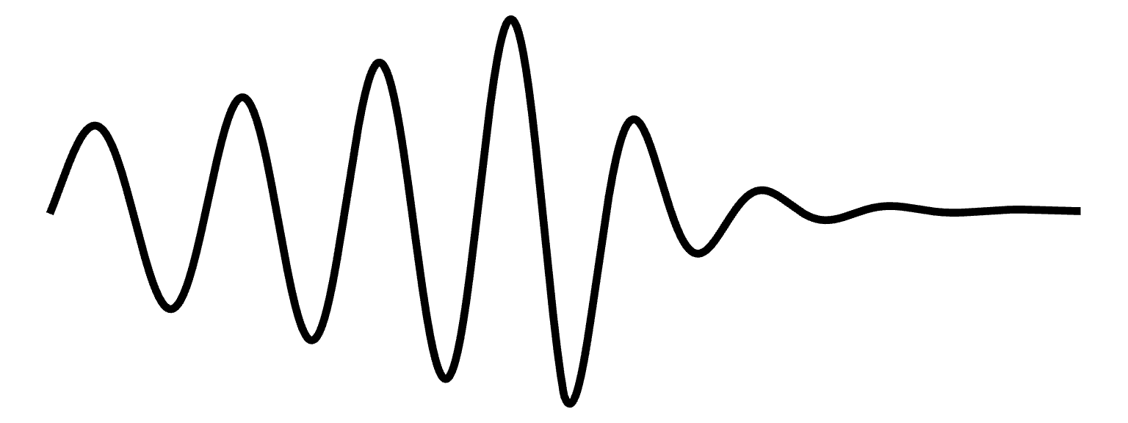
M
M/D_{L}
Geraint Lewis, The Conversation

Slide 7
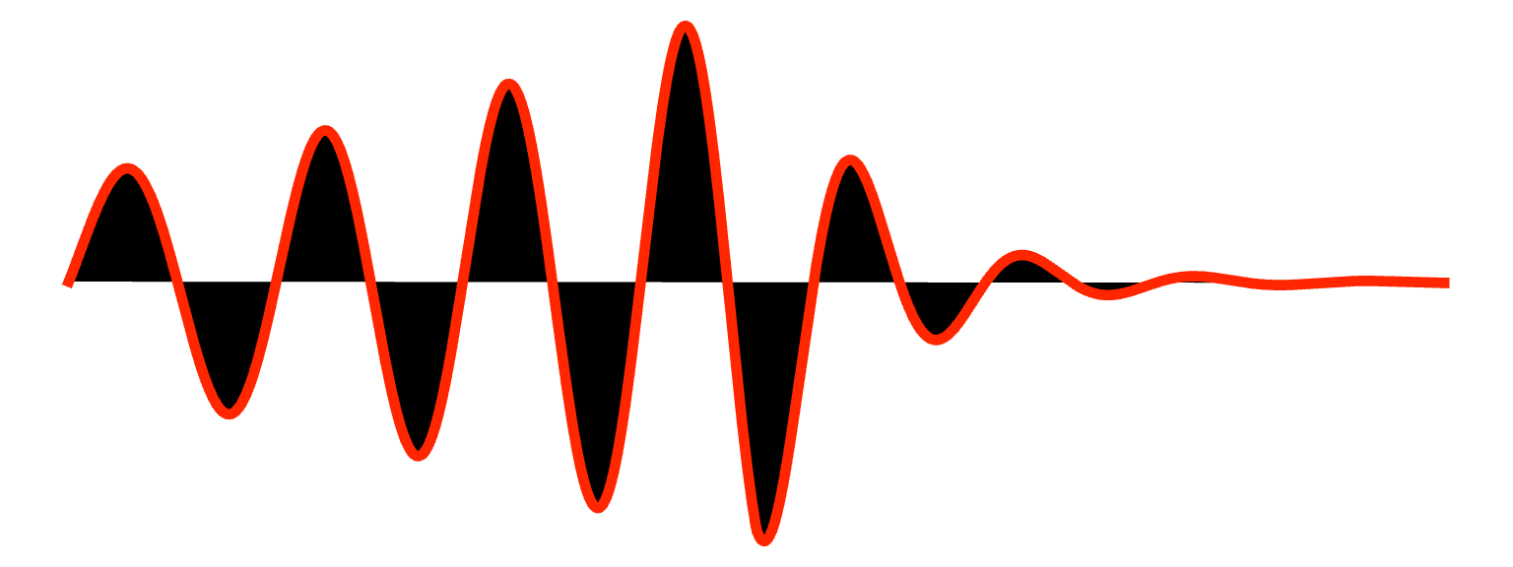
M
M/D_{L}
Geraint Lewis, The Conversation

Slide 8


M
M/D_{L}
Geraint Lewis, The Conversation

Slide 9
M (1 + z)
M (1 + z)/D_{L}
Geraint Lewis, The Conversation

Slide 10
M (1 + z)
M (1 + z)/D_{L}
We need:
-redshift
-luminosity distance
Geraint Lewis, The Conversation

Slide 11

M (1 + z)
M (1 + z)/D_{L}
We need:
-redshift
-luminosity distance
Geraint Lewis, The Conversation

Slide 12

M (1 + z)
M (1 + z)/D_{L}
We need:
-redshift
-luminosity distance
Geraint Lewis, The Conversation

Slide 13
Standard siren redshift inference

Slide 14
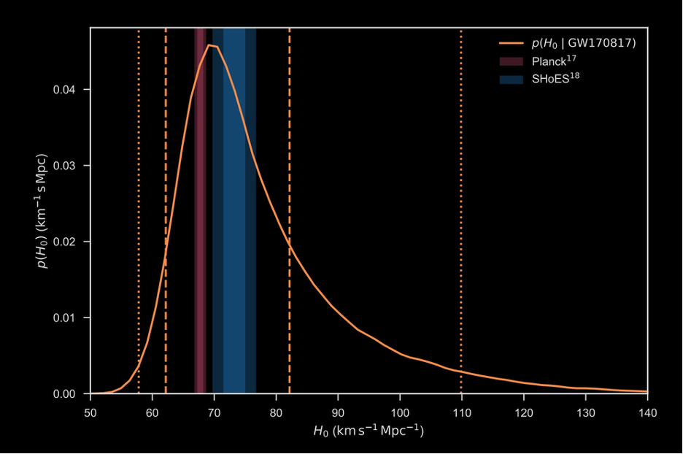
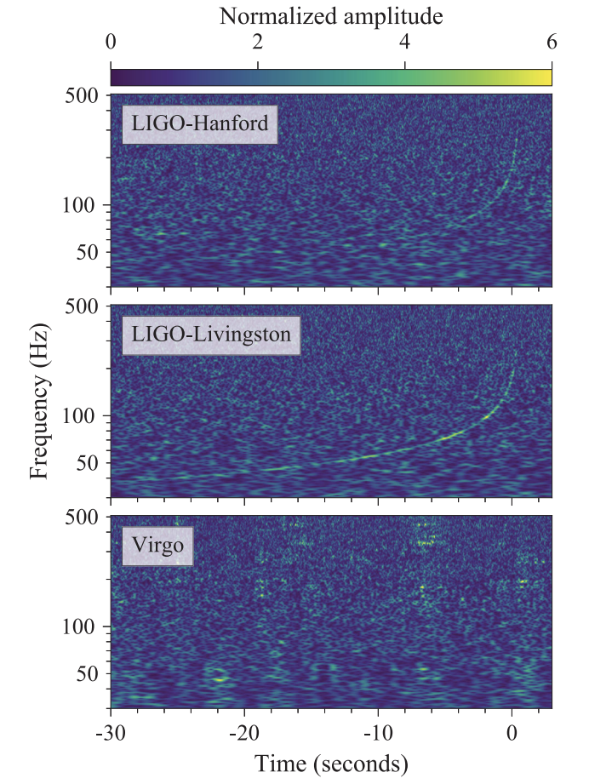
Standard siren redshift inference
Bright sirens

Slide 15
Bright sirens: GW170817
Electromagnetic counterpart to the merger. Direct redshift estimate.
Abbott + 2017
Abbott + 2017

Slide 16
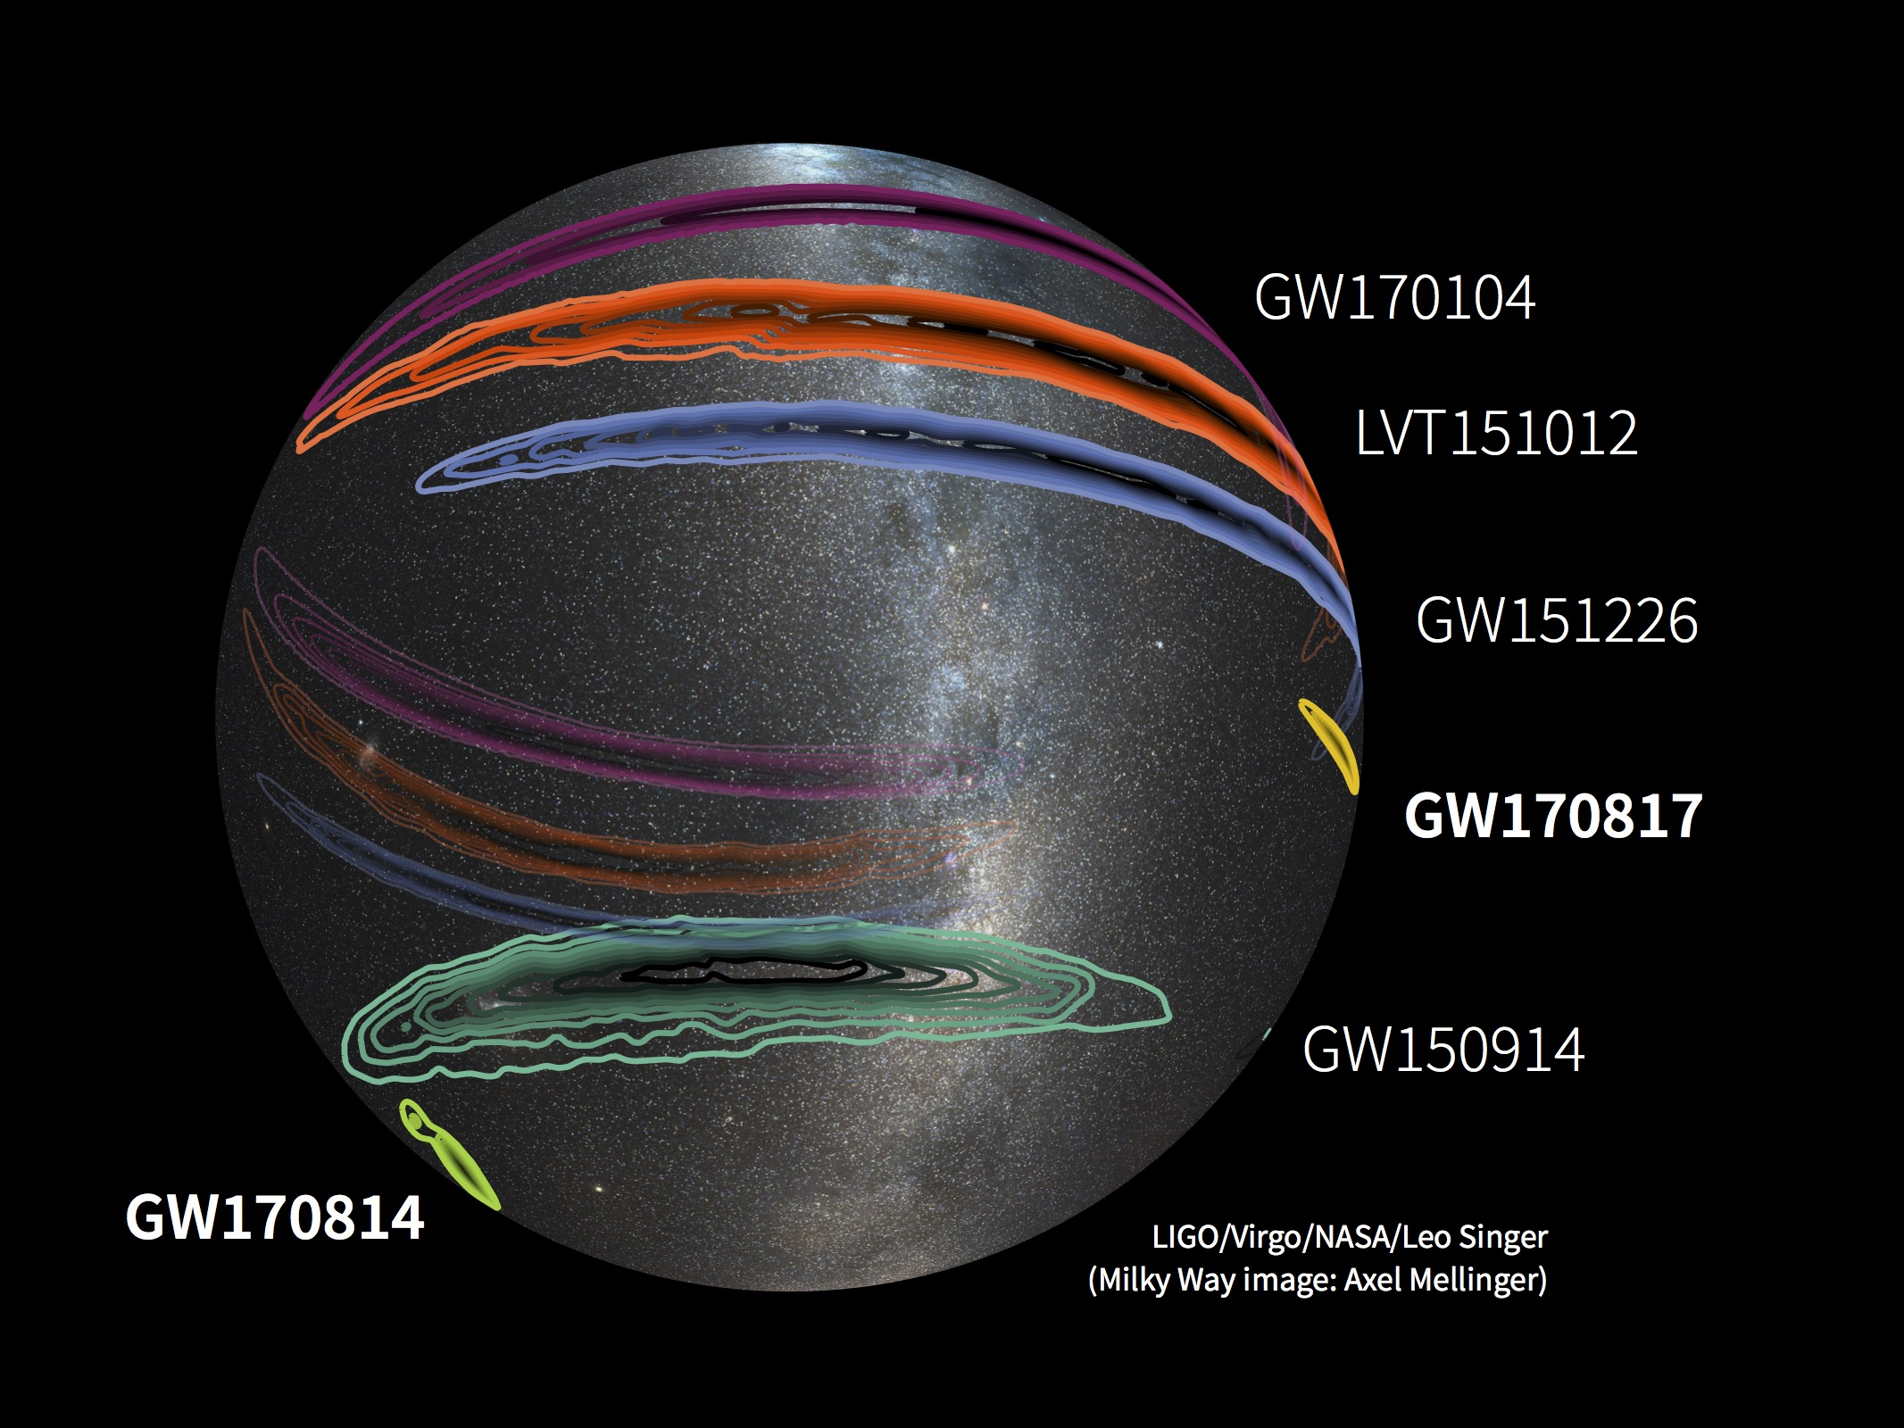
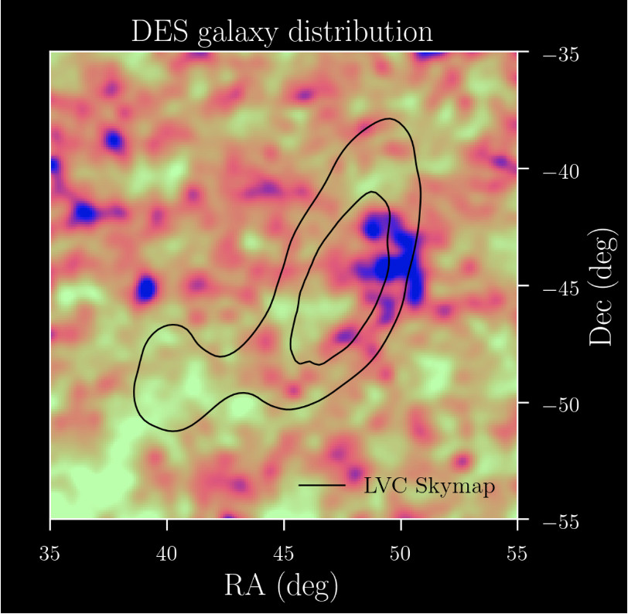
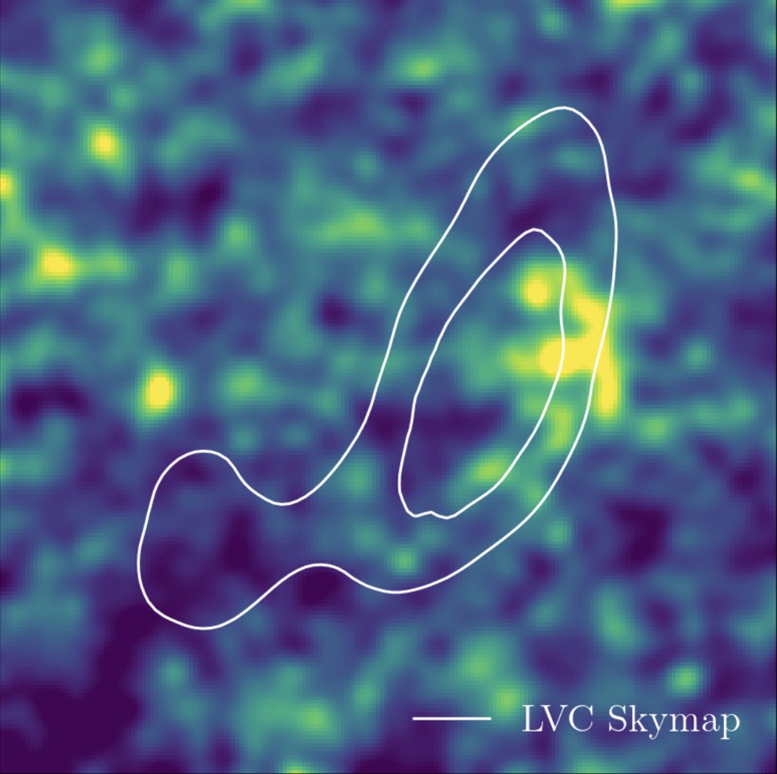
Standard siren redshift inference
Bright sirens
Dark sirens

Slide 17
Dark sirens: marginalizing over galaxy catalog
Without an electromagnetic counterpart, we can consider all galaxies in the localization volume.
Palmese + 2019

Slide 18
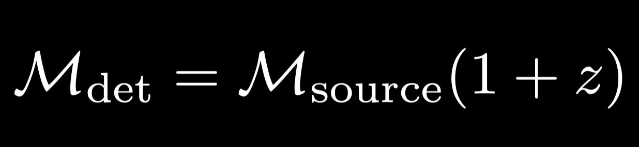
Standard siren redshift inference
Bright sirens
Dark sirens
Spectral sirens

Slide 19
Spectral sirens: extract redshift from features in the mass distribution

Slide 20
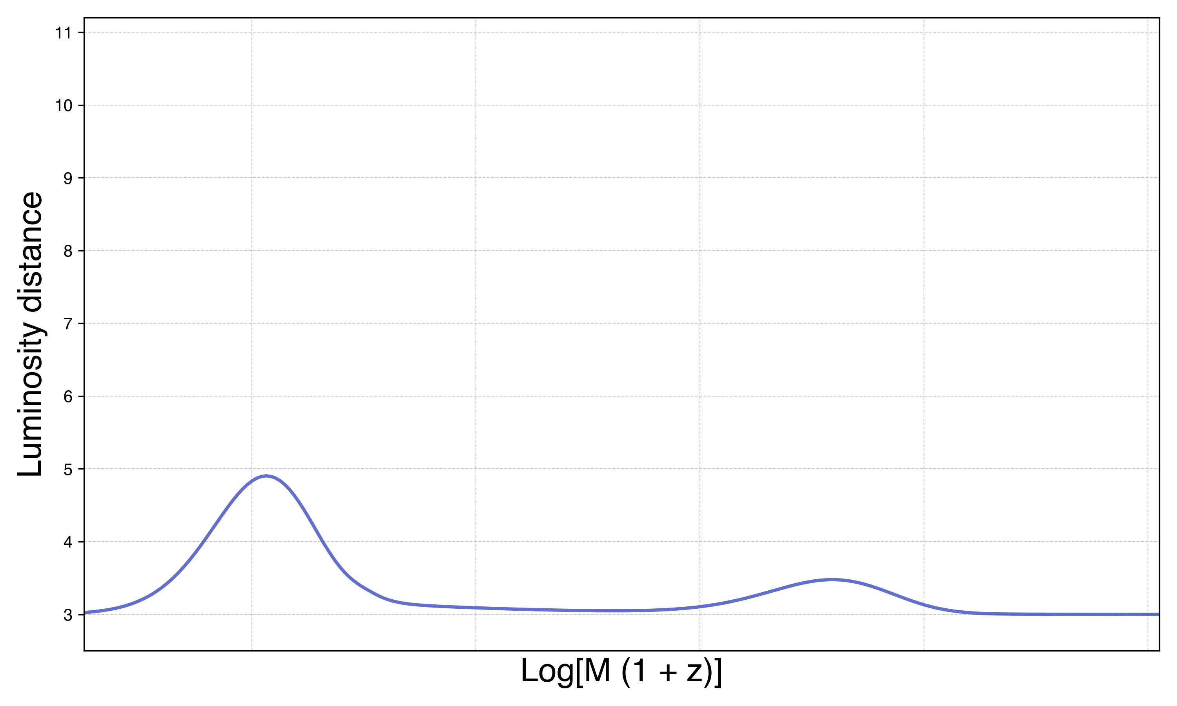

Slide 21
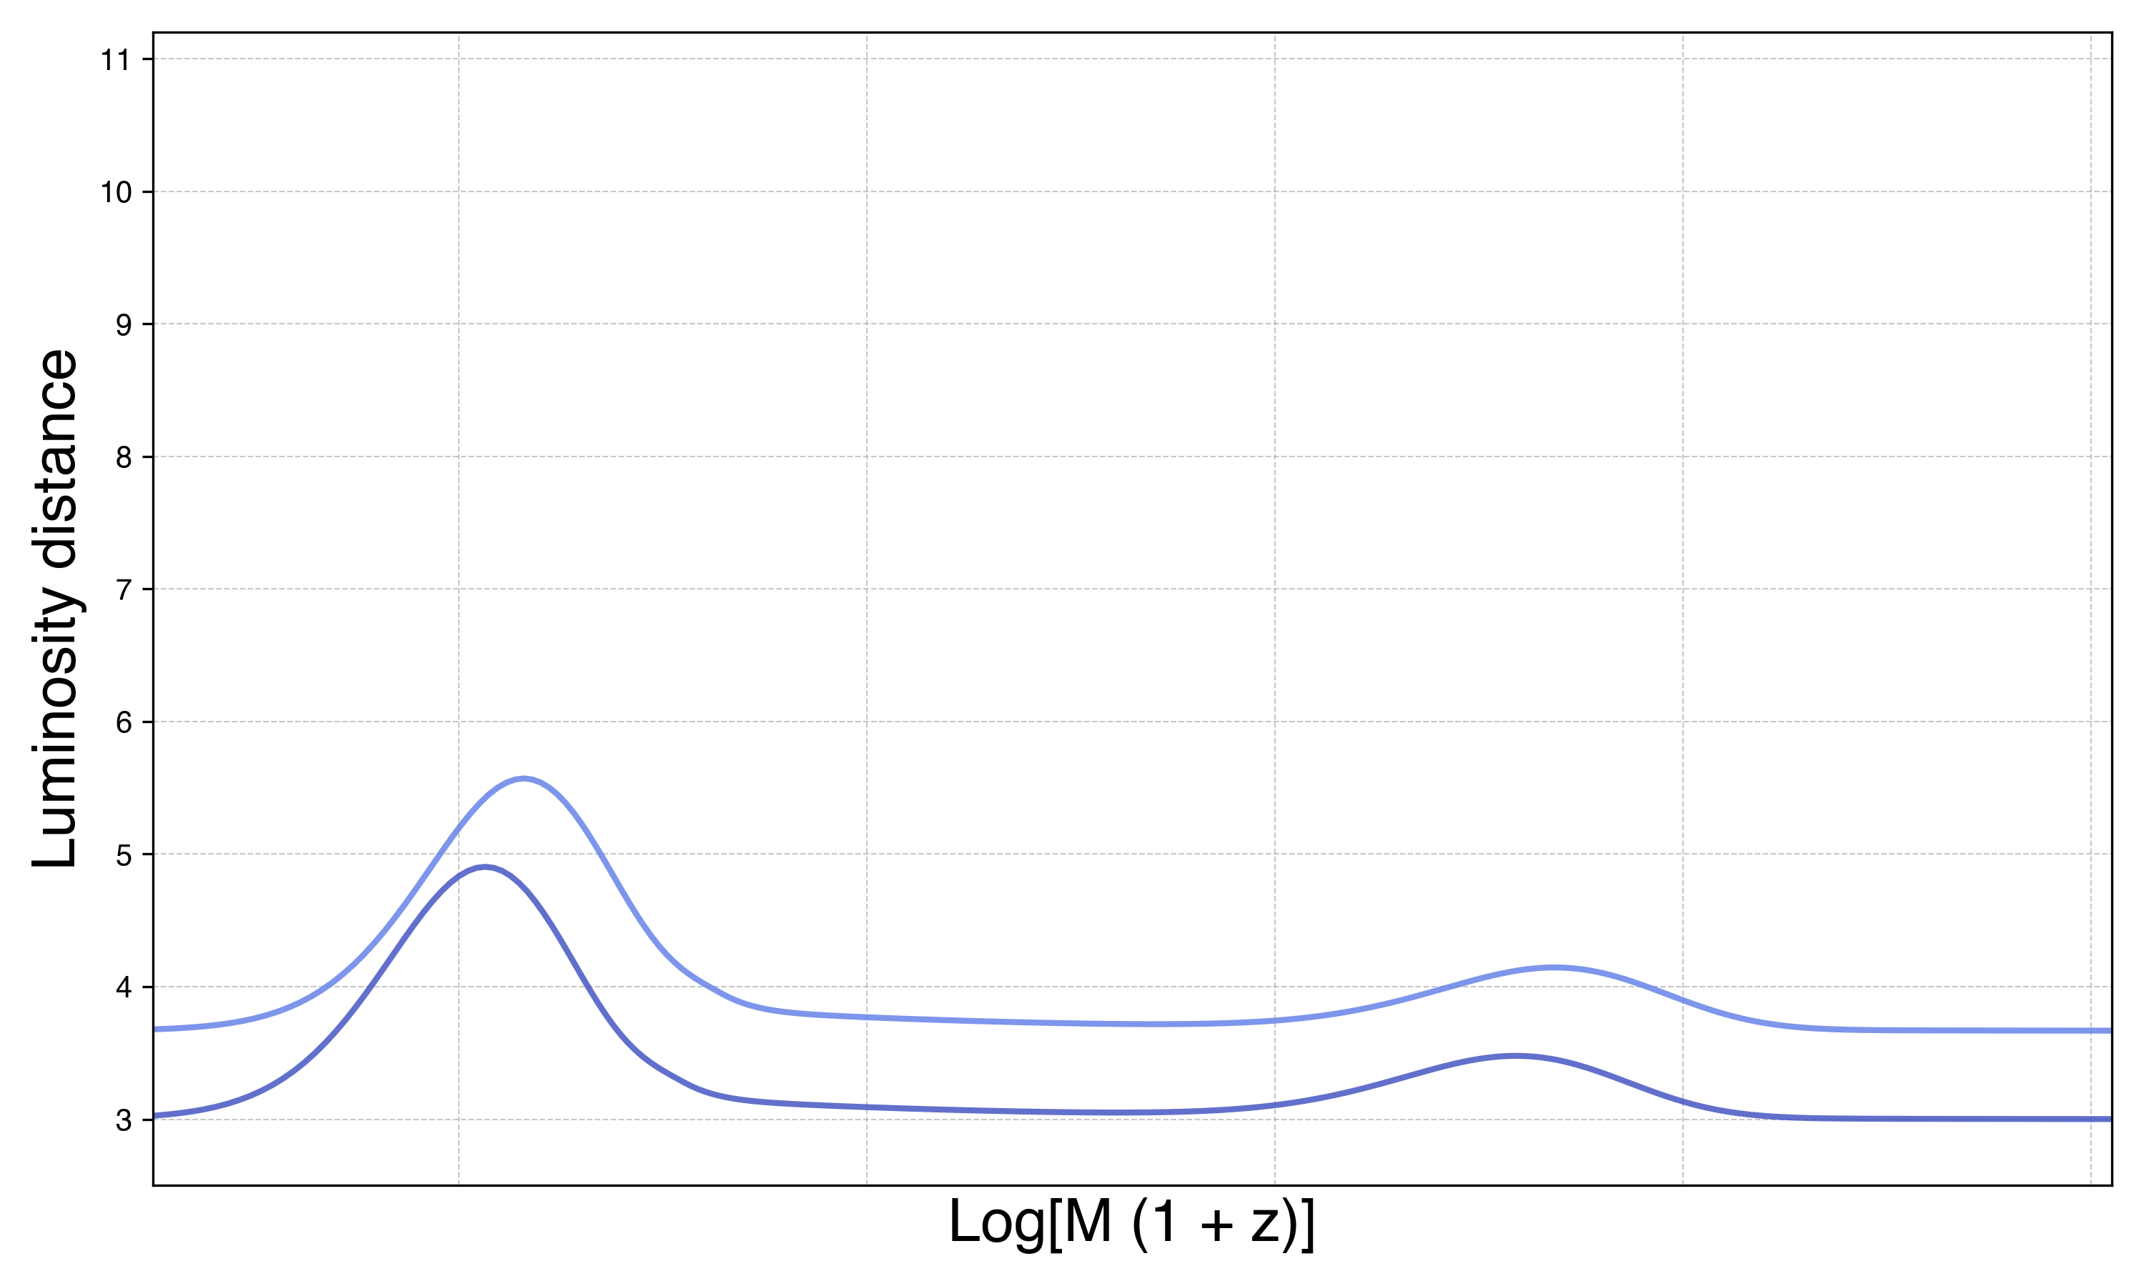

Slide 22
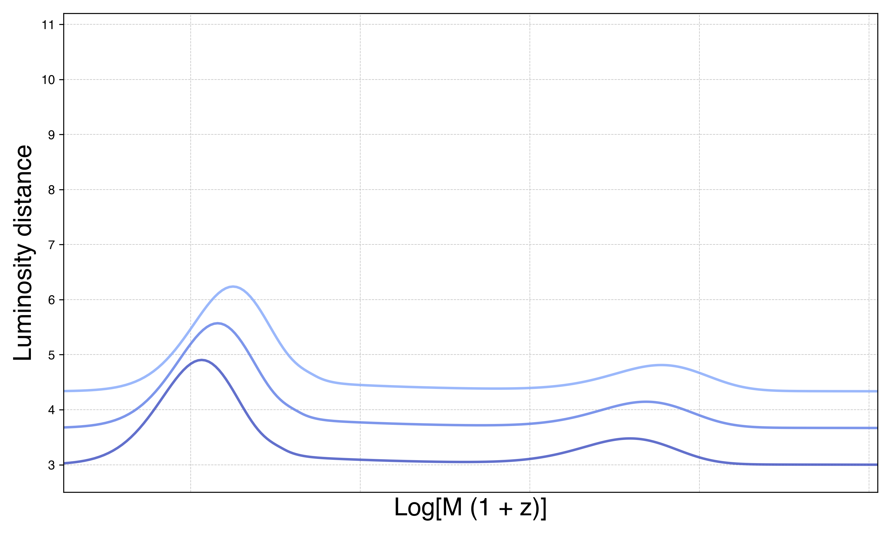

Slide 23
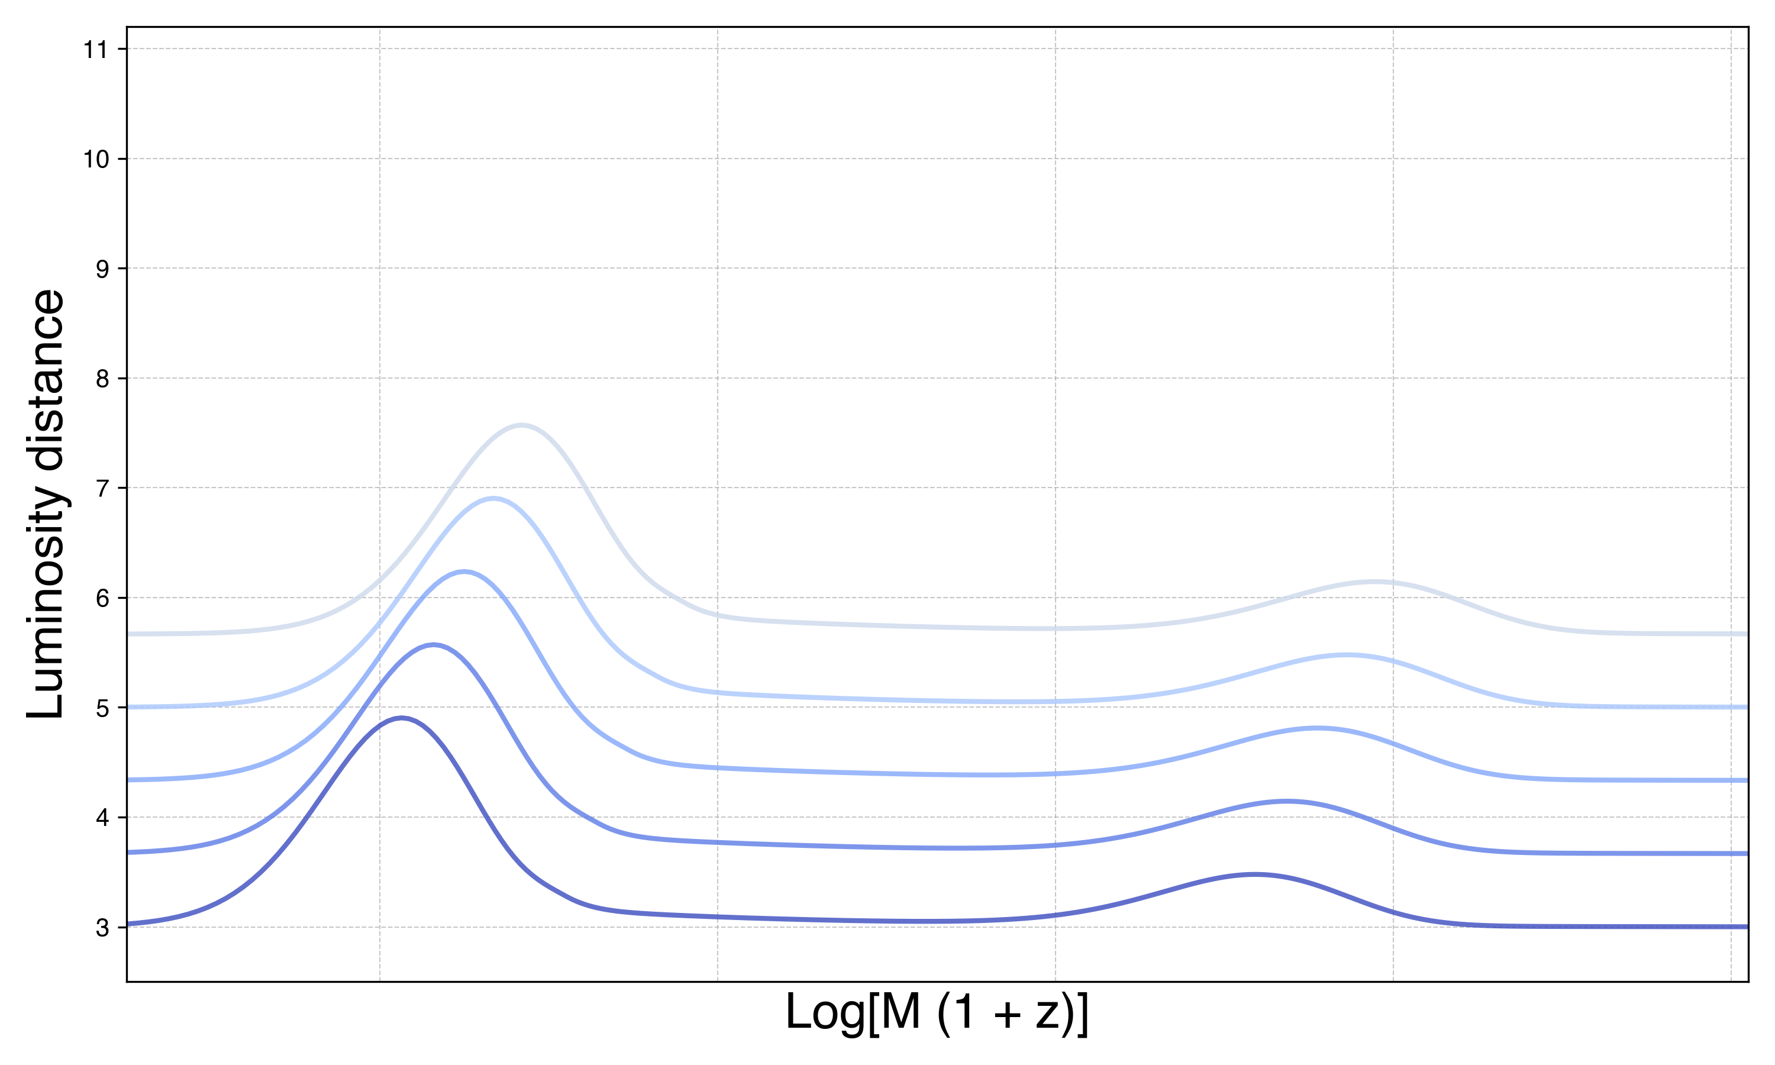

Slide 24
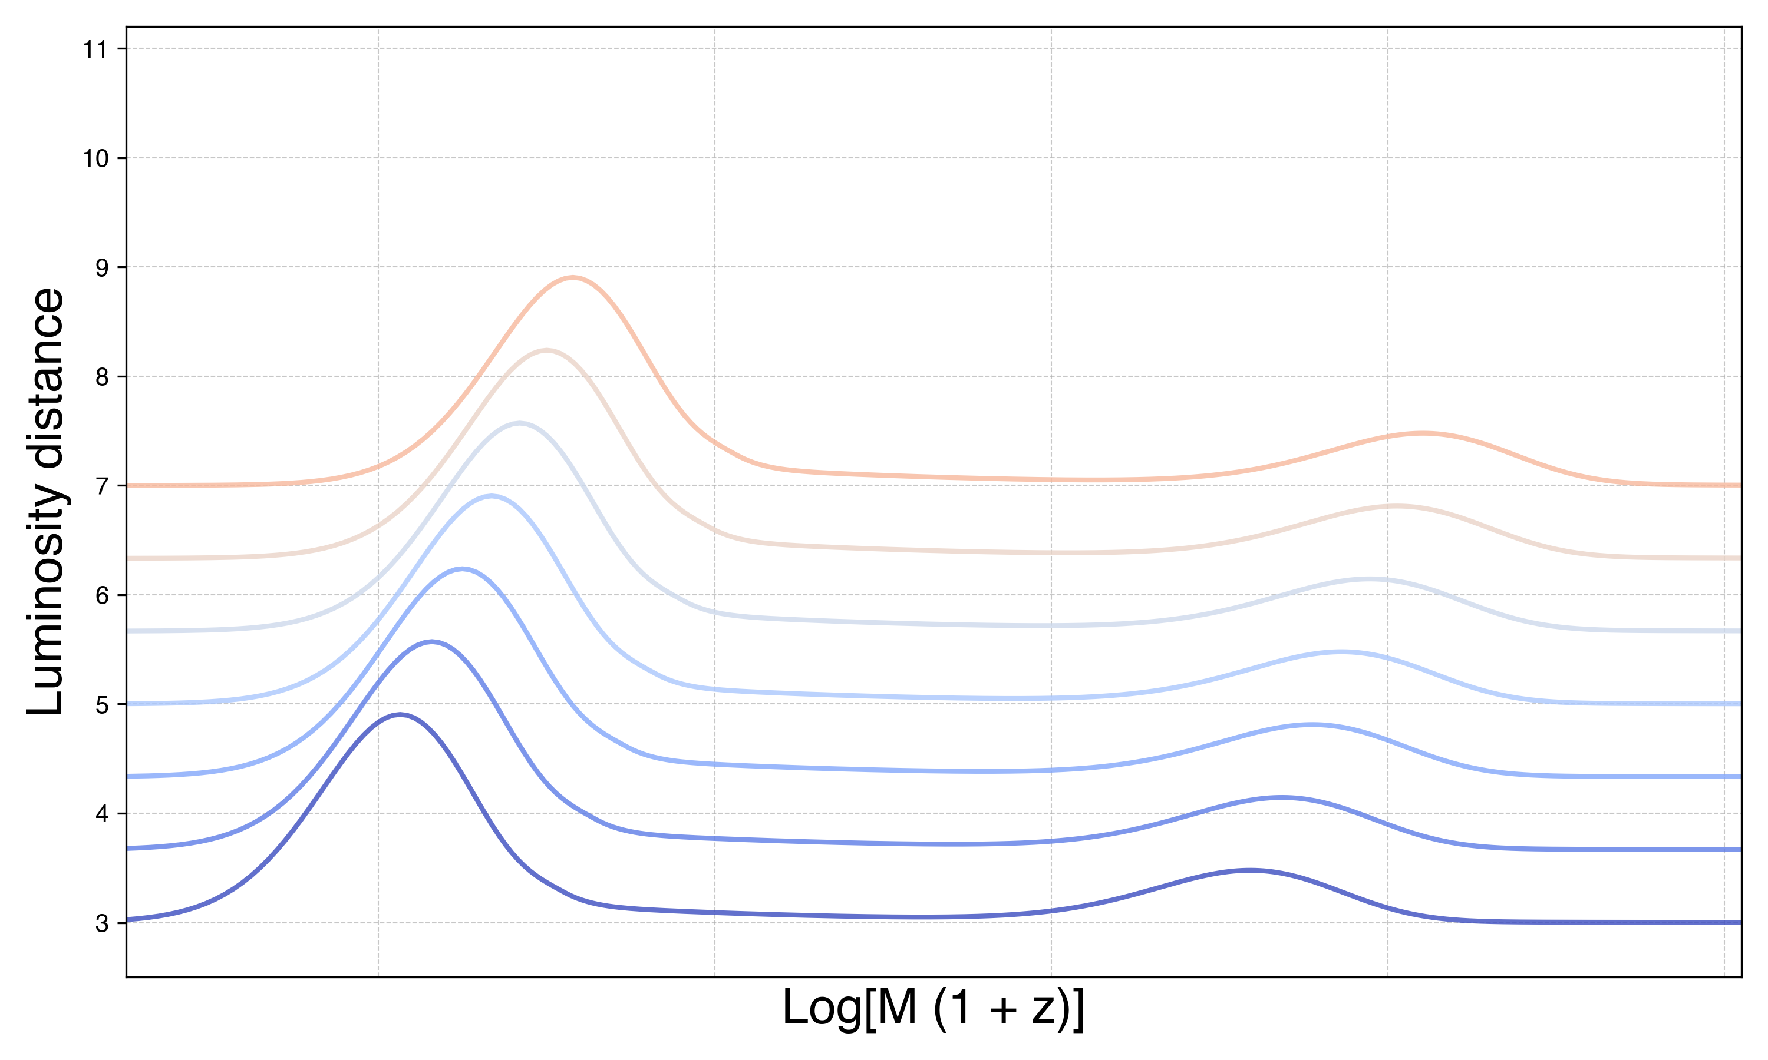

Slide 25
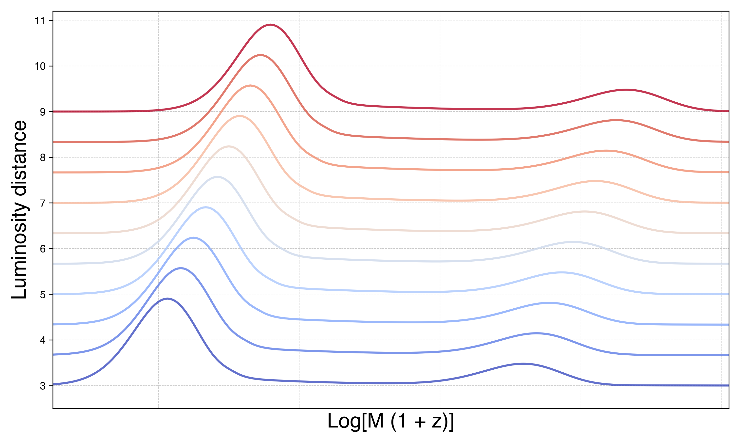

Slide 26


Slide 27
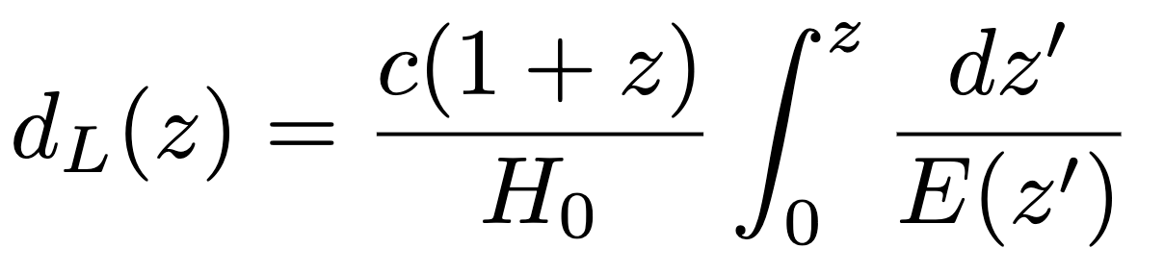

Slide 28
Workflow

Slide 29
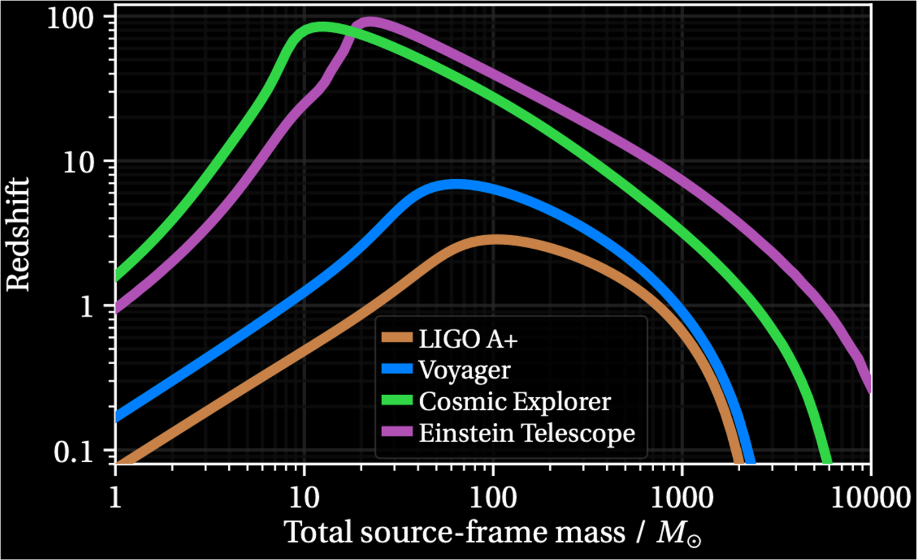
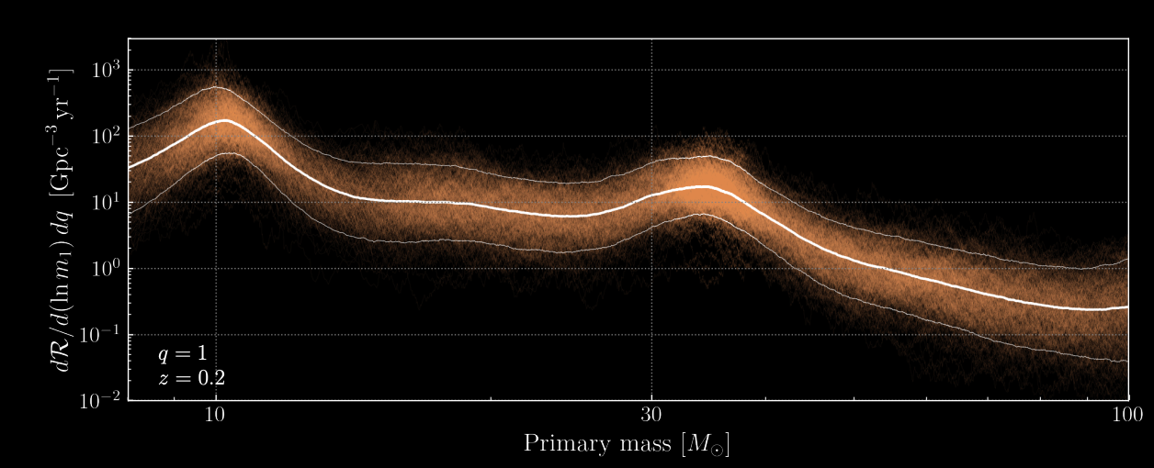
Workflow
Simulate next-generation catalog

Slide 30
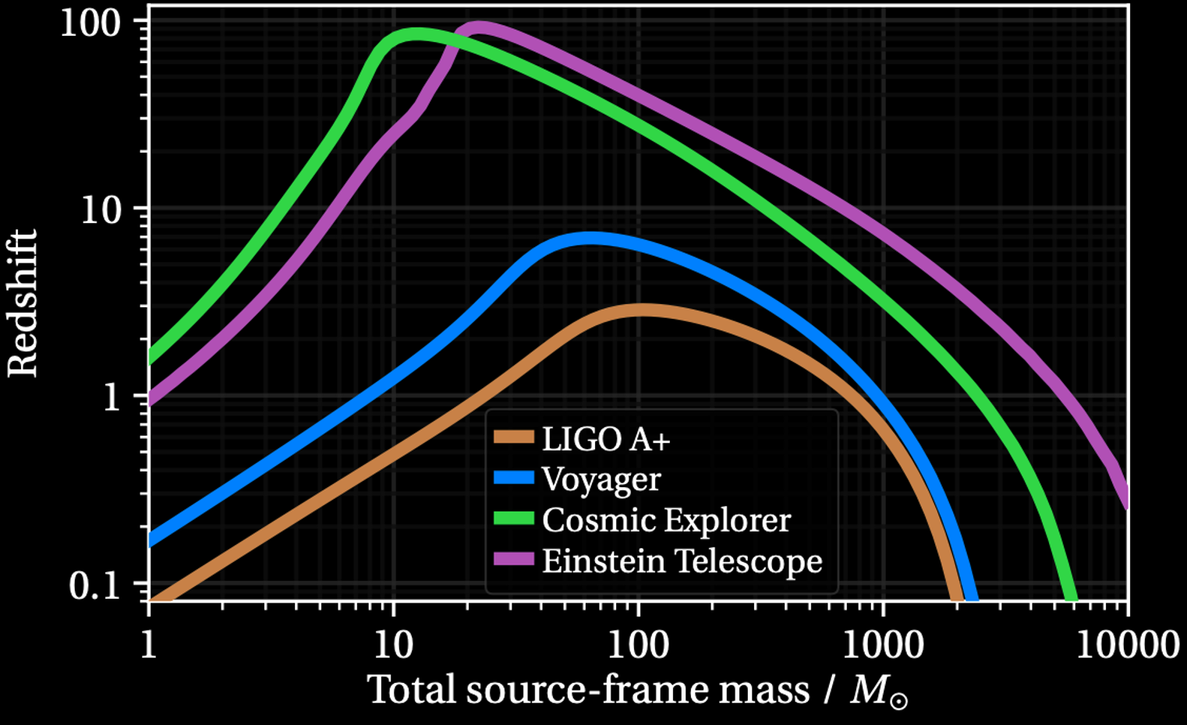
Simulate next-generation catalog
Cosmic Explorer
Callister + 2024

Slide 31
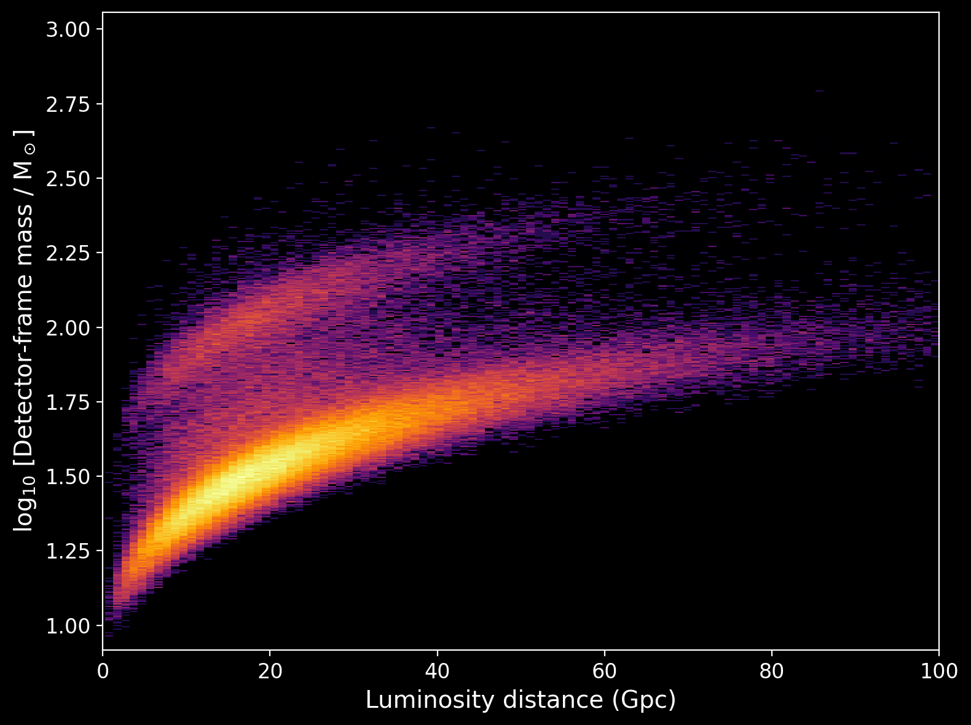
Workflow
Simulate next-generation catalog
Find features in mass distribution

Slide 32
Find features in mass distribution

Slide 33
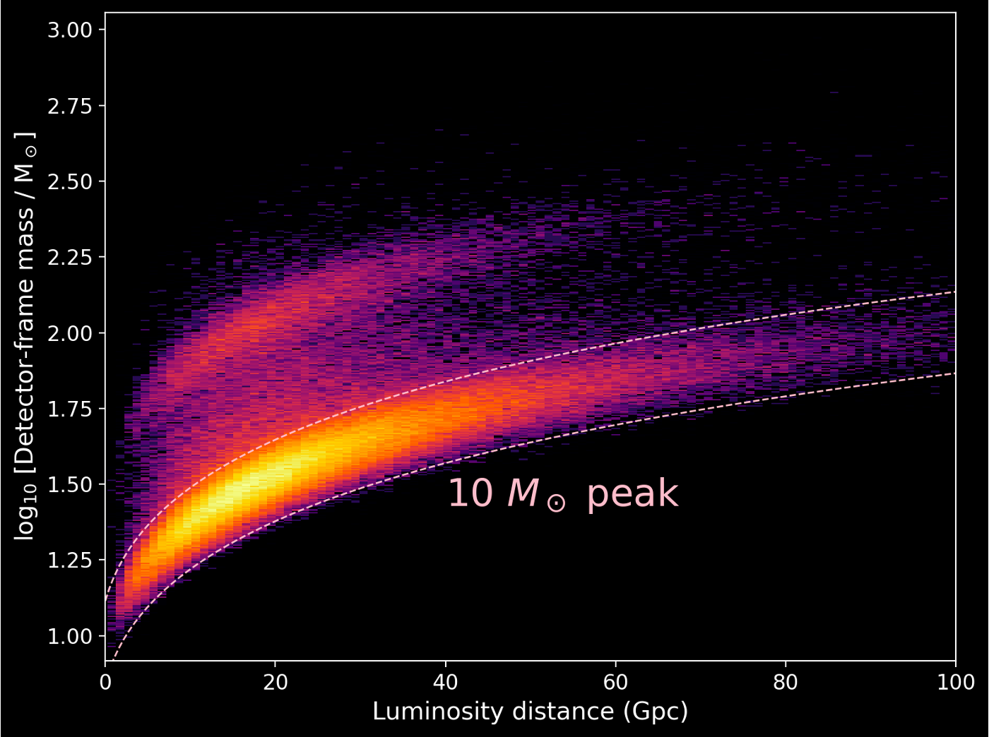
Find features in mass distribution

Slide 34
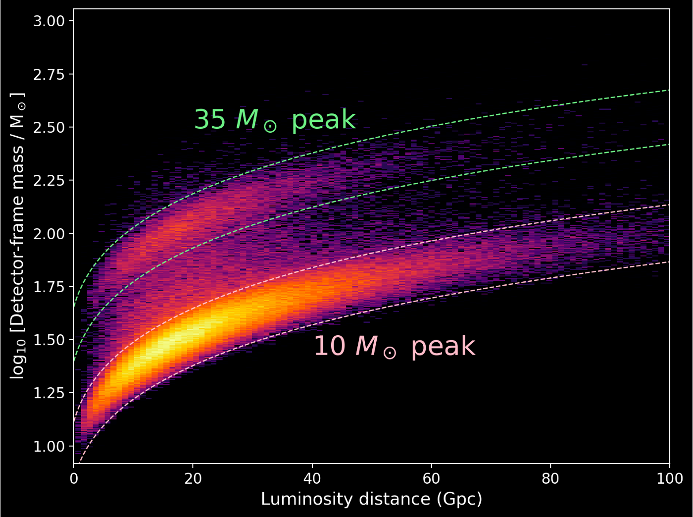
Find features in mass distribution

Slide 35
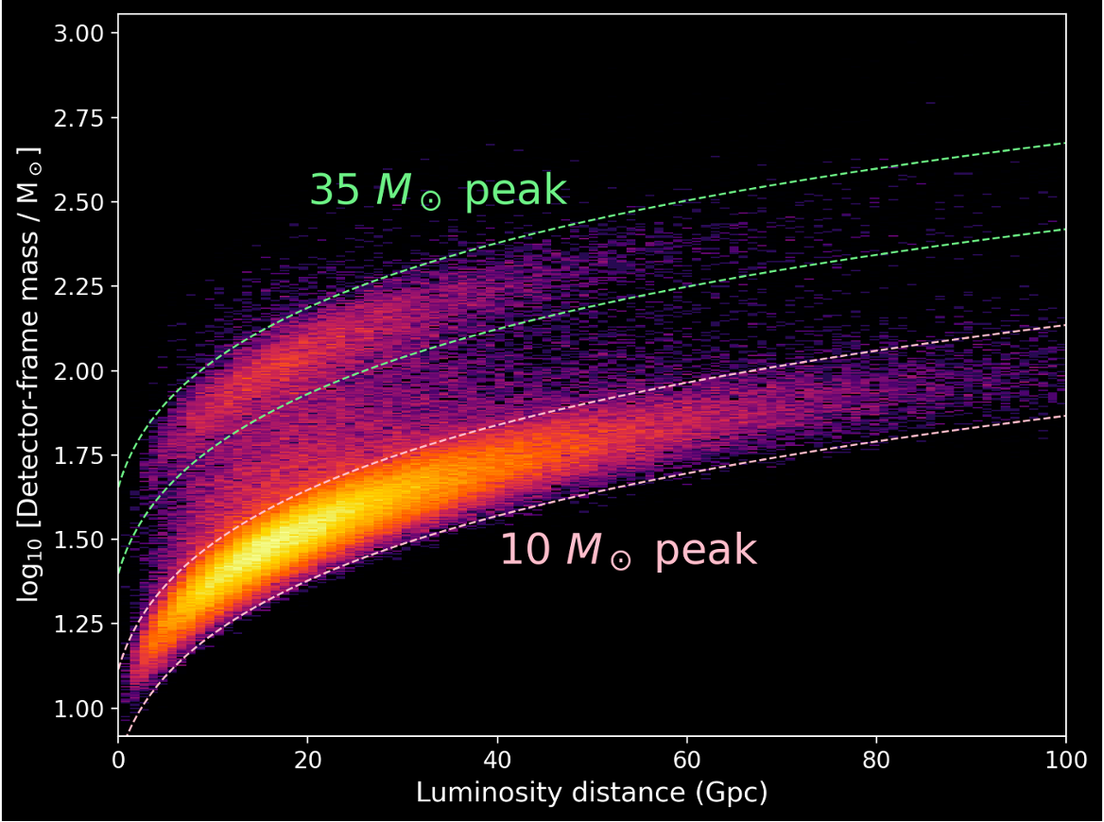
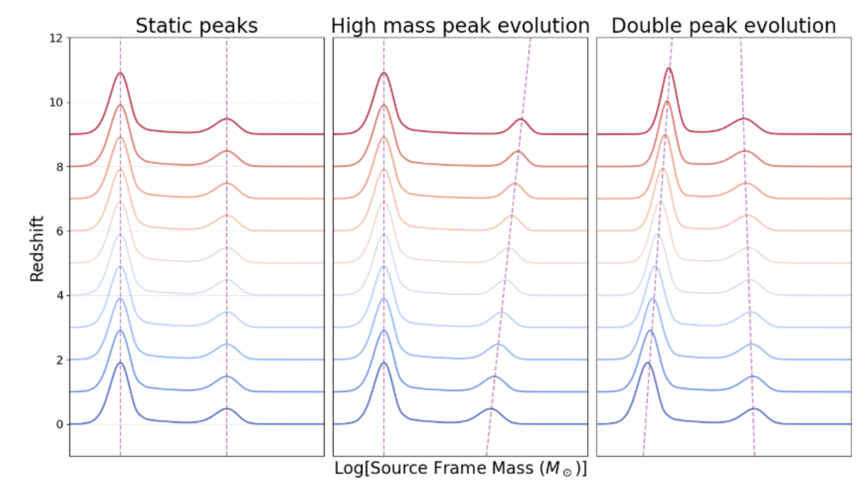
Workflow
Simulate next-generation catalog
Find features in mass distribution
Simultaneously fit for astrophysics and cosmology

Slide 36
Astrophysical evolution of peaks
Possible sources of evolution: metallicity, hierarchical mergers

Slide 37
Astrophysical evolution of peaks
Possible sources of evolution: metallicity, hierarchical mergers
Different features can evolve independently

Slide 38
Astrophysical evolution of peaks
Possible sources of evolution: metallicity, hierarchical mergers
Different features can evolve independently
Mismodeling astrophysics can bias cosmology

Slide 39
Astrophysical evolution of peaks
Possible sources of evolution: metallicity, hierarchical mergers
Different features can evolve independently
Mismodeling astrophysics can bias cosmology
Multiple features can break the degeneracy

Slide 40
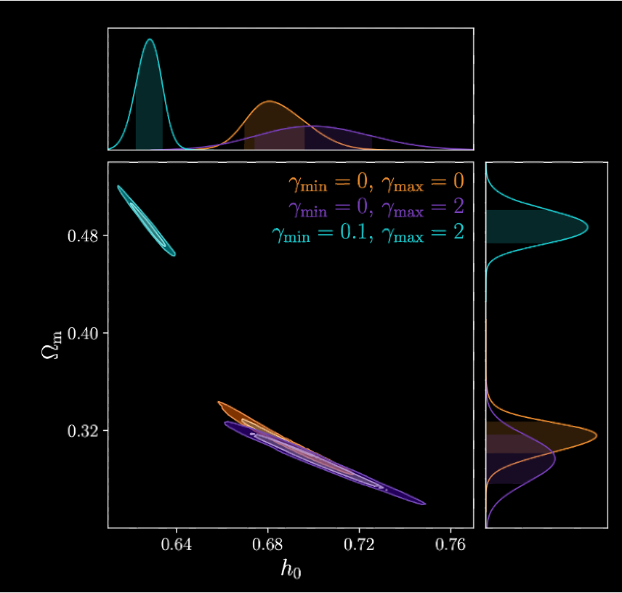
Dangers of mismodeling evolution
Ezquiaga + 2022

Slide 41
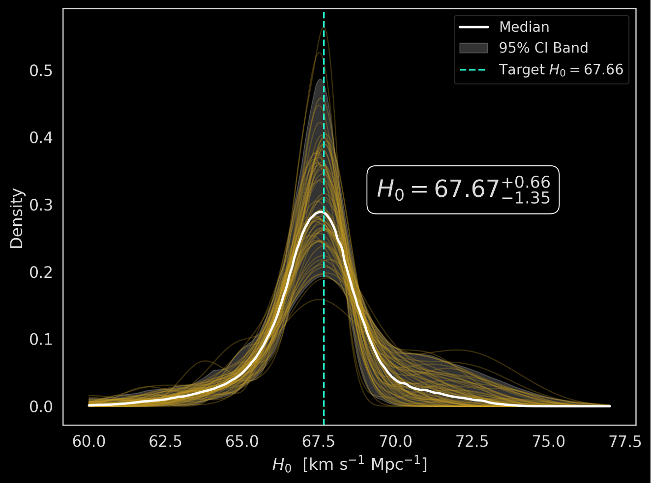
Posterior on H₀
1 year of next generation data, assuming a linearly evolving peaks.
~1% level estimates on H₀

Slide 42
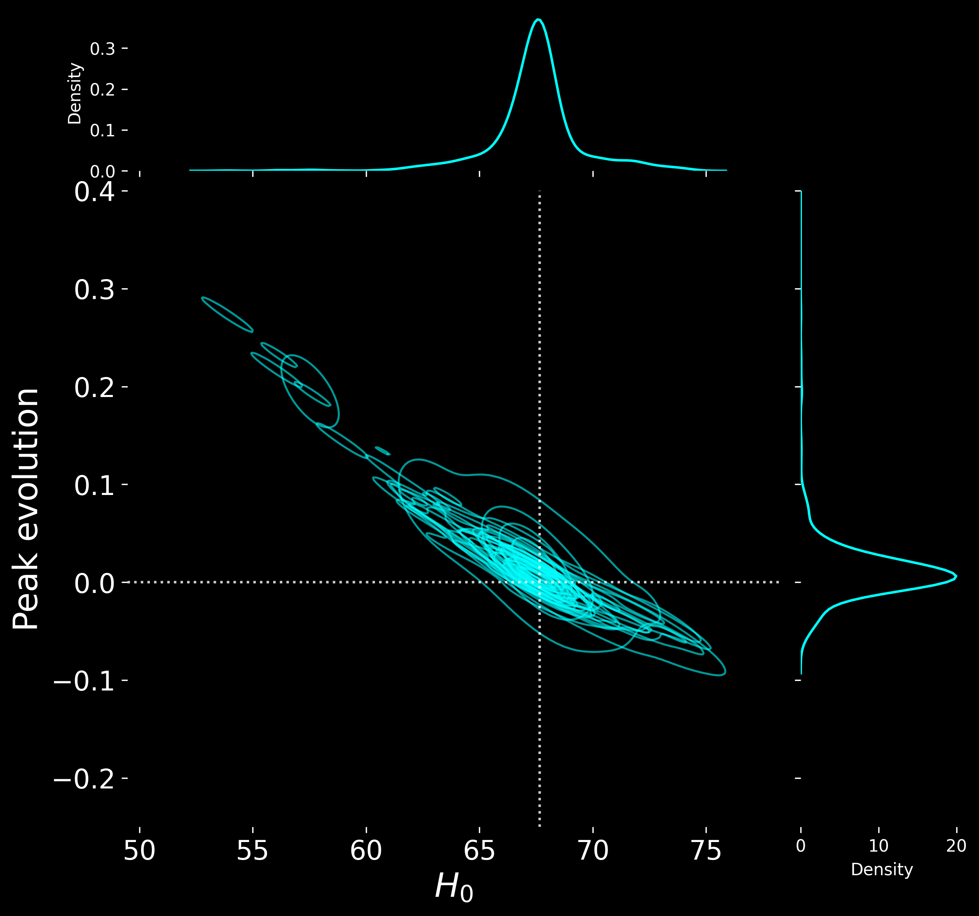
Peak evolution is still degenerate with cosmology
Multiple features break the degeneracy
Next step: non-linear evolutions

Slide 43
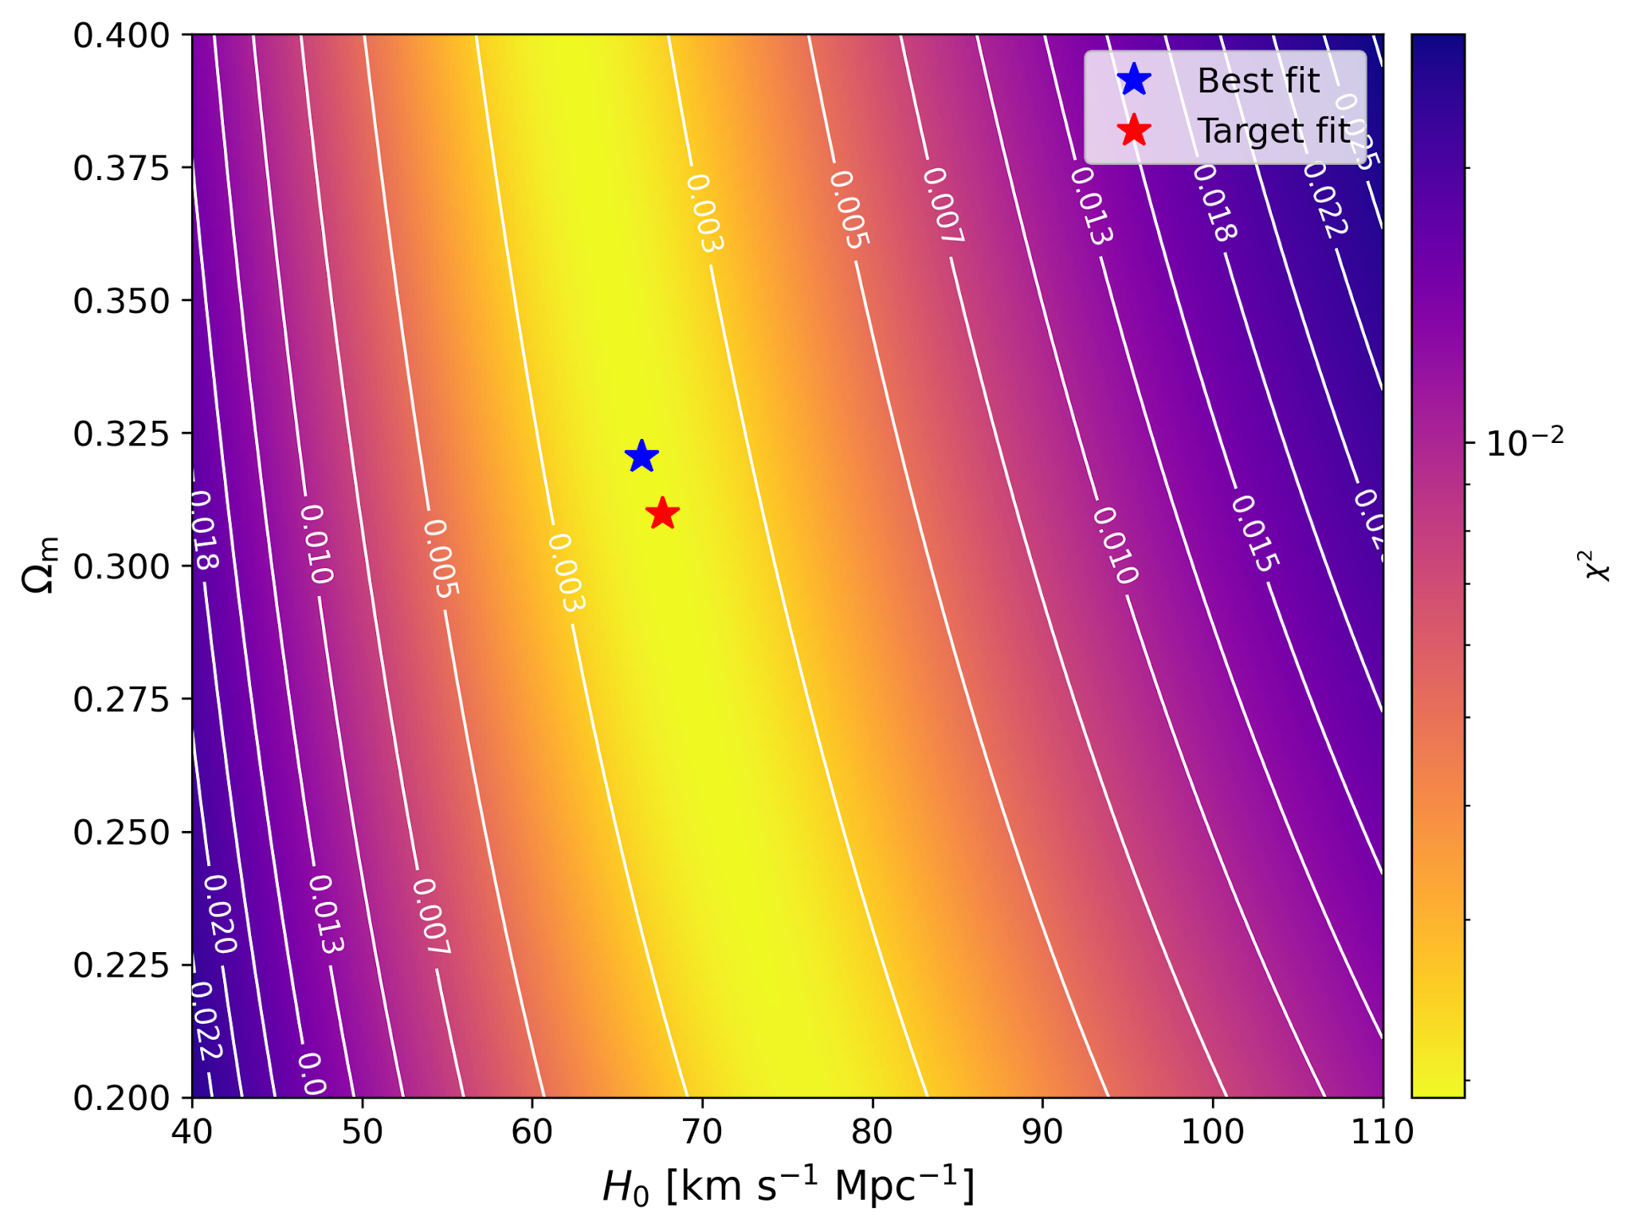
Other cosmological parameters?

Slide 44
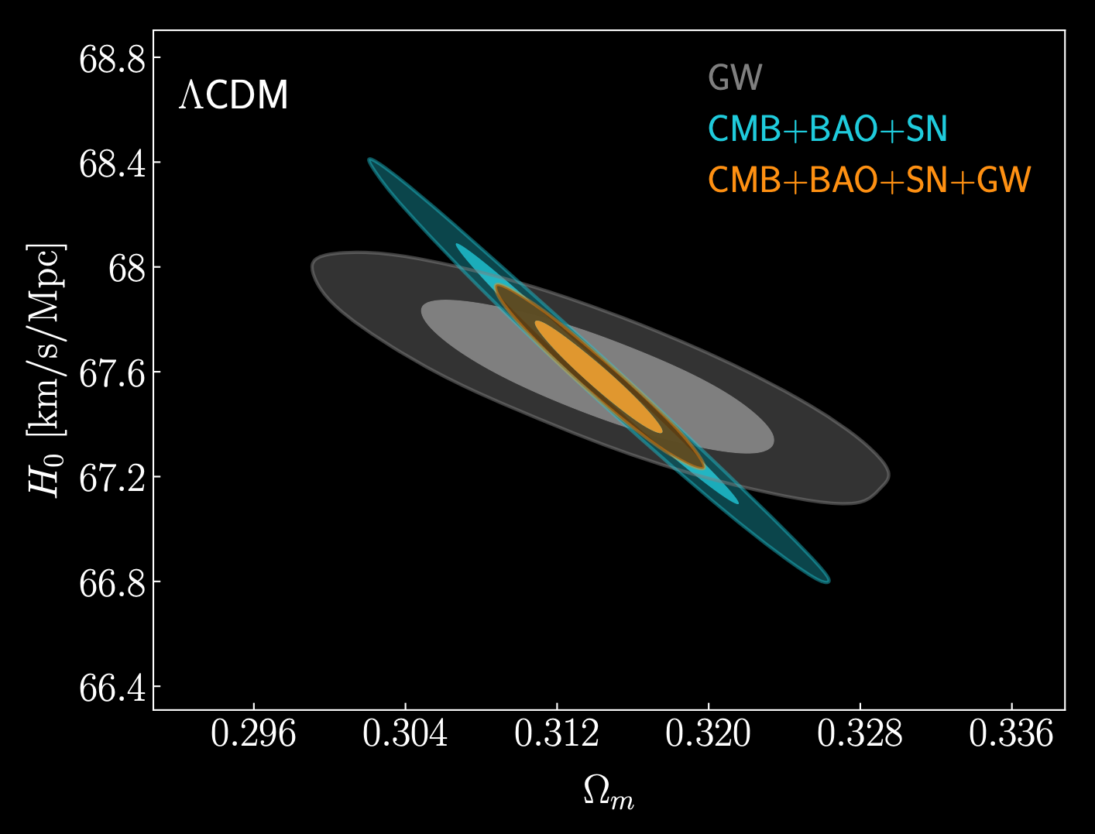
Other cosmological parameters?
Jin + 2020

Slide 45
Summary and future directions
Spectral sirens method can simultaneously fit for the black hole mass distribution and cosmology
Can yield competitive estimates on H₀
Constraining additional cosmological parameters: Ω_{M}, w₀, w_{a}
More general functional form for astrophysical evolution

Slide 46
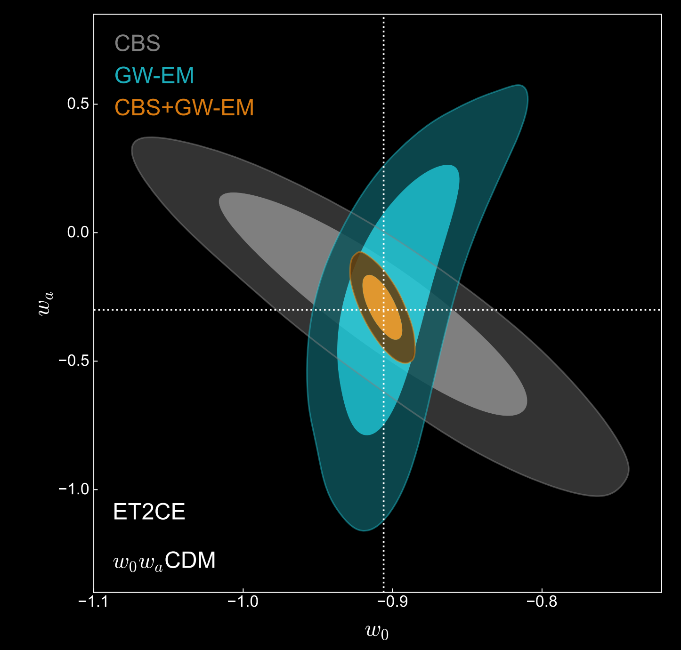
Han + 2025

