Slide 1
Combinatorial optimization with large language models
2025/3/5
Presented by Shanda Li
Joint work in Yiming’s group, CMU

Slide 2

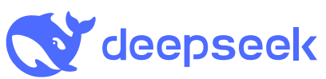
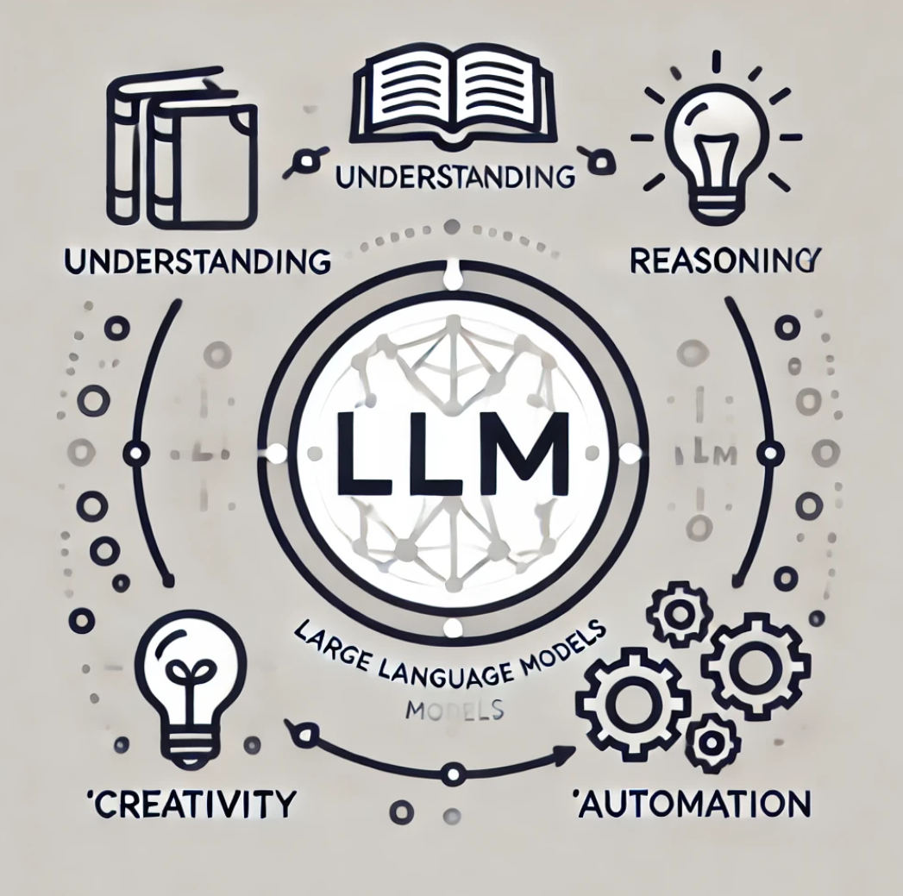

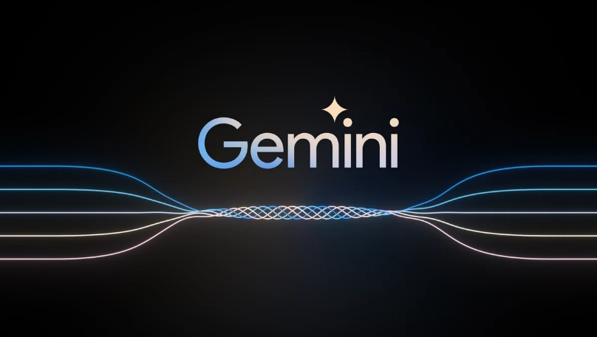

Background
LLMs have demonstrated human-level capability on diverse tasks.

Slide 3
Solving combinatorial optimization problems
Many combinatorial optimization (CO) problems are NP-hard.
Practitioners employ search-based algorithms to obtain solutions;
Heuristics are critical in the algorithm design.
El-Kishky, Ahmed, et al. "Competitive Programming with Large Reasoning Models." arXiv preprint arXiv:2502.06807 (2025).

Slide 4
Code generation with LLMs
Contemporary LLMs possess extraordinary coding capability.

Slide 5

Code generation with LLMs
Contemporary LLMs possess extraordinary coding capability.
Solve GitHub issues.
Jimenez, Carlos E., et al. "SWE-bench: Can Language Models Resolve Real-world Github Issues?." ICLR. 2024.

Slide 6
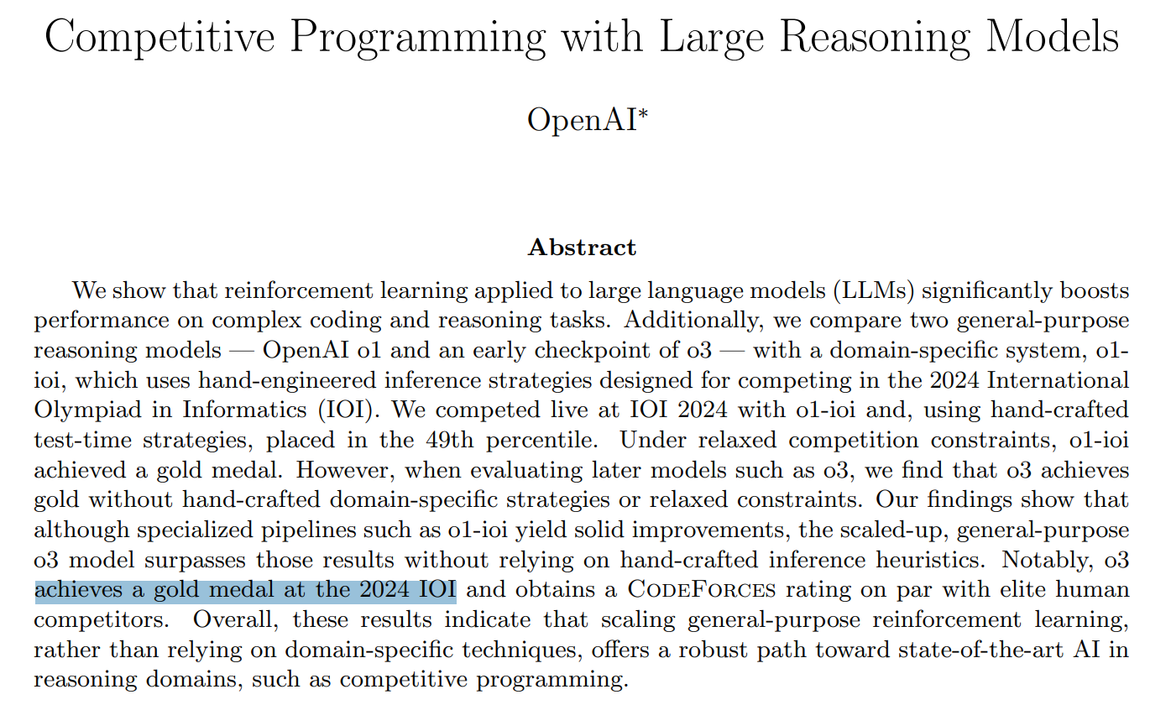
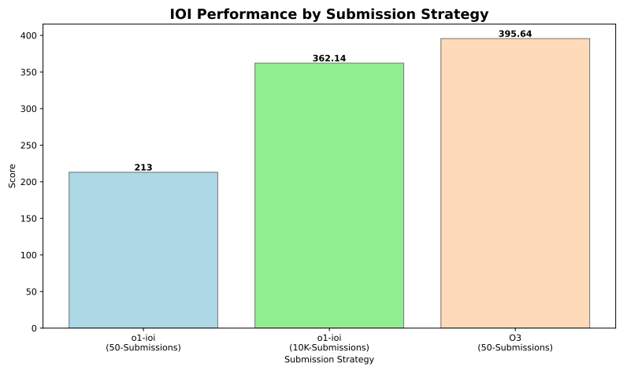
Code generation with LLMs
Contemporary LLMs possess extraordinary coding capability.
Solve GitHub issues;
Solve competitive coding problems.
El-Kishky, Ahmed, et al. "Competitive Programming with Large Reasoning Models." arXiv preprint arXiv:2502.06807 (2025).

Slide 7
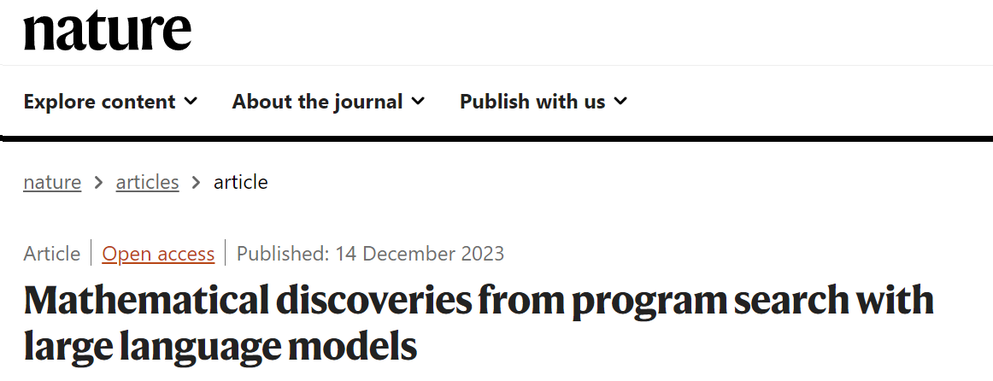
Code generation with LLMs
Contemporary LLMs possess extraordinary coding capability.
Solve GitHub issues;
Solve competitive coding problems;
Implement novel algorithms for combinatorial problems.
El-Kishky, Ahmed, et al. "Competitive Programming with Large Reasoning Models." arXiv preprint arXiv:2502.06807 (2025).

Slide 8
The cap set problem
What is the largest possible subset S⊆Z₃^{n} (known as a cap set) such that no three vectors in S sum to zero?
Z₃={0, 1, 2} denotes the group of integers modulo 3.
Arithmetic in Z₃ is performed modulo 3, e.g., 2+1=0.
For example, Z₃² ={(0, 0), (0,1), …, (2, 2)}.
S={(0,0), (0,1), (1,0), (1,1)} is valid (no three vectors in S sum to zero).
S={(0,0), (0,1), (1,0), (1,1), (1,2)} is invalid because (1,0) + (1,1) + (1,2) = 0.

Slide 9
The cap set problem
What is the largest possible subset S⊆Z₃^{n} (known as a cap set) such that no three vectors in S sum to zero?
We can search with the greedy algorithm:
Initializing S as an empty set.
Doing the following iteratively:
  Compute the “priority” of each element in Z₃^{n}\S using some function that evaluates how “safe” it is to add the new element.
  Add the element with the highest priority to S.
  Terminate if S is invalid.

Slide 10
Main idea
The priority function can be generated by LLM in the form of code.
Current LLMs already have strong coding capability.
The generated algorithm can be easily evaluated.
A simple evaluator scores for the generated algorithm.

Slide 11
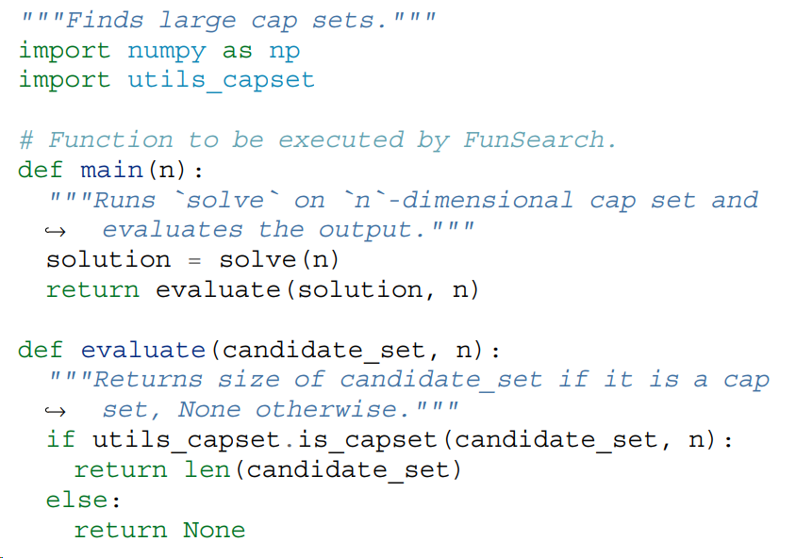
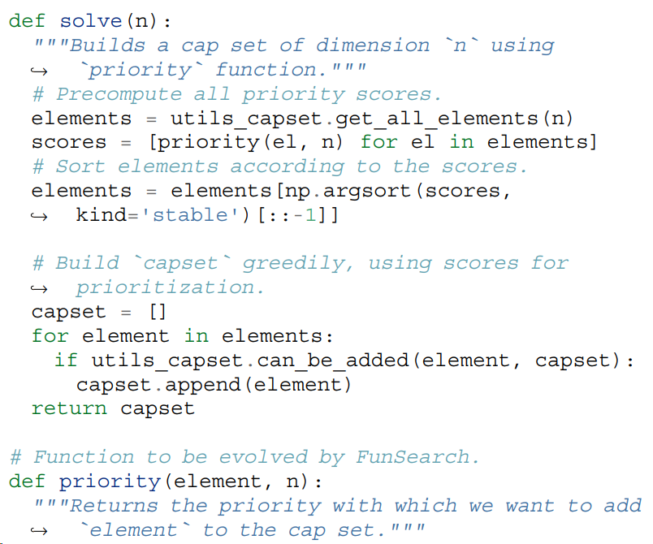
Problem specification (prompting)
Initial program: evaluation & code skeleton (boilerplate code).

Slide 12
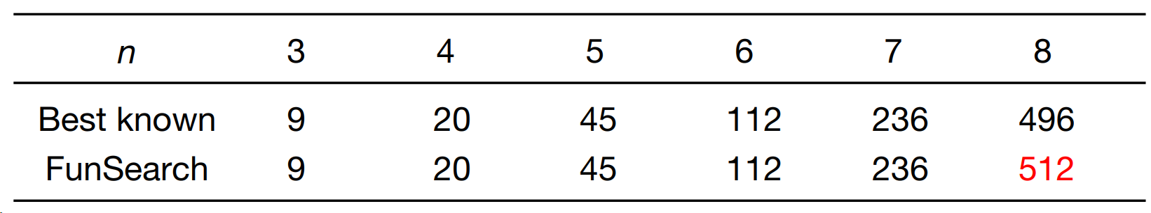
Results
The cap set problem: Finding the largest possible set of vectors in Z₃^{n} (known as a cap set) such that no three vectors sum to zero.

Slide 13

Research question
Can LLMs design algorithms, in the form of computer code, for solving general CO problems?

Slide 14
Benchmarking LLMs on solving CO problems
Data: Extract realistic CO problems & data from literatures.
Baselines: Proposed methods in literatures.
Methods: LLMs with different inference algorithms / agentic workflows.

Slide 15
Benchmarking LLMs on solving CO problems
Data: Extract realistic CO problems & data from literatures.
Baselines: Proposed methods in literatures.
Methods: LLMs with different inference algorithms / agentic workflows.

Slide 16



Data extraction
Collect 55 CO problems from existing papers;
Extract the mathematical formulations and evaluation protocols of the problems into a unified format.
Raw data
Problem sets

Slide 17
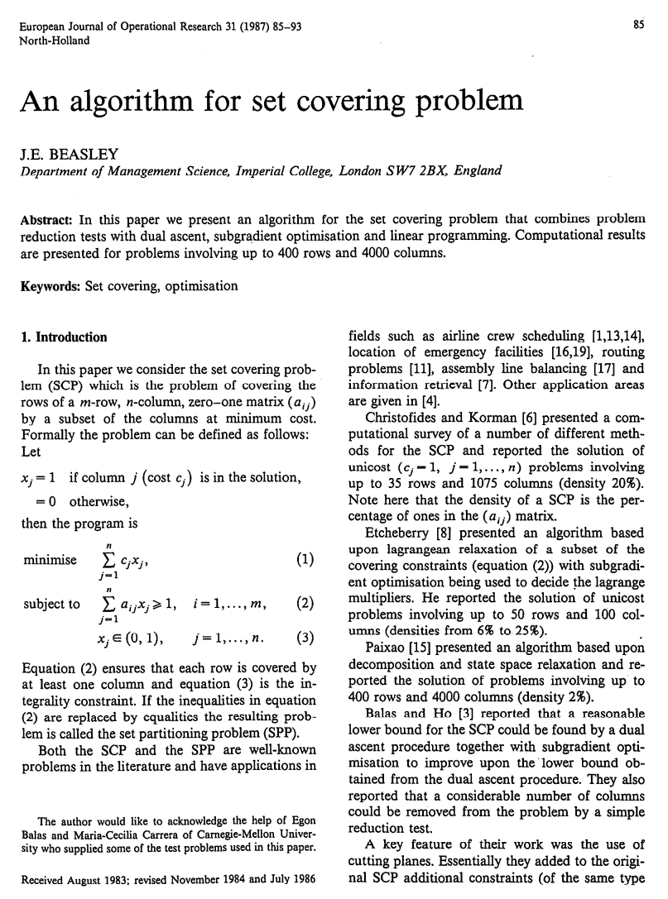
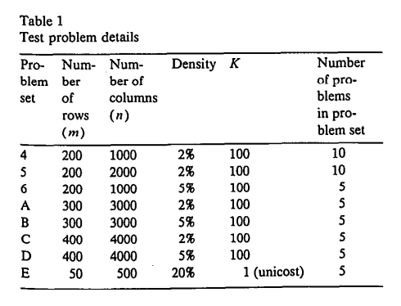
Data example

Slide 18
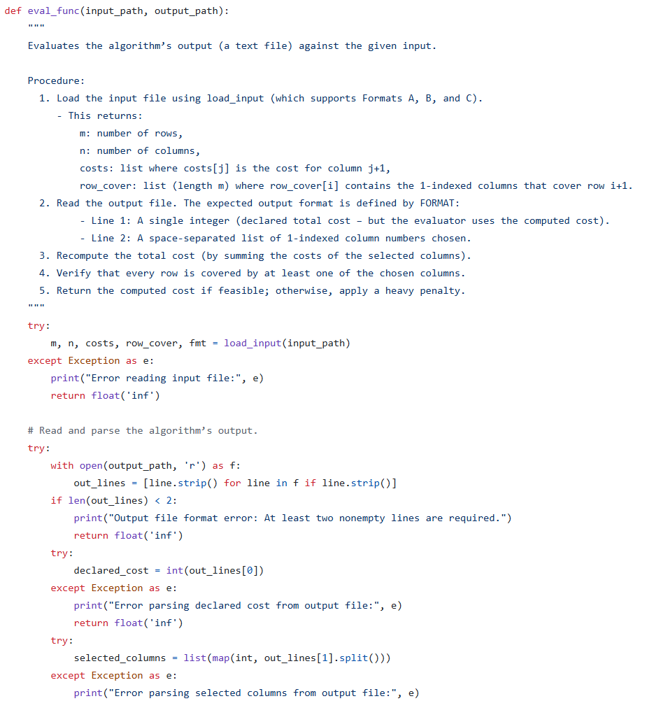
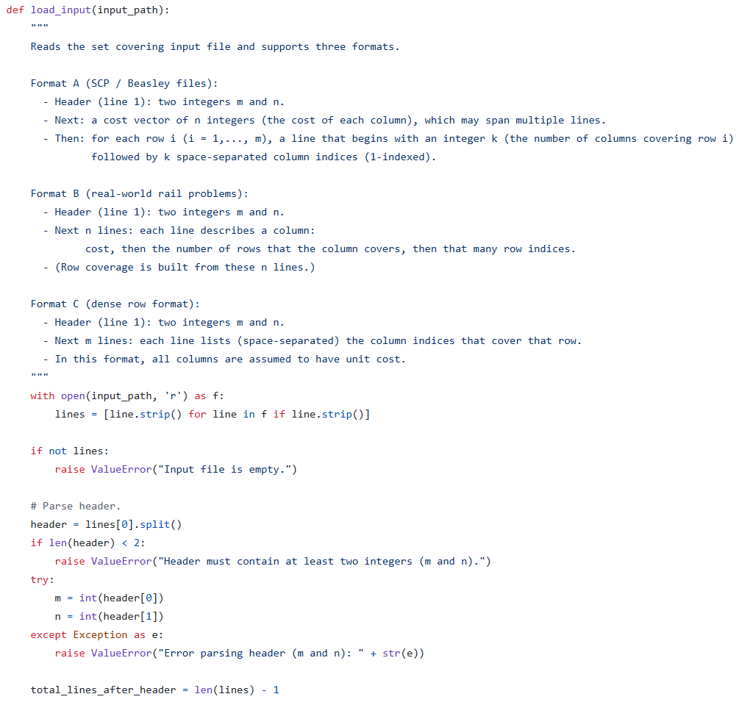
Data example

Slide 19

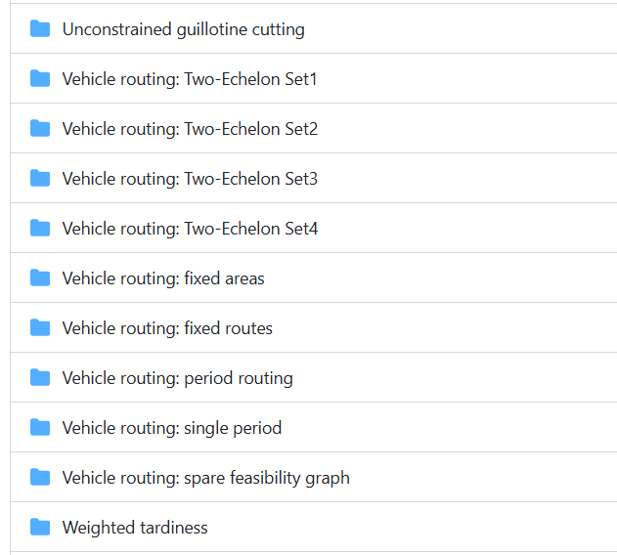
Problem sets

Slide 20


Next steps
Problem
Code execution
Automated debugging
Code improvement
LLM
Code generation
Evaluators

Slide 21
Next steps
Understanding and comparing LLMs’ capabilities on CO algorithm designs and code generation;
Facilitating the development of novel algorithms;
Setting up an environment for LLM agent evaluation and optimization;
Potentially generalizable to more real CO problems.

