Slide 1
HFCC News
3 April 2025
Steering Committees: Marcel Demarteau, Sarah Eno, Steve Gourlay, Matthias Liepe, Ritchie Patterson, Srini Rajagopalan,
Tor Raubenheimer, Jean-Luc Vay

Slide 2
Welcome
This is the first Monthly Meeting of the US Higgs Factory Community
Plan
Meet on the First Thursday of each month
Agenda:
  1. News
  2. Featured presentation
Presentations will address technical topics related to Higgs Factory physics, detectors and accelerators; circular colliders and linear colliders
Talks will be aimed at the full community, including non-experts

Slide 3
News: European Strategy Input
US white papers for the European Strategy have been submitted
See https://indico.global/event/14242/timetable/
Submissions include
US National Input by DPF and DPB Executive Committees
Input from HFCC
>300 endorsers. Full list: https://indico.global/event/14344/
Thanks to the HFCC Editorial Board
and other authors for their work

Slide 4
HF Physics, Expts, Detector R&D Awards
Calorimetry
Engineering design for analog FE for DR crystal matrix for upcoming TB run (FNAL)
Endcap design for LAr turbine structures and associated PCB (Arizona)
Tracking
Prototype Straw tracker development Michigan (Michigan)
Physics, Simulations, Tracking
Simulation Support for DD4HEP (Princeton)
Simulation Support & Analysis Tools (Princeton)
Key4HEP support/development (LBNL)
Workshops, training (FNAL)
Total amount awarded:
$340k

Slide 5
HF Accelerator R&D Proposals
R&D proposal solicitation
R&D topics should be relevant to an off-shore Higgs Factory and could morph into a significant contribution from the US to such a project
Examples: 800 MHz CM for FCC-ee or 1.3 GHz SRF for ILC
US National efforts should follow DOE programmatic priorities and guidance and be aligned with international initiatives and efforts
Proposals should identify partner efforts including, but not limited to, HEP GARD, the FCC Design, ICFA, the IDT, ECFA and other major stakeholders
Max two pages
Deadline: Friday, June 13
See backup slides for further guidance
Submissions to date:
Beam Physics – 2
Magnet Systems - 2
RF Systems - 2
Diagnostics & Instrumentation
Infrastructure Engineering
Integration & Sustainability
Machine-detector Interface

Slide 6
Outreach to government
It is important to make our government and the public aware of the importance of our research.
The US LHC Users Association, the Fermilab Users and Affiliates Executive Committee and the SLAC Users Organization will visit the Hill the week of 21 April.
Write or call your house and senate members alert them to the opportunity to meet with the trip representatives
The letter does not have to be long. A short, to-the-point message
can be very effective and pave the way for the visit.
Emailing is easy. Google “write to your-senator-or-congresspersons-name here” and it will take you to a form. Choose “science” from the pull down menu.

Slide 7
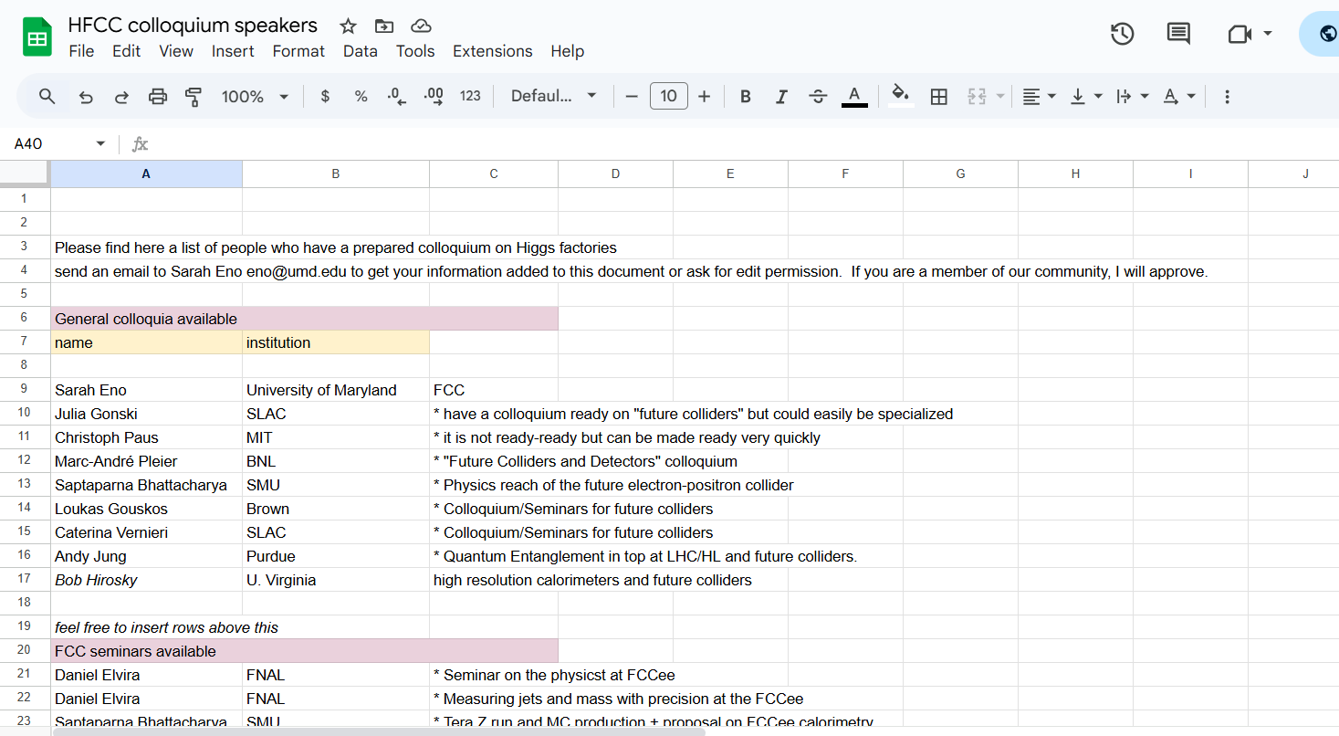
Colloquium campaign
Colloquia build excitement for a Higgs Factory in the broader physics community.
→ Invite and give colloquia
See the data base at: https://docs.google.com/spreadsheets/d/16ft0UeMhzG8V4hc8is0CKWHI54akNODqJufryauWkyI/edit?usp=sharing or contact Sarah Eno

Slide 8
Upcoming events: April & May
Third US HF-FCC 2025 workshop
The third US HF-FCC Workshop (FNAL/ANL - April 14-17, 2025) has extended the deadline for abstracts to Friday, March 21st. Abstracts are welcome for a lightening talk, an oral presentation, or a poster. For further information, see: https://indico.fnal.gov/event/67484/ .
International FCC workshop on Tracking
This tracking workshop will take place on May 7-9, 2025 at BNL and will brainstorm and evaluate possible design choices for an integrated tracker for a future collider (FCC-ee), ahead of the FCC week in Vienna. Indico: https://indico.cern.ch/event/1516157/
First community workshop on AI/ML at the Front-end (ML4FE)
This workshop will take place May 19-21, 2025 at the University of Hawaii Manoa in Honolulu. HEP physicists and engineers interested in ML developments for real-time/hardware applications will share results, brainstorm future directions, build collaborations, pursue funding, and share infrastructure. https://indico.phys.hawaii.edu/event/2506/. Abstracts are invited through April 18th.
FCC Week 2025
International FCC Week 2025 will take place at the Hofburg Palace in Vienna, Austria on May 19-23, 2025. Registration is open at https://indico.cern.ch/event/1408515/ and abstracts are invited through April 30.

Slide 9
Upcoming events: Summer and beyond
European Strategy for Particle Physics - Open Symposium
An Open Symposium for the community on the Strategy Update will take place in Venice Lido (Italy) on 23-27 June. See https://agenda.infn.it/event/44943/overview .
MAPS Academy 2025
A summer school July 23-30 at KEK, Japan, for people who have started or would like to start to develop Monolithic Active Pixel Sensor (MAPS) with CMOS technology. See https://wiki.kek.jp/display/mapschool/MAPS+Academy
SUSY 2025 Conference
the 32nd International Conference on Supersymmetry and Unification of Fundamental Interactions at UC Santa Cruz August 18 - 23. See https://indico.cern.ch/event/1446820/
Lepton Photon Symposium
August 25-29 in Madison Wisconsin. See https://agenda.hep.wisc.edu/event/2188/
Linear Collider Workshop (LCWS 2025)
The next Linear Collider workshop will take place 20 - 24 October
in Valencia, Spain. See https://agenda.linearcollider.org/event/10594/.
Organizing an event?
Tell us

Slide 10
Join HFCC
US Higgs Factory Accelerator (ACC) Working Groups
Beam Physics
Infrastructure Engineering
Integration & Sustainability
Magnet Systems
Machine-detector Interface
RF Systems
Diagnostics & Instrumentation
US Higgs Factory Physics, Experiments & Detectors (PED) Working Groups
AI, Integration and Microelectronics (AIM)
Calorimetry
Muon detectors
Physics, Software and Computing (PSC)
Trigger and Data Acquisition (TDAQ)
Trackers
Agendas: https://indico.cern.ch/category/19010/.

Slide 11
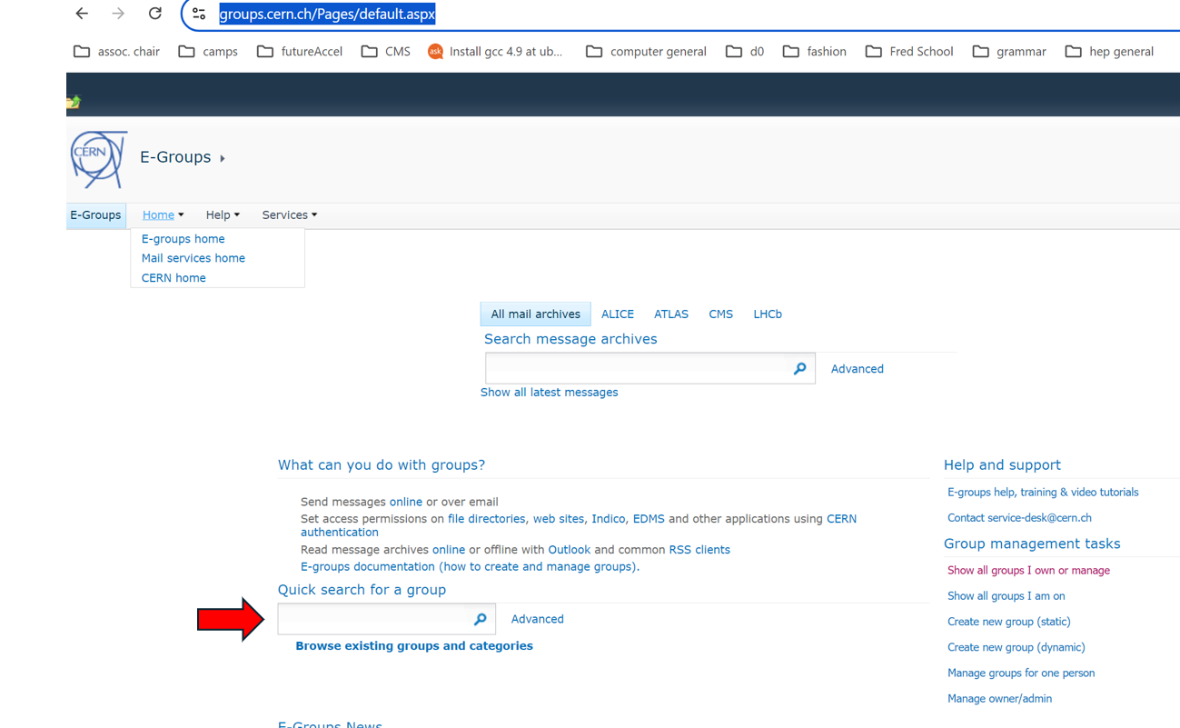
Email lists
Working group mailing list sign-up:
Go to https://groups.cern.ch/Pages/default.aspx
In the box with the red arrow pointing towards it, type us-hfcc or us-hfcc-acc
Sign up for FCC mailing lists: https://fcc-ped.web.cern.ch/##
Sign up for the US-LC and US-FCC mailing lists: https://groups-portal.web.cern.ch/
Need help?
Contact jlvay@lbl.gov or
jrp3@cornell.edu

Slide 12

Suggestion Box
Suggest technical talks for future meetings in this series
Send to:
Steve Gourlay sgourlay@fnal.gov,
Sarah Eno eno@umd.edu,
or Ritchie Patterson jrp3@cornell.edu
Next up: Preview the upcoming US-HF-FCC workshop
by chairs Jinlong Zhang and Daniel Elvira

Slide 13
Backups

Slide 14
HFCC-A Proposal Template
[PI Name]
[Institution(s)]
Research areas:
  [General subject of Research Scope]
[Budget Request]
[Background of the primary participants]
[Higgs Factory project contact]
Narrative
[Bulleted list of objectives]
  [Objective 1.1]
  [Objective 1.2]
  …
[Impact]
  [Uniqueness of the contribution and long-term contribution to a Higgs Factory]]
[Relevance and/or benefit to US HEP program]
Synergies with existing R&D programs
Deadline: June 13

