Slide 1


Lowri Mathias
Nuclear pasta and neutron star dynamics
1

Slide 2
Overview
Background
What is a neutron star?
Neutron star structure
Why does nuclear pasta form?
How can we model nuclear pasta?
Previous work and challenges
The Lattice Boltzmann Method
The future
Connections to neutron star observables
2

Slide 3

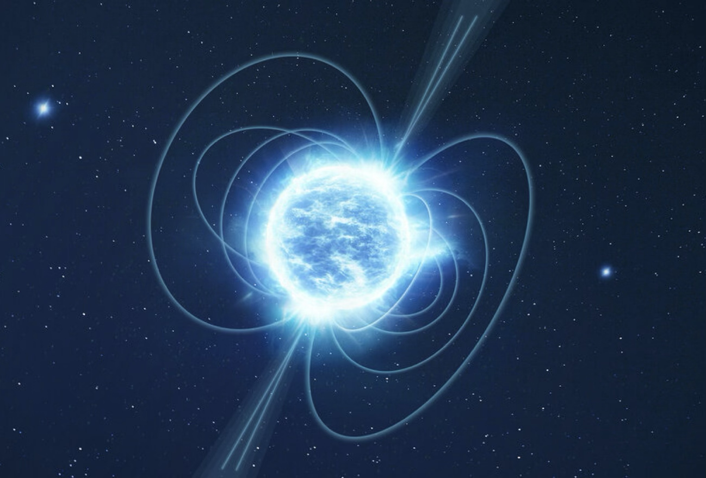
What are neutron stars and why are they interesting?
Multimessenger astronomy
=
Gravitational wave
Electromagnetic signal
+
3

Slide 4


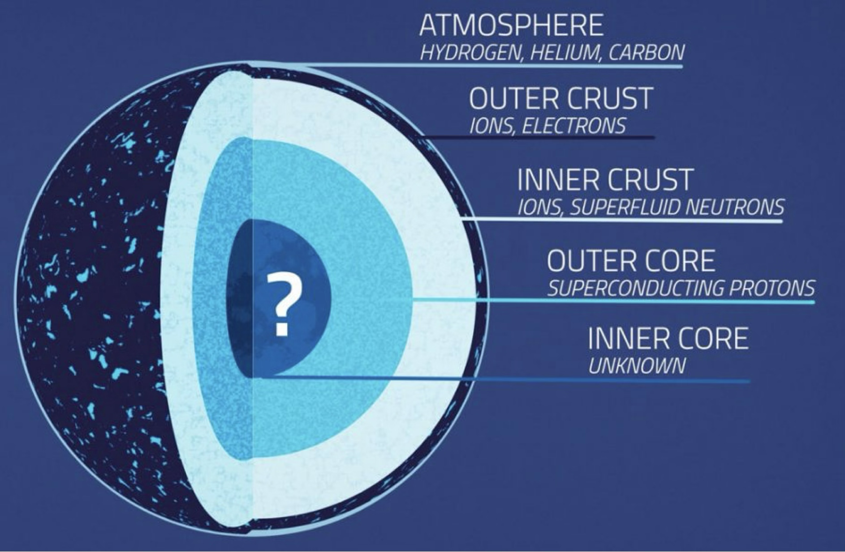

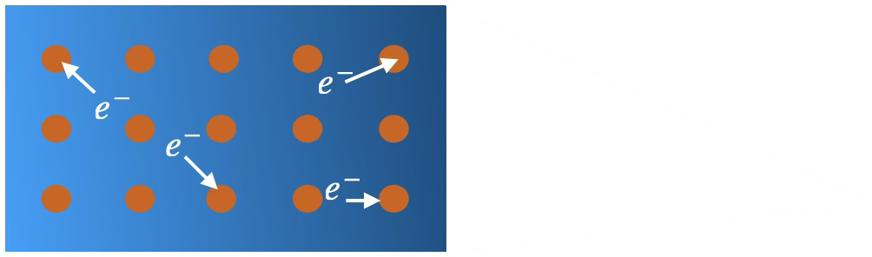


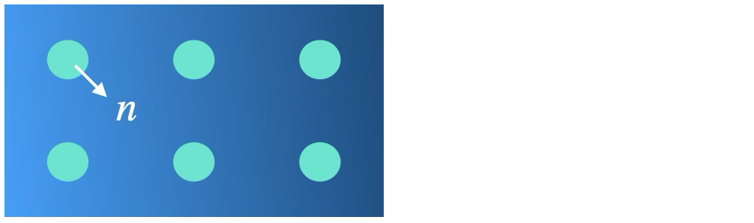

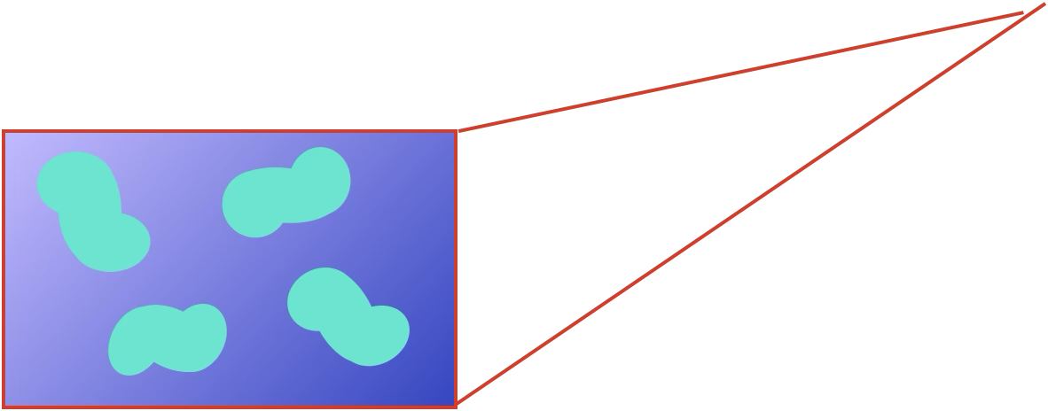

Neutron star structure
CRUST-CORE TRANSITION
NUCLEAR PASTA
4

Slide 5

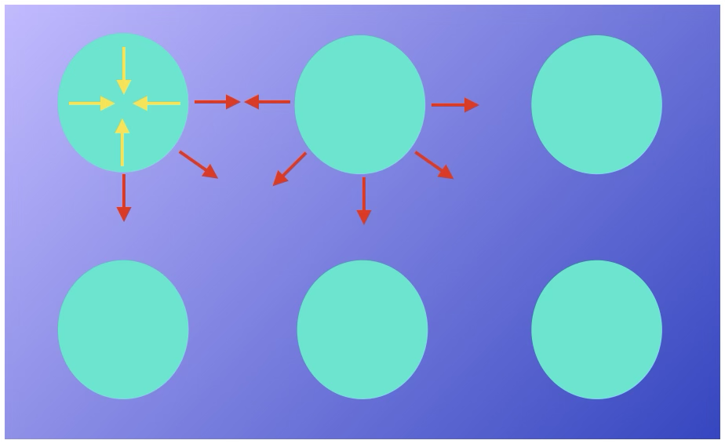


Why does nuclear pasta form?
Neutron rich nuclei in a sea of superfluid neutrons
Competition between forces
Matter becomes frustrated $→$ nuclear pasta forms
Nuclear force binding nuclei
Coulomb repulsion between nuclei
5

Slide 6
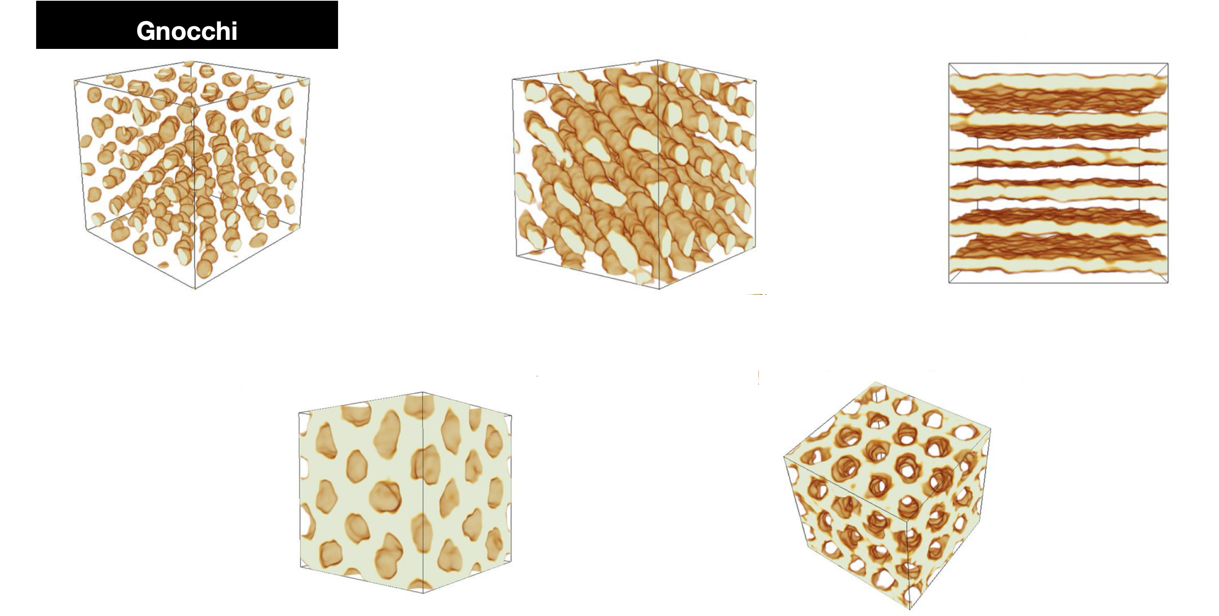
Nuclear pasta shapes
6
Caplan, M. E., Howrowitz, C. J., 2017, Colloquium: Astromaterial science and nuclear pasta. APS, 89, 041002

Slide 7

Previous work and challenges
Previous work:
Liquid drop model (1983) - predicted 5 different pasta shapes
More recent work uses molecular dynamics
Challenges:
Unphysical assumptions made (p/n ratio, neutron background)
Focus on pasta shapes, not transport properties
Transport properties are needed to link nuclear pasta to neutron star observables
7

Slide 8
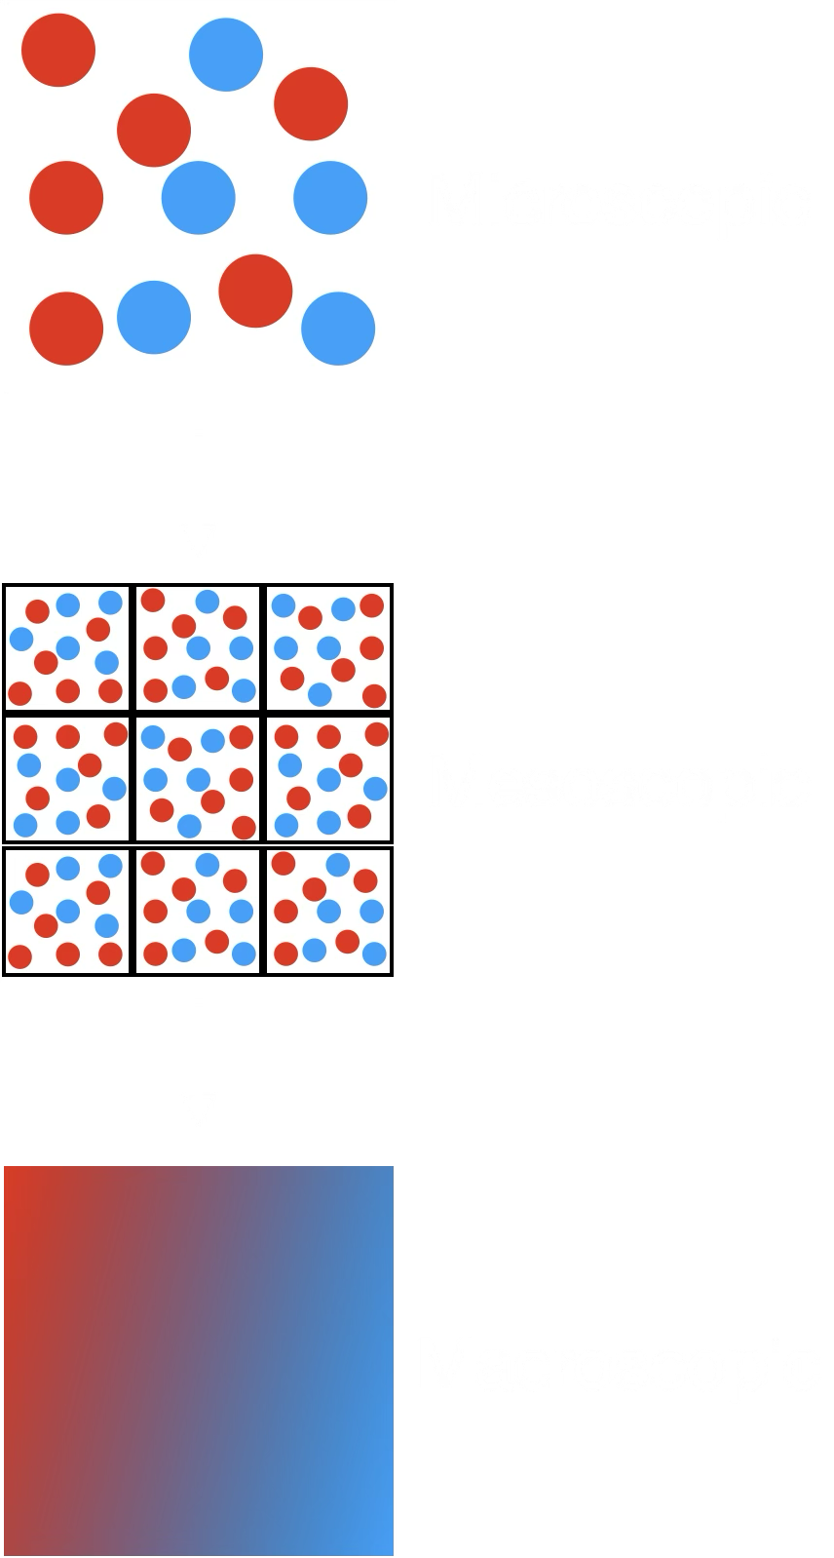
Lattice Boltzmann Method
Computational method derived from the Boltzmann equation
Captures mesoscopic behaviour of fluids
Has been widely used to simulate fluid behaviour on Earth, never in Astrophysical setting
Nuclear pasta phenomenologically similar to many soft matter systems on Earth:
- Liquid crystals
- DNA
- Proteins
8

Slide 9

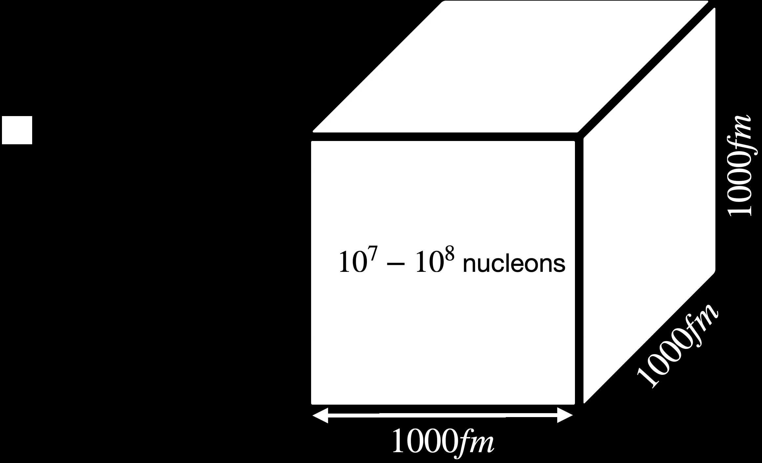
Lattice Boltzmann Method
Pasta region
9

Slide 10
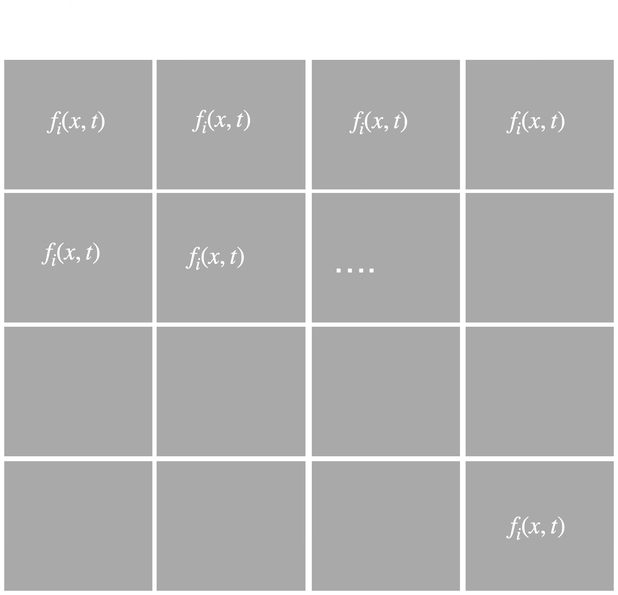


Lattice Boltzmann Method
Start with grid containing many lattice points
Each lattice point has its own set of distribution functions $f_{i}(x,t)$
10

Slide 11
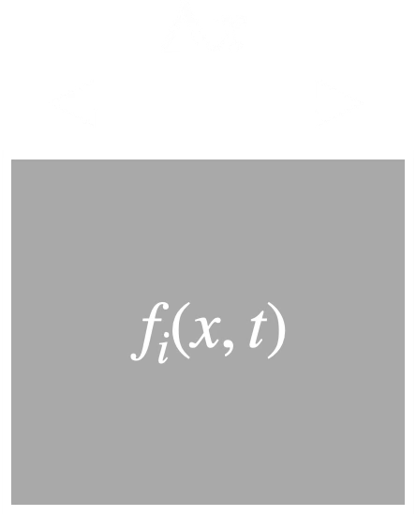
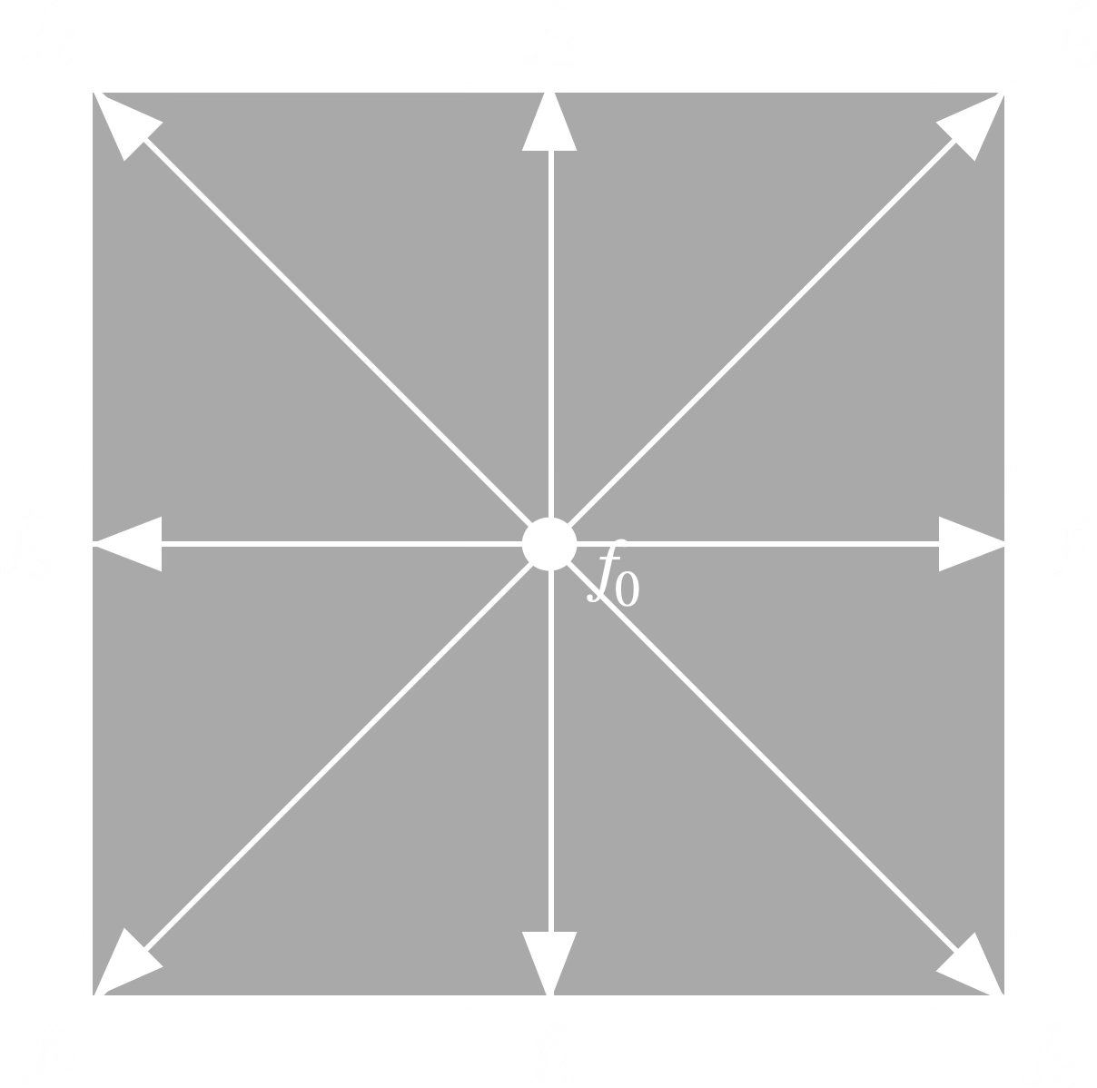

Lattice Boltzmann Method
D2Q9
11

Slide 12










Lattice Boltzmann Method
$$f_{i}\left(x,t\right)→f_{i}^{eq}\left(x,t\right)$$
$$f_{i}\left(x,t\right)→f_{i}^{eq}\left(x,t\right)$$
$$f_{i}\left(x,t\right)→f_{i}^{eq}\left(x,t\right)$$
$$f_{i}\left(x,t\right)→f_{i}^{eq}\left(x,t\right)$$
Model system by evolving $f_{i}(x,t)$ at each lattice point
Repeat process many times until equilibrium is reached
$$f_{i}\left(x,t\right)→f_{i}^{eq}\left(x,t\right)$$
$$f_{i}\left(x,t\right)→f_{i}^{eq}\left(x,t\right)$$
….
$$f_{i}\left(x,t\right)→f_{i}^{eq}\left(x,t\right)$$
12

Slide 13
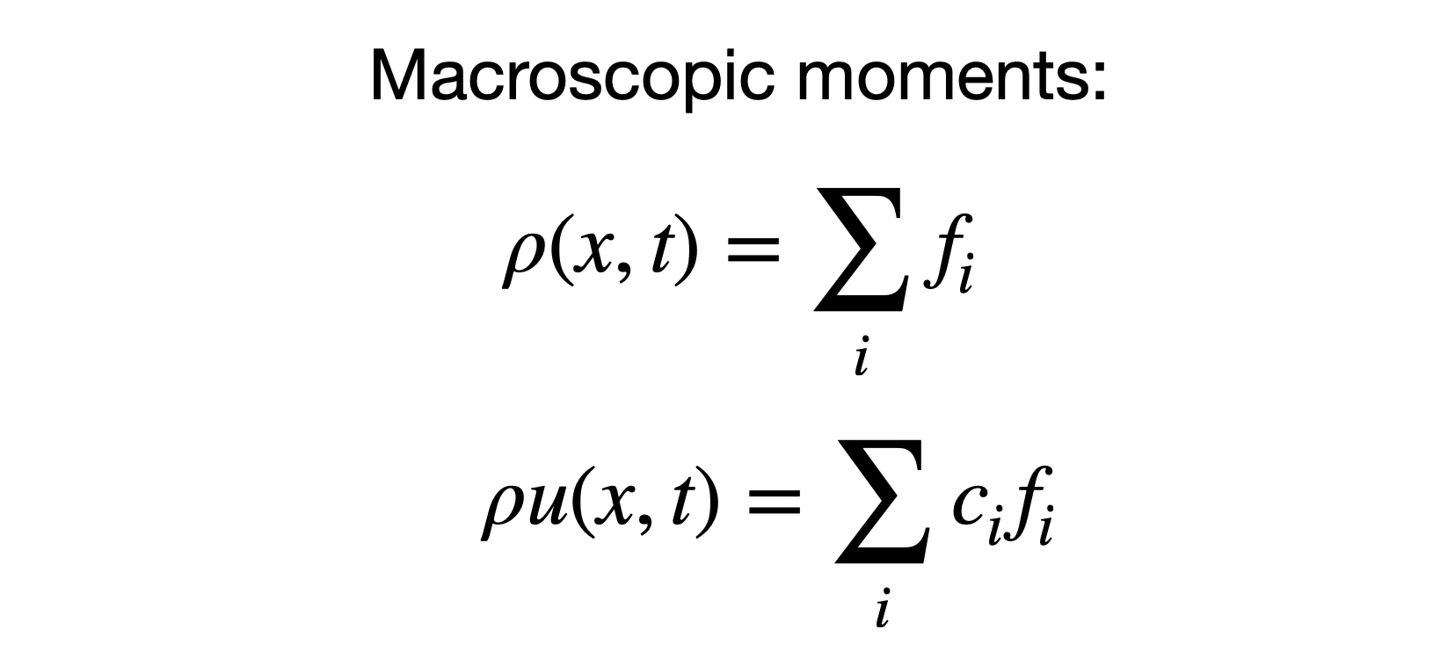
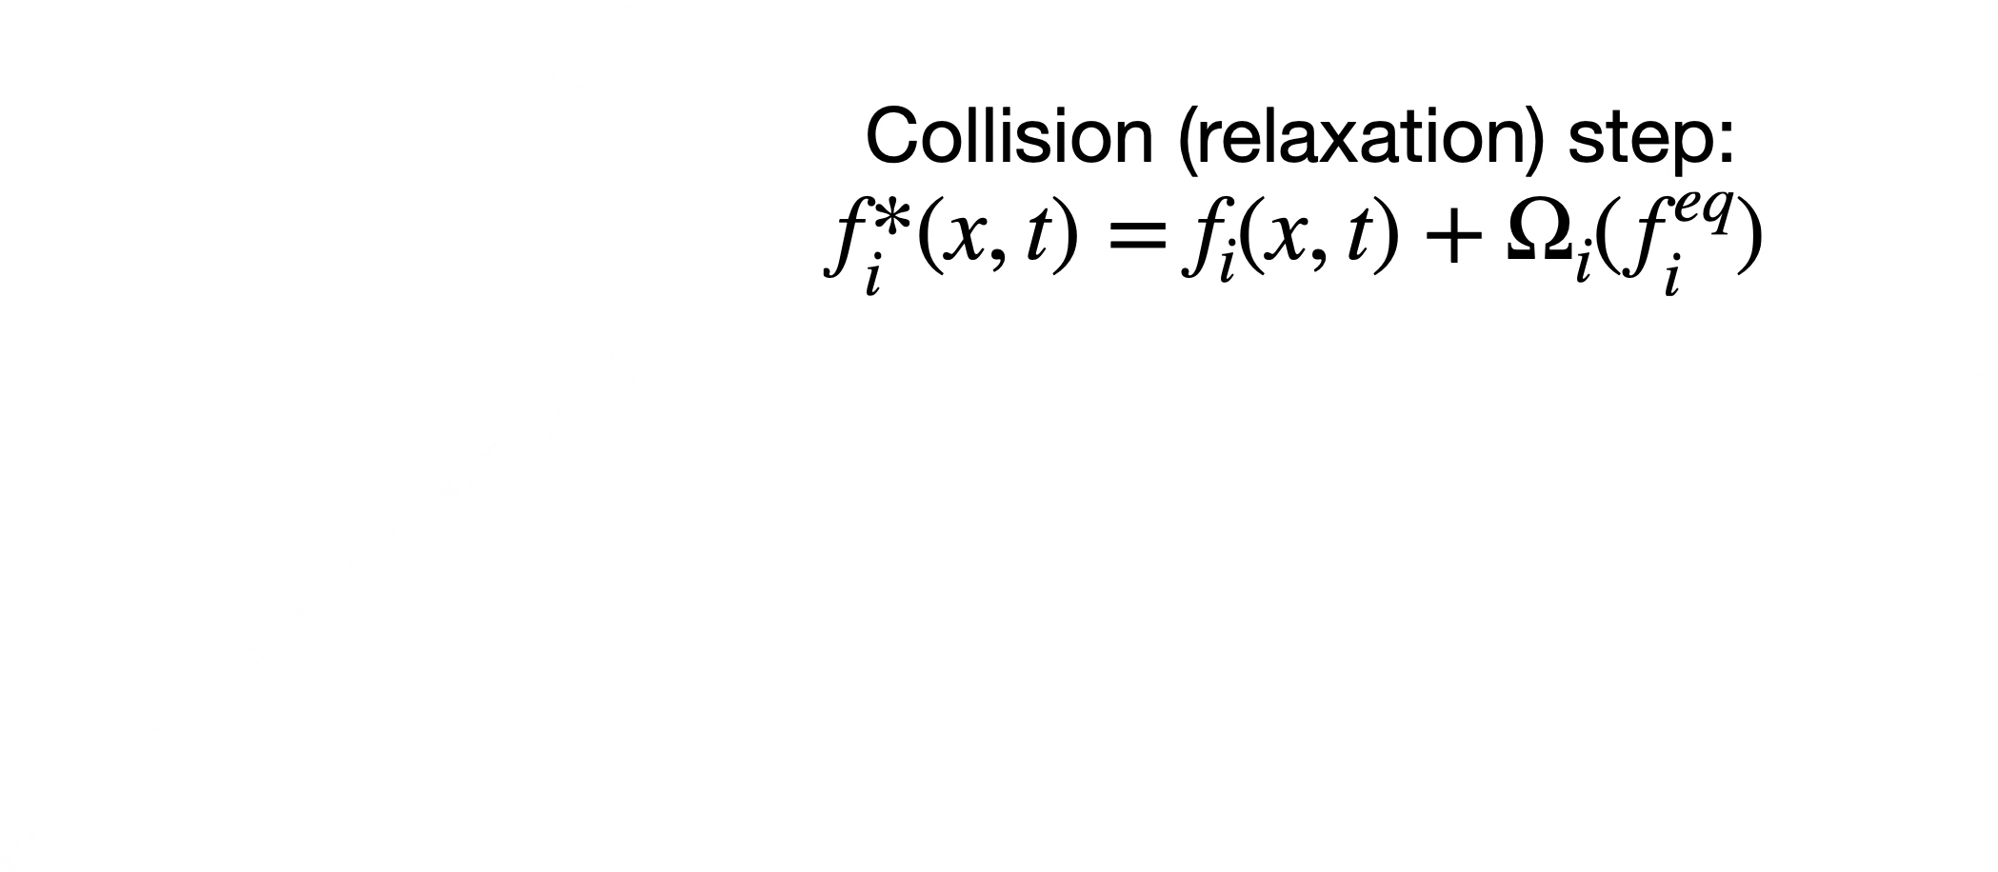
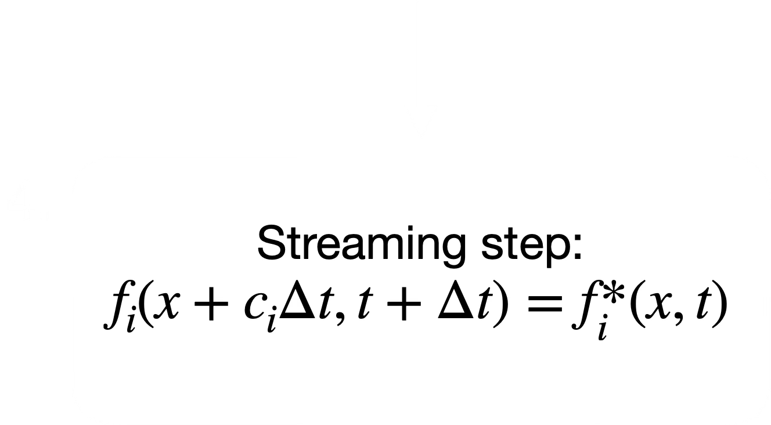
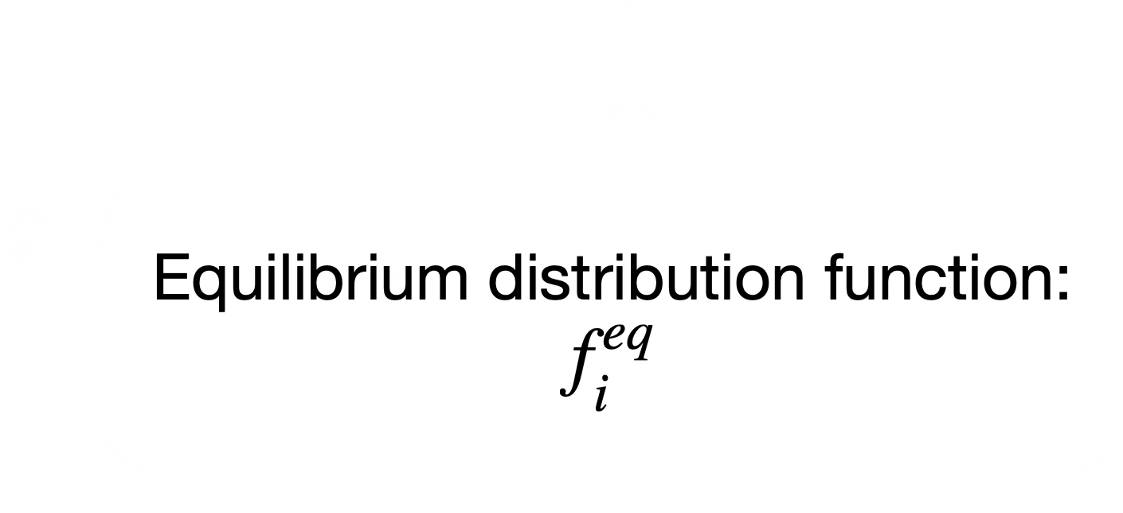
Time step algorithm
Krüger, T., Kusumaatmaja, H., Kuzmin, A., Shardt, O., Silva, G. and Viggen, E.M., 2017. The Lattice Boltzmann Method : Principles and Practice [Online]. 1st ed. 2017. Cham: Springer International Publishing. Available from: https://doi.org/10.1007/978-3-319-44649-3.
13

Slide 14
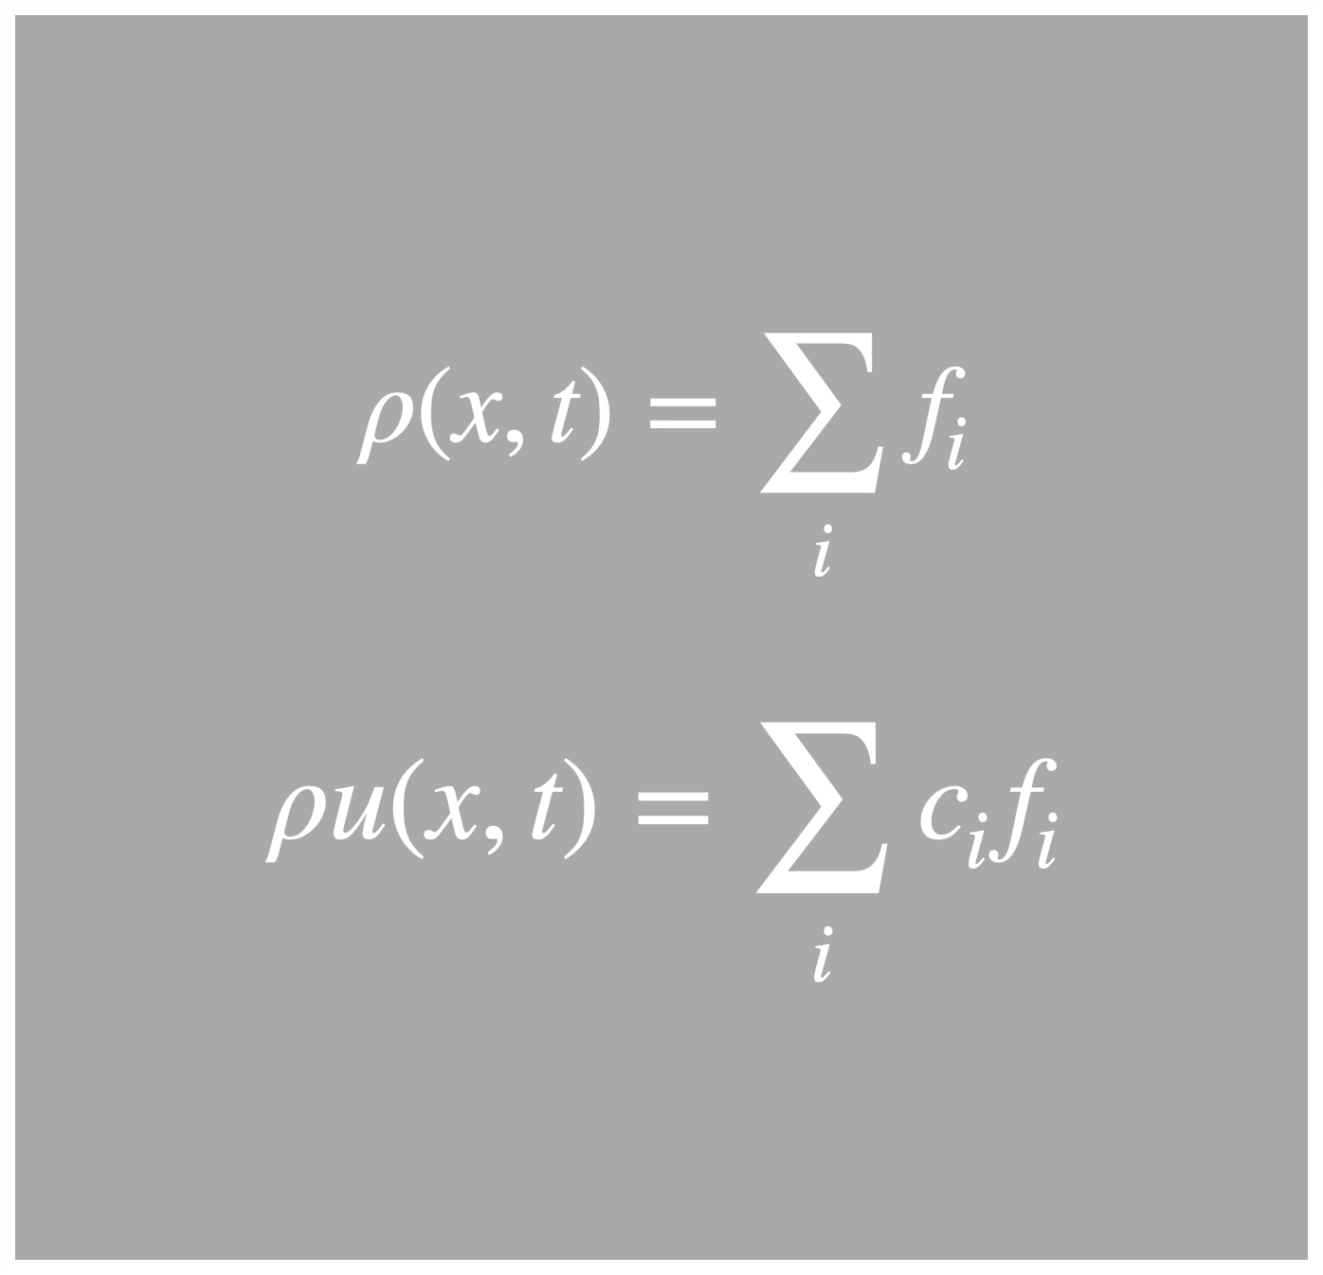
Time step algorithm
1. Macroscopic moments
14

Slide 15
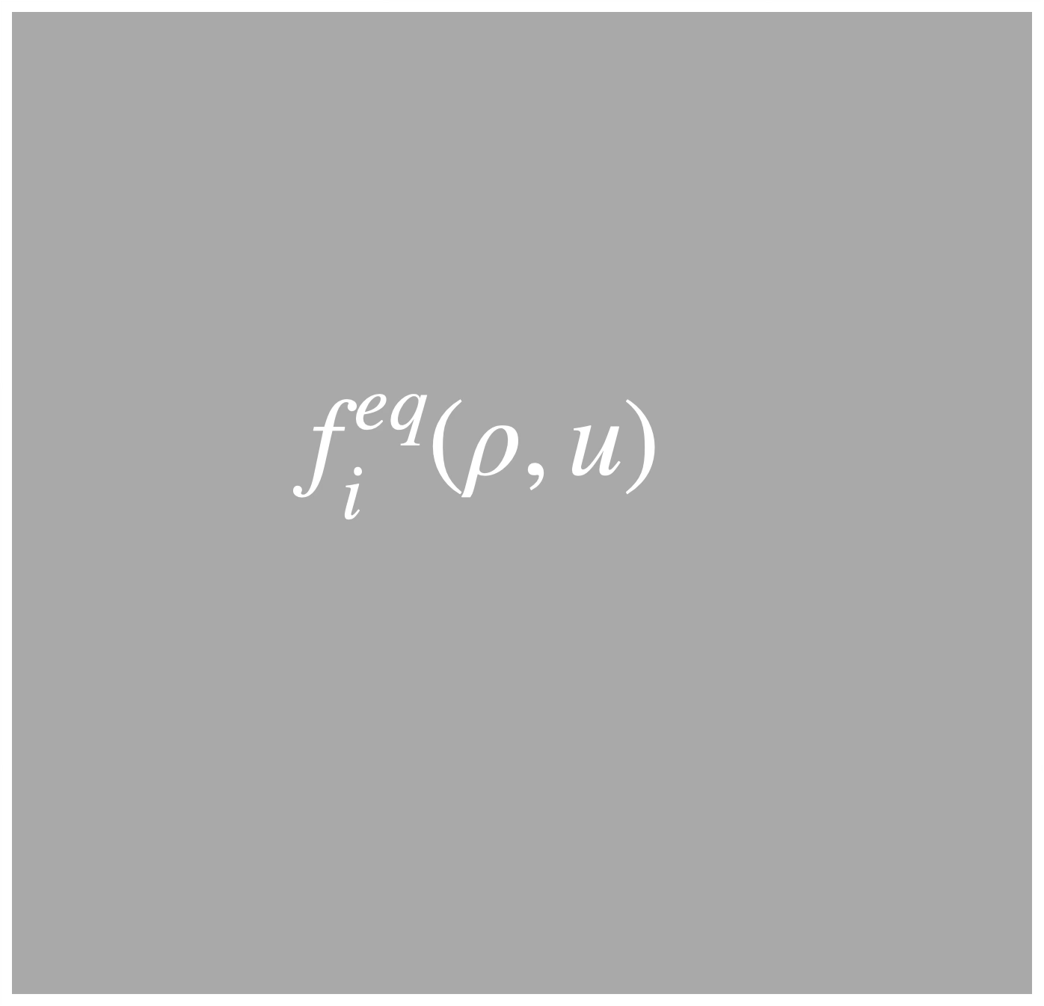
Time step algorithm
2. Equilibrium distribution function
15

Slide 16

Time step algorithm
3. Collision (relaxation) step
16

Slide 17

Time step algorithm
4. Streaming step
17

Slide 18







Lattice Boltzmann Method
$$f_{i}\left(x,t\right)→f_{i}^{eq}\left(x,t\right)$$
$$f_{i}\left(x,t\right)→f_{i}^{eq}\left(x,t\right)$$
$$f_{i}\left(x,t\right)→f_{i}^{eq}\left(x,t\right)$$
$$f_{i}\left(x,t\right)→f_{i}^{eq}\left(x,t\right)$$
$$f_{i}\left(x,t\right)→f_{i}^{eq}\left(x,t\right)$$
$$f_{i}\left(x,t\right)→f_{i}^{eq}\left(x,t\right)$$
….
$$f_{i}\left(x,t\right)→f_{i}^{eq}\left(x,t\right)$$
18

Slide 19
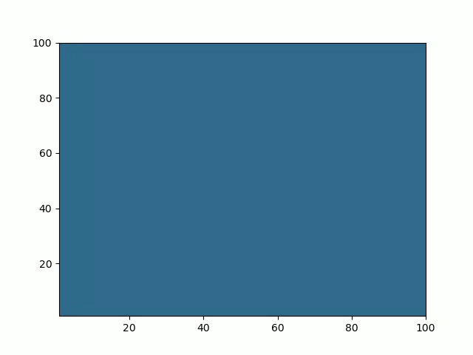
Work done so far
Lattice Boltzmann simulation of two-phase liquid-gas system.
Reproducing results from: Swift, M. R., Osborn, W. R., Yeomans, J. M., Lattice Boltzmann Simulation of Nonideal fluids, 1994, Physical review letters, 75, 5.
19

Slide 20
Goals and outcomes
Goals:
See if nuclear pasta shapes form
Learn about its transport properties
Challenges:
Incorporating all the microscopic forces at play
Ensuring the simulation remains stable
20

Slide 21
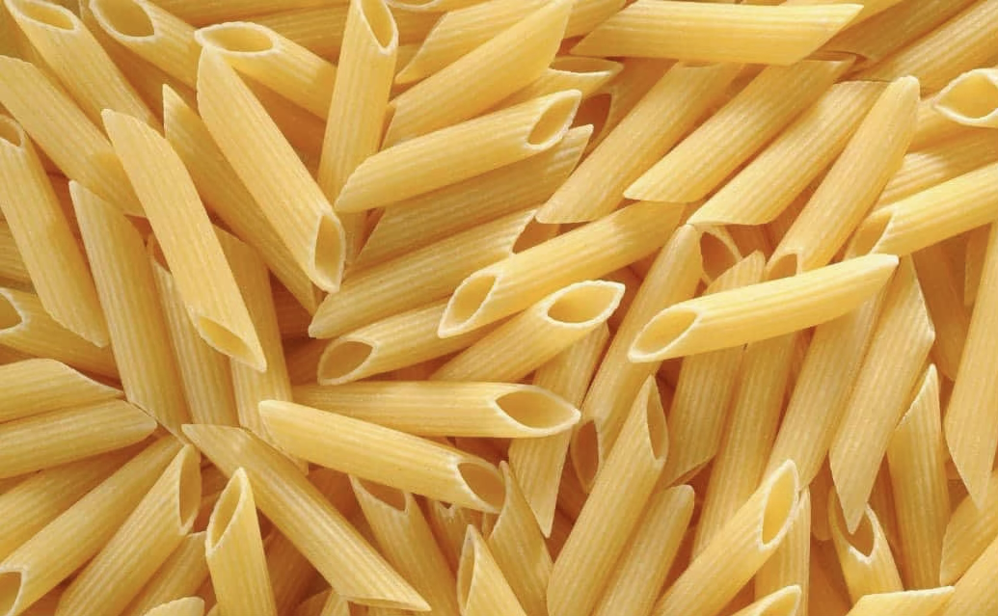
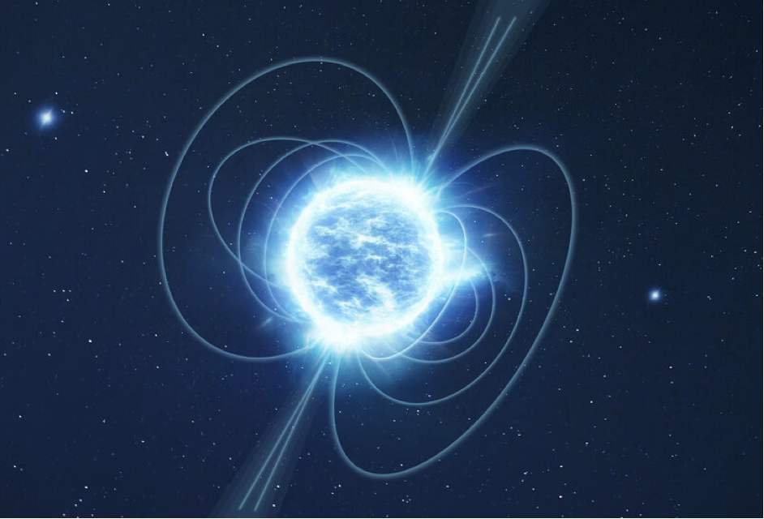
Goals and outcomes
Link nuclear pasta to neutron star observables
Nuclear pasta region has an effect on neutron star observables:
- Gravitational waves (i-modes)
- Resonant shattering flares
- Superfluid glitches
Detections of these observables will aid in interpreting results of simulations to help constrain the behaviour of nuclear pasta
Source:https://www.esa.int/Science_Exploration/Space_Science/Neutron_stars_pulsars_and_magnetars
21

Slide 22
Summary
PhD project: nuclear pasta and neutron star dynamics
What it is and why it forms
Will use Lattice Boltzmann method to model nuclear pasta in order to
- See whether nuclear pasta shapes form
- Investigate its transport properties
Link results of simulations to neutron star observables
22

