Slide 1



Impact of external vibrations on atom interferometers
George Parish
george.w.parish@kcl.ac.uk

Slide 2
I
Basics of Atom Interferometry

Slide 3
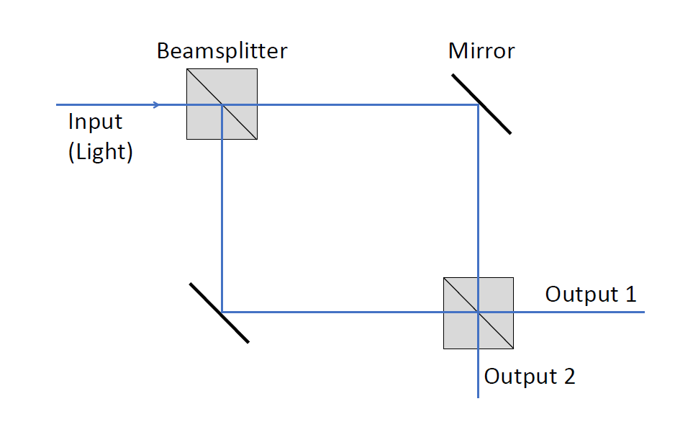
Atom Interferometer Sequence
Mach-Zehnder Light Interferometer

Slide 4
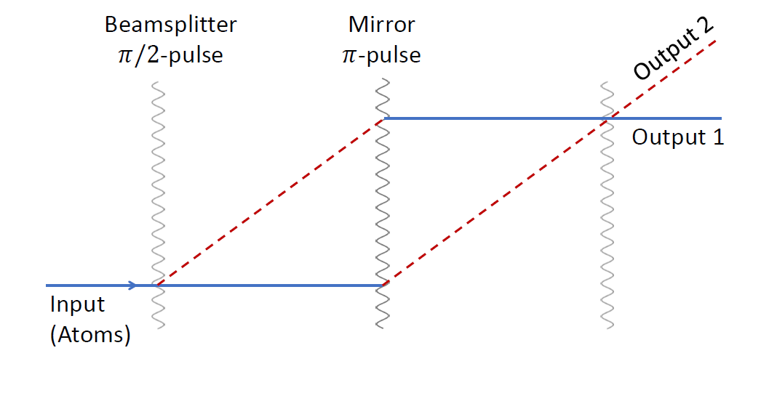
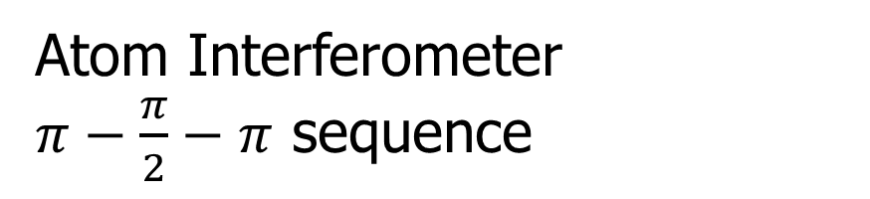
Atom Interferometer Sequence
Mach-Zehnder Light Interferometer
Atom Interferometer
$π−\frac{π}{2}−π$ sequence

Slide 5
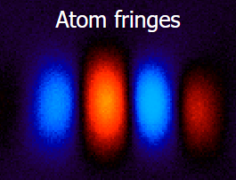
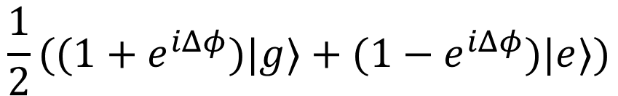

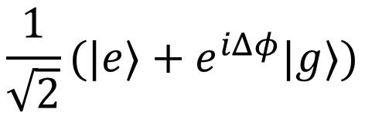
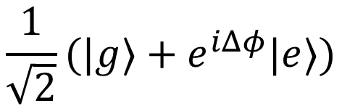



Atom Interferometer Sequence
$$|g⟩$$
Beamsplitter
$$\frac{1}{\sqrt{2}}(|g⟩+e^{iΔφ}|e⟩)$$
$$|e⟩$$
Mirror
$$\frac{1}{\sqrt{2}}(|e⟩+e^{iΔφ}|g⟩)$$
$$|g⟩$$
Beamsplitter
$$\frac{1}{2}((1+e^{iΔφ})|g⟩+{(1−e}^{iΔφ})|e⟩)$$
$$\left|e\right\rangle =|g+ℏk⟩$$

Slide 6
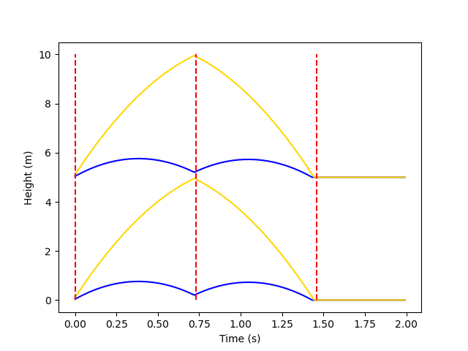
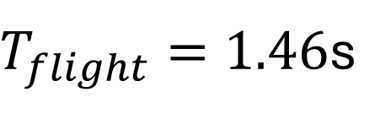
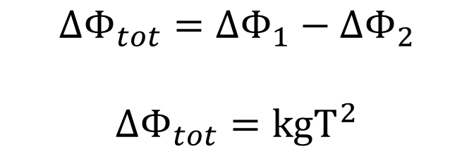
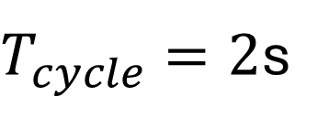
AION Setup
$T_{flight}=1.46$s
$T_{cycle}=2$s
$$ΔΦ_{1,2}=ΔΦ_{sep}+ΔΦ_{laser}+ΔΦ_{prop}$$
$ΔΦ_{tot}=ΔΦ_{1}−ΔΦ_{2}$
$$ΔΦ_{tot}={kgT}^{2}$$
Two stacked interferometers gives gradiometer configuration - cancels common laser phase

Slide 7
II
Where’s the fundamental physics?

Slide 8
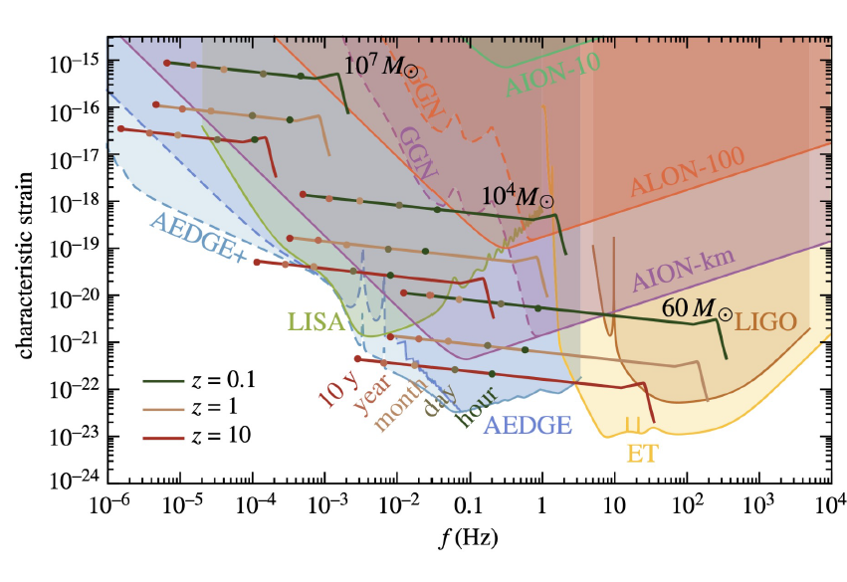
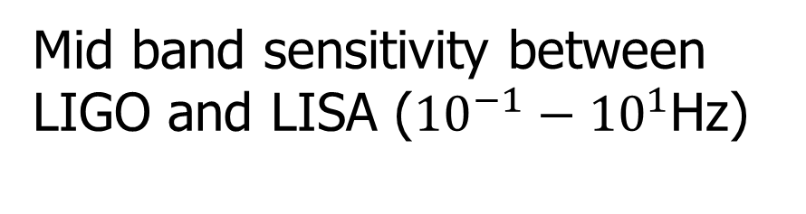
Gravitational Wave Searches
Mid band sensitivity between LIGO and LISA (${10}^{−1}−{10}^{1}$Hz)
Strain from gravitational waves modifies the space between the falling atoms
This changes light propagation time, giving rise to a phase shift between the spatially separated interferometers
L Badurina et al, arXiv 2108.02468

Slide 9
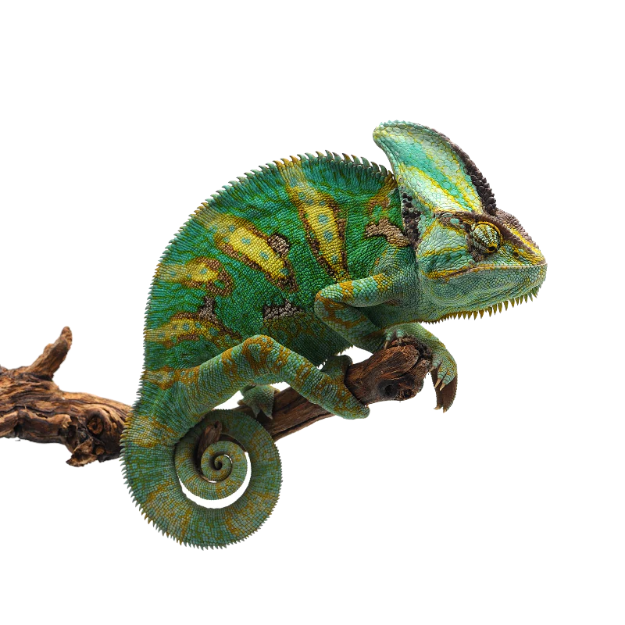
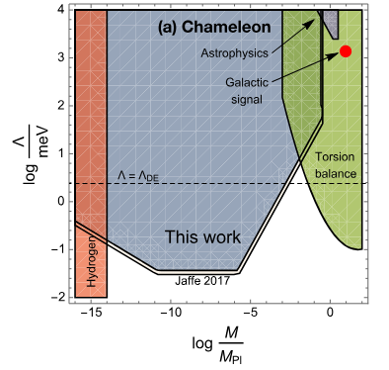
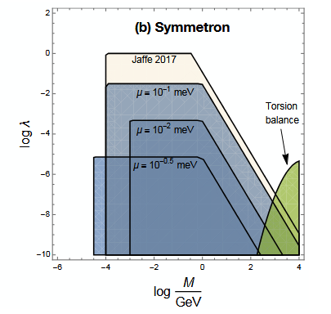
Dark Energy
C Burrage et al, arXiv:1812.08244

Slide 10
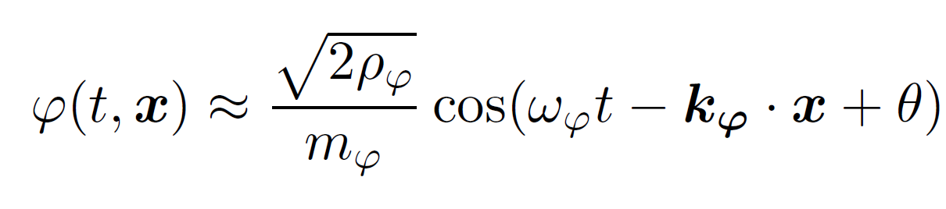
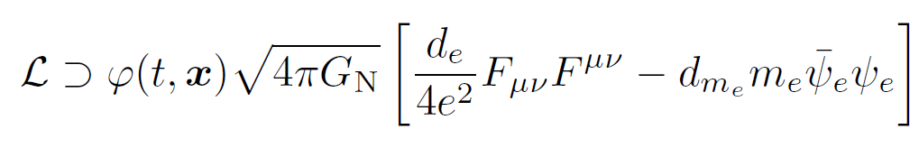
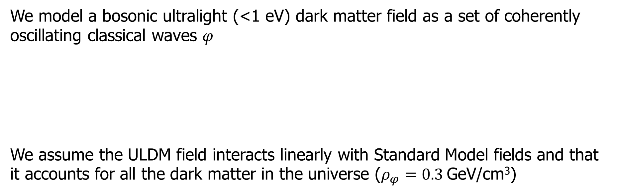
Ultralight dark matter
We model a bosonic ultralight (<1 eV) dark matter field as a set of coherently oscillating classical waves $φ$
We assume the ULDM field interacts linearly with Standard Model fields and that it accounts for all the dark matter in the universe ($ρ_{φ}=0.3$GeV/cm³)

Slide 11
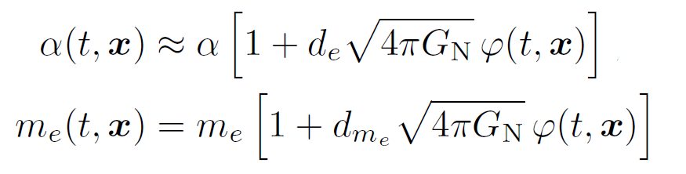
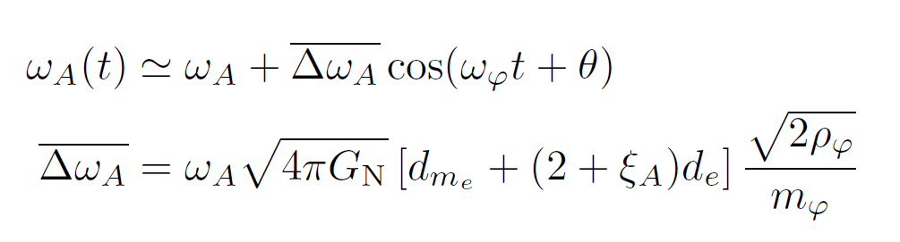
Ultralight dark matter
These interactions introduce time dependent corrections to the fine structure constant and electron mass
Which in turn induce time dependent oscillations to the transition energies of atoms

Slide 12
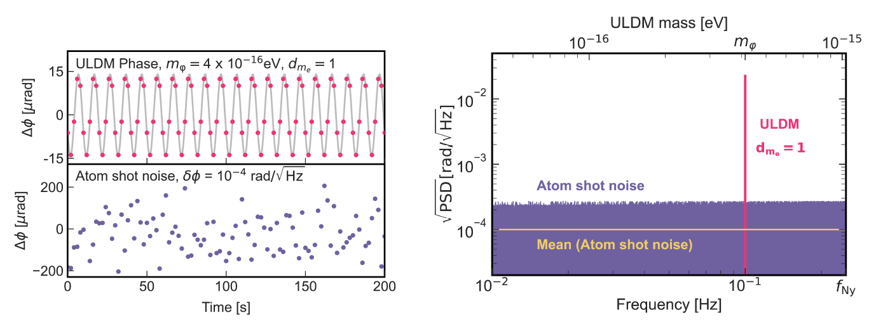
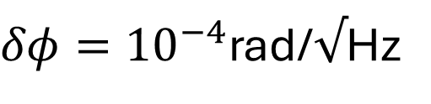
Can we see Ultralight dark matter?
The time dependent nature of the transition frequencies in turn induces a phase difference in the atom interferometer setup
$δφ={10}^{−4}$rad/$√$Hz
J Carlton, C McCabe, arXiv:2308.10731

Slide 13
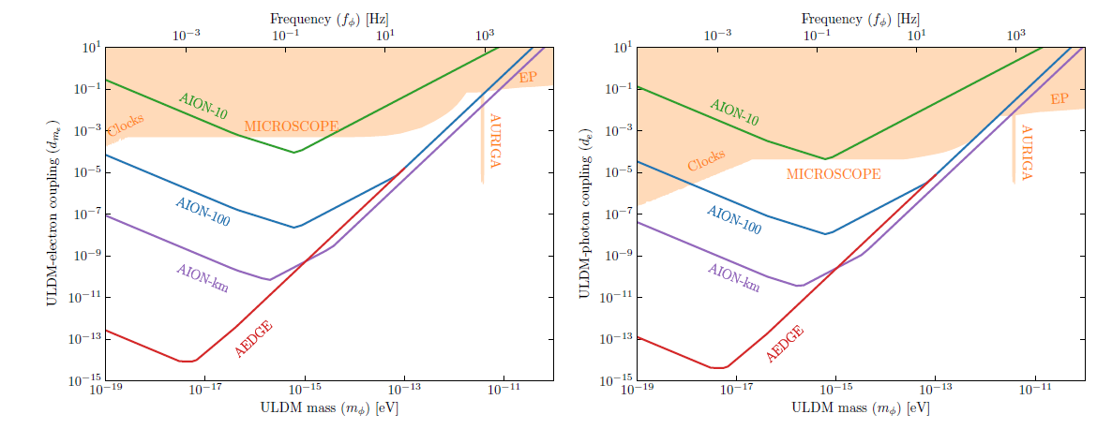
Can we see Ultralight dark matter?
J Ellis, O Buchmueller arXiv:2306.17726v1

Slide 14
III
Gravity Gradient Noise

Slide 15
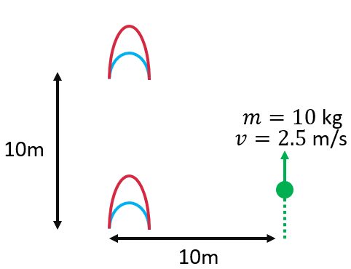
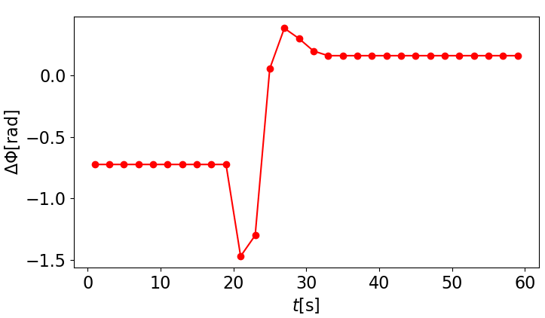
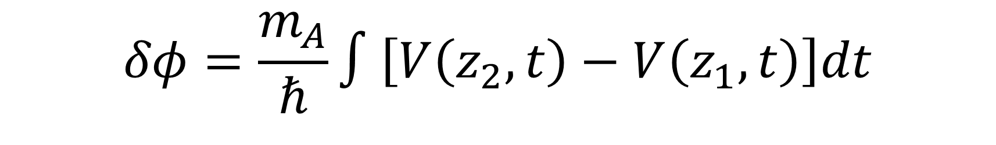
Gravity Gradient Noise
$$δφ=\frac{m_{A}}{ℏ}∫\left[V\left(z_{2},t\right)−V\left(z_{1},t\right)\right]dt$$

Slide 16
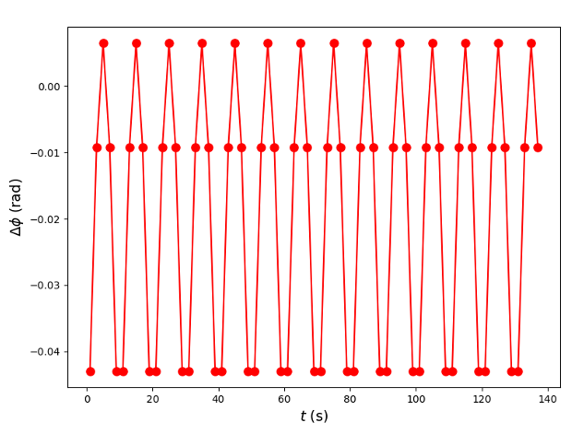
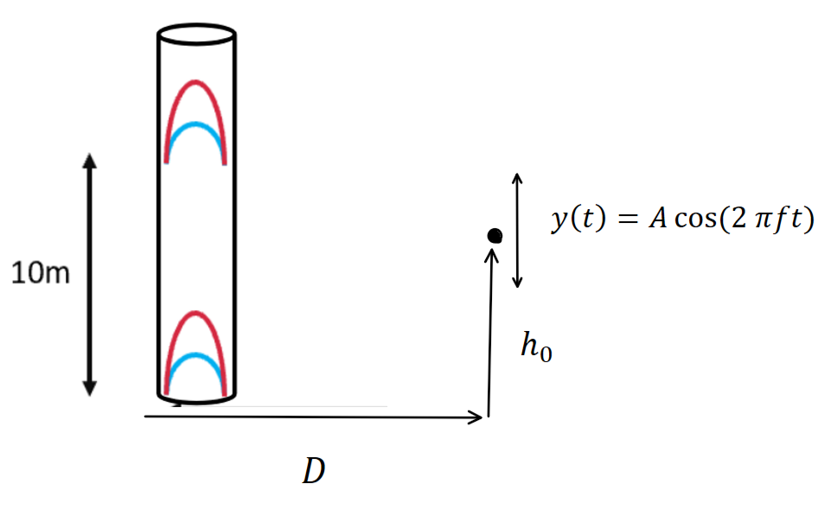



Oscillatory Noise
Considering a simple toy model of a harmonic oscillator of mass 10kg moving in the vicinity of the AION-10 setup
$f=0.1$ Hz
$=1$m
$=5$m

Slide 17
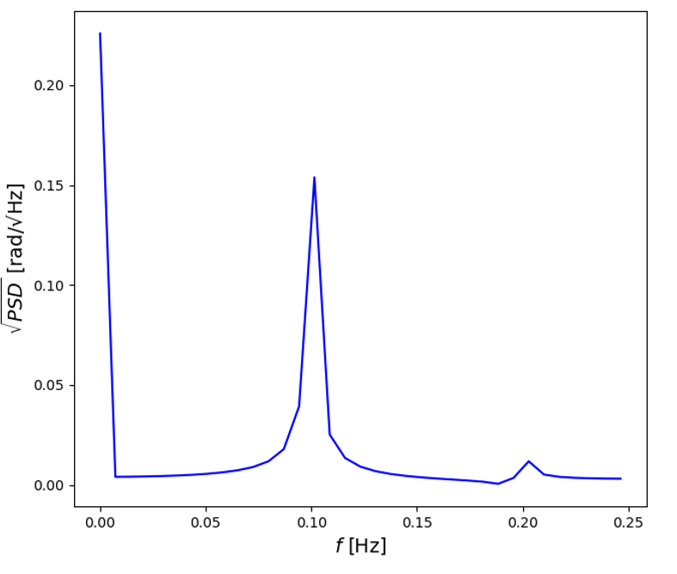
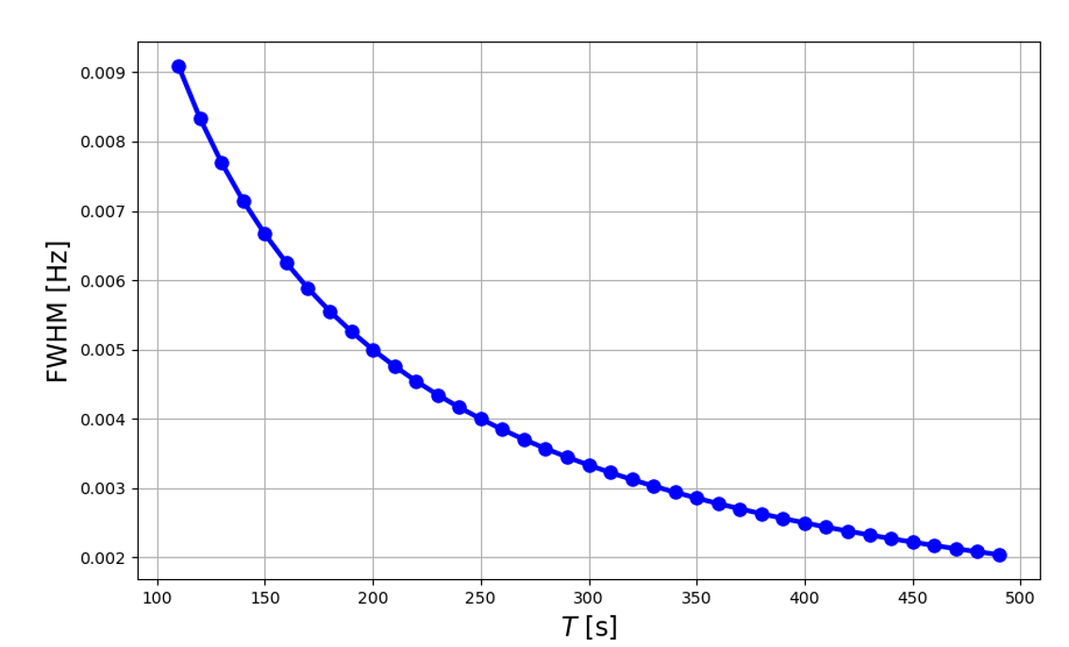
Oscillatory Noise
A long experimental run is better for identifying oscillatory peaks in the phase difference readings

Slide 18
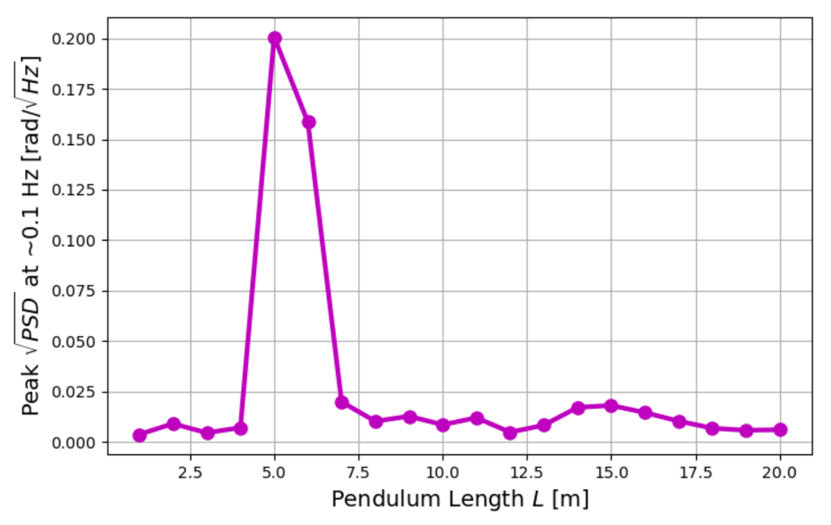
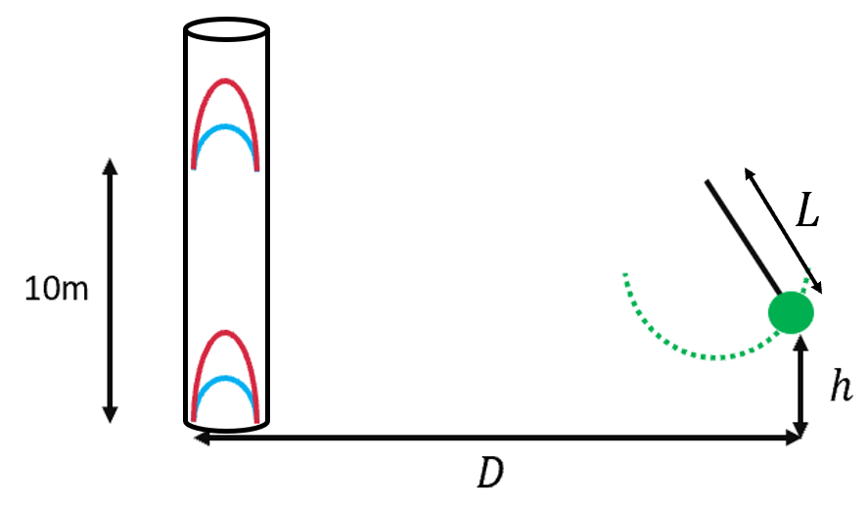

Oscillatory Noise
$=5$m

Slide 19
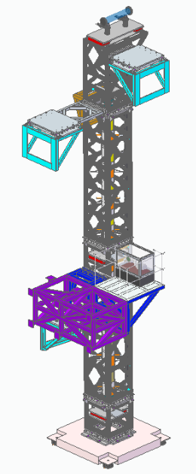
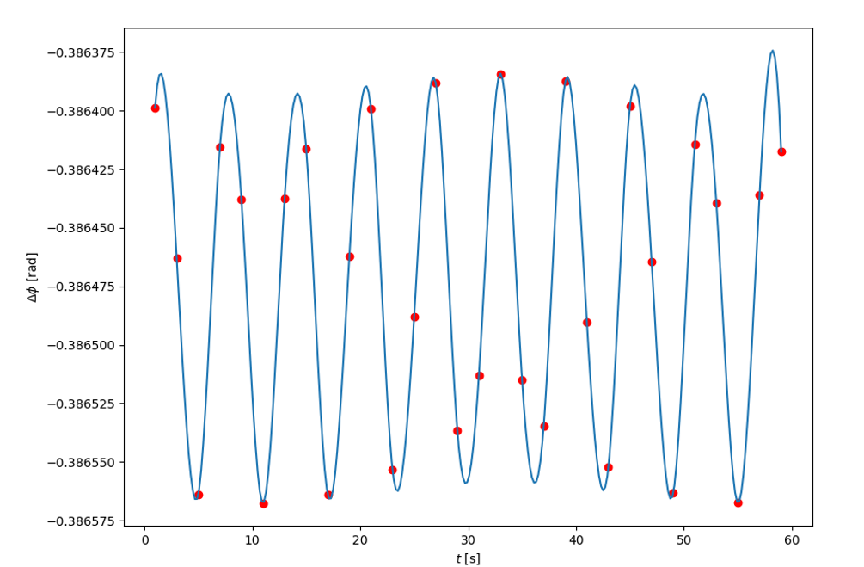
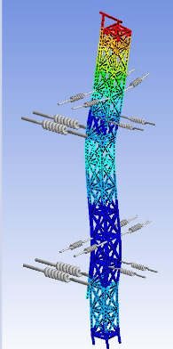
Shape Dependent Oscillatory Noise
Considering a meter long cylinder of steel, of radius 10cm, oscillating sinusoidally with amplitude 1mm. Situated 1m below the bottom atom source.
Much work to do to model the effects of vibrations of complex objects
Z Pan, Structural Stability and Instrument Installation of a 10m interferometer

Slide 20
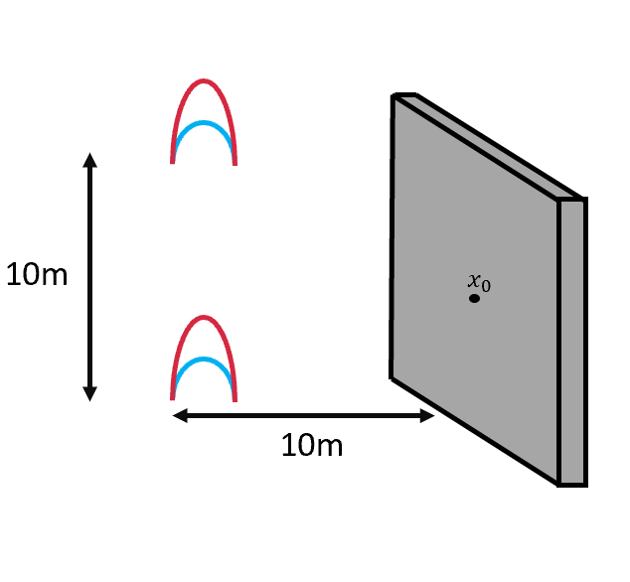
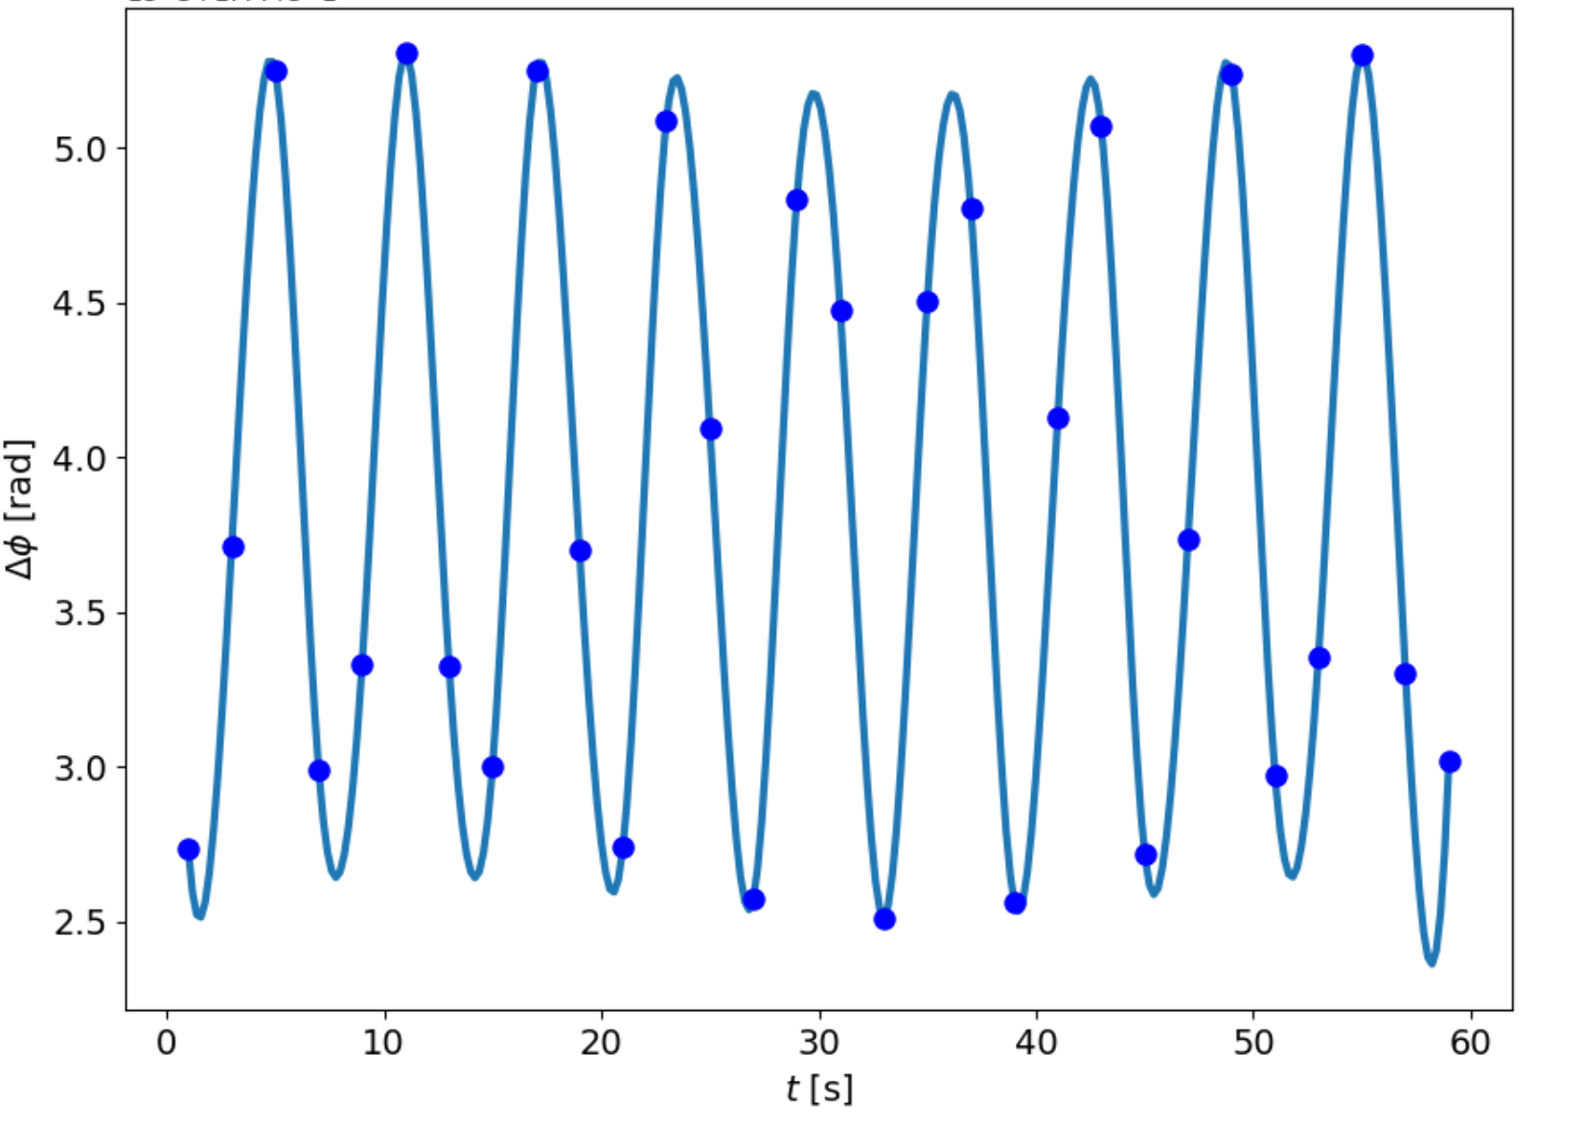

Shaky Walls
Small oscillations will be present in the walls of Beecroft. Do these matter? Can we mitigate the noise they create?
$$x_{0}=10+1×{10}^{−6}sin⁡(t)$$

Slide 21
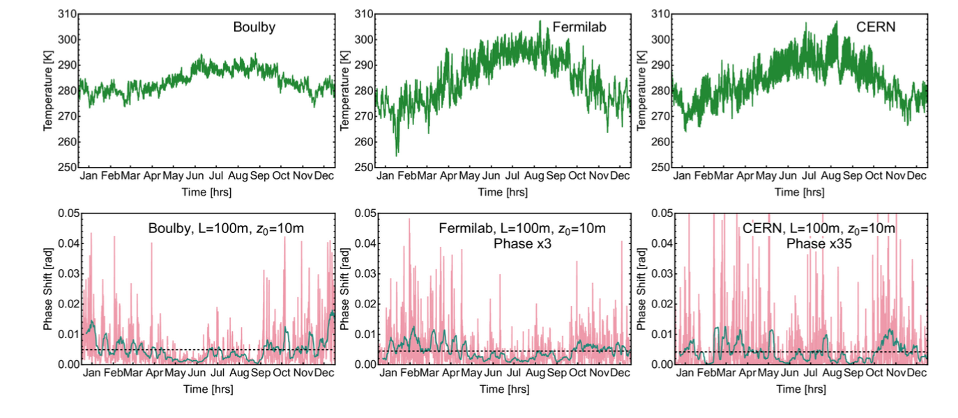
Atmospheric Noise
J Carlton et al, arXiv:2412.05379v1

Slide 22
IV
The Future & Summary

Slide 23

Around the World
AION
VLBAI
MAGIS
MIGA
Stanford
ZAIGA

Slide 24
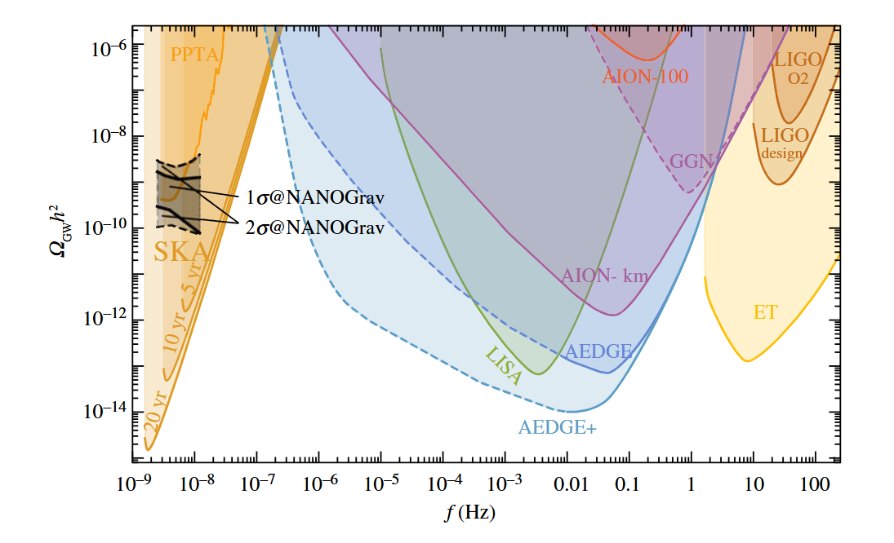

Future Detectors
Longer Baseline
Longer time of flight
Sensitive to smaller $Δφ$
Different noise-based challenges. No seismic noise in space!

Slide 25
Summary
Atom Interferometers such as AION, MAGIS and VLBAI show promise as ways of detecting fundamental physics signals such as ultralight dark matter, gravitational waves and dark energy.
Gravity gradient noise provides significant challenges in detangling these desired signals from moving masses in the surrounding environment
The shape of the interferometer response can be characterised by both the characteristics of the external moving object (mass, shape) and the oscillations themselves (amplitude, frequency etc)
As interferometers get bigger and more sensitive, the sensitivity to noise will increase too, so it is essential we put in the work to characterise this noise!

Slide 26
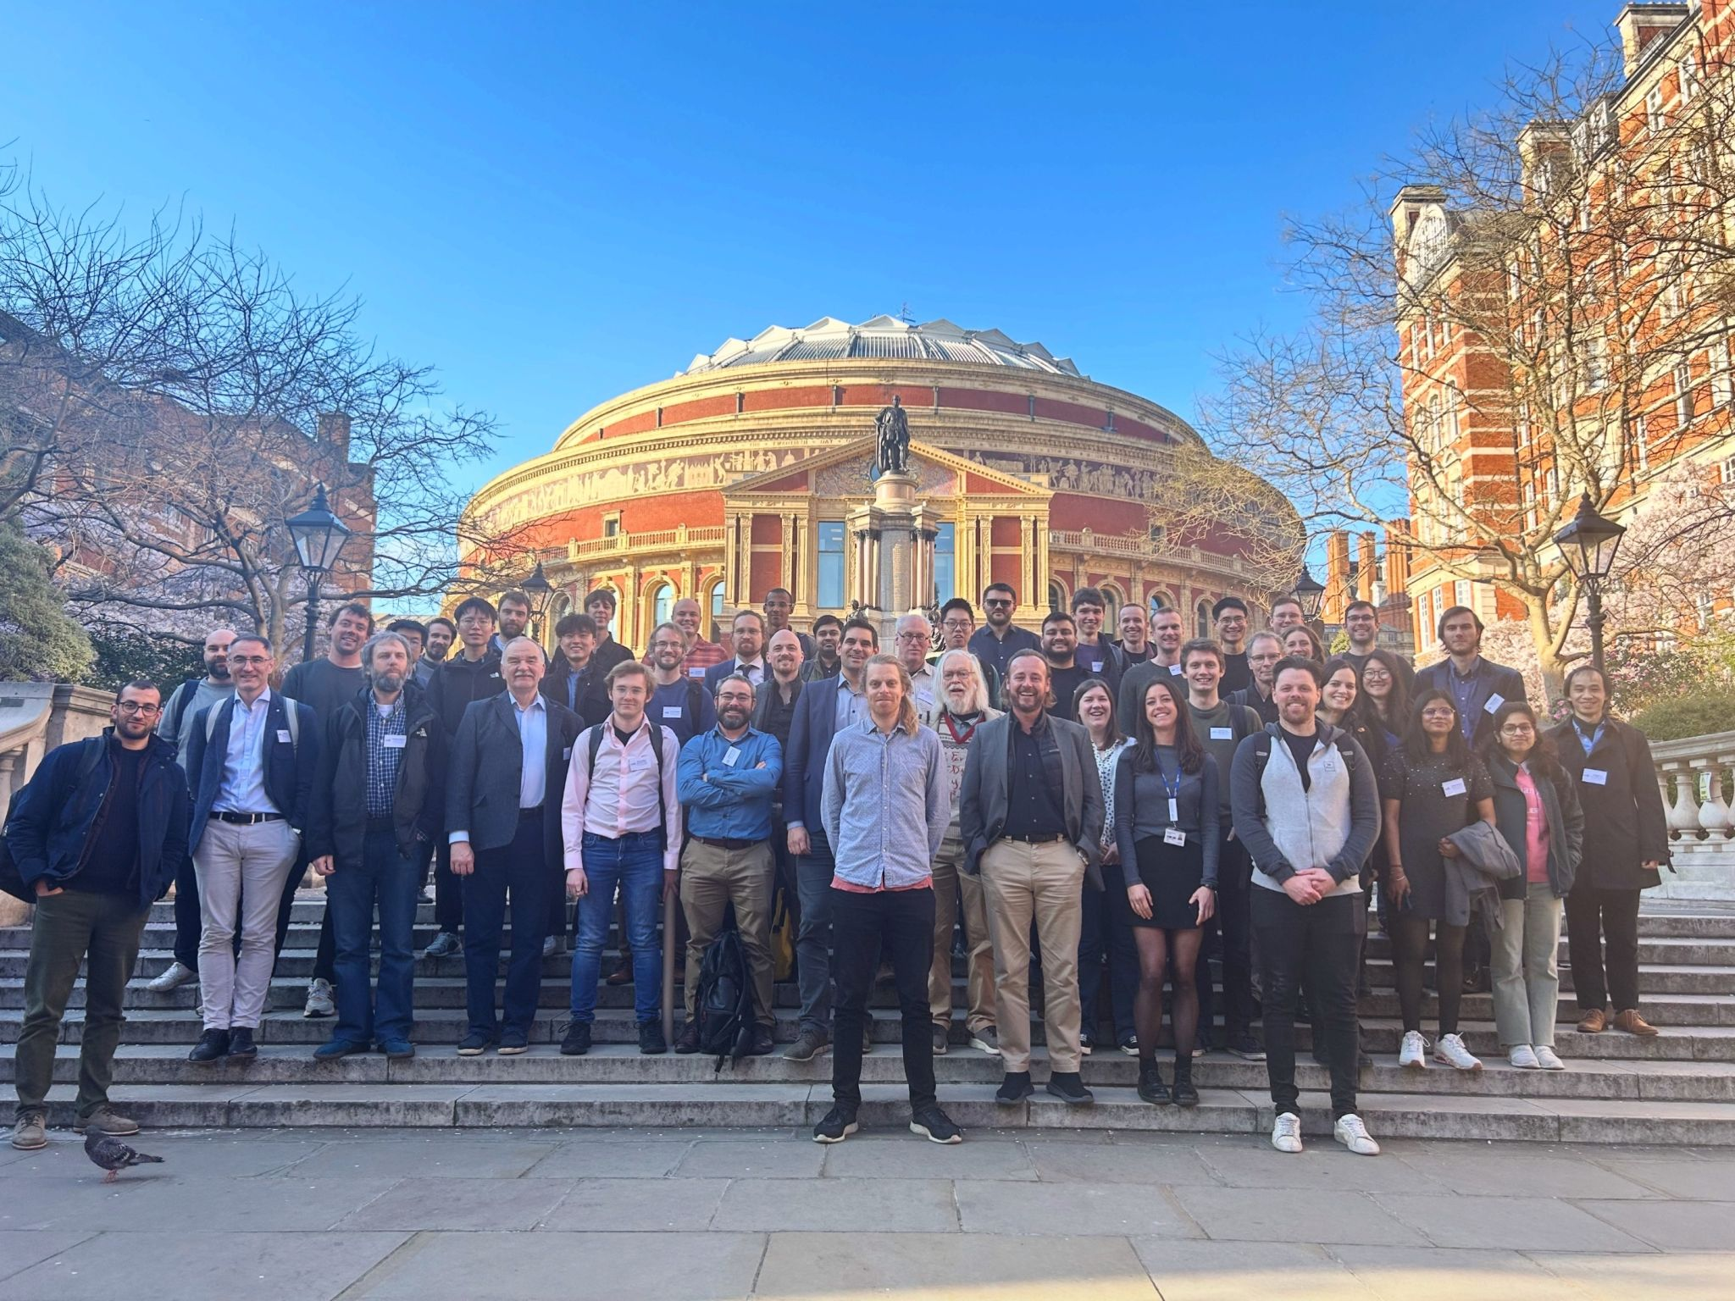

Slide 27
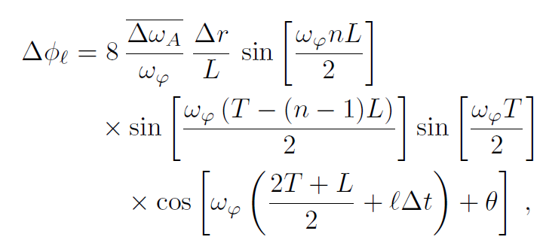
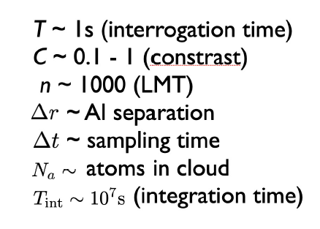
Backup

