Slide 1
Radiatively generated symmetron mechanism in curved spacetime
Łukasz Bunio
XV NExT PhD Workshop, 17.07.2025
Based on work done together with P. Millington

Slide 2
Outline
Introduction: The scalar-tensor theories of gravity and screening
The radiatively generated symmetron screening in flat spacetime
The calculation in curved spacetime
The differences induced by curvature corrections

Slide 3

Introduction
The problem
  Einstein’s gravity + SM ≠ the observed cosmology
Solutions
        $Λ$-CDM model: Alternative options:
    Dark matter+ $Λ$ constant e.g. modified gravity

Slide 4
Introduction
The problem
  Einstein’s gravity + SM ≠ the observed cosmology
Solutions
        $Λ$-CDM model: Alternative options:
    Dark matter+ $Λ$ constant e.g. modified gravity
Higher derivatives of the metric
Additional fields
Additional dimensions

Slide 5



Introduction
Einstein-Hilbert Action
Scalar-tensor gravity
e.g.

Slide 6
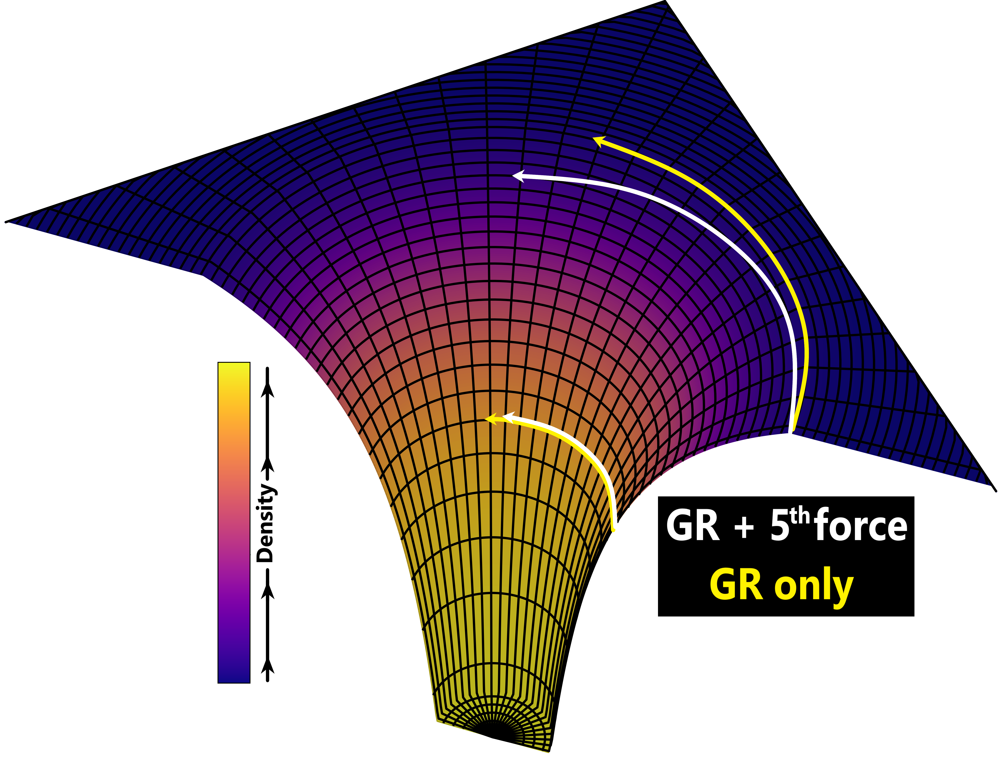



Introduction
The symmetron [1]:
Note:
The 5th force:
[1] „Symmetron Fields: Screening Long-Range Forces Through Local Symmetry Restoration”, K. Hinterbichler and J. Khoury, Phys.Rev.Lett. 104, (2010)

Slide 7
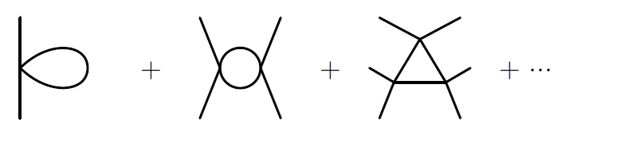

Radiative symmetron screening [2]
[2] „Radiative Screening of Fifth Forces.”, C. Burrage, E.J.Copeland, and P. Millington, Physical Review Letters, 117(21). (2016).

Slide 8



Radiative symmetron screening
In flat spacetime:

Slide 9




Curved spacetime calculation
The propagator defined using the Schwinger proper time s:
1-loop contribution to the effective action
where

Slide 10


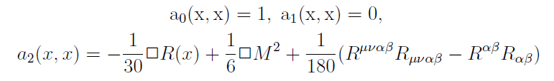
Curved spacetime calculation
As x goes to x’ and s to zero [3]
where
and
[3] “Proof of summed form of proper-time expansion for propagator in
curved space-time” I. Jack and L. Parker. , Phys. Rev. D 31 (1985).

Slide 11
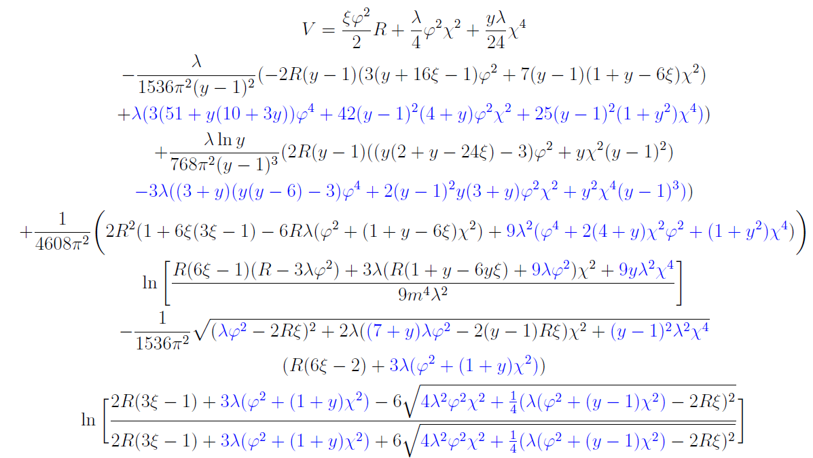

Slide 12



Curved spacetime calculation

Slide 13


Curved spacetime calculation
Curved spacetime
Flat spacetime

Slide 14
Curved spacetime calculation

Slide 15
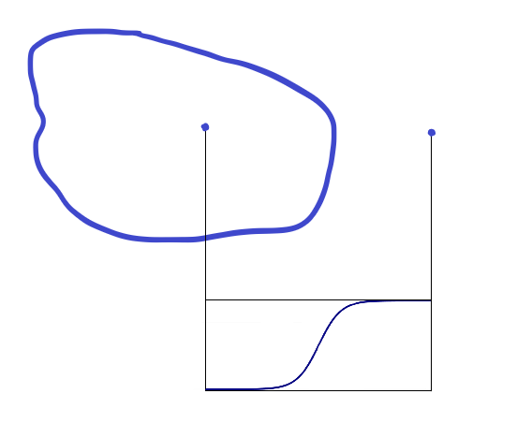
The field profile
0
vev
vev
0
r
[4] “phi-enics: Vainshtein screening with the finite element method” J. Braden et al., Journal of Cosmology and Astroparticle Physics . 2021.03 (2021)

Slide 16
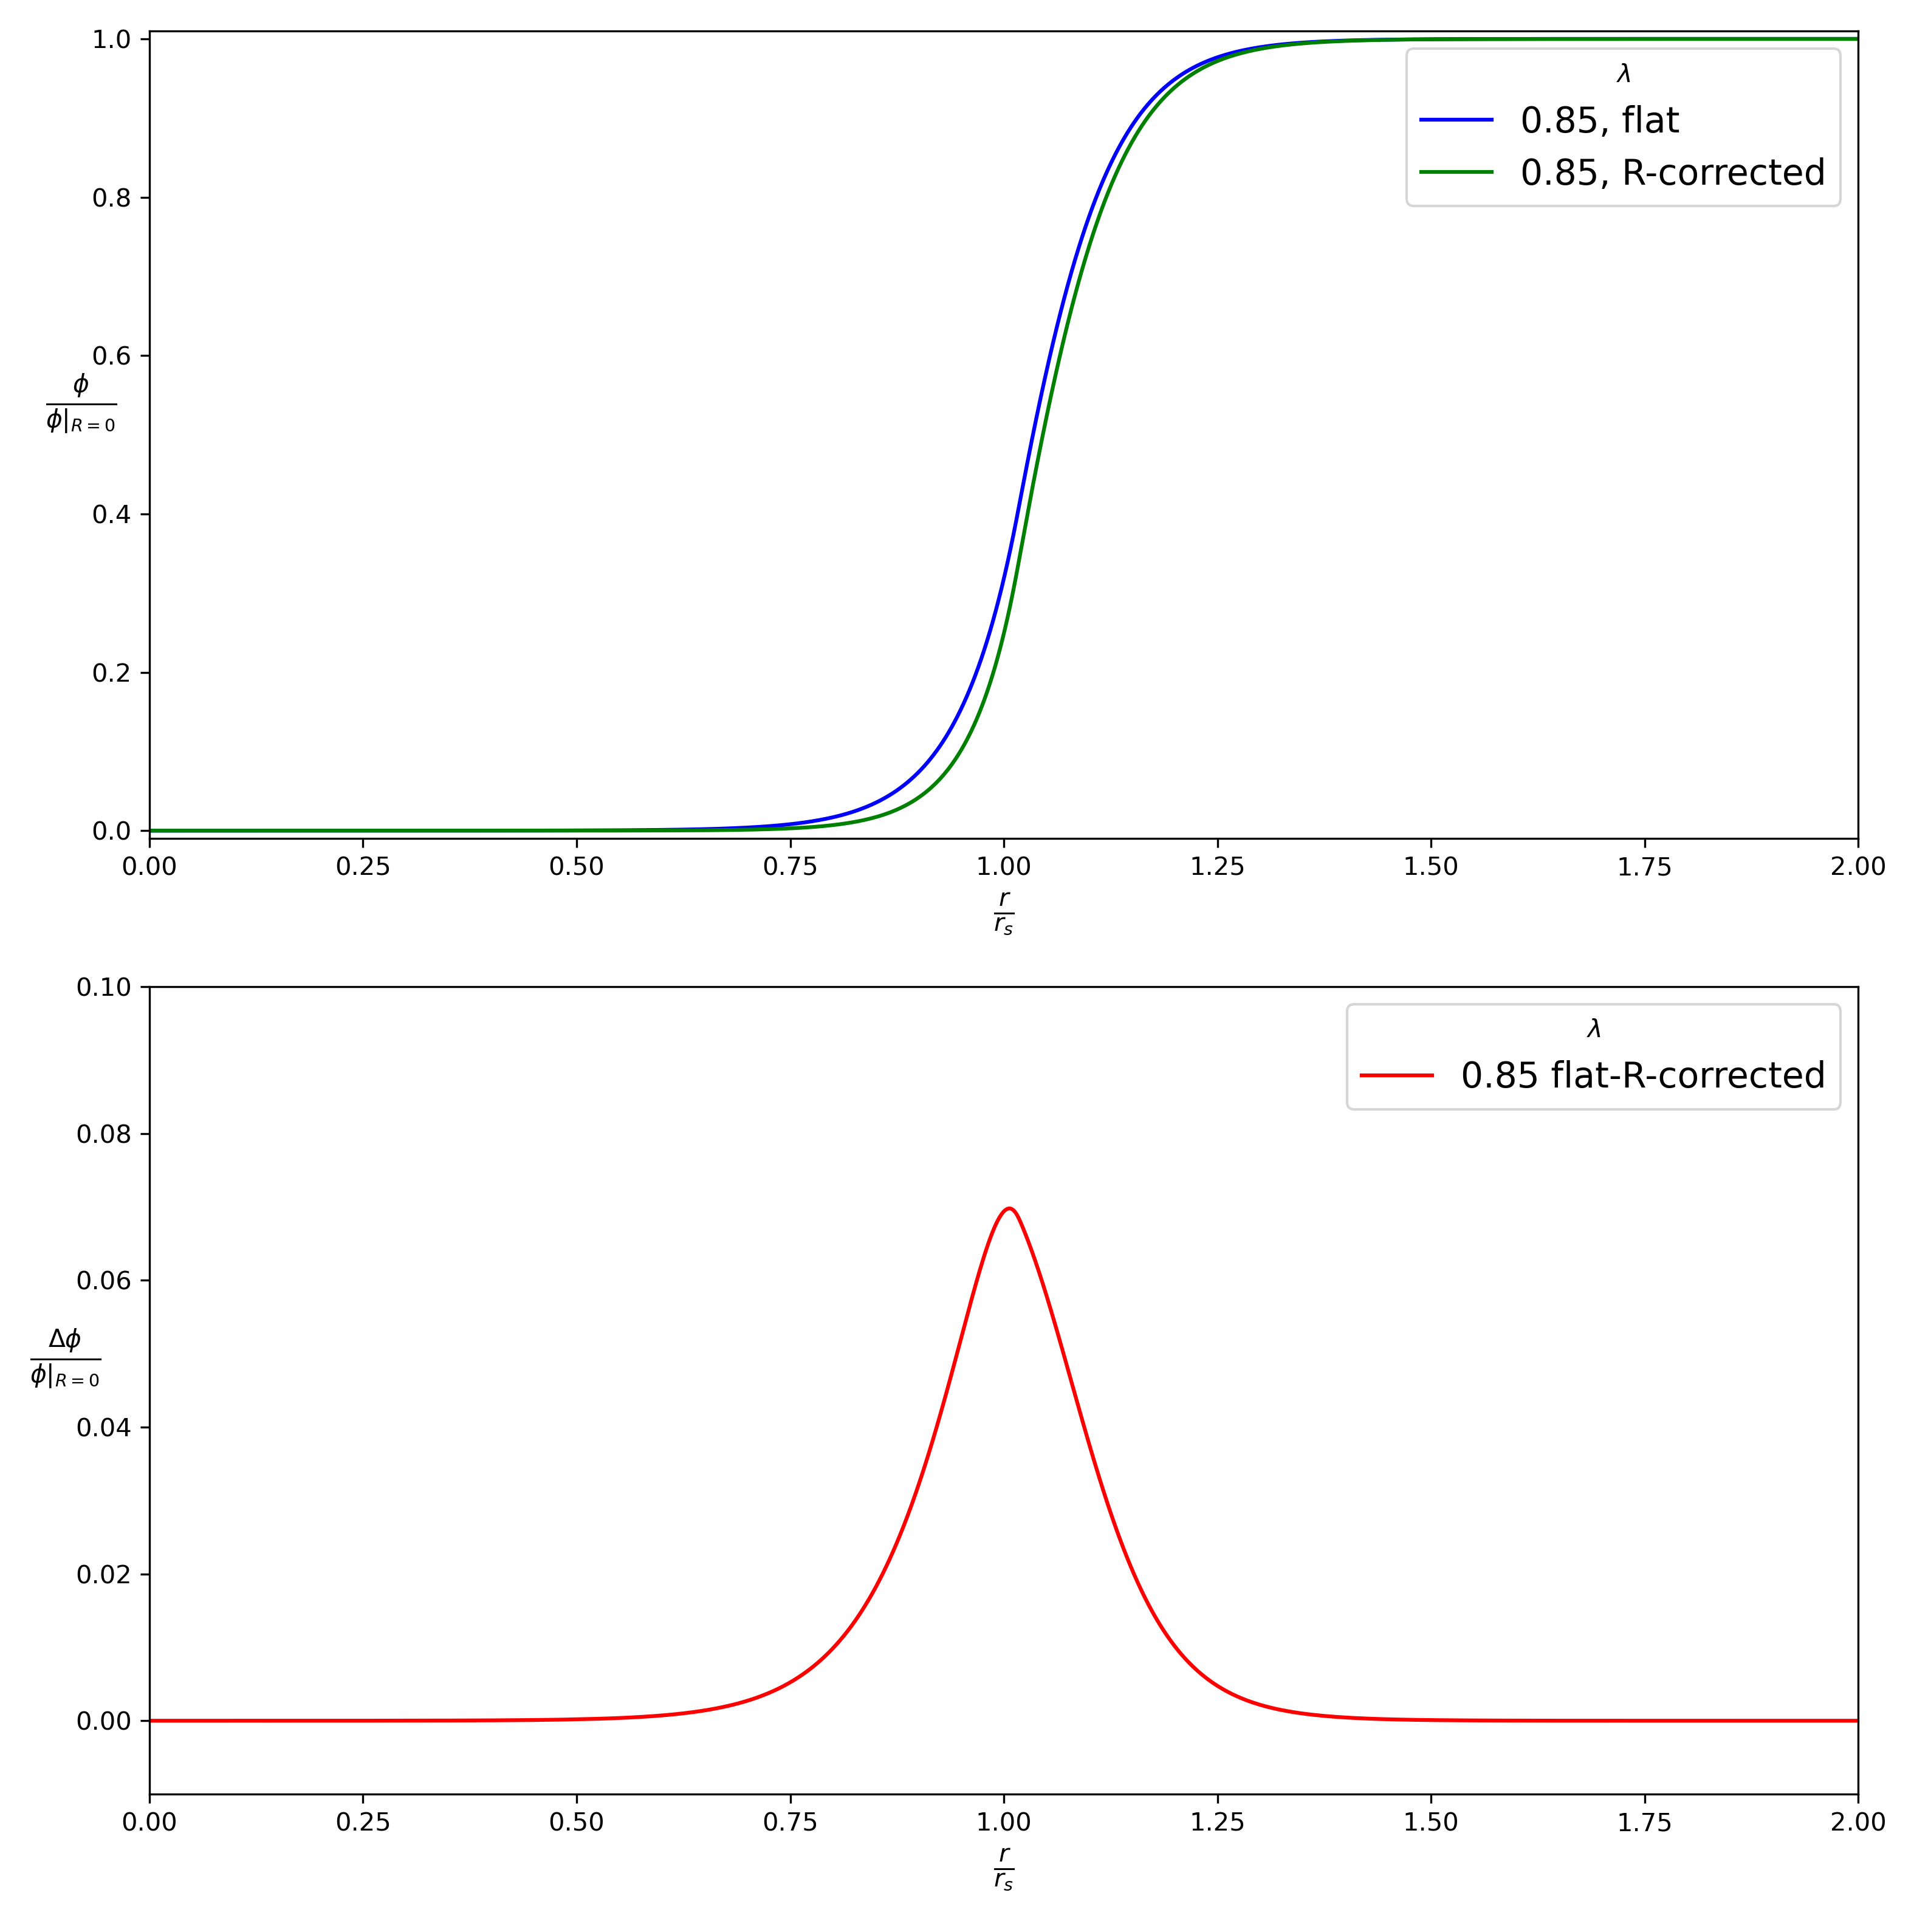

Slide 17
Thank you!

