Slide 1
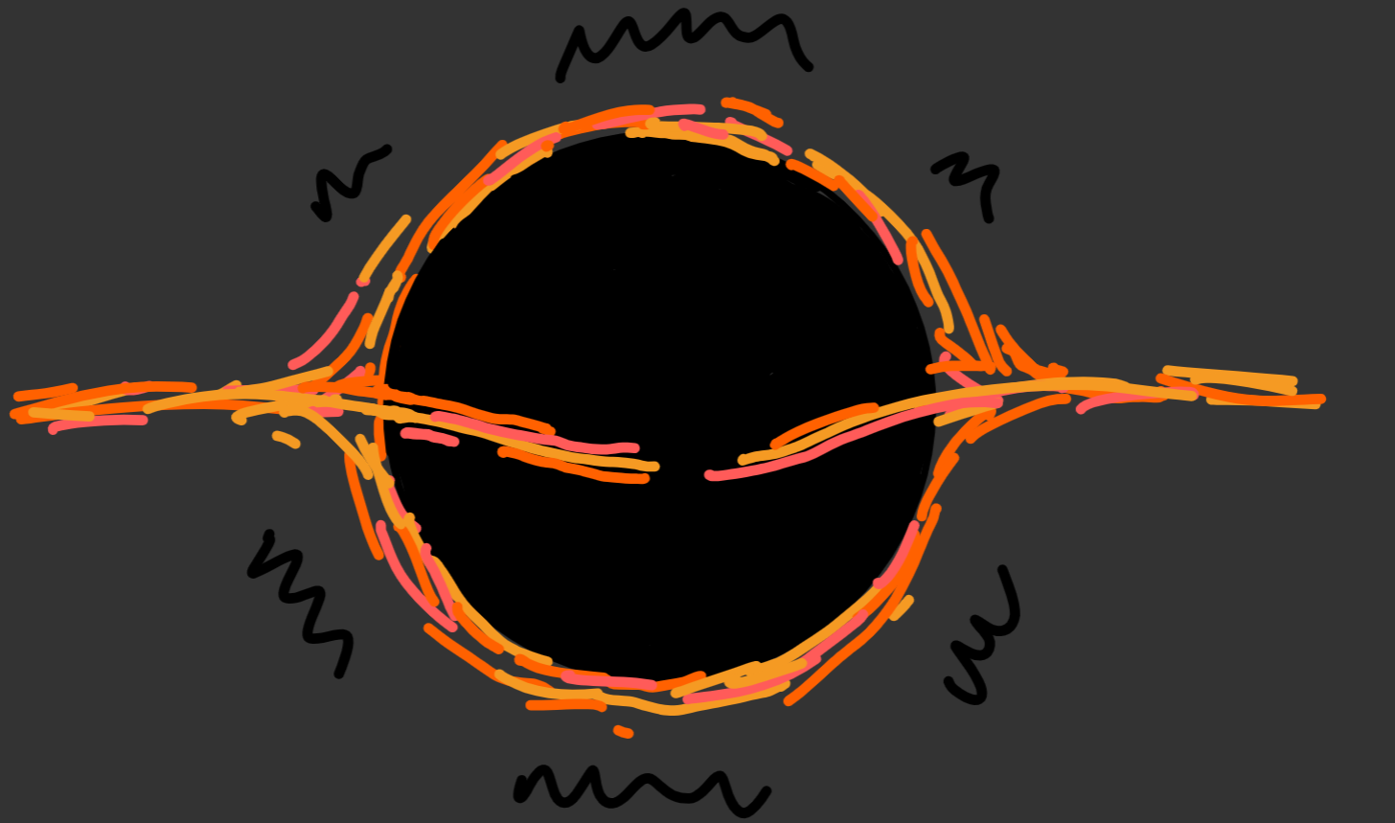
The Black Hole
Isospectrality Problem
Samuel Franklin
Notes:
Talk is all about the Isospectrality problem which I have been studying during my PhD
This is mostly a literature review with the aim of summarising the most important details of the problem, with a brief mention of future work at the end if there’s time

Slide 2
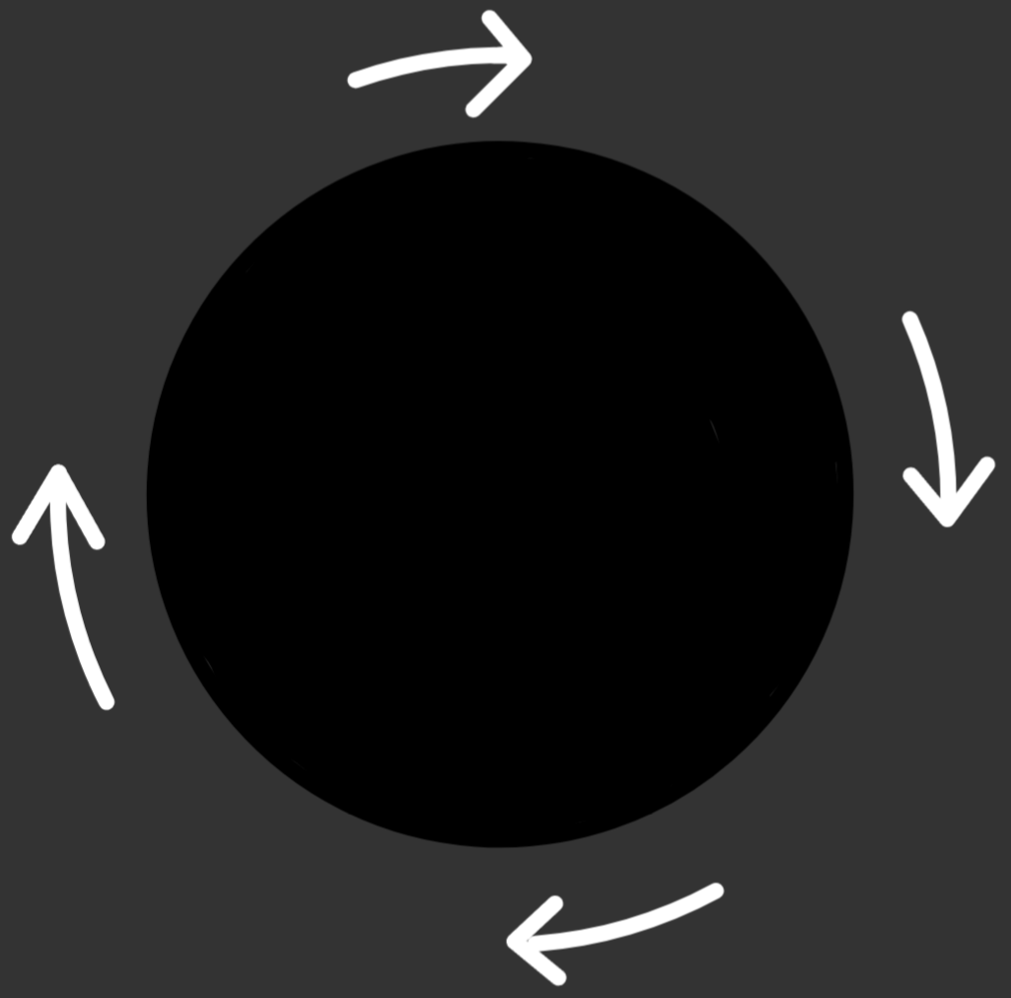

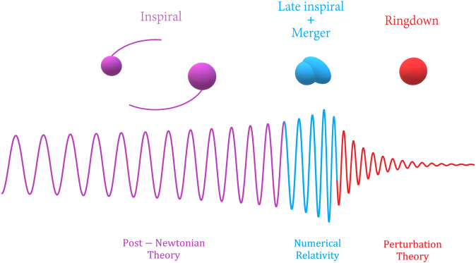
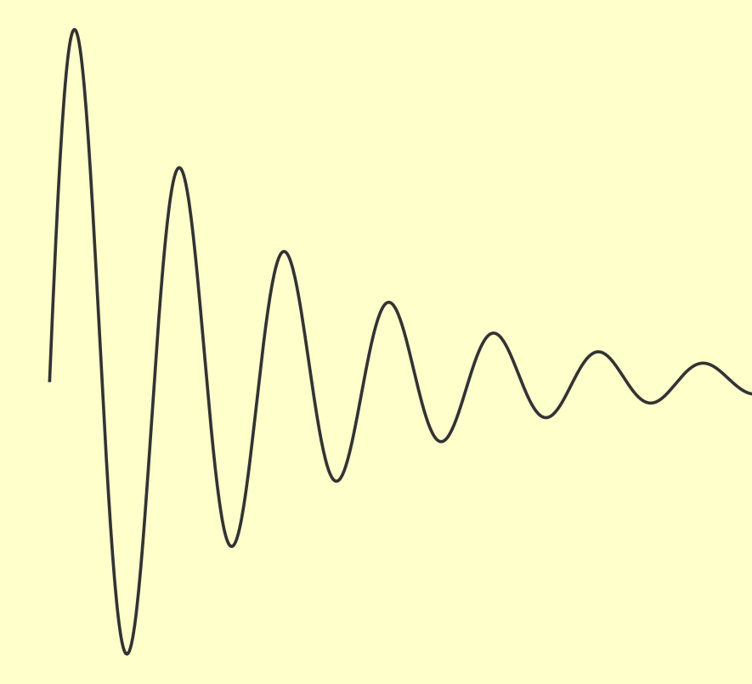
Basics
1/14
Notes:
The Isospectrality related to ringdown phase of a merger and the black hole perturbation theory that governs it.
Stems from the two ways which black holes are perturbed. In simplified terms the black hole spacetime can either be spun or squashed/stretched.
To first order the evolution of these ‘axial’ and ‘polar’ perturbations can be decoupled, so each evolves independently of the other.
Isospectrality is the equivalence of the ringdown spectrum for these two types of perturbations.
The Isospectrality Problem refers to our lack of physical understanding as to why this happens despite our rigorous mathematical assertion that it does.

Slide 3



Related interests
Spinning (charged) black holes
Greybody factors
Tidal Love Numbers
2/14
Notes:
While we’ll focus on Schwarzschild black holes for simplicity, Isospectrality can also be found in Kerr black holes and Reissner-Nordstrom black holes
Not only is this isospectrality relevant for QNMs but also:
Greybody factors (by how much does the BH spectrum vary from a blackbody spectrum)
Responsible for the equivalence of even and odd parity Tidal Love Numbers (determining the ‘rigidity’ of the black hole)
Much of the maths involved is identical to that of Super symmetric quantum mechanics

Slide 4
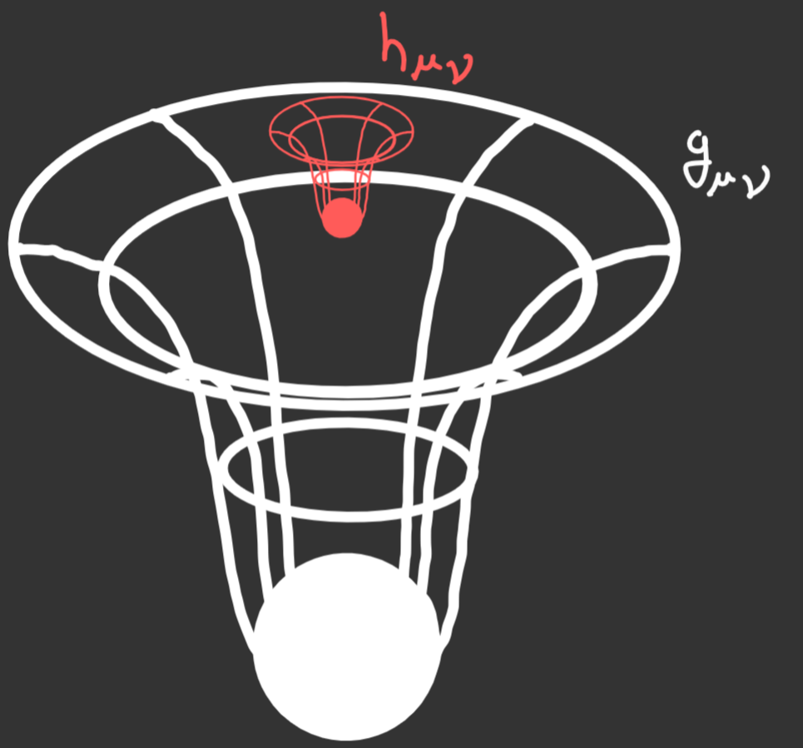
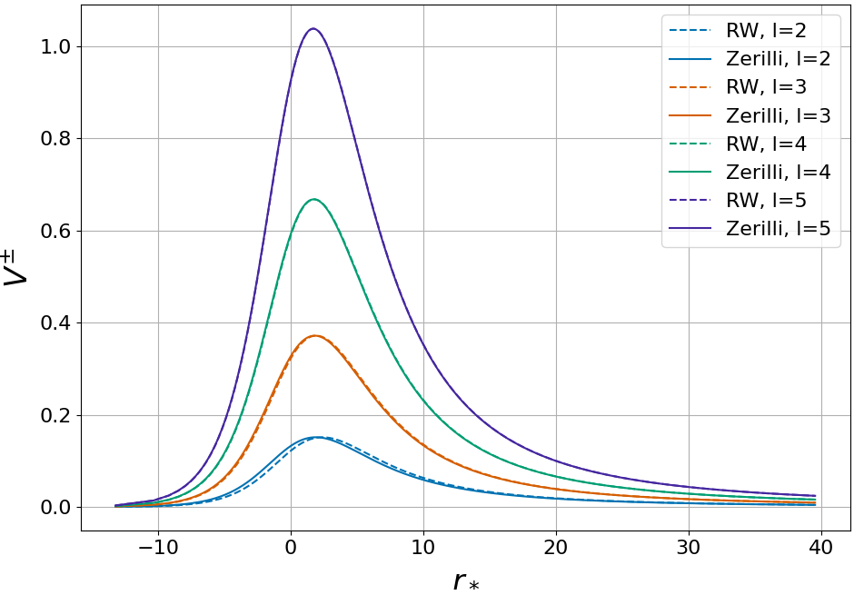
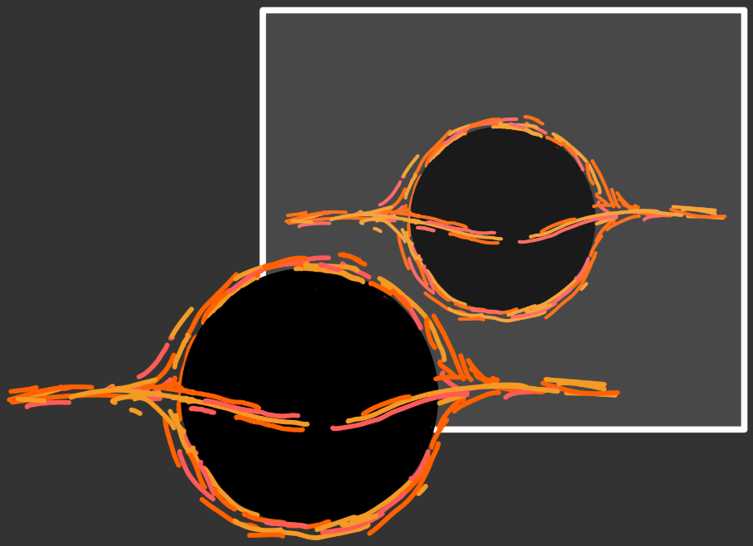
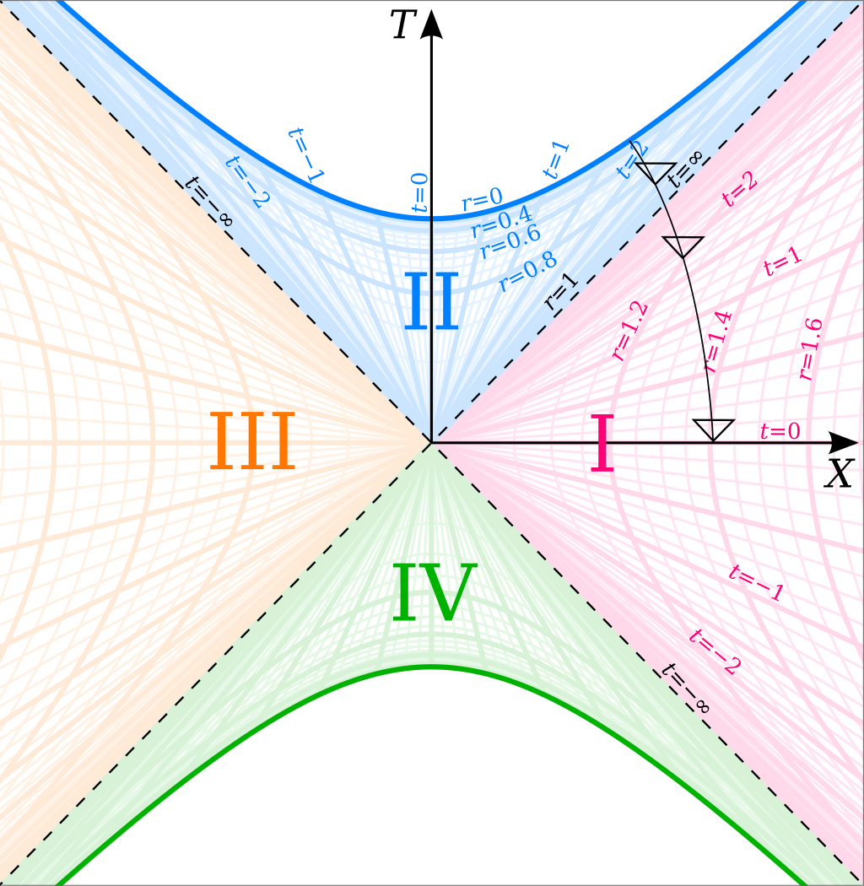


Overview
Perturbing Black Holes
Axial & Polar Potentials
$$h_{μν}$$
$$g_{μν}$$
Reflection & Transmission
Future Work
3/14
Notes:
As an overview:
Start by discussing the two types of perturbations for a Schwarzschild black hole; a useful way to understand them physically; showing that they decouple; and showing how the evolution for both types can be described with a 1D wave equation.
Next, I’ll discuss the potentials for these 1D wave equations and how they relate to one another.
Then I’ll go into details of the reflection and transmission of this wave equation to show how the link between these two potentials result in isospectrality!
Finally, I’ll briefly mention some of the future work I hope to do to resolve the isospectrality problem.

Slide 5

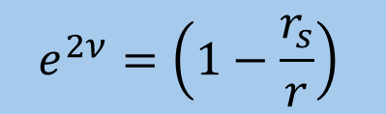
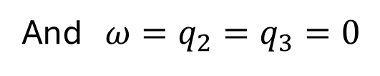
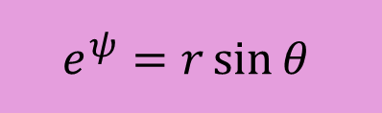

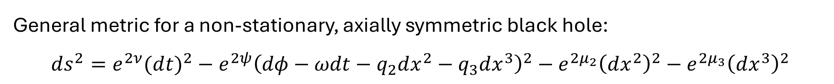
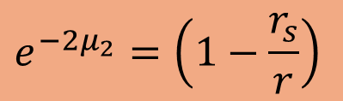
Schwarzschild Black Hole Metric
(+---), G=c=1
General metric for a non-stationary, axially symmetric black hole:
$$ds^{2}=e^{2ν}(d{t)}^{2}−e^{2ψ}{\left(dφ−ωdt−q_{2}dx^{2}−q_{3}dx^{3}\right)}^{2}−e^{2μ_{2}}{\left(dx^{2}\right)}^{2}−e^{2μ_{3}}{\left(dx^{3}\right)}^{2}$$
$$e^{2ν}=\left(1−\frac{r_{s}}{r}\right)$$
$$e^{−2μ_{2}}=\left(1−\frac{r_{s}}{r}\right)$$
$$e^{μ_{3}}=r$$
$$e^{ψ}=r\sin{θ}$$
And $ω=q_{2}=q_{3}=0$
Schwarzschild Metric:
$$ds^{2}=\left(1−\frac{r_{s}}{r}\right){\left(dt\right)}^{2}−{\left(1−\frac{r_{s}}{r}\right)}^{−1}{\left(dr\right)}^{2}−r^{2}{\left(dθ\right)}^{2}−r^{2}\sin^{2}{θ}{\left(dφ\right)}^{2}$$
4/14
Notes:
In perturbing a Schwarzschild Black Hole, we expect to go from a spherically symmetric, stationary metric to some axially symmetric non-stationary metric.
To understand what’s going on physically it’s useful to write down the general metric for a non-stationary, axially symmetric black hole.
dx^2 and dx^3 here are superscripts not powers
To recover Schwarzschild: must set the following relations.
Insight here: to recover a spherically symmetric BH $ω, q_{2}$ and $q_{3}$ are set to zero. Meaning they must be axial in nature.

Slide 6

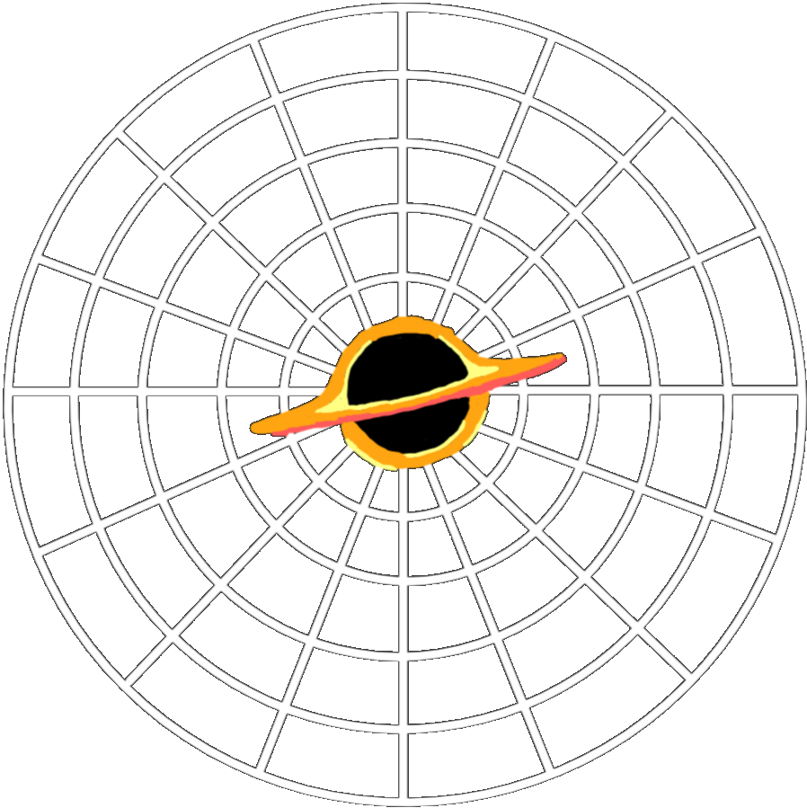


Perturbations
General perturbation of a Schwarzschild metric results in the small (first order) quantities
Axial
Polar
$$ω, q_{2}, q_{3}$$
$$δν, δμ_{2}, δμ_{3}, δψ$$
5/14
Notes:
Therefore, a Schwarzschild Black hole is perturbed in two distinct ways.
Axial perturbations introduce rotation and frame dragging
Polar perturbations impart no such rotation
This intuitive way of looking at things suggests that the two types of perturbations may be treated separately

Slide 7
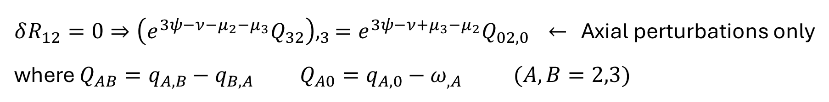
Decoupling Perturbations
Vacuum field equations: $G_{μν}=R_{μν}=0 →δG_{μν}=δR_{μν}=0$ govern the perturbations.
e.g.
$δR_{12}=0⇒{\left(e^{3ψ−ν−μ_{2}−μ_{3}}Q_{32}\right),}_{3}=e^{3ψ−ν+μ_{3}−μ_{2}}Q_{02,0}$ $←$ Axial perturbations only
where $Q_{AB}=q_{A, B}−q_{B, A} Q_{A0}=q_{A,0}−ω_{,A} (A,B=2,3)$
And
$δR_{03}=0⇒{\left(δψ+δμ_{2}\right)}_{,θ}+\left(δψ−δμ_{3}\right)\cot{θ}=0$ $←$ Polar perturbations only
Confirms the separation of axial and polar perturbations
6/14
Notes:
The Vacuum Field equations govern the behaviour of our perturbations.
When inspecting the components we find some that depend solely on the Axial perturbations, and some depend only on polar perturbations (to first order)
We find a sufficient number of such equations to confirm the decoupling of the equations governing each perturbation type.
$X,_{A}$ is partial derivative w.r.t. $A$
The next step is to actually investigate the behaviour of each of these decoupled perturbations. To do that…

Slide 8
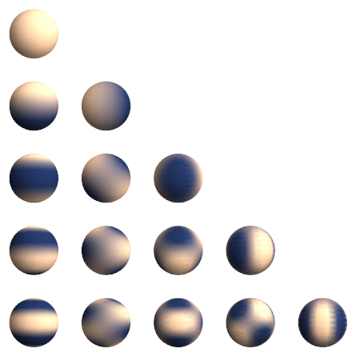
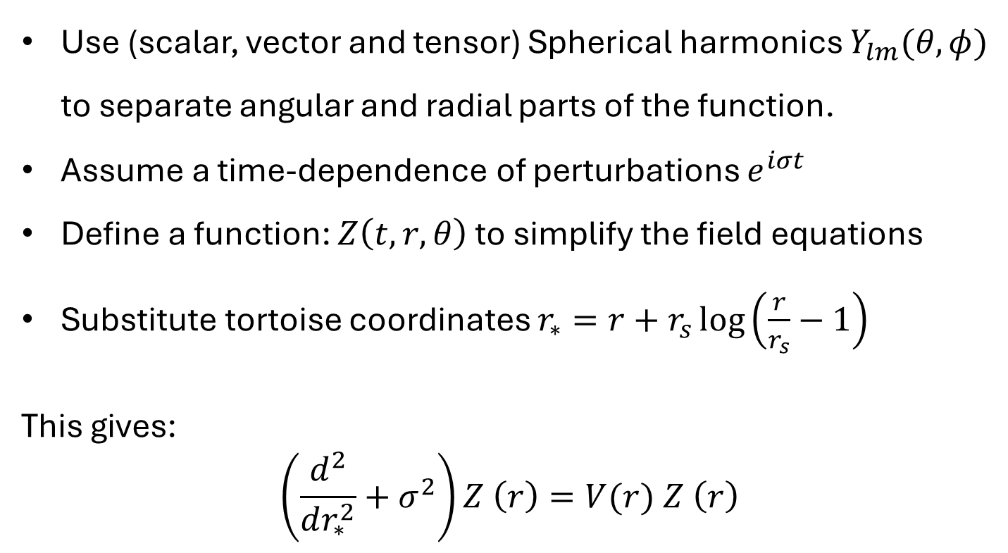


Regge-Wheeler-Zerilli Equations
Equations for both axial and polar perturbations can be reduced to a 1D Schrödinger wave equation
$$m$$
Use (scalar, vector and tensor) Spherical harmonics $Y_{lm}(θ,φ)$ to separate angular and radial parts of the function.
Assume a time-dependence of perturbations $e^{iσt}$
Define a function: $Z\left(t,r,θ\right)$ to simplify the field equations
Substitute tortoise coordinates $r_{∗}=r+r_{s}\log\left(\frac{r}{r_{s}}−1\right)$
This gives:
$$\left(\frac{d^{2}}{dr_{∗}^{2}}+σ^{2}\right)Z \left(r\right)=V(r) Z \left(r\right)$$
$$l$$
7/14
Notes:
Both axial and polar perturbations evolution can be reduced to a one-dimensional wave equation. Simpler to do for axial perturbations.
Define a new function that simplify field equations.
Assume time dependence of $e^{iσt}$ where $σ$ is our frequency, (although this isn’t strictly required)
Use spherical harmonics to separate radial and angular parts. $l$ determines angular structure (multipole order). $m$ determines orientation.
Substitute the ‘tortoise coordinates’ (which run from $−∞$ at the horizon to $+∞$)
Arrive at the Regge-Wheeler equation for axial perturbations. For polar perturbations the identical, in form, Zerilli Equation is found instead, with its own solution and potential.

Slide 9


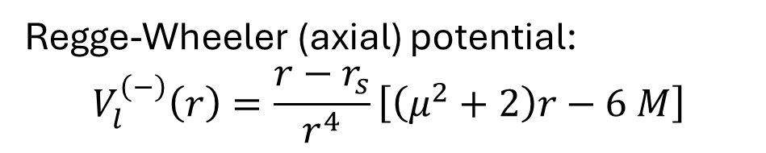
Regge-Wheeler & Zerilli Potentials
Zerilli (polar) potential:
$$V_{l}^{\left(+\right)}\left(r\right)=\frac{2\left(r−r_{s}\right)}{r^{4}{\left(nr+3M\right)}^{2}}\left[n^{2}\left(n+1\right)r^{3}+3n^{2}Mr^{2}+9nM^{2}r+9M^{3}\right]$$
Regge-Wheeler (axial) potential:
$$V_{l}^{\left(−\right)}\left(r\right)=\frac{r−r_{s}}{r^{4}}\left[\left(μ^{2}+2\right)r−6 M\right]$$
Where:
$$μ^{2}=2n=\left(l−1\right)(l+2)$$
8/14
Notes:
While both types of perturbations are governed by this same 1D wave equation the potential $V_{l}^{\left(±\right)}$ in each case is of completely different form.
Despite this both potentials look remarkably similar, it even seems the two potentials approach the each other at high $l$, why is this?

Slide 10
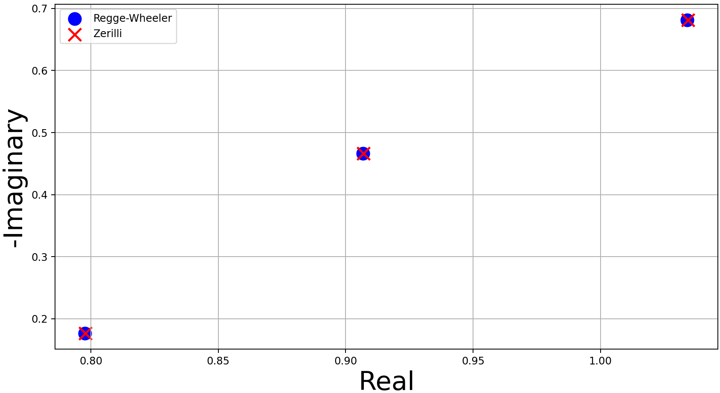
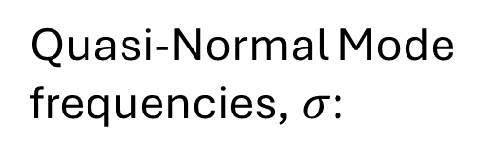

What is Isospectrality?
$$l=2;m=0,1,2$$
Quasi-Normal Mode frequencies, $σ$:
9/14
Notes:
Things get weirder when we solve for the QNMs of the Regge-Wheeler and Zerilli equations using the 1D wave equations asymptotic behaviour. We find that the solutions for each are identical!
(The plot here uses the WKB approximation to find approximate QNM frequencies for the Regge-Wheeler and Zerilli equations)
This is what I mean by Isospectrality, there is an equal spectrum for both types of perturbations.
This is a possible observables whose quality is important to confirm GR.

Slide 11

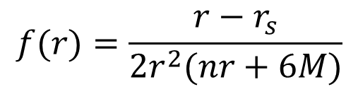

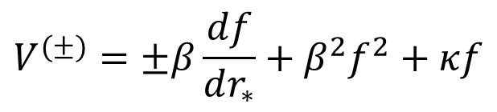
Relation Between Potentials
Regge-Wheeler
potential
Zerilli potential
$$V^{(±)}=±β\frac{df}{dr_{∗}}+β^{2}f^{2}+κf$$
$$f(r)=\frac{r−r_{s}}{{2r}^{2}(nr+6M)}$$
$$β=3r_{s}$$
$$κ=4n\left(n+1\right)$$
$$\left(\frac{d^{2}}{dr_{∗}^{2}}+σ^{2}\right)Z^{(±)}=V^{\left(±\right)} Z^{(±)}=\left(±β\frac{df}{dr_{∗}}+β^{2}f^{2}+κf\right) Z^{(±)}$$
10/14
Notes:
Chandrasekhar was able to show how both potentials are related by this single Superpotential
It is this mathematical relationship that explains why our potentials look so similar despite a very different mathematical form
It explains why they approach the each other for large $l$ and $r$ (since $\frac{df}{dr_{∗}}$ shrinks at large $l$ and $r$)
And in the end it is this link between the two potentials is also the cause of the isospectrality problem.

Slide 12
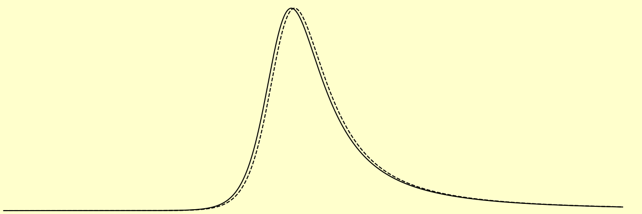

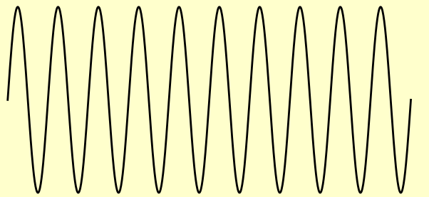








Reflection and Transmission
$$0$$
$$V^{\left(±\right)}$$
$$0$$
${−∞←r}_{∗}$
$r_{∗}→+∞$
$$Z^{\left(±\right)}→e^{+iσr_{∗}}+R^{\left(±\right)}(σ)e^{−iσr_{∗}}$$
$$Z^{\left(±\right)}→T^{\left(±\right)}(σ)e^{+iσr_{∗}}$$
$$\frac{d^{2}Z^{(±)}}{dr_{∗}^{2}}+σ^{2}Z^{(±)}→0⟹Z^{\left(±\right)}→A(σ)e^{+iσr_{∗}}+B(σ)e^{−iσr_{∗}} (r_{∗}→ ±∞)$$
$${\left|R^{\left(±\right)}(σ)\right|}^{2}+{\left|T^{\left(±\right)}(σ)\right|}^{2}=1$$
11/14
Notes:
To show how this link causes isospectrality we first need to look at how our wave equation simplifies when $r_{∗}→±∞$.
When approaching either the horizon or infinity the potential drops off to zero. Meaning at these boundaries the solution to our 1D wave equation is a planar wave.
We don’t expect there to be incoming waves from infinity to the problem becomes one of reflection and transmission of planar waves from the horizon, across the potential and out to infinity.

Slide 13

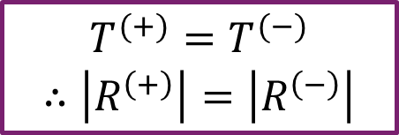
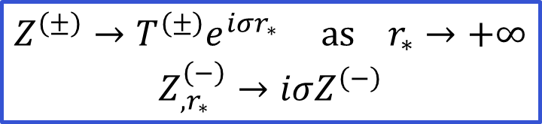
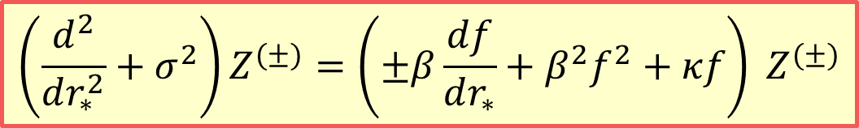
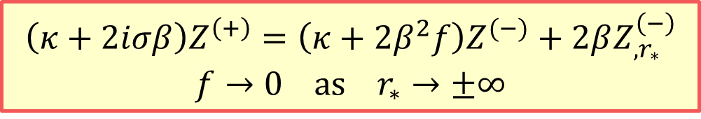
Isospectrality
$$\left(\frac{d^{2}}{dr_{∗}^{2}}+σ^{2}\right)Z^{(±)}=\left(±β\frac{df}{dr_{∗}}+β^{2}f^{2}+κf\right) Z^{(±)}$$
$$Z^{\left(±\right)}→T^{\left(±\right)}e^{iσr_{∗}} as r_{∗}→+∞$$
$$Z_{,r_{∗}}^{\left(−\right)}→iσZ^{\left(−\right)}$$
$${\left(κ+2iσβ\right)Z}^{\left(+\right)}=\left(κ+2β^{2}f\right)Z^{(−)}+2βZ_{,r_{∗}}^{\left(−\right)}$$
$$f→0 as r_{∗}→±∞$$
$${\left(κ+2iσβ\right)Z}^{\left(+\right)}→\left(κ+2iσβ\right)Z^{(−)} as r_{∗}→ +∞$$
$$T^{(+)}=T^{(−)}$$
$$∴\left|R^{\left(+\right)}\right|=\left|R^{\left(−\right)}\right|$$
12/14
Notes:
We’re now able to show how Chandrasekhar’s transformation result in Isospectrality?
In essence Chandrasekhar’s potentials allows us to derive a relation between the solutions for different perturbations.
Can be combined with asymptotic behaviour of the solution to find that the transition coefficient is the same.
This is precisely what we mean by isospectrality!
Why is this a problem? Although this all clearly works mathematically; the physical reason for the transformation and why it causes isospectrality isn’t well understood. Without a deeper physical understanding its easy to see how we’re missing some underlying property of the problem.

Slide 14
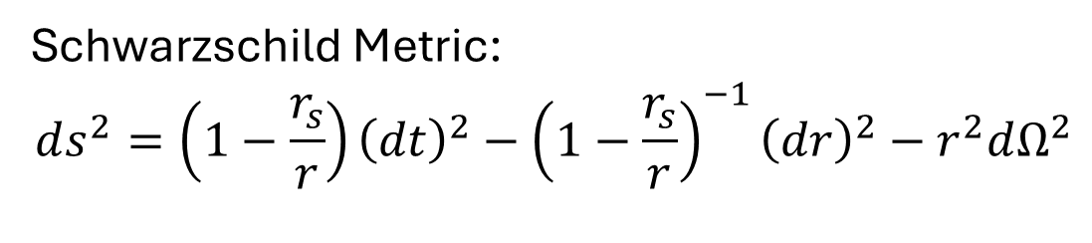
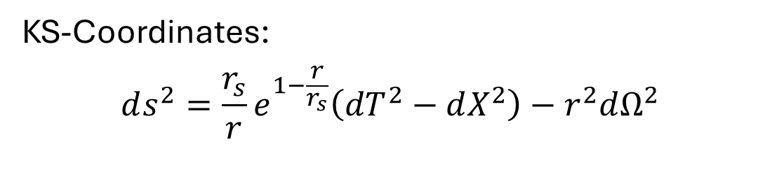
Kruskal-Szekeres Coordinates
(+---)
Schwarzschild Metric:
$$ds^{2}=\left(1−\frac{r_{s}}{r}\right){\left(dt\right)}^{2}−{\left(1−\frac{r_{s}}{r}\right)}^{−1}{\left(dr\right)}^{2}−r^{2}dΩ^{2}$$
KS-Coordinates:
$$ds^{2}=\frac{r_{s}}{r}e^{1−\frac{r}{r_{s}}}\left(dT^{2}−dX^{2}\right)−r^{2}dΩ^{2}$$
13/14
Notes:
One clear problem in this derivation is the use of Schwarzschild coordinates which contain a coordinate singularity at the horizon. This obscures the physical nature of what’s going on there.
To address this, we hope to use Kruskal-Szekeres Coordinates which describe an extended version of the spacetime but have no coordinate singularity at the horizon.
In KS-coordinates rays of light always remain at 45 degrees including at the horizon (similar to Minkowski).
We hope performing a similar analysis in this space time will present us a clearer reason for isospectrality that can hint at a physical reason for it.

Slide 15
Summary
Perturbing Black Holes
Axial & Polar Potentials
$$h_{μν}$$
$$g_{μν}$$
Reflection & Transmission
14/14
Notes:
To summarise the key take aways, we’ve shown the two physically distinct types of perturbations and how their behaviour is governed by a 1D wave equation
We discussed the two different potentials for the two 1D wave equations and how they’re linked by Chandrasekhar's transformation
Finally, we showed precisely how this transformation results isospectrality aka the Quasi-normal modes due to each perturbation type are identical

Slide 16
Questions?

Slide 17
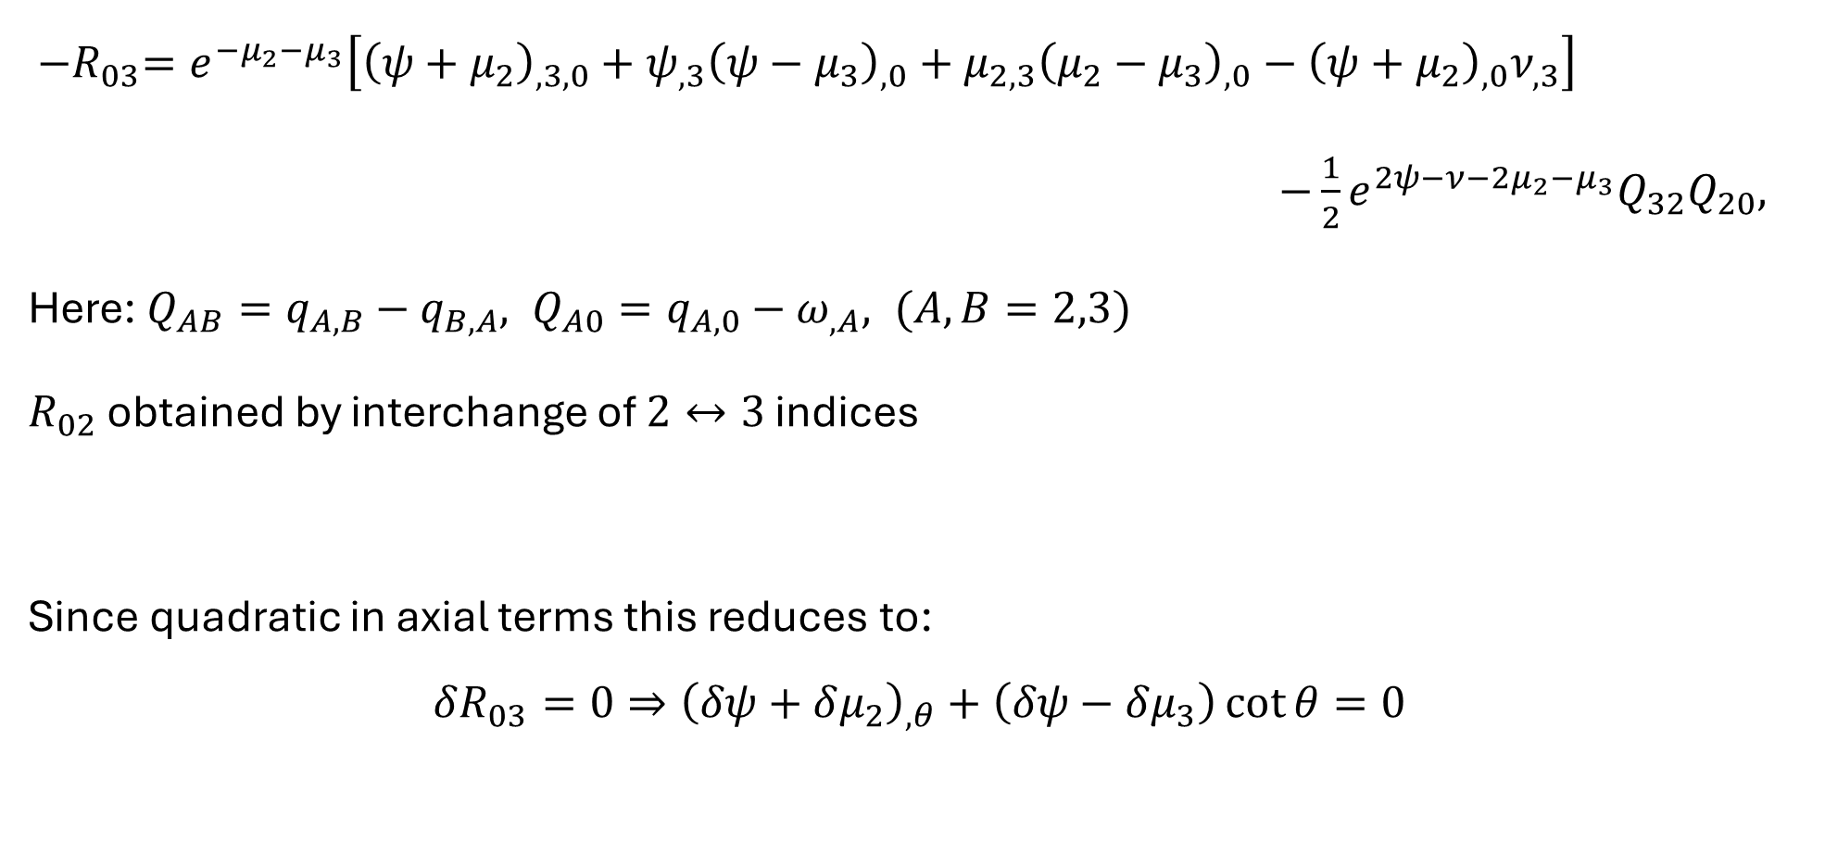
Extra: Field Equation Components
${−R}_{03}=e^{−μ_{2}−μ_{3}}\left[{\left(ψ+μ_{2}\right)}_{,3,0}+ψ_{,3}{\left(ψ−μ_{3}\right)}_{,0}+μ_{2,3}{\left(μ_{2}−μ_{3}\right)}_{,0}−{\left(ψ+μ_{2}\right)}_{,0}ν_{,3}\right]$
$−\frac{1}{2}e^{2ψ−ν−2μ_{2}−μ_{3}}Q_{32}Q_{20},$
Here: $Q_{AB}=q_{A, B}−q_{B, A}, Q_{A0}=q_{A,0}−ω_{,A}, (A,B=2,3)$
$R_{02}$ obtained by interchange of $2↔3$ indices
Since quadratic in axial terms this reduces to:
$$δR_{03}=0⇒{\left(δψ+δμ_{2}\right)}_{,θ}+\left(δψ−δμ_{3}\right)\cot{θ}=0$$

