Slide 1


The NOvA Test Beam Program
Emerson Bannister
14th July 2025
Test beam uni logos
NOvA logo (all over slides)

Slide 2
Outline
Neutrinos and why we study them.
The NOvA experiment.
NOvA’s Test Beam Program: what, why and how.
2
9th July 2025 – PUG Talk– Emerson Bannister

Slide 3
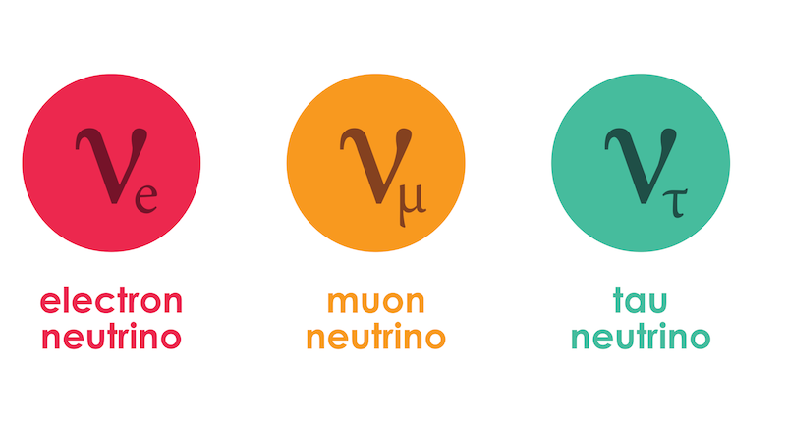
Neutrinos
  The lightest fundamental particles
  Three flavours of neutrino
3
14th July 2025 – XV NExT PhD Workshop – Emerson Bannister

Slide 4


Neutrinos
  The lightest fundamental particles
  Three flavours of neutrino
Billions of neutrinos
every second!
  They rarely interact with anything
4
14th July 2025 – XV NExT PhD Workshop – Emerson Bannister

Slide 5
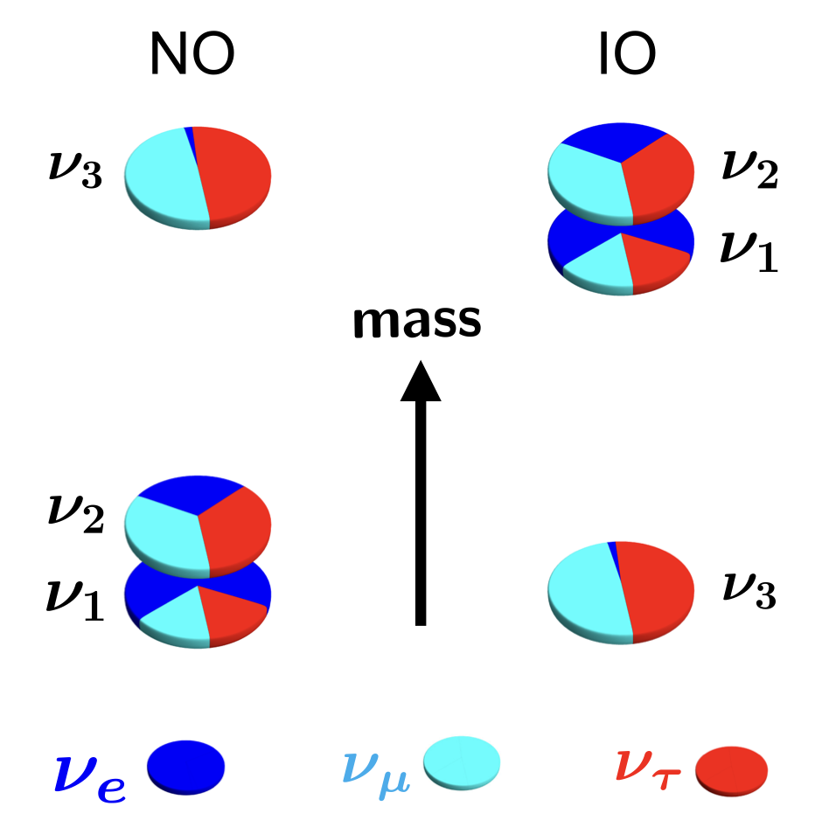
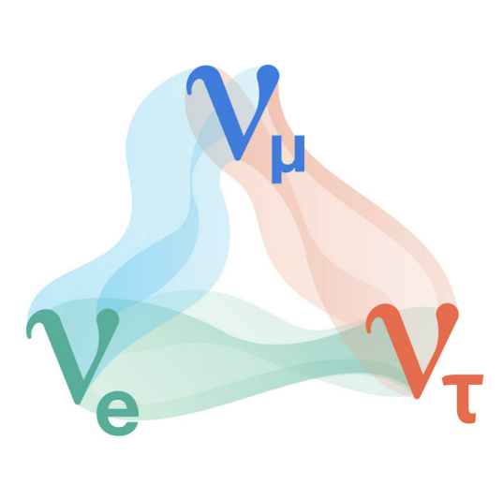
Neutrinos
Three flavour states
Three mass states
Neutrino oscillations
14th July 2025 – XV NExT PhD Workshop – Emerson Bannister

Slide 6
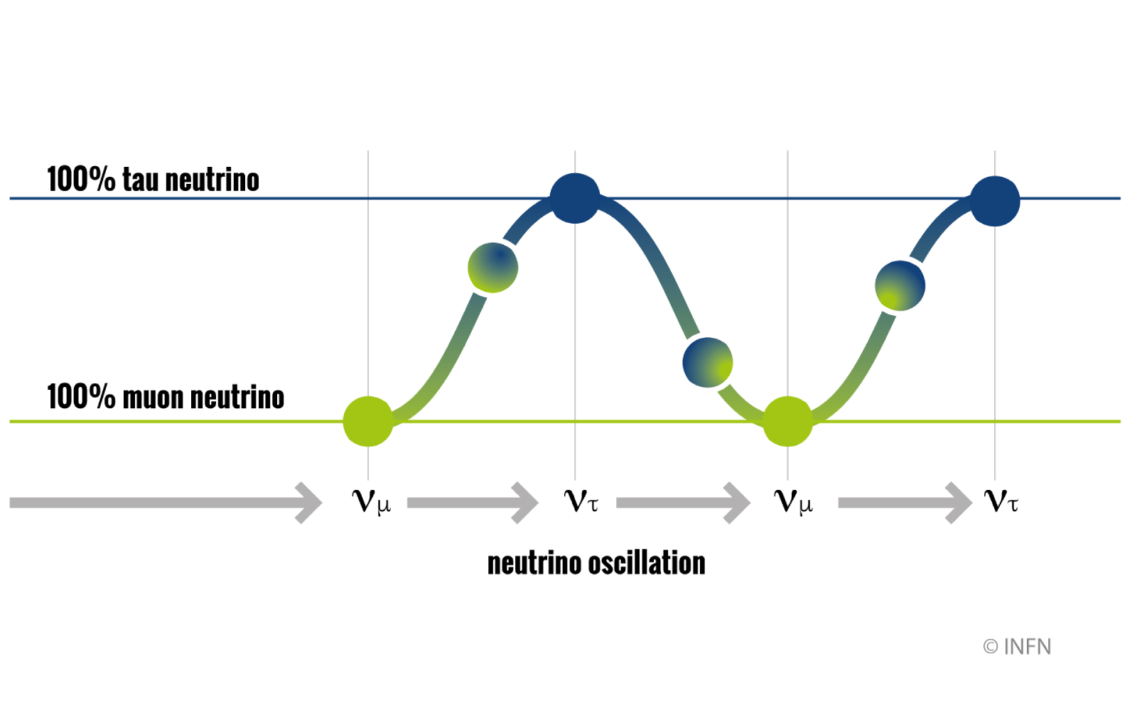
Neutrino Oscillations
14th July 2025 – XV NExT PhD Workshop – Emerson Bannister

Slide 7
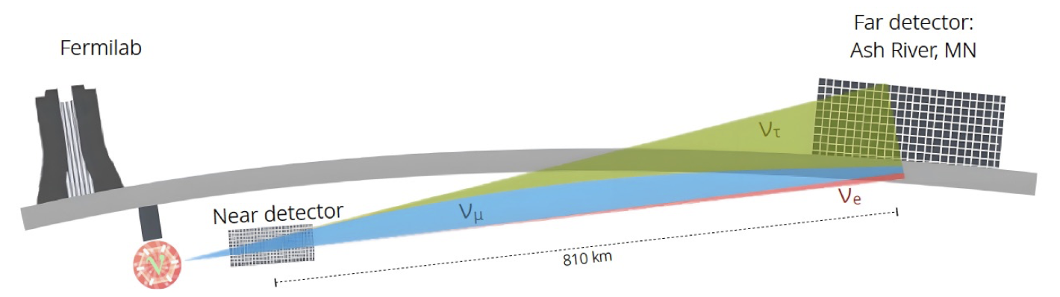

The NOvA Experiment
NuMI Off-Axis $ν_{e}$ Appearance Experiment
Long-baseline neutrino oscillations
14 kton
300 ton
14th July 2025 – XV NExT PhD Workshop – Emerson Bannister

Slide 8

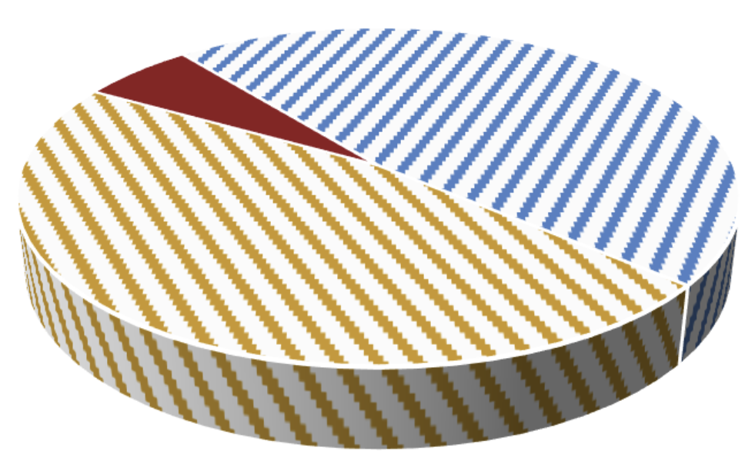
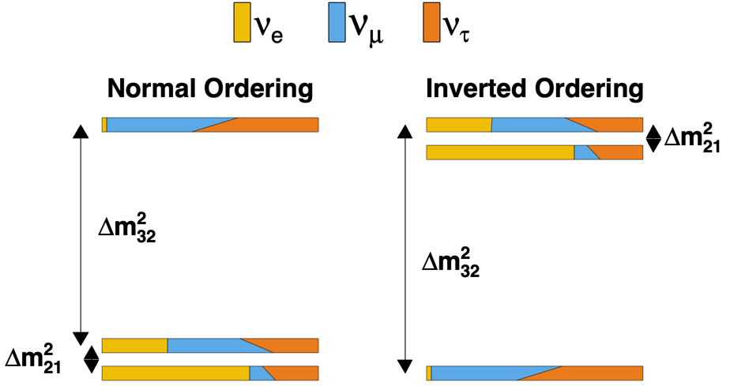
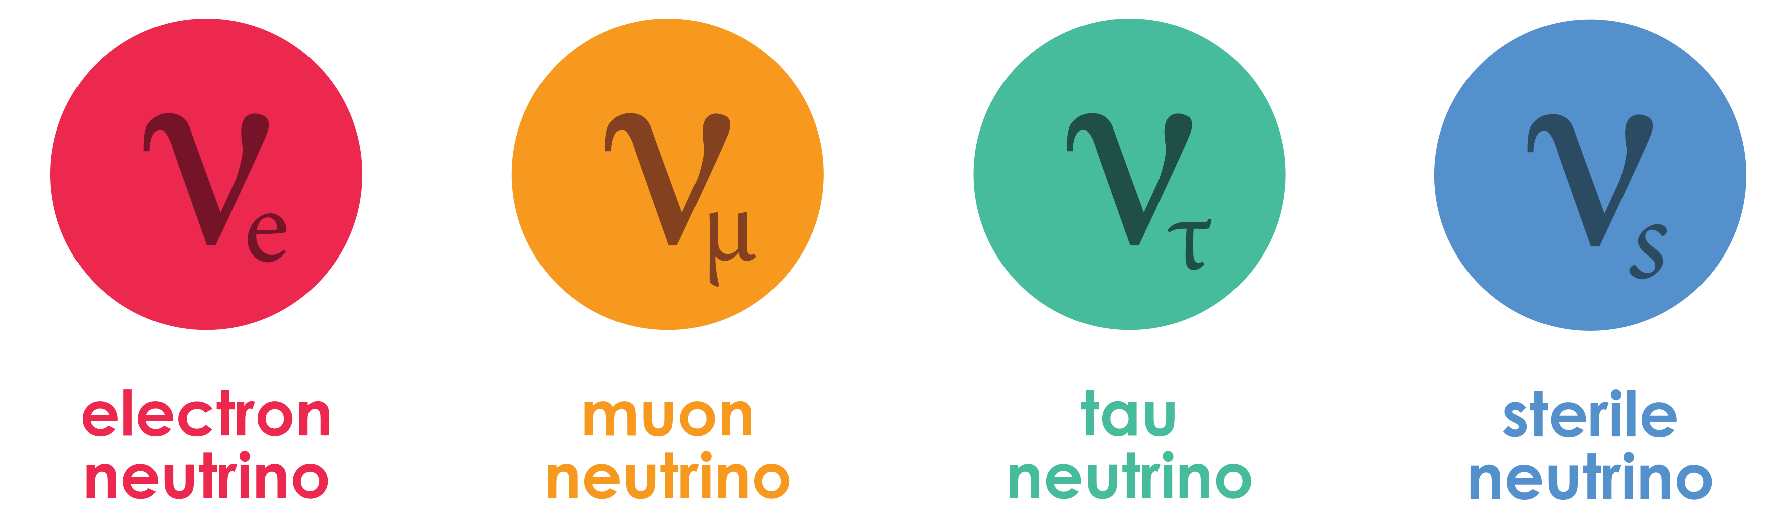





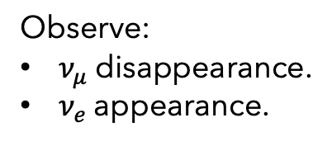
The NOvA Experiment
Is $θ_{23}$ maximal?
Observe:
$ν_{μ}$ disappearance.
$ν_{e}$ appearance.
Neutrino mass hierarchy:
Inverted or normal ordering?
$ν_{μ}=ν_{τ} in ν_{3}?$
More analyses:
Sterile neutrino search.
Neutrino cross-sections.
Exotics, ...
$δ_{CP}$: Do neutrinos violate CP?
Matter
Antimatter
8
14th July 2025 – XV NExT PhD Workshop – Emerson Bannister

Slide 9




The NOvA Experiment
Is $θ_{23}$ maximal?
Observe:
$ν_{μ}$ disappearance.
$ν_{e}$ appearance.
Neutrino mass hierarchy:
Normal or inverted ordering?
$ν_{μ}=ν_{τ} in ν_{3}?$
More analyses:
Sterile neutrino search.
Neutrino cross-sections.
Exotics, ...
$δ_{CP}$: Do neutrinos violate CP?
Matter
Antimatter
9
14th July 2025 – XV NExT PhD Workshop – Emerson Bannister

Slide 10

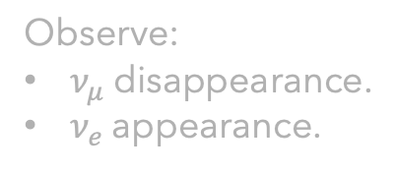
The NOvA Experiment
Is $θ_{23}$ maximal?
Observe:
$ν_{μ}$ disappearance.
$ν_{e}$ appearance.
Neutrino mass hierarchy:
Normal or inverted ordering?
$ν_{μ}=ν_{τ} in ν_{3}?$
More analyses:
Sterile neutrino search.
Neutrino cross-sections.
Exotics, ...
$δ_{CP}$: Do neutrinos violate CP?
Matter
Antimatter
10
14th July 2025 – XV NExT PhD Workshop – Emerson Bannister

Slide 11
The NOvA Experiment
Is $θ_{23}$ maximal?
Observe:
$ν_{μ}$ disappearance.
$ν_{e}$ appearance.
Neutrino mass hierarchy:
Normal or inverted ordering?
$ν_{μ}=ν_{τ} in ν_{3}?$
More analyses:
Sterile neutrino search.
Neutrino cross-sections.
Exotics, ...
$δ_{CP}$: Do neutrinos violate CP?
Matter
Antimatter
11
14th July 2025 – XV NExT PhD Workshop – Emerson Bannister

Slide 12

The NOvA Experiment
Is $θ_{23}$ maximal?
Observe:
$ν_{μ}$ disappearance.
$ν_{e}$ appearance.
Neutrino mass hierarchy:
Normal or inverted ordering?
$ν_{μ}=ν_{τ} in ν_{3}?$
More analyses:
Sterile neutrino search.
Neutrino cross-sections.
Exotics, ...
$δ_{CP}$: Do neutrinos violate CP?
Matter
Antimatter
12
14th July 2025 – XV NExT PhD Workshop – Emerson Bannister

Slide 13
The NOvA Experiment
Is $θ_{23}$ maximal?
Observe:
$ν_{μ}$ disappearance.
$ν_{e}$ appearance.
Neutrino mass hierarchy:
Normal or inverted ordering?
$ν_{μ}=ν_{τ} in ν_{3}?$
More analyses:
Sterile neutrino search.
Neutrino cross-sections.
Exotics, ...
$δ_{CP}$: Do neutrinos violate CP?
Matter
Antimatter
13
14th July 2025 – XV NExT PhD Workshop – Emerson Bannister

Slide 14
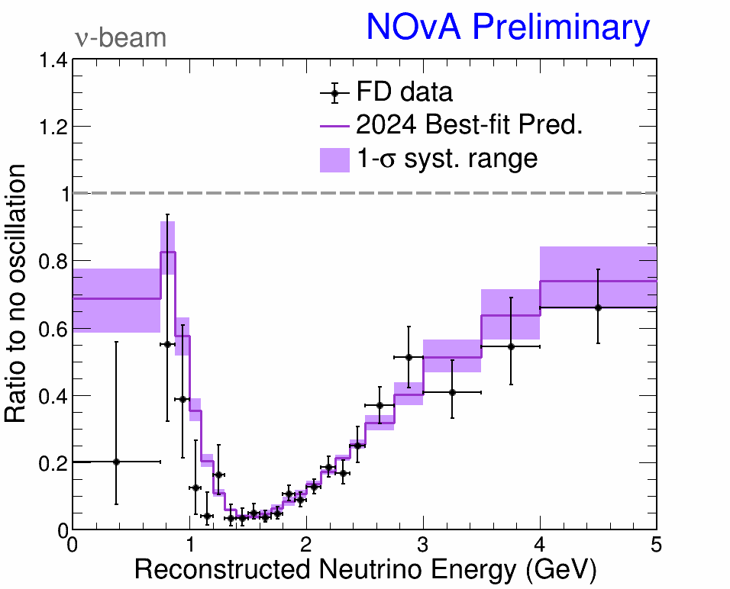
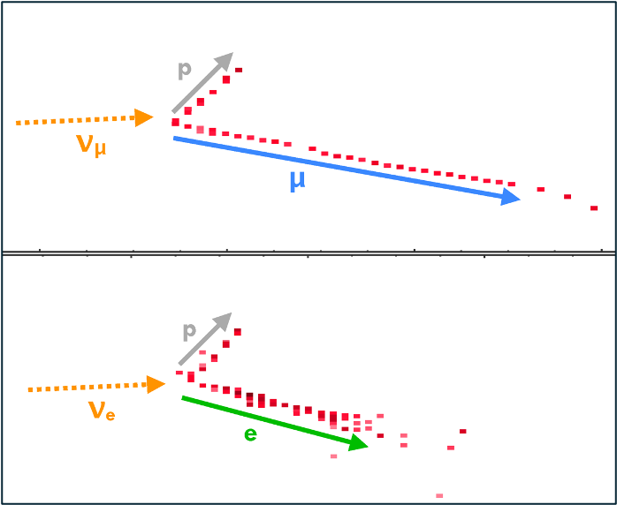
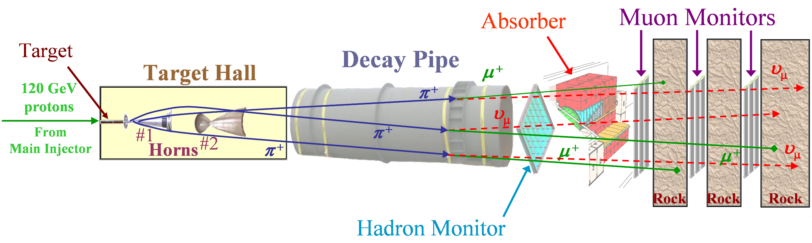
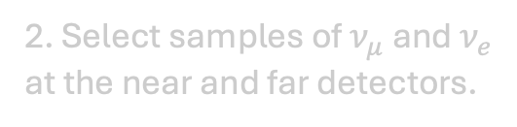
The NOvA Experiment
2. Select samples of $ν_{μ}$ and $ν_{e}$ at the near and far detectors.
3. Fit neutrino energy spectra.
1. Produce a beam of muon (anti)neutrinos.
14
14th July 2025 – XV NExT PhD Workshop – Emerson Bannister

Slide 15
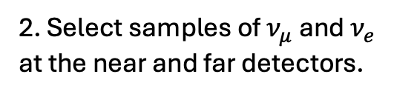
The NOvA Experiment
2. Select samples of $ν_{μ}$ and $ν_{e}$ at the near and far detectors.
3. Fit neutrino energy spectra.
1. Produce a beam of muon (anti)neutrinos.
15
15
14th July 2025 – XV NExT PhD Workshop – Emerson Bannister

Slide 16
The NOvA Experiment
2. Select samples of $ν_{μ}$ and $ν_{e}$ at the near and far detectors.
3. Fit neutrino energy spectra.
1. Produce a beam of muon (anti)neutrinos.
16
16
14th July 2025 – XV NExT PhD Workshop – Emerson Bannister

Slide 17
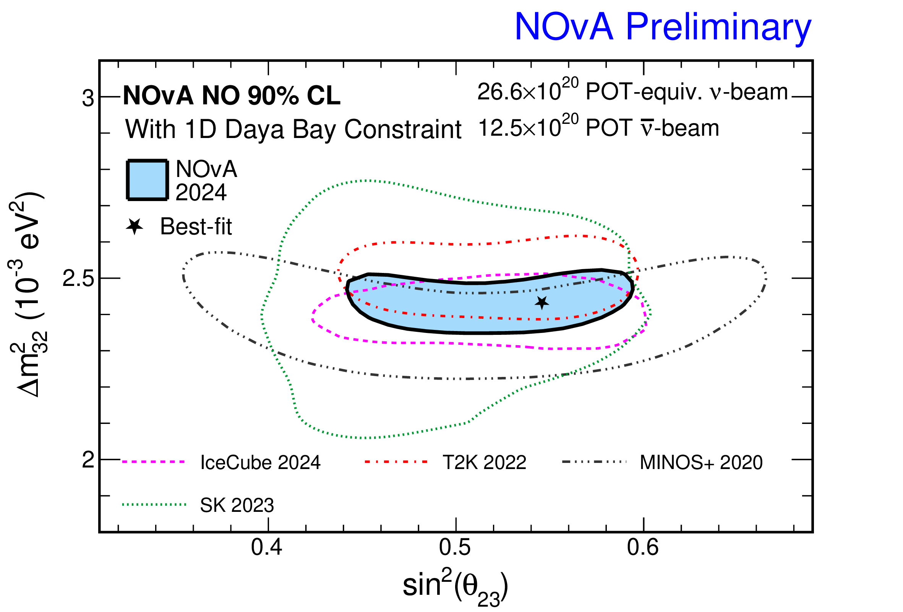


The NOvA Test Beam Program: Motivation
Fit neutrino energy spectra
Extract oscillation parameters
$$Δm_{32}^{2}$$
Version Thiago used without the other experiments?
$$θ_{23}$$
17
17
14th July 2025 – XV NExT PhD Workshop – Emerson Bannister

Slide 18
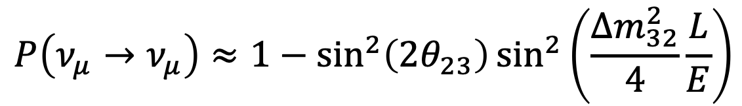
The NOvA Test Beam Program: Motivation
Fit neutrino energy spectra
$$P\left(ν_{μ}→ν_{μ}\right)≈1−\sin^{2}\left(2θ_{23}\right)\sin^{2}\left(\frac{Δm_{32}^{2}}{4}\frac{L}{E}\right)$$
$$Δm_{32}^{2}$$
$$θ_{23}$$
Fixed L: Distance between near and far detectors.
Need to know E.
18
18
14th July 2025 – XV NExT PhD Workshop – Emerson Bannister

Slide 19
The NOvA Test Beam Program: Motivation
The Test Beam Program can reduce the largest systematic uncertainty on NOvA measurements.
Goals:
Improve NOvA detector calibration.
Improve detector response and energy reconstruction.
14th July 2025 – XV NExT PhD Workshop – Emerson Bannister

Slide 20
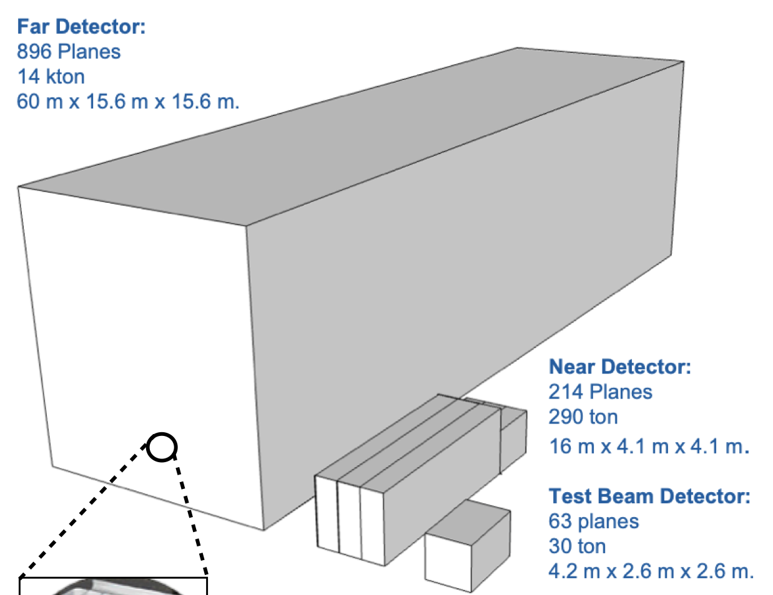
The NOvA Test Beam Experiment
  Test Beam Experiment:
  Smaller version of main experiment’s detectors
  Beam of particles → detector
20
20
14th July 2025 – XV NExT PhD Workshop – Emerson Bannister

Slide 21
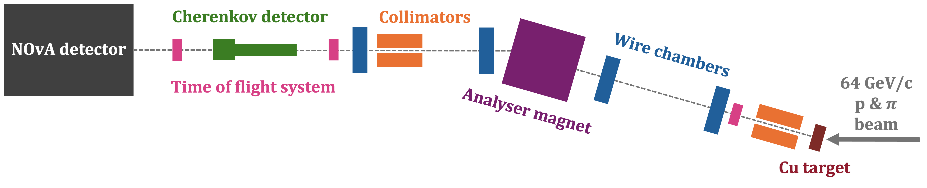
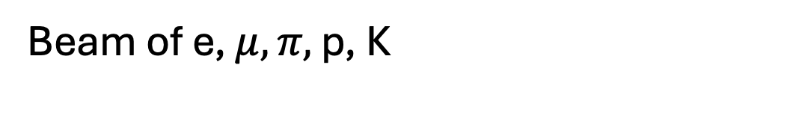
Instrumentation
Beam of e, $μ, π,$ p, K
21
14th July 2025 – XV NExT PhD Workshop – Emerson Bannister

Slide 22
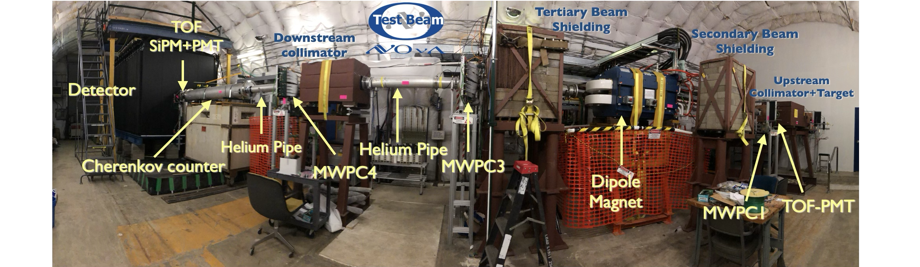
Instrumentation
22
14th July 2025 – XV NExT PhD Workshop – Emerson Bannister

Slide 23
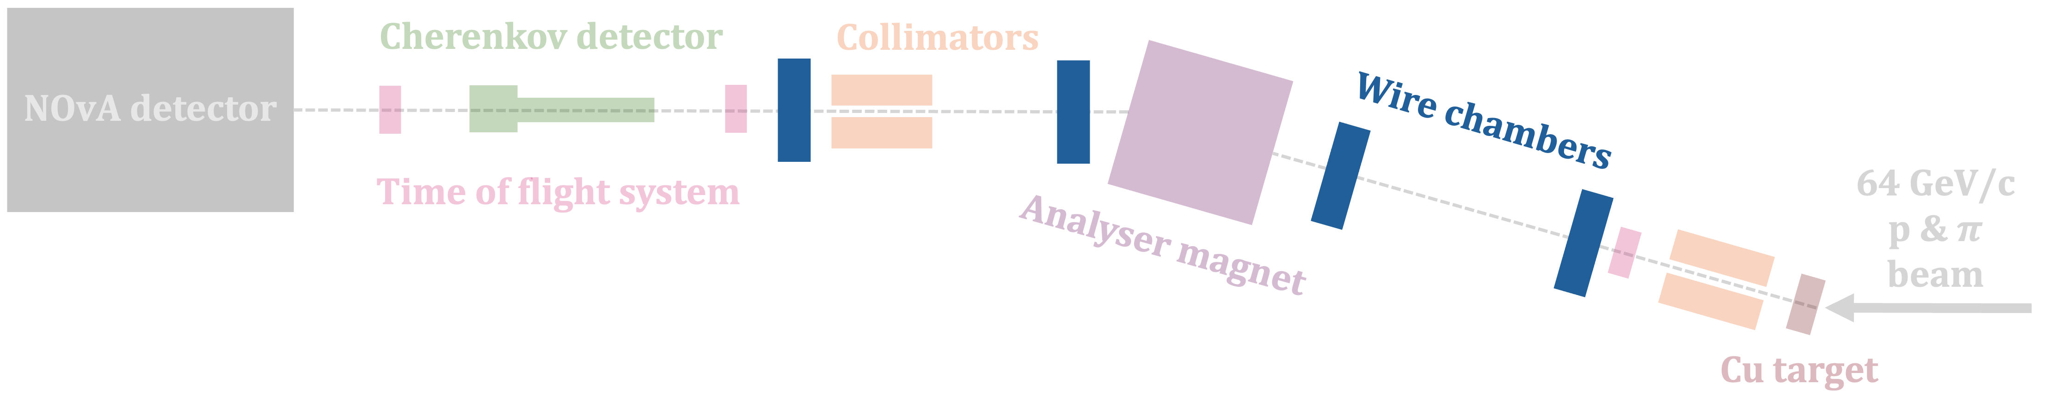
Instrumentation
Multiwire proportional chambers: Particle tracking and momentum reconstruction.
  Ionisation detector.
  85% argon, 15% isobutane gas mixture.
  Gold-tungsten wires.
Photo? Diagram?
Look at LArIAT
23
14th July 2025 – XV NExT PhD Workshop – Emerson Bannister

Slide 24
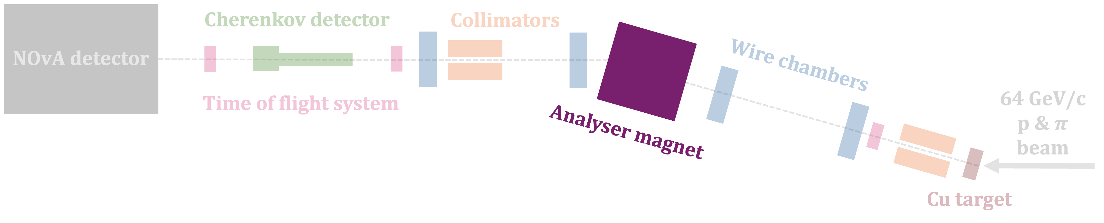
Instrumentation
±1000 A
Analyser magnet: To select the particle momentum and charge of interest.
0.4 – 1.5 GeV/c
±500 A
±750 A
±1250 A
24
14th July 2025 – XV NExT PhD Workshop – Emerson Bannister

Slide 25
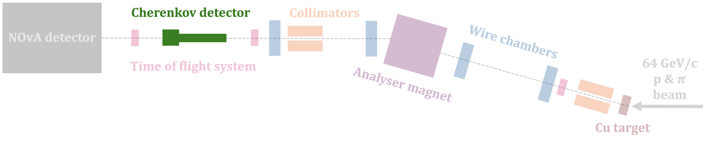
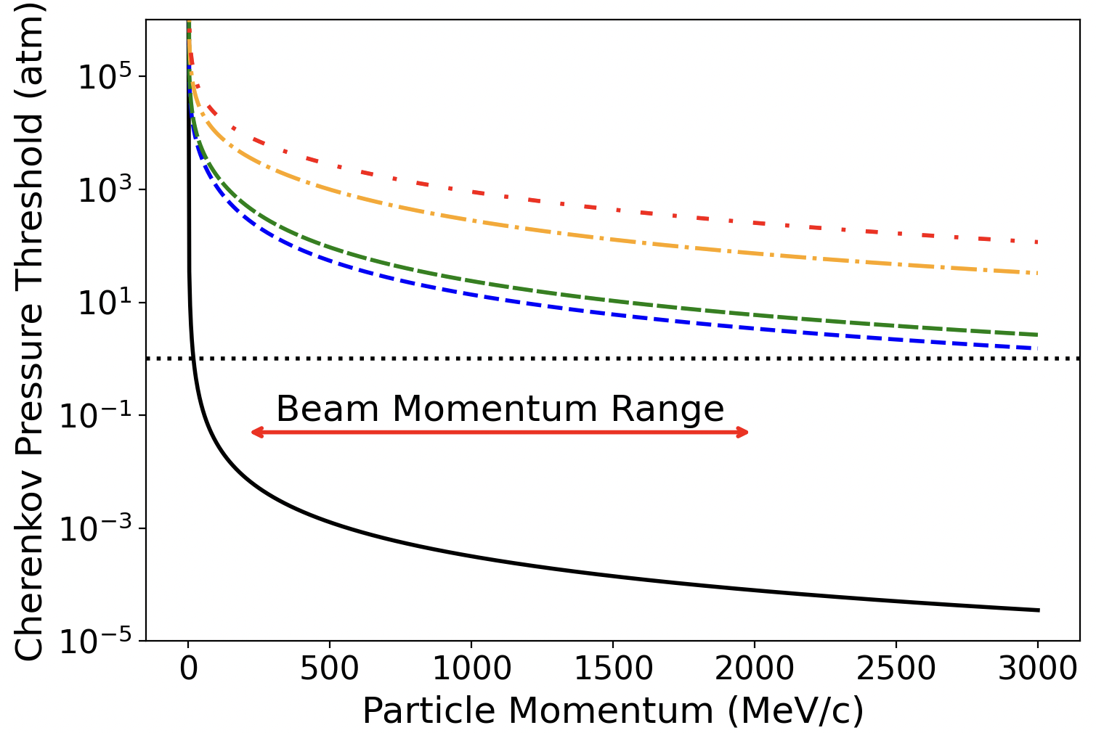
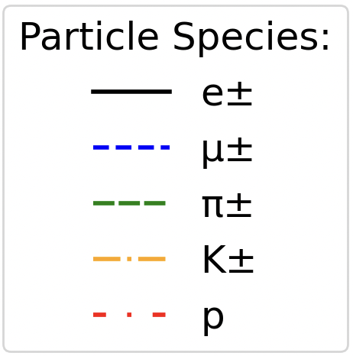
Instrumentation
Cherenkov detector: Electron tagging.
25
14th July 2025 – XV NExT PhD Workshop – Emerson Bannister
Figure 14: Relationship between momentum and Cherenkov pressure threshold for the particle species produced in the NOvA TB experiment. The dashed black line is the 1atm. pressure line at which the Cherenkov Counter operated. This value is only above the threshold pressure for e± in the expected beamline momentum range (shown with the red arrow).

Slide 26
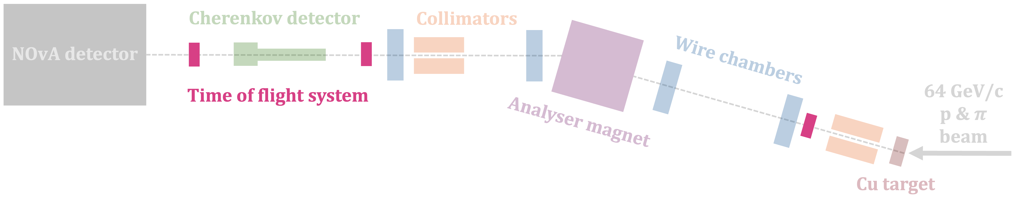
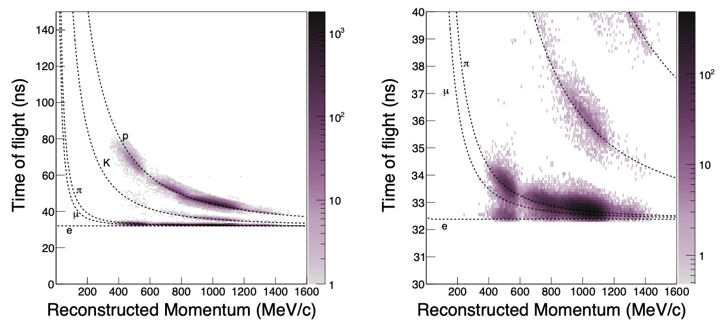
Instrumentation
Time of flight system: Identification of heavier particles (protons and kaons).
26
14th July 2025 – XV NExT PhD Workshop – Emerson Bannister
Figure 33: The reconstructed time-of-flight versus momentum in data after applying beamline data quality and particle ID selections on mass and time-of-flight, described in the text, left: the full range of phase space, right: zoom in on low time-of-flight region, highlighting the difficulty we would have in separating electrons from muons and pions without the inclusion of a Cherenkov detector in the tertiary beamline.

Slide 27

Instrumentation
Reconstructed momentum and time of flight.
Reconstructed mass of particles.
Used to ID protons and kaons.
Sets upper bound for pion mass.
Electrons separated by Cherenkov detector.
27
14th July 2025 – XV NExT PhD Workshop – Emerson Bannister
The reconstructed mass of particles passing the preliminary selections in Tab. 6 using the reconstructed momentum and time of flight as per Eq. 13. The mass of light particles using this technique does not reproduce the particle mass because the calculation relies on time-of-flight measurements that cannot be resolved between pions and electrons - they differ by only a fraction of a nanosecond over the distance of ∼9.7m used in this experimental setup. Because of this, only an upper bound of 300MeV is used for the pion selection criteria. The reconstructed masses of protons and kaons are however a decent proxy for the mass of the particle, and are therefore used for particle ID

Slide 28
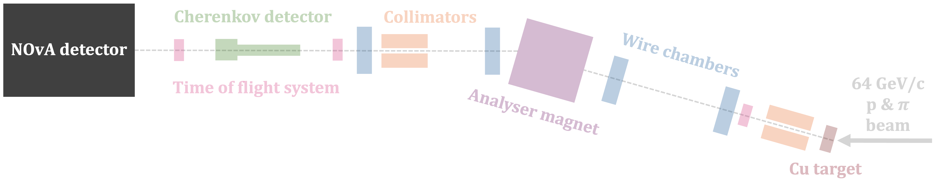
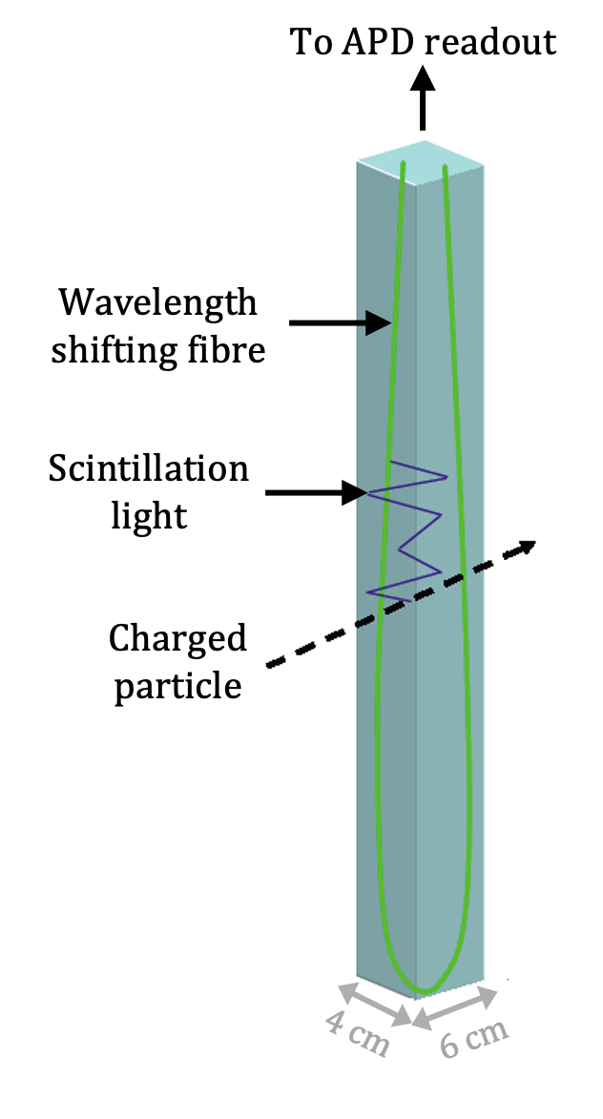
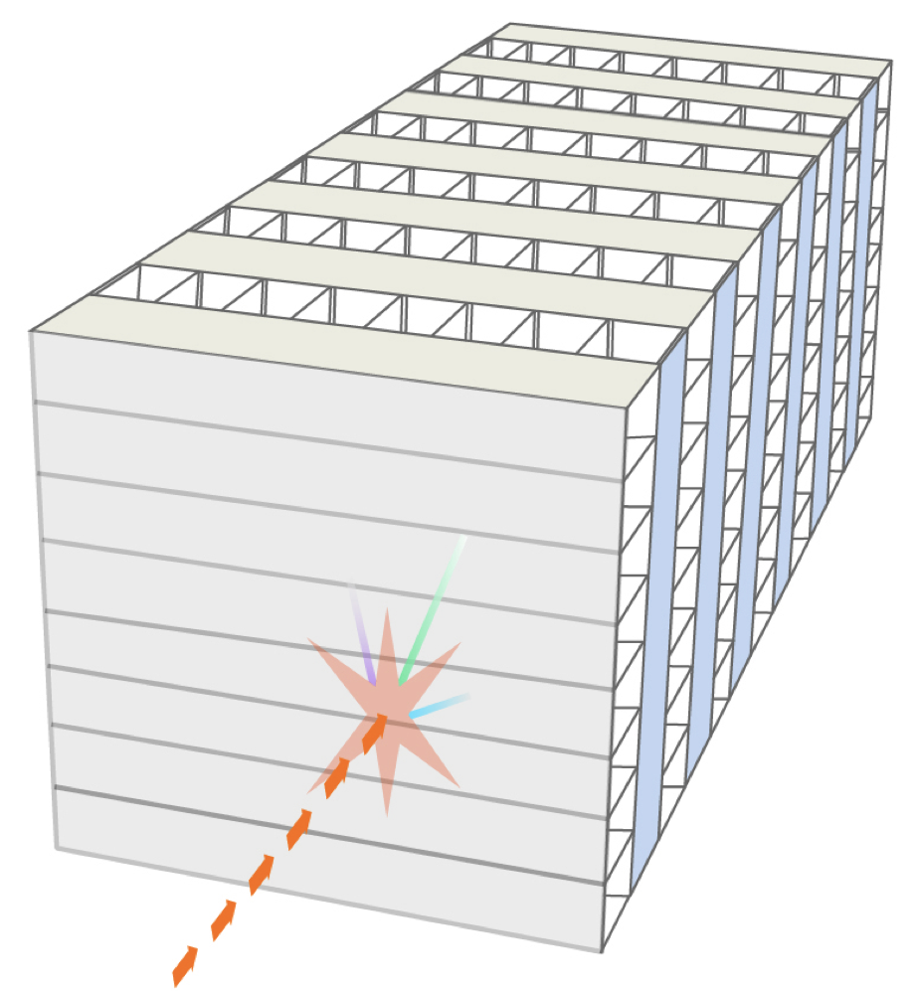
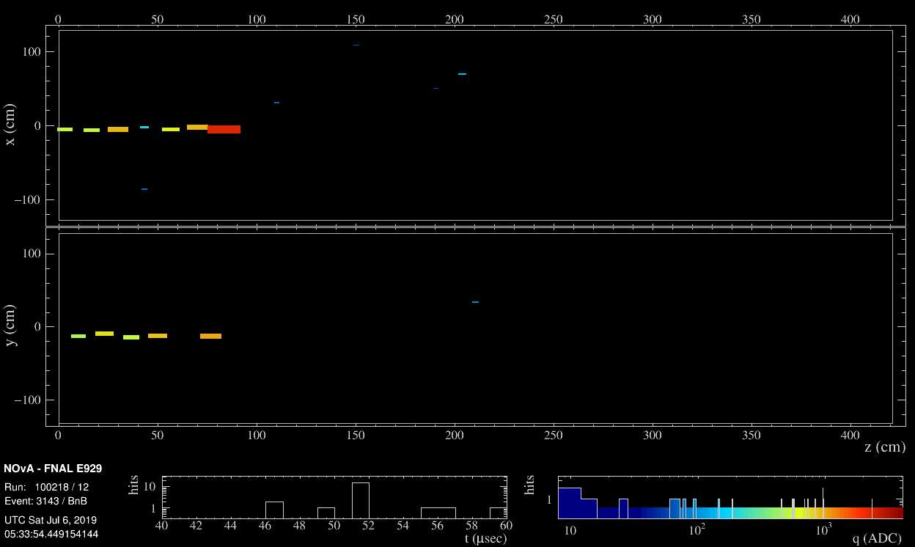
Instrumentation
30 ton scaled-down NOvA detector.
  Liquid scintillator.
  Segmented.
PROTON
28
14th July 2025 – XV NExT PhD Workshop – Emerson Bannister

Slide 29
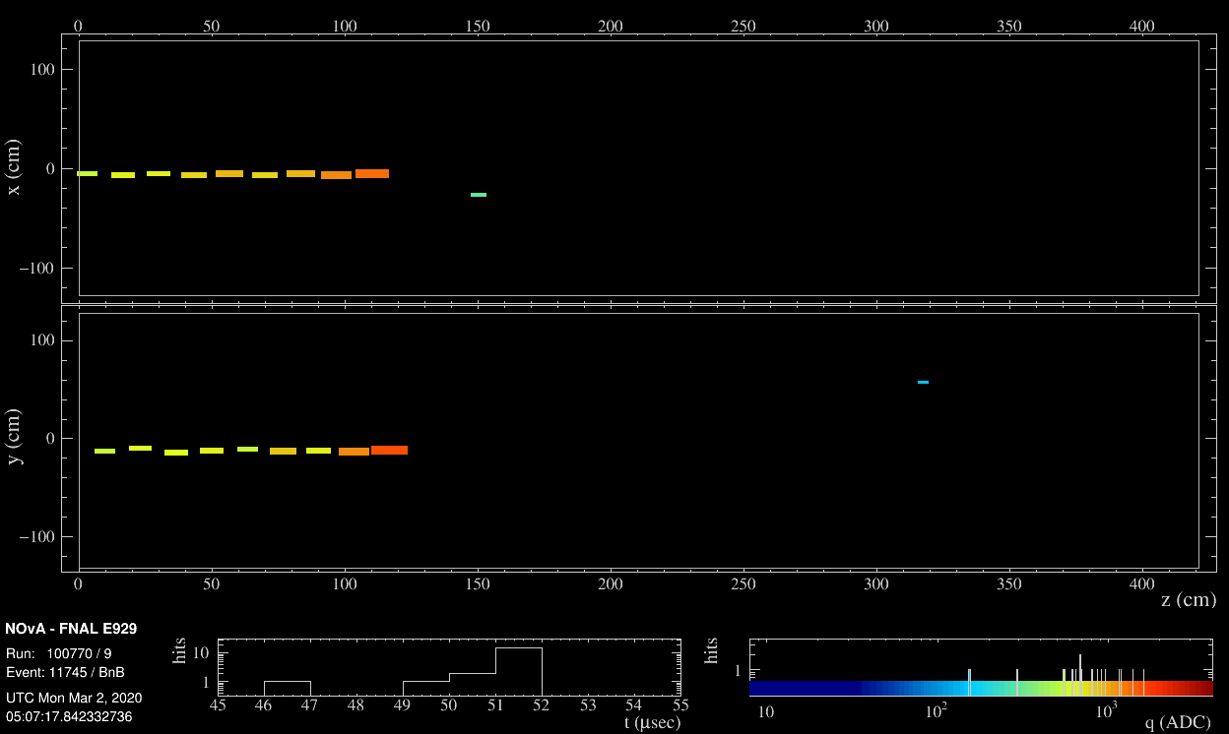
Event Displays
1.0 GeV/c PROTON
29
14th July 2025 – XV NExT PhD Workshop – Emerson Bannister

Slide 30
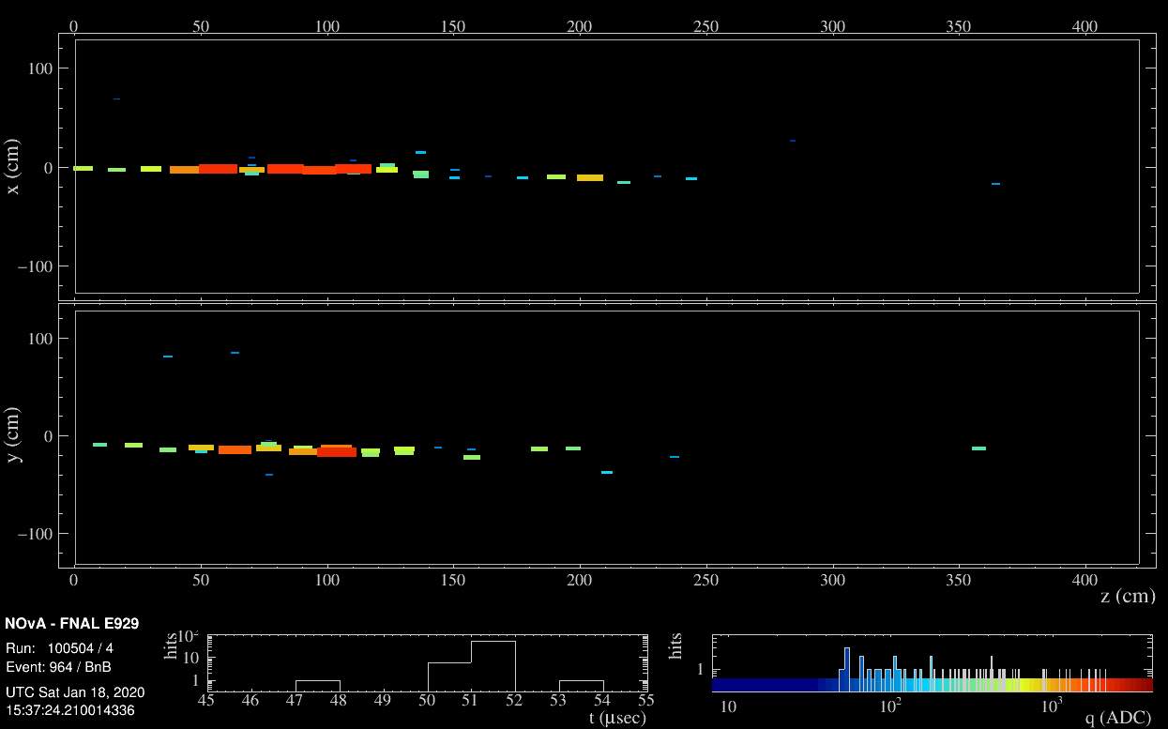
Event Displays
1.3 GeV/c ELECTRON
30
14th July 2025 – XV NExT PhD Workshop – Emerson Bannister

Slide 31
The NOvA Test Beam Experiment
  Test Beam Experiment:
  Smaller version of main experiment’s detectors
  Beam of particles → detector
  Apply what we learn from the Test Beam Experiment to the main NOvA experiment and improve the quality of our measurements.
31
31
14th July 2025 – XV NExT PhD Workshop – Emerson Bannister

Slide 32
Summary and Outlook
NOvA’s Test Beam Program: To reduce NOvA’s detector calibration and detector response systematic uncertainties.
Instrumentation for particle momentum and time of flight reconstruction → particle mass reconstruction → particle ID.
32
14th July 2025 – XV NExT PhD Workshop – Emerson Bannister

Slide 33
Summary and Outlook
NOvA’s Test Beam Program: To reduce NOvA’s detector calibration and detector response systematic uncertainties.
Instrumentation for particle momentum and time of flight reconstruction → particle mass reconstruction → particle ID.
Coming soon:
The NOvA Test Beam Detector and Beamline paper.
Incorporating particle-based energy uncertainties into analyses.
Measurements of the pion, electron, and proton energy responses.
33
14th July 2025 – XV NExT PhD Workshop – Emerson Bannister
Energy response = reconstructed energy / incident energy

Slide 34
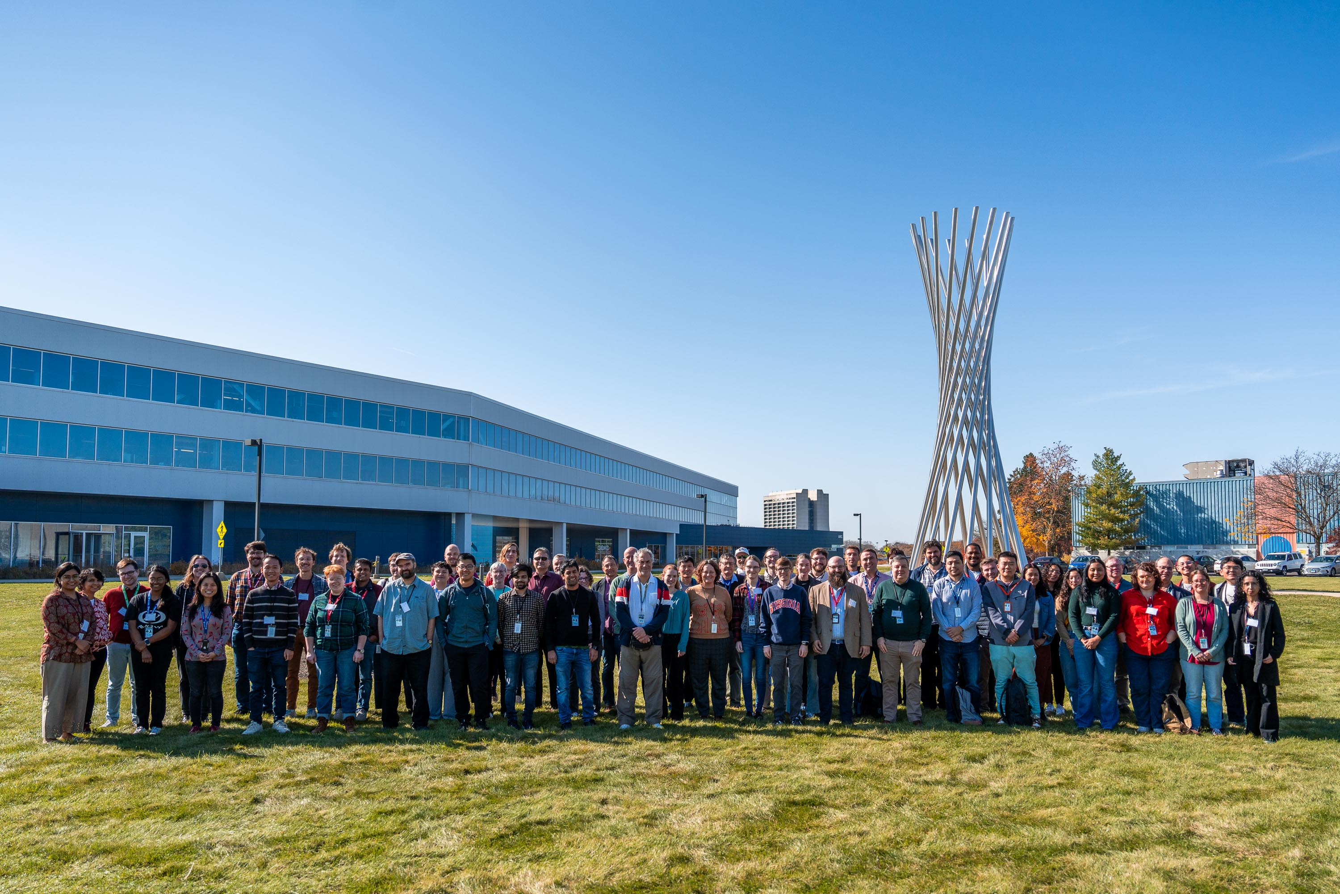
Thank you!
34
14th July 2025 – XV NExT PhD Workshop – Emerson Bannister

Slide 35
Backup

Slide 36
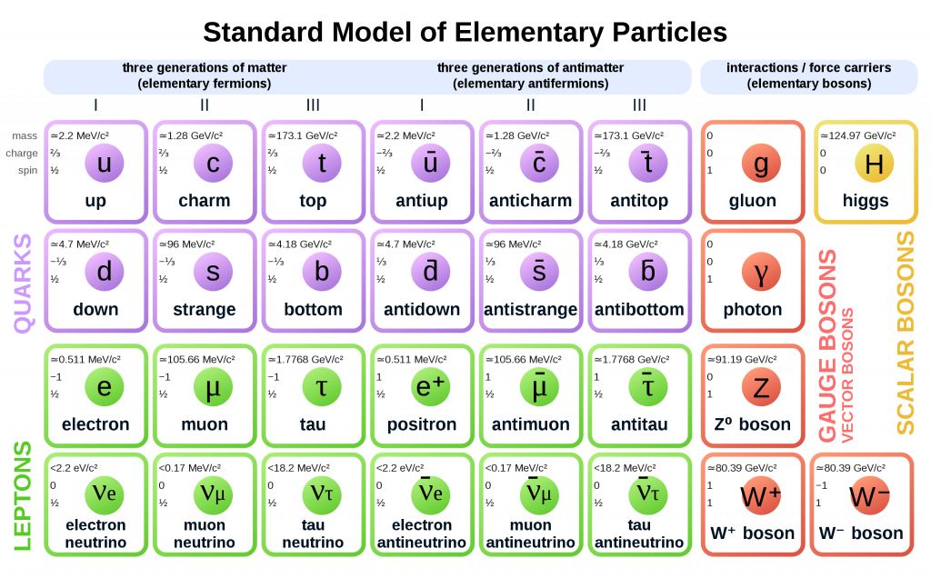
NOvA Three Flavour Neutrino Oscillation results
Thiago Bezerra
36
9th July 2025 – PUG Talk– Emerson Bannister

Slide 37
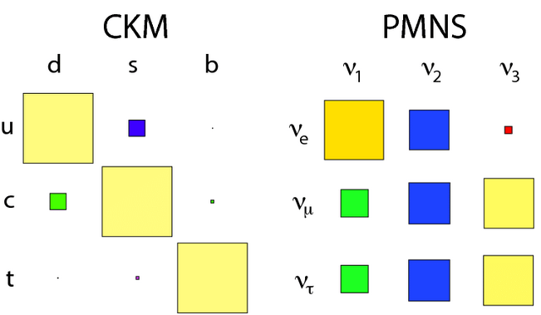
37
9th July 2025 – PUG Talk– Emerson Bannister

Slide 38
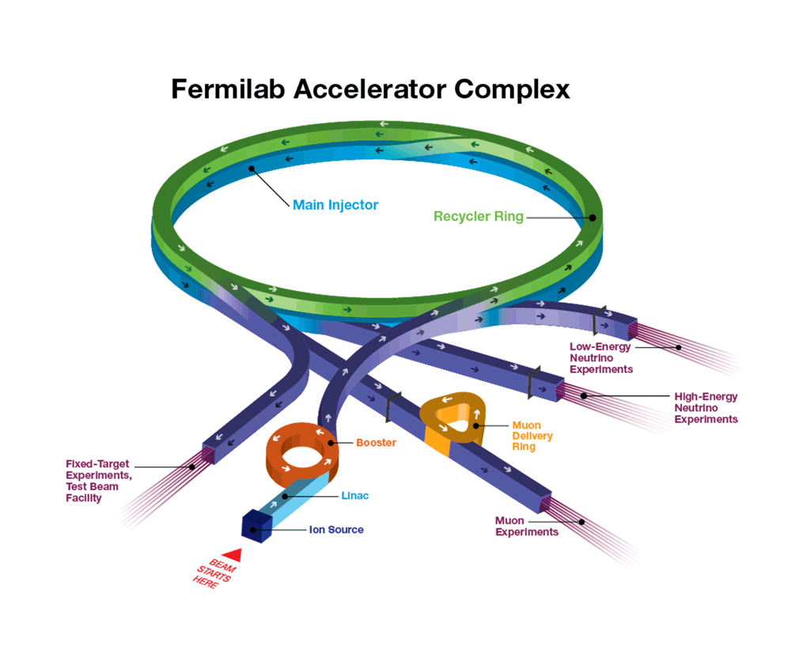

Producing a Beam of Particles
120 GeV/c protons from the Main Injector interact with a primary target.
Secondary beam of 64 GeV/c protons and pions.
Second copper target.
Fixed target experiments, Test Beam facility
Beam of $e,μ,π,K, p$.
38
14th July 2025 – XV NExT PhD Workshop – Emerson Bannister

Slide 39
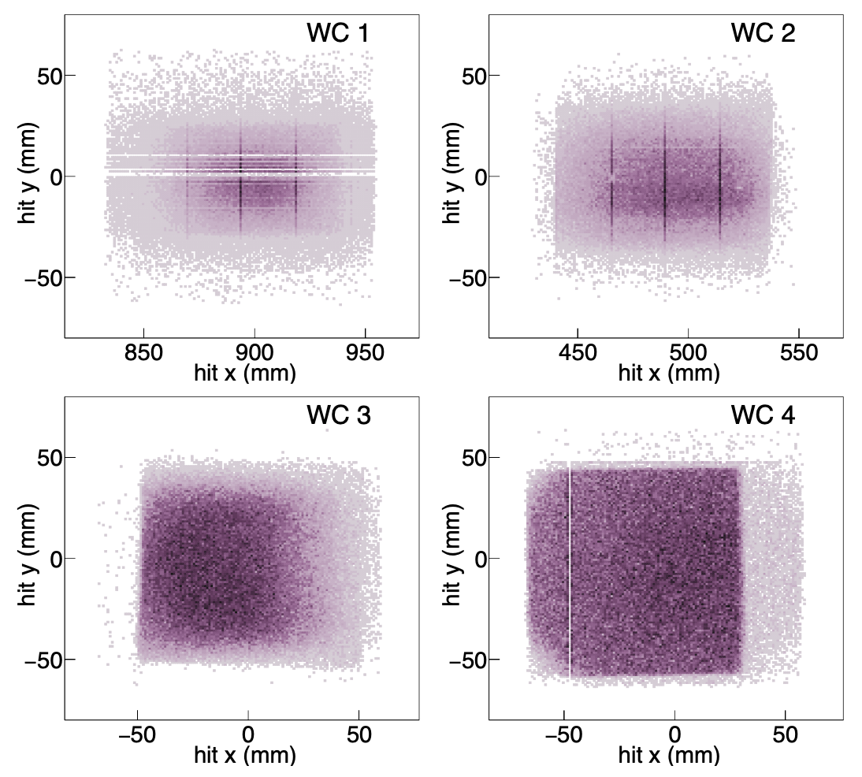
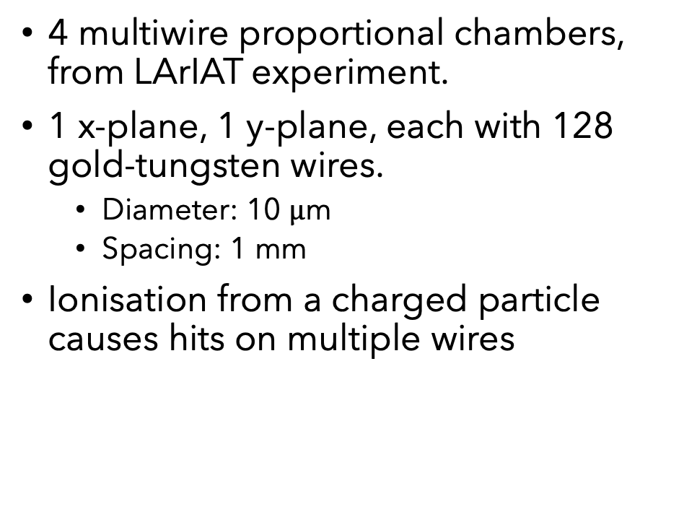
MWPC
4 multiwire proportional chambers, from LArIAT experiment.
1 x-plane, 1 y-plane, each with 128 gold-tungsten wires.
  Diameter: 10 $μ$m
  Spacing: 1 mm
Ionisation from a charged particle causes hits on multiple wires

Slide 40
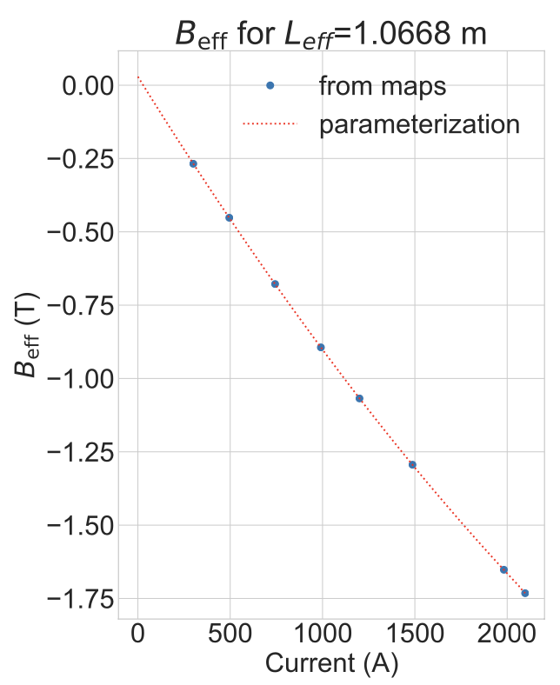

Magnet

Slide 41
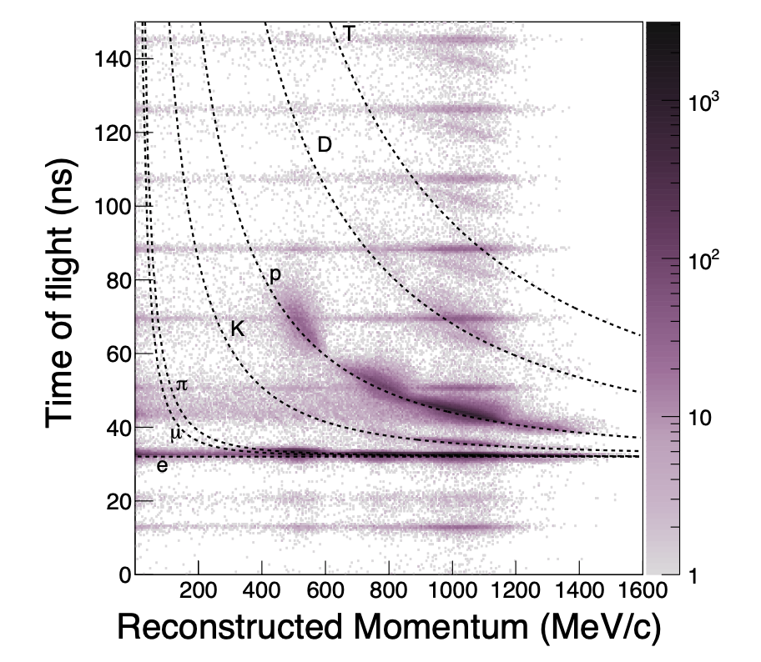
Time of Flight (ToF)
Identification of heavier particles (protons and kaons).
  Cherenkov detector needed to separate electrons from muons and pions.
Figure 33: The reconstructed time-of-flight versus momentum in data after applying beamline data quality and particle ID selections on mass and time-of-flight, described in the text, left: the full range of phase space, right: zoom in on low time-of-flight region, highlighting the difficulty we would have in separating electrons from muons and pions without the inclusion of a Cherenkov detector in the tertiary beamline.

Slide 42
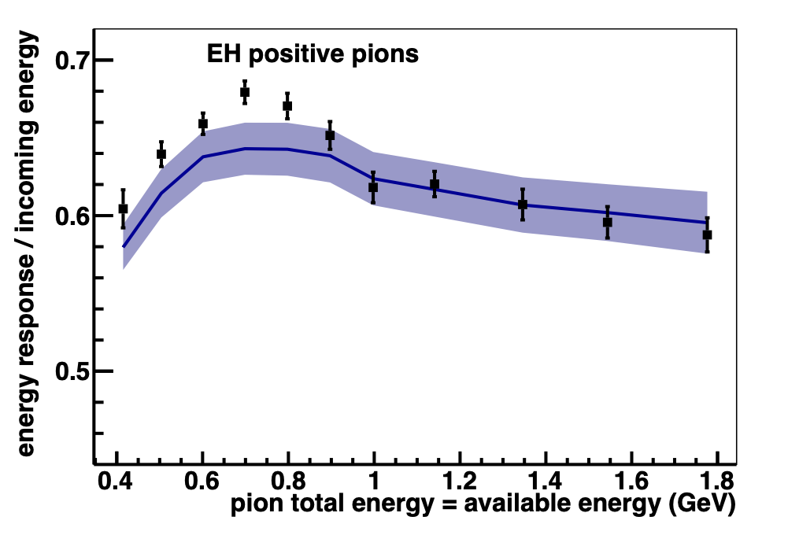
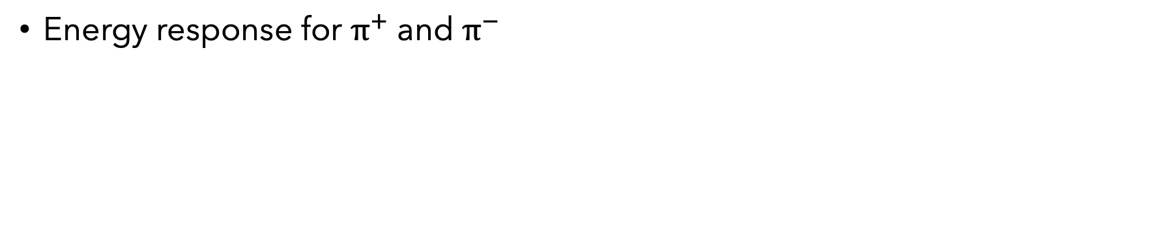
Electrons
ML to increase number of candidates
High energy loss through beamline
Energy response
Protons
Measuring the Birks quenching parameter for protons
Energy response
Pions
MINERvA
https://arxiv.org/abs/1501.06431
Energy response for $π^{+}$ and $π^{−}$

