Slide 1


CSS to Phoebus Transition at KIT
E. Blomley, J. Gethmann, J. L. Steinmann, Institute for Beam Physics and Technology (IBPT), KIT
S. Marsching, aquenos GmbH
Thursday poster session

Slide 2
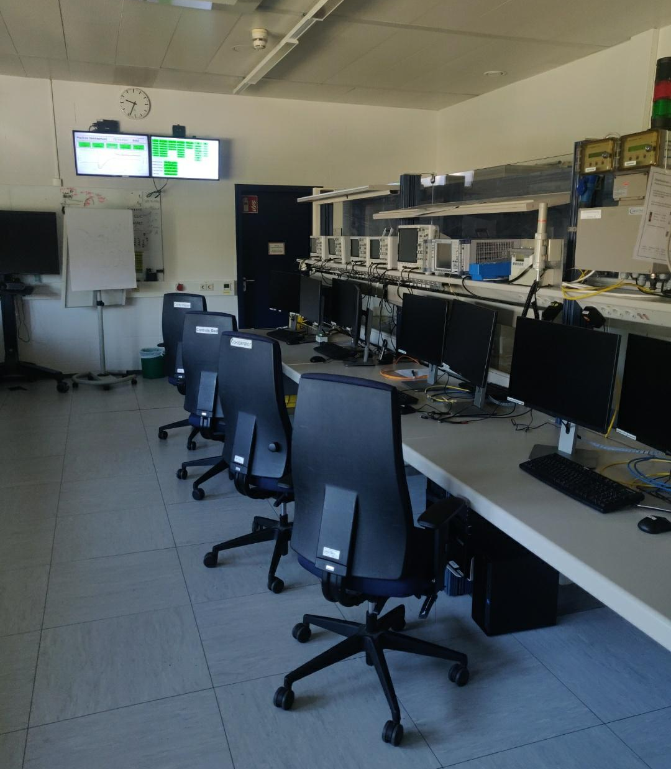

Environment
  KARA
      Operators only present inside control room during injection: ~ 1 hour per day
      ~ 23 hours: empty
  FLUTE has „on demand“ experiment driven operations
  Recently additions of multiple laboratories/beamlines
      Either new or just now migrating to EPICS
Office
Lab 1
KARA
FLUTE
Lab 5
Lab 2
Lab 3
Lab 4
cSTART
Lab 6
Office
Office
Office
Office
~ 10 km
Home Office
Lab 7
Student Accelerator
Home Office
Control room on a typical day: empty

Slide 3
“Requirements”
Access to Panels
  From anywhere look at any lab or accelerator (read-only)
  Phoebus should “behave” the same everywhere
  Support Linux, Windows and MacOS (Intel and Apple Silicon)
Develop Panels
  95 % of panel development made by core controls “group” (1-2 people)
  Keep overview across all locations
  Be efficient. No manual panel deployment.
Develop Phoebus
  Stay synchronized to upstream
  Maintain one distribution which works everywhere
  All deployment processes should require minimal manual interaction
As seamless and simple as possible for users
Never have to manually update software or panels
As efficient as possible for developers, accepting increased complexity in panel structure and technical implementation

Slide 4

KIT Phoebus Features
  KIT Phoebus Product
      Alternative Java bindings: EPICS Jackie (available upstream)
      Fully automated build and deployment for 4 architectures and services
  KIT Phoebus Launcher
      Self-update mechanism and embedded dependencies
      Command line parameters for advanced usage
  Configurations
      Central “Mementos” + site specific settings + services configuration
  Mono-Repository for all panels
      Deployed from GitLab to web server and streamed to clients
      No local panels
      Git branches and CI features for previews/reviews and/or versioning
  Phoebus specific high-availability server cluster for panels, services and distribution of Phoebus/launcher
KIT Phoebus distribution & KIT Phoebus Launcher project publicly available:
https://gitlab.kit.edu/kit/ibpt/controls/phoebus
More details on panel structure and configurations? Talk to me!
edmund.blomley@kit.edu

Slide 5
Next…
  Panel “linting” using CI
      find broken links..
      check for style guide…
      Analyse/report on macro usage
      Panel/widget statistics
  Better “remote” memento support
  Streaming panels from embedded devices…?
  More services…
Anyone working on that (and can share progess?)

Slide 6
















Technical Details
Git Projects
Back-End Services
ChannelFinder Upstream
Phoebus Upstream
Git submodule
automatic deployment
ChannelFinder Product
KIT Phoebus Product
KIT Phoebus Launcher
Configurations
Panels
Phoebus
Server Cluster
Launcher
Auto Update
Developer
File Storage
Streamed panels
User

