Slide 1


Welcome to the September 2025 EPICS Collaboration Meeting
20 September 2025
Palmer House Hilton, Chicago

Slide 2

Safety
Emergency Procedures

Slide 3
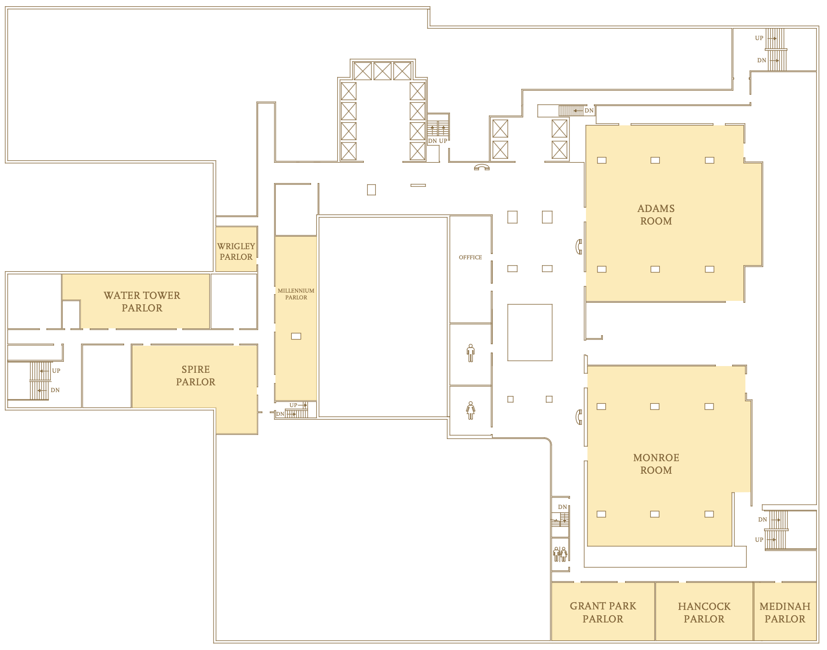

If the hotel must be evacuated because of an emergency, use Stairwell 4 by the elevators, which services all floors. Hotel staff will direct and assist.
The assembly area for guests is at 55 East Wabash.
To report an emergency to the Hotel Security Department, call extension 66 on a house phone.
Beyond the hotel, US emergency services are reached by dialing 911 from most phones.
4
SIXTH
floor
Safety Emergency procedures

Slide 4
Hotel
Information

Slide 5
WiFi 🛜
From the ICALEPCS (cvent) Mobile App
Network: ICALEPCS2025 Password: Accelerator
Hotel Wifi

Slide 6
Facilities on floor 6
Restrooms are across the hallway to the left.
Refreshments will be served in the hallway just outside during our breaks at 10:30 and 15:30.
☕️🍪
Hotel Facilities

Slide 7
Workshop
Information

Slide 8
Meeting Sessions
09:00 Welcome 09:10 Standard talks (4) 10:30 Refreshment break |  | 14:00 Lightning session (6) 14:30 Standard talks (3) 15:30 Refreshment Break
11:00 Lightning session (6) 11:30 Standard talks (2) 12:30 Lunch break |  | 16:00 Lightning session (6) 16:30 EPICS Council Report 16:50 Spring 2026 Meeting
Speakers
Please make sure your talks have been uploaded before your session starts, preferably earlier.
Workshop Session timetable

Slide 9
Lunch
Suggestions from a Chicagoland native
There are many cafes, restaurants and fast-food places nearby. Here are some ideas for good places to eat, according to someone who has lived around Chicago for a many years (not me!)
Miller’s Pub American, Bar, Pub 134 S Wabash Ave, Chicago, IL 60603 www.millerspub.com |  | Russian Teatime Restaurant Coffee House, Russian, Modern European 77 E Adams St, Chicago, IL 60603 www.russianteatime.com
The Berghoff German-American 17 W Adams St, Chicago, IL 60603 www.theberghoff.com |  | The Gage by the BEAN Gastropub, American 24 S Michigan Ave, Chicago, IL 60603 thegagechicago.com
Workshop Suggestions for places to eat

Slide 10
Thank You for Your Attention!

