Slide 1
PVmapper EPICS nameserver without a database
September 20th, 2025 | EPICS workshop Sept 2025
Klemen Vodopivec
Oak Ridge National Laboratory
This material is based upon work supported by the U.S. Department of Energy, Office of Science, Office of Basic Energy Sciences under contract number DE-AC05-00OR22725

Slide 2
Why a nameserver?
EPICS uses aggressive broadcast mechanism to find PVs in distributed environment
UDP broadcast packets are delivered to (but not necessarily processed by) every node on the network
Scales well, but not all devices are happy
Non-existing PVs can degrade the network quickly
Nameserver reduces or completely removes the broadcast search requests
See ICALEPCS talk TUBR004 for specific examples and details

Slide 3
Why a new nameserver?
Need to support a variety of Channel Access clients and servers
EPICS 3.13, 3.14.8, 7.0.8.1, LabView etc.
Bug in early version of EPICS prevents new EPICS versions to communicate through nameserver
https://github.com/epics-base/epics-base/issues/426
https://github.com/epics-base/epics-base/issues/621
Diverse set of IOC platforms
LabView, VME/vxWorks, MicroTCA
Makes populating a static PVs database difficult
PCAS not part of EPICS base
Limited API
Nameserver
CA_V413
CA_V413
CA_V413
CA_V413
CA_V411
Client
IOC
x
No response from IOC --- must be CA_V413
Existing implementations
ca-nameserver - https://epics.anl.gov/extensions/nameserver/index.php
ChannelFinder - https://channelfinder.github.io/

Slide 4



Or not to use a nameserver?
Single point of failure
Small or segmented networks not impacted as much
Potentially slower PV resolution

Slide 5
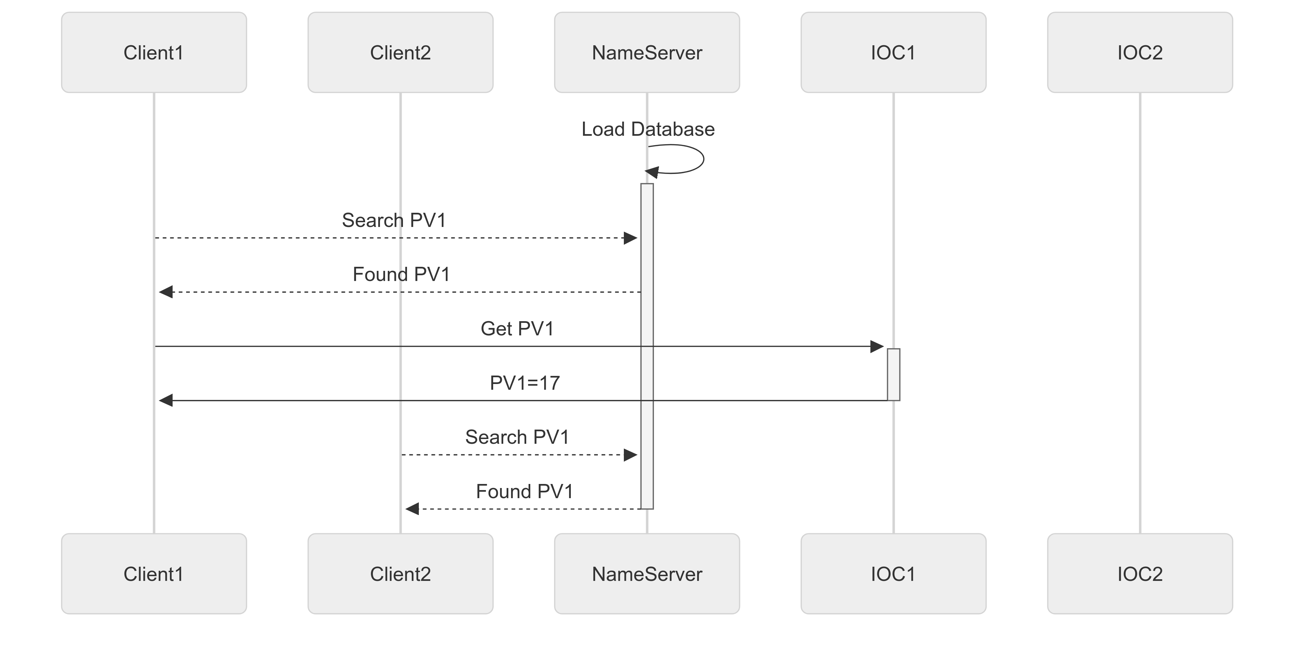
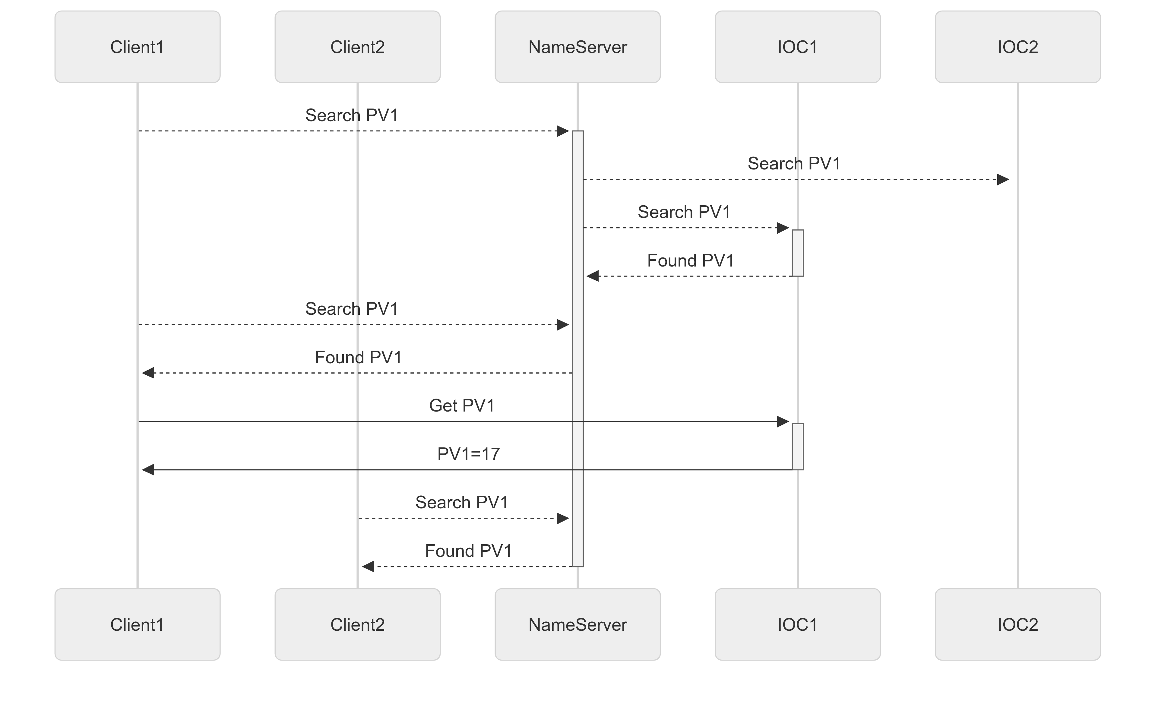
How does an EPICS nameserver work?
With database - PVs pre-loaded
Without database - PVs searched and cached
TCP
UDP
Broadcast UDP

Slide 6
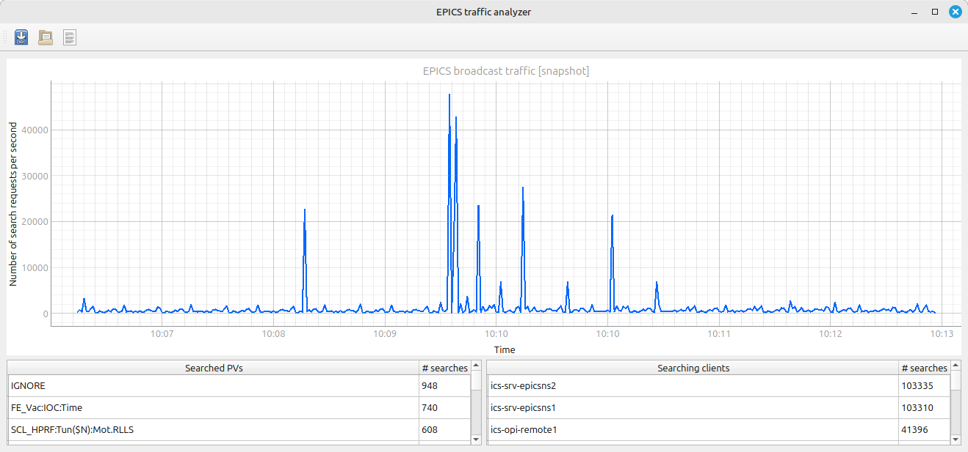
How to analyze the impact?
Python tool to decode and visualize EPICS search requests in real-time

Slide 7
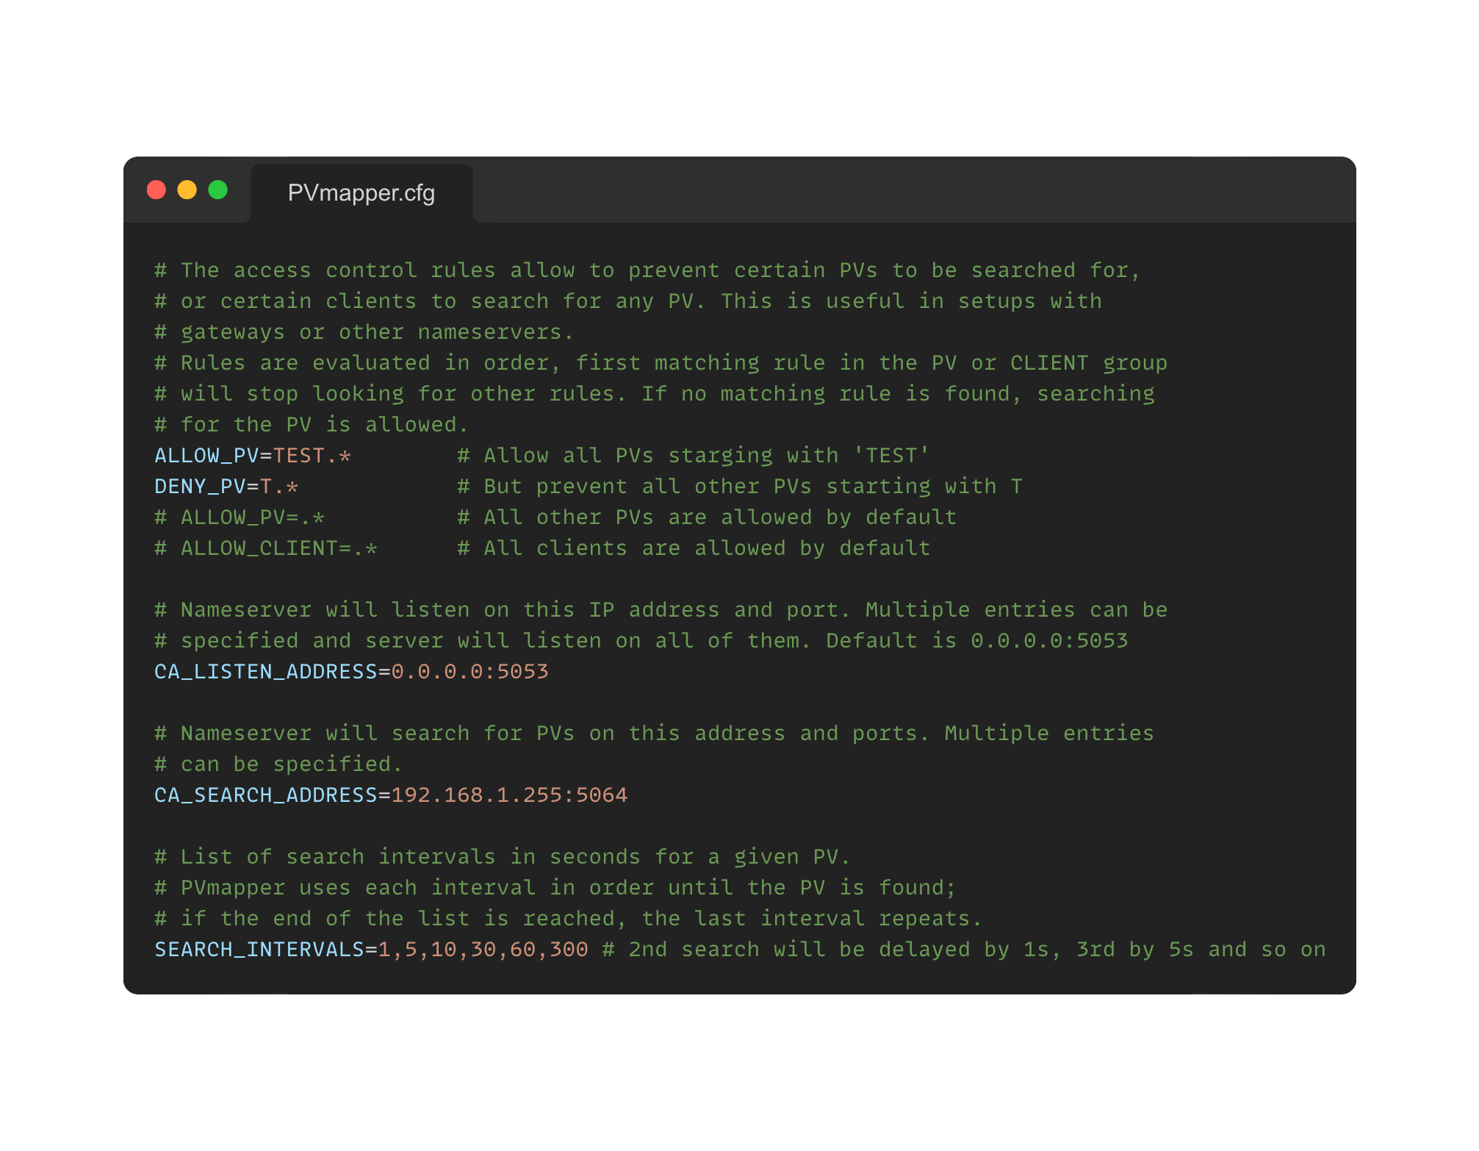
Goals for PVmapper project
Works in any EPICS environment
Tunable
Easy to deploy and use
Extendable
Low performance

Slide 8
Project status
Custom Channel Access
Limited to UDP search requests and TCP echo messages
“Copy” UDP packet response from IOC to client
Search in multiple networks
Single file configuration
Block unknown clients (ie. port scanners)
Block ill-formatted PV names with regex (ie. $(P):Volt)
Comprehensive or extended logging
Adjustable at runtime
Allows for forensics and troubleshooting
POSIX compliant
Really only tested on Linux
Uses poll()
No dependencies
Extract statistics
Specify search intervals/periods
Log file or syslog
Single threaded

Slide 9
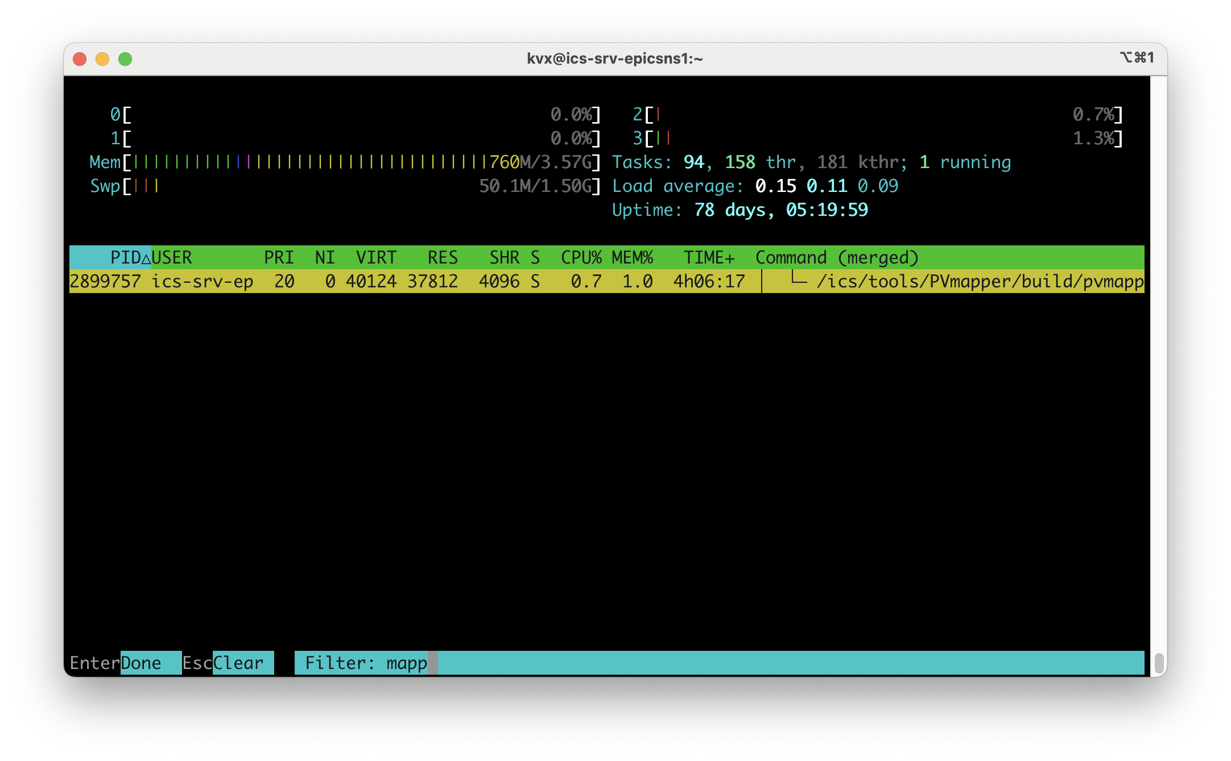
Operational experience at SNS
In production in SNS Accelerator network since May 2025
Serves all OPI consoles, gateway, archiver, alarm handler
Except chief OPI console, IOCs
Serving approx. 85,000,000 searches/day
Helped reduce periodic search spikes
Reduced broadcast traffic by order of magnitude
Helped remove non-existing PVs
Recently added second instance for redundancy

Slide 10
Future directions
Support for PVAccess
Integrated fault tolerance
Keep it simple

Slide 11
Thank You
GitHub link available soon!

