Slide 1
PVA-i-fy your Control System Java implementation of secure PV Access and CA-to-PVA gateway
Klemen Vodopivec Kay Kasemir
September 2025
This material is based upon work supported by the U.S. Department of Energy, Office of Science, Office of Basic Energy Sciences under contract number DE-AC05-00OR22725

Slide 2
Java Implementation supports Recent PV Access Updates
 | PVXS | core-pva
Language | C++ | Java
PV Access Compliance | Full PV Access server and client reference implementation | Aims to stay compatible with latest PVXS implementation
Key use | IOC, P4P Python, PVA-to-PVA gateway | CS-Studio (phoebus)
Contacts | Michael Davidsaver, George McIntyre | Kay Kasemir
(both interoperate with earlier C++ and Java implementations)
Sept. 2024 EPICS meeting
PVXS and core-pva support secure sockets
Sept. 2025 EPICS meeting
PVXS offers certificate management service (PVACMS)
core-pva can use the same certificates
IOC can allow or block write access based on securely authenticated username
Growing “Secure EPICS” ecosystem ready for testing
Notes:
Michael and George have more details in their talk, but it’s worth iterating since this has been confusing to a few people:
“PVXS” is the PV Access reference implementation, in C++, for the IOC and other key tools.
The “core-pva” Java implementation aims to stay fully compatible and is used by CS-Studio.
At the last EPICS meeting, we presented initial support for secure sockets.
Now, there’s a “PVA Certificate Management Service” to help with, well, managing the certificates, and IOCs can use the authentication info to control write access.
In short, there’s a growing “Secure EPICS” ecosystem ready for testing.

Slide 3
PV Access Advantages
Like Channel Access, plus
‘description’ from DESC, time stamp ‘userTag’ from UTAG, alarm ‘message’ from AMSG
Single subscription provides efficient updates (no more ‘DBE_PROPERTIES’)
Designated data type for Area Detector images … with optional compression
Supports IPv4 as well as IPv6
Supports Transport Layer Security (TLS)
Authentication
Encryption
Allows custom data types for special applications
Notes:
In case you’re not already using PV Access, you should know that it’s just like Channel Access but with several advantages.
It can be used on IPv6 networks, and as just mentioned there’s support for secure networks, authentication and encryption.
One point that’s often mentioned is that you can use PVA to handle custom data types, but that is almost the least important feature.

Slide 4
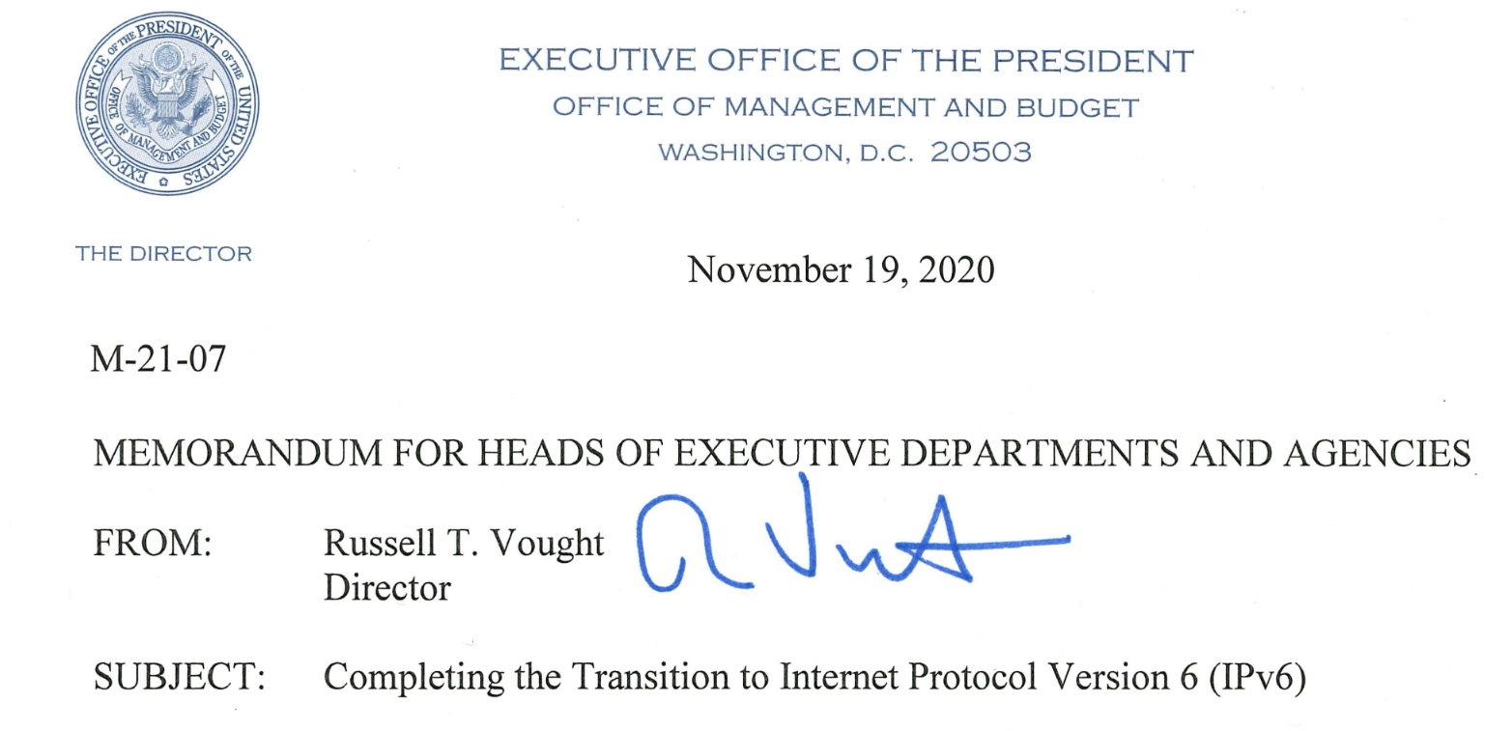
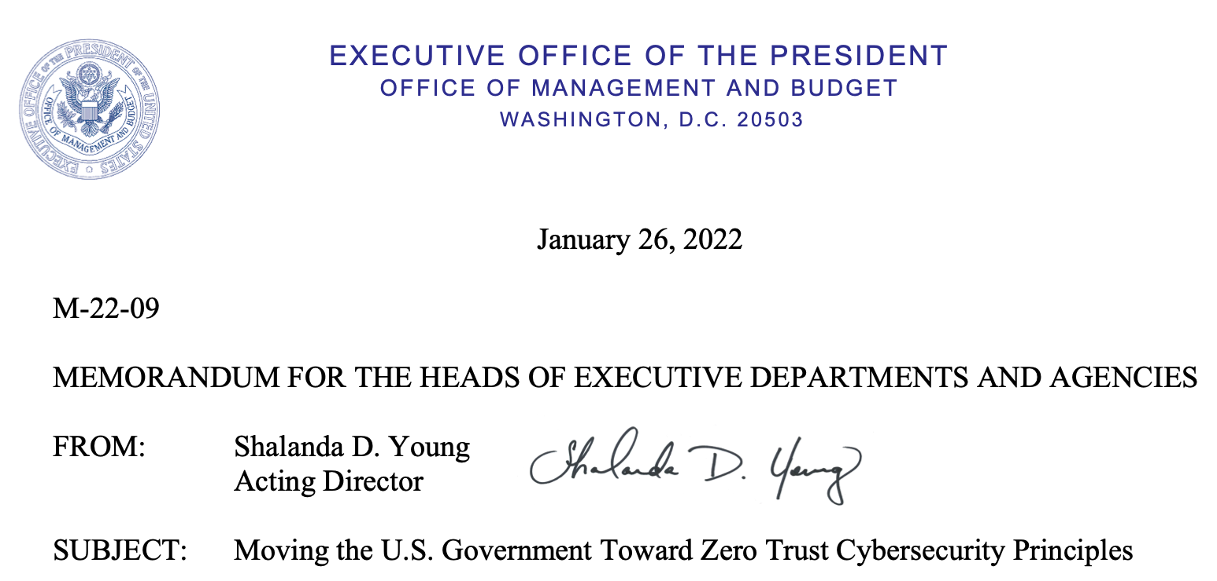
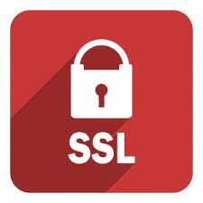
Transitioning to PV Access
You like the PVA advantages
You may soon need IPv6 and Security
.. but you have an established control system
Older devices (VME/vxWorks) won’t run EPICS 7
MEDM, EDM, PCASpy, XAL, … rely on CA
Even where possible, updates take time
➔ PVA-i-fy the control system!
Keep IOCs on Channel Access, proxy the information to PV Access clients
Allows for gradual PVA transition
PVA-i-fy
Secure Clients
PV Access
Channel Access
IOCs
Notes:
At this point, you may want to use PVA because of its advantages,
or you need to use it because IPv6 and security become mandatory.
This is easy for a new installation, but you may be stuck with an established control system where some components have no easy upgrade path.
This is certainly the case at our site, the Spallation Neutron Source at Oak Ridge Natl. Lab.
We see a CA-to-PVA proxy as a key building block in a gradual transition to PVA.

Slide 5
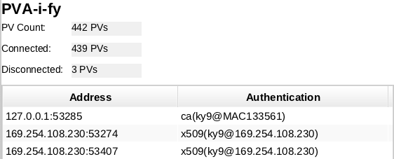
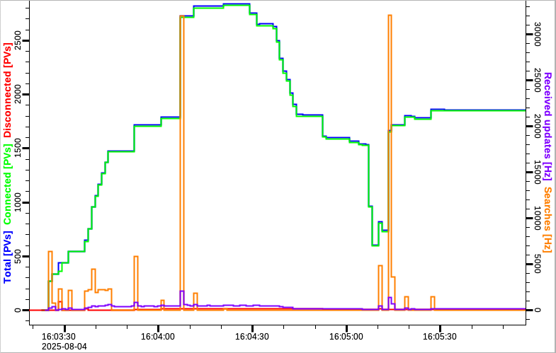
PVA-i-fy: CA to PVA Proxy
Prototype of intended functionality
For now, read-only. Use secure authentication to prepare for eventual write access. Once key clients are secure, add controlled write access. Update IOCs to PVA at own pace.
Office Network
PV Access, IPv4 or IPv6, optionally TLS, supports TCP/TLS name search
Control System Network Channel Access, IPv4
PVA-i-fy
µTCA IOC
Secure C++ Client
Secure PVA Server
Channel Access Client
VME IOC
Secure Java Client
PV & Value Cache
Soft IOC
…
Notes:
PVA-i-fy is a gateway or proxy from Channel Access to PV Access.
The established control system can for now stay with Channel Access, IPv4 and legacy devices on its isolated network.
The proxy makes that information available on the larger site network via PVA, allowing use of IPv6.
The proxy is for now read-only, like our CA gateways have been for the last 20 years.
But we can start to introduce secure PVA clients, and eventually we might allow controlled write access for certain securely authenticated users.
Meanwhile, IOCs can migrate to EPICS 7 with PVA enabled at their own pace. We can add PVA-to-PVA gateways for them, and in the long term all traffic becomes PVA and we’ll remove PVA-i-fy

Slide 6
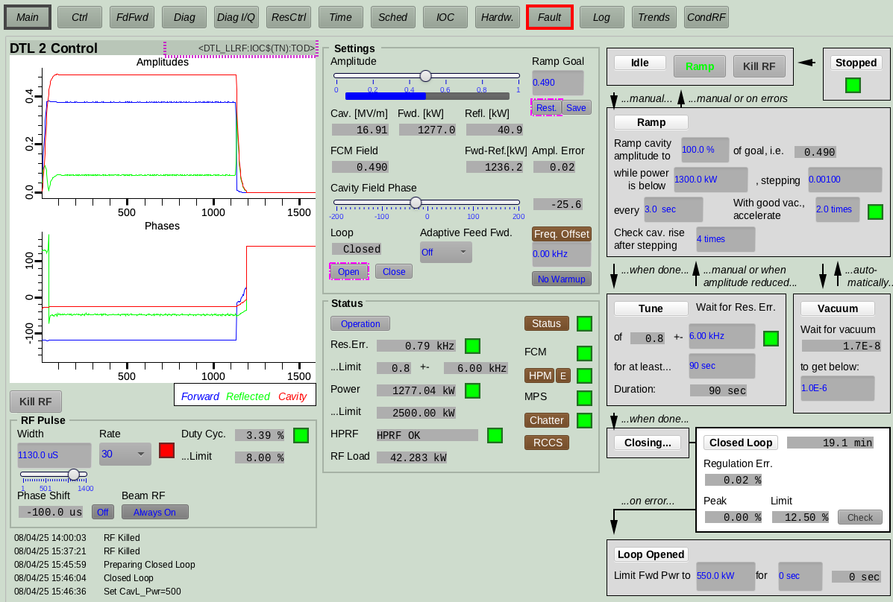
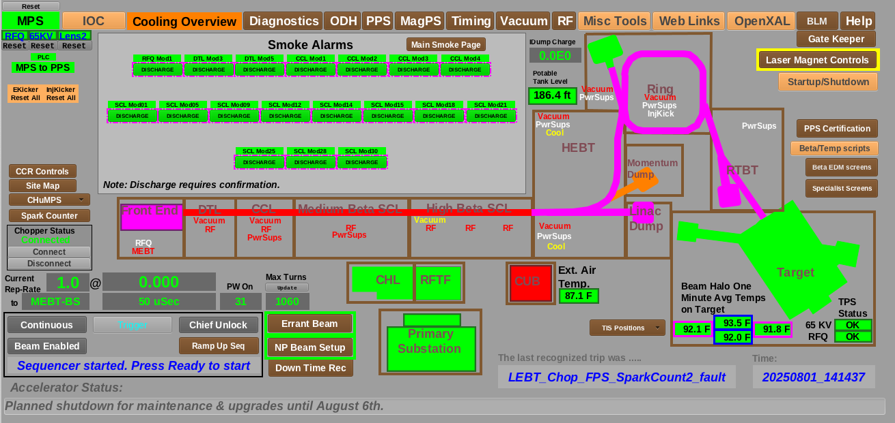
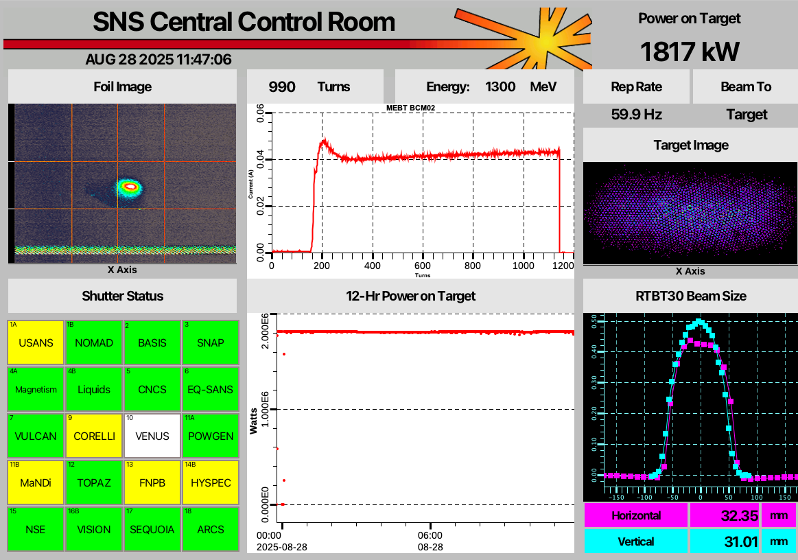
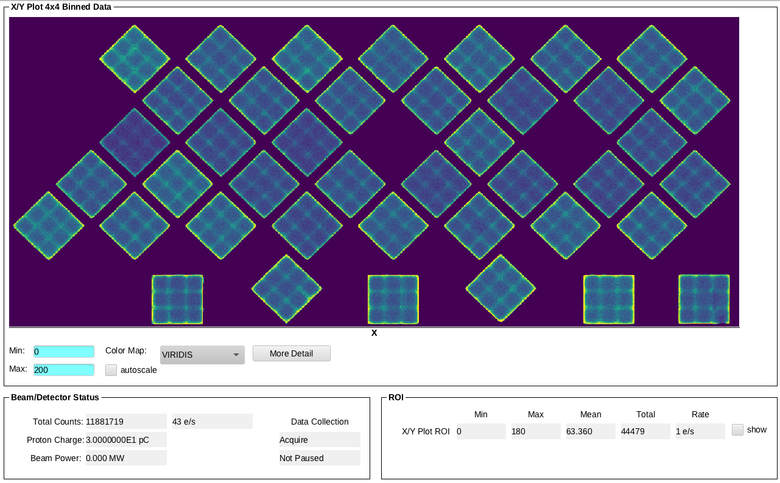
Test of PVA-i-fied SNS Accelerator and Instrument Displays
EDM screens,
Auto-converted
to CS-Studio,
using PVA
SNS Accelerator
“Mandi” Instrument
CS-Studio
Eventually move proxy down into firewall, remove CA gateways
PVA-i-fy
ICS CA Gateway
Instrument CA Gateway
Accelerator
Instruments
Notes:
We’re in the early testing phase.
For the tests, PVA-i-fy is not directly bridging from the control system network, it’s placed on top of existing CA gateways, with security enabled, but IPv4, not IPv6.
It does so far successfully transfer all the scalar and waveform data of accelerator and instrument displays.
This includes EDM displays which are auto-converted into CS-Studio and then used with PVA.

Slide 7
PVA-i-fy Prototype available for testing
https://github.com/ControlSystemStudio/pvaify
PVA-i-fy
Secure Clients
PV Access
Channel Access
IOCs
Notes:
You’re invited to check it out!
Anticipating Possible Questions:
Is this all done and operational? - No, it’s an ongoing development, secure PVXS code is on a branch. It’s ready for testing, with surprisingly good documentation, and a chance to still influence details
Wasn’t there already a CA to PVA gateway? - Yes, the original PVA gateway based on pvAccessCPP included a CA client, but the older pv*CPP doesn’t support IPv6, nor encryption, and isn’t actively maintained. The current PVA-to-PVA gateway based on PVXS is purely PVA-to-PVA, so we needed a CA-to-PVA gateway that’s up to date on the PVA server side (IPv6, security, adjustments to the protocol, …)
Will PVA-i-fy handle custom data types? - It’s a CA to PVA gateway, so it handles the types received via CA (DBR_CTRL_...) and turns them into “normative types”. For custom data you need a PVA server on the IOC.
What about CA clients (EDM, MEDM, pyDM,…), how can they use PVA? - If you want to continue with your *DM, you’ll have to add a PVA client (via PVXS) to it.

