Slide 1
Notes:
Timeline:
Control room could not connect to PVs in OPIs (https://olog.esss.lu.se/logs/29848)
INFRA go to room to investigate (Stephanne) (https://jira.ess.eu/browse/INFRA-12146)
HWI also investigate (Joao, Lucas) (https://jira.ess.eu/browse/ICS-1445
Problematic IOC found (mateuz) (https://jira.ess.eu/browse/ICSHWI-19205)
Debugging leads to find in pva database (Breakdown at https://confluence.ess.eu/pages/viewpage.action?pageId=649461921 )
Fix implemented in IOC level (Lucas) (https://jira.ess.eu/browse/E3-1822)
Pvxs design means doesn’t have this problem (mdavidsaver)
Work starts on fix in core-pva (Abraham, Kay) (https://jira.ess.eu/browse/CSSTUDIO-3113)
Some IOCs are found to be unresponsive (mateuz, Andreus, Karl) (https://jira.ess.eu/browse/ICS-1527 )
PVs also found to be connected but not archiving (me) (https://jira.ess.eu/browse/AS-296)
Restarting IOC sometimes works (mateuz)
Discover Archiver engine run out of memory (Stephanne, me) (https://jira.ess.eu/browse/INFRA-12541
IOCs creating zombie threads (hwi) (https://jira.ess.eu/browse/ICS-1509
Debugging leads to two problems
Old java pva library is more memory intensive than core-pva (https://jira.ess.eu/browse/AS-298
Another thread problem in pva IOC (https://jira.ess.eu/browse/ICS-1509 )
Pvxs doesn’t have problem
Fix in core-pva helps (https://jira.ess.eu/browse/AS-307

Slide 2
EPICS PVA Connections and Threads
Some more PVXS marketing
PRESENTED BY Sky brewer, João Paulo martins, Stephanne armanet, Lucas Magalhaes, Abraham wolk, Mateusz nabywaniec, simon rose

Slide 3
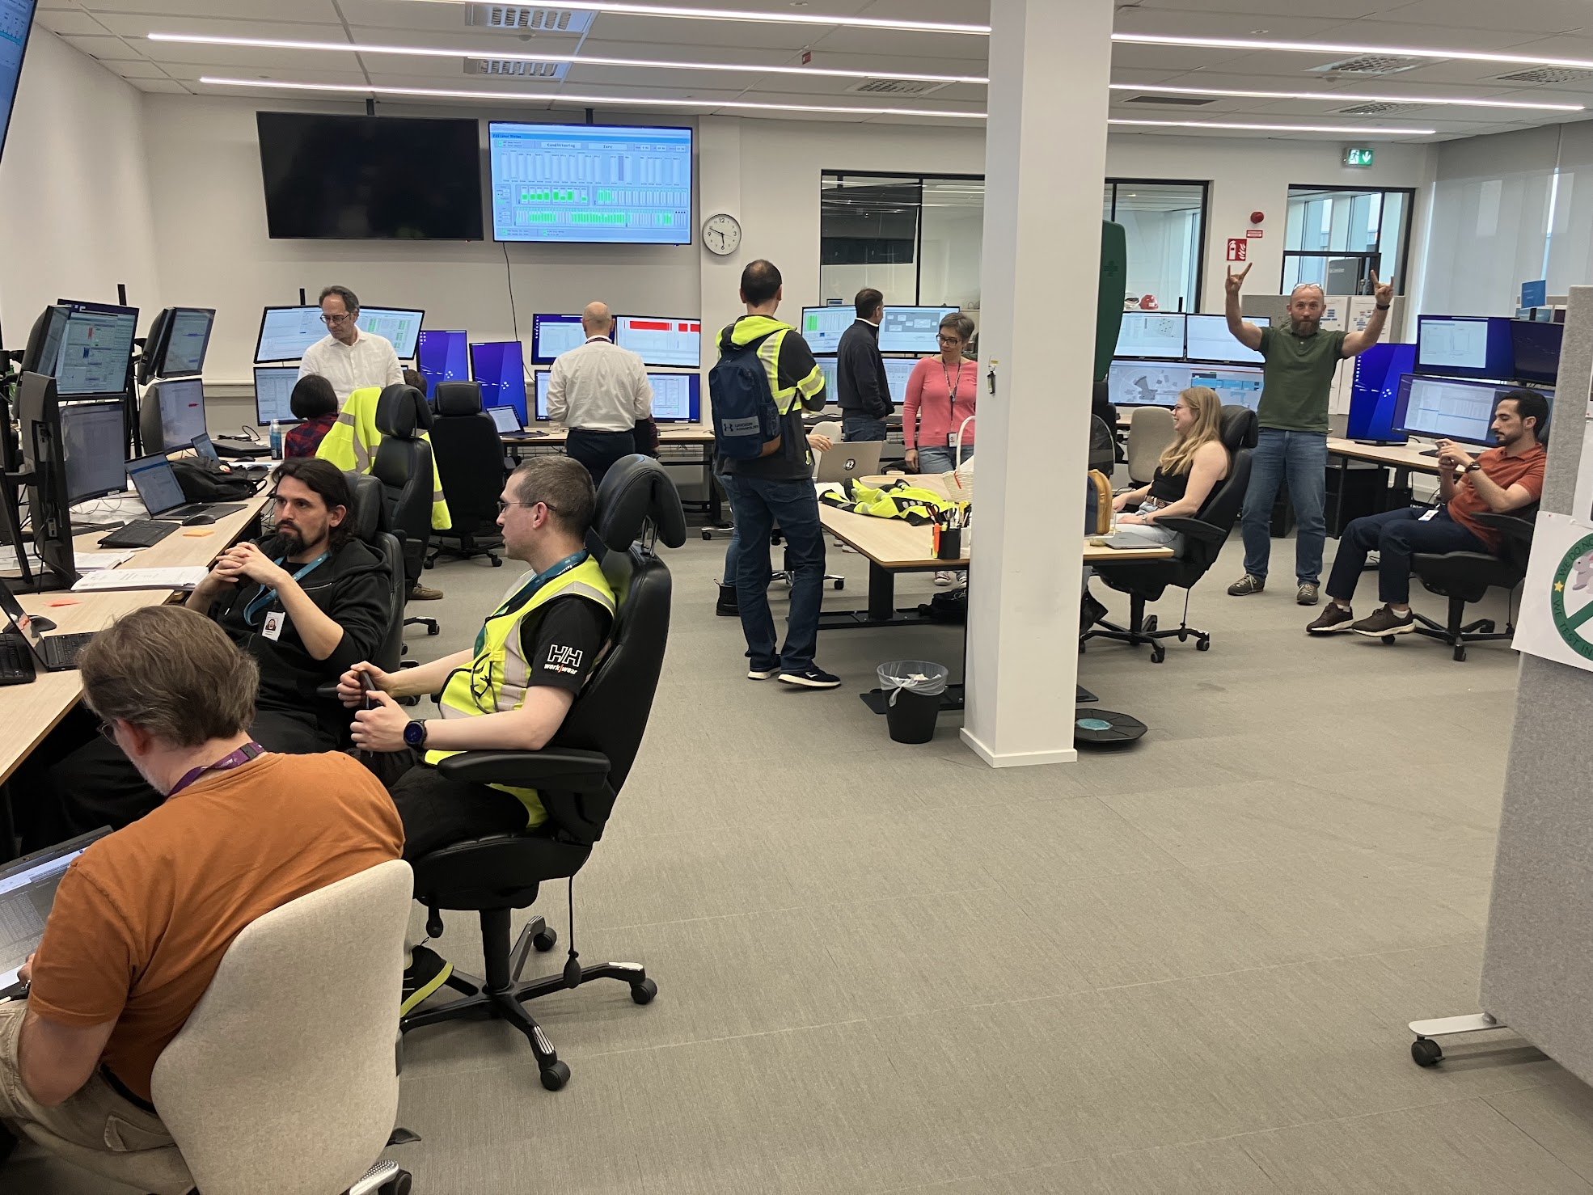
MCR Chaos
Beam commissioning begins with confused faces
Notes:
a bunch of physicists, accelerator engineers and operators waiting to be able to inject beam for the first time after 2 years while three worried infrastructure engineers ran out of ideas on why the OPIs lost connection with almost all PVs
We had many OPIs with tons of connections to multiple IOCs with waveforms

Slide 4
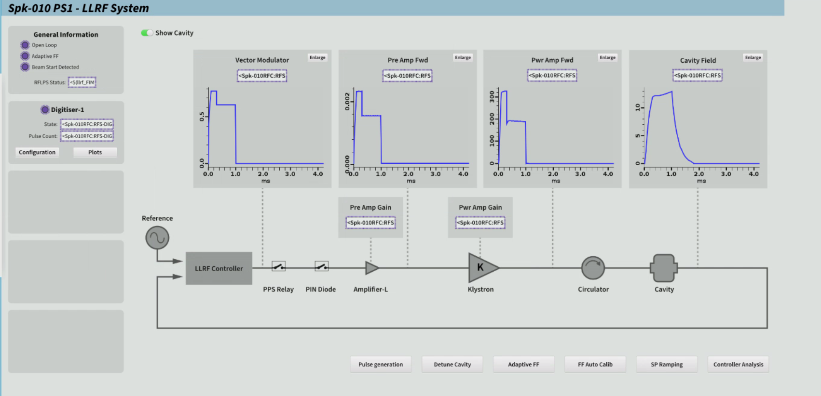
OPIs cannot connect to PVs
Beam commissioning begins with high and low level debugging
Our Infrastructure engineers go down to investigate, they initially assumed a network issue as many PVs were not getting connection.
OPIs already connected could continue monitoring them.
Using pvget and pvmonitor appeared to be working.
One System Owner suggests only looking at LLRF IOC

Slide 5
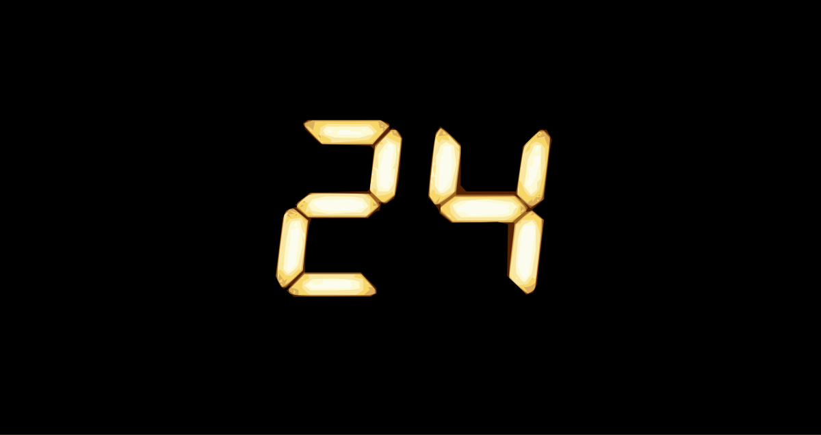
Temporary fixes
24 hour deadline to provide a solution
Reproduction is produced the next day by repeatedly opening and closing filter connections with the IOC at speed.
All decimation channel filters are removed from OPIs
In the short term, hotfix release of e3 for the LLRF IOC has the pva library replaced with pvxs, as this is tested to not have the problem.
Notes:
We had seen this issue with the IOC before, but at a smaller scale of once per year

Slide 6
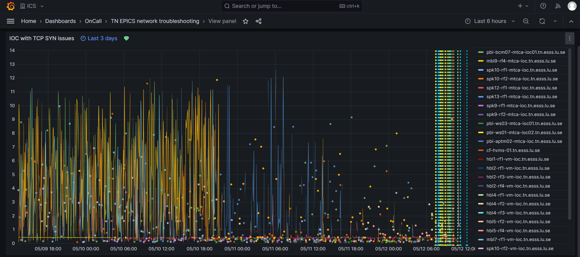
Debugging the LLRF IOC
IOC crashes
A call to 'assert(status == epicsMutexLockOK)'^M
by thread 'PDB-event' failed in ../freeList/freeListLib.c line 169.^M
On the client
- UDP broadcast was reaching the IOC and the reply was reaching the WS
- the WS initiated a TCP SYN but the IOC never sent a TCP SYN+ACK
Notes:
The first one is by using array filters the ioc thread that handles PVA connections would crash during a closing connection. This is a mixture of use-after-free bug in array list and PVA not respecting the correct closing procedure.

Slide 7

A perfect storm
Channel Filters
PVget hanging
PVA Bad Connection handling
EPICS Base use after free
IOC thread suspended
Phoebus thread frozen

Slide 8
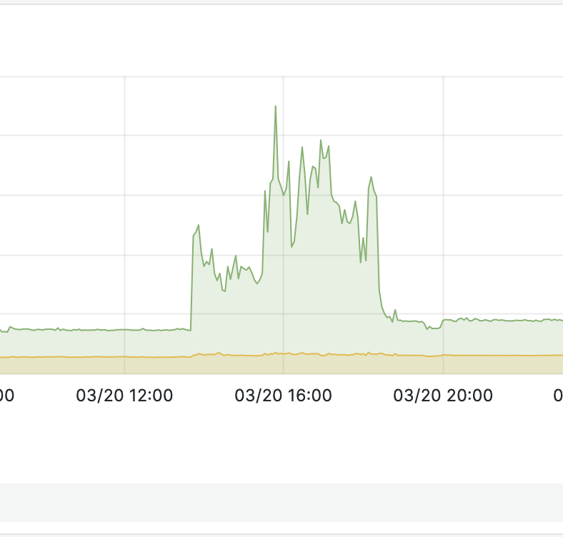
Solutions Ideas in phoebus
TCP connection same thread for all PVs
New thread per creation of a connection?
Heavy
New Virtual thread per connection?
Requires migrating all of phoebus to Java 21
Reduce the timeout?
Set up to be configurable
Context switches

Slide 9


Solutions
Working together
Discussion on a fix for one filter in epics-base
PVXS determined as the main solution
Investigation of using Virtual Threads
Investigation of thread management for new TCP Connections with existing thread handlers

Slide 10

Everything seems to be working fine…
Then rolls another Friday afternoon…

Slide 11
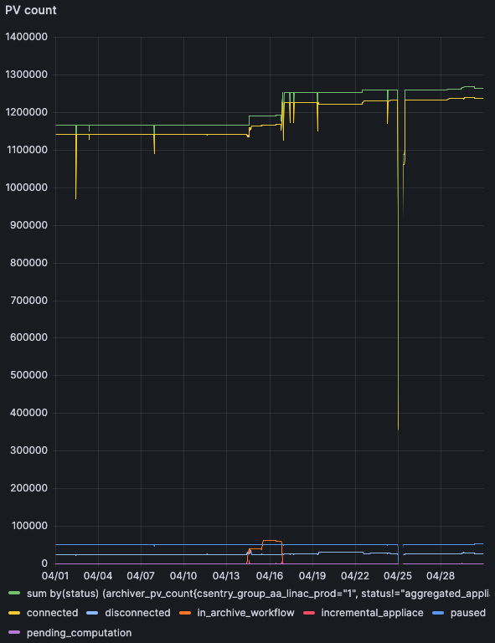
Archiver blows up
Reports of PVs being “connected” in the archiver but not archiving?
What happened recently? 90 000 PVs were added to the Archiver using pvAccess.
Restarting affected IOCs doesn’t fix the issue.

Slide 12
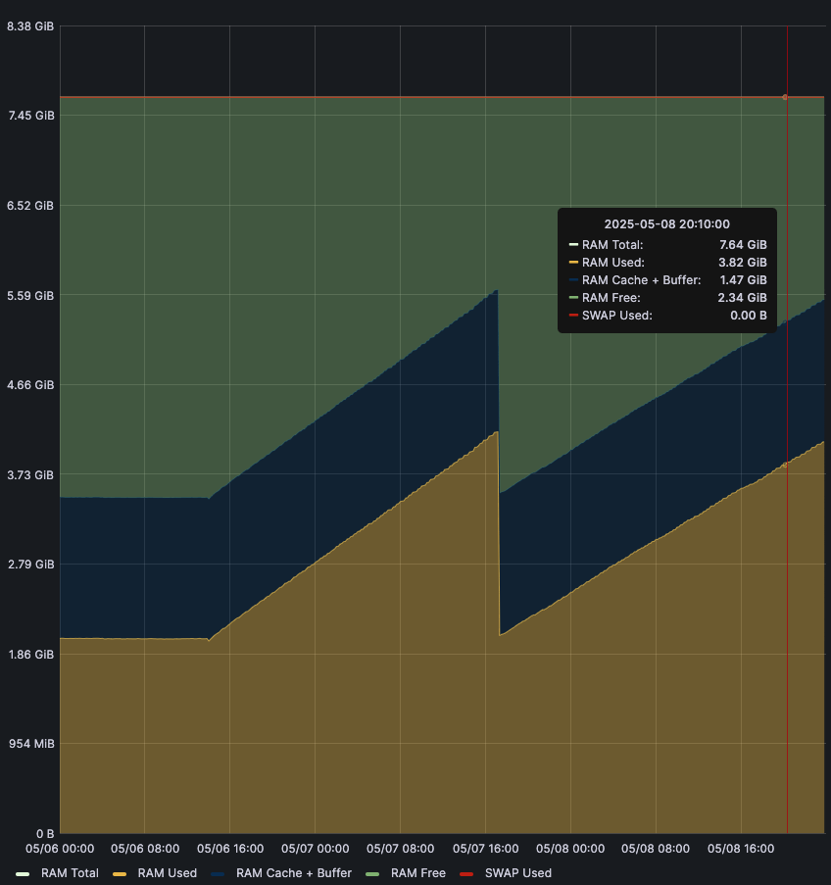
The rabbit hole
The Archiver Appliance engines had run out of memory.
Leading to logs of OutOfMemoryError and a drop of TCP connections.
PVXS IOCs unaffected, but PVA IOCs creating zombie threads increasing IOC memory usage
May 09, 2025 4:28:54 PM org.epics.pvaccess.client.impl.remote.ClientContextImpl getTransport
SEVERE: Failed to create transport for: /172.16.61.156:53251
org.epics.pvaccess.impl.remote.ConnectionException: Failed to connect to '/172.16.61.156:53251'.
at org.epics.pvaccess.client.impl.remote.tcp.BlockingTCPConnector.connect(BlockingTCPConnector.java:163)
at org.epics.pvaccess.client.impl.remote.ClientContextImpl.getTransport(ClientContextImpl.java:922)
at org.epics.pvaccess.client.impl.remote.ChannelImpl.searchResponse(ChannelImpl.java:453)
at org.epics.pvaccess.client.impl.remote.search.SimpleChannelSearchManagerImpl.searchResponse(SimpleChannelSearchManagerImpl.java:388)
at org.epics.pvaccess.client.impl.remote.handlers.SearchResponseHandler.handleResponse(SearchResponseHandler.java:94)
at org.epics.pvaccess.client.impl.remote.ClientResponseHandler.handleResponse(ClientResponseHandler.java:108)
at org.epics.pvaccess.impl.remote.udp.BlockingUDPTransport.processBuffer(BlockingUDPTransport.java:336)
at org.epics.pvaccess.impl.remote.udp.BlockingUDPTransport.processRead(BlockingUDPTransport.java:263)
at org.epics.pvaccess.impl.remote.udp.BlockingUDPTransport$1.run(BlockingUDPTransport.java:159)
at java.base/java.lang.Thread.run(Thread.java:833)
Caused by: java.lang.OutOfMemoryError: Java heap space

Slide 13
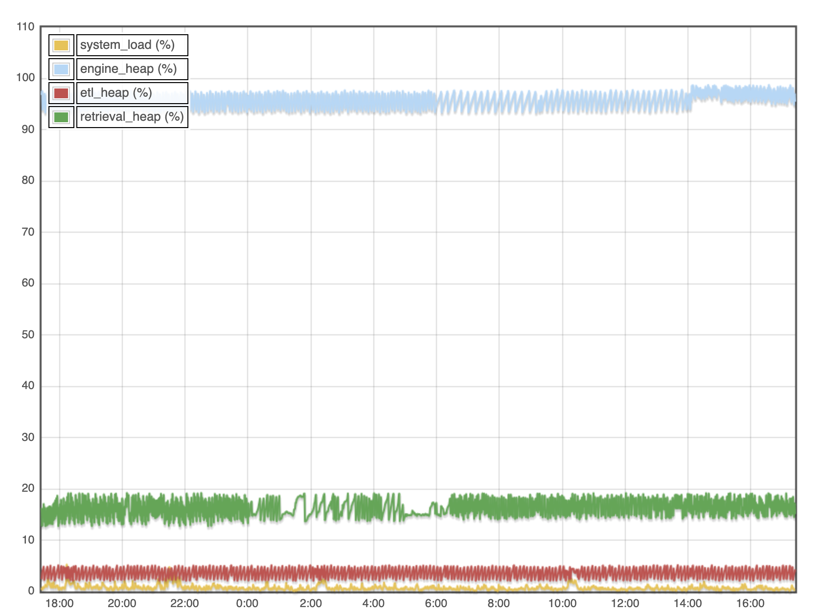
Short term fixes
Archiver Appliances restarted with more memory
Some PVs swapped to Channel Access in the Archiver

Slide 14
A perfect storm continued
Channel Filters
PVget hanging
PVget hanging
PVA Bad Connection handling
Zombie threads
EPICS Base use after free
IOC thread suspended
Phoebus thread frozen
Archiver makes lots of connections

Slide 15


In Progress Solutions
Latest Archiver Appliance (above 2.0.9) with new core-pva library found to be considerably more memory efficient.
i.e. 2GB memory engine handles 8000 vs 45 000 pva PVs.
Next e3 release (ESS built version of epics) will use pvxs (QSRV 2) to replace the PVA stack for all IOCs at ESS.
Fix in phoebus core-pva library is finalized

Slide 16
Lessons Learned
PVXS rocks! Thanks Michael
Don’t run java applications at over 100% memory usage…
Core-pva also rocks! Thanks Kay
Scale produces problems everywhere you don’t expect
Multi team task forces enable quick solutions and debugging

Slide 17
Most of all, thank you all
ESS Infra:
Stephane Armanet
ESS Software:
Abraham Wolk
Simon Rose
Anders Lindh Olsson
ESS ICS-HWI:
João Paulo Martins
Lucas Magalhães
Mateusz Nabywaniec
Karl Vestin
Outside of ESS
Michael Davidsaver
Kay Kasemir
And I’m sure more.
Collaboration and Community works.
We have four implementations of pva
Lots of people willing to come in to help and debug

Slide 18
Questions

