Slide 1
Phoebus PVWS Data Source WebSocket access to EPICS PVs
Kunal Shroff – BNL
Alexa Rivera, George Bonilla, Jack Soesman – SUNY Old Westbury

Slide 2
Phoebus
How to remotely access PVs?
EPICS protocols (CA, PVA) work well within your controls n/w but are a bit more challenging to access remotely.
VPNs, Gateways, tunnels and relays are great solutions but with caveats and limitations.
Goal: Seamlessly extend Phoebus to support remote use while using standard web infrastructure
Notes:
remote access to EPICS PVs often blocked by firewalls
CA and PVA are not always network-friendly
Need for web-standard, firewall-friendly transport
Goal: Phoebus apps working securely over the web
👉 Sets up the problem: traditional CA/PVA is powerful but not always accessible remotely.
Firewalls, VPNs, and custom tunnels make external access difficult

Slide 3
PVWS: PV WebSocket
Clients
DBWR/PVInfo/ Phoebus (new via pvws DS)
PVWS
Bridges EPICS CA/PVA → WebSockets
Allows remote clients (Phoebus, browsers, scripts) to connect using standard web infrastructure
Transmits values + metadata
Sends metadata (units, display ranges, limits, status/severity, timestamps) with first value
only deltas when metadata changes, reducing bandwidth.
Flow Control
Access Control
HTTP
ws:// or wss://
PVWS
ca / pva clients
ChannelAccess
PVAccess

Slide 4
Phoebus DataSources
core-pv
Provides a pluggable/extendable interface for accessing data as Process Variables (PVs) across multiple data sources and control protocols.
Data Sources define how to:
Subscribe (CA, PVA, Sim, Sys, MQTT, PVWS, …)
Read/Monitor (value + metadata updates)
Write (when permitted)
Vtype mapping
Existing Data Sources:
Channel Access (ca://) & PVAccess (pva://) → Connect to live EPICS PVs.
Simulated (sim://) → Generate test signals (sine, noise, ramp, etc.).
System (sys://) → Represent system attributes like time.
MQTT (mqtt://) & Tango (tga://, tgc://) → Access MQTT & Tango control system data.
Archive Data Source (archive://), Replay Data Source (replay://)

Slide 5
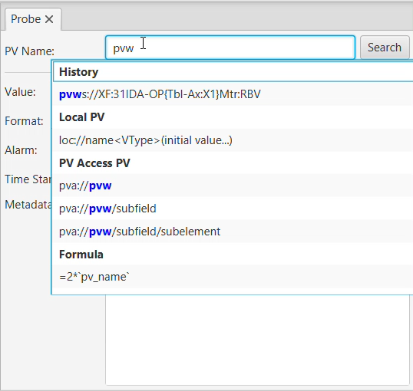
PVWS DataSource
New Phoebus datasource: pvws:// Connects directly to PVWS WebSockets
Provides:
Subscription to live PV
Updates with Metadata (units, limits, severity, timestamp)
Write support (when backend allows)
Notes:
Server side
PVWS server fetches PVs from CA/PVA IOCs
Publishes values + metadata over WebSockets in JSON (binary for large arrays)
Client side (pv-pvws)
Located in phoebus/core/pv-pvws
Implements the Phoebus PV SPI interface
PVWSClient extends TooTallNate’s Java-WebSocket class
Handles: heartbeat, auto-reconnect, subscription, metadata caching, throttling
Converts JSON messages into VType objects for seamless Phoebus integration
Design choice:
Tested STOMP vs. non-STOMP
Chose non-STOMP → lower latency, smaller payloads, backward compatibility with server, more customizable

Slide 6
PVWS Datasource Lifecycle
Create a PVWS PV:
Datasource creates WebSocket connection to PVWS service
Subscribe PVs for updates
Update Handling:
Parse JSON value
Reuse cached metadata to reconstitute full Vtype
Connection Management:
Heartbeat + auto-reconnect
Cleanup:
Unsubscribe unused PVs to stop receiving updates.
Close websocket on shutdown
Notes:
Connection Establishment
User requests pvws://PV
Datasource initiates WebSocket handshake with PVWS server (ws:// or wss://)
Open
WebSocket connection enters the OPEN state
Datasource sends a subscribe message for the PV
Message Exchange
Server sends JSON frames with PV value + metadata (first message has full metadata, later messages are deltas)
Datasource maintains a metadata cache and reconstitutes complete VType objects for Phoebus
Heartbeat / Ping-Pong
Client periodically sends ping frames
Server responds with pong frames
Ensures the connection stays alive and detects inactivity
Error & Reconnect
If heartbeat fails or connection closes unexpectedly, datasource attempts automatic reconnect with backoff
Unsubscribe & Close
When PV is no longer needed, datasource sends unsubscribe message
WebSocket enters CLOSING → CLOSED state
Resources cleaned up

Slide 7
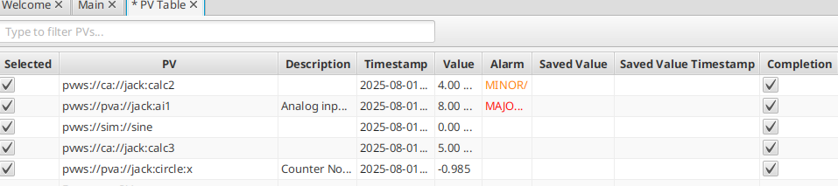
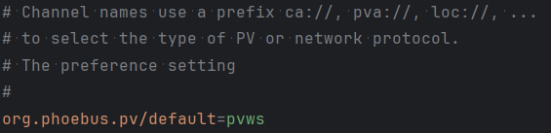
Seamless Integration in Phoebus
The pvws:// datasource is available to all Phoebus applications
Applications remain protocol-agnostic — no code changes required
Users see no major difference in workflow
Notes:
Once added, the pvws:// datasource is available to all Phoebus applications
Applications remain protocol-agnostic — no code changes required
Same rich PV context (value + metadata) as CA/PVA sources
Operators see no major difference in workflow

Slide 8
Future Development
Enhanced Security
Integration with site authentication systems
Support for two-factor authentication (2FA) and token-based accessStronger control of write permissions
Smarter Connection Management
Automatic reconnection when connections drop
Exponential backoff to avoid overload during outages
Improved resiliency for long-running sessions
Operational Improvements
More monitoring and diagnostics hooks
Expanded deployment guides for containerized environments

Slide 9
Useful links
http://phoebus.org
Fork us on github https://github.com/ControlSystemStudio

