Slide 1
A Phoebus Client for the Bluesky Queue Server
Kunal Shroff, Jordan Mitacek – BNL

Slide 2
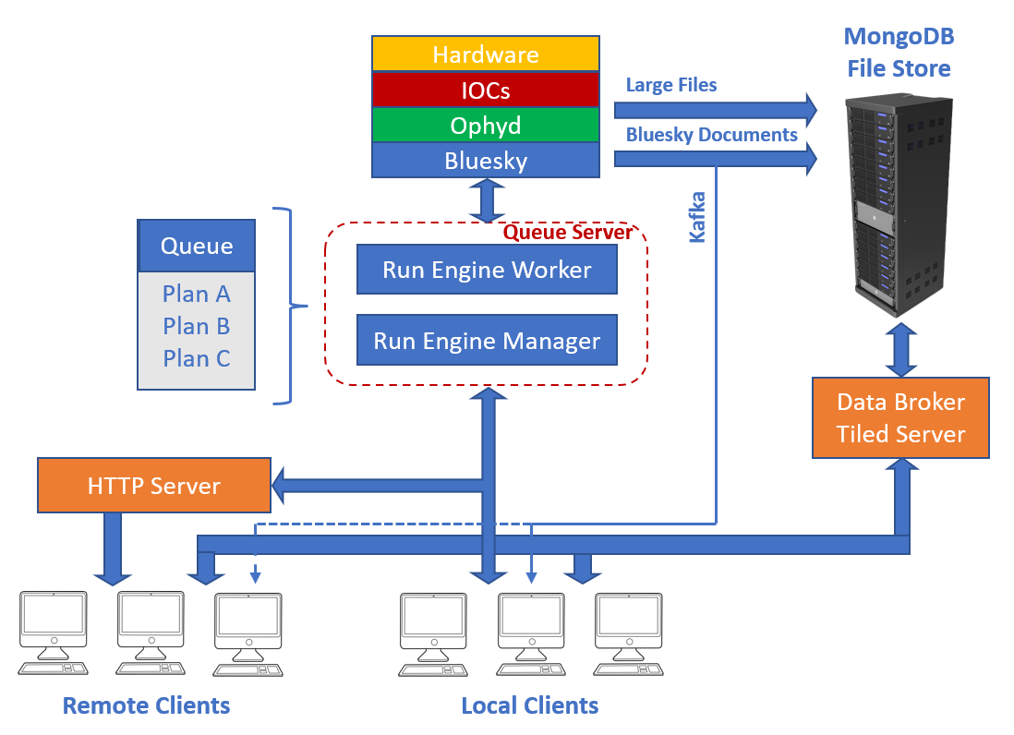
The Bluesky Queue Server
Bluesky: Python-based framework for experiment orchestration & data acquisition
Run Engine: Executes user-defined experimental plans with metadata capture
Queue Server: REST + 0MQ API to
  Submit/reorder/execute plans
  Open/close run engine environment
  Monitor status & console output
Notes:
Bluesky
Python framework for experiment orchestration & data acquisition
Hardware abstraction, streaming, rich metadata
Run Engine (RE)
Executes user-defined plans (with structured metadata)
Pause/resume/stop, safe state transitions
Queue Server (QS)
REST + 0MQ API for remote RE control
Submit / validate / reorder plans
Start / pause / stop execution
Open / close RE environment
Status, history, and live console streaming
Speaker notes (concise)
Bluesky is the DAQ/orchestration layer; the RE is the execution core.
The Queue Server exposes RE control over REST/0MQ—so higher-level tools (like our Phoebus client) can manage plans remotely.
We rely on QS features: validation, queue ops, env lifecycle, and console/status streaming.

Slide 3
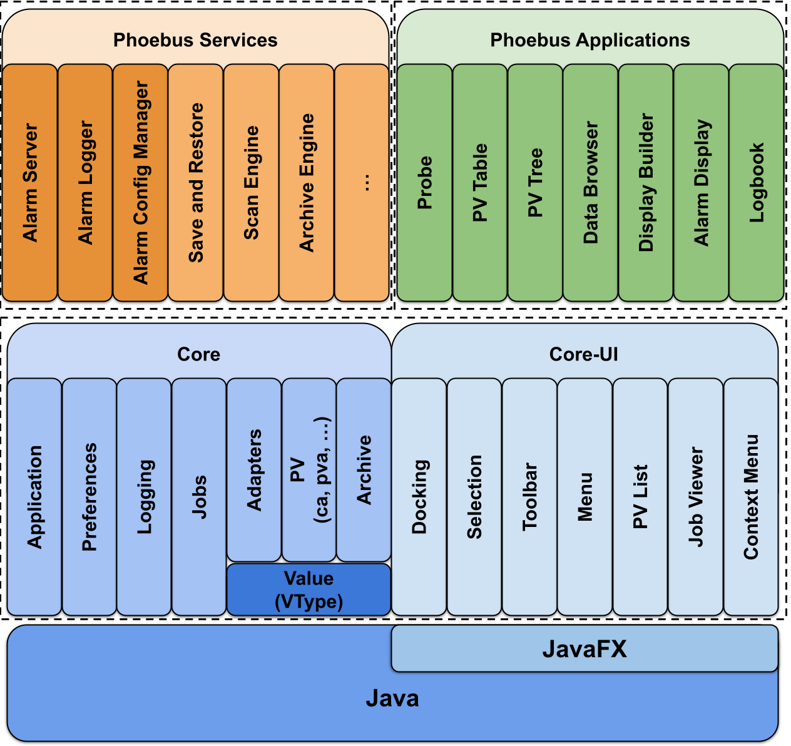
Phoebus
Applications: Display Builder, Data Browser, Alarm UI, Logbook
Integrated suite of control system applications
Applications: Display Builder, Data Browser, Alarm UI, Logbook
  Common look & feel
  Seamless transitions
  Shared runtime resources
Workflows: experiment control, day-to-day operations, diagnostics & debugging
Shared core enables seamless context & resource sharing across apps
Notes:
Applications: Display Builder, Data Browser, Alarm UI, Logboo
Common look & feel: unified menus, docking, shortcuts
Seamless transitions: selection/adapter services carry PVs, timestamps, units, alarm state, archive sources, display paths
Shared runtime resources: pooled PV connections, REST clients, Kafka listeners, DB connection pools, centralized auth/logging
Workflows covered: experiment control, day-to-day operations, diagnostics & debugging, shift logging
Extensible via SPI: add apps/services while preserving UX and context-sharing
k

Slide 4
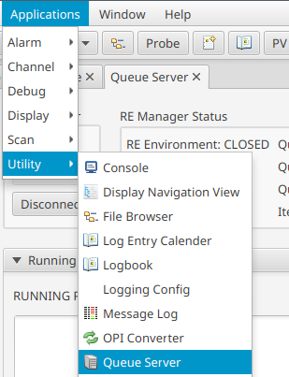
Motivation
Operators need both Phoebus (controls) and Bluesky tools (experiments)
Context switching → inefficiency & higher cognitive load
Native Phoebus client for the Queue Server
  Unified workflow in a single environment
  Streamlined, error-resistant operations
Notes:
Single environment: operate devices, inspect data, and run experiments without leaving Phoebus
Seamless context: selection/adapter services pre-fill plans from PVs; one-click Logbook capture after runs
Full RE control: submit & validate plans; start / pause / resume / stop; open/close environment with guardrails
One pane of glass: live queue, RE state, history, and console in the same UI
Leverages site plumbing: shared auth, pooled PV/REST/DB/Kafka resources; consistent prefs & logging
Robust by design: client-side rate limiting + retries; typed DTOs; clear error surfacing

Slide 5
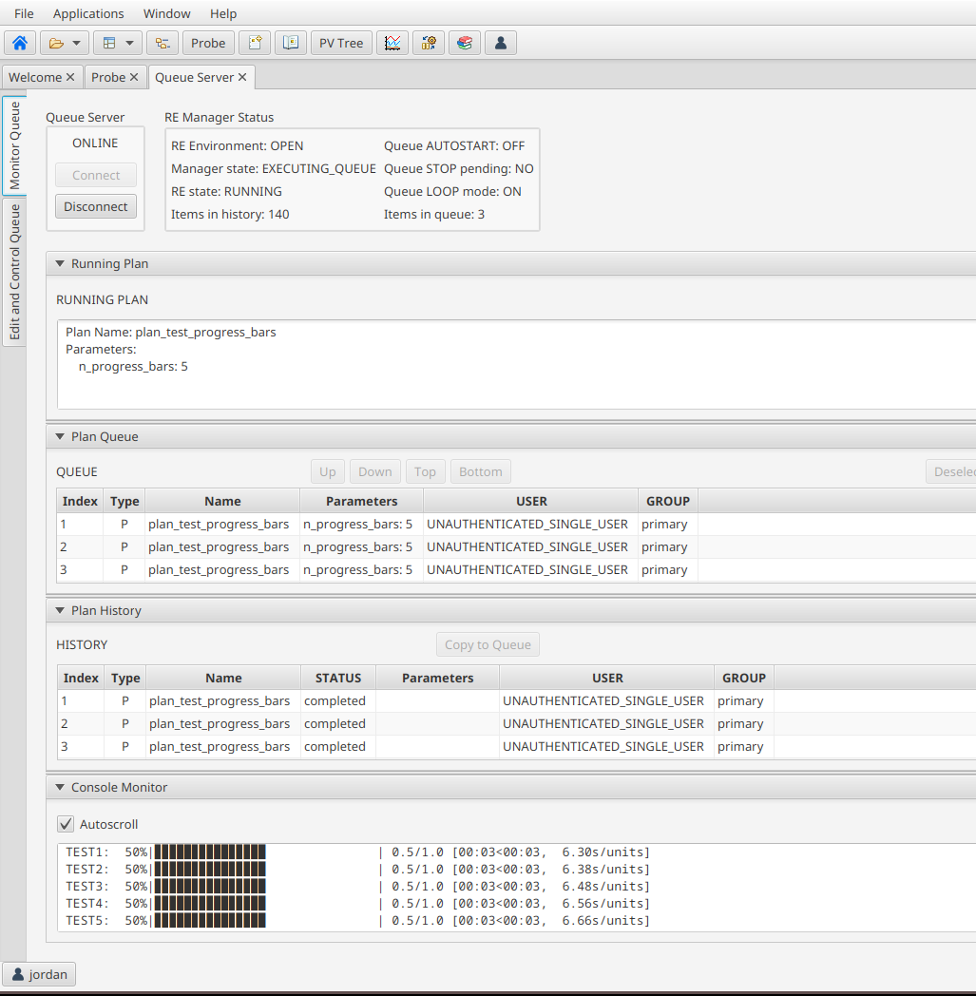
Queue Monitor
Queue Server Monitoring
Run Engine & Env: state (Idle/Running/Paused), env Open/Closed, heartbeat/version
Queue at a glance: depth, next/active plan, pending/failed/completed counts
Execution history: recent runs with status, duration, UID (quick jump to details)
Live console stream: tail/pause/copy, level filter; responsive & rate-limited
Operator controls: Start / Pause / Resume / Stop, Open/Close env, prioritize/remove/clear
Error surfacing: validation/network/auth issues shown inline; safe-guards on destructive actions
Notes:
Queue Server Monitoring
Run Engine & Env: state (Idle/Running/Paused), env Open/Closed, heartbeat/version
Queue at a glance: depth, next/active plan, pending/failed/completed counts
Execution history: recent runs with status, duration, UID (quick jump to details)
Live console stream: tail/pause/copy, level filter; responsive & rate-limited
Operator controls: Start / Pause / Resume / Stop, Open/Close env, prioritize/remove/clear
Error surfacing: validation/network/auth issues shown inline; safe-guards on destructive actions

Slide 6
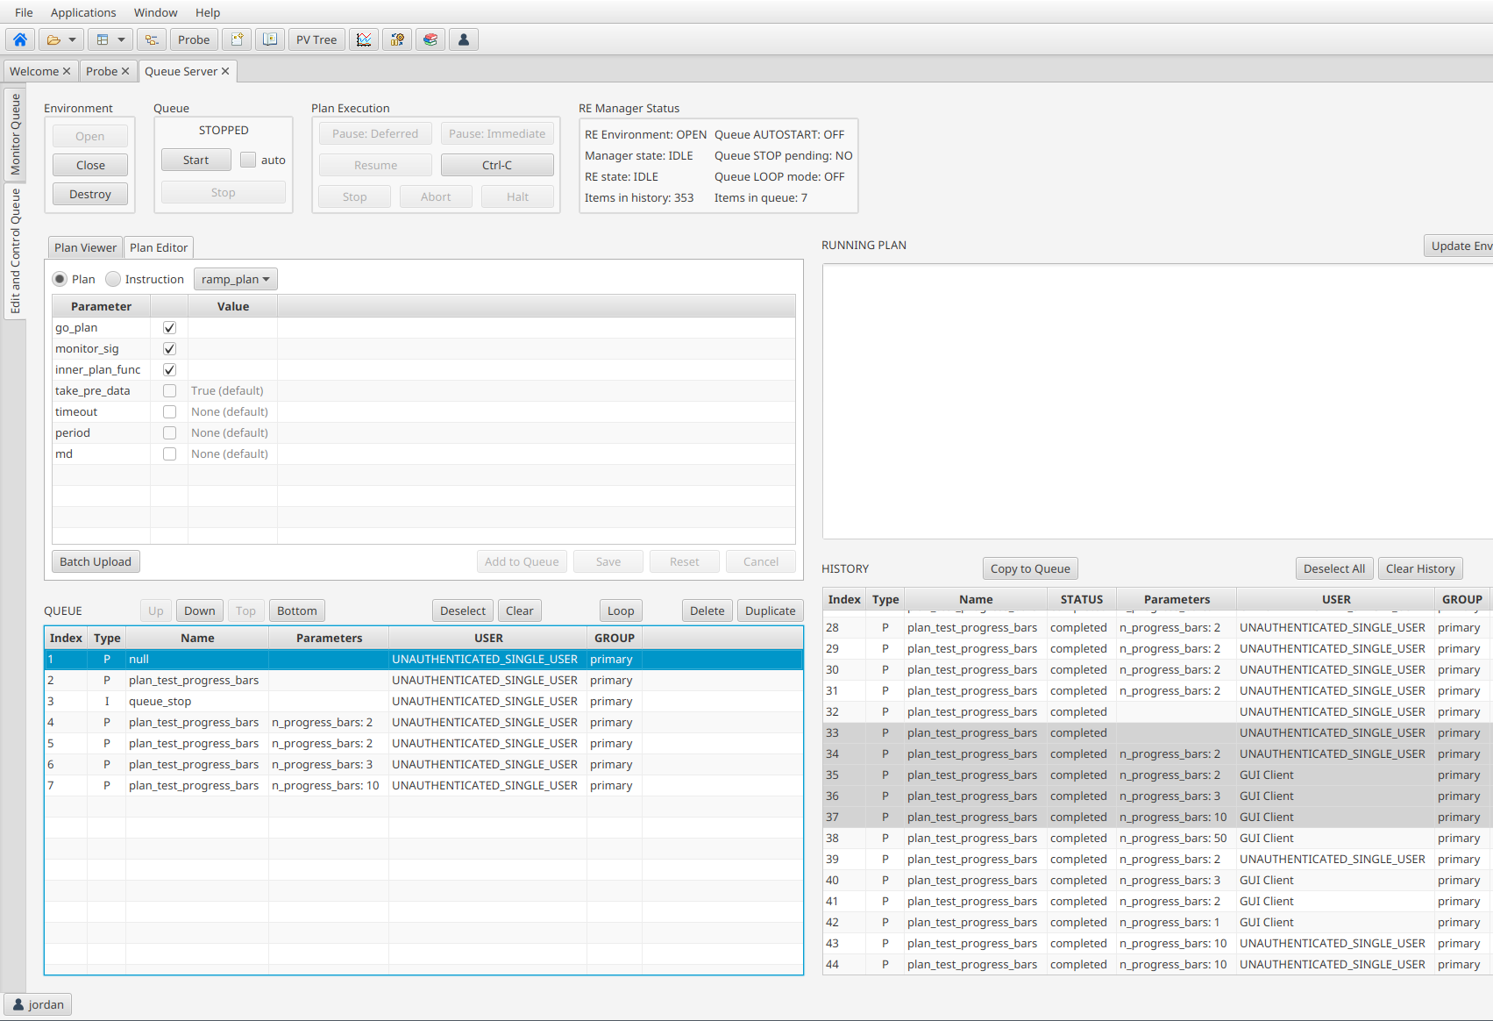
Queue Editor
Queue at a glance: pending, active; next-up highlighted
Reorder: drag-and-drop; promote; move to top/bottom
Manage items: remove selected; clear queue (confirm)
Control processing: Start / Pause / Resume / Stop
Notes:
Queue editing interface providing comprehensive plan management capabilities including plan editing and creation, queue order management, and execution control.
Queue management
View upcoming/active/held items; drag-and-drop reorder, prioritize, remove/clear
Queue at a glance: pending, active; next-up highlighted
Reorder: drag-and-drop; promote; move to top/bottom
Manage items: remove selected; clear queue (confirm)
Control processing: Start / Pause / Resume / Stop
Live updates & guardrails: UI reflects RE env/state

Slide 7
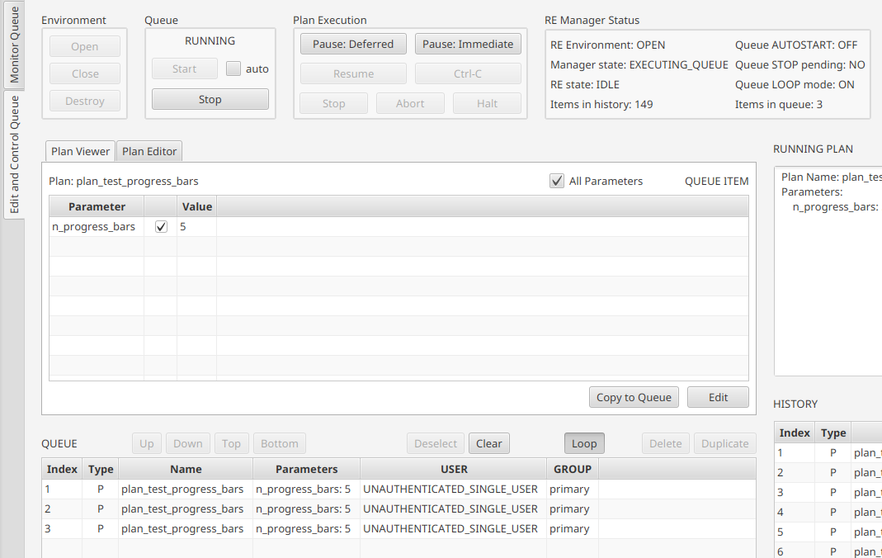
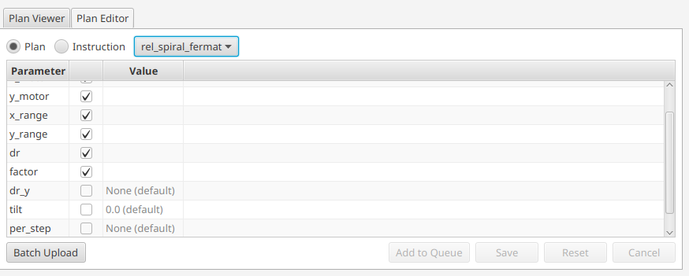
Plan Editor
Create / Edit plans with structured, form-based inputs
Typed fields (numbers, enums, arrays, booleans) with inline hints & units
Future Features
Validate before enqueue — highlights missing/invalid params
Context pre-fill from current selection (when available)
Notes:
Form-based plan editing
Typed parameters (numbers, enums, ranges), inline validation & hints
Validate before enqueue; preview request payload
Execution controls
Enqueue, Start now, Pause/Resume/Stop via the same panel
Safe-guards on destructive actions; clear error surfacing
Integrated context (when available)
Pre-fill parameters from current Phoebus selection (PVs, displays) to reduce typing
Robust by design
Client-side rate limiting and retries; typed DTOs to catch mistakes early

Slide 8
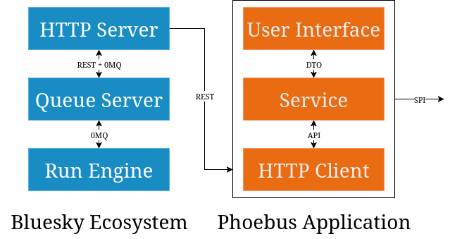

Slide 9
Future Development
Streaming status (WebSocket)
  Push updates for queue + RE state (replace polling)
  Robust reconnect/backoff; optional console streaming
Schema-driven plans
  Auto-generate forms from plan/device schemas (service-provided)
  Pre-fill parameters from Phoebus context (selected PVs/displays)
  Type/enum/range checks at edit time
  Dry-run / simulate before enqueue
Deeper Phoebus integration
  Open Data Browser for time-series trends of plan PVs
  Link to control screens for devices/components referenced in plans
Notes:
Streaming status (WebSocket)
Push updates for queue + RE state (replace polling)
Robust reconnect/backoff; optional console streaming
Schema-driven plans
Auto-generate forms from plan/device schemas (service-provided)
Pre-fill parameters from Phoebus context (selected PVs/displays)
Type/enum/range checks at edit time
Dry-run / simulate before enqueue
Deeper Phoebus integration
Open Data Browser for time-series trends of plan PVs
Link to control screens for devices/components referenced in plans

Slide 10
Useful links
Phoebus: A framework and set of tools to monitor and operate large scale control systems
http://phoebus.org
Bluesky: A library for experiment control and collection of scientific data and metadata.
https://blueskyproject.io

