Slide 1



Slide
1
Tests on Integration of Industrial and Scientific Control Systems for IFMIF-DONES
www.s2innovation.com
Wojciech Soroka

Slide 2
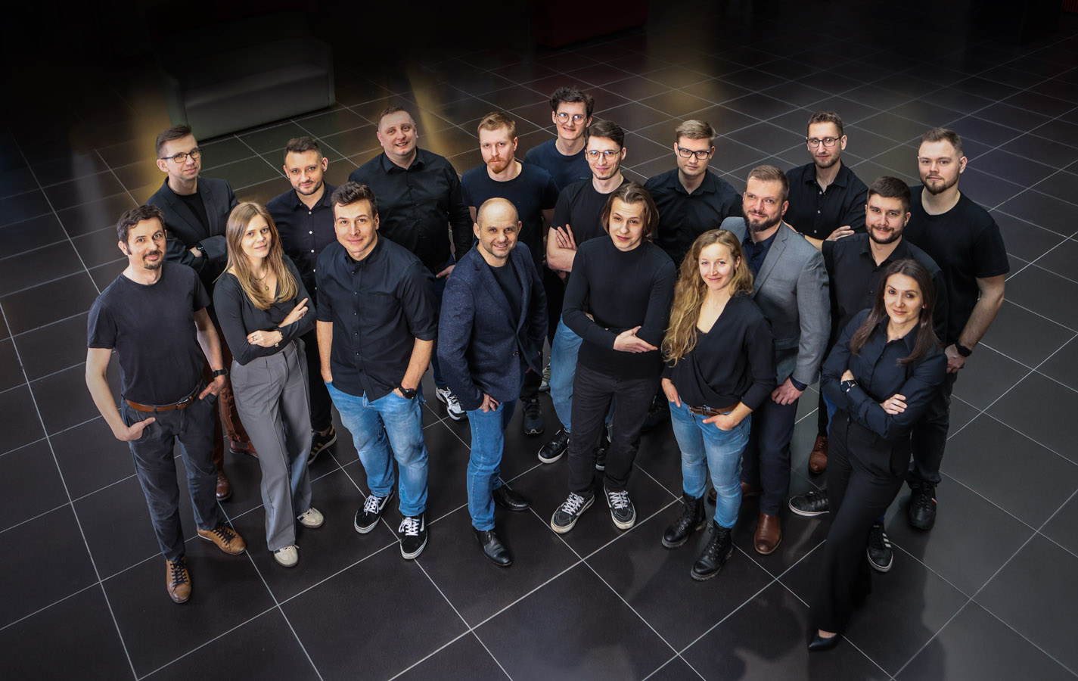

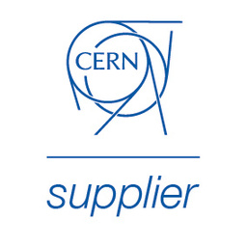





Slide
2
S2Innovation is a Polish company specializing in delivery of software and control systems solutions for particle accelerators and other complex scientific infrastructures.
Started in 2017 we are working with:
ALBA, CERN, ESS, ESRF, FAIR, IFMIF DONES, MAX IV, Tango Community, SOLARIS, XFEL,

Slide 3
Slide
3
Cooperation between S2Innovation and IFMIF-DONES
Eurofusion grant: WP20-ENS: Early Neutron Source

Slide 4

Slide
4
Integration of SCADA systems in a hybrid environment (EPICS + WinCC OA)
Objective:
Develop and test a prototype communication interface (“Bridge”) to integrate EPICS with the industrial SCADA system WinCC OA, ensuring both flexibility (research) and certified safety (industry).
Results:
Prototype Bridge (Java), co-developed with Siemens WinCC OA support.
Achieved low-latency, bidirectional communication (12–28 ms).
MPS requirements for response times <50 ms for safety-critical applications have been achieved.
Reliability exceeded 99.5% during stress tests.
Decision taken to rewrite Bridge in C++ to further improve performance and maintainability.

Slide 5
Slide
5
Integration of SCADA systems in a hybrid environment (EPICS + WinCC OA)
Conclusions :
Integration of EPICS and WinCC OA is technically feasible and stable.
Hybrid architecture combines the advantages of open-source based control systems (EPICS) with industrial SCADA.
Moving from Java to C++ will increase efficiency and align with industry practices.
Benefit for DONES:
Proof that a hybrid EPICS + WinCC OA architecture can work reliably. Reduced technological risk for future integration of research and industrial systems. Provides a certified and scalable path for building DONES control infrastructure.

Slide 6
Slide
6
Integration of PLC communication with EPICS IOCs
Objective:
Analyse the impact of diferent device support/drivers on communication delays between Siemens PLC’s (S7 1200, CPU 1212C / S7 1500, CPU 1513-1 PN) and EPICS IOCs in the Machine Protection System (MPS) architecture.
Built a dedicated test stand enabling communication between an EPICS server and multiple PLCs.
Implemented and tested both direct (IOCs <->PLC) and in-direct (IOCs <->MasterPLC <->PLC) communication types.
Extended testing with added IOCs simulating physical devices to ensure realistic test conditions.
Results:
Direct communication:
S7nodave (S7-1200 / S7-1500) → ~25 ms average latency (best-case, within MPS requirements).
s7plc (S7-1200 / S7-1500) → 163–178 ms average latency.
OPC UA (S7-1200) → 470–596 ms, limited by hardware sampling times.
In-direct communication (via Master PLC controller): adds ~200–500 ms overhead, reducing performance of all protocols.

Slide 7
Slide
7
Integration of PLC communication with EPICS IOCs
Conclusions:
Direct S7nodave on modern PLCs offers the best chance to meet MPS latency targets.
OPC UA and s7plc showed stable communication, but latency exceeded required thresholds.
In-direct paths add significant delays and should be avoided for critical signals.
Benefit for DONES:
Clear comparative analysis of communication protocols, including their advantages and limitations, enabling an informed choice of the safest and most reliable solution for the Machine Protection System (MPS).

Slide 8
Slide
8
EPICS to OPC-UA pilot implementation
Objective:
Analyse the functionality and performance of OPC UA technology.
Build a local test stand with both direct (EPICS↔PLC/IPC) and indirect (EPICS↔PLC↔EPICS) communications.
Evaluate delays for different data types (single-bit, multi-bit, analog) under varied sampling/publishing settings.
Compare PLC (S7-1200, CPU 1212C) vs IPC (427E with S7-1500, Software Controller CPU 1507S) to assess hardware influence.
Results:
Direct communication:
PLC S7-1200 → ~250 ms average latency (all data types, stable but too high).
SIMATIC IPC 427E (S7-1500)→ ~15 ms average latency (dramatic improvement, meets MPS target).
Indirect communication:
Adds ~200–300 ms overhead (total ~500 ms).
Parameter tuning:
Publishing interval dominates performance (200 → 400 ms doubles delay).
Sampling interval has minor effect. Interface modifications (LLDP/Boundaries): negligible or negative impact on stability.

Slide 9
Slide
9
EPICS to OPC-UA pilot implementation
Conclusions:
Simatic IPC (S7-1500) with direct OPC UA is the best viable option for meeting MPS latency requirements.
PLC S7-1200 hardware constraints (min. 100/200 ms) make it unsuitable for critical paths.
Data type has negligible effect – performance depends mainly on hardware and publishing config.
Indirect communication should be avoided for safety-critical signals.
Benefit for DONES:
Provides clear, measurement-based recommendations for using OPC UA.
Identifies IPC as a superior hardware platform, ensuring low latency and high stability.
Reduces technological risk by showing which setups to avoid and which deliver reliable performance.

Slide 10

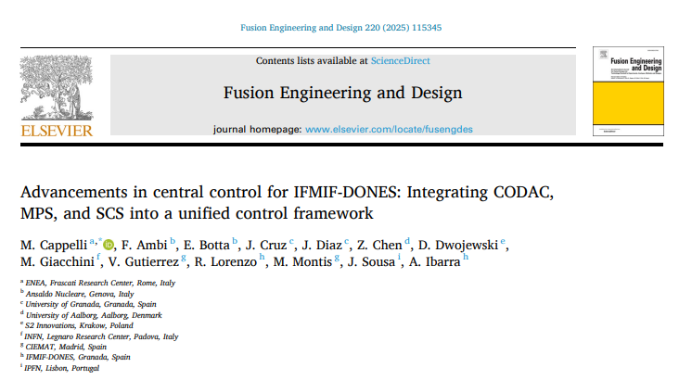
Slide
10
More details
We are proud to contribute to the development of knowledge and best practices in the field of control systems. S2Innovation team co-authored a published scientific paper on integrating EPICS and SCADA systems in the context of projects such as DONES.

Slide 11

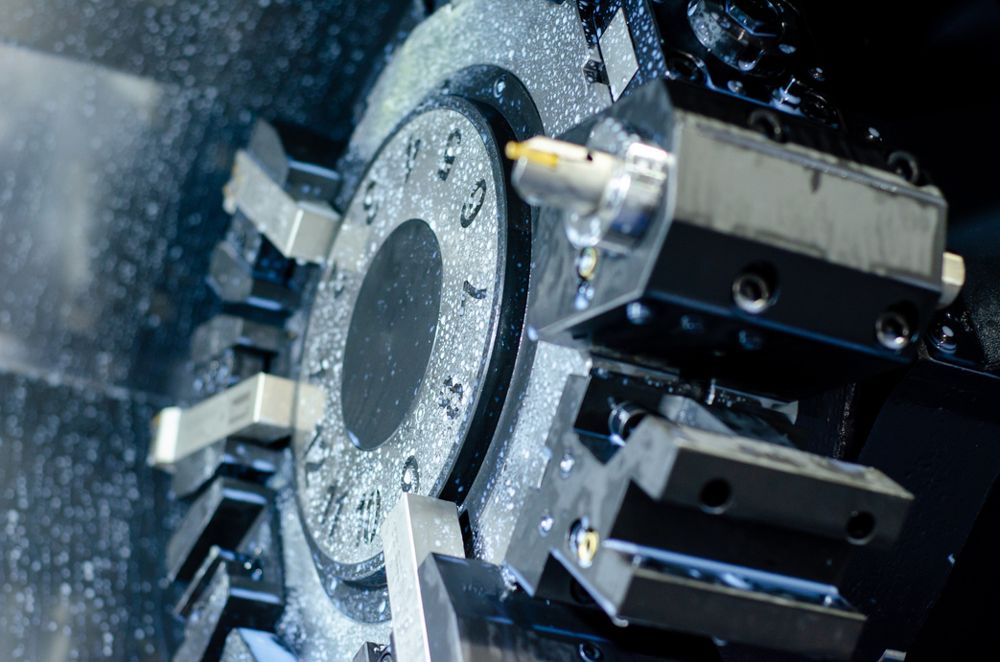

Slide
11
Thank You
For Your Attention
Wojciech Soroka
Email: wojciech.soroka@s2innovation.com
Mobile: +48 795 794 676
www.s2innovation.com

