Slide 1

Report from EPICS Council Meeting
Karen S. White
September 20, 2025

Slide 2
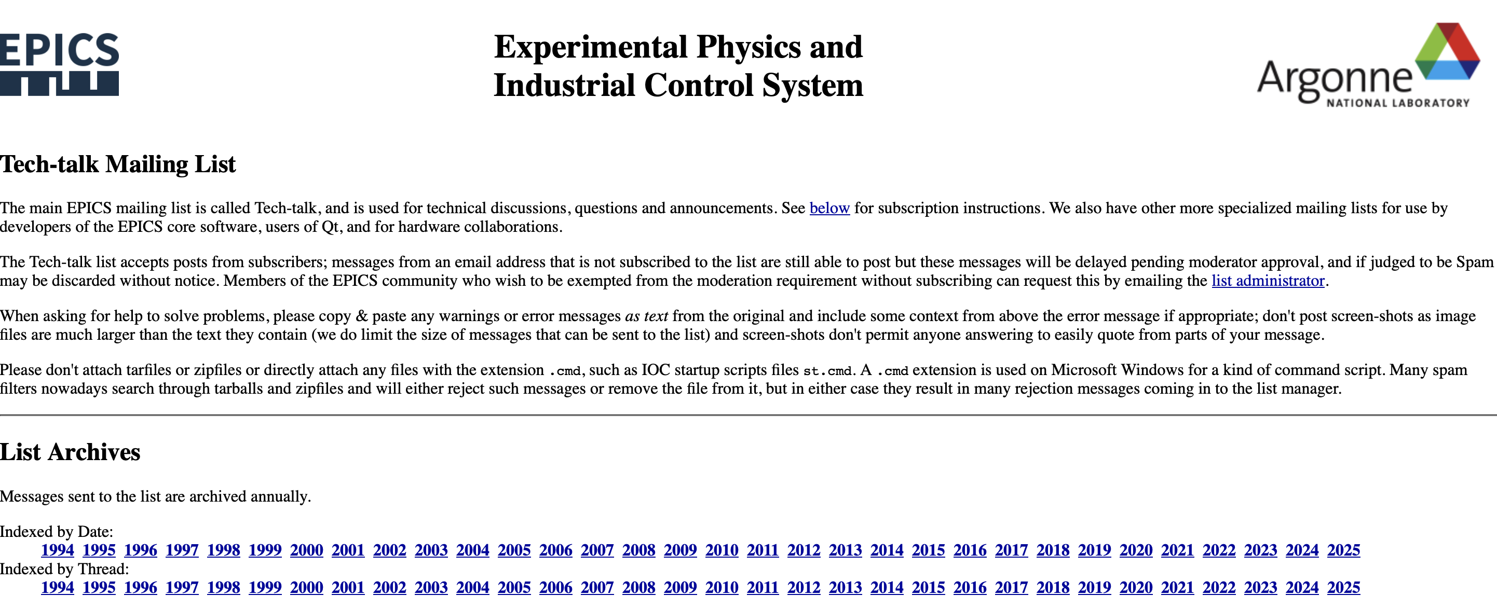
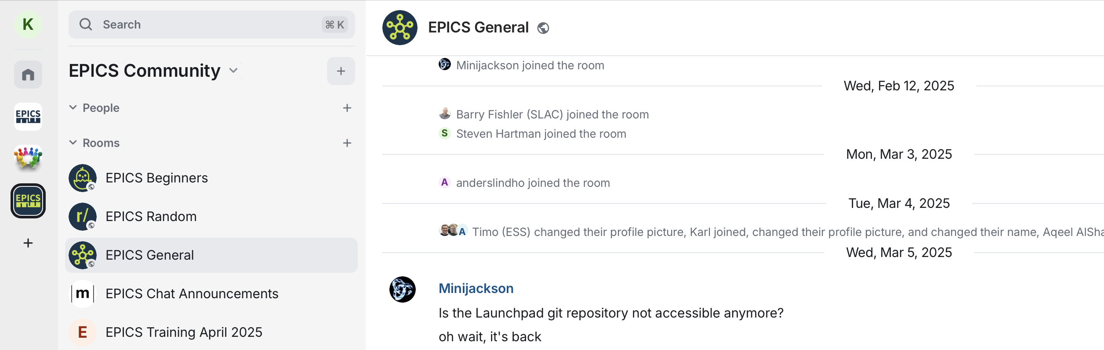
Communications
EPICS Tech-talk mailing list https://epics.anl.gov/tech-talk/
Providing expert support for over 30 years
Hosted at Argonne
Thanks to Andrew Johnson
New EPICS Chat using Matrix https://epics-controls.org/epics-chat/
Flexible chat room structure
Hosted by Fritz Haber Institute
Thanks to Heinz Jukes, Ralph Lange

Slide 3
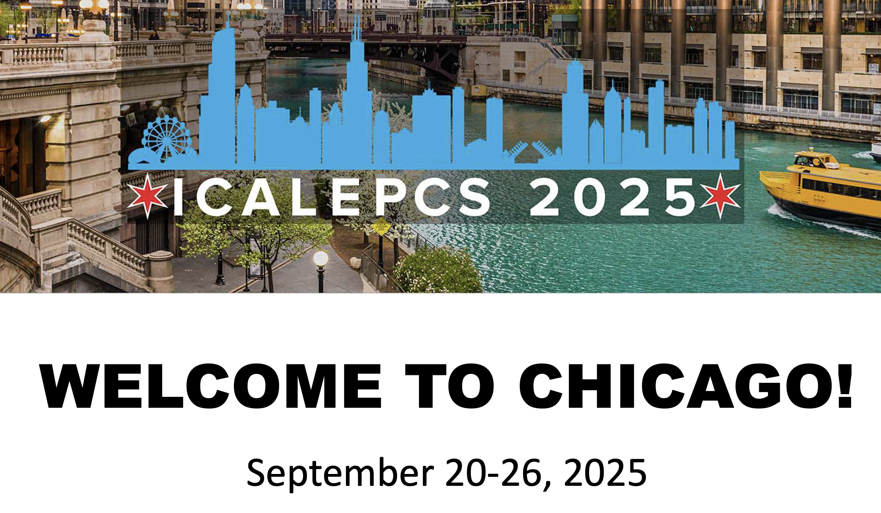
You might also like…ICALEPCS
September 20-27, 2025
Hosted by Argonne National Laboratory
1-day EPICS meeting 9/20/25
Plenty of great EPICS content at the conference
Search of abstracts finds the word EPICS 350 time
Next ICALEPCS hosted by KEK in Japan
https://indico.jacow.org/event/86/overview
Registration and abstract submission are open
Abstracts due 4/30/25
Notes:
In case of emergency follow instructions from an ORNL employee or PA announcements
Assembly points – Exit through the emergency exits near the stage or lobby front doors, assemble just past the flagpole
Your visitor badge allows you to be unescorted in this building (8600)
Please obey all safety postings – most relevant for the tours on Friday
While you are at ORNL, please do not take photographs of areas that indicate photography is forbidden
Our planned tour route allows photos at all locations

Slide 4

How do we pay for EPICS?
EPICS is open source but not free, but also not funded
The EPICS Collaboration does not receive any specific on-going funding to maintain or improve the software, but this work is essential for sustainability
The collaboration relies on donated labor from organizations using EPICS software
The collaboration provides an incredible community of support (“free”, see tech-talk)

Slide 5
Core Working Group requests for support
Some core working group projects that need support (providing a person to do the work or funding a person to work on a Core need)
  PVA Protocol changes to add access rights messages and APIs to PVXS and P4P; Channel Access has had this functionality, but it is not yet in PVA and the client applications could really use it (ORNL will fund this)
  Finish RTEMS development work into a full EPICS release; there are pull requests for changes needed to run EPICS on RTEMS-6 but these are not actively being worked (who is using RTEMS?)
  Rewrite IOC dbEvent subsystem; simplify the code that uses these events; need to develop a design and implement (Possible support from PSI)
  There is much, much more, so volunteer!

Slide 6
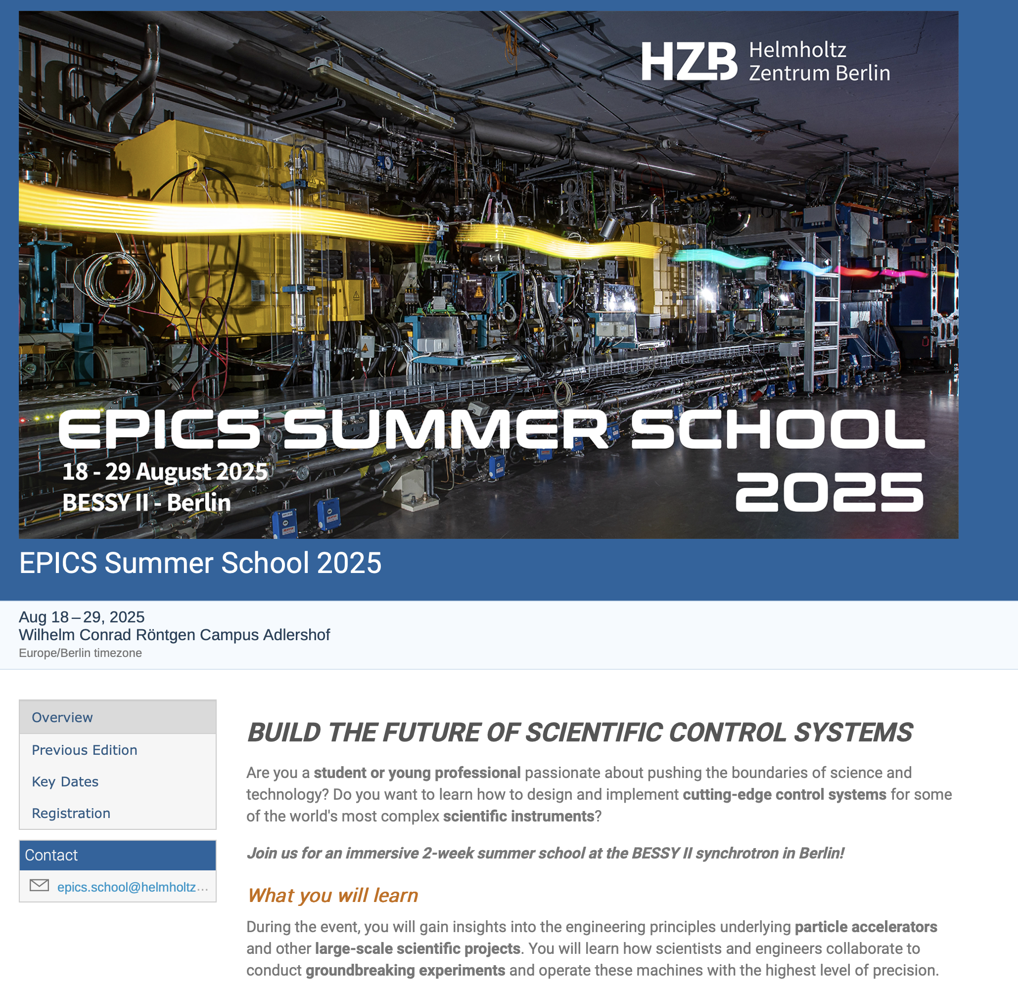
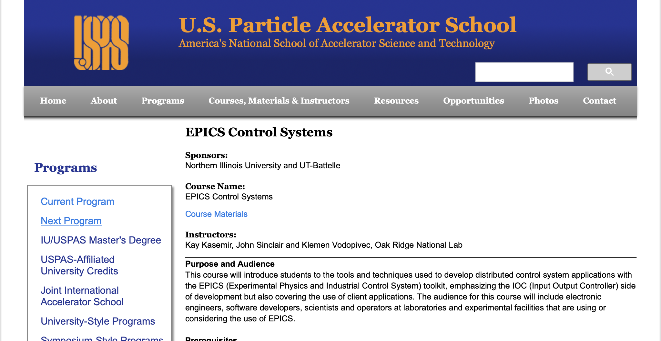
Learning
EPICS training has been offered in different forums over the years
EPICS Council recognizes the need to support developers with regular EPICS training opportunities at multiple levels
Ralph Lange has developed a virtual machine framework to facilitate EPICS training see mini-oral and poster on Tuesday
ORNL and ESS have started development of additional training materials working with Osprey
Goal is to offer beginner and advanced training this summer, then annually

Slide 7
How can you get involved?
Opportunities to join working groups such as EPICS core, CS-Studio, more
Send someone to a code-a-thon or document-a-thon, great learning opportunities
You can work with international experts => develop more advanced skills that benefit your professional development and your effectiveness for your home organization
Leadership, host an EPICS Collaboration Meeting, code-a-thon, document-a-thon or developer’s meeting
There is no functional collaboration without active collaborators

Slide 8
Code-a-thon and Document-a-thon
Confirmed dates: 23 to 26 February 2026
The plan is to follow the format of 2023’s code-a-thon (*):
  Monday core developers’ meeting
  Tuesday to Friday coding
Able to host about 30 participants
Social programme: code-a-thon dinner
Planning to have a website and registrations from early Nov 2025
Contact: Ronaldo Mercado ronaldo.mercado@diamond.ac.uk
(*) reported on 26/4/23 at the EPICS collaboration meeting https://indico.fnal.gov/event/58280/contributions/264578/attachments/166341/221424/Report-from-the-2023-Codeathon.pdf
Notes:
In case of emergency follow instructions from an ORNL employee or PA announcements
Assembly points – Exit through the emergency exits near the stage or lobby front doors, assemble just past the flagpole
Your visitor badge allows you to be unescorted in this building (8600)
Please obey all safety postings – most relevant for the tours on Friday
While you are at ORNL, please do not take photographs of areas that indicate photography is forbidden
Our planned tour route allows photos at all locations

Slide 9
EPICS Collaboration Meetings
2025-2 Chicago, Illinois (1-day)
  Hosted by Argonne National Laboratory in conjunction with ICALEPCS 2025
2026-1 Announcement after this talk
Contact: Karen White whiteks@ornl.gov
Notes:
In case of emergency follow instructions from an ORNL employee or PA announcements
Assembly points – Exit through the emergency exits near the stage or lobby front doors, assemble just past the flagpole
Your visitor badge allows you to be unescorted in this building (8600)
Please obey all safety postings – most relevant for the tours on Friday
While you are at ORNL, please do not take photographs of areas that indicate photography is forbidden
Our planned tour route allows photos at all locations

Slide 10
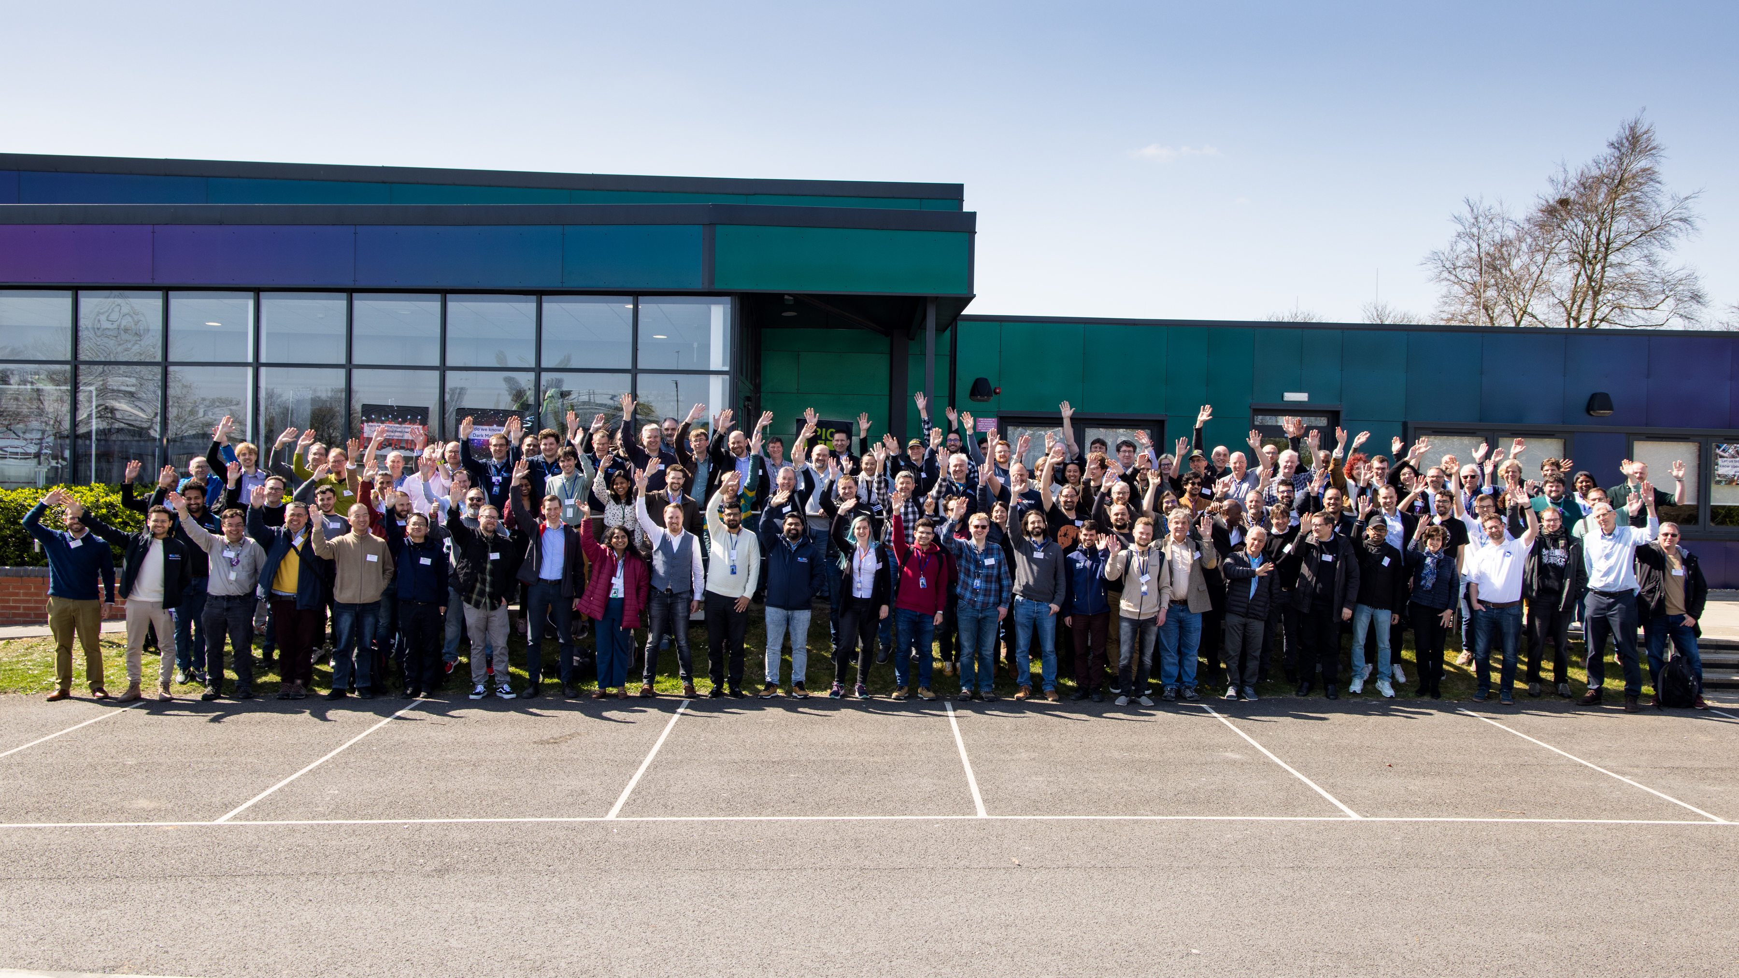
“In the long history of humankind those who learned to collaborate and improvise most effectively have prevailed.”
-Charles Darwin
EPICS Collaboration Meeting hosted by ISIS, Spring 2025
EPICS is only as good as its collaborators
Notes:
Weinberg was fired by the Nixon administration from ORNL in 1973 after 18 years as the laboratory's director, because he continued to advocate increased nuclear safety and molten salt reactors (MSRs)

Slide 11
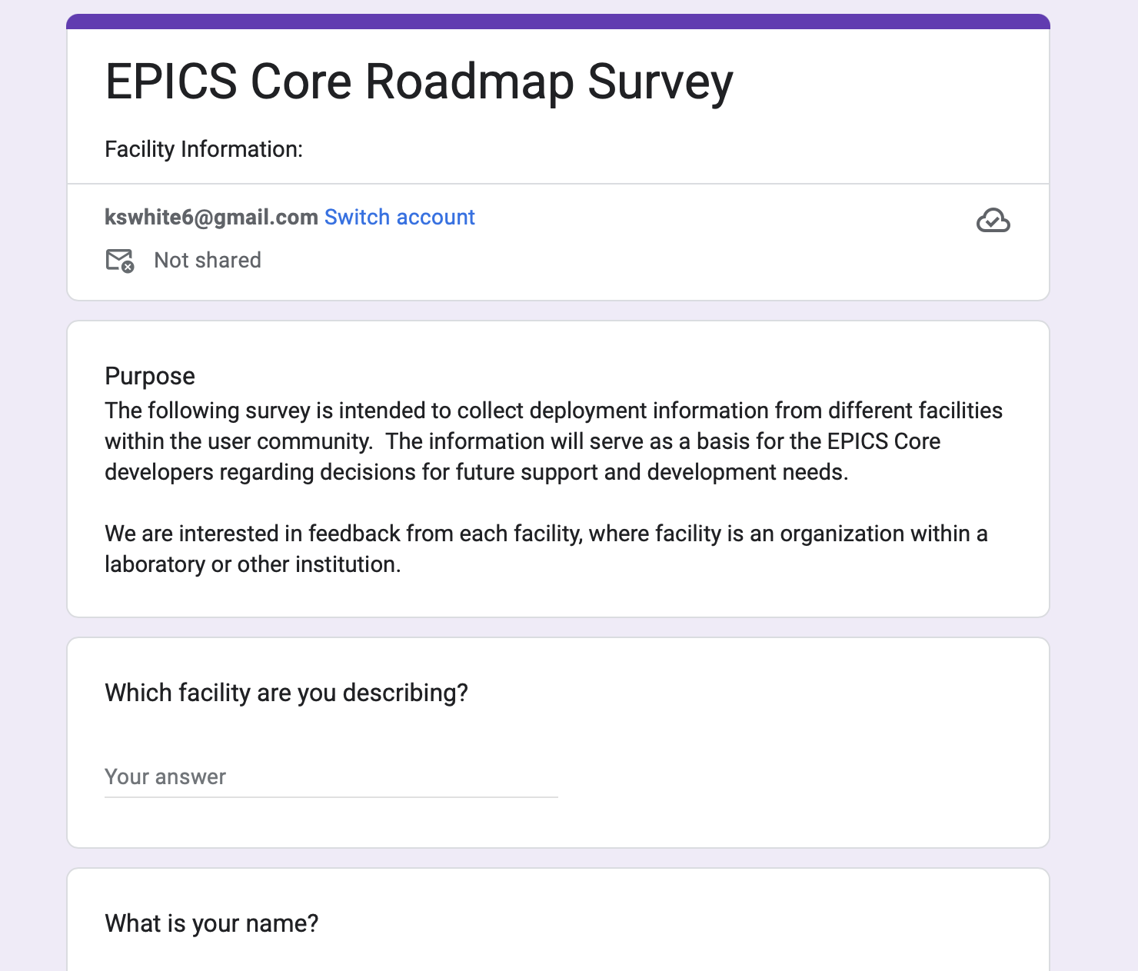
Long term planning
To inform a longer-term roadmap for EPICS, Pierrick is collecting input through a survey
https://docs.google.com/forms/d/e/1FAIpQLSfLbTYmJ-0xbPX8kIwOfEbDBvKn4CoDCybvuJH4uStVHSIyCw/viewform?usp=header
We would like one response per facility recognizing some laboratories may have multiple facilities
Contact: Pierrick Hanlet hanlet@fnal.gov
Notes:
In case of emergency follow instructions from an ORNL employee or PA announcements
Assembly points – Exit through the emergency exits near the stage or lobby front doors, assemble just past the flagpole
Your visitor badge allows you to be unescorted in this building (8600)
Please obey all safety postings – most relevant for the tours on Friday
While you are at ORNL, please do not take photographs of areas that indicate photography is forbidden
Our planned tour route allows photos at all locations

Slide 12
EPICS Core Survey
The survey is intended to collect deployment information from different facilities within the user community.
The Council has been working with the EPICS Core developers to develop the survey
The information gathered is intended to serve as a basis for the EPICS Core developers regarding decisions for future support and development needs.
We are interested in feedback from each facility, where facility is an organization within a laboratory or other institution.

Slide 13
EPICS Core Survey – so far
Fermilab
SPEAR
ISIS neutron and muon source
ISIS UK (instruments)
Diamond
NLCTA
Extreme Photonics Innovation Centre
SLAC - LCLS (photon side)
LCLS Accelerator Controls
Advanced Photon Source
SNS
European Spallation Source
PSI
INTER-UNIVERSITY ACCELERATOR CENTRE, NEW DELHI, INDIA
ITER
Fritz Haber Institute (Max Planck Society)

Slide 14
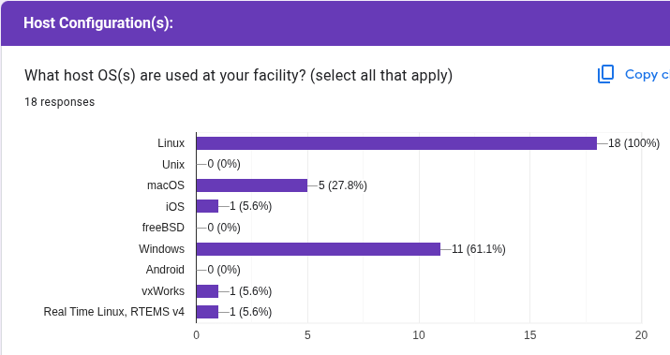
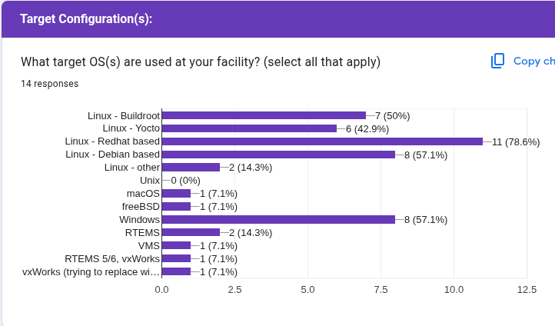
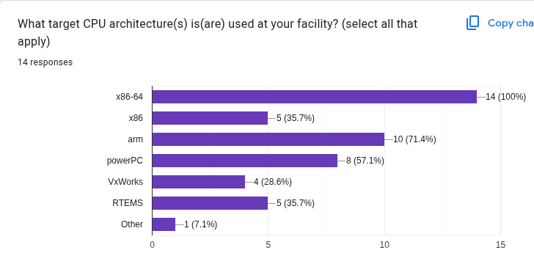
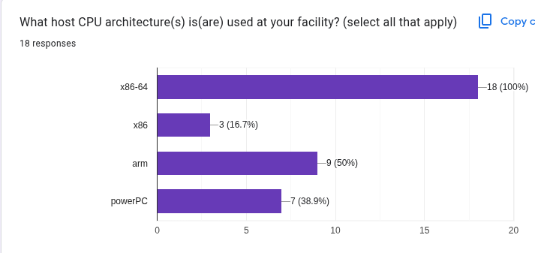
EPICS Core Survey
HOST
TARGET

Slide 15
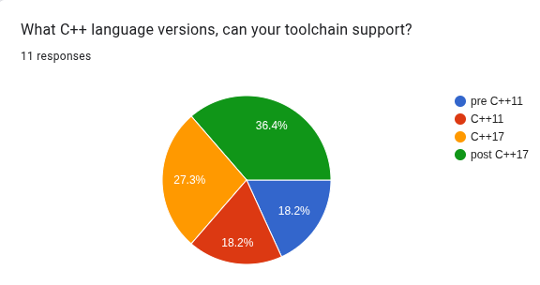
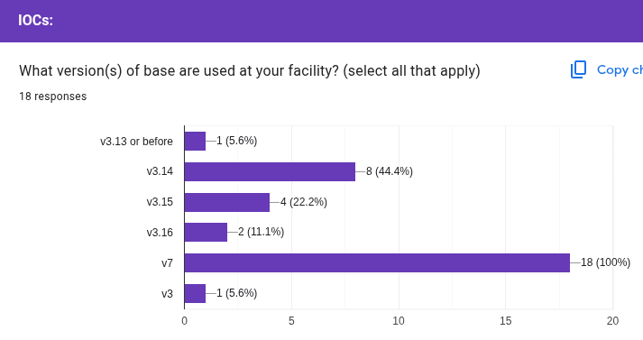
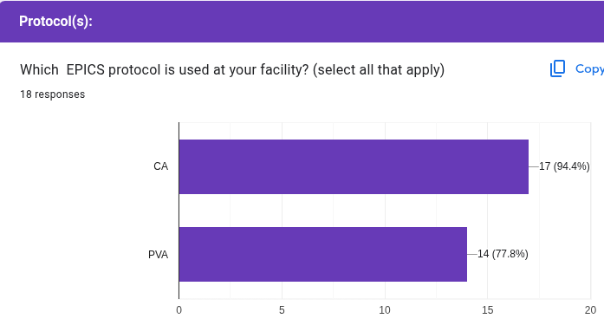
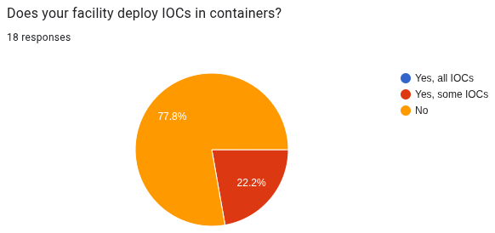
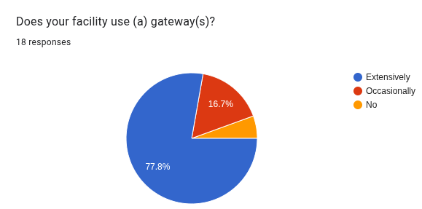
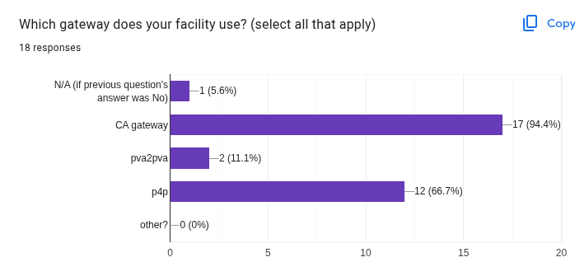
EPICS Core Survey

Slide 16
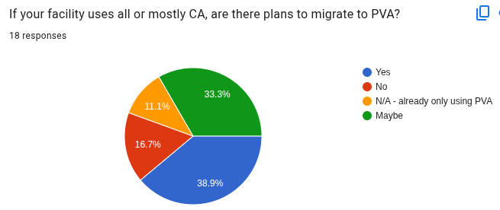
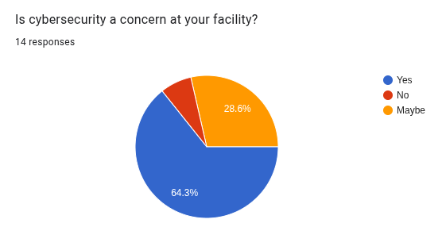
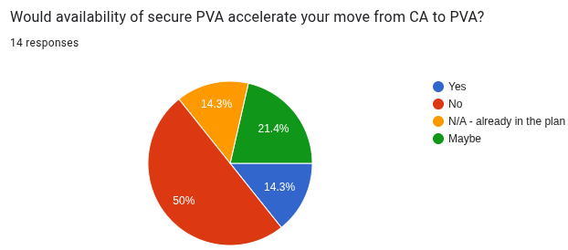
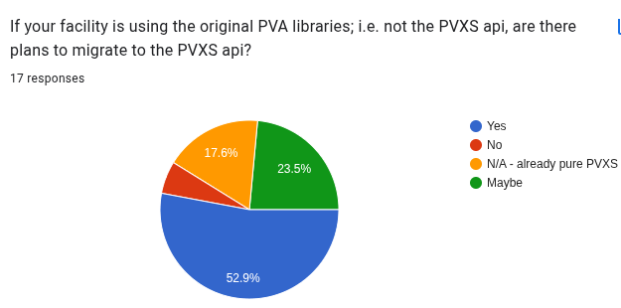
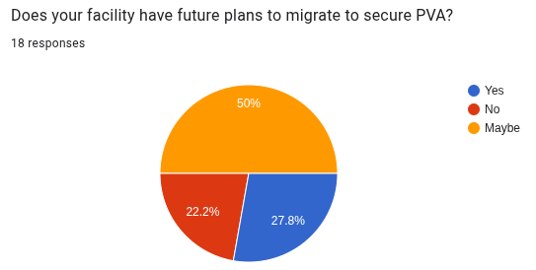
EPICS Core Survey - securePVA

Slide 17
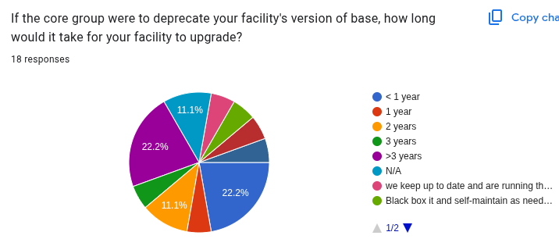
EPICS Core Survey

Slide 18
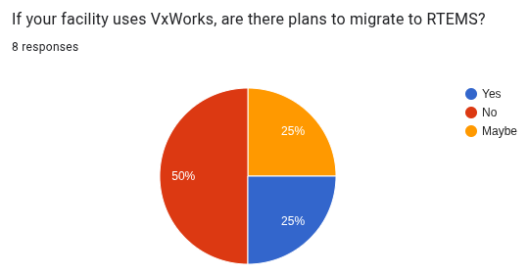
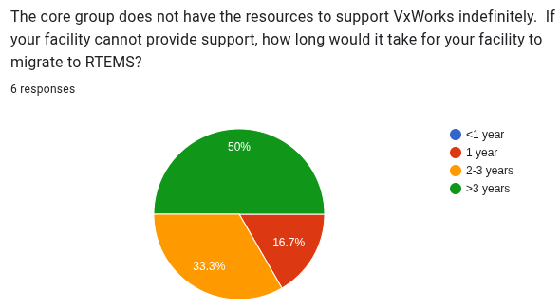
EPICS Core Survey

