Slide 1

Fast Beam Interlock (FBI) with MRF
Luka Peruško
luka.perusko@cosylab.com

Slide 2
Goals
Fast Beam Interlock leveraging MRF hardware
Input to Output sub 30 µs response time in a 2 hop topology
Retain MRF timing functionalities
Highly user configurable
Accurate timestamping
Interlock logging
Failsafe communication (CRC + Timeout)
Compatible with stock MRF timing hardware/firmware
Postmortem trigger event

Slide 3
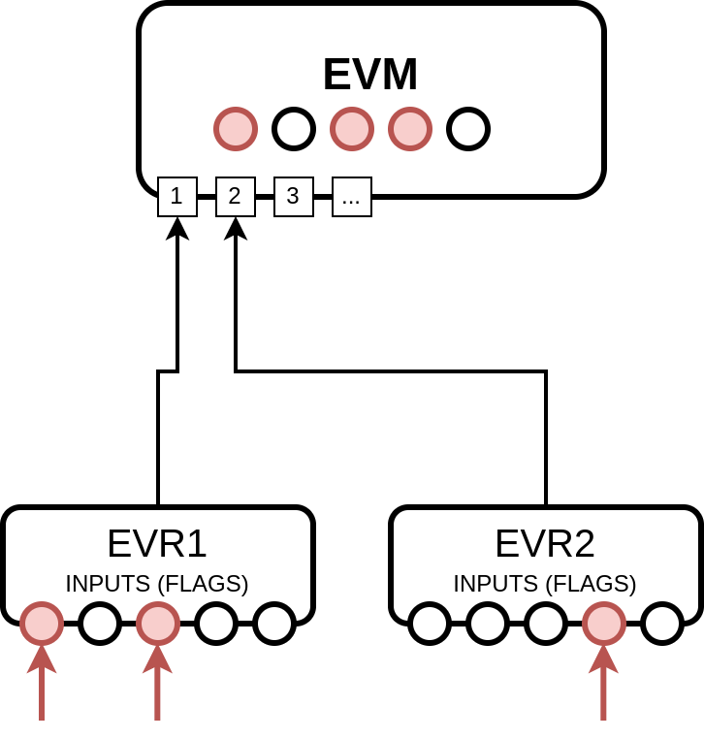
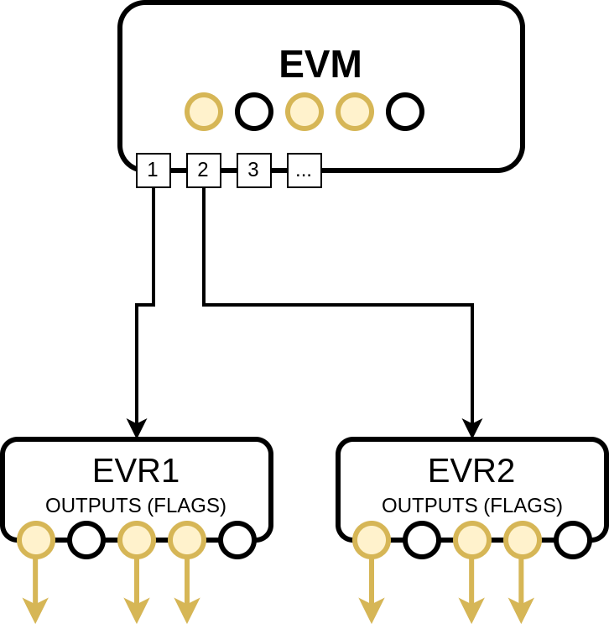
Principle of operation
Input status is sampled and mapped to one or more bits in a 16 bit register – FLAGS
Flags from all EVRs are transferred to the EVM
All received flag registers are ANDed to get a single 16-bit register by the EVM
EVM propagates the flags back to the EVRs to trigger or modulate outputs

Slide 4
Fail-safe communication
The communication is transmitting the 16-bit flag register
FBI communication can be enabled/disabled per SFP module
Communication period can be configured
Error checking:
CRC validation
Timeout detection
Communication errors are propagated to all devices
Can also trigger/modulate outputs
Downside: MRF dbus functionality is hijacked

Slide 5
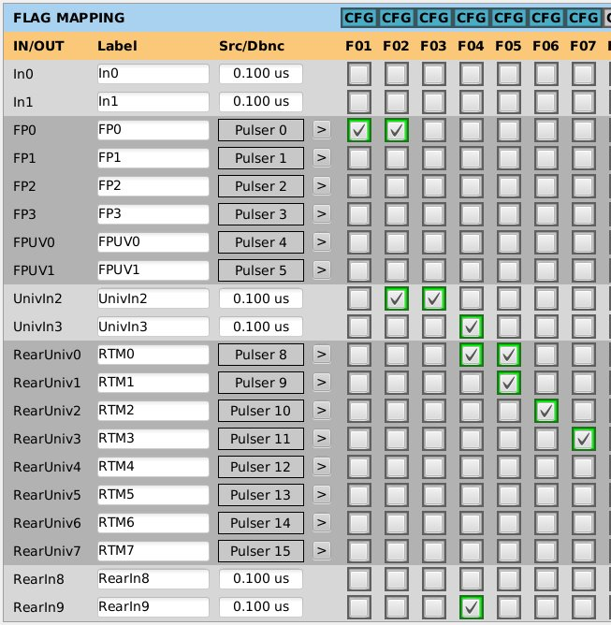
EVR
Each input can be mapped to one or more flags
When this input is low the flags activate
Input signal debounce can be configured
One or more flags can be mapped to one output
When this flag is active the output is triggered OR output source is modulated
Communication errors can also be treated as an extra flag

Slide 6
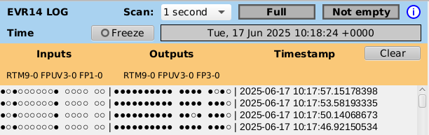
EVR Log
When a flag changes its state all MRF input/output state registers are logged along with its time stamp
FIFO buffer with capacity for 4096 entries
When log is full, the contents are frozen until the user empties it
Reading period is configurable by SCAN field

Slide 7
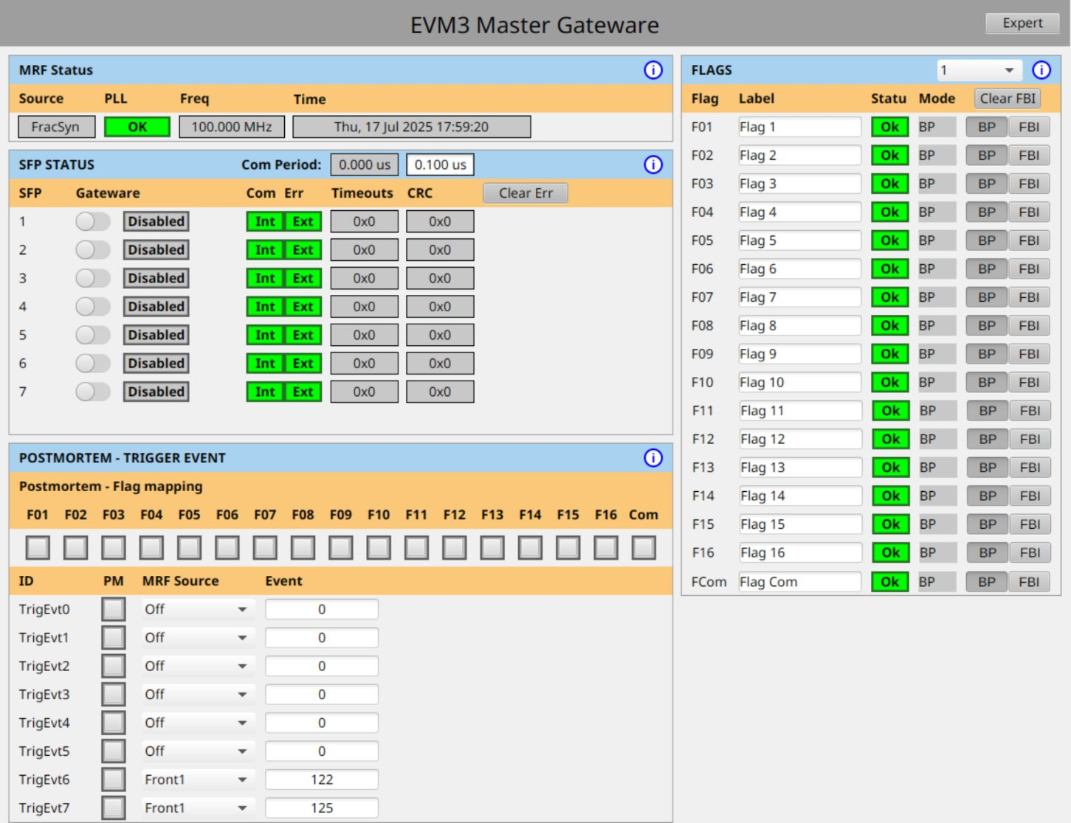
EVM
Each SFP module can have its fail-safe communication enabled/disabled
Each flag can be latched
Each flag can be labeled
A flag can trigger a Postmortem Event
Achieved by expanding Trigger Event functionality
Any combination of flags can trigger a PM event

Slide 8
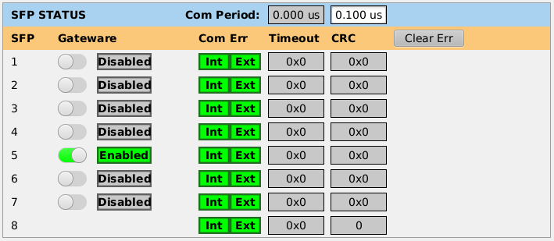
EVM
Each SFP module can have its fail-safe communication enabled/disabled
Each flag can be latched
Each flag can be labeled
A flag can trigger a Postmortem Event
Achieved by expanding Trigger Event functionality
Any combination of flags can trigger a PM event

Slide 9
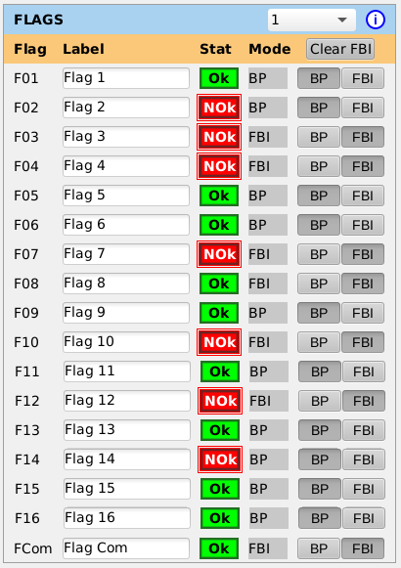
EVM
Each SFP module can have its fail-safe communication enabled/disabled
Each flag can be latched
Each flag can be labeled
A flag can trigger a Postmortem Event
Achieved by expanding Trigger Event functionality
Any combination of flags can trigger a PM event

Slide 10
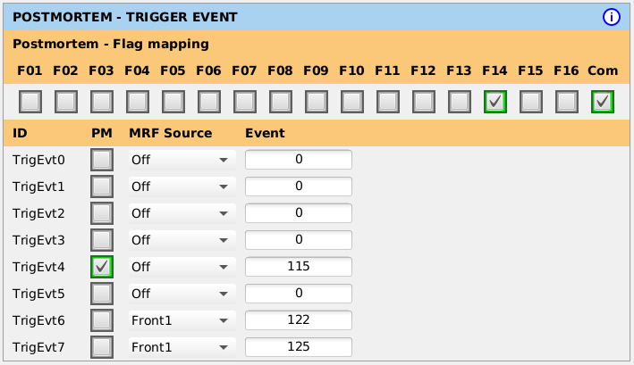
EVM
Each SFP module can have its fail-safe communication enabled/disabled
Each flag can be latched
Each flag can be labeled
A flag can trigger a Postmortem Event
Achieved by expanding Trigger Event functionality
Any combination of flags can trigger a PM event

Slide 11
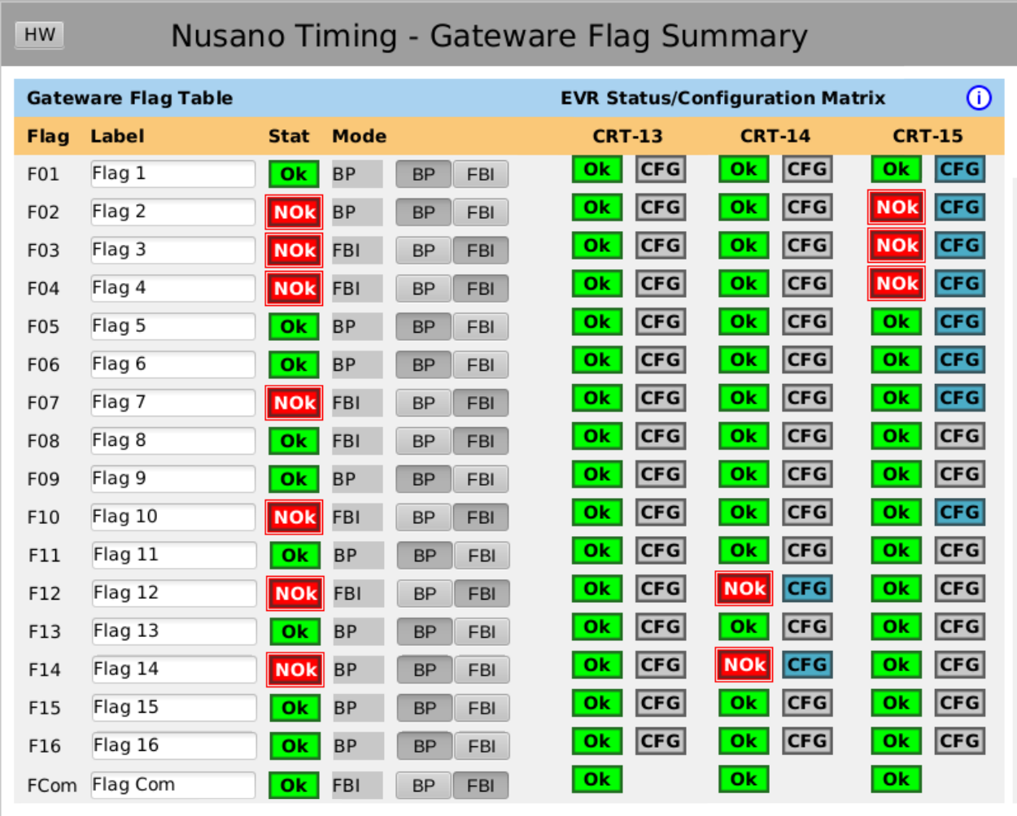
Summary screen
Quick overview of all EVR flag statuses
Easy to find origin of error

Slide 12
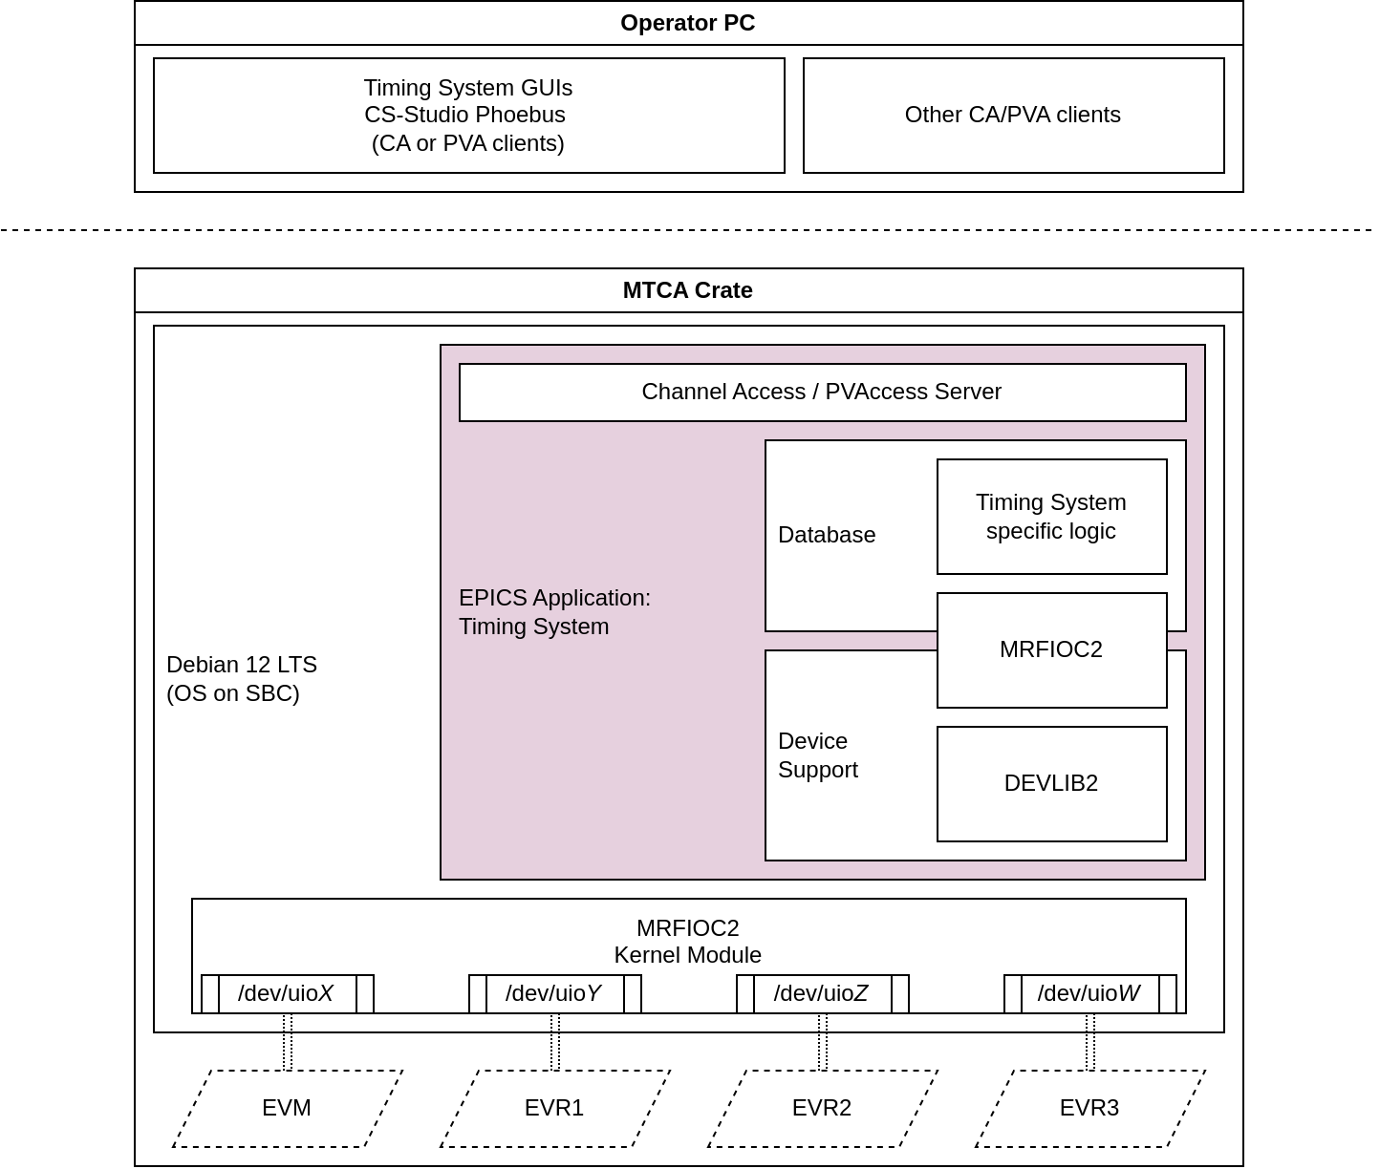
EPICS module
mrfioc2 was modified
Extension of EVM/EVR classes that add FBI functionality
Challenge: Reading log message FIFO buffer
A device interrupt was added to indicate that the log is not empty
"Atomic" read of 4 32-bit registers

Slide 13
EPICS module
Standard MRF functionality is still used
Prescalers
Sequences
Delay compensation
Timestamp propagation
Delay generators
Thanks to EPICS community for updated Phoebus GUIs

Slide 14
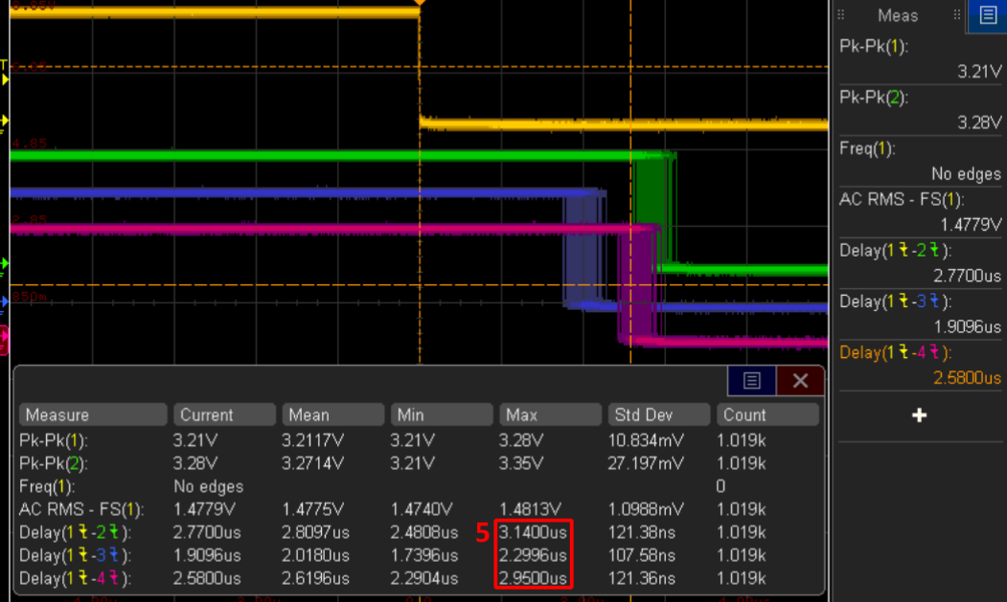
Results
High user configurability covers many use-cases
Interlock logging can be a good debugging/diagnosing tool when a lot of signals are triggered at once, with accurate timestamping
When communication period set to 0.2 µs and debounce to 0.1 µs, response time is approximately 3 µs

Slide 15
Luka Peruško
luka.perusko@cosylab.com

