Slide 1


Concepts for Gating EPICS Alarm
E. Blomley & J. Gethmann

Slide 2
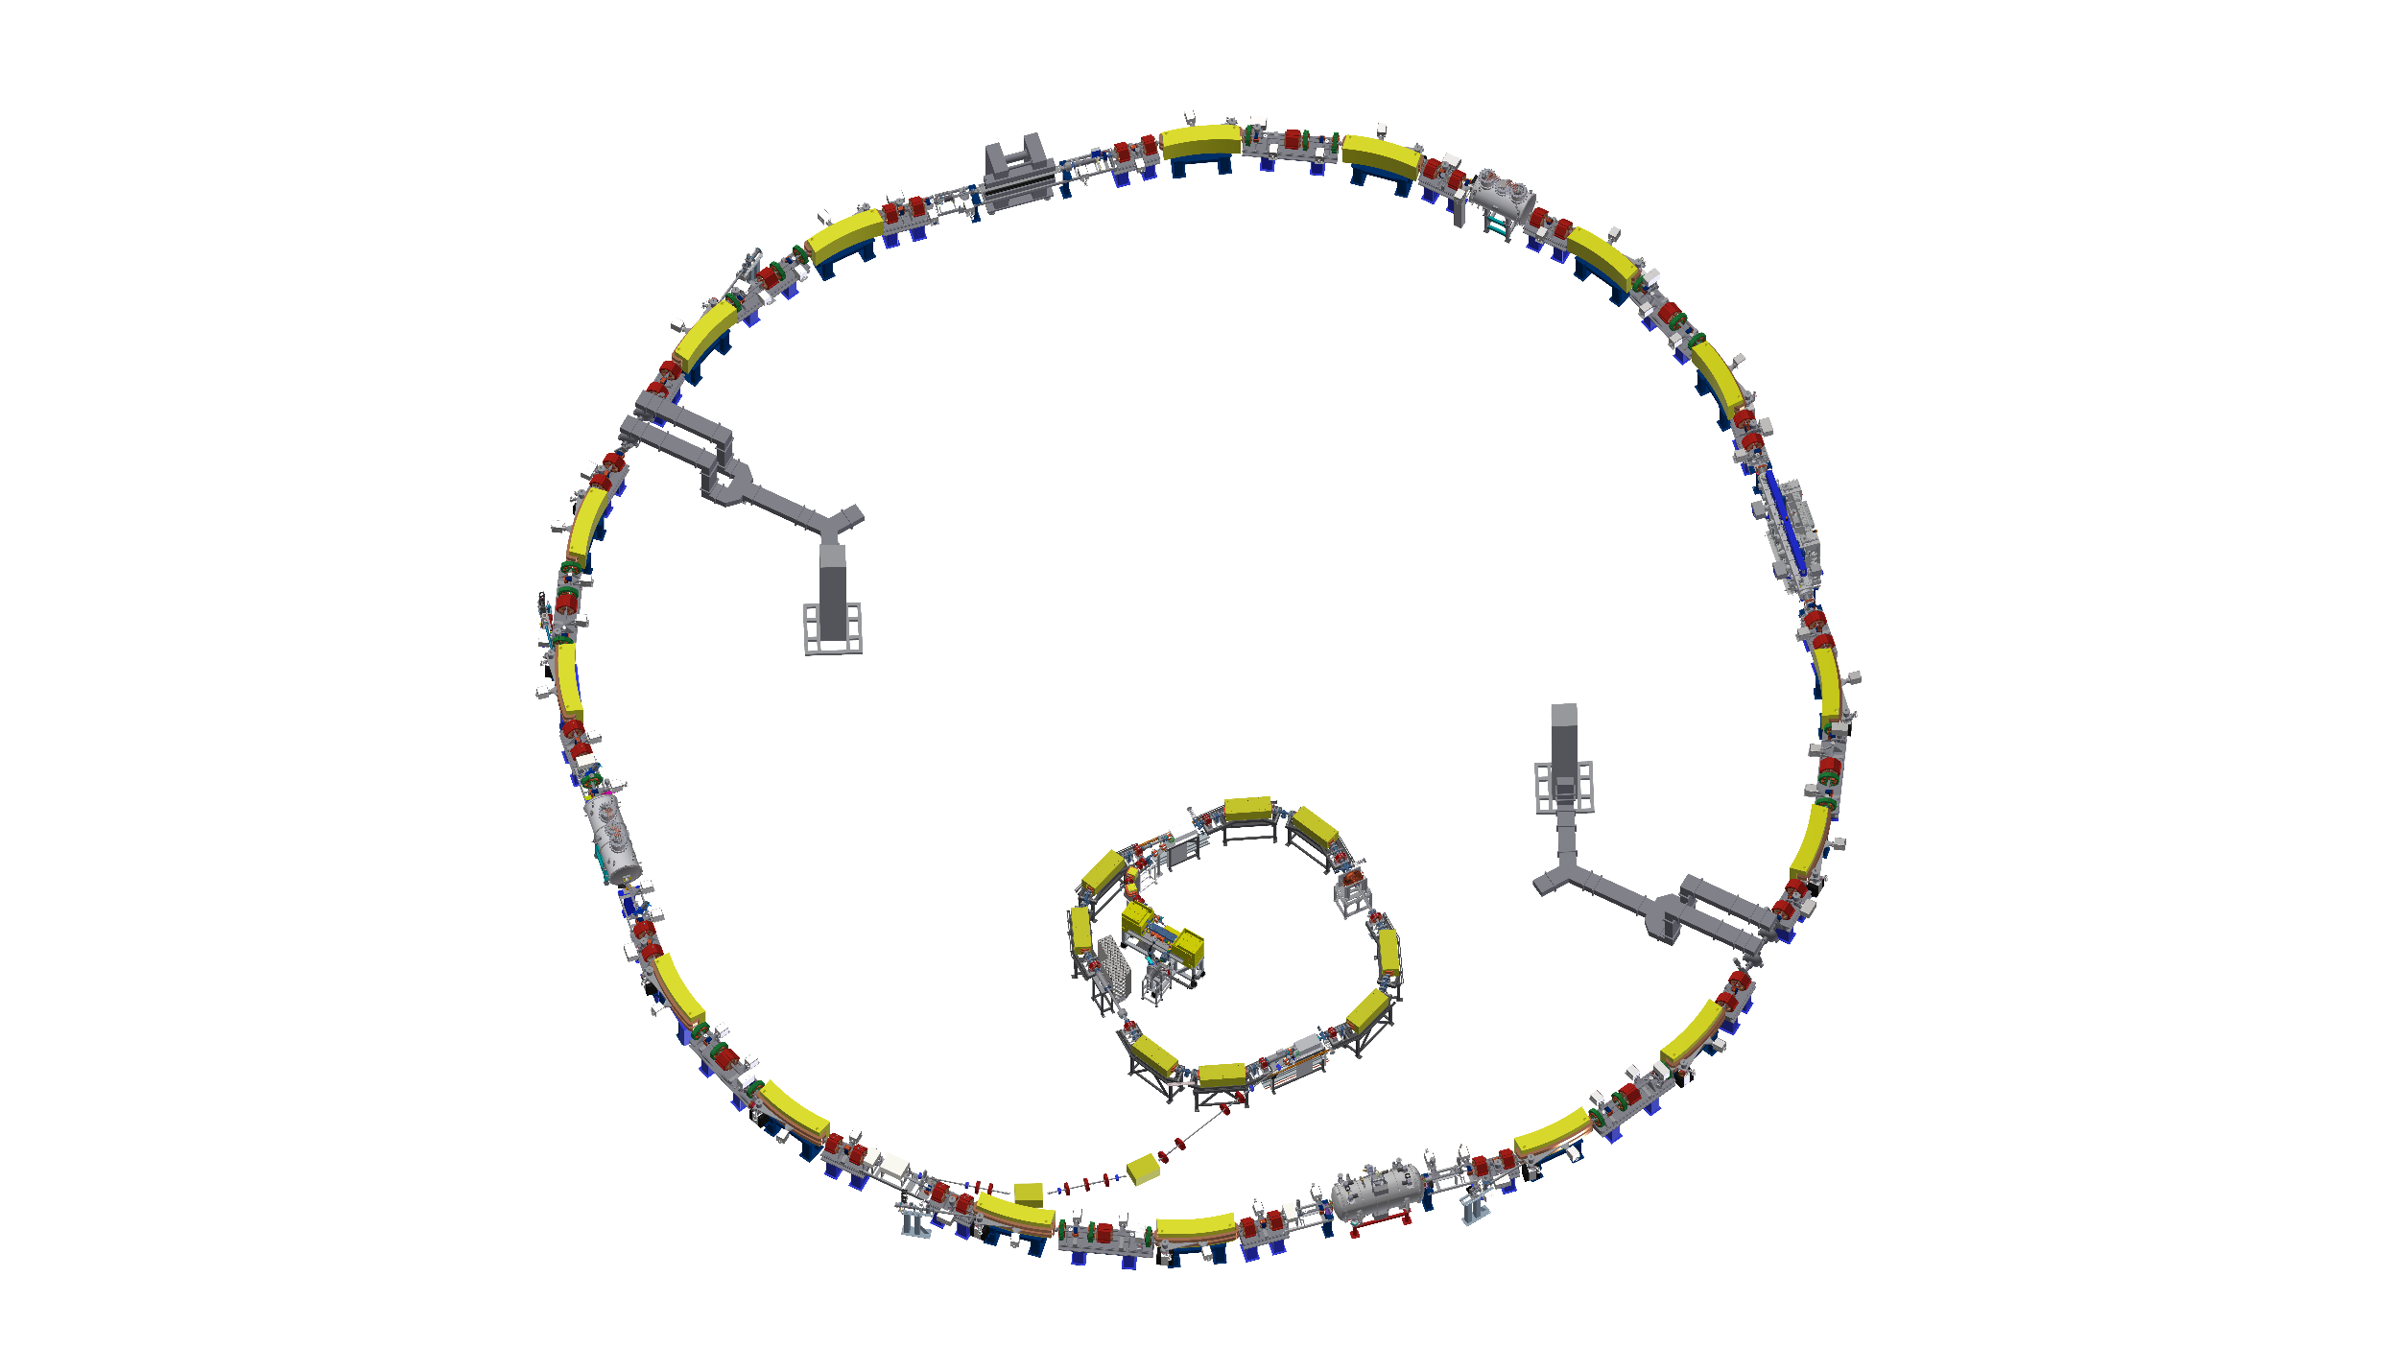

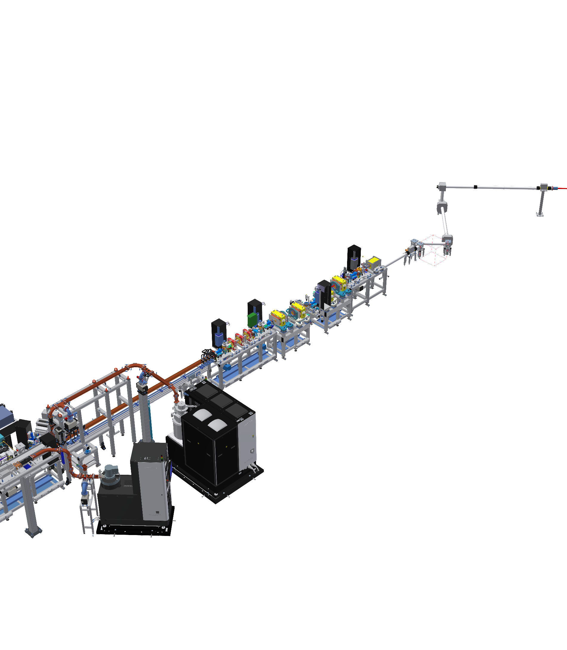
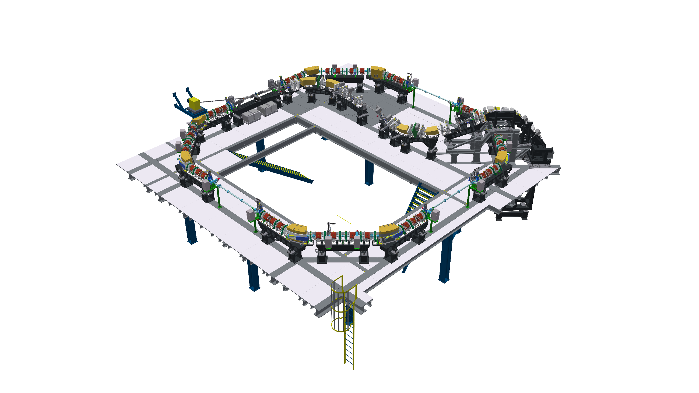







KIT Accelerators
KARA (Karlsruhe Research Accelerator)
Mix of user operation and accelerator research
FLUTE (Ferninfrarot Linac- und Test-Experiment)
Experiment driven without fixed beam schedule
cSTART
Storage ring for non-equilibrium physics
FLUTE and laser plasma accelerator as injector
Installation starts ~ Mid 2026, commissioning ~ 2027
Software stack
EPICS 7 (still Channel Access only)
Ubuntu (24.04) for terminals & servers
Most servers run inside VM

Slide 3
Motivation: Gating Alarms?
record(bi, Kicker:Status:On) {
field(ZSV, “MAJOR“)
field(OSV, “NO_ALARM“)
}
Make “alarms” (dis)appear based on certain conditions
Kicker magnet OFF → Alarm, ON → No alarm
But only in injection mode. Otherwise:
Kicker magnet OFF → No alarm, ON → Alarm,
“Alarms” in EPICS and this talk:
The alarm severity and alarm threshold fields of records
“Alarms” in EPICS can also be seen as notifications:
Help operators to identify & fix potential issues
record(ai, Magnet:Current) {
field(LOLO, “5“)
field(LLSV, “MAJOR“)
field(LOW, “8“)
field(LSV, “MINOR“)
field(HIGH, “14“)
field(HSV, “NO_ALARM“)
}
Not talking about actual (hard-wired) alarms & interlocks: machine protection, personal safety systems, required by regulations, …
Gating Alarms → Dynamic EPICS notifications to support operators

Slide 4
Examples
If in injection mode
In all other operation modes
record(bi, Kicker:Status:On) {
field(ZSV, “MAJOR“)
field(OSV, “NO_ALARM“)
}
record(bi, Kicker:Status:On) {
field(ZSV, “NO_ALARM“)
field(OSV, “MAJOR“)
}
Kicker On
If beam energy is low
If beam energy is high
If in machine development mode
record(ai, Magnet:Current) {
field(LOLO, “5“)
field(LLSV, “MAJOR“)
field(LOW, “8“)
field(LSV, “MINOR“)
field(HIGH, “14“)
field(HSV, “MAJOR“)
field(HIHI, “20“)
field(HHSV, “MAJOR“)
}
record(ai, Magnet:Current) {
field(LOLO, “5“)
field(LLSV, “MAJOR“)
field(LOW, “8“)
field(LSV, “MAJOR“)
field(HIGH, “14“)
field(HSV, “NO_ALARM“)
field(HIHI, “20“)
field(HHSV, “MINOR“)
}
record(ai, Magnet:Current) {
field(LOLO, “5“)
field(LLSV, “NO_ALARM“)
field(LOW, “8“)
field(LSV, “NO_ALARM“)
field(HIGH, “14“)
field(HSV, “NO_ALARM“)
field(HIHI, “20“)
field(HHSV, “NO_ALARM“)
}
Magnet Strength

Slide 5
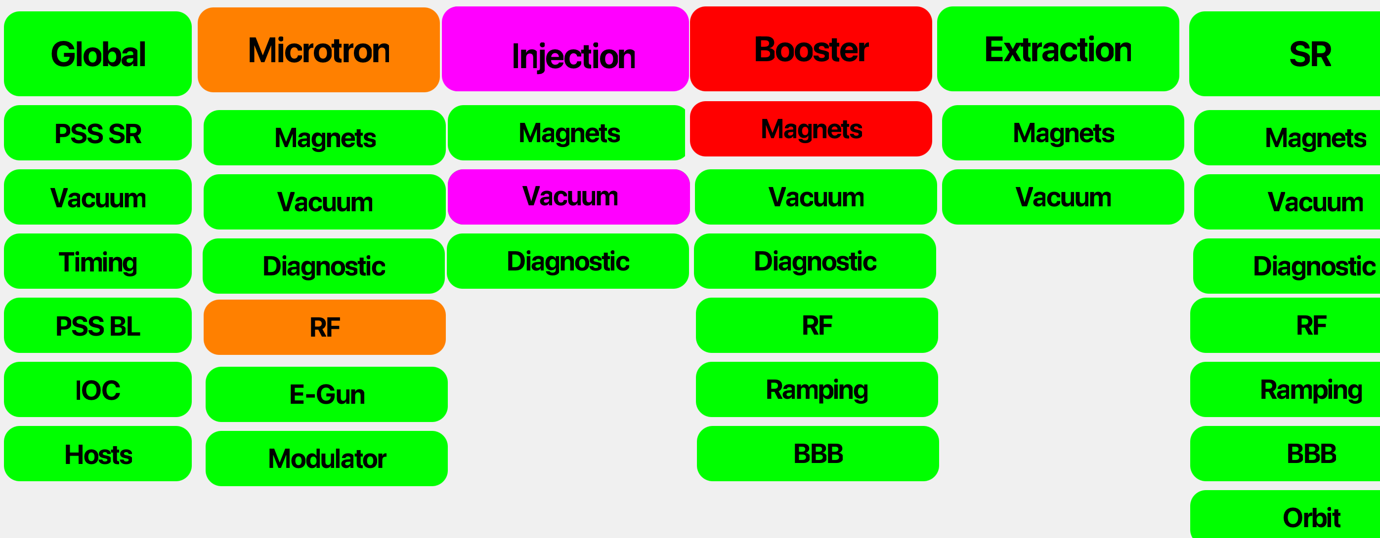
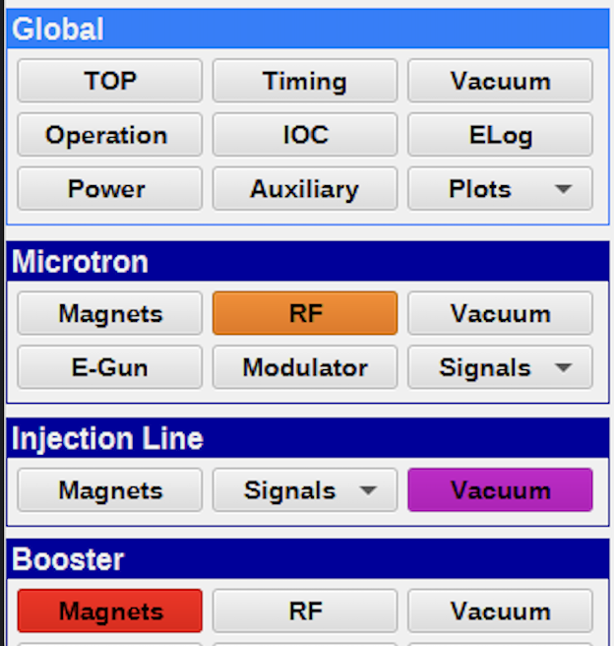
Use Case: Guide the operator
Support operator to quickly identify potential issues
Alarm summaries mapped to navigation menu
Lead to panel where the issue can be fixed
1. and 2. level alarm hierarchy reflects our navigation
Opening the panel should clearly indicate the alarm (or lead to another panel): Would expect to directly see minor alarm on RF panel
Often not necessary to switch to alarm view!

Slide 6
System Design
The task: Design a system which provides such a functionality
Define conditions which in which an alarm should change
Process the configuration
Monitor conditions and “switch” alarm levels
Configuration
Deploy
Execute
Central application
Part of IOC(s)
Condition
Global file
File per IOC
Per record
Global
Local
Adjustment
XML, YML, ….
New Alarm PVs
Change existing records
Condition

Slide 7
Configuration – On Record Level
record(ai, Magnet:Current) {
field(LOLO, “5“)
field(LLSV, “MAJOR“)
field(LOW, “8“)
field(LSV, “MINOR“)
field(HIGH, “14“)
field(HSV, “MAJOR“)
field(HIHI, “20“)
field(HHSV, “MAJOR“)
info(alarmGate1, „HighEnergyStatus“
info(alarmLSV1, “MAJOR“)
info(alarmHSV1, “NO_ALARM“)
info(alarmHHSV1, “MINOR“)
info(alarmGate2, „MachineOperation“)
field(alarmLLSV2, “NO_ALARM“)
info(alarmLSV2, “NO_ALARM“)
info(alarmHSV2, “NO_ALARM“)
info(alarmHHSV2, “NO_ALARM“)
}
If in injection mode
In all other operation modes
record(bi, Kicker:Status:On) {
field(ZSV, “MAJOR“)
field(OSV, “NO_ALARM“)
}
record(bi, Kicker:Status:On) {
field(ZSV, “NO_ALARM“)
field(OSV, “MAJOR“)
}
record(bi, Kicker:Status:On) {
field(ZSV, “MAJOR“)
field(OSV, “NO_ALARM“)
info(alarmGate1, “NotInjectionMode“)
info(alarmZSV1, “NO_ALARM”)
info(alarmOSV1, “MAJOR”)
}

Slide 8
Adjust alarm fields of existing record – using records
record(bi, Kicker:Status:On) {
field(ZSV, “MAJOR“)
field(OSV, “NO_ALARM“)
info(alarmGate1, “NotInjectionMode“)
info(alarmZSV1, “NO_ALARM”)
info(alarmOSV1, “MAJOR”)
}
record(longout, Kicker:Status:On:AlarmOSV1) {
field(OMSL, “closed_loop”)
field(DOL, “{const: 2} “)
field(OUT, “Kicker:Status:On.OSV“)
}
record(longout, Kicker:Status:On:AlarmZSV1) {
field(OMSL, “closed_loop”)
field(DOL, “{const: 0} “)
field(OUT, “Kicker:Status:On.ZSV“)
}
record(calc, Kicker:Status:On:AlarmCond1) {
field(INPA, “<alarmGate1>“)
field(CALC, “A==1“)
}
Instead of records: also external application could do that!
Or an EPICS module?

Slide 9
Possible side-effects of in-place adjustments?
In-place adjustments
EPICS record processing: Look at how alarm propagation behaves
Phoebus widgets: Do (all) widgets pick up changes and adjust alarm borders etc?
Does the archiver pick this up and logs correctly?
How will this look like in the alarm server & logger?
How about disconnects and restarts?
Additional alarm records
EPICS level: value and alarm state now in separate records
Phoebus: Add all PVs to panels? Use JavaScript??
Archiver: Again, add alarm PVs also to archive?
Alarm server & logger?
How about disconnects and restarts?

Slide 10
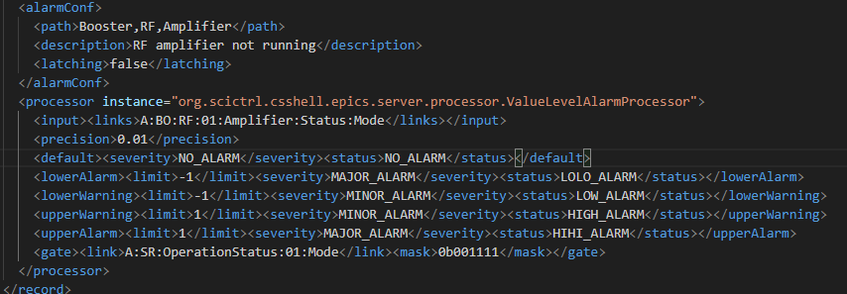
Putting it Together – Our current system
Central XML configuration
Central custom Java application
creating additional alarm records
Change severity of alarm records
Layer 2
Layer 3
EPICS PVs
JAVA Alarming
CSS Alarming
XML configuration + templating
CSS Alarm Tree

Slide 11
Alternative Approaches
YML file for each IOC → Python script to parse this → create additional alarm records during/after IOC init
In-record configuration → process during IOC init (similar to autosave) → generate internal EPICS records which modify the alarm fields of the actual record
In-record configuration → ChannelFinder picks up INFO fields → ChannelFinder PostProcessor used for central application
…

Slide 12
Technology Stack
Our custom system is in operation for 10+ years, but we cannot maintain or develop the custom Java code anymore
Scaling to potentially millions of PVs relevant? (not for us)
Use technology which best fits to us? (No Java nor C++ developer)
Make use of complex features such as ChannelFinder?
Try to do it only with EPICS base and EPICS modules to avoid ANY additional dependency?
Is there interest in the EPICS community?
If not, we might just go for implementing what is easiest and makes most sense for us

Slide 13



Quo Vadis?
We are using gated alarms for a long while.. and plan to continue…
Need to replace our current system and addition of new accelerator good opportunity
But before committing to design, resources & time: Looking for feedback!
Feedback, opinions, discussions?
Still other approach?
Maybe you do something similar?
Community Interest?
edmund.blomley@kit.edu

