Slide 1
Phoebus Tools and Services
Kunal Shroff – NSLS2
Kay Kasemir – SNS
Georg Weiss, Sky Brewer, Abraham Wolk – ESS
Ivan Finch - ISIS
Martin Gaughran – DLS
Katy Saintin, CAOUEN Loïc - CEA
Tynan Ford – ALS
Evan Daykin – FRIB
Ralph Lange – ITER
Dariusz Jarosz – APS

Slide 2
Phoebus Tools and Services The Ecosystem
EPICS Tools Phoebus CS-Studio
EPICS core java: Consists of Channel Access and PVAccess client libraries, utility libraries (epics-util, VType)
EPICS middle layer Services: Archiver, Alarm, Save Restore, Channel Finder, Olog, …
EPICS tools: CS-Studio & Phoebus
EPICS Service Archiver, ChannelFinder Save Restore, Olog, Alarm …
Notes:
Explain each of the modules

Slide 3
EPICS Tools Phoebus CS-Studio
EPICS Service Archiver, ChannelFinder Save Restore, Olog, Alarm …
CS-Studio & Phoebus
Notes:
Explain each of the modules

Slide 4
Phoebus
EPICS Tools Phoebus CS-Studio
4.7.4 release, Apr 2025
5.0.2 release, Jul 2025
JDK 17
JavaFX upgraded to 21.0.7
stability, bugfixes PR #3375
Preparing for JDK 25 LTS
EPICS Service Archiver, ChannelFinder Save Restore, Olog, Alarm …
Notes:
Explain each of the modules

Slide 5
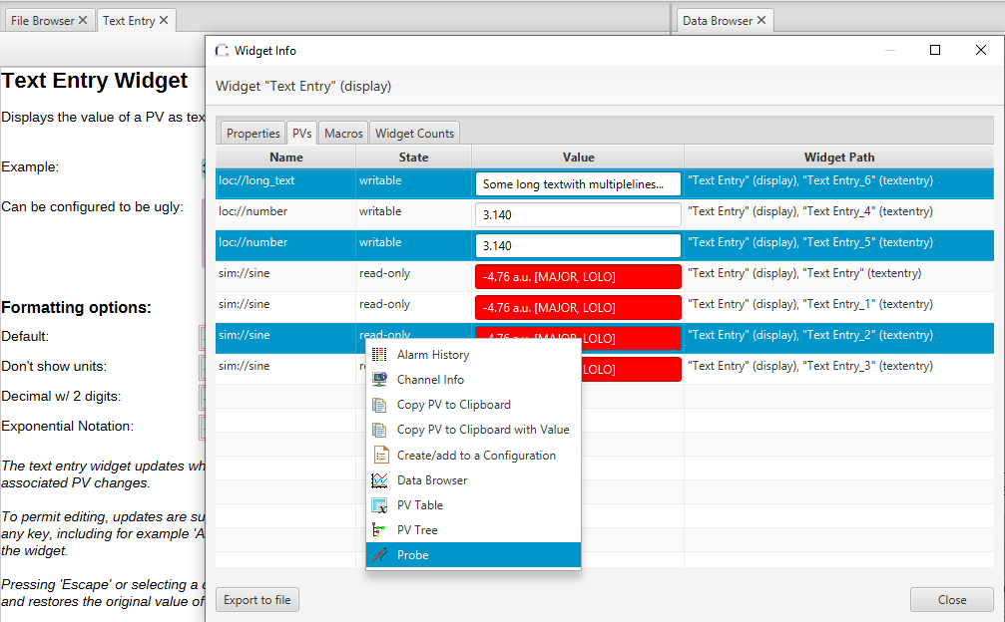
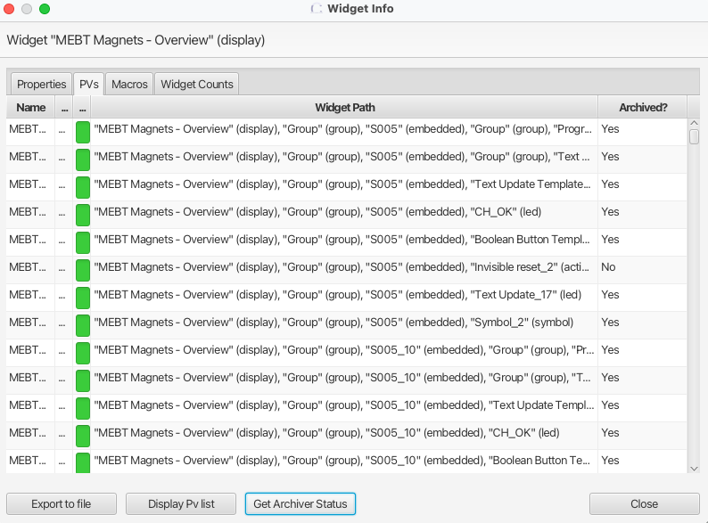
Phoebus 5.x.x: User Experience
Default runtime zoom factor in preferences PR #3369
improves usability on high-DPI and wall displays
Widget Info dialog
PR #3057: better PV selection, copy, and integration with other Phoebus apps
PR #3387:archive status check, export to file
Notes:
Default runtime zoom factor in preferences PR #3369 → improves usability on high-DPI and wall displays

Slide 6
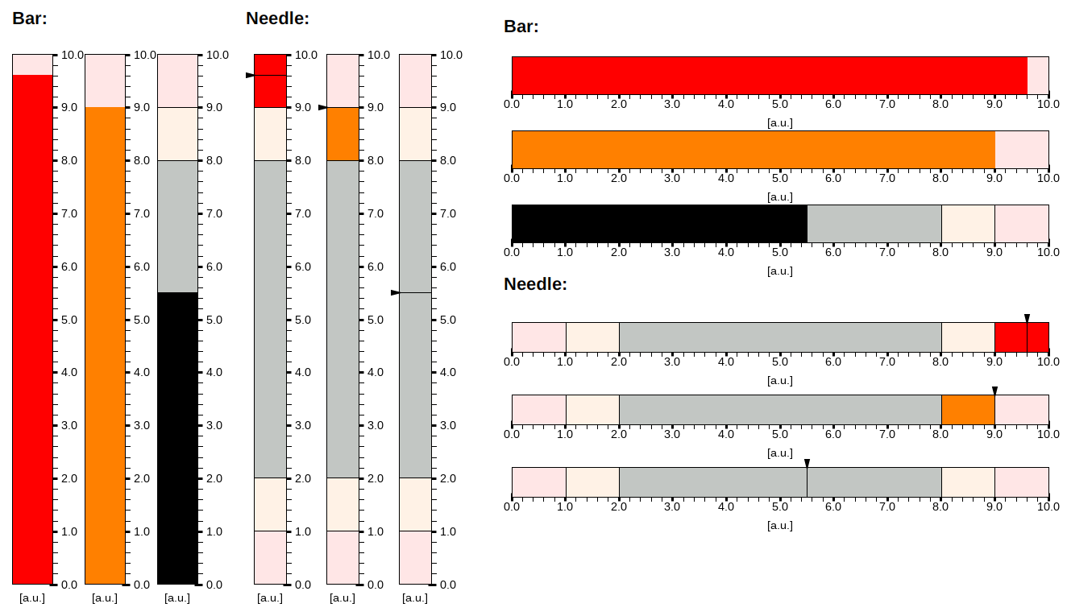
Phoebus 5.x.x: Widgets & Visualization
Improvements to the Linear Meter widget #3514
Notes:
Perhaps most noticeably, it implements a new mode: the indicator can now be drawn as a bar in addition to the existing functionality to be drawn as a needle. The following screenshot shows the bar-mode and the needle-mode side by side:
With the goal of improving performance and responsiveness on multicore processors, the concurrency of the Linear Meter has been made more fine-grained. Previously, concurrency issues were avoided by both reading and modifying state only on the JavaFX Application thread using Platform.runLater(). This pull request replaces that strategy by instead relying on a ReentrantReadWriteLock, allowing for simultaneous read-accesses while write-operations are sequential.
The widget property "Limits from PV" has been generalized: In addition to allowing for the options "Limits from PV" and "No limits from PV", the property now also allows for the options "Min & max from PV" and "Alarm limits from PV", allowing the user more fine-grained control over this option. This functionality has been implemented in a manner such that OPIs saved using the previous version of the Linear Meter will still be loaded correctly. However, an OPI created using the new version of the Linear Meter implemented in this pull request should not be loaded using an older version of Phoebus.
It is now possible to reduce the width of the widget to 10 pixels at minimum instead of 25 pixels.

Slide 7
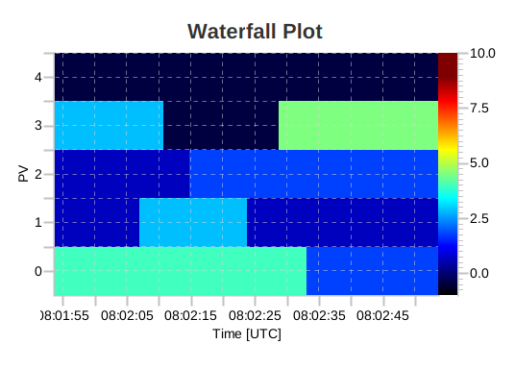
Phoebus 5.x.x: Widgets & Visualization
Waterfall Plot #3520
Time series representation of waveform PV or a set of Scalar PVs
Built on a charting library focused on performance optimised real-time data visualisation
https://github.com/fair-acc/chart-fx

Slide 8
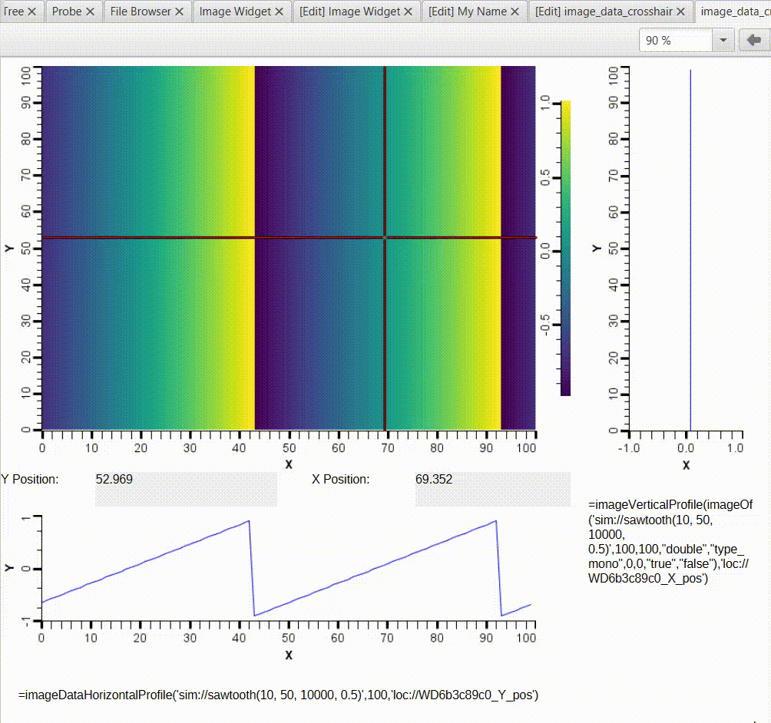
Phoebus 5.x.x: Widgets & Visualization
Horizontal/vertical profiles for intensity plots #3263
=imageVerticalProfile(img, x_pos)
=imageHorizontalProfile(img, y_pos)
Notes:
Removed obsolete “knobs” PR #3517

Slide 9
EPICS Tools Phoebus CS-Studio
EPICS Service Archiver, ChannelFinder Save Restore, Olog, Alarm …
Phoebus Middle Layer Services
Notes:
Explain each of the modules

Slide 10
Phoebus Tools and Services
EPICS Tools Phoebus CS-Studio
Standardization of middle layer services
springboot 2.7.x ( in preparation for springboot 3.x.x )
Standardization Authentication Authorization
spring-security (ldap, ActiveDirectory,…)
ChannelFinder, Phoebus-Olog, Save and Restore
Standardization REST API’s
Use swagger to generate REST API documentation
Generate python clients using swagger ChannelFinder https://github.com/mrakitin/pychannelfinder/ Olog https://github.com/Olog/phoebus-pyolog
EPICS Service Archiver, ChannelFinder Save Restore, Olog, Alarm …
Notes:
Explain each of the modules

Slide 11
Phoebus Tools and Services
EPICS Tools Phoebus CS-Studio
Websockets
Replace periodic polling with push updates
lower latency
less load
react instantly to new/updated entries
Save & Restore WS (PR #3389), Olog WS (PR #3521)
EPICS Service Archiver, ChannelFinder Save Restore, Olog, Alarm …
Notes:
Explain each of the modules

Slide 12
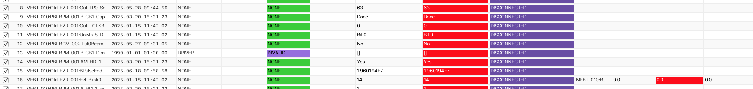
Phoebus Tools and Services: Save & Restore
Expanded Service REST API
Take, Restore, and Compare snapshots
Push, not poll
SAR service now broadcasts changes via WebSockets
Per-PV compare & tolerance
New config field supports absolute/relative tolerance ≥ 0
Snapshot view readability
Delta cells now use alarm-color backgrounds
Sorting
Notes:
Push, not poll: S&R service now broadcasts changes via WebSockets; Phoebus adds a generic WebSocketClient and the UI updates live for actions like tag/untag, filter add/update/remove, move/copy/delete nodes. GitHub
Per-PV compare & tolerance: New config field supports absolute/relative tolerance ≥ 0; backend /compare endpoint evaluates live vs. snapshot using PV-specific criteria; editor supports PV rename, RO flag, and read-back PV. (Client can use, but endpoint is service-side and independent.) GitHub
Snapshot view readability: Delta cells now use alarm-color backgrounds (icon removed) for quicker triage; aligns alarm-related columns with the rest of Phoebus’ color semantics. GitHub
Triage & sorting: Added delta sorting for string PVs to surface meaningful changes first. GitHub
Safer closes & UX polish: Close-checks run on app exit (not just tab close); plus refactors and small doc updates around filtering behavior.

Slide 13
EPICS Tools Phoebus CS-Studio
EPICS Service Archiver, ChannelFinder Save Restore, Olog, Alarm …
EPICS Core Java
Notes:
Explain each of the modules

Slide 14
Phoebus Tools and Services
EPICS Tools Phoebus CS-Studio
The ChannelAccess libraries are stable
core-pva: PVAccess client library
Improved support for ipv6, security, …
PR #3345: epics_pva_tcp_socket_tmo Fixing connection delays Mitigates a long-standing issue where connections would stall if an IOC didn’t respond quickly.
PR #3429 PVA: Handle client’s connection to server in receive thread
PR #3348 — Move TCP connection to thread, fully unregister completed search
Deprecation notice
PVAccessJava, PVDataJava, normativeTypesJava
EPICS Service Archiver, ChannelFinder Save Restore, Olog, Alarm …
Notes:
PR #3429 — PVA: Handle client’s connection to server in receive thread
TCP connect is now performed at the start of the receiver thread in ClientTCPHandler. GitHub
No more hang during ClientTCPHandler construction (connect no longer blocks object creation). GitHub
Removed the need for a short-lived helper thread for the handler. GitHub
Follow-ups noted in thread: search cleanup and proto v3 support planned separately. GitHub
PR #3348 — Move TCP connection to thread, fully unregister completed search
Moves the TCP connection work out of the constructor path; part of a series following #3345 to reduce connection stalls. GitHub
Fully unregisters completed searches, avoiding leftover search entries after resolution. GitHub
Discussion explores avoiding computeIfAbsent blocking on slow connects and proposes using ConcurrentHashMap<server, Future<ClientTCPHandler>> so map access returns immediately while connect proceeds. GitHub
Ensures only one TCP handler per server GUID, while minimizing cross-server contention during connects.
Fewer hangs: Closing Phoebus no longer leaves lingering PVA threads or sockets.
Cleaner resource usage: Connections and searches are properly torn down → less noise in network monitoring.
Better operator experience: Avoids “PV stuck in connecting” states that used to require restarting the client.
Path toward EPICS 7 adoption: These fixes build confidence for facilities planning to rely more on PVA (especially with IPv6 and security features).

Slide 15
EPICS Tools Phoebus CS-Studio
EPICS Service Archiver, ChannelFinder Save Restore, Olog, Alarm …
Collaboration
Notes:
Explain each of the modules

Slide 16
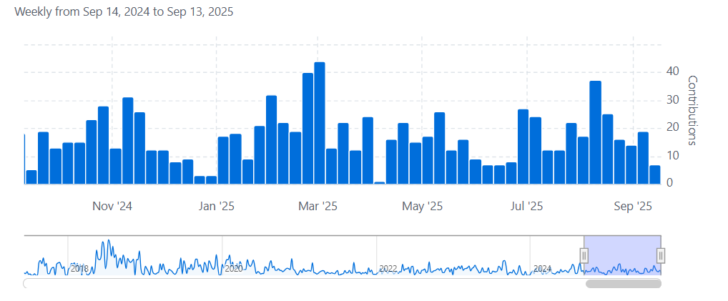
Phoebus Collaboration
EPICS Tools Phoebus CS-Studio
EPICS tools: CS-Studio & Phoebus
EPICS Service Archiver, ChannelFinder Save Restore, Olog, Alarm …
Notes:
Explain each of the modules

Slide 17
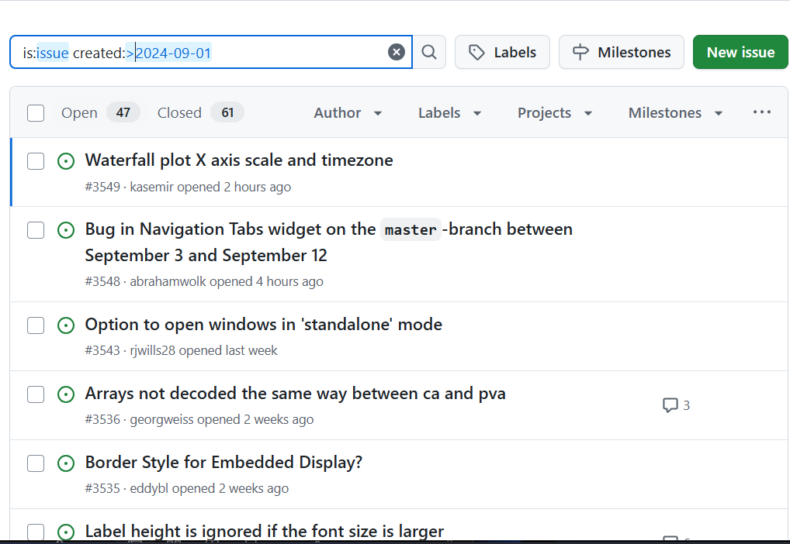
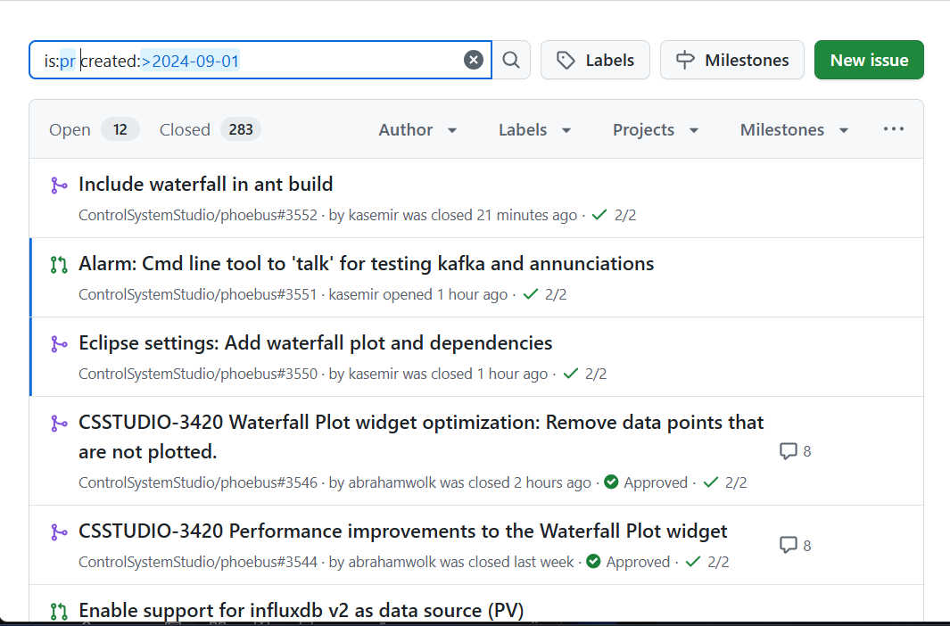
Phoebus Collaboration
EPICS Tools Phoebus CS-Studio
Phoebus
~300 PR’s
~100 Issue
ChannelFinder
Phoebus-Olog
EPICS Service Archiver, ChannelFinder Save Restore, Olog, Alarm …
Notes:
Explain each of the modules

Slide 18
Collaboration

Slide 19
Next Steps (Collaboration)
Web toolkit
Aligning disparate web tool efforts: pvinfo, PVWS, dbwr, etc.
DLS-led Web Toolkits survey and performance tests on PVWS
Navigation
Ongoing discussions: navigation models (embedded buttons, tabs, dedicated apps)
Notes:
Aligning disparate web tool efforts: pvinfo, PVWS, dbwr, etc.
DLS-led Web Toolkits survey and performance tests on PVWS
Ongoing discussions: navigation models (embedded buttons, tabs, dedicated apps)

Slide 20
Next Steps (Technology Stack)
JDK 25 migration
JavaFX 25+
Spring boot 3
Kafka 3+
Expand WebSockets across services
ChartFX evaluation
Notes:
Expand WebSockets across services
ChartFX evaluation
Olog search with natural language → Elastic queries
JDK 25 migration + container-first deployments

Slide 21
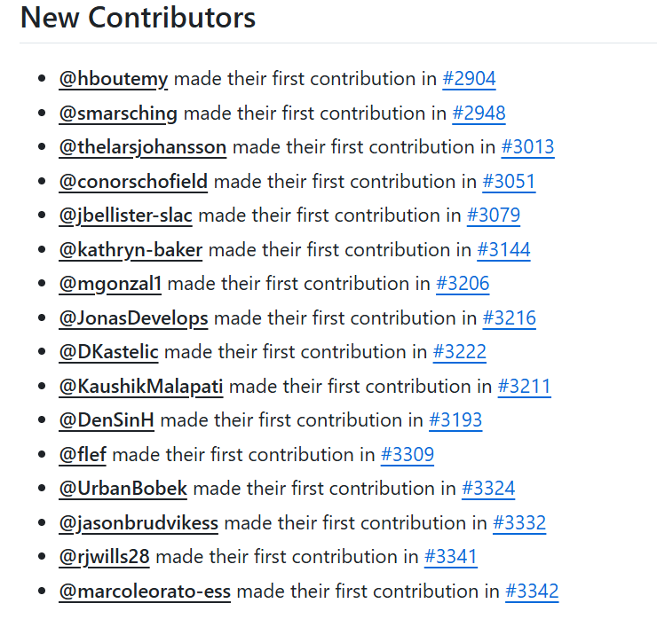
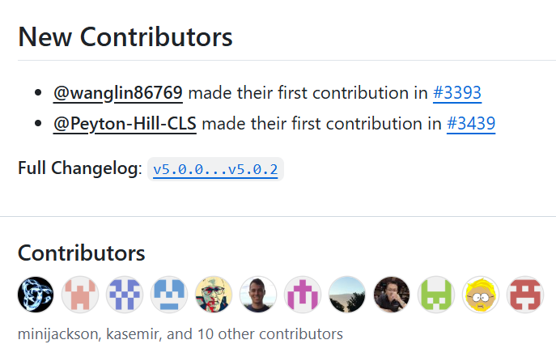
How to contribute
GitHub Issues
Monthly meetings on the 2nd Wednesday of each month.
Participate in codeathon / documentathon
Location to be announced soon

Slide 22
Useful links
https://controlsystemstudio.org/ http://phoebus.org
Fork us on github https://github.com/ControlSystemStudio
ChannelFinder http://channelfinder.github.io/
Olog https://github.com/Olog
SaveRestore, Alarm Services, Scan Server https://github.com/ControlSystemStudio/phoebus/tree/master/services

