Slide 1
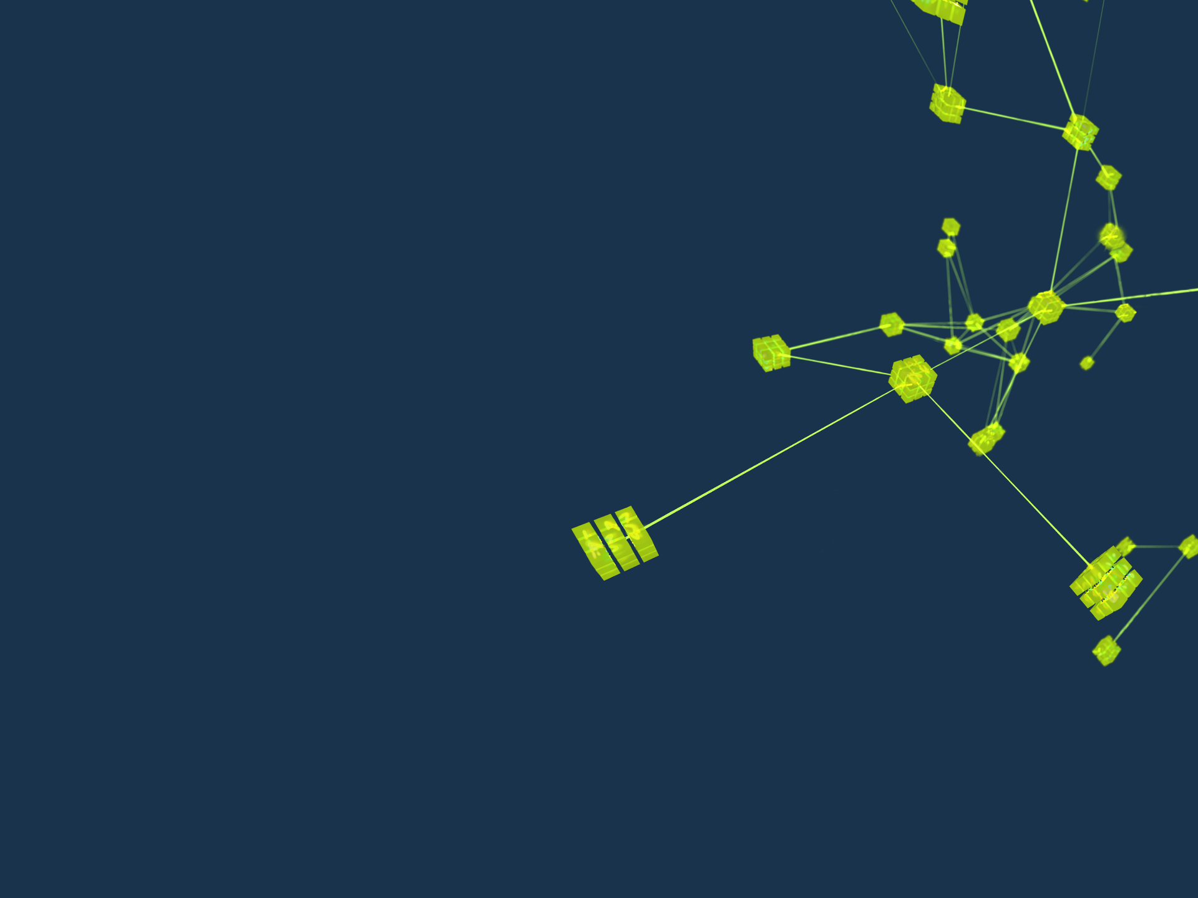
EPICS – As Part of a Scientifc Control Solutions
The collective as seen by Bob Dalesio

Slide 2
Outline
Scientific Control Systems – Scope
Scientific Control Systems - Requirements
EPICS is part of a Scientific Control System
EPICS – Core is built to scale to large physics facilities
EPICS - Services Support and Application Development
Scientific Control Systems - Conclusion

Slide 3
Scientific Control System - Scope
Anything related to electrons that is not in a vacuum vessel:
All electronics, hardware, firmware and software, racks, chassis, power, EMI
All systems industrial and beam control related
All network, computing and storage electronics
It does not include physics: scientific mission, lattice design, radiation calculations.
It does not include machining vacuum vessels or anything mechanical – but it does include motor controls.
Conventional facilities were not consequential to the scientific control system. Unless there is a temperature loop that is needed to control a warm RFQ at 10 Hz. Johnson Controls HVAC system is supposed to provide comfort, not control.
Anything with a signal or calculated information i.e. packet drops or configuration information i.e. serial number or sample rate should be read into the control system

Slide 4
Scientific Control System - Scope
Physics operation of the machine for integration, commissioning, operations, off normal operations, physics studies.
This phase is important to solicit requirements that are most frequency ignored and occasionally lead to serious problems.
Instrumentation for each subsystem
Beam related instruments are most challenging and impact the architecture
Industrial instruments are most significant in count and need to be integrated into the control system
Global Controls – fast machine protection, safety, timing, network, services
Each subsystem has to define the interface to these global systems
Most of the effort of a Scientific Control Solution is System Engineering which is rarely as assigned position. Each subsystem and global system needs one control engineer that is responsible for that scope.

Slide 5
Scientific Control System - Requirements
Each facility is unique – this is not an oil refinery; each of our facilities is a prototype.
Each construction project has constraints: time, budget, space
A project is usually composed of staff that operated the last facility
Operations has all of the time in the world, resistance to change and limited capital expenditures
A construction budget is the opposite: lots of money for capital equipment, a need to change to avoid obsolescence and a very limited amount of time.
Requirements tend to reflect what was done 25 years ago only fixing the problems from that solution.
Existing portions of a facility are frequently left in place which presents challenges for change.
Reach out to colleagues at like facilities

Slide 6
Scientific Control System – Requirements gone awry
Archive everything, all of the time. That requires $10M worth of disk space. OK we don’t really need all of that.
There is no need for Beam Position Monitors to be correlated. (Engineer hears no timing system is needed. Physicist meant that 35 microseconds was required).
Each beamline will require 50 motors and 32 single pixel inputs with a 20 kHz count rate. These ended up being 250 motors and detectors that were 1M pixels at 1 kHz. As $3M detectors were purchased, there was no money for labor to actually build the beamlines or time to write software to collect and manage such data files.
There will be 10,000 Process Variables that change at 10 Hz. As the system grew to 100’s of thousands of PVs, the SCADA system was changed in the middle of commissioning.

Slide 7
Scientific Control System - Requirements
Over 2 million PVs
About 200,000 physics IO points
About 200 device types and up to 1,000 instances of some types
80% of all signals are industrial I/O – 10 Hz, scalar
20% of all signals are beam related and these require 80% of the labor
The control system is the most labor intensive aspect of a scientific control system.
Project Management (financial) have a hard time to quantify what labor is needed for the Non-Recurring Engineering. How many new devices will require a complicated driver to provide correlated time stamps from a device that does not integrate with the timing system like detectors.

Slide 8
Scientific Control System – Instrument Challenges
Low Level RF - Local : GHz phase control, Global: kHz feedforward, MHz fault detection
Beam Steering - Local : 100 kHz magnet power supply monitoring, BPMs 1 GHz signal quality Global: kHz feedforward, MHz fault detection
Timing - Event and Data Correlation over distances of km. Global: nsec resolution, psec jitter, long term drift correction
Machine protection - Global response time from sensor to mitigation is from 2 microseconds to 100 microseconds
Dats Acquisition
Physics Studies – Machine Learning 1k BPMs at 1 kHz continuous, 1k BPMs Turn By Turn for 10 seconds
Instrument State of Health – local failure detection and collection
Experimental Data -1 Mpixel detectors at 1 kHz continuous
New Instrumentation requires 3 to 5 years to develop and should be fully operational 1 year before first need. This is the new frontier of schedule and obsolescence risk.

Slide 9
Scientific Control System – Where is SCADA
Requirements…… for everything from electrical and radiation shielding through operations
Physics Applications
Instrumentation for each subsystem – selection, development/selection and driver/integration
Data Acquisition – for scopes and photon detectors is not the DA in SCADA
Global Controls
Fast Machine Protection
Safety
Timing
Network – SCADA, Instrumentation, Data Acquisition
Services – this is the SCADA system.
Supervisory Control and Data Acquisition Systems SCADA are from industrial control. Scientific Facilities are not similar to Industrial Control Systems except the scale and performance is two orders of magnitude more demanding.

Slide 10
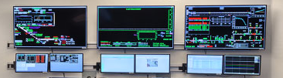
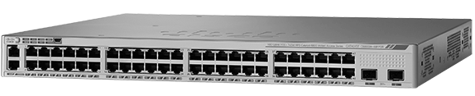
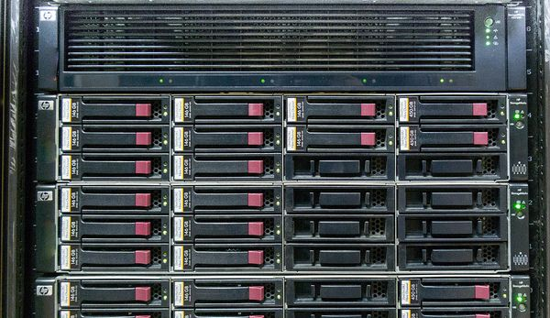
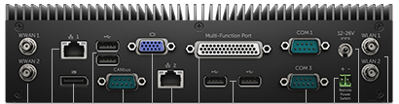
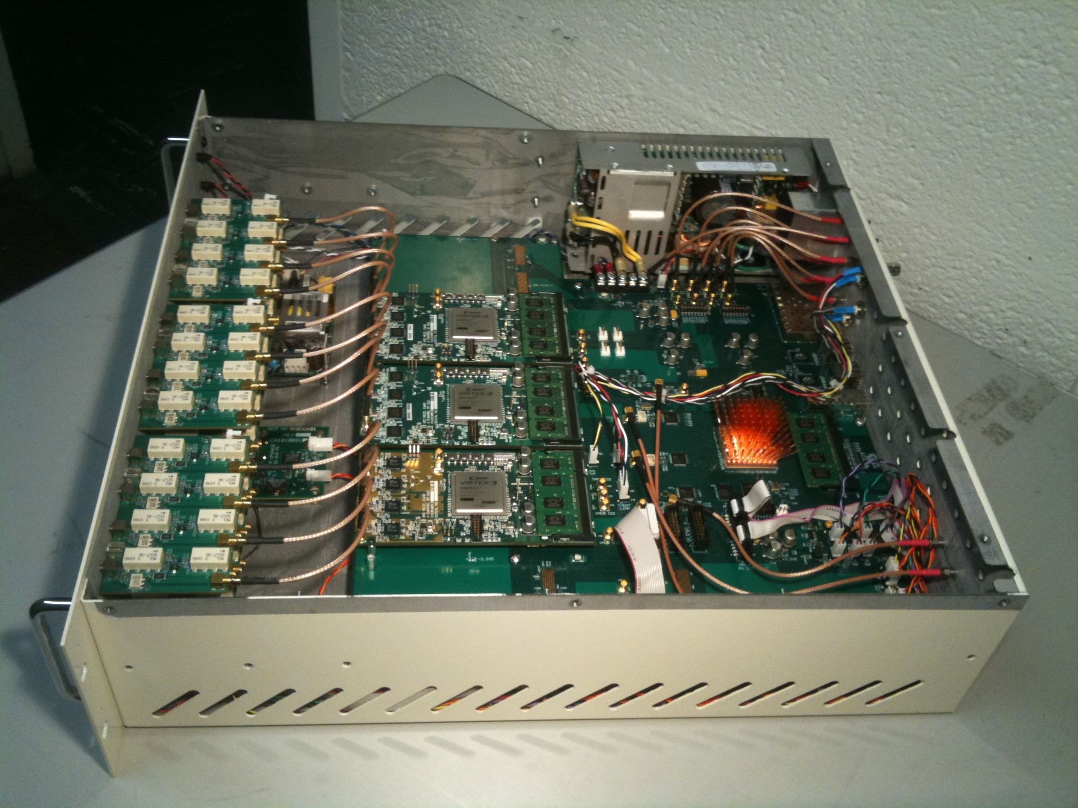
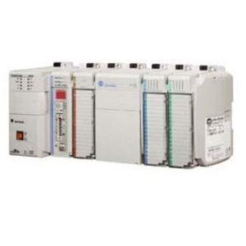

EPICS – As part of a Scientific Control System
I/O Controller
Command and Monitor
Firewall
I/O Controller
Data Acquisition Computer
Console Server
Ethernet UDP/TCPIP for EPICS pvAccess
Ethernet instrumentation Command and Monitor
Event
Generator
Ethernet Instrumentation Large Buffer Xfer
Deterministic Timing Distribution Network
Deterministic Data Distribution Network MPS/FOFB
Cables to
instruments

Slide 11
EPICS is a well proven SCADA platform
PVXS and Channel Access provide published communication protocol with optimized transfer methods, a narrow interface that supports general purpose services and a large community of developers that have used the interface with demonstrated success.
PVXS and Channel Access Servers are the most used and proven data servers
Commercial grade services exist for GUIs, Alarm Management, Time Series Archiver, Save/Restore
Client APIs are available in C++, JAVA, MATLAB, Python etc..…
Process Database provides a configuration tool to integrate all instrumentation and provide it through Channel Access and PVAccess.
Signals are represented by Records (new normative types for images, tables, statistical samples are under development)
These records have built in mechanisms to provide time stamps for correlation from Drivers (FPGA provided), NTP or adopted from links to other records.
Low Latency and high sample rates are support by an Event Scan mechanism
Process Database Templates configure sets of Records. Llcksets created for “linked” records assure that they are atomic operations.
There is a well-defined interface to integrate new hardware. The quality of the IO integration is dependent on the quality of the driver. Well written drivers provide a data layer that assures that the Process Database execution is stateless.

Slide 12
EPICS provides a well proven SCADA platform
CS Studio:
Synoptic Display
Directory Clients
Elog Client
Archive Browser
MASAR Client (restore)
Channel Access Server
C, C++, Java, Python MATLAB, State Notation Language
Client Applications:
Channel Access Gateway
PVA/CA Access
PVA/CA Access
PVA /CA Client
PVA/CA Client
Operator Log
Alarm Aggregation
Channel
Finder
MASAR
Archive
Appliance
PVA/HTTP
PVA
PVS/HTTP
PVA/HTTP
PVA/HTTP
EPICS - SCADA
Micro Services
Optics
Directory
Save Sets
Time Series Data
Simulation IOCs
Injection Extraction IOC
PVA/CA
RF IOC
Vacuum IOC
PVA/CA
Diagnostic IOCs
Power Supply IOCs
PVA/CA
PV/CAA
PVA/CA
PV/ACA
Instrumentation
Instrumentation
DLS Simulation

Slide 13
EPICS adapts to late requirements – configure vs write code
EPICS was developed to provide a robust, scalable, low latency, high performance SCADA system for scientific facilities. The goal was to provide support for 80% of the needs of a scientific facility and APIs for each facility to develop solutions for the last 20%.
It was designed for instrumentation engineers to configure their control systems with a minimum need for programming. (Process Database).
The communication protocol was designed to provide an Application Programmer Interface that allowed the development of client applications with these same requirements listed above.
The API is designed to be narrow so as to enable the development of general purpose tools such as time series archiving, graphical user interfaces, alarm managers, etc.….
Between GTACS (1985) and EPICS (1991) the most significant improvements made were to create a clean API between the Process Database and the Drivers used to integrate hardware as well as the Locksets that made record processing a uninterruptable operation).
This basic architecture has provided support for scalar signals from desktop applications to large facilities such as KEK-B in Tsukba, Japan. (Register your site on the new EPICS website)
As instrumentation evolved, the need for high density Records and PVs was demonstrated in areaDetector, and realized in the new communication protocol (PVAcces) and Narrow Datatypes (Normative Types)

Slide 14


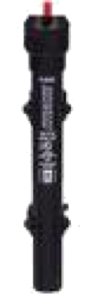


Example: Basic Temperature Control
EPICS – Process Database
Task:
Read temperature
Open/close switch as needed
Repeat
Software?

Slide 15
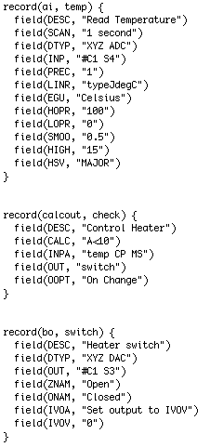
EPICS – Process Database
Analog Input Record
SCAN Field
Binary Output Record

Slide 16
EPICS - Configure Monitor and Control Instrumentation
Ex. A
Ex. B
Ex. C
Temp_1
SCAN .1 Second
PHAS 0
INP #C0 S0
VAL
Temp_2
SCAN .1 Second
INP #C0 S0
FLNK Check_2
VAL
Temp_3
SCAN Passive
INP #C0 S0
VAL
Check_3
SCAN Passive
INPA Temp_3 PP
VAL
Check_1
SCAN .1 Second
PHAS 1
INPA Temp_1
VAL
Check_2
SCAN Passive
INPA Temp_2
FLNK Switch_2
VAL
Switch_3
SCAN .1 Second
DOL Check_3 PP
OMSL Closed-loop
Switch_1
SCAN .1 Second
PHAS 2
DOL Check_1
OMSL Closed-loop
VAL
Switch_2
SCAN Passive
DOL Check_2
OMSL Closed-loop
VAL

Slide 17
EPICS – Process Database
Order of Operation
Ex. A Ex. B Ex. C
Records
Routines for Record Processing
Temp PACT = 1 1 1 5
Read 2 2 6
Conversion 3 3 7
Alarm 4 4 8
Monitor 5 5 9
Forward Link 6 6 10
PACT = 0 7 22 11
Check PACT = 1 8 7 3
Read Inputs 9 8 4
Do CALC 10 9 12
Alarms 11 10 13
Monitors 12 11 14
Forward Link 13 12 15
PACT = 0 14 21 16
Switch PACT = 1 15 13 1
Read Setpoint (DOL) 16 14 2
Limits 17 15 17
Output 18 16 18
Alarm 19 17 19
Monitor 20 18 20
Forward Link 21 19 21
PACT = 0 22 20 22

Slide 18
PVXS/CA Narrow Interface is PVs not Signals
CA and PVA:
Monitor request--------
Add Event to
alarm change
monitor change
archive change
Channel Access Client:
Connect to Double Float Field “LSX16a:M1:LVDT<.VAL>”
LSX16a:M1:LVDT.VAL 22
LSX16a:M1:LVDT.STAT
LSX16a:M1:LVDT.SEVR
LSX16a:M1:LVDT.TS
LSX16a:M1:LVDT.HOPR
LSX16a:M1:LVDT.LOPR
LSX16a:M1:LVDT.EGU DGC
Connect to Enumerated Field “LSX16a:M1:LVDT.SCAN”
LSX16a:M1:LVDT.SCAN 0.15 Sec
LSX16a:M1:LVDT.STAT
LSX16a:M1:LVDT.SEVR
LSX16a:M1:LVDT.TS
# Choices
List of choices
Records for each signal
Analog Input:
Name
SCAN 0.15 Sec
EGU dgc
VAL 22
STAT ACK
SEVR ACKT
HOPR EGU
LOPR
HIHI HHSV
HIGH HSV
LOW LSV
LOLO LLSV
DBR Double
double value
alarm_t alarm
int severity
int status
time_t timeStamp
long secondsPastEpoch
int nanoseconds
DBR Enum
enumerated value
etc.…..

Slide 19
EPICS is Robust – PVA / CA
Every I/O Controller is stand alone – it operates independently. The Channel Finder Service on the IOC allows any PVXS (or Channel Access Client) to connect to any PV on this IOC. When an IOC is booted, it sends out a beacon to all clients to notify them that a new IOC is online. Any clients with unresolved PVs sends out connection requests for PVs that may be on this new IOC.
PVXS and Channel Access have a separate connection for each client that connects to a PV which isolates any given connection from holding up others when a client is not reading the events off of the client side queue quickly enough.
There are many different time domains from interfaces to high speed instruments, through the Process Database and it’s related queues for issuing monitors, to PVXS/CA server queues to optimize packet size for network throughput. The same is true on the client side. A Cache is lossy and a queues is less lossy.
The most common mistake that is made on GUI development is to connect an event directly to a widget update. These fail is the most embarrassing way. Changing the state of a digital input wood show up on the display 10’s of seconds later.
On one project, there were multiple instances of Phoebus screens monitoring the 10 kHz orbit data. We were called to the control room to diagnose why the operator screens were operating sluggishly.

Slide 20
EPICS Core
PV Access Client
Connect RPC/Get/Put/Monitor
Channel Access Client
Connect Get/Put/Monitor
Directory
Channel Finder Server
RecCaster
Ethernet
UDP
TCP/IP
UDP
TCP/IP
HTTP
TCP/IP
TCP/IP
UDP
Channel Access Server Send
pvAccess
Access
pvAccess
Channel Access
Access
Channel Access
Server Receive
…
…
Recc
Caster
rsrv
dbAccess
Lookup Routine
IOC Database Records
Record Name Hash Table
.015 Sec Scan Task
IO Scan Task
.015 Sec Scan Task
.015 Sec Scan Task
Read/Write
Device Read and Write Data Tables in IOC
Periodic R/W Task
Synch Write Task
Asynch Read Task
Devices
TCP/IP or Serial Communication

Slide 21
EPICS is Robust - Process Database
Each SCAN period for each priority has it’s own thread. These threads are each scheduled on the next period of the SCAN frequency by “sleeping” the difference between the period and the time it tasks for this thread to process all of its records.
A Record and all related Records linked by links, belong to a “Lock Set” which has a semaphore that makes the entire lock set an atomic operation.
All of these mechanisms were put in place to operate smoothly and fail predictably and gracefully.
One project wrote a driver that bypassed the Process Database by taking an events from a driver, writing the value to a record and then directly calling dbEvent to queue and send the event to all clients. This consumed all 12 Ethernet ports and all 24 processors with over 50% of their time at Kernel level and finally deadlocked the driver.

Slide 22
EPICS is Scalable
Add another IOC to support more IO bandwidth.
PVXS and Channel Access collect events into a queue for each client that is connected. These queues are flushed by each scan thread after all records are processed. The buffers are also flushed during a scan when they have reached the maximum buffer size for network packets. This limits the system calls on both the server and client side and optimizes the use of the network bandwidth. For PVXS, only NTType fields that have changed are transmitted – this allows monitors of metadata without additional network usage.
PVXS and Channel Access keep values that are being monitored until all clients are notified. They provide monitor “types” – archive, alarm and value to allow clients to request PVs on specific conditions.
Records can link to PVs in other IOCs. This allows a Record to aggregate PVs from a distributed network.
Records are added with no programming – only configuration is required.
VLANs may provide more performance by isolating subsystems or large data sets to isolate network traffic, which is one of the resources that can limit throughput and latency.
With a tight budget, one project decided to limit the number of IOC and load records onto a very limited number of IOCs. This saved on capital expenditure, but the cost of additional labor and the risk of developers working on the same machine lead the project to relent within one year and start adding processors

Slide 23
EPICS supports low latency high frequency IO
Records have the following SCAN options: Passive, Event, Period (where these are determined by the IOC clock frequency.
SCAN rates are preconfigured in the EPICS release. That menu is in a .DBD file where new scan rates are added by editing the file and rebooting the IOC. See the “Application Developers Guide”.
“Event” is the mechanism to use for record processing initiated by a hardware event.
Passive Records process when any record references them such as a PVXS put from a client.
For Low Latency response, it is important to have an expert writing the driver and someone trained to the Process Database properly to implement the application.
Drivers should scan at the rate provided by the hardware and store values in cache, queues or vectors that are decoupled from record processing.
The Process Database is intended to be stateless.
Motors are not stateless. Asynchronous drivers also violate this ideal.
Test the driver by displaying every parameters form that hardware on a UI and unplugging the communication cable. Well written clients will do the same.
To scan with low latency and high frequency is to use the Event Scan. In the first release of GTACS in 1985 or so, the database was characterized by hooking a pulse generator to a VME card that had a database with 1,000 records. On a 6800 processor, we were processing 200 records at 1 kHz.

Slide 24
EPICS Tools have 10’s of man years of development
IOC
User Interfaces
Since ~1990:
record(ai, “my_record”) {
field(DTYP, “MyDevice”) field(INP , “@channel2”) field(SCAN, “1 second”) ... More supported platforms: vxWorks, RTEMS, Linux, OS X, Windows, .. 68000, Intel, PPC, Arm, ..
Since 2010
N-Dimensional Arrays
Tables
Statistical Samples
edd/dm 198x
medm 199x
edm 200x
CS-Studio 201x 2009: BOY 2017: Display Builder 2019: Web Runtime
All major software packages were developed with a small, diverse team, had performance specifications to meet and
required at least one rewrite. These were then released to a small number of users that reviewed and invariably improved.
(Pebble in the Pond”. These include: EPICS Core, Servers and Clients that are widely used.

Slide 25
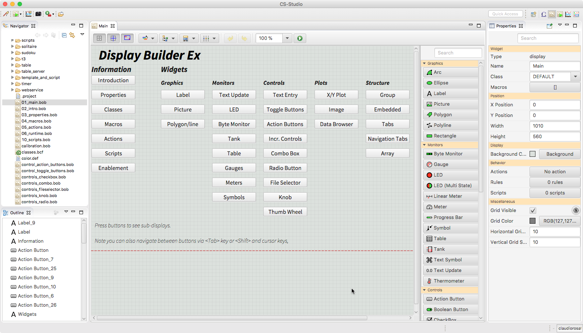
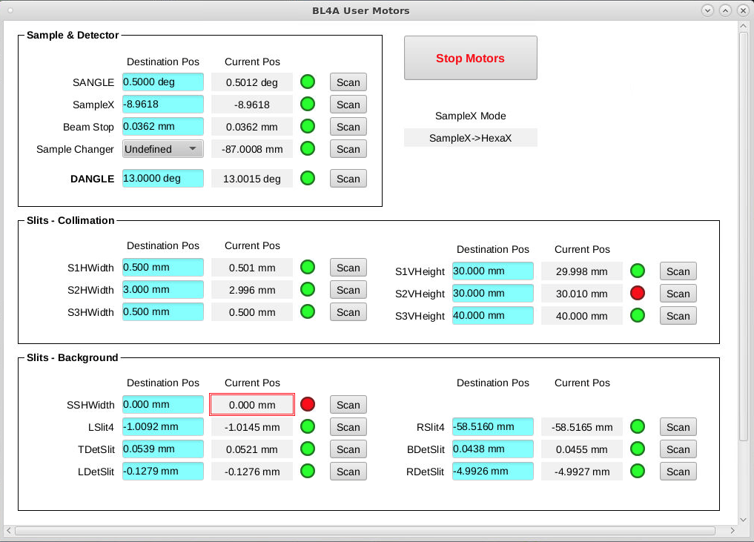
Synoptic Display – WYSIWIG Editors with XML Files

Slide 26
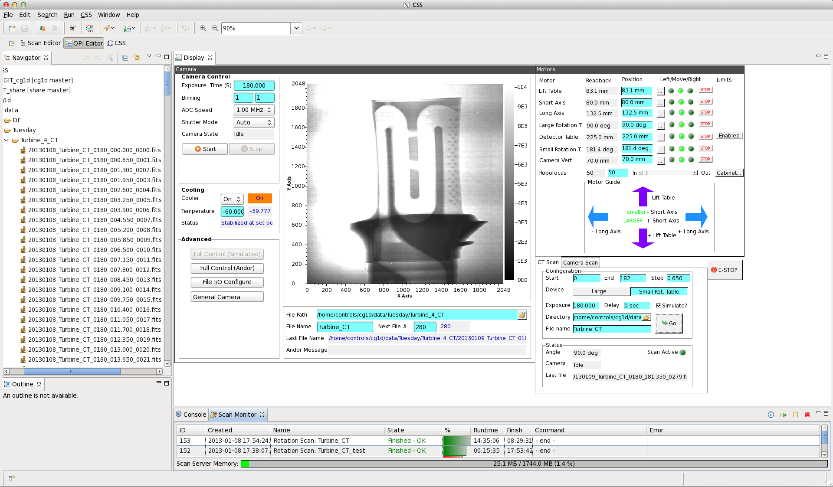
Synoptic Display - ORNL HFIR CG-1D
First EPICS/CSS operation with beam, Jan. 8, 2013

Slide 27
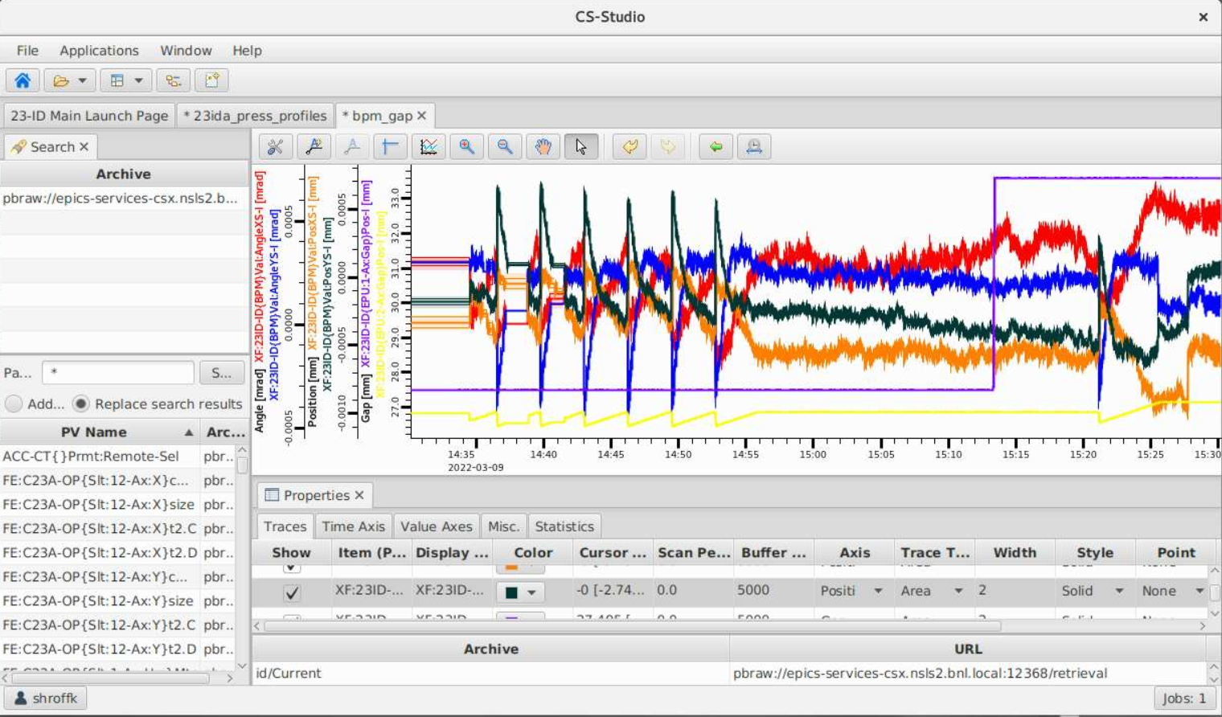
Archive Appliance Scales to >1M PVs

Slide 28
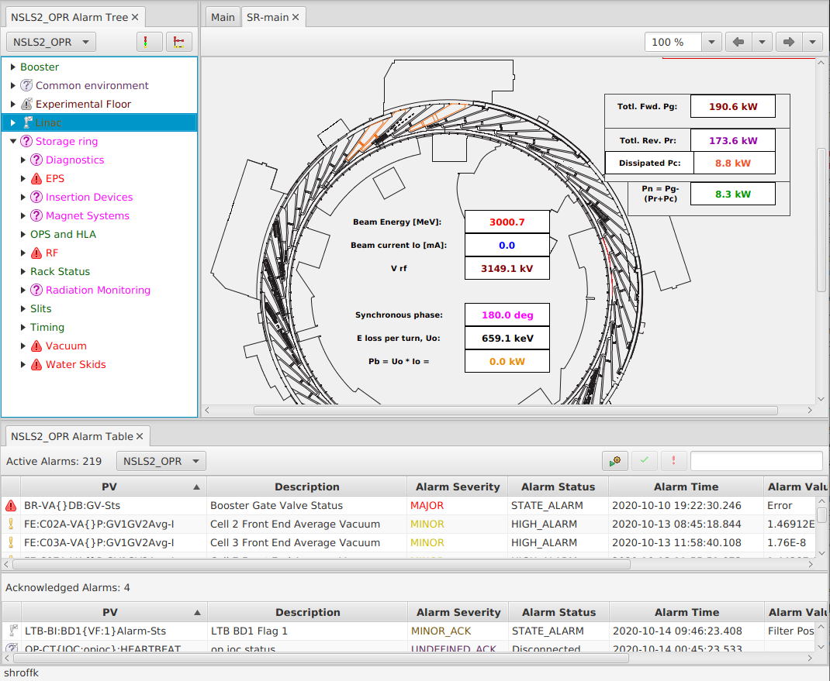
Alarm Server handles 5k alarm changes per second

Slide 29
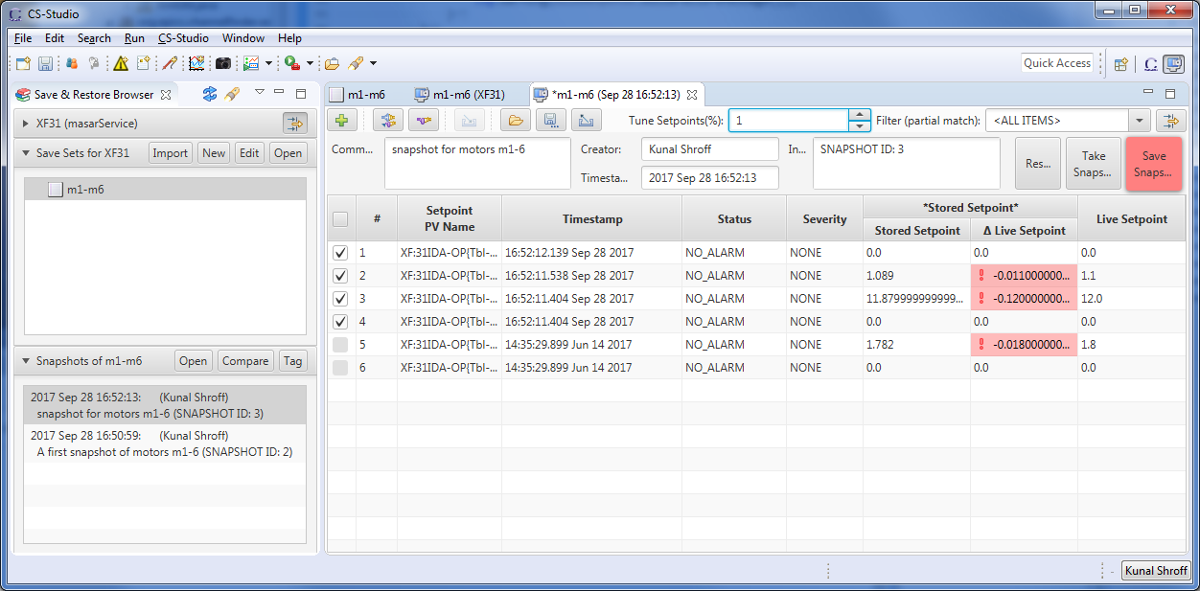
Save/Compare/Restore Sets for Managing Settings

Slide 30
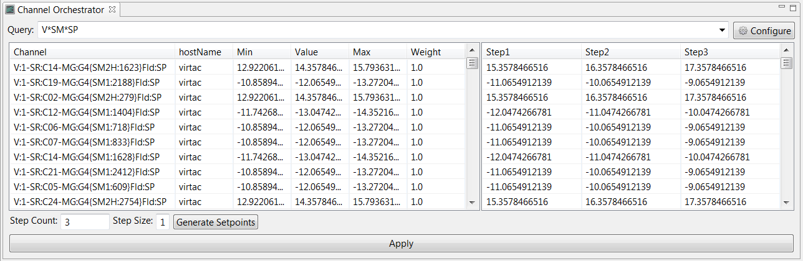
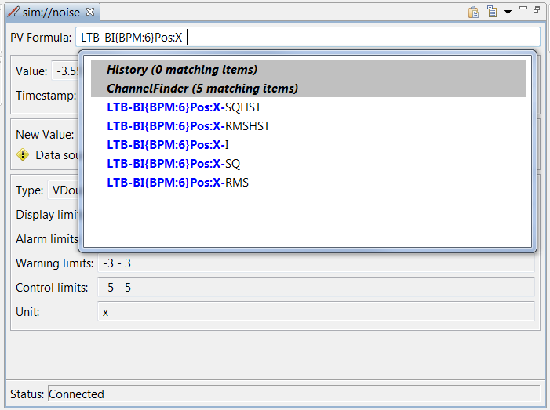
Channel Finder Provides Views of >1M PVs

Slide 31
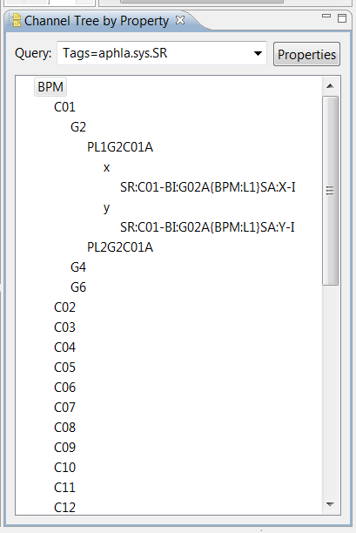
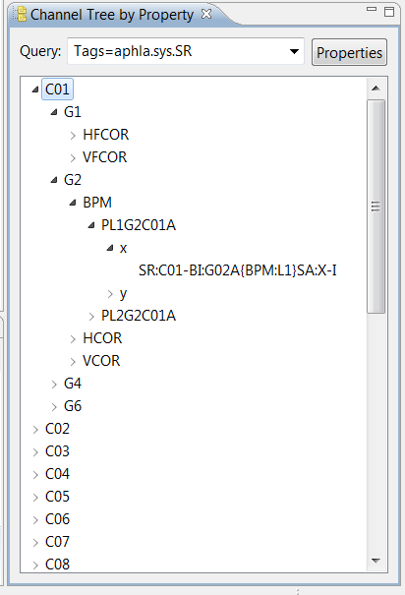
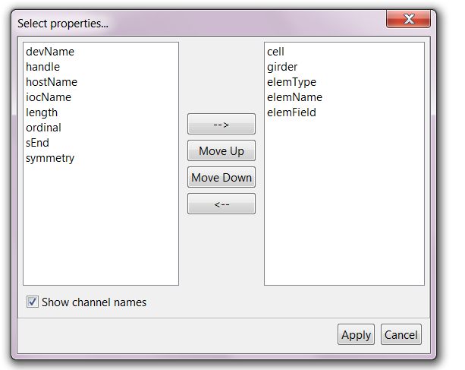
Channel Finder provides hierarchical view

Slide 32
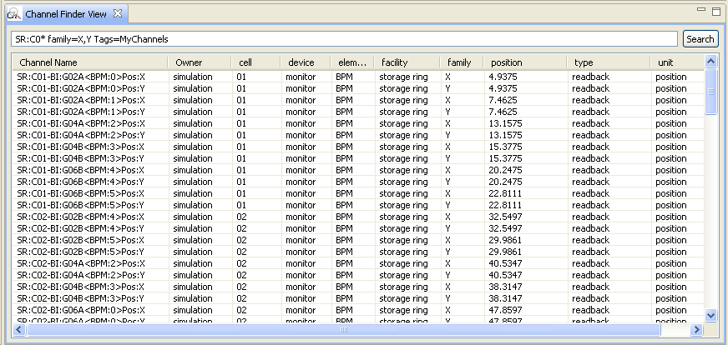
Channel Finder queries names and properties

Slide 33
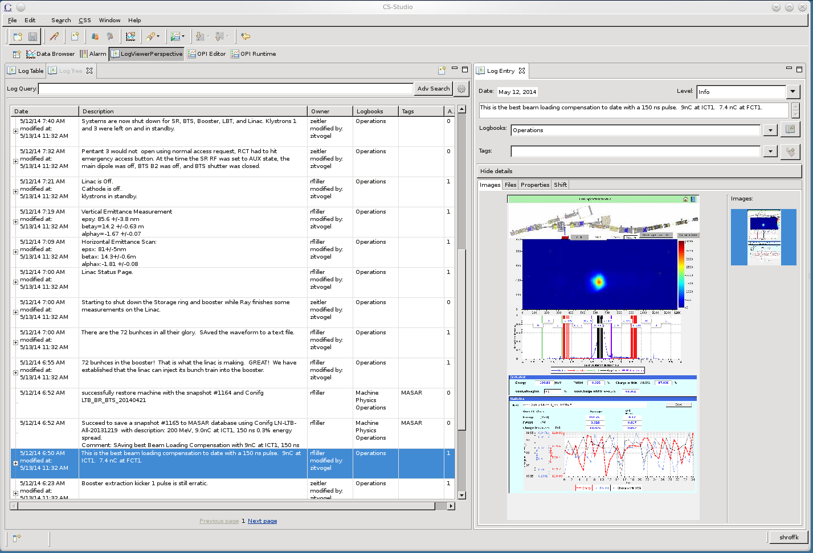
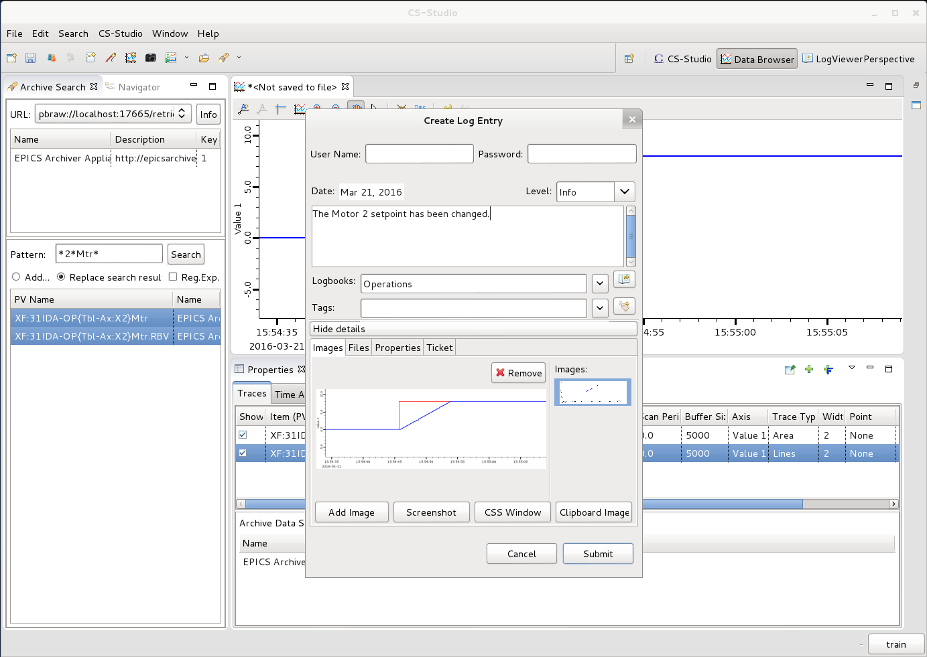
eLog is an electronic log book – Enter, Search, Amend
Viewer
Create Entry

Slide 34
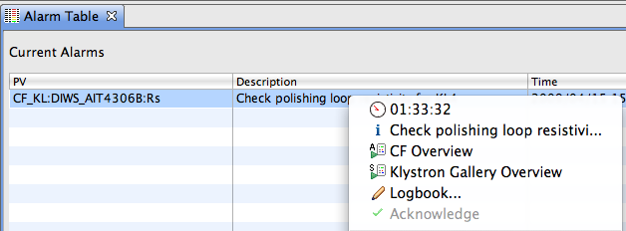
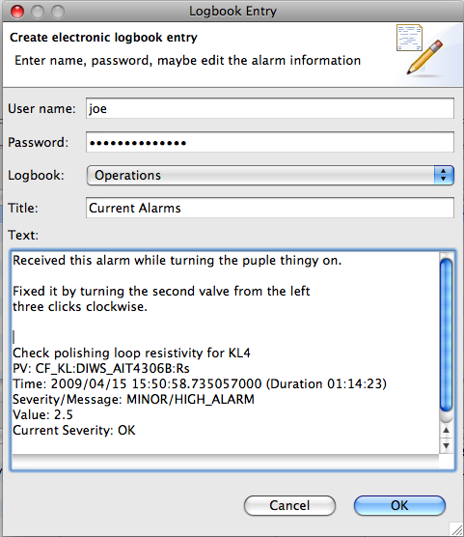
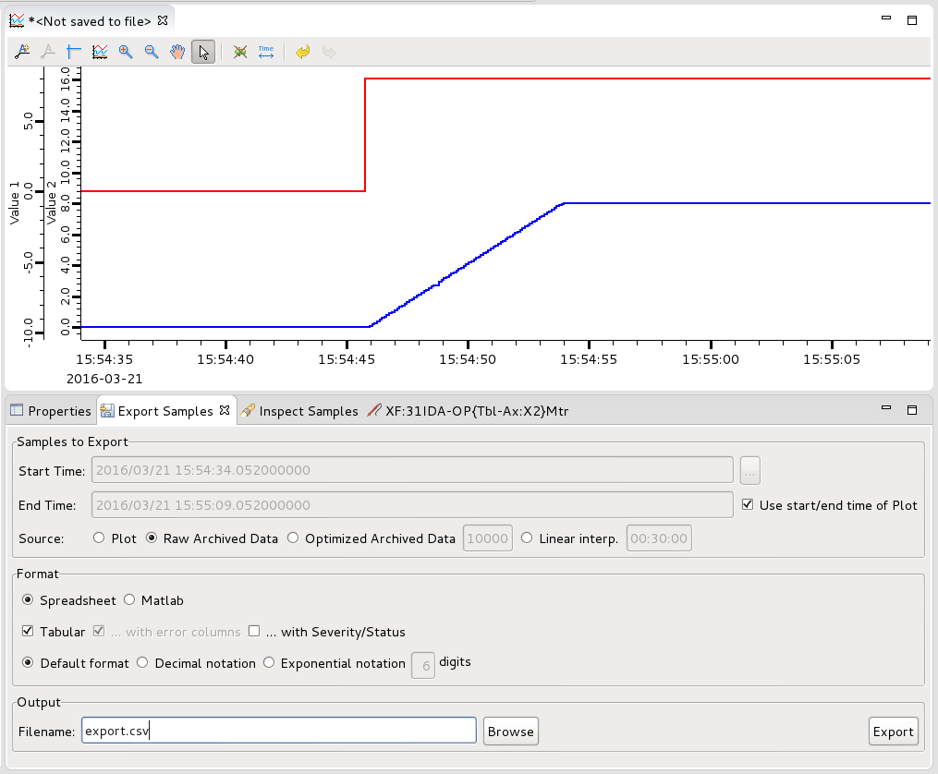
Phoebus Supports Workflow Between Services

Slide 35
EPICS Can Integrate High Performance Systems
The driver and devices support layer provide an interface to high performance systems. For DAQ, a driver can stream data to a network based disk at 1024 signals * 250 kHz * 3 bytes continuously while providing samples of the data to an EPICS record for real time monitoring.
Time stamps, triggers and machine metadata for high performance systems come from embedded event receivers along with the data that are provided to the Process Database for nanosecond data correlation.
FPGA applications are configured and monitored through a driver interface. FPGA based devices have 100’s of monitor points, metadata and configuration information.
A lifecycle data collection and management tool has been developed for Machine Learning and Experimental Data (Machine Learning Data Platform).

Slide 36
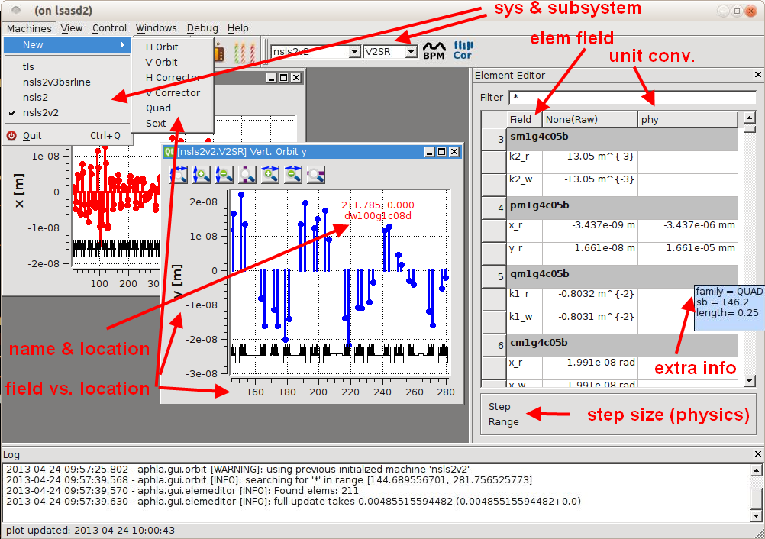
EPICS – PVA/CA and Services Compliment Applications

Slide 37
EPICS - supports high performance systems
MLDP
Ingestion
Viewer
Export API
Data Management
CS Studio:
Synoptic Display
Directory Clients
Elog Client
Archive Browser
MASAR Client (restore)
Channel Access Server
MATLAB, Python, Java:
Realtime Physics Applications:
C, C++, Java, Python MATLAB, State Notation Language
Client Applications:
Channel Access Gateway
PVA/CA Access
PVA/CA Access
PVA /CA Client
GRPC
PVA/CA Client
Inventory
Beam Data (TBT BPMs, …)
Operator Log
Save Sets
MASAR
Archive
Appliance
Experiment Data
PVAS/HTTP
GRPC
Alarm Aggregation
Channel
Finder
PVA/HTTP
GRPC
PVA/HTTP
PVA
PVS/HTTP
PVA/HTTP
EPICS - SCADA
Micro Services
Optics
Directory
Save Sets
Time Series Data
Snapshot Data
Component DB
Snapshot Data
DAQ
Simulation IOCs
Beamline DAQ IOC
Injection Extraction IOC
PVA/CA
PVA/CA
RF IOC
Vacuum IOC
PVA/CA
Diagnostic IOCs
Power Supply IOCs
PVA/CA
PV/CAA
Pt to Pt Comm
PVA/CA
PV/ACA
Timing
Snapshot Data
DAQ Driver
Instrumentation
Instrumentation
DLS Simulation
Timing
FPGA Instrument
FPGA Instrument
FPGA Instrument
FPGA Instrument
FOFB/MPS

Slide 38
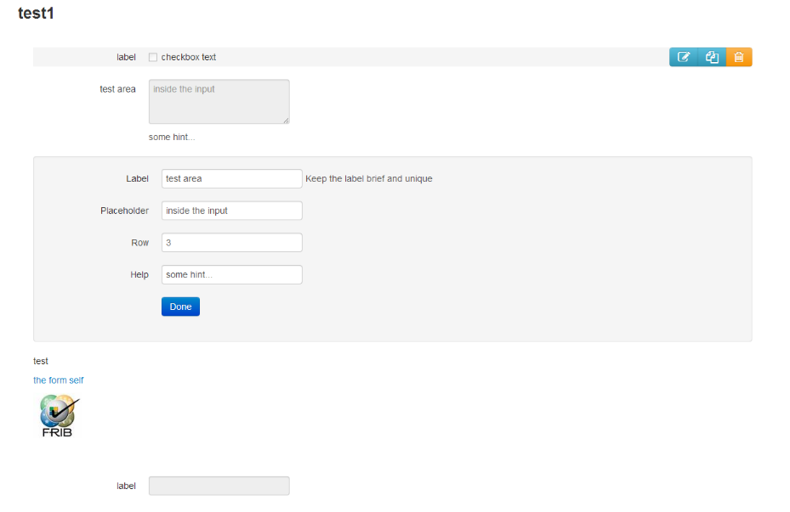
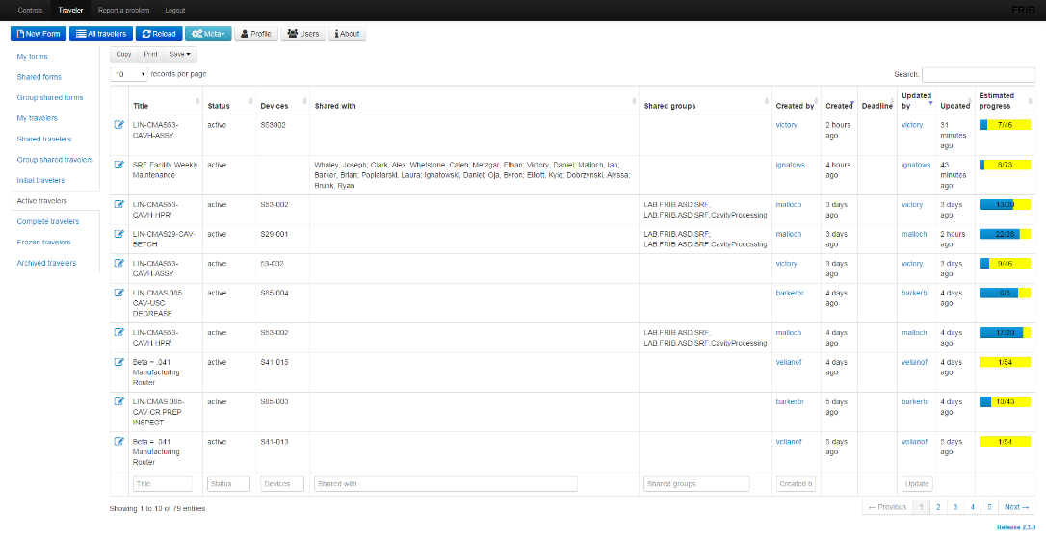
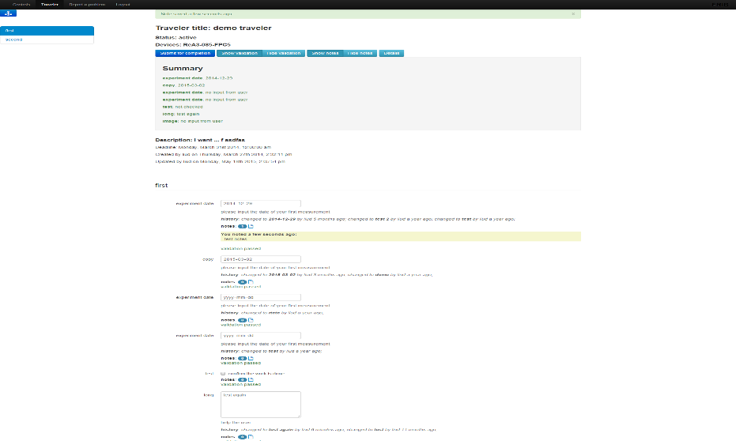
Generally useful tools - eTraveler
Main UI
Form builder
Traveler Page

Slide 39
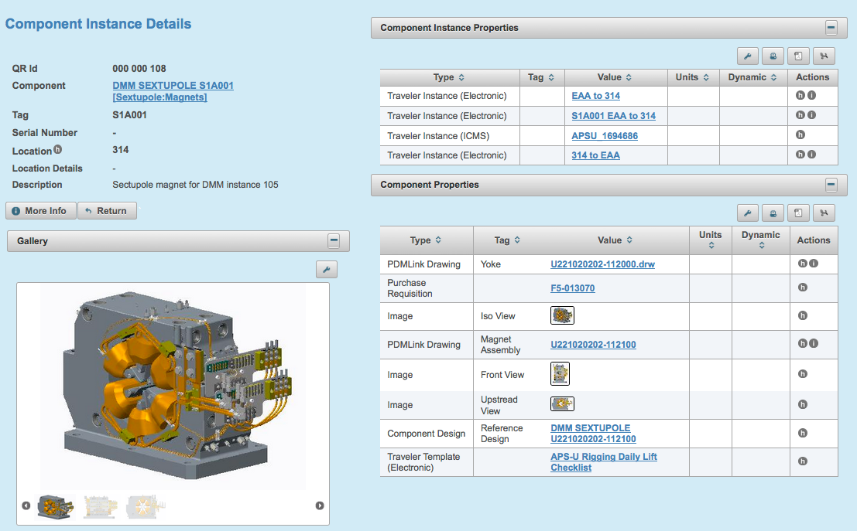
Generally useful tools – Component Database

Slide 40
Collaboration is not limited to SCADA
The community that exists around the use of a common platform provides some common language to solve common problems.
Open hardware is just starting to show promise with several groups completing hardware projects – spearheaded by the group at LBNL/ALS with an open source FPGA base board (Marble) and a LLRF controller board (Zest).
Tools for inventory (Component Database) and electronic travelers (eTraveler) and directory services (Channel Finder) - are developed in this community and used outside by other control systems.
Drivers developed for hardware in this community have been used in other environments. Still put up all of the PVs and unplug and re-plugin the communication cables.
The support from this collaboration has made it possible for small and large facilities from private startups to university laboratories to poorly funded facilities without adequate resources to provide a solid core functionality.

Slide 41
Scientific Control Solutions - Conclusions
Scientific Control Systems cover a large range of disciplines. The most challenging part of a scientific control system is defining requirements, interfaces and specifications.
A SCADA system is a small part of a scientific control system.
PVXS and NTTypes covers 80% of the present day requirements. There are more than 2 million PVs in a large facility. The Process Database is has not yet reflected these new capabilities.
A collaboration provides a network of cooperating engineering groups that have worked together to address some of the challenges that are outside of the narrow scope of a SCADA system such as physics, DAQ and AI. Next stop – open-source hardware.

