Slide 1


Shaking the oac-tree

Slide 2
Adapting oac-tree for EPICS environments
Disclaimer: this presentation is to bring up some ideas for discussion, not to present actual implementations.
Sequencing in a complex environment
  State machines vs behaviour trees
Embedding in (typical?) EPICS infrastructures.
  Management of parameters,
  Replication and reuse of components
Reacting to unforeseen changes
  Design methodologies
Get the software from: https://github.com/oac-tree
My private repo for some simple examples: https://github.com/ttkorhonen/vlinac (to be extended)

Slide 3
Getting to a known machine state – and maintaining it
In a complicated machine, preconditions are not trivial. Some kind of sequencing and state checks are required.
    EPICS sequencer written in SNL?
      Scalability, PVA support, configurability,…issues
Save & Restore, or „save, compare and restore“ is a common tool to save a known machine state and restore it at a later stage.
However:
  EPICS S&R restores PV values, but does not consider state, nor does it check the result. However, this “typically works®”.
  Some kind of combination of S&R and sequencing needed.

Slide 4
Enter “OACTree”
OACTree is based on Behaviour Trees:
  Sequences can be implemented easily, but not only that: OACTrees can be made to react to changing circumstances
  Actions can be modularized and combined to form larger entities
But: how to handle cases that are logically similar but differ in parametrization?
  Typical use cases: Set up accelerator optics, RF stations, ….
  Differing number of devices, each with their specific parameters.
And, how to integrate with typical EPICS infrastructure?

Slide 5

Simple use case example
Virtual linac demo. Small but illustrative.
  Enhance the demo by adding beam “mode”, beam destinations
  Mode: allowed beam parameter “envelope”.
How to break up setup in smaller units?
->
Setup
E-gun
Setup
to GV1
Setup to
final destination

Slide 6
Simple use case example
OACTree supports procedures
In this example, magnet current setting always follows the same procedure
How to parametrize the same rule for multiple, (almost) identical devices
  Downstream setting depends on destination. More about that later…
->
Setup
E-gun
Setup
to GV1
Setup to
final destination

Slide 7
Ingredients: templates + logic
To manage the configuration, a data store is needed.
  To nicely fit in, a JSON-capable datastore is convenient.
  For example, ChannelFinder can provide PVs if properly tagged with section information
A convenient editor helps to create and manage the behaviour trees.
  Component directories and composition
Data store
(database, etc.)
BT Editor
JSON
Logic template
Template
processor
OACTree
XML
Submit job

Slide 8
Example of logic (XML)
This consists of one simple procedure “MagnetSetting”. Just checks if the PV already has the correct value; if not, then sets it.
The sections in blue will be expanded using a template processor (“mustache” templating language)
<?xml version="1.0" encoding="UTF-8"?>
<Procedure>
<Plugin>libsequencer-pvxs.dylib</Plugin>
<Plugin>libsequencer-control.dylib</Plugin>
<Sequence name="MagnetSetting">
<Fallback name="Set magnet">
<Equals leftVar="$MagnetSP" rightVar="$SetPoint"/>
<Sequence>
<Copy inputVar="$SetPoint" outputVar="$MagnetSP"/>
</Sequence>
</Fallback>
</Sequence>
<Sequence isRoot="true">
<WaitForVariables varType="PvAccessClient" timeout="5.0"/>
{{#magnetList}}
<Include path="MagnetSetting" MagnetSP="{{magnet}}.value" SetPoint="{{magnet}}SP"/>
{{/magnetList}}
</Sequence>
<Workspace>
{{#magnetList}}
<PvAccessClient name="{{magnet}}" channel="{{MagnetPV}}"/>
<Local name="{{magnet}}SP" type='{"type":"float64"}' value="{{setpoint}}"/>
{{/magnetList}}
</Workspace>
</Procedure>
Fallback: if the condition is met, return “success”, otherwise fall back to (==execute) the following statement(s)

Slide 9
Substituting configuration
The blue sections in the previous example will be expanded using a template processor (“mustache”)
Below is a sample setting (JSON array), consisting of
  Magnet identifier “magnet”
  Corresponding PV “magnetPV”, and
  A setpoint value.
{
"magnetList" : [
{"magnet": "BM1", "MagnetPV" : "timokorhonen:BM1:setCurrentC", "setpoint" : "214.55"},
{"magnet": "h1A", "MagnetPV" : "timokorhonen:H1:setCurrentC", "setpoint" : "-1.31"},
{"magnet": "v1A", "MagnetPV" : "timokorhonen:V1:setCurrentC", "setpoint" : "1.79"},
{"magnet": "h2A", "MagnetPV" : "timokorhonen:H2:setCurrentC", "setpoint" : "2.67"},
{"magnet": "v2A", "MagnetPV" : "timokorhonen:V2:setCurrentC", "setpoint" : "-1.39"},
{"magnet": "h3A", "MagnetPV" : "timokorhonen:H3:setCurrentC", "setpoint" : "-1.68"},
{"magnet": "v3A", "MagnetPV" : "timokorhonen:V3:setCurrentC", "setpoint" : "-0.8"},
{"magnet": "h4A", "MagnetPV" : "timokorhonen:H4:setCurrentC", "setpoint" : "1.63"},
{"magnet": "v4A", "MagnetPV" : "timokorhonen:V4:setCurrentC", "setpoint" : "0.1"},
{"magnet": "h5A", "MagnetPV" : "timokorhonen:H5:setCurrentC", "setpoint" : "-1.83"},
{"magnet": "v5A", "MagnetPV" : "timokorhonen:V5:setCurrentC", "setpoint" : "2.21"}
]
}

Slide 10
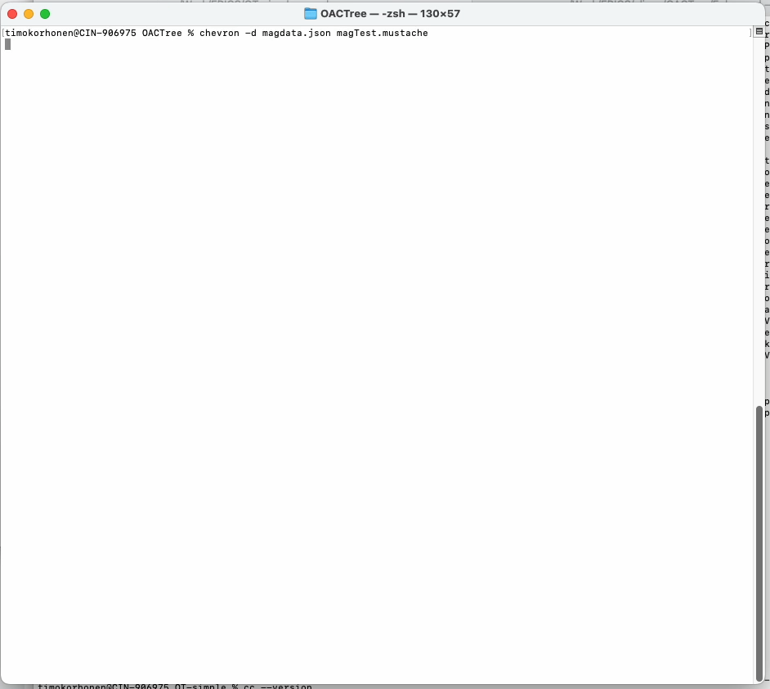
Substitution result
This short screen capture shows the end result.
The resulting XML snippet can be inserted in a top-level XML as an external procedure.
The simple internal “check&set” procedure is called for each substituted line.

Slide 11
Reacting to changes:
In a complex system, running a linear sequence has ist limits
  What if something happens during or after the sequence is done?
    A component fails, setting fails, configuration changes,…
  Re-run the whole sequence?
    Structuring a big state machine to react to changes is tough!
  With oac-tree, using “Repeat“, conditions can be made to be constantly evaluated. This is probably the more common case.
<Repeat maxCount="-1">
<Sequence>
<Fallback name="Beam Dest check">
<Equals leftVar="BeamDest.value.index" rightVar="FC2"/>
<Sequence>
<Copy inputVar="LowCurrent" outputVar="BeamMode.value.index"/>
</Sequence>
</Fallback>
…(sequence continues…)
A snippet showing continuous evaluation.

Slide 12
Reacting to changes: design methods
Going back to the earlier magnet setting snippet:
<Sequence name="MagnetSetting">
<Fallback name="Set magnet">
<Equals leftVar="$MagnetSP" rightVar="$SetPoint"/>
<Sequence>
<Copy inputVar="$SetPoint" outputVar="$MagnetSP"/>
</Sequence>
</Fallback>
</Sequence>
This is a simple representation of the “Postcondition-Precondition-Action“ design pattern.
  Precondition: is the magnet current where it should be?
  Postcondition: magnet current is properly set
  Action: setting the current.
This may look trivial, but recursively combining this kind of (small) snippets, one can easily build systems that react to changes – also out of a linear sequence.
->
?
Magnet set?
Set
current
A snippet showing continuous evaluation.

Slide 13
There is more:
To have an end-to-end demo, I used rethinkdb to store settings for different destination (and mode) combinations.
  Any JSON-capable datastore is OK.
Destination change triggers a corresponding change of settings, in a proper sequence.
The OACTree sequences also contain rules and constraints, e.g.:
  The vlinac (enhanced) has „low current“ and „high current“ modes.
  „high current“ mode is not allowed when destination is FC1. A reactive OACTree prevents this from being applied and automatically reverts to an allowed mode („low current“)
no time to demo the db now!
Talk to me offline if interested.

Slide 14
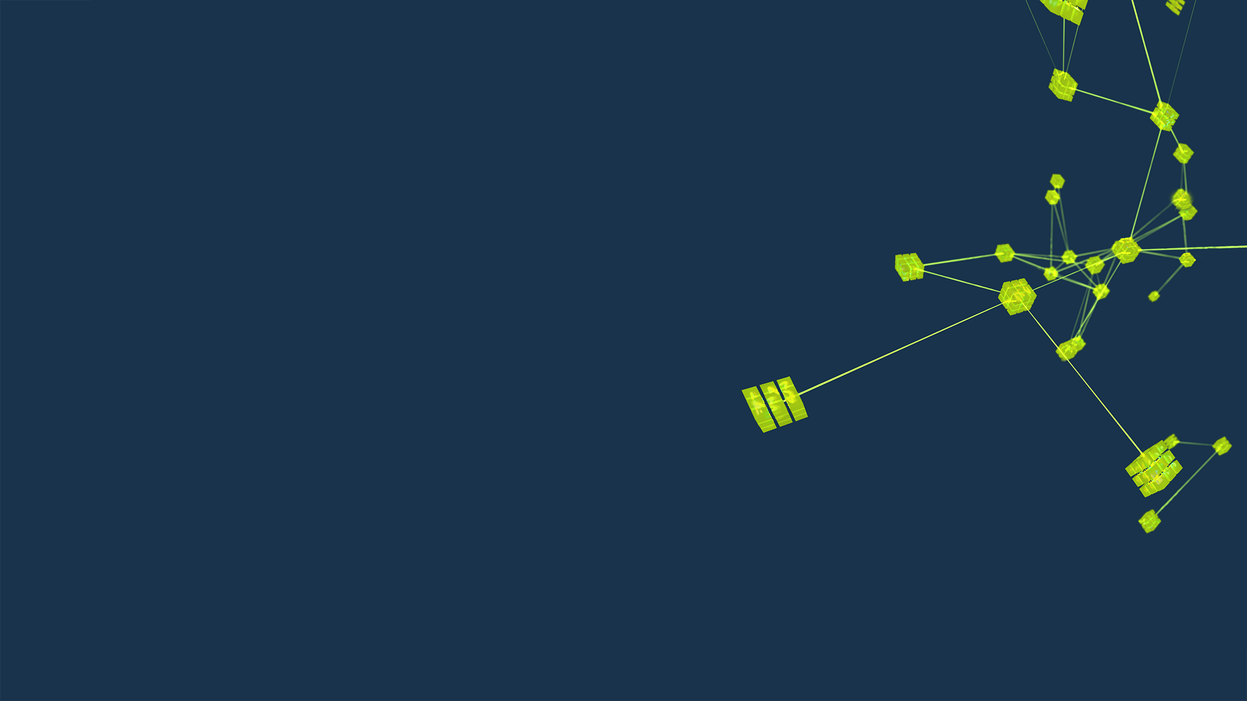
Thank You for Your Attention!
Credits:

