Slide 1

Spring EPICS Meeting at Saclay (Paris)
From 20-24 april 2026
Alexis Gaget alexis.gaget@cea.fr Françoise Gougnaud françoise.gougnaud@cea.fr Paul Lotrus paul.lotrus@cea.fr

Slide 2
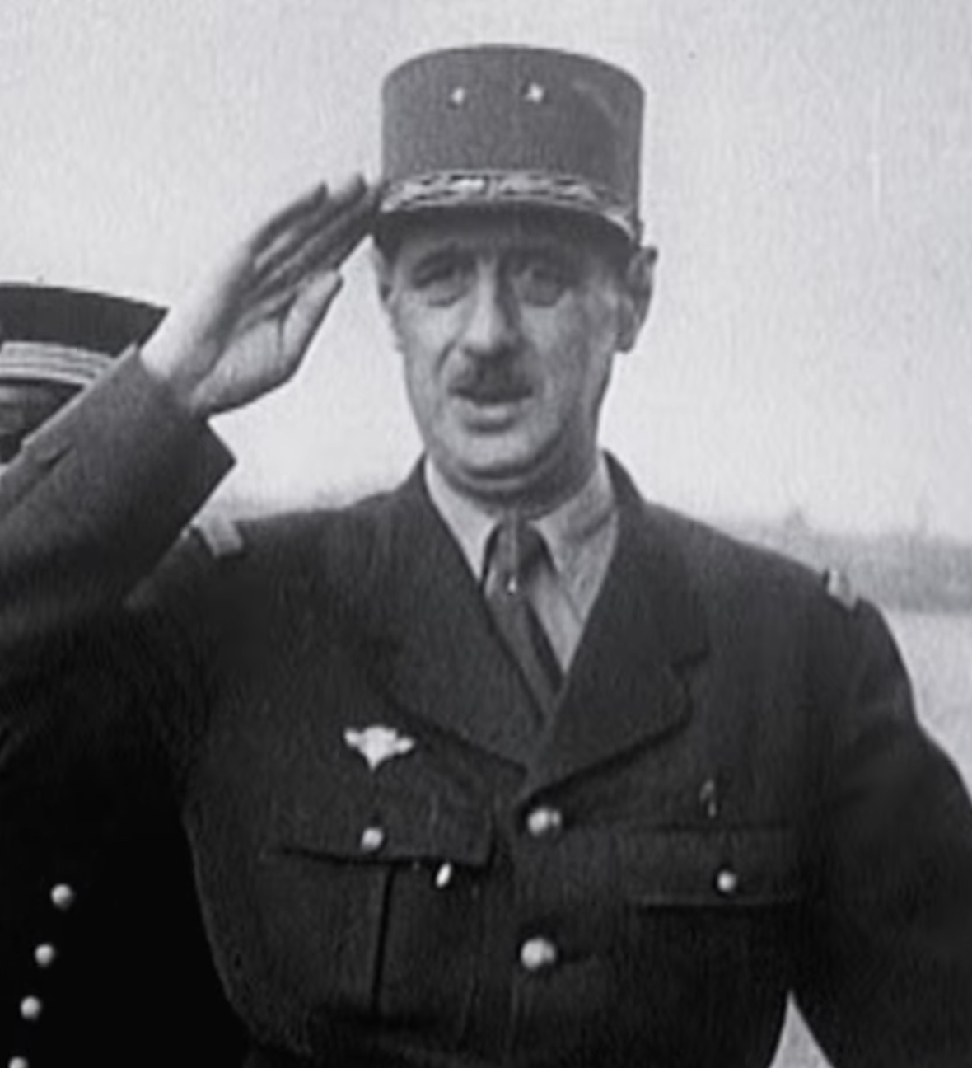
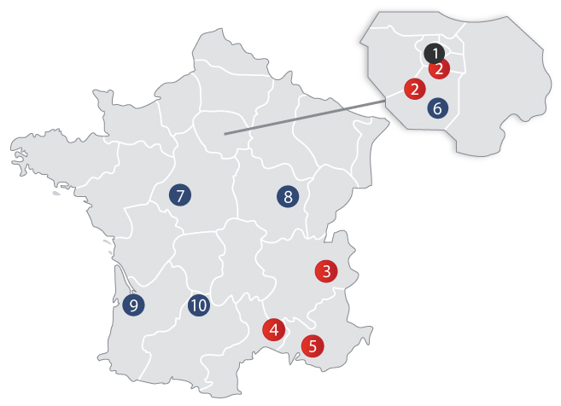
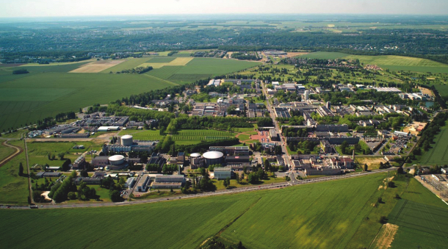
What is CEA ?
The Commissariat aux Energies Atomiques et aux Energies Alternatives (CEA) created in 1952 by Président Charles de Gaulle.
venue
15000 people all around France, 8000 people at Saclay.
3 main area:
Energy
Military
Fundamental Research
Aerial photo from early 2010’s
My office

Slide 3
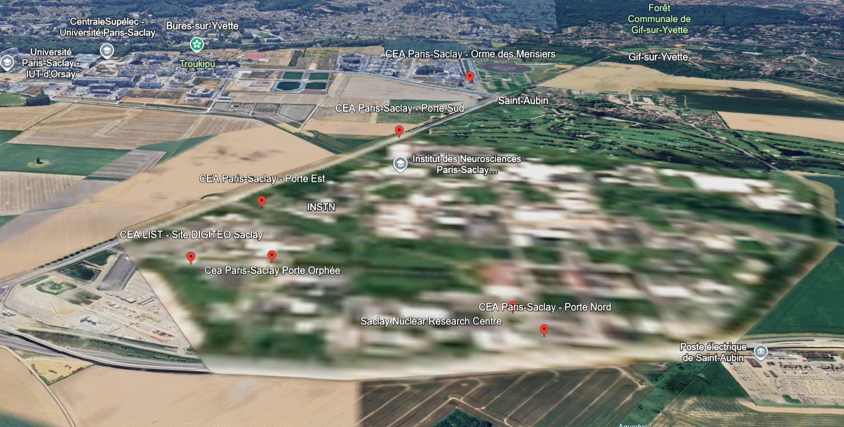

What is CEA ?
The Commissariat aux Energies Atomiques et aux Energies Alternatives (CEA) founded in 1952 by President Charles de Gaulle.
venue
hotel
15000 people all around France, 8000 people at Saclay.
3 main area:
Energy
Military
Fundamental Research
Google Earth now

Slide 4
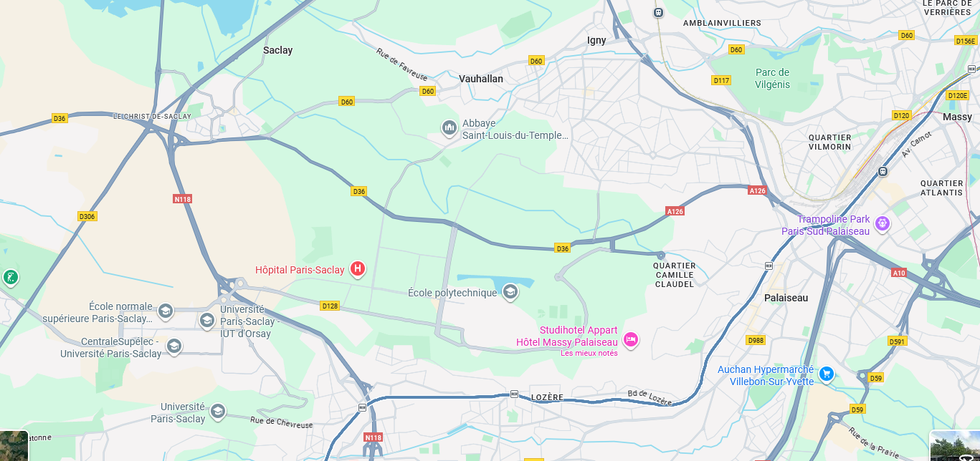
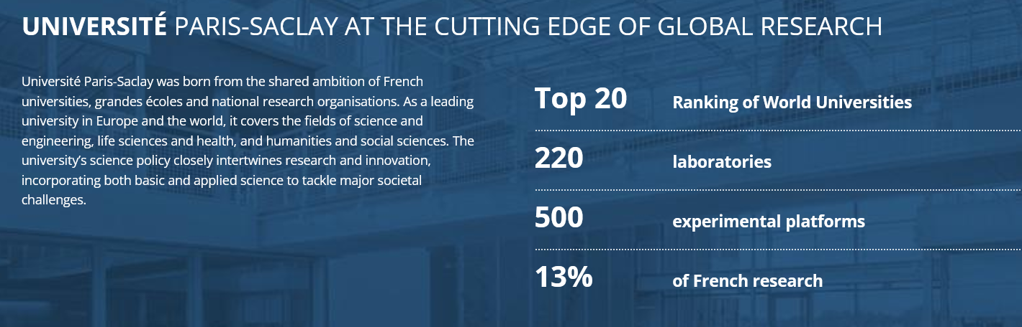
What is Université Paris-Saclay?
On the “Plateau de Saclay”
CEA

Slide 5
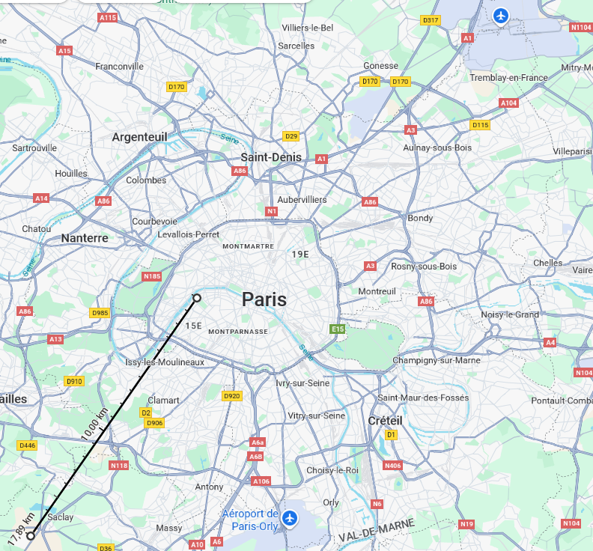
Where is « Plateau de Saclay » ?
Only 17,89km « à vol d’oiseau » from Eiffel Tower

Slide 6
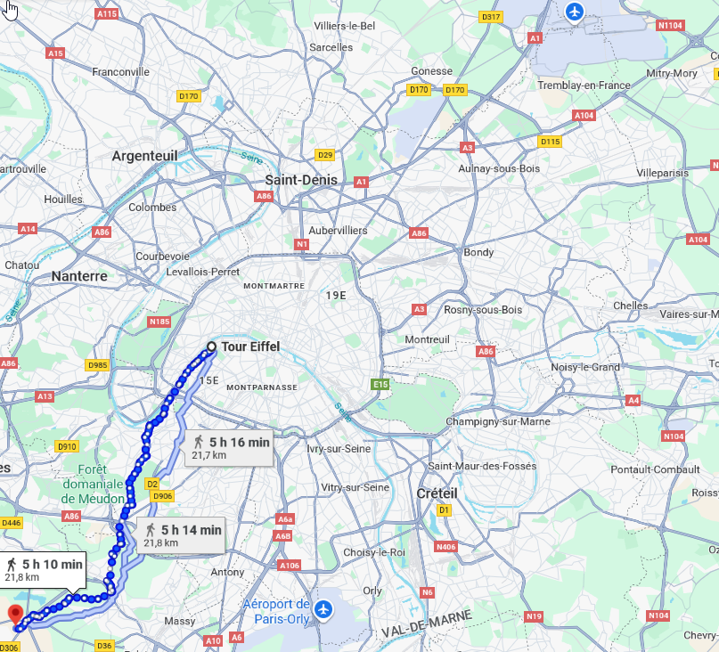
Where is « Plateau de Saclay » ?
Only 5h10m walk for the brave ones. Certainly not the most pastoral hike in France.

Slide 7
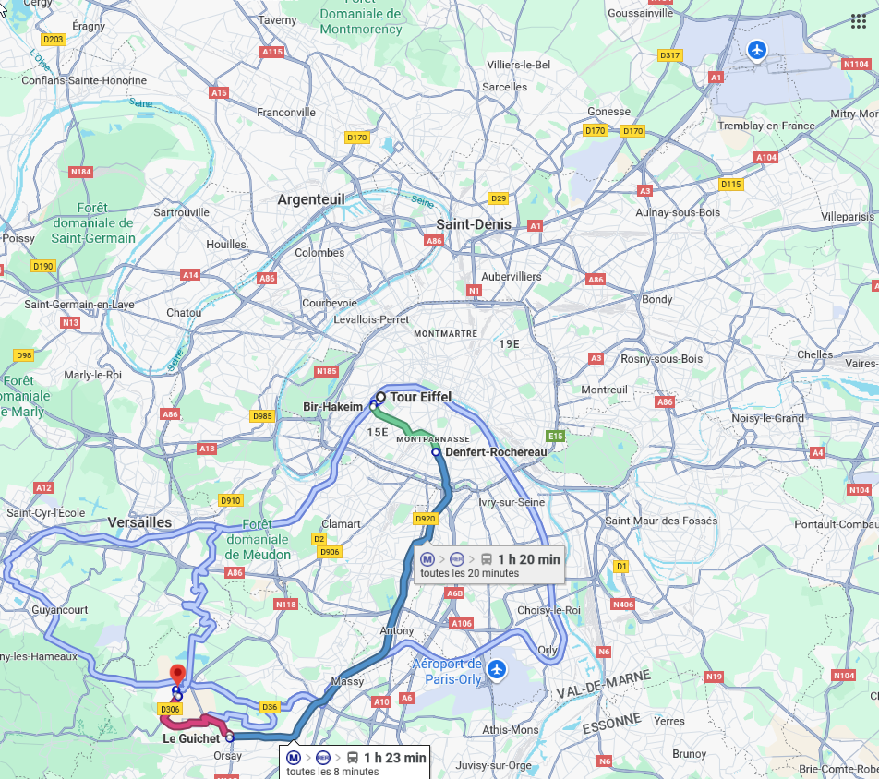
Where is « Plateau de Saclay » ?
1h20 by public transportation (from CEA to Eiffel Tower)
Massy < - - > Denfert Rochereau ~ 25min

Slide 8
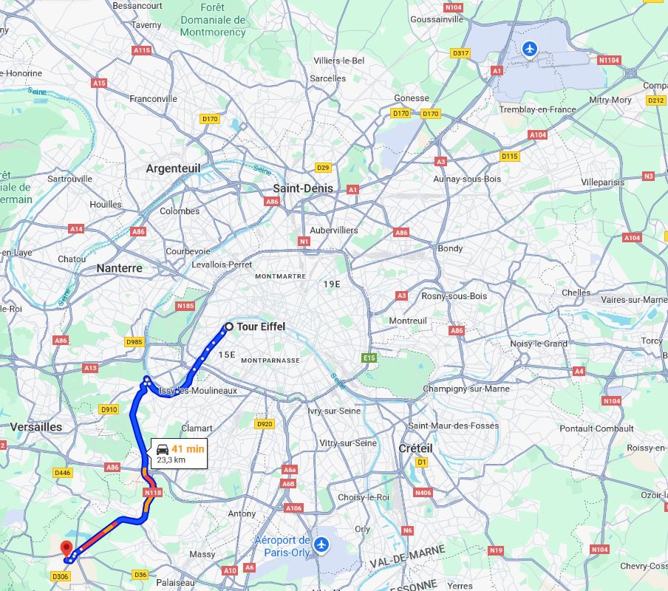
Where is « Plateau de Saclay » ?
41min by car at 17h20

Slide 9
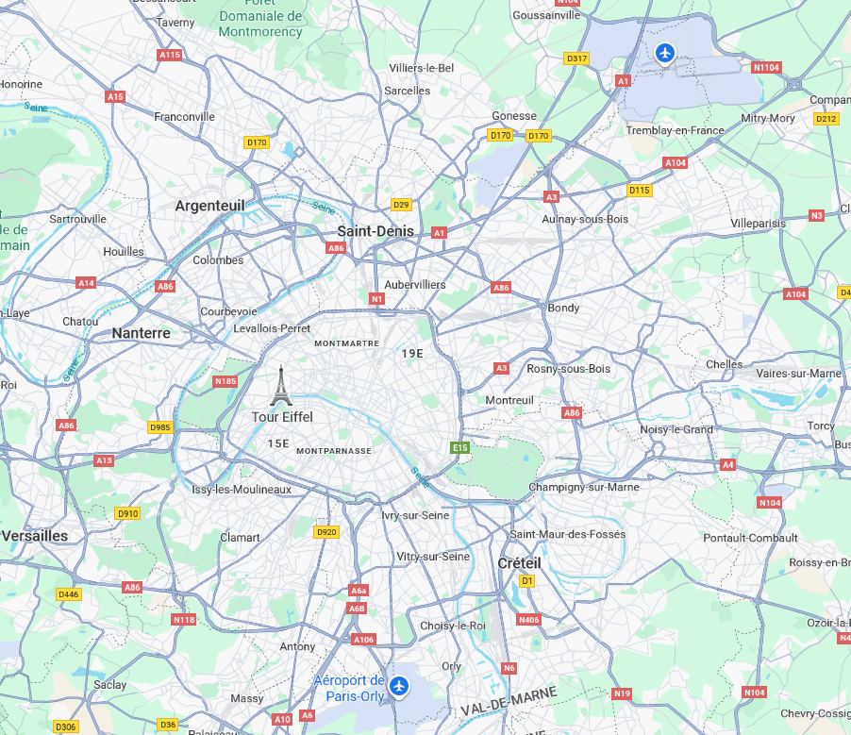
Where will you arrive ?
Most international flights land in Charles de Gaulle Airport (CDG) and others in Orly (ORY)
CDG
CEA
ORY

Slide 10
How to come to « Plateau de Saclay » ?
- The conference will take place at the Ecole Normal Supérieure (ENS) de Paris-Saclay.
CEA
- We will have 80 possible rooms there at Campanile (a brand new hotel in a brand new neighborhood). ~120€/night
- From the Train station “Massy-Palaiseau” and “Le Guichet”, buses go directly to ENS. There are Hotels around train stations.

Slide 11
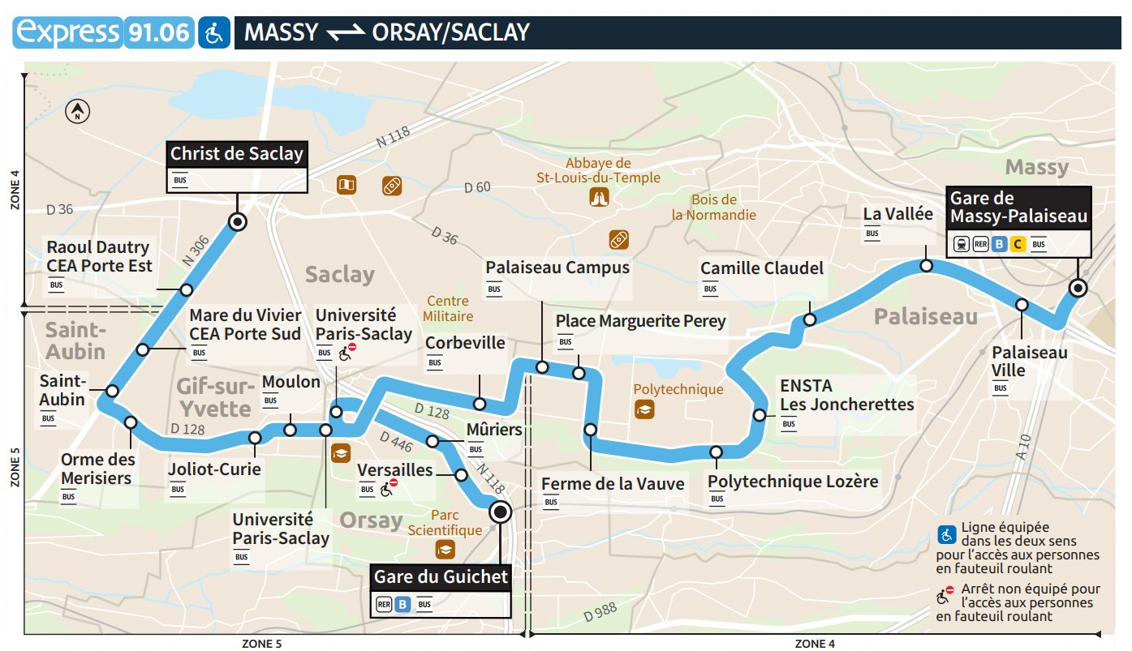
How to come to « Plateau de Saclay » ?
Phone App for public transportation
Citymapper
Transportr (open source)
IDF mobilité
Bonjour Ratp
- Stop in front of the venue

Slide 12
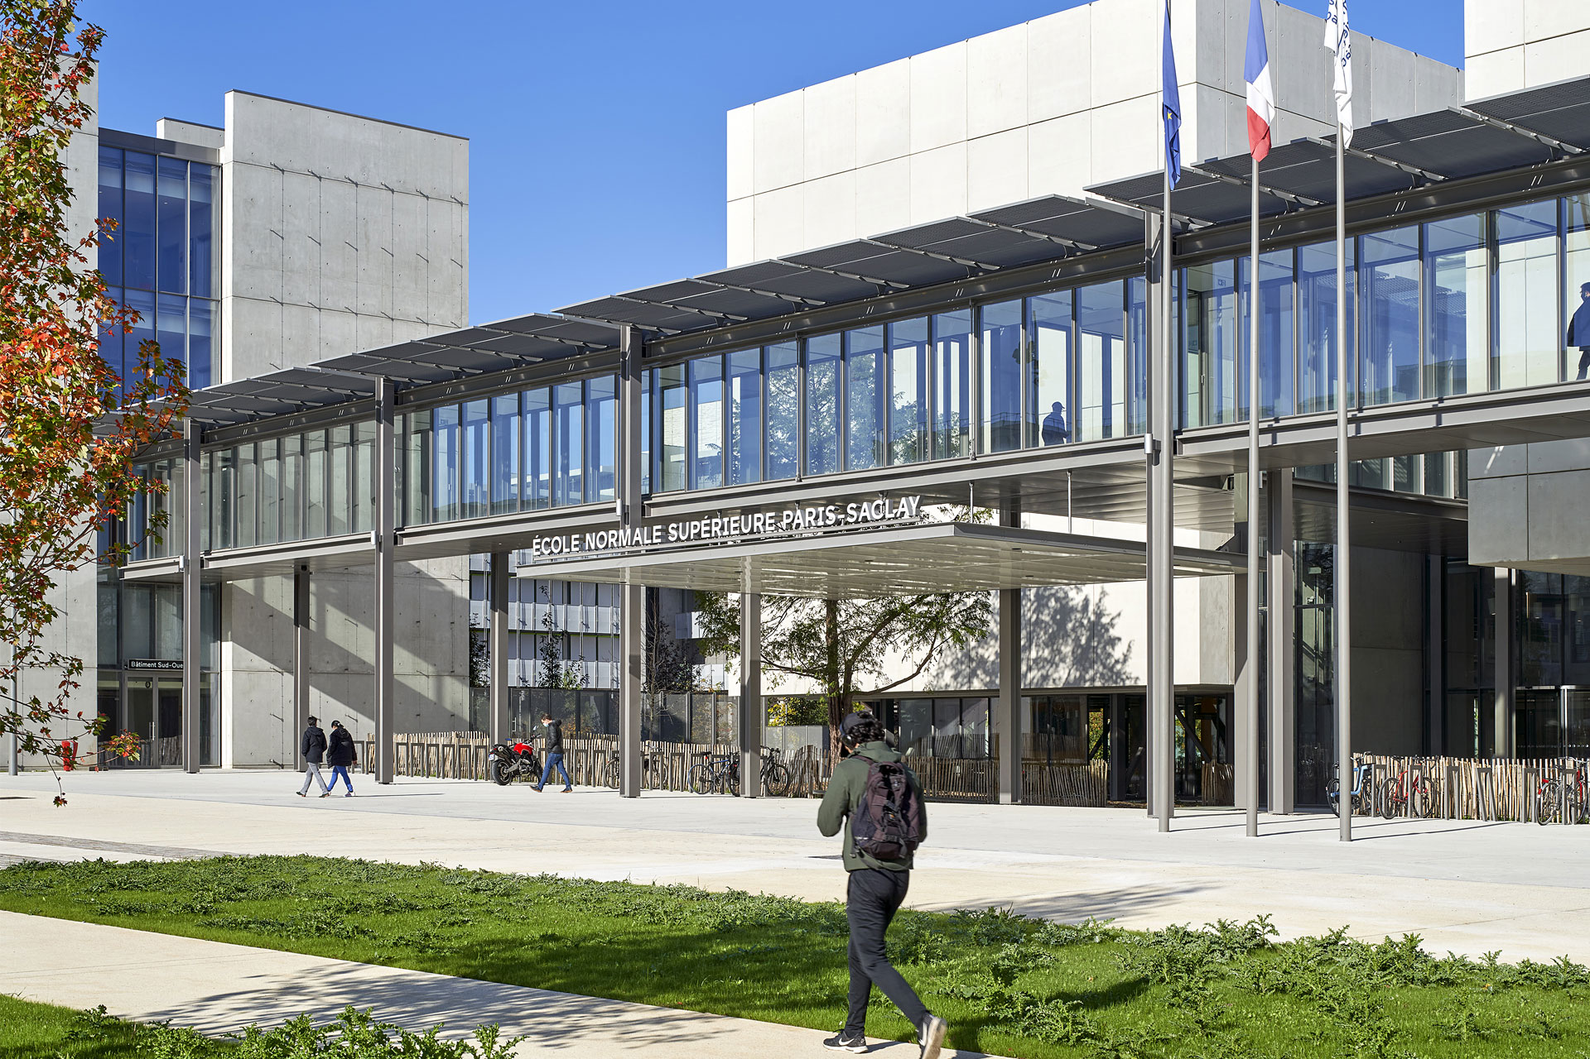
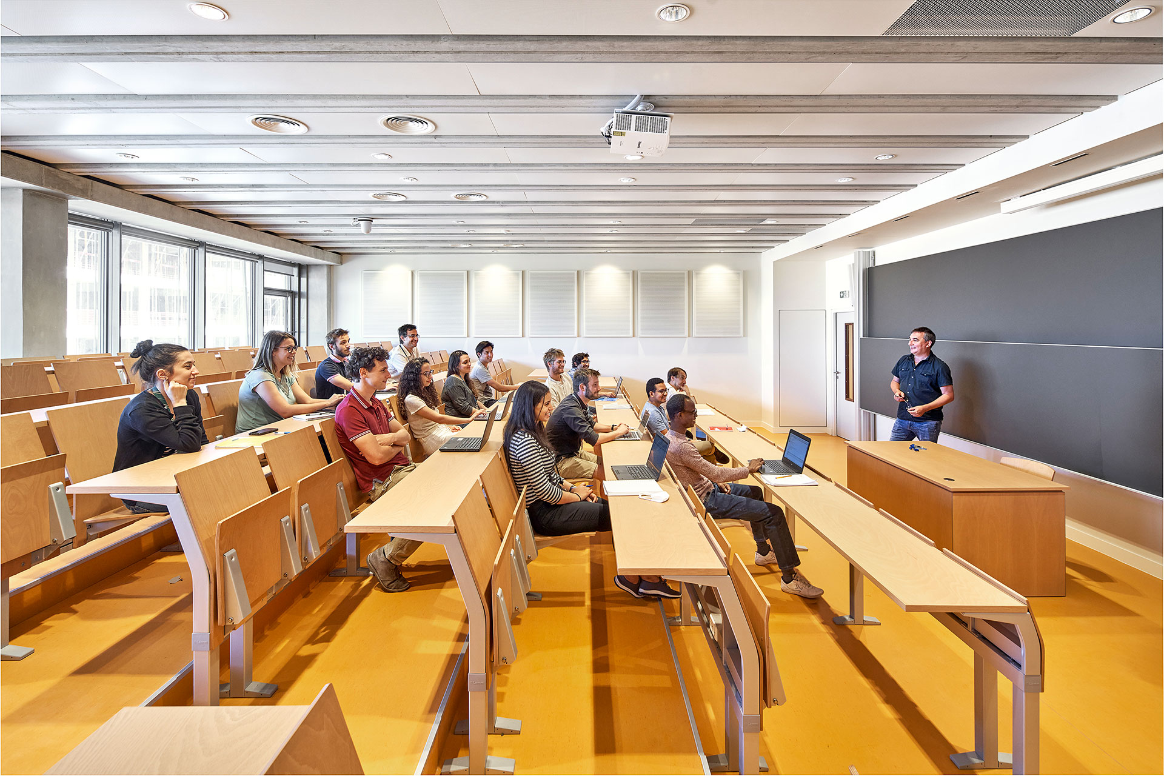
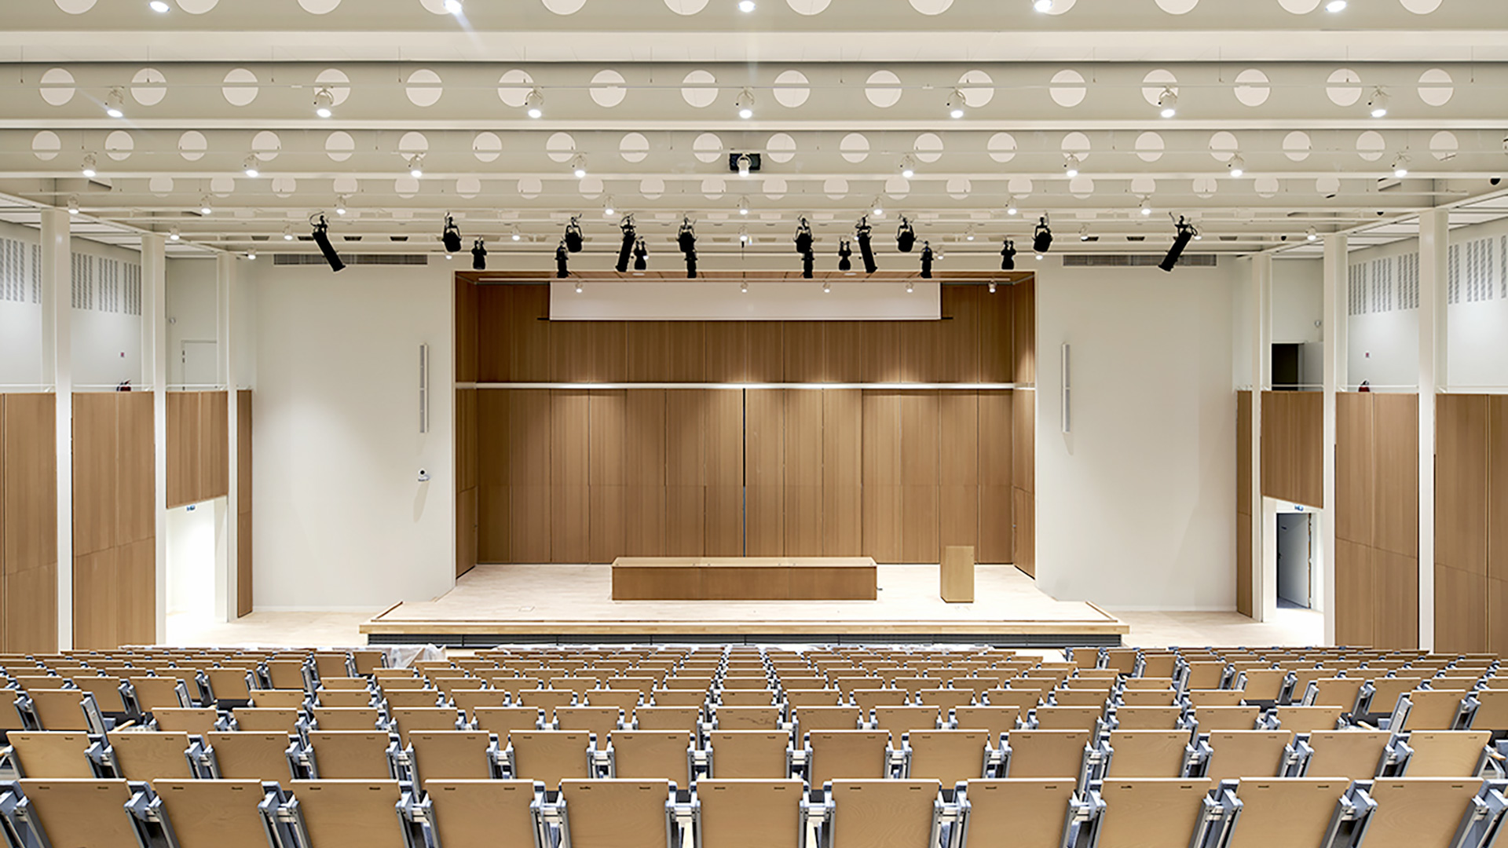
The venue
Ecole Normal Superieur (ENS) Paris-Saclay
Member of the Paris-Saclay University such as CEA
Amphitheater Alain Aspect – 400 seats
3 Rooms for workshop

Slide 13
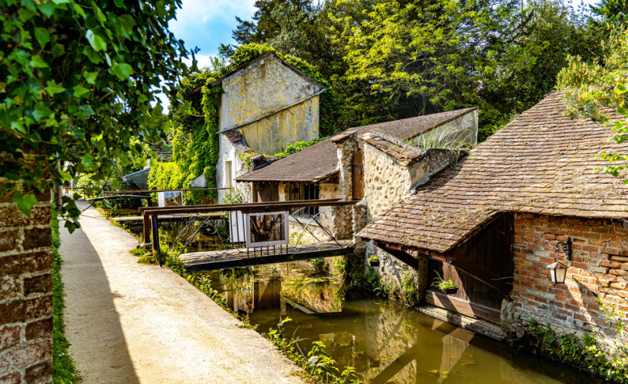
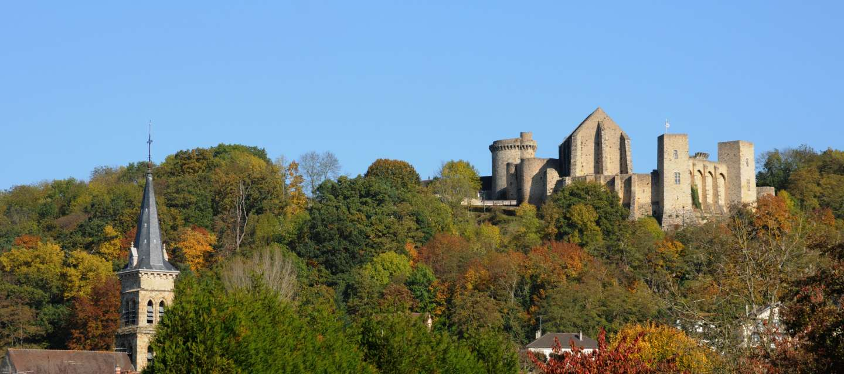
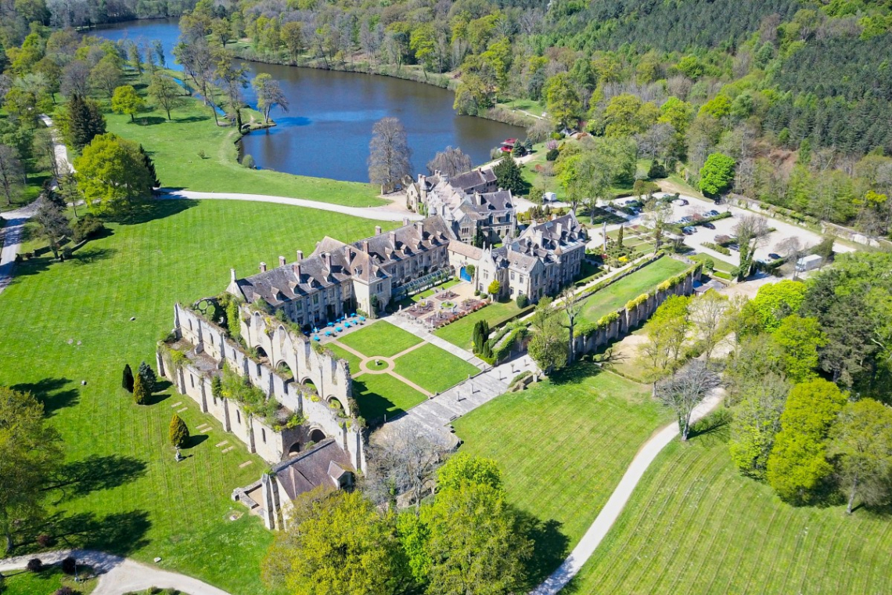
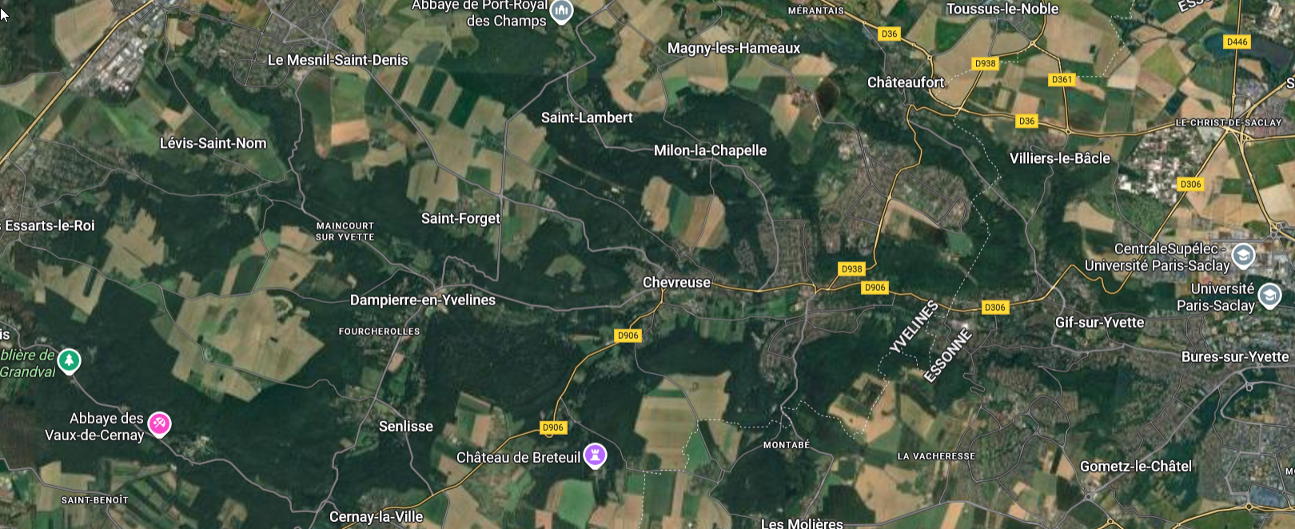
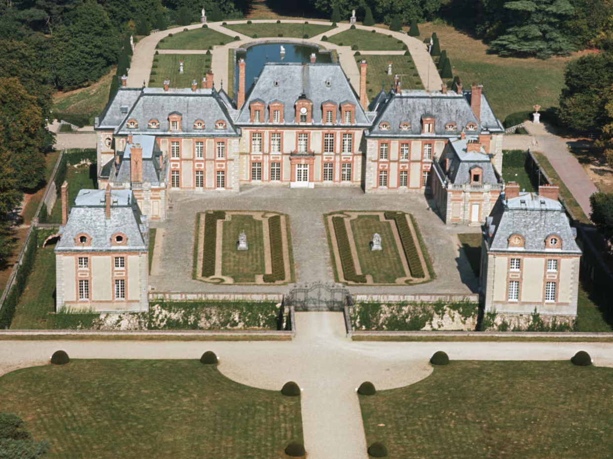
What to do around Saclay ?
Very near Saclay « La vallée de chevreuse »
Lots of hiking, biking, horseback riding
Castles
Gardens
CEA

Slide 14
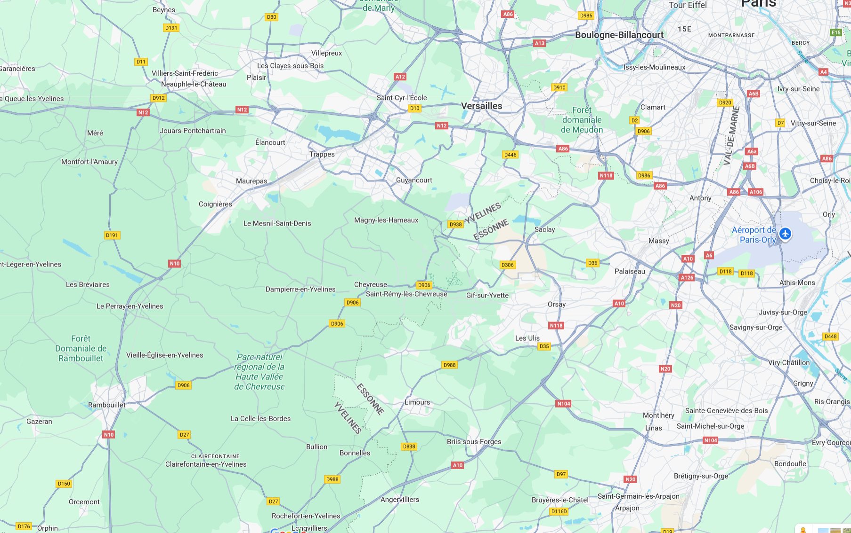
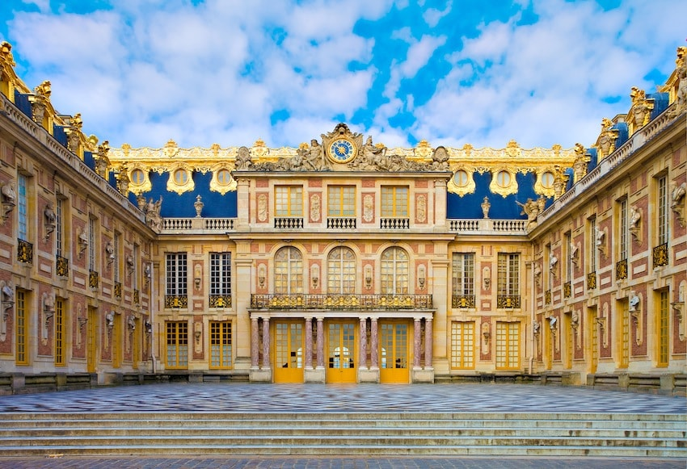
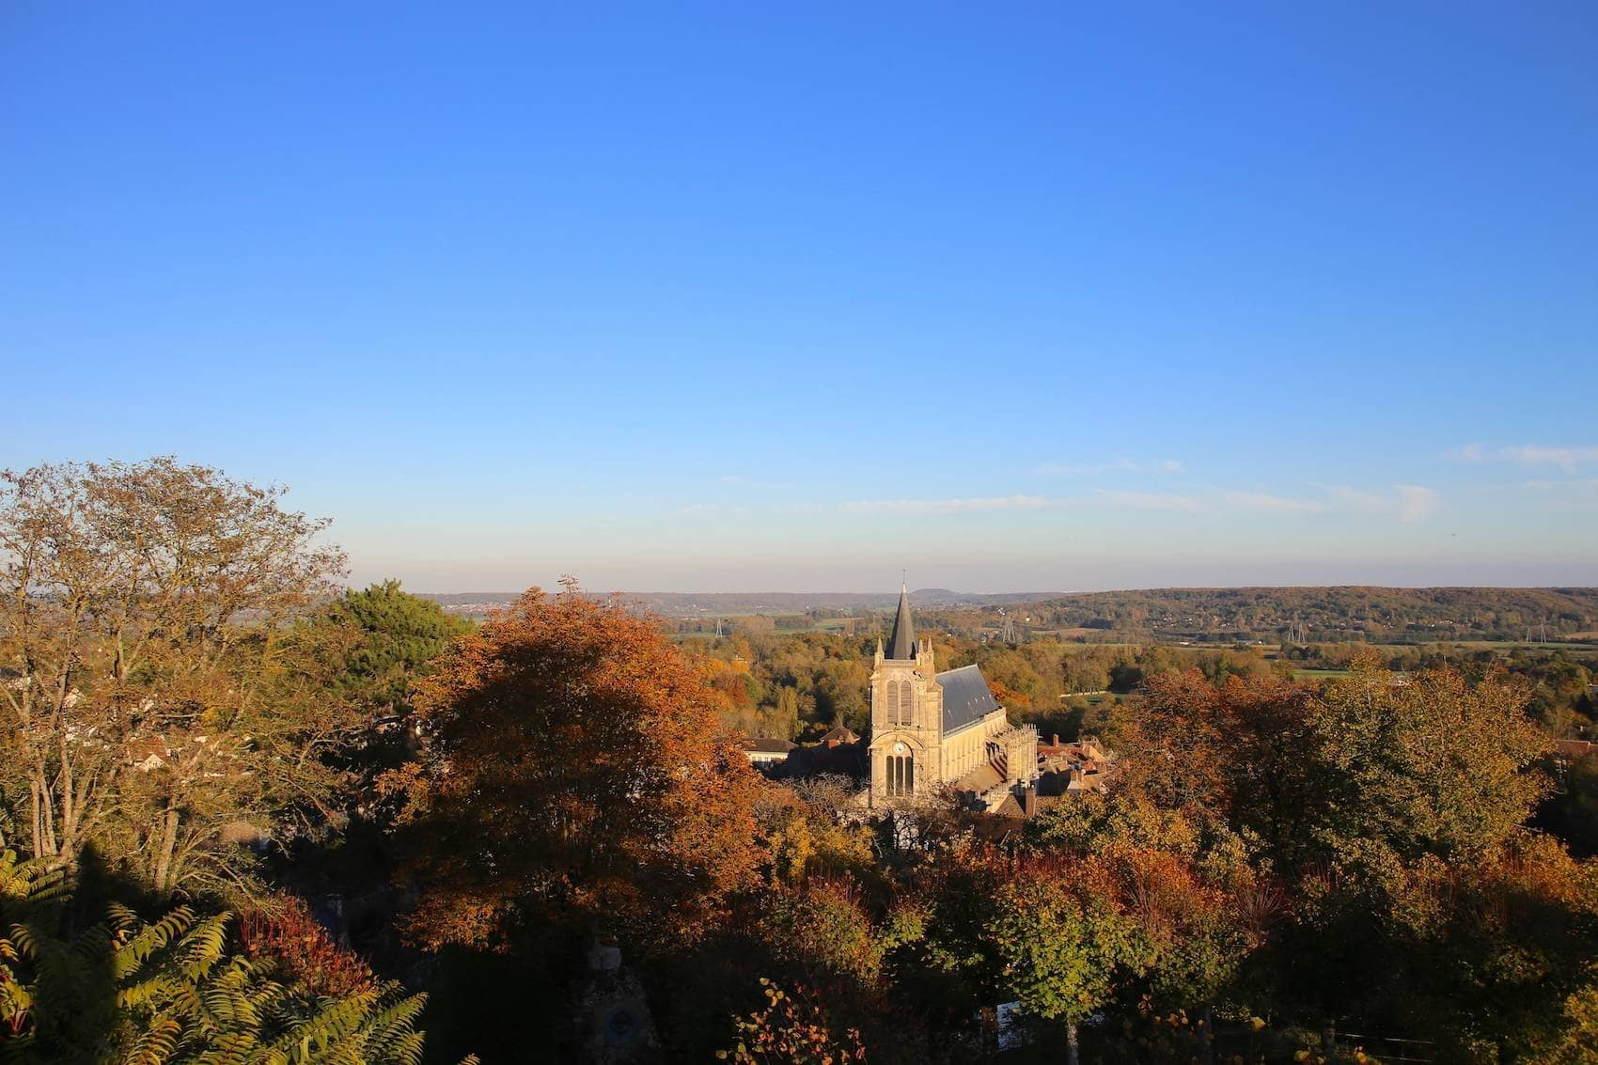
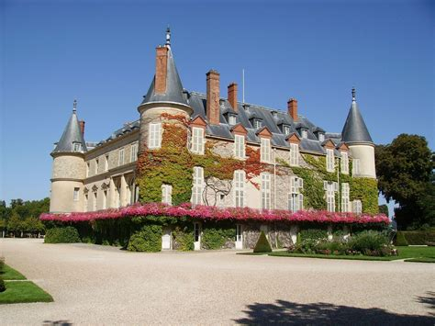
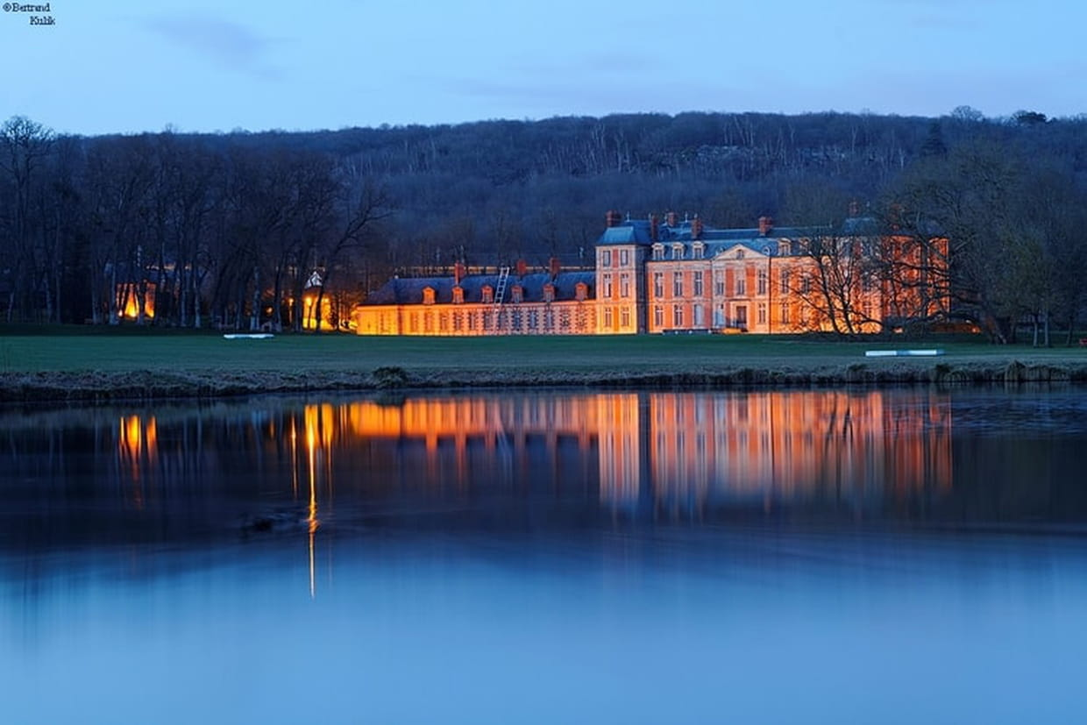
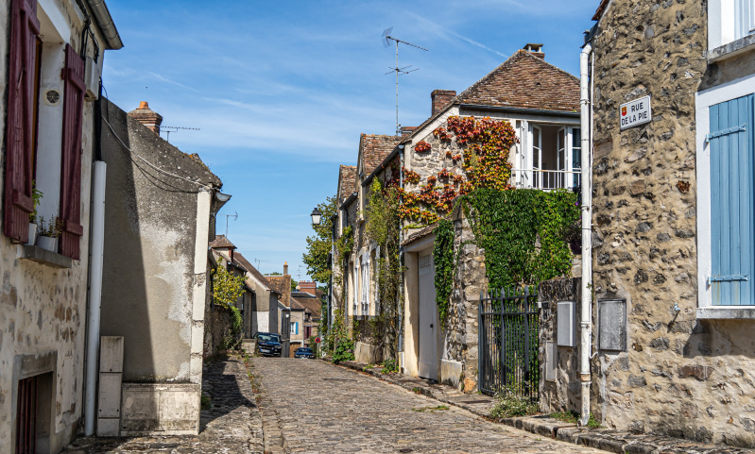
What to do around Saclay ?
Versailles castle
Montfort l’Amaury village
Chamarande domaine
Rambouillet Castle
Rochefort en Yvelines village
CEA
https://www.sortiraparis.com

Slide 15
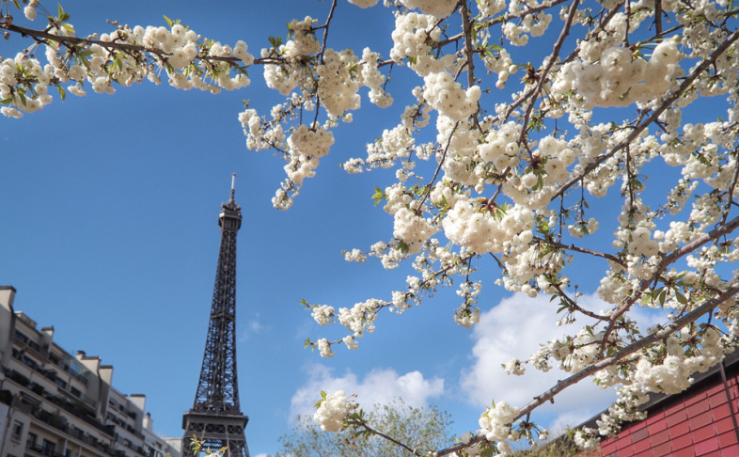
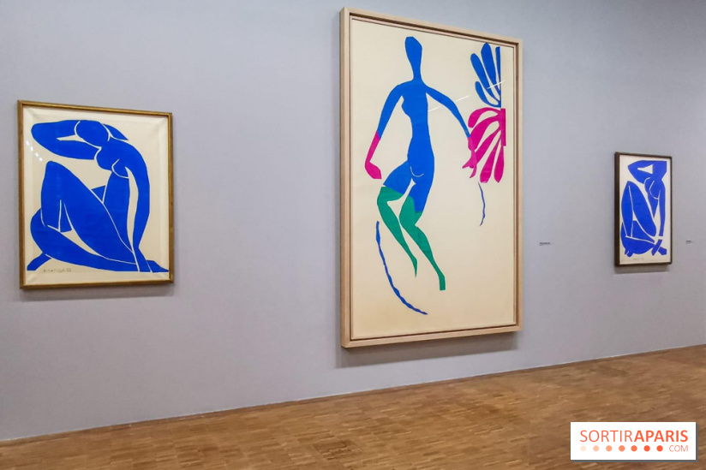
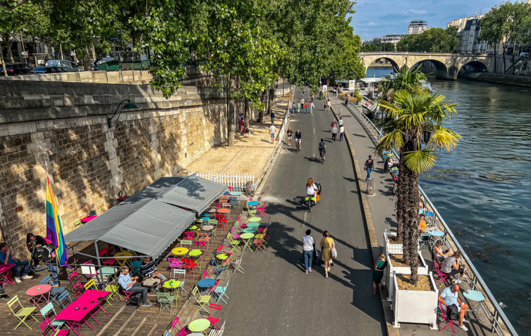
What to do around Saclay ?
A secret plan, a little town called : Paris
Henri Matisse at « Grand Palais » in April
Bateau Mouche (boat on the Seine)
A walk along the Seine
Notre Dame has reopened last year
« Chez Ammad » in Montmartre typical troquet only known by Parisian
…

Slide 16
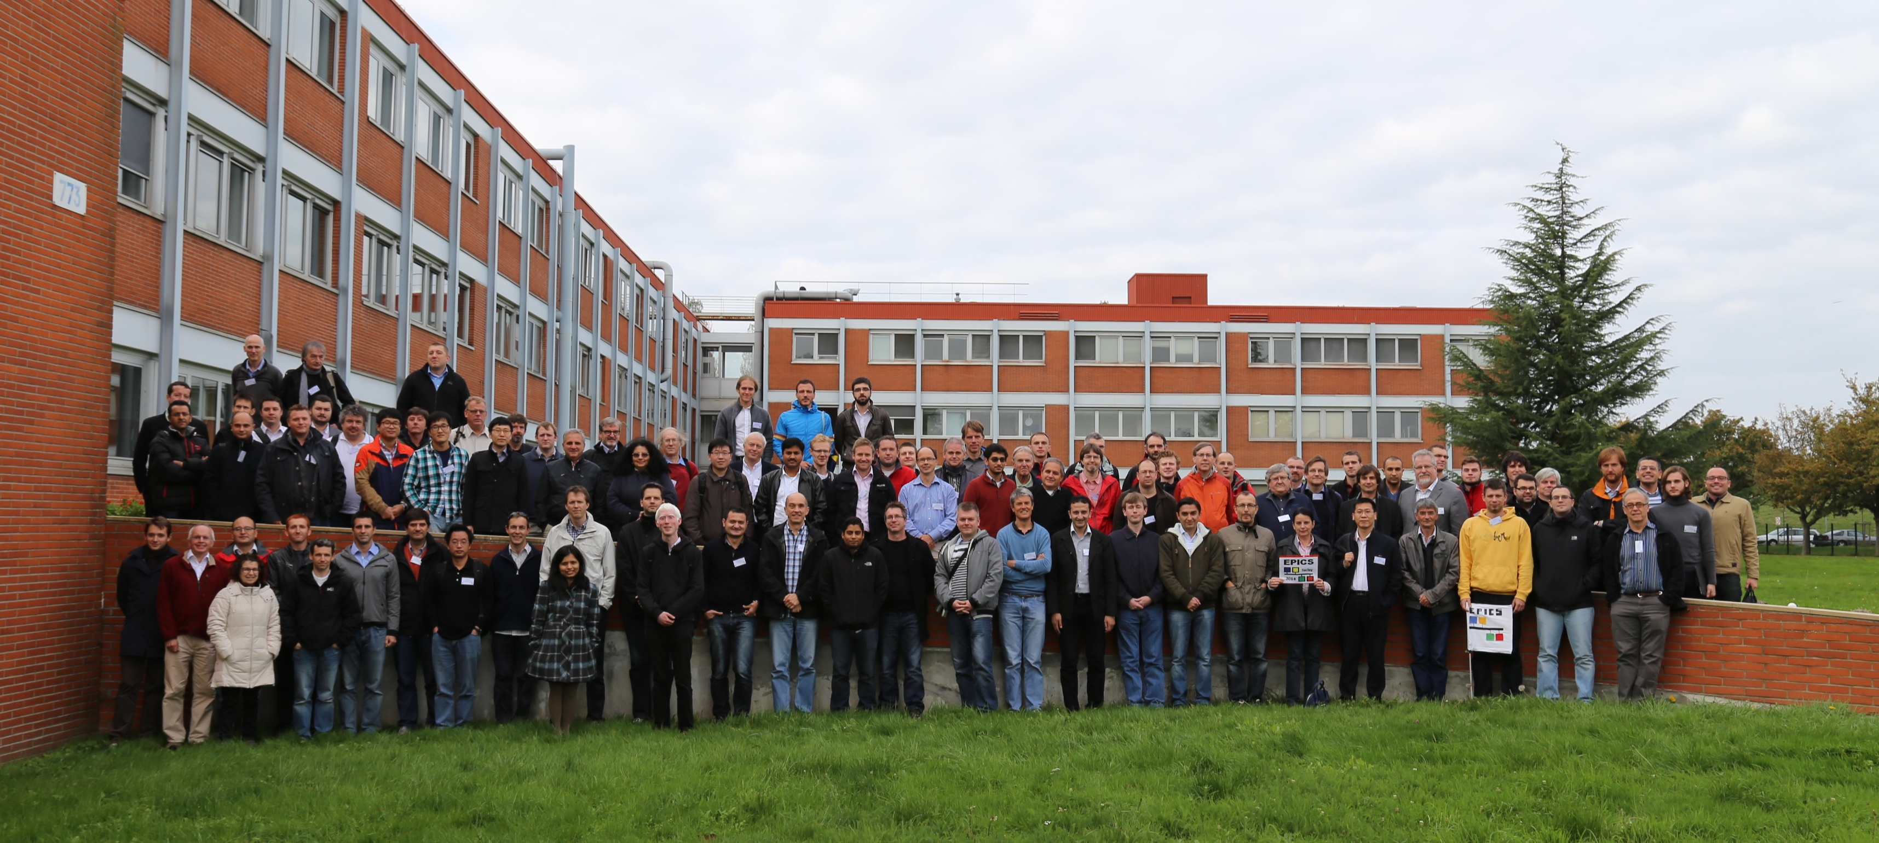
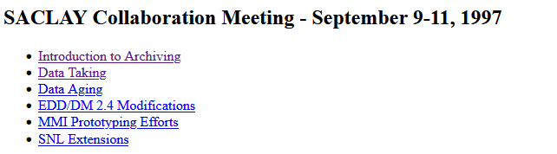
See you soon
Thank you for your attention, and we hope to see you next spring with a lot of interesting topics.
More information will be available soon; please check Tech-Talk and Element.
11 years ago at Saclay
28 years ago at Saclay
Contacts:
Promotional video about « Université Paris-Saclay »
Alexis Gaget alexis.gaget@cea.fr Françoise Gougnaud françoise.gougnaud@cea.fr Paul Lotrus paul.lotrus@cea.fr

