Slide 1





SuperCDMS … and Beyond
Miriam Diamond & Ziqing Hong, University of Toronto
2025 Canadian Astroparticle Physics Community Meeting

Slide 2
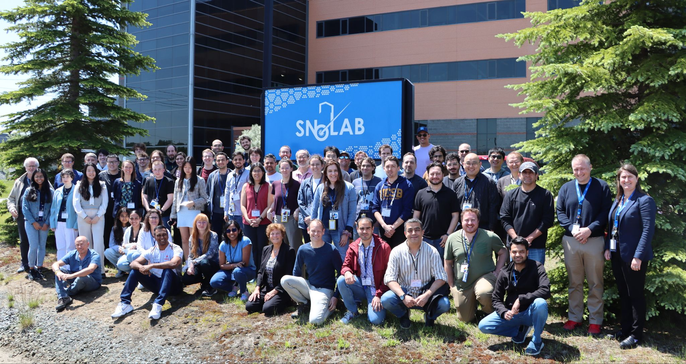








The Super Cryogenic Dark Matter Search
A direct detection search experiment employing an array of ultra-pure silicon and germanium detectors to search for low-mass (< 10 GeV/c²) DM candidates
Canadian PIs:
Miriam Diamond, Ziqing Hong, Pekka Sinervo (UofT)
Wolfgang Rau (TRIUMF)
Scott Oser (UBC)
Andy Kubik, Matt Stukel, Jodi Cooley (SNOLAB)
Alan Robinson (UdeM)
~ 100 researchers at 28 institutes across 6 countries
Canada taking the lead!

Slide 3
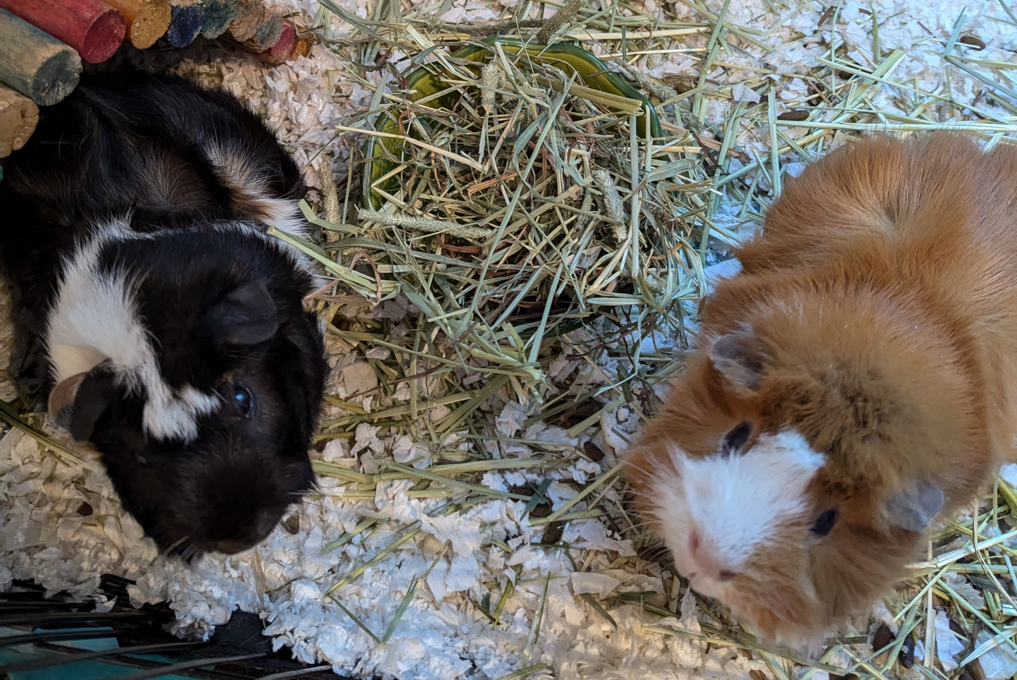
Outline
Science goals
Experiment layout & detector technology
Installation & integration
Schedule
Tower testing in CUTE
Simulations & background modeling
Sensitivity projections
HVeV R&D program
Far-future R&D initiatives
  HONEYCOMB
  SPLENDOR
  Underground detector fabrication
Highly Qualified Piggies (HQPs)

Slide 4
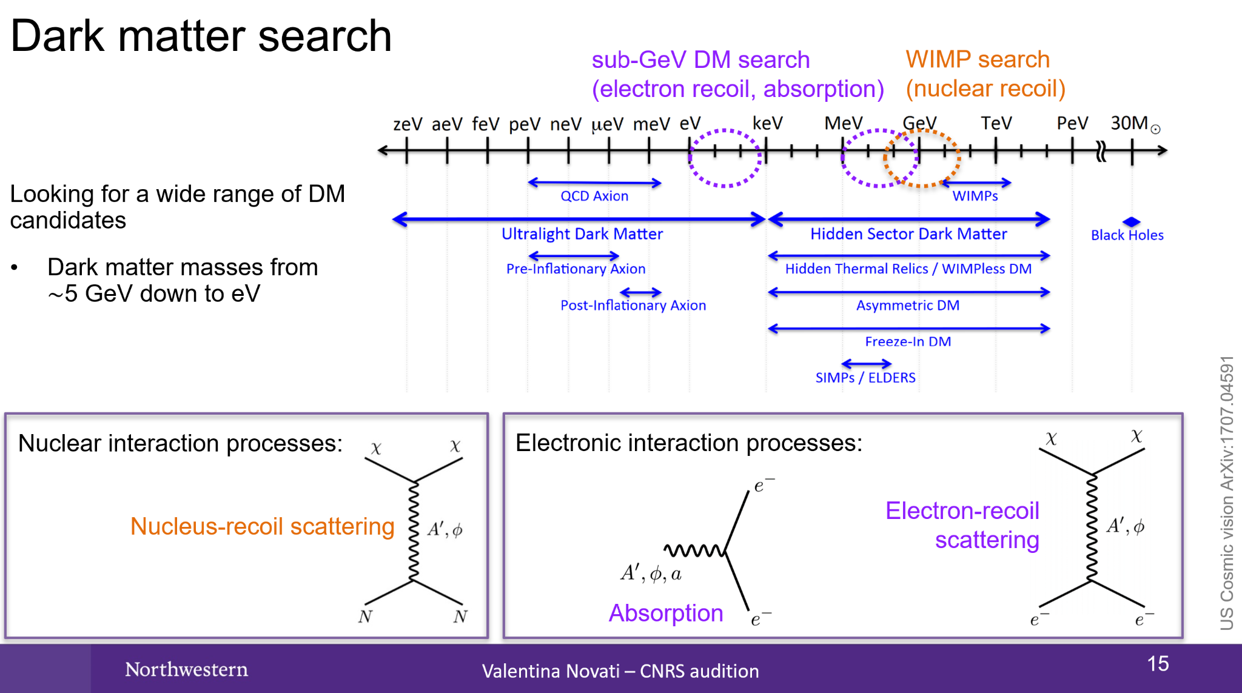
Science Goals

Slide 5
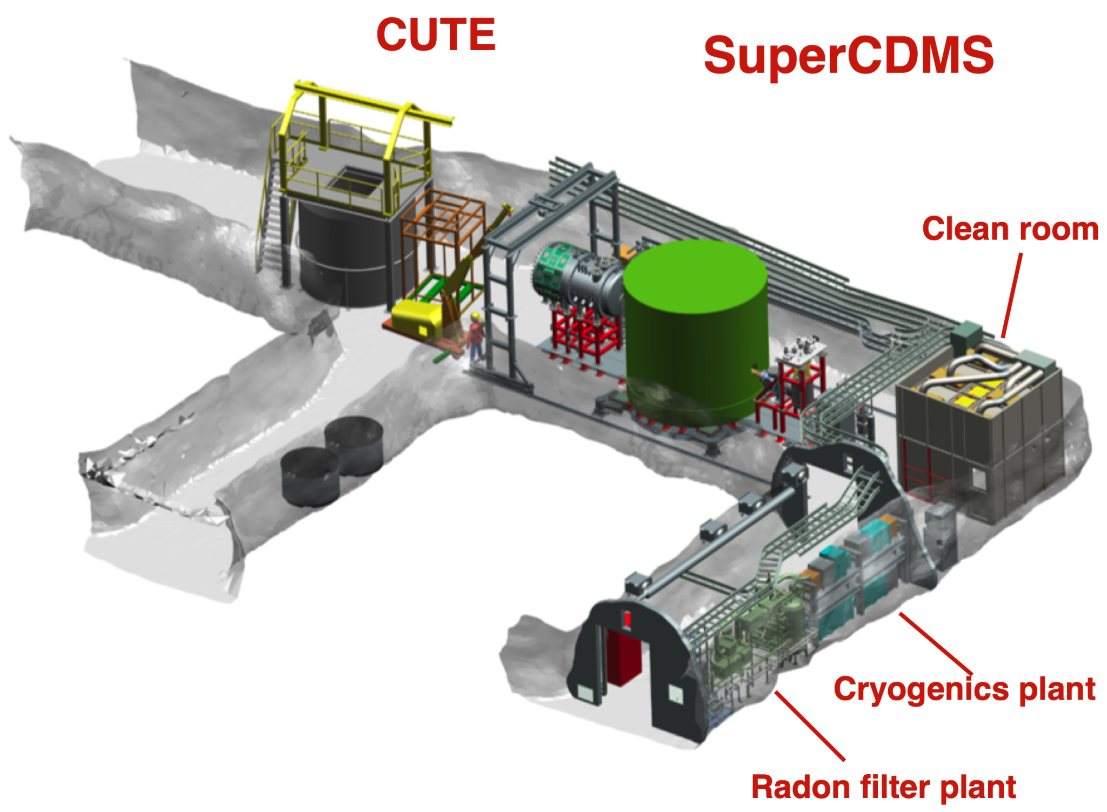
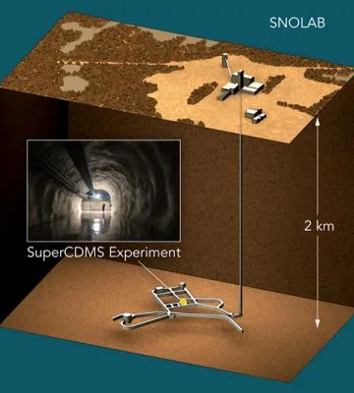
SuperCDMS @ SNOLAB Experiment Layout

Slide 6
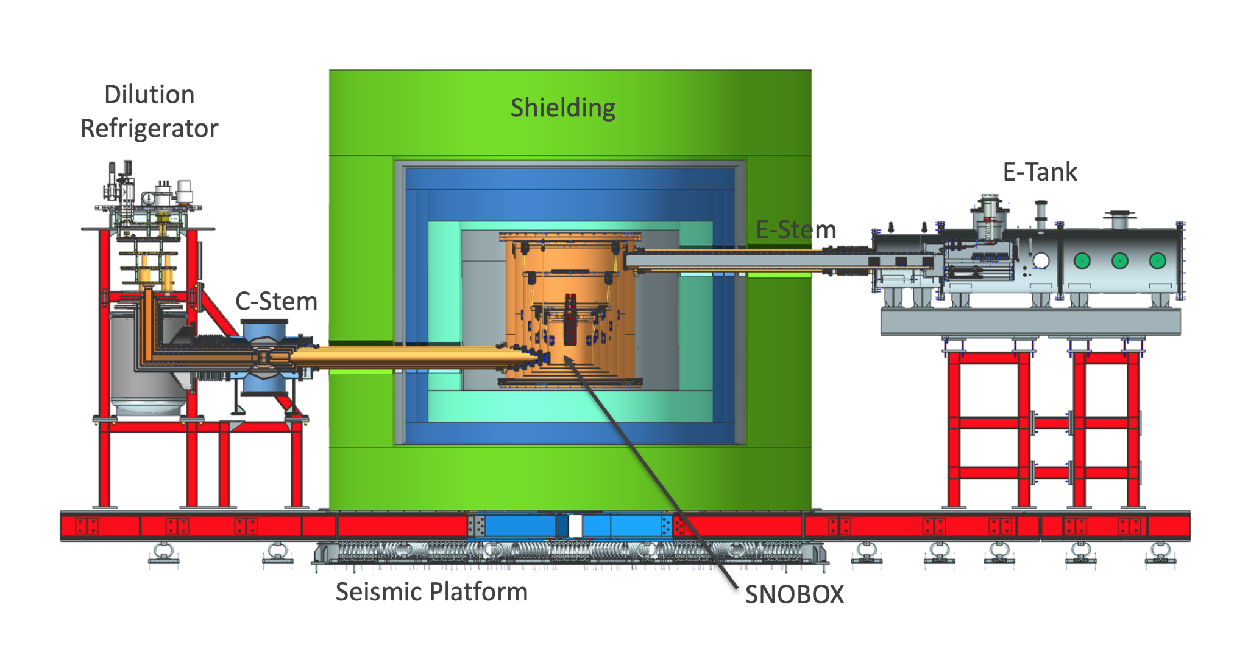
SuperCDMS @ SNOLAB Experiment Layout
Facility:
6000 m.w.e. overburden
15 mK base temperature
Initial Payload: ~30 kg total
Electron Recoil Backgrounds:
External and facility: O(0.1 /keV/kg/d)
Det. setup: O(0.1(Ge)-1(Si) /keV/kg/d)
Total: O(0.1-1 /keV/kg/d)
Designed to be dominated by solar neutrinos in NR background
Vibration isolation:
Seismic: spring loaded platform
Fridge on active vibration damper
Cryo coolers: soft couplings
  Braids, bellows
Copper cans: hanging on Kevlar ropes

Slide 7
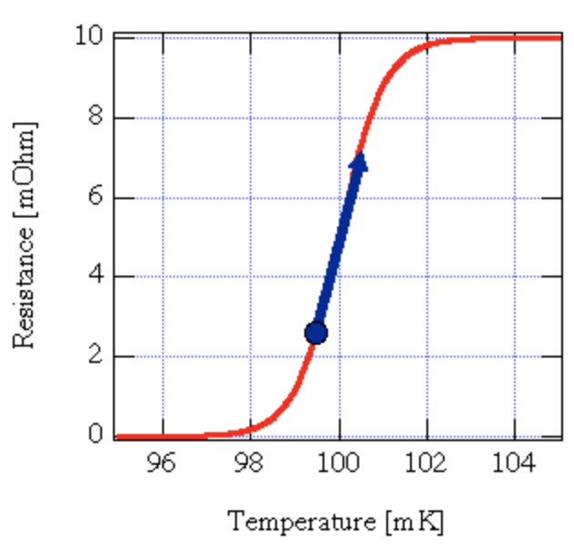

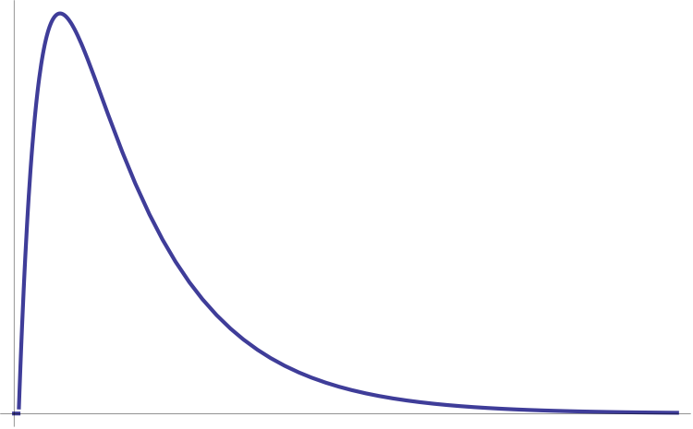
SuperCDMS Detector Technology
Cryogenic Calorimeter
Transition-Edge Sensor (TES)
Energy
Resistance [mOhm]
web.mit.edu/figueroagroup
TES
Absorber
Temperature [mK]
Response of TES
Weak Thermal Link
Thermal Bath
Current
Cryogenically cooled in dilution fridge
Time

Slide 8
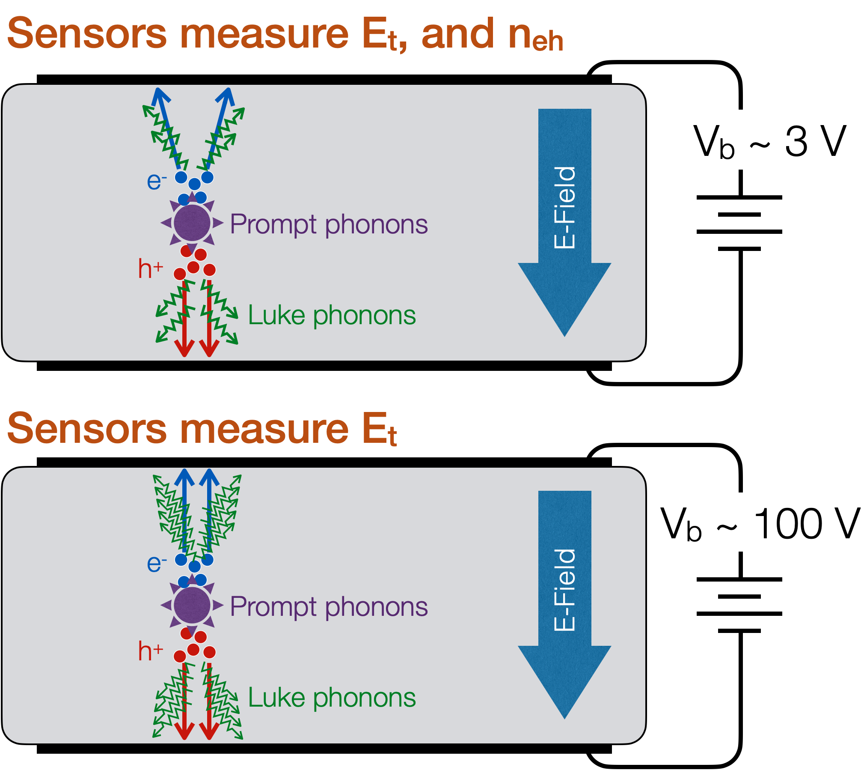
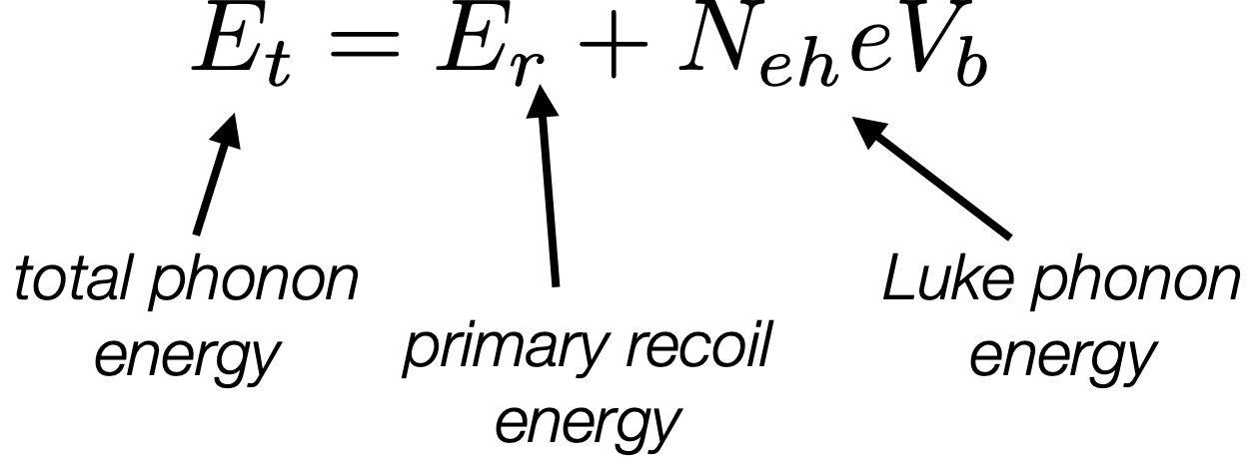
SuperCDMS Detector Technology
Discriminating
iZIP Detector:
Prompt phonon and ionization signals allow for discrimination between nuclear and electron recoil events
HV detector:
Drifting electrons/holes across a potential (V_{b}) generates a large number of phonons (Luke phonons).
  Enables very low thresholds!
  Trade-off: No event-by-event NR/ER discrimination
Low Threshold

Slide 9
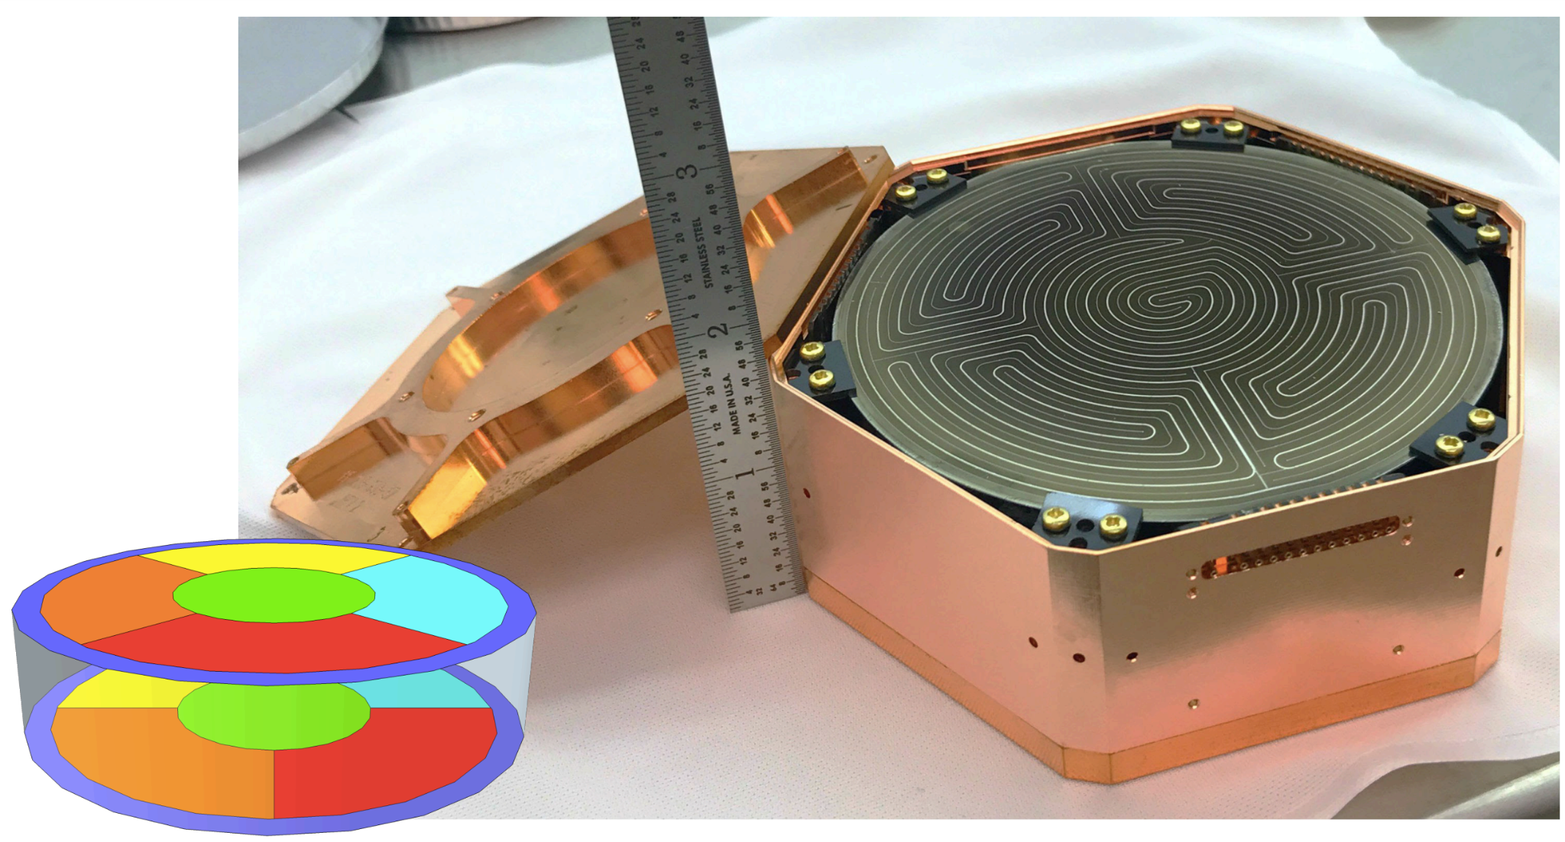
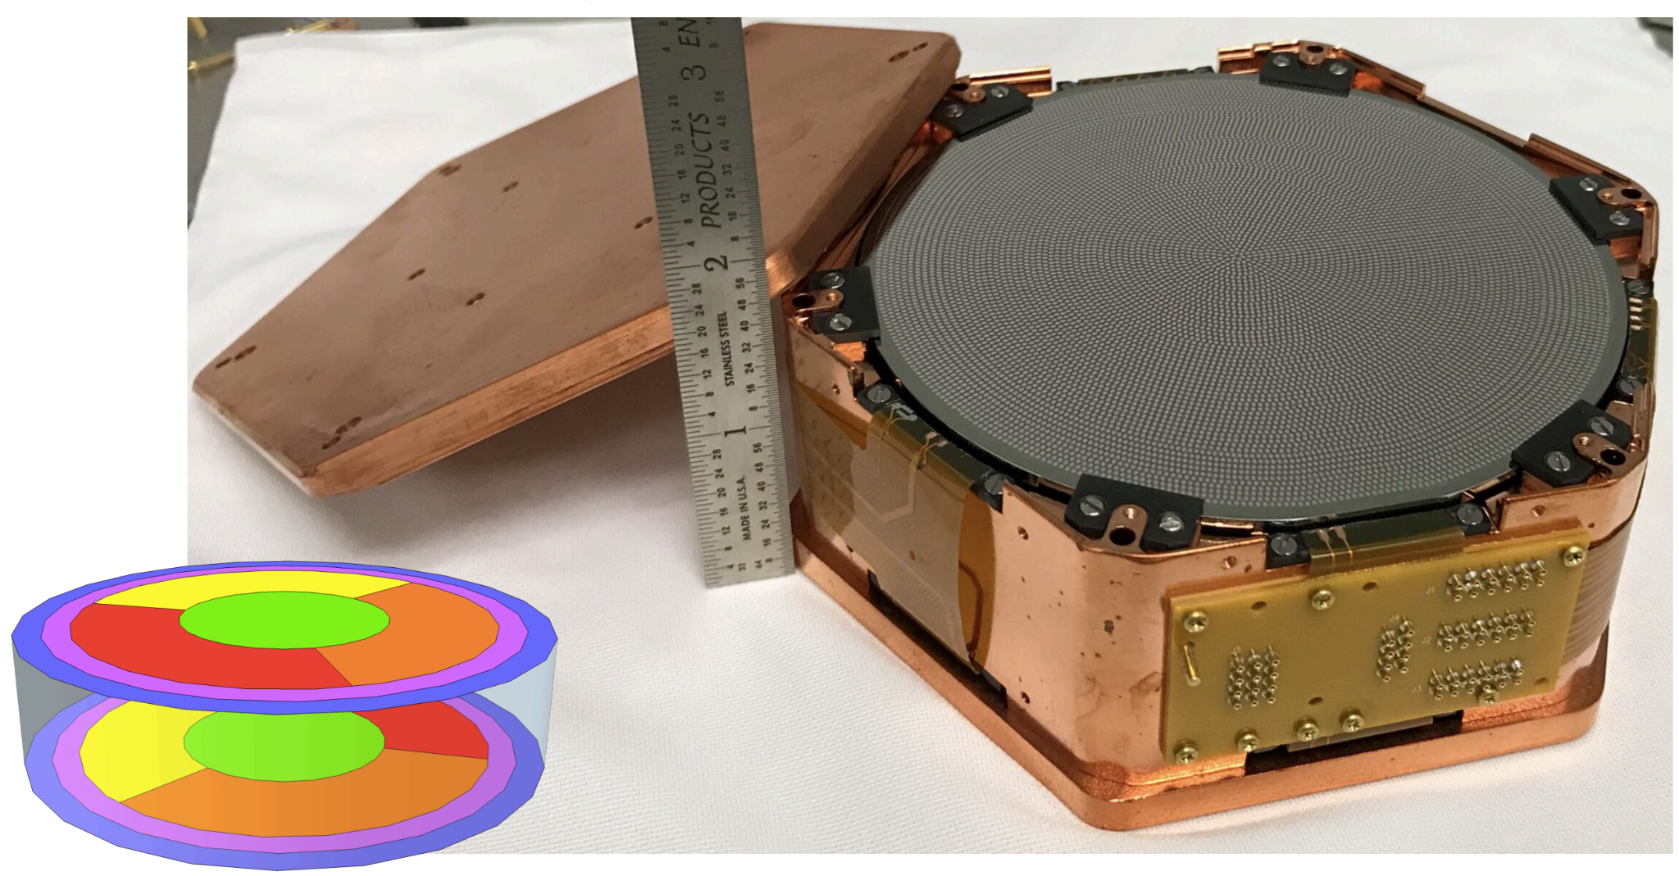
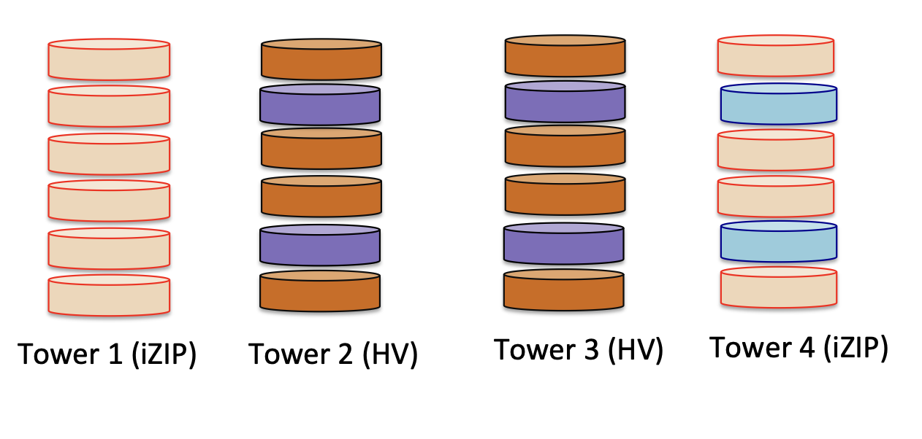
SuperCDMS Detector Technology
Detectors made of high-purity Ge and Si Crystals
  Si (0.6 kg each): sensitivity to lower DM masses
  Ge (1.4 kg each): sensitivity to lower DM cross-sections
Low operation temperature: ~15mK
  Athermal phonon measurement with TESs
  Ionization measurement (iZIP) with HEMTs
Multiple channels per detector to identify
event position
Initial payload: 4 “towers” of 6 detectors each
  2 iZIP : 10 Ge / 2 Si
  2 HV : 8 Ge / 4 Si
iZIP
HV

Slide 10
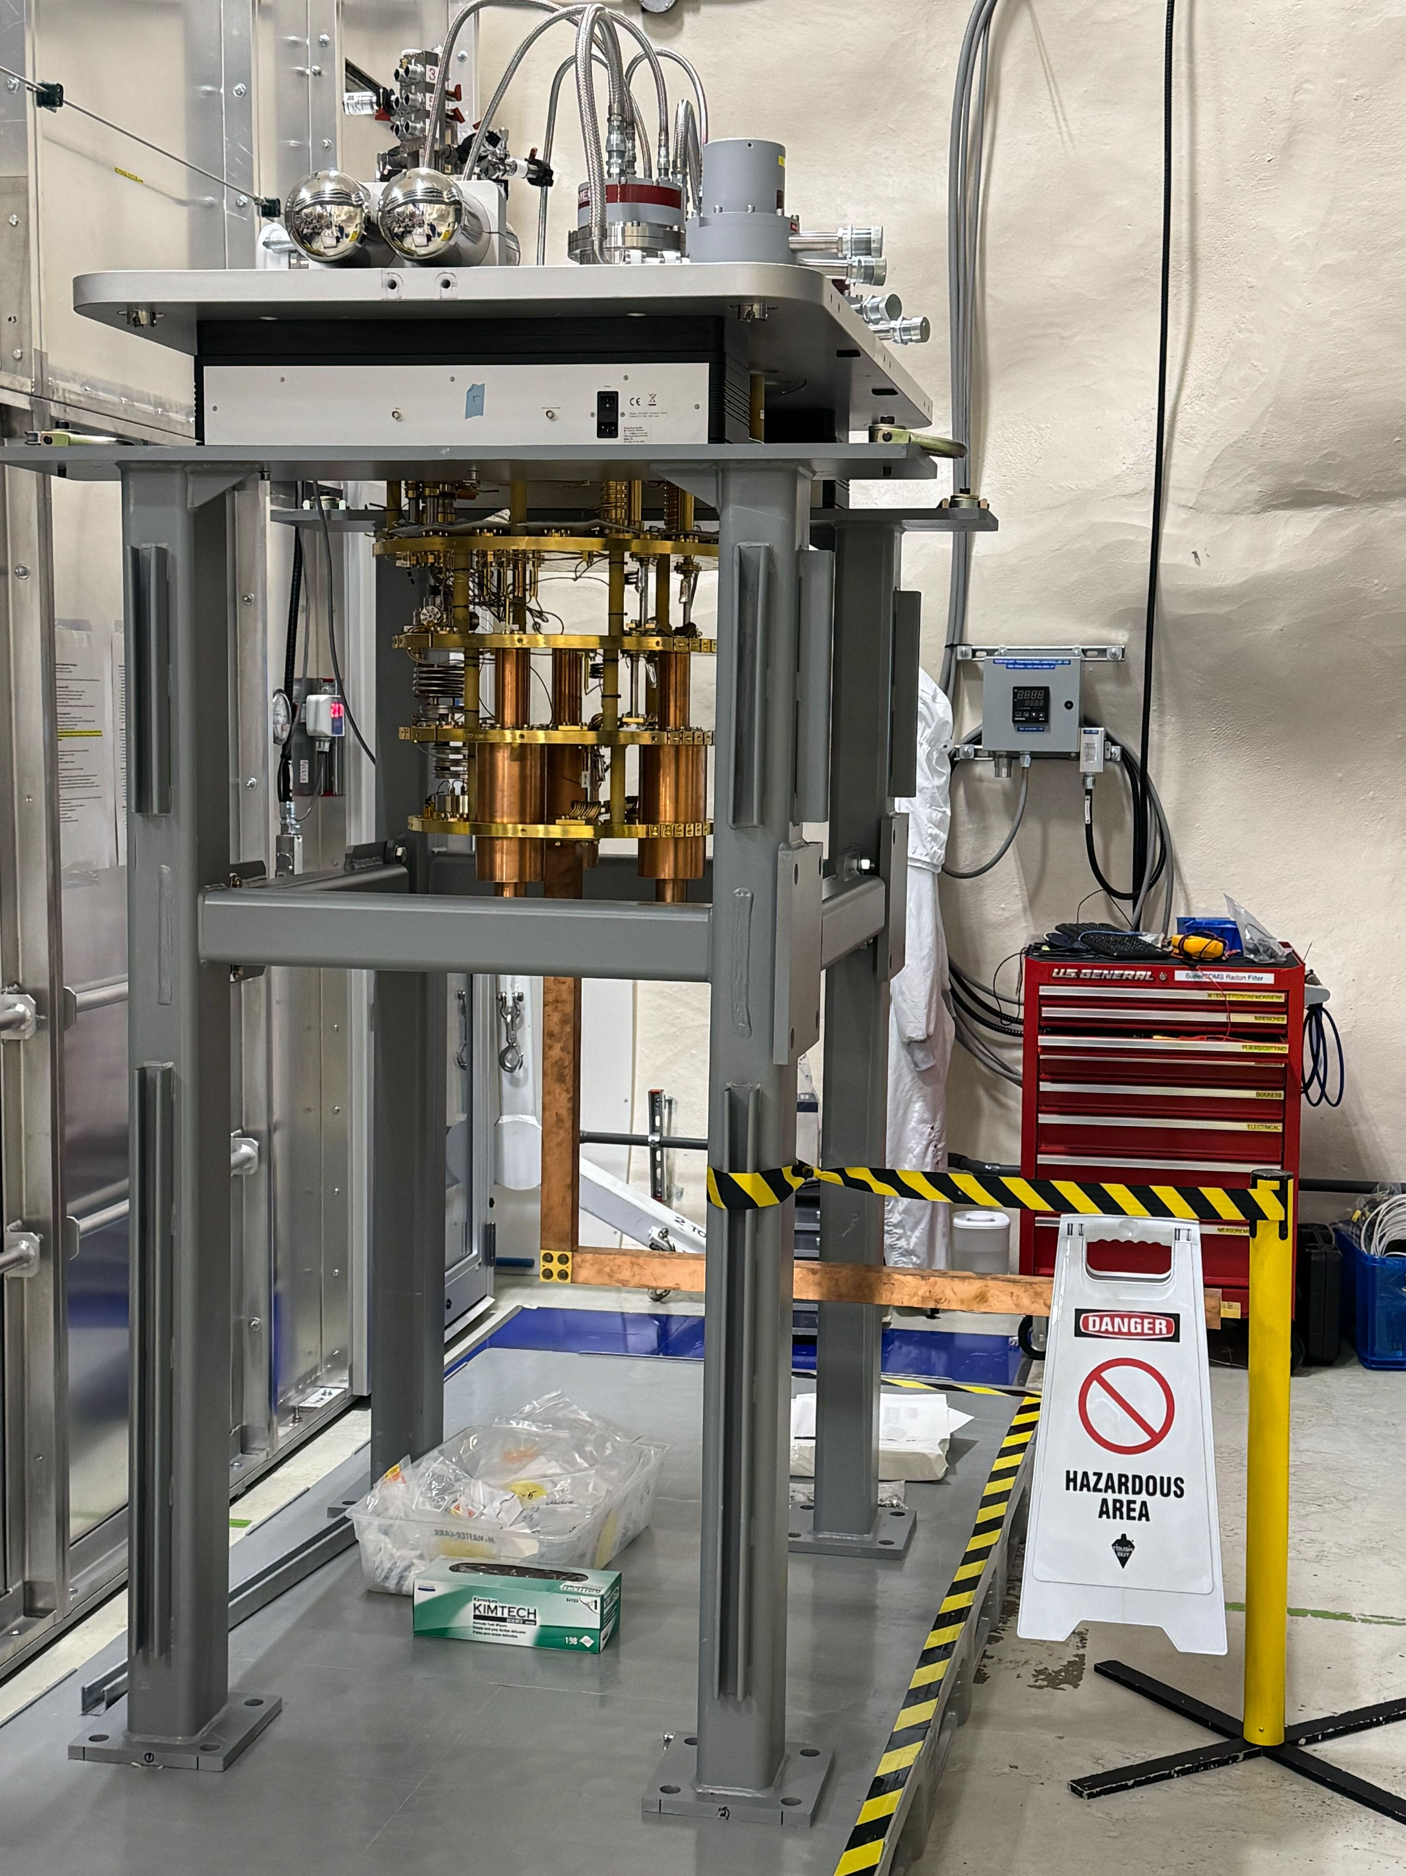
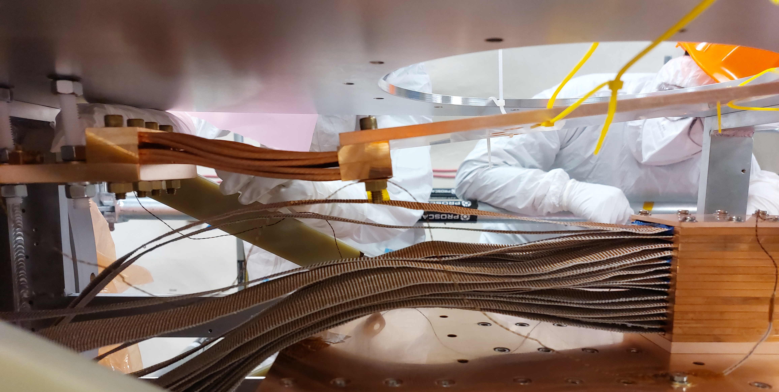
SuperCDMS Installation & Integration
Thermometry installation
Dilution fridge on temporary stand
Lower portion of shield

Slide 11
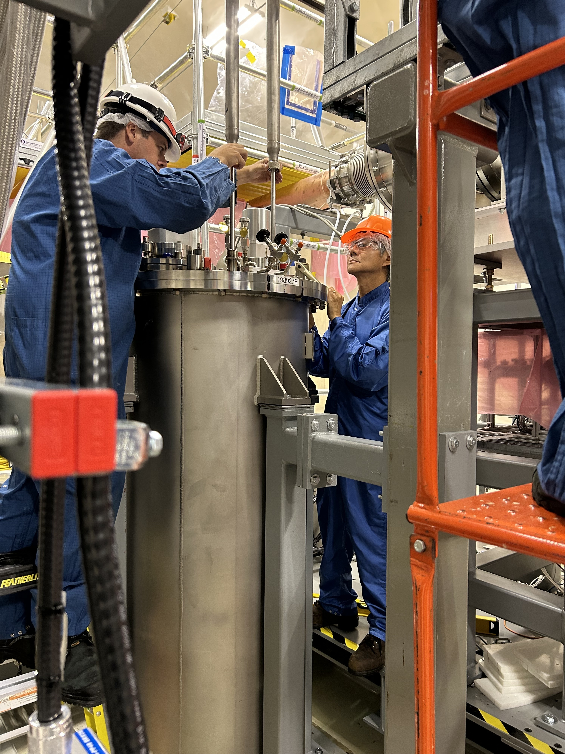
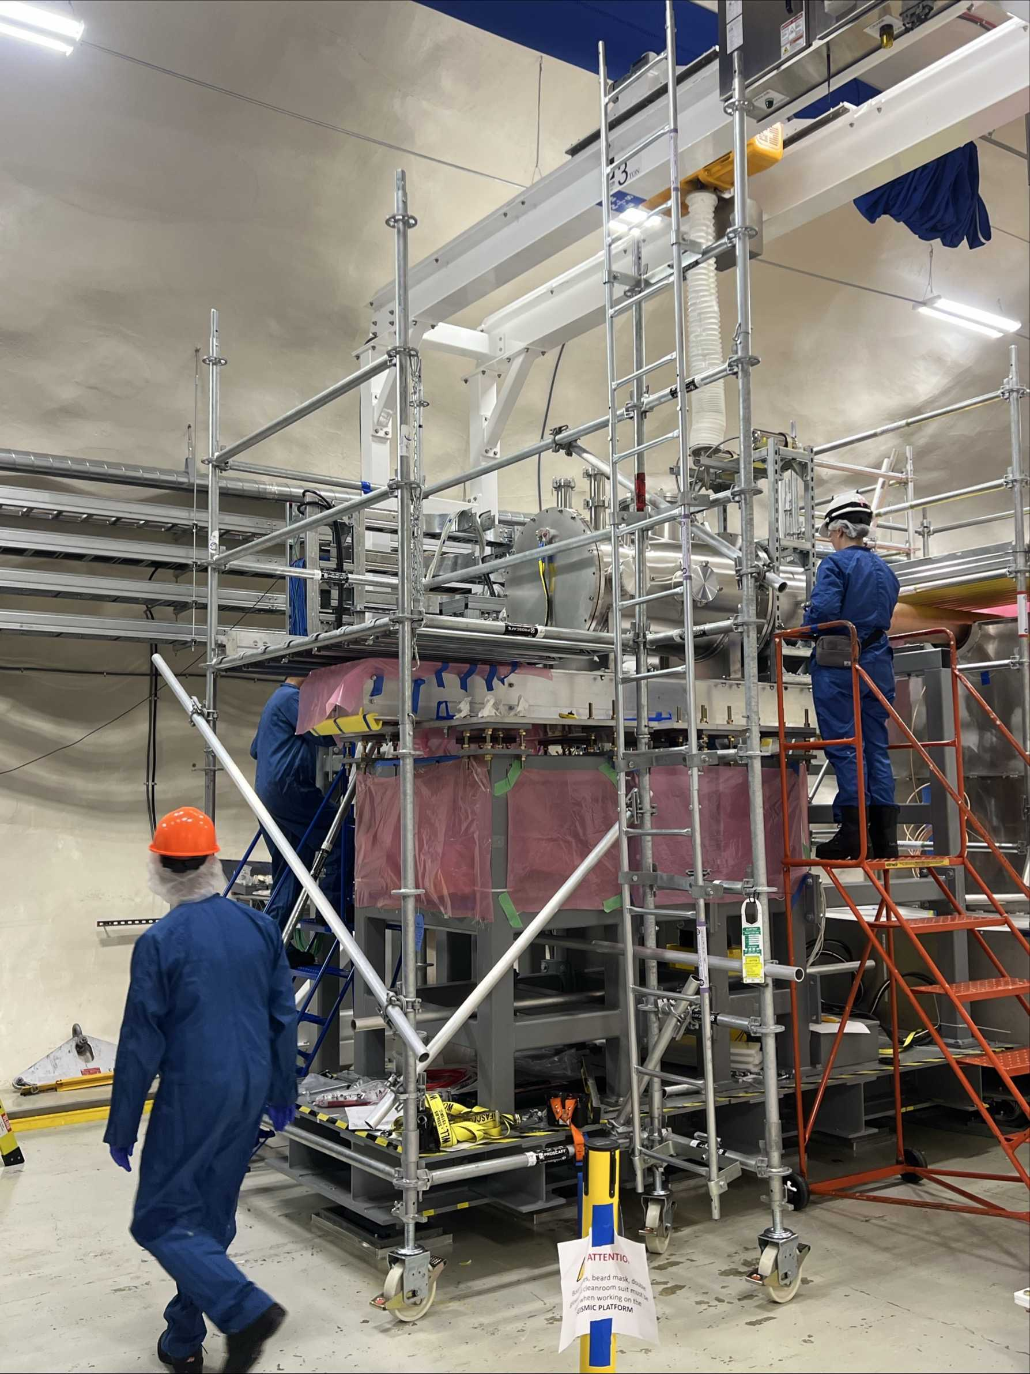
SuperCDMS Installation & Integration
E-stem cabling completion
50K Cooler installation
ETank scaffolding

Slide 12
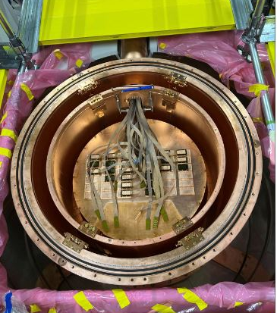
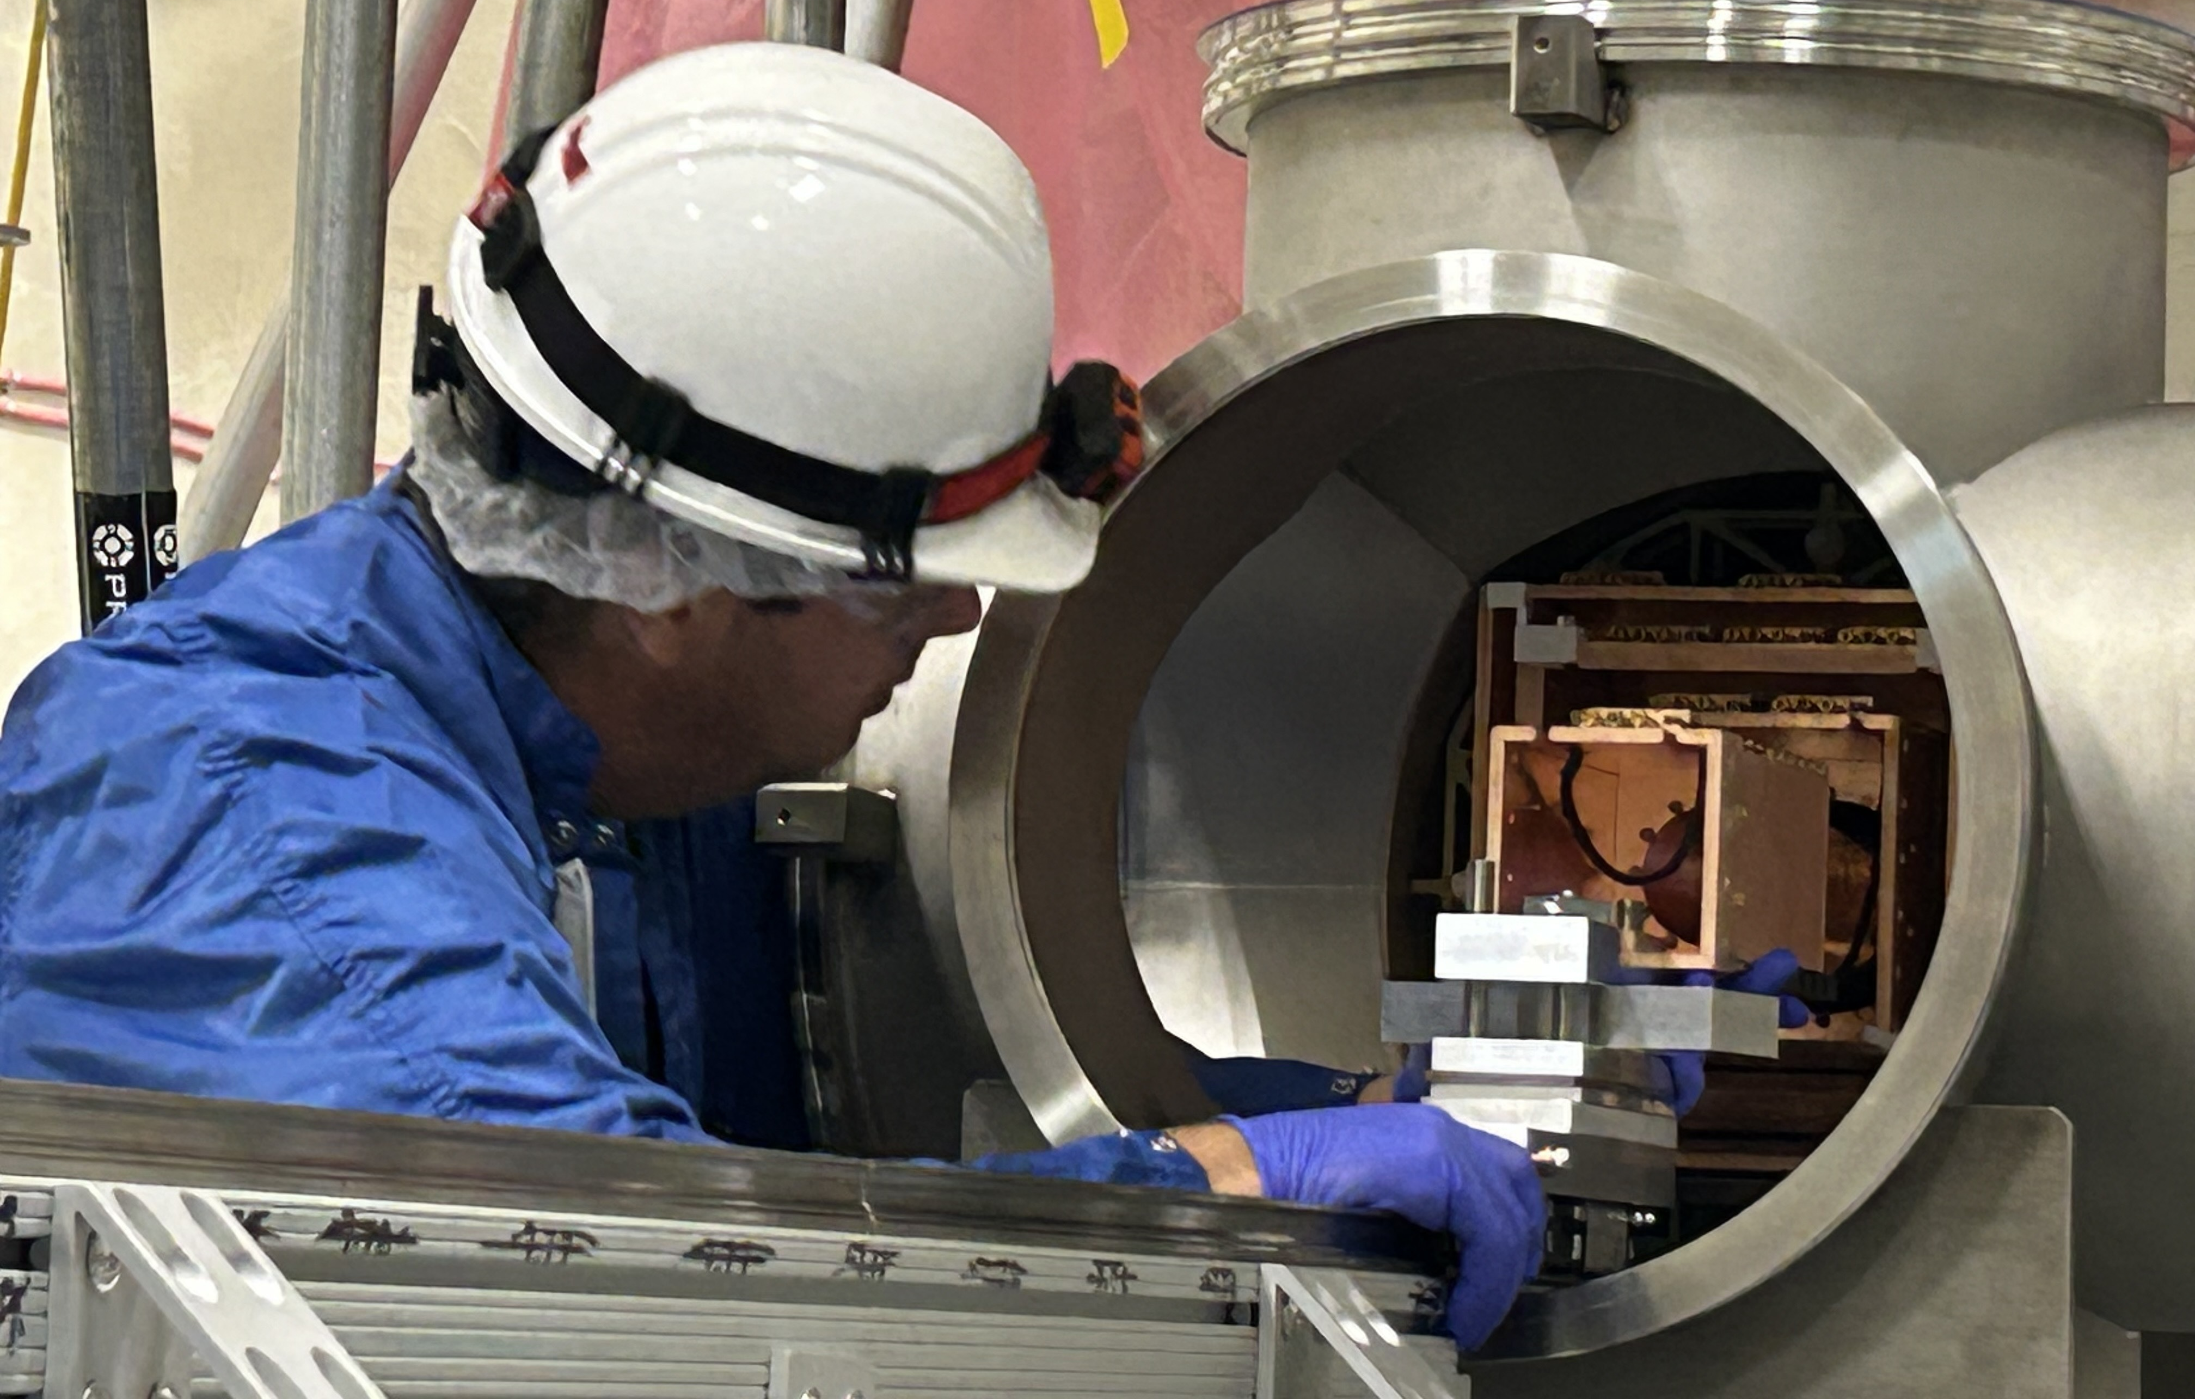
SuperCDMS Installation & Integration
CP Stem insertion
Detector Readout Cables connection
DAQ connection
Vacuum vessel installation

Slide 13
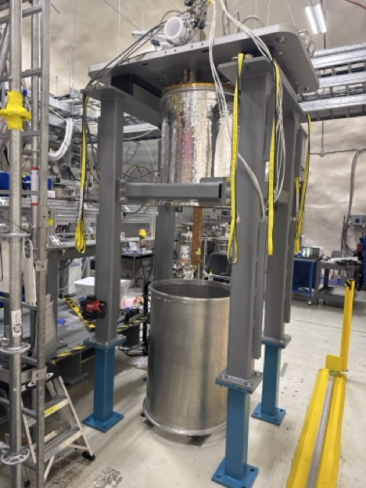
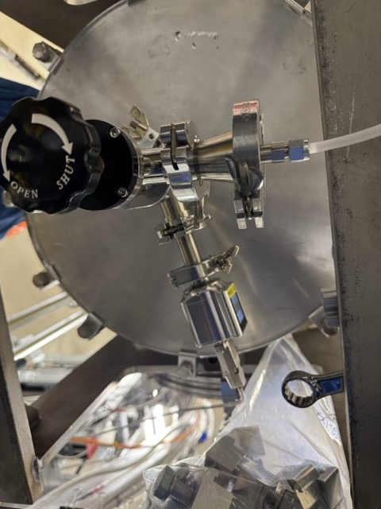
SuperCDMS Installation & Integration
Calibration system assembly
Dilution Fridge Tails installation
Cryostat purge

Slide 14
SuperCDMS Schedule

Slide 15
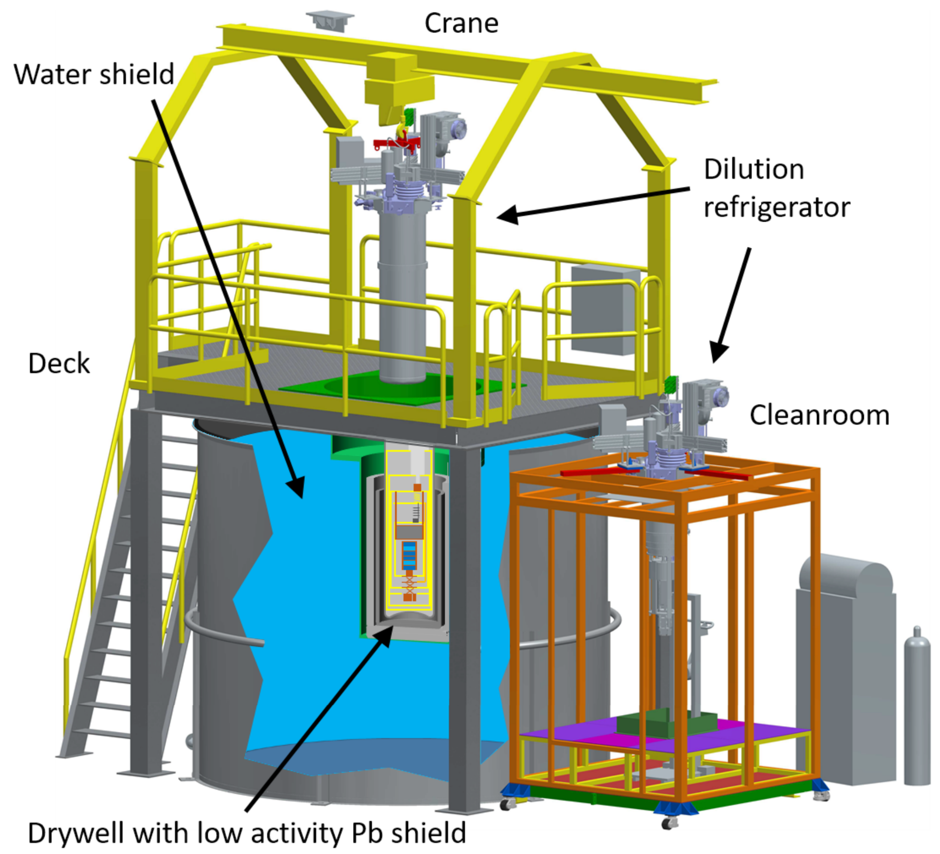
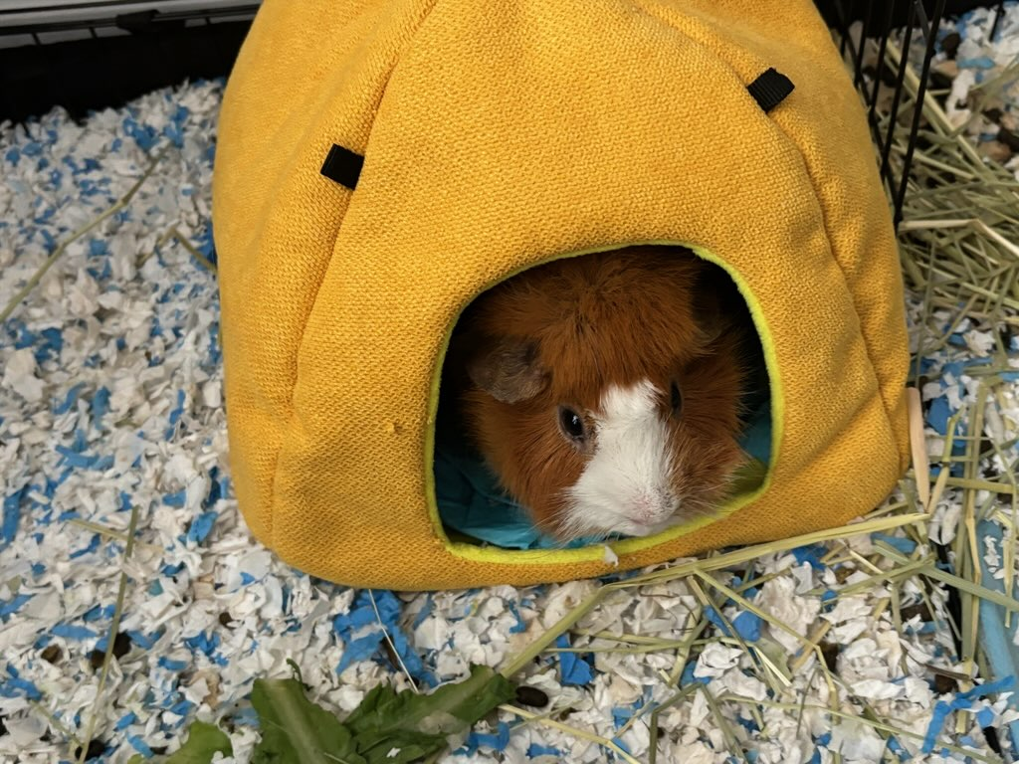
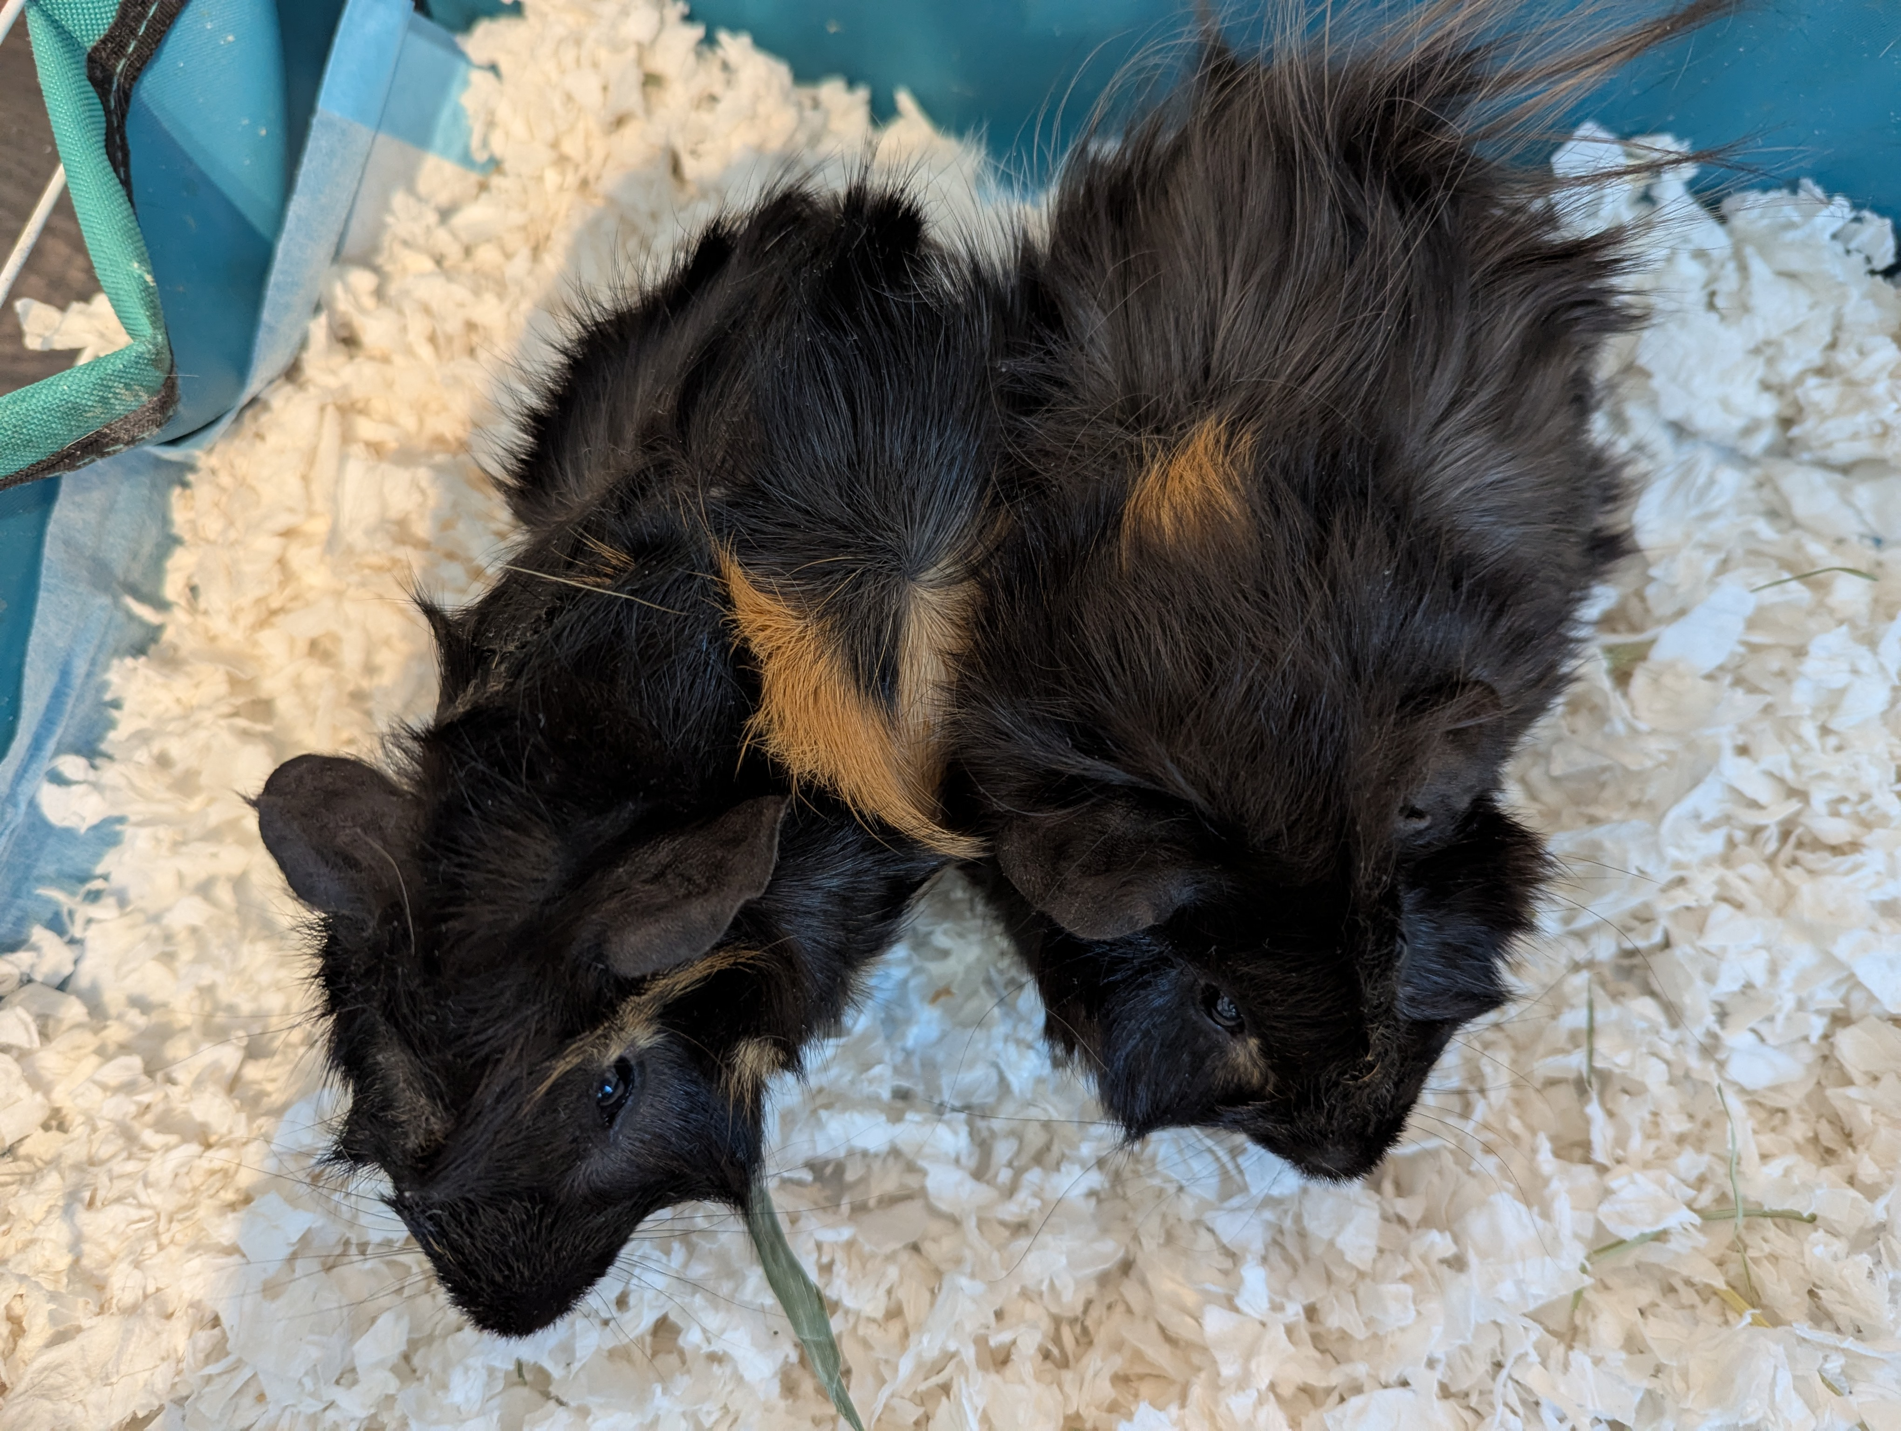
Cryogenic Underground TEst facility (CUTE)
Friendly neighbour
Taking on critical mission of detector testing
  Exercise & debug detectors before SuperCDMS cryostat in place
Same environment, same electronics → similar challenges expected
Small science exposure - mostly to exercise the analysis tools
WE ARE VERY CUTE!

Slide 16
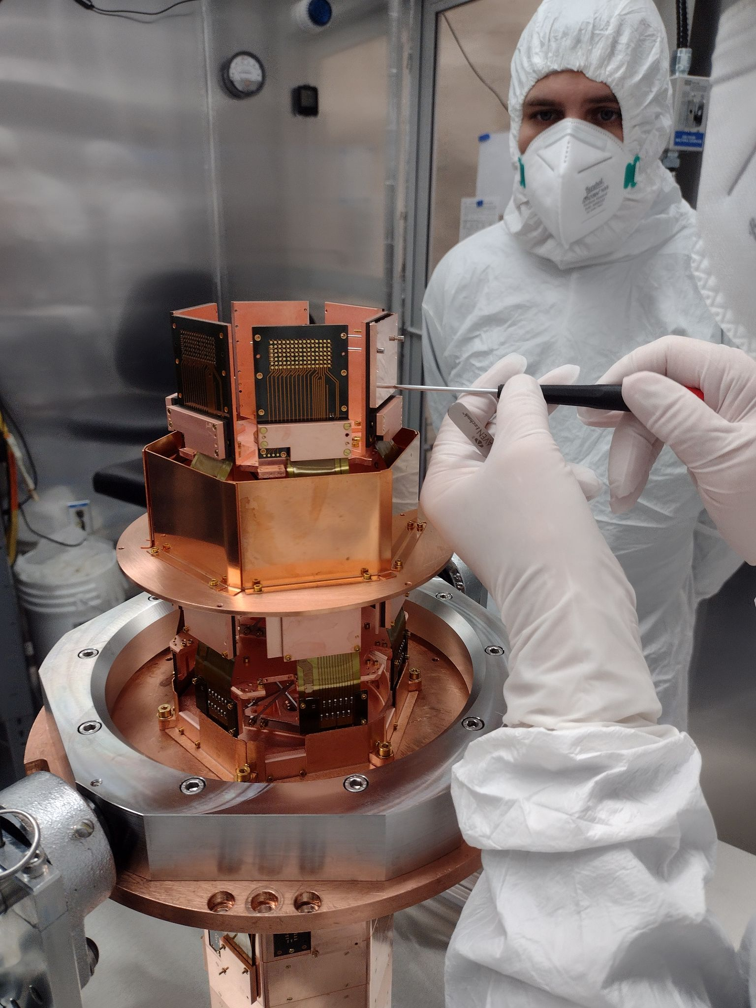
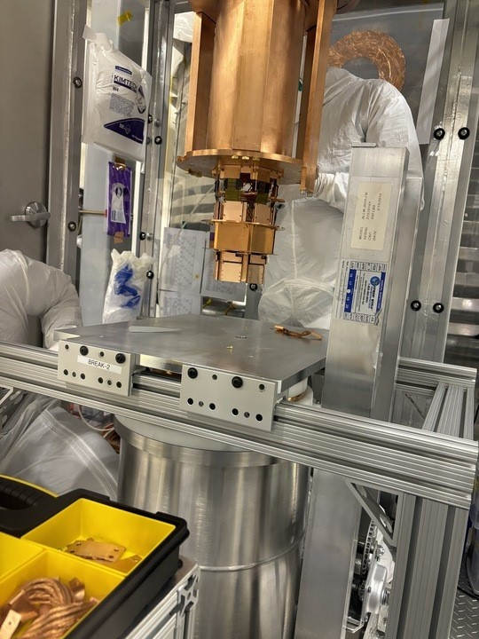
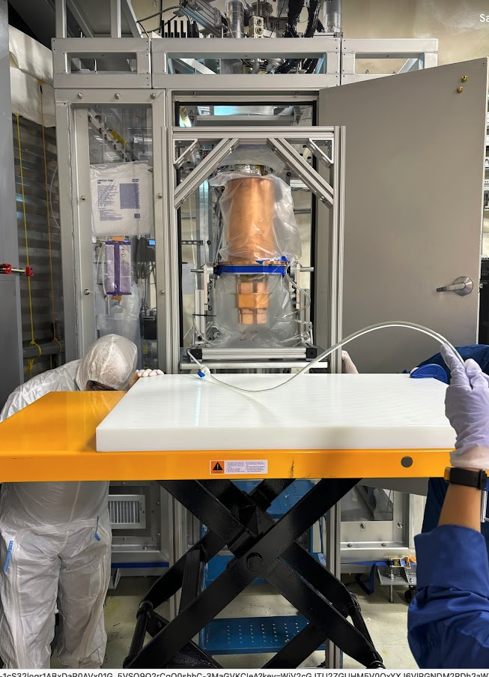
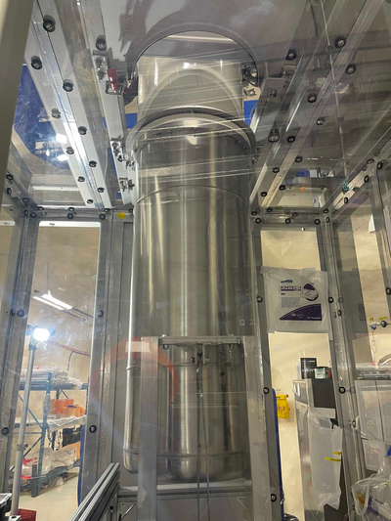
SuperCDMS Tower Testing at CUTE
Tower-3 (HV detectors) installed & operated at CUTE
Oct 2023 - March 2024
First time operating HV detectors in deep underground low-background facility!

Slide 17
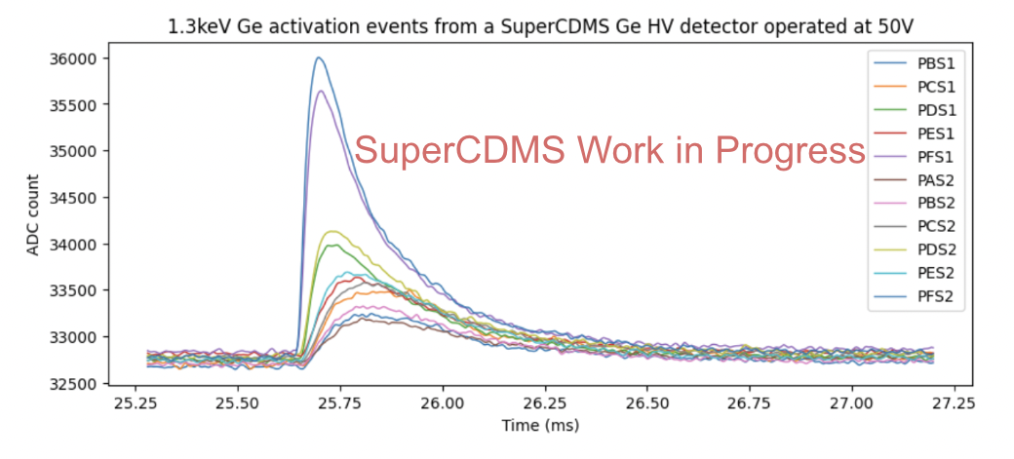
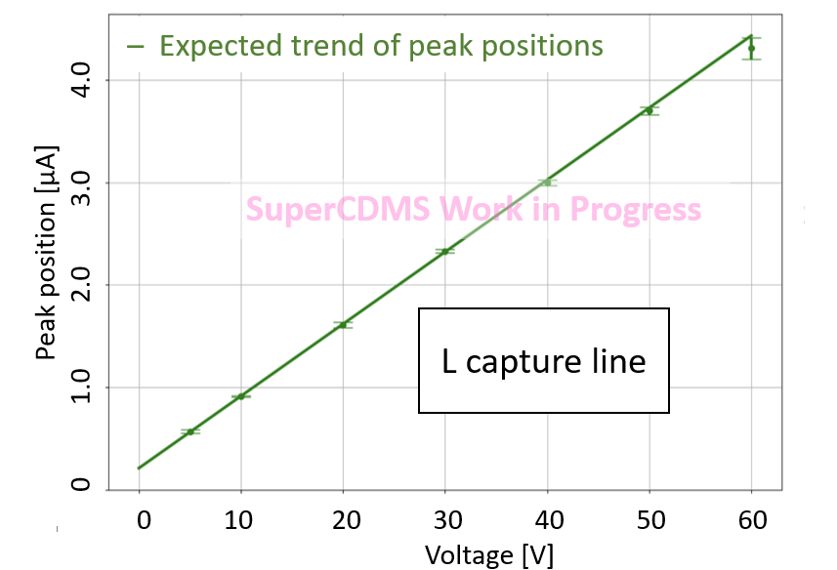
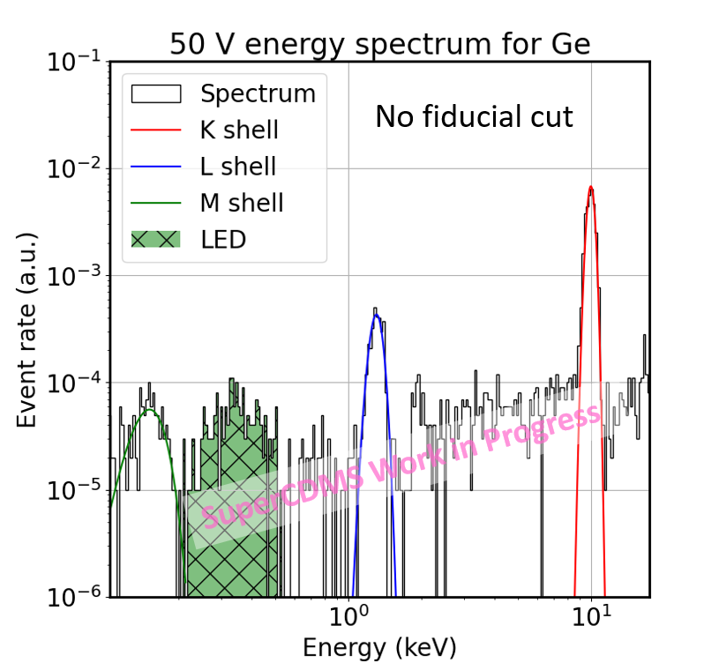
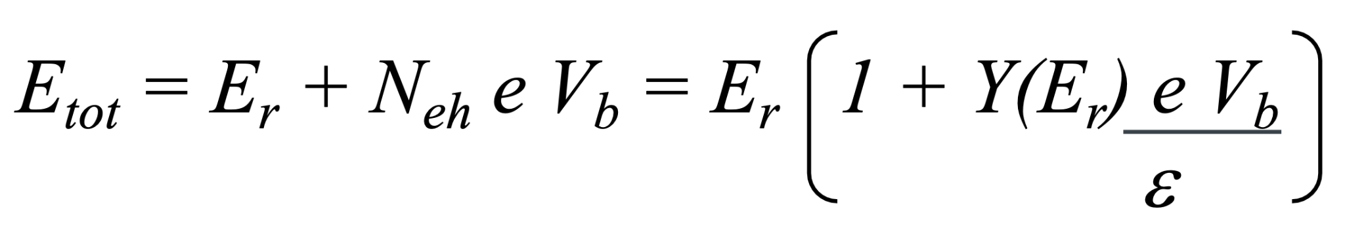
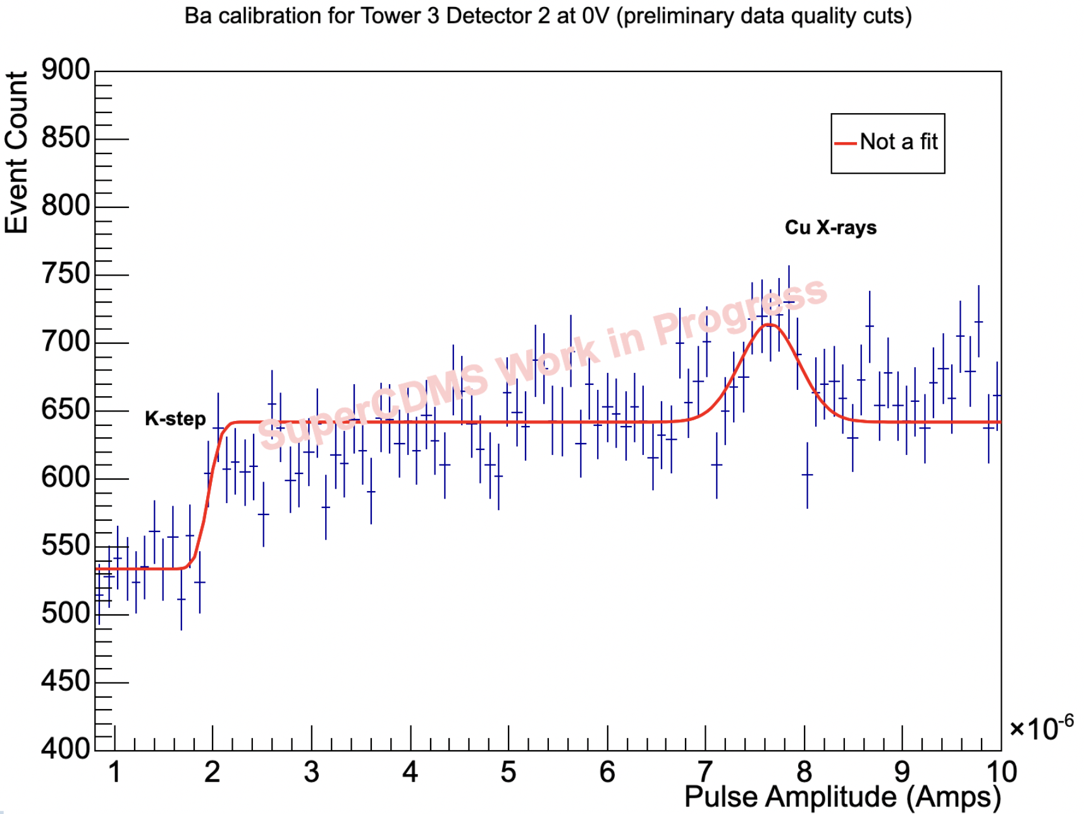
SuperCDMS Tower Testing at CUTE
151 days of operation:
  ~ 2 months of calibration data
  ~ 2 months of low background data
  Several weeks for detector characterization (e.g. noise performance, HV testing)
Phonon pulses
HV amplification
Ge calibration using activation lines
Si calibration using Compton step features
1.3 keV
Stay tuned!

Slide 18
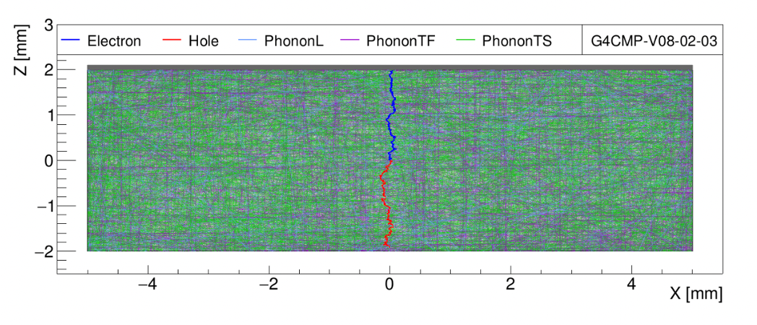
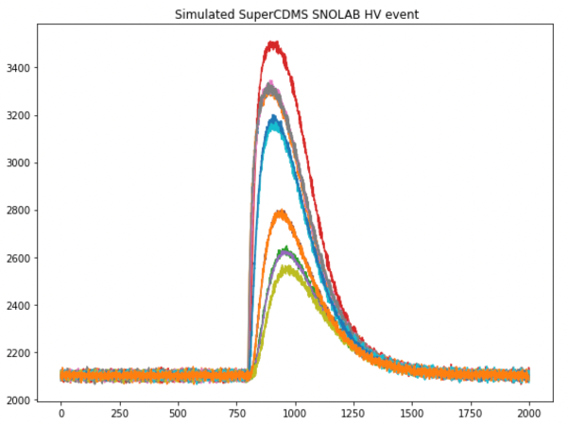
Understanding Detector Response: Simulations
GEANT4 + G4CMP based simulation
  GEANT4 for energy depositions
  G4CMP for charge and phonon propagations in crystals (NIM A 1055 168473 (2023))
Deriving detector response modeling from first principle
Validation with existing calibration data ongoing
Voltage (arbitrary unit)
Time (samples)

Slide 19
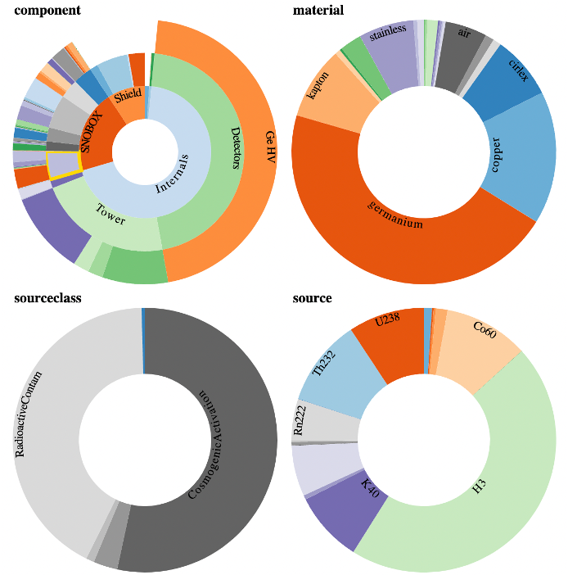

Background Modeling
https://github.com/bloer/bgexplorer-demo
Background: extensive material
cleaning, tracking and screening
eTraveller: Bookkeeping tool to keep track of material movement
  Precision accounting for cosmogenic activations
BGExplorer: Background estimate based on material assay results

Slide 20
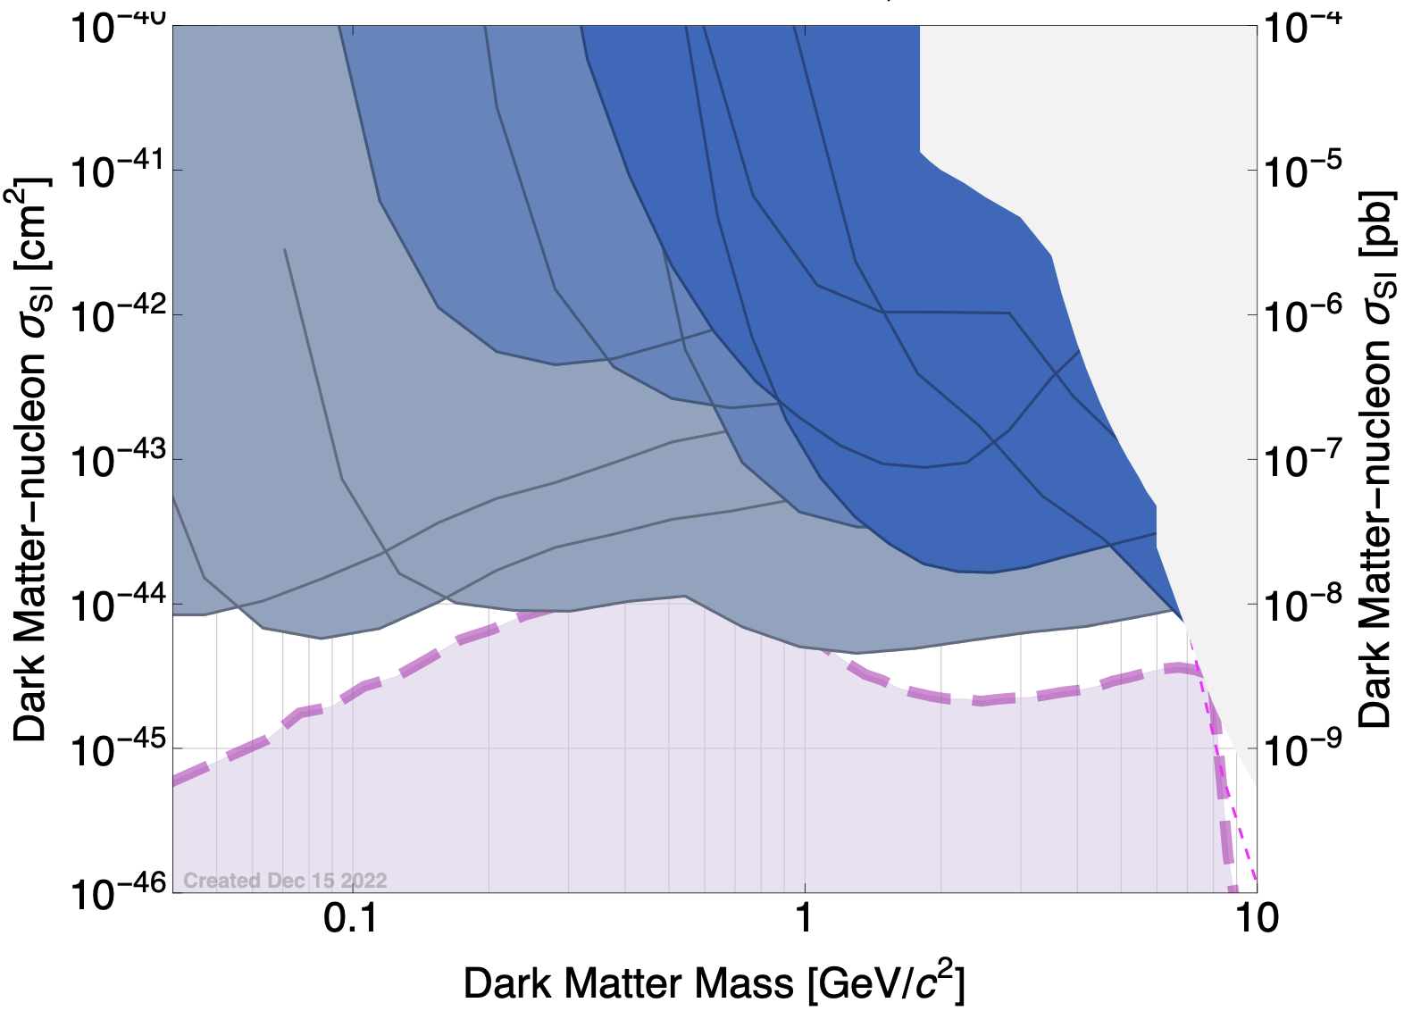
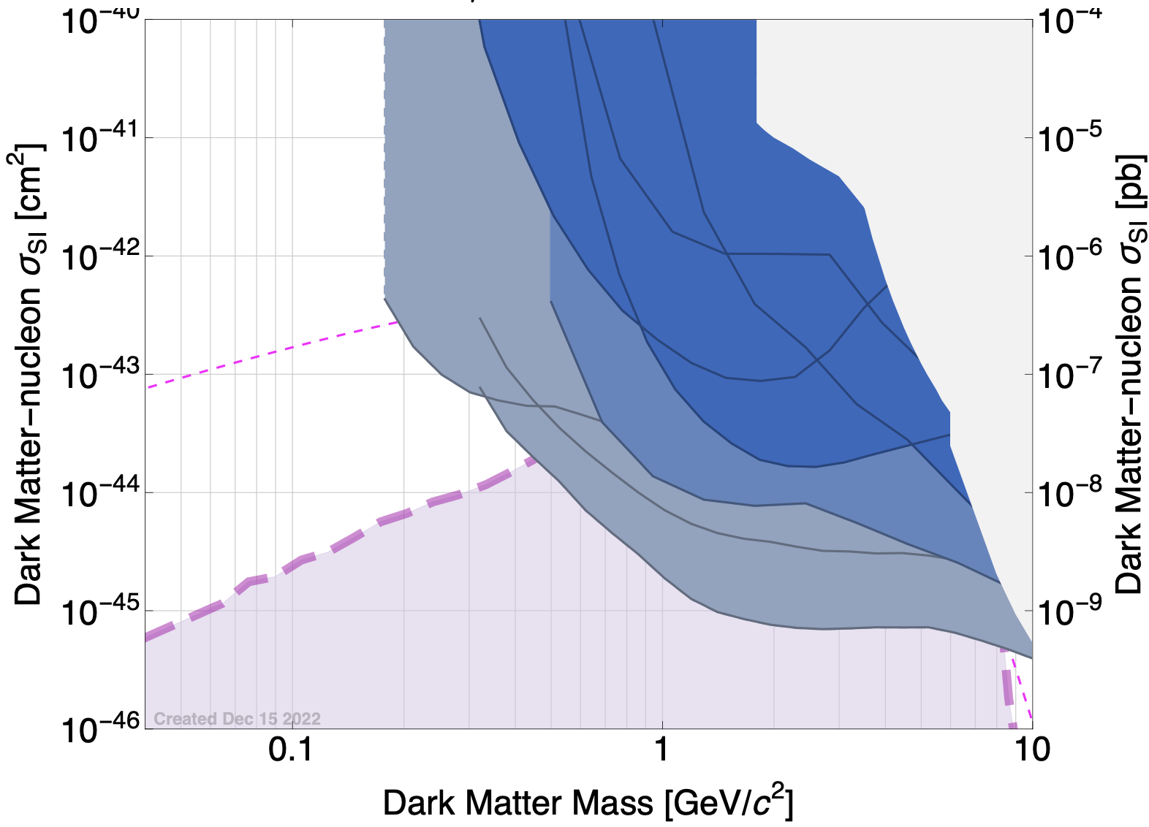
SuperCDMS Sensitivity Projection : NRDM
Current constraints
(Already excluded)
Current constraints
(Already excluded)
I
II
No ionization
Si 1 cm³
Si 10 cm³
SuperCDMS SNOLAB
(Initial payload)
SuperCDMS SNOLAB
(Initial payload)
10 cm³ piZIP Si/Ge
Ge 10 cm³
10 cm³ Ge iZIP
Si 1 cm³
Si 10 cm³
Ge 10 cm³
arXiv:2203.08463
arXiv:2203.08463
10 cm³ Ge piZIP
x20 mass
Neutrino Fog
Neutrino Fog
Pushing the sensitivity to lower DM mass
Future Improvement in phonon resolution: 0V Si/Ge 1 cm³, 10 cm³
At lower DM masses, DM spectrum steeply rises whereas ER bkg is flat
  Improved 𝜎_{phonon} allows bkg subtraction statistically with PLR
  NB: LEE not taken into consideration
Pushing the sensitivity into the neutrino-fog : three avenues
HV-SNOLAB-sized detectors : improved 𝜎_{phonon} → spectral discrimination
10 cm³ iZIP detectors: improved 𝜎_{ionization} → better ER/NR discrimination
10 cm³ piZIP detectors: measure phonons from E_{R} and N_{eh} separately → ionization-yield discrimination
Upgrade scenario
I : with in-hand detector technology upgrade
II : with significant technology upgrade & x20 mass

Slide 21
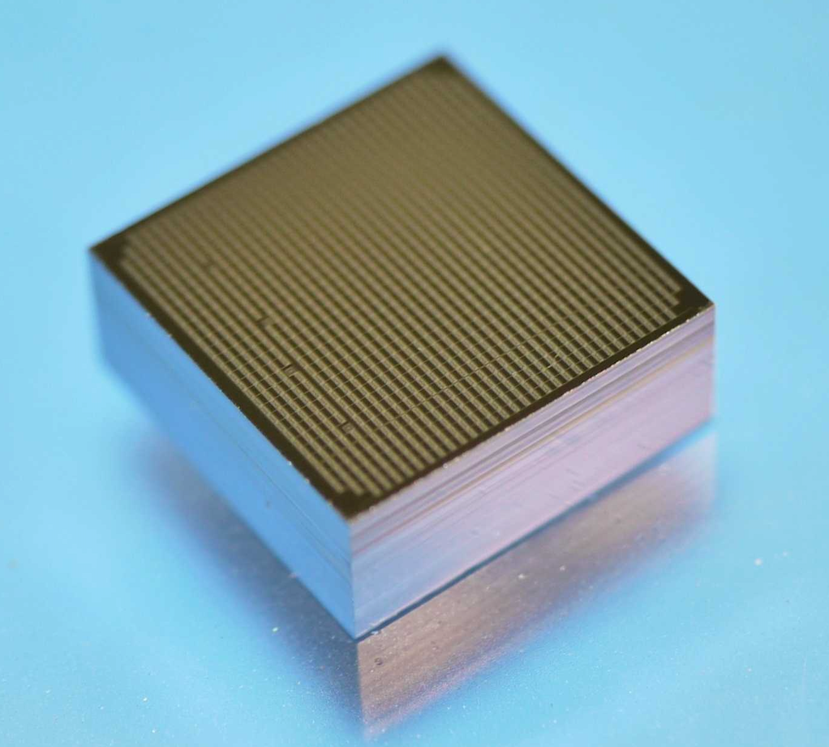
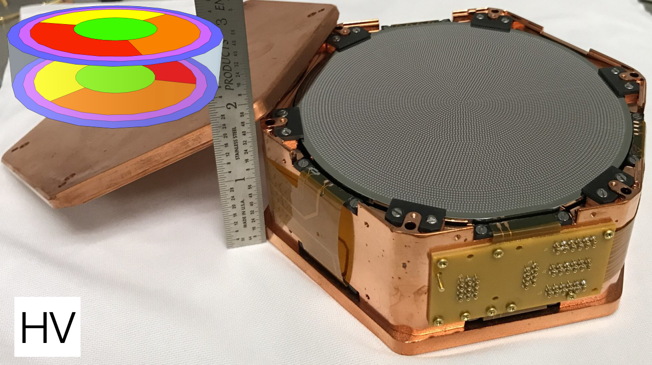
Exploring the Sensor Limits:
HV → HVeV Detectors
HVeV
HVeV: Prototype HV detector
Gram scale
eV level resolution
(“Run 4”: low-energy calibration using Compton steps in Si
https://arxiv.org/abs/2508.02402 )

Slide 22
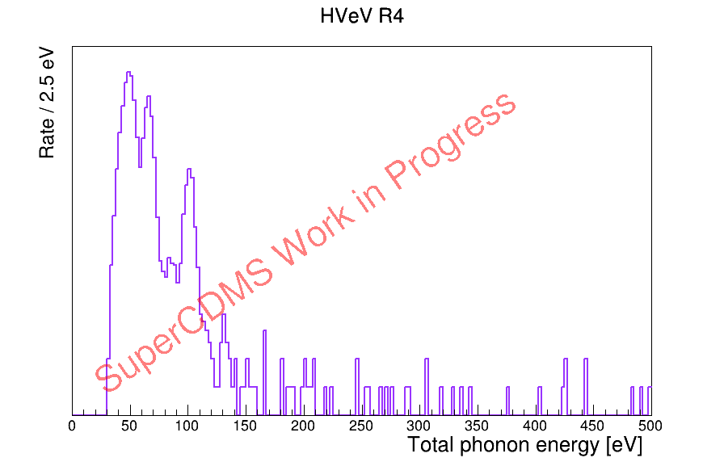
Background Challenges in Low-Mass DM Searches
1-eh peak
Could be from electrode leakage, light leakage, etc.
Attempting electrode blocking materials for mitigation
Also building better light tight enclosures
Sub 1-eh peaks
Hypothesized from unpolished sidewalls
Will attempt sidewall etching/polishing
Low energy excess
Evidence hints different ionization from ER and NR
  “Heat only”
Unpacking ER/NR/Heat Only components by operating with different NTL gains
What are these?

Slide 23
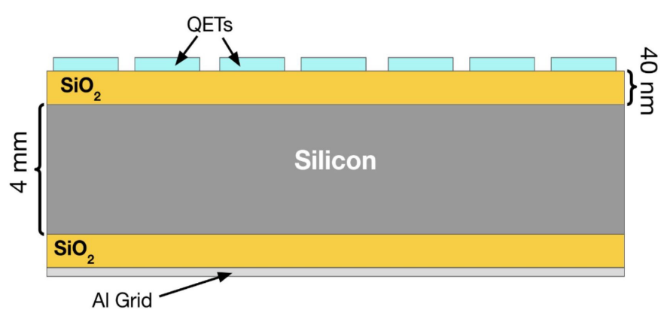
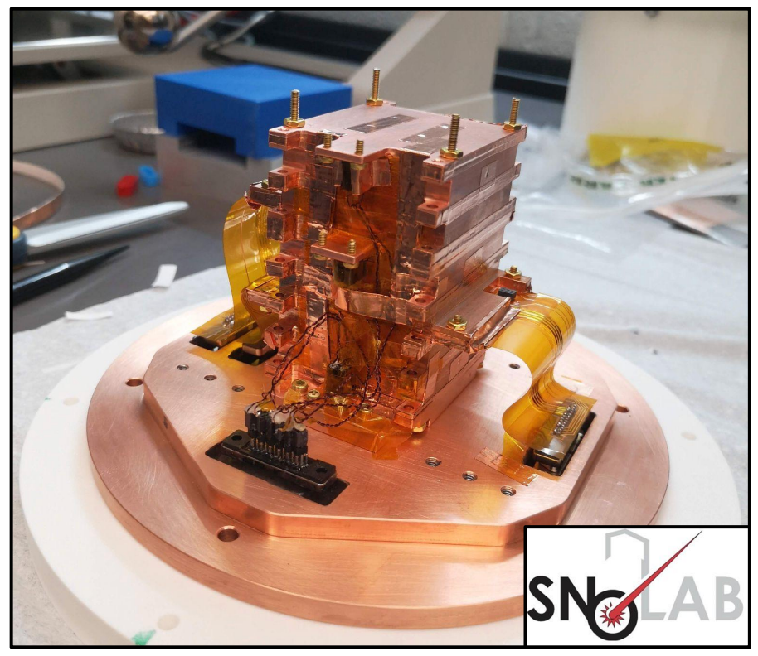
HVeV “Run 5” @ CUTE
New light tightness standard
More sensitive TES sensors
  Lower Tc, requires lower noise
Quieter electronics
SiO₂ insulating layer for charge injection
Lower background
Operating detector at multiple voltages to model non-ionizing backgrounds

Slide 24
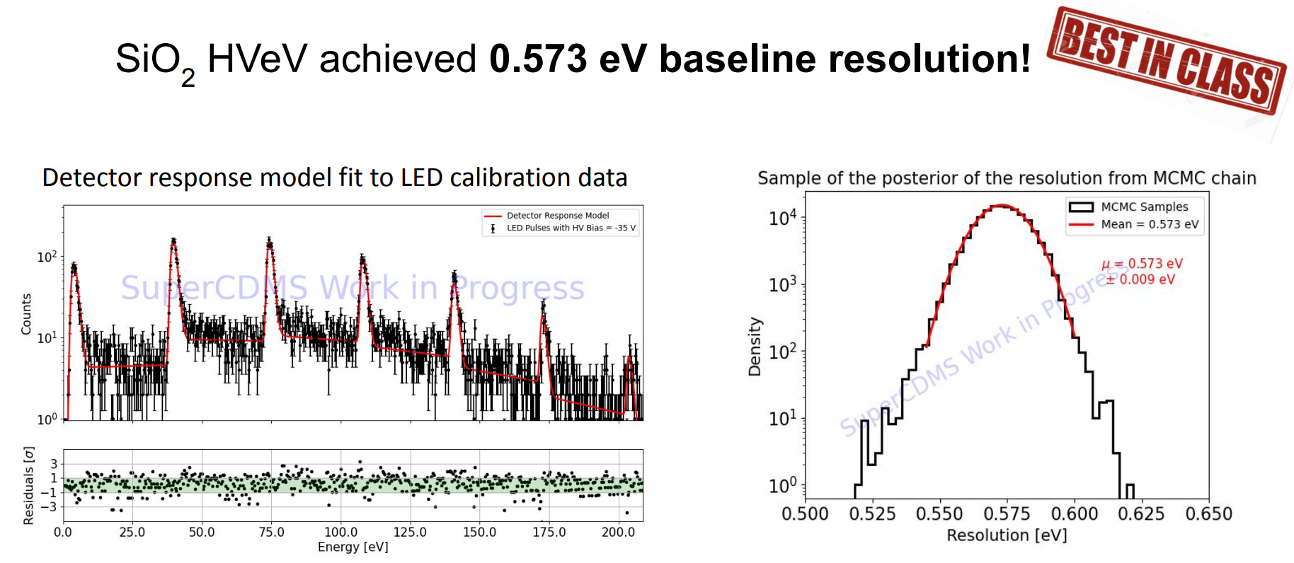
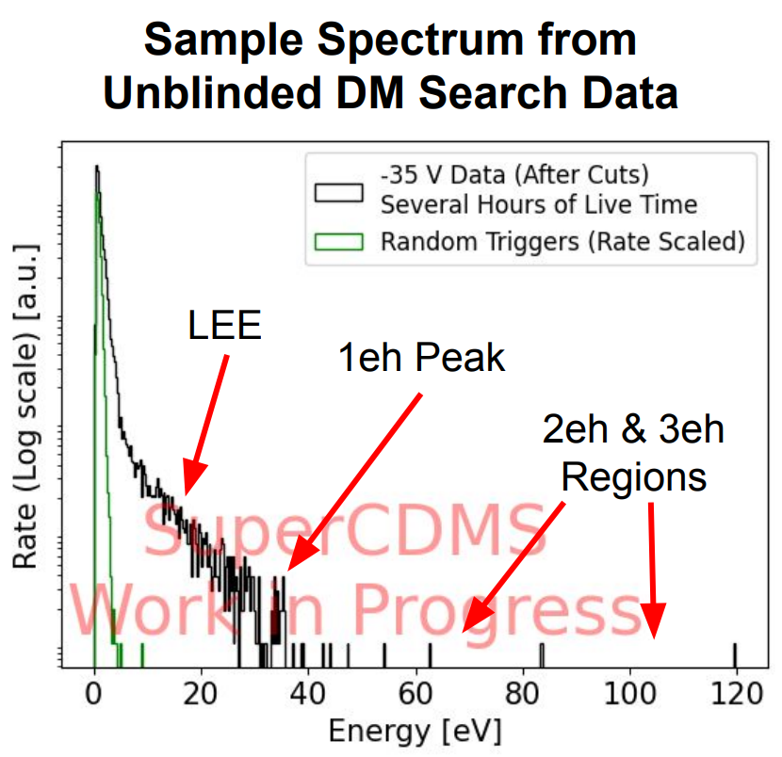
HVeV “Run 5” @ CUTE
0V data in hand to help model this

Slide 25
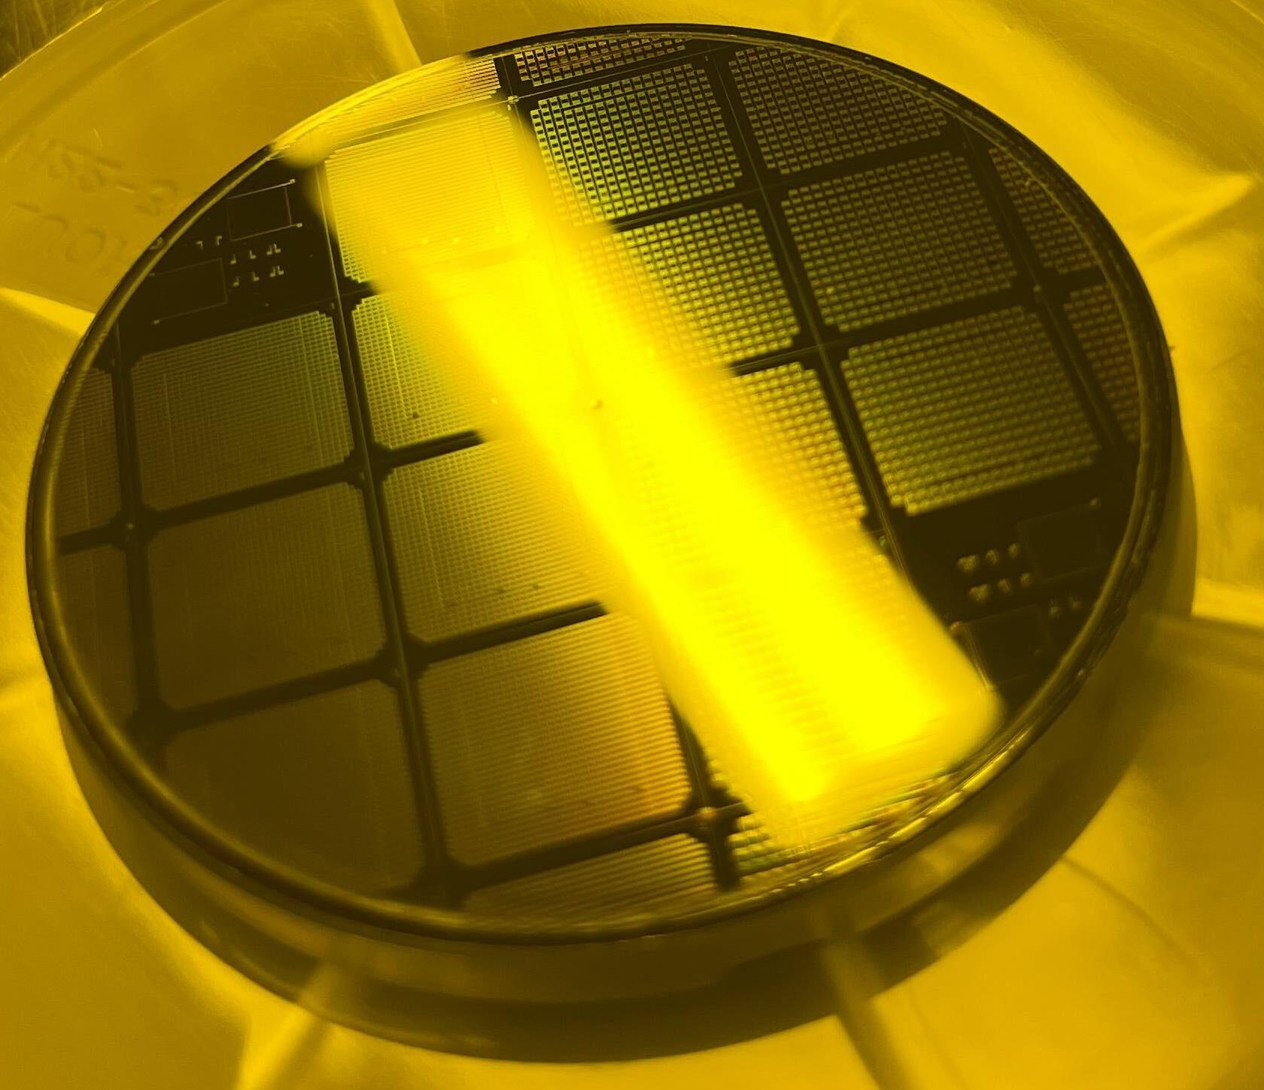
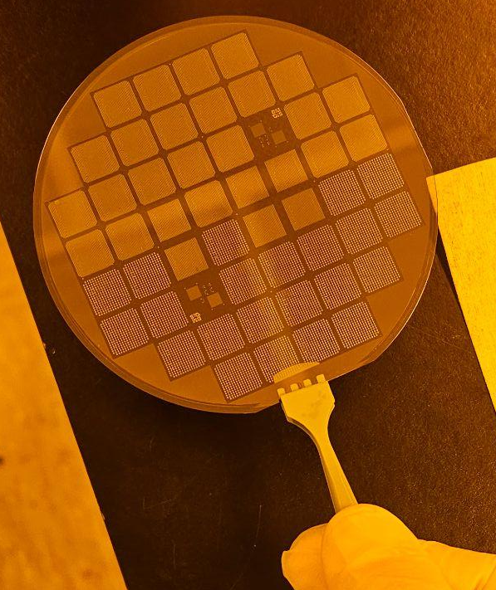
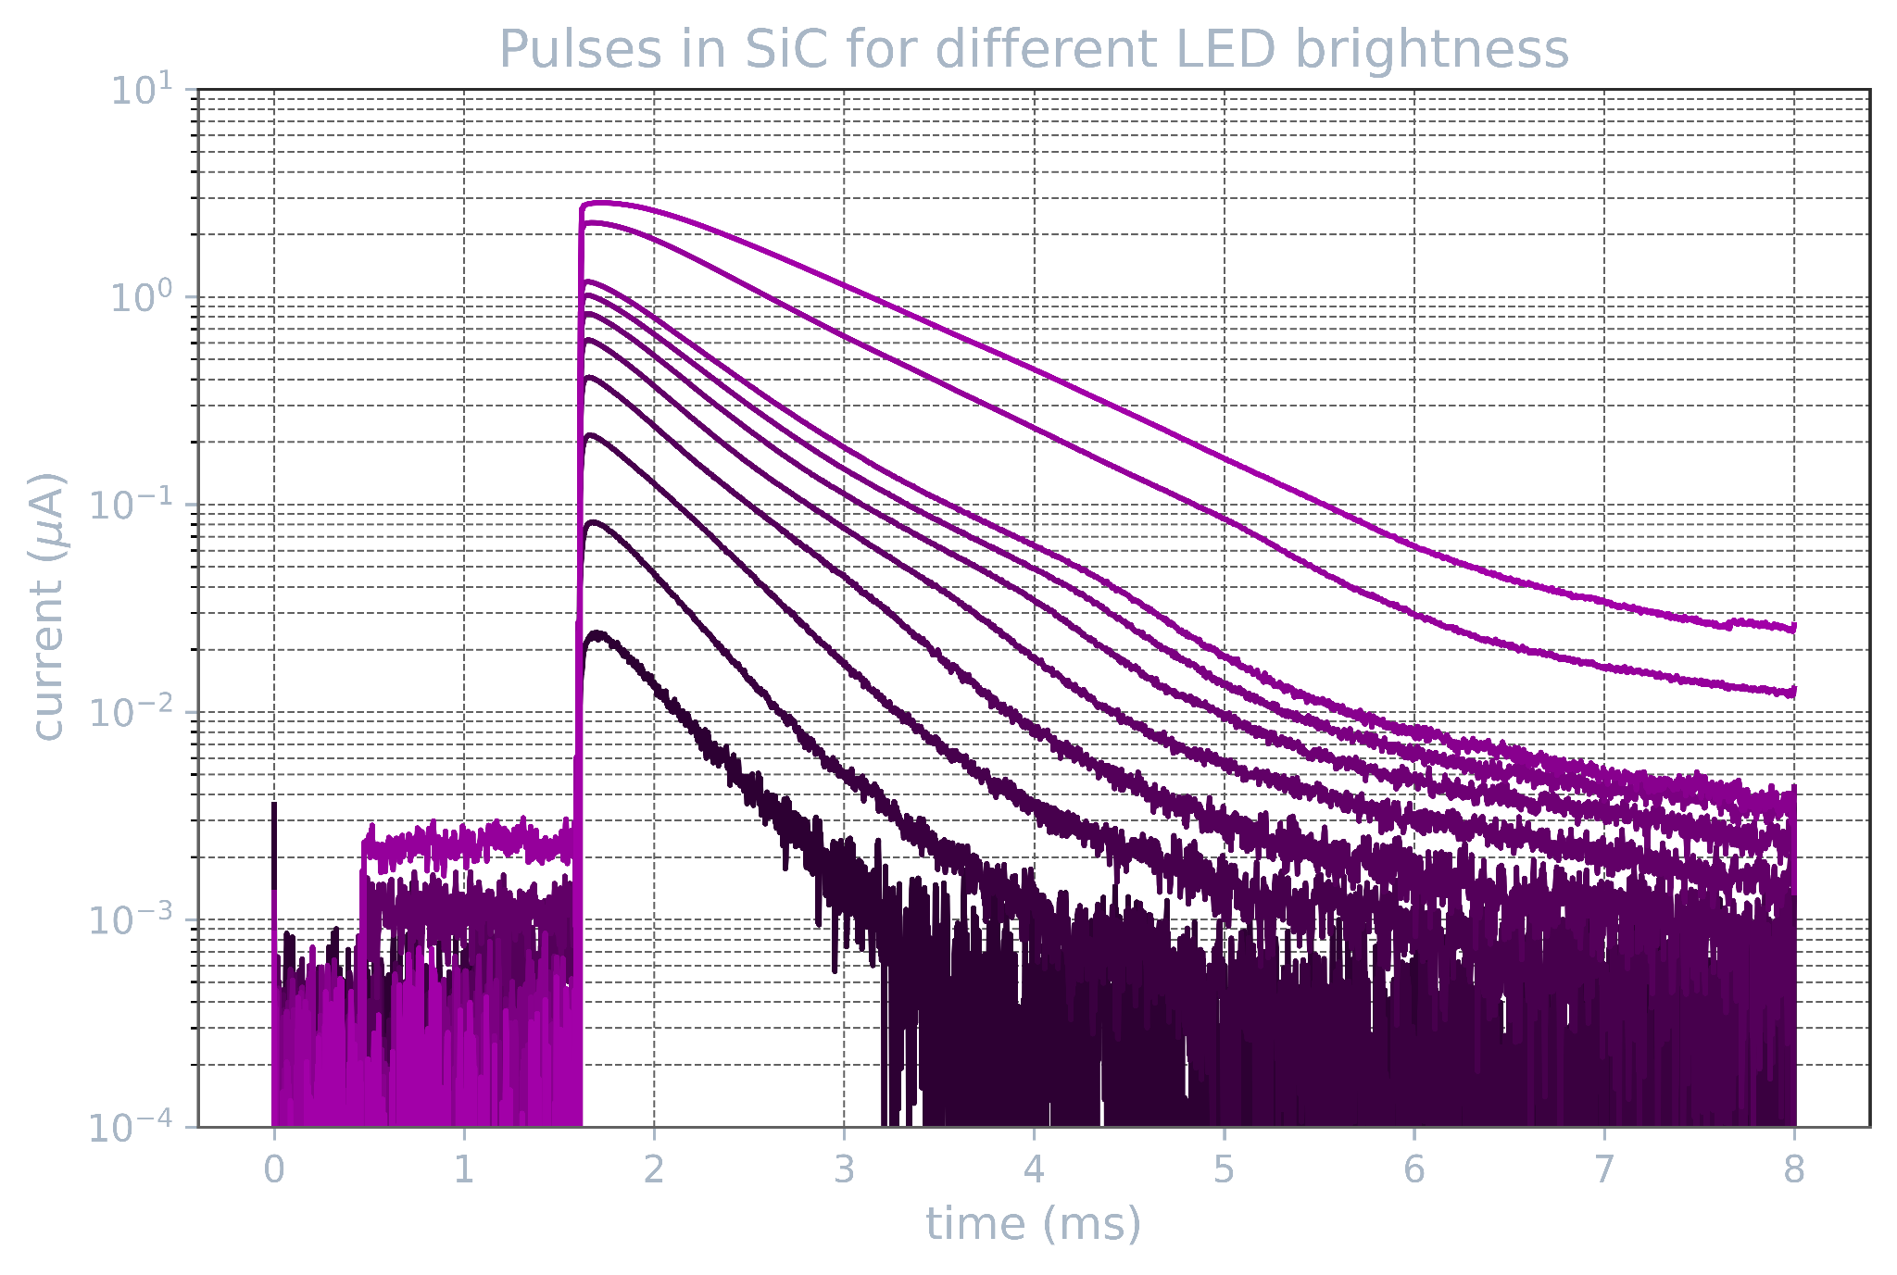
R&D: HVeV with more targets
Try HVeV with different target materials: Germanium, SiC, Diamond, maybe others
Better low-mass WIMP sensitivity with Carbon
Exploring arts of fabrication
Coming to SNOLAB soon!

Slide 26

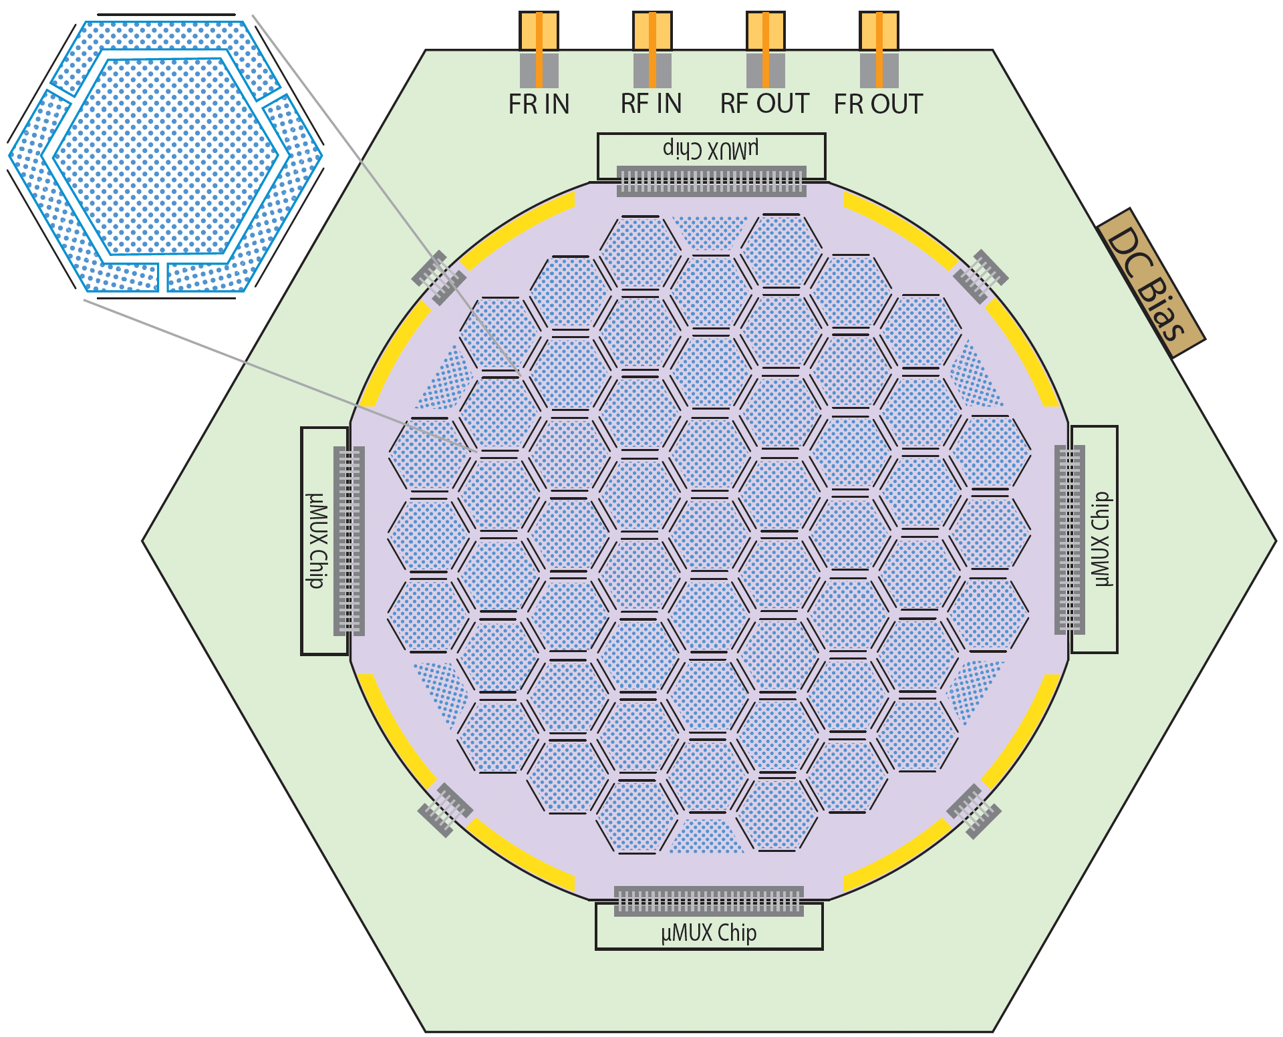
HONEYCOMB
Scaling up HVeV concept
A few grams each
“Dicing” wafer with Deep Reactive Ion Etching trenches
  Leave a small “bridge”
  for thermal conduction
  Smooth dicing reduces
  sidewall charge injection
  Stress-free mounting, hope to
  reduce/remove low energy excess
Multiplexing readout with uMUX
  With multi-stage cryogenic amplifiers
10 cm

Slide 27
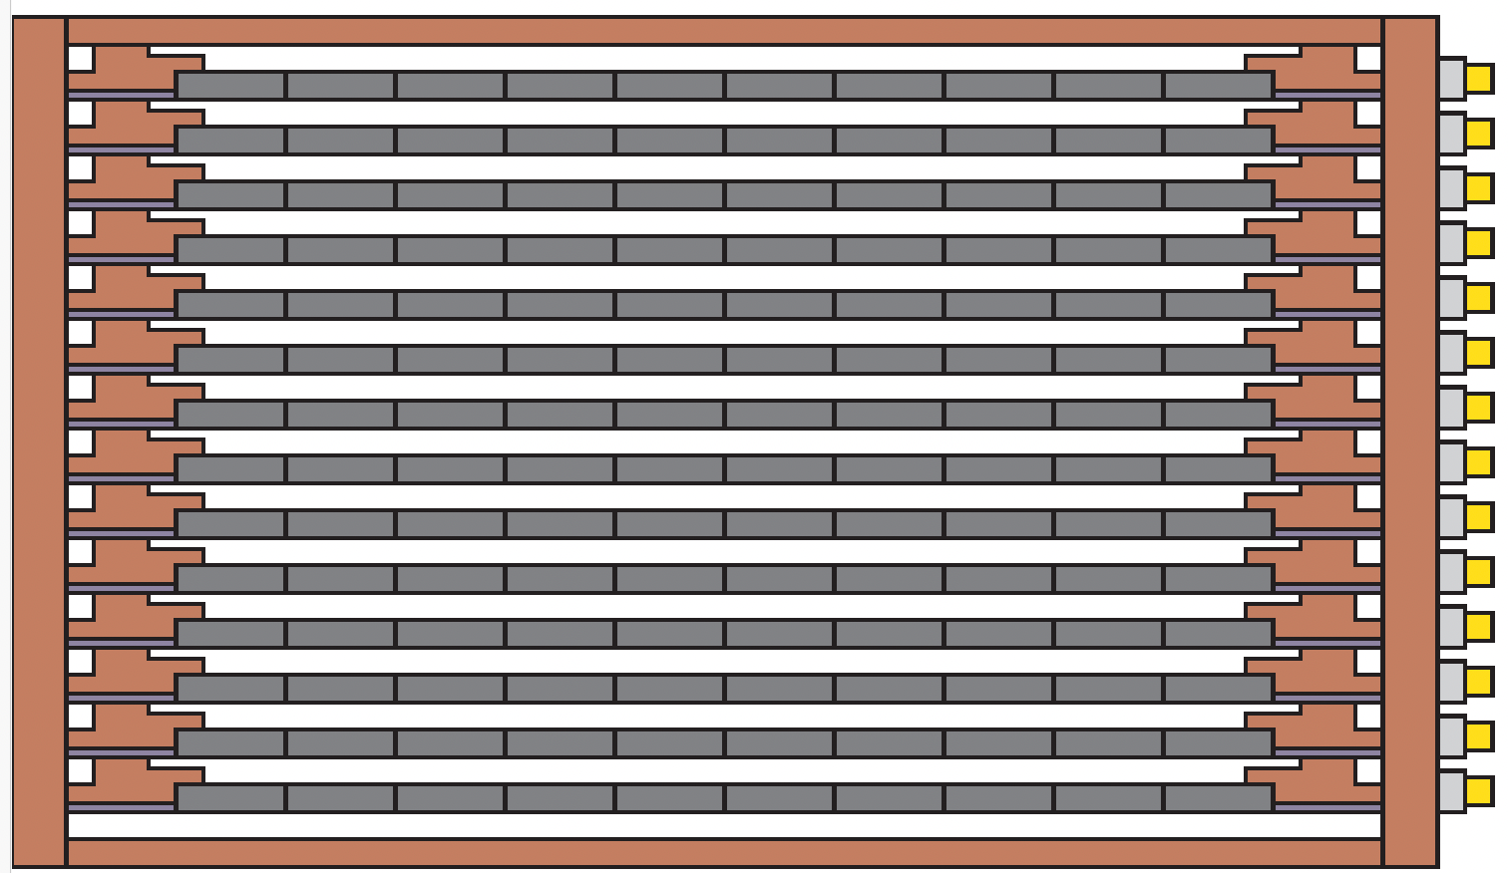
HONEYCOMB
Stacking multiple wafers for O(10 kg) payload
Aiming for eV level threshold
Multiple chips serve as active veto for each other
Perfect match for recent RF readout upgrades for the CUTE facility

Slide 28


SPLENDOR
Narrow bandgap materials
Slides from Taylor Aralis

Slide 29

SPLENDOR
Two-stage charge readout
Slides from Taylor Aralis
7.2 electron resolution achieved!
Best in class!
(arXiv:2311.02229)

Slide 30

Far Future: Underground Detector Fabrication?
With all detectors/technology under control, circle back to backgrounds
Background budget dominated by Tritium (cosmogenic activation)
Solution: Keep the whole detector fabrication cycle underground!
Also benefit from electroformed copper underground

Slide 31
Conclusions
SuperCDMS is well suited for low mass DM searches
Low threshold enables low mass NR searches
  iZIP provides background rejection
  HV pushes down threshold further
SNOLAB commissioning well underway
  Lab provides critical resources for all aspects
HVeV detectors achieve sub-1 eV resolution
  More varieties of HVeV coming soon!
Two more future experiments on the horizon
  HONEYCOMB -- extreme phonon sensor
  SPLENDOR -- charge readout with nano-gap materials

Slide 32
Bonus Slides

Slide 33


QET Design and Transport

Slide 34

SuperCDMS Detectors & Dark Matter Mass Scales
Dark Matter Mass Ranges
  "Traditional" Nuclear Recoil: Full discrimination, ≳ 5 GeV
  Low Threshold NR: Limited discrimination, ≳ 1 GeV
  HV Detector: HV, no discrimination, ∼0.3 – 10 GeV
  Migdal & Bremsstrahlung: no discrimination, ∼0.01 – 10 GeV
  Electron recoil: HV, no discrimination, ∼0.5 MeV – 10 GeV
  Absorption (Dark Photons, ALPs): HV, no discrimination, ∼1 eV – 500 keV (“peak search”)

