Slide 1




BBN Constraint on Heavy Neutrino Production and Decay
Yu-Ming Chen
Carleton University
With Y. Zhang
arXiv: 2410.07343
CAP2025
Notes:
Hello everyone, I’m Yu-Ming Chen, grad student here. Today I’m going to tell you something about the early Universe and how we can use it to constraint on new physics.

Slide 2
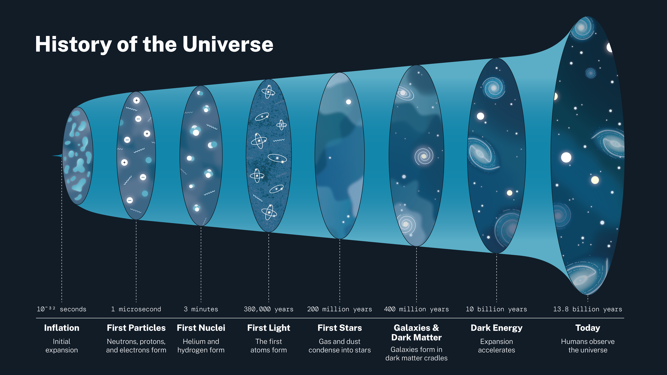
Big-Bang Nucleosynthesis
When the Universe is cool enough (...still 10¹⁰ Kelvin)
Credit: NASA
Notes:
To set the stage, the period I’m going to talk about is called the Big-Bang Nucleosynthesis. If you can see the small word over there, it begins at about 1 second after the Big-Bang and last for around 10 minutes. At this time, the Universe is cool enough, of course for the particles not for us, for some light elements to form like deuterium, tritium and helium.

Slide 3
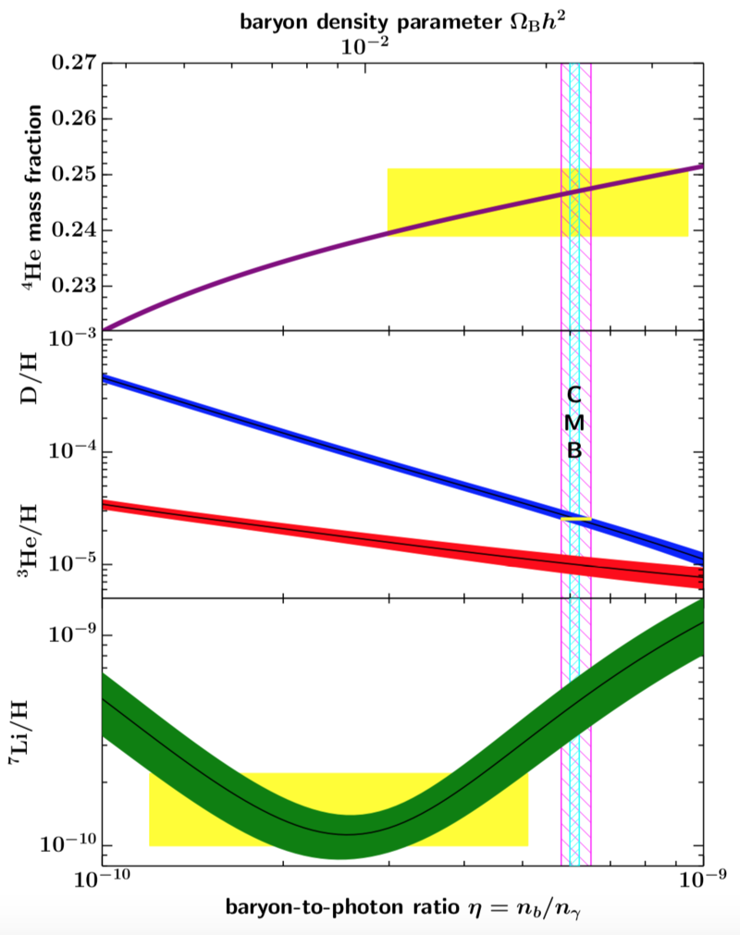
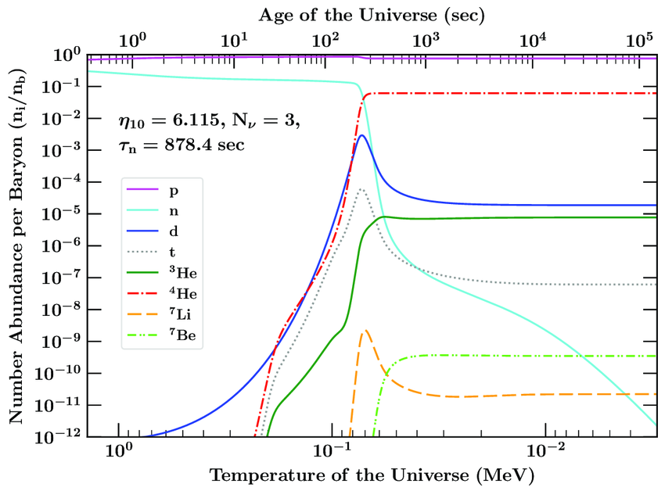
Big-Bang Nucleosynthesis
The first epoch in cosmology that we have precise observational data!
Credit: 2303.04140
Credit: PDG 2022
Notes:
It is also the earliest period that we have a precise data in cosmology. By measuring the light element abundances in low metallicity galaxies, we are able to determine its value to 1 percent precision. For example the left figure is the light element abundance evolution, what we measure is the final abundance when BBN ends. It’s also sensitive to theh baryon asymmetry in the right figure. So if we pretend there is no lithium problem, then everything fits well with the CMB prediction.

Slide 4
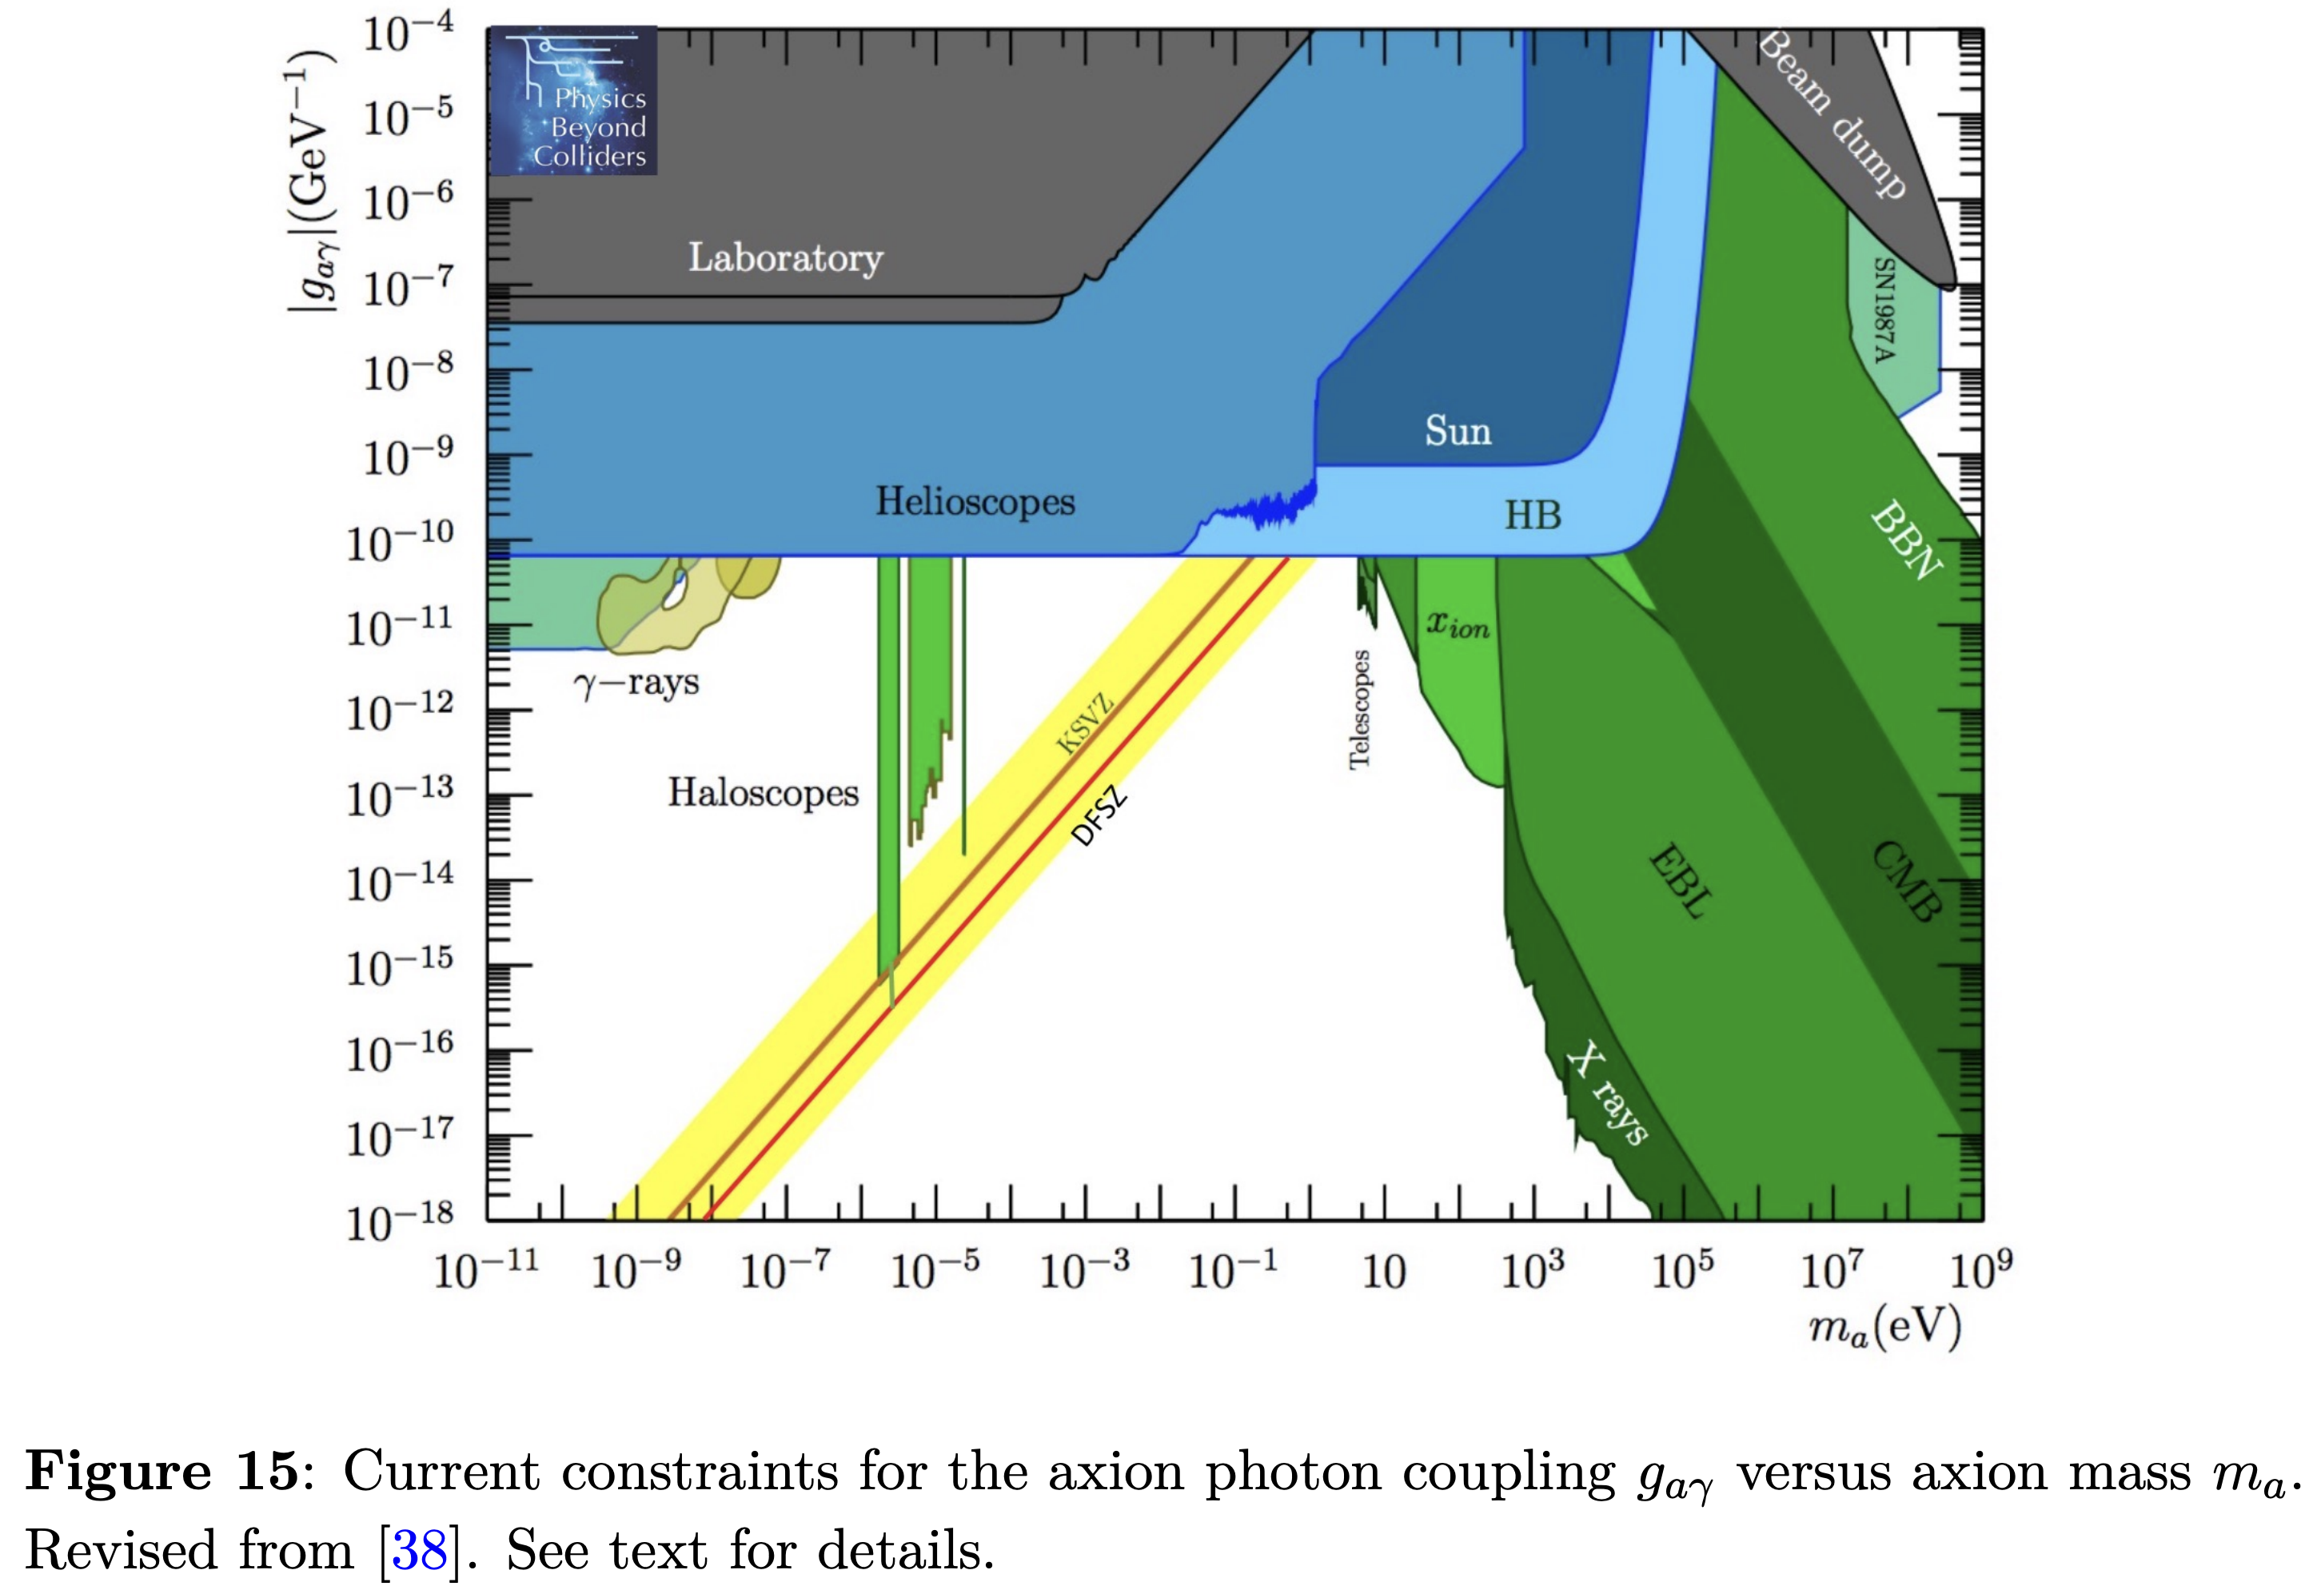
Big-Bang Nucleosynthesis
The first epoch in cosmology that we have precise observational data!
Credit: arXiv: 1901.09966
Notes:
These precise data could then be used to set constraint on various new physics, like the coupling between axion and photon

Slide 5
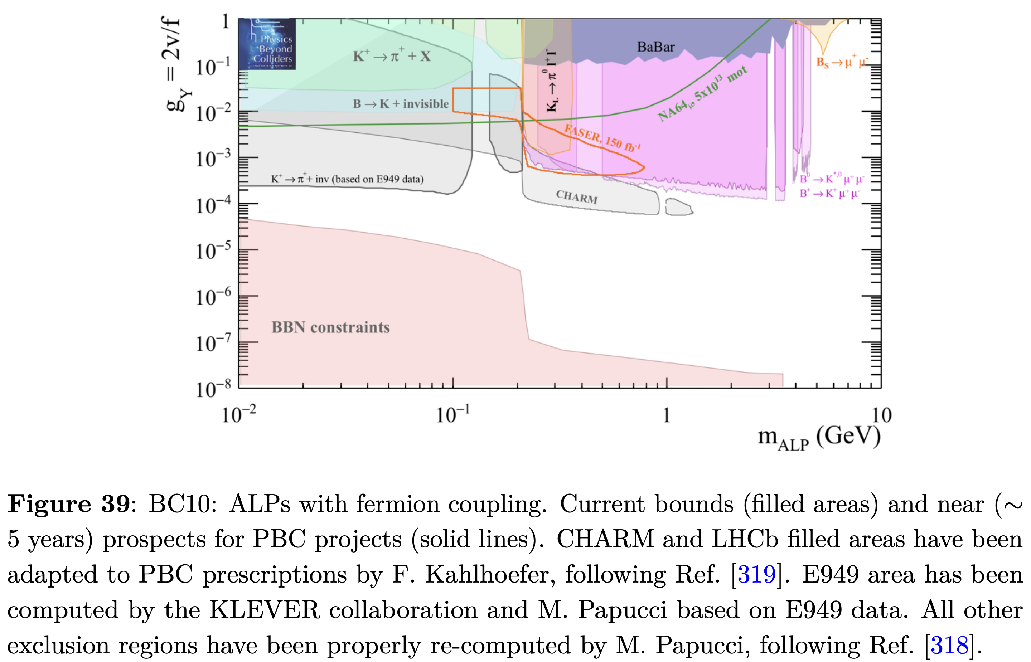
Big-Bang Nucleosynthesis
The first epoch in cosmology that we have precise observational data!
Credit: arXiv: 1901.09966
Notes:
Axion and fermions

Slide 6
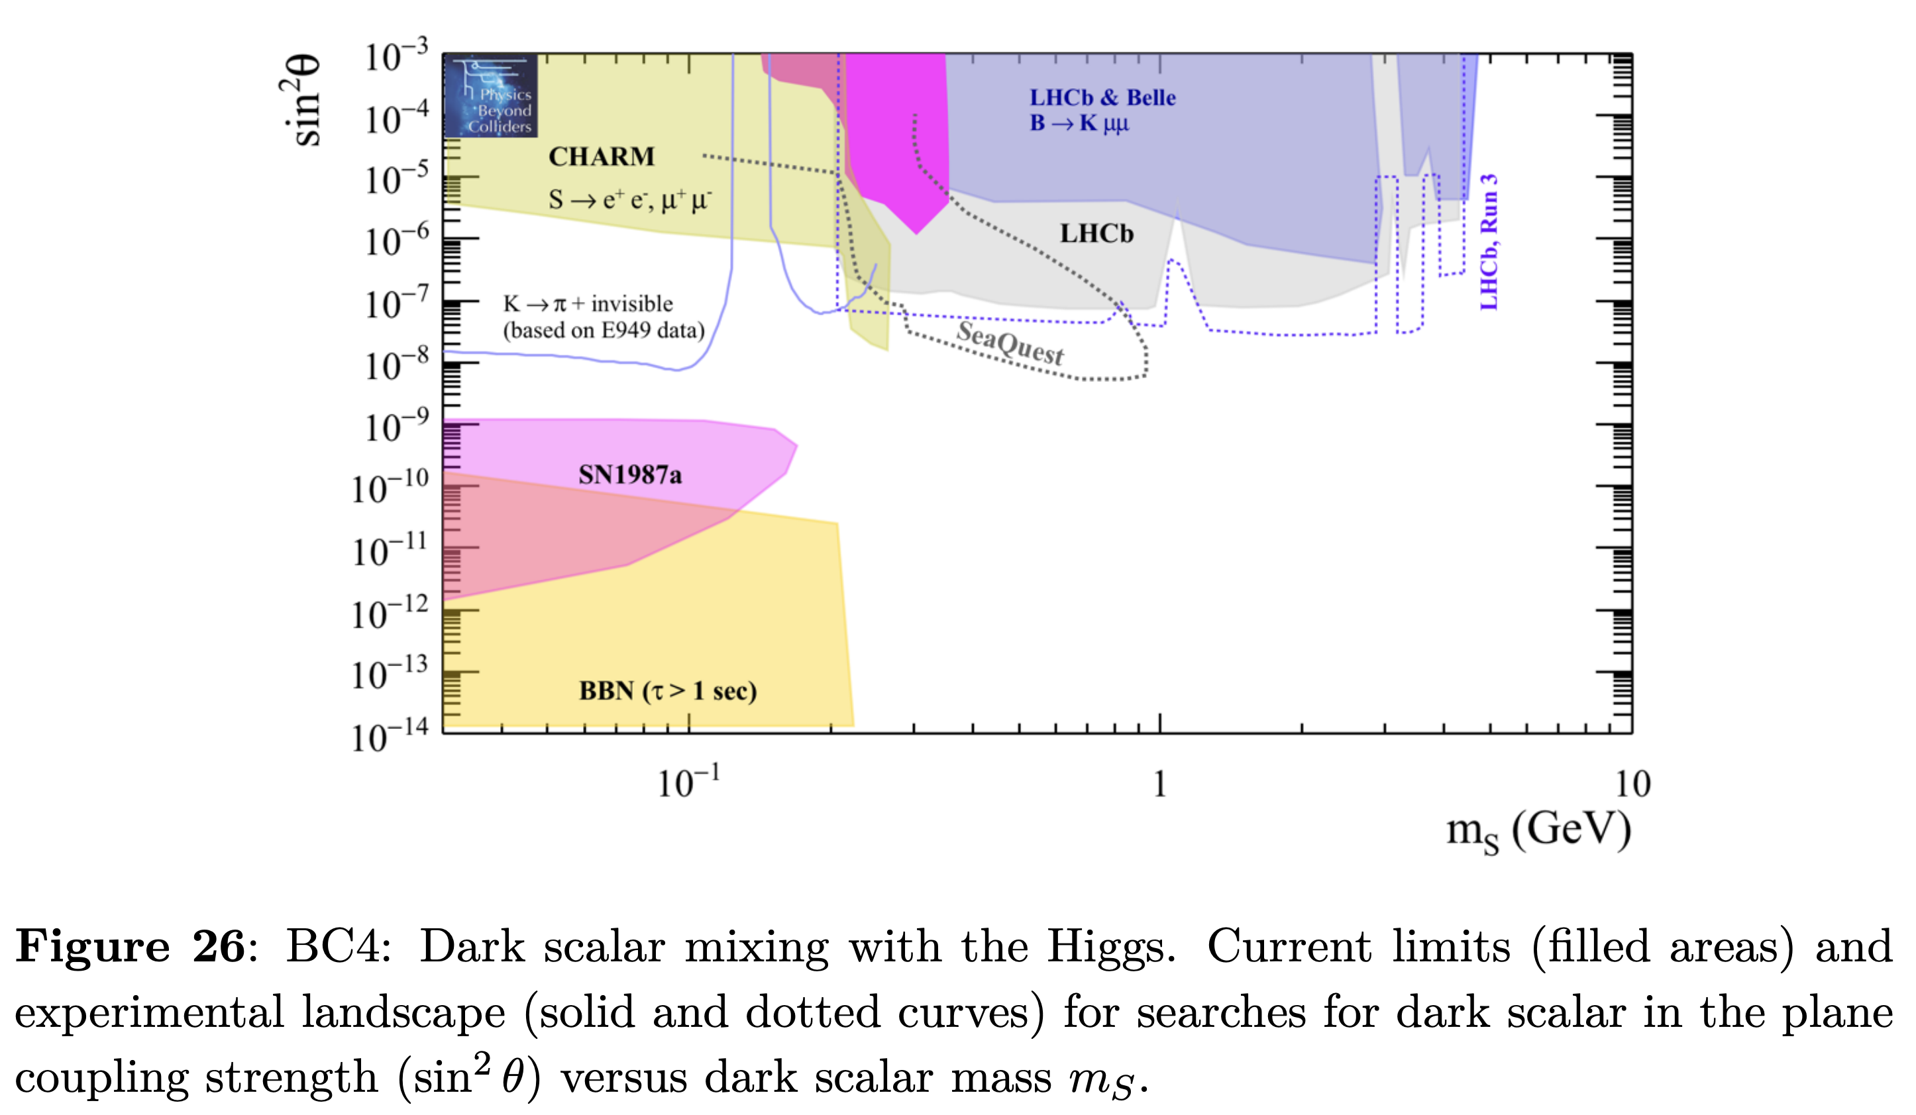
Big-Bang Nucleosynthesis
The first epoch in cosmology that we have precise observational data!
Credit: arXiv: 1901.09966
Notes:
dark scalar and Higgs

Slide 7
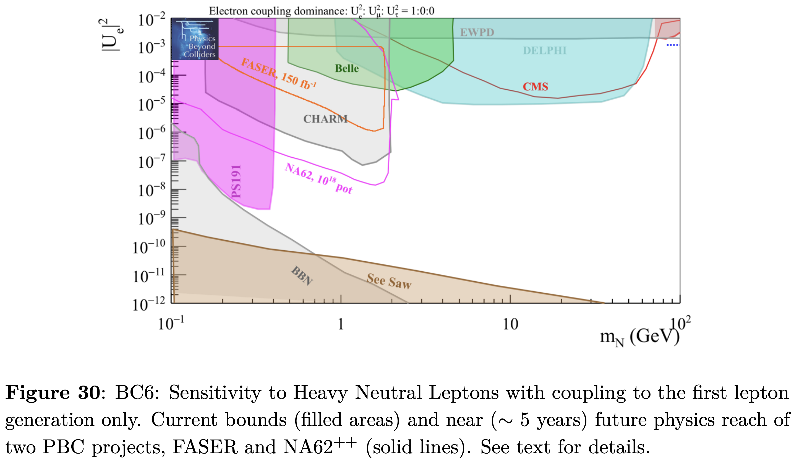
Big-Bang Nucleosynthesis
The first epoch in cosmology that we have precise observational data!
Credit: arXiv: 1901.09966
Notes:
and of course, our main character heavy neutrino and active neutrino. I will go back to this in a moment

Slide 8
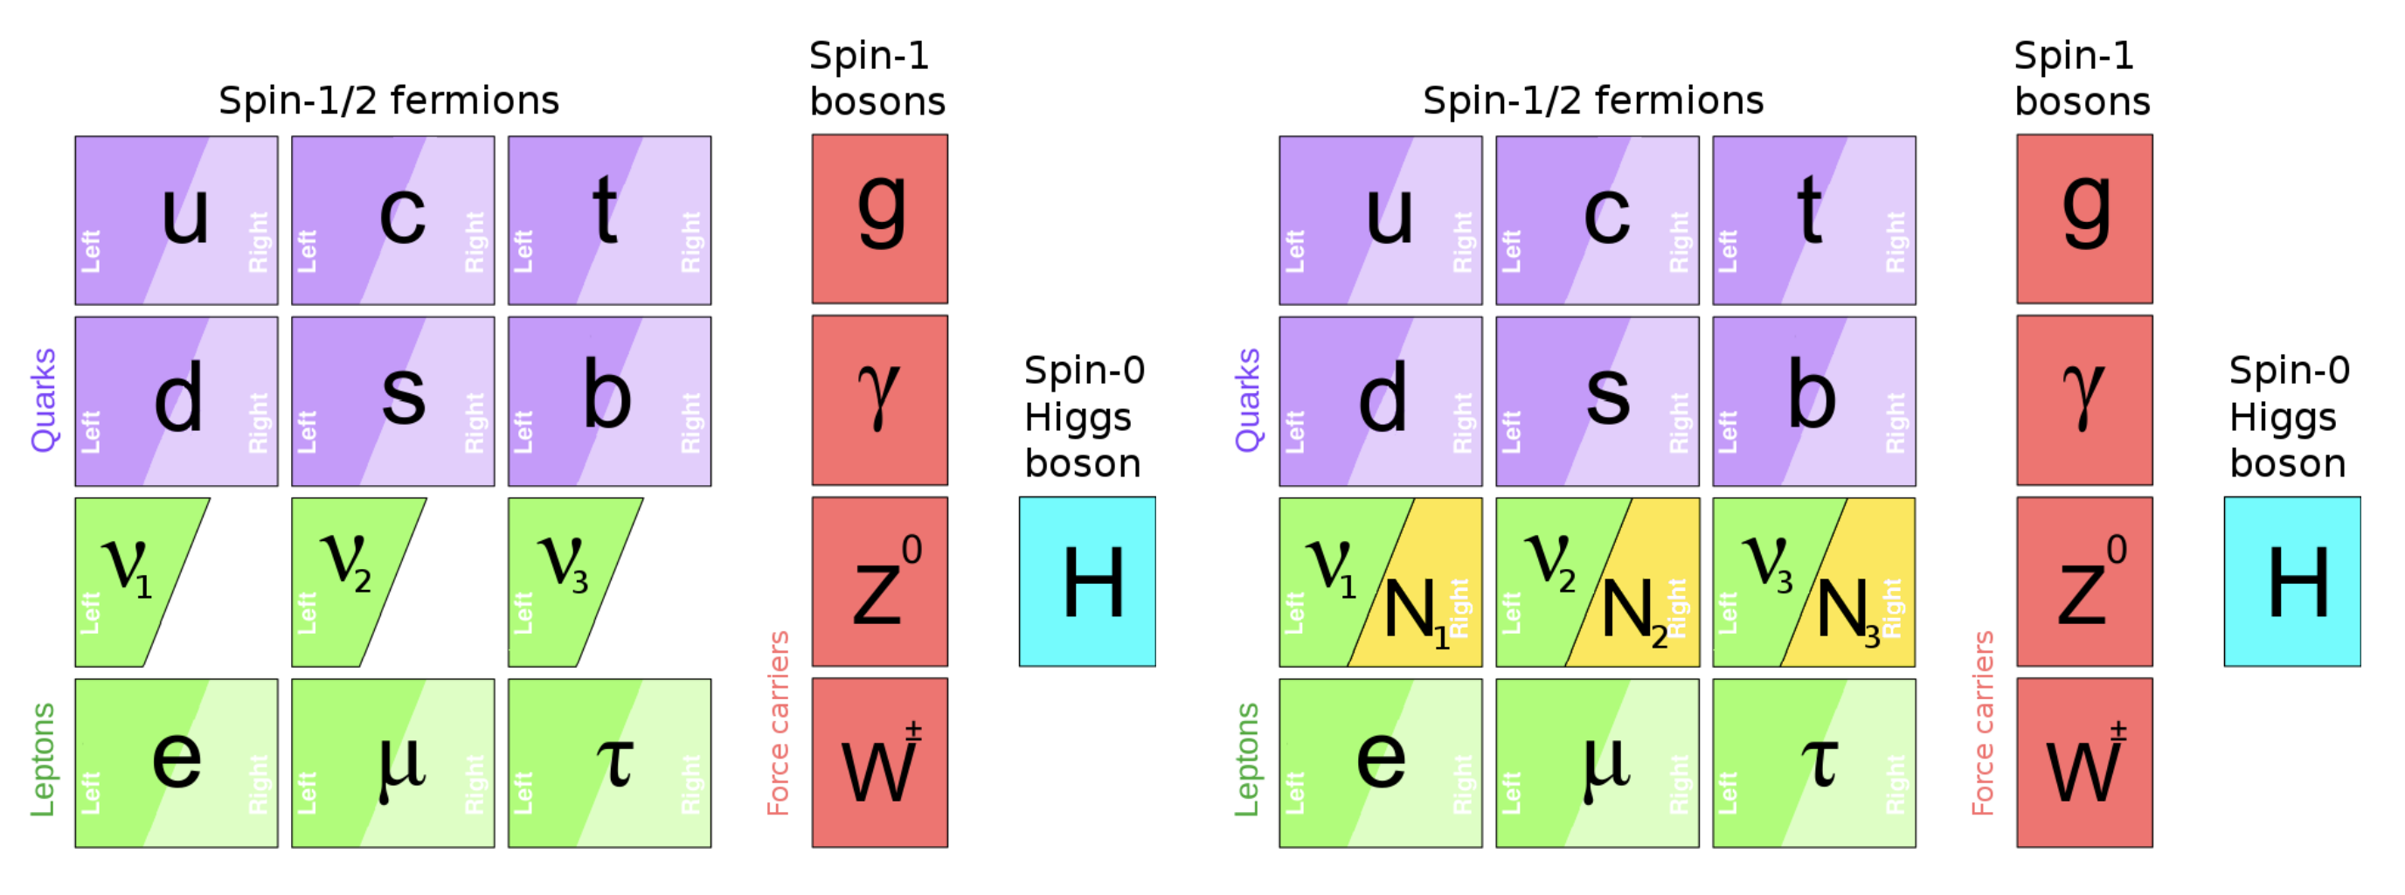
Why Heavy Neutrinos?
There is no heavy neutrino in the SM
Figure credit: 1704.08635
Notes:
Since our stage is set. Now let’s introduce our main player, the heavy neutrino or sterile neutrino or heavy neutral lepton whatever you like to call it. But we know there no such particle in the Standard Model

Slide 9
Why Heavy Neutrinos?
But there is always room for new physics
Figure credit: 1704.08635
Notes:
However there is always room for new physics

Slide 10

Why Heavy Neutrinos?
But there is always room for new physics
Credit: Symmetry Magazine
SM singlet
no EM interaction
no strong interaction
no weak interaction
Credit: 1704.08635
Notes:
These heavy neutrinos are Standard Model singlet. It has no EM, no strong, no weak interaction. In the simplest extension, its production is only by active neutrino osccillate into the sterile state.

Slide 11

Why Heavy Neutrinos?
Couple with active neutrino:
Notes:
Just like I show here. If we assume the heavy neutrino only couples to 1 flavor of active neutrino, then it becomes a simple two-state system which can be solved by quantum mechanics.

Slide 12
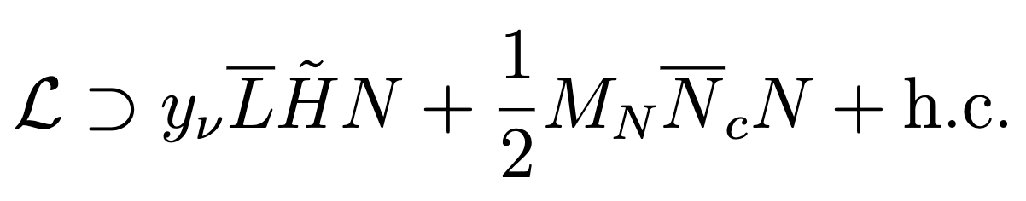
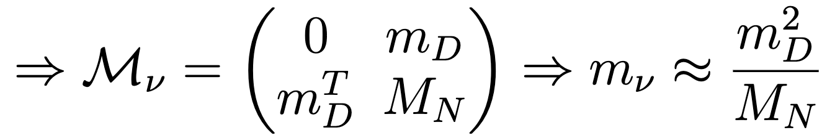
Why Heavy Neutrinos?
Couple with active neutrino:
Can be used in different aspect:
Seesaw mechanism
Notes:
Despite being a simple extension, it’s also very versatile. Probably the most famous one is the seesaw mechanism, which explains why active neutrino mass is so tiny comapred to other Standard Model particles. Because we have a capital M suppression which is the mass of sterile neutrino,

Slide 13

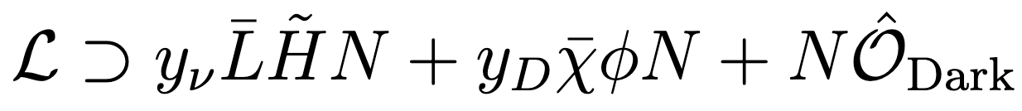
Why Heavy Neutrinos?
Couple with active neutrino:
Can be used in different aspect:
Seesaw mechanism
Connect with dark portal
  Neutrino portal
Notes:
It can also link to dark sector through the so-called neutrino portal as the second term shows or probably some higher order operator as the third term here.

Slide 14
Big-Bang Nucleosynthesis
Credit: arXiv: 1901.09966
Notes:
So go back to this plot in the previous slide. As you can see, the BBN constraint here only occupies the lower-left corner, equivalently blocks out everything that with smaller mass and smaller mixing, which is unreasonable when you think about it. For example, if you have a super tiny mixing angle, let’s say 10 to the minus 50, you could barely produce any heavy neutrino in the first place, so how can it be constraint by the data. So here is the main motivation of our work, we want to see the whole picture of this BBN constraint, including its upper and lower bound.

Slide 15
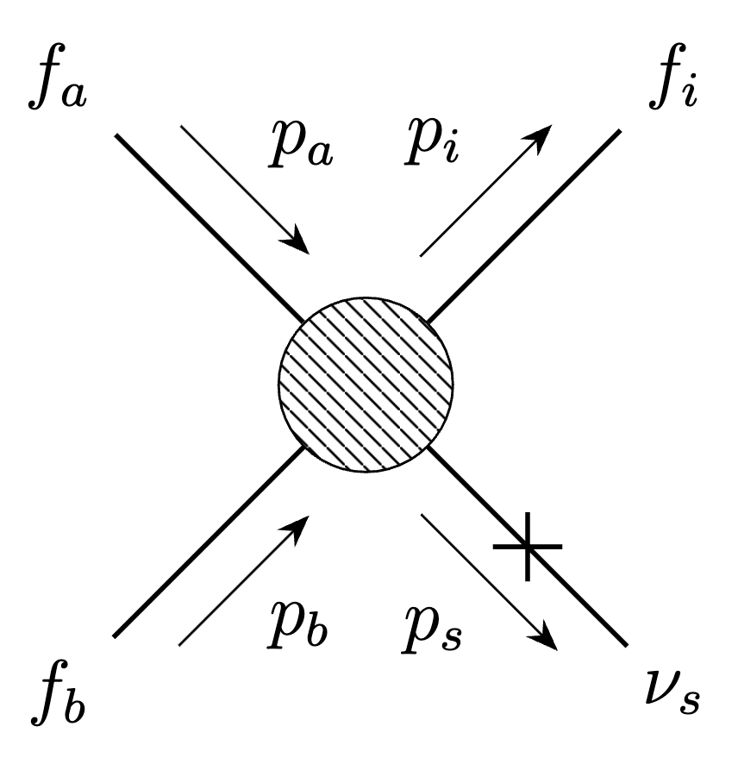
Temporary Matter Domination
If we overproduce heavy neutrino, it may dominate the Universe during BBN, which is disfavored by observation.
Notes:
In order to constraint it, we need to first produce it. In this blob, we take into account all the weak processes that an active neutrino can participate in in the early universe. Then through this insertion, it can oscillate into the sterile state.

Slide 16
Temporary Matter Domination
If we overproduce heavy neutrino, it may dominate the Universe during BBN, which is disfavored by observation.
Notes:
But here comes a problem, BBN is strictly radiation dominated. When we produce too many heavy neutrinos, as temperature decreases, its energy density will become matter-like, which redshifts slower than the energy density of radiation and it may dominate the universe at some time during BBN as red line shows.

Slide 17
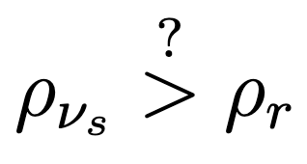
Temporary Matter Domination
If we overproduce heavy neutrino, it may dominate the Universe during BBN, which is disfavored by observation.
Notes:
So, the big question here is will the energy density of heavy neutrino be larger than that of radiation when BBN happens?

Slide 18
Temporary Matter Domination
If we overproduce heavy neutrino, it may dominate the Universe during BBN, which is disfavored by observation.
Notes:
By this condition, we can first set up a constraint on the mass and mixing parameter space, it will mainly occupy the smaller mass and larger mixing region. Since we need to produce a lot, so the mixing has to be large. But we cannot let it decay too quick, so the mass should be small.

Slide 19
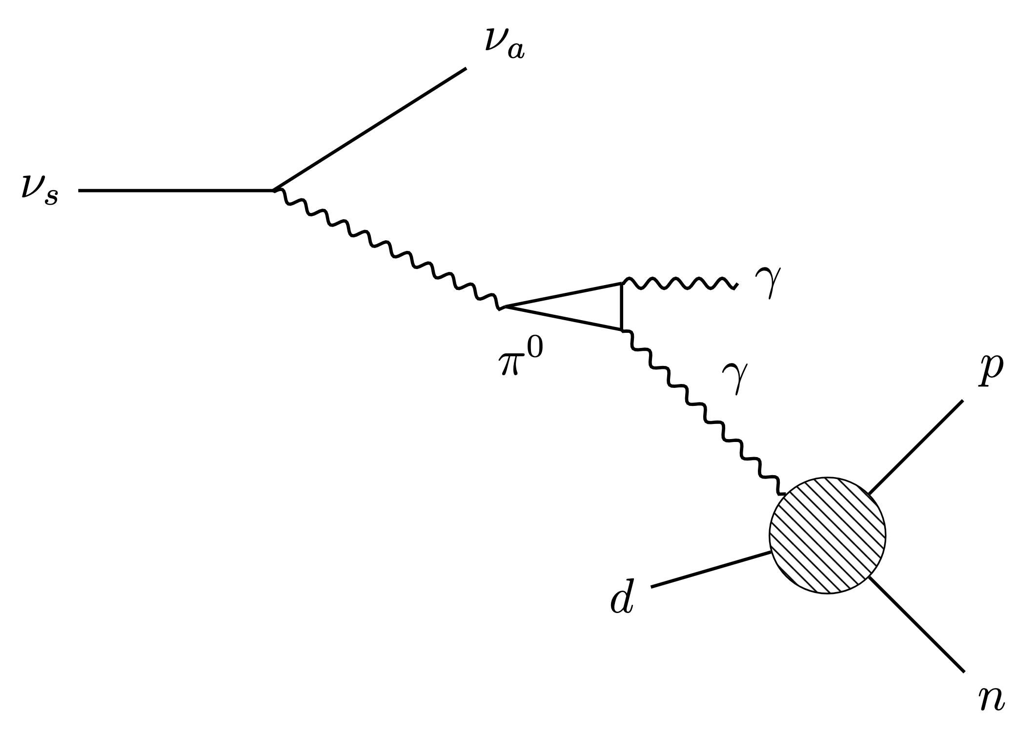

Decay Effect: Photo-dissociation
Light nuclei can be dissociated by photons from heavy neutrino decay, take deuterium for example
Notes:
OK, now let’s fast forward to the time when sterile neutrino is about to decay. The first important process is the photodissociation where heavy neutrino first decays to neutral pion, which subsequently decay to a pair of photons and those photons find a light nucleus and destroy it. The important thing here is that these photons are much hotter than the background photons, so the dissociation process is only effective through these population.

Slide 20
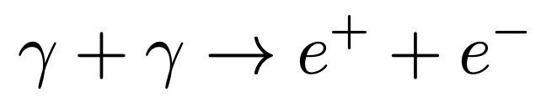
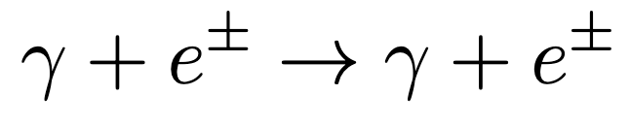
Decay Effect: Photo-dissociation
Light nuclei can be dissociated by photons from heavy neutrino decay, take deuterium for example
Photon can also participate in other EM interactions
Dominated channels would be
Pair production
Compton scattering
Notes:
But there are some EM process that can take away energy from those photons for example pair production to electron positron and high energy Compton scattering

Slide 21
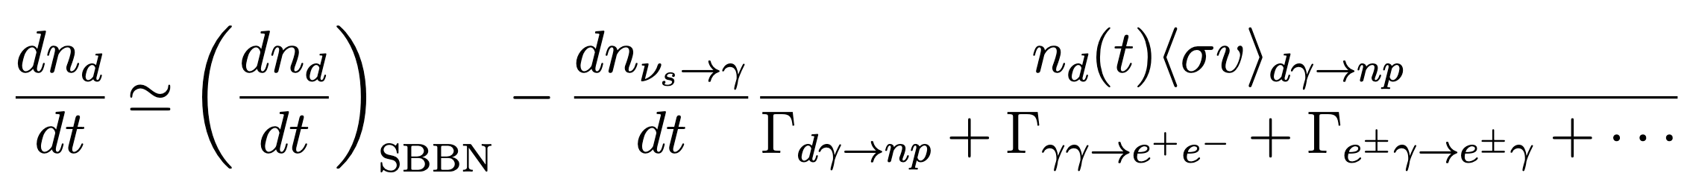

Decay Effect: Photo-dissociation
Light nuclei can be dissociated by photons from heavy neutrino decay, take deuterium for example
Photon can also participate in other EM interactions
Dominated channels would be
Pair production
Compton scattering
Boltzmann Equation for deuterium
we also consider other photodissociation up to ${}_{ }^{4}{He}$
Notes:
So the Boltzmann equation for deuterium is first we calculate how many photons we produce, then times a factor that account for how many photon amoung them go into the dissociation process we care about. Beside deuterium we include the dissociation processes up to helium-4.

Slide 22
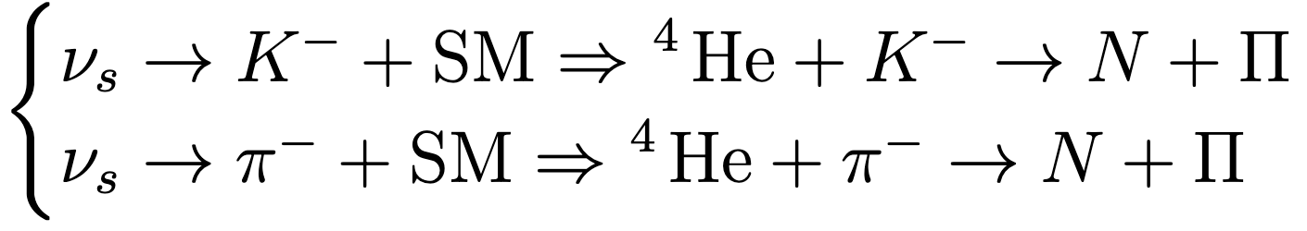
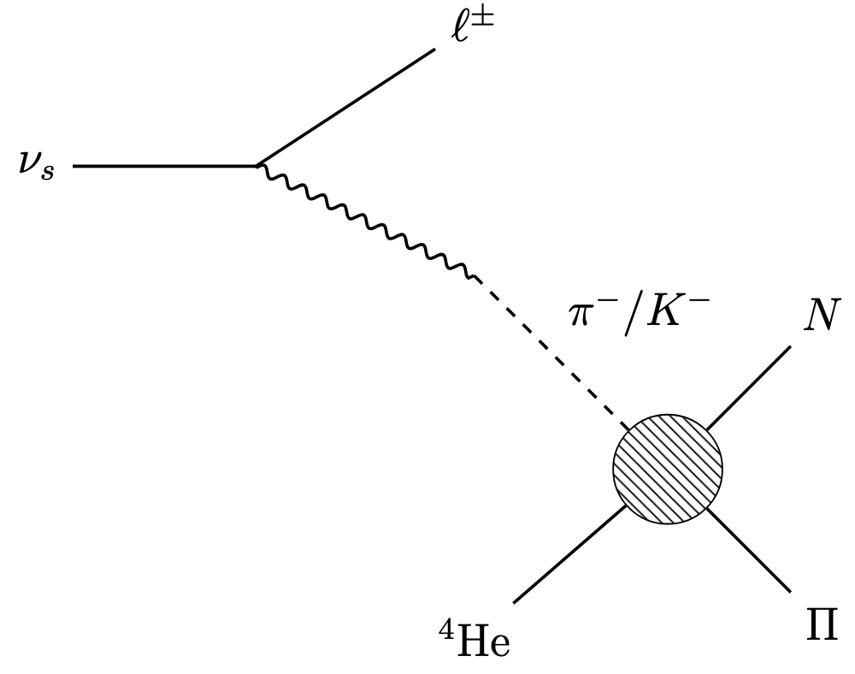

Decay Effect: Hadro-dissociation
Charged mesons may destroy helium-4 to various final states
Notes:
Another similar process is the hadrodissociation of helium-4 where heavy neutrino decays to charged mesons then these charged mesons destroy helium-4 to some lighter nuclei.

Slide 23
Decay Effect: Hadro-dissociation
Charged mesons may destroy helium-4 to various final states
  Charged mesons are stopped before decay
Notes:
Since EM interactions have not decoupled yet, these charged mesons would lose their energy quickly and thermalize with the plasma before decay so we could use the thermalized cross sections for these interactions which are independent of charged mesons’ momentum.

Slide 24
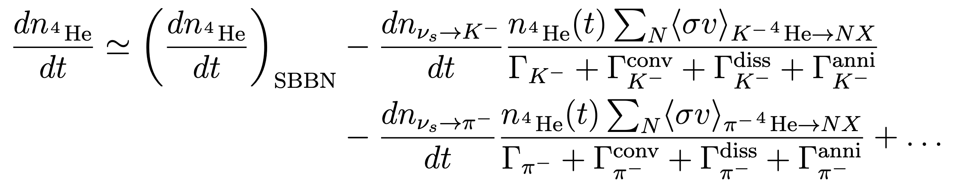
Decay Effect: Hadro-dissociation
Charged mesons may destroy helium-4 to various final states
  Charged mesons are stopped before decay
  Charged mesons from heavy neutrino decay can choose to decay, self-annihilation or participate in interactions
Notes:
The Boltzmann equation for helium-4 is also similar to the photodissociation that we calculate how many charged mesons we produce from heavy neutrino decay times a factor to account for whether this charged meson choose to decay away or participate in any accessible interaction. In the denominator, the second term is the nucleon conversion which I will talk about later, the third one is the hadro-dissociation, and the final one is the self-annihilation.

Slide 25
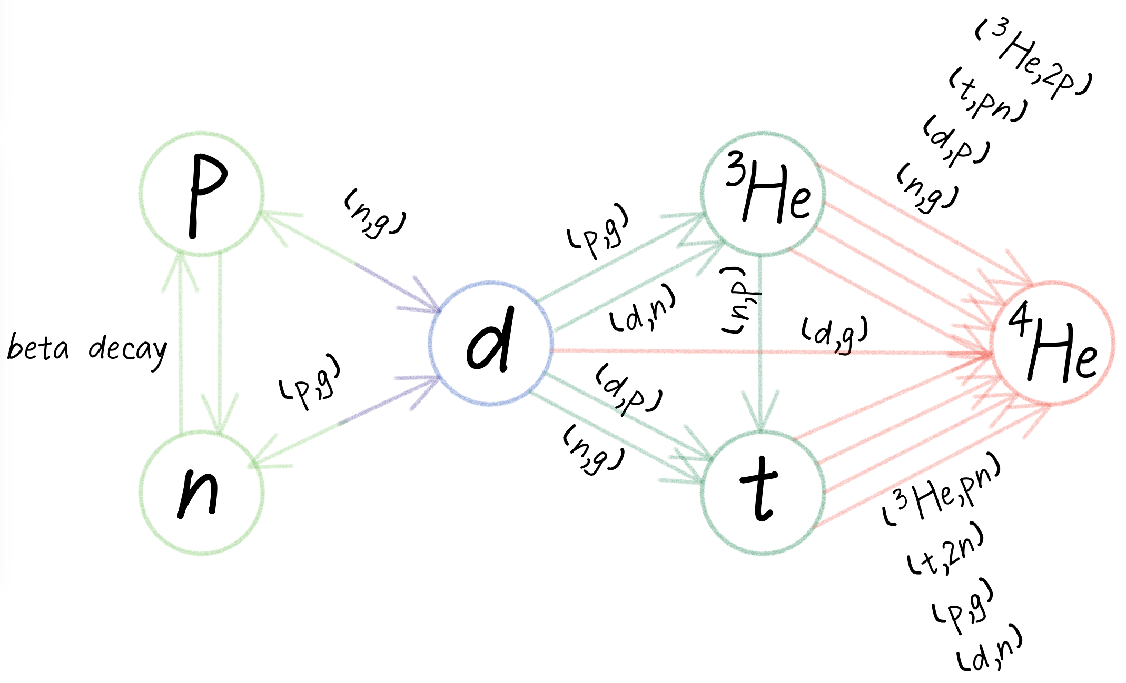
BBN Review
Two important temperatures:
Notes:
Before going to the next process, I want to do a quick review of BBN, there are two important temperatures,

Slide 26

BBN Review
Two important temperatures:
T=0.8MeV
  Weak interaction decouples,
              $\frac{n}{p}=\frac{1}{5}$
Notes:
First, when the temperature equals to .8 MeV, the weak interaction just decouples, at that time the ratio between neutron and proton is 1 to 5.

Slide 27

BBN Review
Two important temperatures:
T=0.8MeV
  Weak interaction decouples,
              $\frac{n}{p}=\frac{1}{5}$
T=100keV
  Deuterium bottleneck
  $n+p→d+γ_{th}⟹$ $\frac{n}{p}=\frac{1}{7}$
Notes:
As the time goes by, the temperature decreases to 100 keV, this is so-called the deuterium bottleneck. It’s when the surrounding photons are not energetic enough to dissociate deuterium, so we can finally start to accumulate it in the Universe, at this time the ratio becomes 1 to 7.
Why is it important? We can look at the plot on the right, deuterium can be seen as the most fundamental element in the synthesize chain. If you want to produce heavier elements, you must go through deuterium.
Along the arrow, we can see that must of the light elements will finally end up in helium-4 since it has the highest dissociating energy among them. So, go back to the first ratio, we could estimate that if every neutron is used to produce helium4, we could have a ratio between helium and proton to about a quarter, which is pretty close to the measured value 24.5 percent. Now, if there is a process that could bring the ratio between proton and neutron closer to 1, we would expect the abundance of helium4 gets a huge boost.

Slide 28
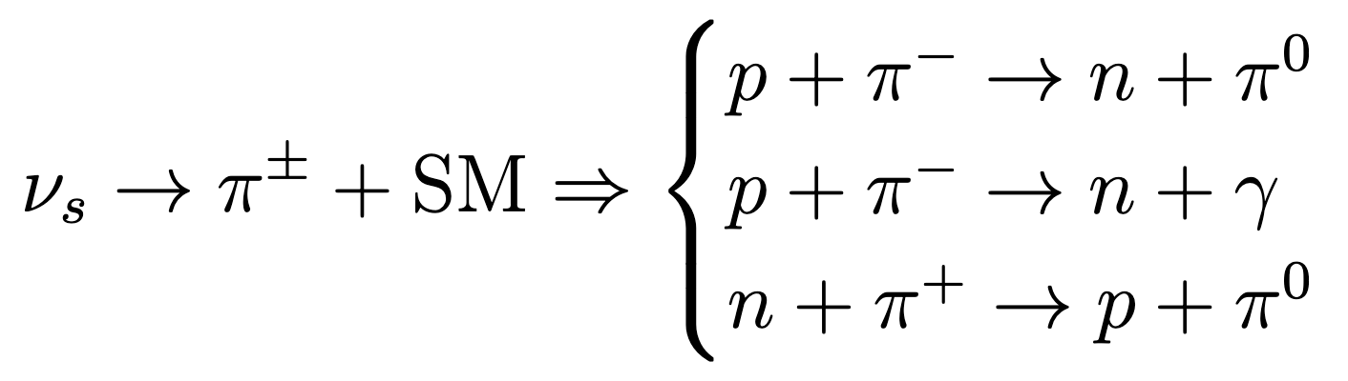
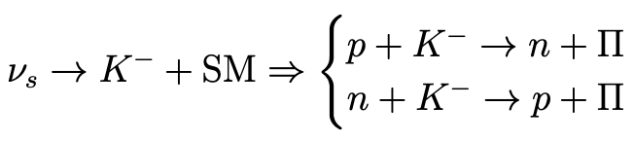
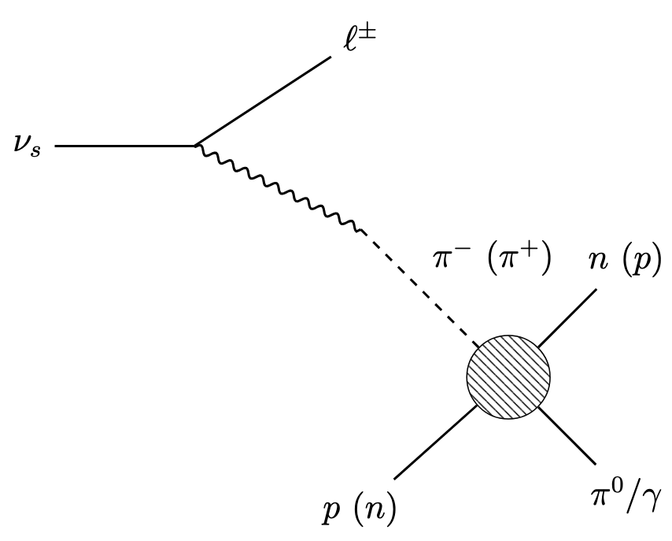
Decay Effect: Nucleon Conversion
By charged mesons
Notes:
The process I mentioned is called the nucleon conversion, First, sterile neutrino can decay to charged mesons, then the charged meson can turn a proton into neutron or the other way around.

Slide 29
Decay Effect: Nucleon Conversion
By charged mesons
  Charged mesons are stopped before decay
  Charged mesons from heavy neutrino decay can choose to decay, self-annihilation or participate in interactions
Notes:
The argument is the same as hadrodissociation, the difference is only in the numerator where we need to replace the dissociation rate to the conversion interaction. The kaon term is very similar, so I will not show it here.

Slide 30
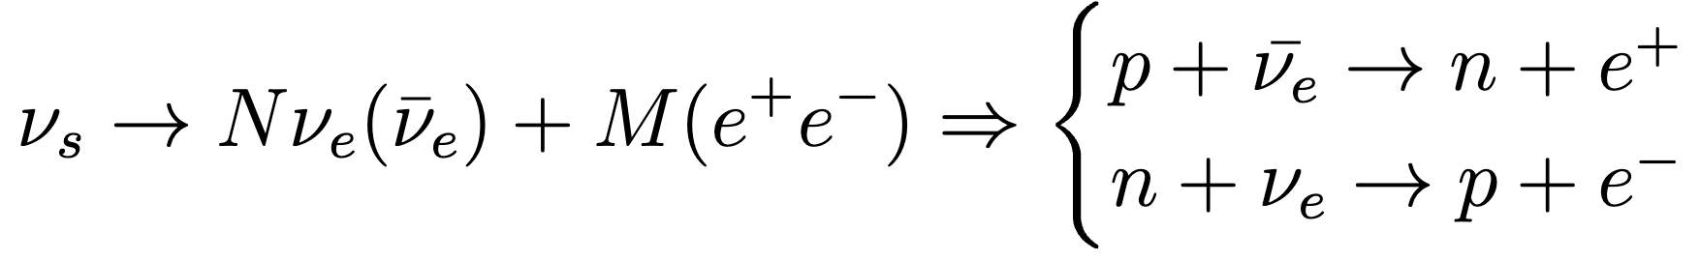
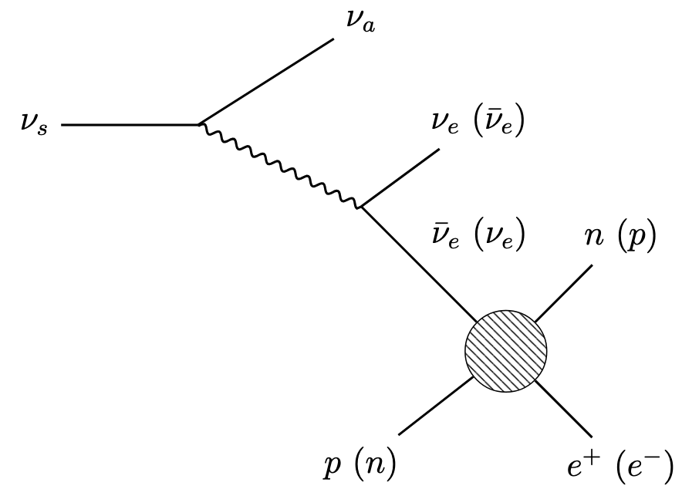

Decay Effect: Nucleon Conversion
By neutrino
Notes:
The same conversion could also be mediated by electron neutrinos through beta decay. Note that these processes are only effective when the sterile neutrino is too light to produce charged pions, otherwise the branching ratio is mostly occupied by the two-body decay to charged mesons

Slide 31
Decay Effect: Nucleon Conversion
By neutrino
  Only effective when heavy neutrino is lighter than charged pion
Notes:
But there are also some benefits. This time, since weak interaction has already decoupled, electron neutrinos can only free stream and lose its energy due to the expansion if it didn’t participate in the interaction.

Slide 32
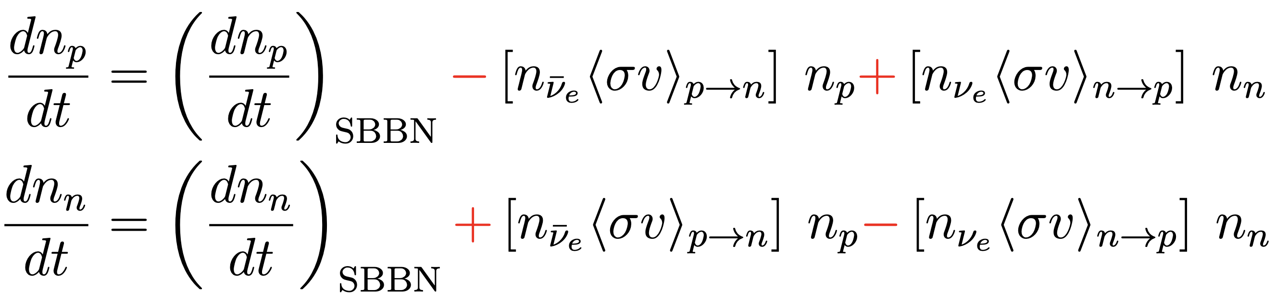
Decay Effect: Nucleon Conversion
By neutrino
  Only effective when heavy neutrino is lighter than charged pion
  Neutrinos from heavy neutrino decay can choose to free-stream or participate in interaction
Notes:
Then, in the Boltzmann equation for proton and neutron, the conversion rate for electron neutrino is simple n sigma v as we are familiar with.

Slide 33
Result: Mixing Angle Dependence
Notes:
Before going to the main result, it will be interesting to see the effect on the abundance versus mixing plot. Where two dashed lines are results when we only turn on one of the interactions and the black line is the combined result. You can see the black follows the blue dashed nucleon conversion first then got taken over by the helium-4 dissociation. However, at very small and very large mixing, the abundance is within 1 sigma range, so we won’t get any constraint in these areas as we expected.

Slide 34
Result: Time Evolution of Abundances
Notes:
This time, we use a BBN simulation package written in python called the PRyMordial and this is the stanard light elements abundance evolution predicted.

Slide 35
Result: Time Evolution of Abundances
Notes:
If we add the sterile neutrino into BBN, this one corresponds to the upper limit of our constraint, and it is nucleon conversion dominated. You can see on the right, the blue and yellow is closer than the standard BBN which indicates a larger neutron to proton ratio and result in an increase in the abundance of the red helium-4 at later time.

Slide 36
Result: Time Evolution of Abundances
Notes:
On the opposite side, this is the lower limit of our constraint, and it is hadro-dissociation dominated where you don’t see any difference in the early neutron to proton ratio, but in the late time, the dissociation of helium-4 results in the increase in the deuterium abundance.

Slide 37
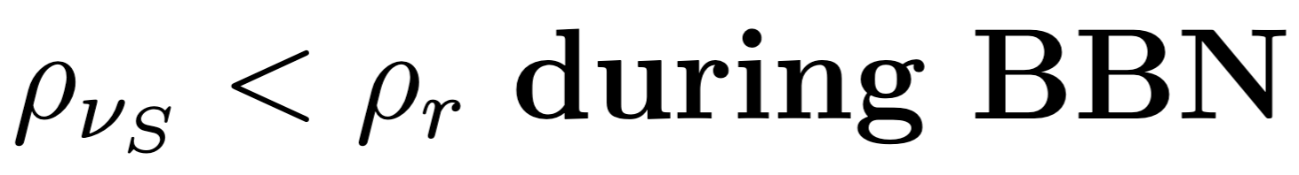
Combined Result: TMD
Notes:
Finally we come to our main result. This is when heavy neutrino couple to electron neutrino. Because different mass has different phenomenology, we separate our analysis into four parts. The first one is the temporary matter domination which simply compare the energy density of heavy neutrino to that of photon.

Slide 38
Combined Result: Small Mass
Notes:
Then the second one is the small mass region. In this region, the mass of sterile neutrino is smaller than the mass of pion, so the only available effect is when sterile neutrino decays to electron neutrinos and then they subsequently do the nucleon conversion.

Slide 39
Combined Result: Medium Mass
Notes:
Then is the medium mass region, where the mass of sterile neutrino is larger than the mass of pion but smaller than a few GeV to prevent complicated hadronization. The dominant decay channel for sterile neutrino now is through two-body decay to mesons, and the available effects are nucleon conversion and hadro-dissociation by charged mesons.

Slide 40
Combined Result: Large Mass
Notes:
Finally, in the large mass region, the mass of heavy neutrino is about 10 to 30 GeV. In this region, the decay of sterile neutrino is through a series of hadronization, and we translate the BBN constraint on long-lived particle where they used a more sophistecated way to account for all the particles coming from sterile neutrino decays.

Slide 41
Combined Result: Electron flavor
Data credit: https://www.hep.ucl.ac.uk/~pbolton/
Notes:
Here is our result compare with terrestrial experiments. As you can see BBN constraint can cover a huge area on the parameter space and is complimentary to the experiments.
One interesting fact is that all the beam-dump experiments are stretched from upper left to lower right. That’s because if the mass and mixing are too small, sterile neutrino will live too long and fly pass the detector; but if the mass and mixing are too large, it will die too quick and cannot make it to the detector.
So, we can consider BBN like a huge cosmological beam-dump experiment, but the filter now is not distance but time.

Slide 42
Combined Result: Muon flavor
Data credit: https://www.hep.ucl.ac.uk/~pbolton/
Notes:
Here is the result for muon, which has similar shape as electron. But in the medium mass region, there is a kink represents the threshold of the mass of muon and charged pion combined, below that nucleon conversion is mediated by neutrinos, above that is by charged pion.

Slide 43
Combined Result: Tau flavor
Data credit: https://www.hep.ucl.ac.uk/~pbolton/
Notes:
Here is the result for tau. Now, in the small and medium mass region, the only available effect is nucleon conversion by electron neutrinos since a tau is too heavy to be produced by a GeV sterile neutrino.

Slide 44

Conclusion
We improve the BBN constraint on heavy neutrino by considering
  Temporary matter domination($ρ_{ν_{s}}>ρ_{r}$)
  Decay effects
    Photodissociation
    Hadrodissociation
    Nucleon conversion by charged mesons
    Nucleon conversion by neutrinos

Slide 45
Thank you!

