Slide 1

NEWS-G
Guillaume Giroux
Queen’s University
August 2025

Slide 2
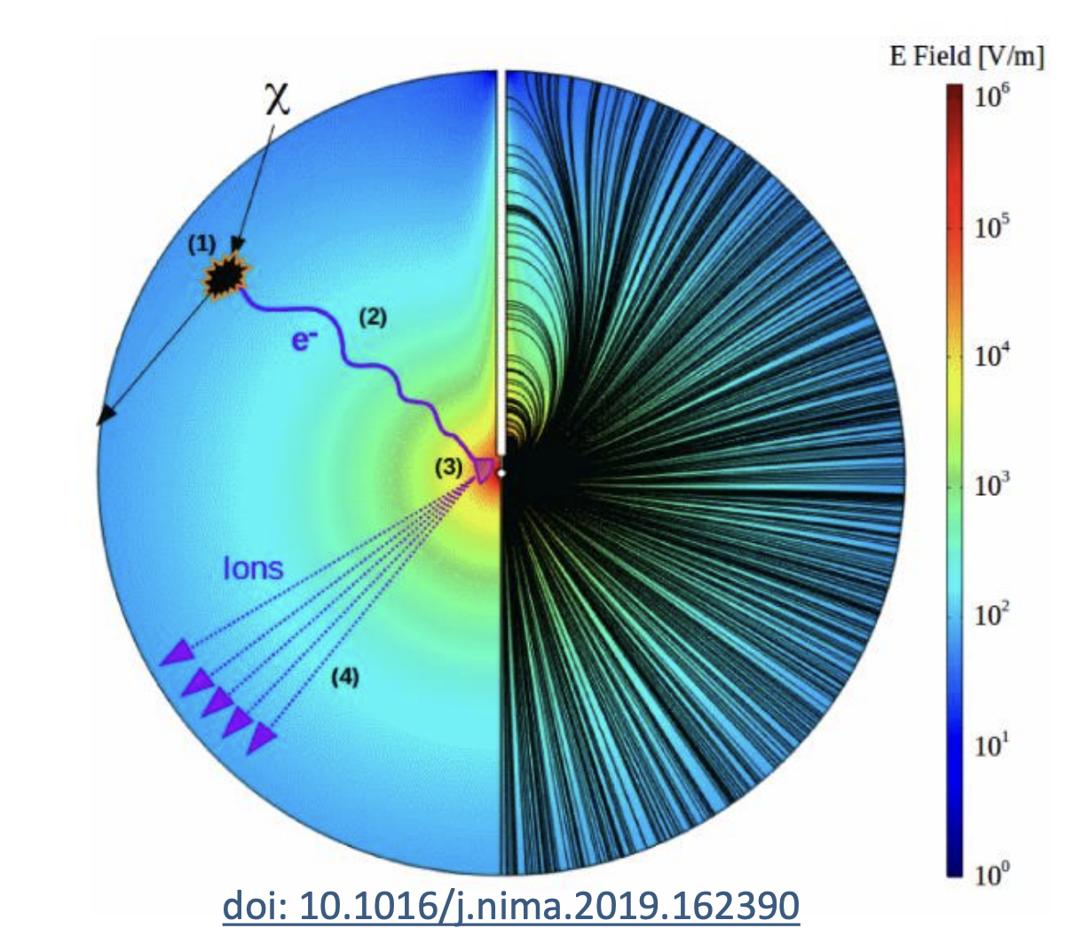
Search for low mass dark matter with SPCs
NEWS-G uses Spherical Proportional Counters (SPCs) to search for low mass WIMPs.
Low mass sensitivity is reached with:
  Light atomic mass targets (H, He, Ne)
  Low threshold
    Low electronic noise
    High amplification
  Low background
    Simple configuration, high purity copper
    Surface electron rejection with pulse shape
Single electron counting

Slide 3
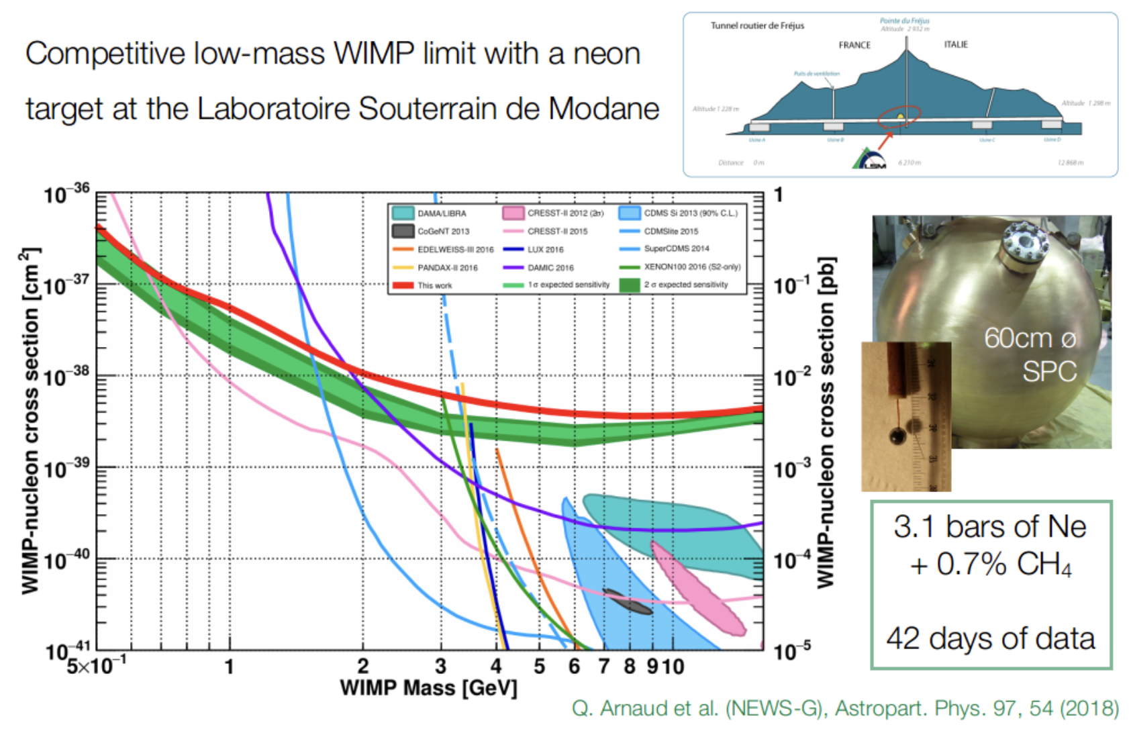
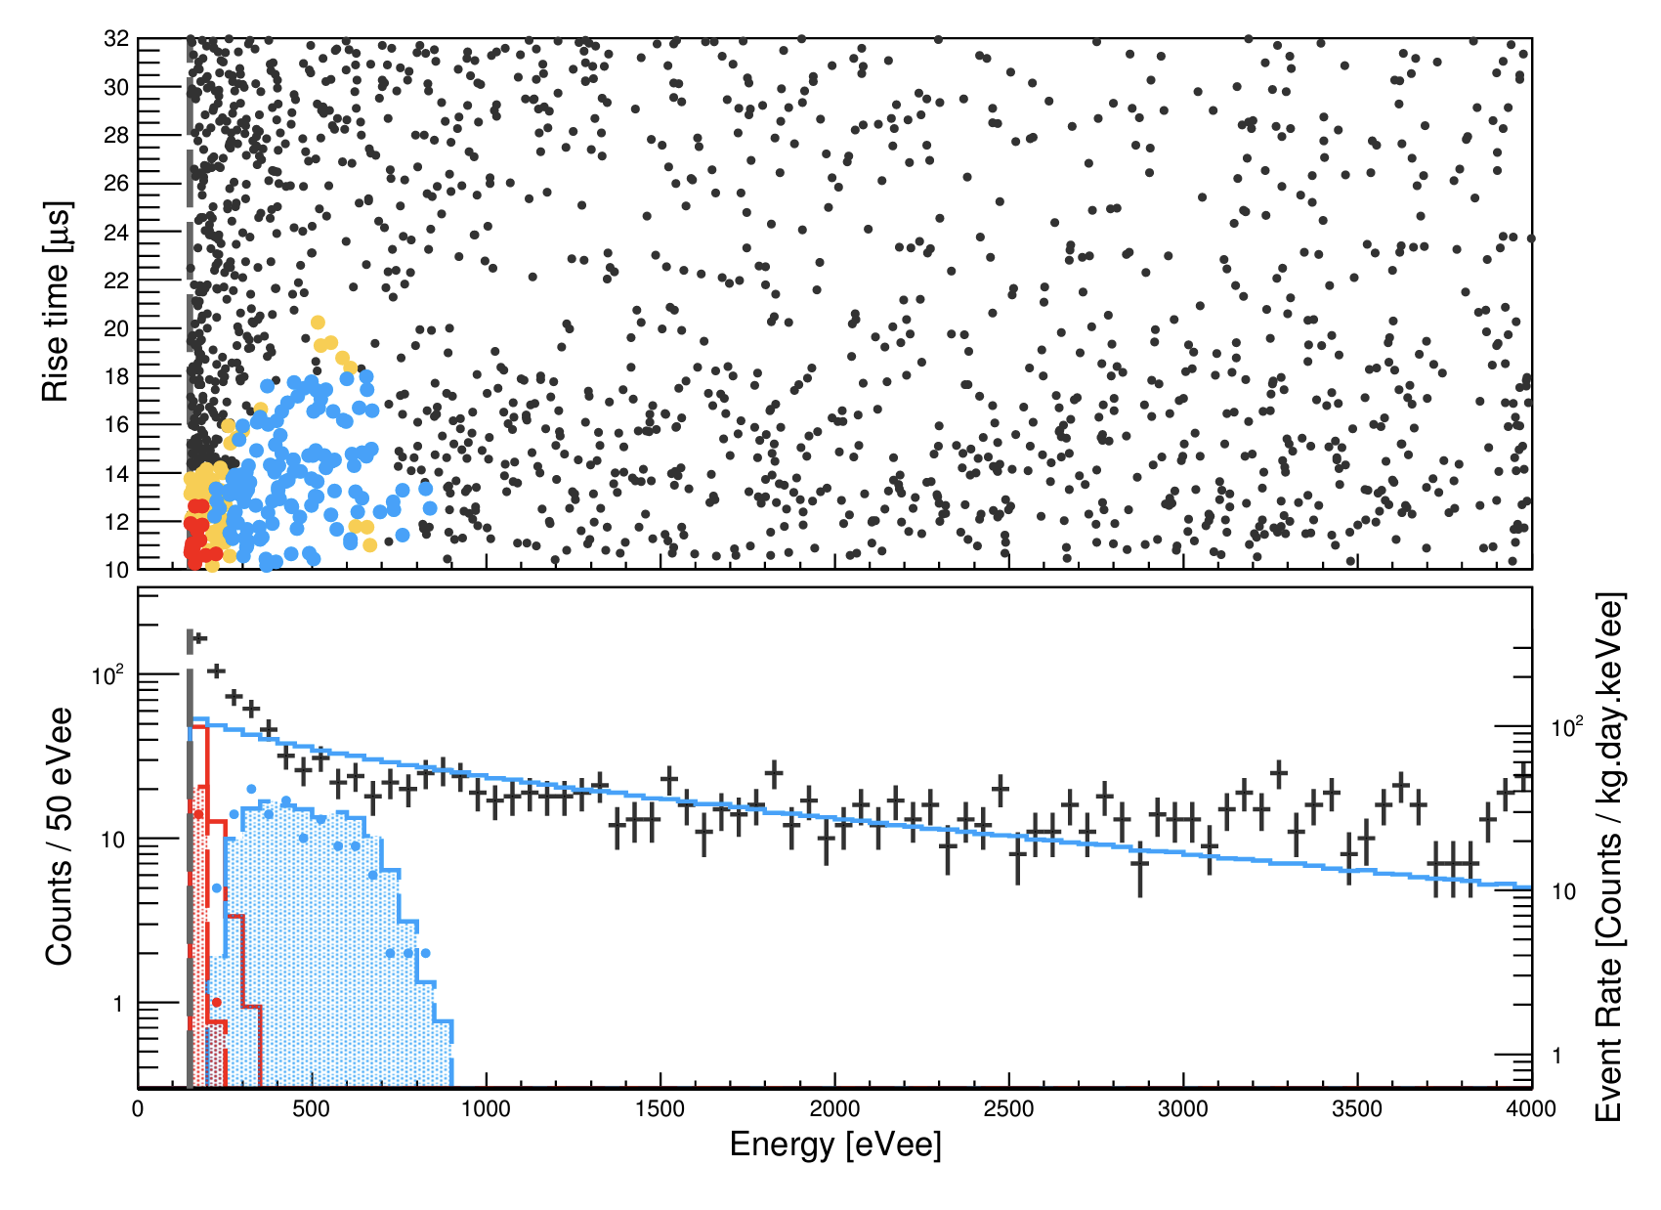
First demonstration: SEDINE at LSM
First DM search results with a 60-cm SPC in 2018.
Simple analysis featuring a booster decision tree to choose the ROI in the rise time vs. energy parameter space
Observation of an “exponential rise” at low energy

Slide 4
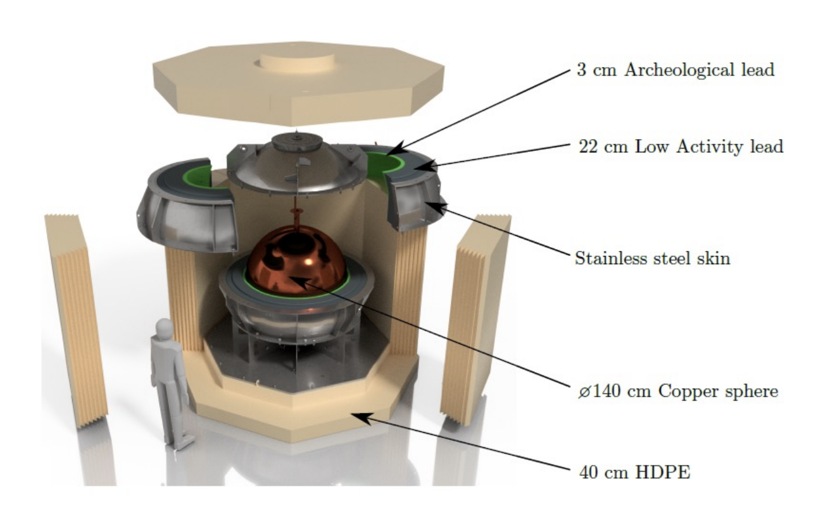
The NEWS-G experiment
140-cm SPC made from commercial C10-100 copper, electroplated with 0.5 mm copper
Compact shield with innermost layer archeological Pb
Stainless steel shell flushed with nitrogen
Gas circulation and radon trapping
Installation completed in summer 2021
L. Balogh et al 2023 JINST 18 T02005

Slide 5
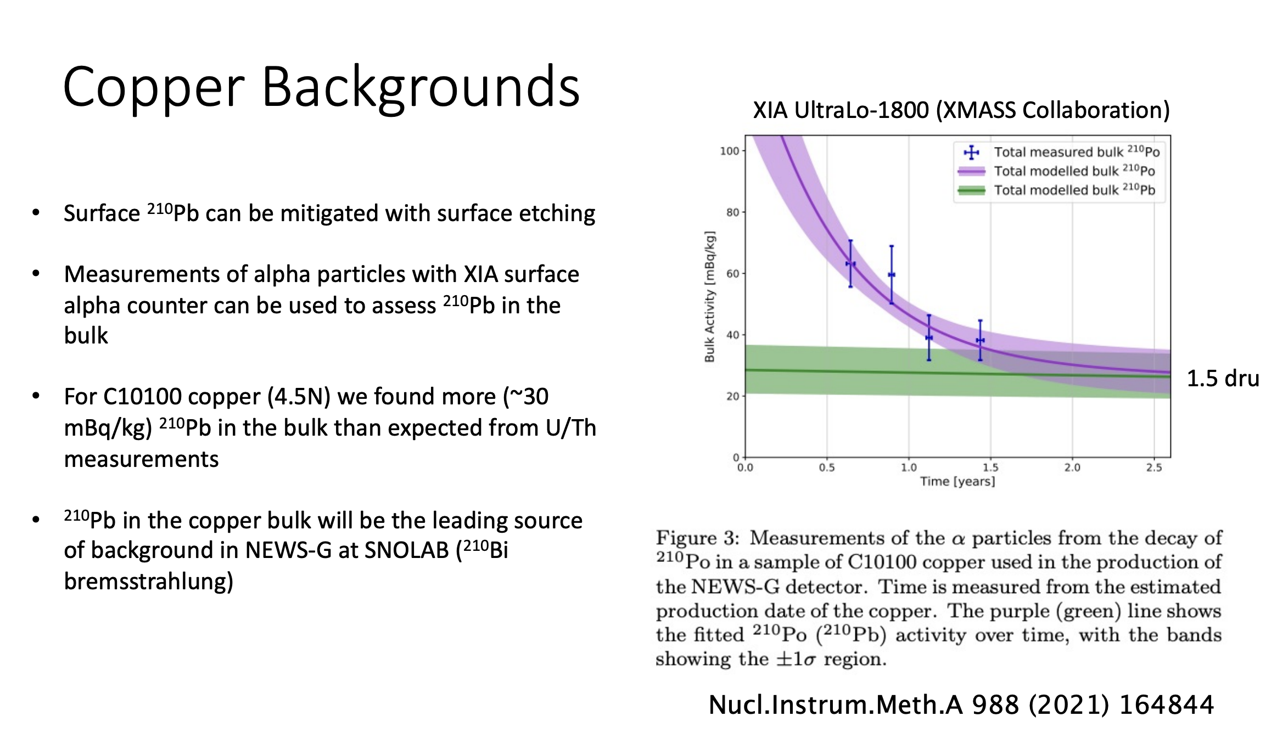

Slide 6
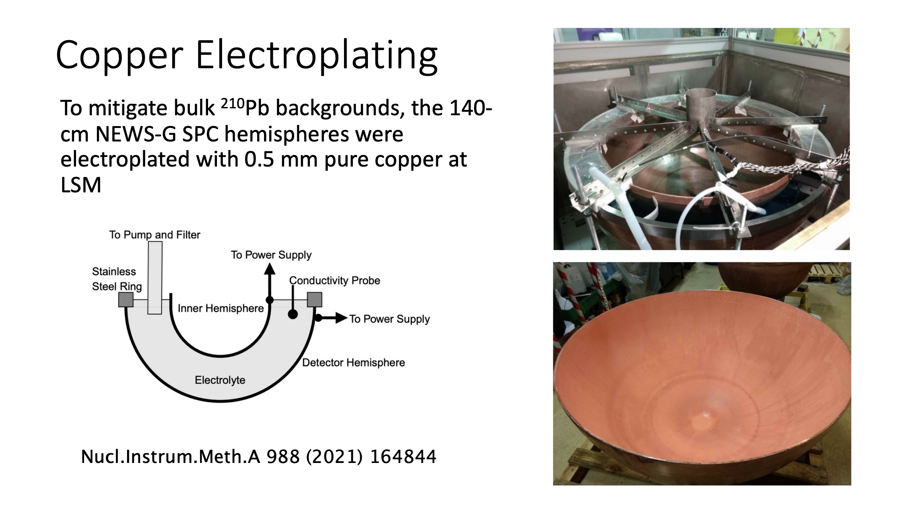

Slide 7
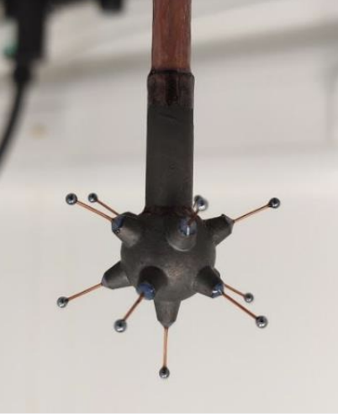
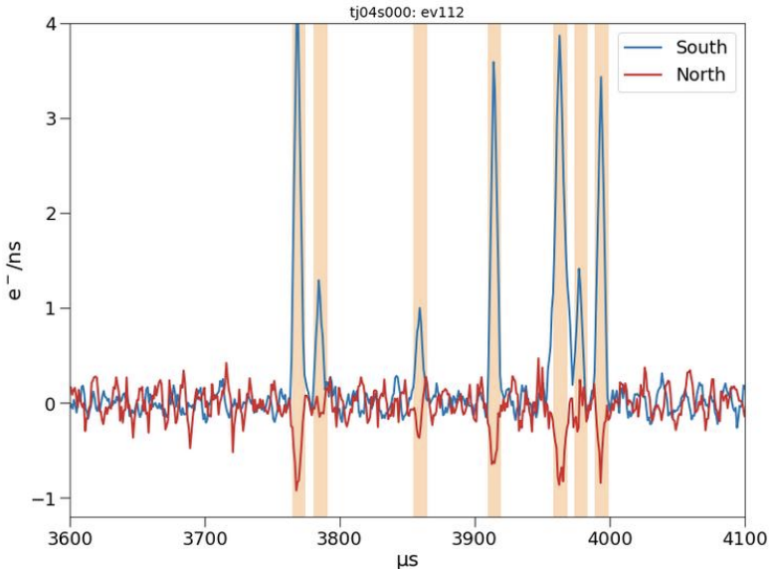
The ACHINOS sensor
Multi-ball sensor enhances the E-field at large radius, while conserving strong amplification
Multi-channel read-out allows for further background rejection (sparks, spurious)

Slide 8
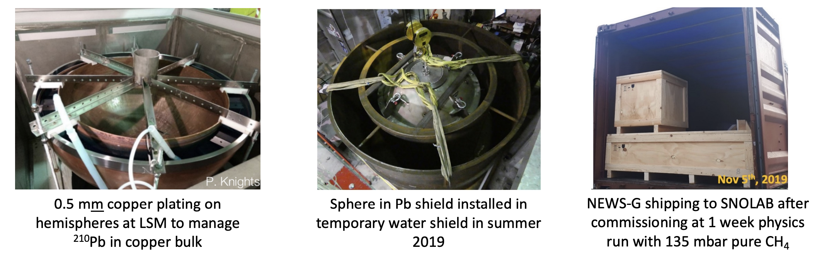
NEWS-G at LSM
Sphere and Pb shield fabricated in France
Storage of copper and electroplating at LSM (Laboratoire Souterrain de Modane) to mitigate cosmogenic activation
Full installation, commissioning and physics run (pure CH₄) at LSM in summer-fall 2019 before DAMIC-M needed the space (from installation to shipping out in 5 months!)

Slide 9
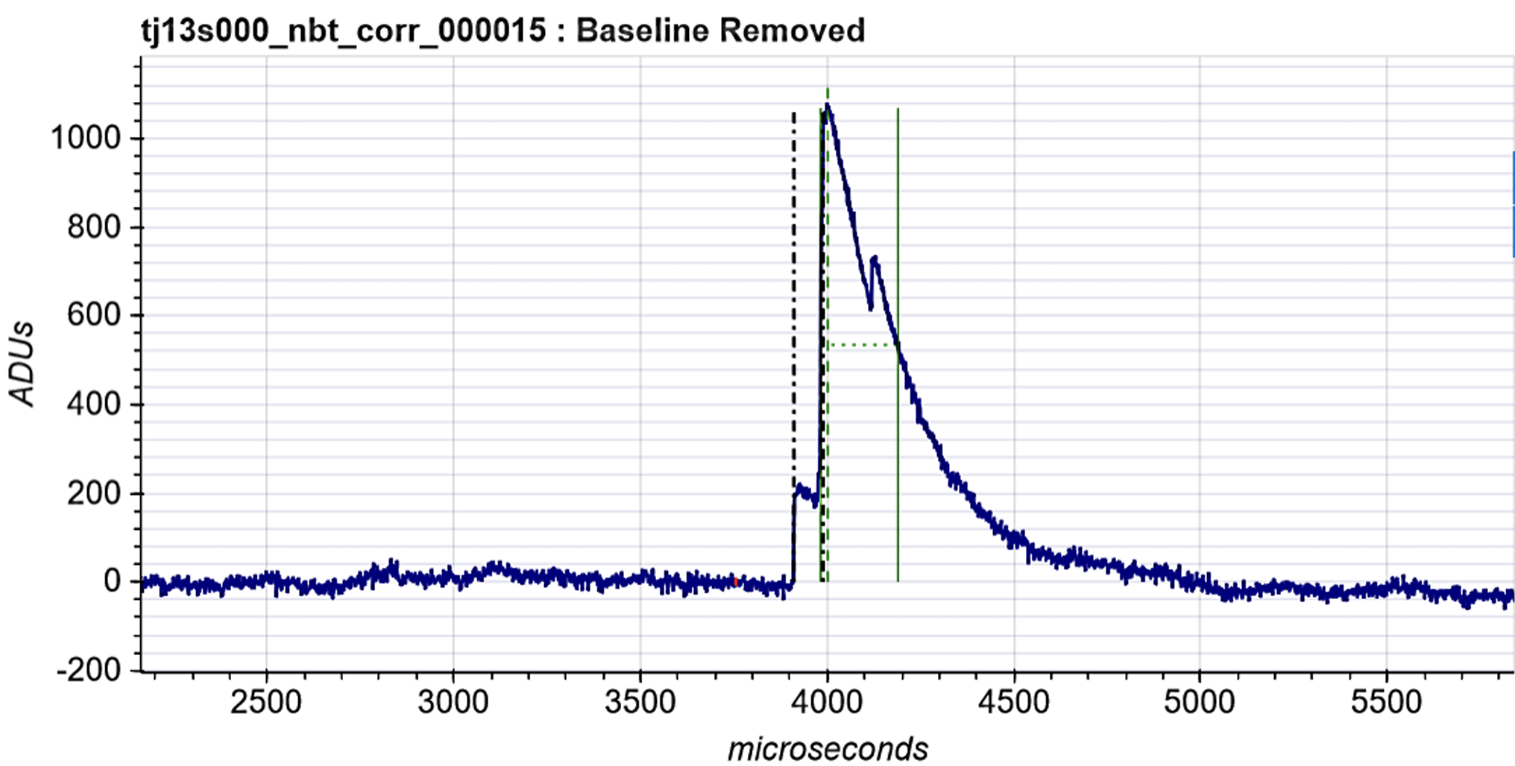
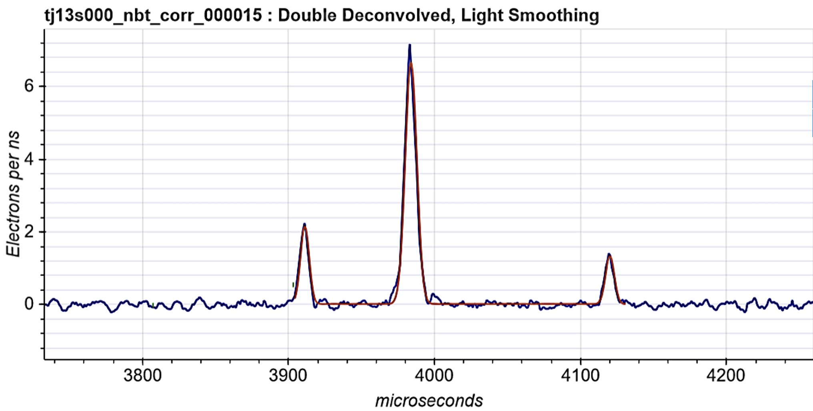
Electron Counting
Raw
Primary electrons diffuse during drift
After pulse processing (double deconvolution), individual electrons (~30 eV) become visible
Discrimination between 1 e⁻ and 2 e⁻ events (background suppression)
Double Deconvolved

Slide 10
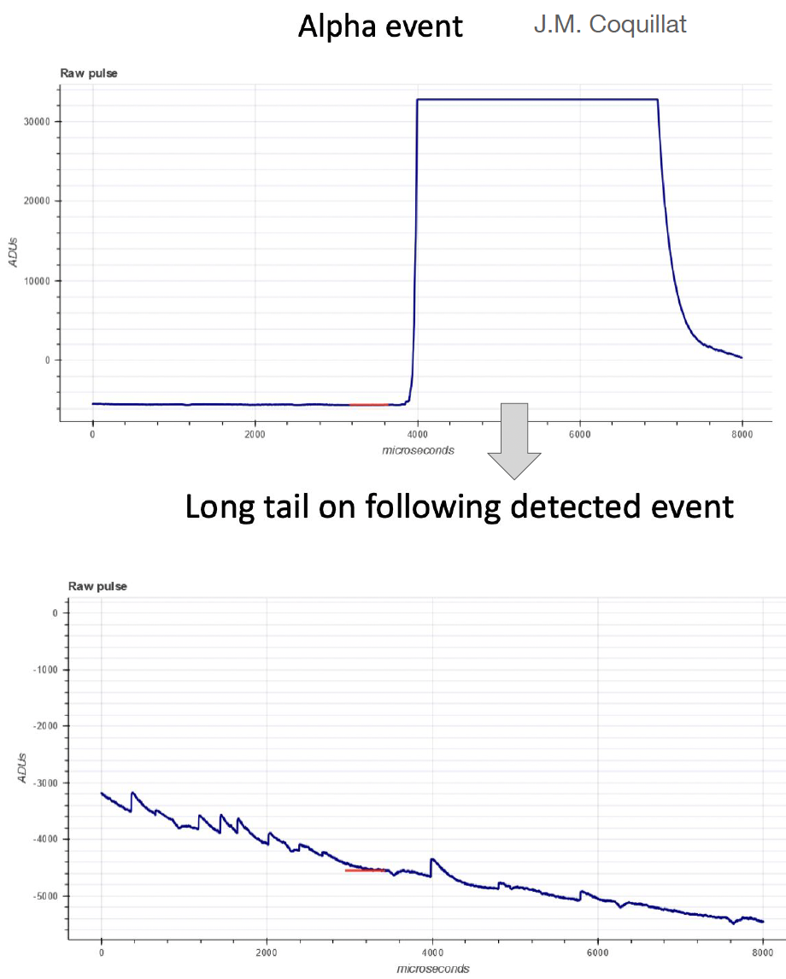
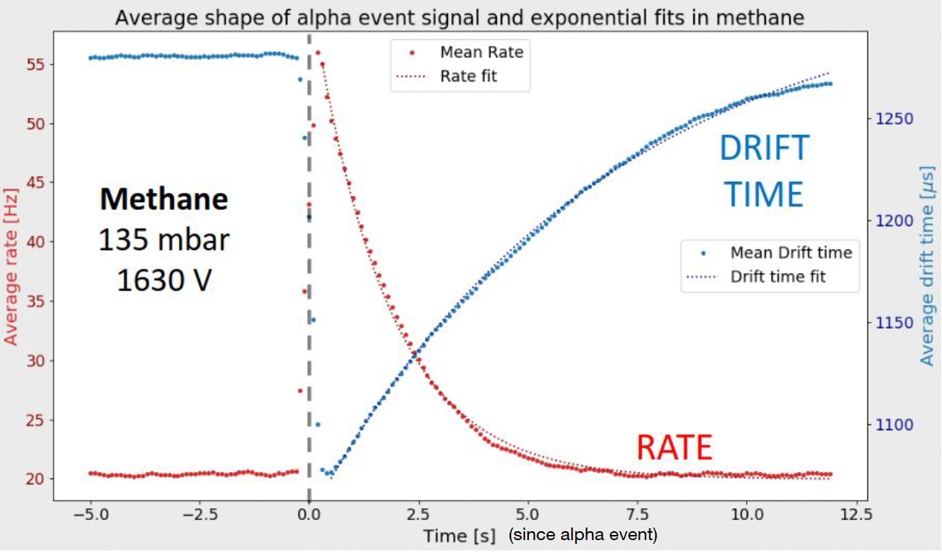
Single electron background
Observation of an excess of single electrons
Especially high after alpha events
Removing 5 sec after each alpha reduces background rate by 70% (14% deadtime)

Slide 11
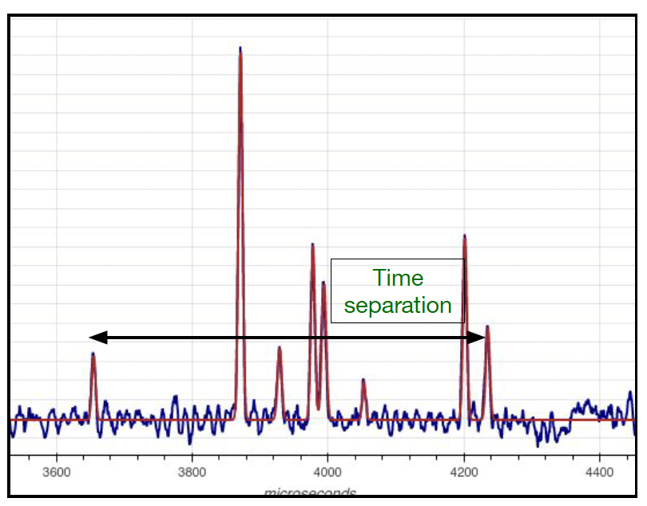
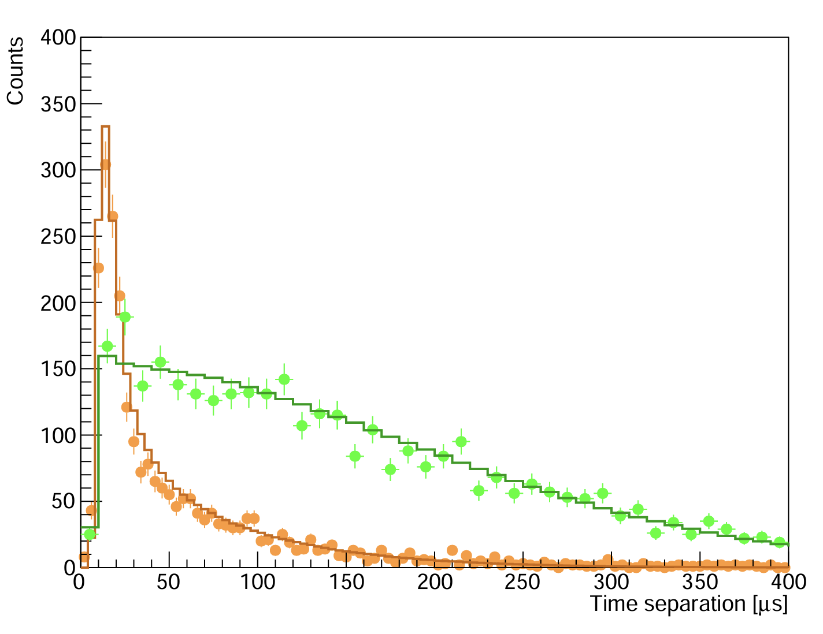
Electron Time Separation
Single electrons are discarded
Time separation between electrons in >1 electron events is a measure of diffusion and allows to reject backgrounds from inner surface
Ar-37 2-electron
(volume)
Laser 2-electron
(surface)

Slide 12
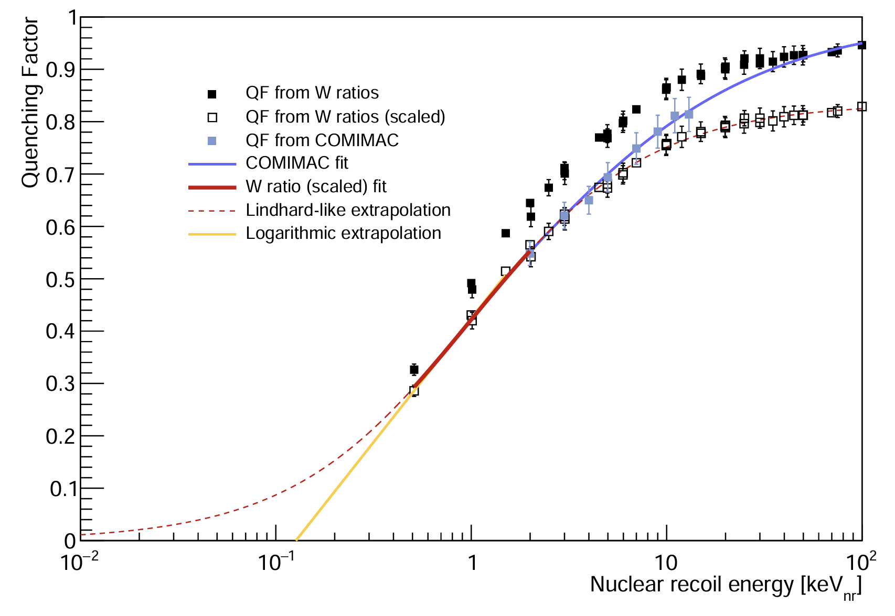
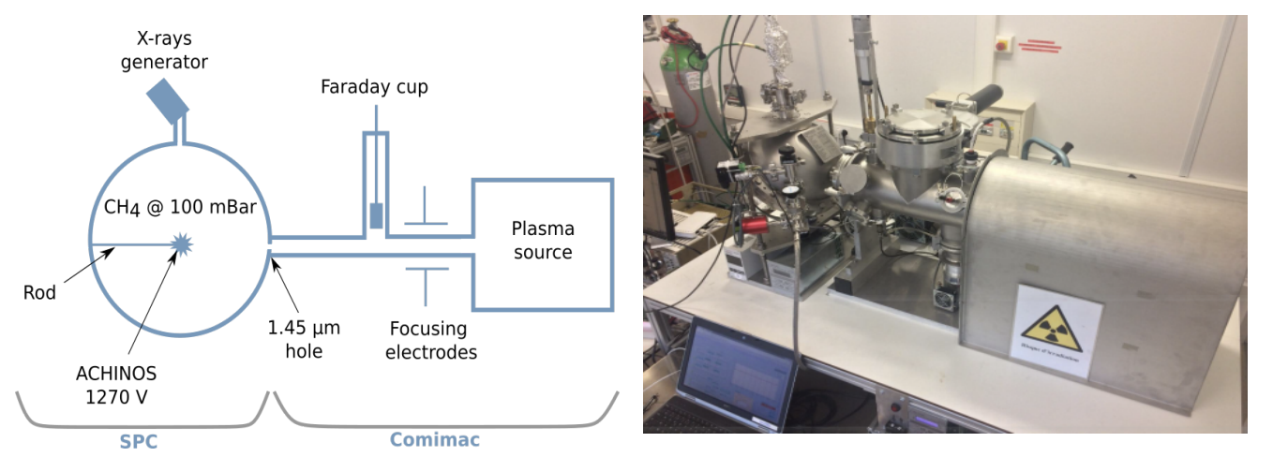
Nuclear Recoil Ionization Yield
Quenching factor values from existing W-value measurements for ions and measurements from COMIMAC
The more conservative logarithmic extrapolation was used to derive the expected WIMP signal
[1] I. Katsioulas et al, Astropart. Phys. 141, 102707 (2022)
[2] L. Balogh et al, EJP C, 2022

Slide 13
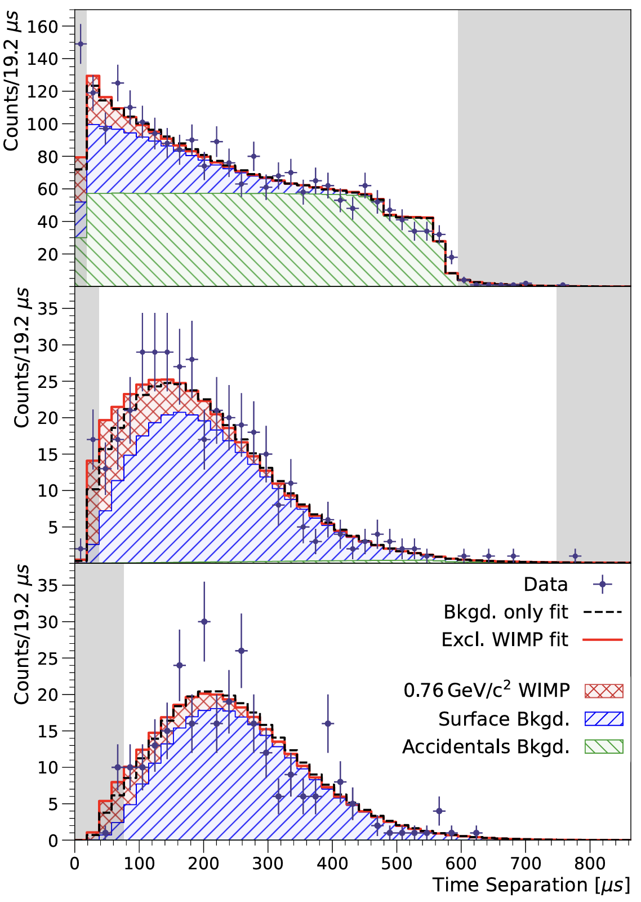
Results
NEW!: Physical Review Letters 134 (14), 141002 (2025)
1.12 kg-day CH₄ physics run
Profile likelihood fit on 2,3,4 electron events
Contribution from WIMP, surface, volume and single electron pileup (accidentals)
No significant WIMP signal is observed

Slide 14
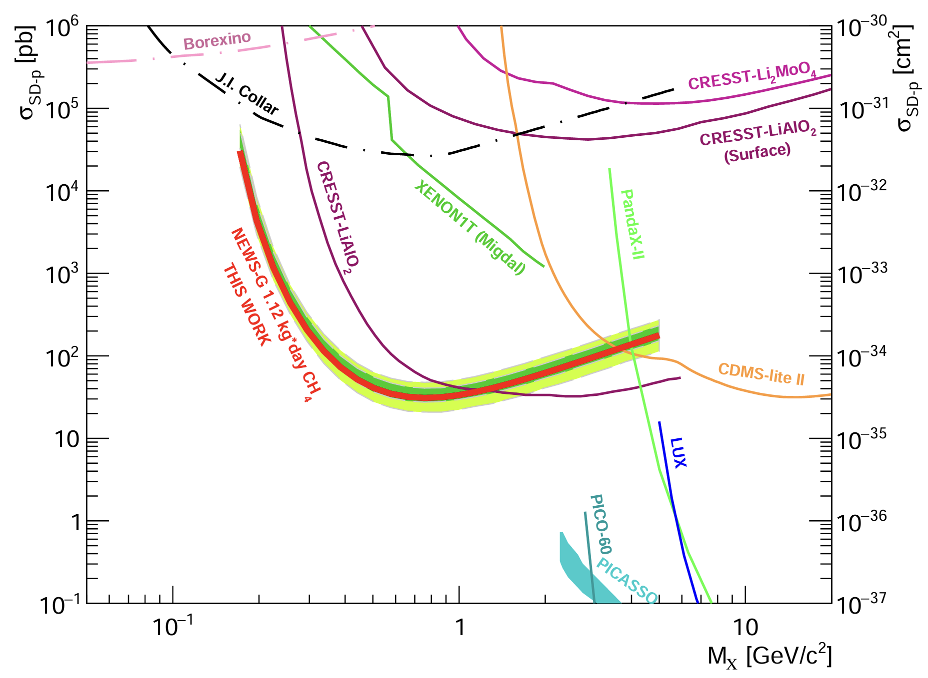
New WIMP Constraints
Strongest constraints on spin-dependent WIMP-proton (directly on H) cross-section in the 0.18 – 1.2 GeV range!
Physical Review Letters 134 (14), 141002 (2025)

Slide 15
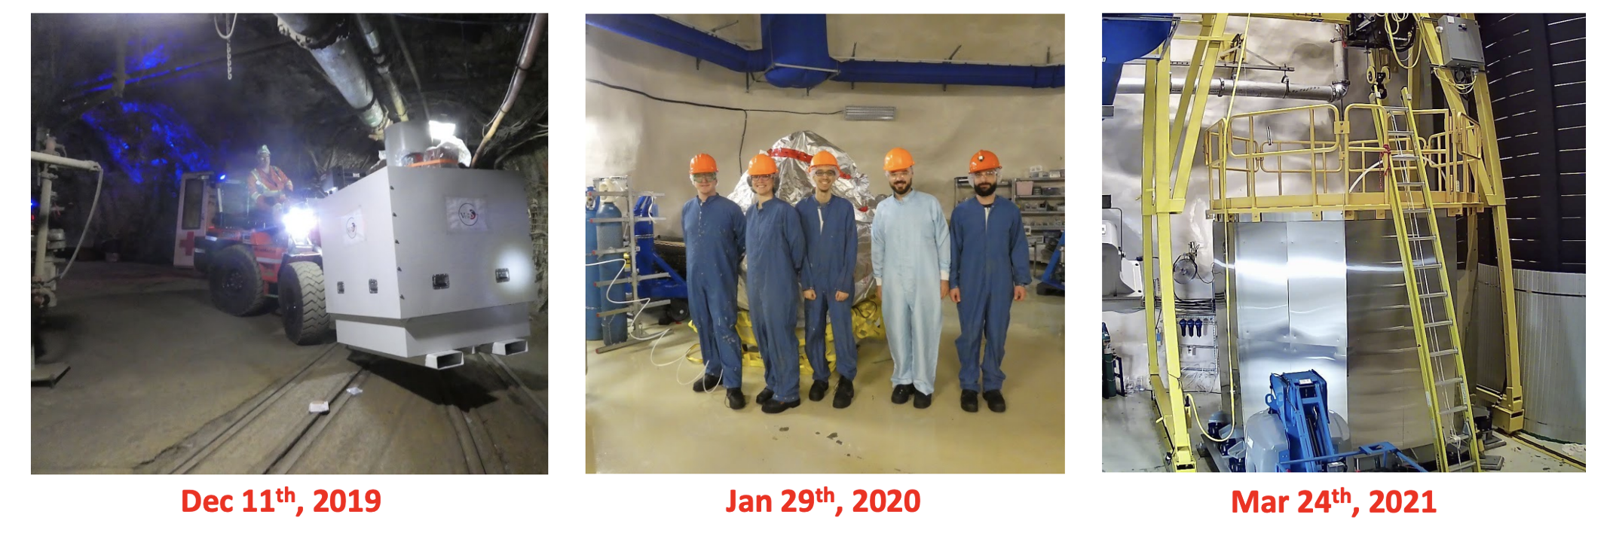
NEWS-G at SNOLAB
Installation and commissioning heavily impacted by pandemic shutdown and restrictions
Strong support from SNOLAB with contractor team installing NEWS-G during fall 2020
Complete installation and beginning of commissioning in summer 2021

Slide 16
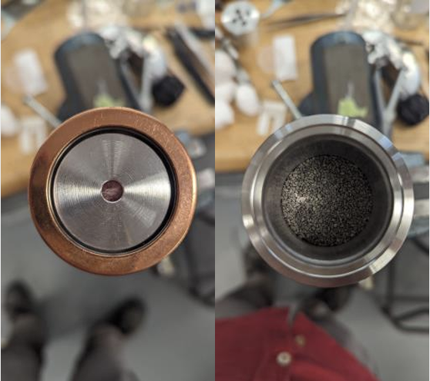
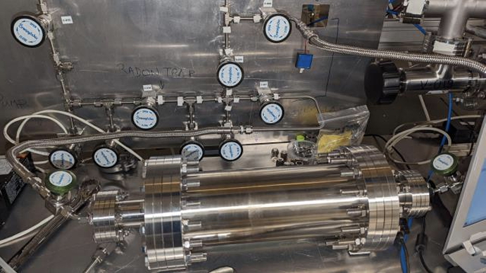
NEWS-G at SNOLAB
NEW!
Physics runs were conducted with Ne-CH₄ and He-CH₄ targets
Surface background is addressed with in-situ etching
Single electron background is addressed with gas purity improvement and radon removal
Several improvements on gas purity and low-frequency noise are underway
More physics soon with Ne-CH₄, CH₄ and He-CH₄
Radon trap
Gas purifier

Slide 17
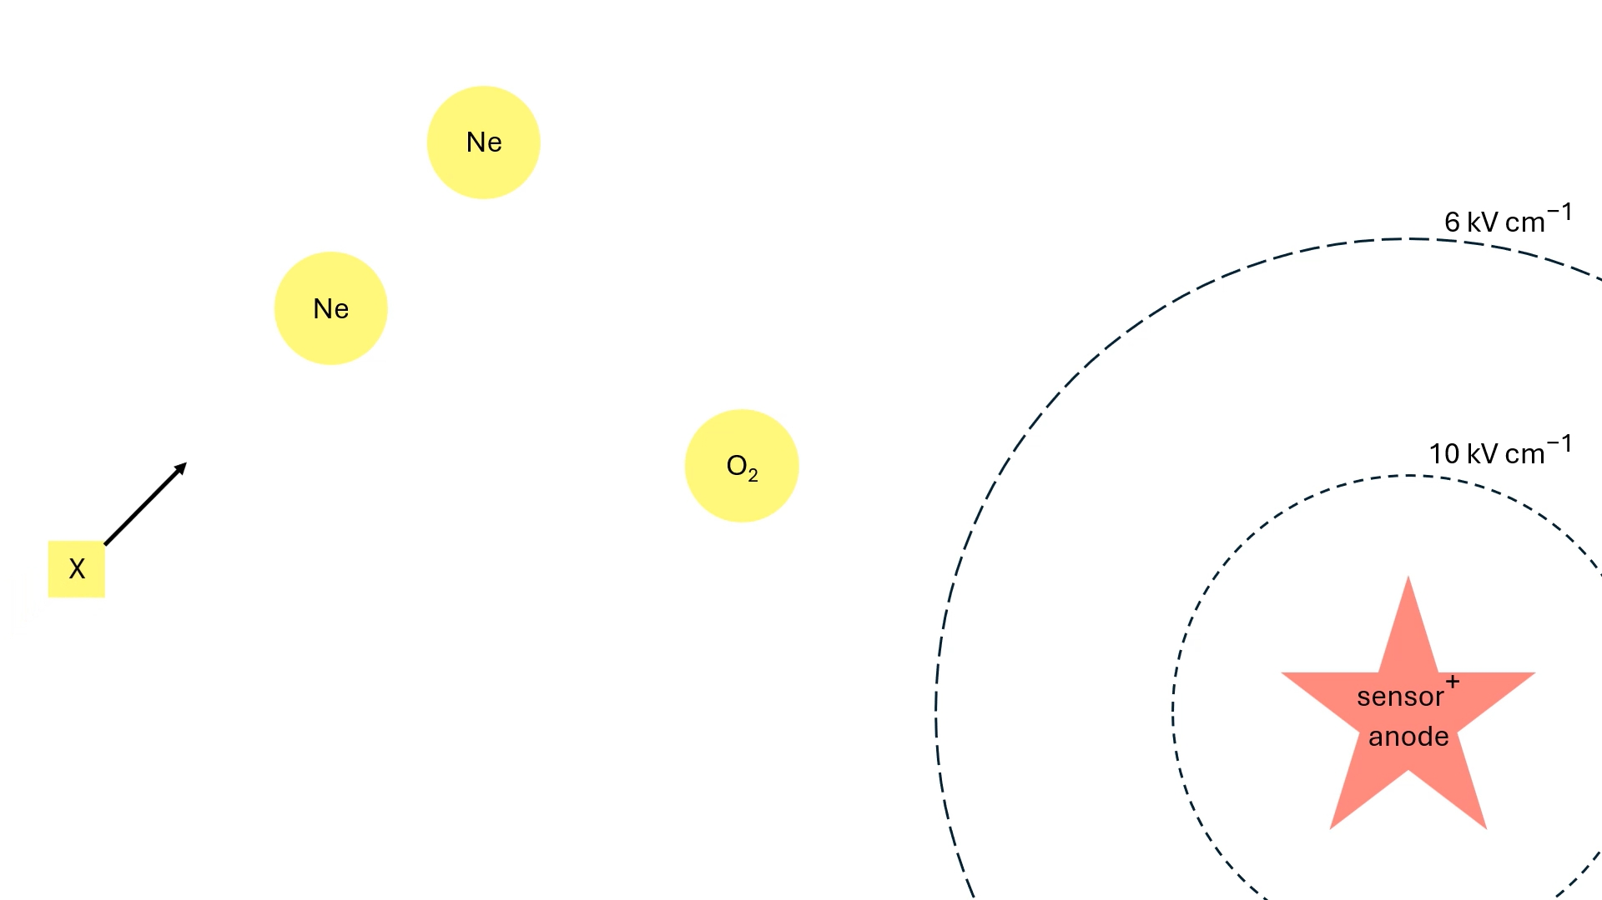
Single-electron background due to electron attachment

Slide 18
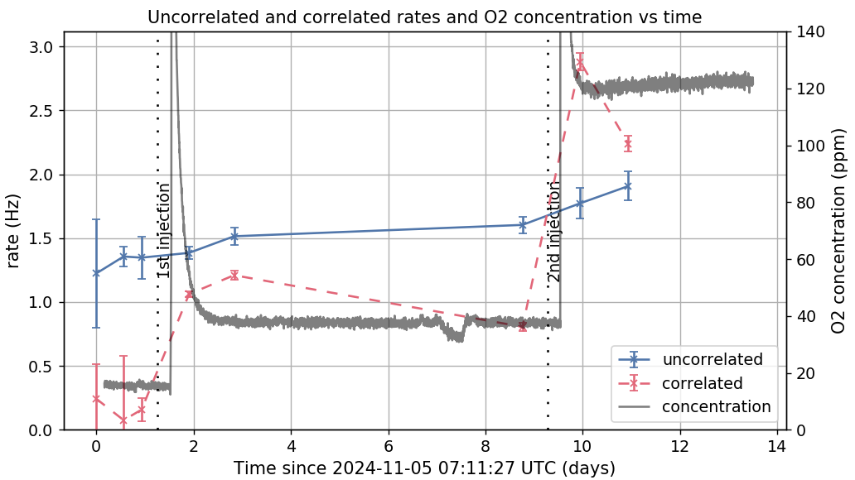
Single-Electron Background
NEW!
Controlled injection of oxygen to understand the effect of electron attachment on the single-electron background (paper in progress)
Preliminary
J. Clarke

Slide 19
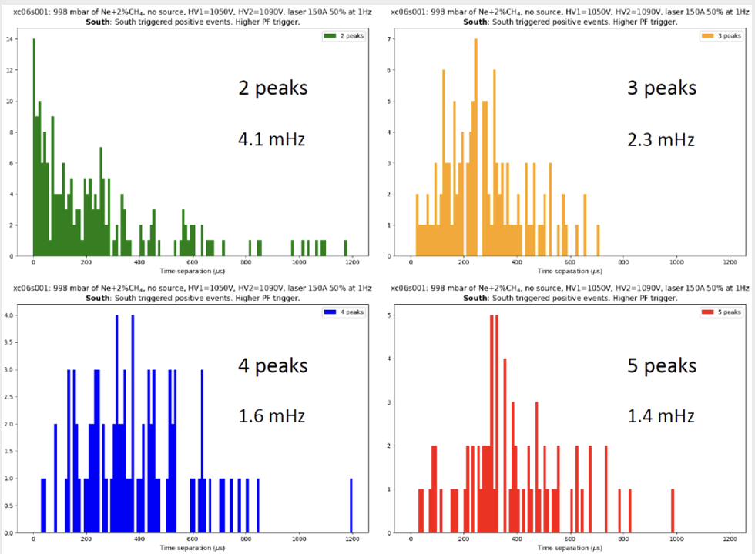
SNOLAB Ne-CH₄ Physics Run Analysis
2nd SNOLAB physics run
  1-bar Ne(98)-CH₄(2)
  Leak fixed, but no gas recirculation
  High-gain, low-noise
Analysis work underway to develop the electron diffusion model and the single electron response
Markov-Chain-Monte-Carlo fitting
Indications of a lower single-electron noise compared to LSM with pure CH₄
Preliminary

Slide 20
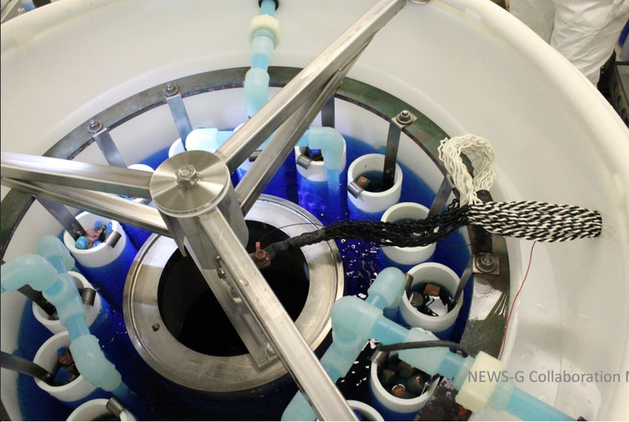
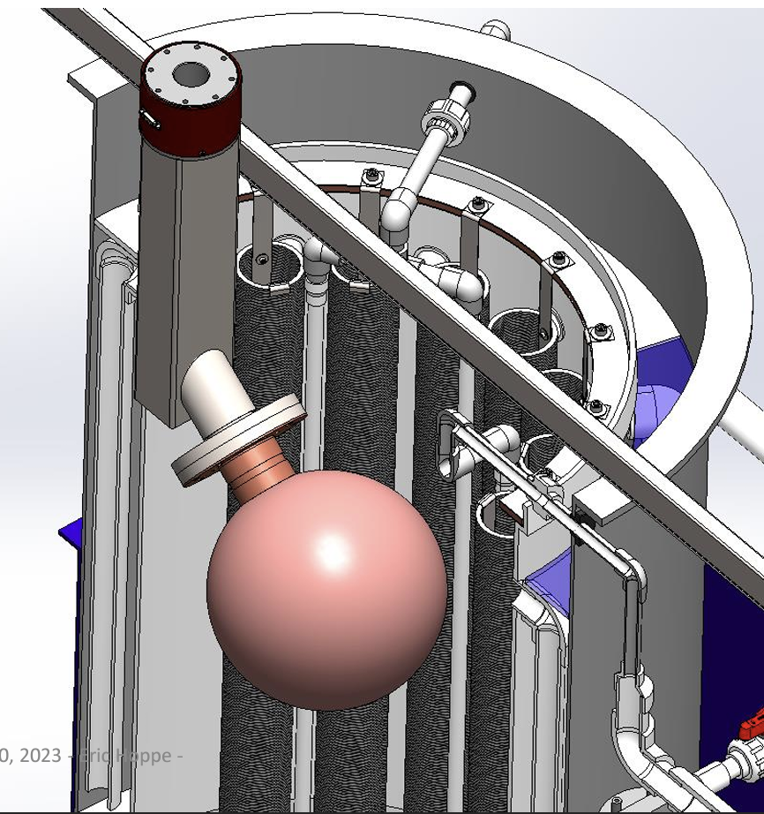
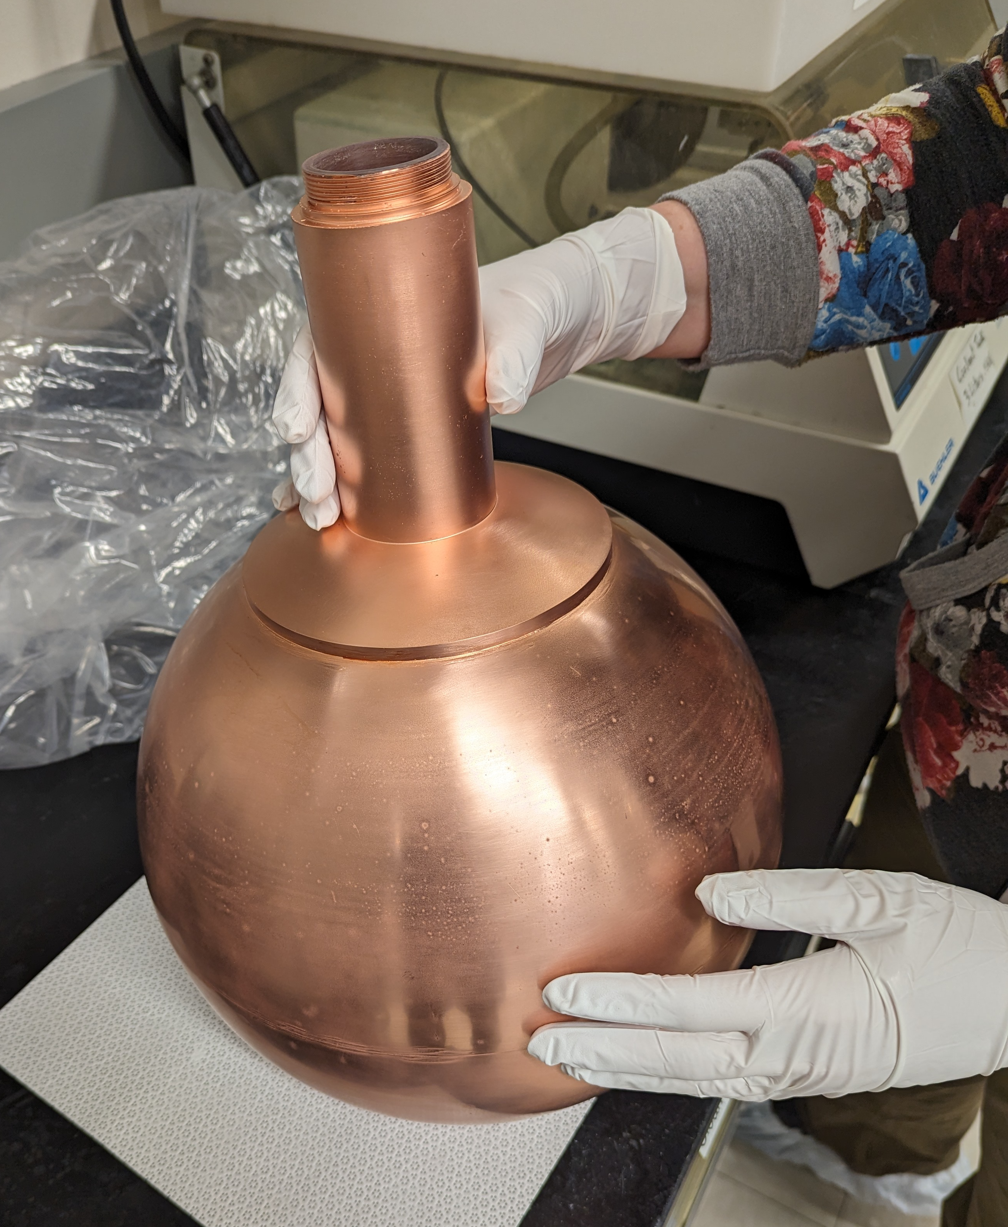
MiniECuME: A 30-cm intact underground-electroformed SPC prototype
Copper and acids samples from platting on a cylindrical mandrel reveal that lower-grade (10X cheaper) acid is viable option
Mini-ECumE mandrel holder assembled
Spherical acrylic mandrel was fabricated but present defects in copper non-electro forming and does not correspond to fabrication drawings
PNNL will proceed with electroforming on spherical mandrel to learn from the experience of platting a spherical object
The ECA electroforming bath at PNNL
MiniECuME mandrel holder
MiniECuME acrylic mandrel

Slide 21
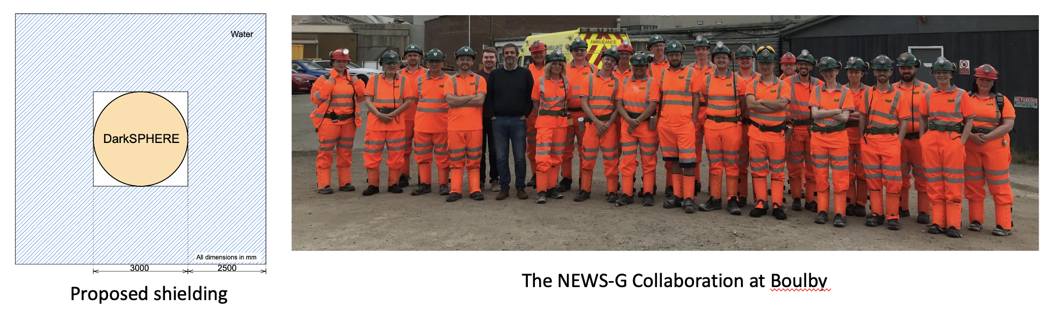
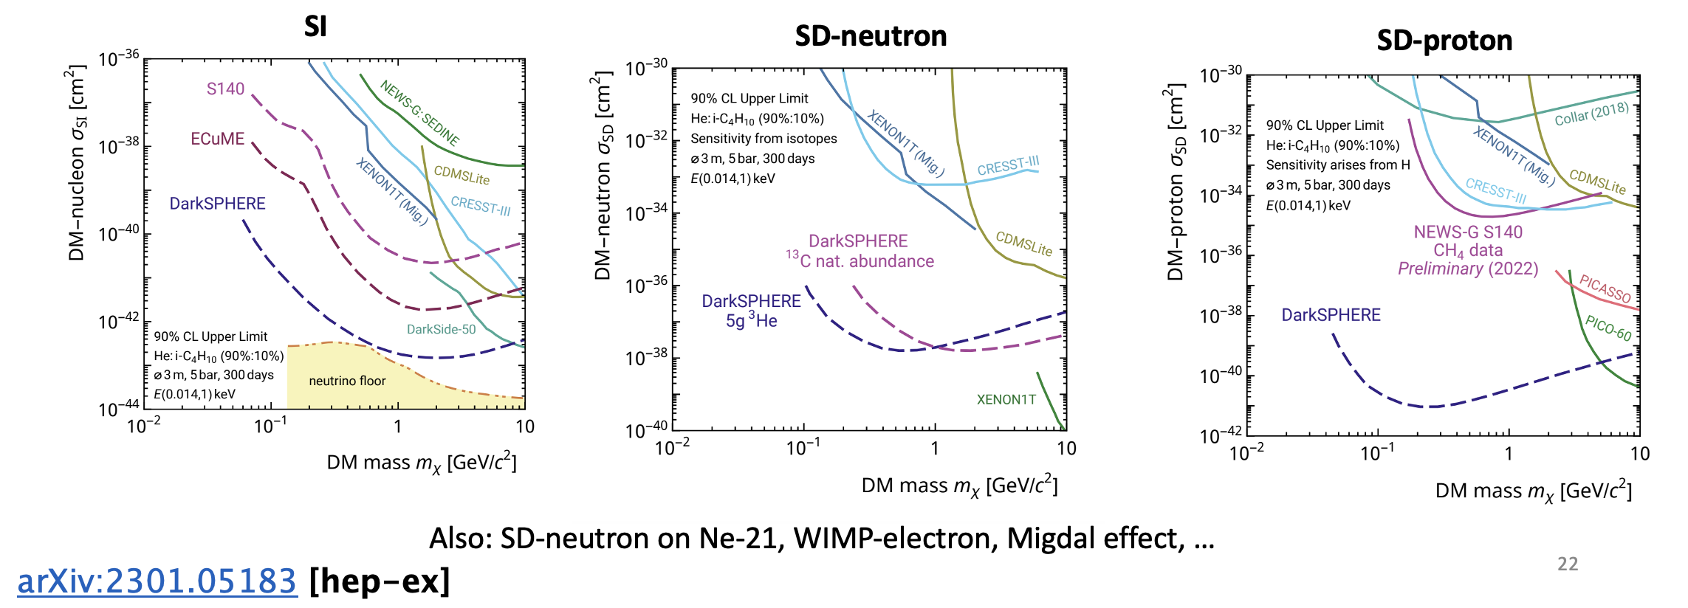
Future of NEWS-G: DarkSphere
Proposal for a 3-m electroformed SPC at Boulby

Slide 22
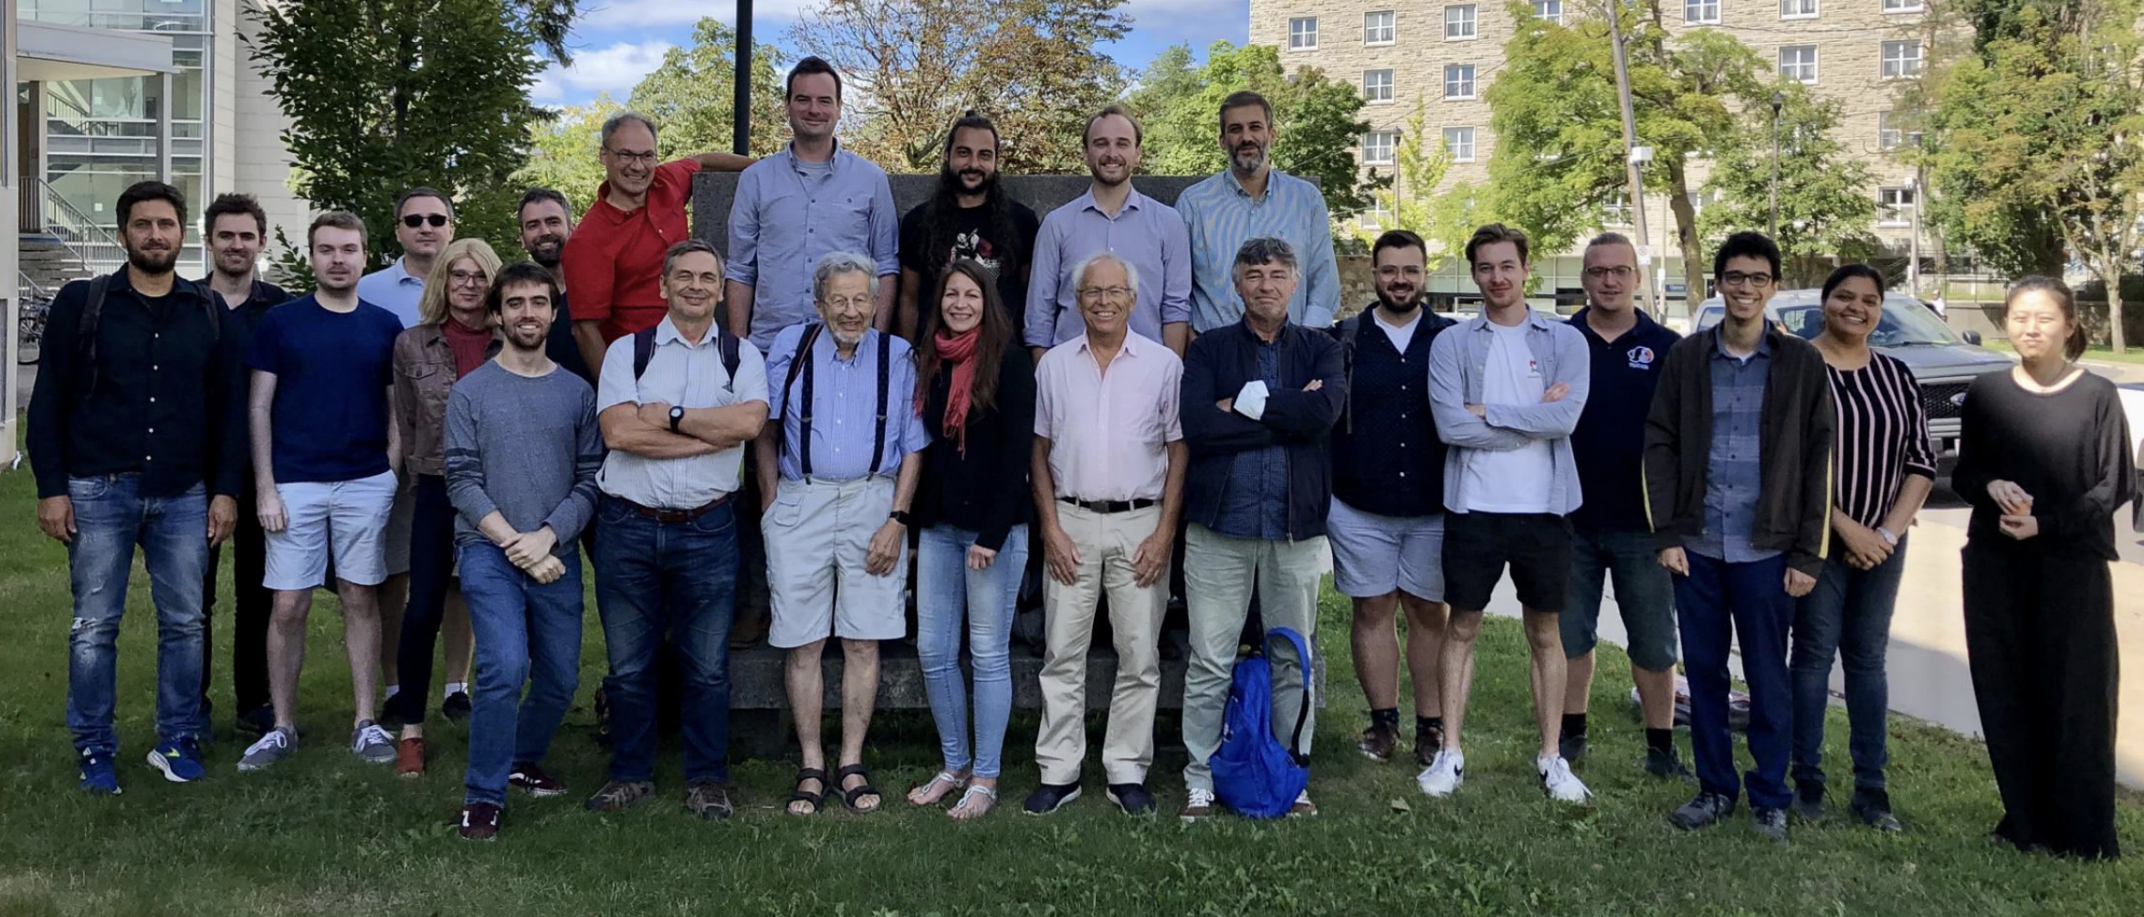
Conclusions
New, world-leading spin-dependent WIMP-proton constraints at LSM
Physics data was collected with neon and helium target at SNOLAB, data analysis underway
Addressing surface background with electrochemistry
Addressing single-electron background with gas purification
We continue physics data taking at SNOLAB with Ne, He and H targets
Electroforming MiniEcume at PNNL is concluding
New-generation DarkSphere was proposed at Boulby while electroforming efforts have started

Slide 23
Thank you!

Slide 24
Extra slides

Slide 25
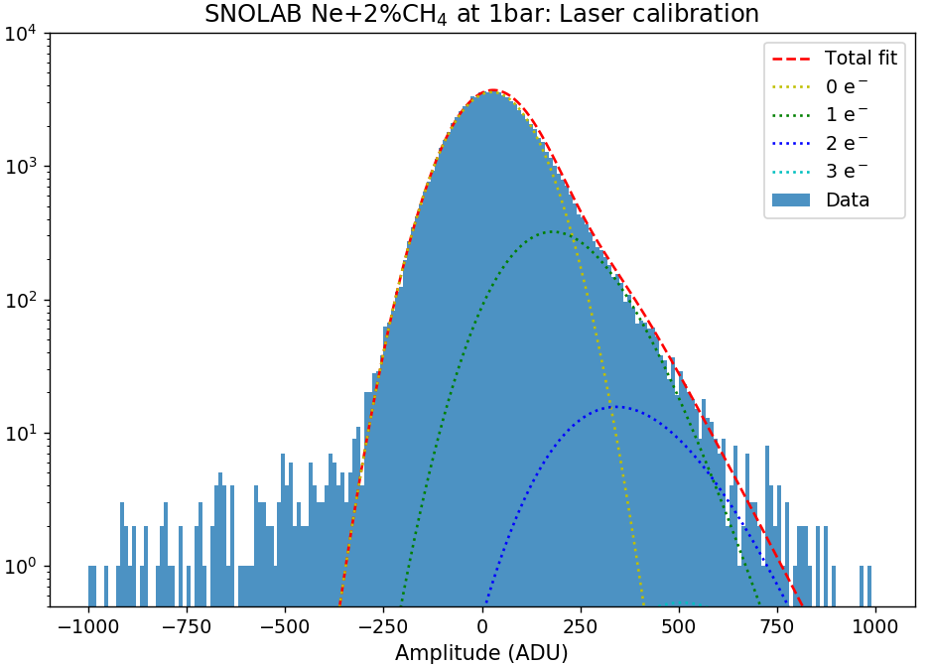
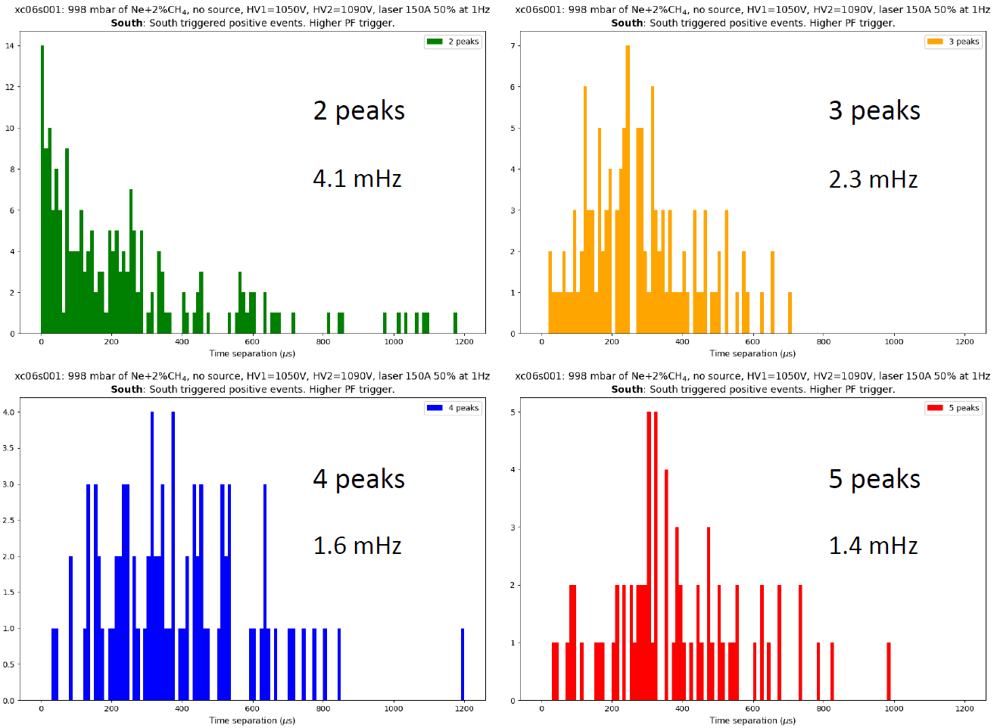
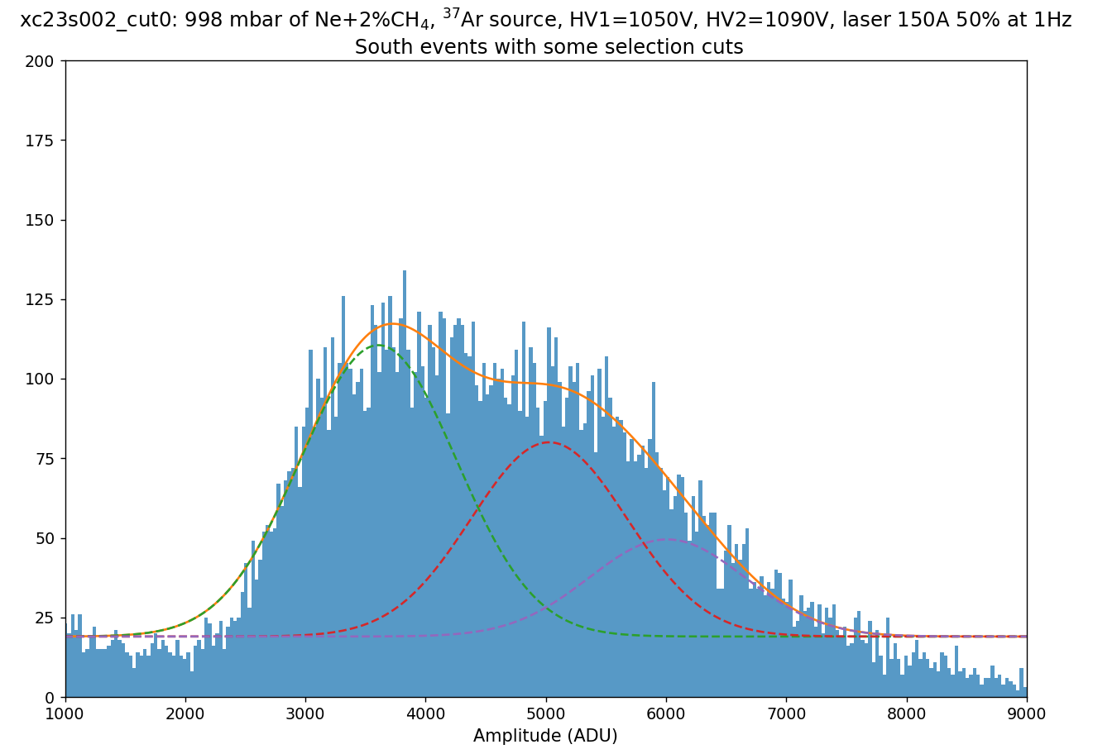
Dark matter preliminary analyses
The DM analysis for the neon data is ongoing.
Laser calibration fits show the contributions from all numbers of primary electrons.
Fits of ³⁷Ar data show different gains for each southern anode of the achinos sensor.
Physics test data for multiple number of electrons hint at a lesser contribution from the single-electron background compared to the LSM data.
New diffusion model that takes
fluctuations into account currently
in the works.
Working on limits using MCMC fits
PRELIMINARY
PRELIMINARY
PRELIMINARY
25

Slide 26
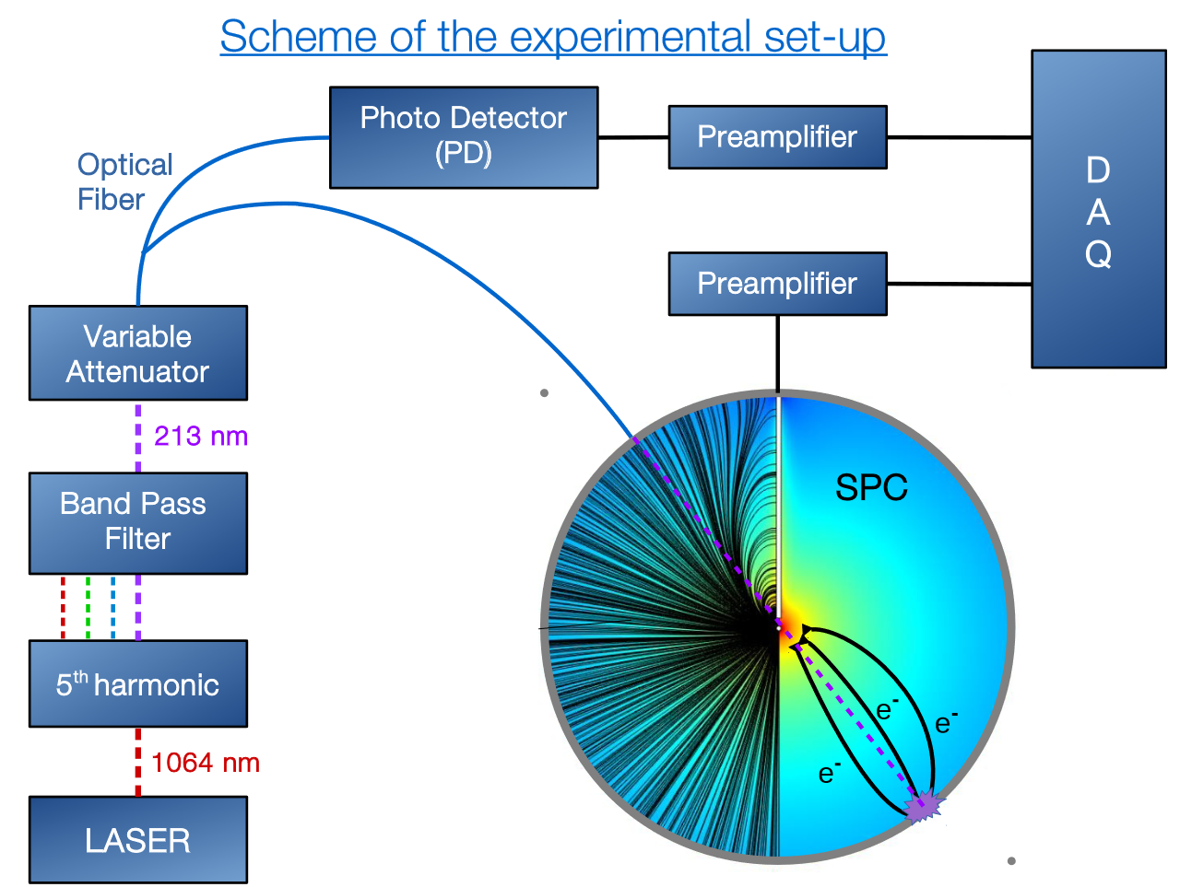
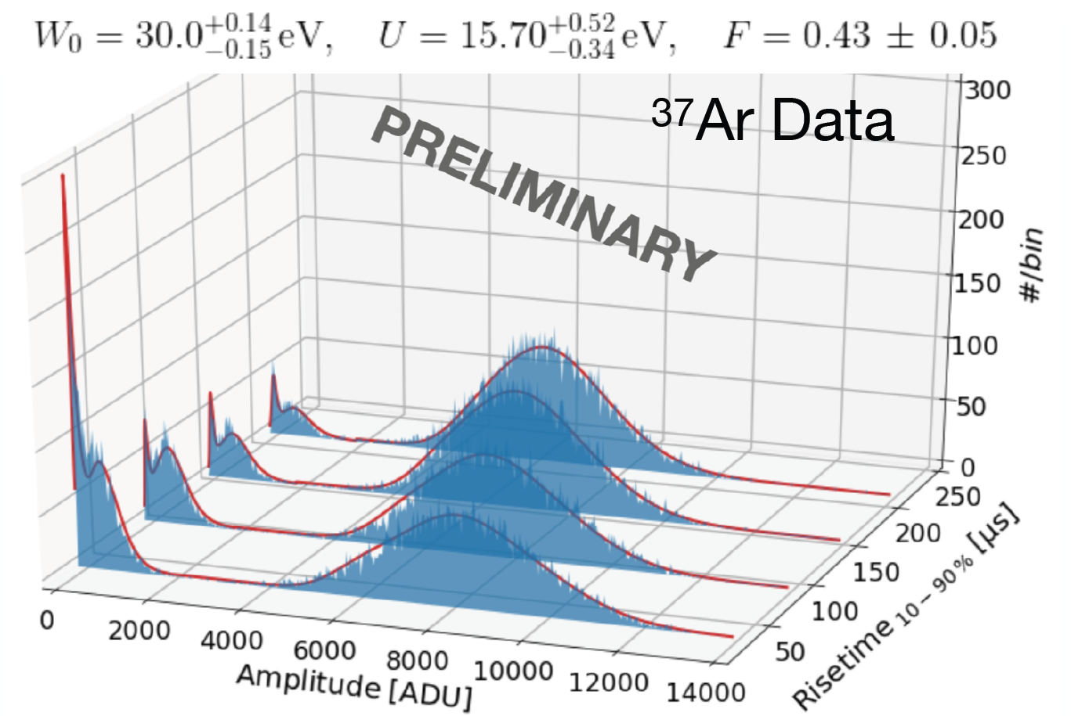
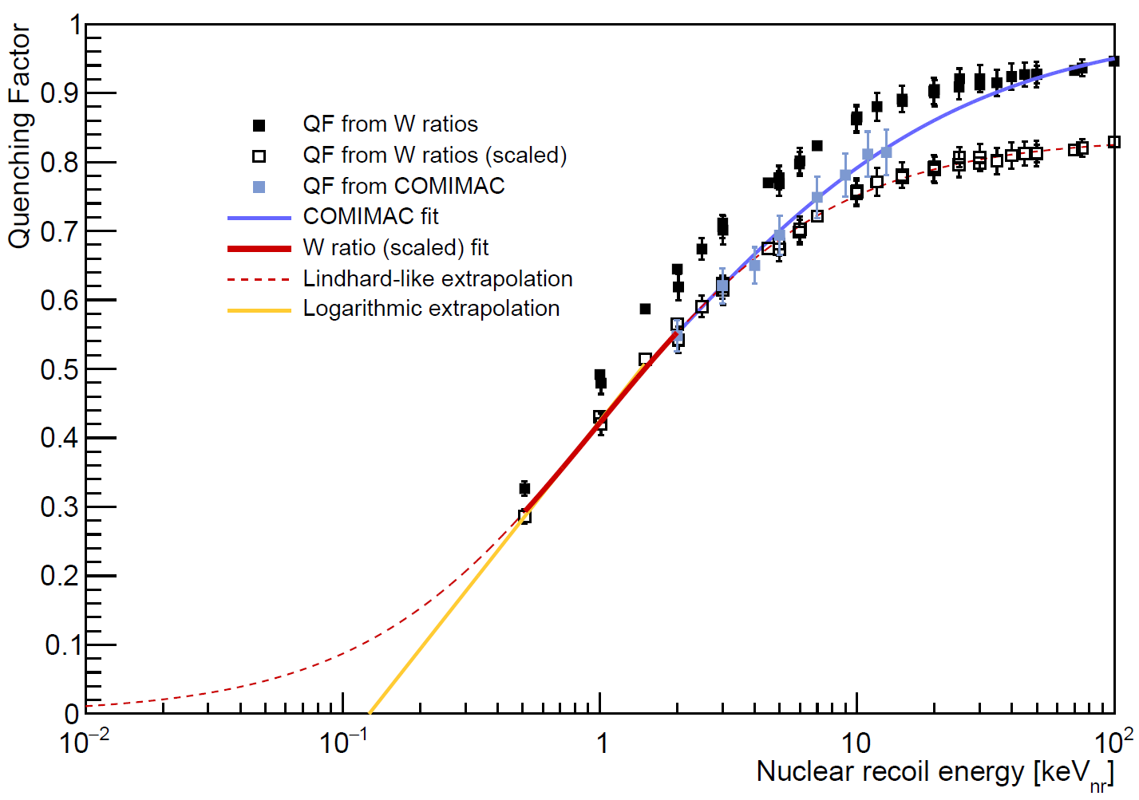
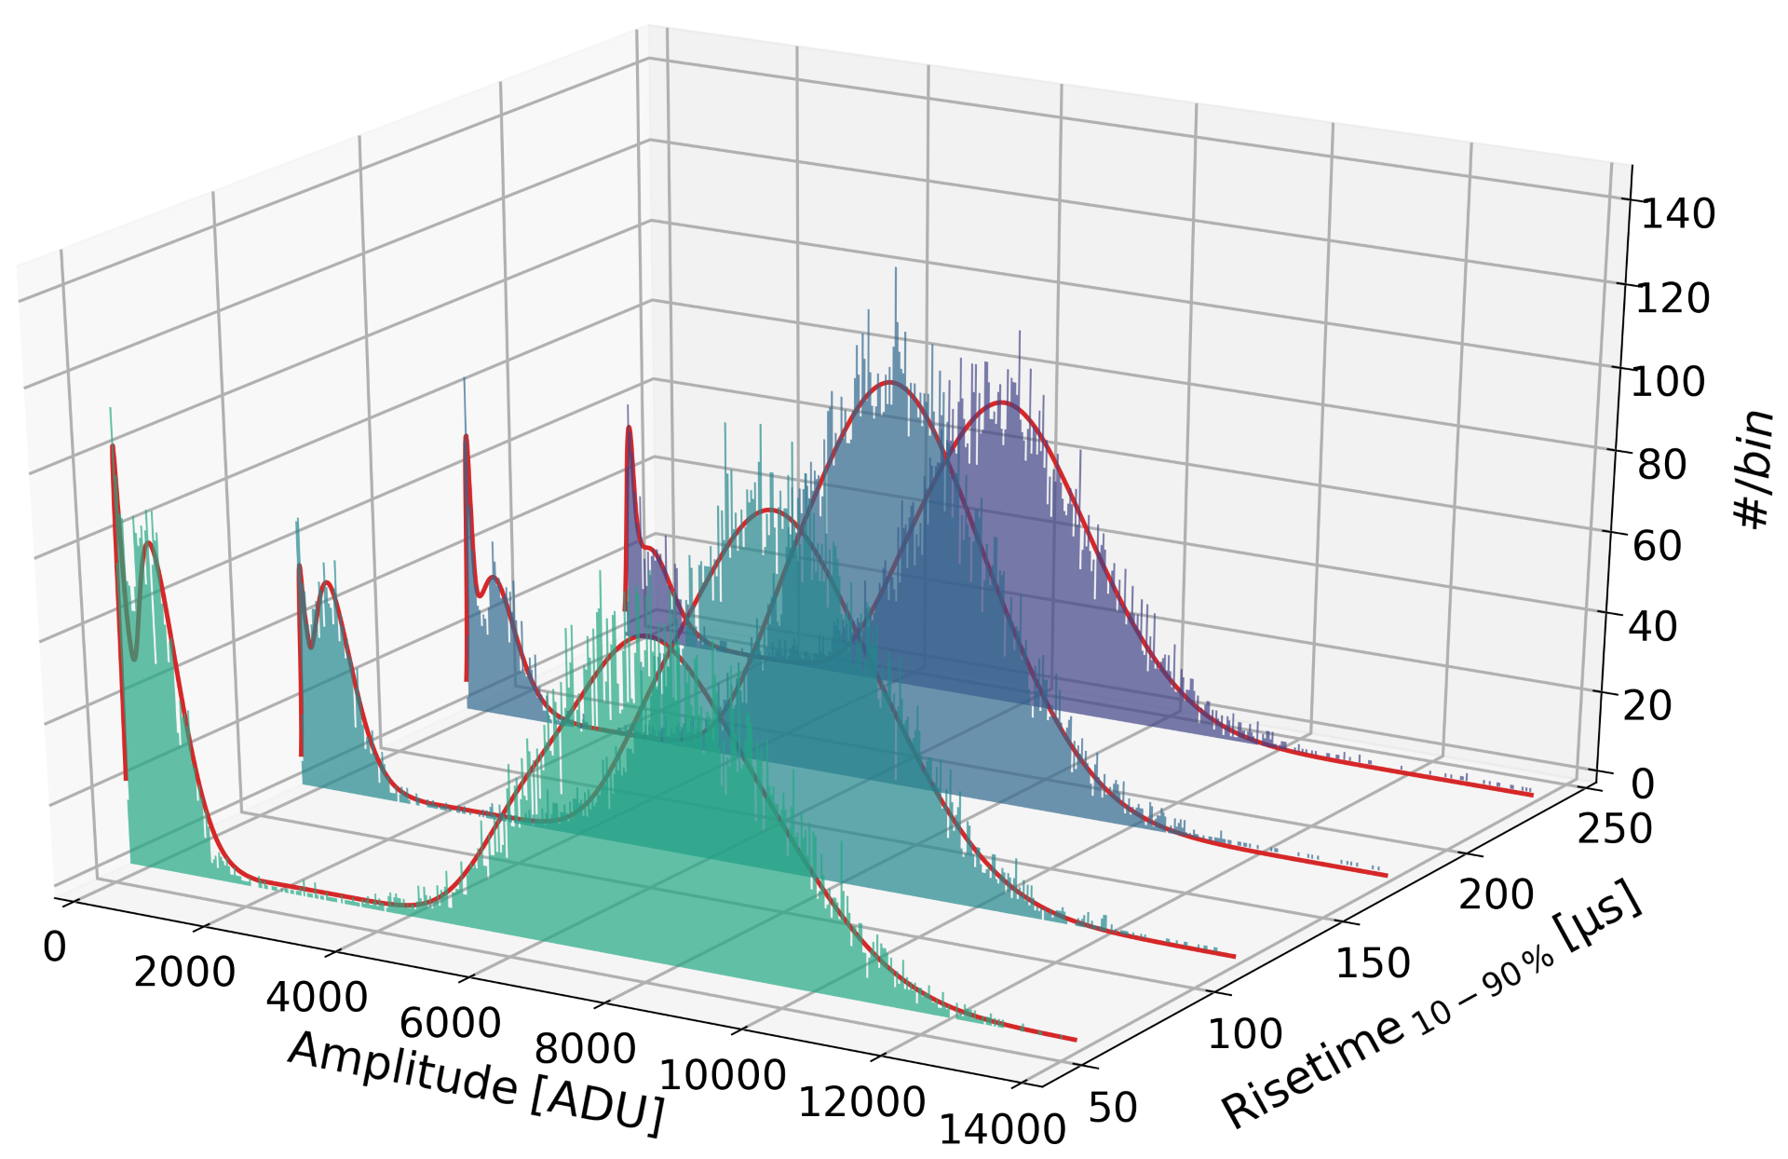
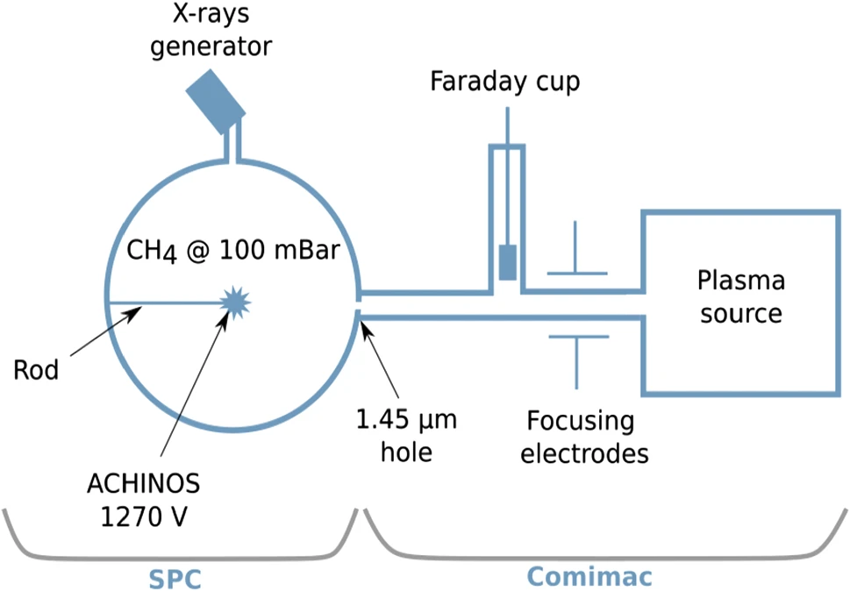
Calibration
A UV laser is directed at the inner copper surface of the sphere and releases electrons through the photoelectric effect. The UV light also goes to a photodetector so the laser events can be tagged as a control.
Some argon-37 is released inside the sphere, and the gas diffuses in the whole volume. This isotope is radioactive and has two peaks that enable energy calibration, as well as ionisation and attachment parametrization .
The quenching factor was measured at COMIMAC as well as obtained
from literature W-values. The
ionization yield was measured in
situ and in a 30 cm sphere at
Queen’s University.
270 eV peak
2.8 keV peak
doi: 10.1103/
PhysRevLett.134.141002
doi:10.1088/1742-6596/2156/1/012059
doi:10.1140/epjc/s10052-022-11063-9
26

Slide 27
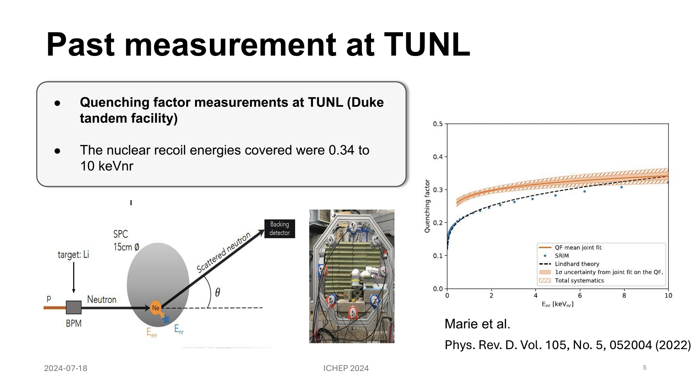
Quenching factor in Ne-CH4
Neha Panchal

Slide 28
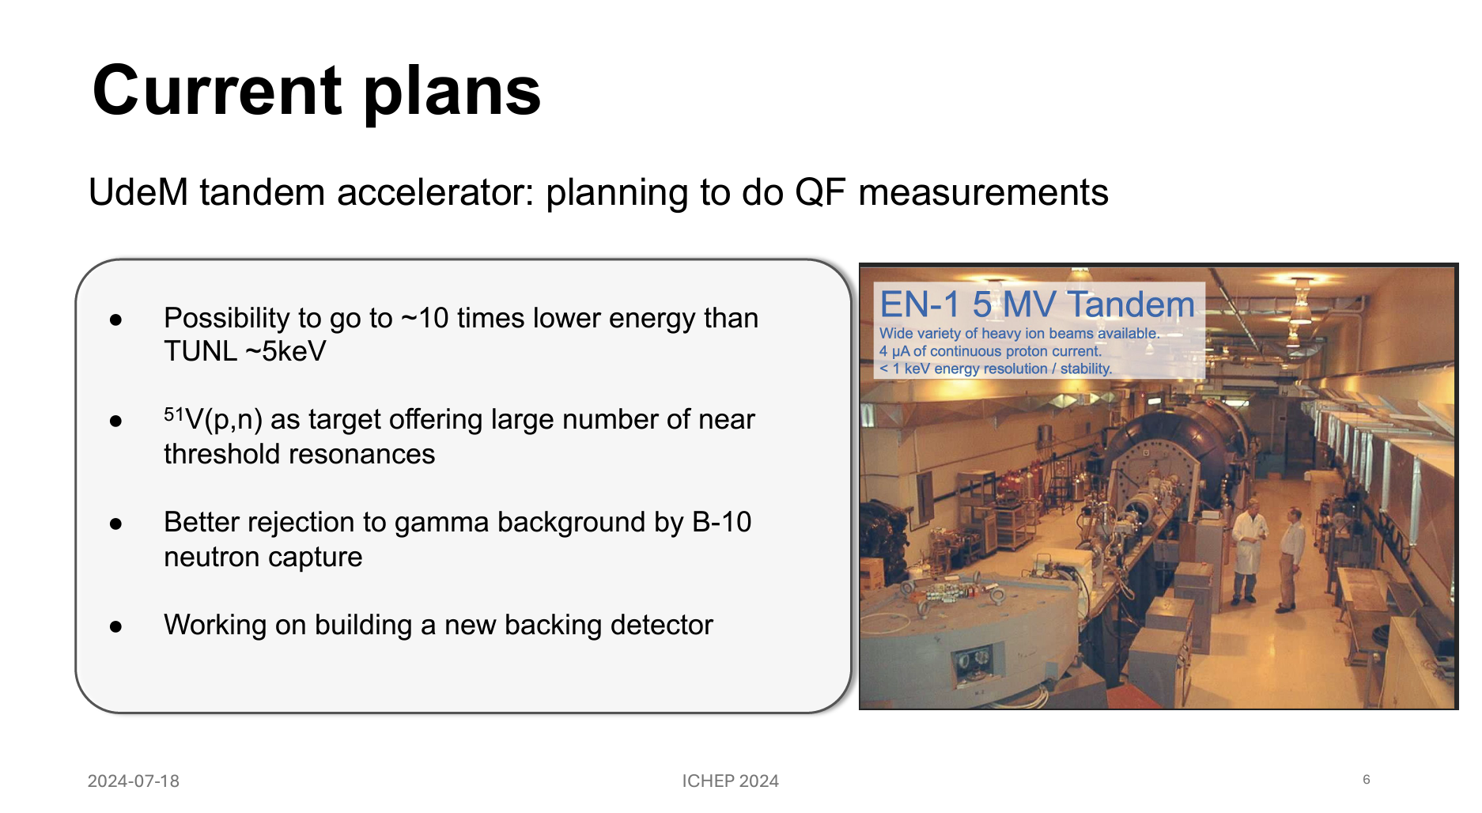
Neha Panchal

Slide 29
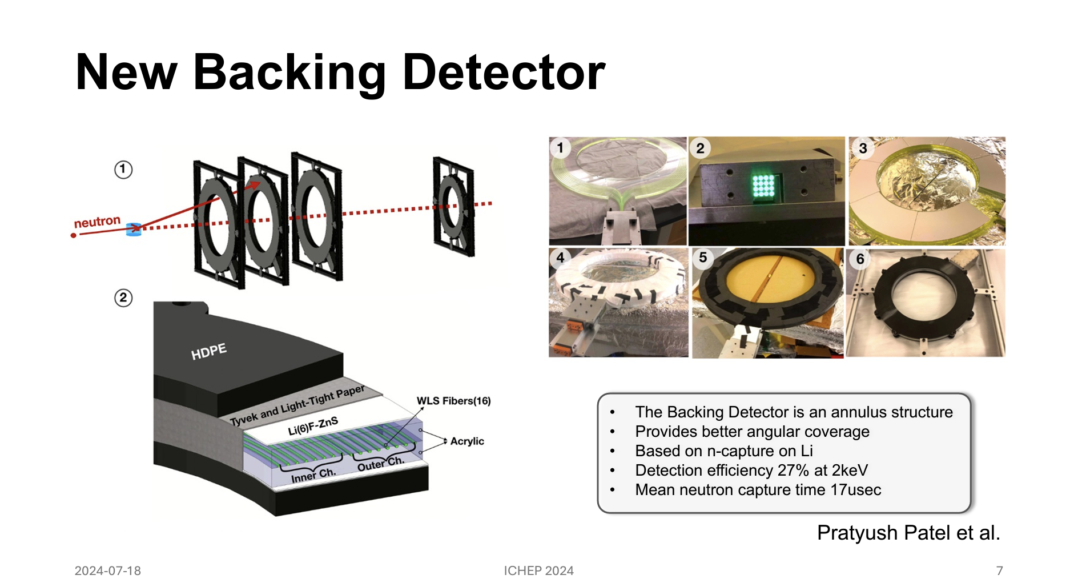
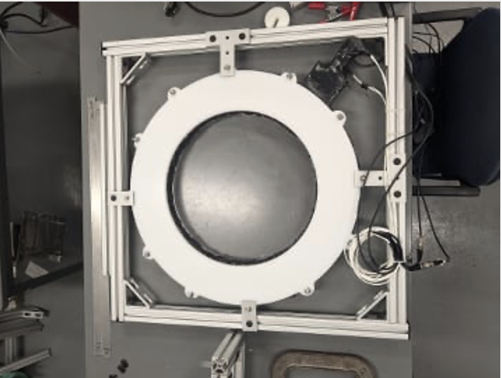
Neha Panchal

