Slide 1


mcdonaldinstitute.ca

Slide 2


MI-HQPAC
McDonald Institute
Highly Qualified Personnel
Advisory Committee
…Also
Advocacy/Action/Advancement
mcdonaldinstitute.ca/hqpac
Notes:
HQPAC Presentation at the Annual Community Meeting: Wednesday, Aug 7th 11:00 - 11:20 AM
I’m Zac, Communications Officer at the McDonald Institute. I’ve been involved in helping organize the HQPAC this year. I’ll pass this on to the committee members in a minute, but I wanted to give a very brief introduction and background on this initiative.
So, before I go on, HQPAC stands for…

Slide 3
MI-HQPAC
McDonald Institute Highly Qualified Personnel Advisory Committee
Who is HQP? All Graduate students, PhD Students, Postdocs, PDFs, and early career engineers, technicians, and researchers working in or studying astroparticle and related physics, or in cross/interdisciplinary research involving astroparticle and related physics.
*and extra keen undergrads!
mcdonaldinstitute.ca/hqpac
Notes:
And just because we always get asked this… HQP are:
It’s a broad group.

Slide 4
MI-HQPAC
McDonald Institute Highly Qualified Personnel Advisory Committee
Meets monthly to develop ideas and initiatives
Hosts monthly virtual community open Town Hall discussions to talk about areas of improvement for the HQP Community
Represents various education/career levels and institutes
Has a budget to make things happen
Advises the McDonald Institute on improvements for the HQP Community
Is a great way to connect and practice community leadership!
The Committee welcomes you to their next open discussion!
mcdonaldinstitute.ca/hqpac
Notes:
So what do they do?

Slide 5
HQPAC Projects
McDonald Institute Highly Qualified Personnel Advisory Committee
Current initiatives:
MI-HQP Seminar Series
Newsletter / Resource page
Mental Health Survey
In-person / Online Social Events
MI-HQP Excellence Award (HExA)
mcdonaldinstitute.ca/hqpac
Notes:
Hussain
Here’s a list of our ongoing projects which includes the seminar series that you might be getting regular emails for. Newsletter, Mental health survey which will soon be sent out and nice thing about it is that some are actually based of feedback we received in the previous meeting such as having in person social events, support for student initiatives, and couple others that we are pursuing, and so we’re eager to hear what more could be done and what could be done differently this time around.
I’ll echo what Zac mentioned earlier/I highly encourage you scan the QR code here since in the days following the annual meeting, there will be several announcements, this includes the mental health survey which we plan to roll out in the next month or so. The announcement for the HQP excellence awards which Brian will tell us more about will also be made in the coming weeks. Our most recent event was the HQP day in Montreal. We plan on organising more of these at various institutions so stay tuned and if interested volunteer to organise. We will make the trip to help facilitate the event as Zac did this time.

Slide 6
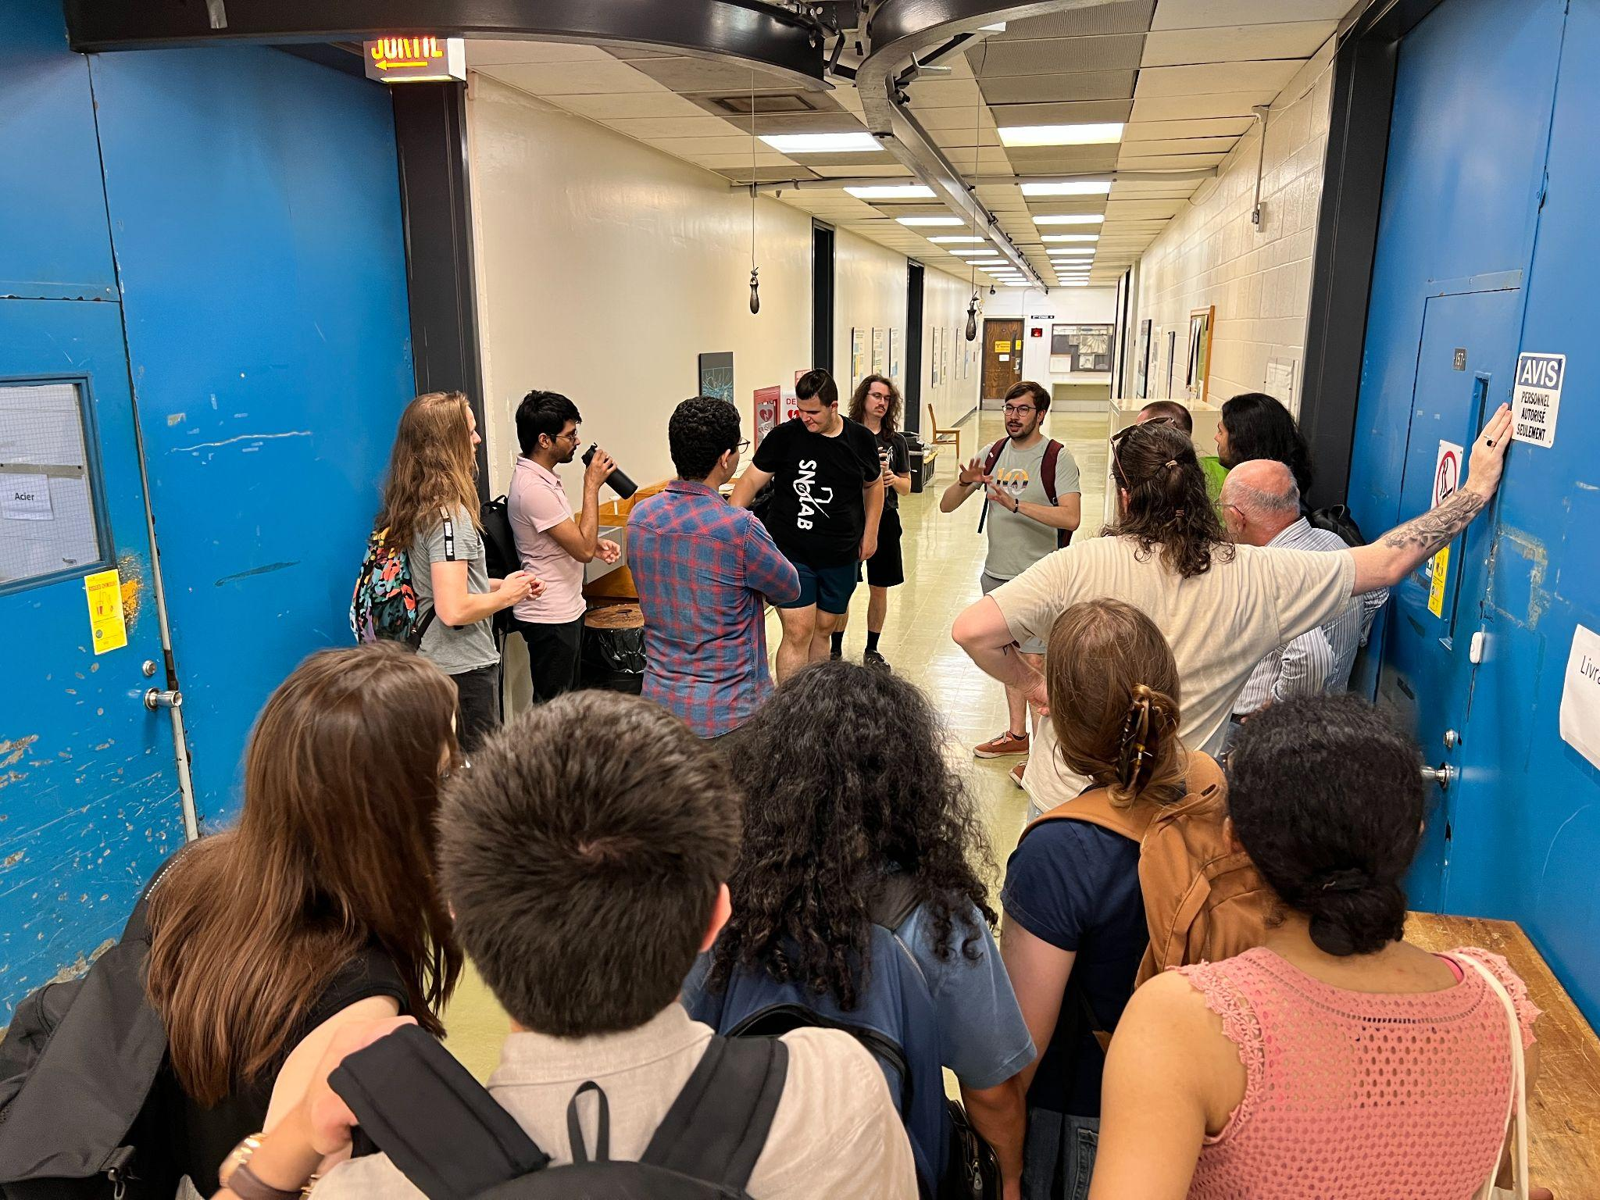
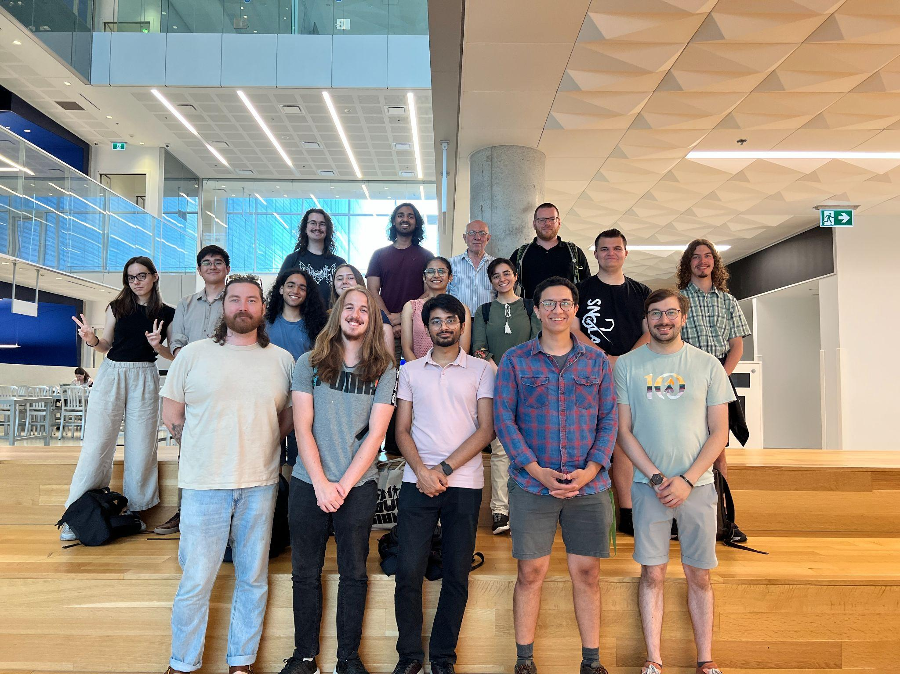
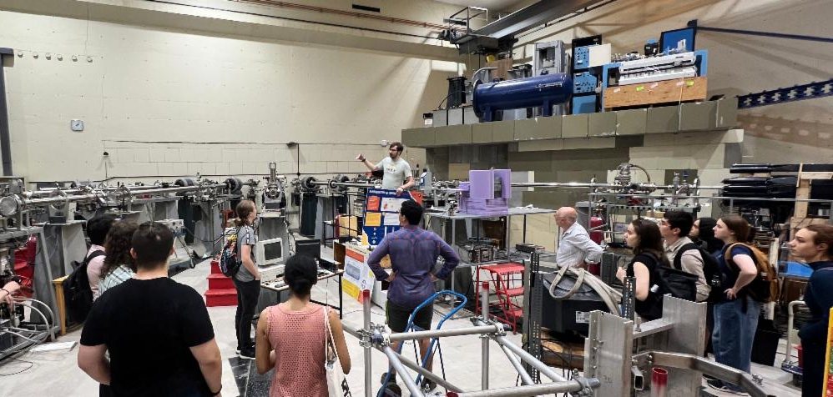
HQP day - Montreal
First of a series of HQP days to be organised…
Pics from the HQP day go here

Slide 7
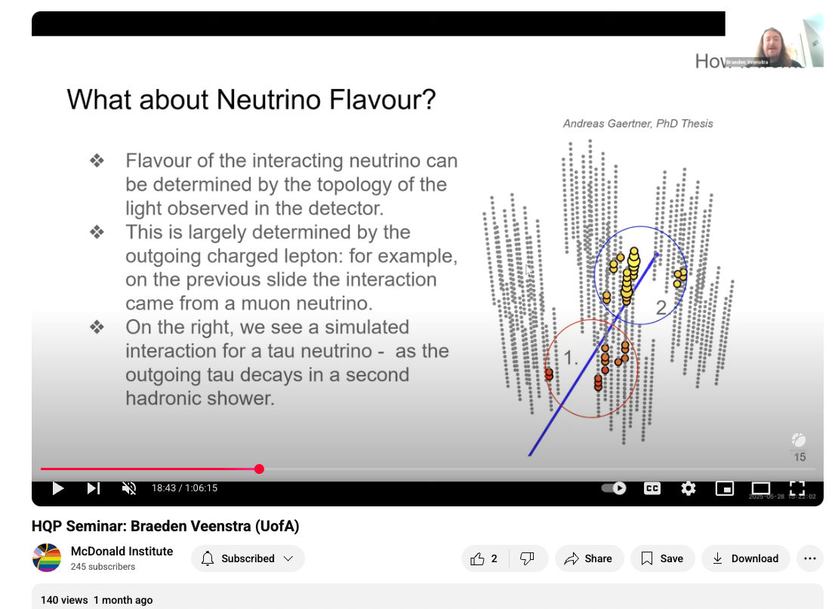
HQP Seminars
•Monthly 1 hr seminar aimed at graduate students and postdocs
•Invited talk: good practice for thesis defense, interview talk
•Open to all members of Canadian astroparticle physics
•Started January 2025, happens last Wednesday of every month
•Lots of interest!
Please contact Ryan Curtis hqpac@mcdonaldinstitute.ca
Recorded seminars available on the Youtube channel
https://www.youtube.com/@mcdonaldinstitute/streams

Slide 8
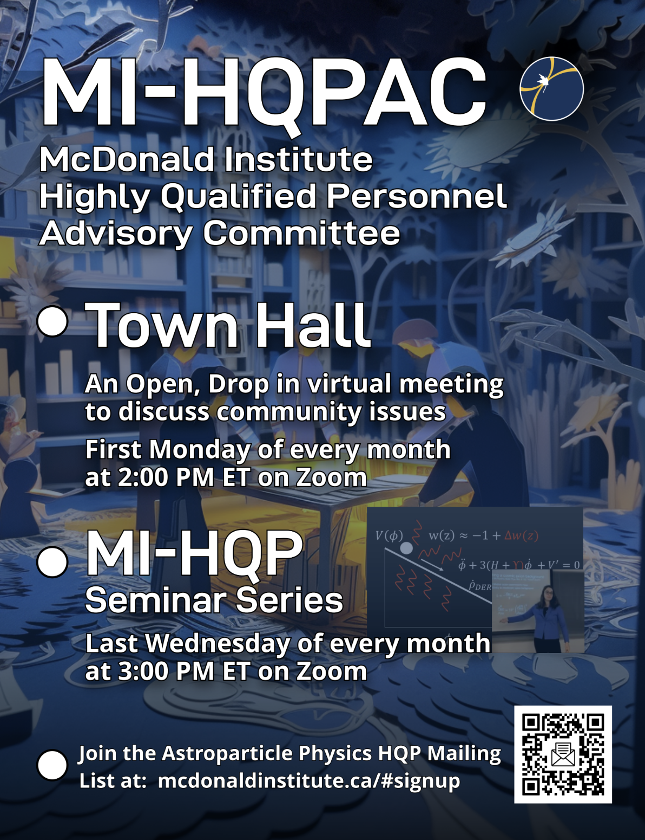

https://drive.google.com/file/d/1L__mBc8vTMjruyLKof0unCqEreFLl0hm/view?usp=drive_link

Slide 9
HQP Welcome Package
Recommendation from the Committee
A small package of goodies: coffee mug, stickers, pen, networking cards, etc. and information about McDonald Institute programs and opportunities.
Links to pertinent websites and mailing list signups.
Available to all new and current HQP.
Coming Fall 2025

Slide 10

Cards will be given out to new/current students, and postdocs as part of the HQP Welcome Package in the Fall
Notes:
Personnel cards can be created by submitting card information through this form: https://forms.gle/2a2CXEgiG2Yx44yd9

Slide 11
MI-HQP Excellence Awards (HExA)
Purpose:
To recognize and support Highly Qualified Personnel (HQP) who demonstrate excellence or initiative in key areas:
Research and Academic Progress
Community Building / Mentorship
Teaching & Science Communication
Budget: $10,000 total pool
No. of awards based on number of applicants
Each category will have multiple awards based on career stage ($1000 per award)
Notes:
Pilot Program in development
Total Pool: $10,000
No. of awards based on number of applicants
$1000 per award. Each category will have multiple awards based on career stage

Slide 12
MI-HQP Excellence Awards (HExA)
Award Categories:
Research Achievement Award
For outstanding progress in thesis work, publications,
or contributions to collaborative research.
Eligibility: MSc, PhD, Postdoc
Community Leadership Award
For fostering an inclusive, supportive, and engaged community
(e.g., organizing events, mentoring, peer support).
Eligibility: MSc, PhD, Postdoc
Teaching & Science Communication
For excellence in TA work, science outreach, workshops,
and/or educational video/podcast creation.
Eligibility: MSc, PhD, Postdoc
Undergraduate Award
For contributions in one or multiple categories listed above.
Eligibility: UG only
Notes:
Pilot Program in development
Total Pool: $10,000
No. of awards based on number of applicants
$1000 per award. Each category will have multiple awards based on career stage

Slide 13
MI-HQP Excellence Awards (HExA)
Eligibility:
Open to all HQP affiliated with the institute (undergrads, grads, PDFs).
Consideration of achievement from September 2024 onwards
Applicants can self-nominate or be nominated.
Each person can apply for one category per round.
Application Requirements:
1-page personal statement
1-page CV
Support letter
Application Deadline: November 15, 2025
Look out for more information in a future Astroparticle Physics Community Newsletter!
Notes:
Pilot Program in development

Slide 14
HQPAC Last Year’s Recommendations
Increased MI national connectivity
Help the broader HQP community develop professional skills and facilitate skills development
Financial support for HQP

Slide 15
HQPAC Last Year’s Recommendations
Increased MI national connectivity
  HQP day in Montreal
  Welcome package from MI
  HQP Seminars
  HQPAC monthly town halls

Slide 16
HQPAC Last Year’s Recommendations
Help the broader HQP community develop professional skills and facilitate skills development
  McDonald Institute hiring Folasade Aladesuyi as Education and Outreach Intern - planning professional development programming
  McDonald Institute hosting HQP PDO day (Aug 5th)

Slide 17
HQPAC Last Year’s Recommendations
Financial support for HQP
  Increased pooled tickets resources
  HQP Awards

Slide 18


Recommendations to McDonald Institute
Observation: Lack of professional development outside of Queen’s
Our hope: Help the broader HQP community develop professional skills
Our proposal: More professional development that focuses on in-demand skill development

Slide 19
Recommendations to McDonald Institute
Observation: The broader MI community doesn’t necessarily know they belong to this community. And those that do, don’t know who else is in it.
Our hope: Increase MI national connectivity
Proposal: Increase in-person networking opportunities

Slide 20
Recommendations to McDonald Institute
Observation: HQP dedicate a lot of time to equity issues, and outreach efforts, that can take away from progressing through their studies / doing other professional development
Our hope: Facilitate HQP skill development
Our proposal: Outreach honorarium to supervisor so HQP can attend professional development.

Slide 21
Recommendations to McDonald Institute
Observation: NSERC awards increased and cost of living increasing
Our hope: Financial support of HQP for an improved standard of living
Our proposal: Increase the number and amount of HQP pooled resources, pooled ticket

Slide 22
HQPAC New Recommendations
Annual meeting
  Broader topics of talks like community projects
  Improve networking connecting PIs to soon-to be looking students/postdocs
Astroparticle thesis awards
  Give a talk about their thesis project

Slide 23
Suggestions for HQPAC:
HQPAC newsletter?
How can we provide something more regular to the community? Maintain a presence. Job listings, funding calls, conderences, link to the next open meeting.
Share link to resource page
Increased SNOLAB engagement with HQP

Slide 24

HQPAC Survey: Where should our priorities be?
HQP Community Response (so far):
Professional Development
Mental Health
Research Community Events
(from 19 responses)
https://l.ead.me/hqp-survey

Slide 25
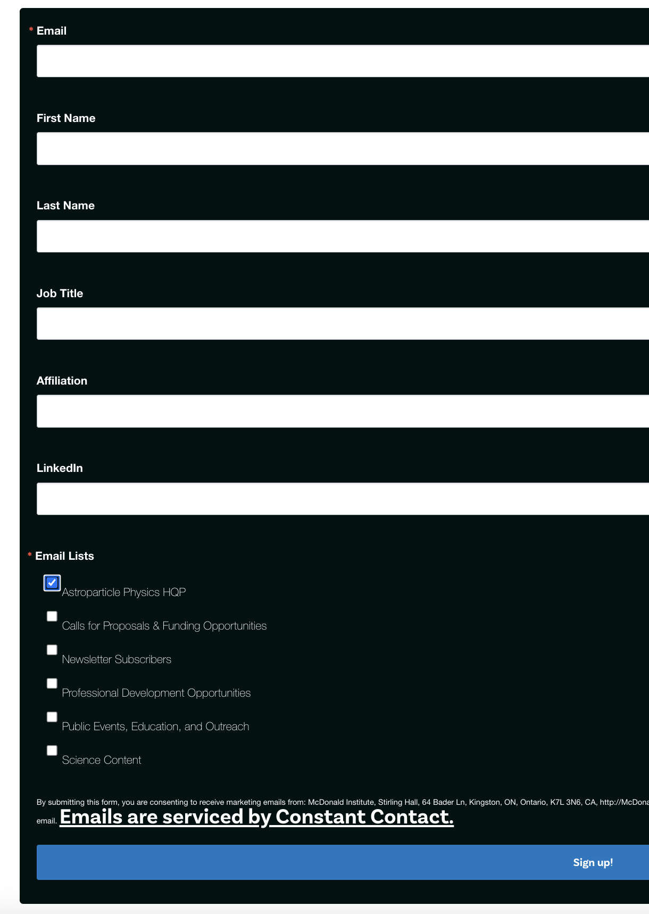
The Committee welcomes you to their next Town Hall Meeting:
August 11, 2025
2:00 - 3:00 PM ET
Join the HQP Mailing List:
mcdonaldinstitute.ca/hqpac

Slide 26
Goals:
Strengthen the Canadian particle-astro community
HQP are a unique part of the community with experiences, concerns & solutions in common
Increased connectivity generates a wealth of positive outcomes
Increased awareness of the HQPAC as a resource & encourage participation
Network of people across institutes for better representation & points of contact
Additional support (people!) needed to launch proposed projects
Notes:
And just because we always get asked this… HQP are:
It’s a broad group.

Slide 27
MI-HQPAC
McDonald Institute Highly Qualified Personnel Advisory Committee
Past Initiatives:
MINTERACT - virtual 1-1 mentoring
Astroparticle Physics Summer Student Workshop - Now organized independently of HQPAC.
HQP Art Contest
HQP Community Discord
HQP Opportunities collection
Several recommendations to McDonald Institute for Professional Development topics.
mcdonaldinstitute.ca/hqpac
Notes:
Zac

