Slide 1


Quantum error suppression
Zhenyu Cai
Notes:
Good morning. I am Zhenyu Cai from the University of Oxford. I am currently working in the Materials Department, but will move to the Engineering Department in the next few months to start my own group there.
My work mostly focuses on various ways that we deal with errors in quantum machines, which is crucial for any quantum applications, including lattice gauge theory simulation. Admittedly I am not an expert in the use of QC in lattice gauge theory and high energy physics. So in order to make a useful talk for you I think my talk will be a bit of a more general talk on introducing quantum error correction and mitigation and then end with some example connection to high energy physics.

Slide 2
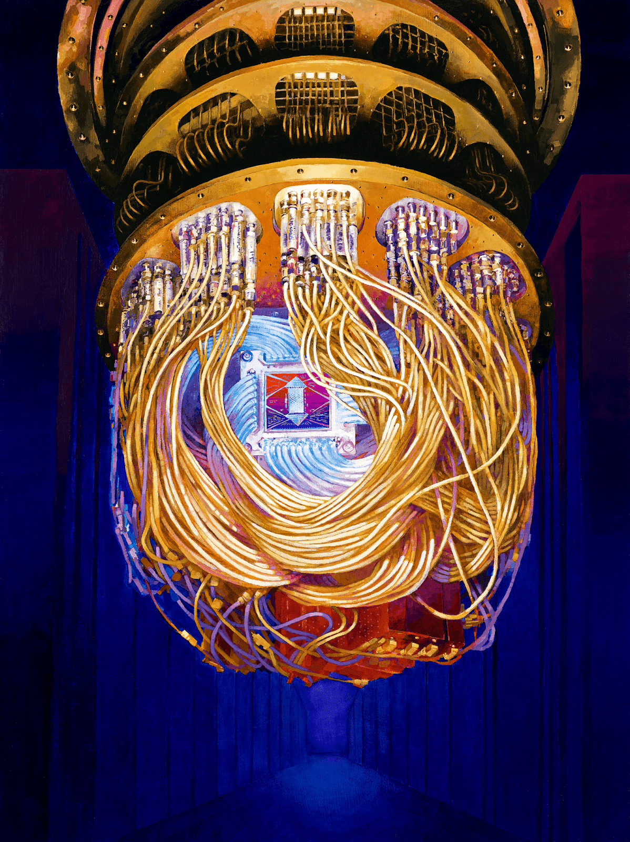

Where is my quantum computer?
Quantum Error Correction
Quantum Error Mitigation
Combination of them
Usage in existing work in LGT simulation
ERRORS!
Images from Google
Notes:
So it begs the question, why don’t we have a quantum computer for performing these tasks already? This is all because quantum computers are very susceptible to errors due to its interaction with the environment and imperfect controls.
In today's talk I am going to tell you why are these errors so damaging, what are the possible solutions to this and my contributions, and then talk about some future outlook for addressing these challenges along with my plan.
20s
Tot:2mins

Slide 3
Classical Error Correction
Encode
Check parity
Decode
0
0
0
Error
Correct
0
0
1
0
0
0
0
0
Check parity
Notes:
We can try to first take a page out of the classical error correction literature. Hence, in order to protect this one bit, we can encode it into three bits. Now if an error occur, we can Now by checking whether the first two bits are the same, i.e. checking their parity and then checking the parity of the last two bits, we can detect which bit went wrong and correct it.
40s
Tot: 3:20

Slide 4
Quantum Error Correction (QEC)
Store the information of one logical qubit into many physical qubits, perform parity checks on subset of qubits to detect errors.
Two types of errors: bit-flip errors and phase-flip errors.
Two types of parity checks: Z parity and X parity.
Notes:
The idea of quantum error correction is similar, we store the information of one qubits into many physical qubits. And the qubit redundancy can protect our quantum information against errors.
The difference is that besides the bit flip error that flip 0 to 1 and 1 to 0, quantum computers is also vulnerable against phase errors which flip the relative phases between the superposed basis. So instead of needing just one type of parity check to check the bit flip error, we have two types of parity checks, X and Z checks to check for phase flip errors and bit flip error respectively.
It seems quite straight-forward so far, however, when we actually trying to implement them in practice, the story is not so simple. First of all, there exists more dangerous errors than the two types that we mentioned here, which may require specialised schemes to deal with them. Secondly, the parity checks consists of faulty components, so how exactly do we implement them is of utmost importance.
A large part of my research deal with these challenges.
1min 30s
4:50

Slide 5
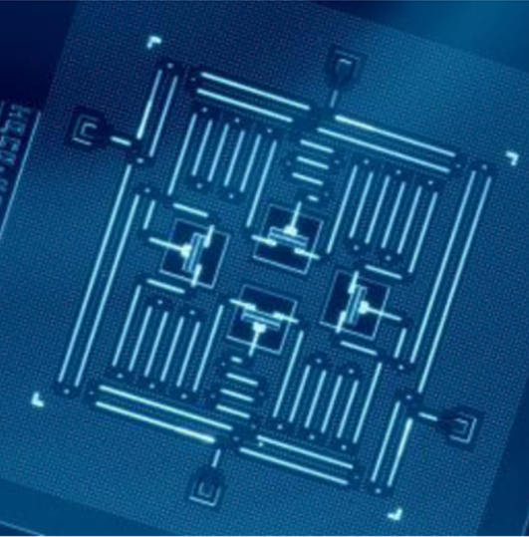
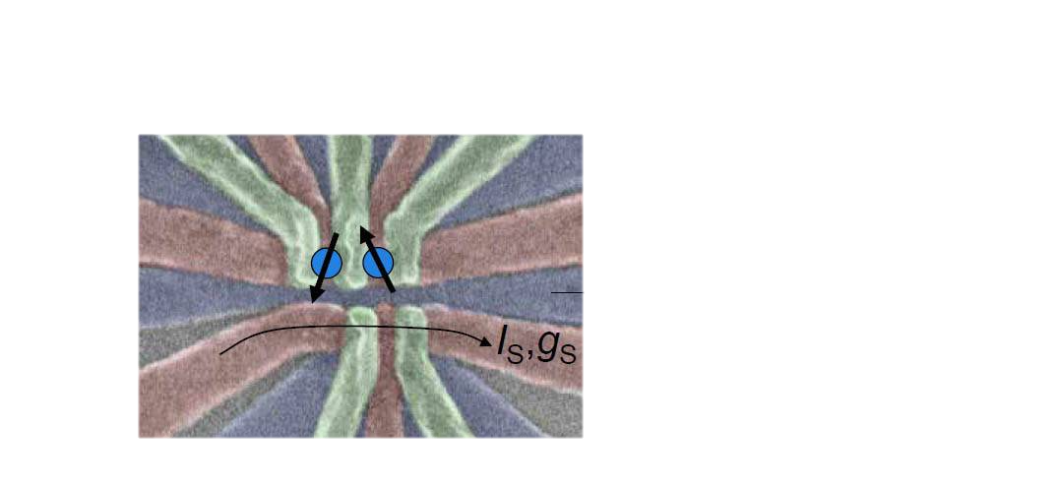
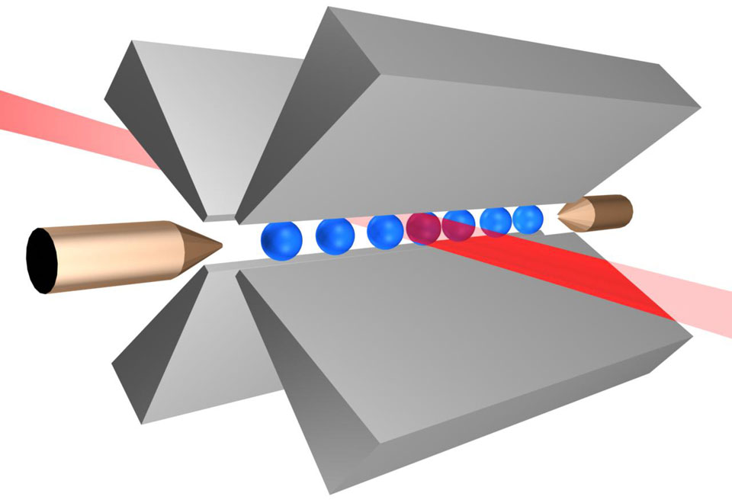
Leading QEC code: Surface Code
Data qubits: store the quantum information
X checks, Z checks
Ancilla qubits: carrying out parity checks
Superconducting
Silicon Spin
Trapped Ions
Notes:
The other question is on how to perform the parity checks. In order to see what checks we need to perform, let us look at the leading QEC code -- the surface code. A surface code is as shown here, which is a 2D array of qubits. The white dots here are data qubits, which correspond to these physical devices. The parity checks we need to performed are denoted using the red and plaquettes here. For example, this green square here means we want to perform Z checks on this 4 qubits.
So how do we carry out the parity checks? We simply use an additional qubit in the middle to interact with all the neighbouring qubits one by one, in such a way we can gather the parity information to the ancilla qubit and then obtain the parity by measuring out the ancilla qubits.
So we need to implement an array of qubits in actual hardware, and we see that there is a close relationship between the topology of our code and the hardware layout we try to achieve.
1min10s
Tot: 6:40

Slide 6
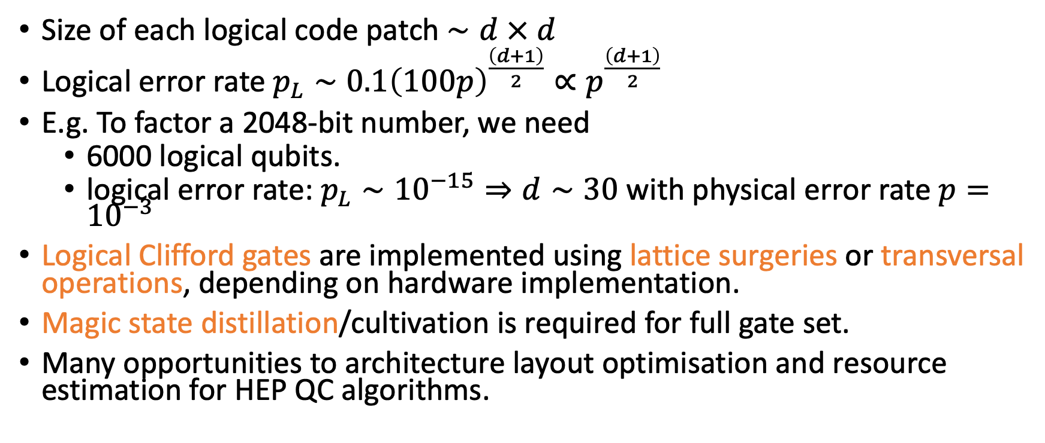
Properties of surface code
Size of each logical code patch $∼d × d$
Logical error rate $p_{L}∼{0.1\left(100p\right)}^{\frac{\left(d+1\right)}{2}}∝p^{\frac{\left(d+1\right)}{2}}$
E.g. To factor a 2048-bit number, we need
  6000 logical qubits.
  logical error rate: $p_{L}∼{10}^{−15}⇒d∼30$ with physical error rate $p={10}^{−3}$
Logical Clifford gates are implemented using lattice surgeries or transversal operations, depending on hardware implementation.
Magic state distillation/cultivation is required for full gate set.
Many opportunities to architecture layout optimisation and resource estimation for HEP QC algorithms.

Slide 7
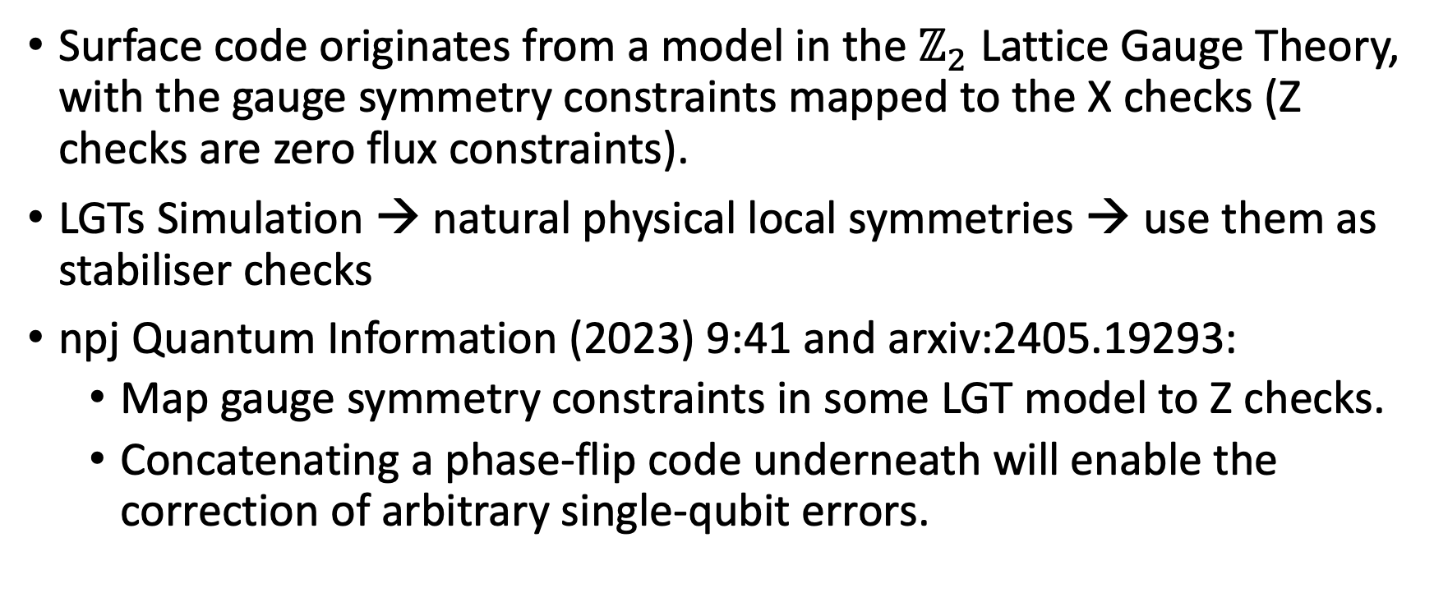
QEC and Lattice Gauge Theory
Surface code originates from a model in the $ℤ_{2}$ Lattice Gauge Theory, with the gauge symmetry constraints mapped to the X checks (Z checks are zero flux constraints).
LGTs Simulation → natural physical local symmetries → use them as stabiliser checks
npj Quantum Information (2023) 9:41 and arxiv:2405.19293:
  Map gauge symmetry constraints in some LGT model to Z checks.
  Concatenating a phase-flip code underneath will enable the correction of arbitrary single-qubit errors.

Slide 8
Quantum Error Correction
Large qubit overhead.
High requirement on gate fidelity.
Logical gates on encoded qubits can be slow.

Slide 9
Dealing with dangerous errors
  Is there a hardware-efficient way to improve the stability of quantum computers outside QEC?
  → Quantum Error Mitigation (QEM)
Cai et al, Quantum error mitigation, Rev. Mod. Phys. 95, 045005 (2023).
Notes:
So How can…

Slide 10
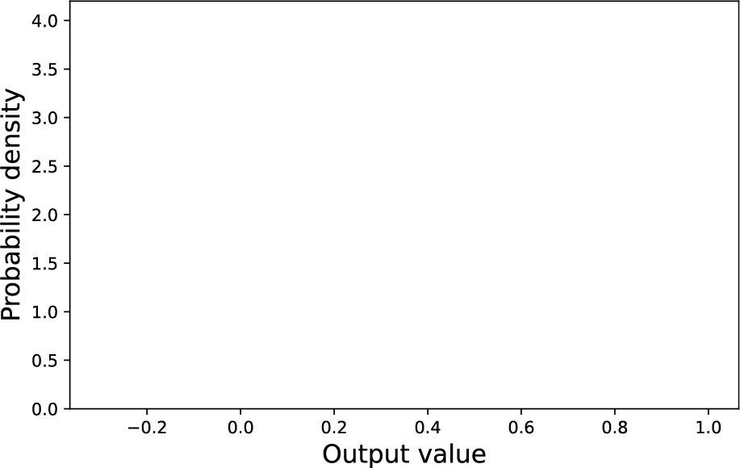
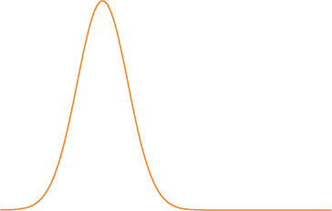
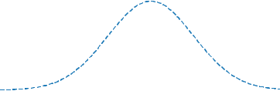




Quantum Error Mitigation (QEM)
Ideal state: $ρ_{0}$ , Noisy state: $ρ$, Observable of interests: $O$
$Tr[Oρ]$
Noisy value
$$E[{\hat{O}}_{em}]$$
$Tr[Oρ_{0}]$
Mitigated value
Ideal value
smaller bias, increased variance

Slide 11
Dealing with dangerous errors
  Symmetry Verification

Slide 12
Overall ideas
Known symmetry of the ideal output state, e.g. gauge symmetry constraints, total spins, particle numbers, etc.
In many cases, we only have a small number of symmetries
→ not enough information to identify the error → no error correction
→ error detection (post-selection) is still possible
Non-local symmetries are hard to measure directly, but can be obtained through post-processing.

Slide 13
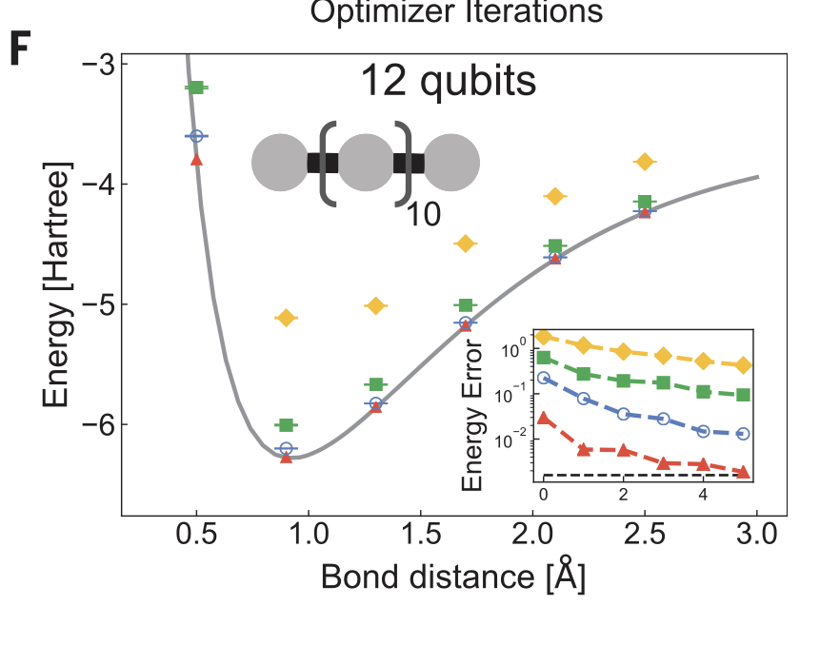
Experiment
Energy of a hydrogen chain
Yellow: raw data
Green: SV with particle numbers
Blue and red: Additional QEM (RDM and subspace expansion) on top of SV.
Science369,1084-1089(2020)

Slide 14
Dealing with dangerous errors
  Zero-noise Extrapolation
Notes:
So How can…

Slide 15
QEM Example: Zero-noise Extrapolation
0.42
Quantum Circuit Output
Experimental Forbidden Zone
0
1
2
3
Relative Noise Level
Notes:
But how exactly do we perform quantum error mitigation, we will use a simple example of the method Zero-noise Extrapolation to illustrate. Suppose we want to obtain the output of a quantum circuit, but we only have a noise version of the circuit. The horizontal axis here is the noise level of the circuit with the lowest noise we are able to achieve defined as 1. The least noisy output we can obtain is as shown here, we cannot go into the forbidden zone, but we can further boost the noise and do this again. In the end, with these additional noisy circuit runs, we can actually try to extrapolate back to the zero noise point to obtain an estimate of the noiseless output. This idea though looks simple, but it is surprisingly effective in practice and has been implemented in many experiments, most recently on a 127 qubit machine. The most important question to this approach is of course what shape of the extrapolation curve to use.
1:30
12:50

Slide 16
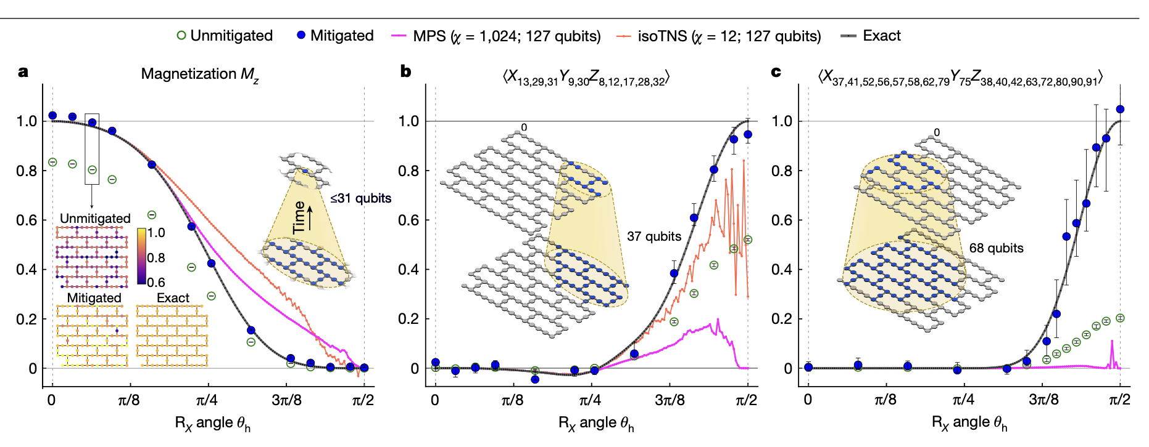
Experiment
Verifiable results up to 68 qubits, there are also results up to 120 qubits (depth 60) which was verified by later papers.
Nature 618, 500–505

Slide 17
Dealing with dangerous errors
  Rescale and shift

Slide 18
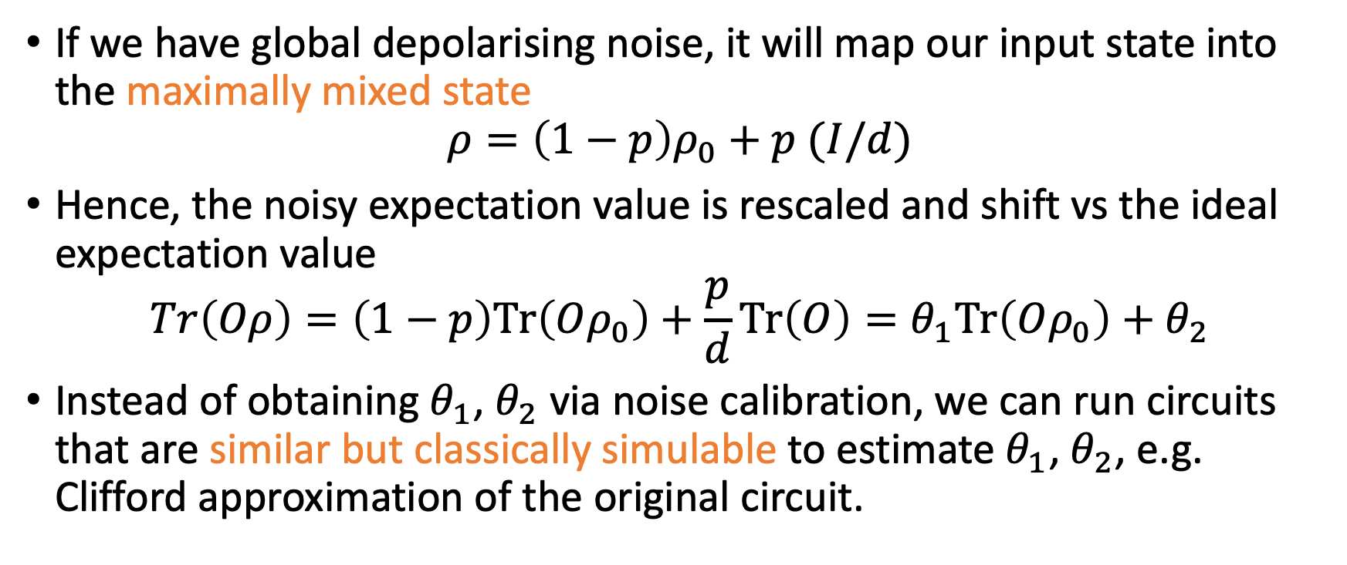
Motivating Example
If we have global depolarising noise, it will map our input state into the maximally mixed state
$$ρ=\left(1−p\right)ρ_{0}+p (I/d)$$
Hence, the noisy expectation value is rescaled and shift vs the ideal expectation value
$$Tr\left(Oρ\right)=\left(1−p\right)Tr\left(Oρ_{0}\right)+\frac{p}{d}Tr\left(O\right)=θ_{1}Tr\left(Oρ_{0}\right)+θ_{2}$$
Instead of obtaining $θ_{1}$, $θ_{2}$ via noise calibration, we can run circuits that are similar but classically simulable to estimate $θ_{1}$, $θ_{2}$, e.g. Clifford approximation of the original circuit.

Slide 19
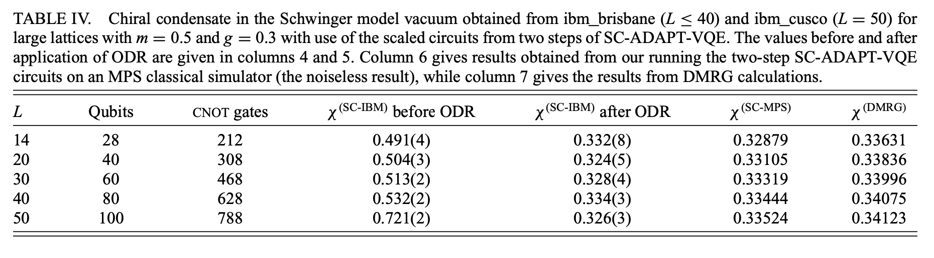
Experimental example
Noisy value
Mitigated value
Ideal value
Prepare the vacuum of the lattice Schwinger model using VQE on 100 qubits (50 sites)
Use the state preparation circuits with the variational parameters set to zero as the reference circuit.
PRX QUANTUM 5, 020315 (2024)

Slide 20
Many other QEM techniques
Rescale and shift belong to the more general learning-based method, which uses reference circuit learning to replace noise calibration in various QEM techniques
Probabilistic error cancellation
Subspace expansion
Purification-based methods
Cai et al, Quantum error mitigation, Rev. Mod. Phys. 95, 045005 (2023).

Slide 21
Dealing with dangerous errors
Can QEC and QEM work together?
Notes:
After learning about QEC and QEC, a natural question is …
This whole section is about 5 min.

Slide 22
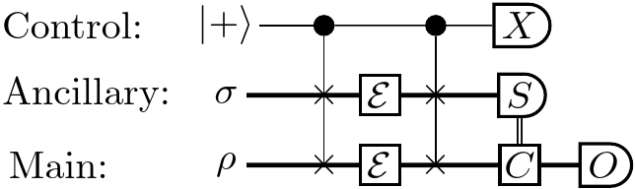
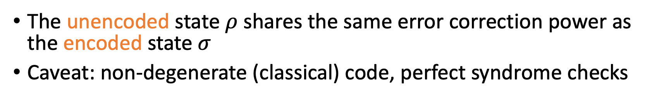
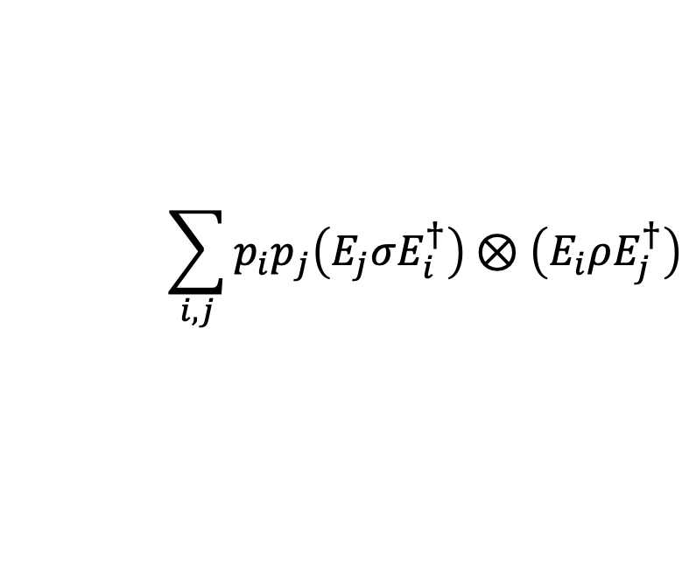
Virtual Error Correction
Code state
Error check on anc register
Correction on the main register
$$\sum_{i,j}{p_{i}p_{j}\left(E_{j}σE_{i}^{†}\right)⊗\left(E_{i}ρE_{j}^{†}\right)}$$
The unencoded state $ρ$ shares the same error correction power as the encoded state $σ$
Caveat: non-degenerate (classical) code, perfect syndrome checks
arXiv:2402.07866 TQC24, QCTiP24
Notes:
This is the first protocol that natively combine QEM and QEC beyond concatenation. And we hope that this can inspire further works on an integrated framework between QEC and QEM.

Slide 23
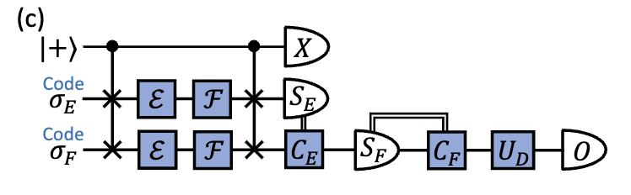
Multiple codes
Notes:
This is the first protocol that natively combine QEM and QEC beyond concatenation. And we hope that this can inspire further works on an integrated framework between QEC and QEM.

Slide 24
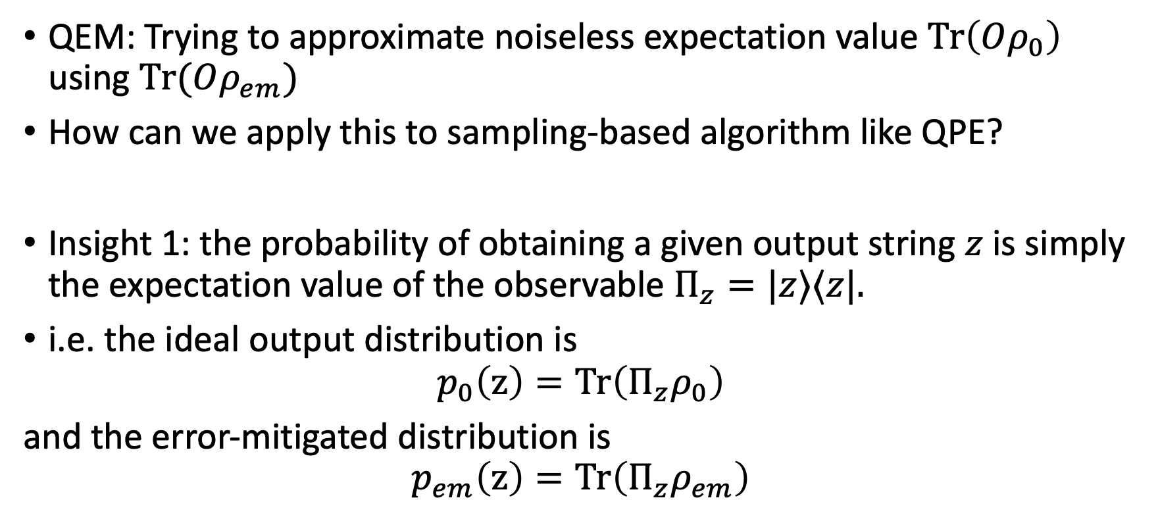
QEM for Sampling Algorithm
QEM: Trying to approximate noiseless expectation value $Tr\left(Oρ_{0}\right)$ using $Tr(Oρ_{em})$
How can we apply this to sampling-based algorithm like QPE?
Insight 1: the probability of obtaining a given output string $z$ is simply the expectation value of the observable $Π_{z}=|z⟩⟨z|.$
i.e. the ideal output distribution is
$$p_{0}\left(z\right)=Tr\left(Π_{z}ρ_{0}\right)$$
and the error-mitigated distribution is
$$p_{em}\left(z\right)=Tr\left(Π_{z}ρ_{em}\right)$$
arXiv:2502.11285 QCTiP25

Slide 25
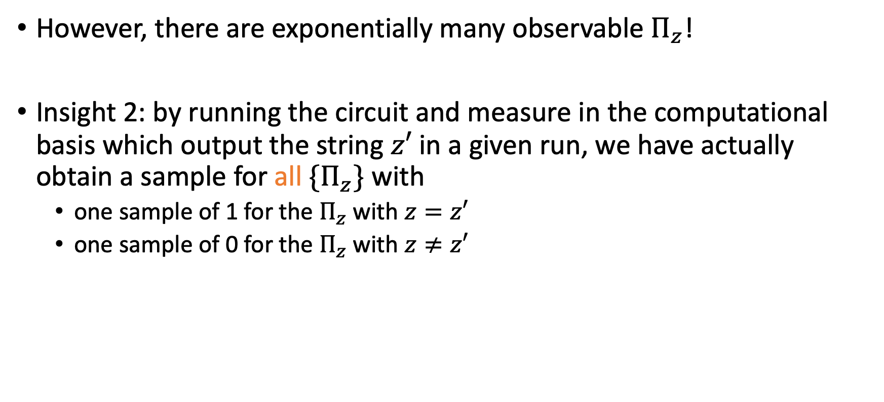
QEM for Sampling Algorithm
However, there are exponentially many observable $Π_{z}$!
Insight 2: by running the circuit and measure in the computational basis which output the string $z′$ in a given run, we have actually obtain a sample for all ${\{Π}_{z}\}$ with
  one sample of 1 for the $Π_{z}$with $z=z′$
  one sample of 0 for the $Π_{z}$with $z≠z′$

Slide 26
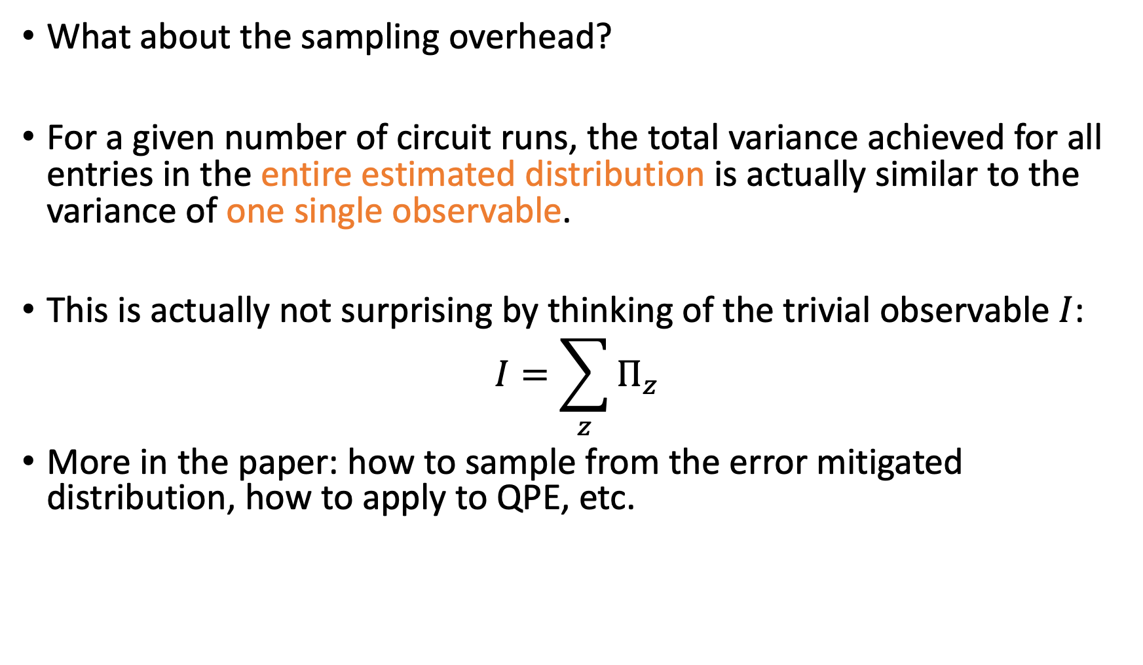
QEM for Sampling Algorithm
What about the sampling overhead?
For a given number of circuit runs, the total variance achieved for all entries in the entire estimated distribution is actually similar to the variance of one single observable.
This is actually not surprising by thinking of the trivial observable $I$:
$$I=\sum_{z}{Π_{z}}$$
More in the paper: how to sample from the error mitigated distribution, how to apply to QPE, etc.

Slide 27
Overall picture
QEC:
  more application-agnostic, acting as the underlying layer
  interesting direction in optimising the architecture layout for a given application and performing resource estimate
QEM:
  more dependent on the target problem, the target state and the circuit noise model
  interesting direction in figuring out the best combination of QEM techniques for a given application scenario
Many possibilities for combining QEC and QEM in the early fault-tolerant era that is right around the corner.
Notes:
Is applicable as long as
1. we have hardware capability to prepare another independent copy and connect them via control permutation operation
2. the main circuit is deep compared to the control-permutation operation

Slide 30
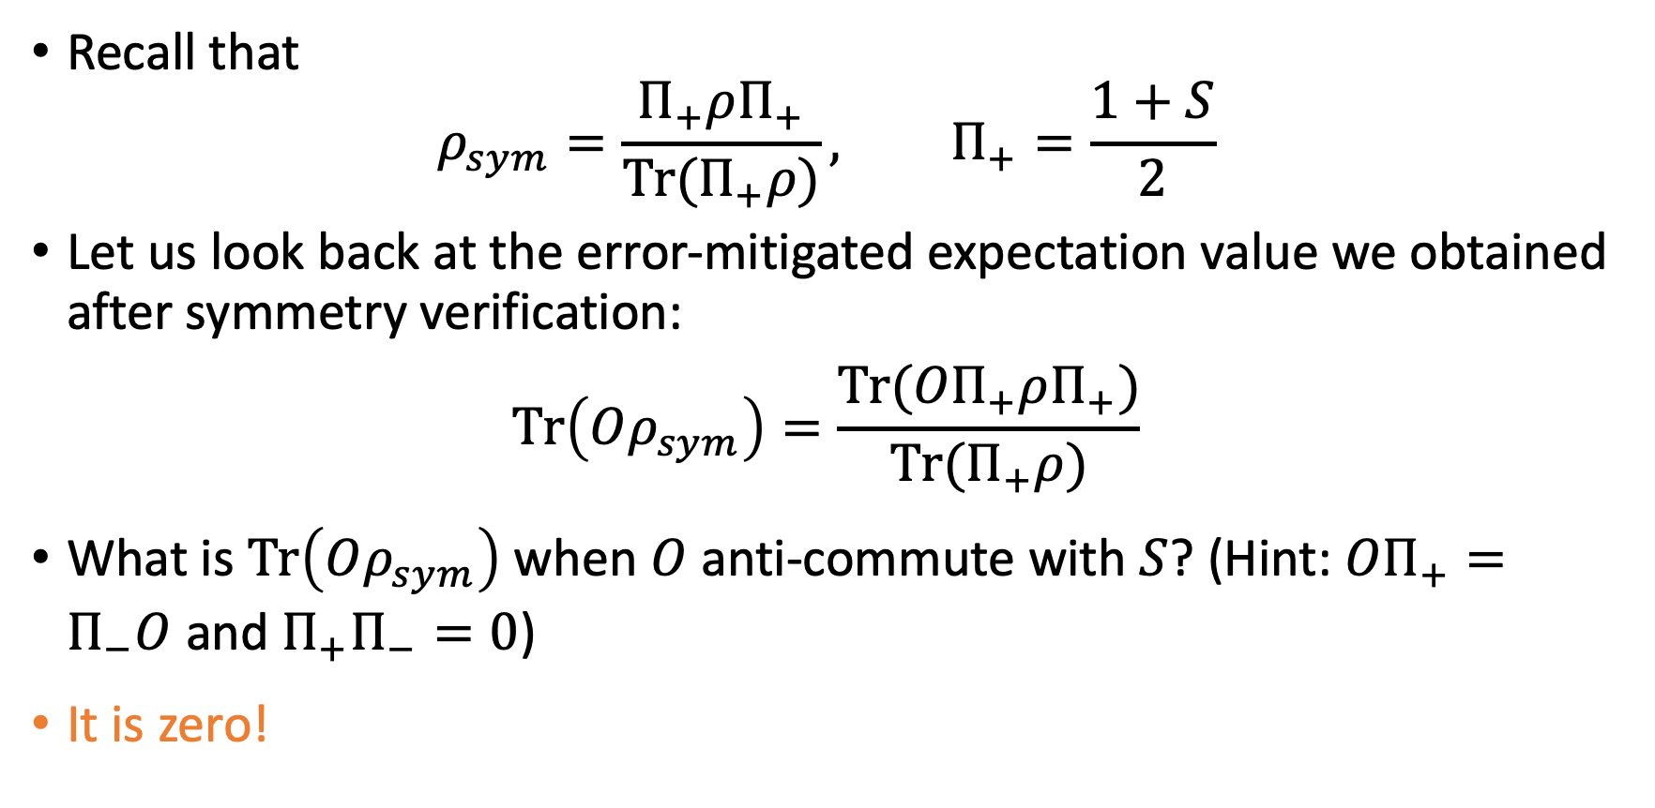
Post-processing SV
Recall that
$$ρ_{sym}=\frac{Π_{+}ρΠ_{+}}{Tr(Π_{+}ρ)}, Π_{+}=\frac{1+S}{2}$$
Let us look back at the error-mitigated expectation value we obtained after symmetry verification:
$$Tr\left(Oρ_{sym}\right)=\frac{Tr({OΠ}_{+}ρΠ_{+})}{Tr(Π_{+}ρ)}$$
What is $Tr\left(Oρ_{sym}\right)$ when $O$ anti-commute with $S$? (Hint: $OΠ_{+}=Π_{−}O$ and $Π_{+}Π_{−}=0$)
It is zero!

Slide 31
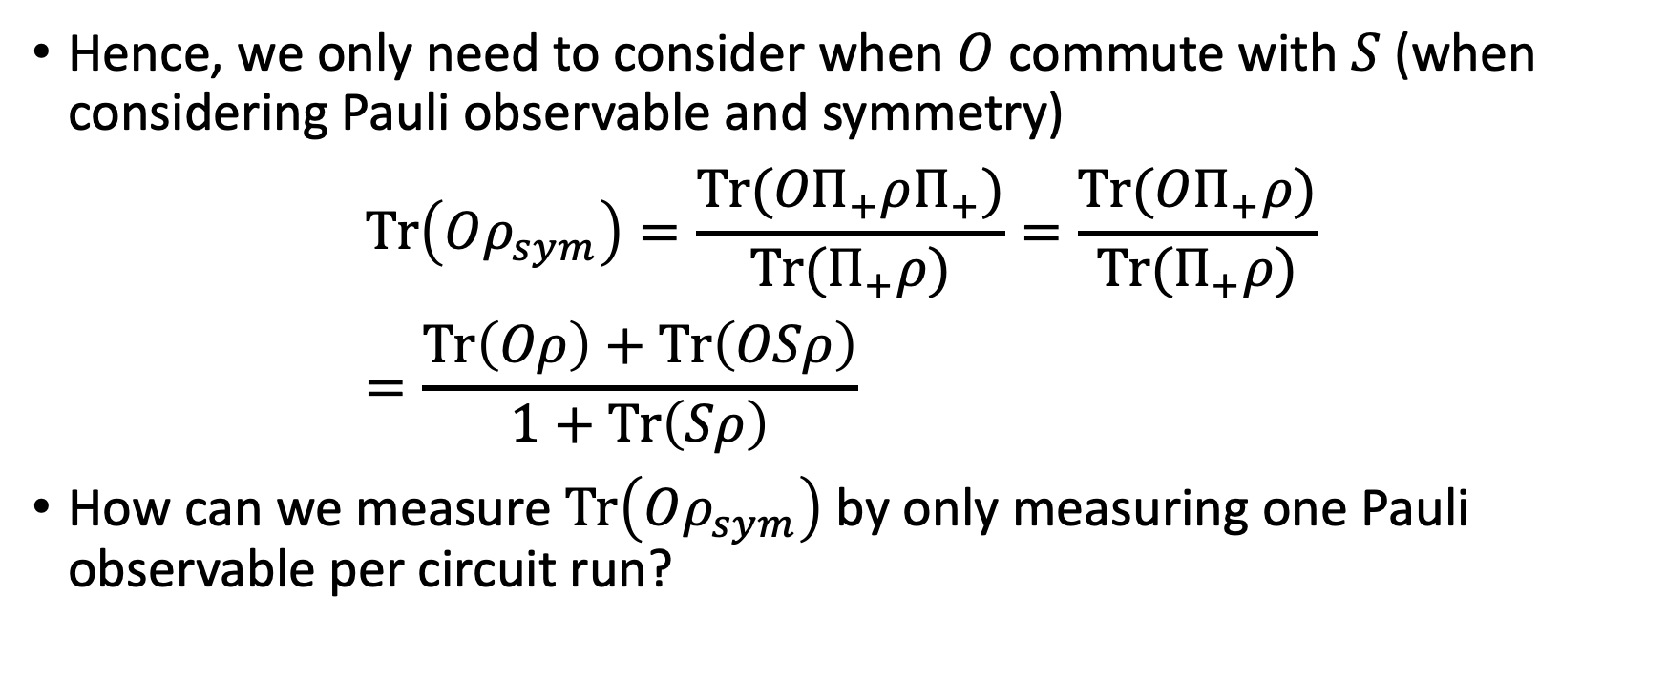
Post-processing SV
Hence, we only need to consider when $O$ commute with $S$ (when considering Pauli observable and symmetry)
$$Tr\left(Oρ_{sym}\right)=\frac{Tr({OΠ}_{+}ρΠ_{+})}{Tr(Π_{+}ρ)}=\frac{Tr({OΠ}_{+}ρ)}{Tr(Π_{+}ρ)} \\ =\frac{Tr\left(Oρ\right)+Tr\left(OSρ\right)}{1+Tr\left(Sρ\right)}$$
How can we measure $Tr\left(Oρ_{sym}\right)$ by only measuring one Pauli observable per circuit run?

Slide 32
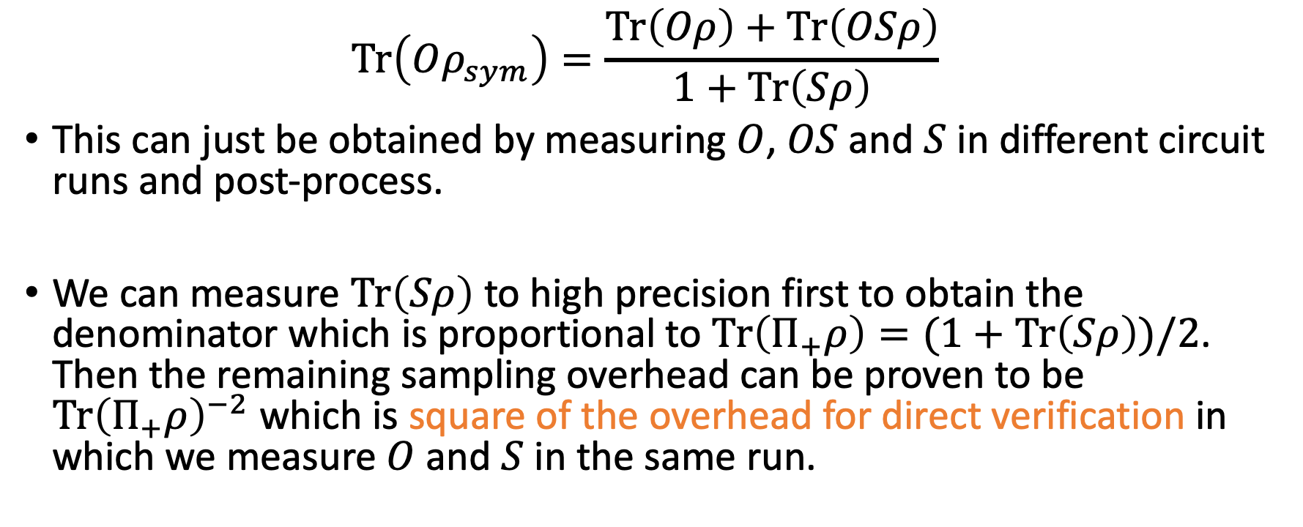
Post-processing SV
$$Tr\left(Oρ_{sym}\right)=\frac{Tr\left(Oρ\right)+Tr\left(OSρ\right)}{1+Tr\left(Sρ\right)}$$
This can just be obtained by measuring $O$, $OS$ and $S$ in different circuit runs and post-process.
We can measure $Tr\left(Sρ\right)$ to high precision first to obtain the denominator which is proportional to $Tr\left(Π_{+}ρ\right)=(1+Tr\left(Sρ\right))/2$. Then the remaining sampling overhead can be proven to be $Tr{\left(Π_{+}ρ\right)}^{−2}$ which is square of the overhead for direct verification in which we measure $O$ and $S$ in the same run.

Slide 33
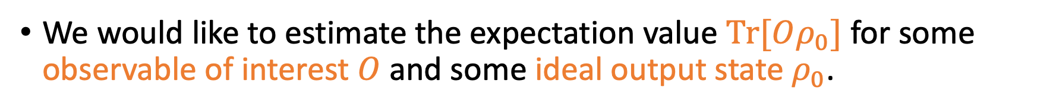
Quantum Error Mitigation (QEM)
We would like to estimate the expectation value $Tr[Oρ_{0}]$ for some observable of interest $O$ and some ideal output state $ρ_{0}$.
$Tr[Oρ_{0}]$
Ideal value

Slide 34
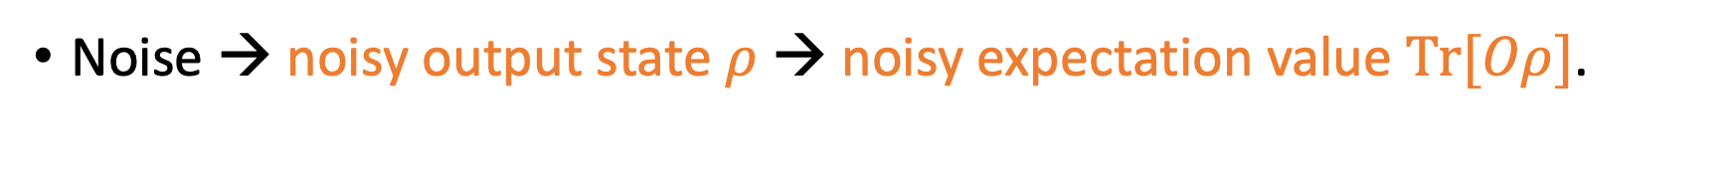
Quantum Error Mitigation (QEM)
Noise → noisy output state $ρ$ → noisy expectation value $Tr[Oρ]$.
$Tr[Oρ]$
Noisy value
$Tr[Oρ_{0}]$
Ideal value

Slide 35
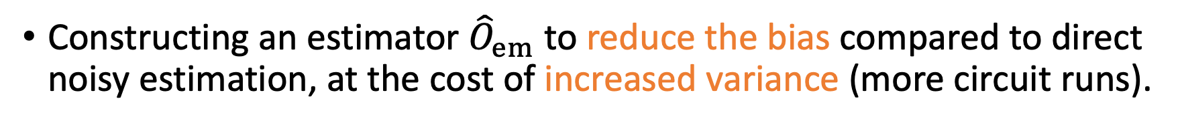
Quantum Error Mitigation (QEM)
Constructing an estimator ${\hat{O}}_{em}$ to reduce the bias compared to direct noisy estimation, at the cost of increased variance (more circuit runs).
$Tr[Oρ]$
Noisy value
$$E[{\hat{O}}_{em}]$$
$Tr[Oρ_{0}]$
Mitigated value
Ideal value

