Slide 1




Towards Scalable Quantum Simulation on Heterogenous Computing Clusters
Ali Rezaei, Dr. rer. nat.
Institute for Computing Systems Architecture, School of Informatics
University of Edinburgh
March 24, 2025

Slide 2









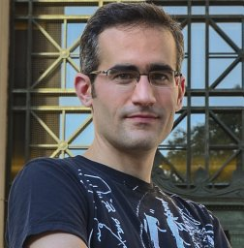
$ whoarewe
Systems Nuts Research Group
https://github.com/systems-nuts
Ali Rezaei
Antonio Barbalace (PI)
Oliver Brown
Research Associate
ICSA
Senior Lecturer in Operating Systems
ICSA
Chancellor’s Fellow
EPCC
Luo Mai
Mahesh Marina
Mike O’Boyle
Amir Shaikhha
Raul Sanchez

Slide 3
Scalable Quantum Simulation
$ goal
Maximize
Single node, Homogeneous PU > Qubits # <
> Performance <
Scalable Quantum Simulation
on Heterogenous Computing Clusters
… before Cluster, Single node
… before Heterogeneous PU, Homogeneous PU
Bottom-up approach =
low-level performance tuning, locality-aware computation
Notes:
We are speaking about quantum classical simulation
…
What is our vision AND what is our immediate goal – that is the topic of this presentation

Slide 4
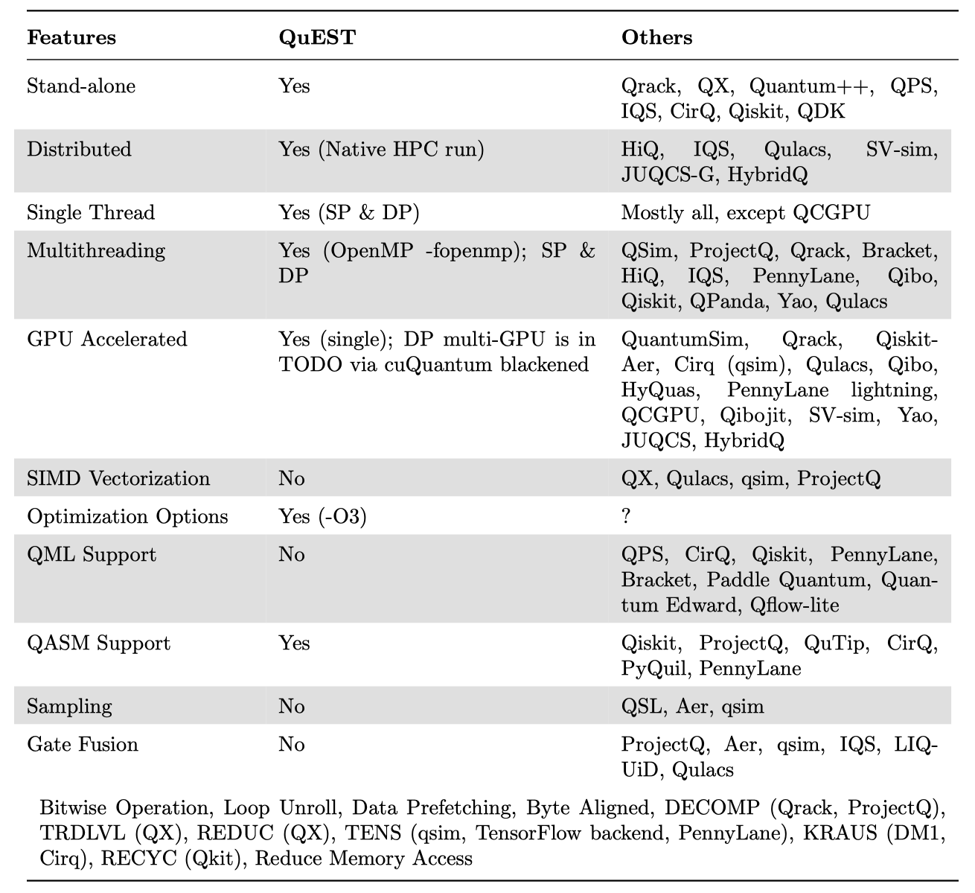

$ weuse QuEST
Quantum Simulators vs Features
Some missing features/optimizations

Slide 5
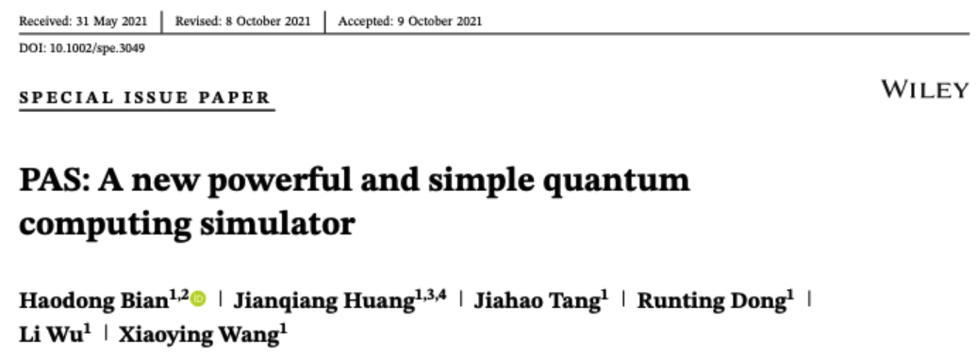
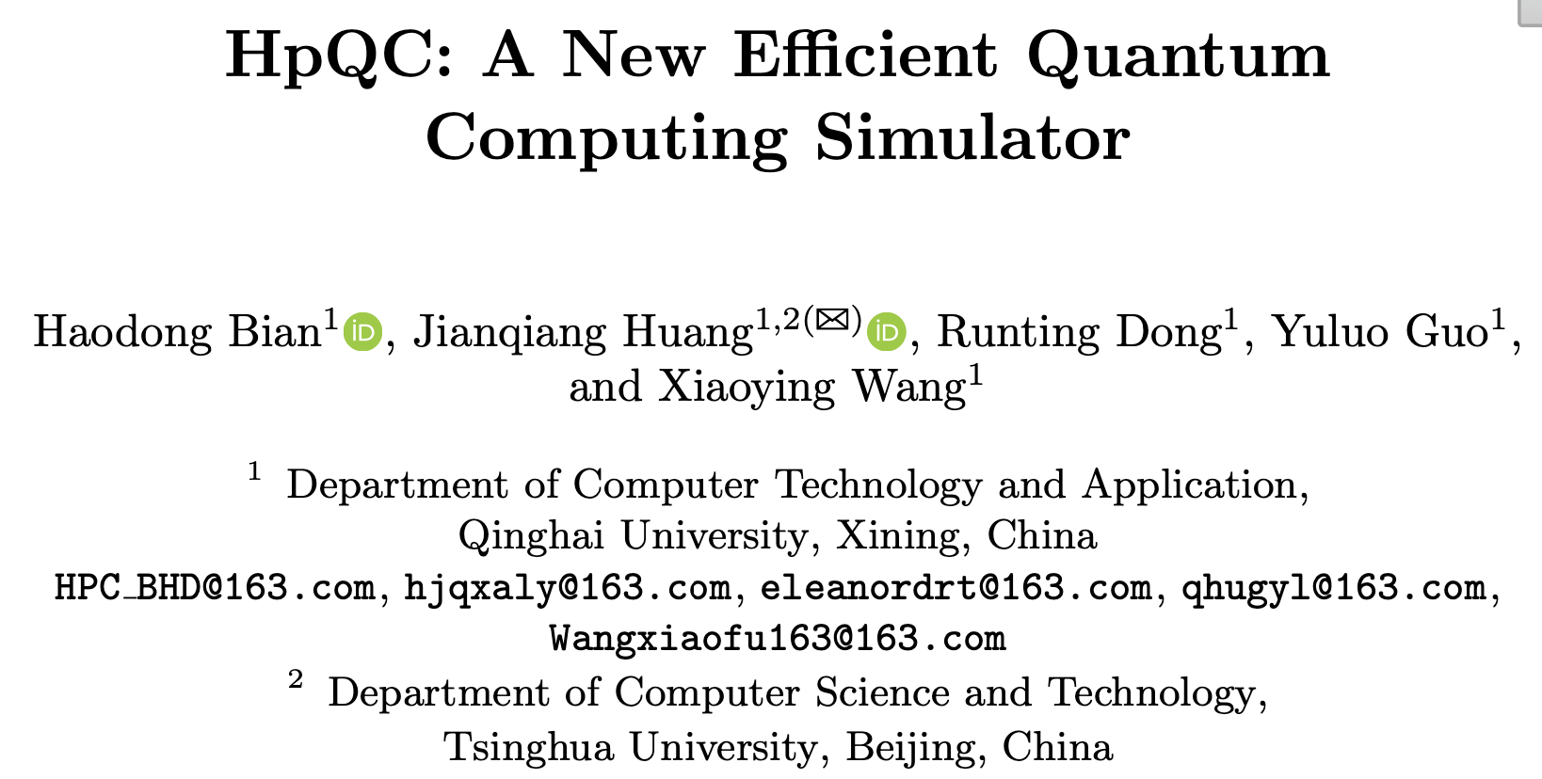
$ weare open-source
Why open-source matters?
Previous works on QuEST addressing some of the optimizations in previous slide exist:
Manual SIMD, bitwise operation, loop unroll, data prefetching, thread affinity, quantum tracking, memory access optimization, ….
QFT of 30 qubits
  Average speedup: 8.6x
AVX2 instruction sets, FMA, bit operation, new data structure, store byte alignment, data software prefetch, …
QFT of 30 qubits
  Average speedup: 2.2x
How to validate the results without access to sources?

Slide 6
Why low-level performance tuning matters?

Slide 7
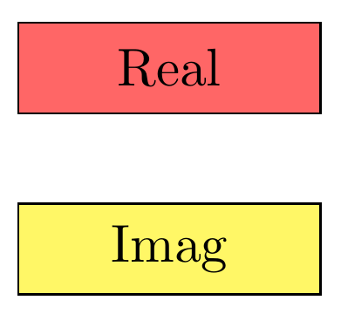
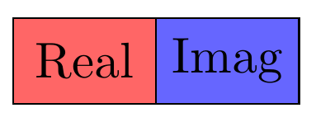
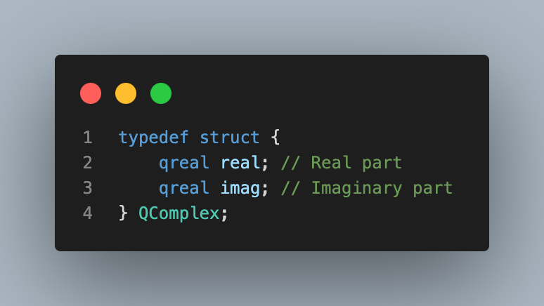
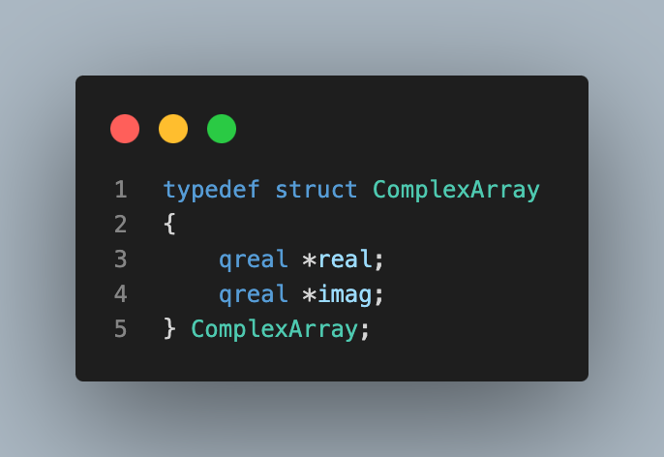
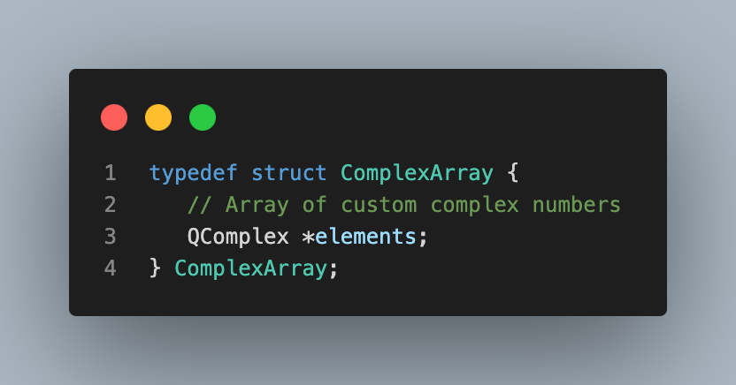
$ performance tuning
    Compiler optimizations are not exploited
      missing bitwise optimization, loop unrolling , etc.
    SIMD/vectorization in modern CPU are not exploited
      only a fraction of the code uses AVX!
QuEST: Two separate vectors each sized to hold 2^{n} elements
Array of
Array of
Pros:
    Enhanced memory locality
      Better cache utilization
    Vectorized operations
      Exploiting SIMD optimization
Compiler compatibility
  Better optimized machine code
Compatibility with existent Math libraries
  Enhances interoperability
    Reduced overhead, simple code, …
Array of

Slide 8
Maximize
Single node,
Homogeneous PU
> Qubits # <
> Performance <
$ agenda
Intro
Core-data structure
NUMA-aware allocation
Locality-aware computation
  Optimizations flow
  Validation: omp configuration
Benchmarks
  Single and two-qubit gates
  QFT
Summary
Future steps
Notes:
4 months on the project

Slide 9
Why data locality-aware computing matters?

Slide 10
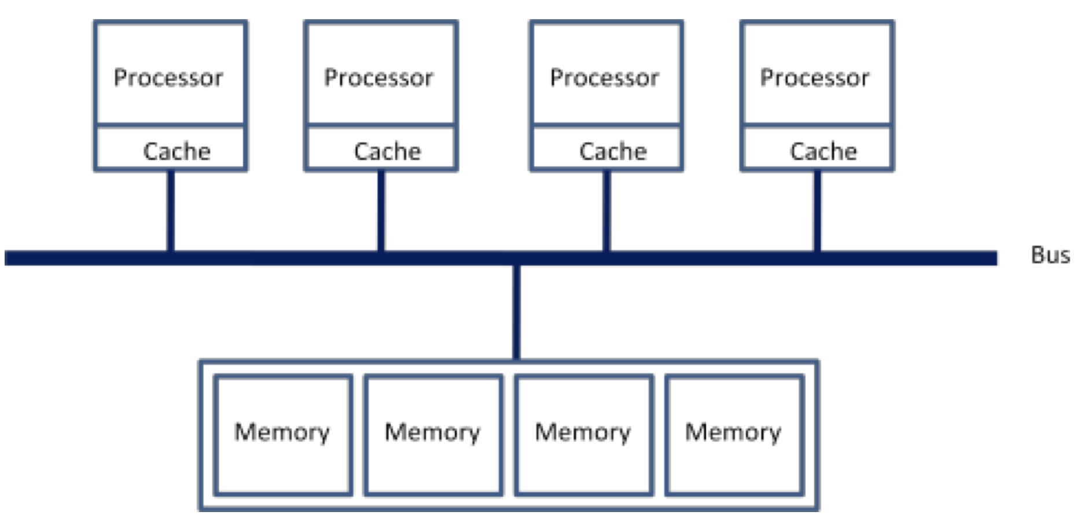
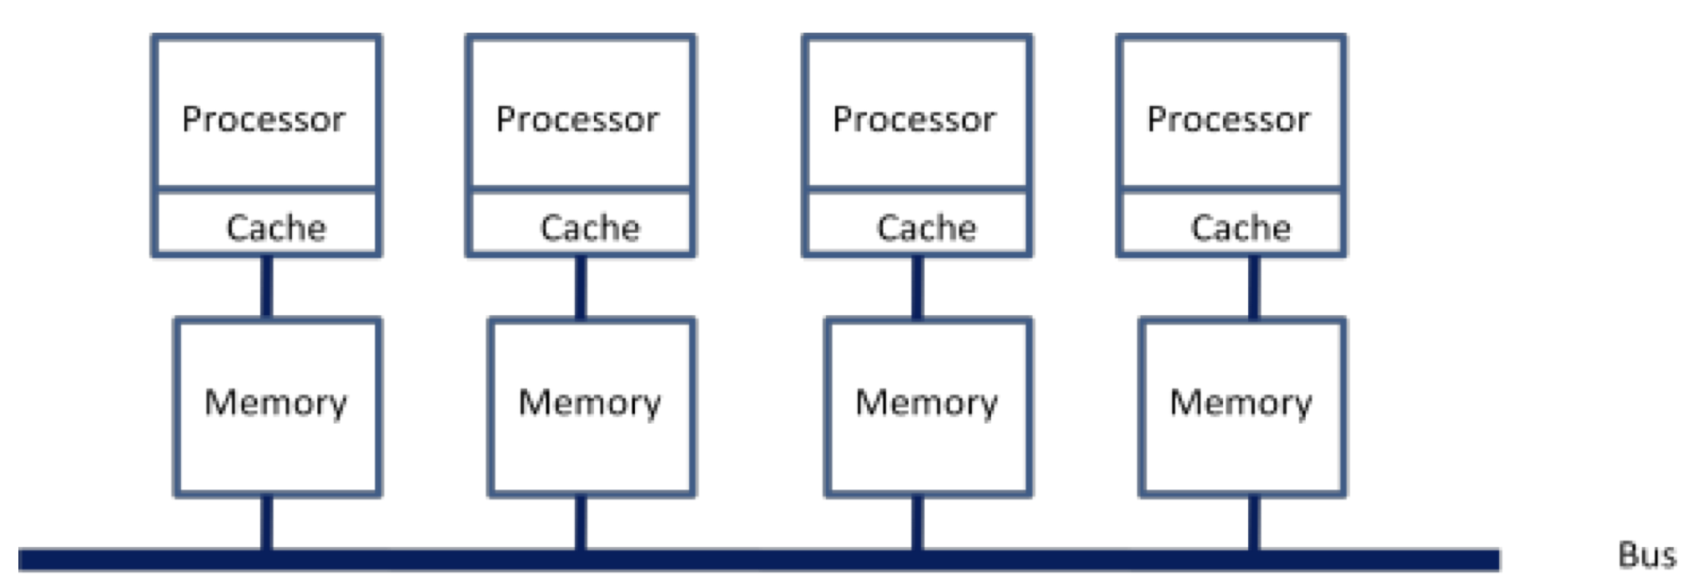
$ NUMA
Laptop/Mobile/Embedded CPU:
Workstation/Server:
Uniform memory access latency
Non-uniform memory access latency
Intel MLC:
Latency:
Local: ~100 ns, Remote: ~ 150 ns
Bandwidth:
Local: ~89 GB/s & 96 GB/s, Remote: ~ 34.5 GB/s
Each node has lower latency when accessing its own memory → faster memory operations
Each node has a higher bandwidth when dealing with its own memory → faster data transfer rates
Rewrite source code to enforce data locality

Slide 11
$ NUMA-aware allocation

Slide 12
$ optimization flow
Default (Parallel PauliY Gate)
Optimised (NUMA-aware PauliY Gate)
Divide state vector [blocks based on target qubit]
Parallelize using OpenMP
For each task:
  Indices for upper and lower states
  Pauli-Y operation:
    Swap real and imaginary parts
    Negate appropriate components
    Apply conjugation factor
    Direct manipulation of continuous array
Process amplitudes sequentially within each thread (shared memory access)
NUMA-aware threading [numa_run_on_node(id)]
Locality-sensitive scheduling: custom distribution
AVX-512 vectorization: __m512d for 512-bit vector [8 DP Ops]
Process state vector in larger chunks – outer loop for blocks, inner loop for X-amplitude chunks [X at a time]
Key optimizations:
  Prefetching: improved cache utilization [_mm_prefetch() for L1 cache, X elements ahead]
  SIMD instructions: parallel computations [_mm512_load_pd(), _mm512_store_pd()]
  Mask-based conditional processing: non-zero amplitudes [_mmask8 check]
  FMA: efficient a*b+c Ops [_mm512_fmadd_pd()]
  Permutations: separate real and imaginary parts [_mm512_permute_pd()]
Scalar fallback & #pragma omp simd for remaining amplitudes
New DS + NUMA-aware allocation + Advanced features:
NUMA binding: better memory access
Manual scheduling: improving spatial and temporal locality
AVX-512: processing 8 DP values simultaneously
FMA: combining multiplication and addition
Prefetching: reducing cache misses
Conditional execution: avoiding unnecessary computations on zero amplitudes
Chunk processing: improving cache-utilization & instruction-level parallelism
CPU features (AVX512, FMA) | memory optimization (NUMA, prefetching) | parallel programming

Slide 13
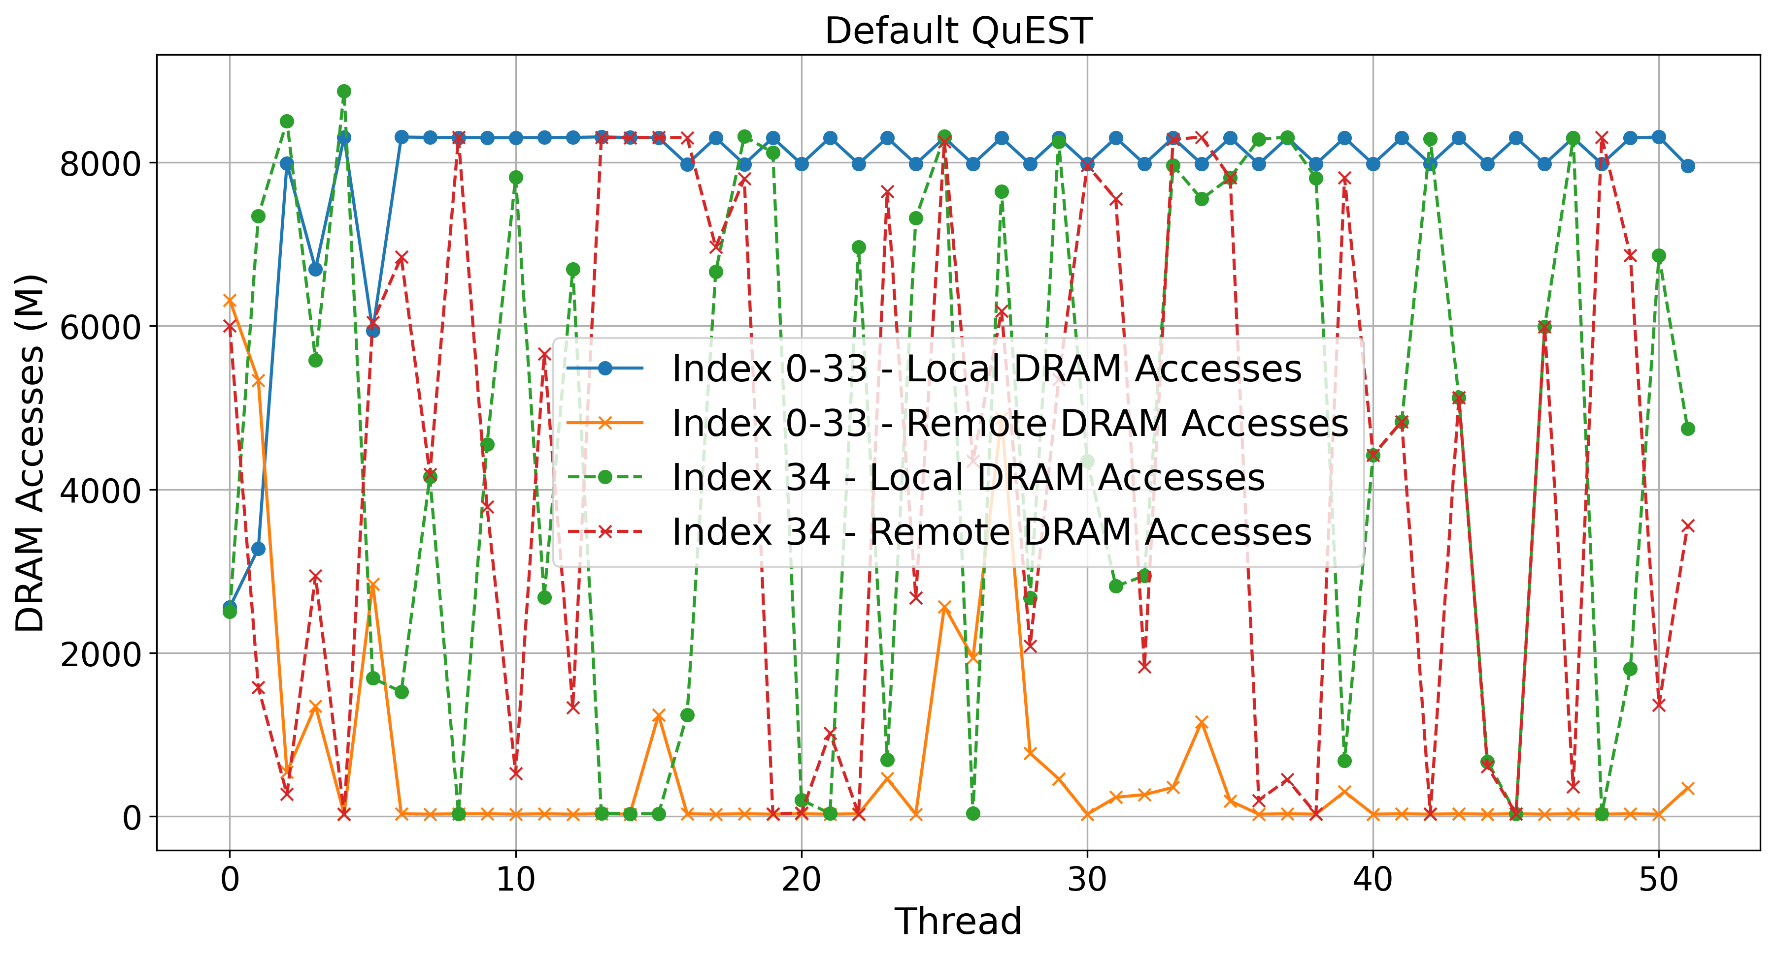
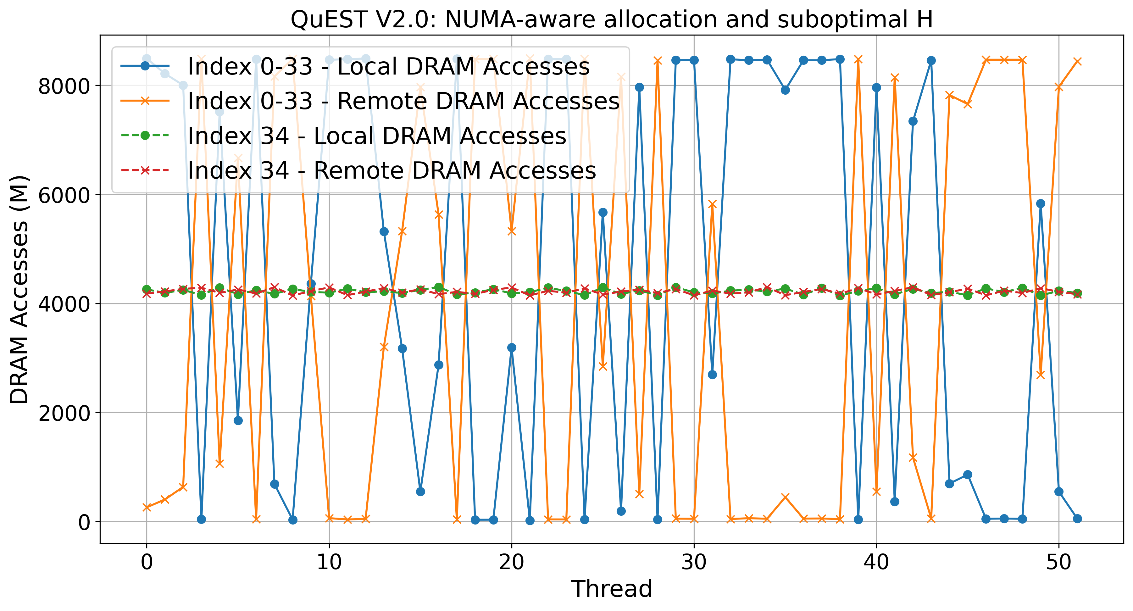
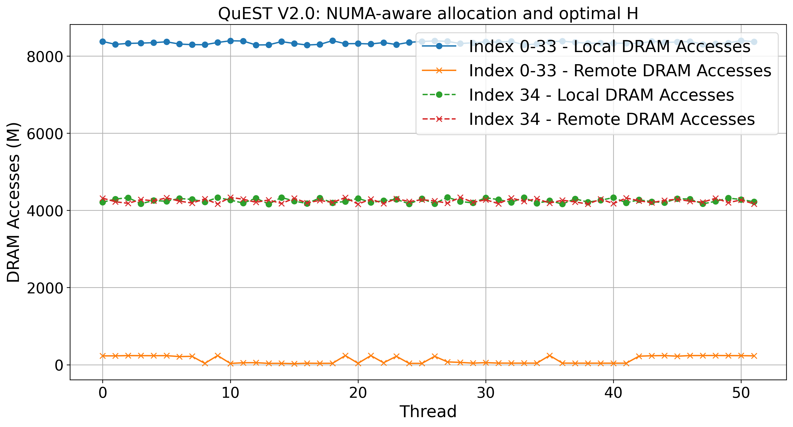
$ NUMA-aware “Locality-sensitive” Scheduling (Hadamard)
Intel PCM-NUMA: local and remote memory accesses in millions ops
Validation
QuEST: Default
The least optimized memory allocation with very high remote DRAM accesses.
1
1
1
1
QuEST: NUMA-aware alloc.:
Performs better than Default QuEST
Indicating the need for optimized NUMA-aware scheduling.
1
QuEST: NUMA-aware alloc. & scheduler:
Clearly shows better performance in terms of local memory access
  Local DRAM Accesses: lower latency and higher bandwidth → faster
  Remote DRAM Accesses: data must travel across interconnect between NUMA nodes → additional latency
1

Slide 14
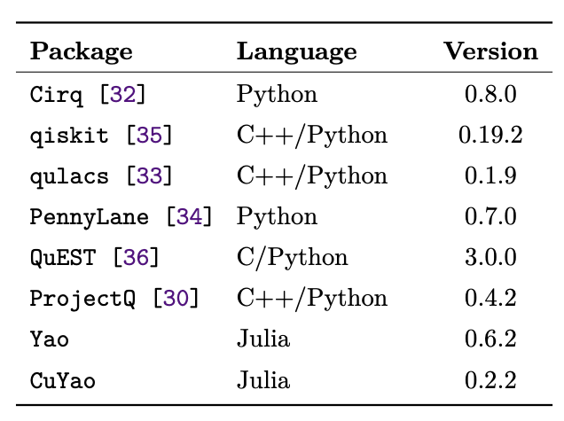
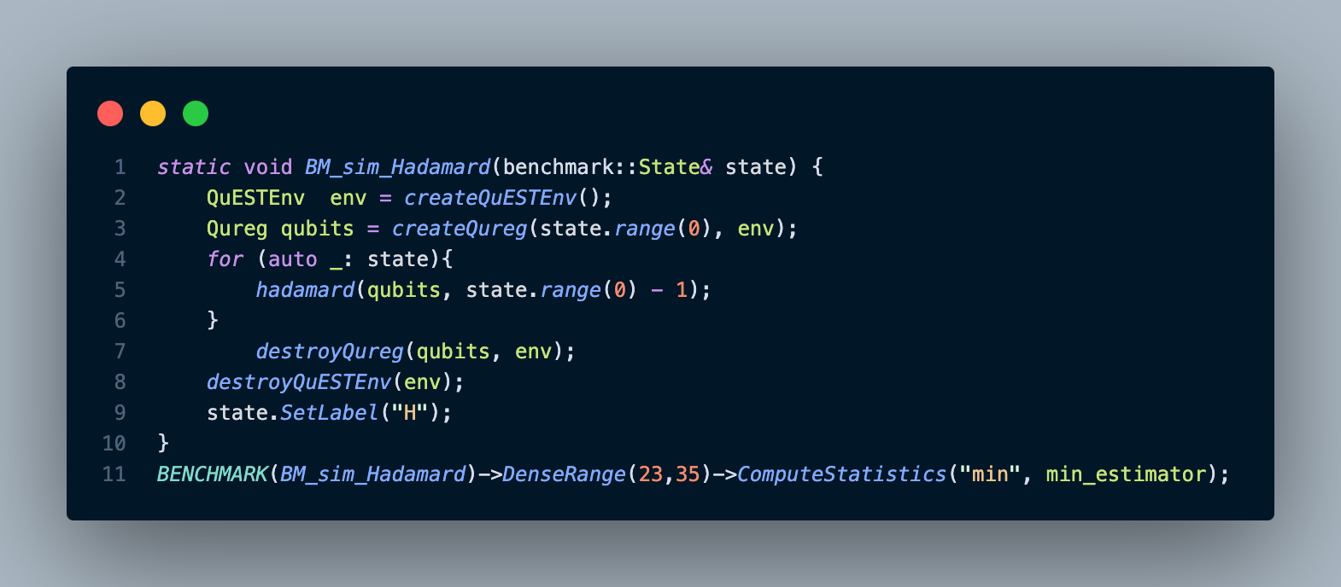
$ benchmark
https://github.com/yardstiq/quantum-benchmarks/tree/master/quest | Yao.jl repo

Slide 15
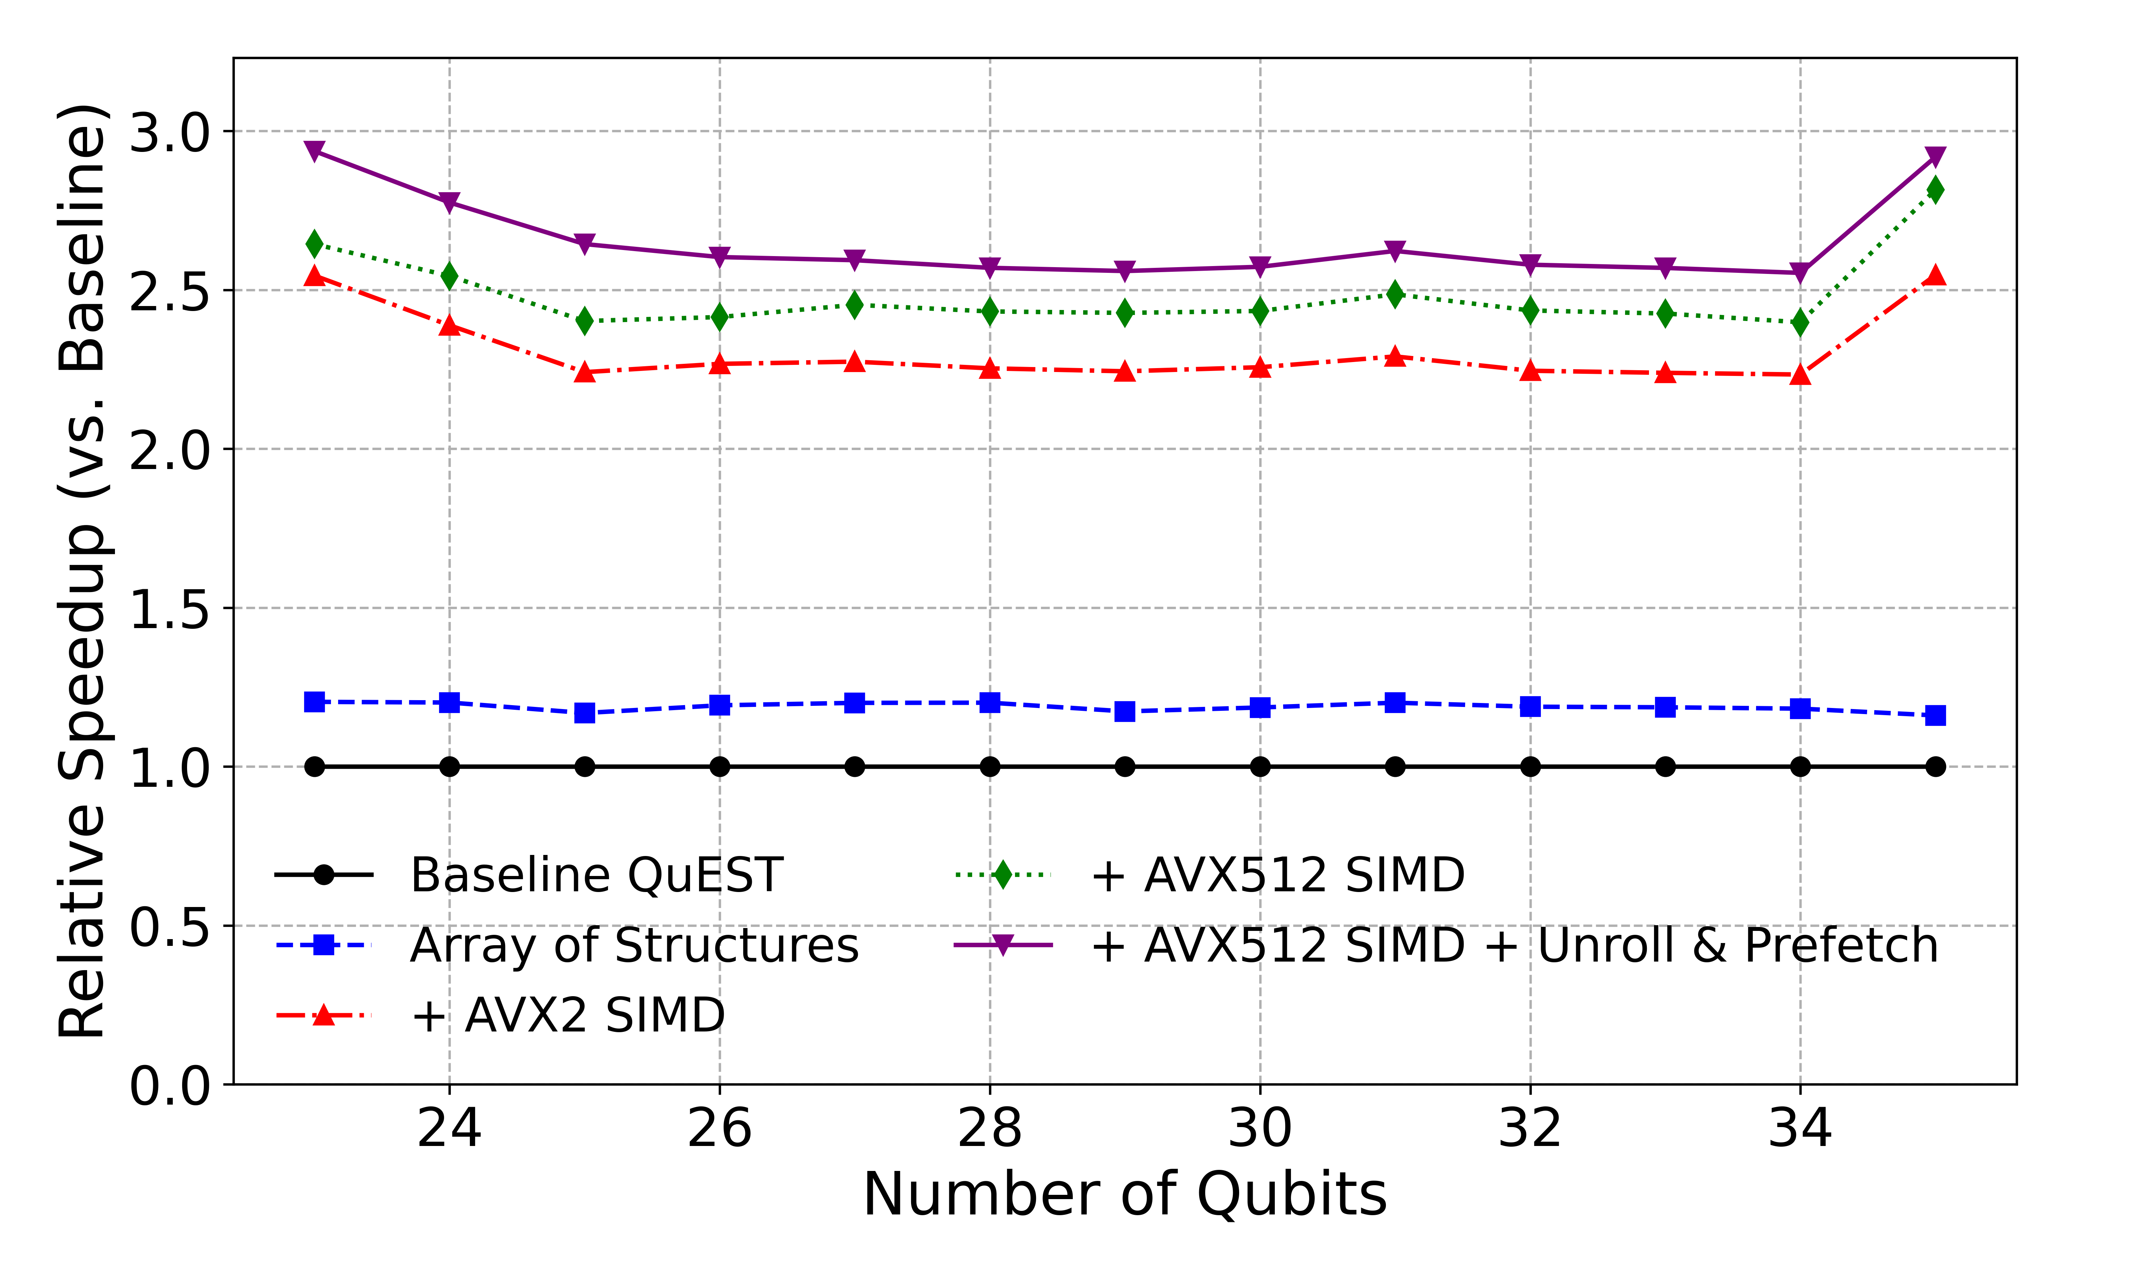
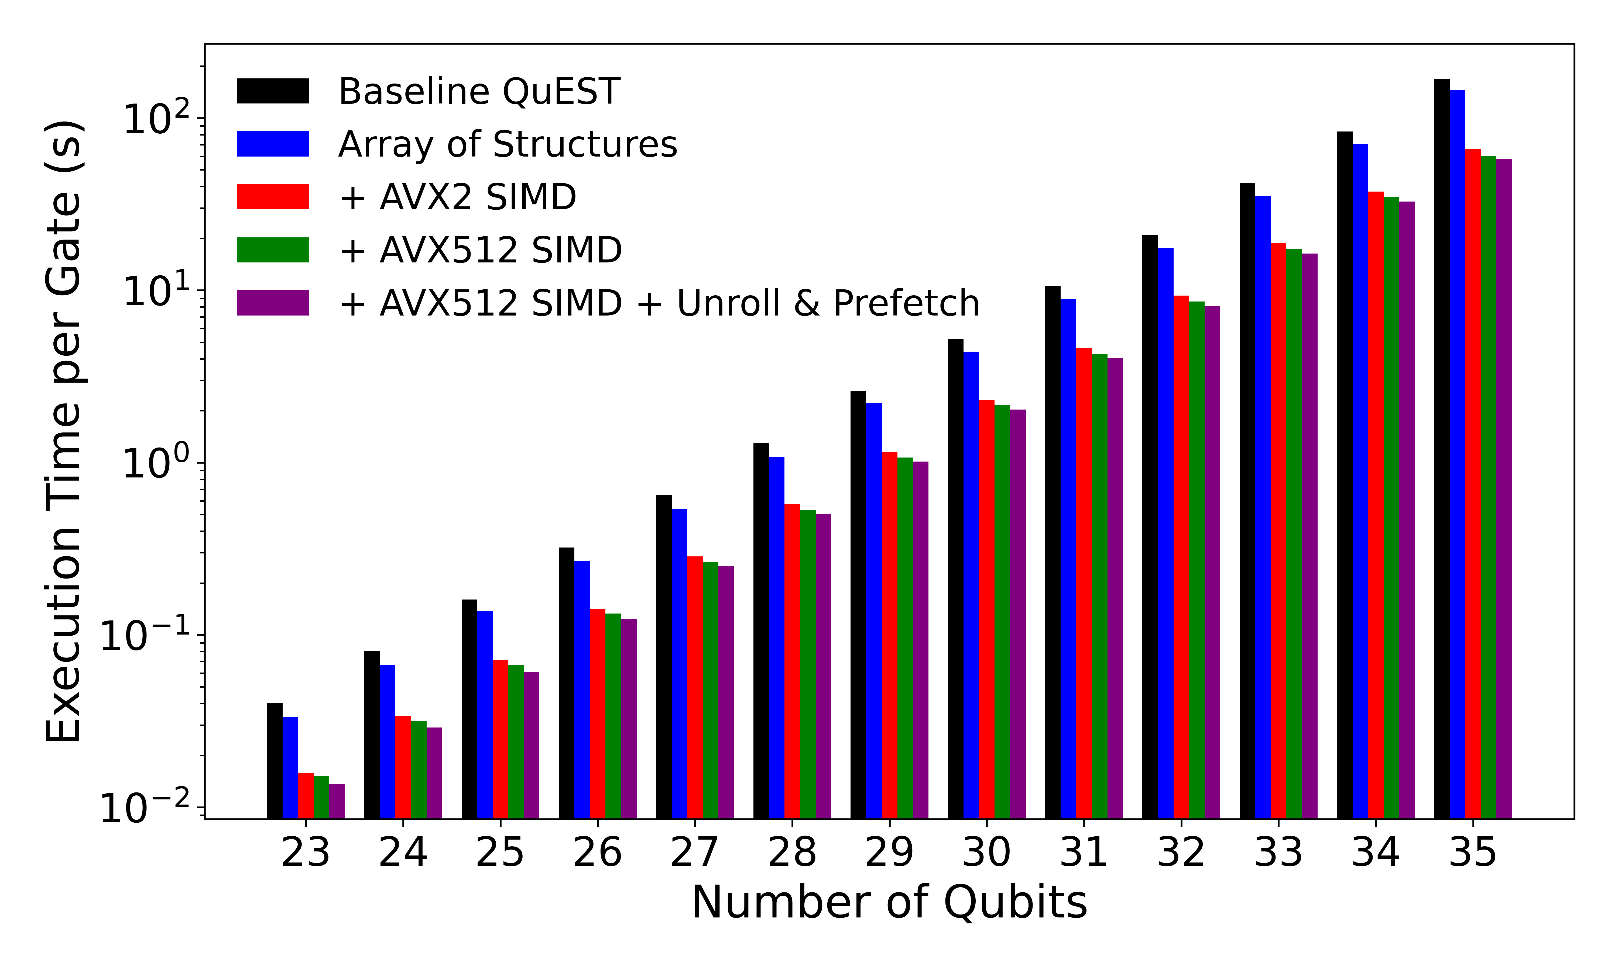
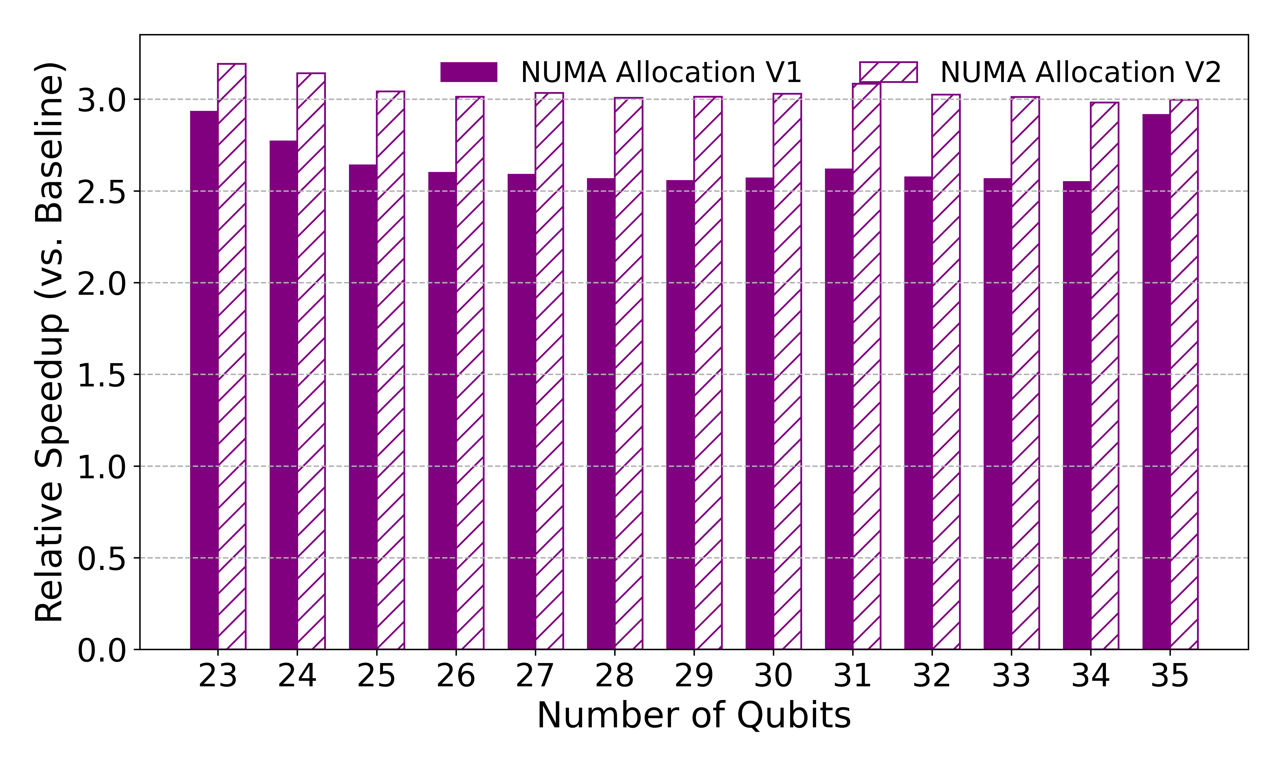
Hadamard
$ results
Hadamard gate is applied to the last qubit of the register [from size 23 to 35 qubits]

Slide 16
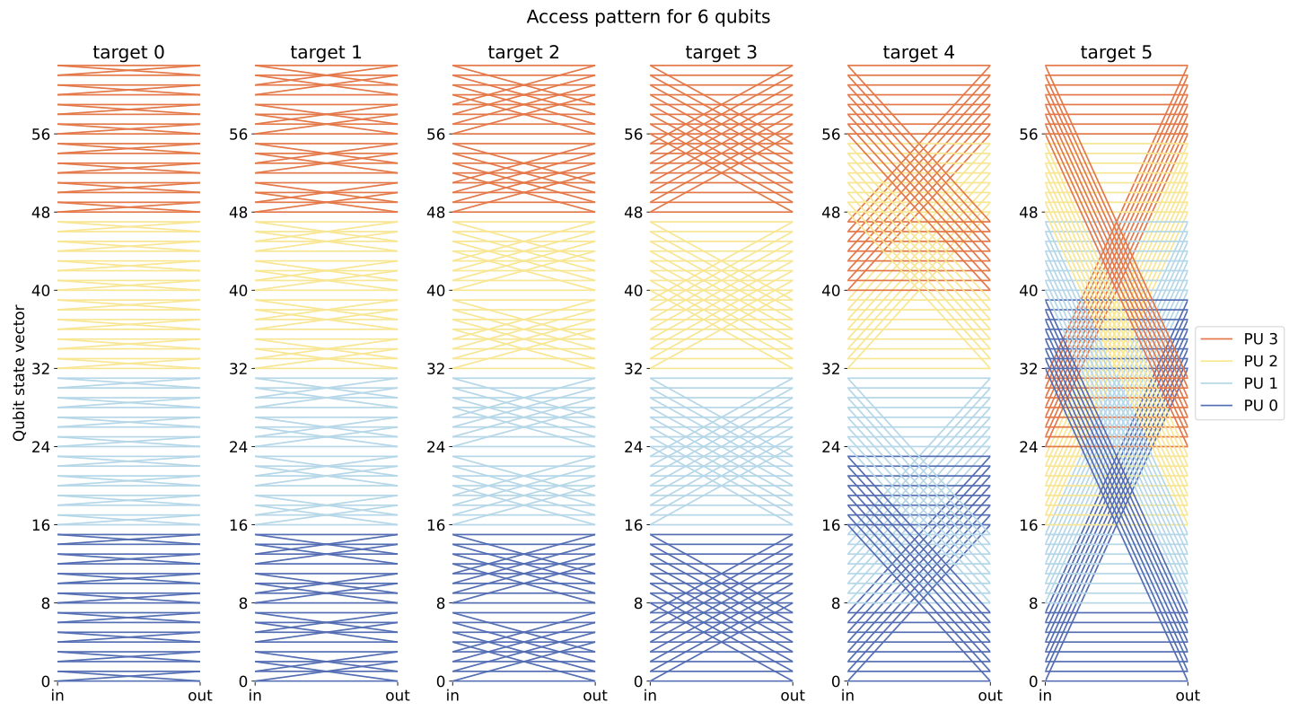
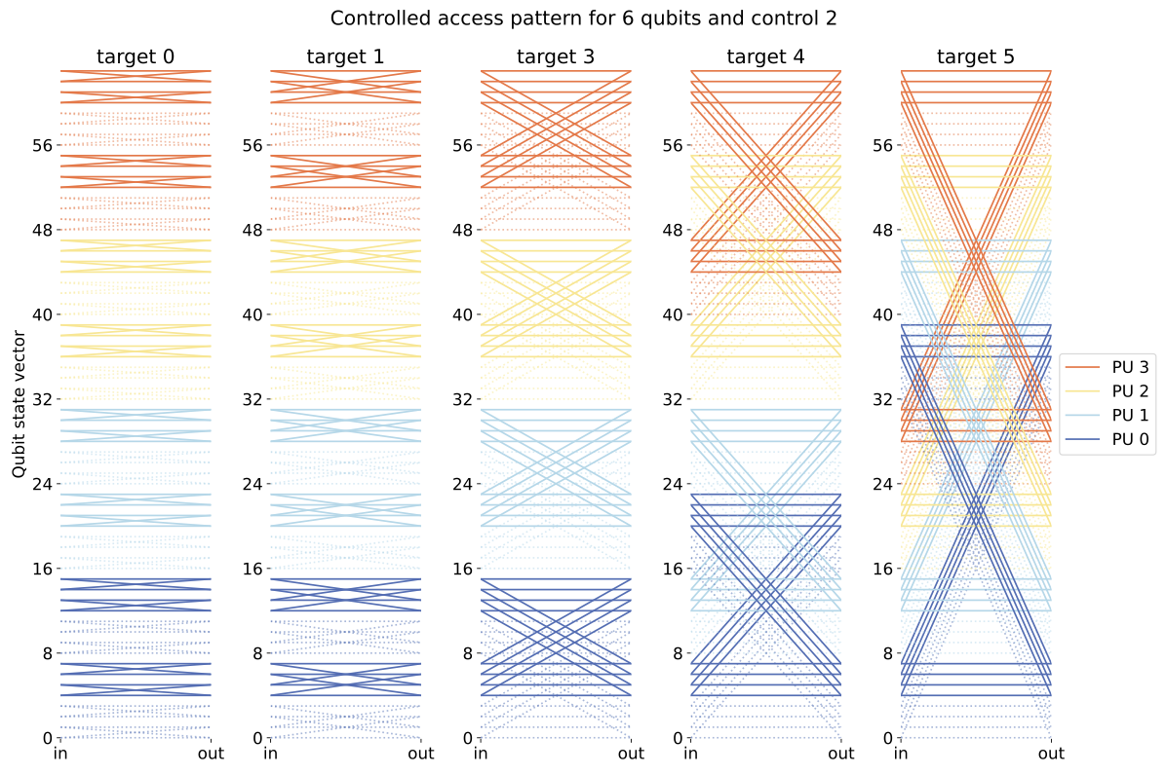
$ access pattern
Permutes every amp in the SV
More regular/contiguous access
Full advantage of SIMD and better cache usage
Toggles only half at a time (control bit is 1); solid vs. dashed lines (no-op)
Split between active and inactive amps → extra branching & index-checking overhead
Less effective SIMD and cache locality

Slide 17
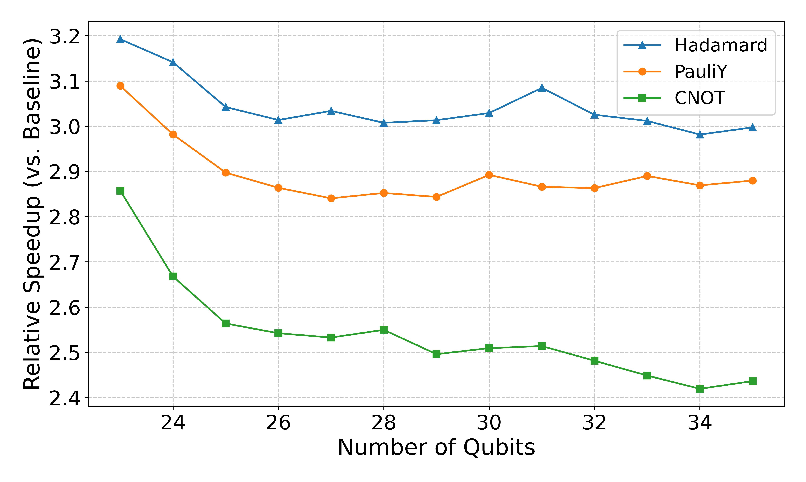
$ results
SIMD: 3x for H, 2.9x for Y, 2.5x for CNOT
How they access and reorder amps
Memory-access pattern doesn’t change drastically with system size
Single-qubit:
  Relatively uniform (contiguous) pattern
  Full advantage of SIMD and better cache usage
Two-qubit:
  More complex index-reordering (mapping)
  Conditionally toggles target amps based on a control qubit
  Less effective SIMD and cache locality

Slide 18
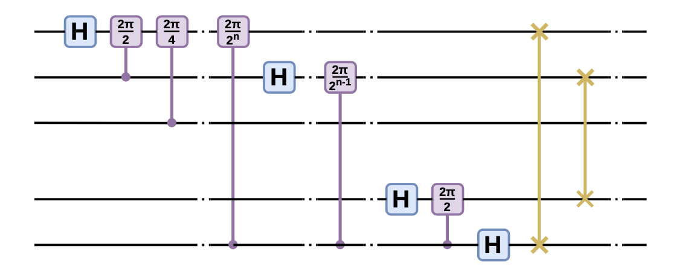
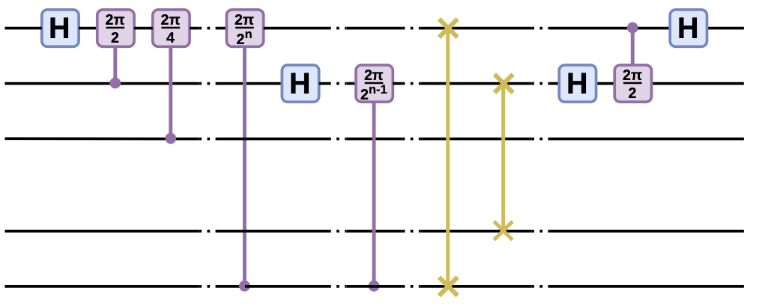
QFT
$ results
Yao/Qiskit QFT (Recursive):
Closely mirrors the mathematical definition but may incur overhead due to recursive function calls.
Standard Iterative:
Reverses the qubit order and performs rotations via nested loops.
Eliminates recursive overhead; performance hinges on loop efficiency and memory access.
QuEST Built-in:
Highly optimized for general use, though less flexible for custom modifications.
Cache-blocked:
Transformation → two partial QFTs (first on an upper block, then on the remaining qubits after a swap).
Improves cache locality & reduces cache misses.

Slide 19
QFT
$ results
All versions are mathematically equivalent
Differences in coding style, memory accesses, and control structures
  → distinct performance outcomes
low-level optimizations are important!

Slide 20
$ summary
  Low-level performance tuning and locality aware
    Speedup on a dual-CPU_socket machine
    Hadamard/PauliY/CNOT: 2.5-3x in execution time
    Built-in QFT: 1.25x in execution time
  Applies to different CPU/platform models
    What about GPU?
Lesson learned
  Locality matters
  CPU is memory bandwidth limited
    Compress floats in memory, gate fusion (data re-use), …
    … high-core count CPUs are not needed …
  SIMD/vectorization improvements are gate and qubit dependent
    Consider a hybrid/dynamic approach
      Switching compiler/runtime

Slide 21
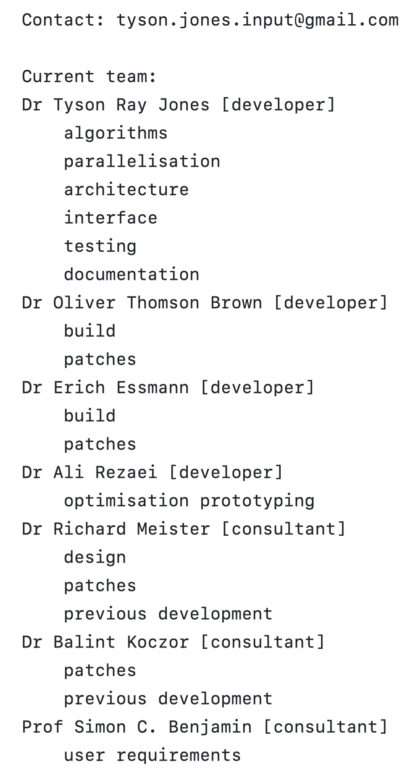
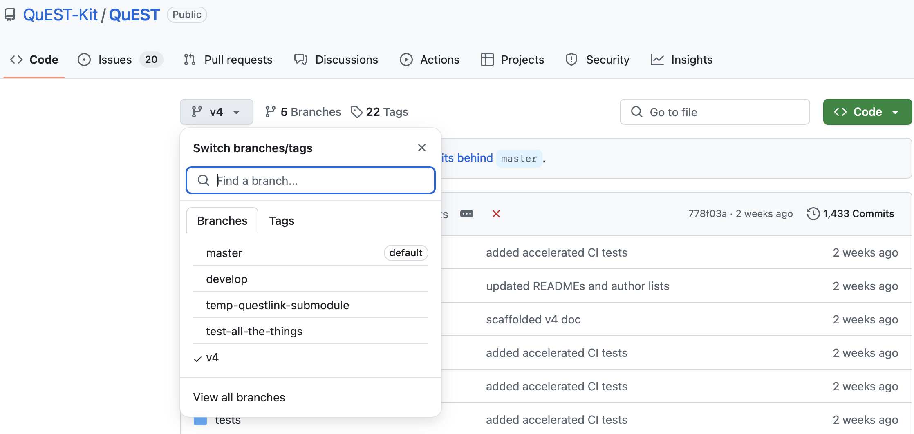

Slide 22
$ near future steps
Target: maximize execution performance (on single node)
Continue current work
  Locality-aware execution and perf tuning
    Supporting other architectures and multi-NUMA [Quad-CPU_socket and Octa-CPU_socket]
  Perf tuning
    Automatic code generation (SIMD, AVX, etc.)
    Automatic prefetch instructions placement
Transfer what we learned to the community
  Locality-aware execution
    Develop a locality-aware version of OpenMP (OMP, which is a standard)
  Perf tuning and locality-aware
    Code integration in mainline QuEST
Extend what we learned to accelerators (GPU and ?)
  Single and multiple GPUs on single node
    Analytical model of data transfers
  NVIDIA NVLink and UVM
    Extend our findings from NUMA CPUs to NUMA GPUs
  Single and multiple FPGAs on single node (new)
    Extend our findings from NUMA CPUs to NUMA FPGAs

Slide 23
$ future research next
Target: maximize qubit count
42 qubits on a single node (double precision)
  Exploit new hardware, develop new runtime
    Fast storage/peripheral-interconnect
      64TB = 16x 4TB PCIe 5.0 SSDs (NVMe), cost ~13kGBP (vs DRAM cost ~250kGBP)
    Tiered memory RAM/PMEM
      CXL extended memory (PCIe-connected), matches traditional RAM cost (128GB/1,500GBP)
    HW/SW memory compression
      In-CPU accelerated, implemented in major OSes
52 qubits in the cluster (with 1024 nodes)
  Exploit multiple machines linked with state-of-the-art interconnect
    MPI/RDMA
    MPI/RDMA and multi-GPUs
      Integrate fast storage/peripheral, tiered memory, compression with MPI/RDMA first, with multi-GPU second
    CXL shared memory
      Disregard MPI/RDMA, rack-level or cluster-level (cc) shared memory (no explicit data transfers)
>52 qubits
  Rethink the algorithm (new hardware and software cannot help further)
    Circuit knitting/cutting

Slide 24

Thanks! Questions?
arezaei@ed.ac.uk
abarbala@ed.ac.uk
o.brown@epcc.ed.ac.uk

Slide 25
Backup Slides

Slide 26
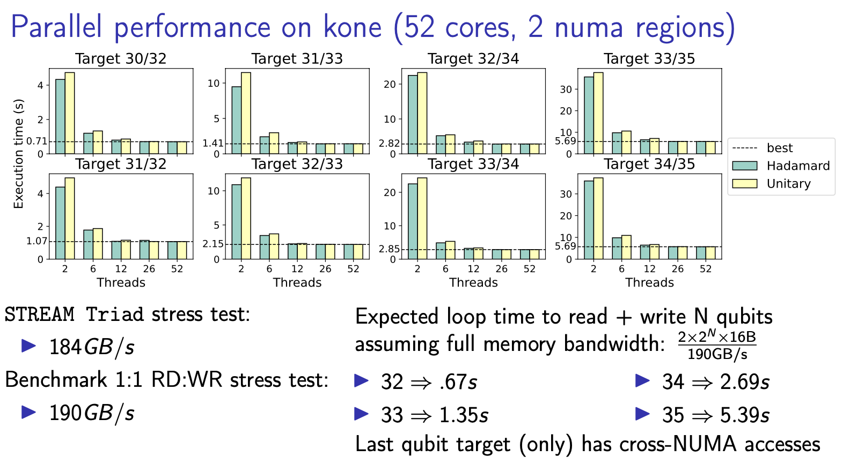
Notes:
how gate execution time scales with the number of threads on a multi‐NUMA system for high‐index qubits. They highlight memory bandwidth constraints (evidenced by comparisons to the STREAM Triad test) and the impact of cross‐NUMA data accesses for gates acting on qubits that reindex large contiguous blocks of the state vector.
In an n-qubit system, each qubit is labeled from 0 (least significant) to n−1 (most significant).
Low‐Index Target (e.g., qubit 0): Toggles or permutes amplitudes in small, interleaved blocks.
High‐Index Target (e.g., qubit 34): Rearranges large contiguous chunks of the amplitude array, often leading to more extensive memory traffic.
Performance Impact:
Because the “target” determines how amplitudes are accessed in memory, gates acting on higher‐index qubits can incur more cache misses and cross‐NUMA accesses, slowing down execution on large, multi‐NUMA systems.
Why It Matters:
These plots show that which qubit you operate on can significantly affect runtime when simulating large quantum states. By examining different targets, we see how memory‐access patterns shape parallel efficiency and overall performance.

Slide 27
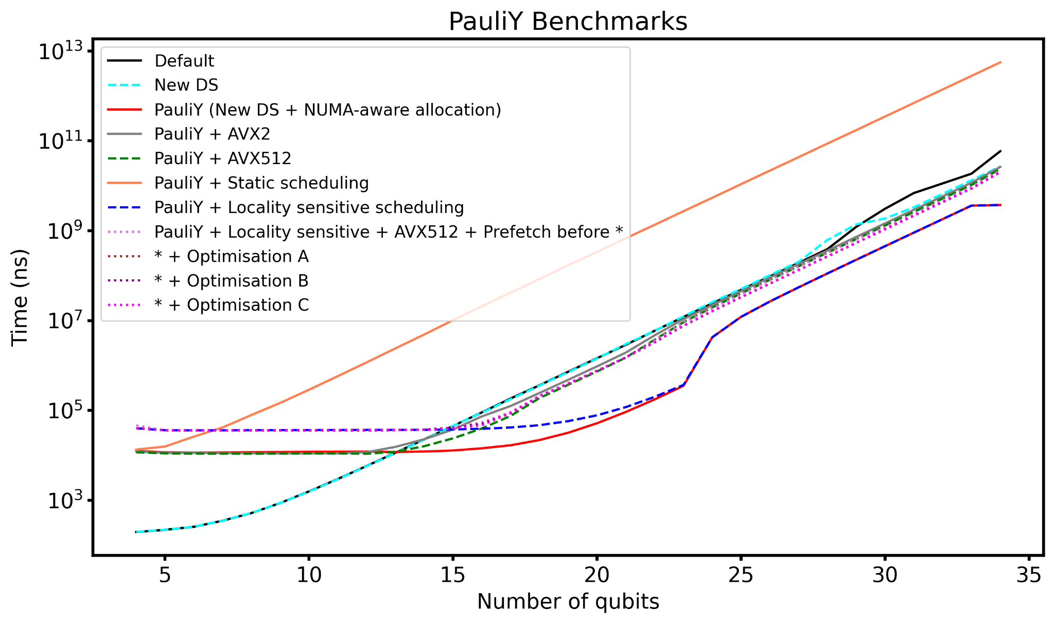
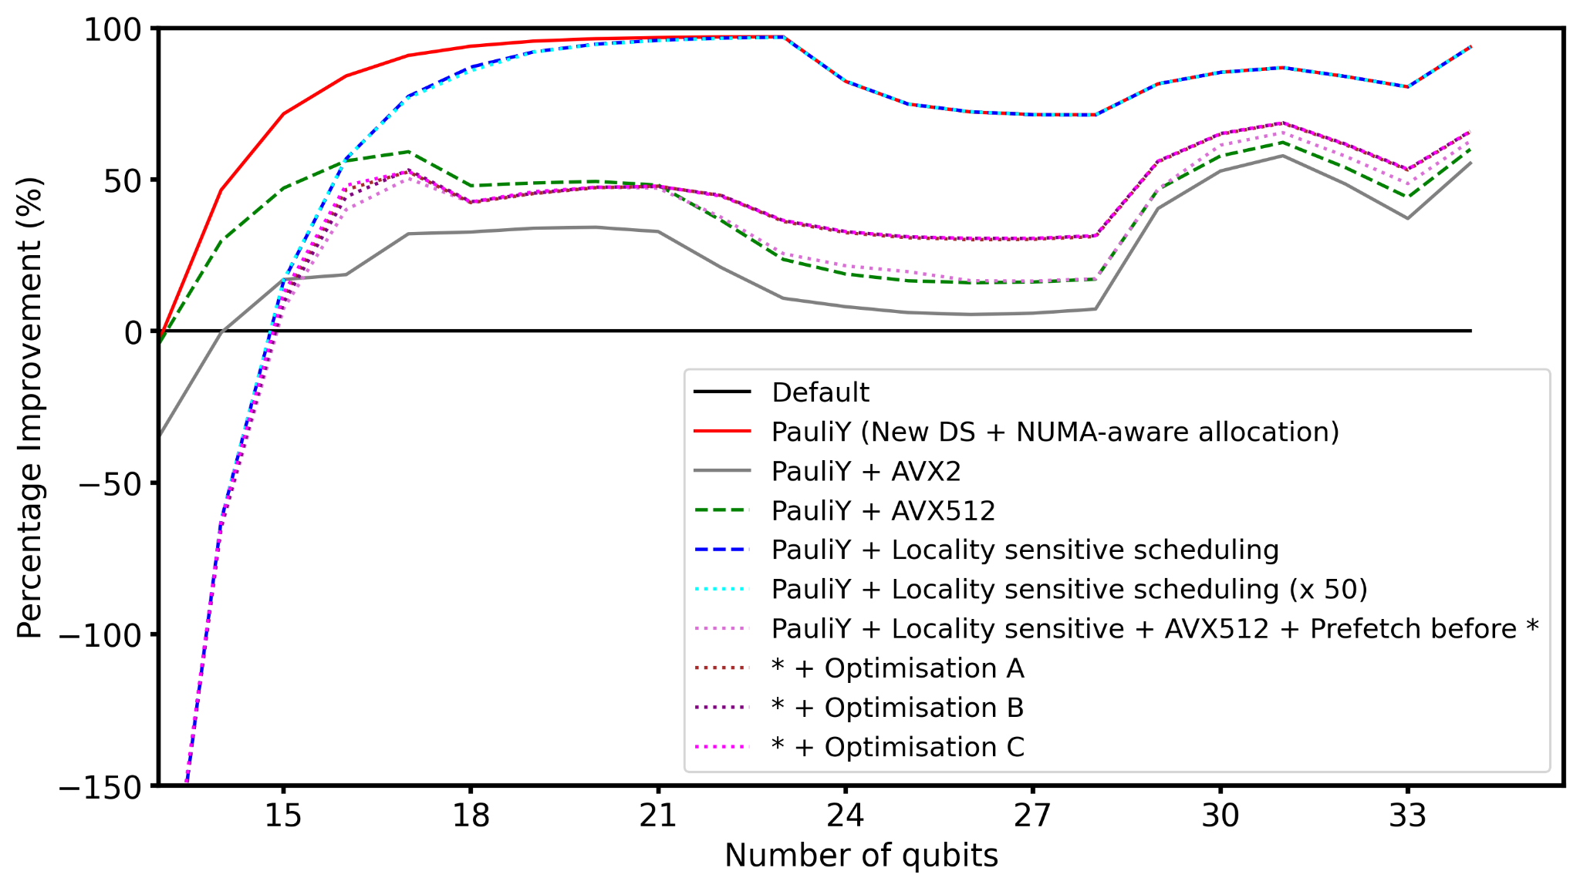
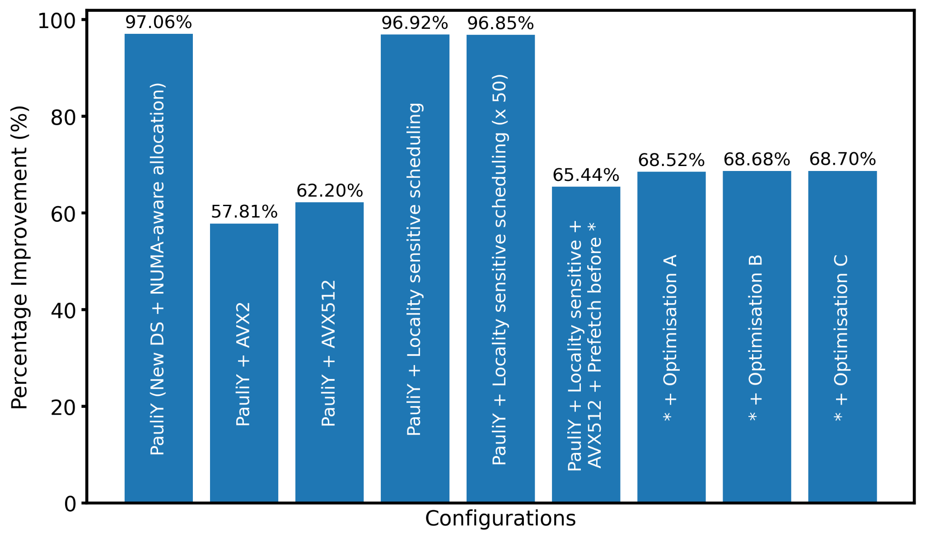
PauliY
$ results
Y gate is applied to the last qubit of the register [from size 4 to 34 qubits]
x50: repetition of 50 times
Optimisations:
- mm512_load_pd/mm512_store_pd (vs loadu/storeu) | _mm512_shuffle_pd (vs permute) | prefetch before (vs after) load | _MM_HINT_T0 (vs T1 & NTA), … | FMA | manual, guided, static scheduling, …
A: Fused Multiply-Add (FMA) + loop unrolling by a factor of 4 + bitwise Ops + #pragma omp simd + stream vs store + prefetch distance = 128
B: Non-zero checks
C: loop unrolling by a factor of 8 + guided OpenMP scheduling
https://github.com/yardstiq/quantum-benchmarks/tree/master/quest | Yao.jl repo

Slide 28
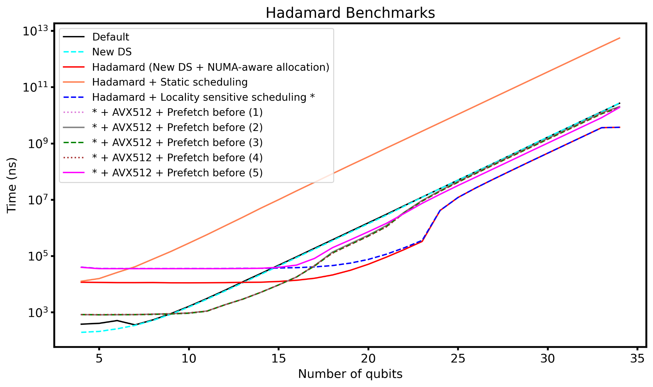
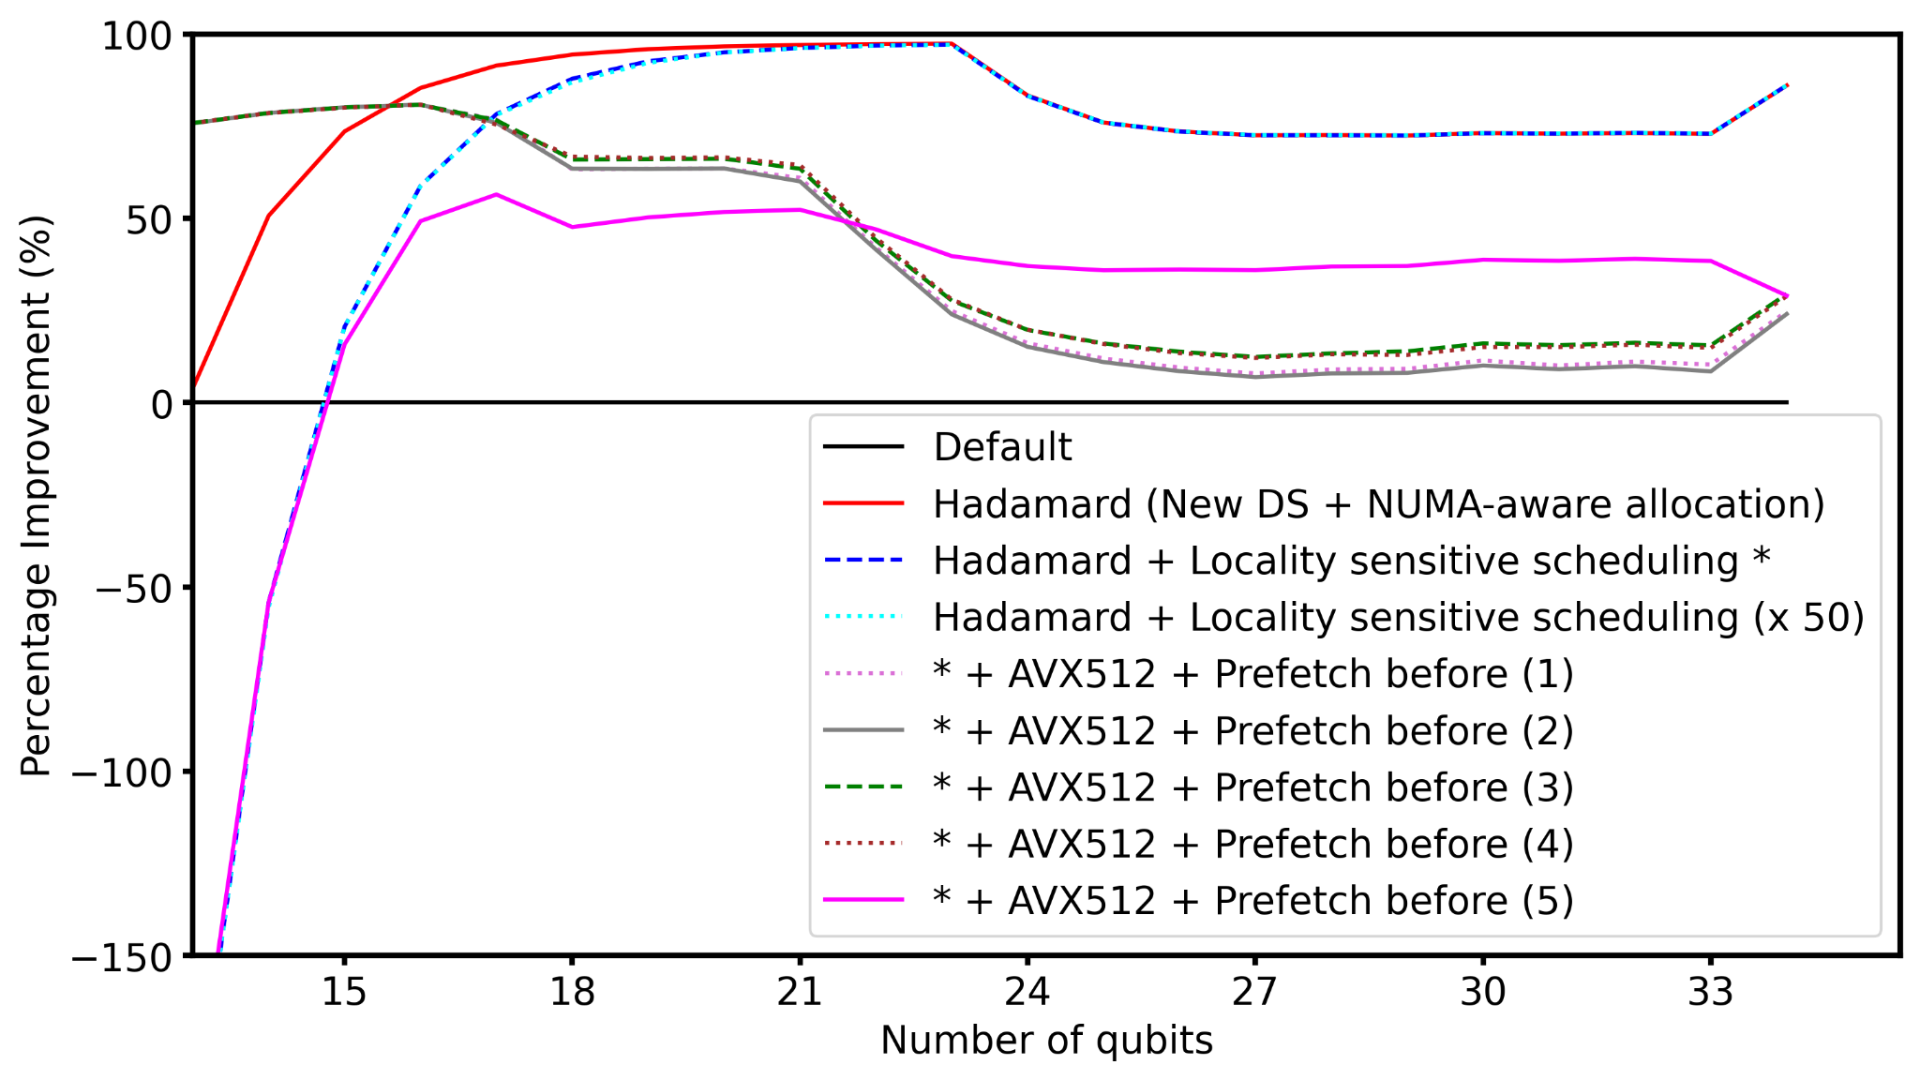
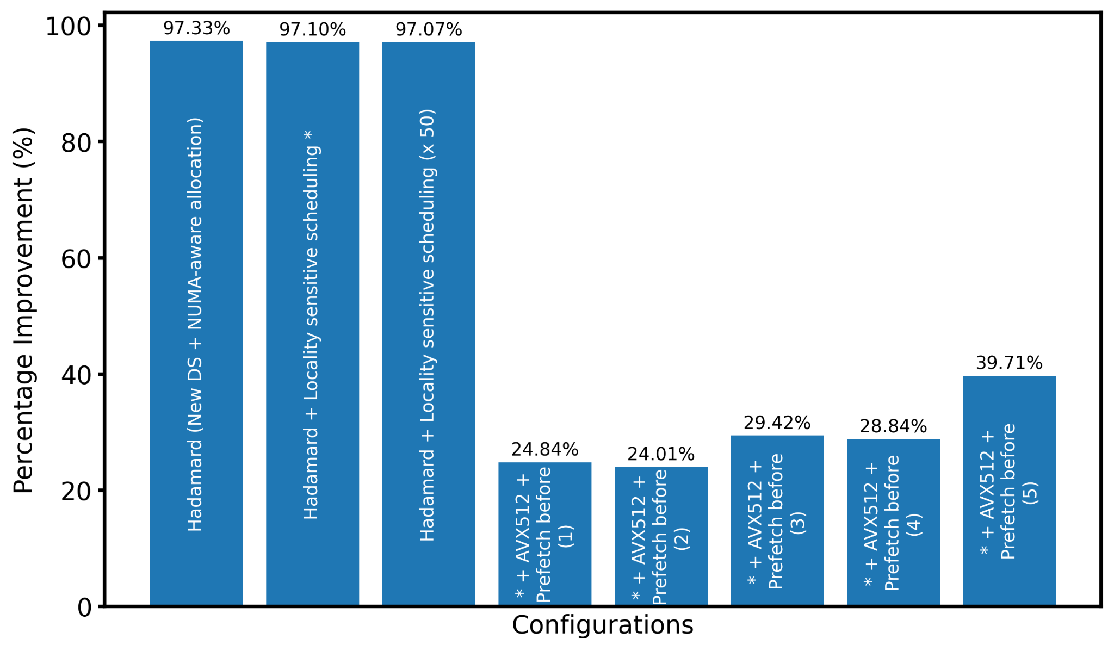
Hadamard
$ results
H gate is applied to the last qubit of the register [from size 4 to 34 qubits]
x50: repetition of 50 times
Optimisations:
- mm512_load_pd/mm512_store_pd (vs loadu/storeu) | _mm512_shuffle_pd (vs permute) | prefetch before (vs after) load | _MM_HINT_T0 (vs T1 & NTA), … | FMA | manual, guided, static scheduling, …
1 - march=native & flags like -ffast-math, -funroll-loops, …
2 - march=native only
3 - march=native & -mavx512f & flags like -ffast-math, -funroll-loops, …
4 - march=native & -mavx512f only
5 - FMA Ops + loop Unrolling by a factor of X + Bitwise Ops + #pragma omp simd to remaining elements
https://github.com/yardstiq/quantum-benchmarks/tree/master/quest | Yao.jl repo

Slide 29
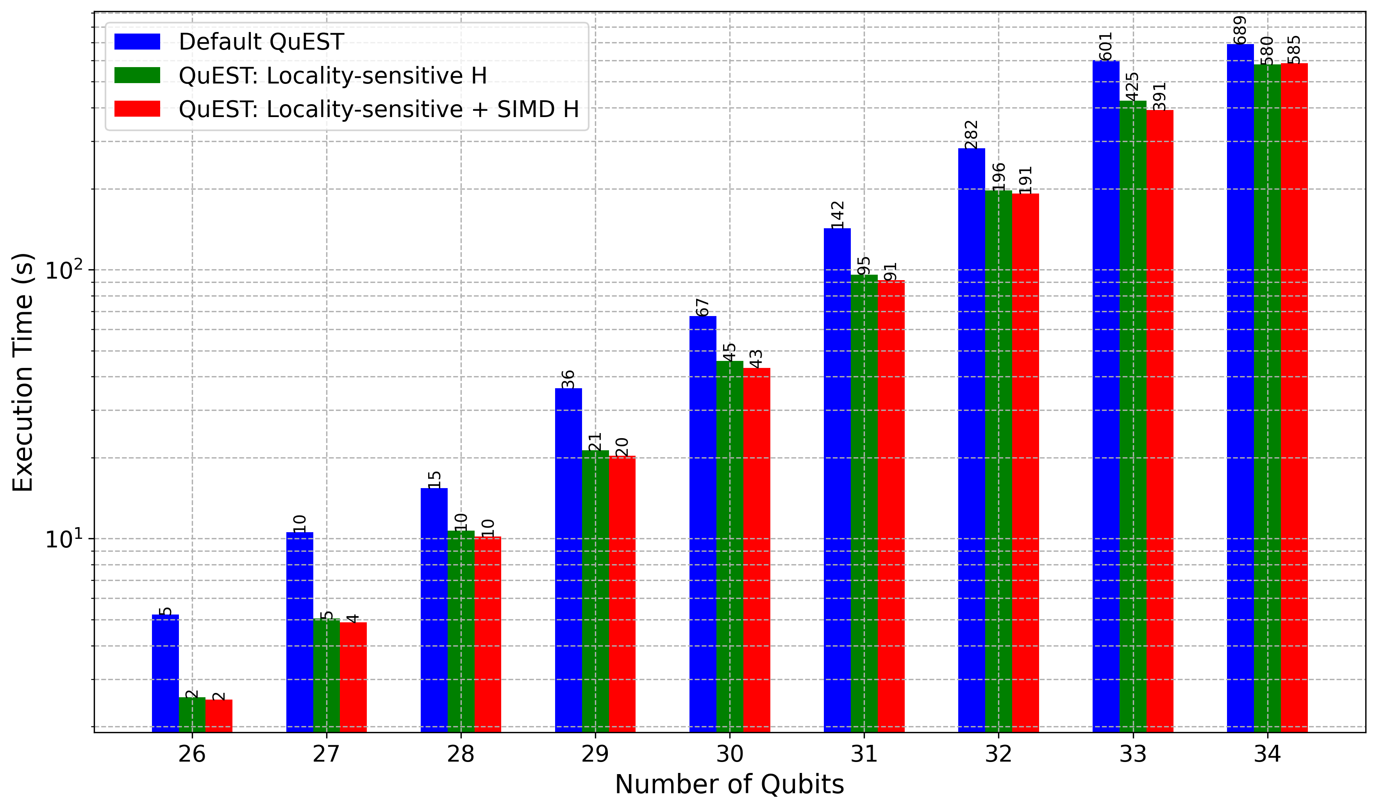
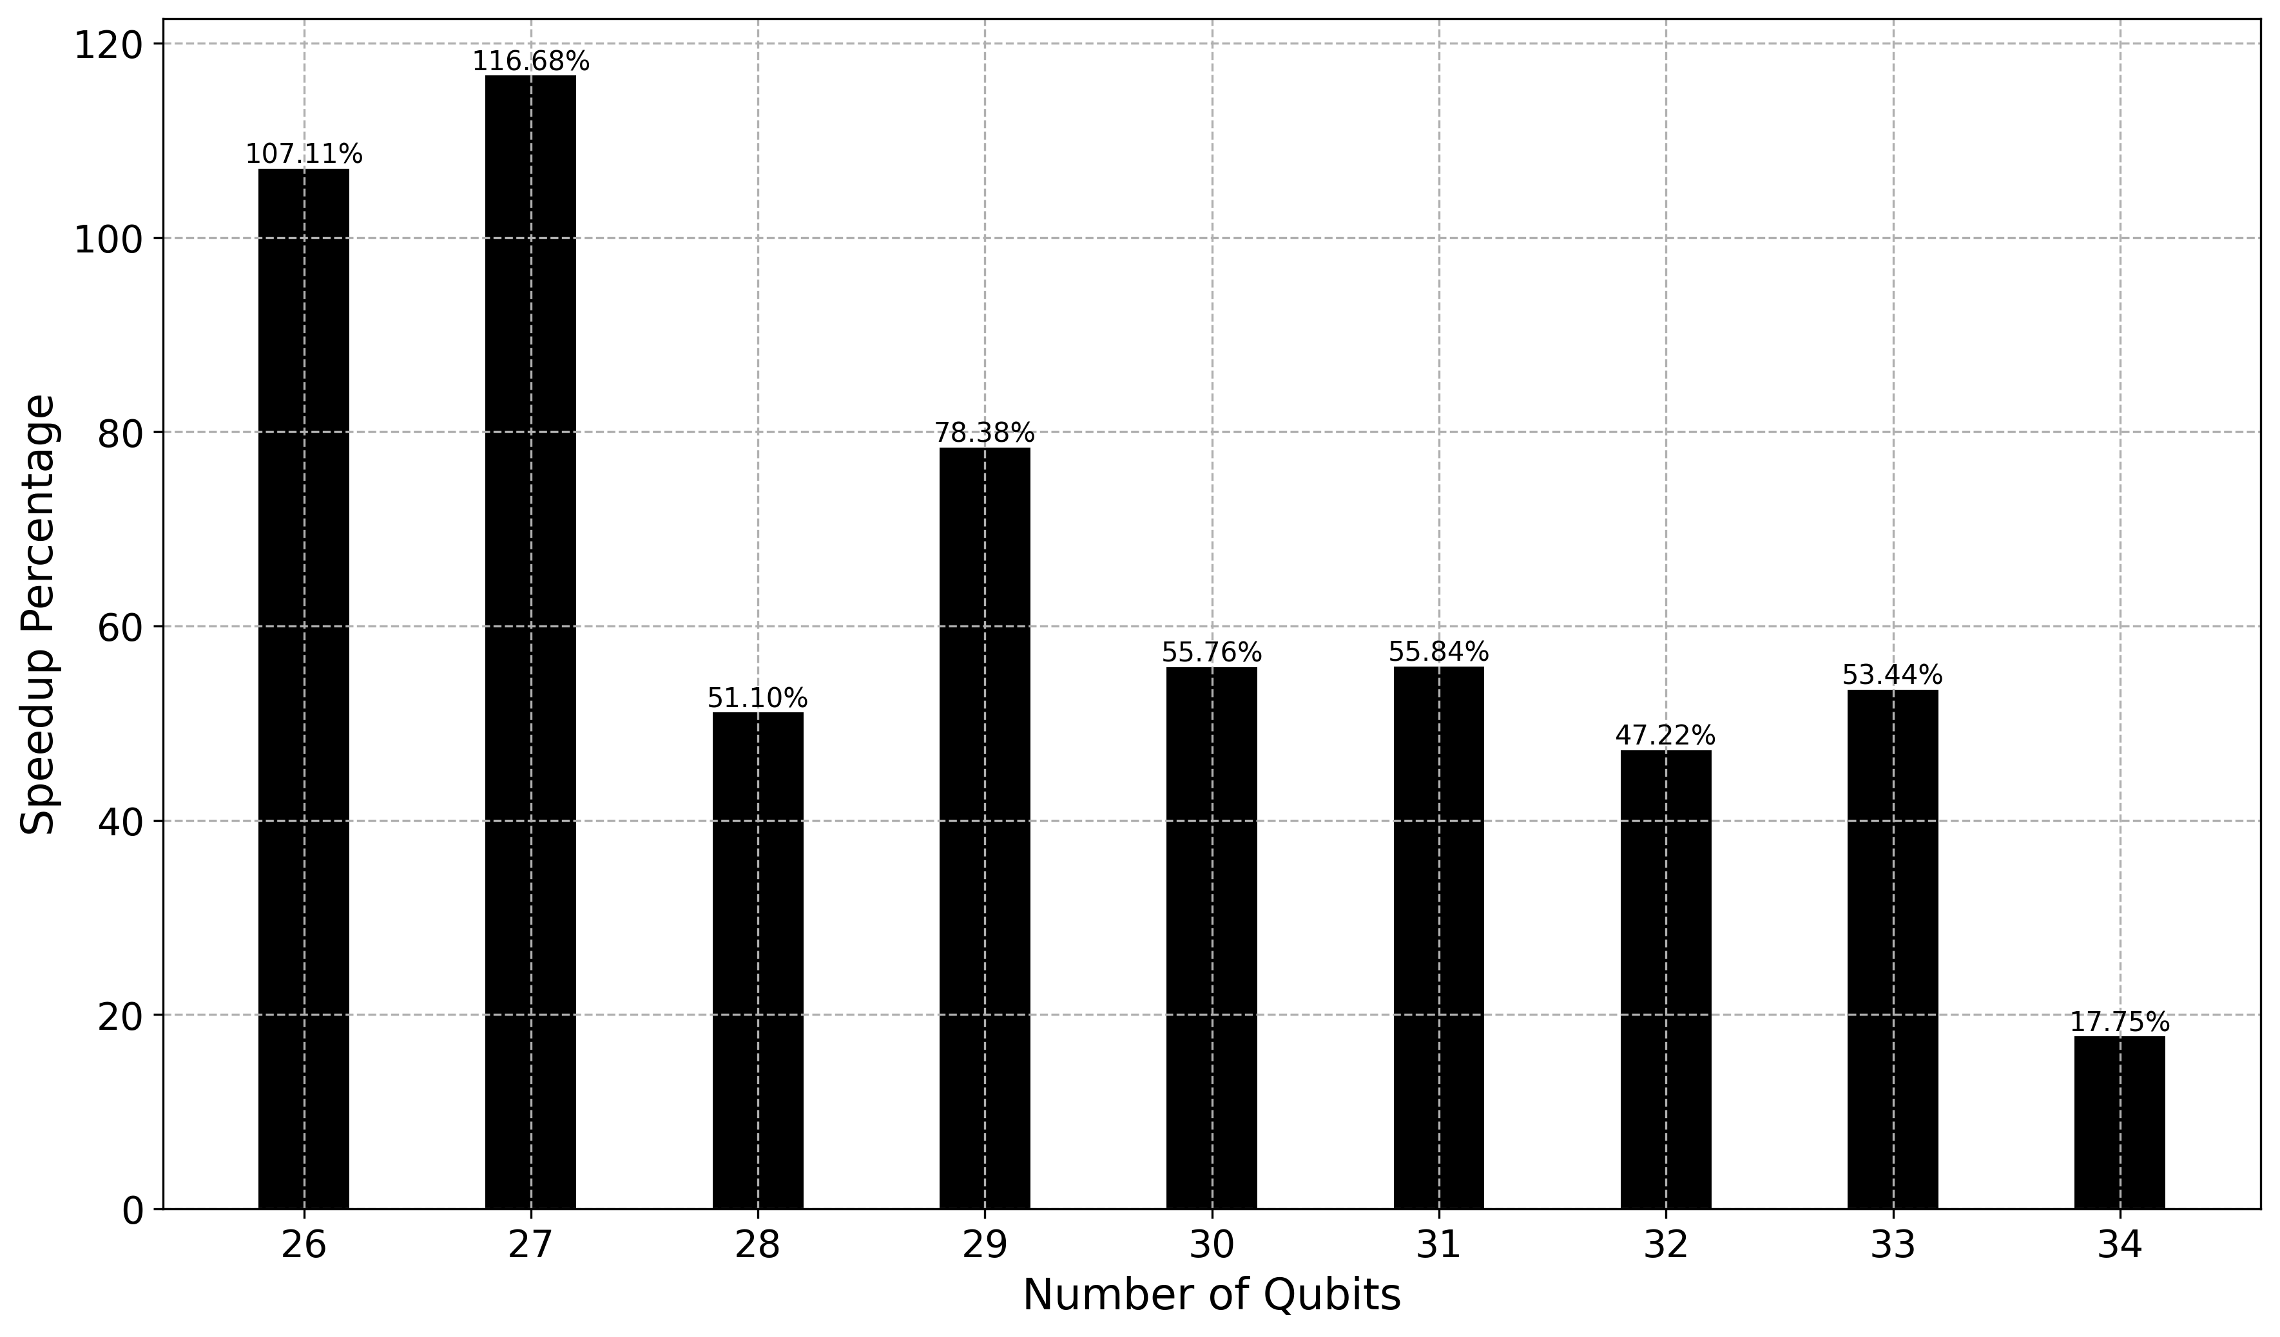
Built-in QFT
$ results
Red vs Blue
Significant performance improvement
Changes between 17%-100+% (1.18-2x faster)
Last qubit doesn’t scale well – better prefetching?
Remaining bottlenecks …
Standard and cache-blocked
Note
Built-in QFT:
  Hadamard
    Fully optimised – needs improvement
  Controlled Phase Function
    Partially optimised
  Swapping Qubits
    Partially optimised

Slide 30
$ B1: Struct of Array vs Array of Struct
    What if they are very far?
    What about using third party libs?
QuEST: Two separate vectors each sized to hold 2^{n} elements
How:
A Vector of length 2^{n} with complex elements
  A std::vector<std::complex<double>>
  each element is a std::complex<double> object
An interleaved Real and Imag vector
  A std::vector<double>
  for 2^{n} qubits → length of vector is 2 x 2^{n}
  each pair represents the Real and Imag parts of a complex amplitude
Pros:
    Enhanced memory locality → better cache utilization
    Vectorized operations → taking advantage of SIMD optimization
Compiler compatibility → better optimized machine code
Compatibility with Math libraries and interoperability
    Native language support
    Reduced overhead, code simplification, …
Notes:
When we do calculation for a qubit we consider both the real and imaginary part at the same time, hence, accessing together matters ( see later on locality)

Slide 31
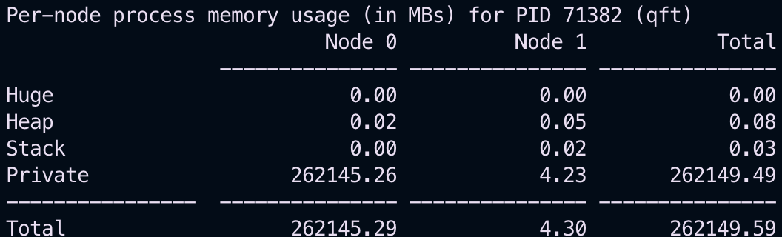
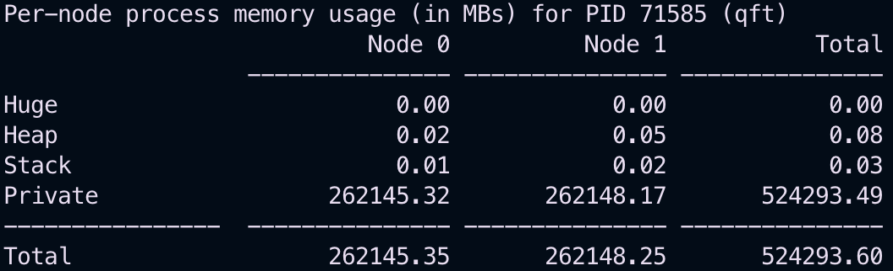
$ B2: NUMA-aware Data Allocation
    Default ‘malloc’:
    Determine number of amplitudes
    Compute the total array size
    Allocate memory using malloc for “stateVec”
      If multiple ranks (processors) → additional memory for “pairStateVec”
    Set Qureg properties
    NUMA-aware ‘mmap’ & ‘mbind’:
    Determine number of amplitudes
    Determine page size [4096 bytes]
    Calculate total array and align to page size
    Check NUMA node sizes
    Ensure alignment to 64 bytes for AVX-512
    Choose allocation strategy based on node capacity
      array size <= node size?
      Yes → allocate and bind to one node
      No → split equally across two nodes – allocate and bind first half to node 0 and second half to node 1
    Set Qureg properties
Allocates memory from the heap
but does not optimize for NUMA nodes
OS and Runtime control where the data is allocated
Ensures memory is localized to NUMA nodes for optimal access
34 qubits
35 qubits

Slide 32
Hadamard
$ B3: NUMA-aware “Locality-sensitive” Scheduling
    Default Hadamard:
    Setup:
      prepare variables [block sizes/tasks]
    Parallel execution:
      OpenMP to run tasks in parallel
    H transformation:
      Loop through each task
      Calculate indices
      Fetch Real/Imag parts of SV
      Update SV elements
    NUMA-aware scheduler [optimal load-balance]:
    Setup
    Parallel execution:
      OpenMP to run tasks in parallel
      Get number of threads and thread ID
      Divide threads between NUMA nodes based on thread ID
      Bind threads to their respective nodes
    Task distribution [round-robin fashion: evenly among threads]:
      Calculate chunk size
      Determine the start/end of task range for each thread
      Ensure end_task <= numTasks
    H transformation:
      if start_task < numTasks
        Iterate from start_task to end_task
        the rest ….
    Reset memory policy to default

Slide 33
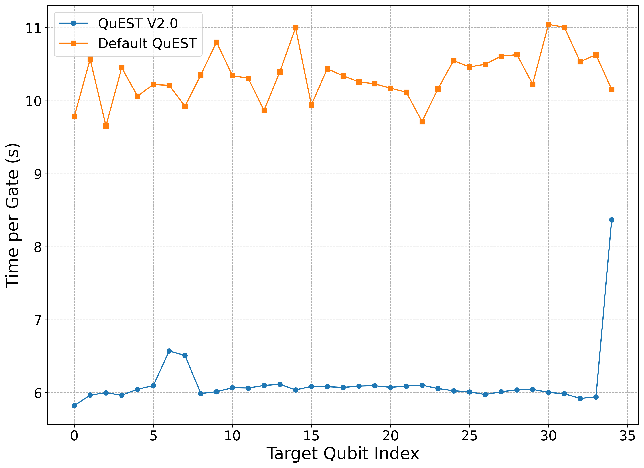
$ B4: NUMA-aware “Locality-sensitive” Scheduling (Hadamard)
Results
Hadamard stress test:
Qureg of 35 qubits
50 gates are applied to each qubit index sequentially
Execution time:
  Starts exactly before the 1st gate
  Stops exactly after the last one
Significant spike for the last qubit → cross NUMA communication
Approx. speedup:
  Index 20: 1.7x
  Last index: 1.3x

Slide 34
$ B8: OpenMP Environment Variables
Keeping threads and their data close – maximum locality
SMT: disabled
  One thread per (physical) core
OMP_PLACES: sockets, cores, threads, custom strand IDs
  cores: mapping the OpenMP software threads to physical cores
    Depends on the OpenMP runtime library understanding labelling of cores/threads
    Architecture dependent
OMP_PROC_BIND: true, false, master, close, spread
  true: static mapping
OMP_NUM_THREADS:
  52: all physical cores of both nodes
GOMP_CPU_AFFINITY:
  0-51: GCC specific – another safeguard
NUMA: binding the process and memory to both nodes
  numactl –cpunodebind=0,1 –membind=0,1

