Slide 1

AION Days @ICL
26-28 March 2025
Oliver Buchmueller,
Imperial College London & Oxford University

Slide 2
AION Days @ICL
These are our final AION days within the first phase of QTFP, ending on March 31, 2025.
The next phase, QTFP2, is expected to begin later this year; AION already has bridging funds secured until then.
While the exact scope of QTFP2 is not yet fully determined, we are confident it will provide a solid pathway for AION to move into its second phase, focusing on building a real detector.
During these AION days, we will review our progress to date and prepare the project for the QTFP2 application, ensuring the next major step for AION.

Slide 3
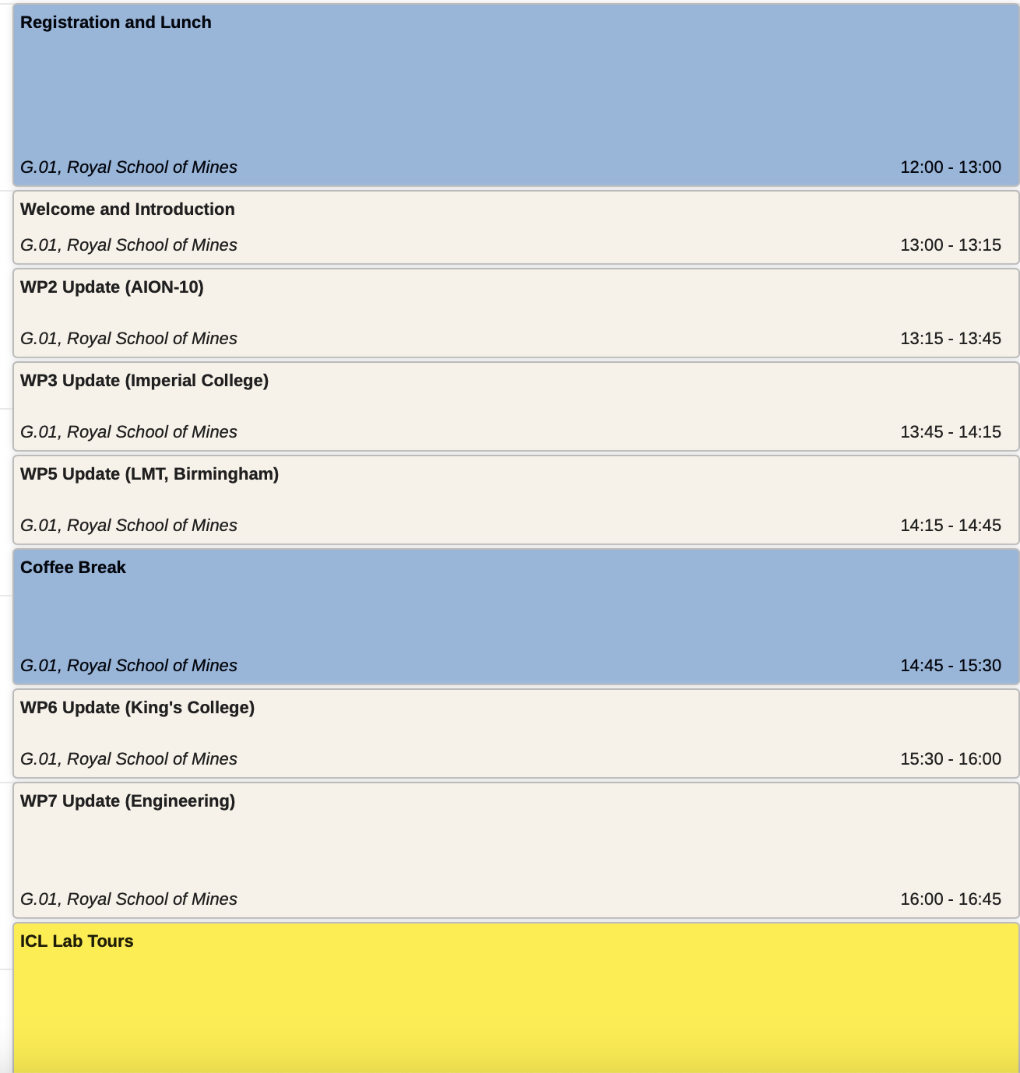
Today

Slide 4
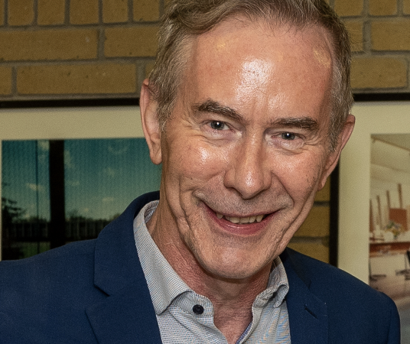
Ian Shipsey
25 July 1959 – 7 October 2024
A true pioneer of the AION project and QTFP, whose legacy will continue to guide and inspire us.
He was also a dear friend, a remarkable colleague, a brilliant physicist, and a truly exceptional person who will forever remain in our hearts.

Slide 5
QTFP: Quantum Technology For Fundamental Physics

Slide 6
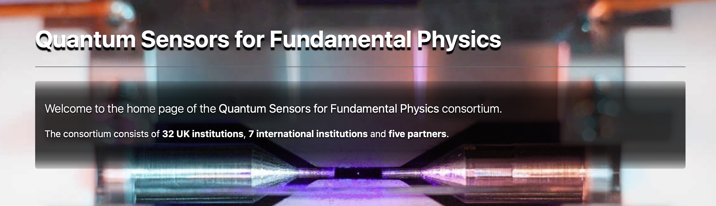
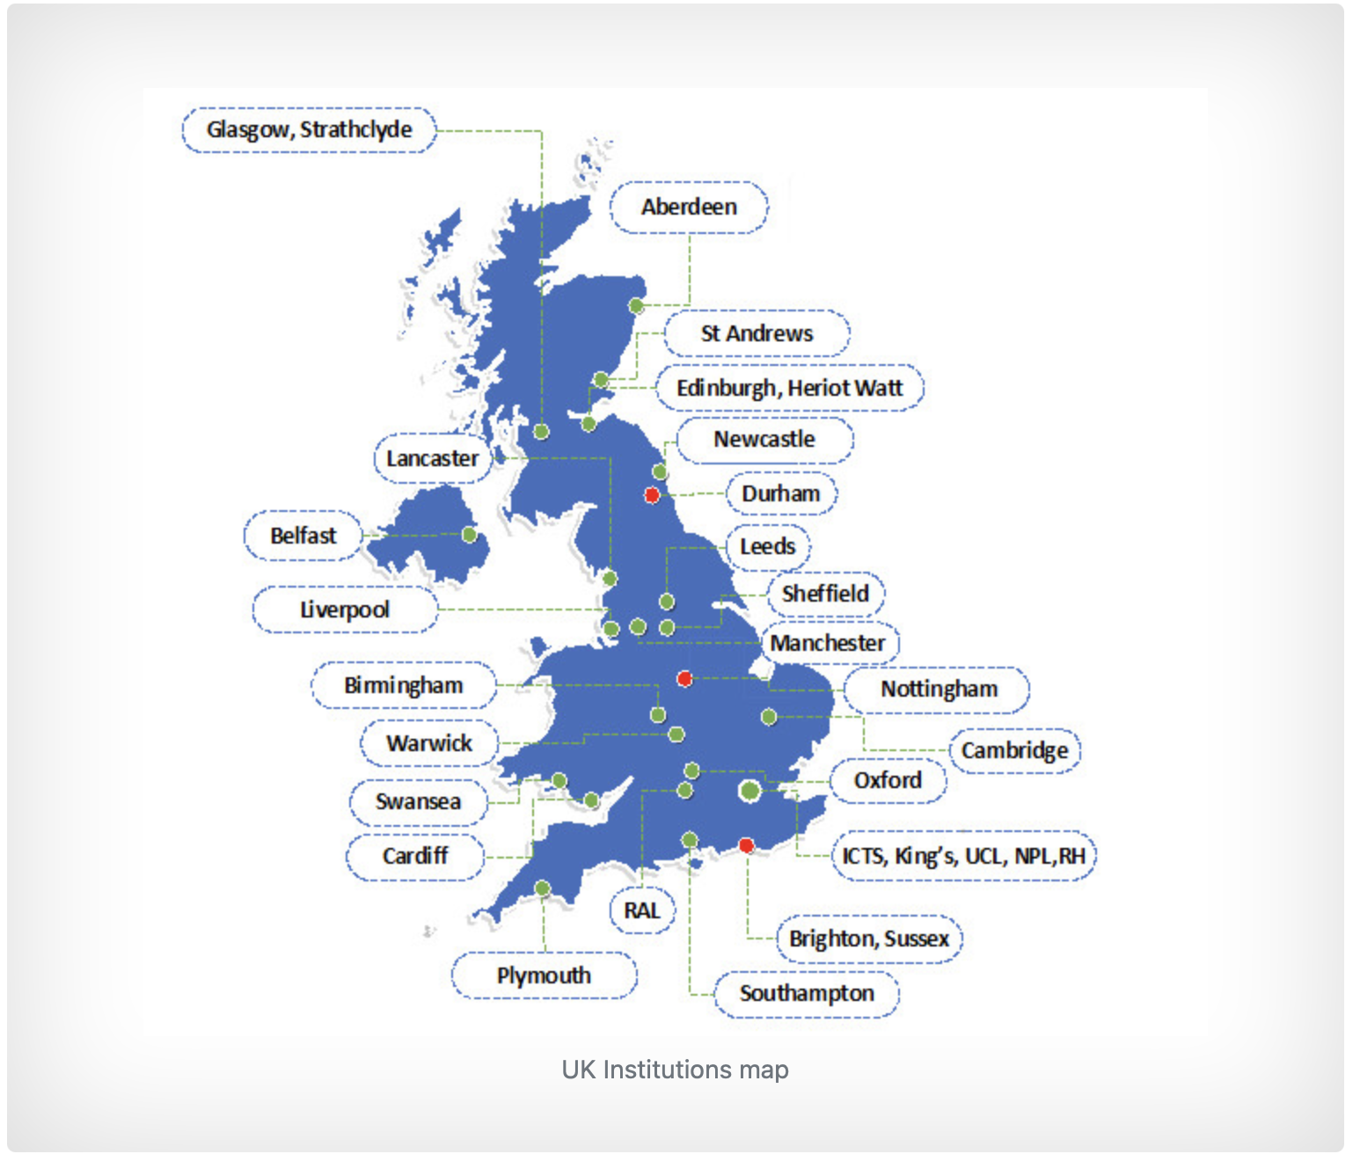
16th October, 2018 First QSFP Workshop
QSFP Programme, lead by Ian, was instrumental to unlock UK funding

Slide 7
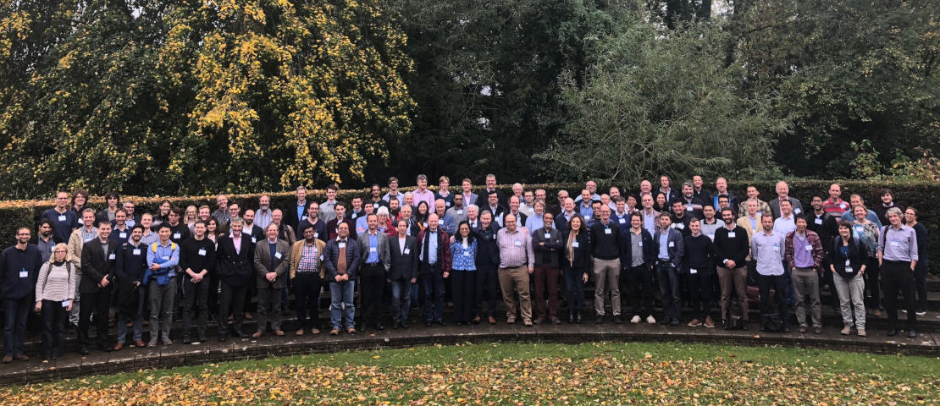
16th October, 2018 First QSFP Workshop

Slide 8









£1bn UK National Quantum Technology Programme Pillars
2020
Quantum Technologies for Fundamental Physics (QTFP)
£40M
New Ideas
Attracting worldwide talent
Internationally leading science
across 7 projects
QT Hubs, Training and Skills, CDTs
£360M
Translating research into applications
Industry-pick up points
IUK, ISCF, Industry
£450M
Prototypes
Products
Spin-offs
Quantum Metrology Institute
£30M
Standards
Validation
National Quantum Computing Centre
£93M
Other
£80M
Slide from Ian Shipsey
Notes:
Science as a customer of QT: A focussed research programme aimed at demonstrating how the application of QT will advance the understanding of fundamental physics questions (£40M over 3 years)

Slide 9
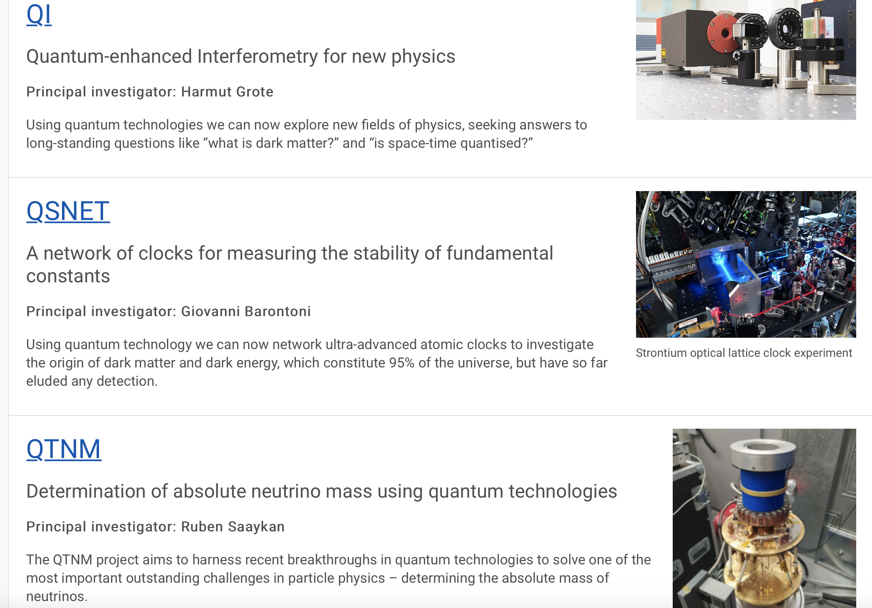
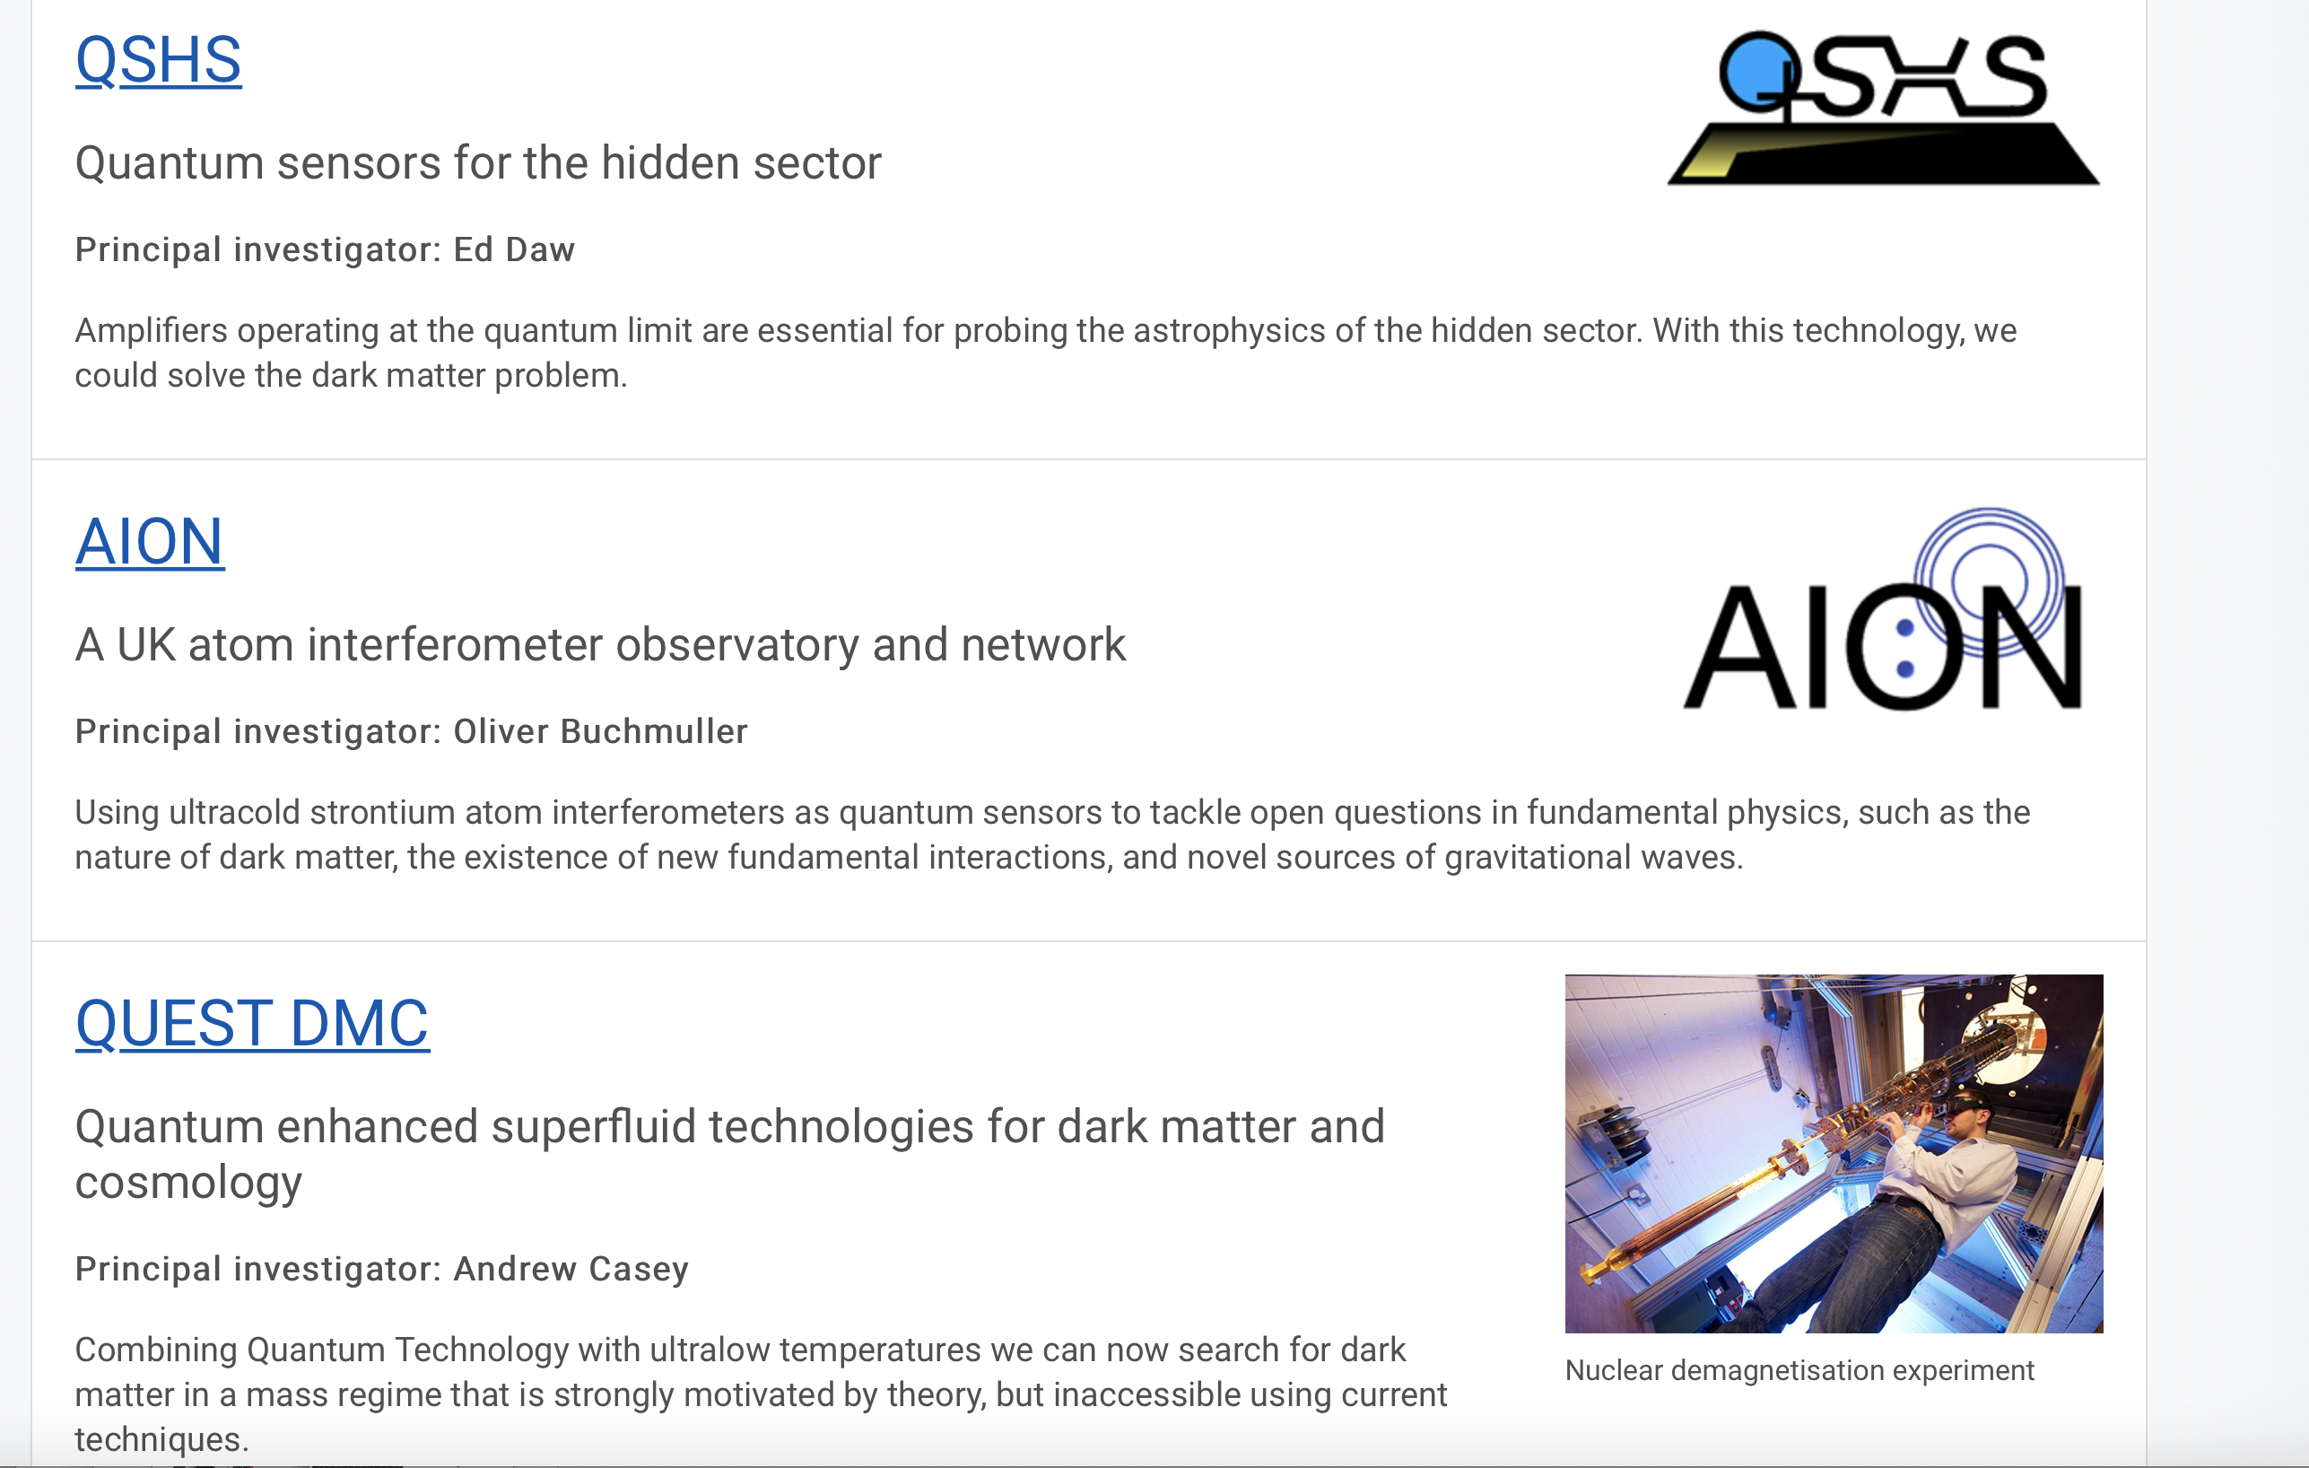
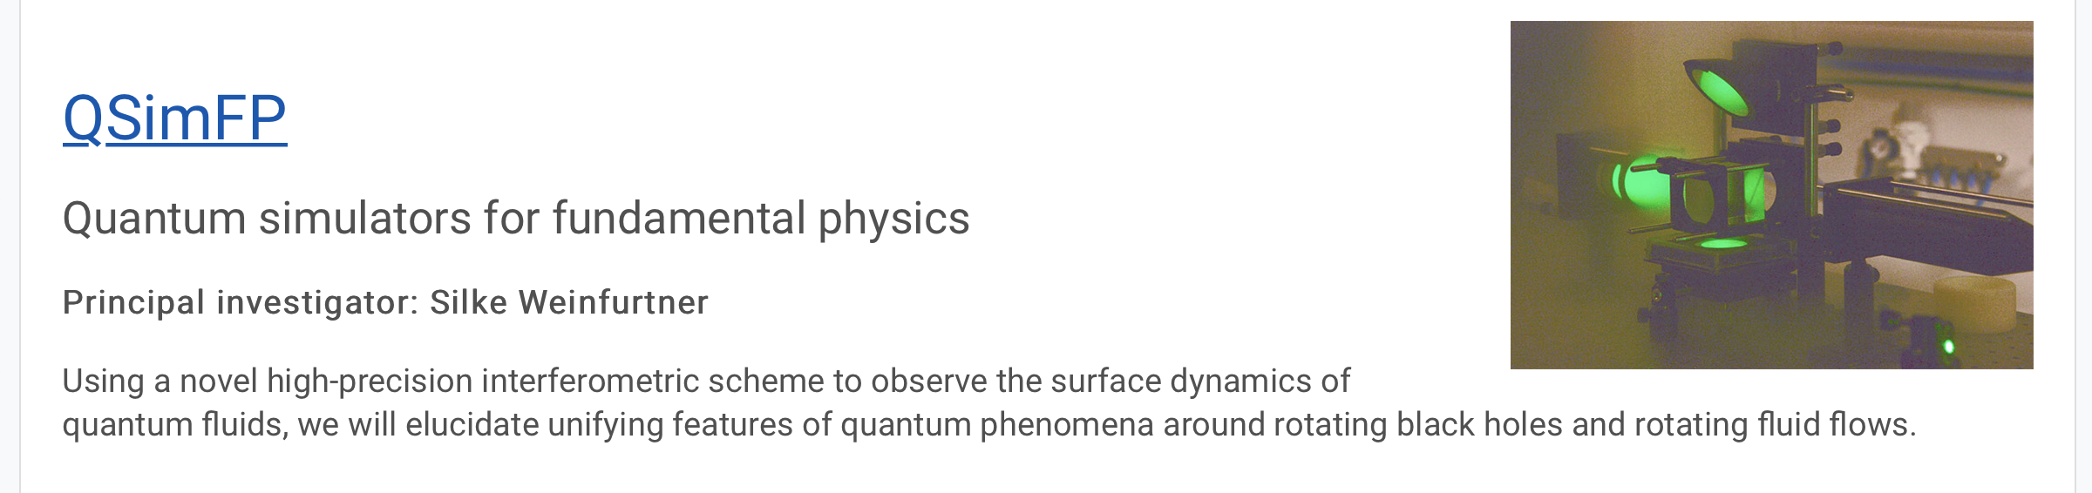
7 main projects plus 17 other
smaller scale funded research projects.
See backup for information
Slide from Ian Shipsey
Notes:
Here are the sevdn fuded projects

Slide 10
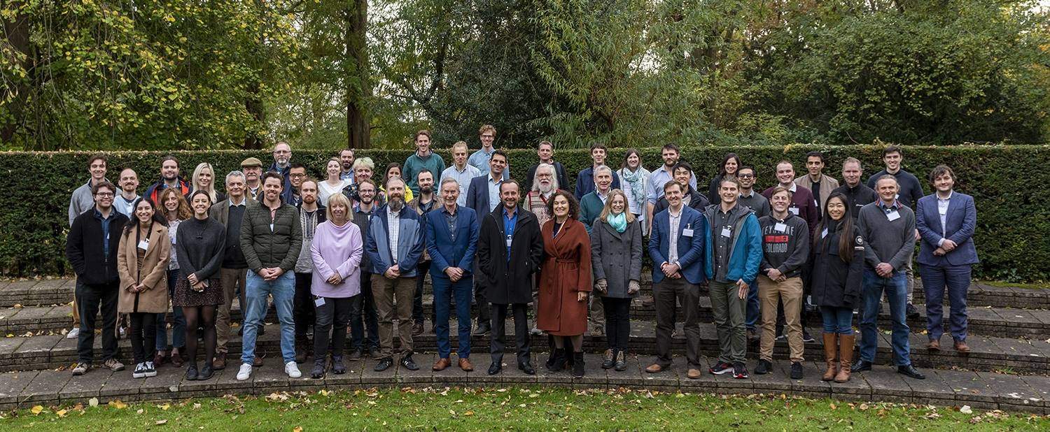
AION Collaboration Days in Oxford: Fall 2021
Today, AION
~60 people
(52 came to Oxford)
Start of AION in 2018
~5 people
https://aion-project.web.cern.ch
Ratio of Cold Atom : Particle/Fundamental Physics people is 1:1

Slide 11

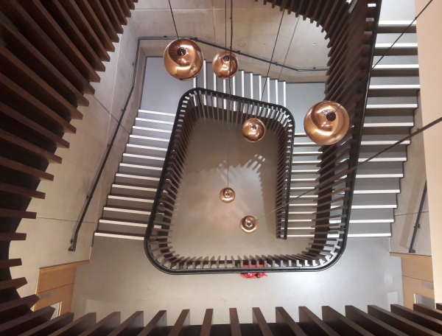
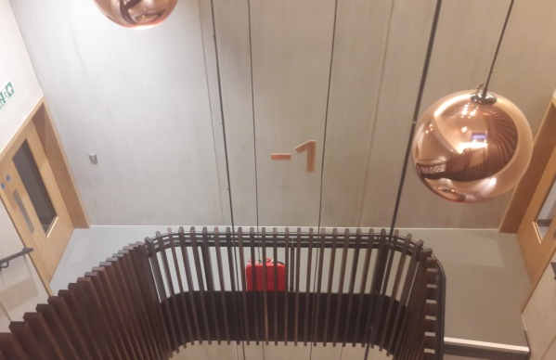
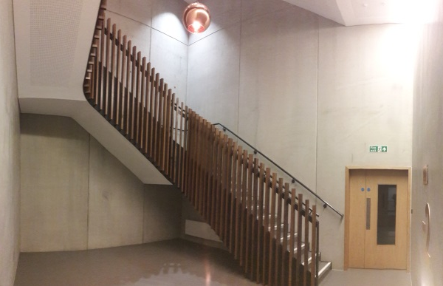
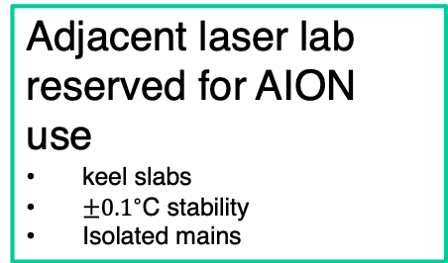
Beecroft building, Oxford Physics
Ultralow vibration
All plant isolated
Thick concrete walls
Adjacent laser lab reserved for AION use
keel slabs
$±{0.1}^{∘}$C stability
Isolated mains
Ground level
AION
12 m
Vertical space
12m basement to ground floor
14.7m floor to ceiling
Aircon infrastructure
Stairwell is not a fire escape route.
Laser lab
Bakeout room and cleanroom nearby
Void
Keel slab

Slide 12
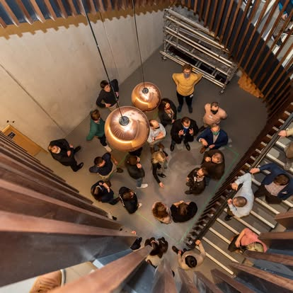
Beecroft building, Oxford Physics
Ultralow vibration
All plant isolated
Thick concrete walls
Adjacent laser lab reserved for AION use
keel slabs
$±{0.1}^{∘}$C stability
Isolated mains
Ground level
AION
12 m
Vertical space
12m basement to ground floor
14.7m floor to ceiling
Aircon infrastructure
Stairwell is not a fire escape route.
Laser lab
Bakeout room and cleanroom nearby
Void
Keel slab

Slide 13
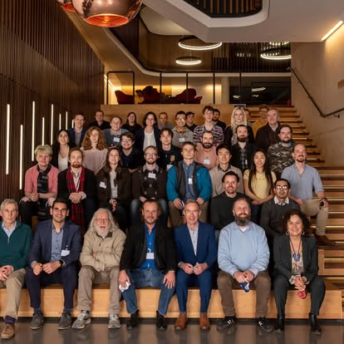
Beecroft building, Oxford Physics
Ultralow vibration
All plant isolated
Thick concrete walls
Adjacent laser lab reserved for AION use
keel slabs
$±{0.1}^{∘}$C stability
Isolated mains
Ground level
AION
12 m
Vertical space
12m basement to ground floor
14.7m floor to ceiling
Aircon infrastructure
Stairwell is not a fire escape route.
Laser lab
Bakeout room and cleanroom nearby
Void
Keel slab

Slide 14
