Slide 1


News from CERN
CROHEP Meeting, February 18, 2025, PMF Zagreb
Vuko Brigljević, Institut Ruđer Bošković, Zagreb

Slide 2
Ulazak u priduženo članstvo

Slide 3
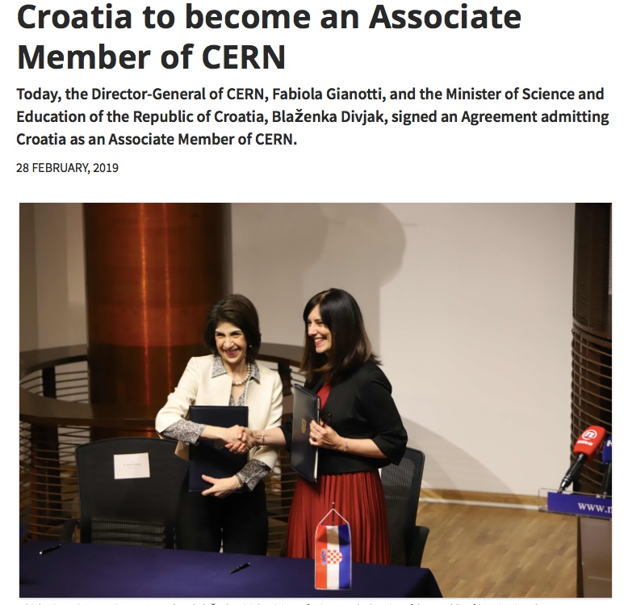
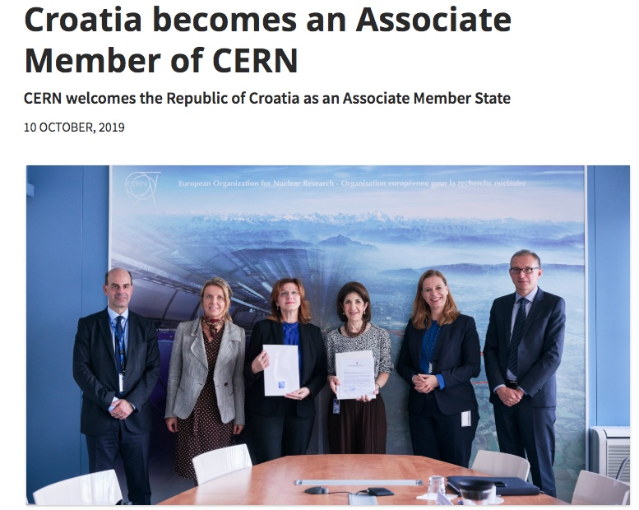
2019: Hrvatska postaje pridružena članica!
Zagreb, 28.2.2019
CERN, 10.10.2019

Slide 4
Croatia’s obligations as CERN AMS
  Annual contribution to CERN budget
  for Associate Members States (AMS):
  ≥ 10% of ‘theoretical’ full Membership contribution, but no less than 1 MCHF:
  Croatia’s contribution as Associate Member:
  1 MCHF / year
  Note: Full contribution in 2019 for RH would be 3’356’300 CHF

Slide 5
Croatia’s benefits: Overview
Access to employment and education programs (excluding tenured positions)
Access to industrial contracts
Representation in CERN Council and its committees (no voting rights)

Slide 6
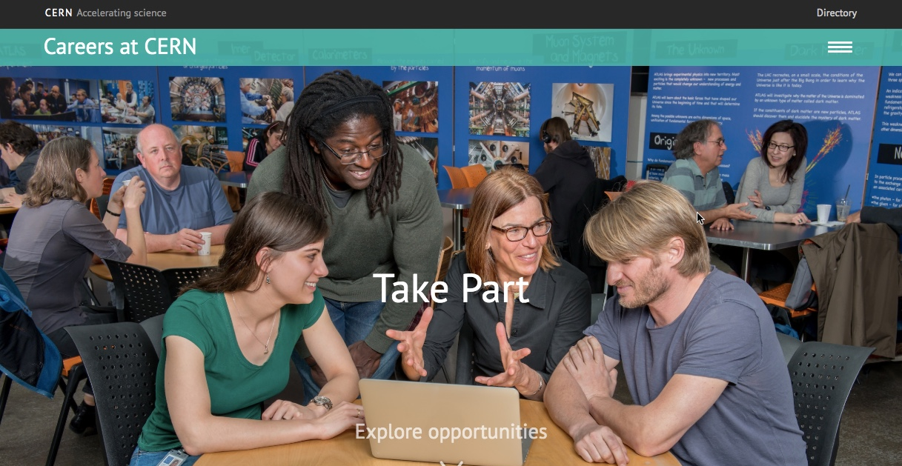
Employment opportunities at CERN
Check detailed information on open positions and requirements at:
https://careers.cern/
For an overview of the different types of positions also
see my overview at the 2019 CROHEP meeting

Slide 7
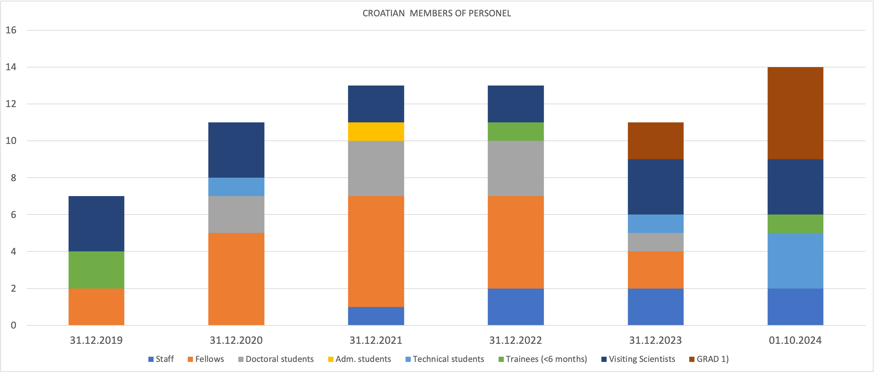
Croatian members of personnel 2019-2024

Slide 8
Croatian members of personnel 2019-2024
 | 31.12.2019 | 31.12.2020 | 31.12.2021 | 31.12.2022 | 31.12.2023 | 01.10.2024
Staff | 0 | 0 | 1 | 2 | 2 | 2
Fellows | 2 | 5 | 6 | 5 | 2 | N/A
Doctoral students | - | 2 | 3 | 3 | 1 | -
Adm. students | - | - | 1 | - | -
Technical students | - | 1 | - | - | 1 | 3
Trainees (<6 months) | 2 |  |  | 1 |  | 1
Visiting Scientists | 3 | 3 | 2 | 2 | 3 | 3
GRAD ¹⁾ | 0 | 0 | 0 | 0 | 2 | 5
1) GRAD program replaces former Fellowship program

Slide 9
Notes on Employment (1)
Croatian nationals have been using the opportunities increasingly and pretty well since 2019
  This is good, but also brings challenges, see later
Doctoral student positions:
  Only for engineering or applied physics
  In connection with a University actually giving the degree
A few associate positions I am aware of:
  Ilja (Split) in Theoretical Physics Department: 3 months in 2021
  Marko Kovač (Split) for CMS Calorimeter: 4 months in 2023
  Toni Ščulac (Split) for CMS Calorimeter: 4 months in 2024

Slide 10
Notes on employment (2)
For all these positions, Croatian applicants enter the quota for Member and Associate member state (MS) nationals
Note: this right corresponds to the nationality of the candidate, not to the country the candidate is working in:
  A national from a NMS country working in Croatia applies as NMS candidate
  A Croatian national working abroad now applies as MS candidate
Only fixed-term positions to Associate Member State nationals
Where does the selection of Croatian applicants happen: at CERN
  No one in Croatia intervenes in the selection procedure (exception: Council delegate for research fellows / GRAD )
  MZOM / Croatian community not given information about Croatian applicants (GDPR)

Slide 11

Opportunities for Croatian companies
CERN awards industrial contracts in total worth of ~ 300 MCHF / year
Since 2019 any Croatian company is free to apply to all CERN tenders
Very broad spectrum of services and abilities, from very high-tech to common needs of any large organization and industrial facility
Important role: Industry Liaison Officer (ILO):
  Facilitates contact companies-CERN, especially to make companies aware of opportunities
  No ILO named currently (former ILO, dr. sc. Siniša Marijan from Končar Institute, went into retirement in 2024)

Slide 12
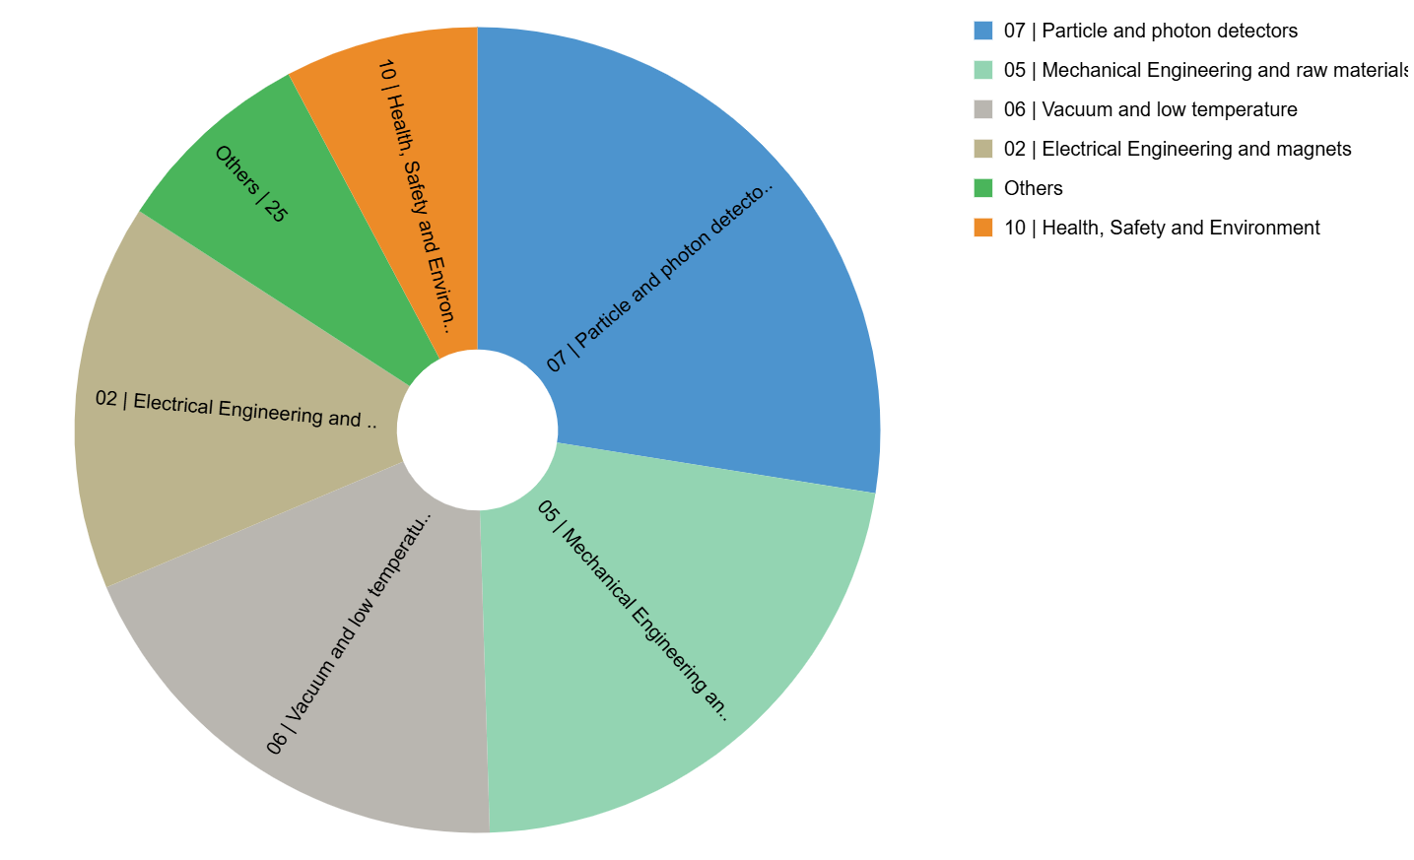
Kako je hrvatsko gospodarstvo iskoristilo mogućnosti
2019-2023
Year | Procurement (kCHF)
2019 | 9
2020 | 148
2021 | 182
2022 | 225
2023 | 312
2024* | 310
Expenditure by (Activity|Procurement) Code (kCHF) for Croatia
* Provisional figure based on commitments

Slide 13
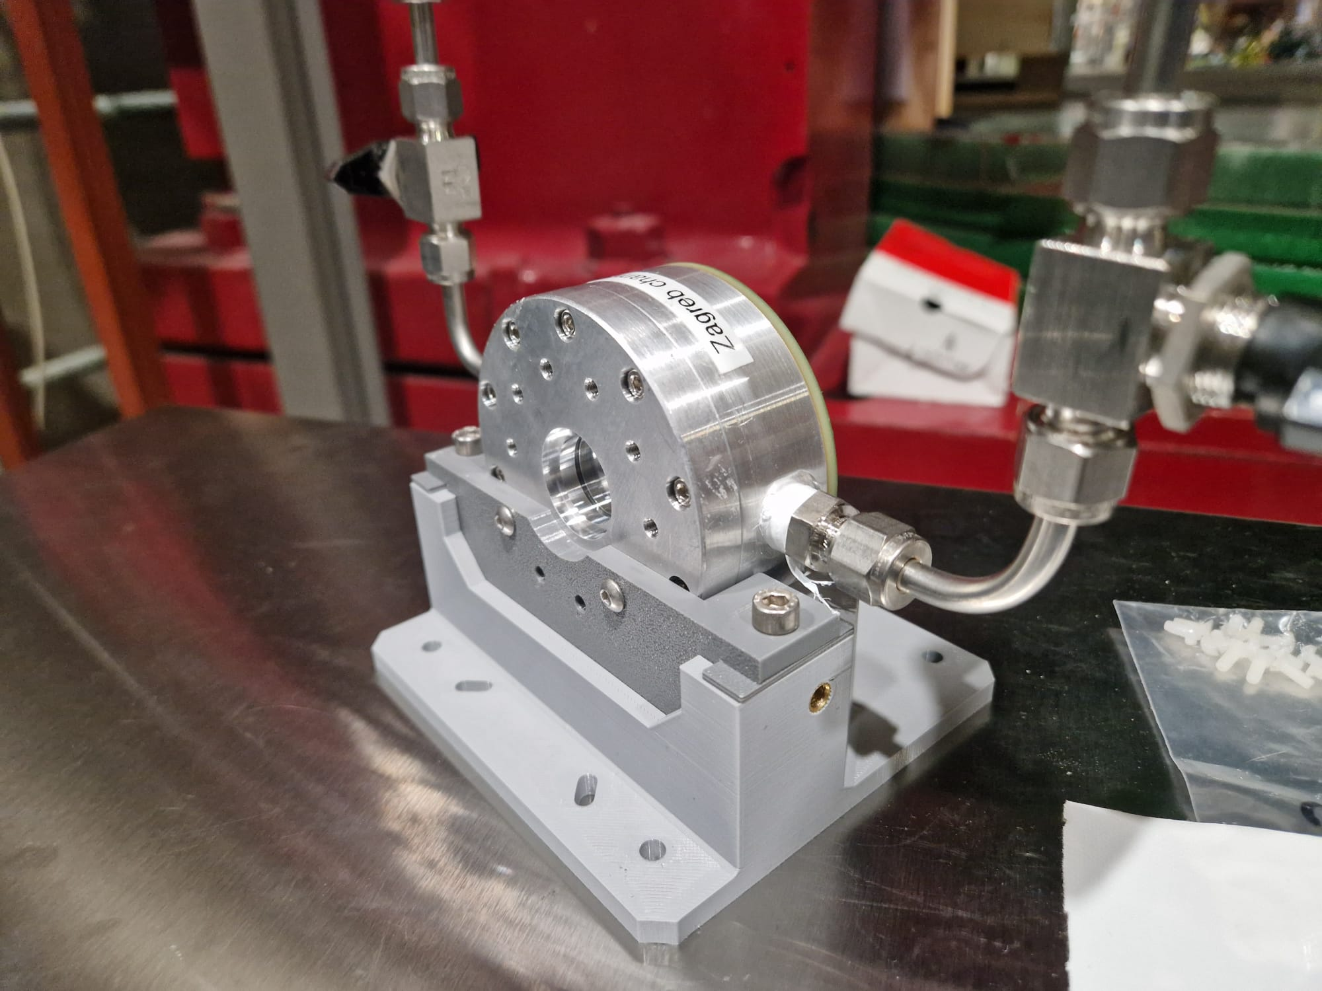
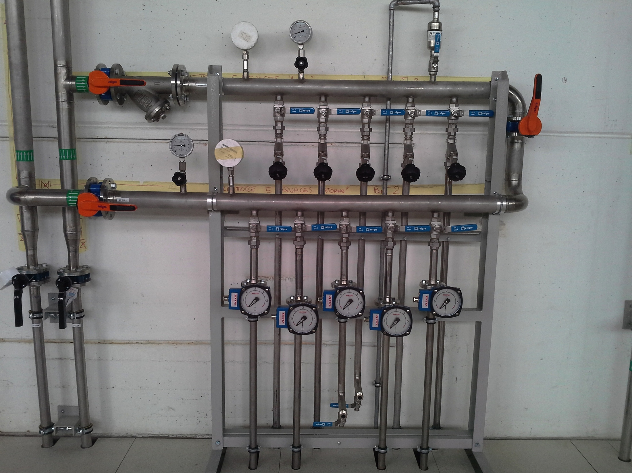
What are Croatian providers doing @ CERN
Manufacturing of parts for detectors and magnets
Irradiation of materials to test radiation hardness (RBI Co60 Source)
Equipment for workshops
Prototype design for silicon sensors (MAPS @ FER, group of Prof. Suligoj)
Maintenance of tubes (coolings, ventilation)
Etc. etc.
Some of these collaborations were triggered by local HEP research groups

Slide 14
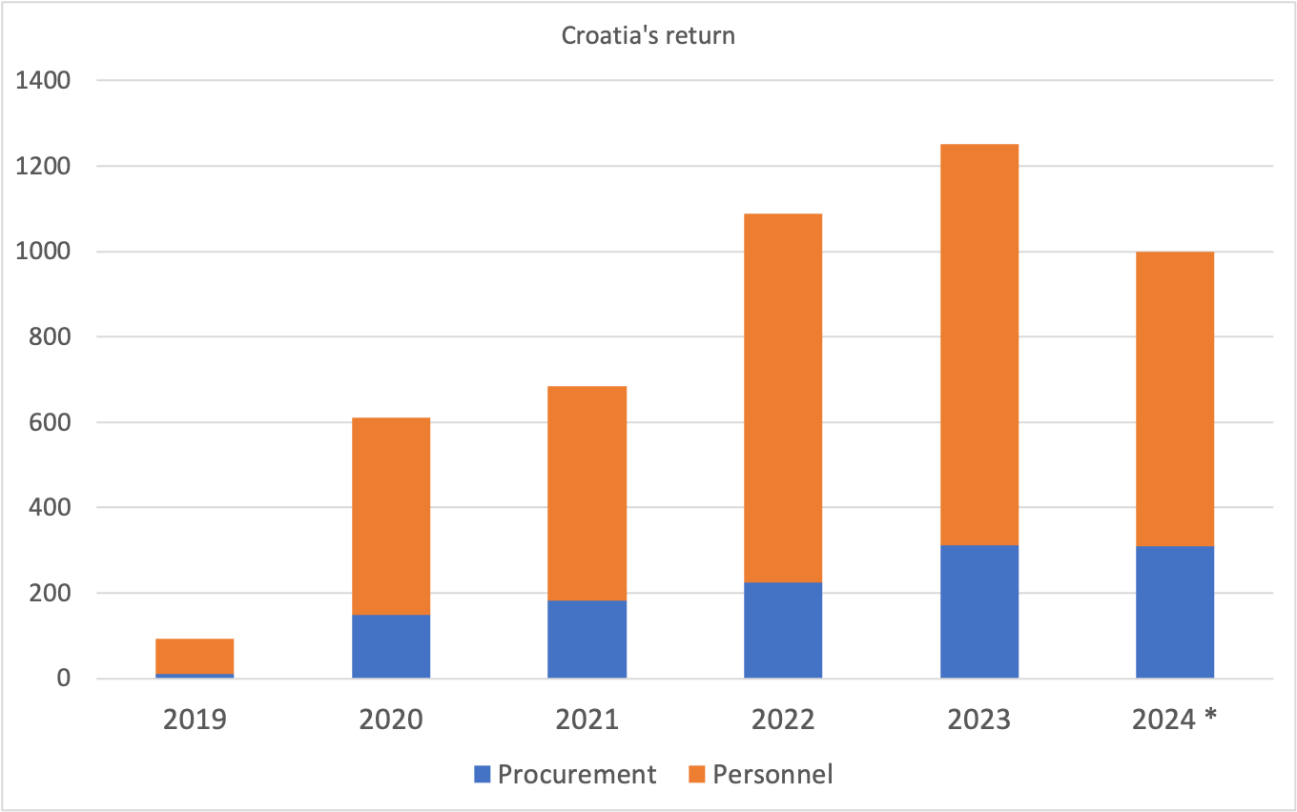
Total Return: Contracts + Employment
For AMS return should not be larger than fee
Personnel is ~70%
Since 2022. Croatia is using fully the potential of AMS
With very limited to no promotion
HR member fee: 1 MCHF
*) not final numbers for 2024

Slide 15
Total Return: Contracts + Employment
Year | Country contribution | Procurement | Personnel | remaining
2019 | 250 | 9 | 83 | 158
2020 | 1000 | 148 | 462 | 390
2021 | 1000 | 182 | 502 | 316
2022 | 1000 | 225 | 864 | -89
2023 | 1000 | 312 | 940 | -252
2024* | 1000 | 310 | 688 | 3
* Provisional figure based on commitments

Slide 16
CERN Technical Mission Visit, February 5-8, 2025
After 5 years of membership, CERN sends a task force to visit new countries to review the state and see what can be improved and listen to feedback
  Check if the country still fulfils conditions for membership
  Benevolent: not an inspection but desire to help local community
CERN Mission aimed at talking to:
  Research community (theory, experiment, instrumentation)
  Industry
  Government (Ministry)
As precondition CERN required Croatia to update the report on the state of things (economy, science, HEP) submitted with the membership application
  A very useful exercise!

Slide 17
The report
written
By MZOM
Written by
research
community
Thanks to
all research groups for providing text and data!
M. Planinić and D.Lelas for contributing to general sections!
Especially to Doris Jozić from MZOM for helping in writing and reviewing the full document!

Slide 18
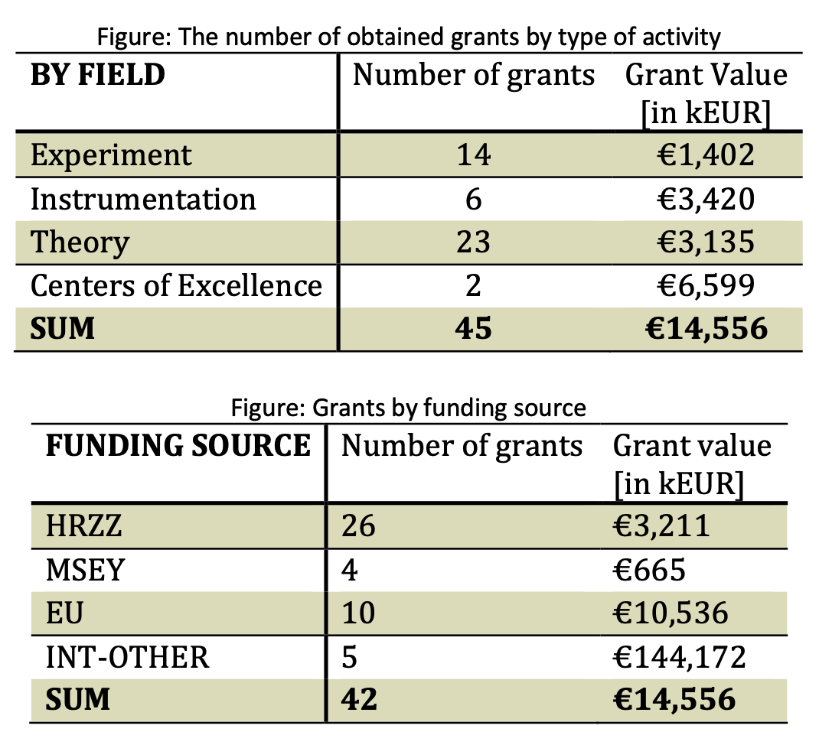
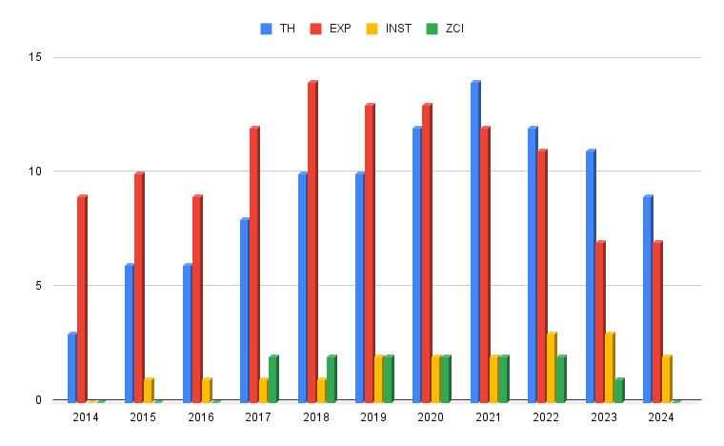
Some interesting figures from the report
(thanks to your input!)
Total number of grants and value
2014-2024
Number of active grants
2014-2024

Slide 19
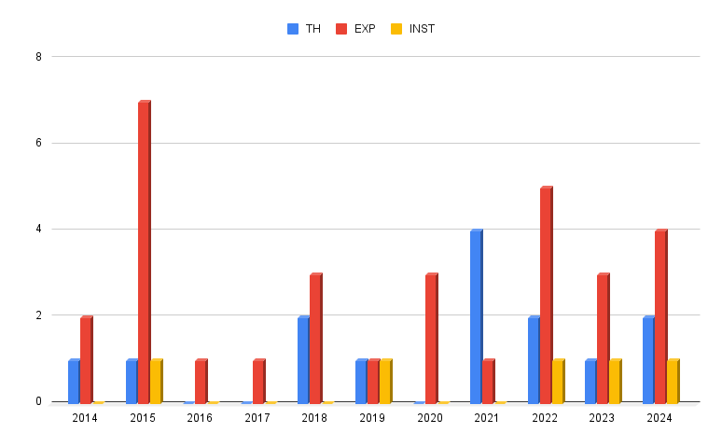
More from the report: PhDs in HEP & related fields 2014-2024
Defended doctoral theses in 2014-2024
TH: Theory
EXP: experiment
INST: Instrumentation

Slide 20
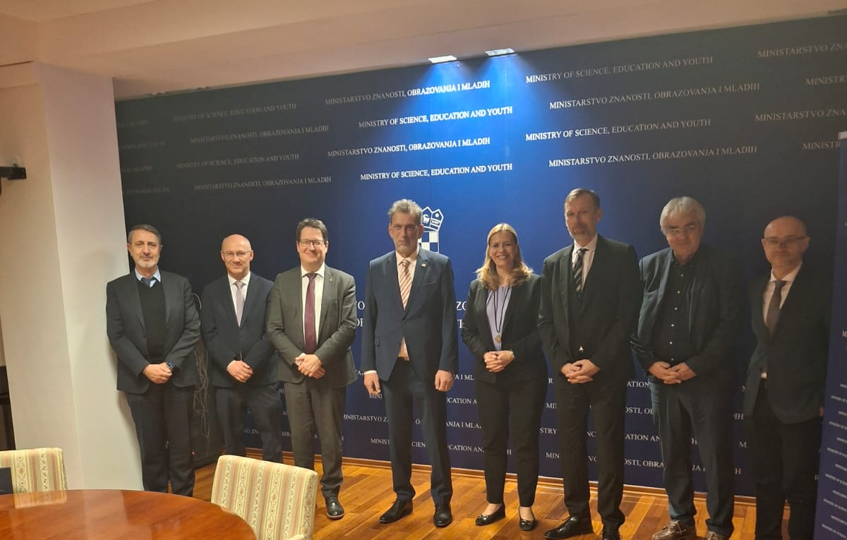
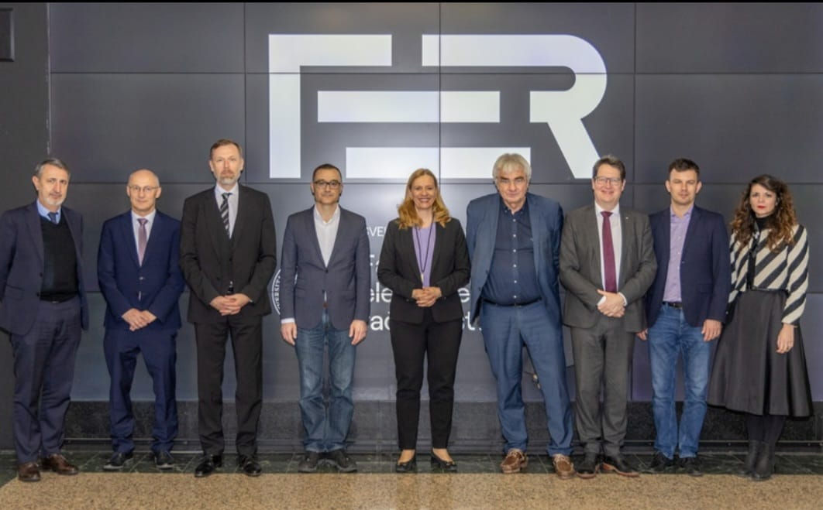
The Technical mission visit: February 5-8, 2025
Thursday February 7
Meeting the HEP community
Visit of FER (Fac. of Electrical Eng. & Comp.)
Meeting with the minister
Friday Februrary 8
Visiting Robotics center at FSB (Fac. of Mechanical Eng.)
Visiting companies (Končar Inst, Končar INEM, Končar D&ST, Teh-Cut)
Meeting at HGK (Croatian Chamber of Commerce): more companies
Meeting at the Government

Slide 21
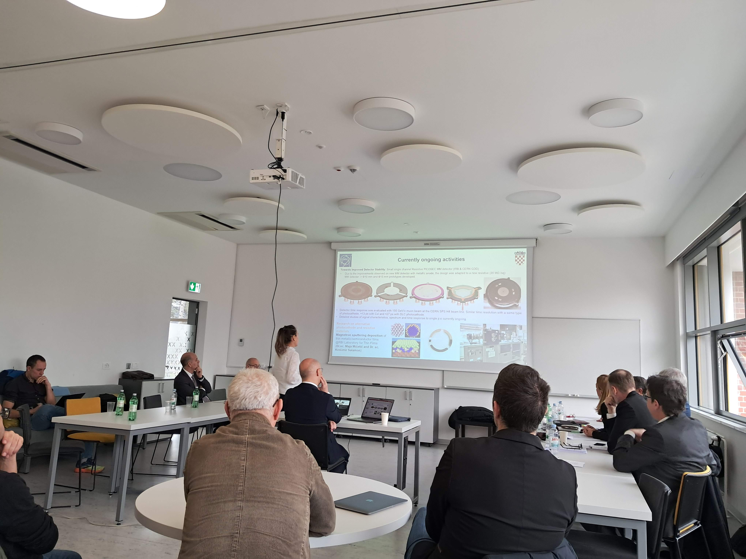
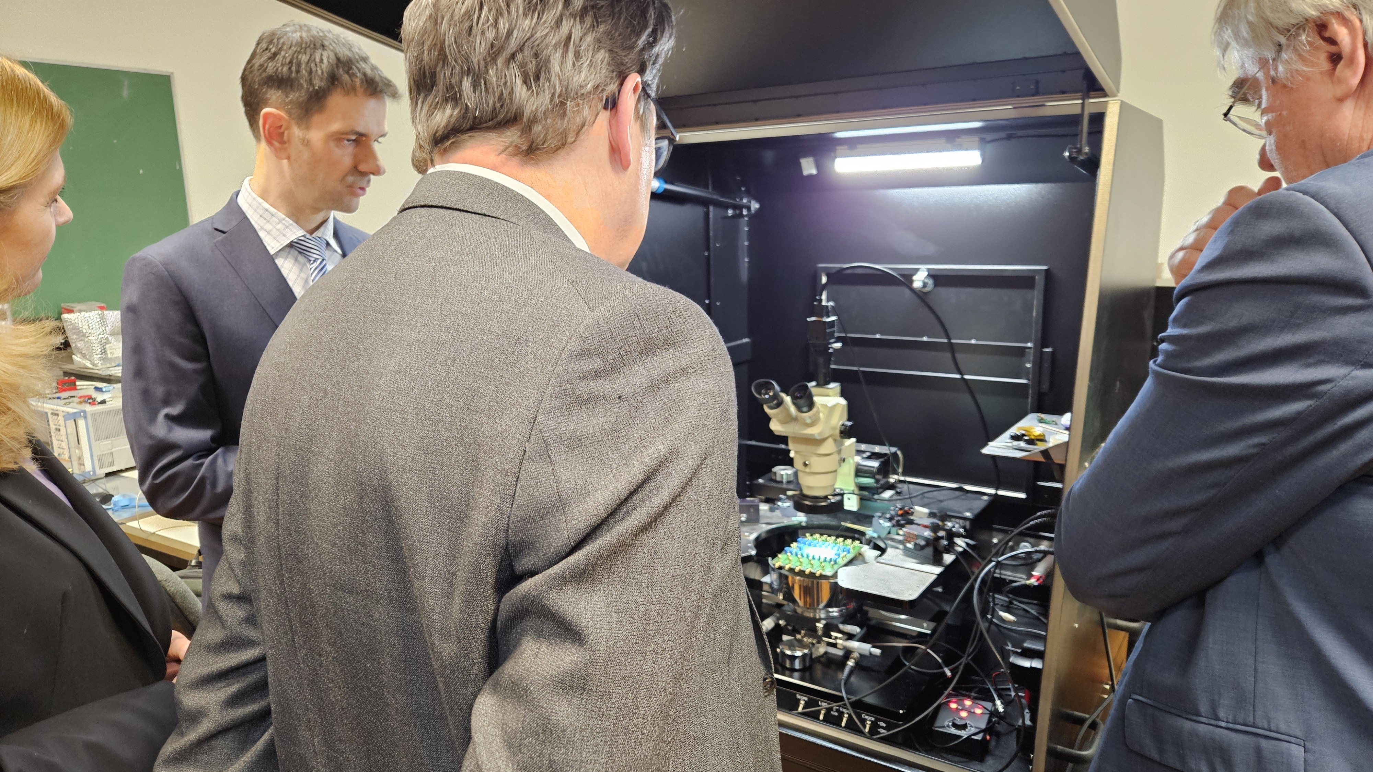
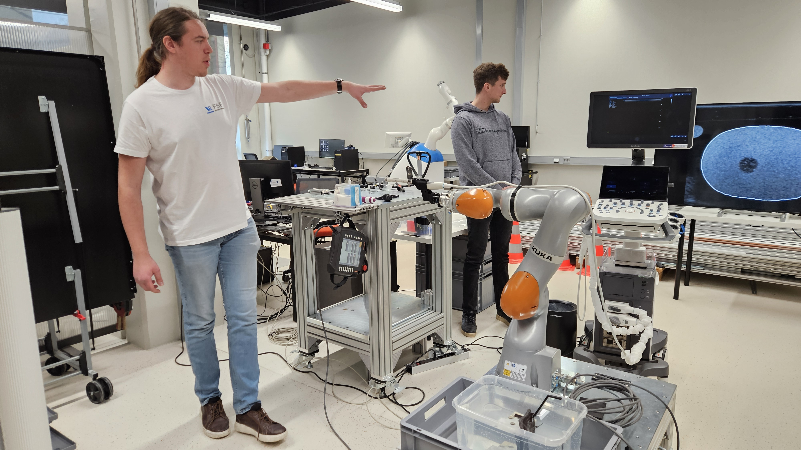
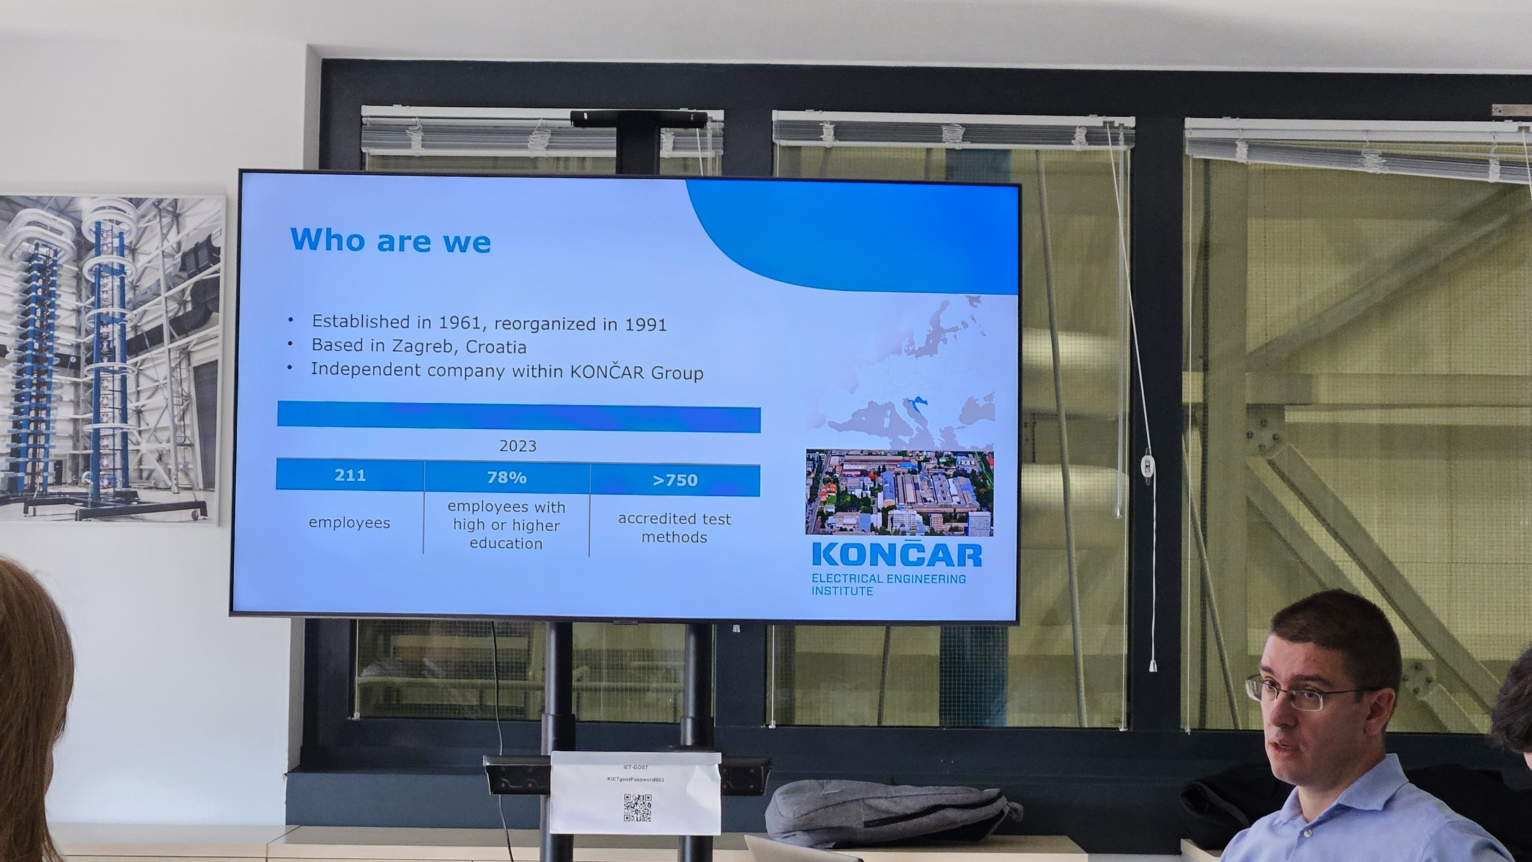
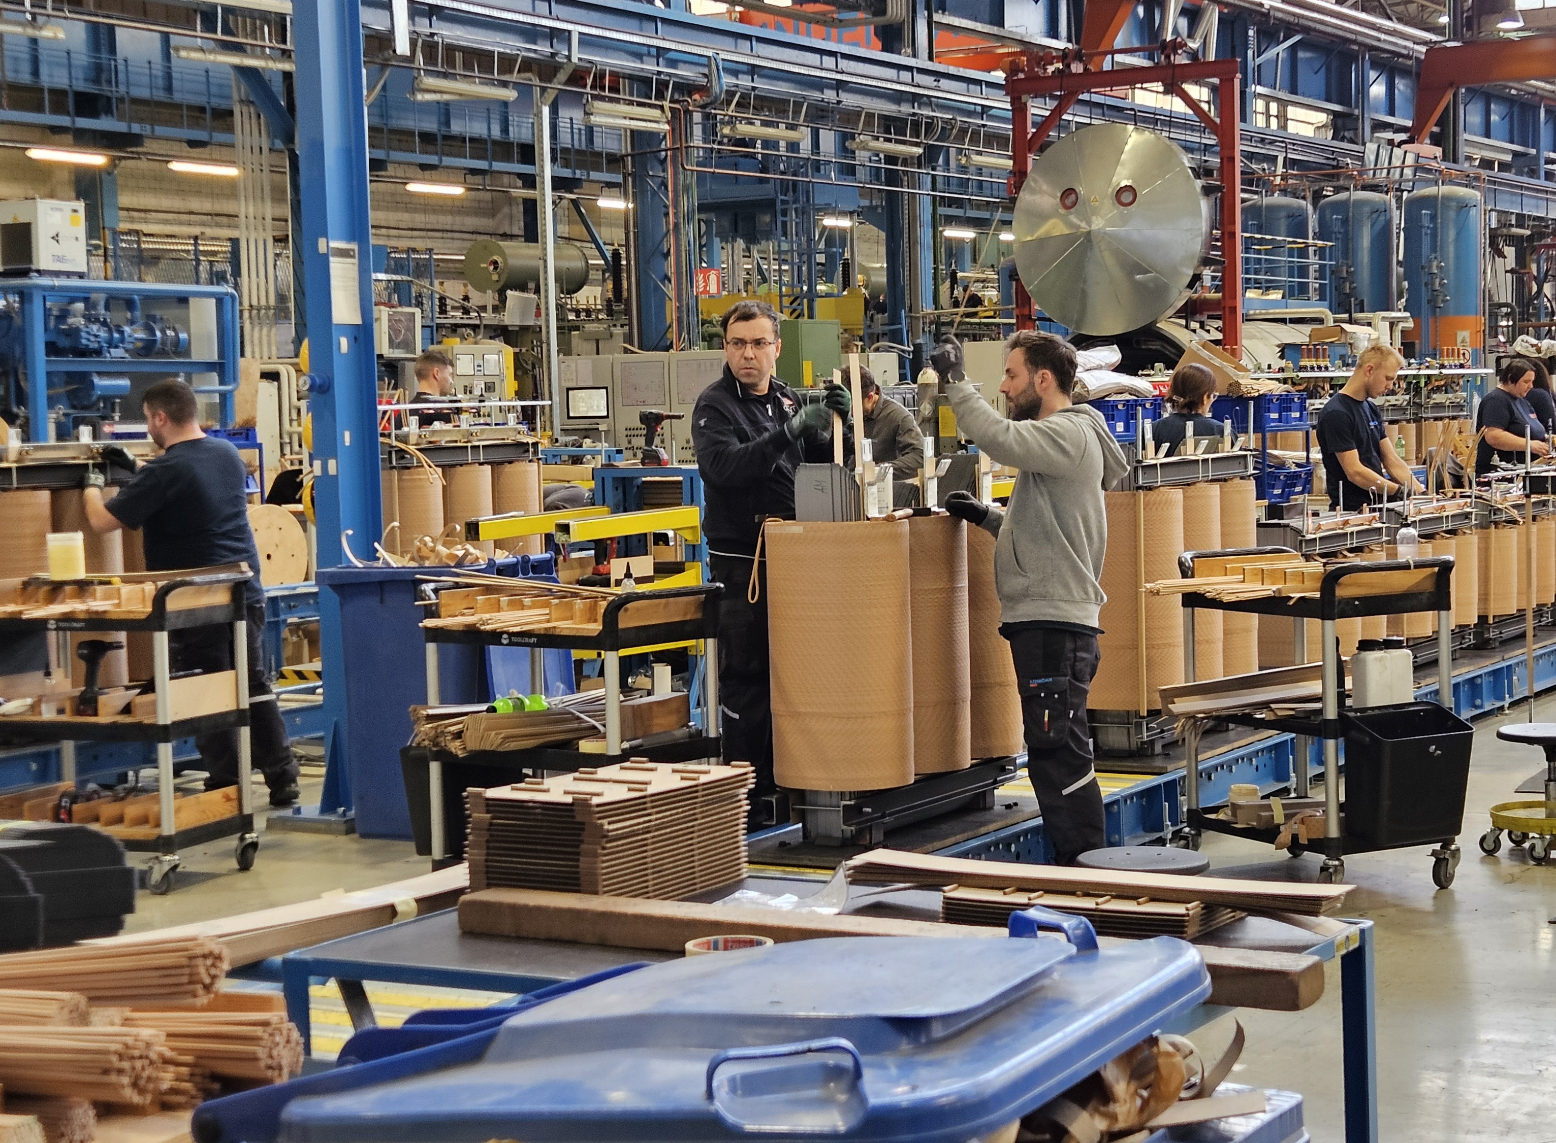
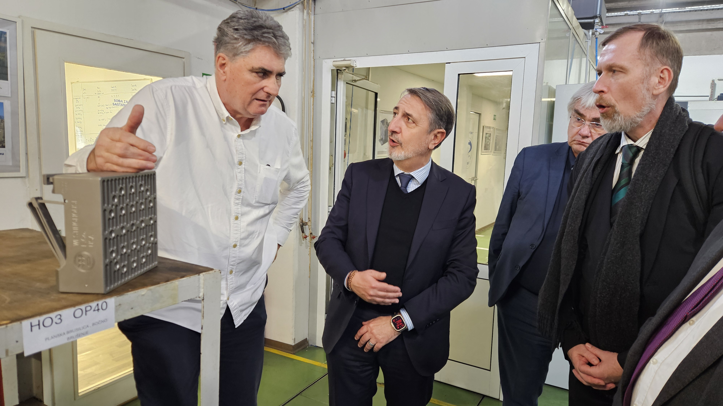
The Technical mission in pictures
CRTA (robotics) @ FSB
HEP Community meeting
MAPS lab @ FER
TehCut
Končar Inst.
Končar D&ST

Slide 22
Technical Mission: Conclusions & next steps
The delegation was positively impressed by:
  HEP Community status and presentations, thanks to everyone!
  Engineering and Industry capacity (from a sample of rather diverse companies)
Our report was appreciated as a very useful document
Next steps:
  The delegation will prepare a report of the visit
  We will get the draft version for fact-checking
  The report is then submitted to the CERN Council, probably in June

Slide 23
Some early recommendations from the delegation
Join the FCC!
Common strategy & initiative: importance of CROHEP community and today’s discussion!
Involve all stakeholders: HEP community, engineering, industry, government
  Importance of the Committee for Cooperation with CERN

Slide 24
Committee for cooperation with CERN
The ministry (MZO) has decided to appoint a commitee to coordinate the cooperation with CERN (Povjerenstvo za suradnju s CERN-om)
This committee should among others:
  Foster networking and exchange of information about the opportunities opend by the Associate Membership
  Provide support to the ILO
  Give recommendation that could strengthen collaboration between the scientific and industrial sectors
  Give advice to Croatian representatives in the CERN Council and its committees
  Foster outreach activities and mobility of researchers and teachers
  Propose measure to enhance capacity for technology transfer
Composition of committee is supposed to have a wide representations: institutions, regions, researchers and companies, etc.

Slide 25
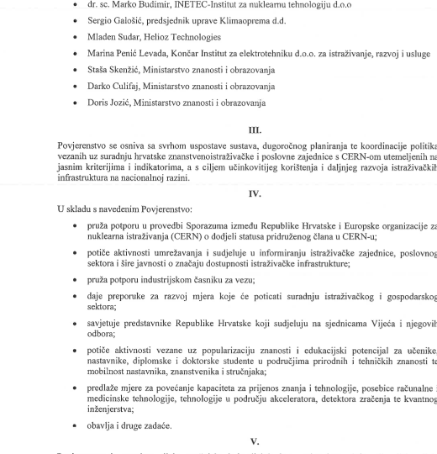
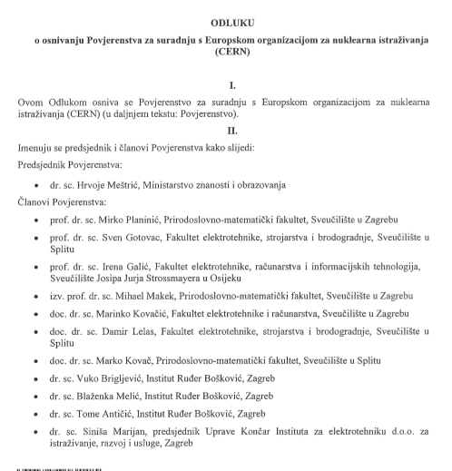
Committee for cooperation with CERN: Composition since 2023
1st Meeting in July 2023!
2nd meeting in Nov. 2024
Appointed by the minister of science and education on January 19, 2023

Slide 26
Towards full membership?
The data from the last 5 years suggest: Croatia has the potential to take advantage from full membership
  As AMS we cannot expect increasing return
The ministry ordered a study of possible return and potential benefit of full membership to a consulting company Inoviraj.com
  Several of you have been contacted to provide feedback
Based on the study, a recommendation will be issued
Eventually, the decision is political

Slide 27
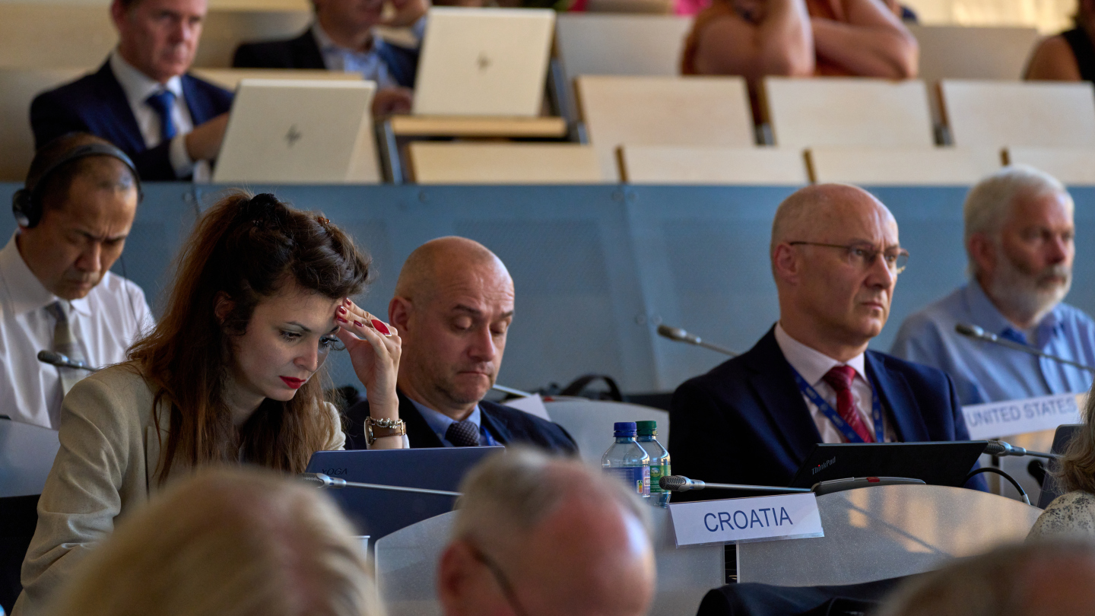
News from the CERN Council

Slide 28
The CERN Council
CERN’s “Board of directors”: The ultimate decision maker
  Management (DG and her team) appointed by Council
Each country represented by 2 delegates (one from government and one from scientists), both appointed by governments
Topics:
  Finances
  Legal aspects (internal rules, contracts)
  Endorses management plans and proposals
  Mid and long term strategy
In the following slides some selected news from the Council that I consider potentially interesting

Slide 29
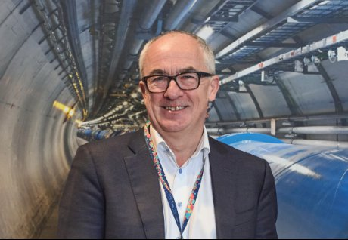
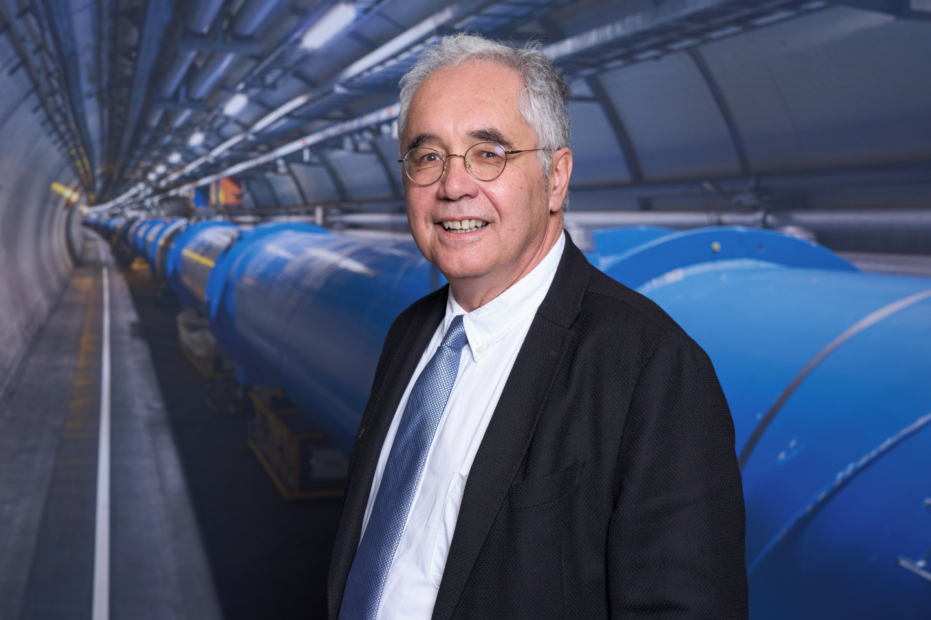
News from CERN Council: Elections
New CERN DG elected (from 1.1.2026): Mark Thomson (UK):
  Prof. at Cambridge Univ.
  Chair of the Science and Technology Facilities Council (STFC) in the UK
  Experimentalist: OPAL, ATLAS
New president of CERN Council: Costas Foutas (GR):
  Prof. University of Ioannina (GR)
  Experimentalist: ZEUS, CMS

Slide 30
News from the CERN Council: FCC
FCC feasibility study ongoing
  Expected to be completed in March 2025
  Decision on FCC Approval: late 2027-2028
  FCC Week in San Francisco on June 10-14, 2024
  Funding: CERN trying to secure important EU contribution
CePC status presented to Council and SPC:
  Rather impressed with the status of the project
  Strong R&D on magnets
    Mile Lamont: ”You can’t fake those plots”
  Scepticism on costs

Slide 31
News from the CERN Council
Next update of European Strategy for Particle Physics
  Last update: June 2020
  Council initiated the process for the next update
  See Budimir’s presentation for more on this topic
CERN enlargement:
  Estonia became MS in August 2024
  Brazil became AMS in March 2024
  Applications for AM from Chile and Ireland received

Slide 32
News from the CERN Council: Situation with Russia
Reminder: in December 2024 the Council decided to terminate the International Cooperation agreement with Russia and Belarus
  Belarus: July 2024
  Russia: 30 Nov. 2024
Consequences:
  No user status possible anymore for people affiliated to institutions of these 2 countries, no visits to CERN
Resolution does not apply JINR/Dubna
  June: Council decided not to terminate ICA with JINR

Slide 33
News from CERN Council: New Graduate program
Replaces the former fellowship programs

Slide 34
News from Council: New Graduate programs

Slide 35
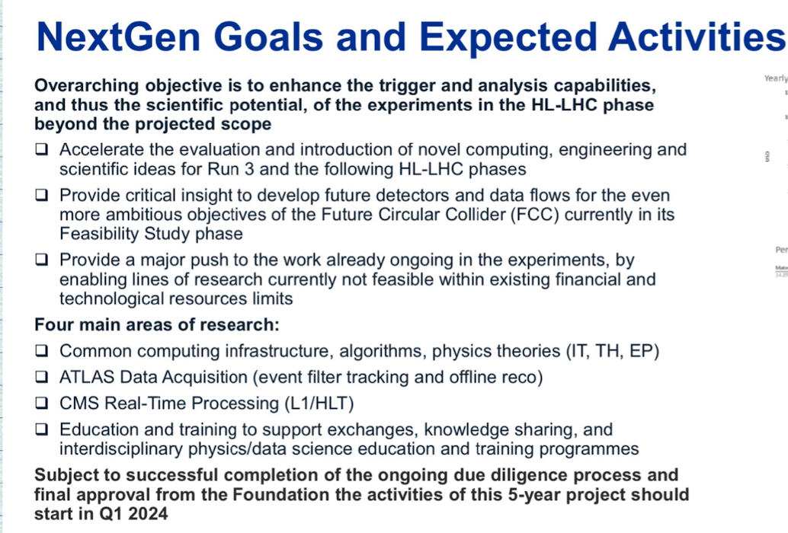
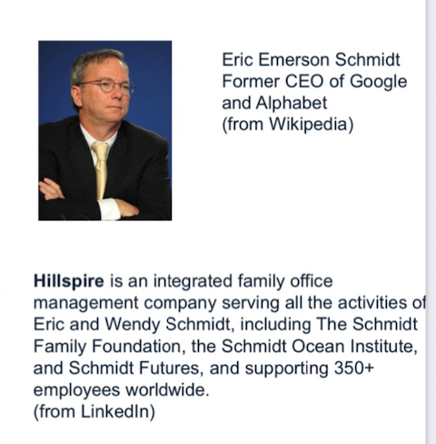
Selected news from CERN Council:
The NextGen Trigger Project
Offer of 50M $
donation
For AI R&D
lf Triggers
for HL-LHC
The project started
~80% of budget: hiring AI experts, ~120 people in total
(61 hired until December 2024)

Slide 36
News from the CERN Council (cont.)
Triggered by NextGEN project: new policy on Fundraising for private donors:
  New: allow for donations for scientific activity (not just outreach)
  Ensure independence of scientific decisions and respect of CERN mission
Collaboration CERN – EU: very intense, many programs, e.g.:
  Mobility: CERN is recipient of the EU "HR Excellence in Research” award
  Support for large research infrastructures
  EU Support for ATTRACT (R&D in detector and imaging)
  e-infrastructures: Open Science Cloud, CERN QTI, etc.
  Open Science: with support of the EC, CERN continued to expand the Zenodo open repository

Slide 38
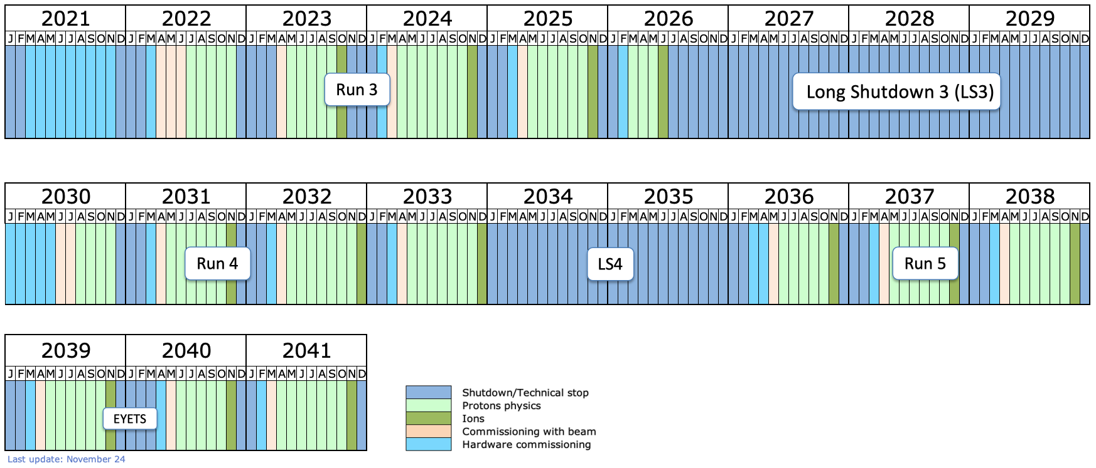
News from the Council: updated LHC schedule
HL-LHC
HL-LHC (Run 4 and on): delayed by ~ 1 year to allow for ”Phase 2” upgrades to complete
Ongoing Run3 extended till mid 2026

Slide 39
Non mainstream CERN activities: Cloud

Slide 42
Non Mainstream CERN Activities: MEDICIS

Slide 46
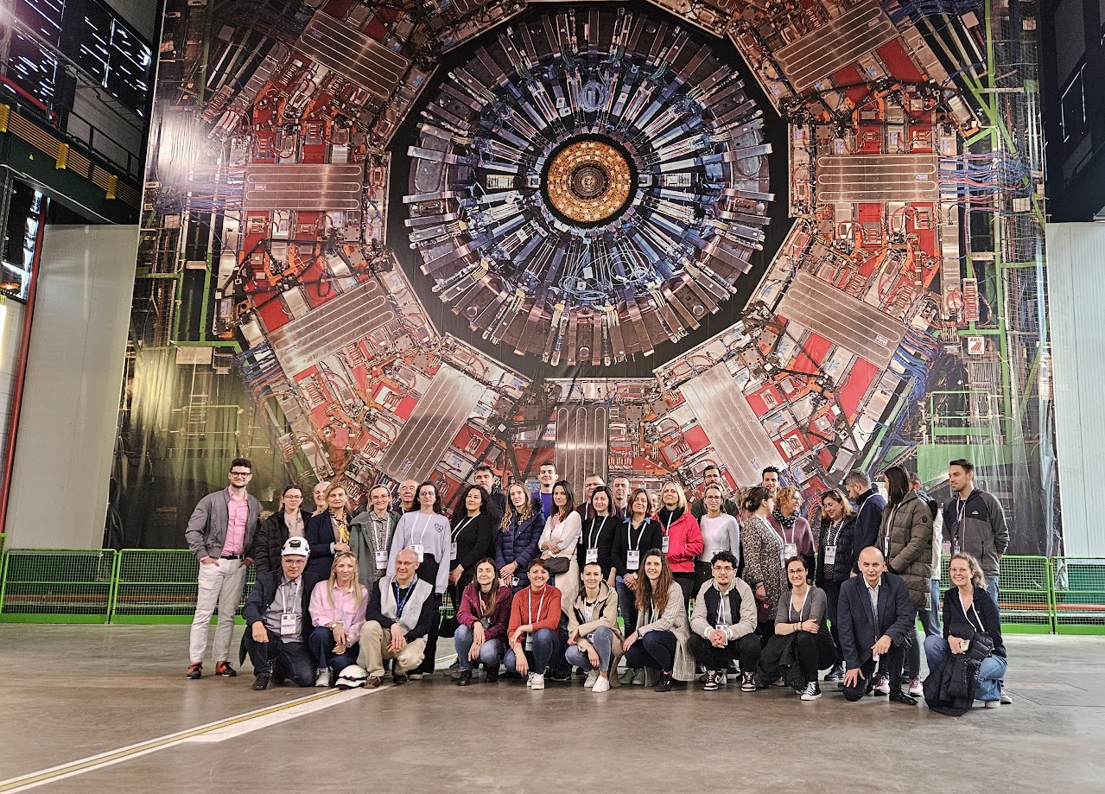
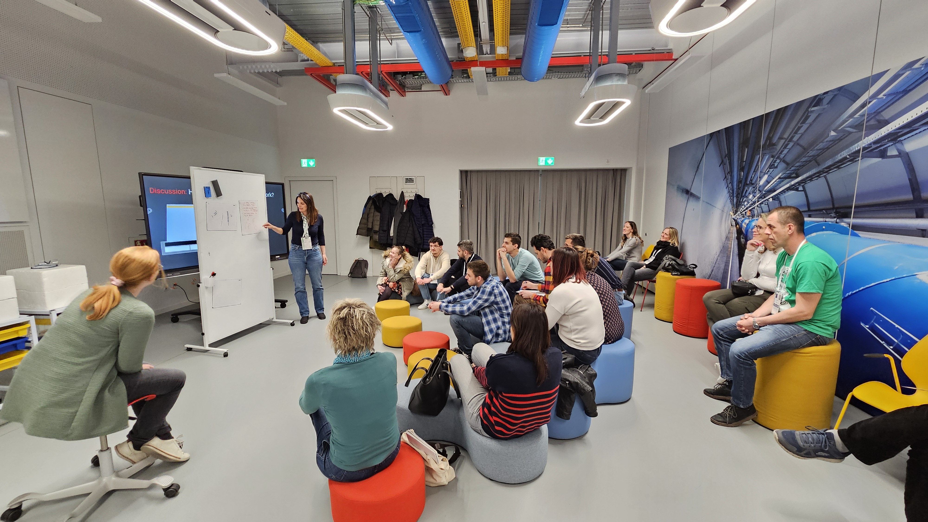
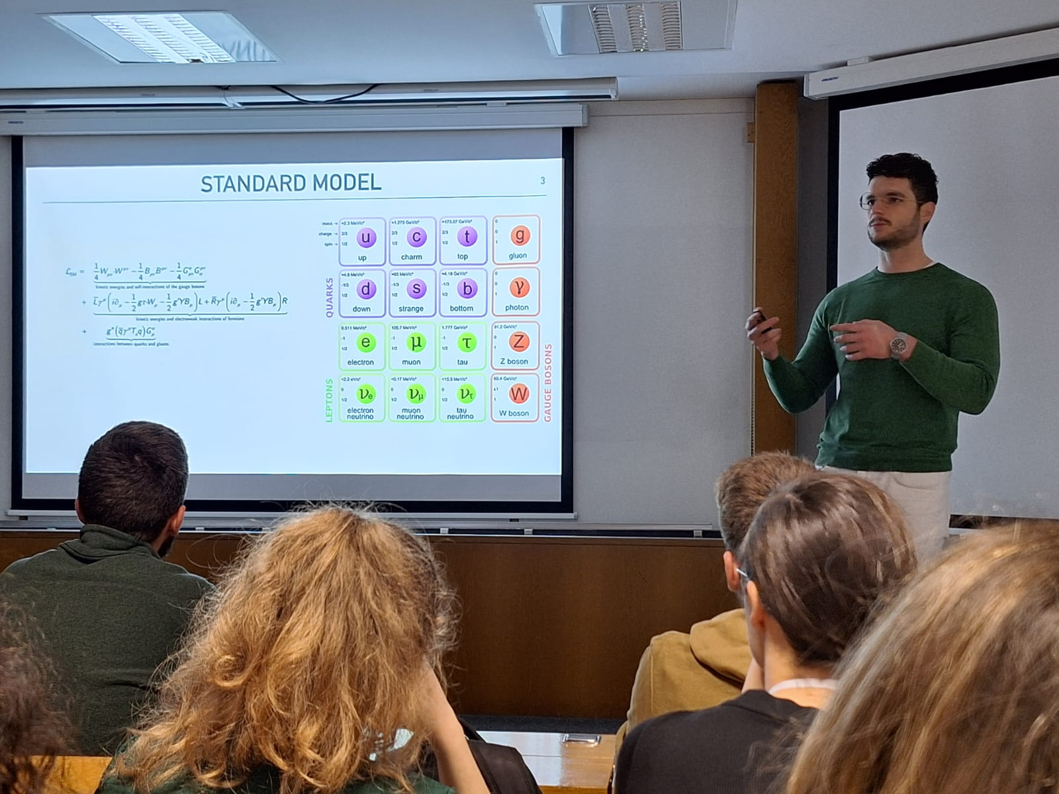
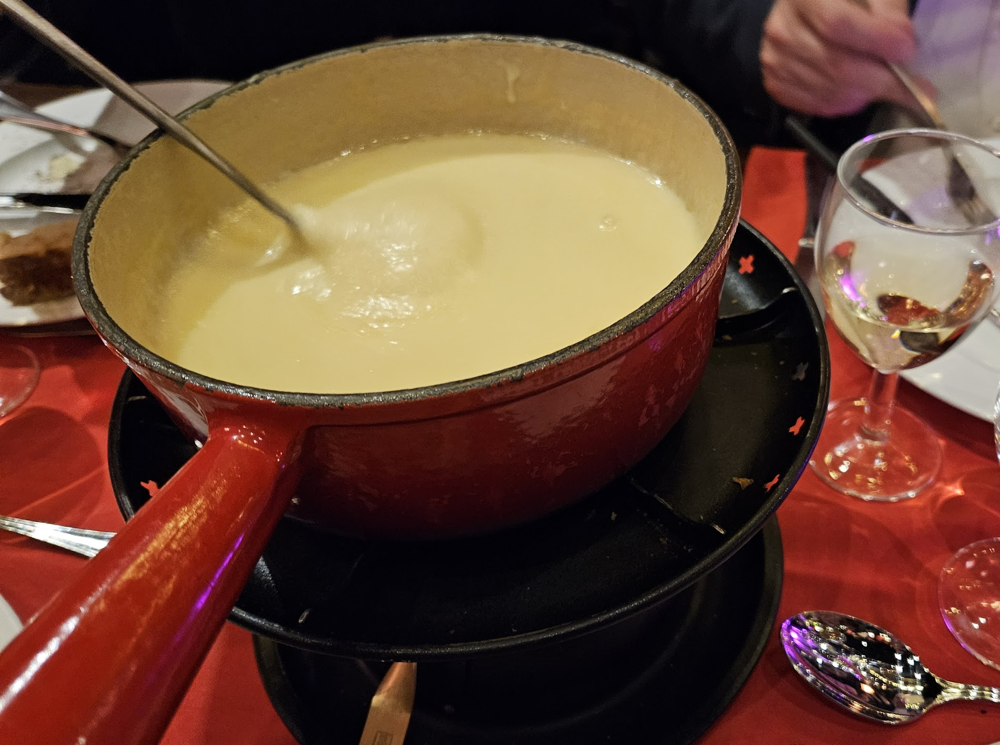
Croatian CERN Teachers Program
Where physics teachers are treated as VIPs
3 full days at CERN: lectures, visits,workshops
More than 200 physics teachers of Croatian elementary and highschools have attended the program since 2015

Slide 47
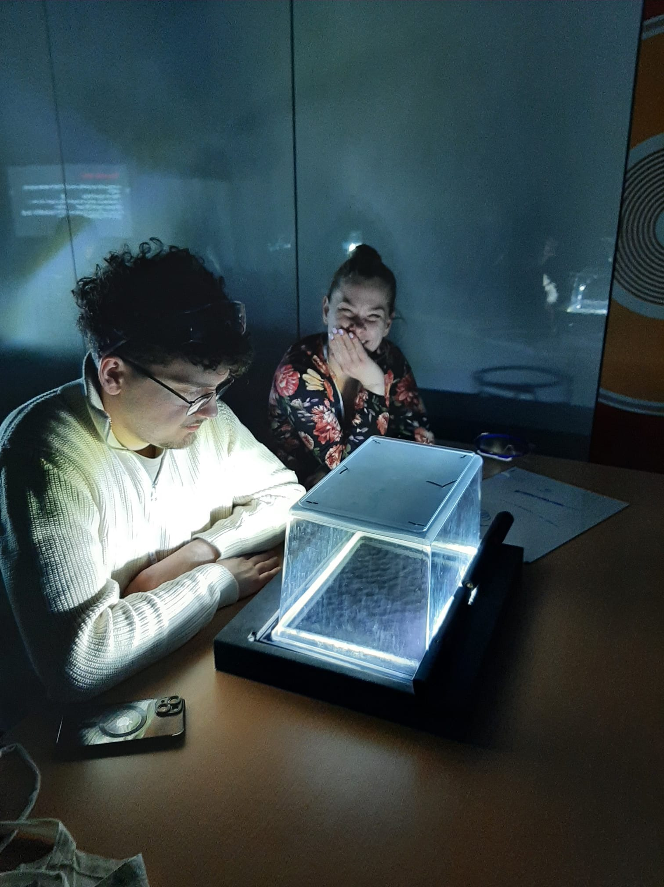
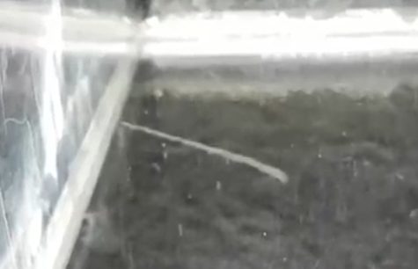
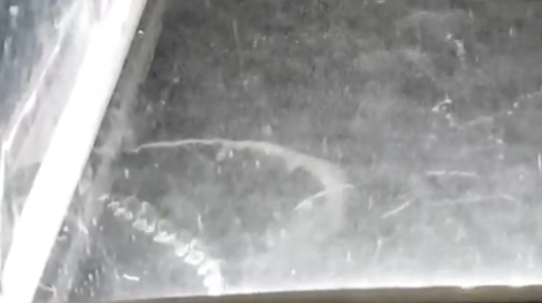
Teachers Program: build your own detector
… tracks of α,β,γ particles were appearing and disappearing in the chambers that the teachers just built

Slide 48

Croatian Teachers Program: Accepting applications NOW!
Do you know
Physics teachers?
Encourage them to apply!
Application
deadline:
28.2.2025

Slide 49
Backup

Slide 50
Top Suppliers in Croatia
By Country of Supplier
By Country of Origin
Supplier Name
Town
No. Orders
CERN Budget (CHF)
Teams Budget (CHF)
Supplier Name
Supplier Country
No. Orders
% HR
CERN (CHF)
Teams (CHF)
UNIVERSITY OF ZAGREB FER
Zagreb
1
84 912
–
UNIVERSITY OF ZAGREB FER
HR
1
100
84 912
–
SPIROFLEX
Ruscica
14
70 854
–
SPIROFLEX
HR
13
97
68 388
–
LEGRADMETAL GREDICAK
Oroslavje
15
52 764
–
LEGRADMETAL GREDICAK
HR
15
100
52 764
–
RUDER BOSKOVIC INSTITUTE
Zagreb
13
27 964
–
ELECTROTEL
RO
6
4
44 277
–
UO CRNI MACAK
Split
1
–
–
RUDER BOSKOVIC INSTITUTE
HR
13
100
27 964
–
LOVATO KONCAR
Zagreb
1
3 281
–
EUROMODUL SCHWEIZ AG
CH
1
71
15 008
–
OCTOPUS DOO
Split
1
–
–
UO CRNI MACAK
HR
1
100
–
–
EKOFIMA
Slavonski Brod
1
3 104
–
ASCENSEURS SCHINDLER
CH
2
2
6 403
–
LOVATO KONCAR
HR
1
100
3 281
–
AMBO
Split
1
–
–
OCTOPUS DOO
HR
1
100
–
–
SEZONSKI OBRT ZA USLUGE IV AN SPORT
Split
1
–
–

Slide 51
List of contract/orders with the highest turnover in 2024 for Croatia
Contract/Order
Description
Supplier
Amount (CHF)
CA1091321
PROTOTYPE PIXEL SENSORS WITH HIGH TIME
UNIVERSITY OF ZAGREB FER
84 912
B1518
SIRIUS ASSEMBLING/CABLING
ELECTROTEL
44 277
CA1097603
REPAIR OF MOBILAB CONTAINER (B.6892)
EUROMODUL SCHWEIZ AG
15 008
CA1204513
J3091516 BELLOWS MODULES SANS INSERT RF
SPIROFLEX
13 950
CA1080159
J3086956 OUTILLAGE CONSOLIDATION SPS
LEGRADMETAL GREDICAK
13 122
CA1093641
J3089509 SPS SCRAPER
LEGRADMETAL GREDICAK
12 428
CA1103655
J3090458 WP12 ID45 WU212510
LEGRADMETAL GREDICAK
10 067
CA1002986
R5P2 IRRADIATION CAMPAIGN LOW DOSE RATE
RUDER BOSKOVIC INSTITUTE
9 767
CA1198959
J3092584 WP12-ID239 LARGE RADIAL BELLOWS
SPIROFLEX
8 898
CA1217250
R8 IRRADIATION CAMPAIGN
RUDER BOSKOVIC INSTITUTE
8 125

Slide 52
Croatian Representative in CERN Bodies
Croatia has the right to nominate representative that will attend:
  CERN Council meetings (exception: closed sessions)
  Finance Committee meetings
  Science Policy Meetings as observers
In the CERN Council and Finance Committee meetings, Croatia representative do not have voting rights but they have the right to participate in discussions without need to be invited to speak
Croatia can also name a delegate in the Advisory Committee of CERN Users (ACCU):
  ACCU: forum for discussion between the CERN Management and the representatives of the CERN Users community to review the practical means taken by CERN for the work of Users of the Lab.

Slide 53
Representatives in CERN Council bodies
All appointed by Ministry of Science and Education (MZO)
CERN Council
2019-2022 Tome Antičić (MZO, state secretary) Ivica Puljak (Univ. of Split) Mirko Planinić (Univ. of Zagreb) | Since January 2023 Hrvoje Meštrić (MZO) Vuko Brigljević (IRB)
CERN Finance Committee
2019-2022 Vuko Brigljević (IRB) Staša Skenzić (MZO) | Since January 2023 Doris Jozić (MZO) Mirko Planinić (Univ. of Zagreb)
CERN Science Policy Committee
2019-2022 Mirko Planinić (Univ. of Zagreb) | Since January 2023 Damir Lelas (Univ. of Split)
ACCU Delegate
2019-2023 Tatjana Šuša (IRB) | Since January 2024 Marko Kovač (Univ. of Split)

Slide 54
Representatives of Croatia in other bodies
All appointed by Ministry of Science and Education (MZO)
Industry Liaison Officer (ILO)
2019-2022 Tome Antičić (MZO) | 2023-2024 Siniša Marijan (Board president at Končar Institute), retired in 2024 Marina Penić Levada (Končar Inst.)
Plenary ECFA
February 2020-February 2024 Vuko Brigljević (IRB) Mirko Planinić (Univ. of Zagreb) Ivica Puljak (Univ. of Split) | Since February 2024 Vuko Brigljević (IRB) Dinko Ferenček (IRB) Damir Lelas (Univ. of Split)
Restricted ECFA
February 2020-February 2024 Mirko Planinić (Univ. of Zagreb) | Since February 2024* Dinko Ferenček (IRB)

Slide 55

ACCU
Prepared by Tatjana Šuša
The Advisory Committee of CERN Users (ACCU) is the forum for discussion between the CERN Management and the representatives of CERN Users to review the practical means taken by CERN for the work of Users of the Laboratory.
The topics include: IT, housing, catering, transportation, infrastructure, insurance, registration, …
Topics can be put forward by the delegates or suggested by users
  In case you would like any topic to be discussed contact Marko Kovač, Croatian representative for the period 2024 - 2026.
ACCU meets four times per year

Slide 56
Committee for cooperation with CERN
The ministry (MZO) has decided to appoint a commitee to coordinate the cooperation with CERN (Povjerenstvo za suradnju s CERN-om)
This committee should among others:
  Foster networking and exchange of information about the opportunities opend by the Associate Membership
  Provide support to the ILO
  Give recommendation that could strengthen collaboration between the scientific and industrial sectors
  Give advice to Croatian representatives in the CERN Council and its committees
  Foster outreach activities and mobility of researchers and teachers
  Propose measure to enhance capacity for technology transfer
Composition of committee is supposed to have a wide representations: institutions, regions, researchers and companies, etc.

Slide 57
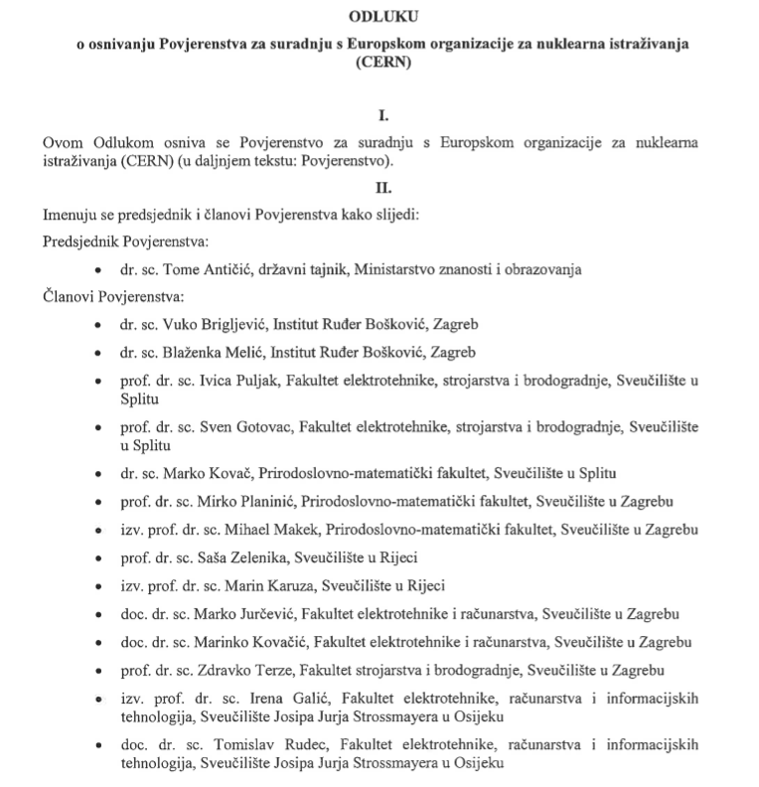
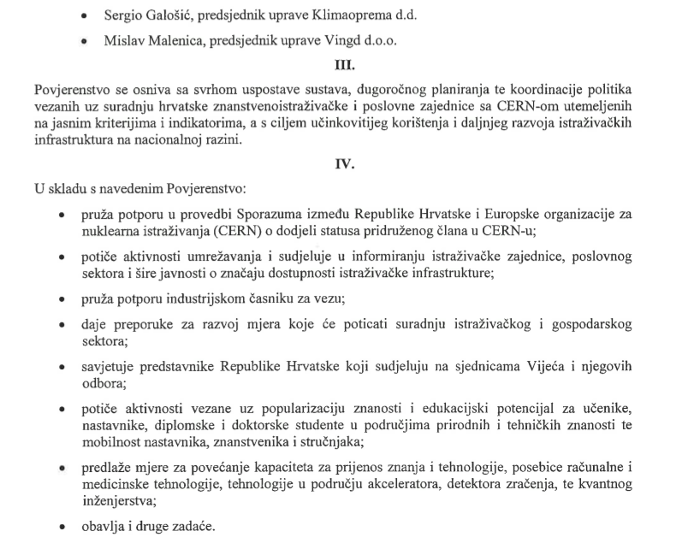
Committee for cooperation with CERN: Composition until 2022
Appointed by the minister of science and education on October 30, 2019:
It never met

Slide 58
Committee for cooperation with CERN: Composition since 2023
1st Meeting in July 2023!
2nd meeting in Nov. 2024
Appointed by the minister of science and education on January 19, 2023

Slide 59
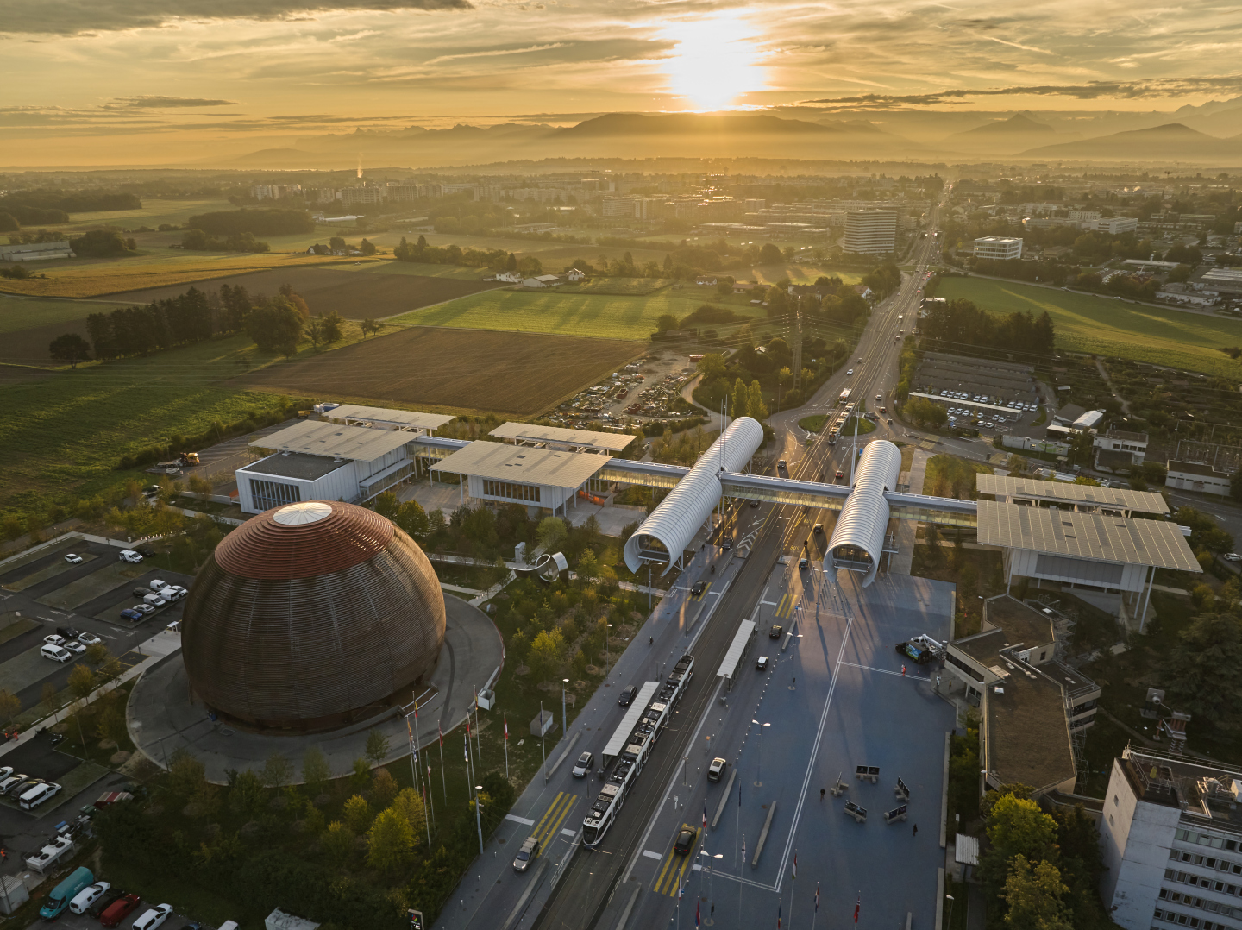
CERN New Public Exhibit:
The Science Gateway
Over 100k visitors since
Opening in October 2023

Slide 60
CERN Science Gateway
Worth a visit!

Slide 61
Thank you!
Hvala!

