Slide 1


Generalized Geodesic Equations from Planck Scale Deformed Dispersion Relations
Zubaida Karim Juthy
Graduate Student
EMJM MASS
University of Bremen

Slide 2
Table of Contents
What is a Dispersion Relation?
Why Modify the Dispersion Relation
Different MDRs
From Dispersion Relation to Geometry
Observable Consequences of MDRs
Geodesic Equation From The MDR

Slide 3

What is a Dispersion Relation?
Connects energy and momentum — governs wave and particle propagation.
Emerges from field equations in a point particle limit or via high-frequency (geometric optics) approximation.
Flat spacetime: Klein-Gordon $→ η^{μθ}p_{μ}p_{θ}+ m^{2}= 0$
Curved spacetime in GR, $g^{μν}\left(x\right)p_{μ}p_{ν}+m^{2}=0$
Also emerge as Casimir operator of symmetries on relativistic point particle kinemetics.
Defines the mass shell — geometric surface in momentum space.
The mass-shell hyperboloid reflects the fundamental constraint imposed by Lorentz invariance and energy conservation.
Encodes causal structure and allowed trajectories.
Notes:
Geometric constraint

Slide 4

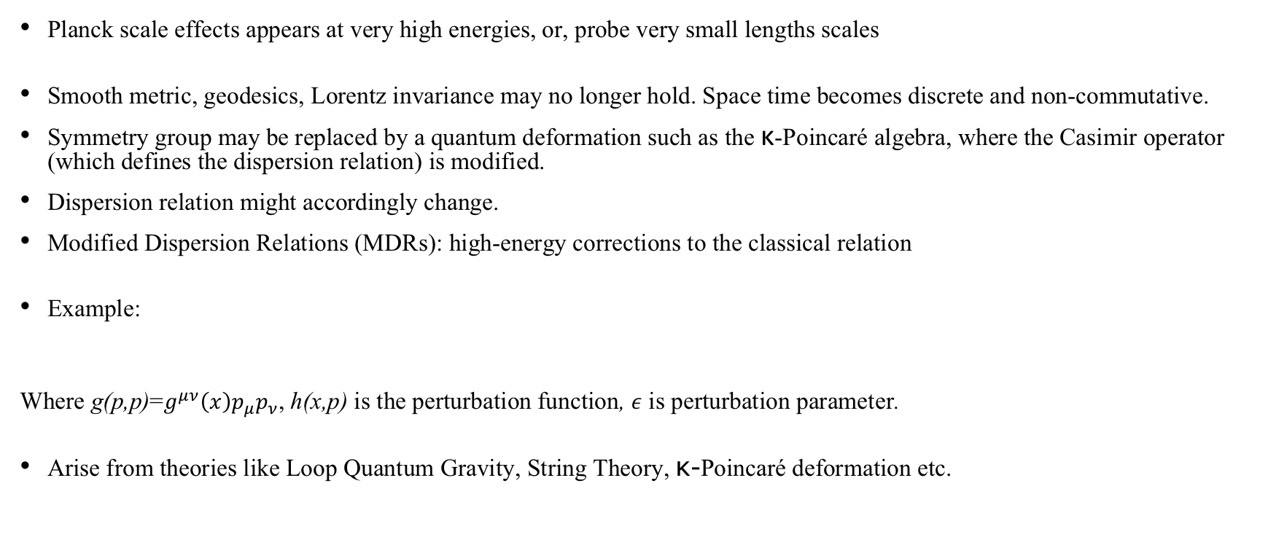
Why Modify the Dispersion Relation
Planck scale effects appears at very high energies, or, probe very small lengths scales
Smooth metric, geodesics, Lorentz invariance may no longer hold. Space time becomes discrete and non-commutative.
Symmetry group may be replaced by a quantum deformation such as the κ-Poincaré algebra, where the Casimir operator (which defines the dispersion relation) is modified.
Dispersion relation might accordingly change.
Modified Dispersion Relations (MDRs): high-energy corrections to the classical relation
Example:
Where g(p,p)=$g^{μν}\left(x\right)p_{μ}p_{ν}$, h(x,p) is the perturbation function, $ε$ is perturbation parameter.
Arise from theories like Loop Quantum Gravity, String Theory, κ-Poincaré deformation etc.
Notes:
1019 GeV, Because these MDRs affect how particles travel, how fast they move, how they bend in a gravitational field, and how they accumulate delays — and all of these are potentially observable. In high-energy astrophysics, the arrival times of photons from gamma-ray bursts or the shape of black hole shadows could carry imprints of such modifications. Thus, MDRs provide one of the most accessible phenomenological windows into quantum gravity — a regime we otherwise cannot probe directly.
phenomenological models which shall capture aspects of quantum gravity often employ Planck scale modified
path-integral quantization, and loop quantum gravity — suggest that spacetime may become discrete, non-commutative, or foam-like due to strong quantum fluctuations.

Slide 5
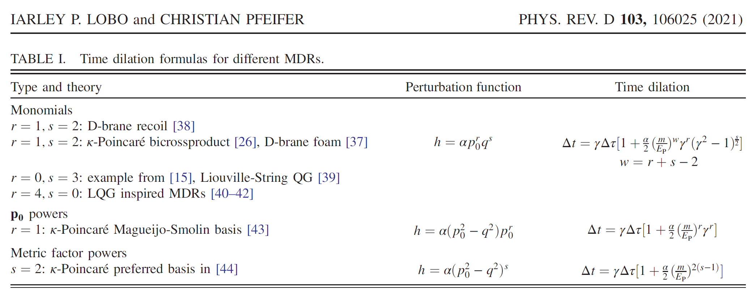
Different MDRs
Notes:
and the time dilation between their rest frame and a laboratory frame, induced by Planck scale MDRs.

Slide 6
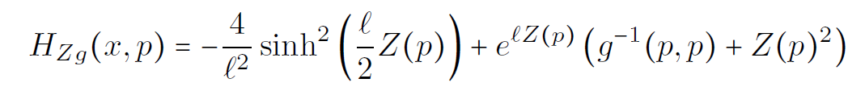
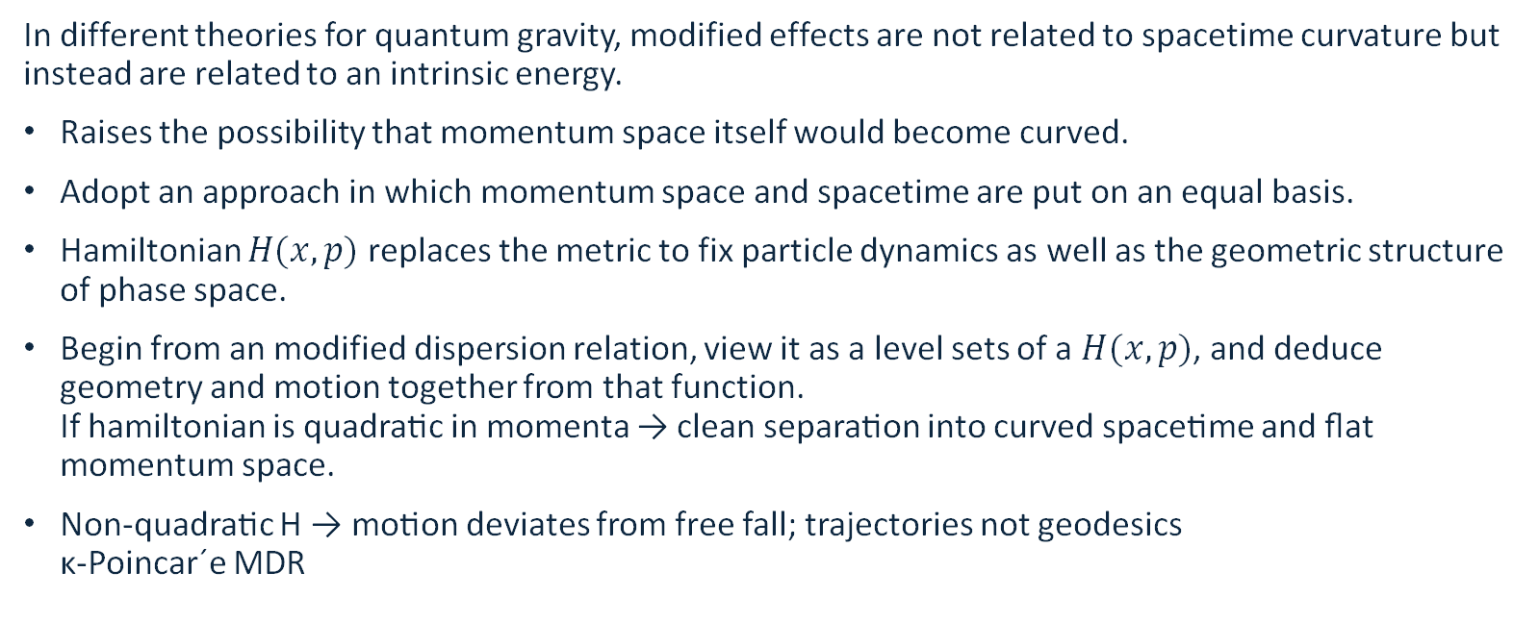
From Dispersion Relation to Geometry
In different theories for quantum gravity, modified effects are not related to spacetime curvature but instead are related to an intrinsic energy.
Raises the possibility that momentum space itself would become curved.
Adopt an approach in which momentum space and spacetime are put on an equal basis.
Hamiltonian $H(x,p)$replaces the metric to fix particle dynamics as well as the geometric structure of phase space.
Begin from an modified dispersion relation, view it as a level sets of a $H(x,p)$, and deduce geometry and motion together from that function.
If hamiltonian is quadratic in momenta → clean separation into curved spacetime and flat momentum space.
Non-quadratic H → motion deviates from free fall; trajectories not geodesics
κ-Poincar´e MDR
Notes:
these extra terms behave like effective forces or drifts that perturb the particle away from classical geodesic motion. They can be seen as encoding a coupling between the particle’s trajectory and a curved momentum space or a dynamical background field,

Slide 7
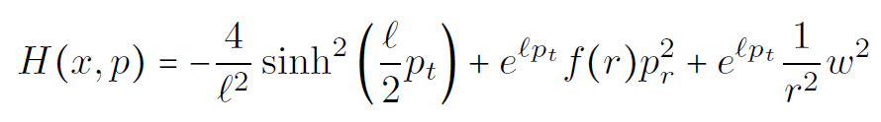
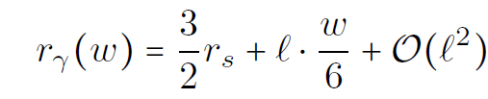
Observable Consequences of MDRs
1. Momentum-Dependent Photon Spheres
In General Relativity, the photon sphere of a Schwarzschild black hole lies at a fixed radius r = 3GM, independent of photon energy or momentum.
In MDR frameworks like κ-Poincaré, this radius becomes momentum-dependent.
The resulting photon sphere radius becomes:
Implication: photons with larger angular momentum w orbit at slightly larger radii.
  This stretches the photon sphere → distorts the black hole shadow.
  Leads to observable deviations from GR in future high-resolution black hole imaging (e.g., with the Event Horizon Telescope).
Notes:
these extra terms behave like effective forces or drifts that perturb the particle away from classical geodesic motion. They can be seen as encoding a coupling between the particle’s trajectory and a curved momentum space or a dynamical background field,

Slide 8
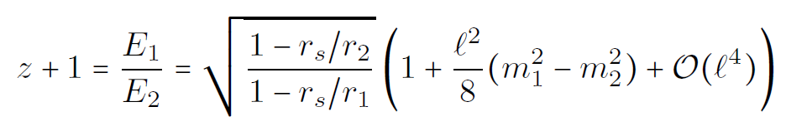

Observable Consequences of MDRs
2. Planck-Scale Corrections to Gravitational Redshift
In GR, redshift is determined purely by gravitational potential difference between two static observers.
In MDRs, the redshift formula gains Planck-suppressed corrections:
New feature: redshift depends not only on geometry but also on observers’ rest masses.
  Violates equivalence principle at leading order in $l^{2}$.
  Observers with different masses would measure slightly different frequencies for the same photon.
Experimental prospect:
  High-precision atomic clocks with known mass differences could detect or constrain such effects.
  Opens a way to test Lorentz symmetry violation in lab or satellite experiments.
Notes:
these extra terms behave like effective forces or drifts that perturb the particle away from classical geodesic motion. They can be seen as encoding a coupling between the particle’s trajectory and a curved momentum space or a dynamical background field,

Slide 9

Generalized Geodesic Equation From The MDR
Hamiltonian in the GR case:
$$H=\frac{1}{2}g^{ab}p_{a}p_{b}$$
Hamilton’s equation of motion:
$${\overset{˙}{x}}^{a}=\frac{∂H}{∂p_{a}}, {\overset{˙}{p}}_{a}=−\frac{∂H}{∂x^{a}}$$
The geodesic equation appears naturally from these equations
$${\overset{¨}{x}}^{a}+Γ_{bc}^{a}{\overset{˙}{x}}^{b}{\overset{˙}{x}}^{c}=0$$
Goal of my thesis:
$H\left(x,p\right)= H\left(g\left(p,p\right), A\left(p\right)\right)$, where $g\left(p,p\right)$= $g^{ab}\left(x\right)p_{a}p_{b}$, $A\left(p\right)=$ $A^{c}\left(x\right)p_{c}$
The example I have considered,
$$H\left(x,p\right)=g^{ab}\left(x\right)p_{a}p_{b}+κg^{ab}\left(x\right)p_{a}p_{b}⋅A^{c}\left(x\right)p_{c}$$
=$g\left(p,p\right)+κg\left(p,p\right)A(p)$
Notes:
these extra terms behave like effective forces or drifts that perturb the particle away from classical geodesic motion. They can be seen as encoding a coupling between the particle’s trajectory and a curved momentum space or a dynamical background field,

Slide 10

Generalized Geodesic Equation From The MDR
The equations of motion
Following similar steps to the GR case we arrive at the geodesic equation
$${\overset{¨}{x}}^{a}=−Γ_{bc}^{a}{\overset{˙}{x}}^{c}+\frac{κ}{4}\left[g\left(\overset{˙}{x},\overset{˙}{x}\right){\overset{˙}{x}}^{c}\left(−∇^{a}A_{c}+∇_{c}A^{a}\right)+2{\overset{˙}{x}}^{a}{\overset{˙}{x}}^{b}{\overset{˙}{x}}^{c}∇_{c}A_{b}\right]$$
coupling between the particle’s trajectory and a curved momentum space or a dynamical background field
Rearranging,
${\overset{¨}{x}}^{a}=−Γ_{bc}^{a}{\overset{˙}{x}}^{b}{\overset{˙}{x}}^{c}+κ{\overset{˙}{x}}^{b}{\overset{˙}{x}}^{c}{\overset{˙}{x}}^{d}Q_{\left(bcd\right)}^{a}$
Where,
$$Q_{\left(bcd\right)}^{a}=−\frac{1}{4}g_{(bd}∇^{a}A_{c)}+\frac{1}{4}g_{(bd}∇_{c)}A^{a}+\frac{1}{2}δ_{(d}^{a}∇_{c}A_{b)}$$

Slide 11
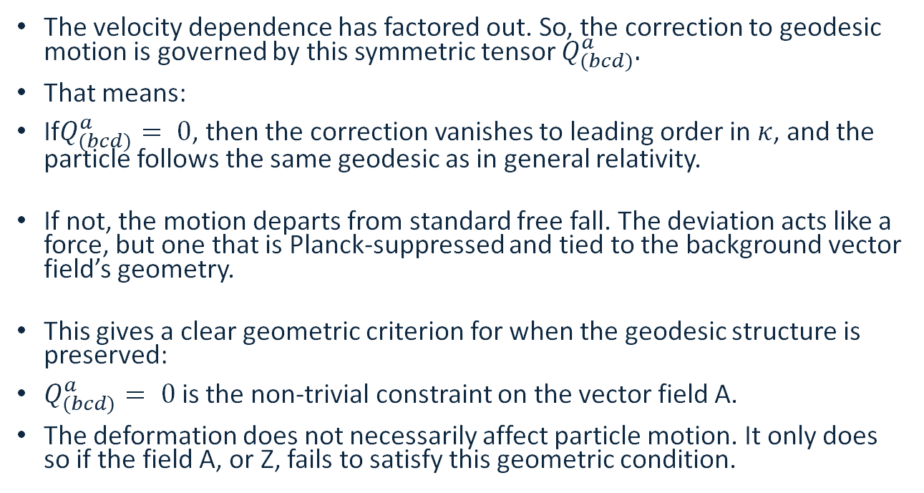
Generalized Geodesic Equation From The MDR
The velocity dependence has factored out. So, the correction to geodesic motion is governed by this symmetric tensor $Q_{(bcd)}^{a}.$
That means:
If$Q_{(bcd)}^{a}= 0$, then the correction vanishes to leading order in $κ$, and the particle follows the same geodesic as in general relativity.
If not, the motion departs from standard free fall. The deviation acts like a force, but one that is Planck-suppressed and tied to the background vector field’s geometry.
This gives a clear geometric criterion for when the geodesic structure is preserved:
$Q_{(bcd)}^{a}= 0$is the non-trivial constraint on the vector field A.
The deformation does not necessarily affect particle motion. It only does so if the field A, or Z, fails to satisfy this geometric condition.

Slide 12
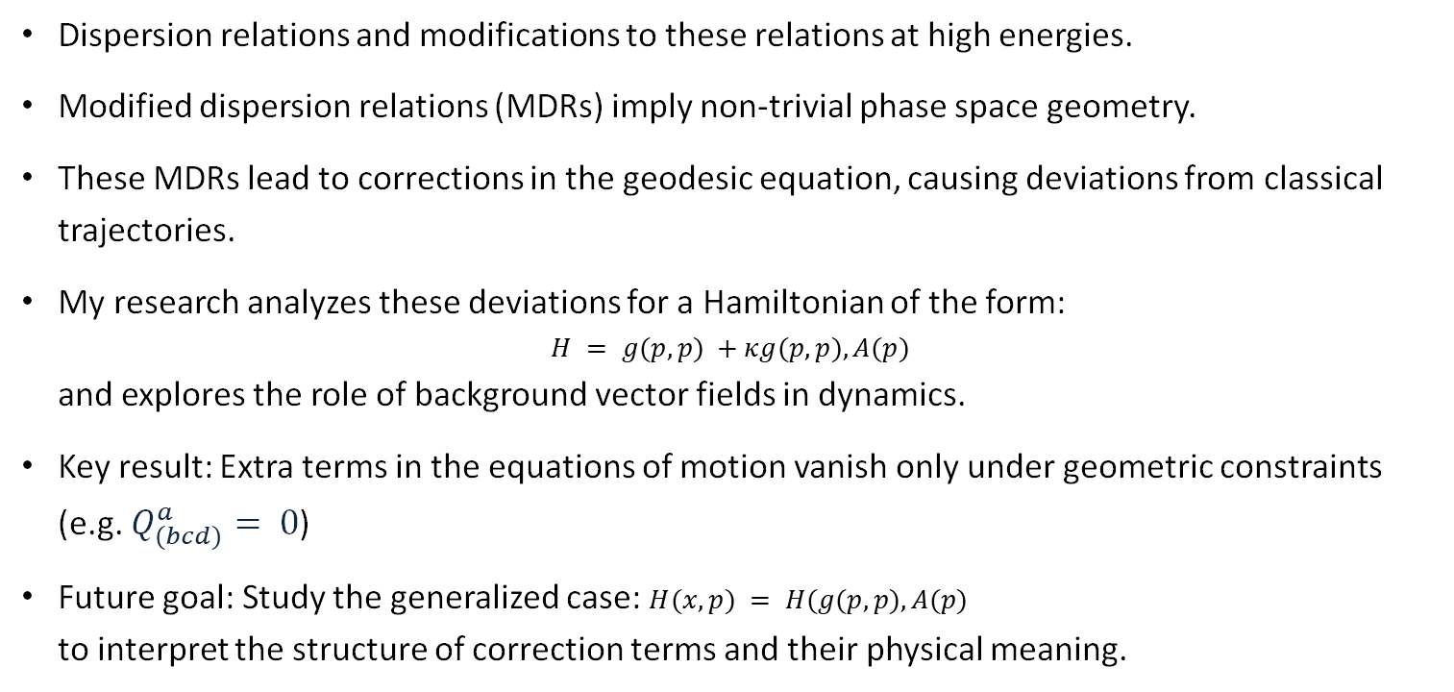
Summary and Outlook
Dispersion relations and modifications to these relations at high energies.
Modified dispersion relations (MDRs) imply non-trivial phase space geometry.
These MDRs lead to corrections in the geodesic equation, causing deviations from classical trajectories.
My research analyzes these deviations for a Hamiltonian of the form:
$H = g(p, p) +κg(p, p), A(p)$
and explores the role of background vector fields in dynamics.
Key result: Extra terms in the equations of motion vanish only under geometric constraints (e.g. $Q_{(bcd)}^{a}= 0$)
Future goal: Study the generalized case: $H(x,p) = H(g(p,p), A(p)$
to interpret the structure of correction terms and their physical meaning.

Slide 13
References
Brahma, Suddhasattwa, and Michele Ronco. "Constraining the loop quantum gravity parameter space from phenomenology." Physics Letters B 778 (2018): 184-189.
L. Barcaroli, L. K. Brunkhorst, G. Gubitosi, N. Loret, and C. Pfeifer, Hamilton geometry: Phase space geometry frommodified dispersion relations, Phys. Rev. D 92, 084053 (2015), arXiv:1507.00922 [gr-qc].
L. Barcaroli, L. K. Brunkhorst, G. Gubitosi, N. Loret, and C. Pfeifer, Curved spacetimes with local κ-Poincar´e dispersionrelation, Phys. Rev. D 96, 084010 (2017), arXiv:1703.02058 [gr-qc].
D. L¨a¨anemets, M. Hohmann, and C. Pfeifer, Observables from spherically symmetric modified dispersion relations, Int. J.Geom. Meth. Mod. Phys. 19, 2250155 (2022), arXiv:2201.04694 [gr-qc]
I. P. Lobo and C. Pfeifer, Reaching the Planck scale with muon lifetime measurements, Phys. Rev. D 103, 106025 (2021),arXiv:2011.10069 [hep-ph].

Slide 14
Thank You For Your Attention!
Any Questions?

