Slide 1
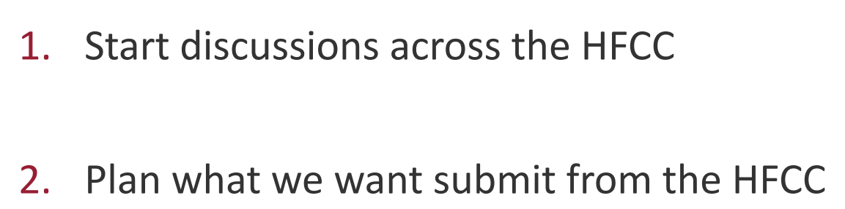
Summary
Strategic Joint M Strategic Joint Meeting of the HFCC
Nov. 8 – 9, at Stony Brook University
S
https://indico.bnl.gov/event/24922/
Two main objectives for this meeting

Slide 2
Participant list
Abidi, Haider, BNL | Janot, Patrick, CERN
Arnold, Hannah, Stony Brook Univ | Li, Derun, DOE
Bafia, Daniel, FNAL | Lipeles, Elliot, UPenn
Bai, Mei, SLAC | Lykken, Joseph, FNAL
Barish, Barry, CalTech | Madrid, Christopher, Texas Tech
Bauerdick, Lothar, FNAL | Nakada, Tatsuya, EPFL
Bee, Chris, Stony Brook Univ | Paramonov, Alexander, ANL
Begel, Michael, BNL | Passarelli, Donato, FNAL
Belomestnykh, Sergey, FNAL | Patterson, Ritchie, Cornell Univ
Bendavid, Josh, MIT | Patwa, Abid, DOE
Canepa, Anadi, FNAL | Paus, Christoph, MIT
Dawson, Sally, BNL | Pilat, Fulvia, ORNL
Demarteau, Marcel, ORNL | Posen, Sam, FNAL
Denisov, Dmitri, BNL | Rajagopalan, Srini, BNL
Eno, Sarah, Univ of Maryland | Raubenheimer, Tor, SLAC
Fischer, Wolfram, BNL | Reina, Laura, Florida State
Geddes, Cameron, LBNL | Reynolds, Elliot, Univ of Kansas
Gessner, Spencer, SLAC | Seryi, Andrei, JLab
Gonski, Julia, SLAC | Shank, James, NSF
Gordon, Howard, BNL | Tuts, Michael, Columbia Univ
Gourlay, Stephen, FNAL | Vay, Jean-Luc, LBNL
Grannis, Paul, Stony Brook Univ | Vernieri, Caterina, SLAC
Haber, Carl, LBNL | Yoshida, Rikutaro, ANL
Hirosky, Robert, Univ of Virginia | Zhou, Bing, Univ of Michigan
Hirschauer, James, FNAL | Zimmermann, Frank, CERN
Hobbs, John, Stony Brook Univ
Jakobs, Karl, Freiburg
Benedikt, Michael, CERN
Burkett, Kevin, FNAL
Cairo, Valentina, CERN
Grojean, Christophe, DESY
Hance, Michael, UCSC
Liepe, Matthias, Cornell Univ
Marsiske, Helmut, DOE
Piot, Philippe, ANL
Rameika, Regina, DOE
Roe, Natalie, LBNL
Russell, Steven, LANL
Shiltsev, Vladimir, NIU
Stapnes, Steiner, CERN

Slide 3
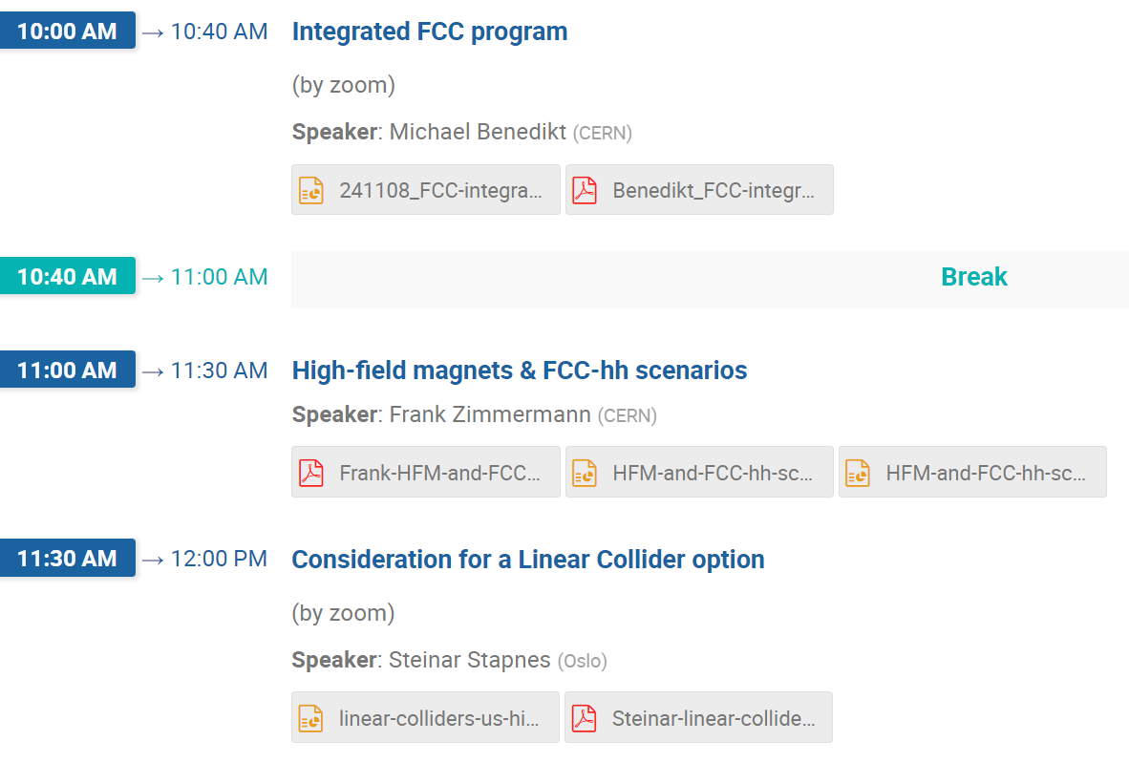
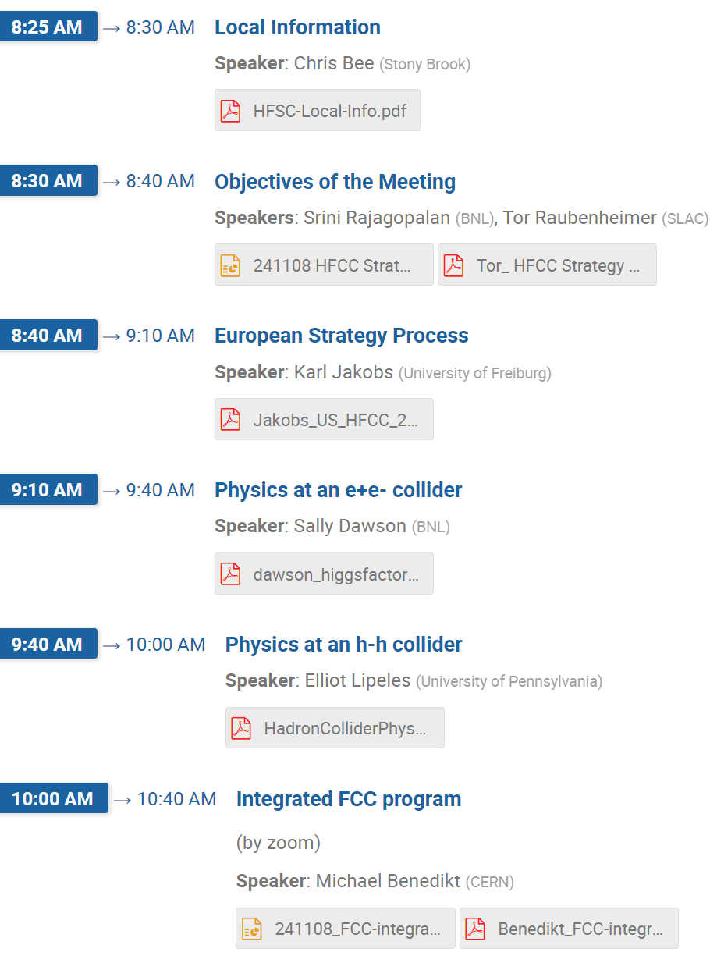
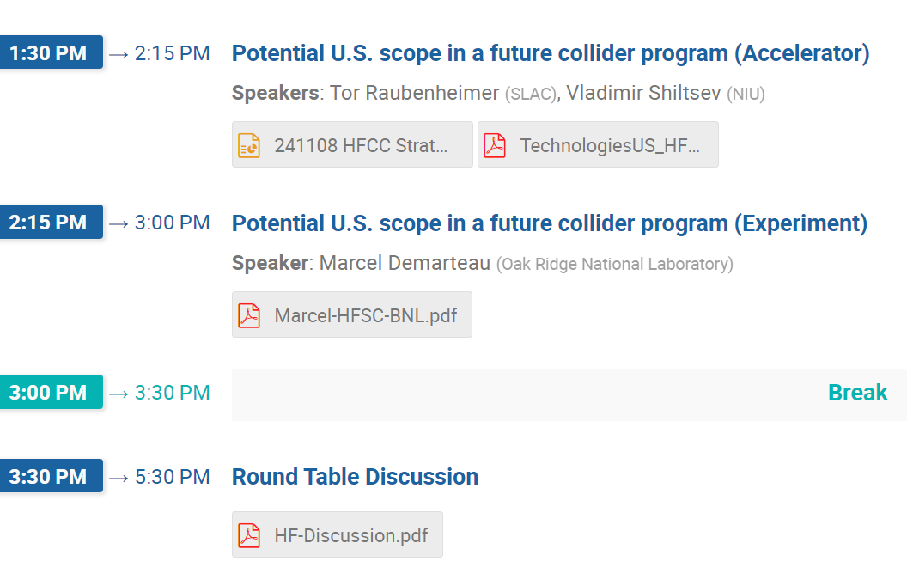
Agenda

Slide 4
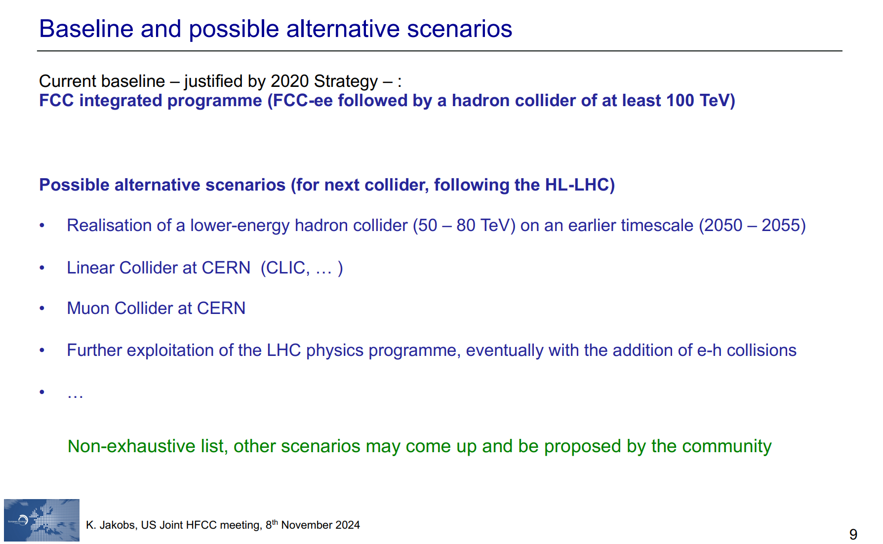
Karl Jakobs (University of Freiburg)

Slide 5
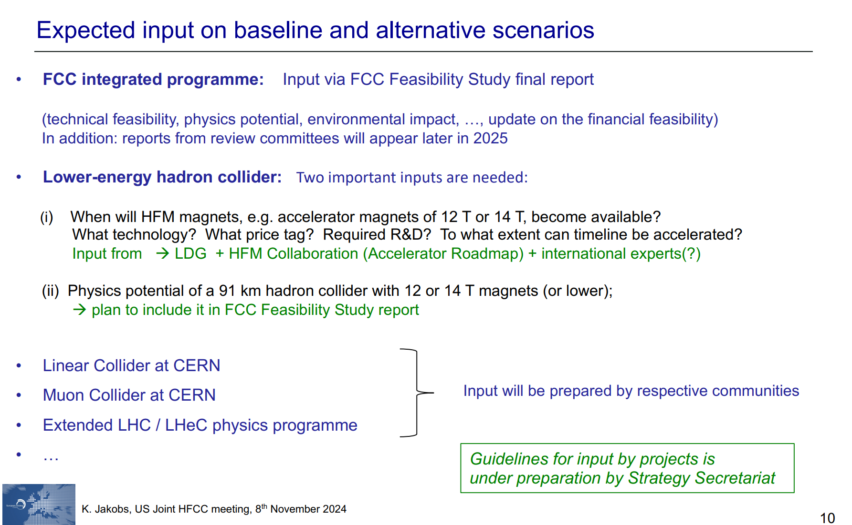
Karl Jakobs (University of Freiburg)

Slide 6
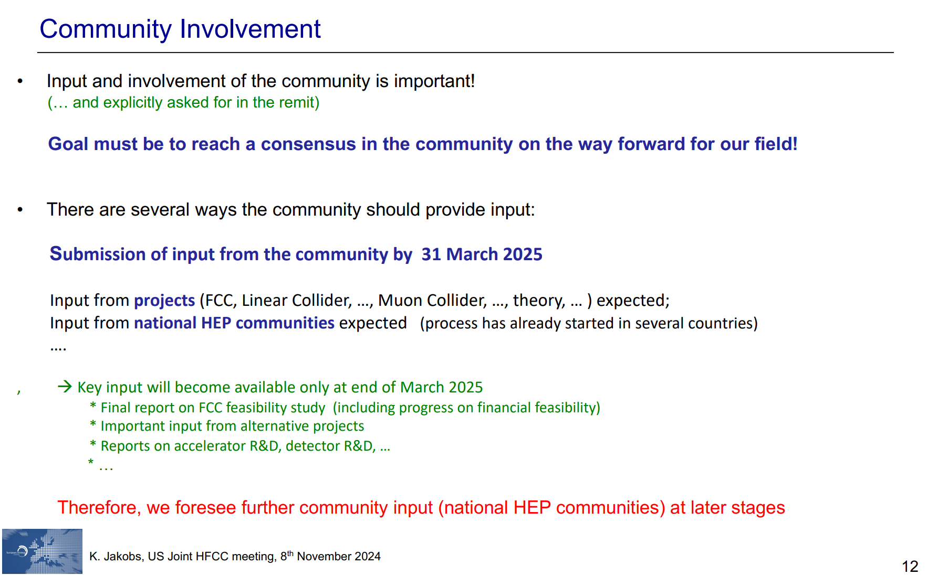
Karl Jakobs (University of Freiburg)

Slide 7
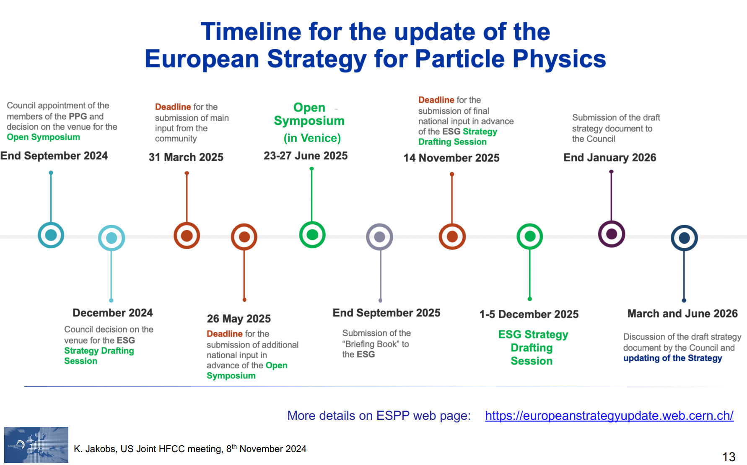
Karl Jakobs (University of Freiburg)

Slide 8
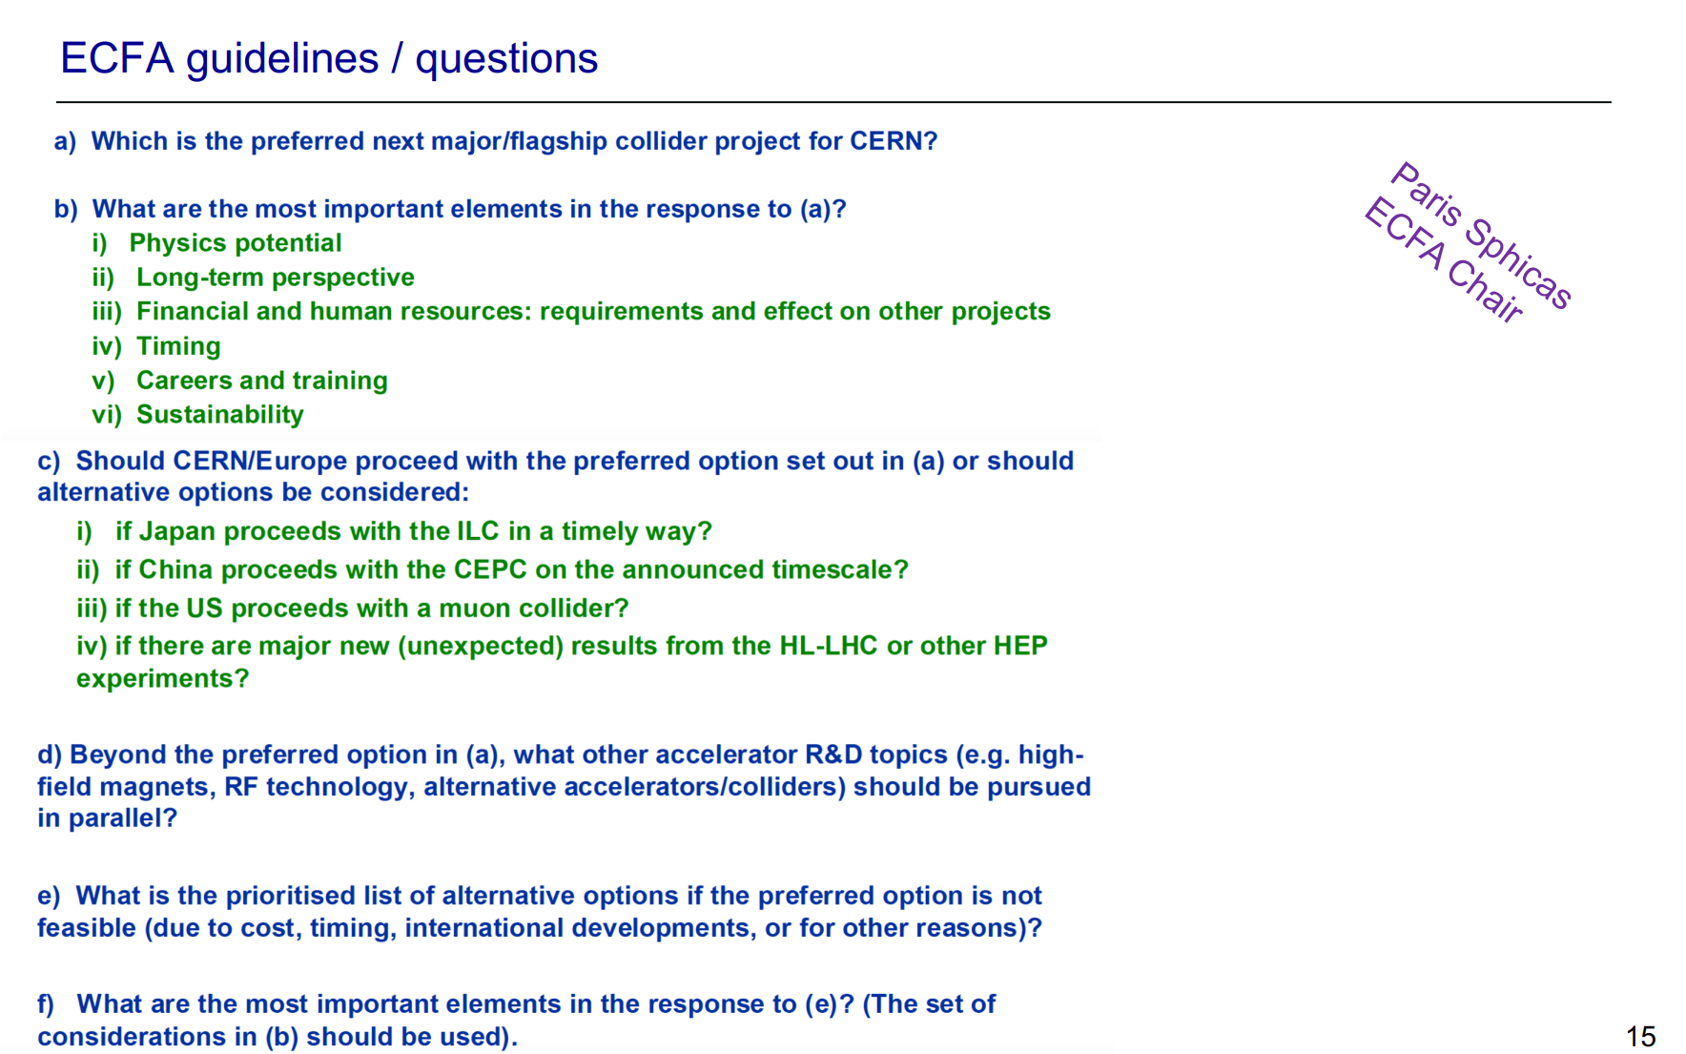
Karl Jakobs (University of Freiburg)

Slide 9
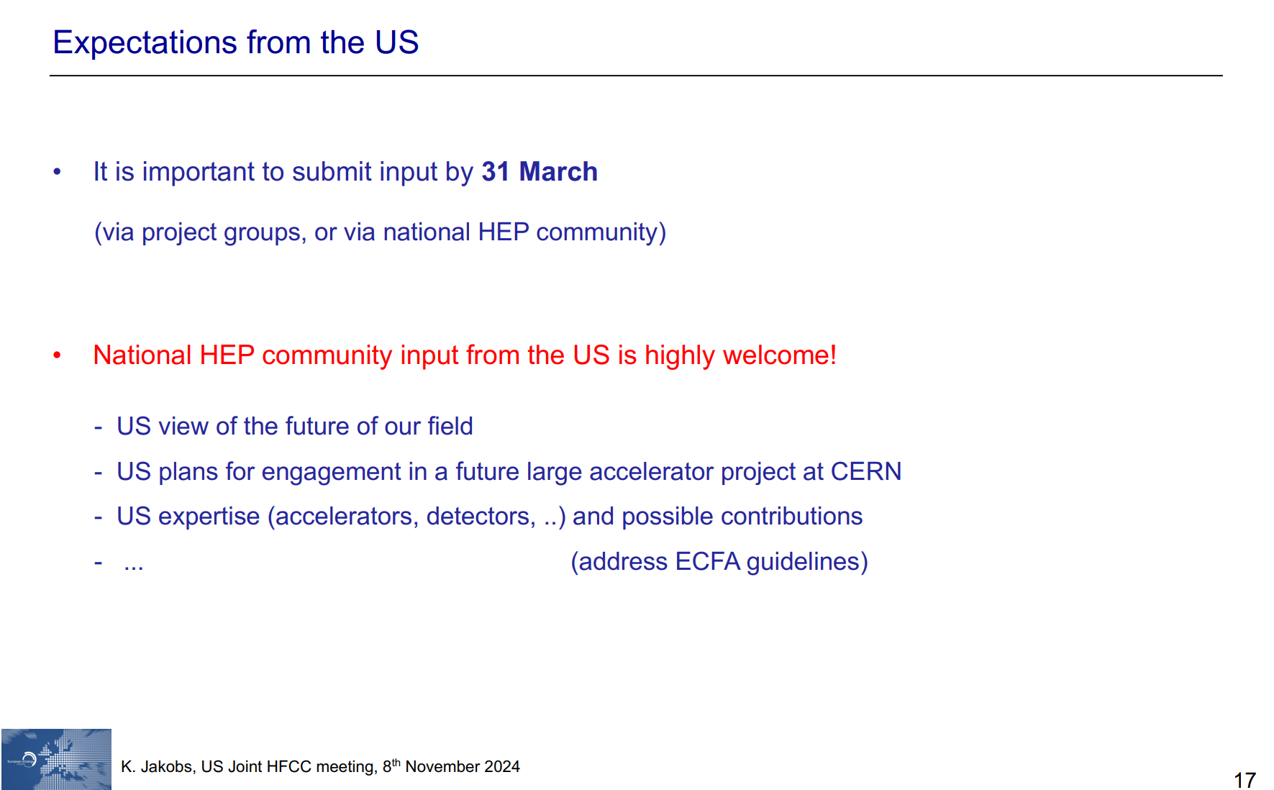
Karl Jakobs (University of Freiburg)

Slide 10
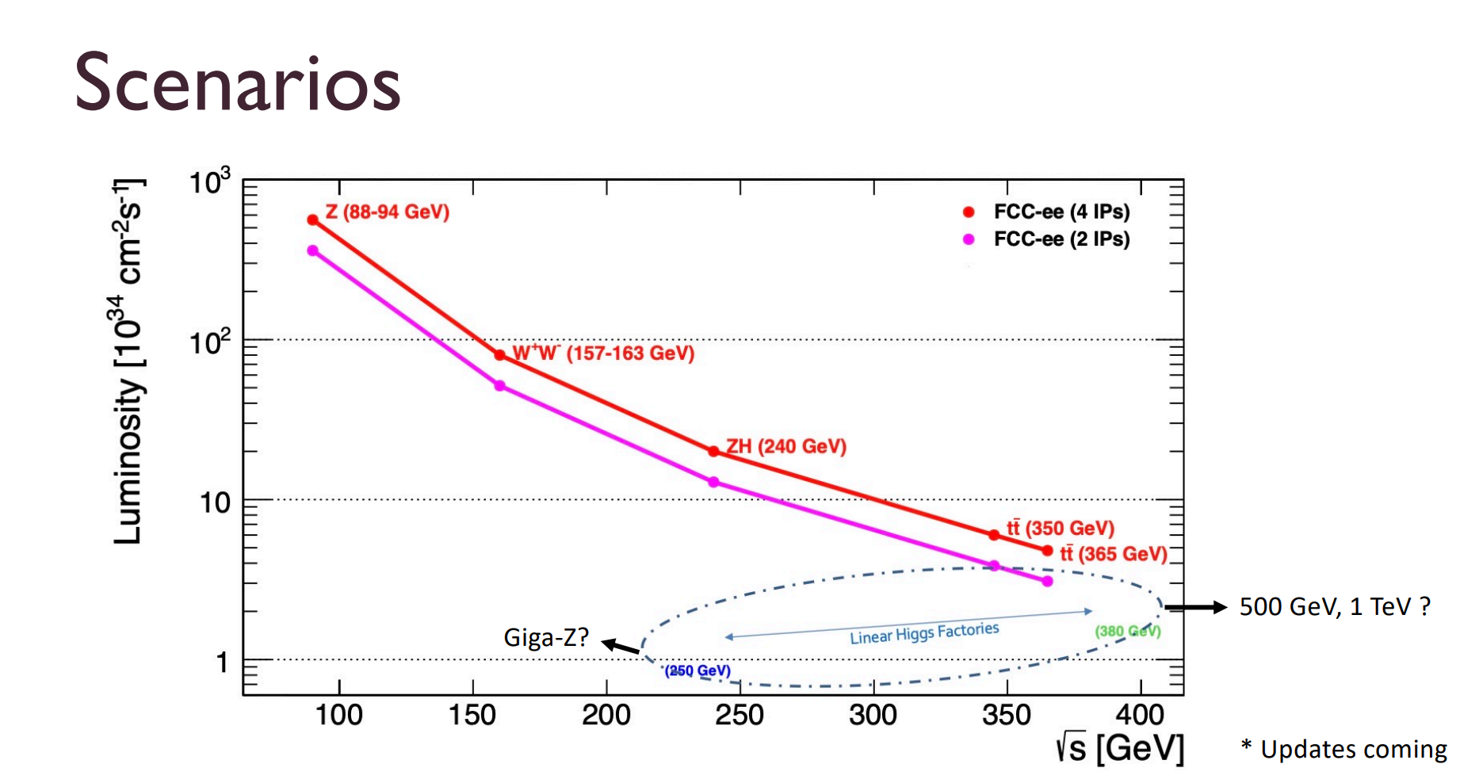
Sally Dawson (BNL)

Slide 11
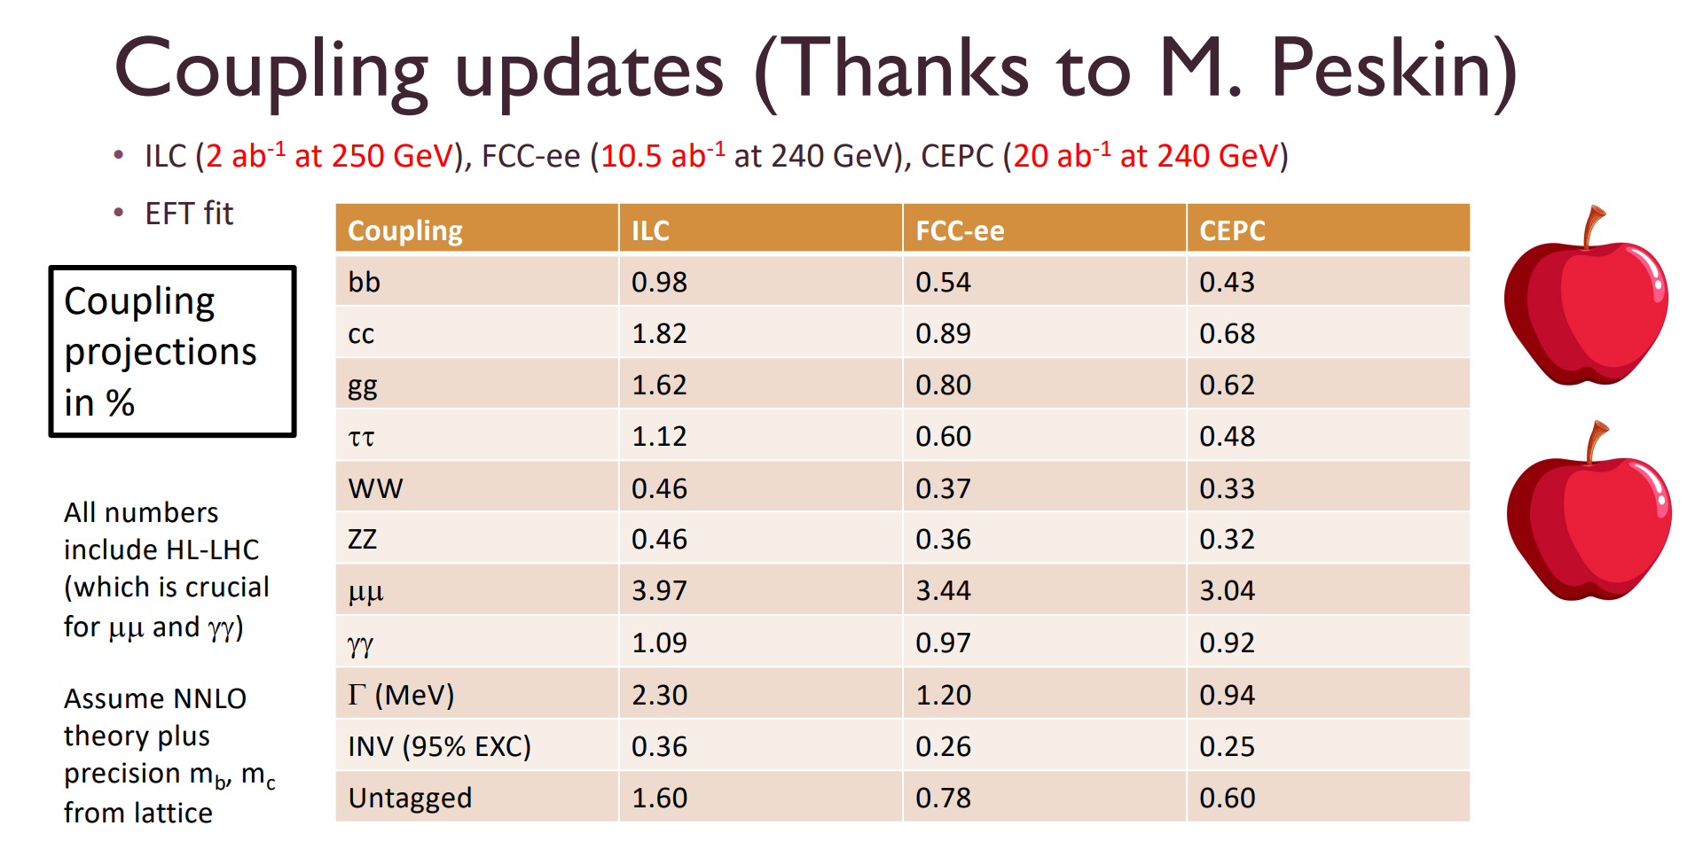
Sally Dawson (BNL)

Slide 12
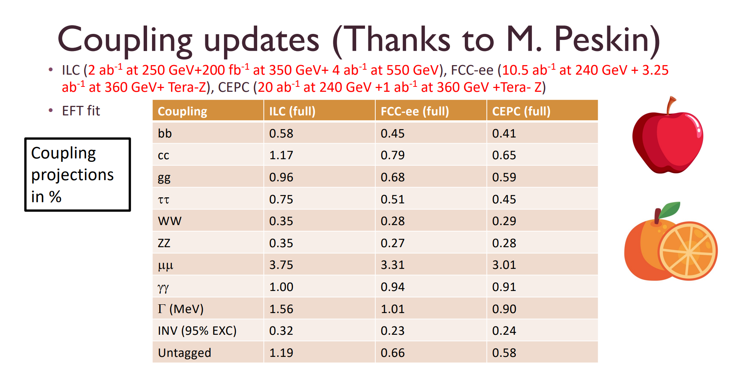
Sally Dawson (BNL)

Slide 13
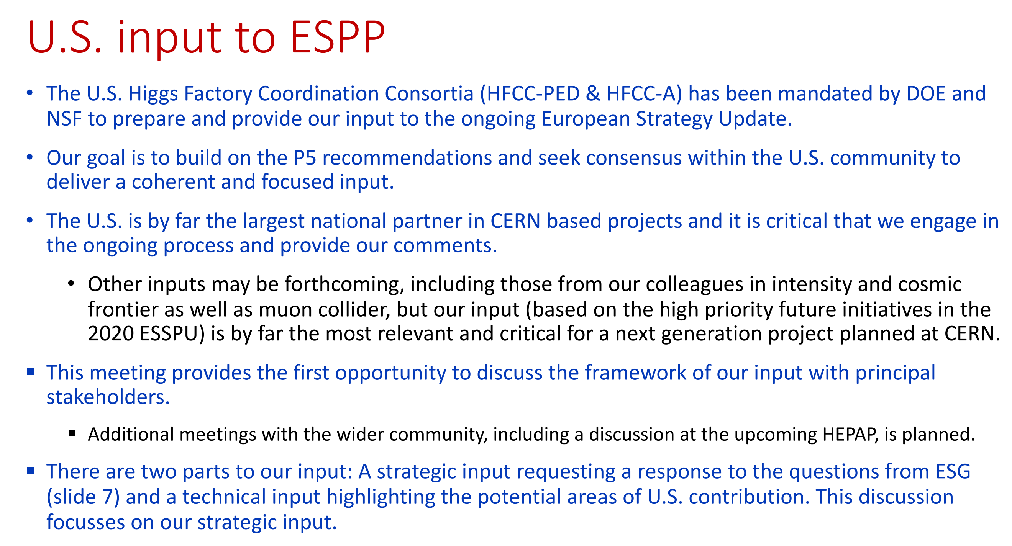
Srini

Slide 14
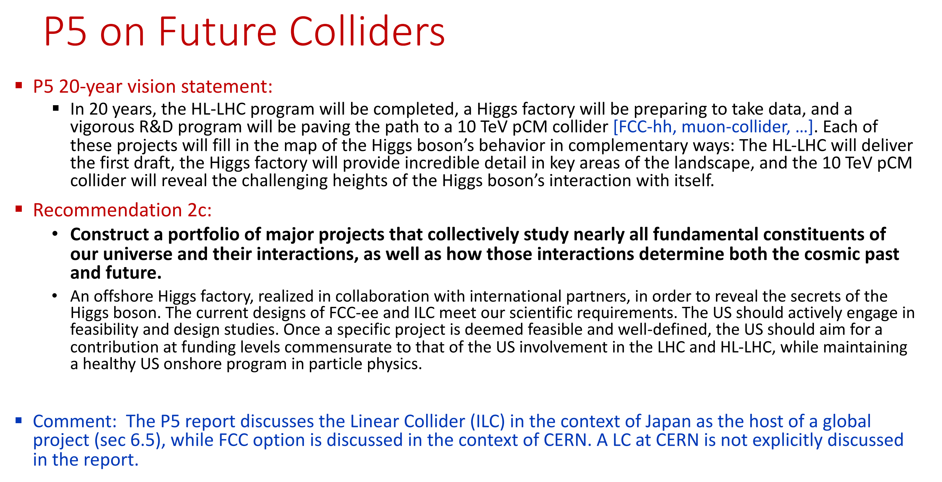
Srini

Slide 15
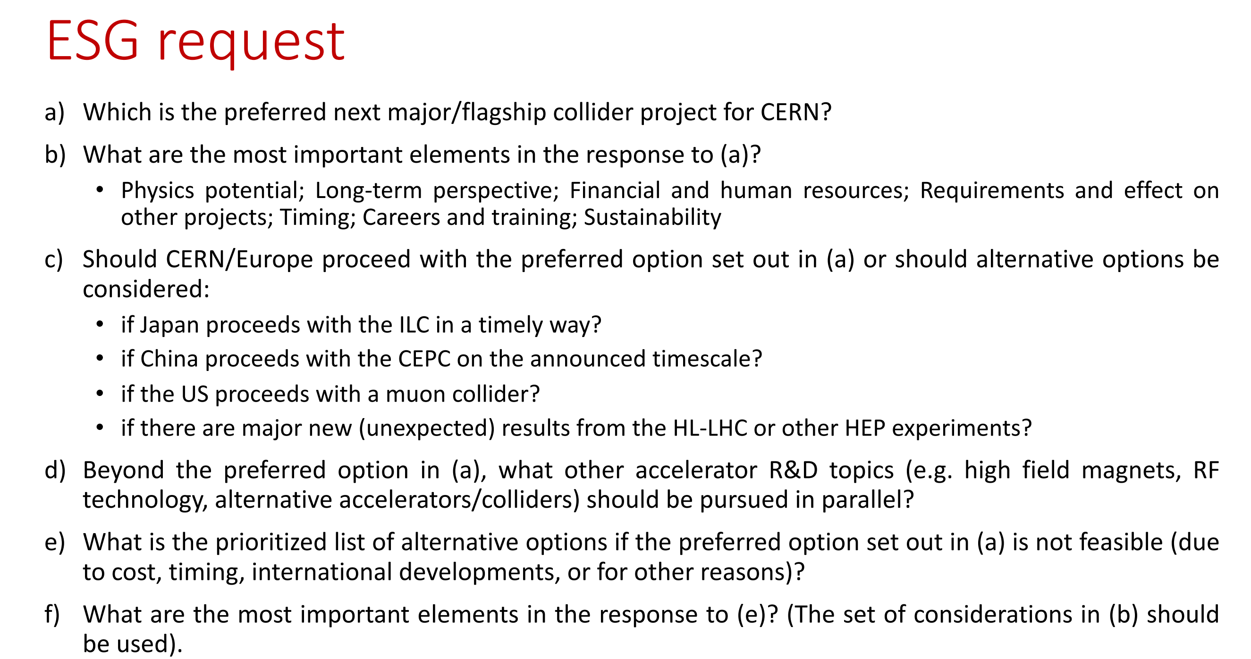
Srini

Slide 16
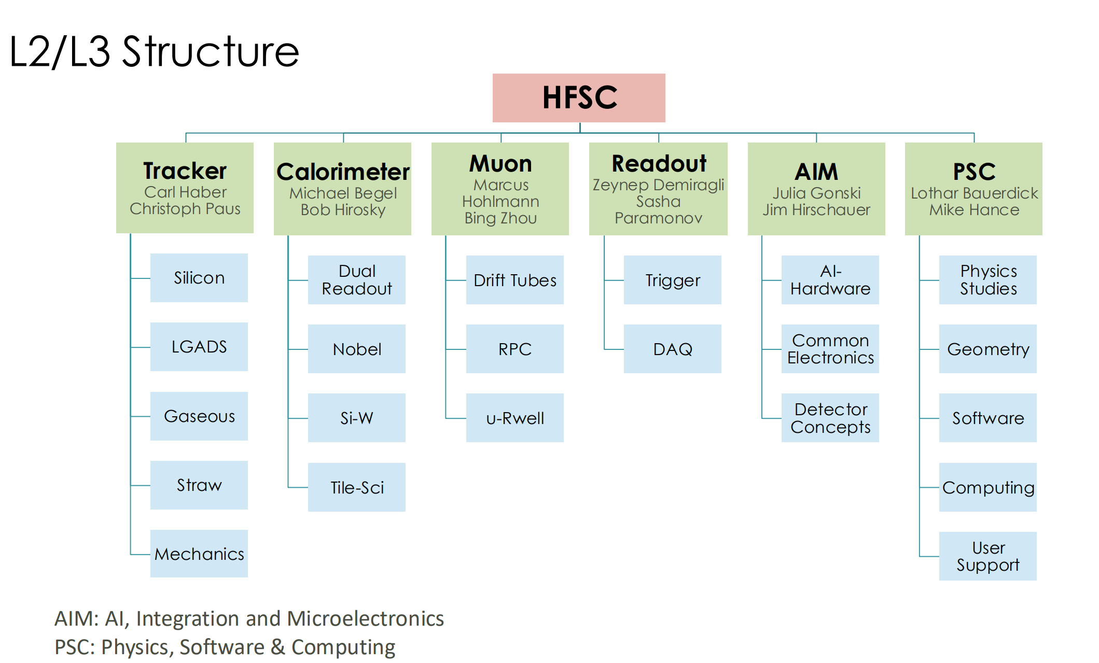
Technical discussion on near term needs, preparing for the SLAC workshop, and the ESPP input
FY25 Request
$700K
$340K
$150K(?)
?
$270K(?)
$350k

Slide 17
The FCC-ee Muon System R&D
Our highest priority is to develop robust, large-area muon/gaseous detectors with fast timing and high spatial resolution. The initial R&D will focus on the muon detector and electronics technology choice for the FCC-ee experiments
Proposed R&D for FY2025, with modest funding request
There are three muon detector R&D areas (L3’s) in the US
Drift tube based detector
    - Study DT chamber gas mixture to meet the Eco-friendly gas requirement
    - Build 1” square drift tube prototype to study the resolution and efficiency, combined with gas studies
μ-RWELL (MPGD) based detector
- Begin developing MPGD production capabilities in the US
- Study eco-friendly gas mixtures for μRWELL
Electronics for muon detection
- Study extensions of current drift tubes to satisfy 3D tracking & trigger requirements
- Investigate new low-power electronics with precise timing resolution

Slide 18
The Drift Tube Muon Detector R&D for HF
Simple, Robust, and inexpensive suitable for large scale construction
Capable of achieving < 200 μm single wire resolution for all muon incident angles
Capable of determining T₀ with triggerless readout mode with ~ns time resolution, determine BCID
The proposed R&D with high priority; modest funding request in FY2025 ($50k)
Study of chamber drift gas mixture
  Climate change a growing concern; Greenhouse Gas emissions is one of the major problems. The search for new environmentally friendly gas mixtures is necessary to reduce GHG emissions and costs as well as to optimize detector’s performance (alternative gas: C₂H₂F₄, SF₆, CF₄,…).
  build a four-channel gas mixture system to test various gas mixture performance on prototype DT chambers
  Using the existing MDT (sMDT) detector prototypes and the ATLAS MDT front-end electronics to study different gas mixture with cosmic rays and test beams, comparing with the ATLAS MDT performance (efficiency, resolution)
Construct and study the squared drift tube performance
Build a prototype chamber by using the existing UM squared-drift tubes to with redesigned end-plugs to locate wire with high precision, in a configuration of 2 multi-layers, each has 4 drift tube layers. To develop and study
  An efficient wiring process with high precision, including an on chamber gas system
  Measure the spatial resolution and efficiency using the ATLAS MDT electronics and MiniDAQ system with cosmic rays and test beams
  Compare the test results with Garfield simulations

Slide 19
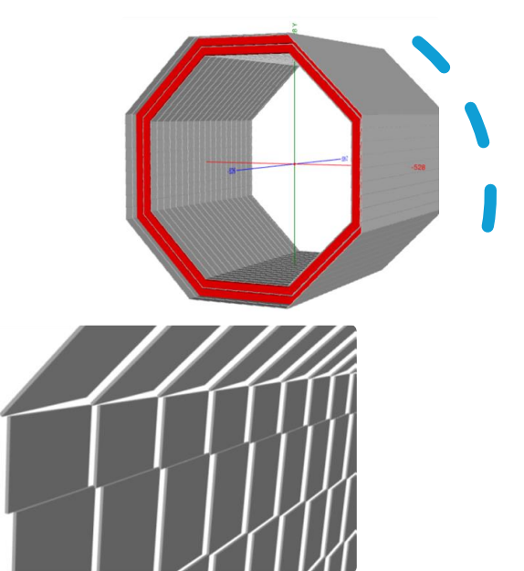
The μRWELL Muon Detector R&D for HF
A modern micro-pattern gas detector (MPGD) with single amplification stage
Currently proposed by IDEA experiment for muon system
IDEA
Muon
system
The Proposed R&D with high priority; modest funding request in FY2025
Begin developing MPGD production capabilities in the US
  Currently only CERN can provide MPGD components
  Lead times for procurements are long (6-12 mos.) and increasing
  Efforts in the past decade to develop commercial vendors (TechEtch, Mecaro, Tectra) have failed; presumably market too small
  A national lab would be an appropriate location for a fabrication site to supply US researchers; JLAB is interested in developing a fabrication site
  Use funding to enable JLAB to transfer MPGD production technology from CERN. Longer-term effort => need to start now to have production capability (even just for R&D) in a few years.
Study eco-friendly gas mixtures for μRWELL
  Using a gas mixing station developed with FY24 US-HF funds measure performance stability of small μRWELL as function of gas composition; in particular attempt to minimize CO₂ concentration.
Endcap CSC disk
Endcap CSC disk
Endcap CSC disk
50cm x 50cm
μRWELL modules
19

Slide 20
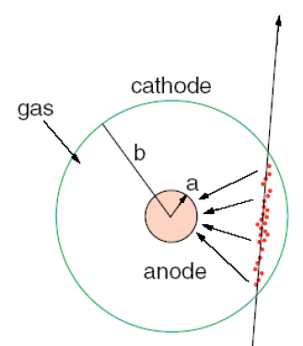
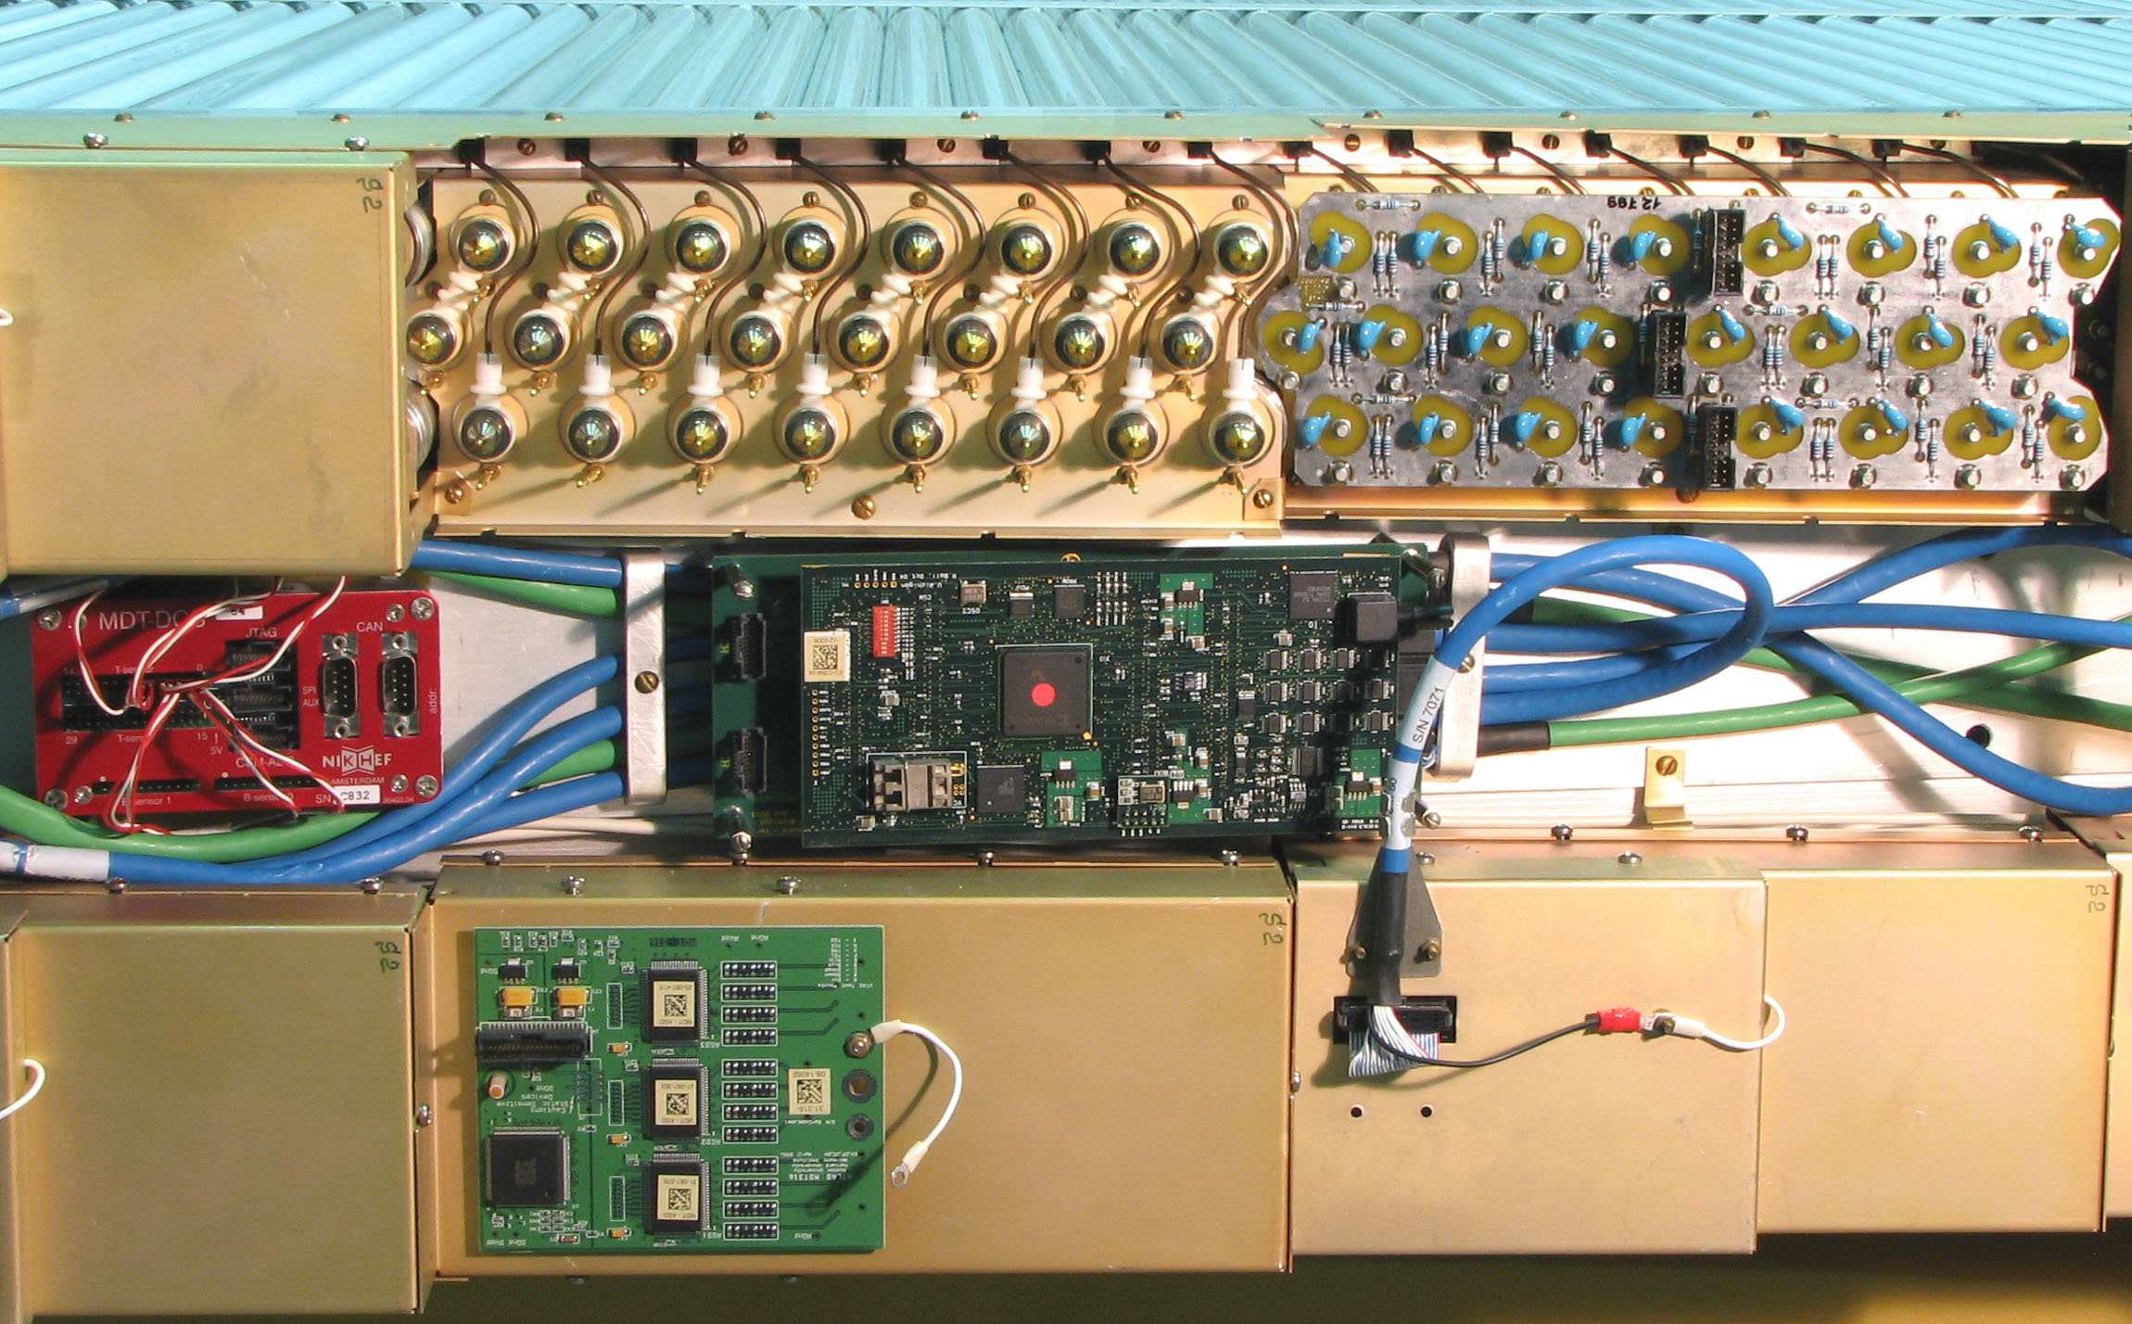
The Muon Detector Electronics R&D
Capable of 3D tracking achieving < 200 μm single wire resolution and <1cm in 2nd coord (along tube)
Capable of trigger: determining t₀ with triggerless readout mode with <ns time resolution, determine BCID
The Proposed R&D with high priority; modest funding request in FY2025 ($50k)
Study extensions of current drift tubes to satisfy 3D tracking & trigger requirements – would make it possible to use drift tubes as single technology for muons
  Explore use of drift tubes for 3D tracking, including the non-precision 2nd coordinate (along the tube direction. Investigate how to read out signal from both ends (currently only one is used) and extract position from time difference. Study signals in simulation, build design and prototype new electronics hedgehog card
  Read out MDT signals using triggerless streaming mode and build events for data recording in an FPGA with BCID determination using current electronics
  Study signals from alternative gas choice and geometry (e.g. square tube) and investigate changes in the electronics requirements using simulations.
Investigate new low-power electronics with precise timing resolution
  Simulations for pathfinding toward future low-power digital TDC designs with sub-200ps measurement resolution. Improved position and timing resolution for tracking and triggering.

Slide 21
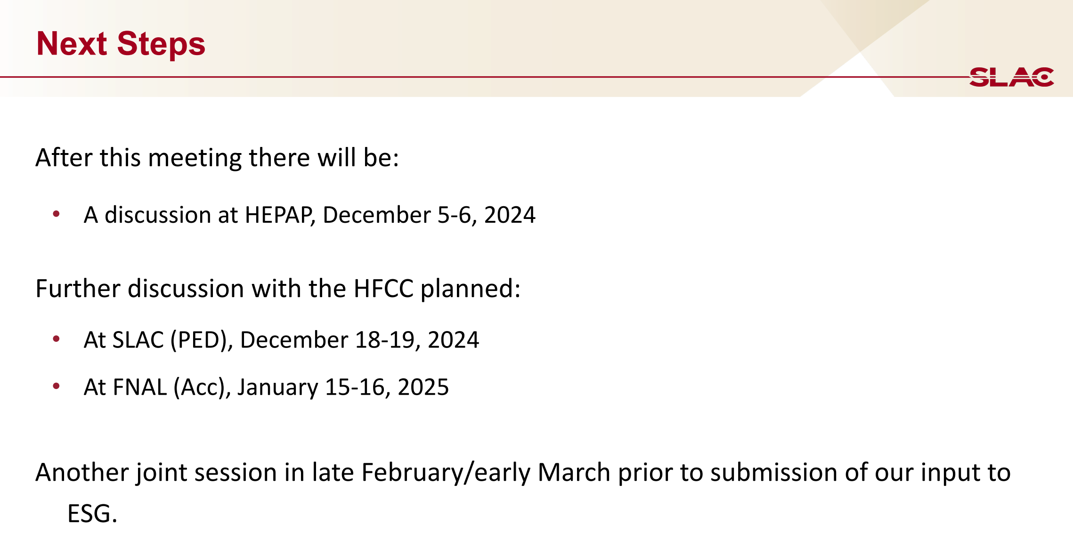
Srini

Slide 22
US Higgs Factory Planning Workshop - Physics Experiments and Detectors
The workshop will take place on December 19-20 at SLAC and registration is open at https://indico.slac.stanford.edu/event/9297/ .
The purposes of the workshop are:
1) Discussion of the near term needs for Higgs Factory detector R&D and software development
2) Initial discussion of the U.S. HFCC input to European Strategy for Particle Physics, both technical and strategic.
3) Discussion of US expressions of interest to international partners.

Slide 23
Prepare for the SLAC (PED) meeting (12/18-12/19)
Open meeting for all the community members
Thursday, Dec. 19: (Day 1)
08:30 – 10:00 : Plenary:
Discuss the strategic component of our input to the ESPPU, the various alternative options with their constraints.
10:30 – 12:30. Detector Parallel sessions
Discuss the research areas at high level where the US has strength and ambition to contribute to a future Higgs Factory. Identify the grand challenges for a future Higgs factory detector and the US ambitions in this space.
12:30 – 2:00 Lunch
2:00 – 3:30. Detector Parallel sessions
Continue the morning discussion; also address the prioritization of the near-term needs.
4:00 – 5:30. Joint Detector Session
Roundtable to discuss cross-cutting areas and refine the grand challenges and priority research areas for US participation taking into account the overlap between the working groups. Refine the near-term needs as well.

Slide 24
Prepare for the SLAC (PED) meeting (12/18-12/19)
Friday, Dec. 20: (Day 2)
08:30 – 10:00 Joint Detector Session discussion.
Develop a first pass articulation of the US input to ESG for the R&D program.
08:30 – 10:00 Other parallel sessions
may be organized here including an ECR session (as needed)
10:30 – 12:30 Plenary session
including summary of detectors and other parallel sessions.
2:00 – 5:00 Community wide discussion on input to ESG:
Discussion of the First draft of the framework of the input to the ESPPU.

Slide 25
Muon/Gaseous Detector R&D Discussions
There will be total 2.0 hours (morning) + 1.5 hours (afternoon) parallel sections
Encourage all the muon community members, particularly L2/L3’s, to participate in this meeting, preferred in-person. It is also OK if participate remotely – please make a registration as soon as possible (So far, 53 people registered in this workshop)
All L3’s together with the collaborators should prepare slides to present the R&D plan in FY2025
  What progress was made in FY2024
  The deliverables
  Milestones
  Funding request (indicates what manpower can be provided from the base programs)
  Progress report

