Slide 1
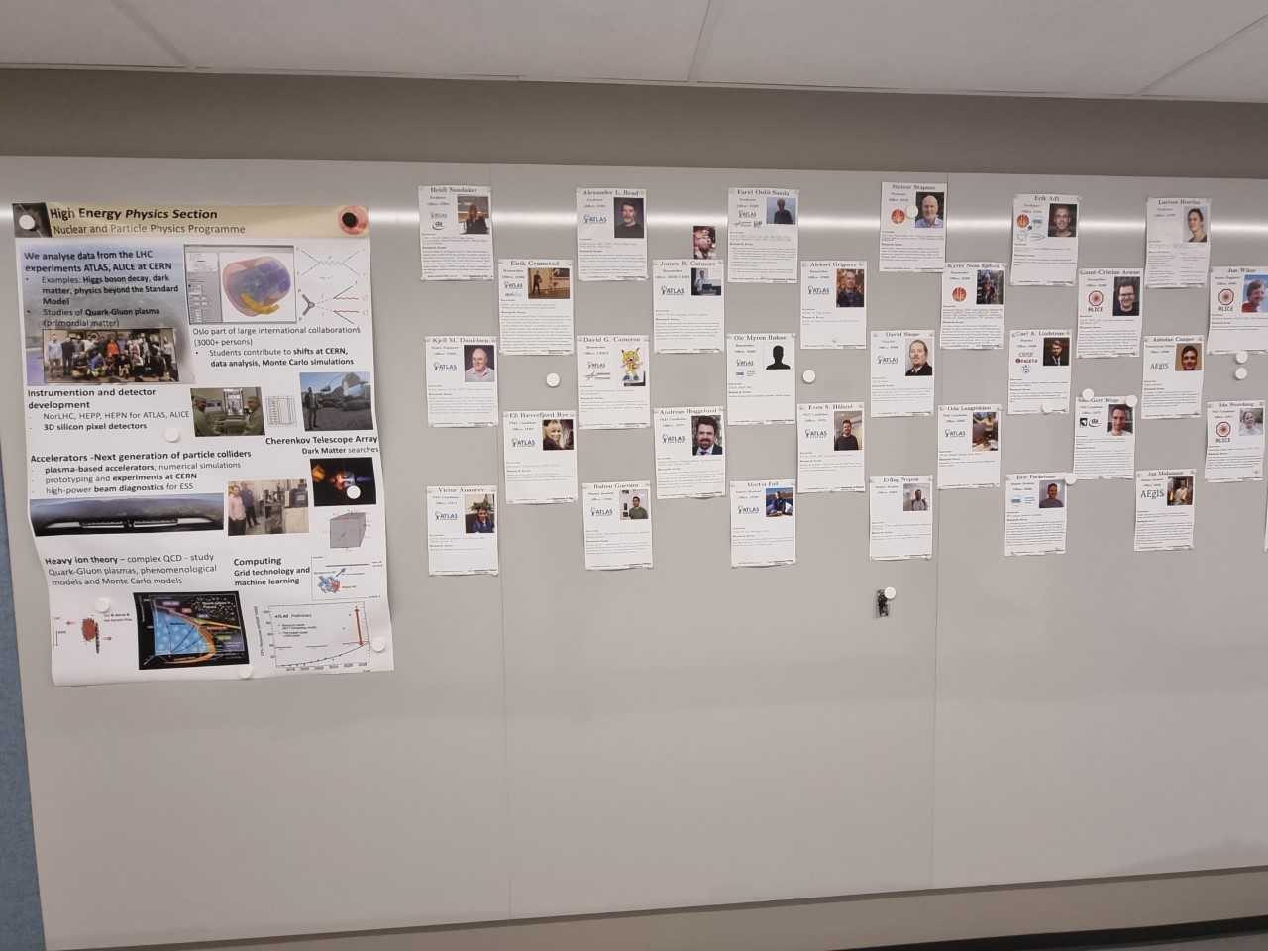
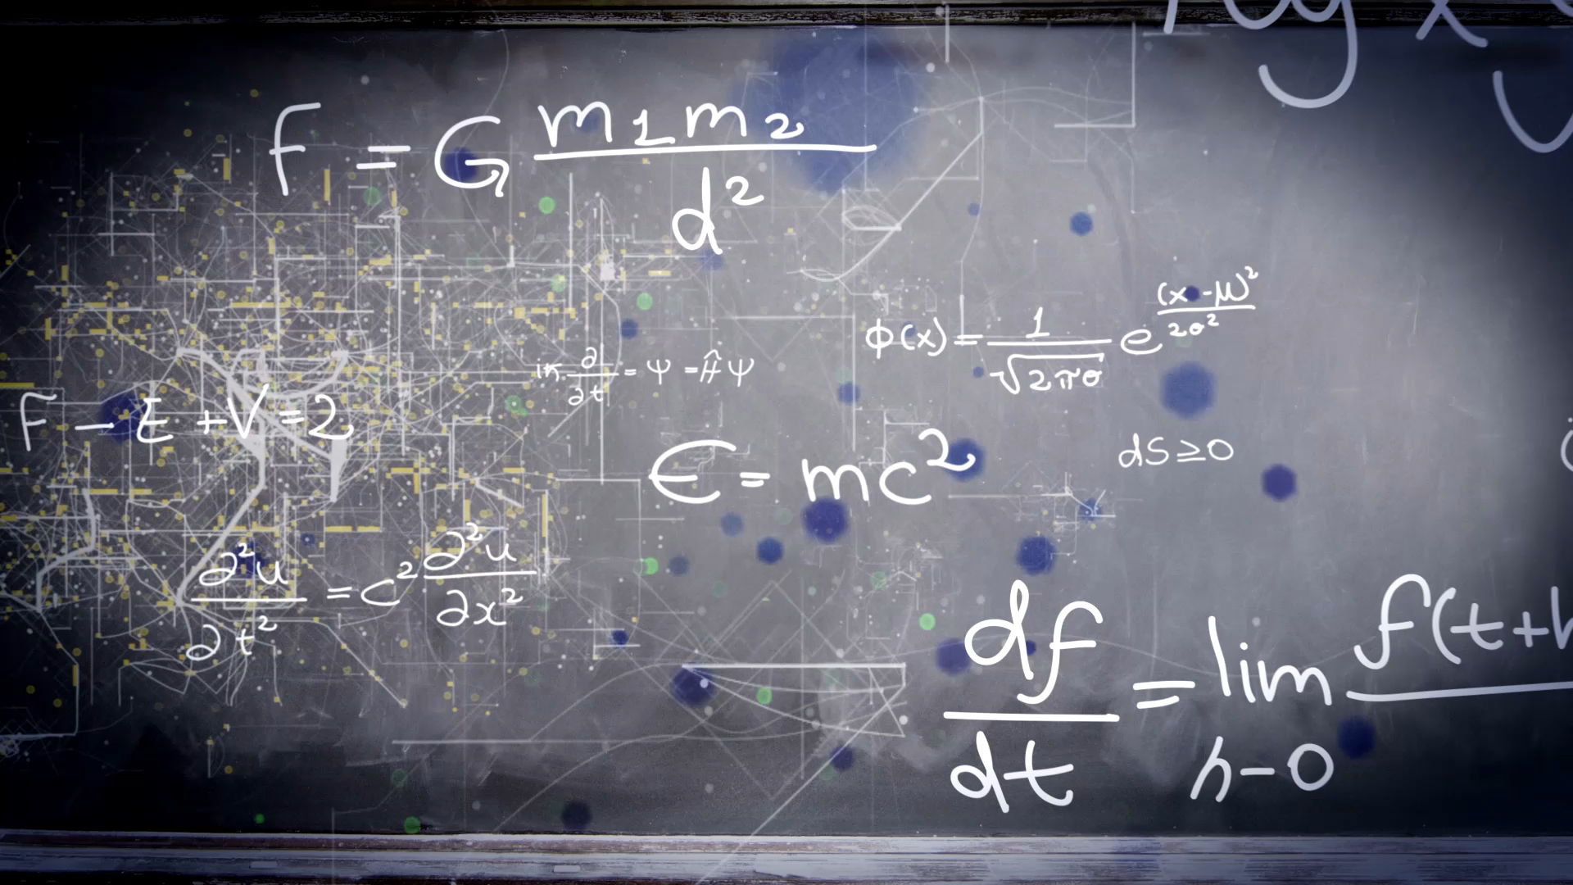
The particle physics experience
As seen by Carl Petter Duedahl

Slide 2
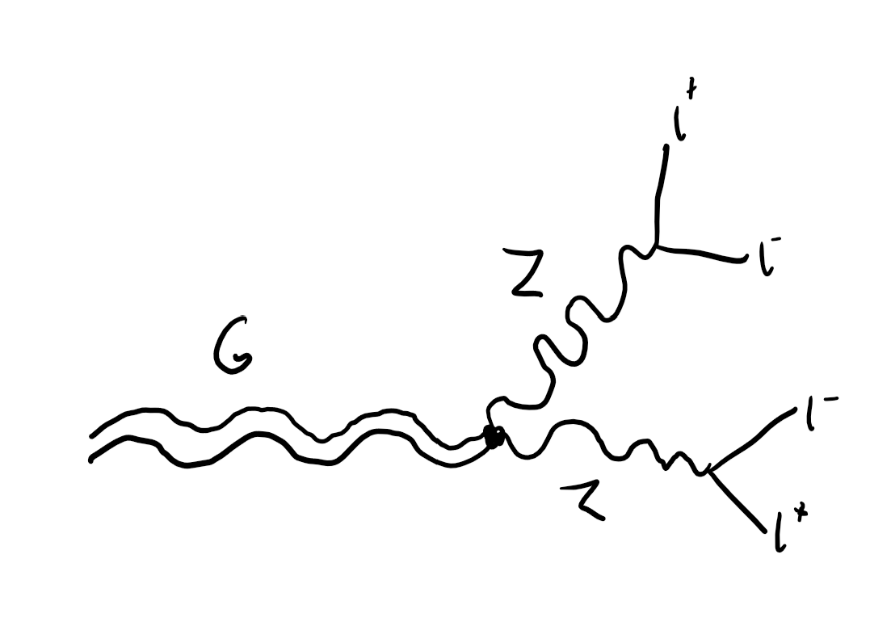
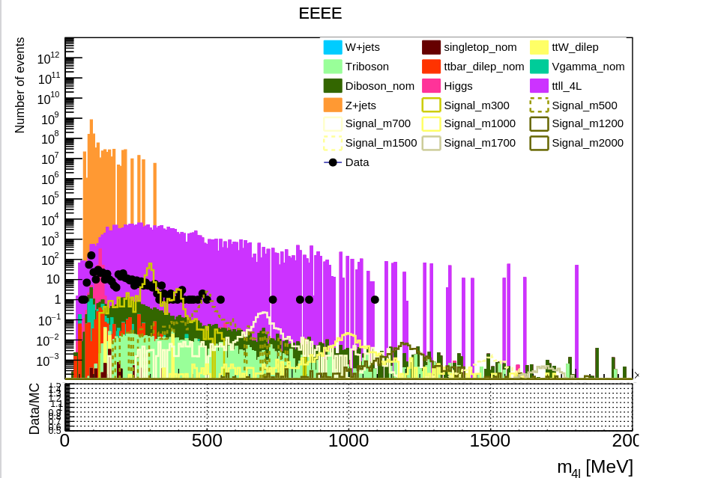
My thesis
Graviton
Four lepton decay from CERN
Data analysis

Slide 3
Courses
Semester 1
Semester 2
FYS4505 – Methods and Instrumentation for Nuclear and Particle Physics
FYS4555 – Particle Physics
FYS4170 – Relativistic Quantum Field Theory
FYS5555 – Research-Based Particle Physics
FYS4411 – Computational Physics II: Quantum Mechanical Systems
FYS4160 – General Theory of Relativity
Notes:
QFT: It’s not necessary. Can be advantageous. Difficult, but not impossible.
GR: Was luckily relevant for my thesis

Slide 4
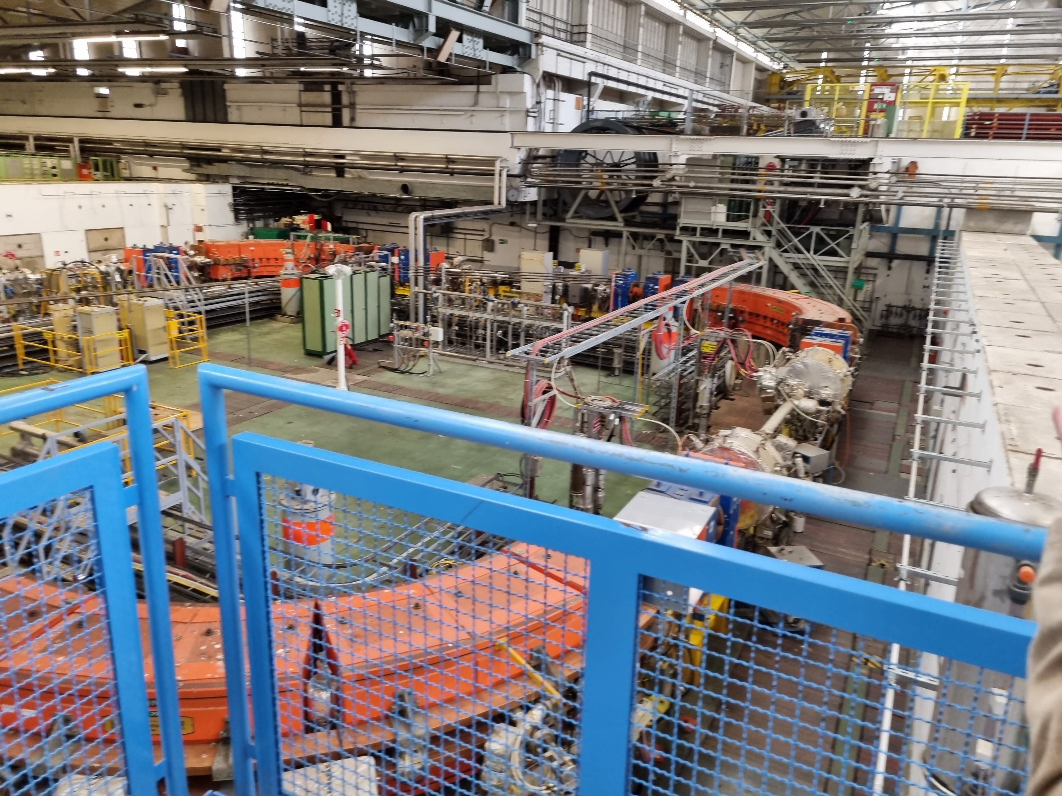
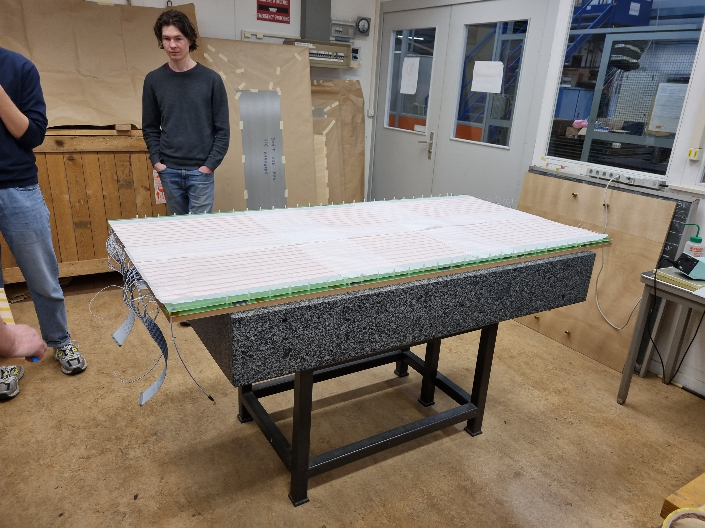
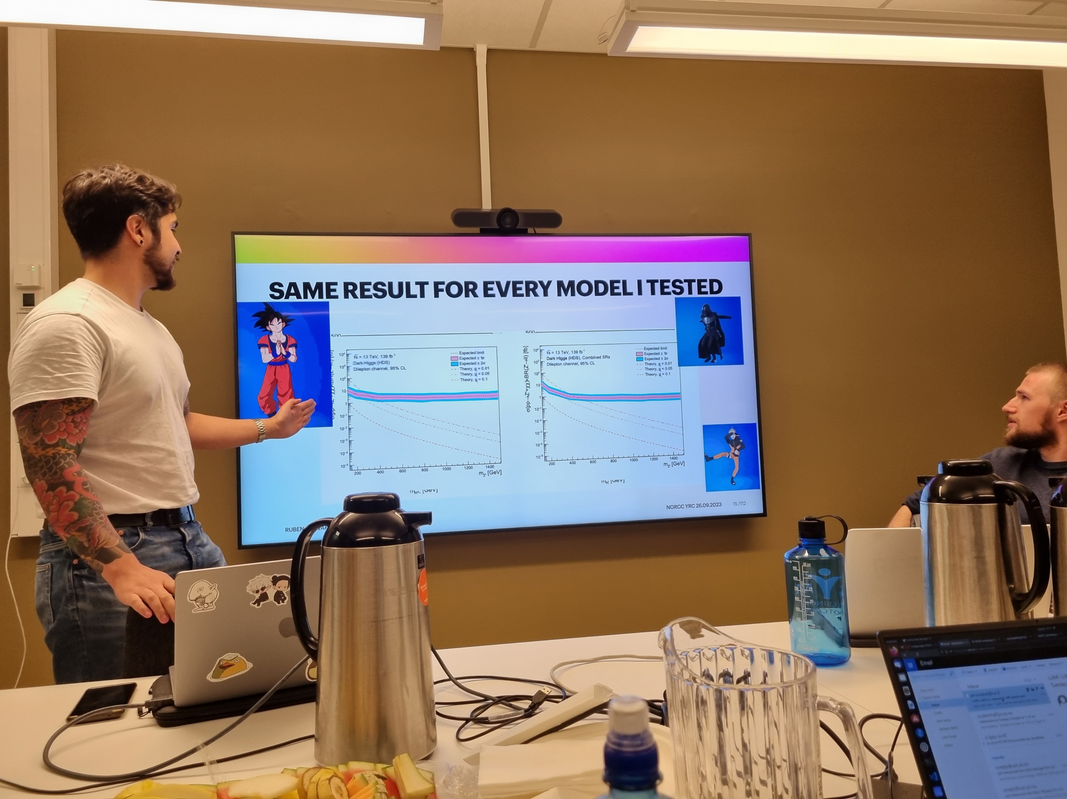
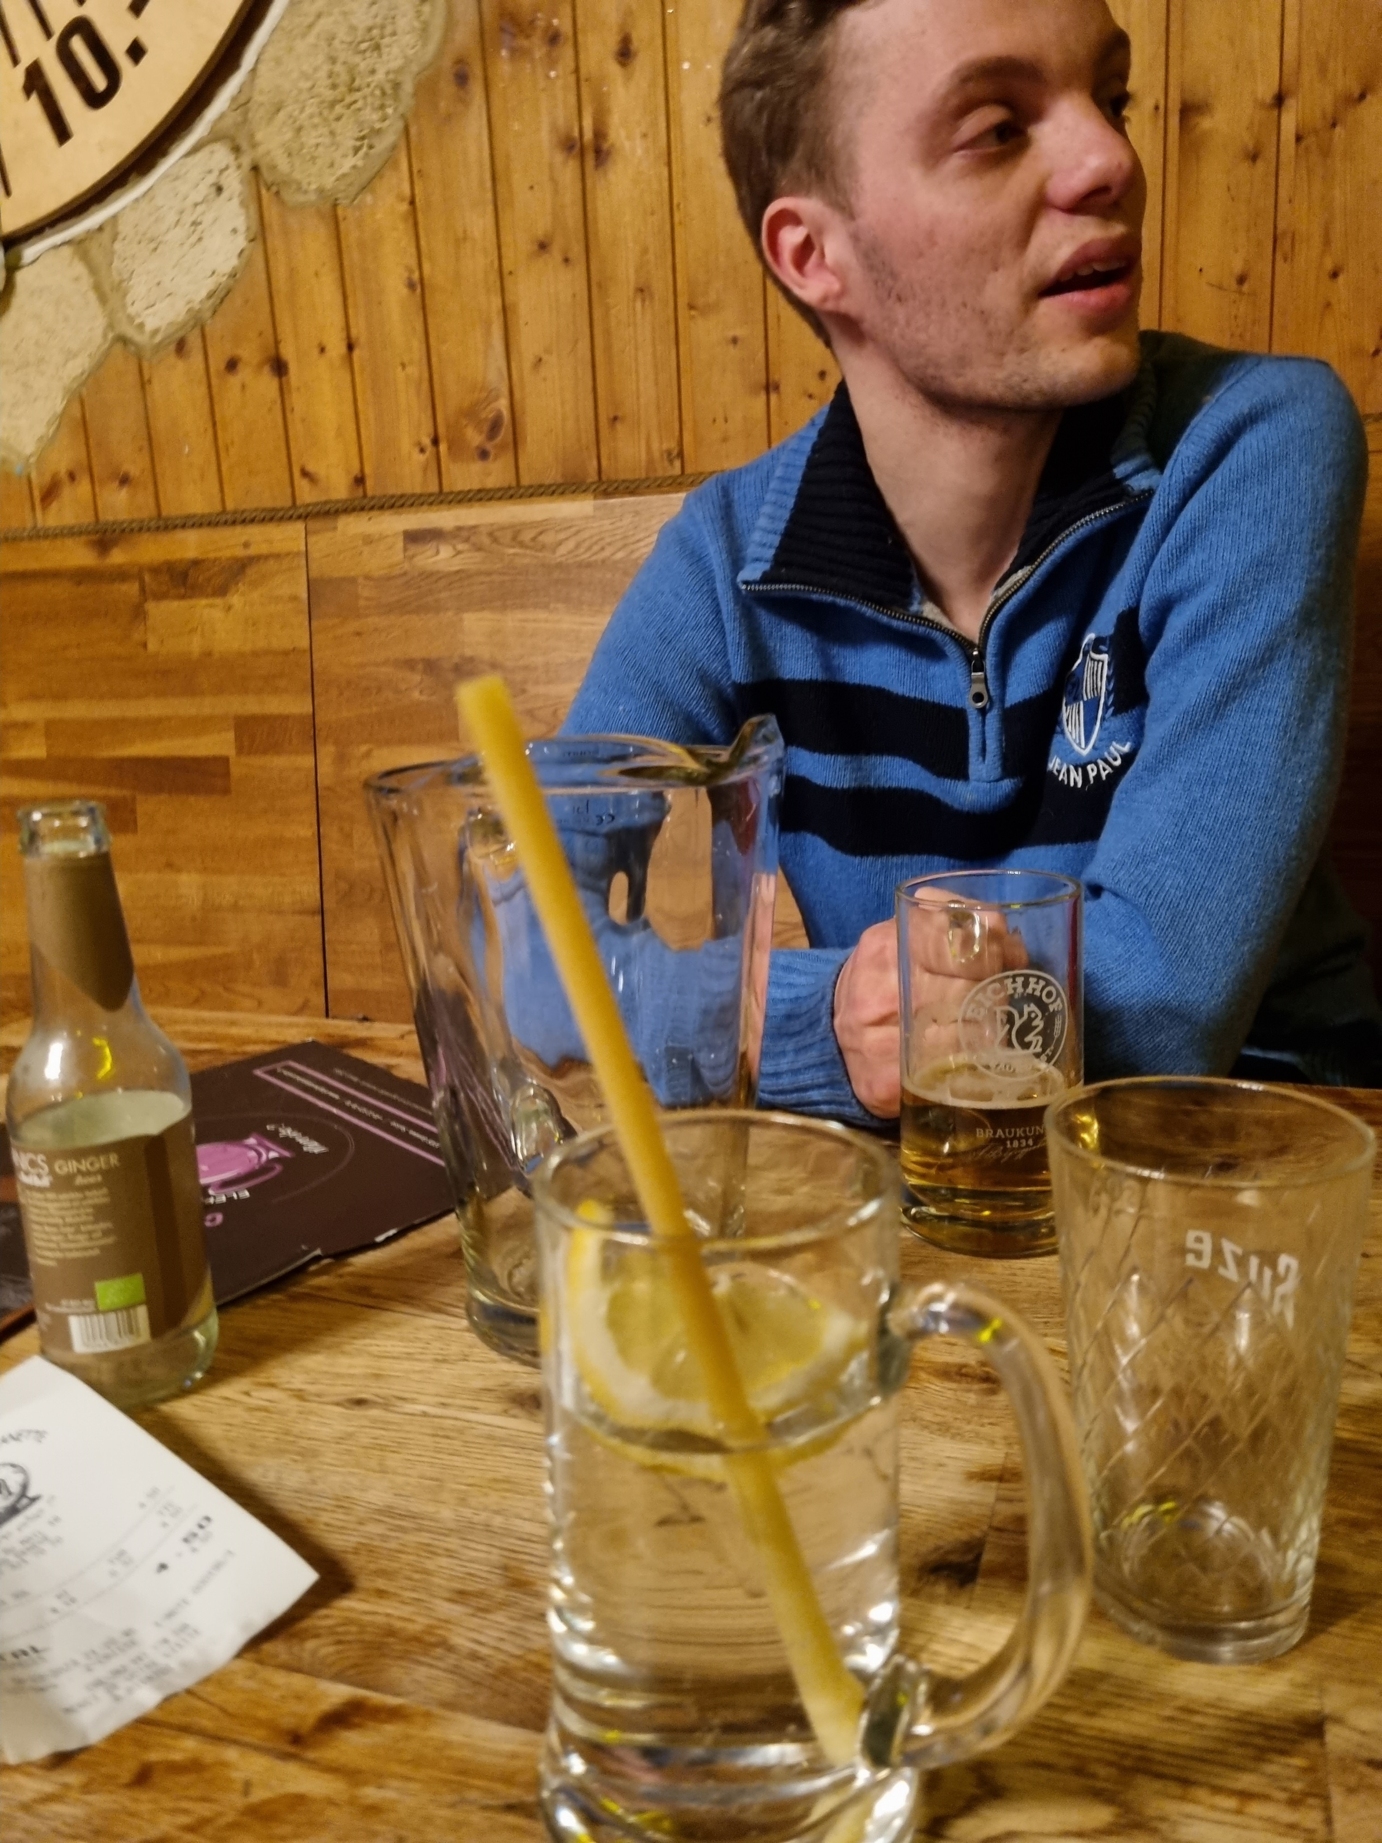
Trips
CERN
  Summer@CERN
  Research-Based Particle Physics
Annual NorCC (Norwegian Centre for
CERN-related Research) meetings
Bi-annual nordic particle physics

Slide 5
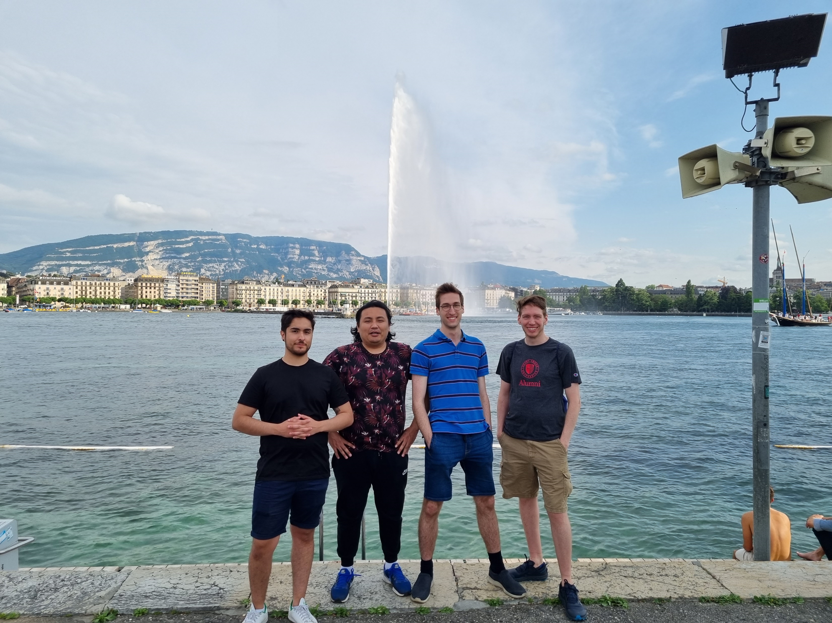
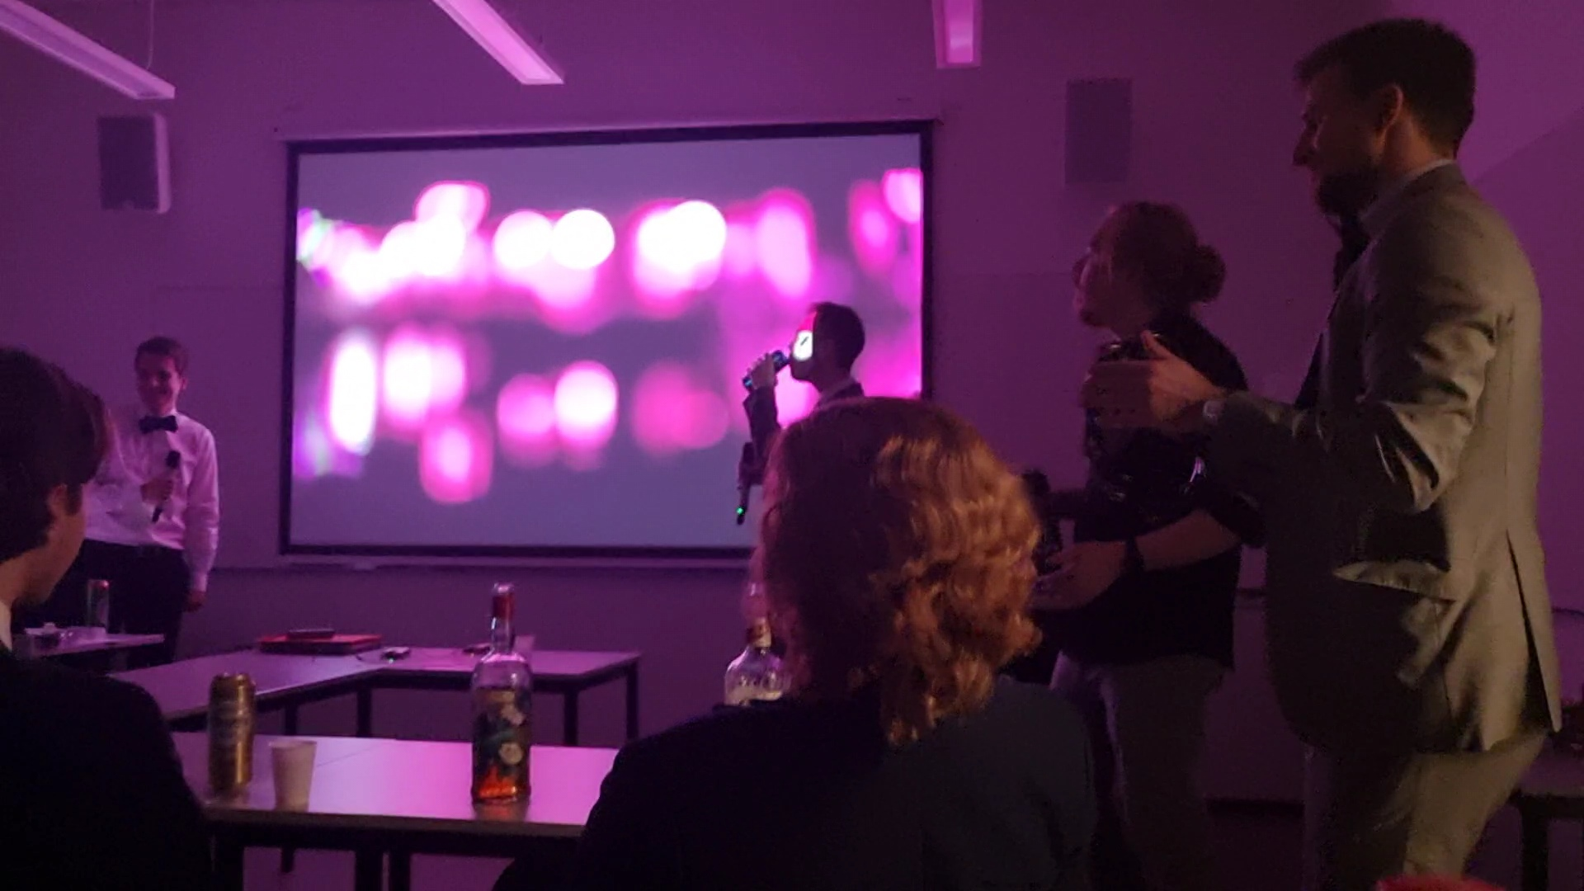
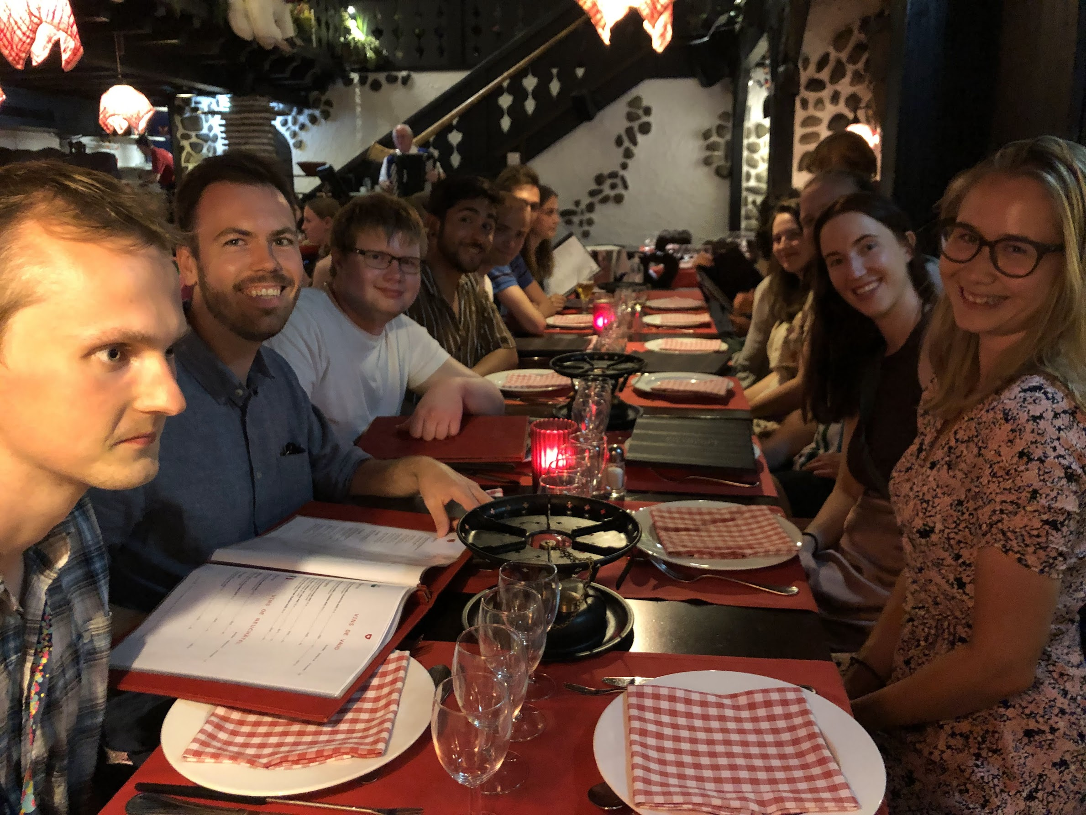
Social
Quizes
Game nigths
Fusball
Julebord (Christmas Party)
  Karaoke
Lønningspils (Salary beer)
Holmenkollstaffeten (relay)
  After-party (also if you don’t run)

Slide 6
Why choose particle physics
Get to study something awesome.
A nice social environment.
Job opportunities

Slide 7
Thank you for listening!

