Slide 1
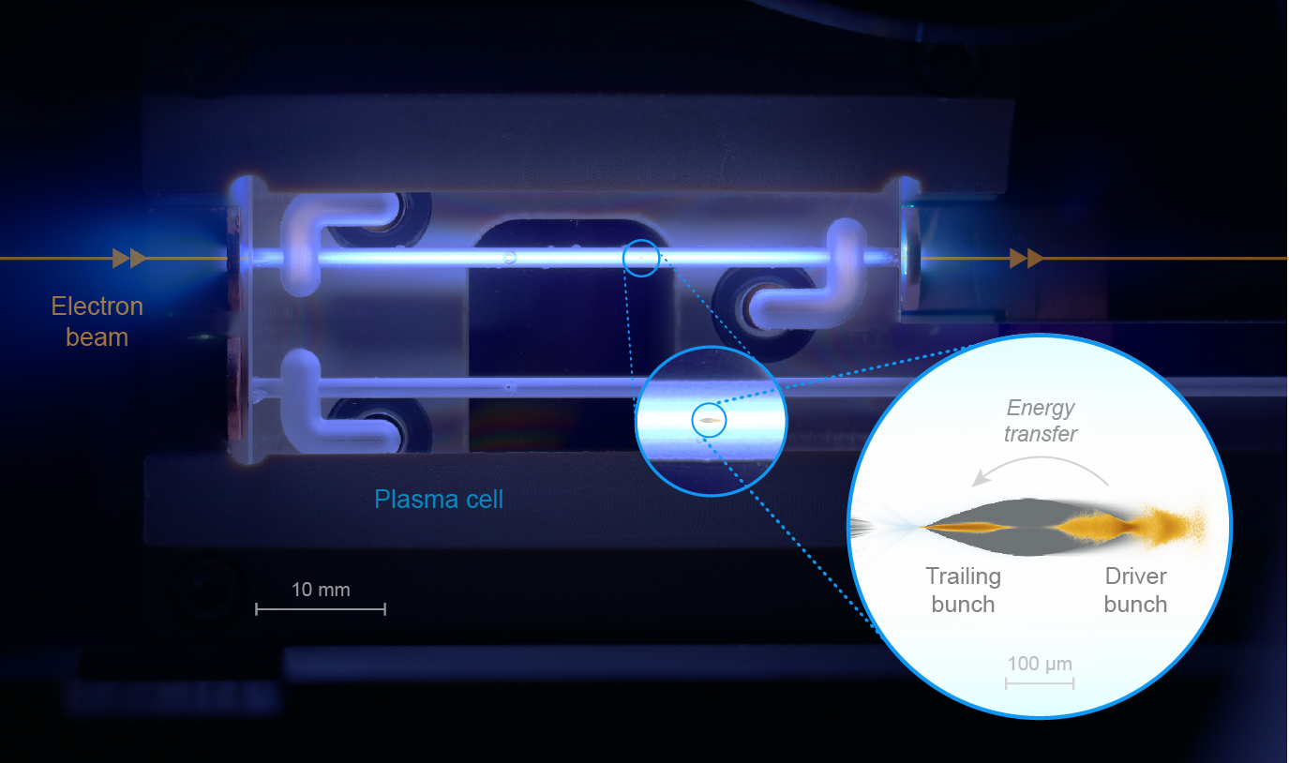
Accelerator Physics
Daniel Kalvik

Slide 2
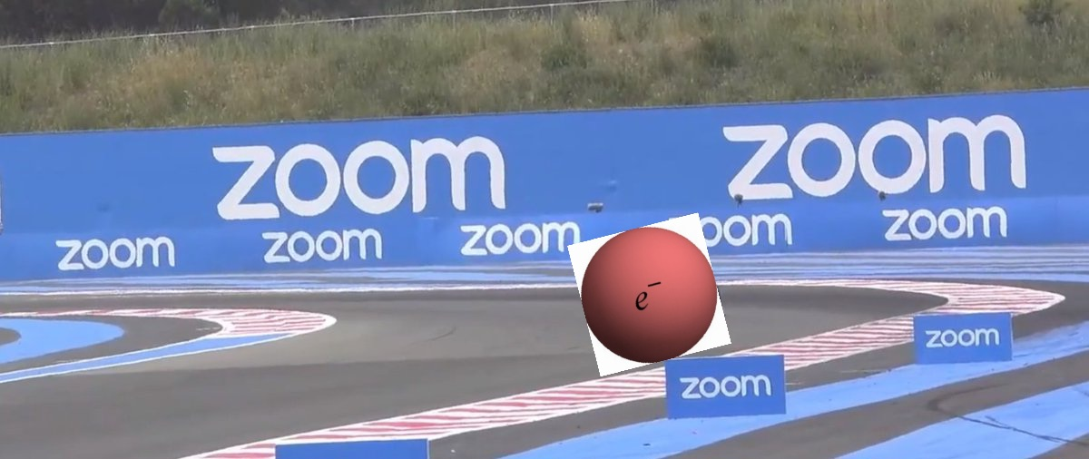
Our Purpose

Slide 3
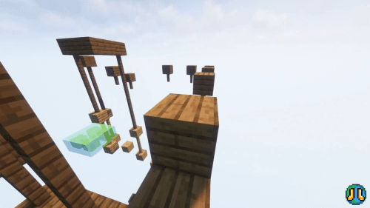
My Background
B.Sc in energy and environmental physics from the Norwegian University of Life Sciences. 2019-2022
M.Sc in nuclear and particle physics, with specialization in particle physics. 2022-present.
Master thesis: Radiation reaction force in plasma wakefield accelerators.

Slide 4
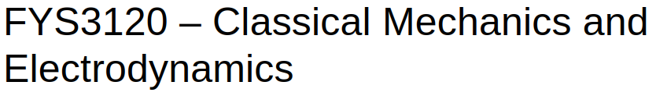
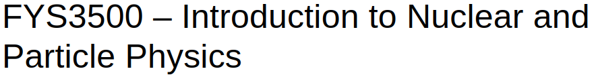
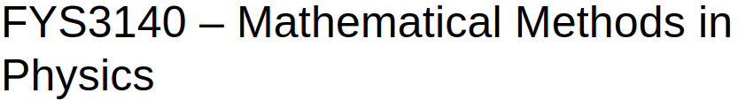
Courses I Wish I Had (But did fine without)

Slide 5

Courses I Chose
FYS4170 – Relativistic Quantum Field Theory (not necessary for accelerator physics, but VERY interesting course)
FYS4150 – Computational Physics (teaches C++ as well as numerical algorithms used in physics).
FYS4505 - Methods and Instrumentation for Nuclear and Particle Physics (Only mandatory course; about detectors and statistics)
FYS4565 - Physics and Applications of Accelerators and Beams (Beam optics, modeling of accelerators in Python)
FYS4130 – Statistical Mechanics (Should be FYS4620- Introduction to Plasma Physics if you want to write about Plasma Wakefield Accelerators)
FYS4555 – Particle Physics (Applied QFT)

Slide 6
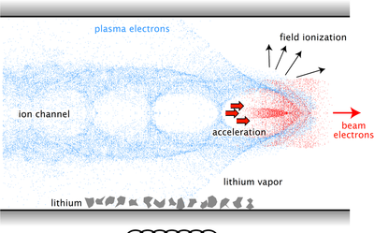
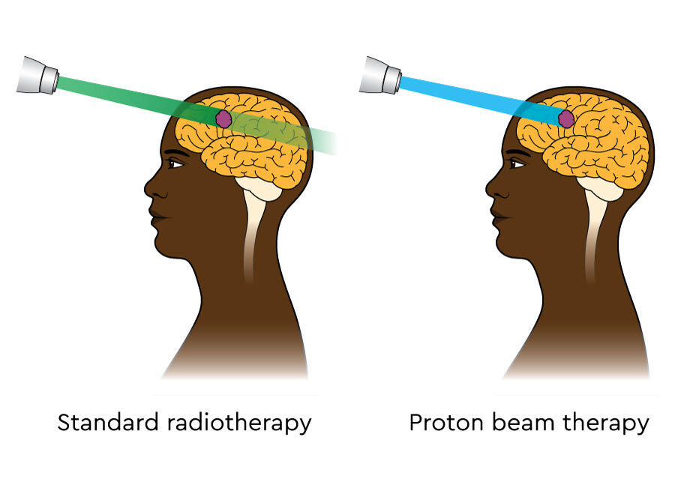
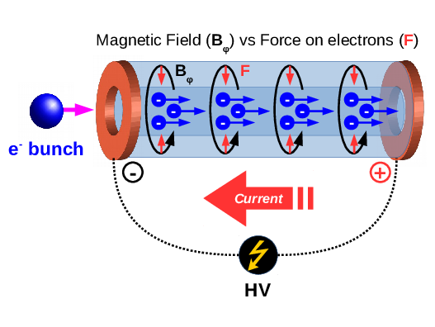
Opportunities in Accelerator Physics
Proton Therapy – Contribute to advancing cancer treatment with proton beams.
Study electron beams in Plasma Wakefield Accelerators; A lot of research is required to achieve high quality beams to be used in electron laser, colliders and medical treatments.
Plasma Physics; Either the plasma in the accelerators, or in plasma lenses to be used in focusing beams.
Transferrable skills if you want to continue with fusion science
Many possibilities within numerical simulations using high performance computing. ALWAYS desired competence in the job-market.
Most Important: Create your own mini-project and be part of developing cutting edge technology.

Slide 7
Experiences
Plasma Accelerator School in Bad Honnef, Germany
Visit to DESY, Germany for HALHF collaberation meeting
NorCC Workshop in Bergen.
Several free dinners/lunch
Also possible: Trips to CERN

Slide 8
Hope to see you next year!!
(If I get the PhD position I applied for)

