Slide 1

MPGD for a Future Circular Collider
Higgs Factory Coordination Consortium – Muon Community
Klaus Dehmelt

Slide 2
HFCC Muon Coordinator L3 Representing MPGD
Klaus Dehmelt – Staff Scientist at Jefferson Lab – kdehmelt@jlab.org
Working on MOLLER and SoLID integration at JLab
25+ years of MPGD involvement
Physics interest: QCD Structure

Slide 3
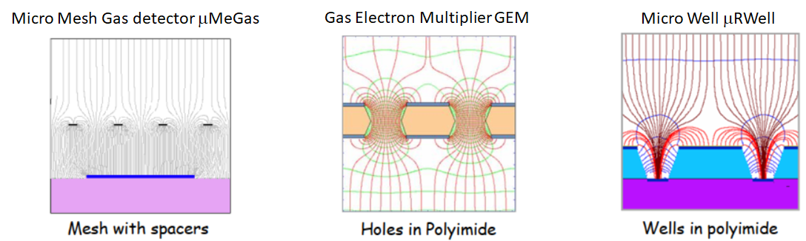
MPGD Technologies
A large variety of MPGD proposed and investigated
Three structures “survived”

Slide 4
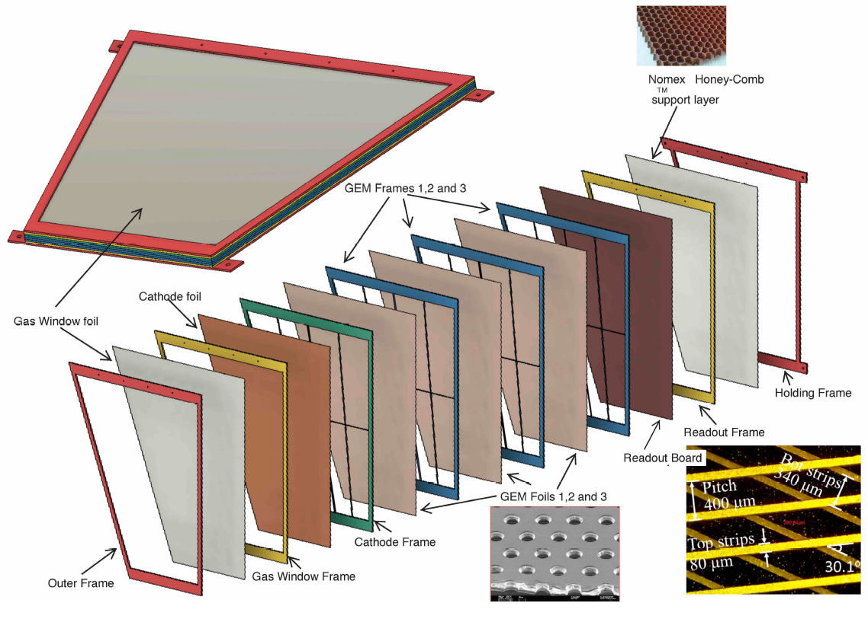
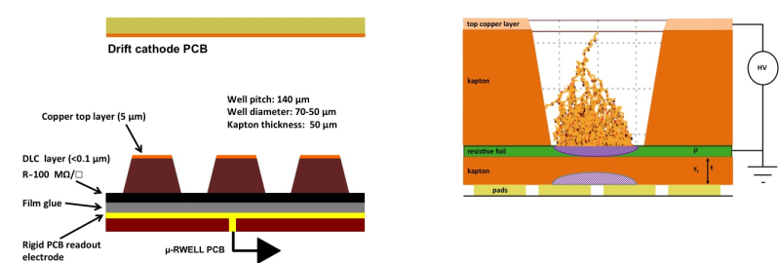
MPGD Technologies
μMeGas and GEM detectors are the workhorses
μRWell and derivatives are under investigation for future projects

Slide 5
MPGD Technologies
μRWell derivatives
  Issues with charge sharing over two coordinate layers ⇨ Efficiency loss
Solution being sought after
  Two detector layers with individual coordinates
  Increase thickness of the Polyimide
  Introduce pre-amplifier (GEM)
  μRGroove structure
  Work on procedures to achieve higher voltage stability
Other initiatives
  Reducing material budget
  Reducing drift gap
  ?
R&D on μR-Structures as the primary goal + appropriate RO electronics

Slide 6
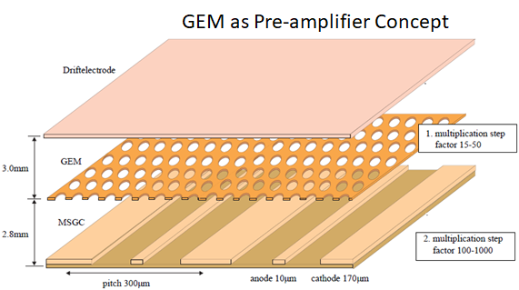
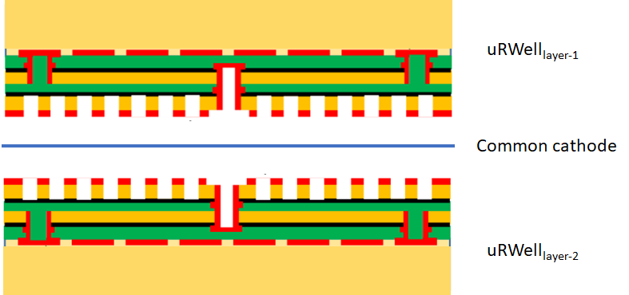
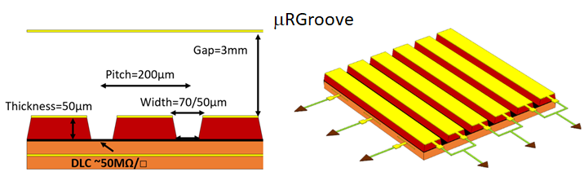
MPGD Technologies
μRWell derivatives

Slide 7
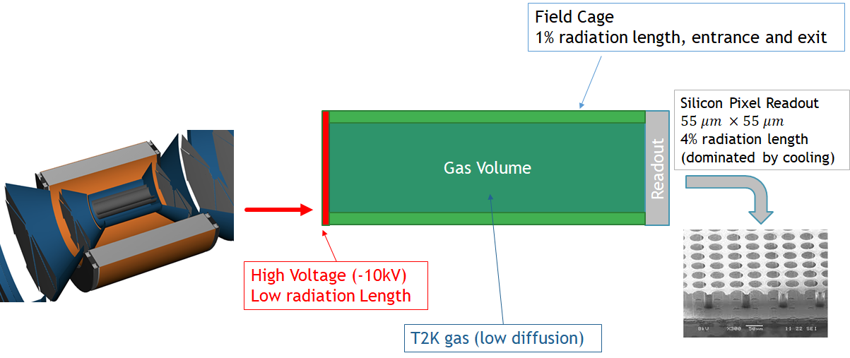
MPGD Application
Time Projection Chambers ⇨ FCC-ee

Slide 8
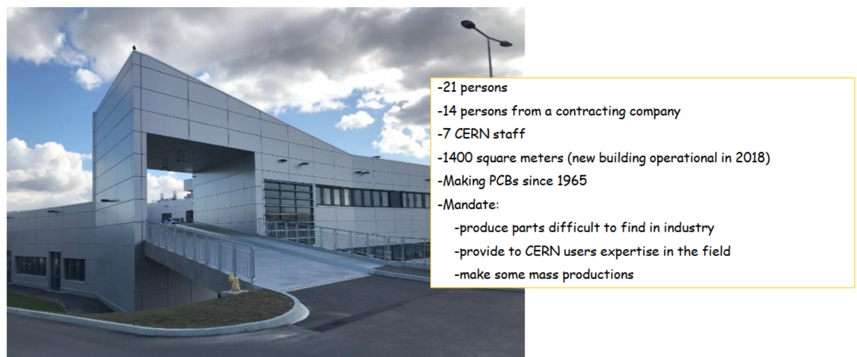
MPGD Production + R&D
MPGD Resource and Development Center at Jefferson Lab based on CERN-MPT
From Rui de Oliveira

Slide 9
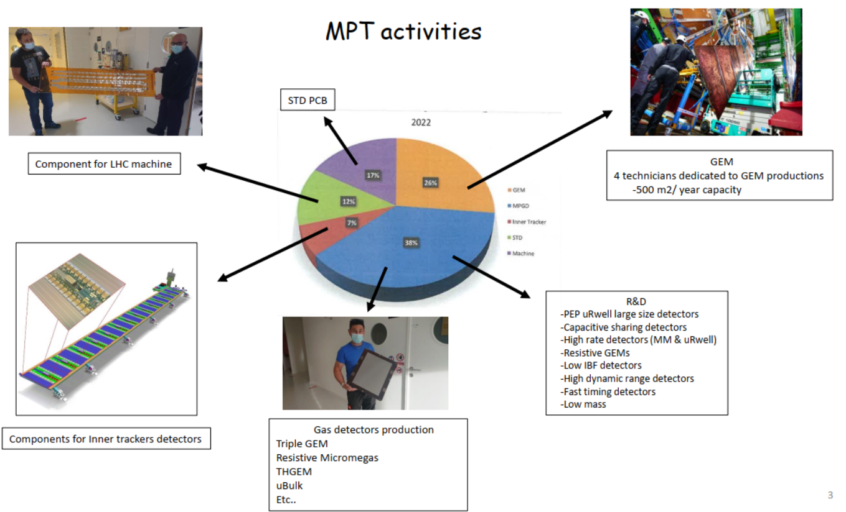
MPGD Production + R&D
MPGD Resource and Development Center at Jefferson Lab based on CERN-MPT
From Rui de Oliveira

Slide 10
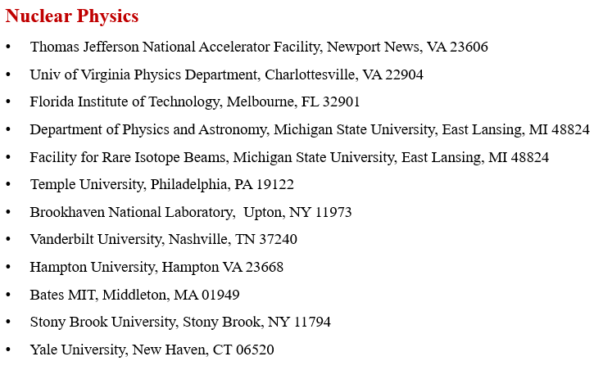
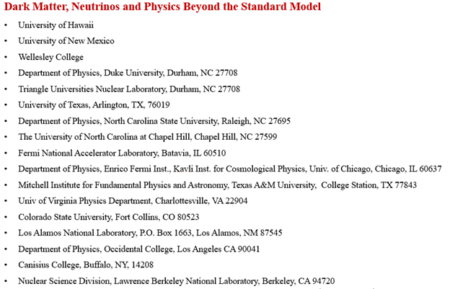
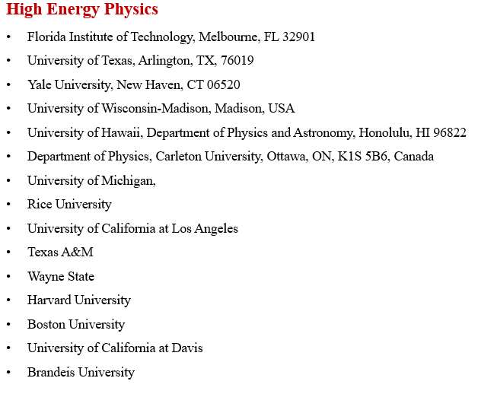
MPGD in the US

Slide 11


Slide 12
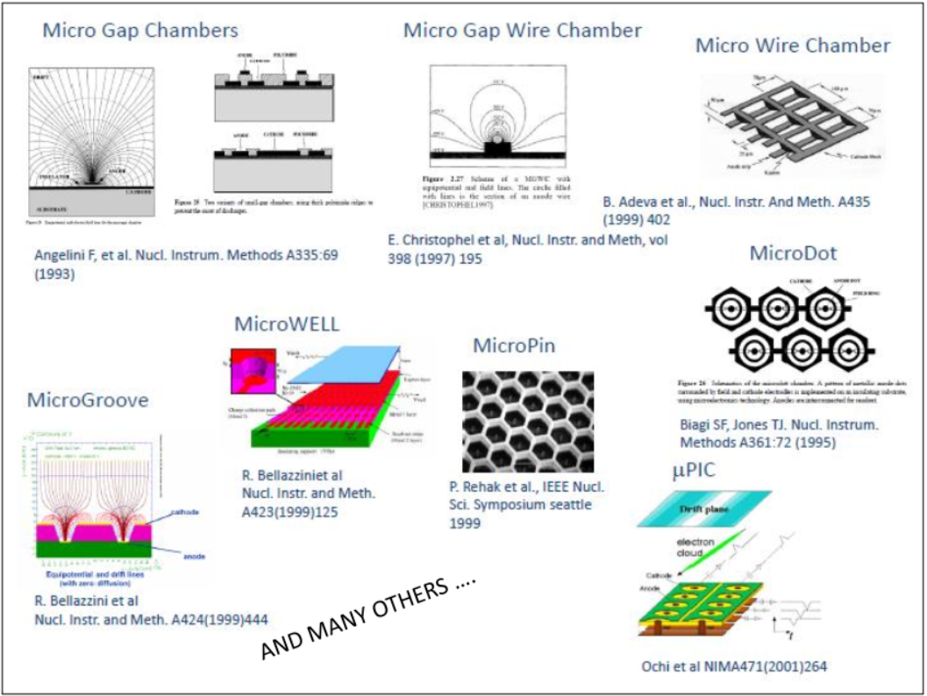
MPGD Technologies
A large variety of MPGD proposed
and investigated

